Slide 1
Self-Supervised Neural Networks for High-Resolution Radio Imaging
Shunyuan Mao
Rice University
National Radio Astronomy Observatory / CosmicAI
Andrea Isella, Hui Li, Li-Ta Lo, Paris Perdikaris and Kwang Moo Yi
International Conference on Machine Learning for Astrophysics
University of Malta

Slide 2
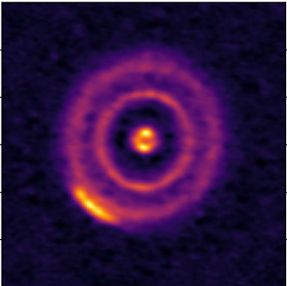
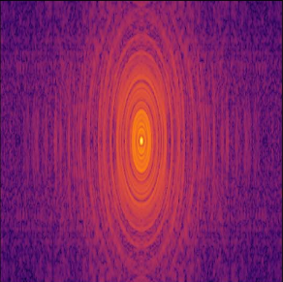
Radio Interferometry: 2D Fourier Transform
Image domain
Fourier domain
densely sampled Fourier transform
Zawadzki et al. (2023)
Notes:
In radio astronomy, we rely on a technique known as **radio interferometry**. The radio interferometry samples the **Fourier transform of the sky's brightness distribution** in Fourier domain. To illustrate this, let’s look at a image on the left and its corresponding **Fourier transform** on the right. In the Fourier domain, the axes represent **2D spatial frequencies** and each value represents the signal at a specific frequency. Values near the **origin** (the center) represent the **large-scale structures** of the image, while those further out represent the fine, **small-scale details**.

Slide 3
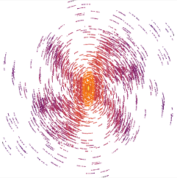
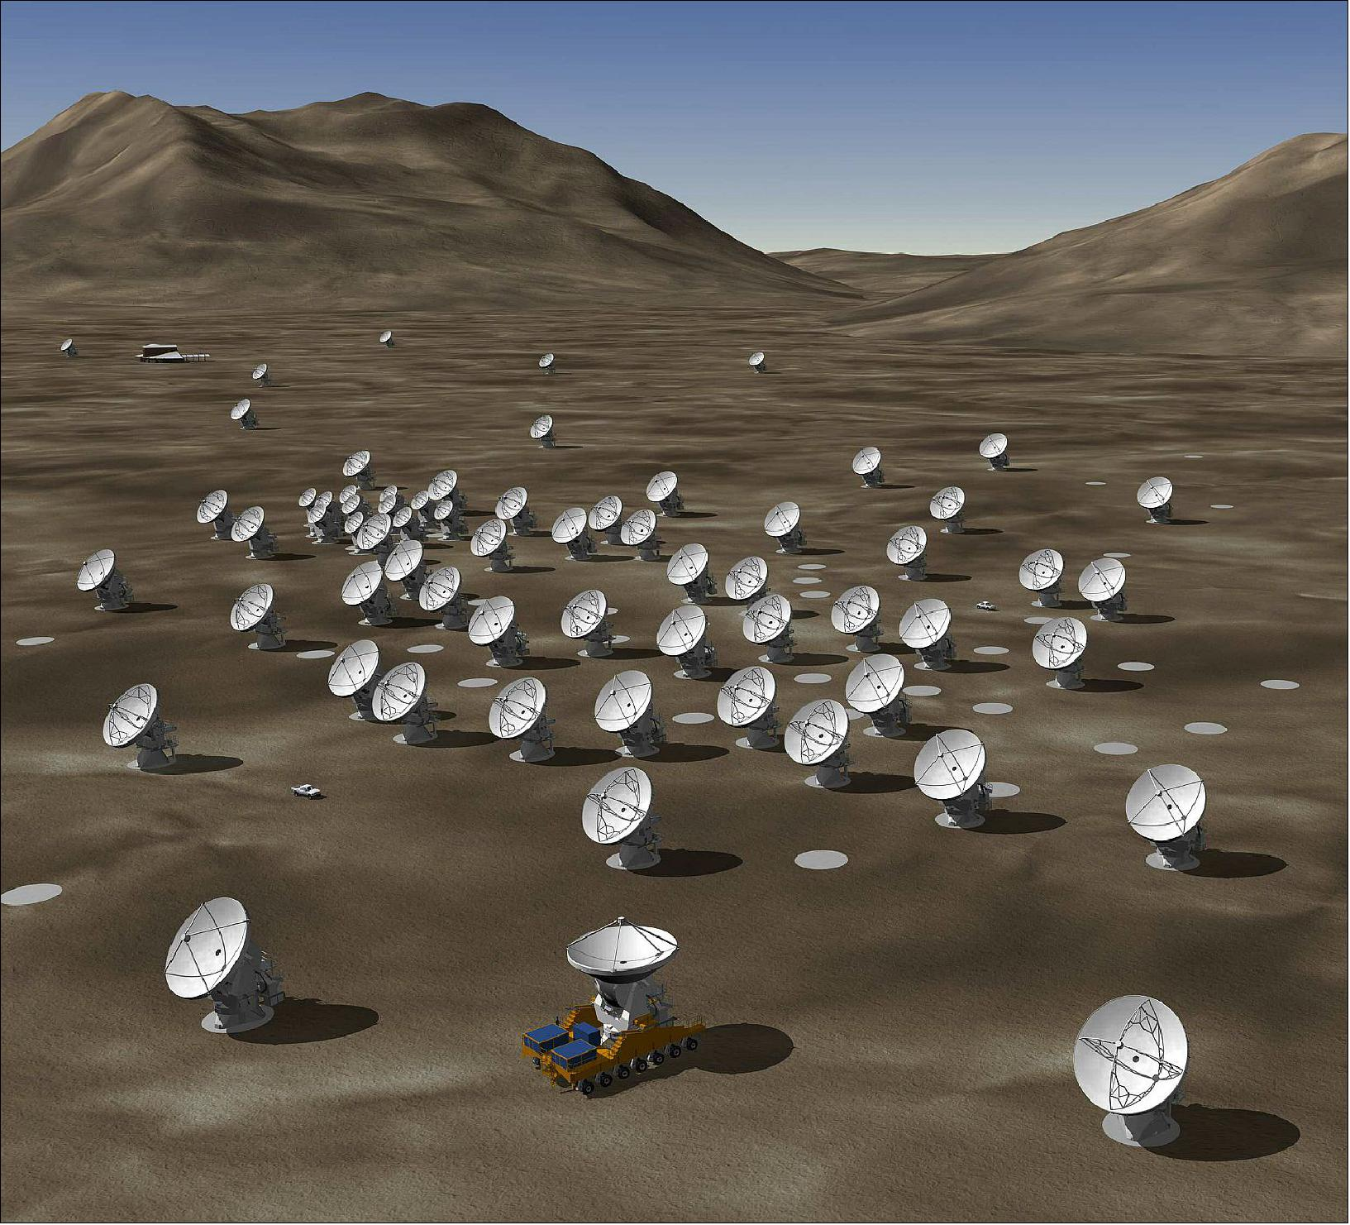
Radio Interferometry: a Sparse Sampling in Fourier Domain
Image domain
Fourier domain
sparse sampled Fourier transform
Zawadzki et al. (2023)
ALMA
Notes:
The **fundamental challenge** is that radio interferometry is **incomplete, sparse** sampling in Fourier domain. This is because our telescope array is **sparsely distributed** on the ground (as shown in the center), and is shown on the right. Each red dot represents a **measured signal**, while the white gaps represent **missing information**. Essentially, we are trying to reconstruct a image from a very limited subset of spatial frequencies.

Slide 4
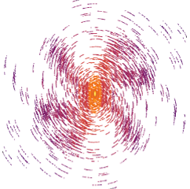
Image Reconstruction in Radio Interferometry
Fourier domain
observation
Image
to reconstruct
?
ill-posed
inverse problem
Challenges
Sparse sampling
Signal to noise ratio ≲ 1
Notes:
Therefore, image reconstruction in radio interferometry is an **ill-posed inverse problem**. We start with observations that are both **sparsely sampled** and **corrupted by noise** in the Fourier domain. Our goal is to reconstruct a image in the spatial domain that we can understand.

Slide 5
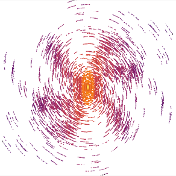
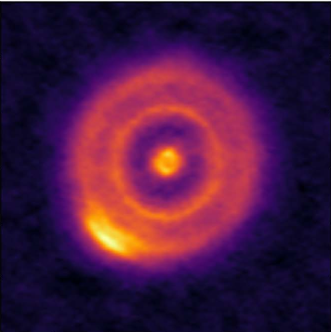
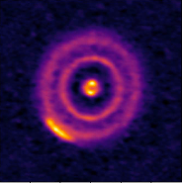
Traditional Method CLEAN Struggles for Extended Objects
Radio telescope
observation
Image blurred with artifacts
Image cleaned
Interpolate & Inverse Fourier Transform
Fit with Point Sources and Gaussians
Issues
Point Spread Function is non-Gaussian
Need infinite point sources to reconstruct extended objects
Andrews et al. (2018)
Zawadzki et al. (2023)
Notes:
The standard for reconstruction is the **CLEAN algorithm**, which follows a **two-step iterative process**. First, an **inverse Fourier transform** converts the Fourier domain data to what we call a **'dirty image.’**, which is blurred with artifacts. To clean the image, CLEAN iteratively fits the dirty image with point sources to build a model. This model is then convolved with a **'clean beam'** to produce the final image.
However, CLEAN has **two major drawbacks**. First, the **Point Spread Function (PSF)** of a dirty image is often **highly irregular and non-Gaussian**; fitting the image with Gaussian beam, we introduce artifacts. Second, CLEAN’s **'point-source' assumption** is fundamentally ill-suited for **extended emissions**, such as protoplanetary disks, requiring an impractical number of iterations to converge.

Slide 6
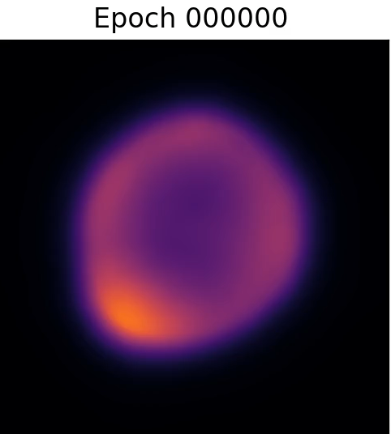
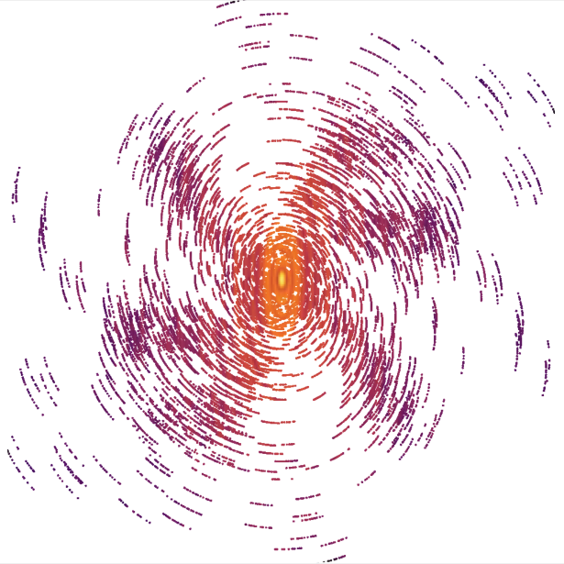
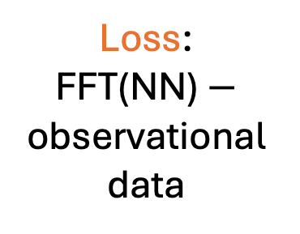
Our Approach:
Fitting Neural Network to Visibility
Image domain
Fourier domain
Neural Network
(NN)
Loss:
FFT(NN) $−$ observational data
Iterate NN parameters
Self-Supervised: No ground truth or prior needed for training
Generalization: Versatile to any array configuration or morphology
Efficiency: 2 seconds / epoch, 5 minutes to convergence (A100 GPU)
Notes:
Our approach **fundamentally different from CLEAN**. Instead of iterative deconvolution, we perform **direct visibility fitting** using a neural network. We parameterize the sky’s brightness distribution as a **continuous function** within a neural network. We apply a **forward Fourier transform** to the network’s output, and we compare it directly with our observed visibilities. The network is then updated iteratively by minimizing the **loss**, which is the difference between the model and the observation in the Fourier domain.
This method offers several key advantages:
Self-Supervised: It requires no ground-truth images or prior training data;
Generalization: It is natively versatile, adapting to any array configuration or complex source morphology without manual tuning.
Efficiency: The training is highly optimized, reaching convergence in just 5 minutes on a single NVIDIA A100 GPU.

Slide 7
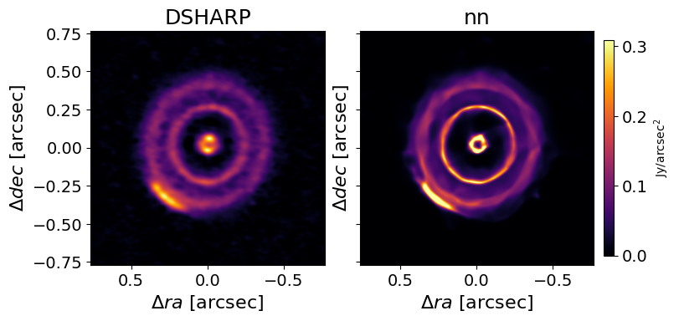
Reconstruction of Real Observation
HD 143006
DSHARP CLEAN
Our Approach
Notes:
Beyond the advantages I just mentioned, our neural network reconstruction produces sharper images than CLEAN, as illustrated here for the real observation from the DSHARP survey.
The image on the left is the traditional CLEAN reconstruction. This right-hand image is our neural network reconstruction from the previous slide. Compared with CLEAN, our reconstruction shows sharper edges, clearer separation between the rings, and higher peak flux densities.

Slide 8
Tests:
Neural Network Imaging of Synthetic Observation
Notes:
Next we test our method on synthetic data. This allows us to compare our reconstructions against a known ground truth to quantify accuracy. Later, I will demonstrate the method's applications on real-world observational data.

Slide 9
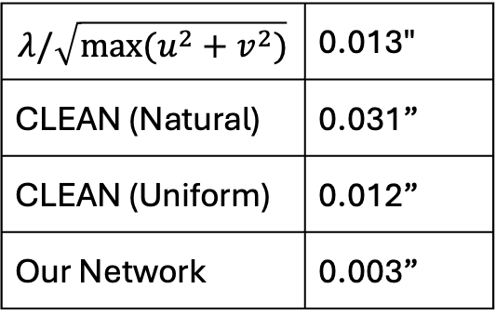
NN → 4-10× Sharper PSF and Less Sidelobes
Point Source
1 arcsec
$$λ/\sqrt{max⁡(u^{2}+v^{2})}$$ | 0.013"
CLEAN (Natural) | 0.031”
CLEAN (Uniform) | 0.012”
Our Network | 0.003”
1 arcsec
synthetic visibility
simobserve
with DSAHRP coverage
and noise
Notes:
To quantify our resolution gains, we first tested the method against a point-source benchmark. We simulated an ALMA observation of a single-pixel delta function using simobserve, mimicking DSHARP conditions. On the right, we compare the normalized Point Spread Function (PSF) of CLEAN under various weighting schemes against our neural network.
While natural weighting provides less sidelobes but a broad 31 mas beam, and uniform weighting pushes resolution to 12 mas at the cost of significant sidelobes, our neural network achieves a 3 mas FWHM. This represents a 4-to-10-fold improvement over CLEAN method. Furthermore, the red profile demonstrates that our model effectively suppresses the sidelobes that typically plague high-resolution CLEAN reconstructions.

Slide 10
NN → Higher Resolution
Two Point Sources
0.010”
0.012”
synthetic visibility
simobserve
with DSAHRP coverage
and noise
Notes:
This sharper PSF means NN gives higher resolution, which evaluated by the minimal separation two-point sources. Two tests, On the left, ground truth are two point sources separated by 10 mas, and on the right, a separation of 12 mas. In both cases, CLEAN produces a single, merged peak, failing to resolve the binary structure. In contrast, our neural network successfully recovers two distinct peaks in both scenarios. While the 10 mas test shows the sources just beginning to separate, the 12 mas test clearly resolves them, demonstrating our method's ability to surpass the classical diffraction limit.

Slide 11
NN → Higher Image Fidelity
Three scores comparing reconstructed images (CLEAN/NN) with ground truth image
Left: Fidelity
Middle: Structure Similarity
Right: Flux Ratio
Higher → Reconstruction closer to ground truth
Notes:
Our neural network get higher fidelity on more complex morphologies, we simulated a system with multiple inclined rings, mimicking the high-resolution conditions of the DSHARP survey using both short and long baseline data. We then performed a comparison between CLEAN and our neural network.
To quantify the results, we used Fidelity and Structural Similarity (SSIM) metrics—where higher values indicate a reconstruction closer to the ground truth. Visually, our neural network produces a much cleaner result with lower noise levels. Quantitatively, it outperforms CLEAN across both metrics, demonstrating superior accuracy in recovering multi-scale ring structures.

Slide 12
Applications:
Neural Network Imaging of Real Observational Data
Notes:
Now that we have validated the method using synthetic benchmarks, I would like to demonstrate its performance on real observational data. In the following examples, you will see how our neural network handles the complexities of actual telescope data

Slide 13
NN → Real Observation PDS70
Data from Benisty et al. 2021
Notes:
Next, we applied our method to the PDS 70 system using data from Benisty et al. (2021). In the top row, we compare the standard CLEAN reconstruction on the left with our neural network image on the right. The second row provides a high-resolution zoom-in on the central region.
You can clearly see that our neural network recovers point-like emission that precisely matches the known locations of the protoplanets PDS 70b and 70c. While these features are often blurred or lost in the sidelobes of a traditional CLEAN reconstruction, our model resolves them with high contrast against the surrounding noise.

Slide 14
Summary
We developed a machine learning tool to reconstruct images from interferometric observations.
The tool
learns directly from Fourier-domain data, without the need for pre-training or “ground truth” priors,
Is highly efficient, converging in just 5–10 minutes on a single NVIDIA A100 GPU for standard DSHARP-scale datasets.
Compared with CLEAN:
4~10× smaller FWHM and higher resolution,
higher overall image fidelity and structural similarity.
Ongoing and Future works
Reconstructing continuous 3D flux distribution from multi-channel data
Extending to
  JWST NIRISS Aperture Masking Interferometry
  ground-based optical/NIR interferometry
  Event Horizon Telescope
Notes:
While we have conducted many more tests than I can cover today, our first paper is currently in the publication pipeline, and we look forward to sharing the full results with you soon.
In Summary: We have developed a novel self-supervised framework for radio interferometric reconstruction. Unlike traditional methods, our tool:
Learns directly from visibility data without the need for pre-training or 'ground truth' priors.
Is highly efficient, converging in just 5–10 minutes on a single NVIDIA A100 GPU for standard DSHARP-scale datasets.
Compared to the CLEAN algorithm, our method consistently delivers:
4–10× smaller PSF and sharper resolution.
Significantly reduced spatial filtering, allowing for the recovery of extended emission.
Higher overall image fidelity and structural similarity.
Looking ahead, we are currently expanding this framework to reconstruct 3D flux distributions from multi-channel spectral line data. We are also adapting the tool for JWST NIRISS masking interferometry, ground-based optical arrays, and the Event Horizon Telescope.

Slide 15
NN → Less Spatial Filtering
UV covered
synthetic visibility
simobserve
with long baseline (C-9) only
Notes:
One of the most significant advantages of our method is its ability to mitigate spatial filtering. In radio interferometry, missing short baselines prevent the telescope from detecting structures larger than a specific angular scale. This often results in 'negative bowls' or the complete loss of extended emission in traditional imaging.
We tested this using a synthetic uniform disk observed with long baselines only. As expected, CLEAN fails to recover the disk's structure because it cannot access the missing low-frequency information. However, our neural network proves far more robust. As shown in the Fourier domain plots below, while CLEAN deviates significantly in the unsampled zone, our network extrapolates into the short-baseline range, reconstructing a profile much closer to the ground truth.

Slide 16
NN → WISPIT 2
Reduces Spatial Filtering and Enables Self-calibration
Facchini et al. 2026, C-10; missing short baseline observation → spatial filtering
Imaging artifacts inside the cavity (left)
Self-calibration: CLEAN → self-calibrated visibility → CLEAN ❌
NN image → self-calibrated visibility → CLEAN use NN image as start model ✅ (middle)
NN image → self-calibrated visibility → NN image ✅ (right)
Notes:
Our first real-world application is the source WISPIT 2. This is a particularly challenging case because the data was taken using only the ALMA Configuration 10 (long baselines). As we discussed earlier, the lack of short baselines causes severe spatial filtering, which manifests as artifacts inside the disk cavity.
In the original paper, the authors noted that CLEAN-based self-calibration failed because the model couldn't accurately represent the filtered emission. However, our neural network is far more robust to these effects. By using our NN reconstruction as the calibration model, we successfully performed self-calibration. As you can see, the artifacts inside the cavity are significantly reduced in both the resulting CLEAN and NN images. This proves that our network provides a more physically accurate model for self-calibration in the presence of incomplete uv-sampling.

Slide 17
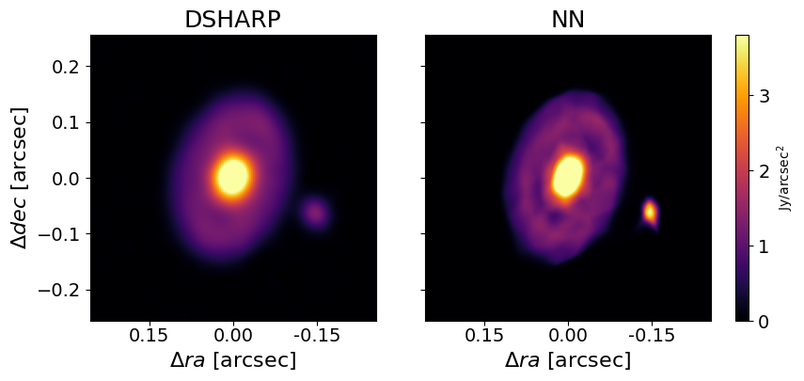
NN → HTLup Substructure

Slide 18
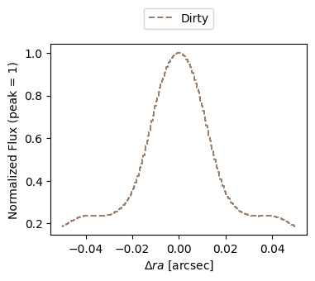
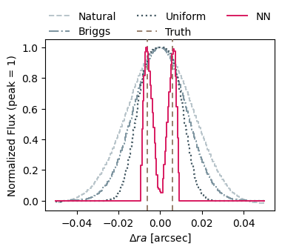
Resolution

