Slide 1
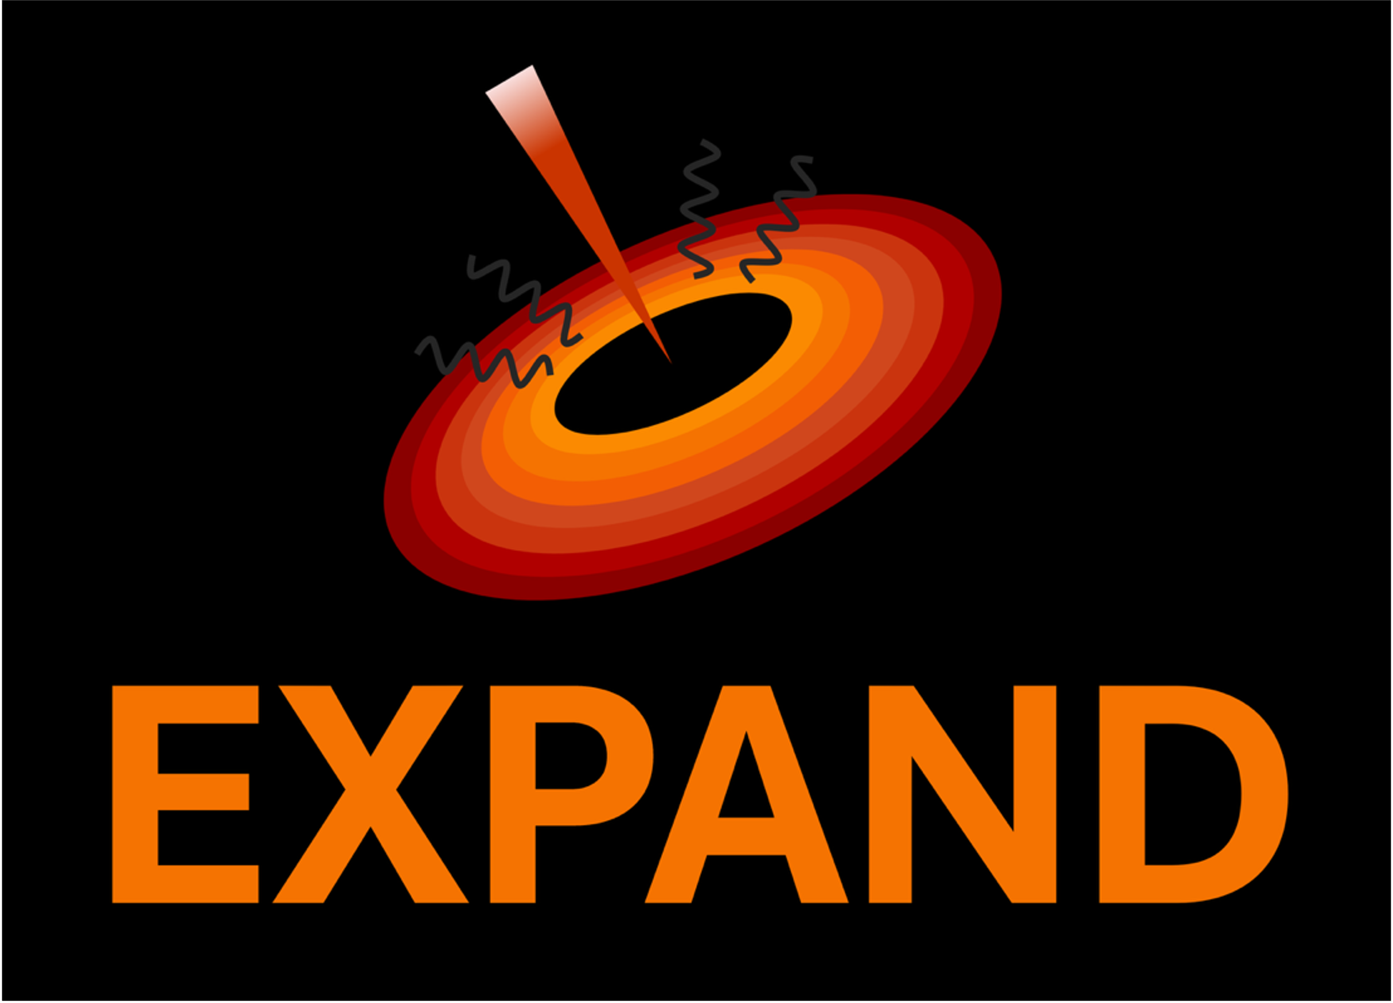


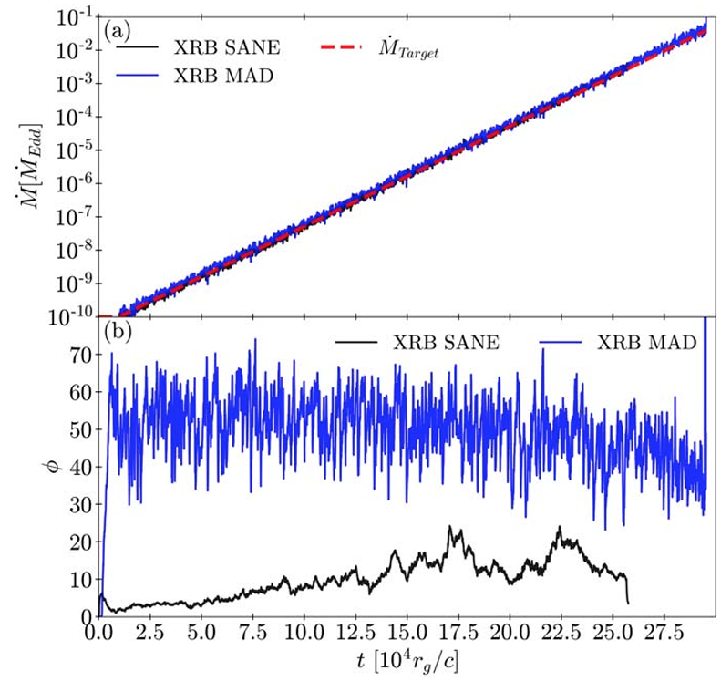
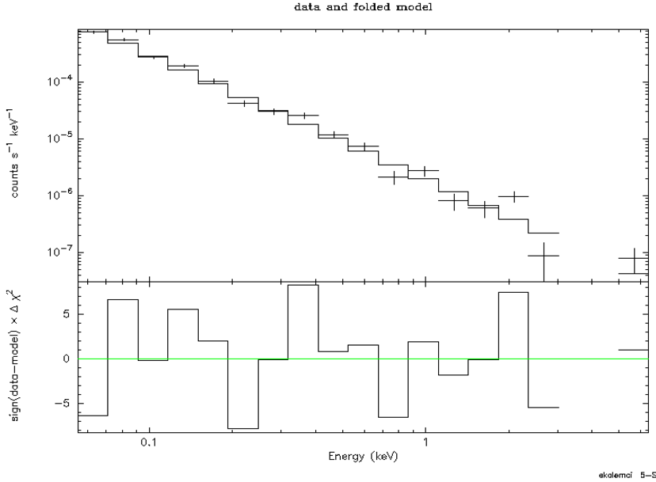
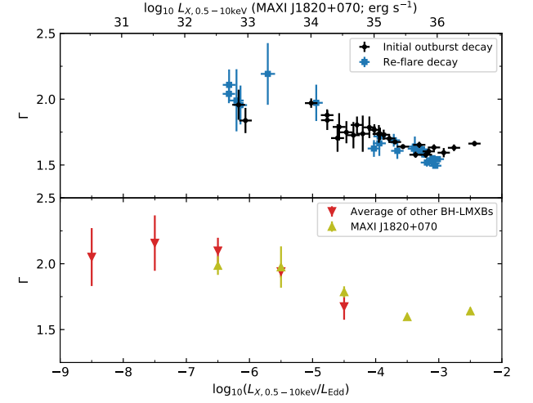
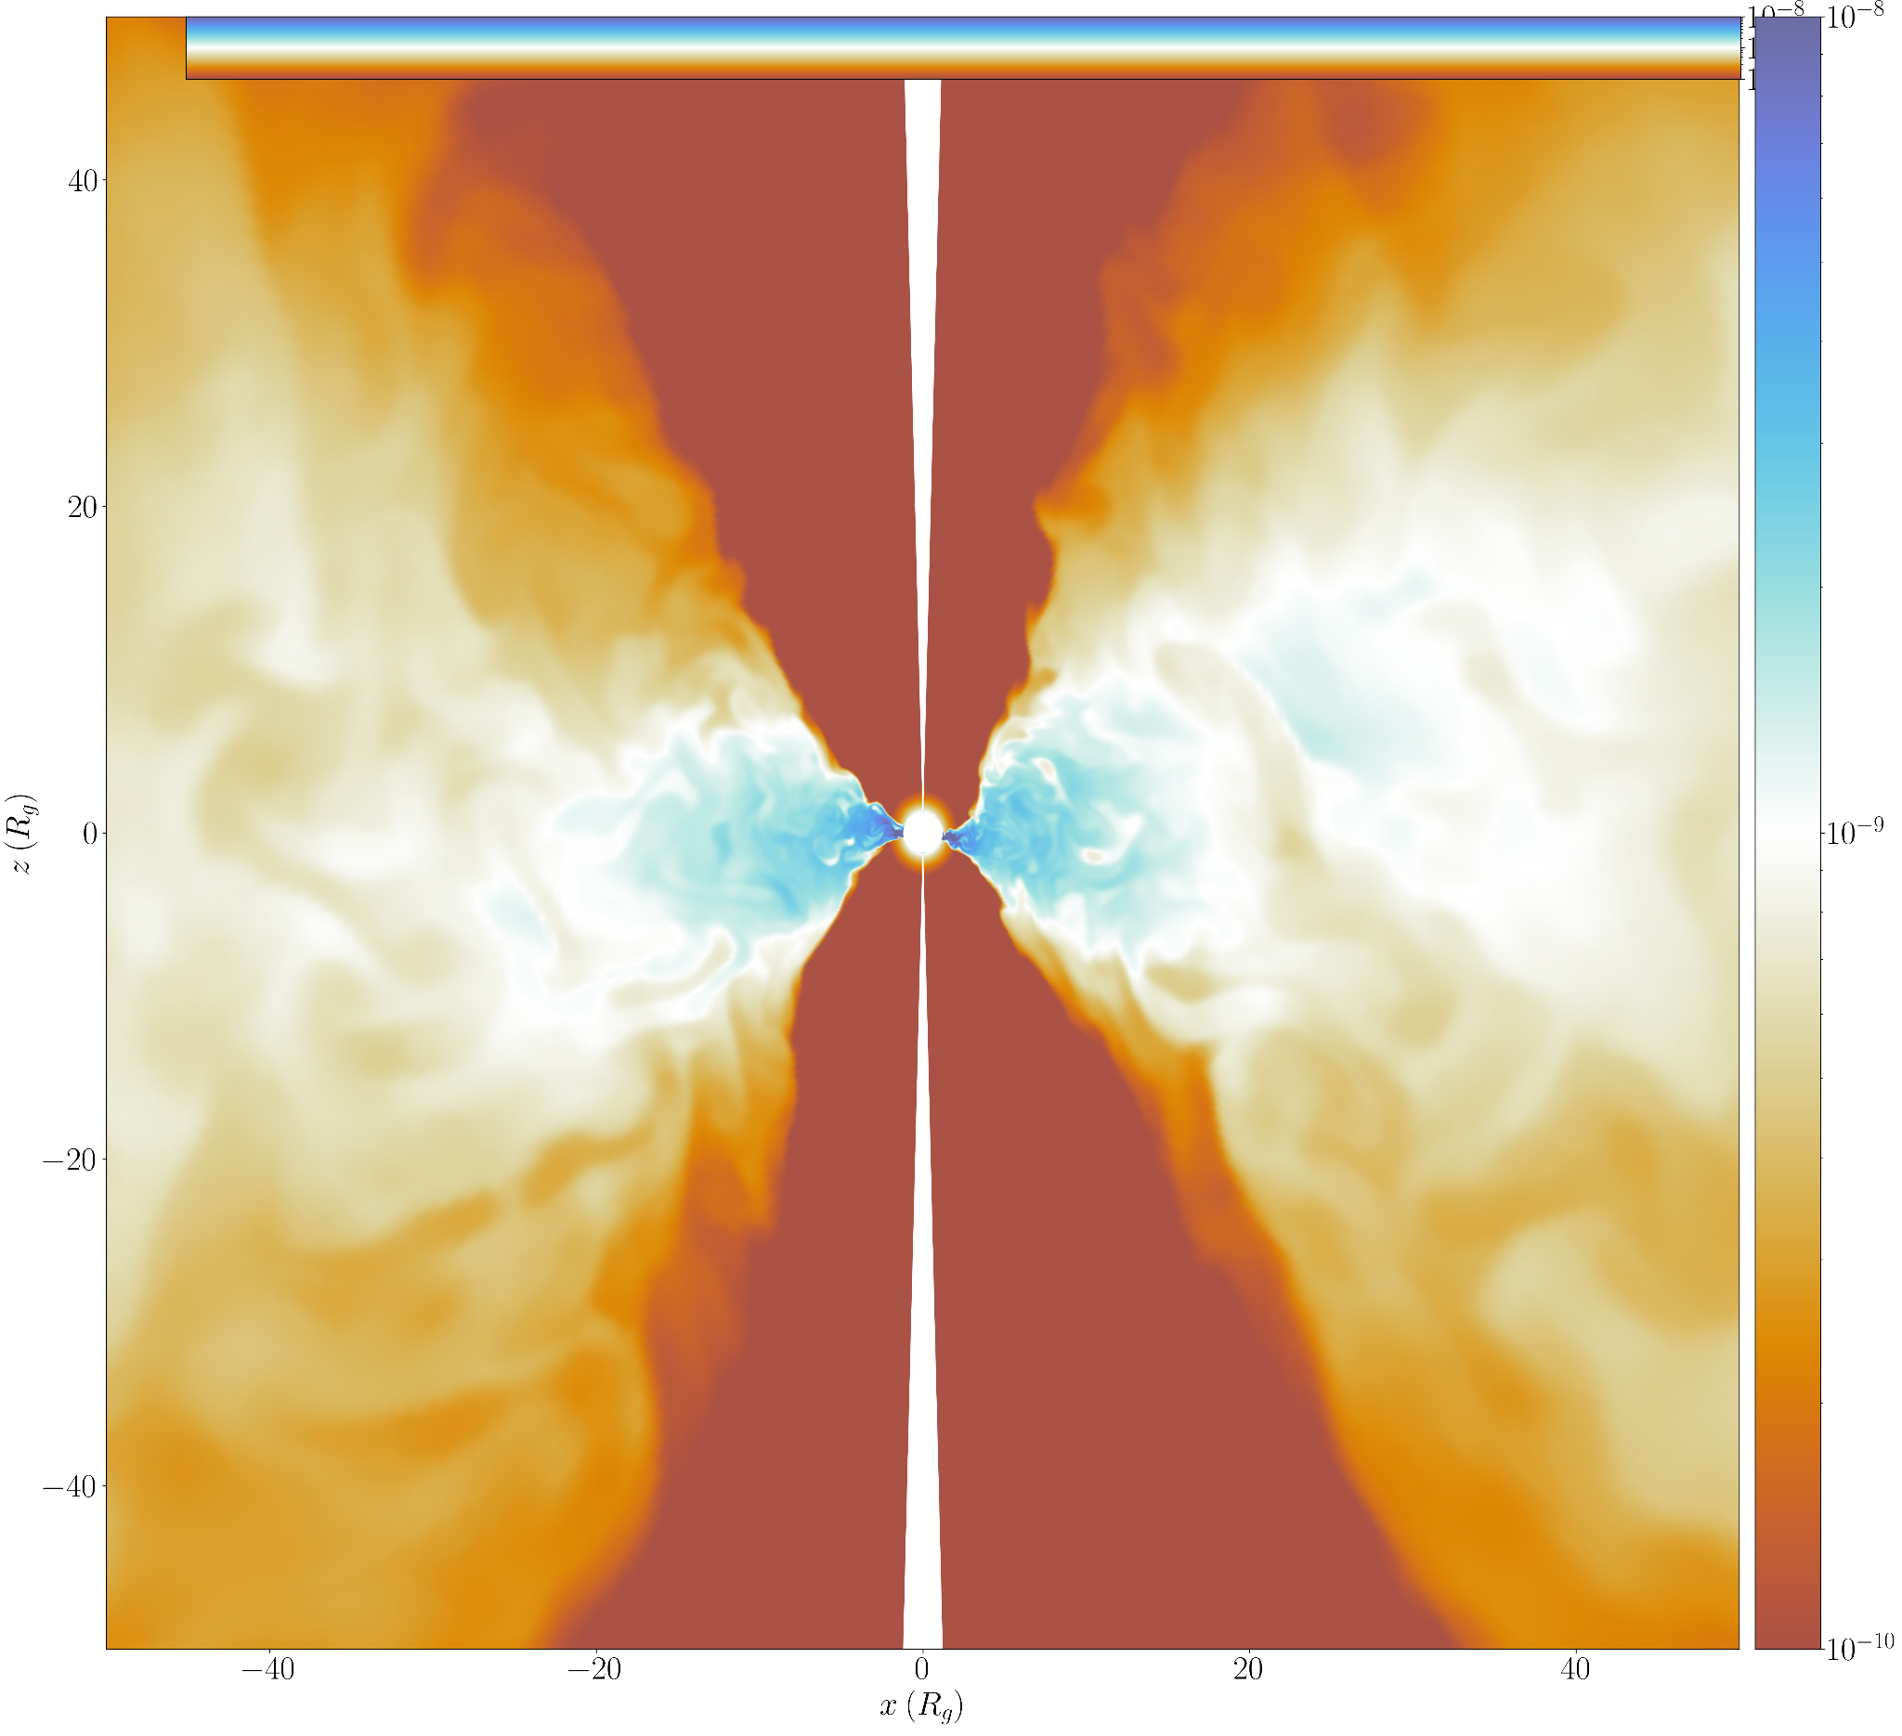
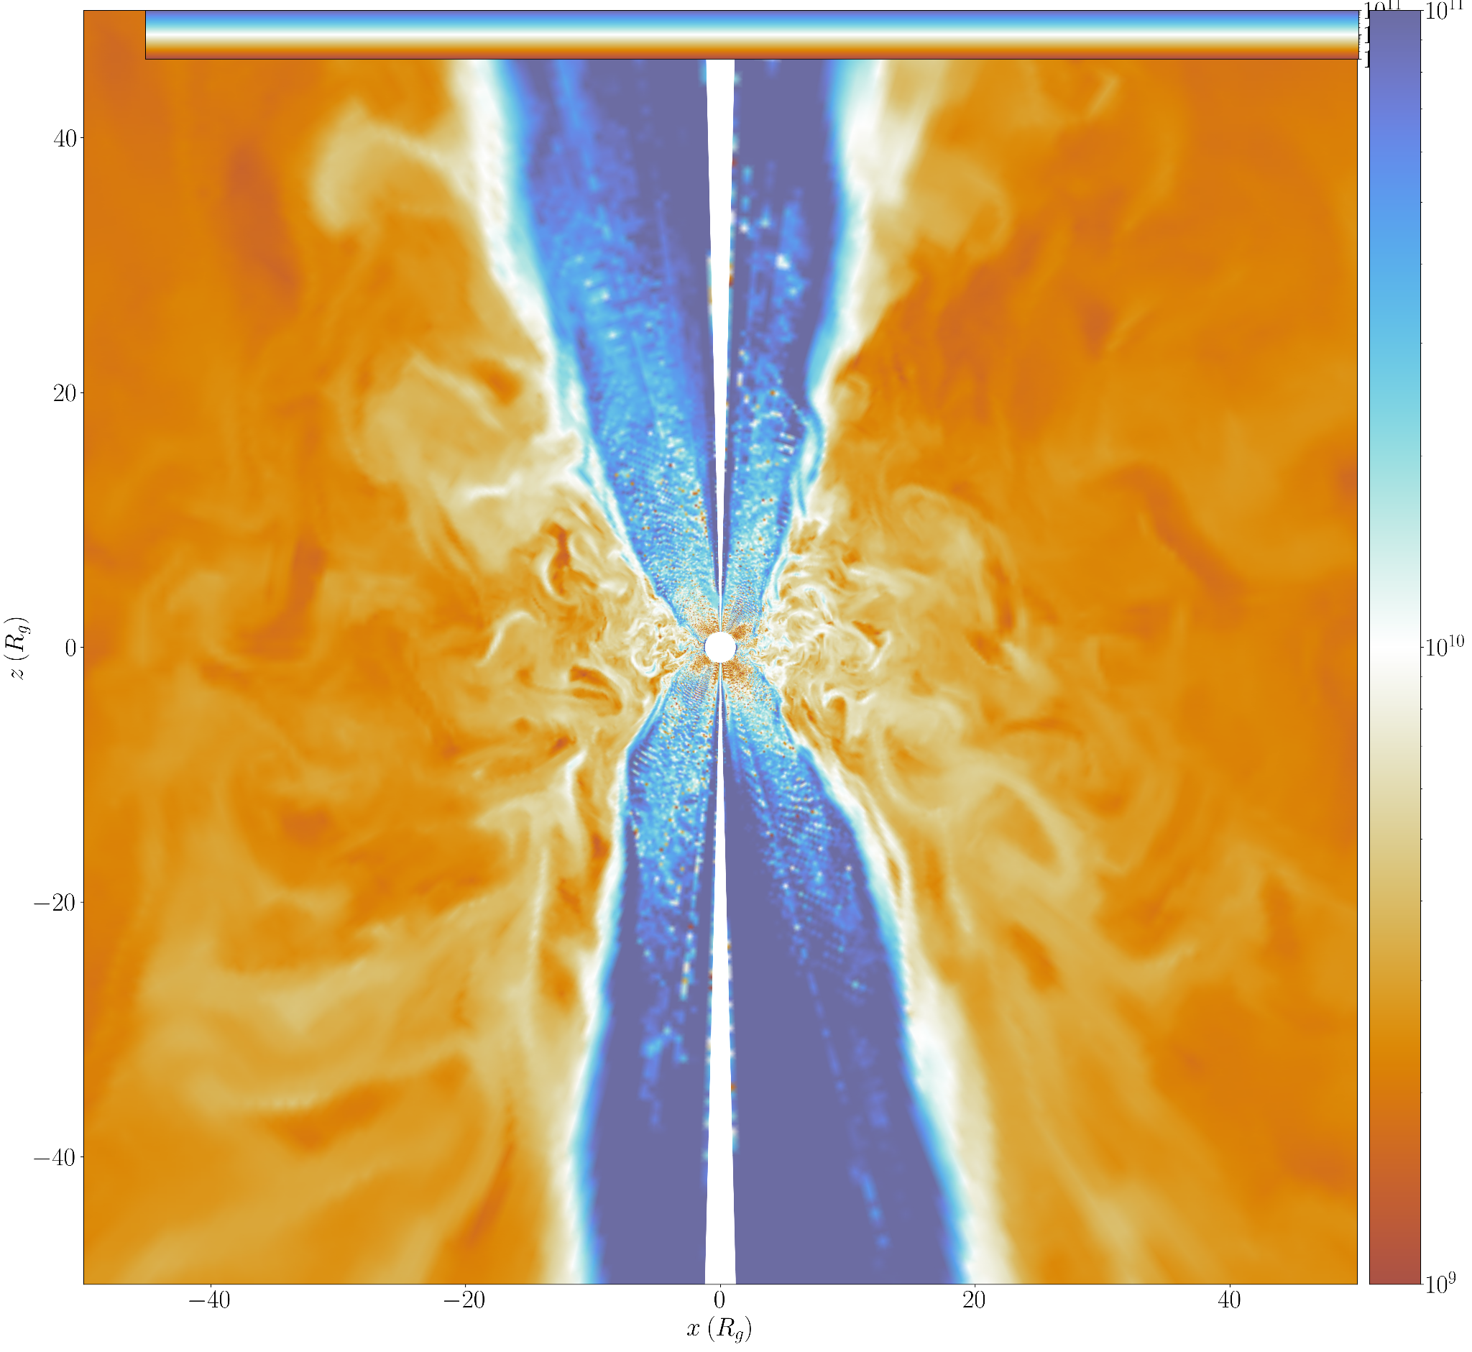
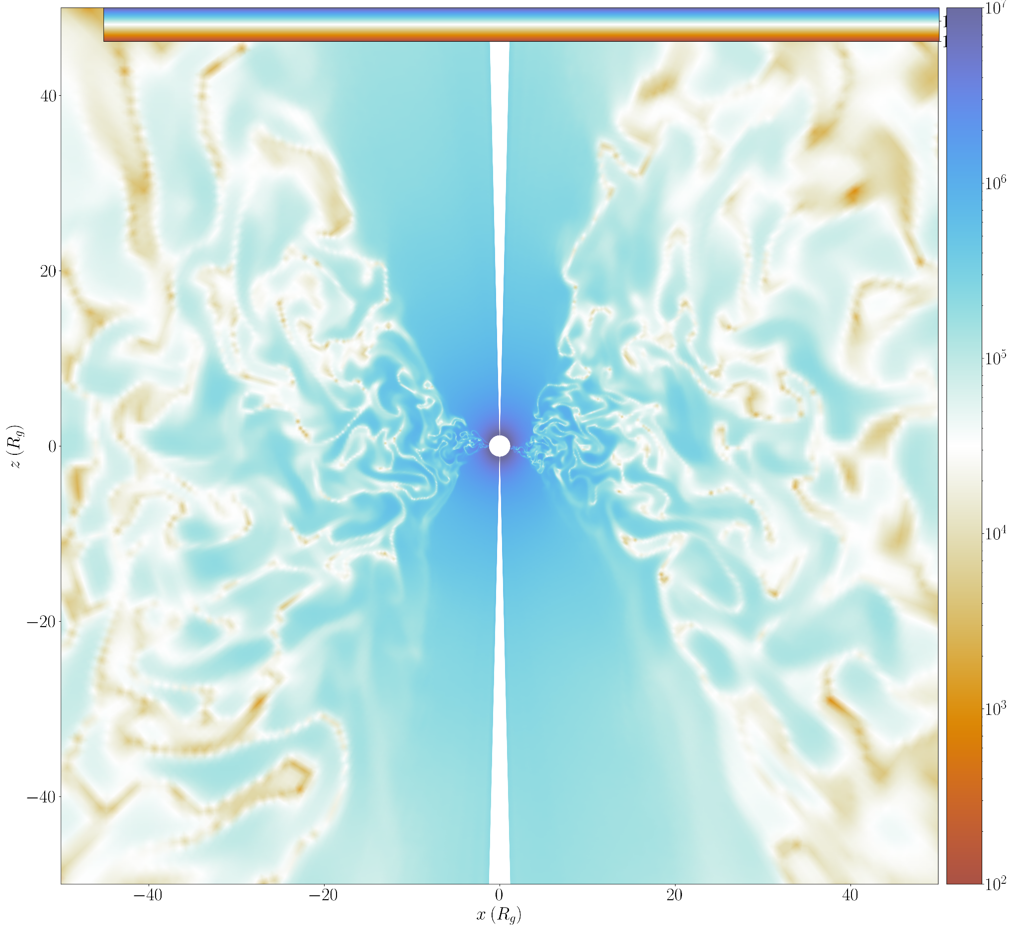
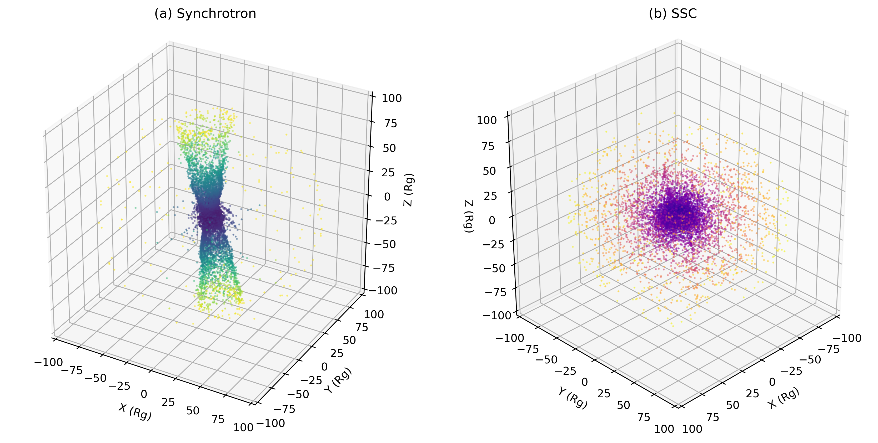
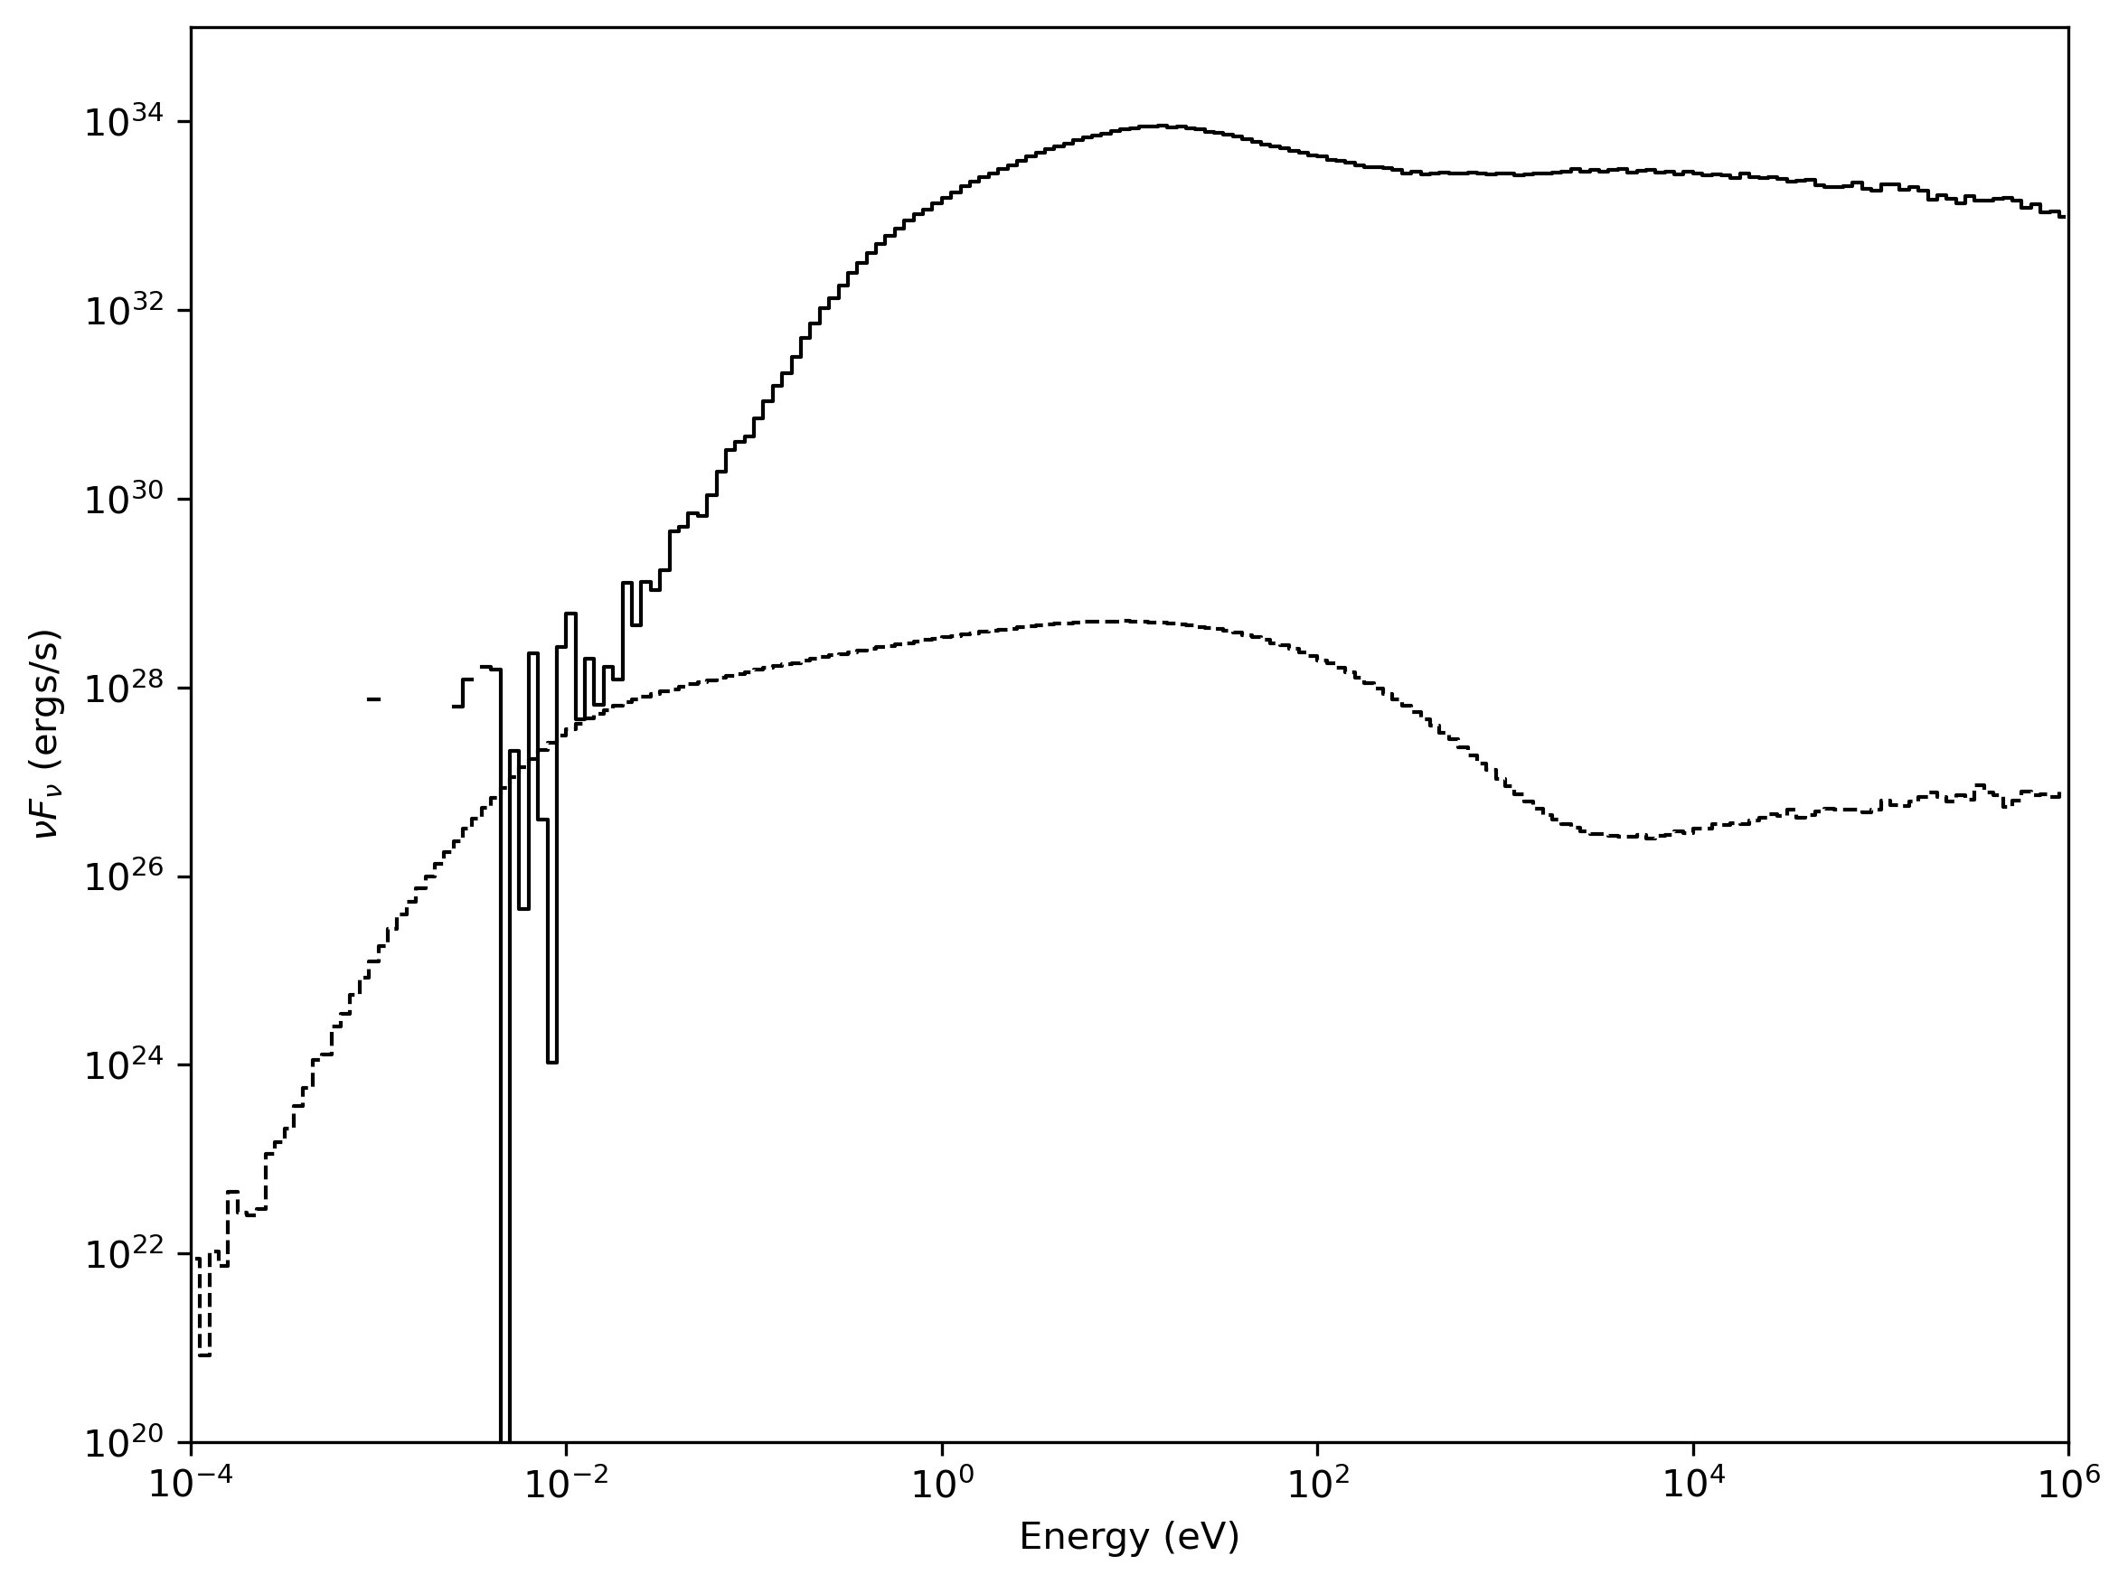
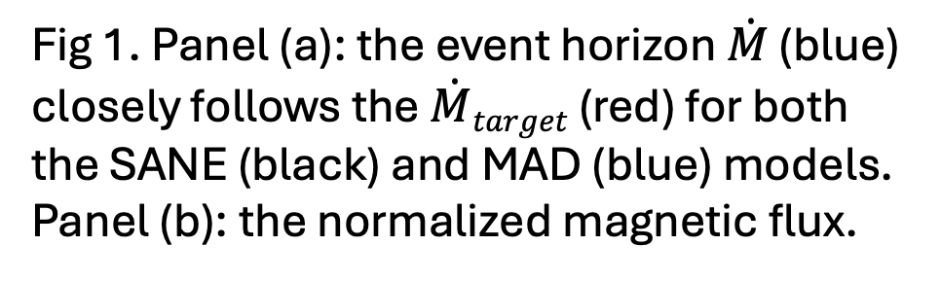
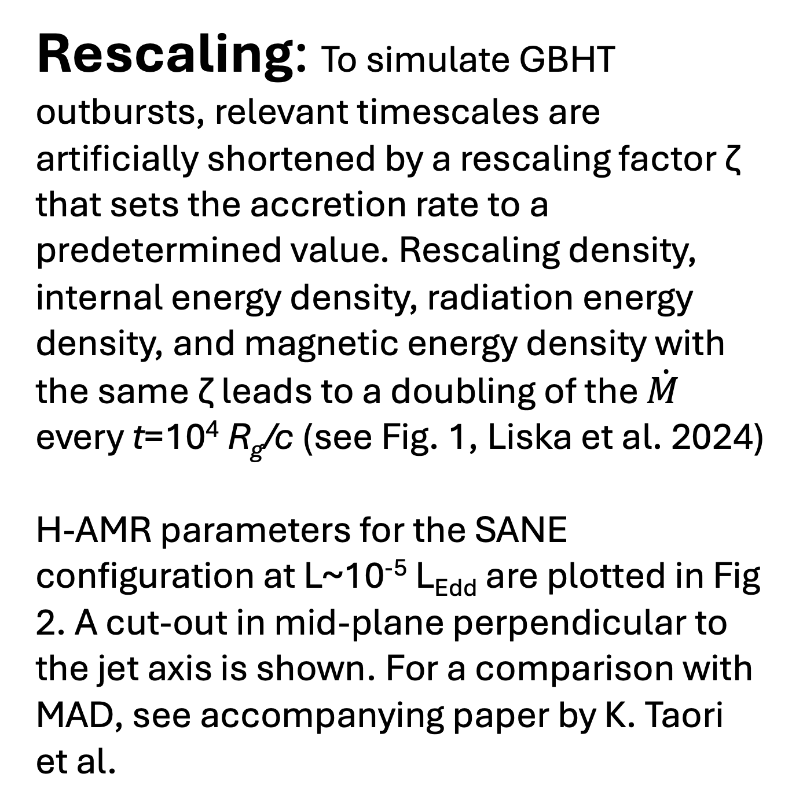
Comparing 3D GRMHD simulation outputs with observations of black hole transients
Emrah Kalemci, Berre Z. Dönmez, Efe Oztaban (Sabanci University)
Matthew Liska, Khushi Taori (Georgia Tech)
AIM: Recreate Galactic Black Hole X-ray Transient (GBHT) Hardness Intensity Diagram (HID) using state-of-the-art 3D GRMHD simulations.
CODES: We use the next generation 3D GRMHD code H-AMR (Liska et al. 2018, 2022) for determining physical parameters of black hoel environments at different Eddington Luminosity ratios. We use RAPTOR (Bronzwaer 2018, 2020) to ray trace synchrotron and Compton scattered photon out of the black hole to create spectra, light curves and images.
Comparison with observations: GBHTs show complex and correlated spectral and timing behavior tied to jets and winds at different luminosities (Kalemci, Kara, Tomsick 2022) which are often discussed within the context of HIDs. Recreating HIDs from simulations requires creating X-ray spectra at different inclinations. This procedure is described in Fig. 4, which includes the SIXTE (Dauser et al. 2019) step allowing creating spectra for any current and future observatory and direct comparison with observations (Fig 5).
Parameter Files
Rescaling: To simulate GBHT outbursts, relevant timescales are artificially shortened by a rescaling factor ζ that sets the accretion rate to a predetermined value. Rescaling density, internal energy density, radiation energy density, and magnetic energy density with the same ζ leads to a doubling of the $\dot{M}$ every t=10⁴ R_{g}/c (see Fig. 1, Liska et al. 2024)
H-AMR parameters for the SANE configuration at L~10⁻⁵ L_{Edd} are plotted in Fig 2. A cut-out in mid-plane perpendicular to the jet axis is shown. For a comparison with MAD, see accompanying paper by K. Taori et al.
FILTER
SED
SIXTE
SPEC
H-AMR
RAPTOR
Event File
Light Curve
Image
QPO
Lags
Fig 4. Method to produce event files, spectra, light curves and images for direct comparison with observational data from any observatory.
a
b
Fig 1. Panel (a): the event horizon $\dot{M}$ (blue) closely follows the $\dot{M}target$ (red) for both the SANE (black) and MAD (blue) models. Panel (b): the normalized magnetic flux.
a
b
c
Fig 5. Panel (a). SIXTE generated X-ray spectrum from the output of H-AMR+RAPTOR at L_{x}~10⁻⁶ L_{edd.} Spectrum is fitted with XSPEC with a power-law index of 2.13. Panel (b) X-ray pectral indices of GBHTs measured at low luminosities in Shaw et al. 2020. Our spectrum is consistent with observations.
Event files allow creating images that we would not normally observe (with the current technology) and playing with different scenarios. In Fig 6. we show the origin of synchrotron photons and SSC photons.
a
b
Fig 2. Panels (a, b, c): Density, temperature, magnetic field distribution, respectively, from H-AMR run at L~10⁻⁵ L_{Edd.}
RAPTOR and Spectral Energy Distributions (SED): While H-AMR takes into account several radiation processes and opacities, it does not currently include photon transport. For each H-AMR run, the parameters are first mapped to a regular grid and then fed into a version of RAPTOR that is capable of producing synchrotron radiation and transport them within the accretion environment taking into account absorption and Compton scattering (synchrotron self Compton, SSC). Two examples of H-AMR+Raptor produced SEDs are shown in Fig. 3.
Fig 6. Panel (a) 3D reconstruction of synchrotron photons within (100 R_{g})³ volume. Great majority (~95%) of the emission comes from very close to the event horizon, and the jet sheath. Panel (b) 3D reconstruction of SSC photons, 27.8% of originating beyond 10 R_{g}.
Conclusions and future work: Ray tracing state of the art 3D GRMHD simulations open up exploring accretion and ejection physics in unprecedented detail, and allowing direct comparison with observations at the same time. The ray tracing will soon be part of H-AMR, increasing performance and allowing emission from more complex physical processes (Bremsstrahlung anf blackbody). We consider adding non-thermal energy distributions (Chael, Narayan, & Sadowski 2017) to characterize its affect on X-ray and near infrared emission. We are creating light-curves to understand variability properties. Finally simulations are underway to characterize reverse transition in outburst decays.
References:
Bronzwaer, T., et al. 2018, A&A, 613, A2.
Bronzwaer, T., et al. 2020, A&A, 641, A126.
Chael, A., Narayan R., & Sadowski A. 2017, MNRAS, 470, 2367-2386
Dauser, T., et al. 2019, A&A, 630, A66
Kalemci, E., Kara, E., & Tomsick, J. A. 2020, in Handbook of X-ray and Gamma ray Astrophysics, eds. Santangelo, A. & Bambi, C. p9
Liska, M. T. P. et al. 2024, ApJ, 966, 47
Liska, M. T. P. et al. 2022, ApJS, 263(2), 26.
Liska, M. T. P. et al. 2018, MNRAS Letters, 474, L81.
Fig 3. SED examples from H-AMR+RAPTOR runs at L~10⁻⁵ L_{Edd.} (solid curve) and at L~10⁻¹¹ L_{edd} (dashed curve). Simulations are conducted in the SANE regime.
Acknowledgments: This research has been supported by TUBITAK 1001 125F512, and TUBITAK BIDEB program 1059B192402204.

