Slide 1
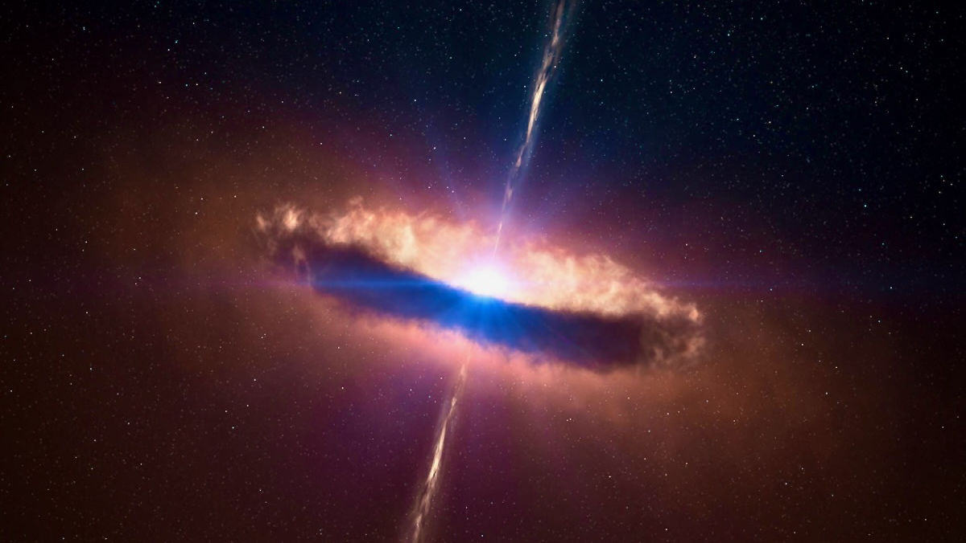
The first IXPE view of the eclipsing
ADC source 4U 1822–37
Alessio Anitra
Università degli studi di Palermo
INAF-IASF Palermo
A. Gnarini, T. Di Salvo, R. Iaria, A. Marino, L. Burderi et many al.
The many tones of accretion
to the memory of Tomaso Belloni
Notes:
1

Slide 2
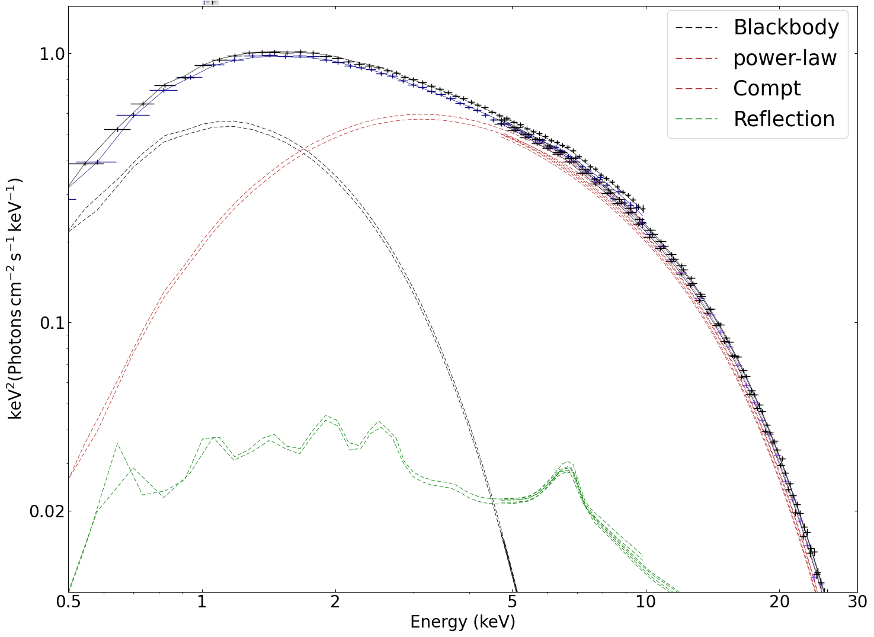
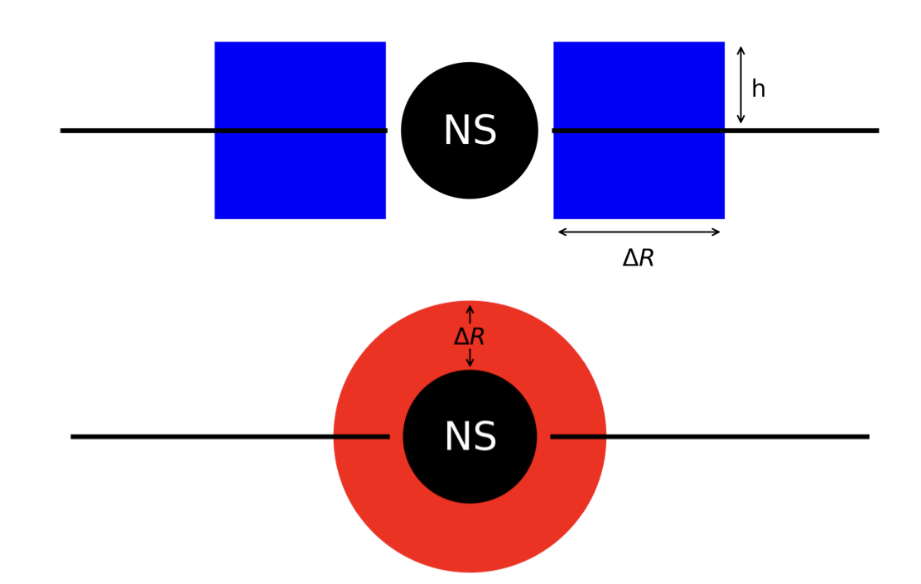
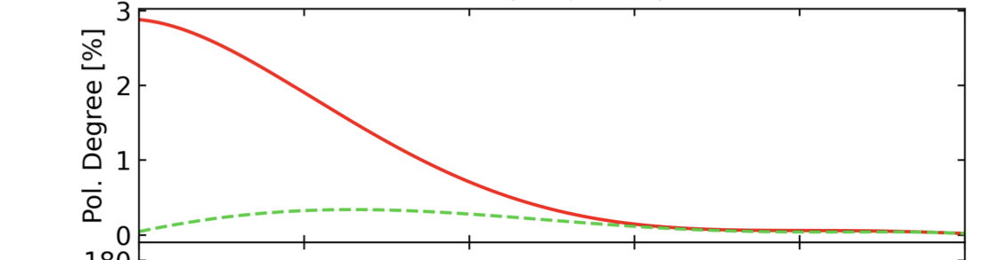
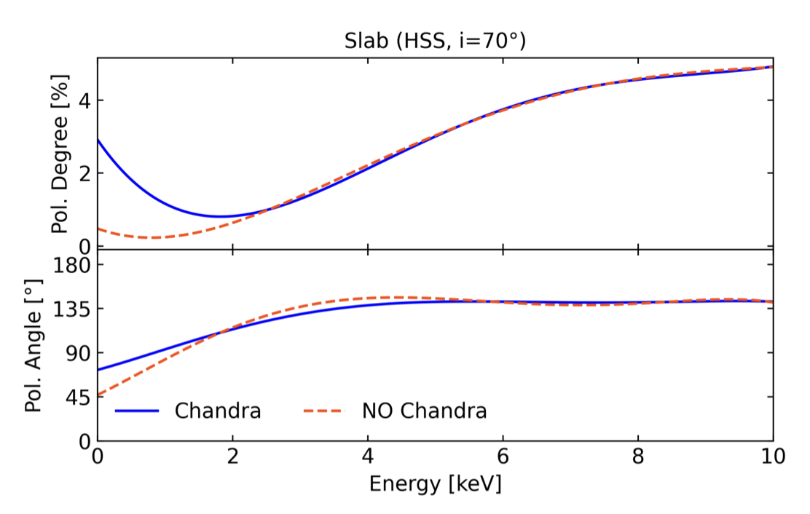


Spectroscopy and polarization
Black Body
Schematic view of Shell and Slab Corona and the associated PD
(Adapted from Gnarini+2022)
Shell ($i={70}^{∘}$)
Example of LMXB spectrum
Slab ($i={70}^{∘}$)
Notes:
2

Slide 3
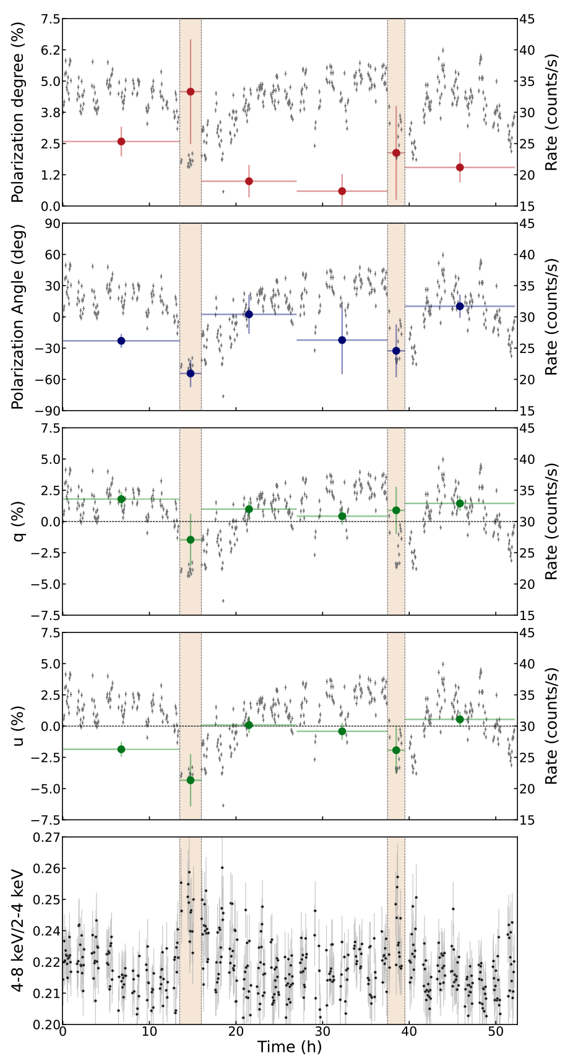
High inclination systems
Di Marco+2024.
In GX 13+1 during the dip the PD increases and the PA swings.
ADC
NS
Sketch of ADC
In high inclination systems scattered and reprocessed radiation becomes important and produces higher PD.
ADC sources : observed emission produced by scattering in an extend sandwich-like corona.
Notes:
3

Slide 4
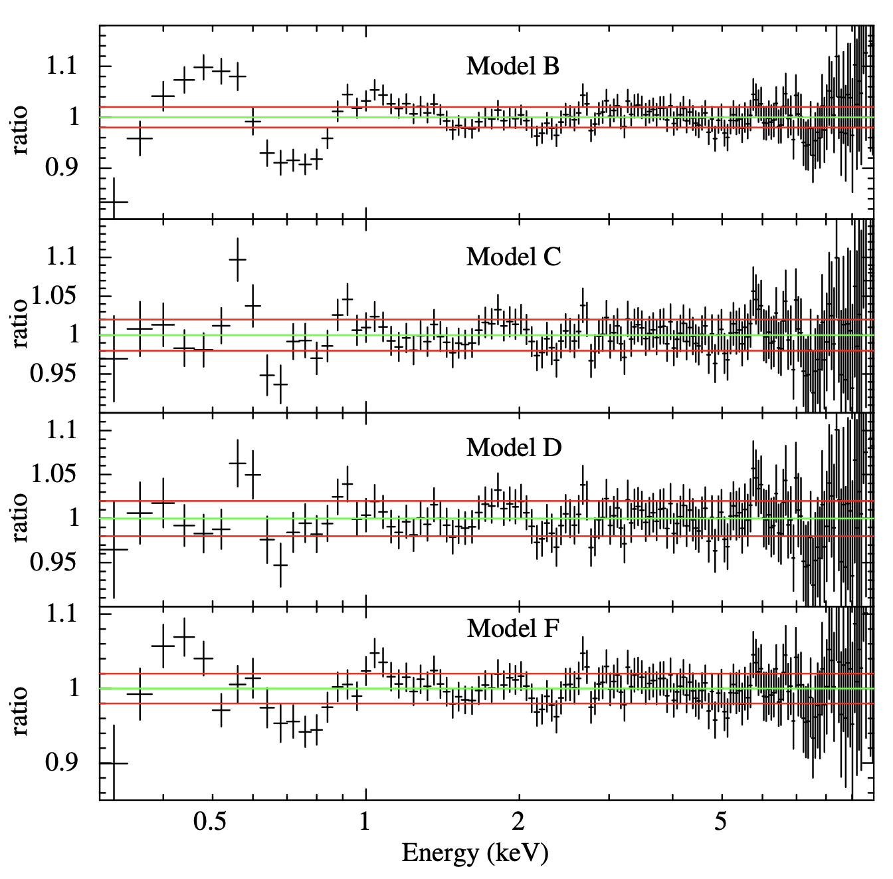
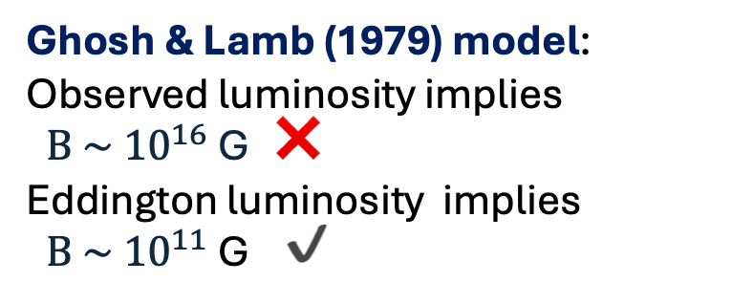

The case of 4U 1822-37
Eclipsing ADC LMXB hosting a 0.59 s X-ray pulsar, viewed at ${80}^{∘}− {85}^{∘}.$
Luminosity mismatch
The observed luminosity is only of order ${10}^{36}\text{erg} {\text{s}}^{\text{-}1}$, but the intrinsic luminosity is close to the Eddington limit (${10}^{38}\text{erg} {\text{s}}^{\text{-}1}$).
Large orbital period derivative implies super-Eddington mass transfer (Burderi+2010).
Cyclotron line at 0.66 keV (Iaria+2024)
Ghosh & Lamb (1979) model:
Observed luminosity implies $B \sim { 10}^{16}$ G ❌
Eddington luminosity implies $B \sim { 10}^{11}$ G ✔️
4U 1822−37 is intrinsically much brighter than it appears
Notes:
4

Slide 5
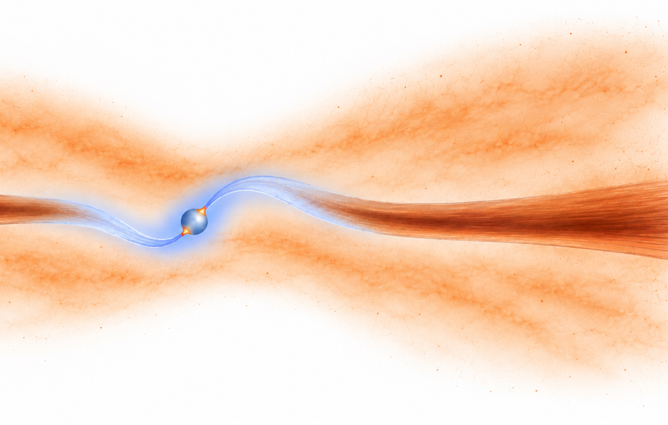

The periscope scenario
Thin
Corona
We can still probe the inner regions.
Thermal emission, Comptonization, Reflection
and X-ray pulsations
(Iaria+2013, 2024; Anitra+2021)
`
Disk
Thick Corona
Periscope:
An extended, optically thin ADC scatters a small fraction of the intrinsic radiation into our line of sight.
Courtesy of ChatGPT
Testing the geometry through a coordinated spectral and polarimetric campaign with XMM-Newton, Swift, NuSTAR, and IXPE
Notes:
5

Slide 6
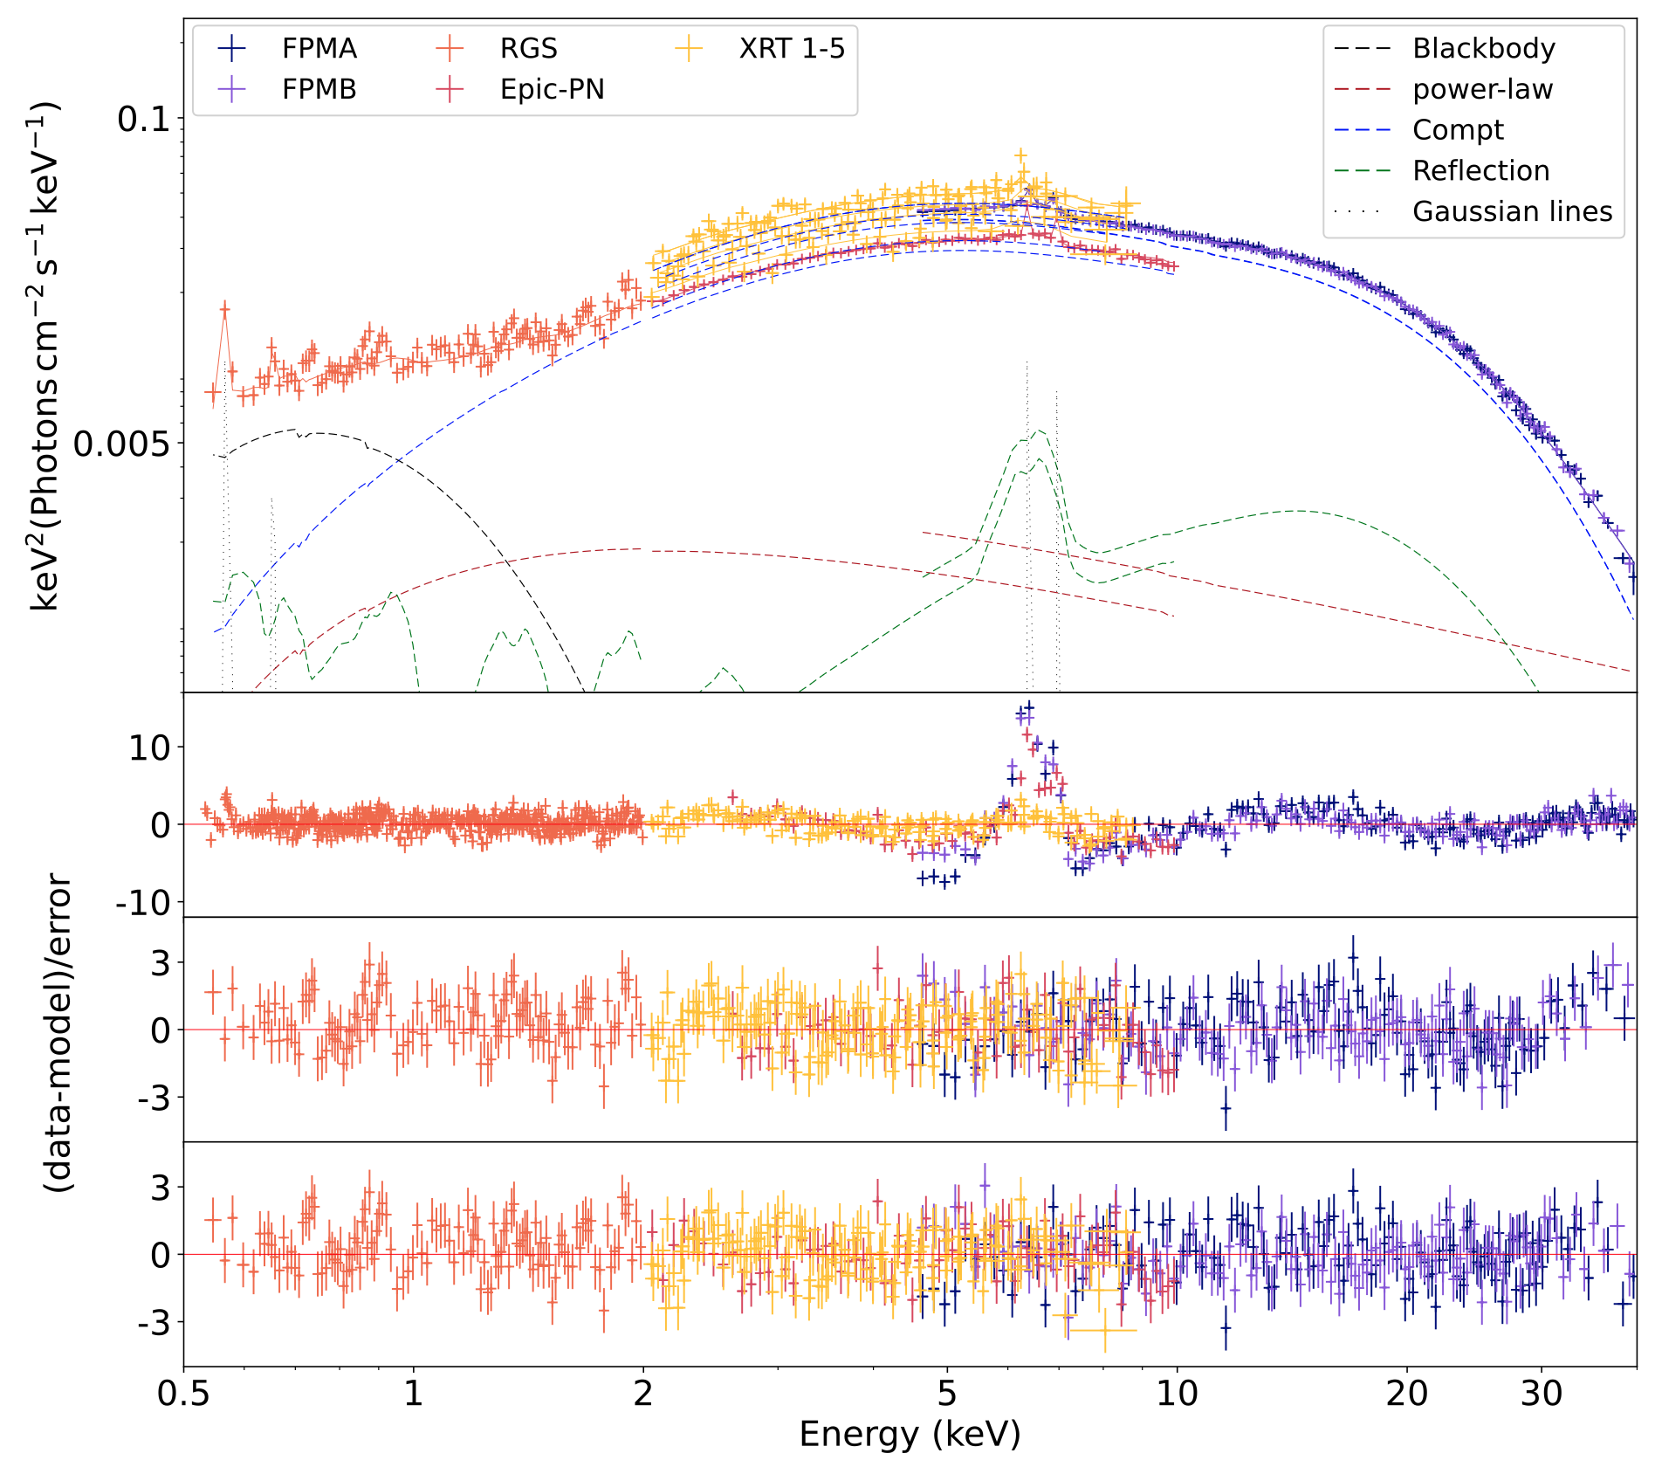
Spectral decomposition
Model = $\text{T}b\text{abs} ×\text{ ( 4 Gaussian + }\text{bbodyrad + }\text{thcomp} × \text{bbodyrad} \text{+}\text{relconv} × \text{rfxconv} \text{+ }\text{power−law}\text{)}$
Consistent ADC picture
Blackbody emitted from the inner part of the disc.
Seed photons compatible with emission from the neutron-star surface.
Inner radius consistent with a truncated disc at the magnetospheric radius.
Notes:
6

Slide 7
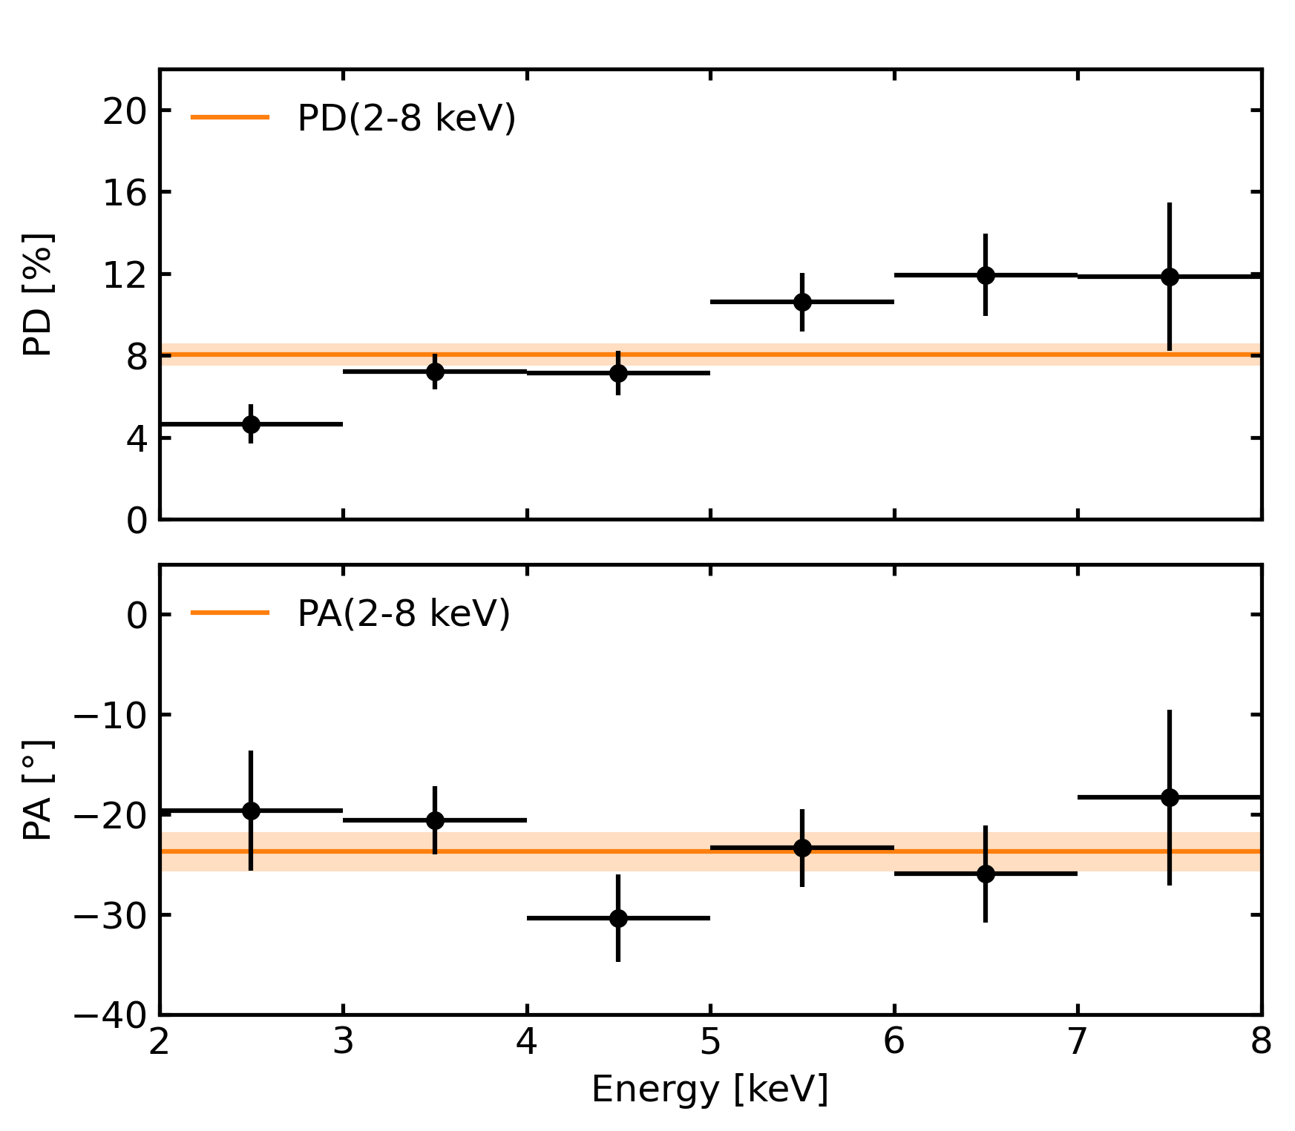

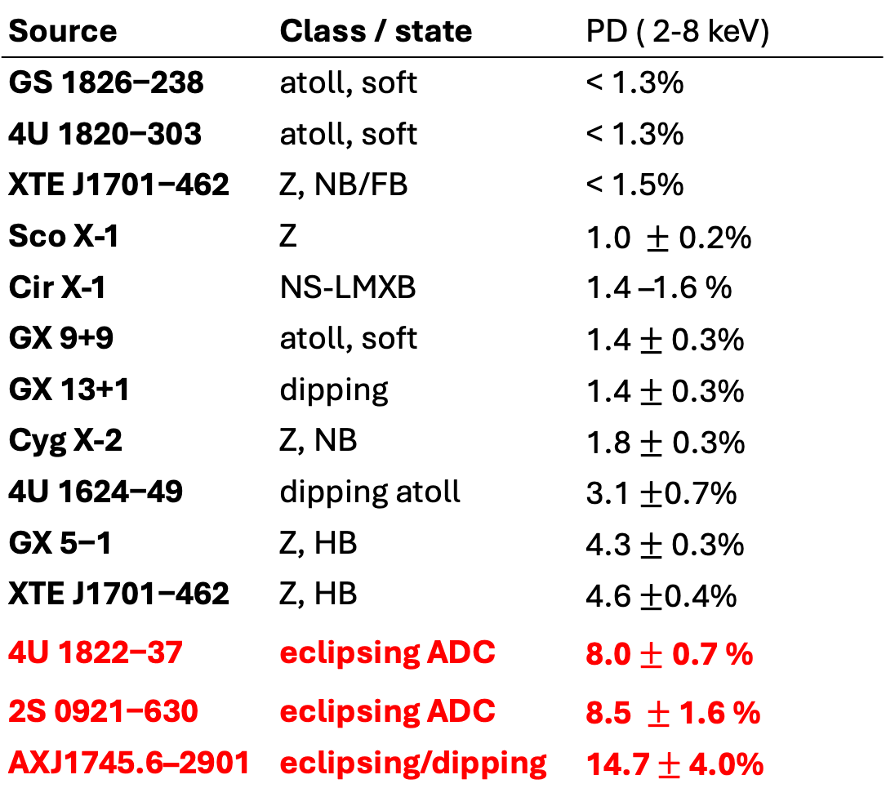
Polarimetric analysis
PD = 8.0 % $±$ 0.7 % and PA = -${21}^{∘}±$ $2^{∘}$.
Source | Class / state | PD ( 2-8 keV)
GS 1826−238 | atoll, soft | < 1.3%
4U 1820−303 | atoll, soft | < 1.3%
XTE J1701−462 | Z, NB/FB | < 1.5%
Sco X-1 | Z | 1.0 $±$0.2%
Cir X-1 | NS-LMXB | 1.4 –1.6 %
GX 9+9 | atoll, soft | 1.4 $±$0.3%
GX 13+1 | dipping | 1.4 $±$ 0.3%
Cyg X-2 | Z, NB | 1.8$±$0.3%
4U 1624−49 | dipping atoll | 3.1 $±$0.7%
GX 5−1 | Z, HB | 4.3 $±$0.3%
XTE J1701−462 | Z, HB | 4.6 $±$0.4%
4U 1822−37 | eclipsing ADC | 8.0 $±$0.7 %
2S 0921−630 | eclipsing ADC | 8.5 $±$1.6 %
AXJ1745.6–2901 | eclipsing/dipping | 14.7 $±$ 4.0%
The PD increases with energy, reaching 11% in
the 7–8 keV bin while the PA is stable.
Notes:
7

Slide 8
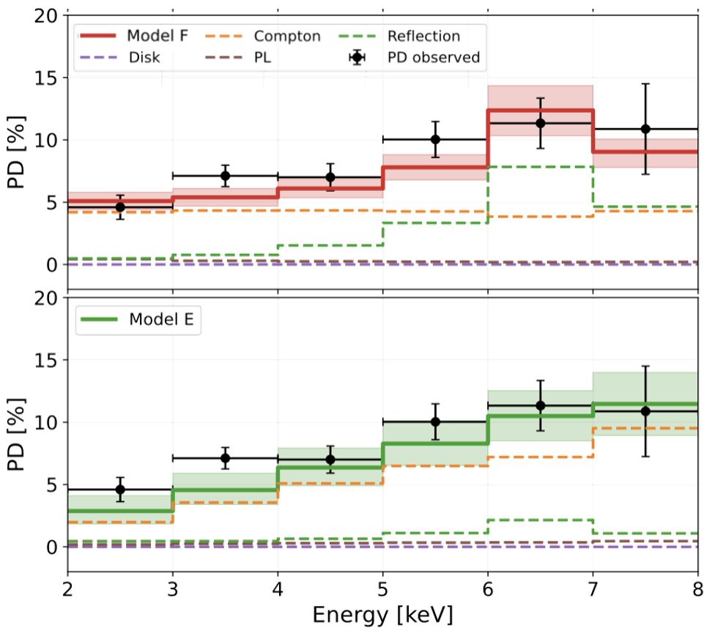
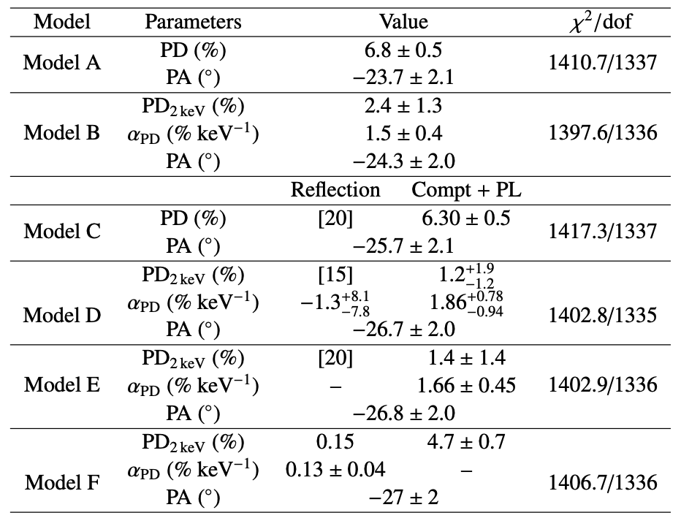


Spectro-polarimetric analysis
Model F: Polconst$\text{× (thcomp×bbodyrad +power−law) + }\text{Pollin} × (\text{relconv }× \text{rfxconv) }$
Unrealistically high reflection PD, around 70–80 %
Model E : Pollin $\text{× (thcomp×bbodyrad +power−law) + }\text{Polconst} × (\text{relconv }× \text{rfxconv) }$
More conservative option
The increase of total PD is robust but the component split is not unique
Notes:
8

Slide 9
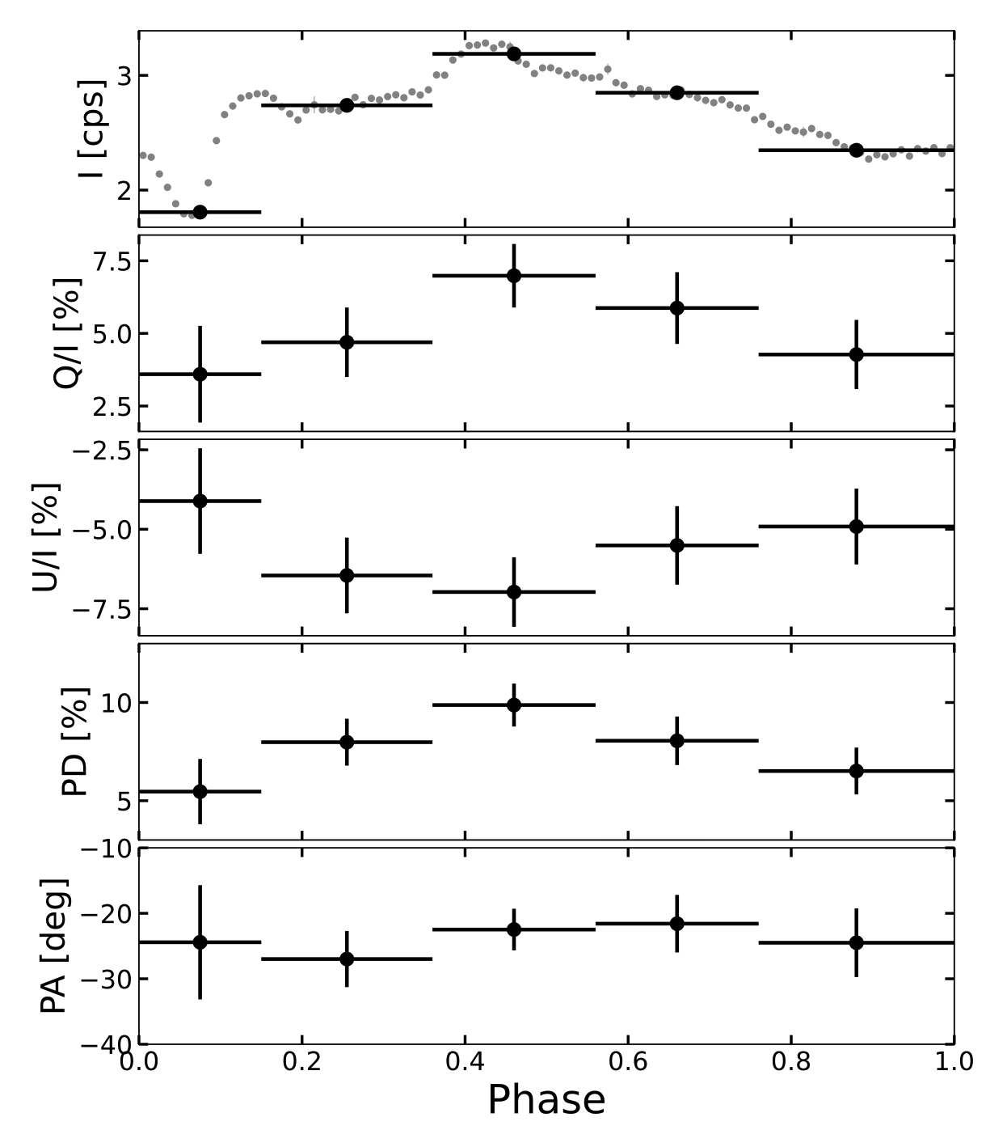
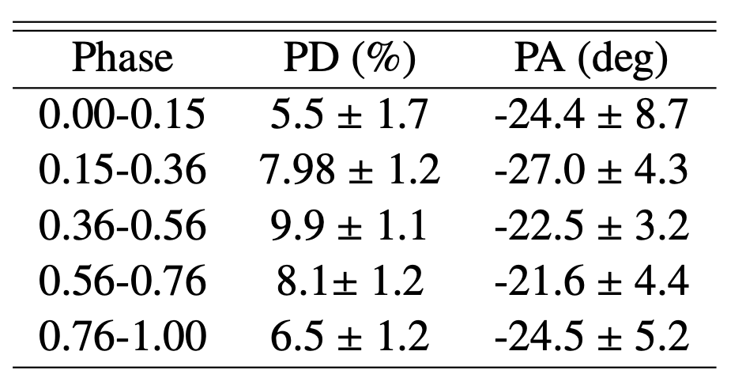
Phase resolved analysis
The PD decreases during the eclipse and the PA remains stable
Notes:
9

Slide 10
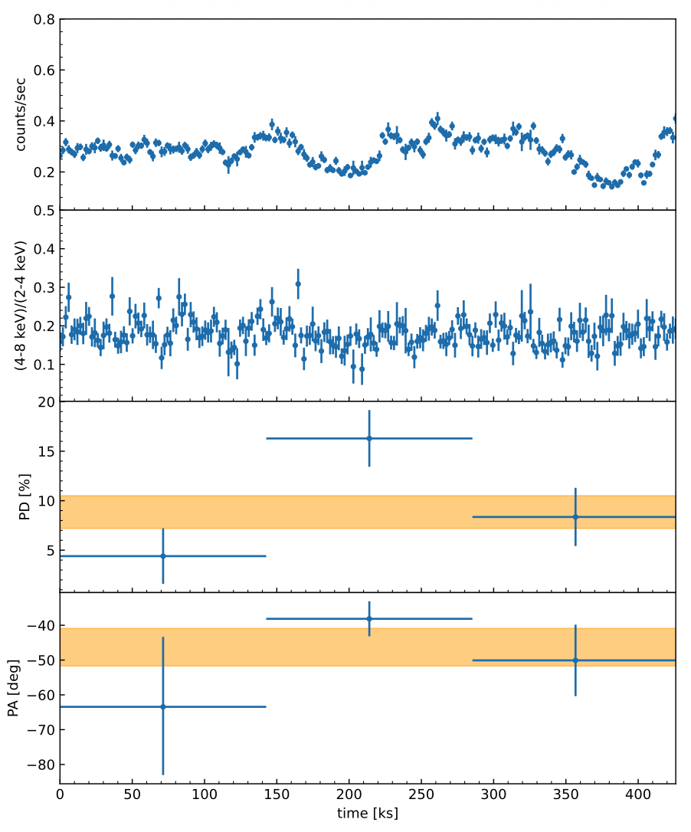
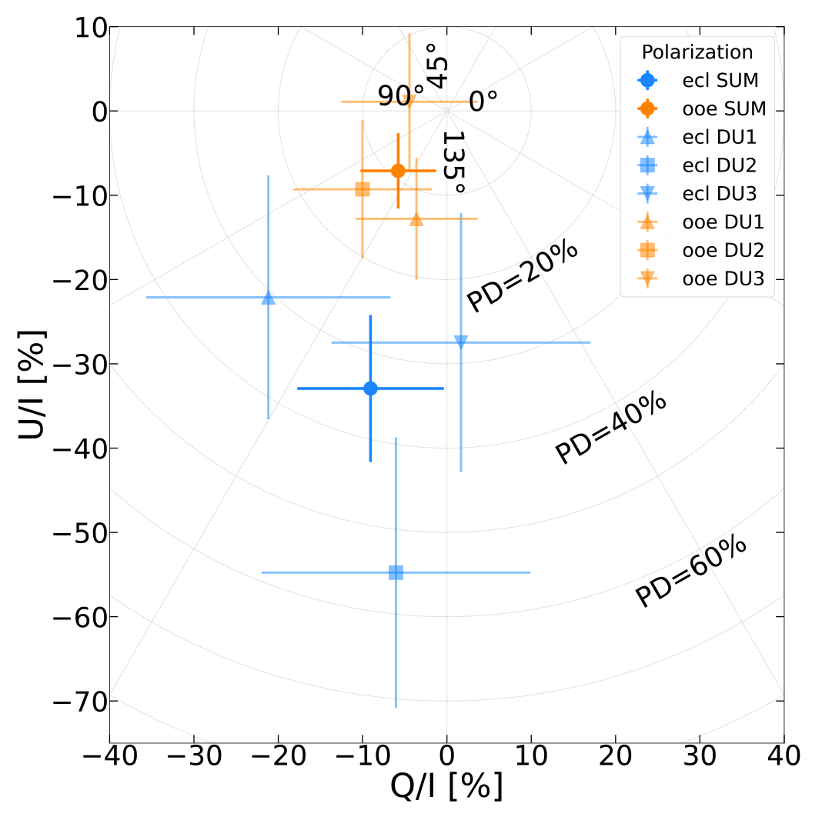
Phase resolved analysis
In other high-inclination sources, the PD increases during dips/eclipses
GX 13+1
2S 0921– 630
AX J1745.6–2901
Di Marco et al 2024
Tomaru et al 2025
Mikusincova et al 2025
Dips/eclipses may preferentially obscure a less polarized spectral component
Notes:
10

Slide 11
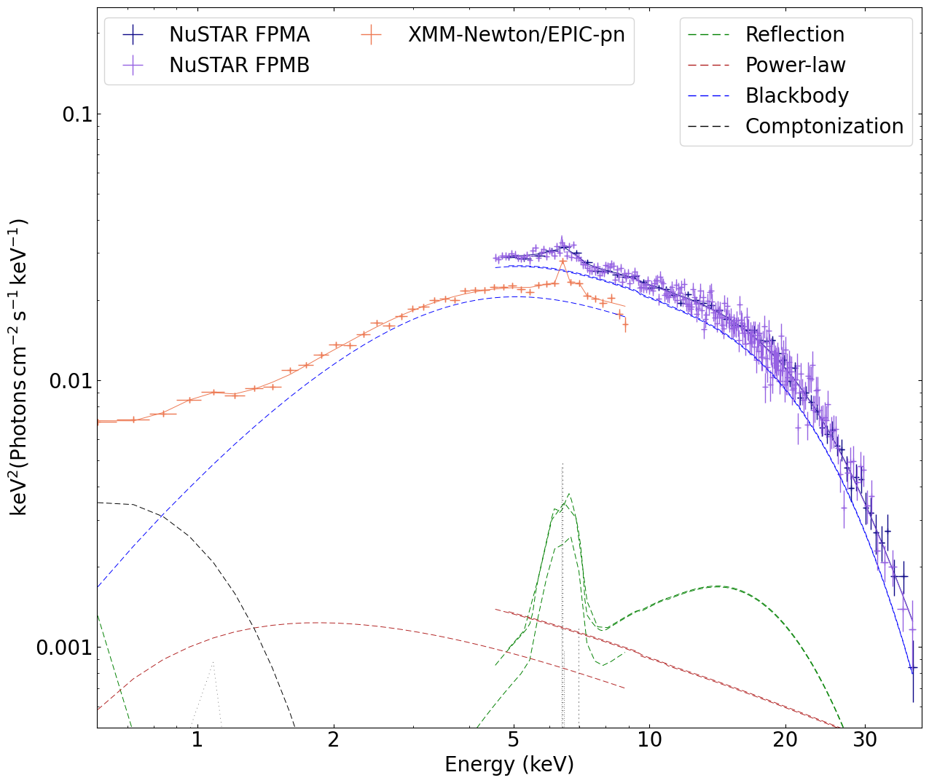
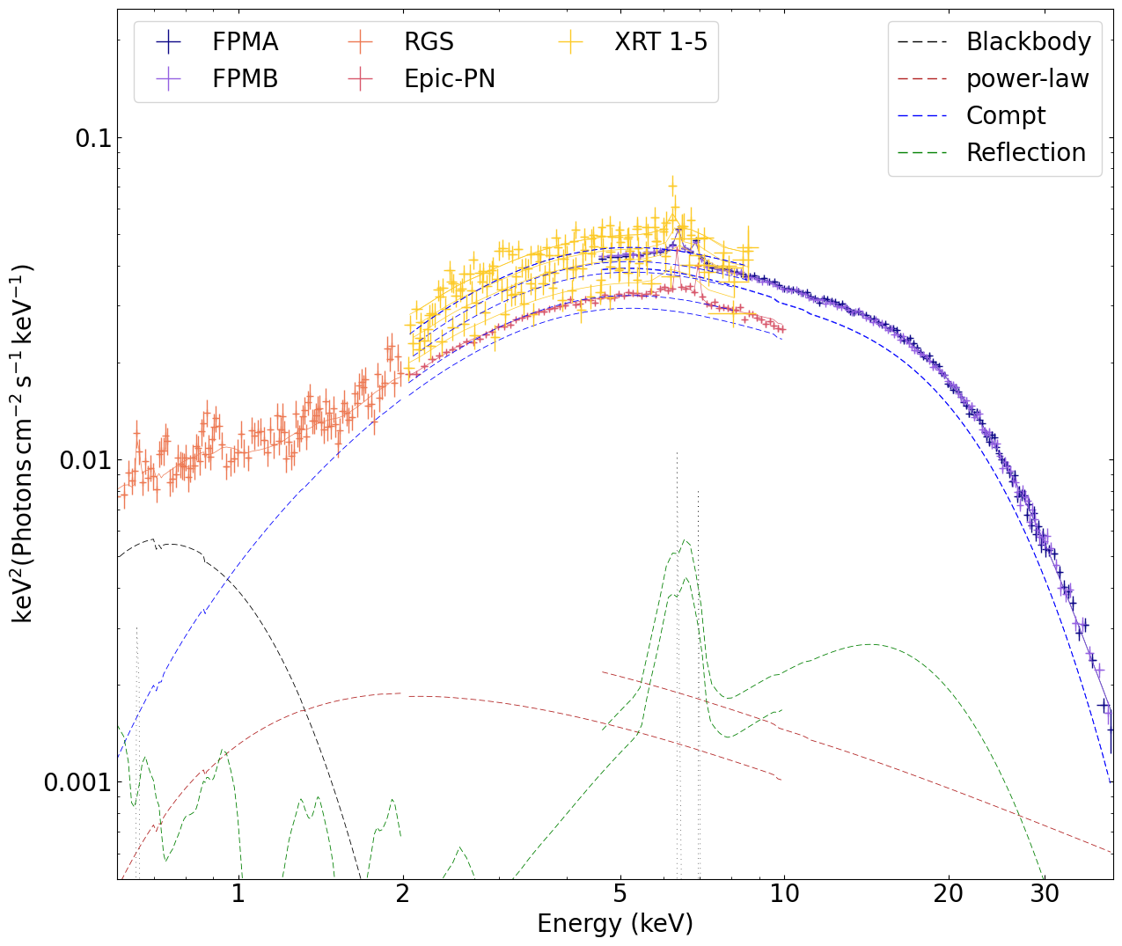
Spectrum during the eclipse
The spectral shape during the eclipse is consistent with the average spectrum
Eclipse spectrum
Average spectrum
Notes:
11

Slide 12
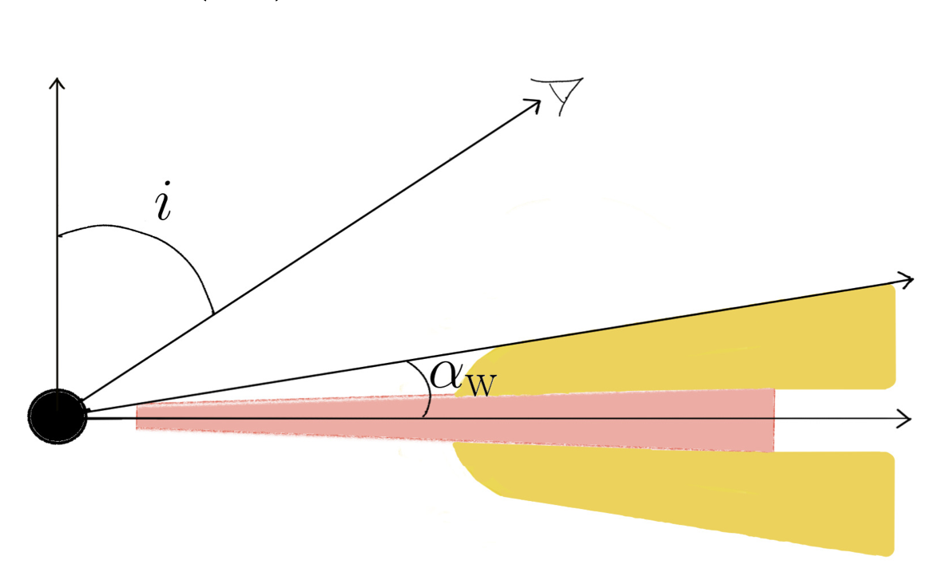



Geometrical Interpretation
Nitindala et al. 2025 showed that the regions producing the most favorable scattering angles correspond to low opening angles ($α_{w}∼{25}^{∘}$).
Adapted from Nitindala et al. 2025
$$\text{δ}$$
Companion
Star
PD Maximum for $α_{w}∼{25}^{∘}$
The eclipse obscures an angle of $δ∼{16}^{∘}$
During the eclipse the companion partially
removes the most efficient polarizing region
Notes:
12

Slide 13

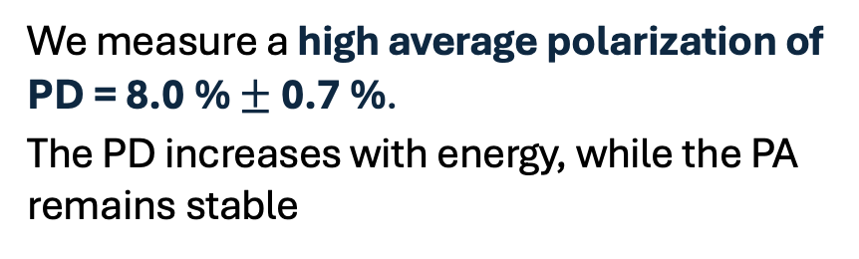
  Summary of the results
  Spectroscopy and polarimetry give a consistent picture:
  4U 1822−37 is observed through an extended scattering medium that shapes the observed X-ray emission and polarization.
During the eclipse the PD decreases, but the PA does not rotate.
The eclipse obscures the low-latitude region that is most efficient at producing polarized scattering.
We measure a high average polarization of PD = 8.0 % $±$ 0.7 %.
The PD increases with energy, while the PA remains stable
Work accepted in A&A (2026)
https://doi.org/10.1051/0004-6361/202661002

Slide 14
  Thank you!

Slide 15
  EXTRA SLIDES

Slide 16
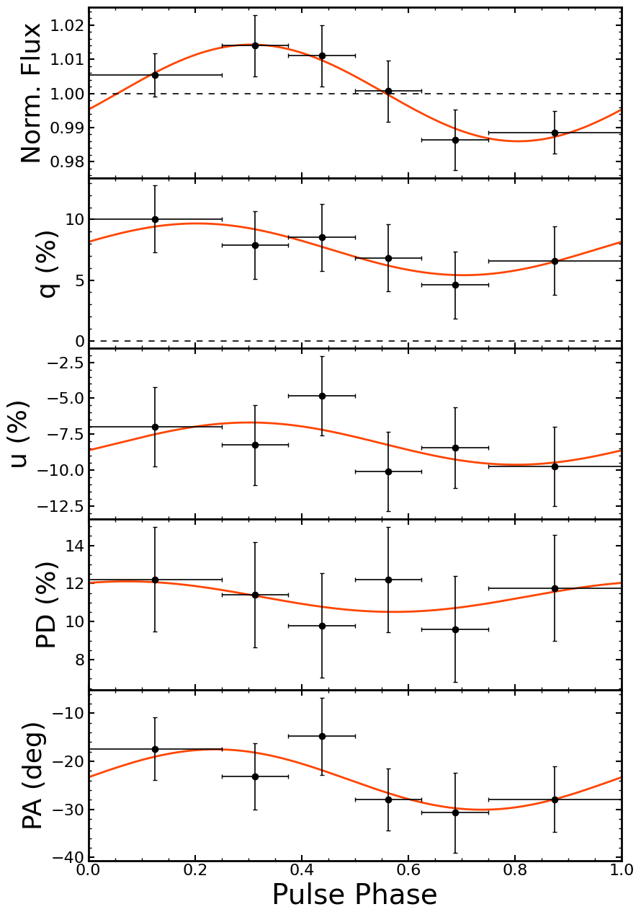
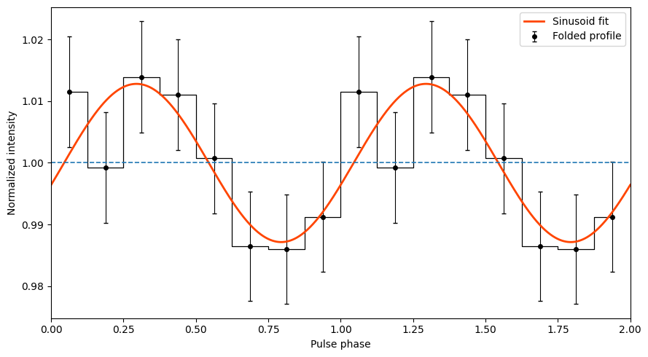
EXTRA SLIDES – Pulsed profile
Pulse profile between 5-8 kev
===== SINUSOID vs CONSTANT =====
Delta chi2 = 8.244 for 2 dof
p-value = 1.621e-02
Significance of modulation ≈ 2.40 sigma
Notes:
16

Slide 17
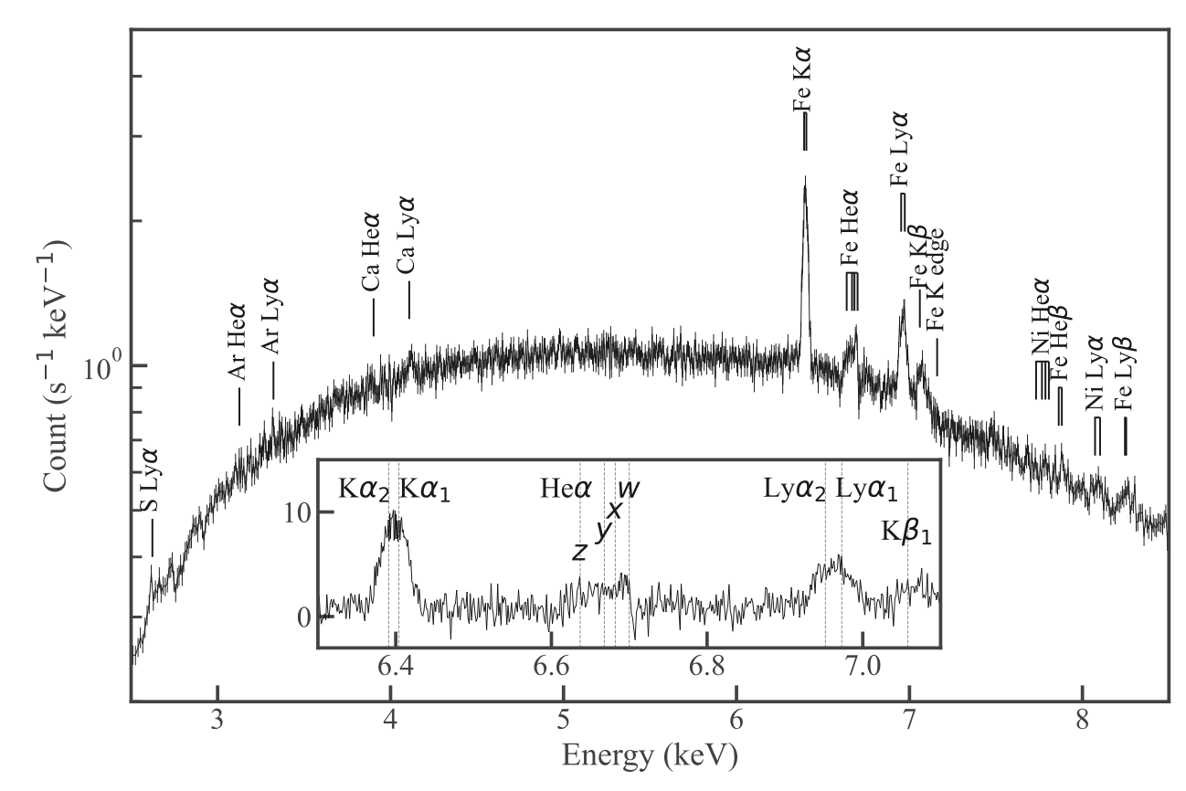
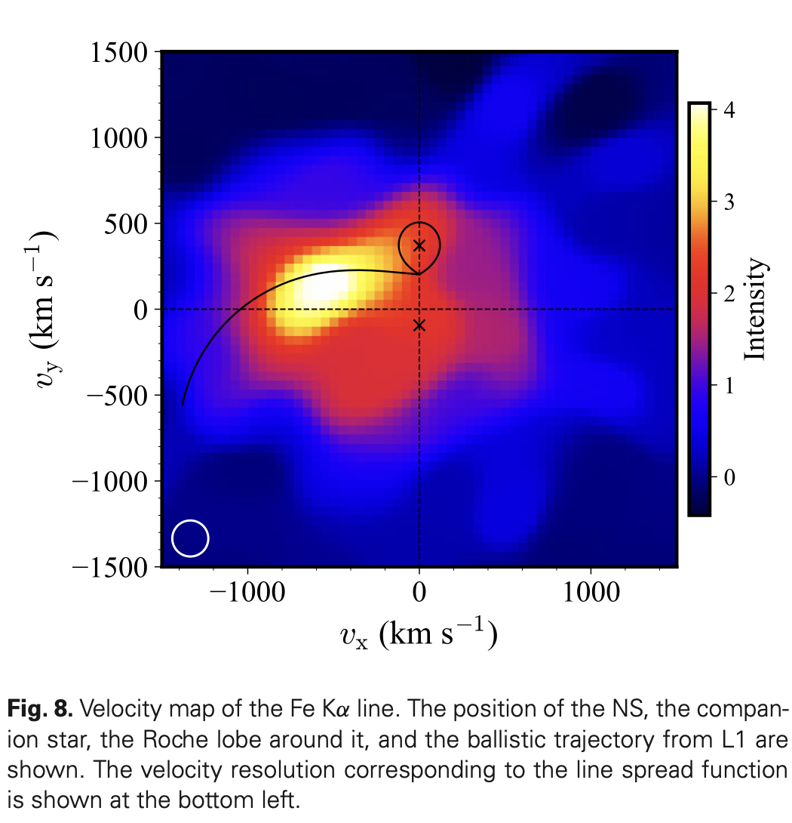
EXTRA SLIDES – XRISM (Sameshima, Tsujimoto & Uemura (2026))
Emission localized near the accretion stream–disc overflow
Distinct from the inner-disc broadband reflection
Narrow Fe Kα variability cannot explain the eclipse PD decrease
Notes:
“Yes. XRISM observed 4U 1822−37 with Resolve and, thanks to the high spectral resolution, they were able to study the narrow Fe Kα emission as a function of orbital phase. They found a phase-dependent Doppler shift and line profile, and Doppler tomography suggests that the narrow Fe Kα originates from a localized region associated with the accretion stream–disc overflow, rather than from an axisymmetric disc or the extended ADC.
This is complementary to our analysis, because the narrow Fe Kα traced by XRISM is different from the relativistically broadened reflection component that we associate with the inner disc.”
17

Slide 18
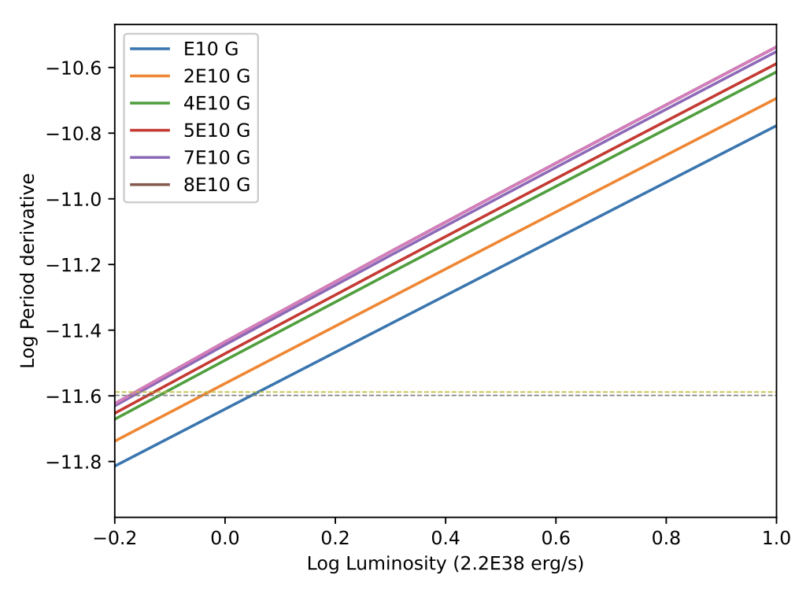
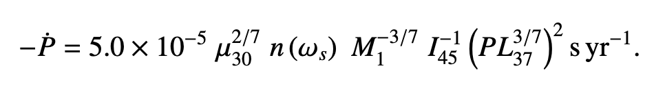
EXTRA SLIDES – Magnetic Field
Ghosh & Lamb (1979) equation, which links the spin-period derivative of the NS, its magnetic field and its luminosity
In this relation, M1 is the NS mass I45 is the NS moment of inertia, and P is the spin period of the source, that is, 0.5915669 s (Mazzola et al. 2019).”
Derivative of the spin period as a function of luminosity for diﬀerent values of the magnetic field.
Notes:
18

Slide 19
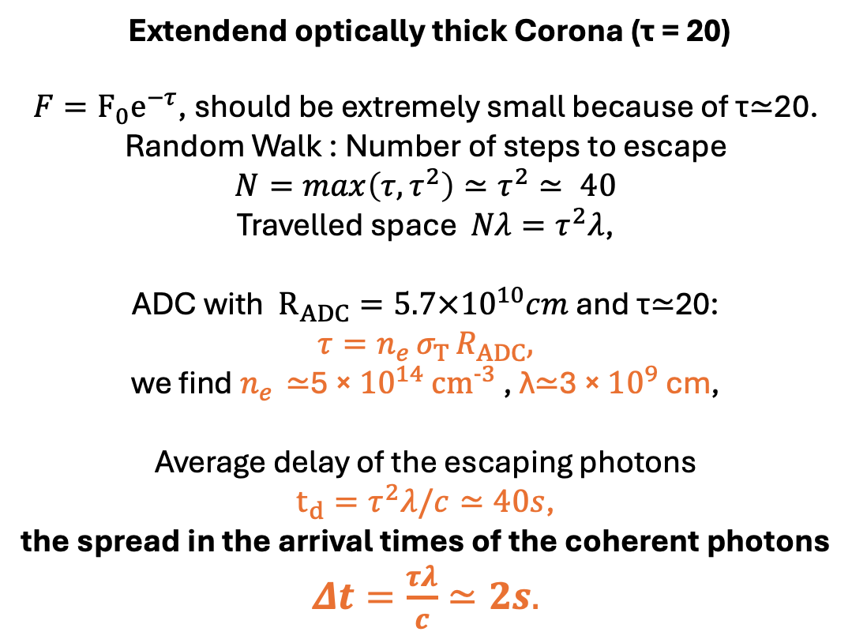
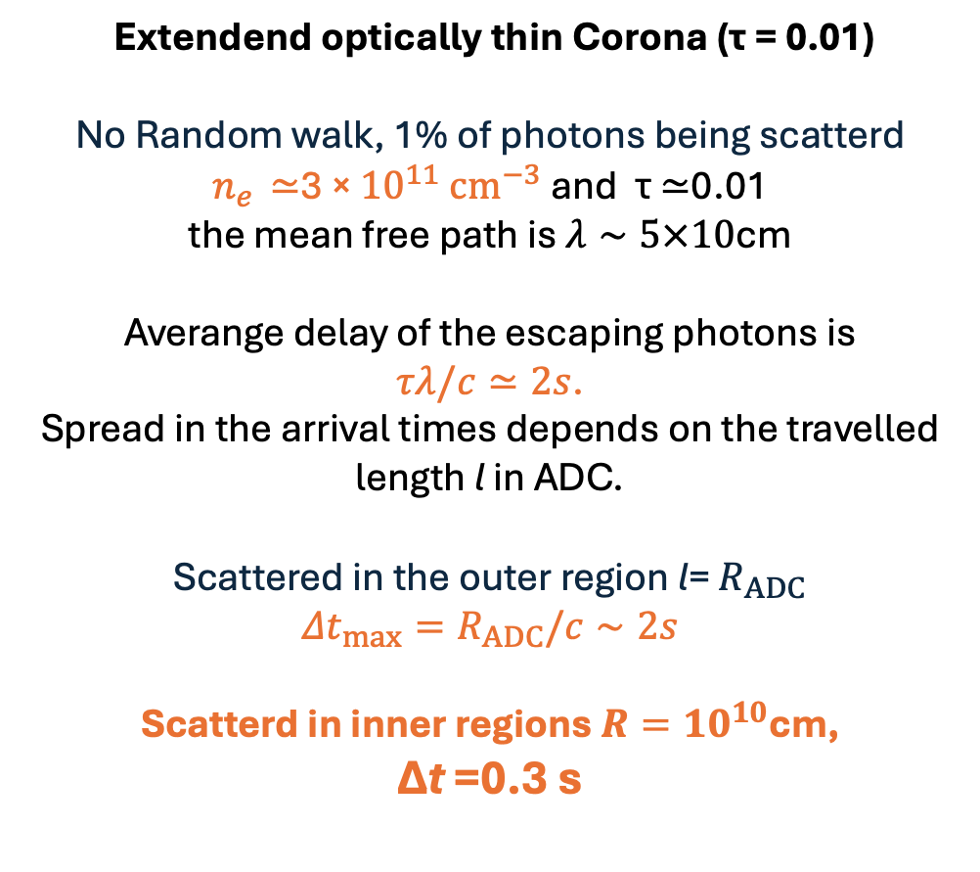
EXTRA SLIDES – How the pulsations survive
Extendend optically thick Corona (τ = 20)
$F=F_{0}e^{−τ}$, should be extremely small because of τ≃20.
Random Walk : Number of steps to escape
$$N=max\left(τ,τ^{2}\right)≃τ^{2}≃ 40$$
Travelled space $Nλ=τ^{2}λ$,
ADC with $R_{ADC}=5.7×{10}^{10}cm$ and τ≃20:
$$τ=n_{e} σ_{T} R_{ADC},$$
we find $n_{e}$ ≃5 × ${10}^{14}$ ${cm}^{−3}$ , λ≃3 × ${10}^{9}$ cm,
Average delay of the escaping photons
$t_{d}=τ^{2}λ/c≃40s$,
the spread in the arrival times of the coherent photons
$Δt=\frac{τλ}{c}≃2s.$
Extendend optically thin Corona (τ = 0.01)
No Random walk, 1% of photons being scatterd
$n_{e}$ ≃3 × ${10}^{11}$ ${cm}^{−3}$and τ ≃0.01
the mean free path is $λ∼5×10$cm
Averange delay of the escaping photons is
$τλ/c≃2s$.
Spread in the arrival times depends on the travelled length l in ADC.
Scattered in the outer region l= $R_{ADC}$
$${Δt}_{max}=R_{ADC}/c∼2s$$
Scatterd in inner regions $R={10}^{10}$cm,
Δt =0.3 s
NO coherent pulsations
Allow coherent pulsations
Notes:
19

Slide 20
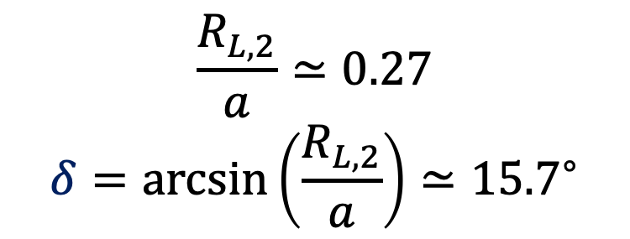


Geometrical Interpretation
$$\frac{R_{L,2}}{a}≃0.27$$
$$δ=\arcsin\left(\frac{R_{L,2}}{a}\right)≃{15.7}^{∘}$$
Companion
Star
$$\text{δ}$$
$$R_{L,2}$$
$$a =orbital separation$$
Notes:
20

Slide 21
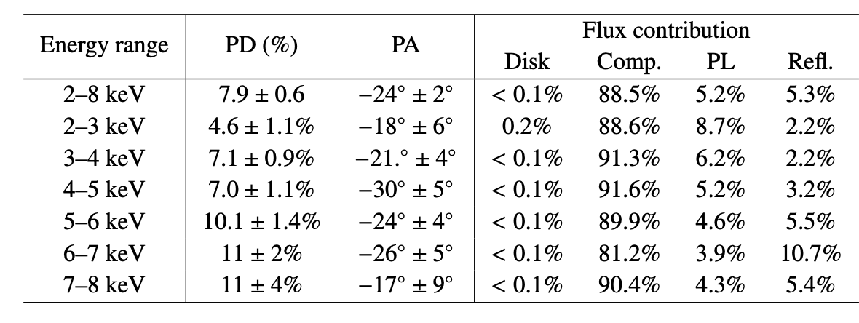
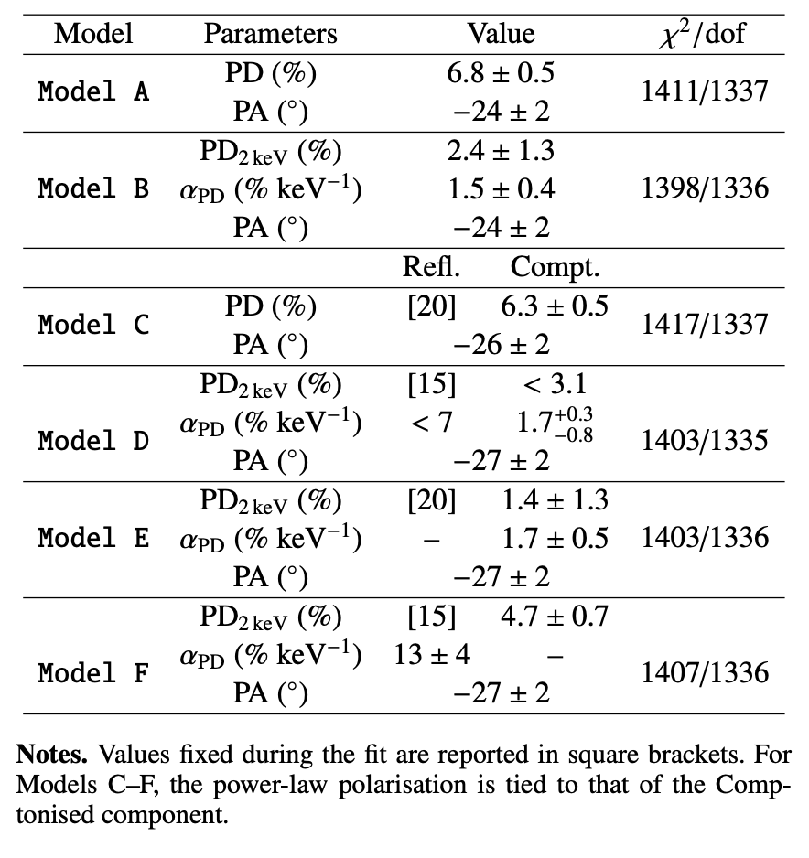

Slide 22
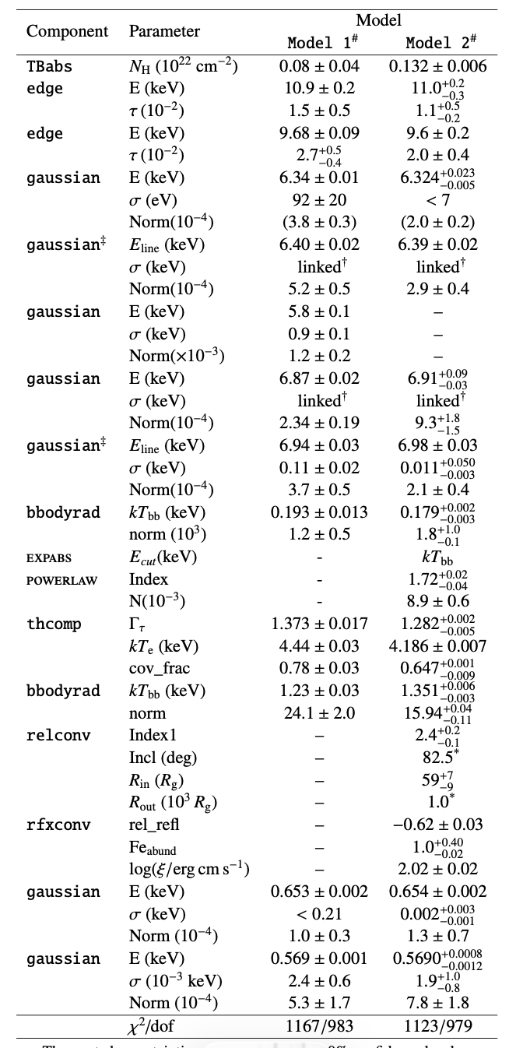
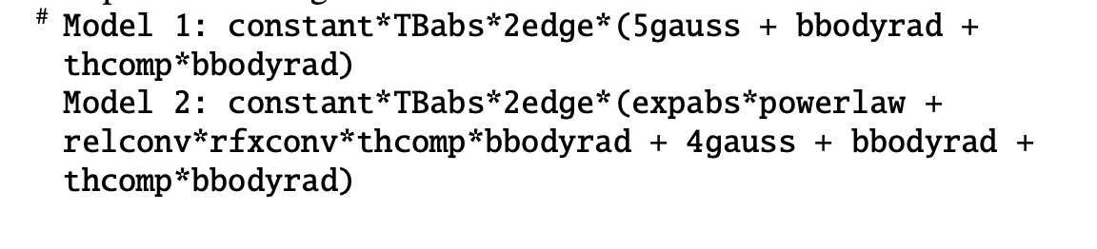
Unabsorbed flux (0.1–100 keV ) 1.37 ×10−9 erg s−1 cm−2.
Assuming a distance of 6.1 kpc (Arnason et al. 2021), luminosity of 6.1 ×10^36 erg s−1

