Slide 1
Geometry of X-ray sources in accreting black-hole binaries in the hard spectral state
Andrzej Zdziarski
Centrum Astronomiczne im. M. Kopernika
Warszawa, Poland

Slide 2
Sombreros and lampposts:
The Geometry of Accretion onto
Black Holes
A Team in the International Space Science Institute, Bern, with Tomaso and me as co-Leaders:
Three meetings: 13-17.01.2020, 29.11-3.12.2021, 12-16.09.2022
Team Zdziarski Belloni.mov
Since then, we’ve made considerable progress, but we are still far from a definite answer.

Slide 3
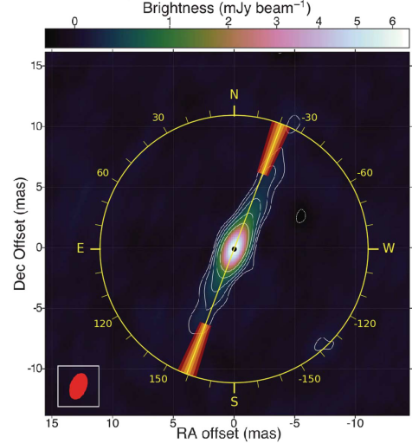
The lamppost model ruled out by the X-ray polarization measurement in Cyg X-1
The X-ray polarization vector in the hard state is aligned with the radio jet. The polarization is due to scattering. This shows that the scattering medium is extended perpendicularly to the jet, consistent with either an accretion disc corona or a hot inner flow downstream of the disc truncation radius, but inconsistent with either a lamppost or X-ray emission from the jet.
Similar results were obtained for several other sources, e.g.,
Swift J1727.8−1613
Krawczynski+22

Slide 4
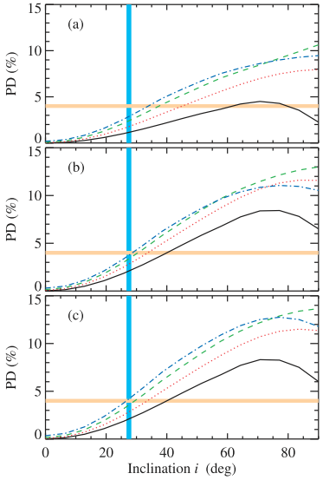
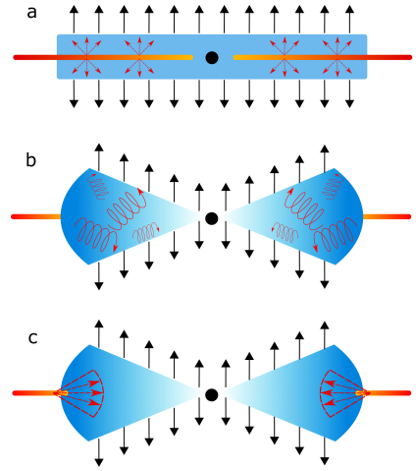
The polarization degree in Cyg X-1 is 4.0%, which is several times too high at the measured inclination of 27−28º.
This can be solved if the hot corona is outflowing with β ~ 0.5, due to the anisotropy from relativistic aberration (Poutanen, Veledina, Beloborodov 23).
β=
0.4,0.6
0.2
0
The favoured geometries
Possible geometries

Slide 5
MAXI J1820+070 – the case for disk truncation
A transient low-mass X-ray binary with a black-hole accretor, P ≈ 0.7 d, M_{BH} ≈ 6−8 M_{sun} (Torres+20).

Slide 6
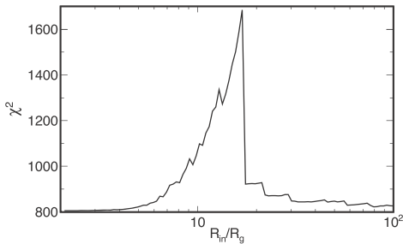
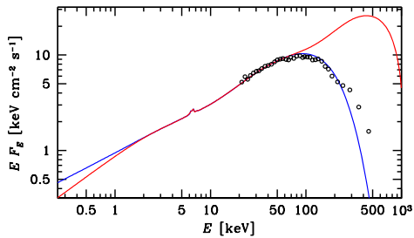
Two solutions in the lamppost model
Buisson+19 fitted a lamppost model, finding R_{in}~R_{ISCO} and the disc inclination of i~30º.
Both the binary and the jet have i ~60−80º (Atri+20, Torres+20).
AAZ+21 found two solutions separated by a wall in χ², the 2nd one for a truncated disc with R_{in} ≳ 20R_{g}, i~60−70º.
The solution of Buisson+19 also disagrees with the INTEGRAL data.
R_{in}~R_{ISCO}
R_{in}R_{ISCO}
simultaneous INTEGRAL data (not fitted)

Slide 7
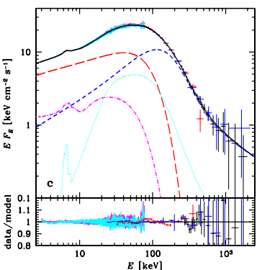
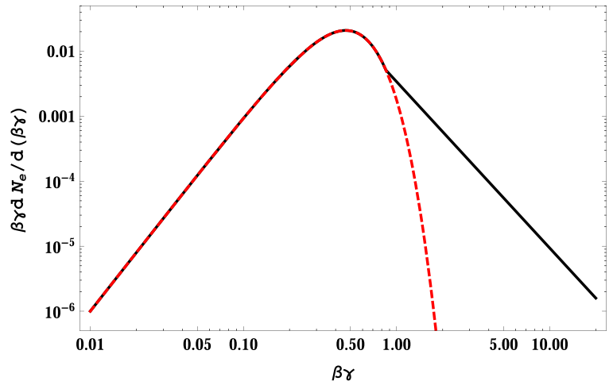
A need for two-component Comptonization and reflection
MAXI J1820+070
hard Compton
soft Compton
R_{in} ≳ 20R_{g}, i ~65º, Z_{Fe}~1,
kT_{e,soft}~12–20 keV,
kT_{e,hard}~20–30 keV, very good fits
soft reflection
hard reflection
Comptonization by hybrid electrons: Maxwellian +
a high-energy tail implied by the MeV tails
NuSTAR+INTEGRAL data; AAZ+21

Slide 8
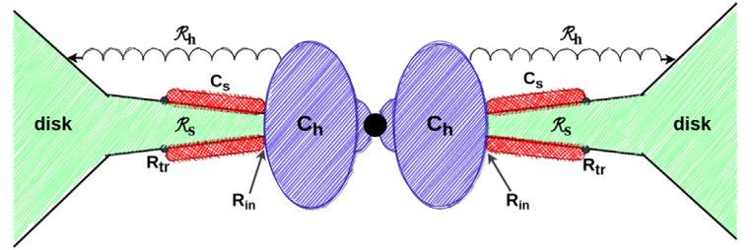
An accretion flow geometry implied by our fits
possible disc flaring
Hard hybrid Comptonization in an inner flow reflecting from remote parts of the disc
Soft Comptonization forming a corona above the disc

Slide 9
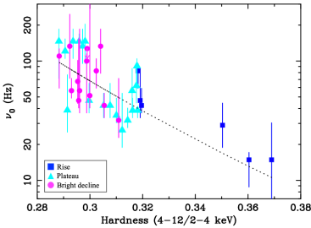

MAXI J1820+070: soft X-ray reverberation lags shorten with the decreasing hardness
De Marco+21
₀ – characteristic frequency of soft lag Fourier spectrum.
This can be interpreted as either the disc truncation radius or the coronal height decreasing. The case of a decreasing coronal height argued for by Kara+19, Wang+21, 22.

Slide 10
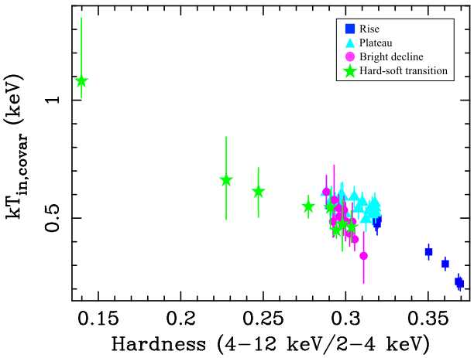
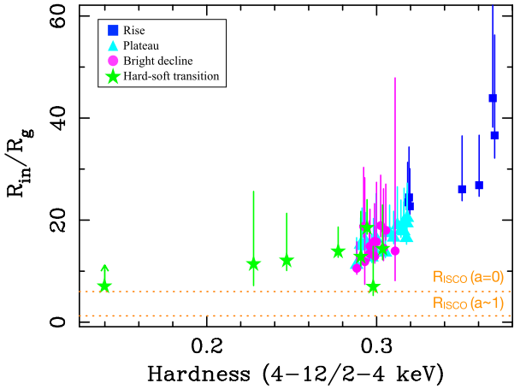
But a truncated disk with a decreasing R_{in} implied by frequency-resolved spectroscopy:
De Marco+21
kT_{in,covar} is the temperature of the disc-blackbody component at the soft-lag Fourier frequencies
disc truncation
MAXI J1820+070

Slide 11
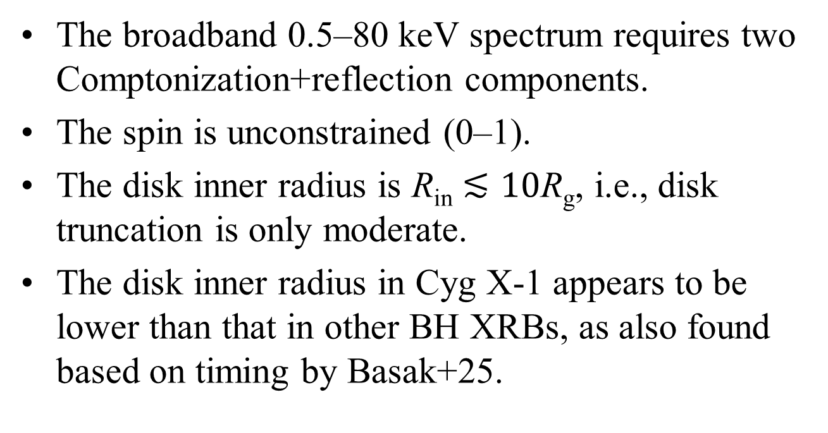
Simultaneous observations of Cyg X-1 with XRISM, NICER and NuSTAR
The broadband 0.5–80 keV spectrum requires two Comptonization+reflection components.
The spin is unconstrained (0–1).
The disk inner radius is R_{in} $≲10$R_{g}, i.e., disk truncation is only moderate.
The disk inner radius in Cyg X-1 appears to be lower than that in other BH XRBs, as also found based on timing by Basak+25.
AAZ+26

Slide 12
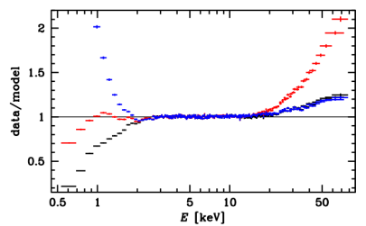
The importance of broad-band coverage
NICER
XRISM
NuSTAR
Three different models with a single continuum+reflection fit the XRISM bandpass equally well, but all give incorrect predictions outside it.

Slide 13
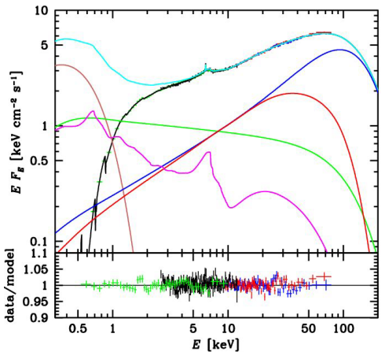
The fit to the broadband spectrum with two Comptonization+reflection components
h
d
s

Slide 14
Conclusions
X-ray polarimetry rules out the lamppost model.
The X-ray source in the hard state is horizontally extended and likely outflowing.
The incident continuum is complex, not a single Comptonization/power law.
The reflecting disk is truncated at some tens of R_{g} in MAXI J1820+070.
The disk in Cyg X-1 extends down to ≈10R_{g}.

Slide 15
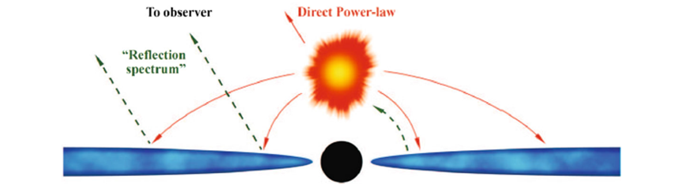
The lamppost model for the source of hard X-rays
Uttley+ 14
Originally adopted due to its mathematical simplicity but then widely used to describe the real source geometry.
100% of the Comptonized emission in the lamppost; dissipation in the blackbody disc at a small fraction of the actual Ṁ.
A small lamppost cannot intercept enough seed photons for Comptonization (Dovčiak & Done 2016).
Physically inconsistent if close to the horizon (claimed in many papers).

Slide 16
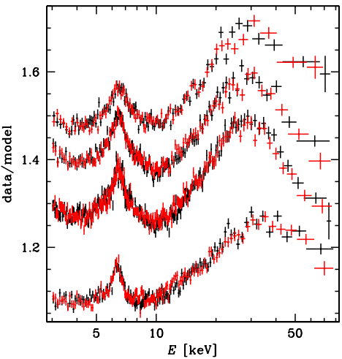
In the two-Comptonization model, the Fe K line remains relatively narrow
MAXI J1820+070
The reflected/Fe K components of the two Comptonization continua
The fitted R_{in} changes from ≈10 to ≈100 R_{g} (AAZ+21).
The Fe K data confirm that the lags result from a moving R_{in} (R_{g}).

Slide 17
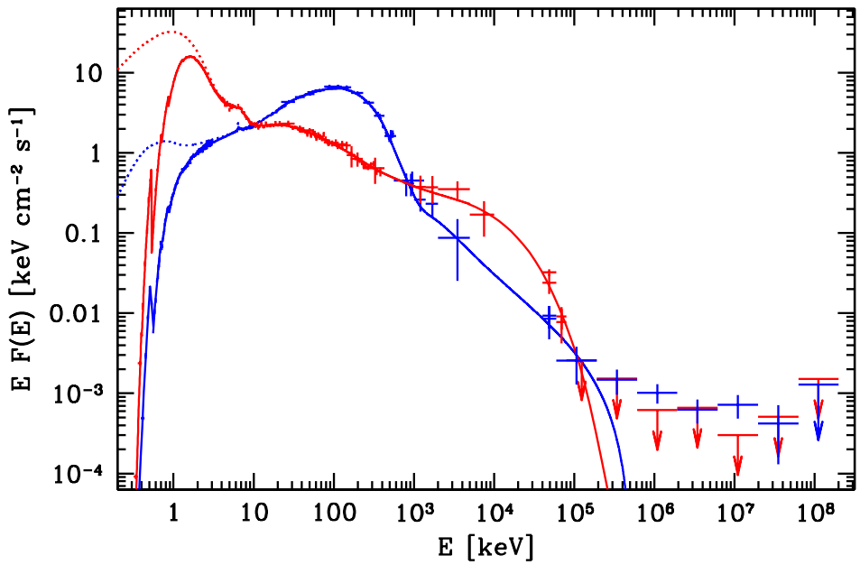
Both transient and persistent black-hole systems show two main luminous states, hard and soft
emitted
Cyg X-1
soft
hard
Flux peaks at ~1 and ~100 keV in the soft and hard state, resp.
accretion emission
observed, bound-free absorbed
high-energy tails
Fermi, jet emission
AAZ, Malyshev & Chernyakova 2017

Slide 18
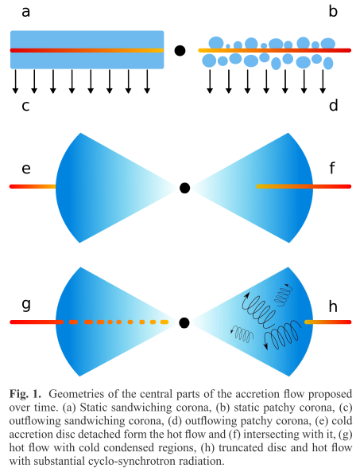
Different possible disc-corona geometries and energy balance
The cold medium is irradiated by the emission of the hot plasma. It partly back-scatters the irradiating photons (Compton reflection) and partly absorbs them and re-emits them.
The reprocessed radiation cools the plasma.
We used the reflection/reprocessing code by J. García.
We calculate the self-consistent X-ray spectra.
We find the cases c, d, f, g, and h to be compatible with the observational data.
Poutanen, Veledina & AAZ 2018

