Slide 1
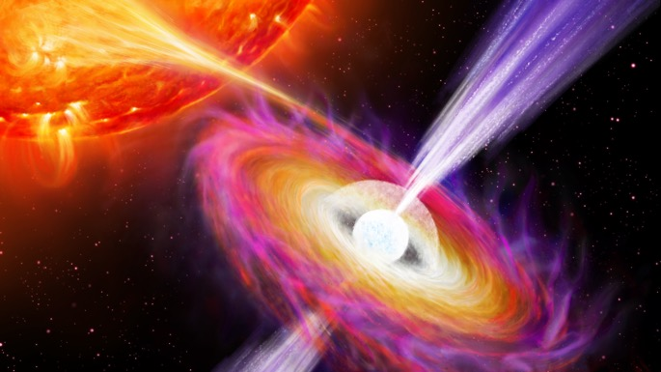

Probing black hole jets through rapid multi-wavelength timing techniques
Alex Tetarenko
University of Lethbridge
E. Lescure, P. Casella, P. Gandhi,
T. Maccarone, J. Miller-Jones, E. Pattie,
D. Russell, T. Russell, F. Vincentelli, among many others…

Slide 2
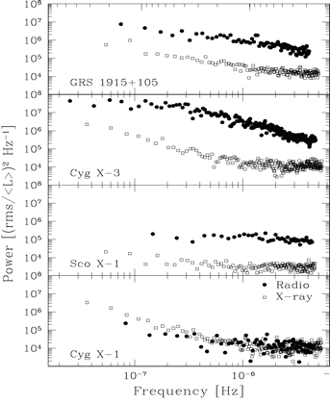
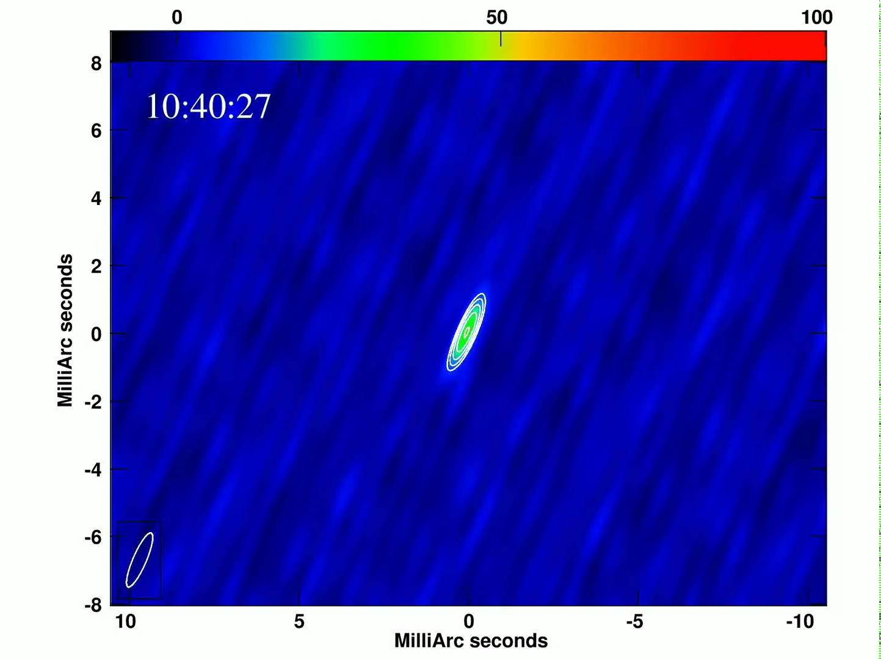




Testing long wavelength fast timing
Tetarenko et al. 2017, Miller-Jones et al. 2019
V404 Cyg
GRS 1915$+$105
Power
Cyg X$−$3
Sco X$−$1
Cyg X$−$1
Freq. (Hz)
10⁻⁷
10⁻⁶
Time (dy)
115
12
Nipoti et al., 2005
Alex Tetarenko – Many tones of accretion; Sep 2026

Slide 3
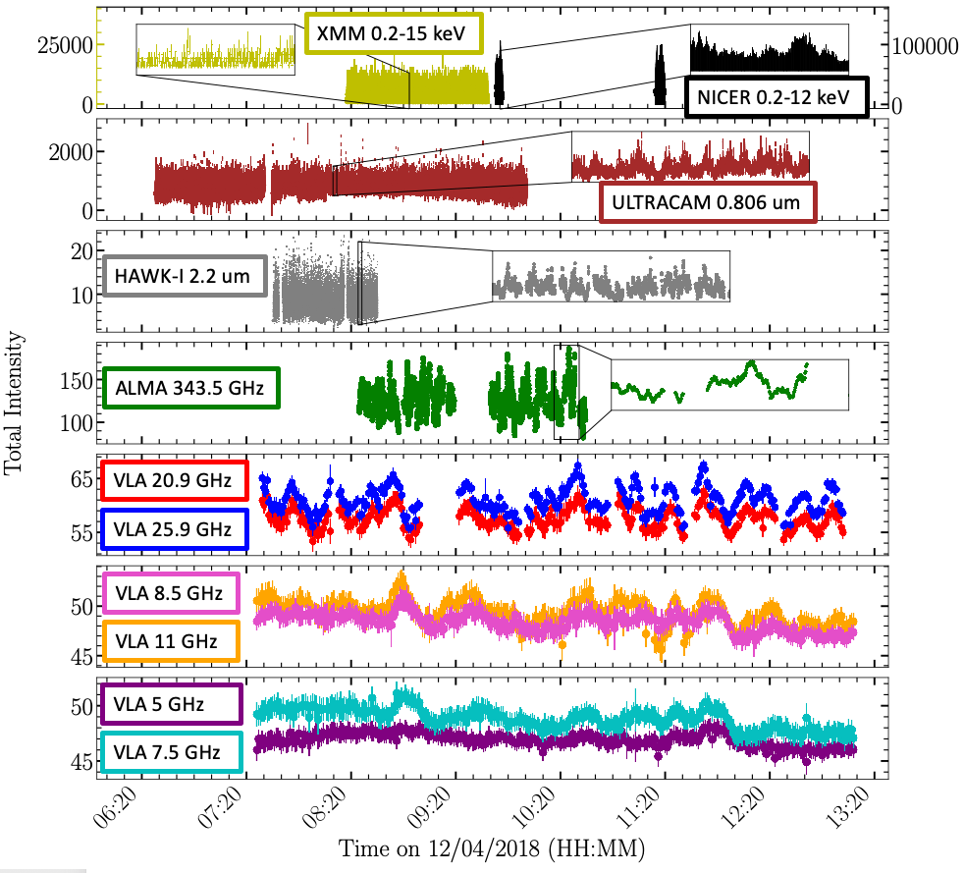
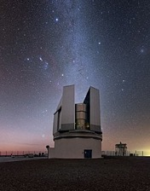
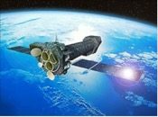
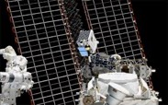

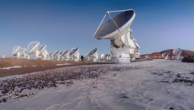
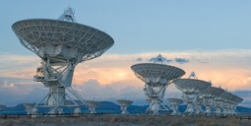

Putting it all together…
MAXI J1820$+$070
Tetarenko et al., 2021
VLT
NuSTAR
NICER
NTT
ALMA
VLA

Slide 4
A black hole jet ruler – mapping Fourier domain properties to physical size-scale
~10¹² cm
~10¹¹ cm
~10⁹ cm
Tetarenko et al., 2021
Alex Tetarenko – Many tones of accretion; Sep 2026

Slide 5

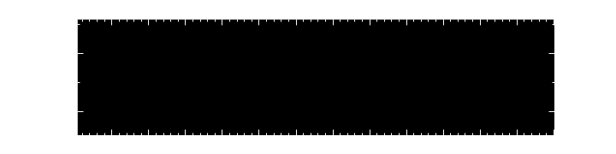
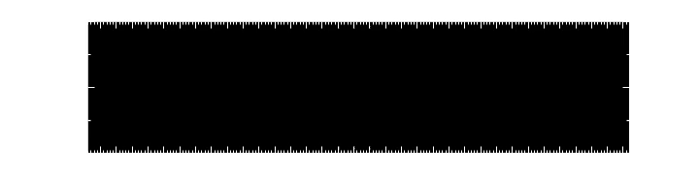
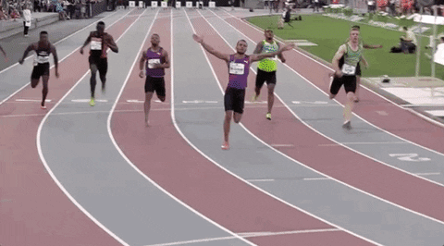



Timing a black hole jet – mapping time lags to jet speed
~20 min
$$>75\% speed of light$$
$$\sim 40 \frac{km}{hr}$$
$$\sim 810000000 \frac{km}{hr}$$
Alex Tetarenko – Many tones of accretion; Sep 2026

Slide 6
What’s next? – Repeat the experiment!
Why? - Sample different accretion states and different sources.
Alex Tetarenko – Many tones of accretion; Sep 2026

Slide 7
What’s next? – Repeat the experiment!
Why? - Sample different accretion states and different sources.
Alex Tetarenko – Many tones of accretion; Sep 2026

Slide 8
What’s next? – Repeat the experiment!
What we need – coordinating ground and space-based telescopes for several hours at a time, repeatedly over weeks to months.
  Multiple DDTs.
  Independent ToOs + endless email chains + hope.
  Adding unlikely suspects to the fast timing instrument suite.
  Joint programs as multi-wavelength rally points.
The Old Ways
The New Ways
Alex Tetarenko – Many tones of accretion; Sep 2026

Slide 9

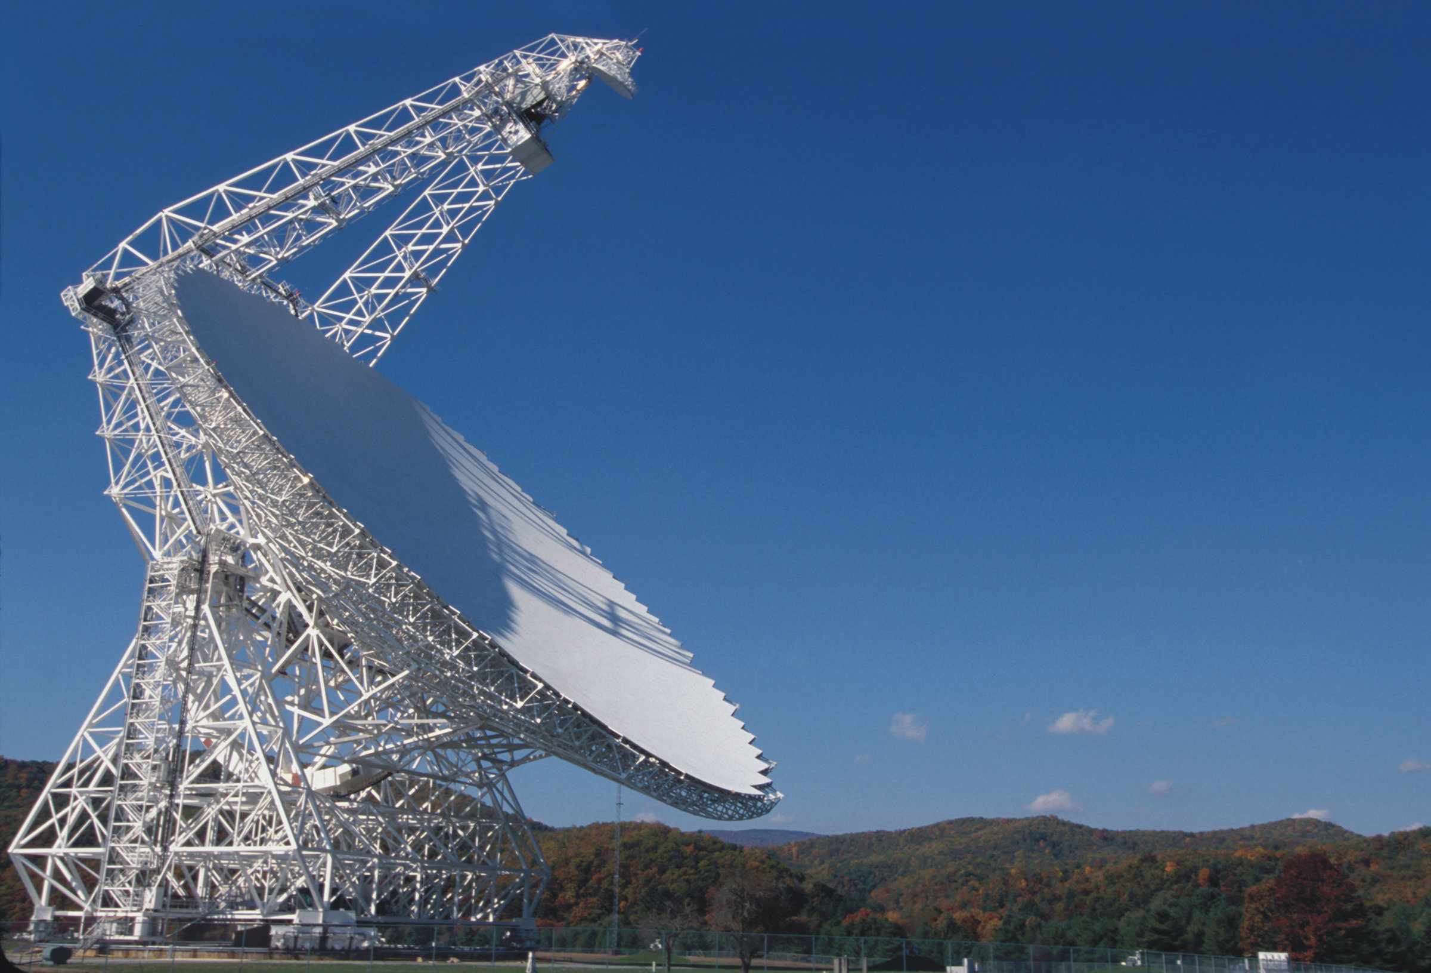


Green Bank Telescope – MUSTANG2
100m single dish telescope.
Bolometric array with 4 arcmin field of view.
3mm band.
Cygnus X$−$1 is an ideal target:
  Persistently bright source.
  Well studied (distance, VLBI jet measurements).
  Spends most of its lifetime in a jet-producing state.
  Previous radio timing observations were performed at cm wavelengths.
Cygnus X$−$1
Alex Tetarenko – Many tones of accretion; Sep 2026

Slide 10
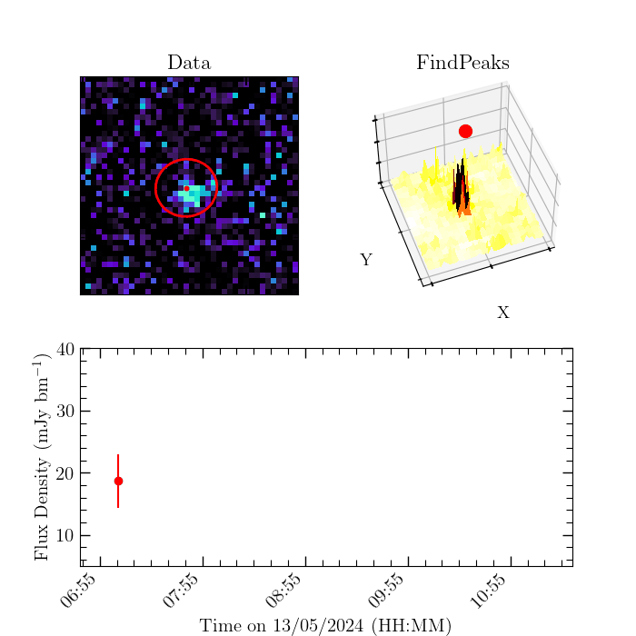

Extracting time-series measurements
Previous techniques (2D Gaussian) that worked for extremely bright sources do not perform well!
Try a simpler approach → Peak finding.
Tetarenko et al., in prep.
Monica Coombs-Rodriguez
MITACS Intern
(Cardiff University)
Alex Tetarenko – Many tones of accretion; Sep 2026

Slide 11
Cygnus X-1 radio/mm timing
Tetarenko et al., 2019
Tetarenko et al., in prep.
Alex Tetarenko – Many tones of accretion; Sep 2026

Slide 12
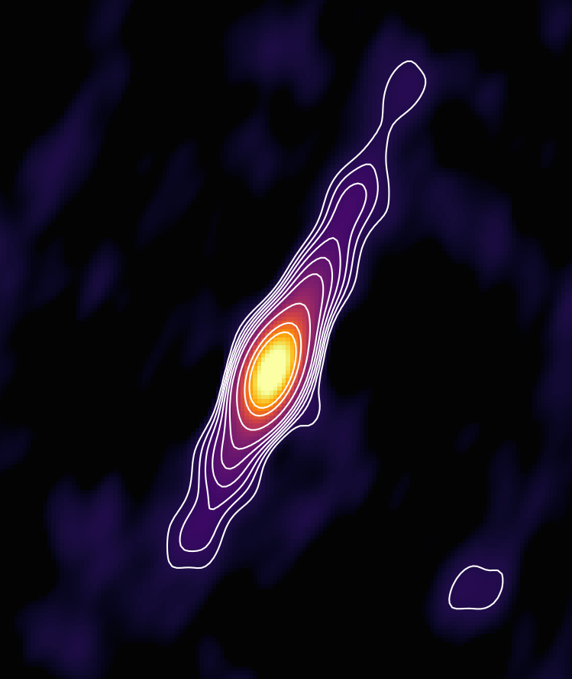
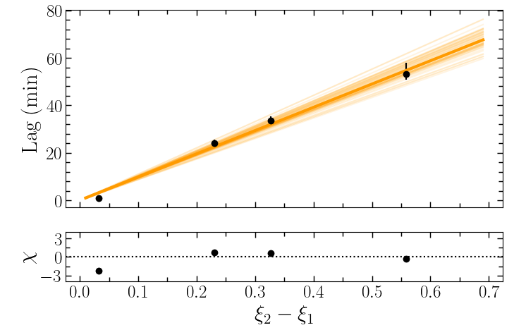
Jet properties – acceleration or non-linear size scale?
Jet elongation measurements + time lags = jet speed
Expectation – time lag linearly proportional to wavelength (Blandford & Konigl, 1979).
2019 work – time lags to cm bands too short!
2026 work – time lag to mm bands?
27 min
24 min
34 min
New data!
16 min
????
Credit: J. Miller-Jones
Prabu et al. 2026
Alex Tetarenko – Many tones of accretion; Sep 2026

Slide 13

Joint Timing Programs – Swift J1727.8$−$1613
Alex Tetarenko – Many tones of accretion; Sep 2026

Slide 14
Joint Timing Programs – BW Cir
Alex Tetarenko – Many tones of accretion; Sep 2026

Slide 15

Joint Timing Programs – MAXI J1750$−$327
Observations
ongoing…
Alex Tetarenko – Many tones of accretion; Sep 2026

Slide 16
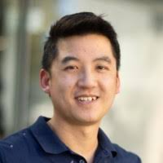

Extracting physics from variability
Tetarenko et al., in prep.
MAXI J1750$−$327
Map changing variability properties to changing jet properties.
  Fourier domain (size-scales, geometry).
  Cross-correlations (speed and power).
  Polarimetry constraints.
  Astro-statistics (e.g., multi-output spectral mixture Gaussian processes).
Preliminary!
Shih Ching Fu
PhD Student
(Curtin University)

Slide 17
Summary
The time-domain opens up new avenues to study the processes of accretion and ejection.
Characterizing simultaneous, multi-wavelength fast timing signals allows for robust measurements of jet and accretion properties.
We need a suite of fast timing-capable facilities and optimal observing strategies to continue to take full advantage of the time-domain.
Thank you!
Alex Tetarenko – Many tones of accretion; Sep 2026

