Slide 1
Why is our community allergic to timelags being produced by Comptonization?
Nick Kylafis
University of Crete
Cefalu, 8 Sept. 2026

Slide 2
Introduction
In my opinion, Comptonization is a neglected mechanism!

Slide 3
X-ray spectra from the corona
Our community generally agrees that the hard X-ray spectra in BHXRBs are produced by Comptonization.
Yet, our community does not look at what other observations Comptonization may explain.
Let’s look at them.

Slide 4
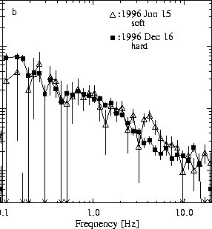

Timelag vs Fourier frequency
$t_{lag}\sim ν^{−0.7}$ (Pottschmidt et al. 2000)
Time lag
Cyg X-1

Slide 5
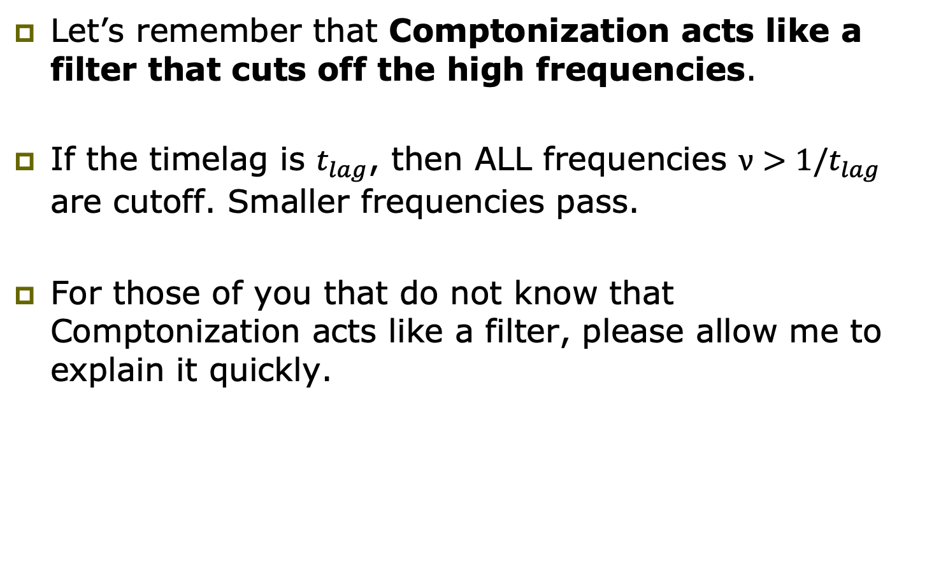
Comptonization can explain this correlation
Let’s remember that Comptonization acts like a filter that cuts off the high frequencies.
If the timelag is $t_{lag}$, then ALL frequencies $ν>1/t_{lag}$ are cutoff. Smaller frequencies pass.
For those of you that do not know that Comptonization acts like a filter, please allow me to explain it quickly.

Slide 6
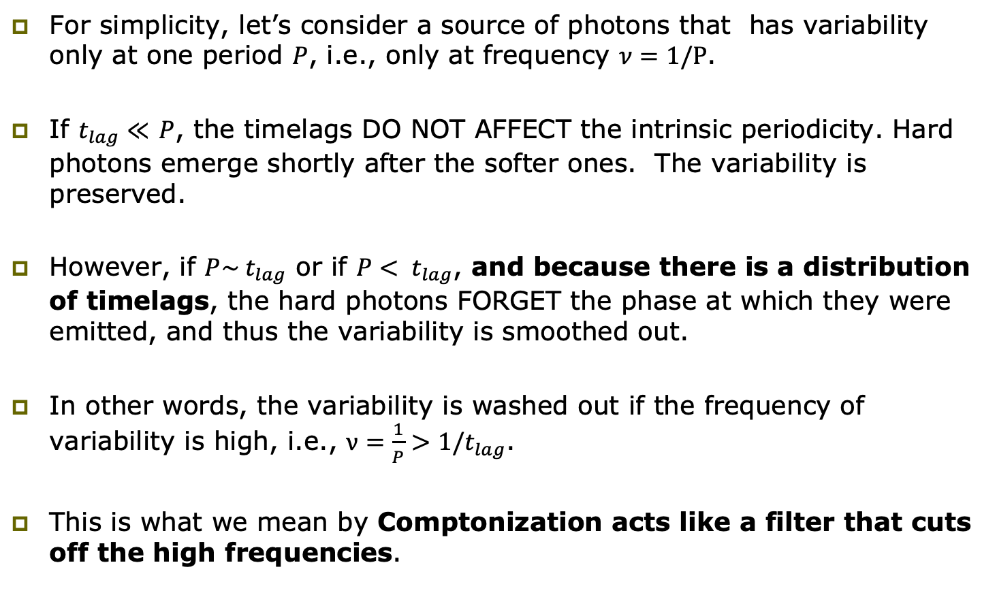
Explanation
For simplicity, let’s consider a source of photons that has variability only at one period $P$, i.e., only at frequency $ν=1/P$.
If $t_{lag}≪$ $P$, the timelags DO NOT AFFECT the intrinsic periodicity. Hard photons emerge shortly after the softer ones. The variability is preserved.
However, if $P\sim t_{lag}$ or if $P< t_{lag}$, and because there is a distribution of timelags, the hard photons FORGET the phase at which they were emitted, and thus the variability is smoothed out.
In other words, the variability is washed out if the frequency of variability is high, i.e., $ν=\frac{1}{P}>1/t_{lag}$.
This is what we mean by Comptonization acts like a filter that cuts off the high frequencies.

Slide 7
Schematic picture of the Comptonization timelags in a parabolic outflow
t_{lag}
R₃
t₃
t₃
t₂
R₂
t₂
t₁
R₁
t₁
1/t₃
1/t₂
1/t₁
ν

Slide 8
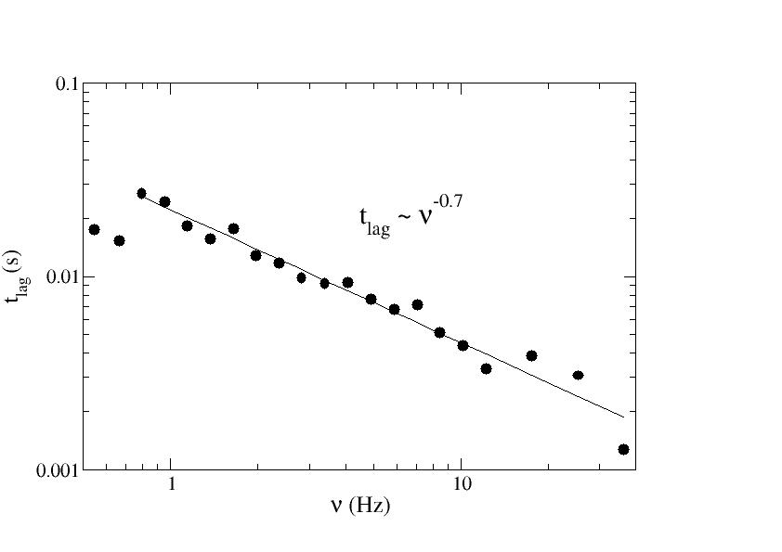
Timelag vs. Fourier frequency
(Reig, Kylafis, & Giannios 2003)
Cyg X-1

Slide 9
Comments
It is important to stress that this correlation cannot be reproduced with just any geometry (e.g., sphere, plane, torus, etc.)
It is only reproduced in a parabolic outflowing corona and it is such a corona that I have been using.

Slide 10
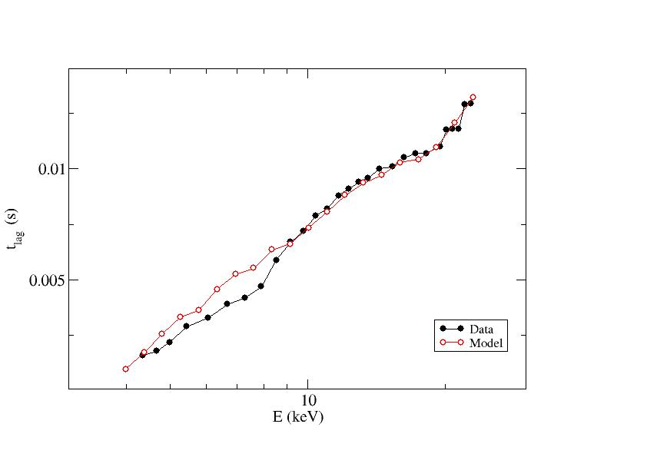
Timelag vs. photon energy
(Kylafis & Reig 2024)
Data are from Kotov et al. (2001)
Cyg X-1

Slide 11
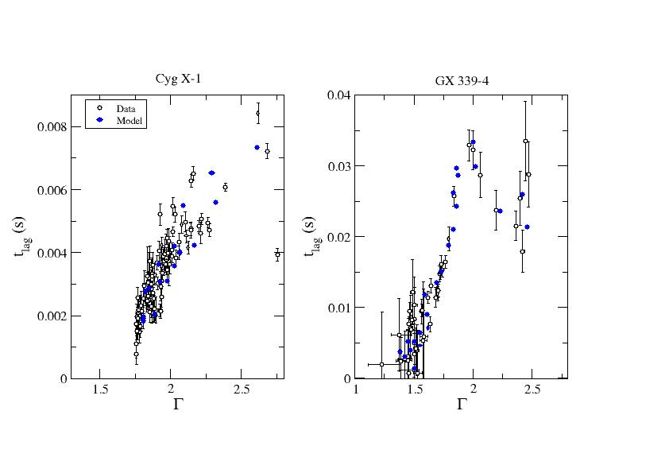
Timelag vs. spectral index Γ
(Kylafis & Reig 2024)

Slide 12
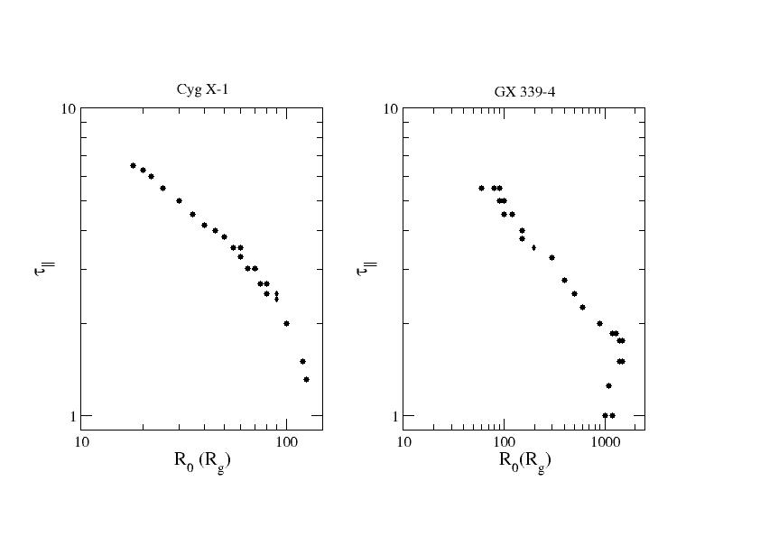
The two parameters of our model
are correlated!!!
(Kylafis & Reig 2024)

Slide 13
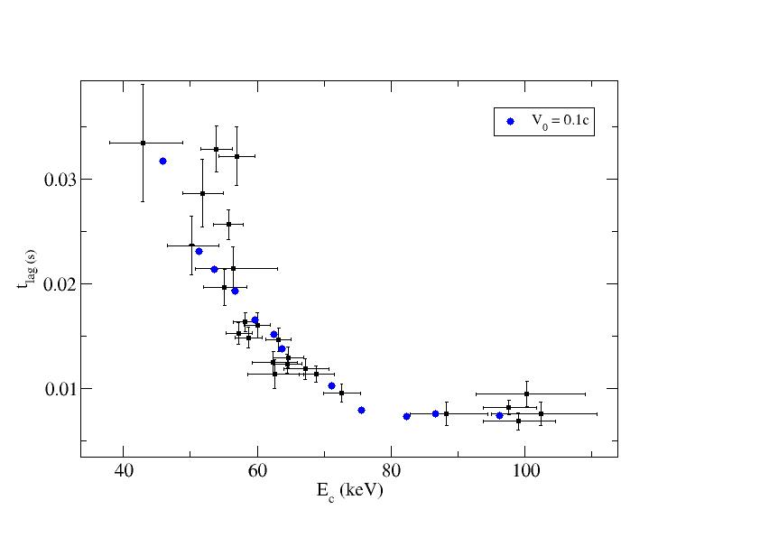
Timelag -- cutoff energy correlation
(data from Altamirano & Mendez 2015)
(Reig & Kylafis 2015; 2024)
GX 339-4

Slide 14
Other successes of the outflowing corona model
The outflowing corona model explained quantitatively the long-standing radio – X-ray correlation in BHXRBs and, like all serious models, made predictions (Kylafis, Reig, & Tsouros 2023).

Slide 15
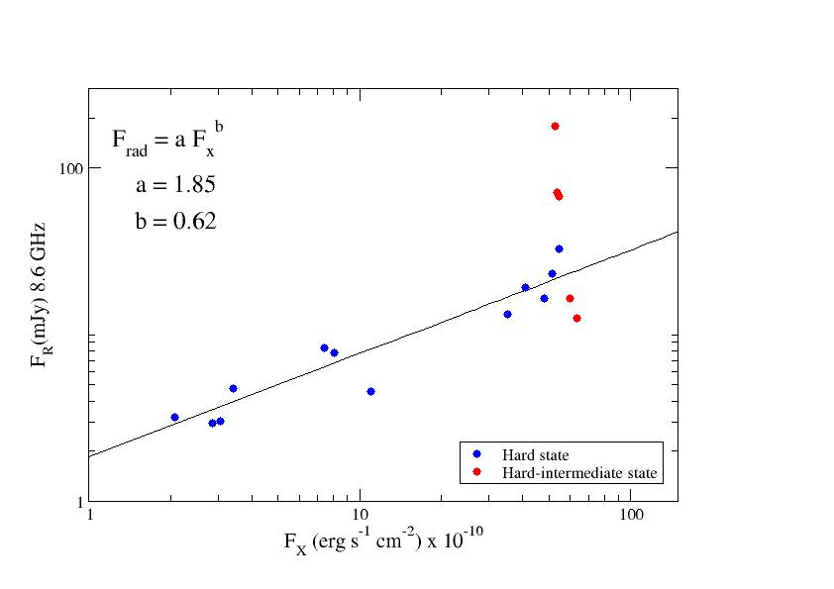
Radio – X-ray correlation for GX 339-4
(Kylafis, Reig, & Tsouros 2023)
Solid line: Corbel et al. (2013)

Slide 16
Other successes of the outflowing corona model
Also, it has the potential (at this moment only potential) to explain the type-C QPOs (Karpouzas, Mendez, Garcia, et al. 2021; Mastichiadis, Petropoulou, & Kylafis 2022) as the interaction between the disk and the corona.
Our community uses this interaction to explain the soft lags, but it does not explore it further.
It should!

Slide 17
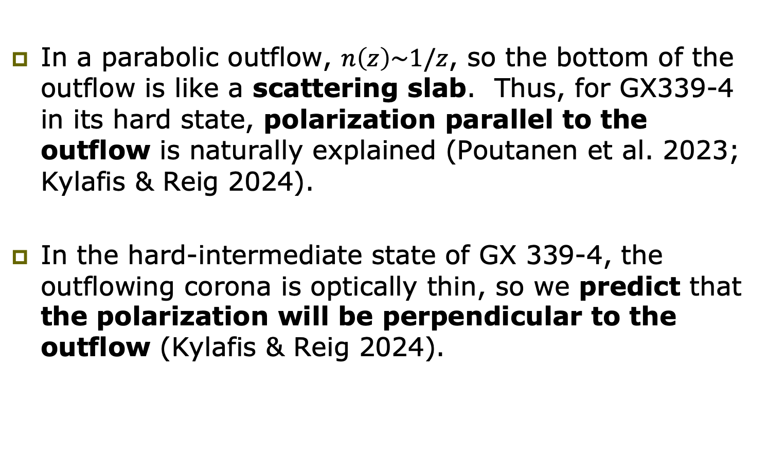
Polarization
In a parabolic outflow, $n\left(z\right)\sim 1/z$, so the bottom of the outflow is like a scattering slab. Thus, for GX339-4 in its hard state, polarization parallel to the outflow is naturally explained (Poutanen et al. 2023; Kylafis & Reig 2024).
In the hard-intermediate state of GX 339-4, the outflowing corona is optically thin, so we predict that the polarization will be perpendicular to the outflow (Kylafis & Reig 2024).

Slide 18
Weaknesses of the model
The outflowing corona model has successes, but it also has weaknesses.
One weakness is that the outflow expels a large amount of matter, for which I have no physical explanation at the moment.
Another weakness is that there is no time variability in the model.
I am too old to cure this last weakness, but it is curable. Younger people must take over.
I am glad to report that Mariano Mendez has started looking at this and he has some preliminary results.
THANKS

