Slide 1


Multi-wavelength correlations in X-ray binaries and beyond
Dave Russell*
Center for Astrophysics and Space Science (CASS), New York University Abu Dhabi
* 21 papers with Tomaso, + 14 ATels (but we worked on different stuff)
D. Bramich, F. Lewis, R. Fender, M.C. Baglio, P. Saikia, K. Albarta, F. Bernardini, E. Caruso, S. Oates, Y.J. Yang, J. Homan, A. AlYazeedi, M. Armas Padilla, C. Cho, A. Sharma, and many more
The Many Tones of Accretion – to the memory of Tomaso Belloni, Cefalù, Sept 2026

Slide 2
Two few fond memories of Tomaso
Dinner in Rome
He spent 2-3 hours telling me how difficult but amazing it is to fly a plane
I showed great interest, I had no idea he was a pilot
After a considerable period I came to the realisation that Tomaso was referring to a flight simulator game
A good example of: “Tomaso talked a lot. Once he started, he was almost unstoppable.” (quoting Andrea Comastri, yesterday)

Slide 3
Two few fond memories of Tomaso
(2) I had the privilege of hosting
Tomaso in March 2016 when he
visited NYU Abu Dhabi for a week,
with Rob Fender
3rd March 2016: e-mail from Tomaso:
“Before I forget, I am getting conflicting information about the temperature there. How warm will it be?”
My reply:
“Hi Tomaso,
Its getting warm here, but inside the aircon is cold! So you might want a jumper with you. Its relatively humid today.
Have a good flight!”
Tomaso:
“I have brought a jumper, I will be OK or so I hope. At the airport now.
See you soon,
Tomaso”

Slide 4

We had the largest storm in a decade
Severe thunderstorms brought torrential downpours and cyclonic winds reaching up to 130 km/h (80 mph)

Slide 5

We had the largest storm in a decade
Severe thunderstorms brought torrential downpours and cyclonic winds reaching up to 130 km/h (80 mph)
He still took some amazing photos, especially from campus
He also made friends with the security guards

Slide 6


Slide 7

Tomaso Belloni tomaso.belloni@brera.inaf.it via nyu.edu
Thu, 10 Mar 2016, 13:29
“Hi Dave,
everything ok for the trip, I am in my office now. Thank you again for your hospitality. It was a very good experience and the NYUAD campus is a great place. Let us get in touch in a few months to see if it is possible to plan a longer visit.
I still have to work on the camera photos, but I will slowly populate a Flickr album with the iPhone photos of NYUAD. You can find it in
https://www.flickr.com/photos/tmbx-mahe/albums/72157663369067284
Cheers,
Tomaso”

Slide 8
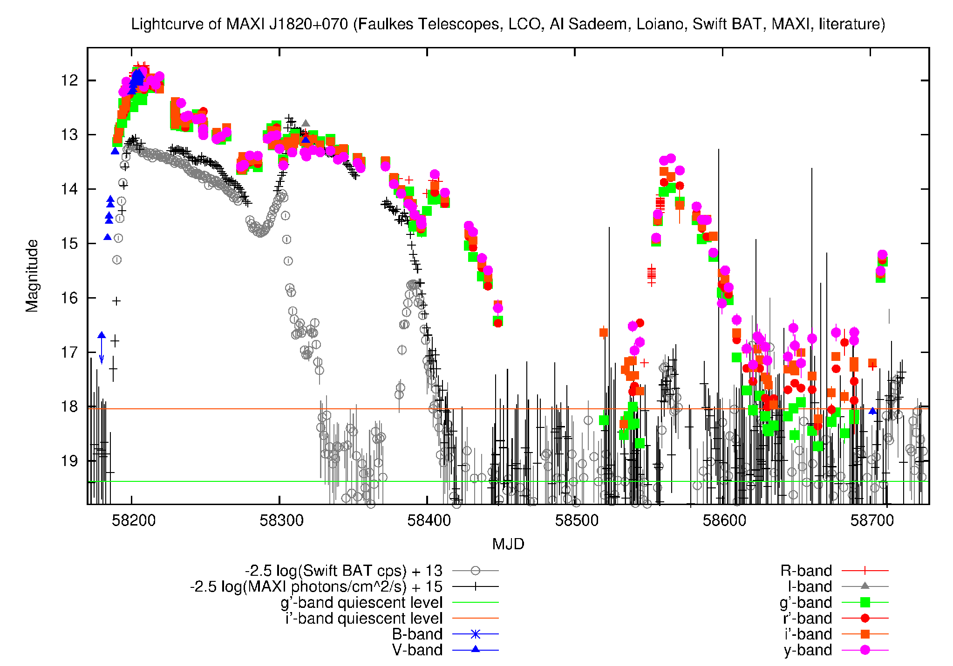
Multi-wavelength monitoring of XRB outbursts
Dense coverage of MAXI J1820+070 in 2018-2019
Multi-wavelength monitoring
campaigns of XRB outbursts can provide a wealth of information that cannot be achieved at
one wavelength
Studying the nature of accretion onto these compact objects sheds
light on several broad
fields in astrophysics
Accretion and ejection physics,
physical properties from:
Broadband spectral modelling
Time evolution, lags, cross-correlations
X-ray state-dependent relations between different components
Here, I focus on the long-term correlated behaviour between radio, optical/infrared (OIR) and X-ray emission

Slide 9
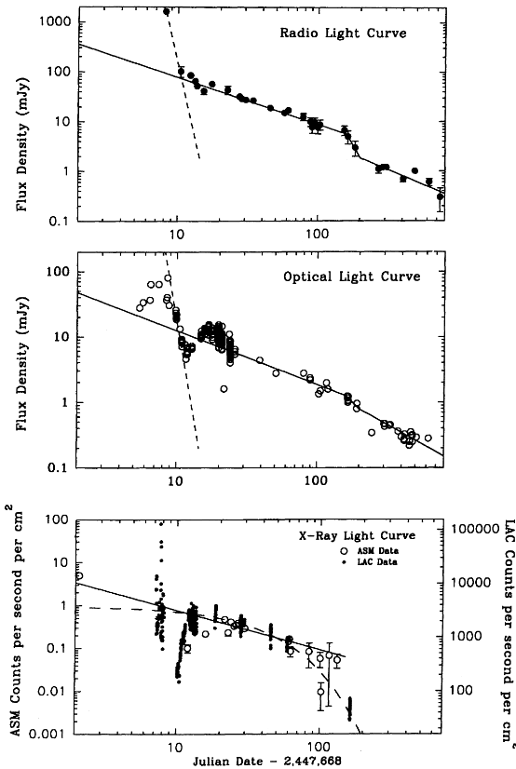
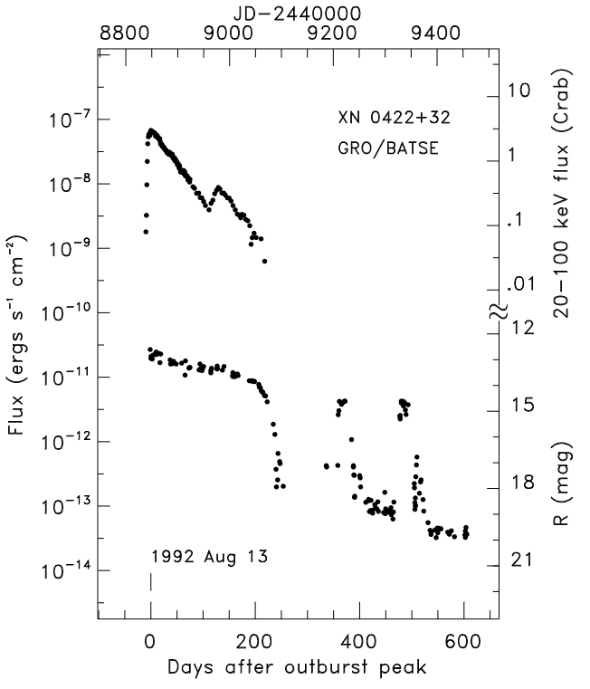
Multi-wavelength monitoring of XRB outbursts
Some early work showed that optical and radio emission faded together with X-rays during outburst decays
Han & Hjellming 1992
1989 outburst of V404 Cyg
GRO J0422+32
Chen et al. 1997
(large compilation
Of X-ray and
optical light
curves)
Radio → jet
Optical → disc
X-ray → corona
+disc

Slide 10
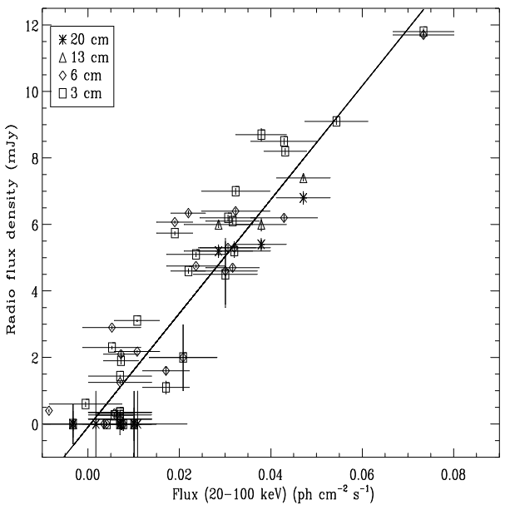
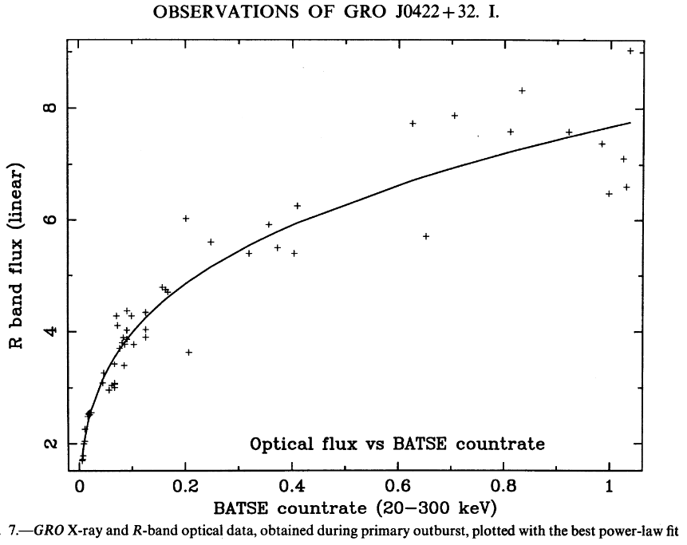
Early correlations
← Corbel et al. 2000 (again GX 339-4)
See also Hannikainen et al. 1998
Callanan et al. 1995 →
Usually we need data within ~1 day to “match” data points (for slowly varying sources)

Slide 11
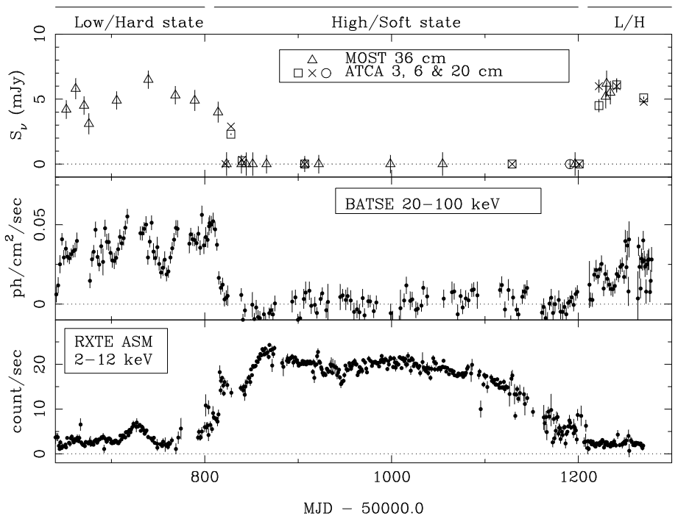
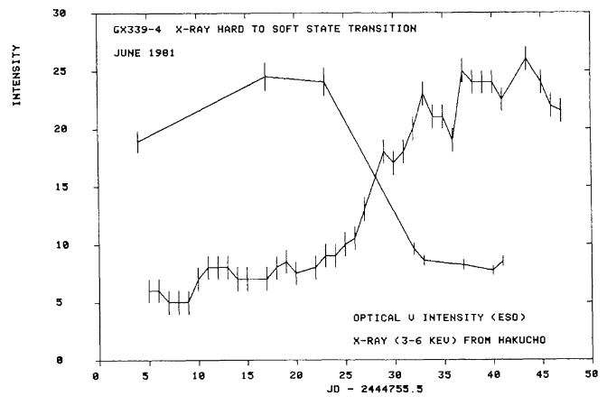
Multi-wavelength monitoring of XRB outbursts
But the light curves were not always positively correlated
← State transition in GX 339-4
Fender et al. 1999
State transition in GX 339-4 →
Motch et al. 1985
See also e.g. Belloni, Migliari & Fender 2000
Correlations must depend on X-ray state

Slide 12
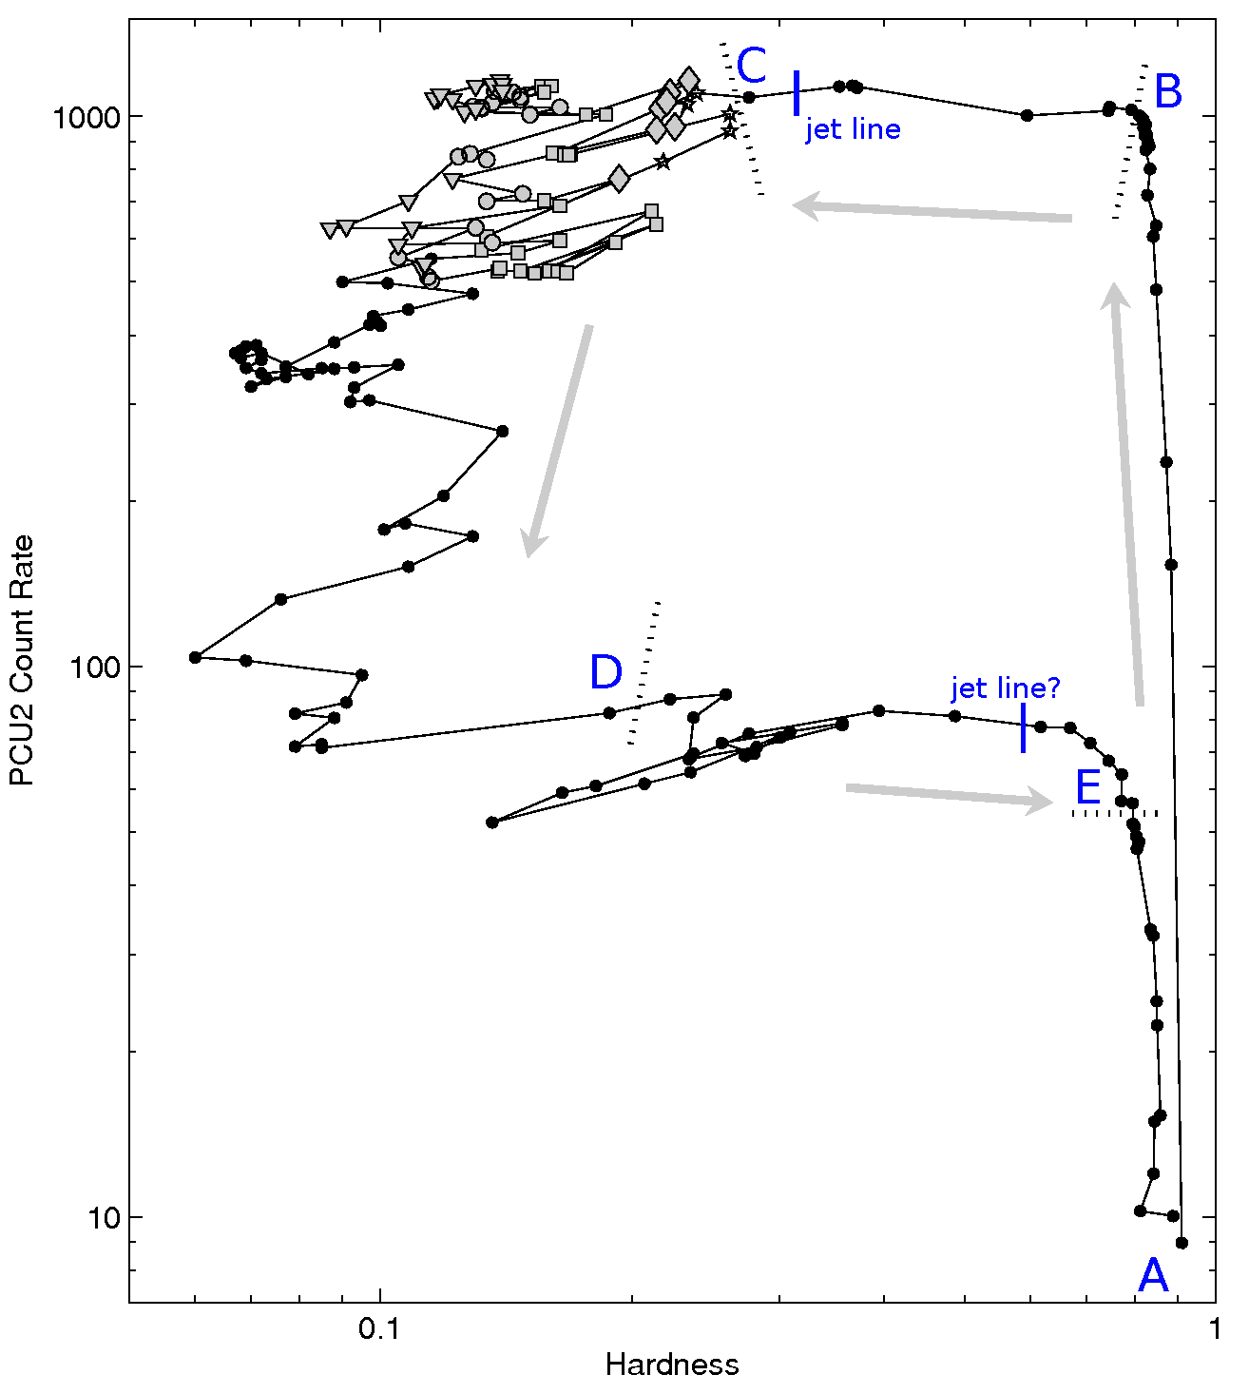
State dependency
The X-ray hardness-intensity diagram (HID):
e.g. Belloni (2010) (see also e.g. Belloni et al. 1999)
C: Getting softer
low X-ray rms
SIMS = soft-intermediate state
Compact jet quenches, launch of discrete ejecta
After C: Soft state
Disc blackbody
Inner disc at ISCO
No power law or steep power law
No jet
B: Leaves the hard state
Disc comes in
HIMS = hard-intermediate state
During fade:
Power law reappears between D and E
Compact jet reappears (when?)
A to B: Hard state rise:
X-ray power law
Comptonized corona
Disc truncated
Compact jet
GX 339-4 outburst; Belloni et al. 2005
Maccarone & Coppi 2003, Fender et al. 2004, 2009
Unified picture of X-ray evolution in BHXBs
Notes:
‹#›

Slide 13
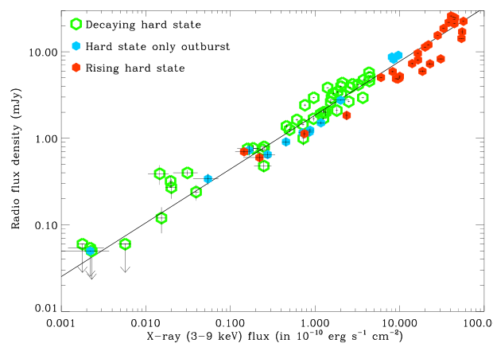
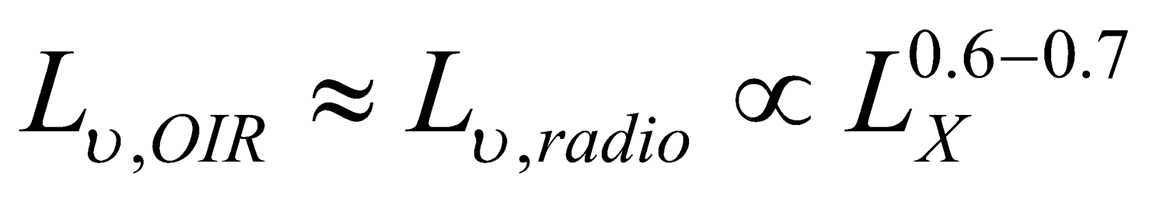
X-ray Binary Jets: Radio/X-ray correlation
7 outbursts of
GX 339-4
Corbel et al. 2013
Disc-jet coupling in action
Radio emission from the jet is known to be well correlated with the X-ray luminosity, in the hard state (e.g. Corbel et al. 2000; Gallo et al. 2003, 2012, 2014, 2018)

Slide 14
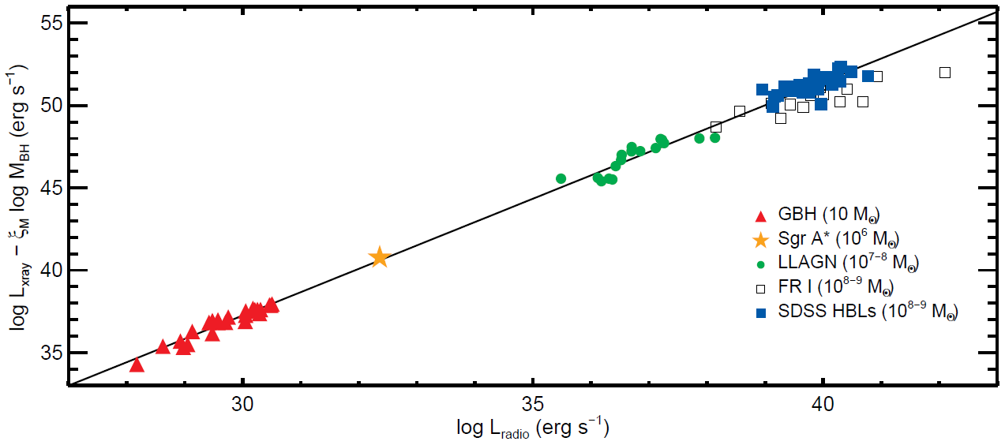
Accretion physics scales with mass
The Fundamental Plane
of black hole activity
From Plotkin
et al. 2012
Hard state BHs
Suggests all jets are coupled to their discs in the same way
BLACK HOLES ARE SIMPLE!
Black holes have 3 parameters: mass, spin and charge ‘no hair theorem’
The Fundamental Plane and other scaling relations imply a single jet formation process
See also: Merloni, Heinz & Di Matteo 2003, Falcke, Körding & Markoff 2004, Körding et al. 2006, McHardy et al. 2006, Koljonen et al. 2015, Saikia et al. 2015

Slide 15

Interlude…
Abu Dhabi Investment Authority (ADIA) Headquarters

Slide 16
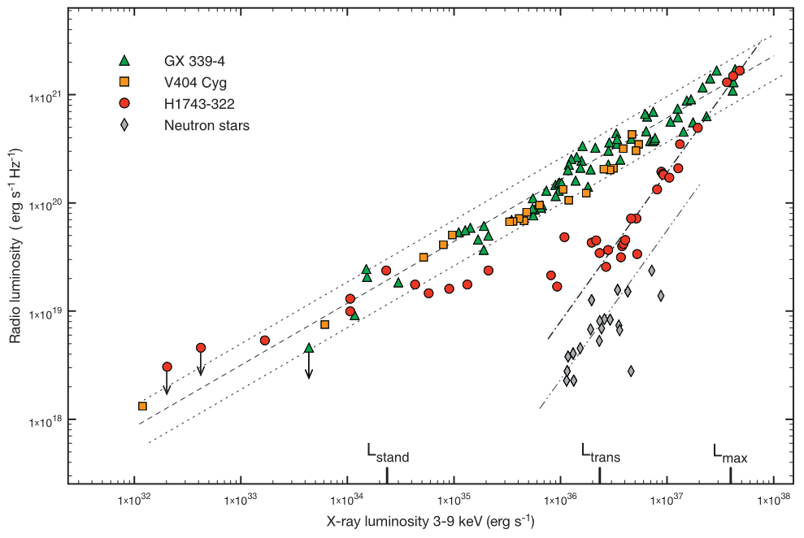
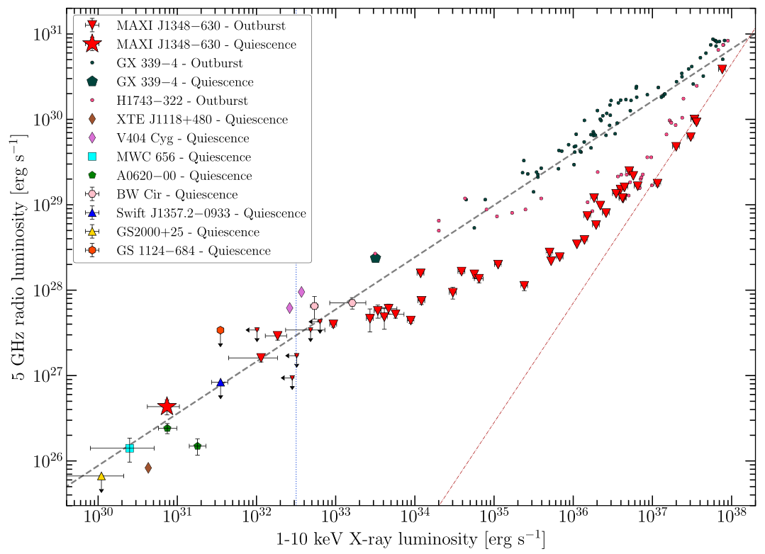
X-ray Binary Jets: Radio/X-ray correlation
H1743-322 →
From Coriat et al. 2011
Steep slope at high Lx
(slope index ~ 1.4)
Shallow part at mid luminosities
Joins standard correlation at low Lx
Could be due to changes in radiative efficiency
Neutron stars are radio-fainter than even the radio-faint BHs
MAXI J1348-630 →
Carotenuto et al. 2021a,b, 2022a,b
Swift XRT, MAXI,
MeerKAT, ASKAP, ATCA

Slide 17
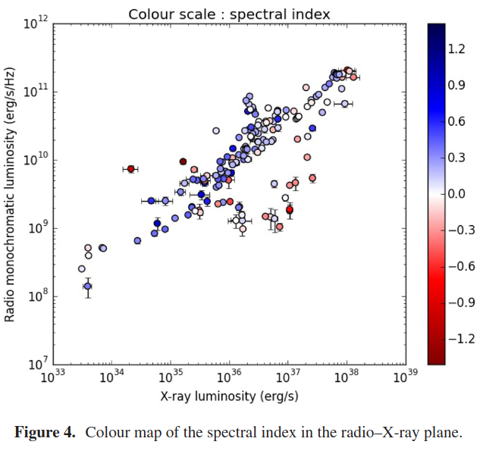
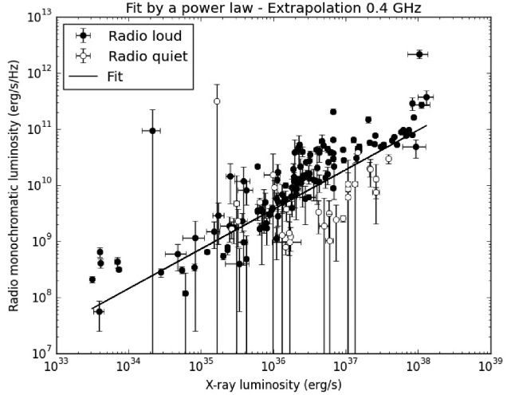
X-ray Binary Jets: Radio/X-ray correlation
Espinasse & Fender 2018 found that radio faintness relates to the radio spectral index
The tracks merge around 400 GHz
Gallo et al. 2003, 2012, 2014, 2018
Islam & Zdziarski 2018
Koljonen & Russell 2019
Carotenuto et al. 2021
Hughes et al. 2025
etc.

Slide 18
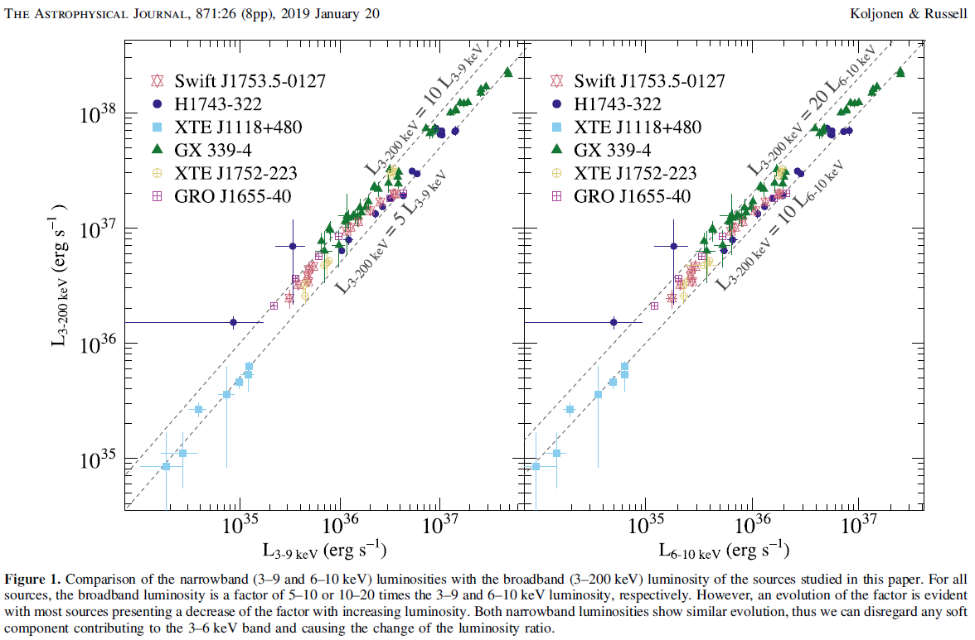
X-ray Binary Jets: Radio/X-ray correlation
We tested if the choice of X-ray energy range affected the radio/X-ray correlation
We found that the ratio between the broadband (3–200 keV) and narrowband
(3–9 keV) luminosities varies between 5 and 10 in the hard X-ray state
The radio/X-ray correlation slopes and normalizations are not significantly different, suggesting that they are not affected greatly by observational biases but are caused by real physical effects Koljonen & Russell 2019

Slide 19
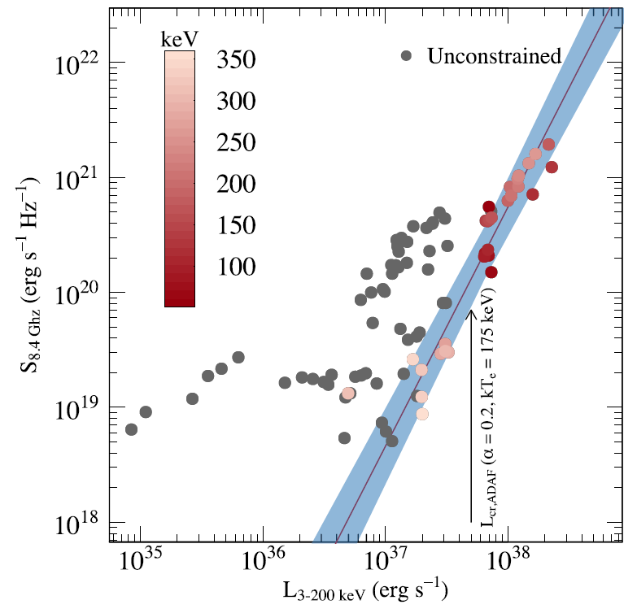
X-ray Binary Jets: Radio/X-ray correlation
hard X-ray cutoff energy colored as a hue of red depending on the energy and gray if unconstrained
Koljonen & Russell 2019
We found that all sources that reach high enough luminosity change their correlation slopes from the universal slope to a much steeper one
Sources in the steeper radio/X-ray track show a distinct cutoff in the high-energy X-ray spectrum at tens of keV
These results suggest there is a morphological change in the accretion flow at a certain critical luminosity, from radiatively inefficient to radiatively efficient flow

Slide 20
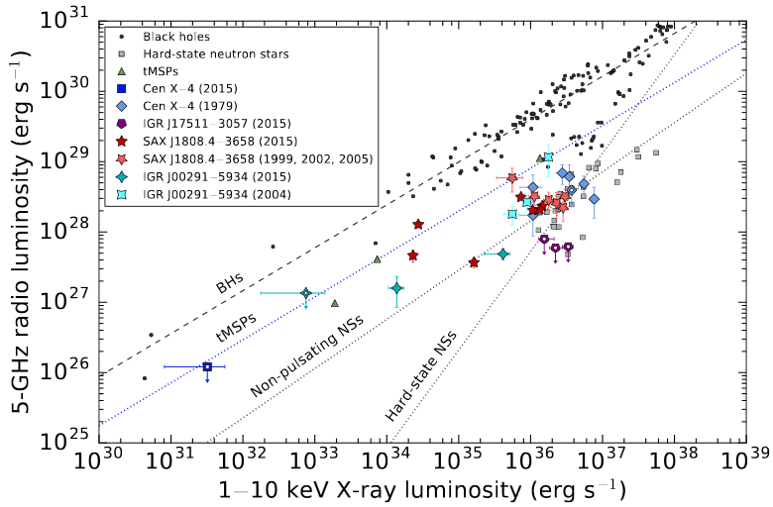
X-ray Binary Jets: Radio/X-ray correlation
Tudor et al. 2017
Neutron star jets are fainter in radio than black hole jets,
some have different correlation slopes
(e.g. Migliari & Fender 2006, Tudor et al. 2017, Gallo et al. 2012; 2018)

Slide 21
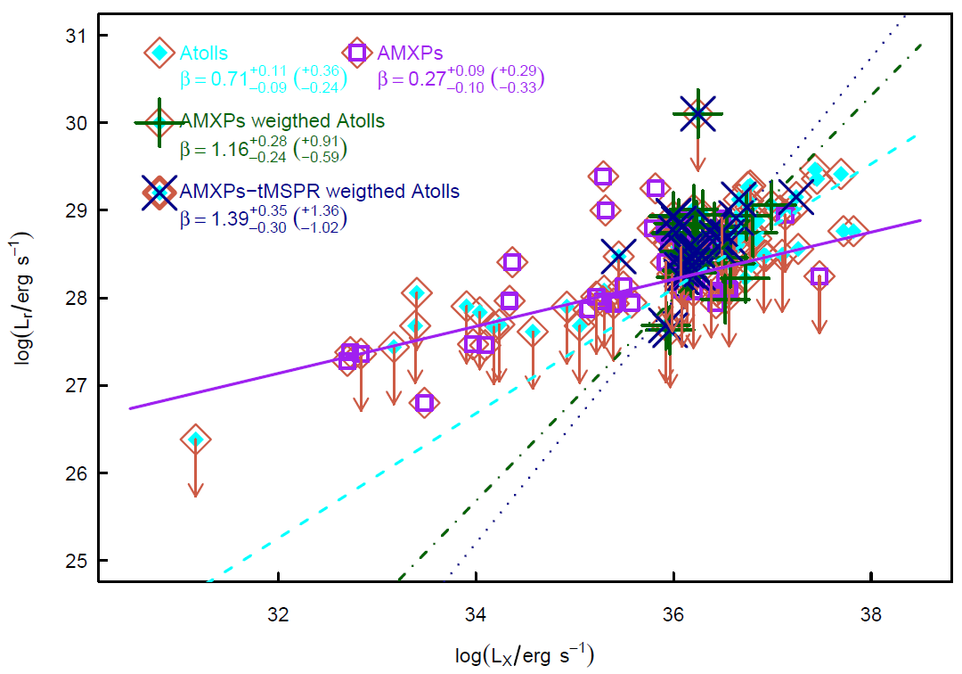
Neutron star jets are fainter than black hole jets
…about 20 times fainter
(at a given L_{X})
Different populations can have different correlation slopes
Possibly due to physical differences in the accretion flow efficiency, or the jet powering mechanism
Radio – X-ray correlation: Tudor et al. 2017 (see also Gusinskaia et al. 2017; Gallo, Degenaar & van den Eijnden 2018, T. Russell et al. 2018, Tetarenko et al. 2018, van den Eijnden et al. 2018, 2019, Pattie et al. 2026, Crook-Mansour et al. 2026)

Slide 22
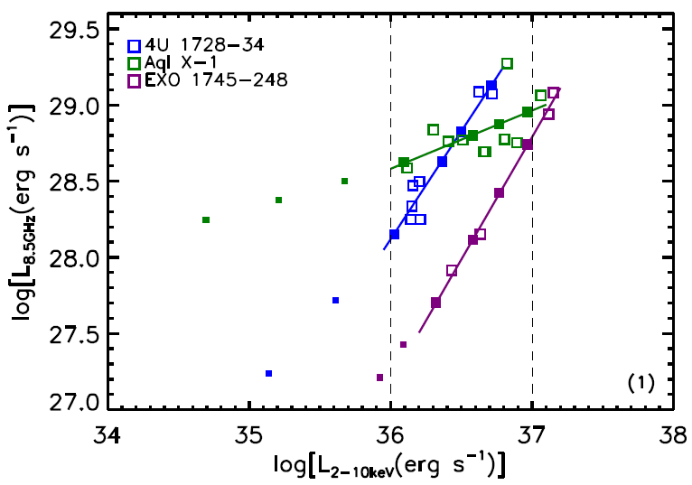
Neutron star jets are fainter than black hole jets
Qiao & Liu (2019) can explain the different slopes with a coupled ADAF-jet model
The fraction of inflow matter entering the jet changes with ṁ, depends on B-field
Radio – X-ray correlation: Tudor et al. 2017 (see also Gusinskaia et al. 2017; Gallo, Degenaar & van den Eijnden 2018, T. Russell et al. 2018, Tetarenko et al. 2018, van den Eijnden et al. 2018, 2019, Pattie et al. 2026, Crook-Mansour et al. 2026)

Slide 23
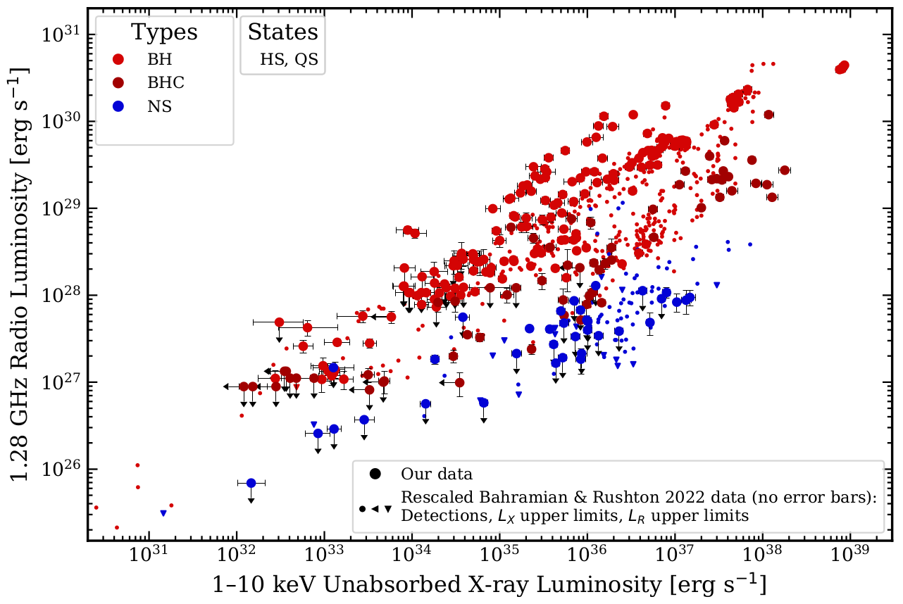
Neutron star jets are fainter than black hole jets
Recent complication using homogeneous samples from MeerKAT and Swift/XRT
See Justine Crook-Mansour’s talk, up next!
Radio – X-ray correlation: Tudor et al. 2017 (see also Gusinskaia et al. 2017; Gallo, Degenaar & van den Eijnden 2018, T. Russell et al. 2018, Tetarenko et al. 2018, van den Eijnden et al. 2018, 2019, Pattie et al. 2026, Crook-Mansour et al. 2026)

Slide 24
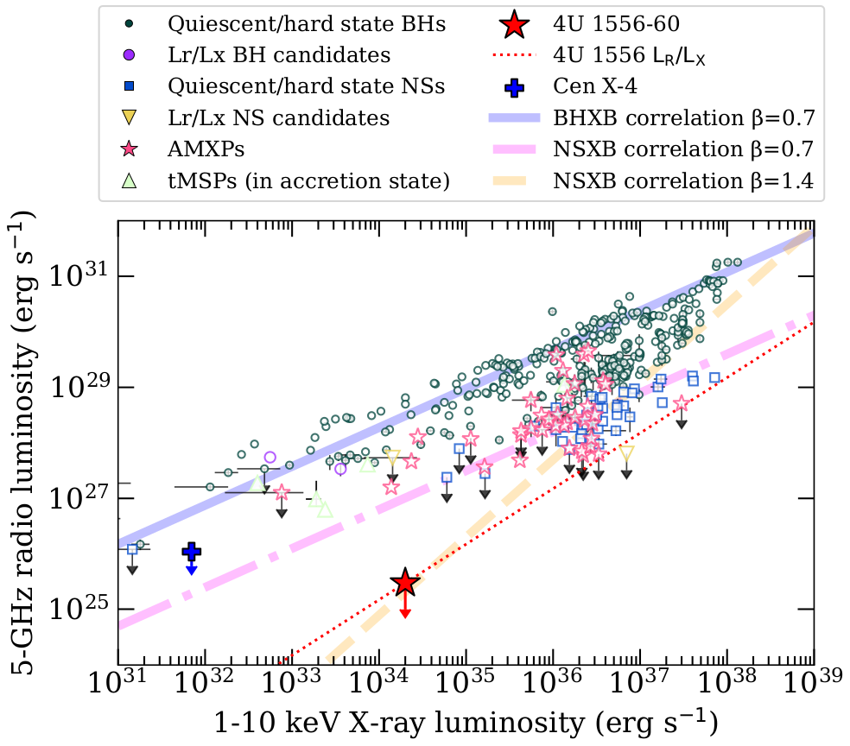
Neutron star jets are fainter than black hole jets
On the other hand, some NS LMXBs are extremely radio-faint
4U 1556-60 is undetected with ATCA
in the hard state
< 10 μJy at a distance of ~700 pc
Radio – X-ray correlation: Tudor et al. 2017 (see also Gusinskaia et al. 2017; Gallo, Degenaar & van den Eijnden 2018, T. Russell et al. 2018, Tetarenko et al. 2018, van den Eijnden et al. 2018, 2019, Pattie et al. 2026, Crook-Mansour et al. 2026)

Slide 25
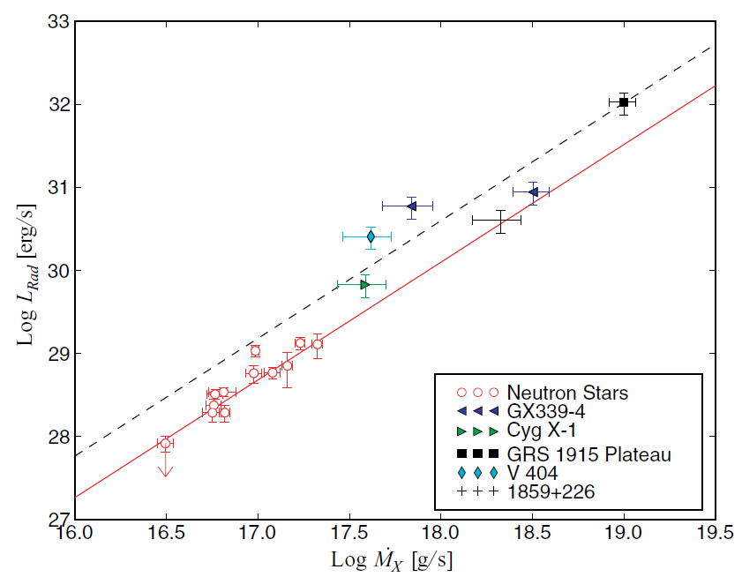
Neutron star jets are fainter than black hole jets
The gap between BHs and NSs is much smaller if you plot radio luminosity vs mass accretion rate (estimated from the bolometric X-ray luminosity)
Kording et al. 2006
i.e. the radio power in BHs and NSs is comparable for a given mass accretion rate
NSs: L_{x} ~ ṁ (radiatively efficient)
BHs in the hard state: L_{x} ~ ṁ²
Note this was shown before the radio-faint population were established

Slide 26

Interlude…
Notes:
‹#›

Slide 27
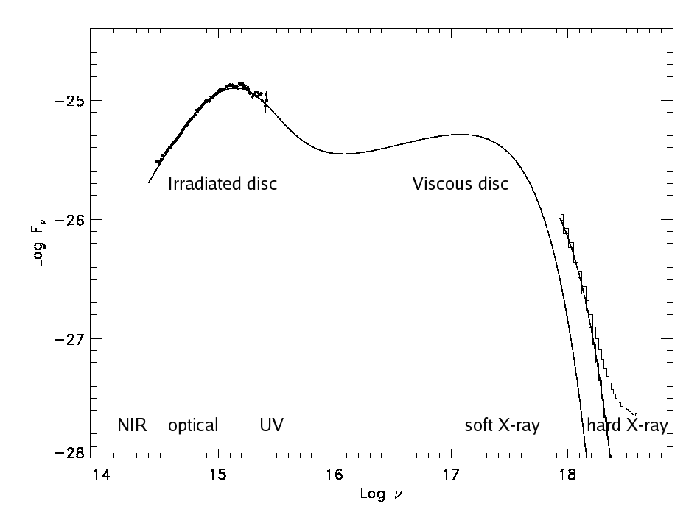
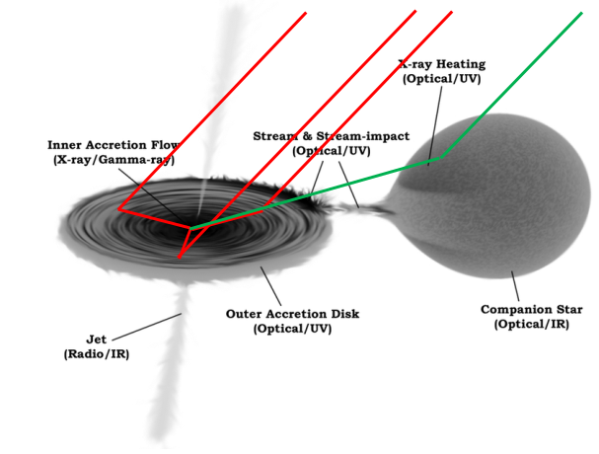
Origin of the optical-IR emission
🡪 Optical spectra very blue: 🡪 accretion disc
🡪 Actually, the X-ray heated disc tends to dominate
BHXB: XTE J1859+226 (Hynes et al. 2002)
Notes:
‹#›

Slide 28
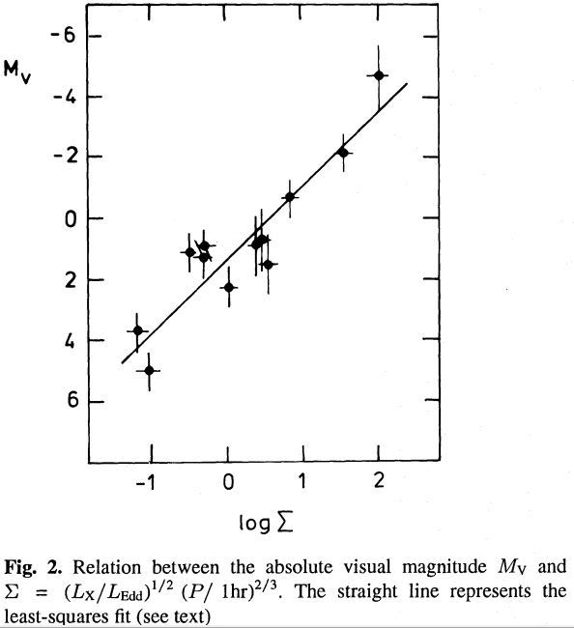
Optical / X-ray correlation
van Paradijs & McClintock 1994
POWER LAW CORRELATION
The few sources at the time were consistent with their theoretical expectation:
Optical reprocessing response is nonlinear due to changing outer disc temperature
Also scales with disc size
Notes:
‹#›

Slide 29
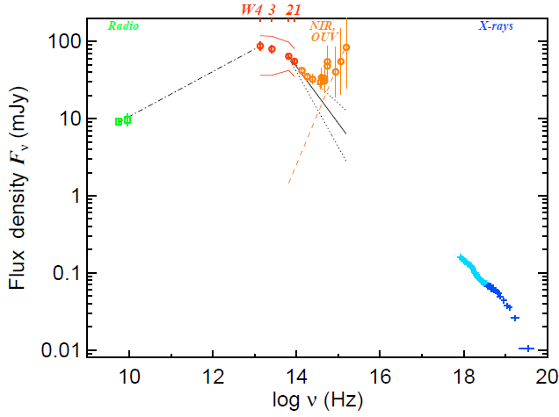
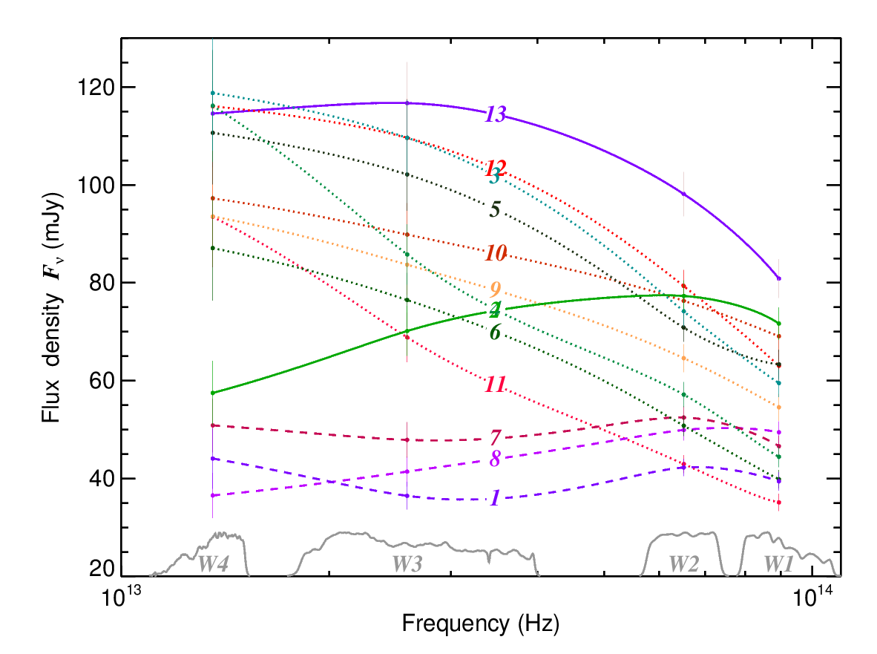
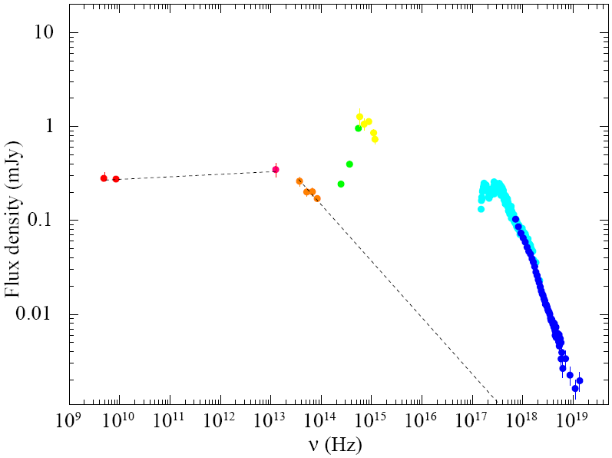
How far does the radio jet spectrum go?
The jet spectral break was found in GX 339-4 in the mid-IR and varying rapidly:
Migliari et al. 2010 identified the jet spectral break in 4U 0614+091: using Spitzer
WISE data
Gandhi et al. 2011 identify the jet break in GX 339-4:
In the mid-IR: moving between 4 and 22 microns (probably further)

Slide 30
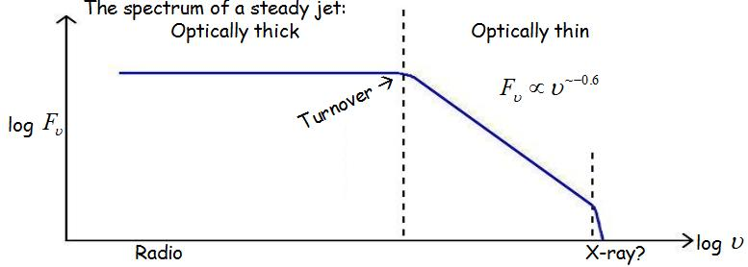
How far does the radio jet spectrum go?
V-shaped spectrum in opt-IR where the disc (spectrally) meets the jet
e.g. Corbel & Fender 2002, Chaty et al. 2011, Russell et al. 2013

Slide 31
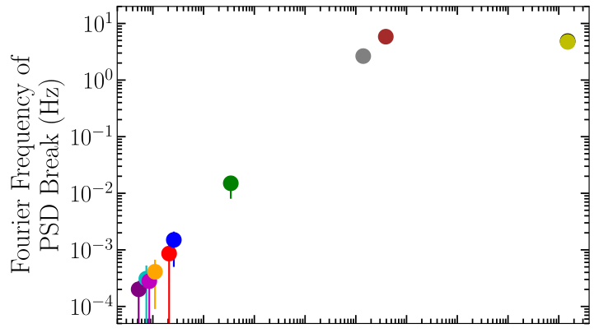
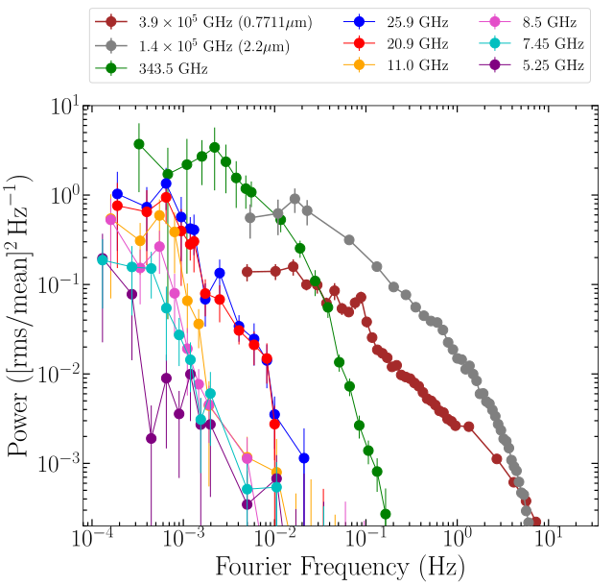
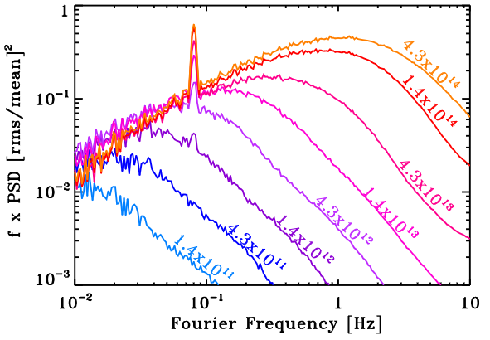
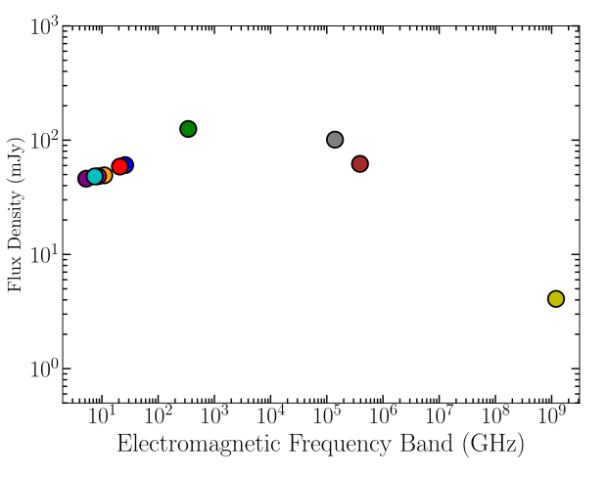
How far does the radio jet spectrum go?
An internal shock model, and variability studies have been successful in fitting the broadband spectra and power spectra of BH LMXBs
Malzac (2013; 2014)
Malzac et al. 2018 model the IR/X-ray lags and broadband spectrum of GX 339-4
Predicted PSDs of jet from mm to optical using X-ray PSD
Tetarenko et al. 2021 model the multi-wavelength PSDs and lags of
MAXI J1820+070
PSD break frequency
PDSs
flux density spectrum

Slide 32
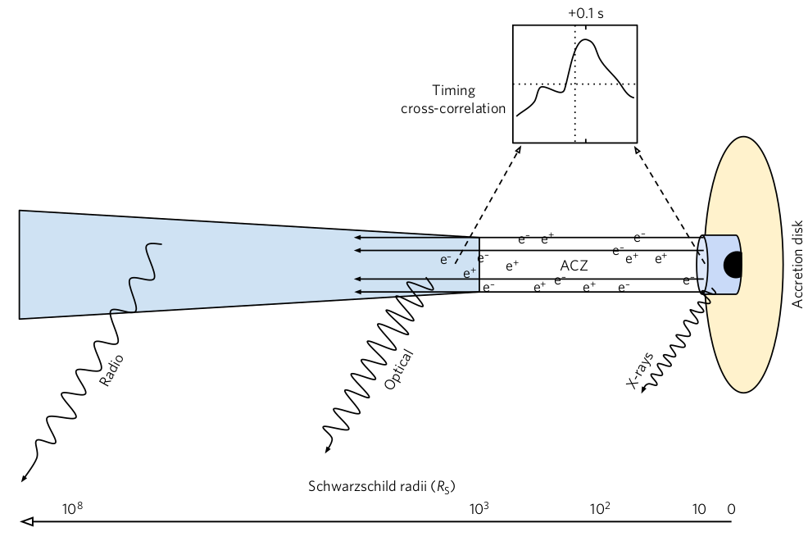
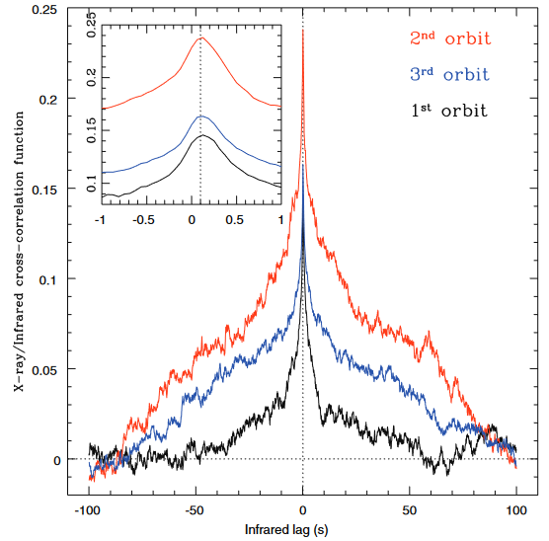
How far does the radio jet spectrum go?
Optical/IR can lag X-rays by 0.1 sec in BH LMXBs (jet synchrotron origin)
GX 339-4: Casella et al. 2010, Gandhi et al. 2010, Kalamkar et al. 2016, Vincentelli et al. 2019
V404 Cyg:
Gandhi et al. 2017
MAXI J1820+070:
Paice et al. 2019, 2021,
Tetarenko et al. 2021
See Pg Casella’s talk!
Gandhi et al. 2017,
Nature Astronomy
Linear polarisation (~1–8%) has also been detected from synchrotron jets in the optical-IR (e.g. Russell & Fender 2008, Baglio et al. 2020) – tangled B field, similar to AGN cores
The lag implies IR
emitting region is
at ~ 100-1000 Rg
Casella et al. 2010

Slide 33
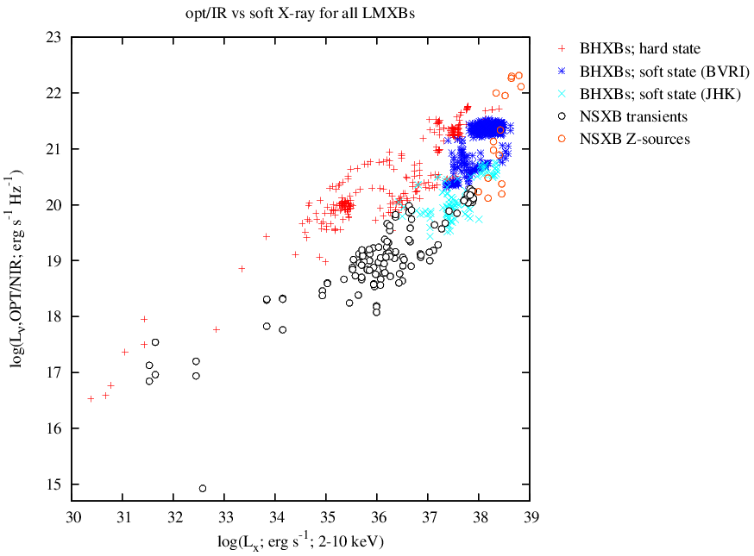
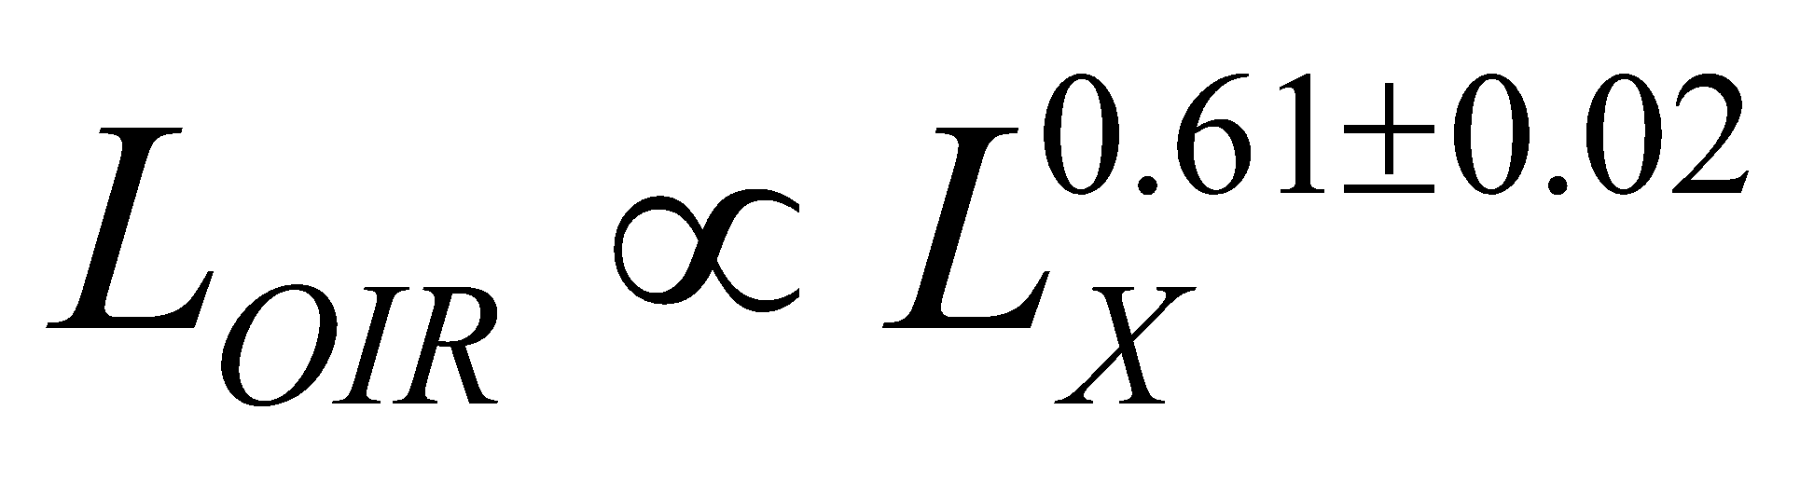
Optical/infrared – X-ray correlations
🡪 We updated this with a wealth of optical, IR and X-ray data (Russell et al. 2006, 2007)
🡪 Correlations exist, but depend on compact object, and X-ray state (also Homan et al. 2005)
Quasi-simultaneous data:
For black hole systems
in the hard state:
Neutron star XRBs are
systematically fainter in
optical than black hole XRBs
Black hole XRBs are optically
fainter in the soft state, for a
given L_{X}
Notes:
‹#›

Slide 34
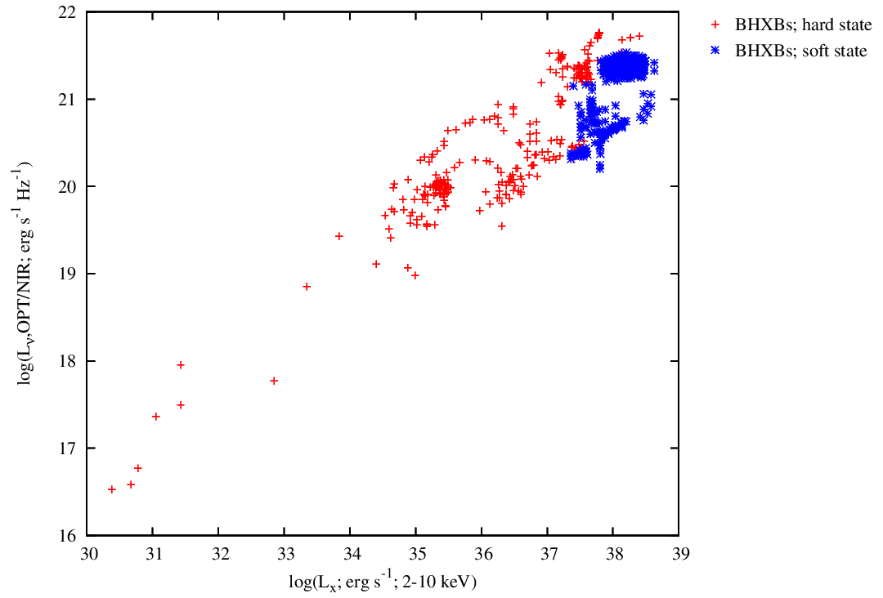
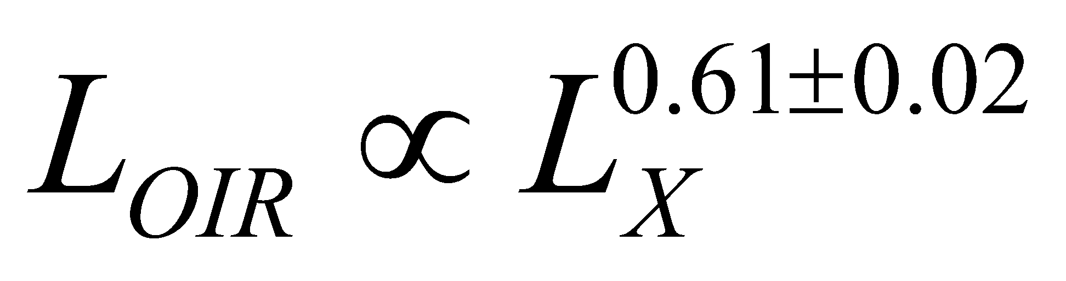

Optical/infrared – X-ray correlations
The correlation can be explained with a combination of disc and jet optical/IR emission
Expected for optical emission from reprocessing of X-rays on the disc surface
van Paradijs & McClintock 1994
Depends on disc size ~ orbital separation, a
where b ~ 0.5
For black hole XRBs in the hard state:
Russell et al. 2006, 2007
Notes:
‹#›

Slide 35



Optical/infrared – X-ray correlations
Theoretical expectations: a
The irradiation (disc reprocessing) relation depends on:
Temperature profile,
n=1/2 for irradiation dominated disc
Surface brightness profile,
Part of disc producing optical: overlapping (flat) part, Rayleigh-Jeans tail, Wein cutoff (so depends on wavelength)
For BHXBs in outburst, optical spectral index is consistent with curved part between these regimes (e.g. Hynes 2005)
Radiative efficiency of L_{X}; how L_{X} depends on mass accretion rate
We expect b ~ 0.5, but could differ depending on above assumptions
(e.g. Coriat et al. 2009; Shahbaz et al. 2015)
Expected for optical emission from reprocessing of X-rays on the disc surface
van Paradijs & McClintock 1994
Depends on disc size ~ orbital separation, a
where b ~ 0.5
Notes:
‹#›

Slide 36
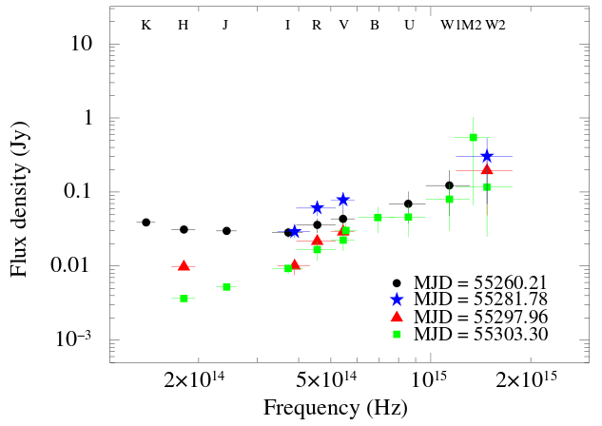
Optical/infrared – X-ray correlations
The correlation can be explained with a combination of disc and jet optical/IR emission
GX 339-4 Cadolle Bel et al. (2011)
Expected relations:
OIR from disc reprocessing:
OIR from synchrotron jet:
Viscously heated disc:
β ~ 0.2-0.5
Observed: black hole systems in the hard state:
The jet emission disappears in the soft state
Russell et al. 2006, 2007
Notes:
‹#›

Slide 37
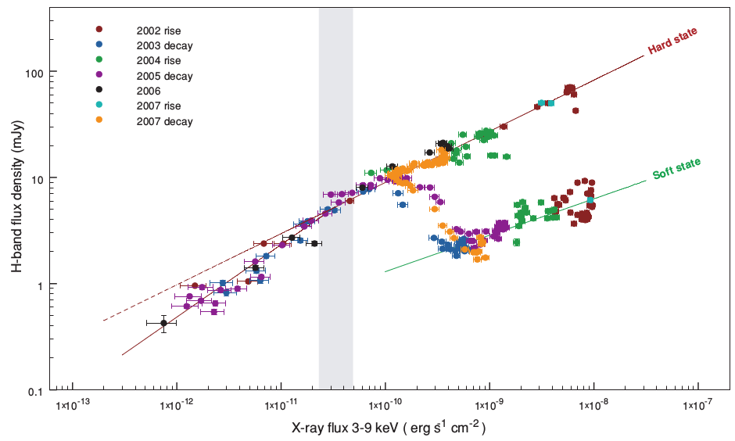
Optical/infrared – X-ray correlations
This is what a black hole system does: GX 339-4
Coriat et al. 2009 – IR quenching in the soft state
Notes:
‹#›

Slide 38
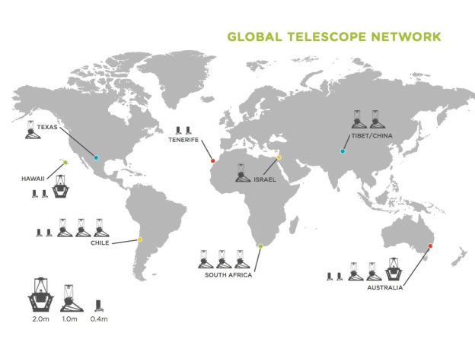
Faulkes Telescope / LCO Monitoring of LMXBs, and XB-NEWS
We are monitoring about 50 LMXBs with the two 2-m Faulkes Telescopes since 2005–2007 (Lewis et al. 2008) – about half are regularly detected in quiescence
Also have access to the 1m Las Cumbres Observatory (LCO) network
Fully robotic, queue scheduled. Typically use V, R, i’ filters, sometimes g’, r’, i’, y or z’
Cadence: about once a week or so, can increase frequency if necessary (e.g. outbursts)
🡪 We now have a real-time pipeline, the X-ray Binary New Early Warning System (XB-NEWS)
Real-time light curves
Fully flux calibrated
Alerts when new outbursts occur, or interesting activity
Bramich et al. in prep.
We also have an approved program on Chandra and NICER for new outbursts (PIs Russell and Homan), and HXMT (PI: Y.J. Yang) for optical/X-ray correlations
Notes:
‹#›

Slide 39
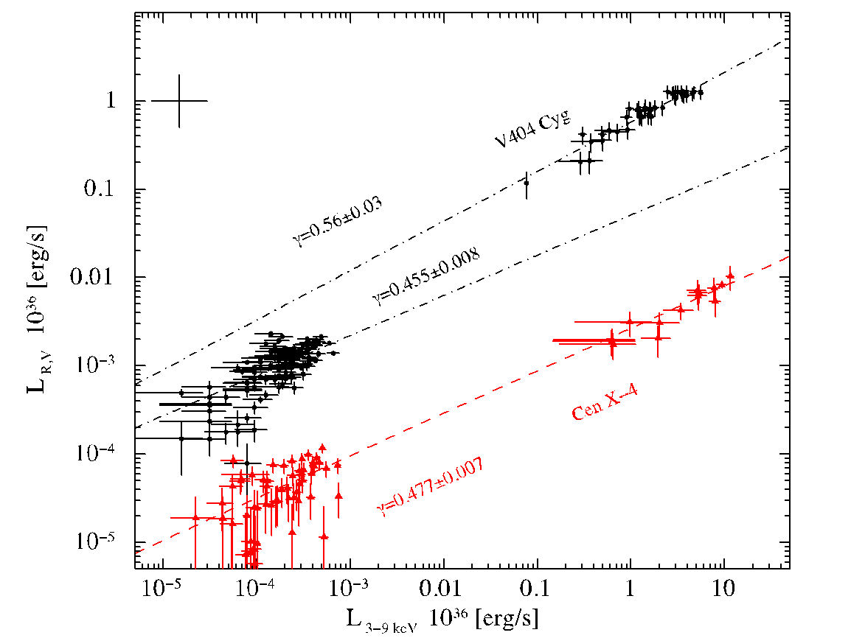
Optical/infrared – X-ray correlations
V404 Cyg = black hole system Cen X-4 = neutron star system
Black hole systems are systematically optically brighter at a given X-ray luminosity compared to neutron stars – by 1–2 orders of magnitude – why?
Bernardini et al. 2016

Slide 40
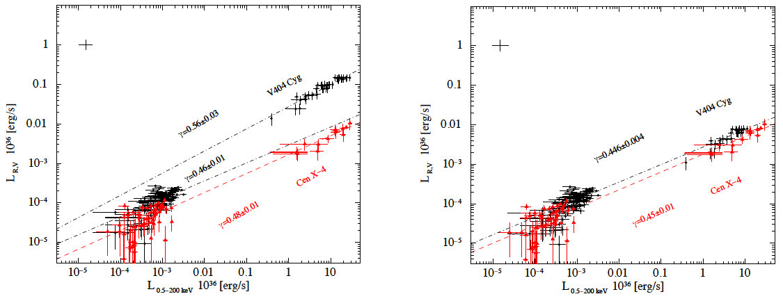
Optical/infrared – X-ray correlations
The differences are found to be due to different disc sizes, compact object masses, more jet emission for black holes, and a bolometric X-ray correction
Bernardini et al. 2016: Optical – X-ray (0.5–200 keV) correlation
Left panel: The same as before, but including the correction for different disk sizes and for bolometric X-ray luminosity, which both affect the amount of optical emission we expect from reprocessing on the disc
Right panel: The same as the left panel, but first subtracting the jet contribution for V404 Cyg in outburst (measured from SEDs) and the X-ray contribution from the NS surface in quiescence for Cen X-4
We are able to explain the differences between black holes and neutron stars in the
optical-infrared/X-ray plane

Slide 41
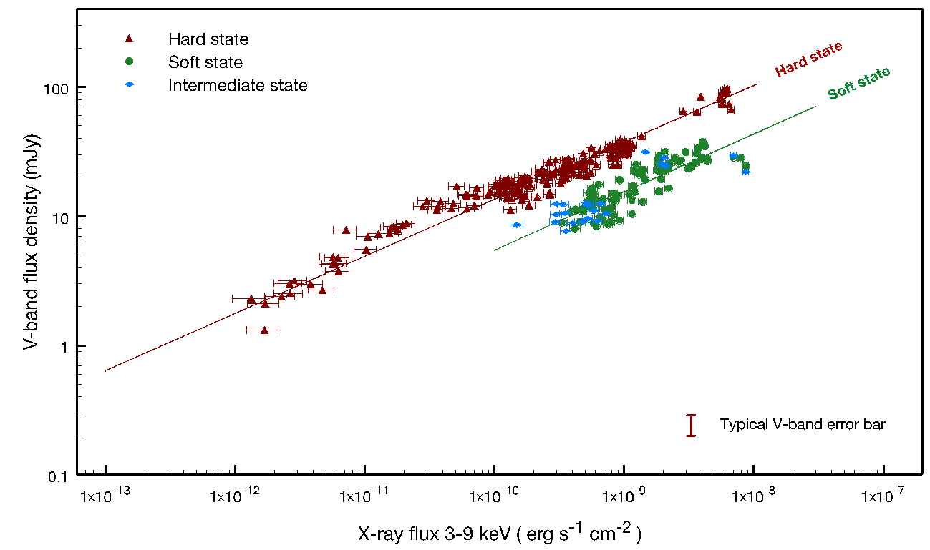
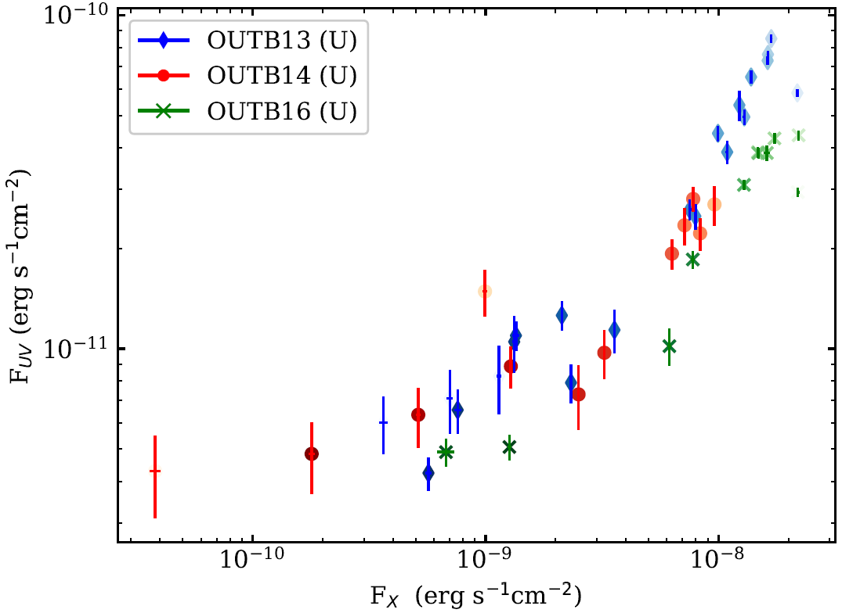
Optical/infrared – X-ray correlations
These correlations can be used to constrain the emission processes, and to constrain the nature of the compact object for new X-ray transients
Aql X-1
López-Navas et al. 2020
GX 339-4
Coriat et al. 2009
Other tools (SEDs, broadband modelling, CMDs, timing, polarimetry) can be used to constrain the emission processes and physical properties
These tools used together can constrain:
  Disc properties: outer disc temperatures, ionization states, disc warping
  Jet properties: luminosities, magnetic field strengths and alignment, acceleration zone radius, Lorentz factor

Slide 42
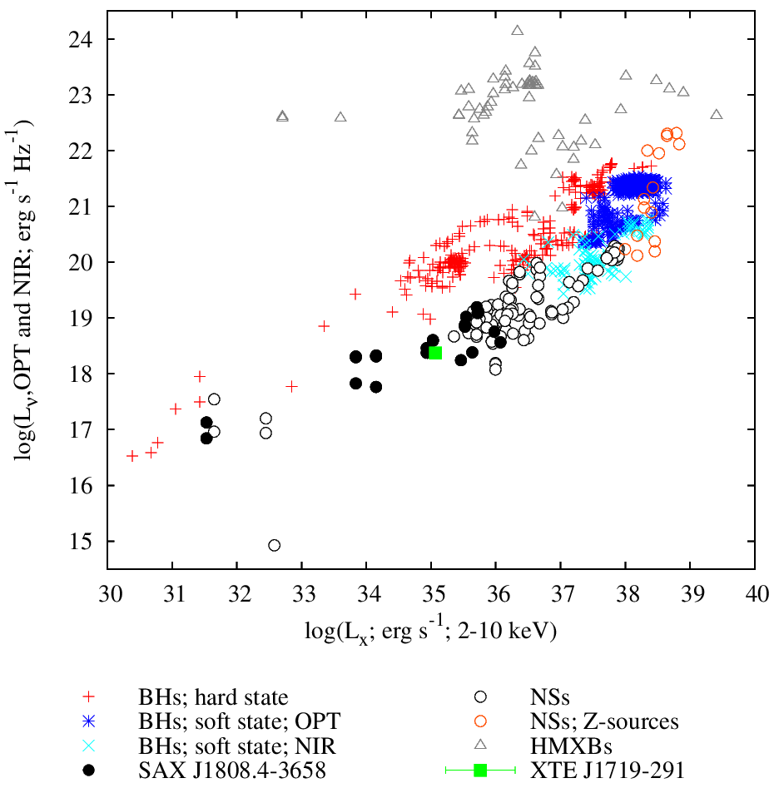
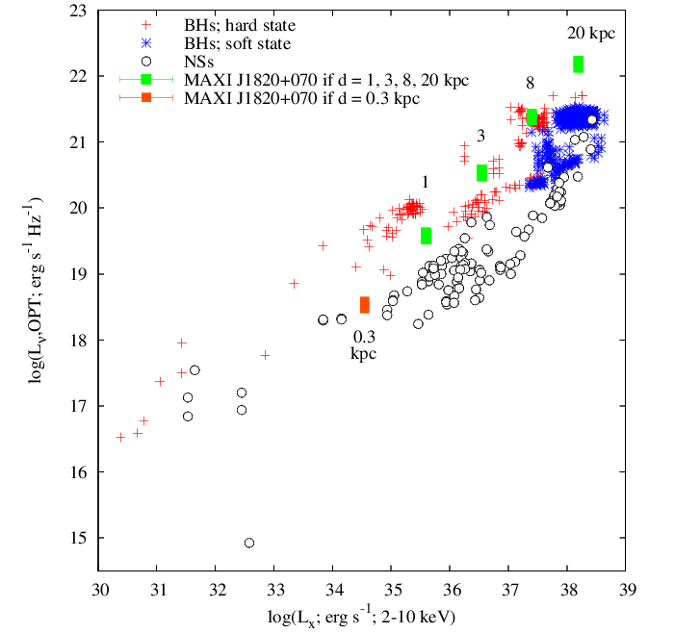
Optical/infrared – X-ray correlations
These correlations can be used to constrain the emission processes, and to constrain the nature of the compact object for new X-ray transients
XTE J1719-291
Armas Padilla et al. 2011, MNRAS, 417, 659
Supports a neutron star XRB nature
MAXI J1820+070
Baglio et al. 2018, ATel #11418
First to suggest this is a black hole XRB

Slide 43
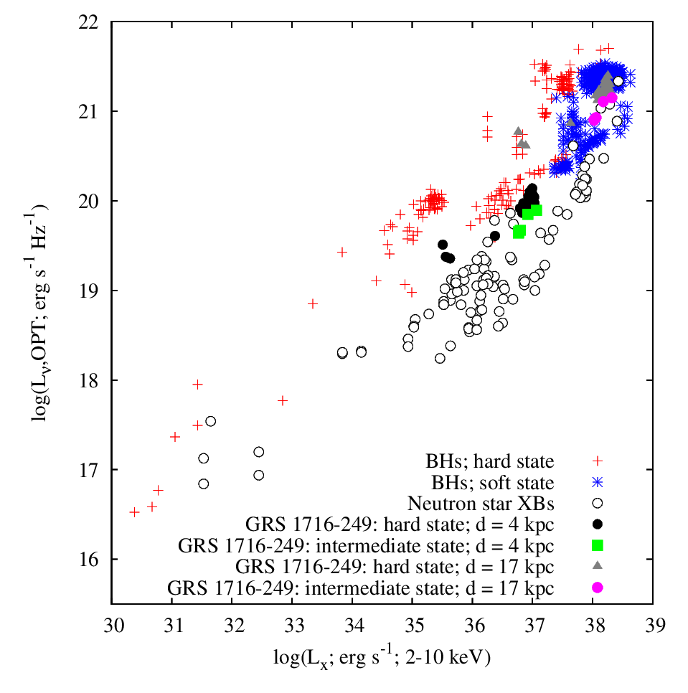

Optical/infrared – X-ray correlations
These correlations can be used to constrain the emission processes, and to constrain the nature of the compact object for new X-ray transients
Original distance estimate of 2.4±0.4 kpc based on comparison to other XRBs (data from 1980s)
della Valle et al. 1994
GRS 1716-249
Saikia et al. 2022
Distance constraint
We find that it lies within the black hole XRB population if the distance is ~ 4 – 17 kpc

Slide 44

Optical/infrared – X-ray correlations
Dependencies on the choice of optical wavelength and X-ray energy range
GRS 1716-249
Saikia et al. 2022

Slide 45

Optical/infrared – X-ray correlations
Dependencies on the choice of optical wavelength and X-ray energy range
Swift J1753.5-0127
Yang et al. 2022

Slide 46

Optical/infrared – X-ray correlations
Dependencies on the choice of optical wavelength and X-ray energy range
Swift J1753.5-0127
Yang et al. 2022
See also Armas Padilla et al. 2013, Patruno et al. 2016

Slide 47

Multi-wavelength correlations: BH XRBs
Radio – optical – X-ray plane
MAXI J1820+070
Bright et al. 2025
See also Casella et al. in prep, Alabarta et al.
in prep. for upcoming radio-IR and radio-optical correlations
Notes:
‹#›

Slide 48

Global Optical/X-ray Correlation For Reprocessing
Using reverberation lags (light crossing times across the disc) we were able to add a sample of AGN with sizes of the reprocessing radius in the disc
Cho, Russell et al. in prep.
Reprocessing is scale-invariant; it functions in the same way for accretion discs around both stellar-mass BHs and supermassive BHs
Correlation is robust, slope of 0.955 implies b = 0.48

Slide 49

Summary
Real-time light curves
Fully flux calibrated
Alerts when new outbursts occur, or interesting activity
Bramich et al. in prep.
We also have an approved program on Chandra and NICER for new outbursts (PIs Russell and Homan), and HXMT (PI: Y.J. Yang) for optical/X-ray correlations
Notes:
‹#›

Slide 50
Summary
In XRBs, correlated flux variations probe links between emitting components, on short as well as long timescales
Power law correlations exist between these different wavelength regimes, especially in the hard X-ray state
Black hole systems are systematically brighter at radio, and optical/IR frequencies, at a given X-ray luminosity compared to neutron star XRBs
The slopes and normalizations of these correlations can be explained with a combination of disc, corona and jet contributions, and in most cases are consistent with analytical model predictions
Using these correlations in conjunction with spectral energy distributions and colour-magnitude diagrams can successfully isolate the different emitting components in order to measure accurate outer disc temperatures and jet synchrotron spectral indices
Both the radio/X-ray and optical/X-ray correlations can be used to constrain the nature of the compact object for new X-ray transients
Dependencies of the correlation slopes on the choice of waveband have added an extra dimension
We present a new power law correlation for XRBs and AGN, between the optical emission due to reprocessing on the disc surface, and the Bolometric X-ray luminosity, with a term for the disc size included
Reprocessing is scale-invariant; we have demonstrated that the same reprocessing mechanism is responsible for disc irradiation in both stellar-mass and supermassive BHs
Notes:
‹#›

Slide 51





X-ray Binary Jets
Black hole XB: GRO J1655-40
Neutron star XB: Sco X-1
Radio emission: 🡪 is synchrotron in nature
🡪 collimated outflows (2 types of jet)
The approximate spectrum of a steady, hard state jet:
Optically thick Optically thin
Turnover 🡪
“jet break”
log
Radio X-ray?
log
The power carried in the jets is uncertain
Depends on the position of the “jet break”
How does the jet spectrum evolve during outbursts? 🡪 Time evolution (impossible for AGN)
What are the conditions in the inner regions of the jets? 🡪 Polarisation
Notes:
‹#›

Slide 52

X-ray Binary Jets
Black hole XB: GRO J1655-40
Neutron star XB: Sco X-1
Radio emission: 🡪 is synchrotron in nature
🡪 collimated outflows (2 types of jet)
The approximate spectrum of a steady, hard state jet:
Optically thick Optically thin
log
Radio X-ray?
log
The power carried in the jets is uncertain
Depends on the position of the “jet break”
How does the jet spectrum evolve during outbursts? 🡪 Time evolution (impossible for AGN)
What are the conditions in the inner regions of the jets? 🡪 Polarisation
Notes:
‹#›

