Slide 1
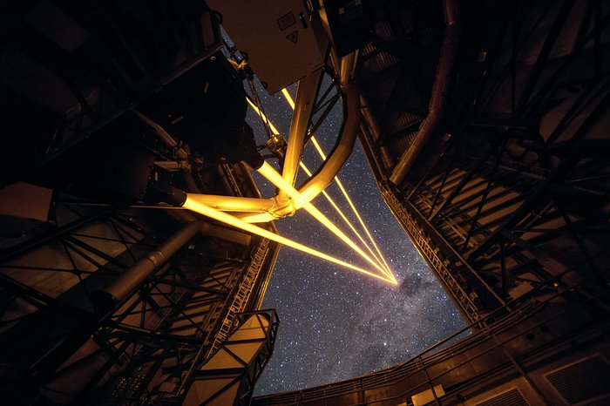


MAVIS
The MCAO Next-Generation Facility Instrument for the VLT
Meeting strumentazione ELT
a guida Italiana
Napoli 15/5/26
Sharper than JWST, deeper than HST
Giovanni Cresci (INAF – Arcetri, Italy)
on behalf of the MAVIS team

Slide 2
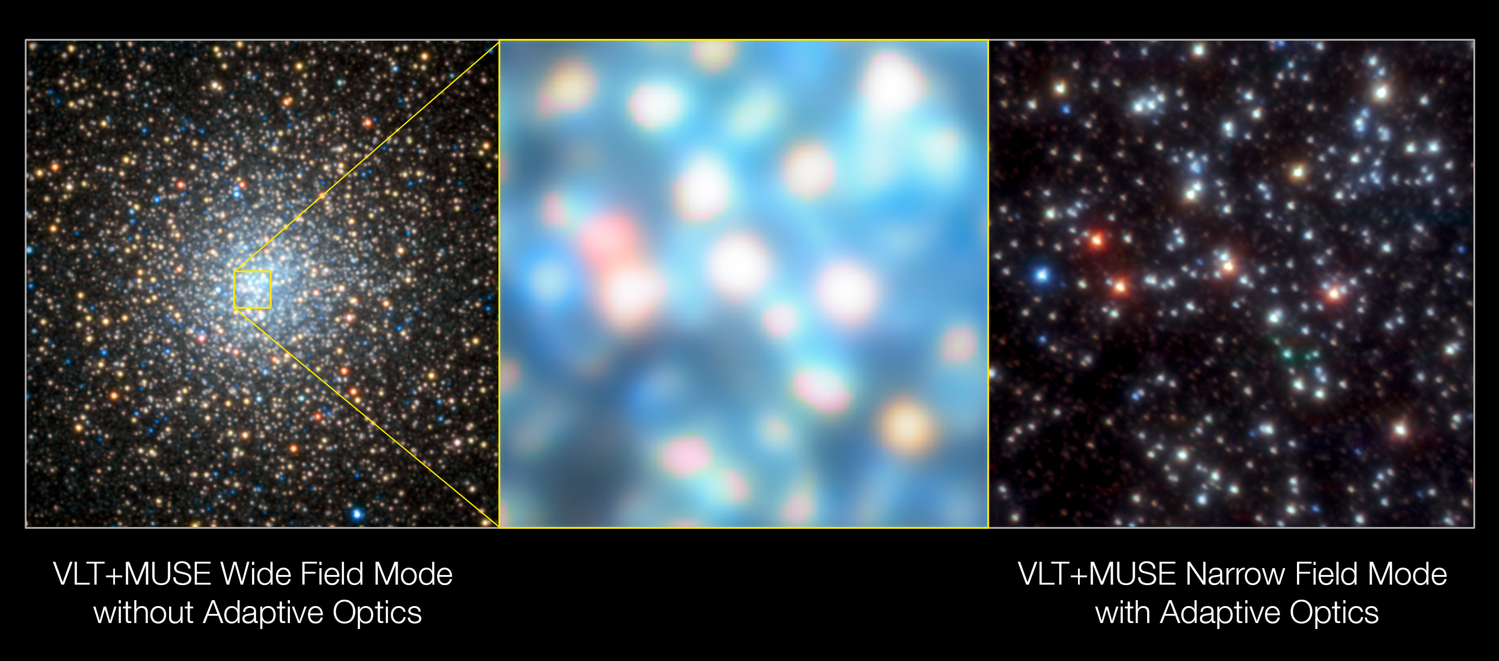
VLT Adaptive Optics Facility
Some background
Upgrade of VLT UT4 since 2016 with AO fully integrated into the telescope
Key technical components:
  Deformable secondary mirror with high actuator density (1170 actuators)
  Four laser guide stars, 20W each, operating above specifications with high photon return
  Both key for high performance in the optical
  Current instrumentation includes NIR and/or Single Conjugate AO systems
Full AOF science potential not being realized yet:
the next step is a
Multi-Conjugate optical instrument
ESO Press Release, July 2018
Credit: S. Kammann (LJMU)

Slide 3
Adaptive Optics in the visible
Some background
Optical wavelengths are information-rich, with many well-understood astrophysical diagnostics
Sky background is x1,000-10,000 times lower than infrared, possible to compete with space facilities
Detectors are larger, lower noise, faster frame rates, and cheaper
500nm on an 8m gives same angular resolution as 2𝛍m on an ELT
HST WFPC2, visible
Gemini GeMS, IR
VLT MAVIS, visible
ELT MICADO, IR

Slide 4
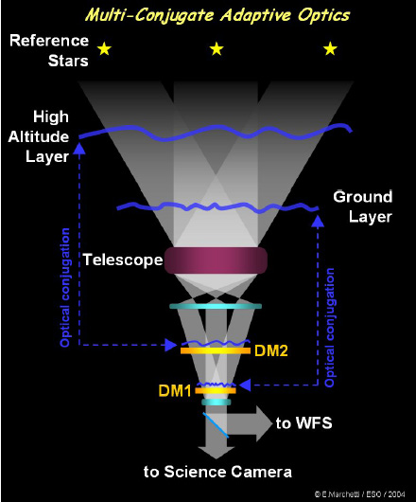
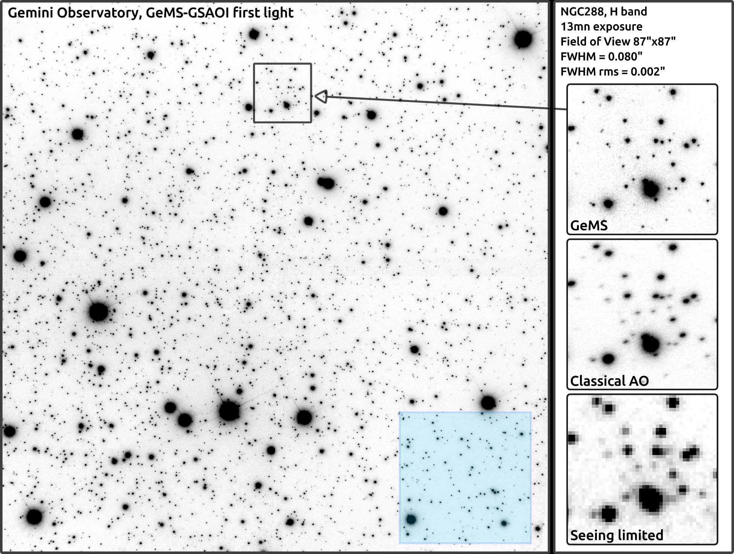
MCAO in the NIR
Some background
see also MAD@VLT with NGS
Classical SCAO has a limited corrected field of view and heavy PSF variations
MCAO uses multi-deformable mirrors, optically conjugated to different altitudes, to correct aberrations produced by different layers
Typical SCAO FoV
Each mirror is driven by different wavefront sensors using different stars or LGS in the field, to reconstruct the 3D structure of the atmosphere
… but MCAO in the optical has never been done before

Slide 5
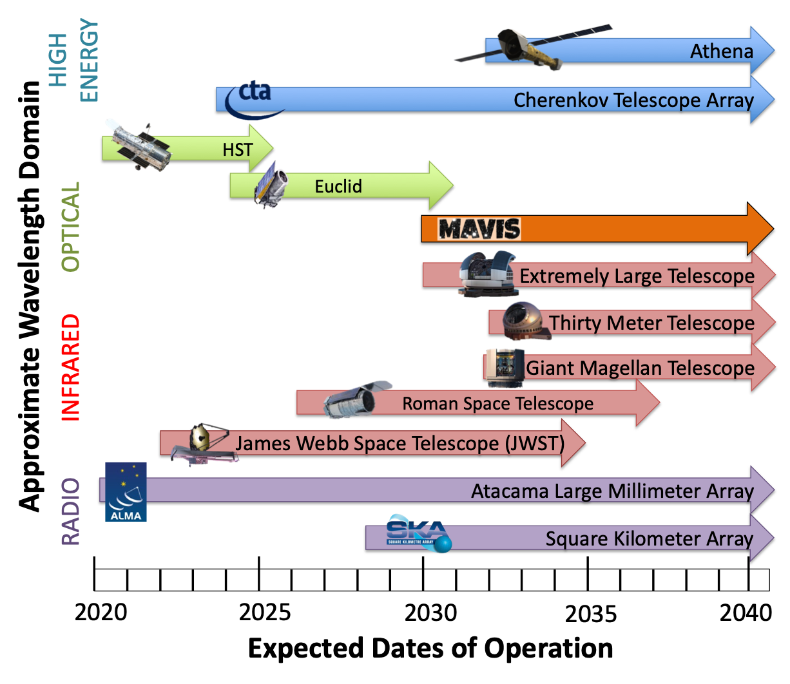
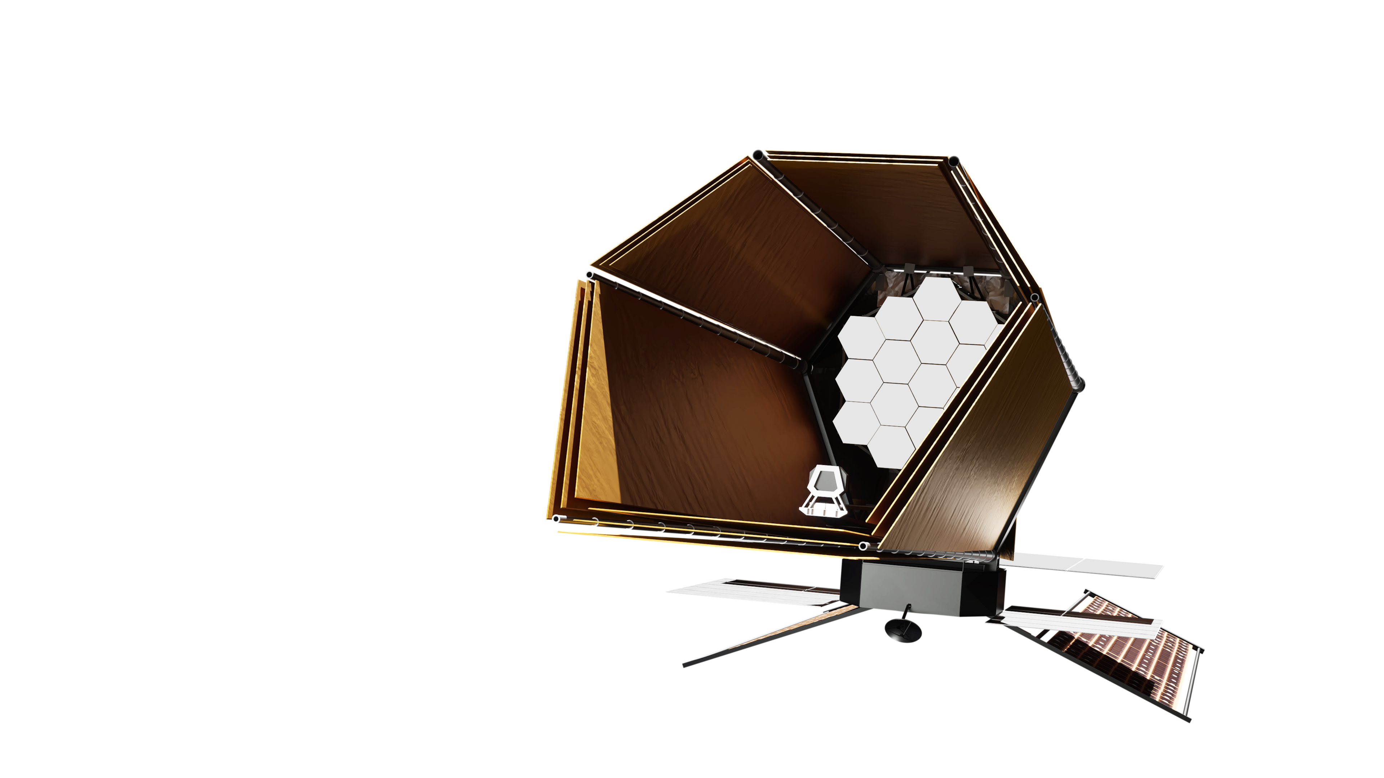
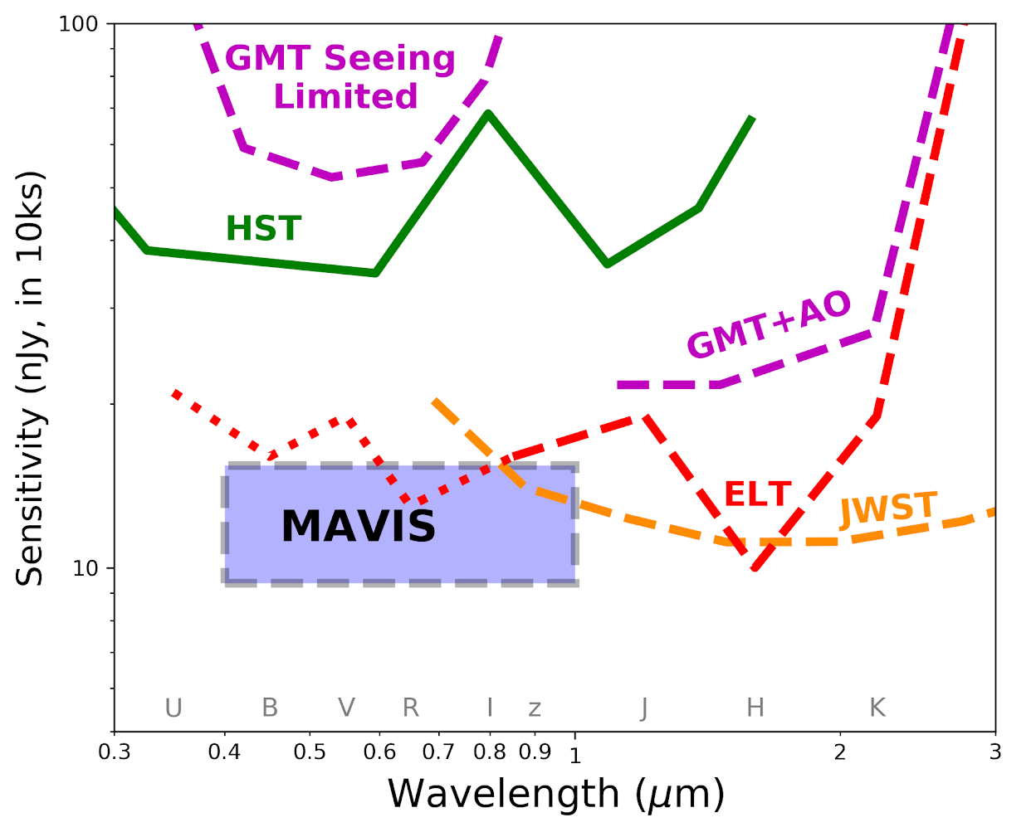
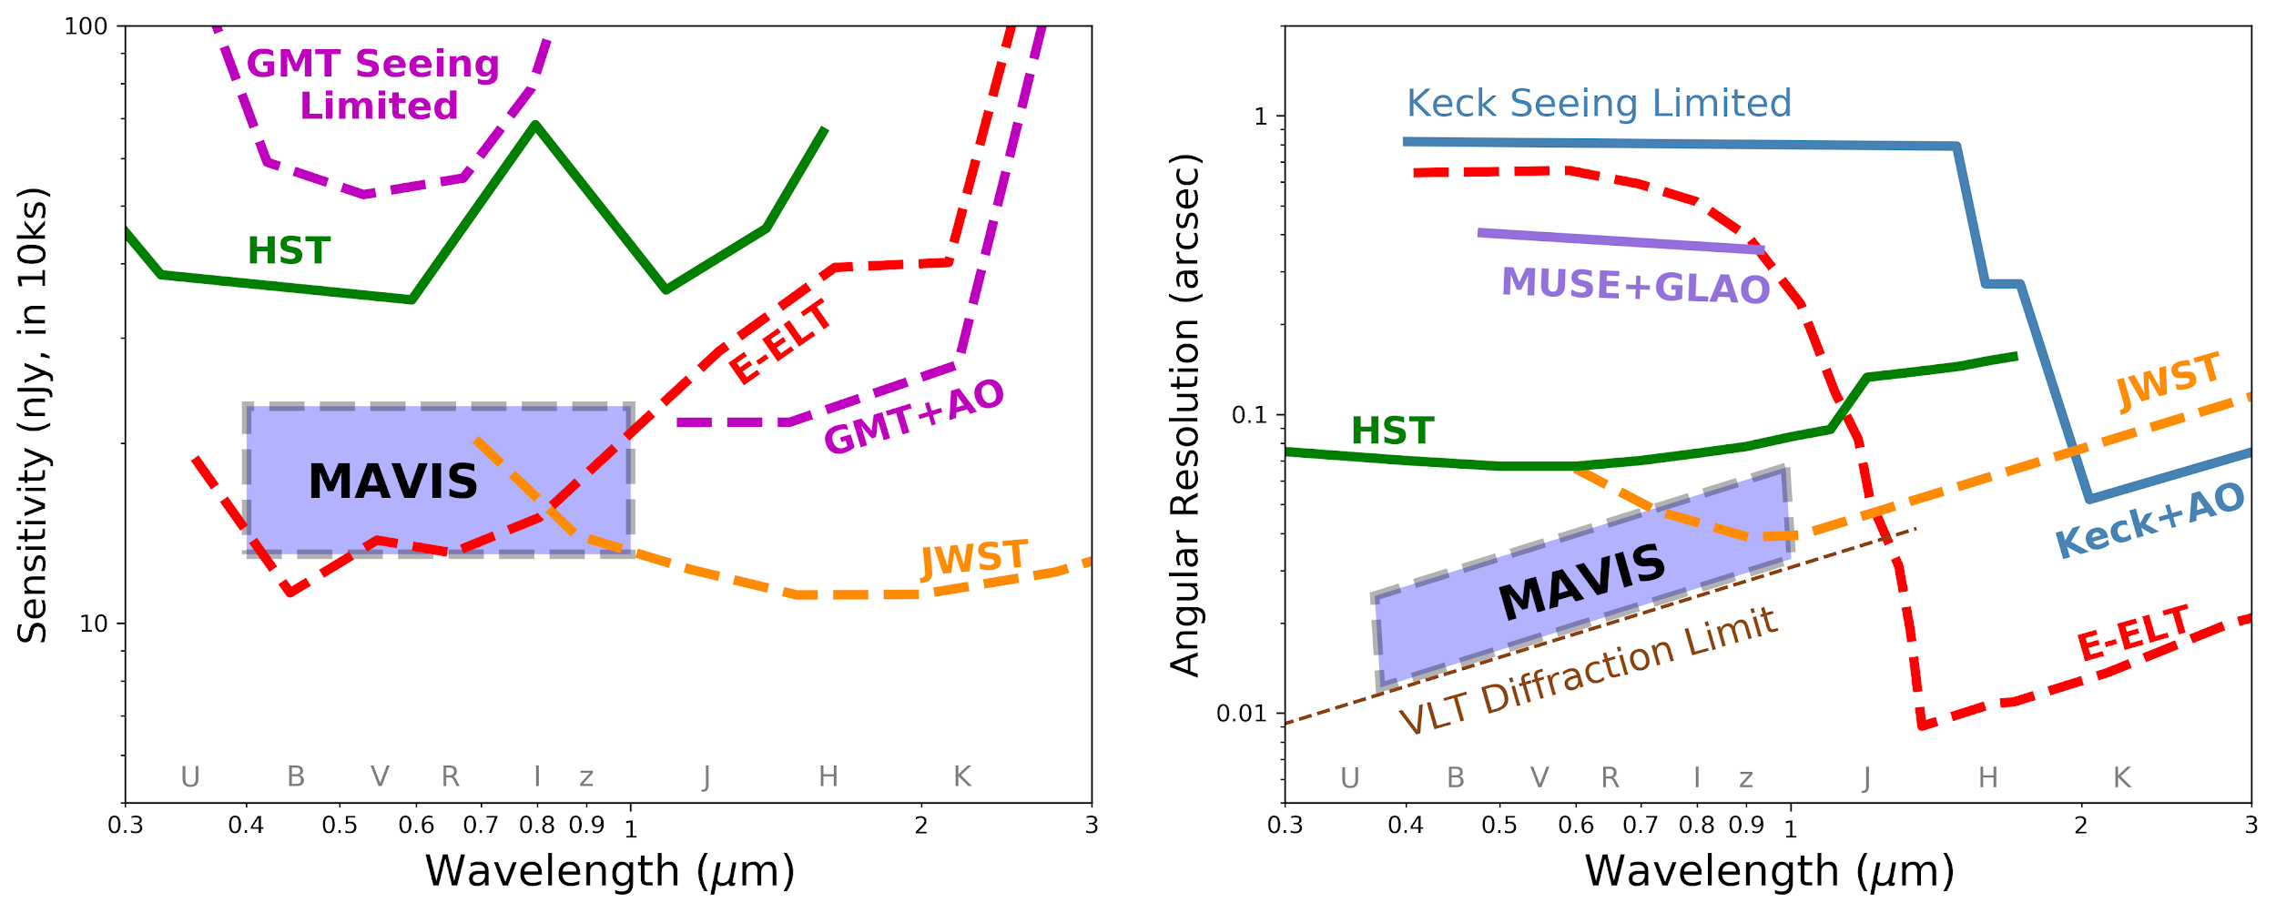
The need for MAVIS
MAVIS in context
2030s as a new era of high resolution and high sensitivity instruments
MAVIS will fill the gap for high resolution and sensitivity optical wavelengths in the post-HST era over most of the sky
Highly complementary to ELT instruments
HWO

Slide 6
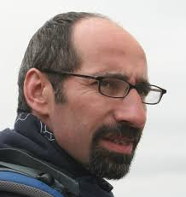
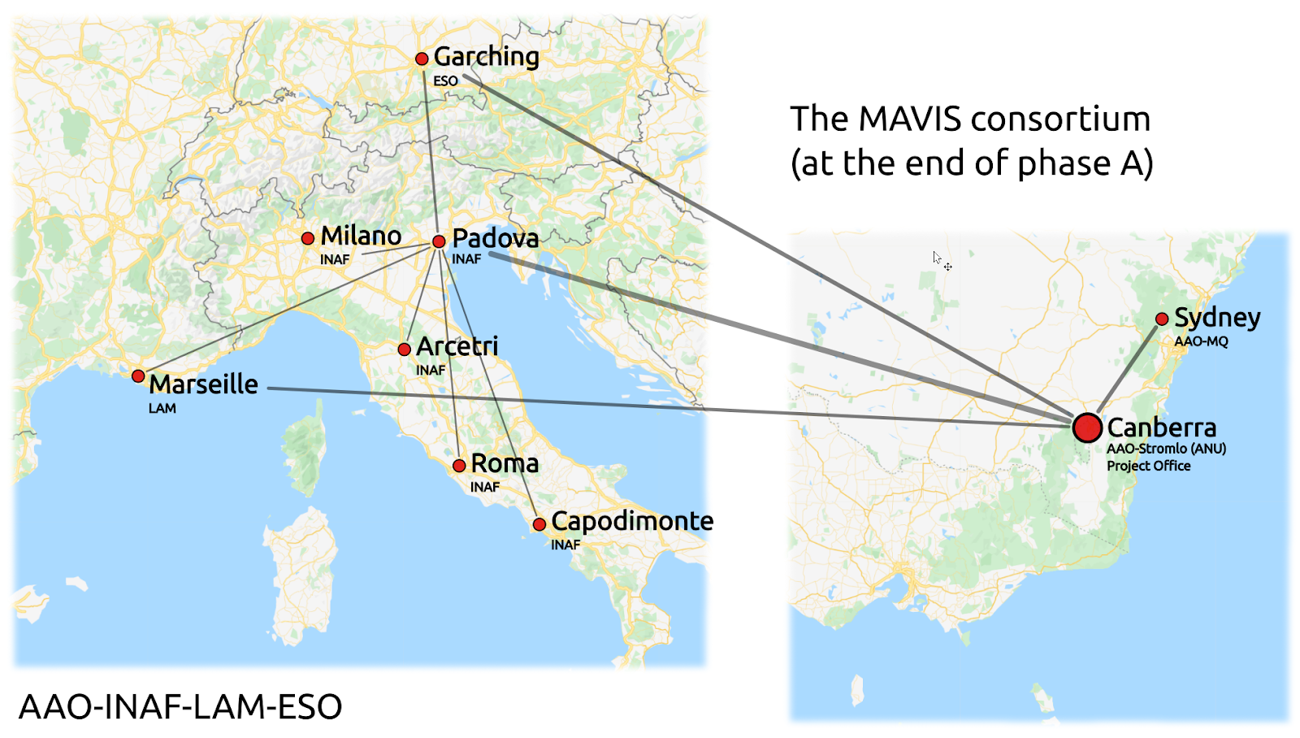

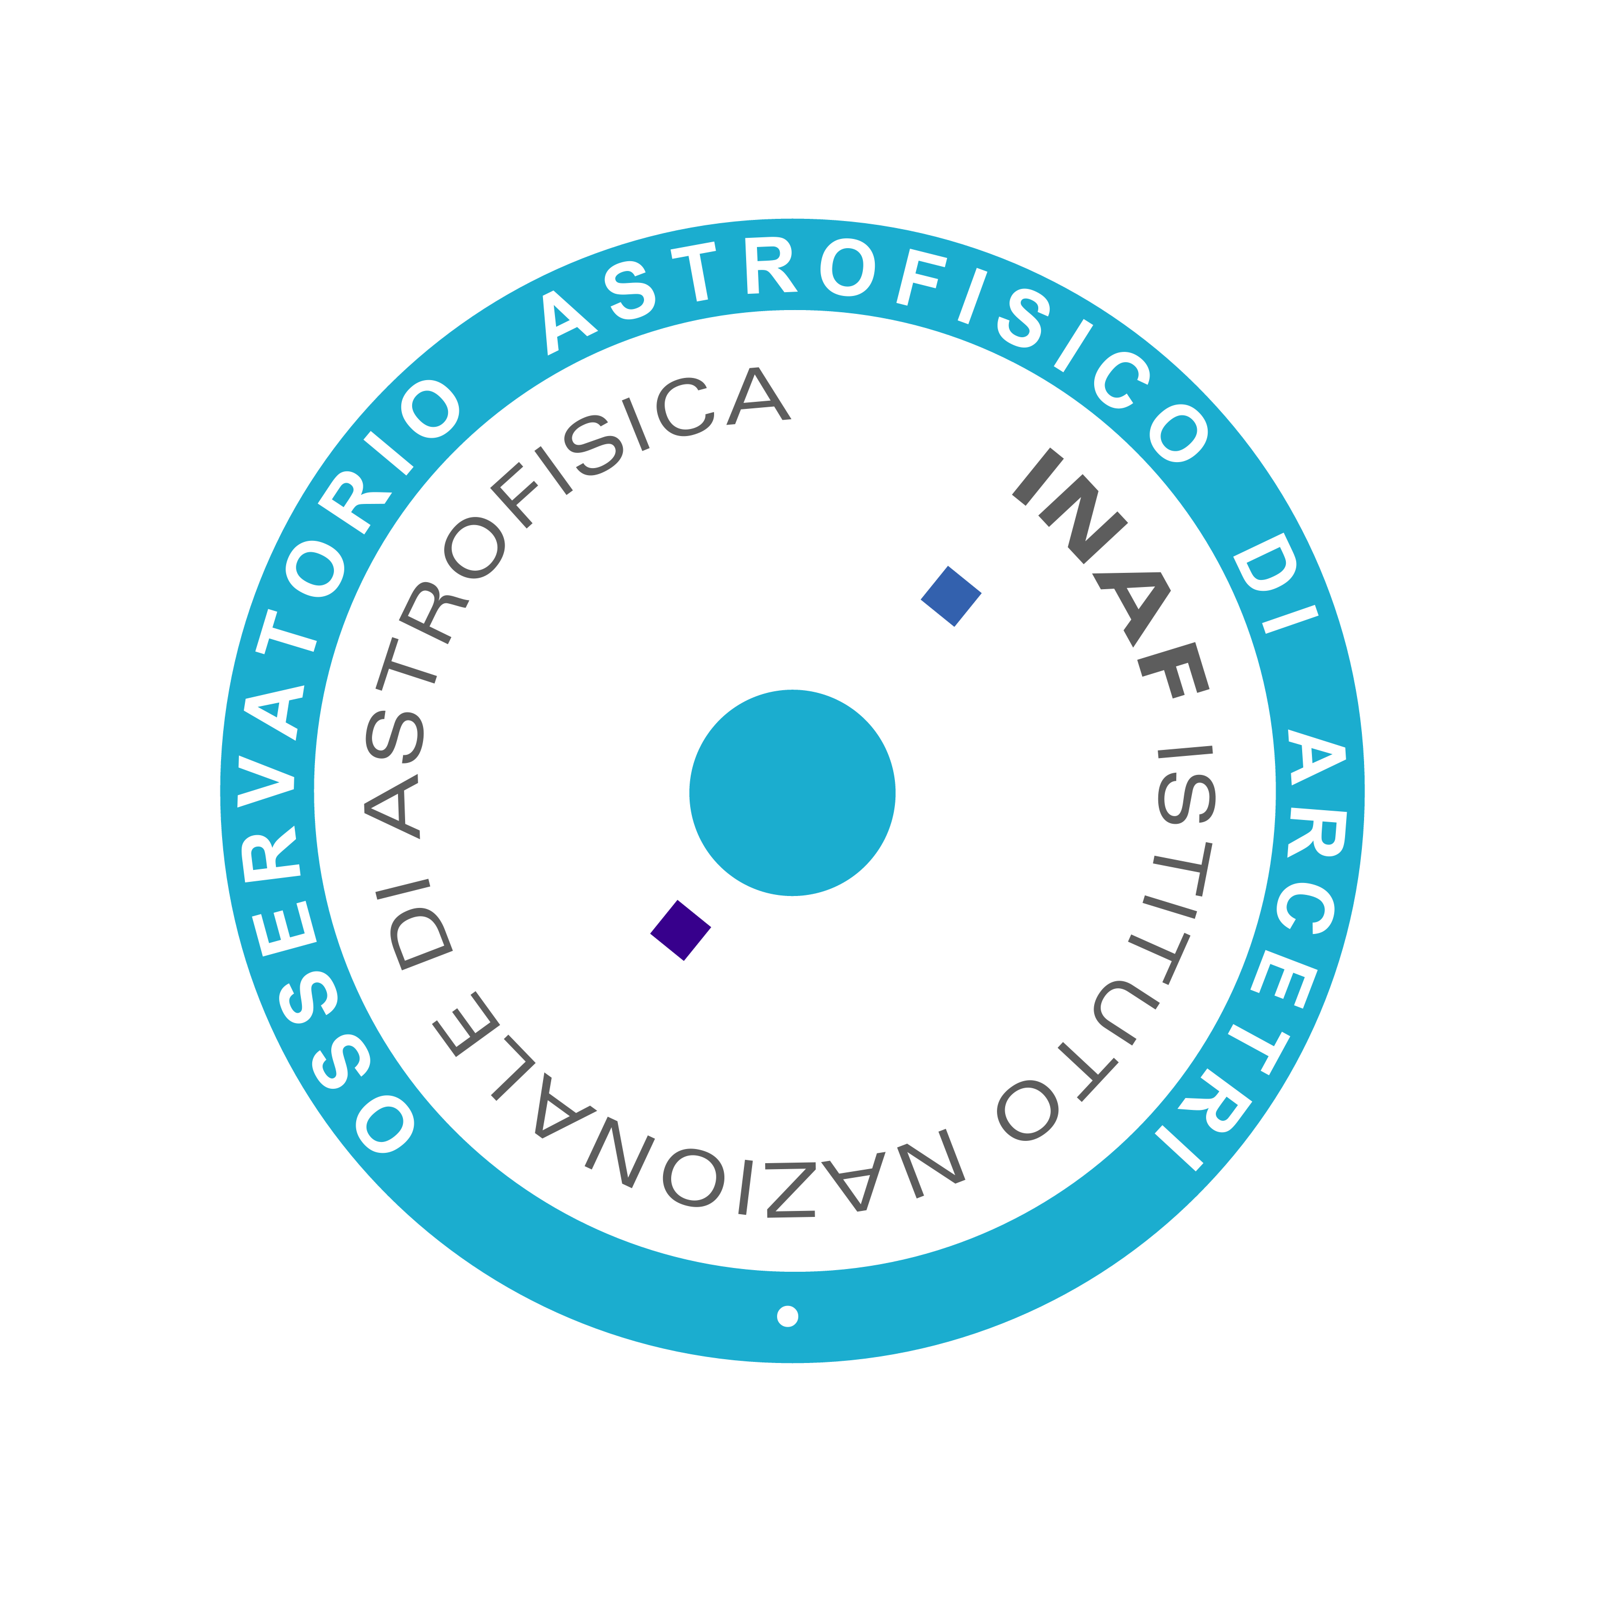



MAVIS CONSORTIUM
Project Structure
PI: F. Rigaut
(Astralis)
Mavis overview
First Australia-led ESO-VLT facility instrument
Workload split ~50-50 Australian/European partners

Slide 7
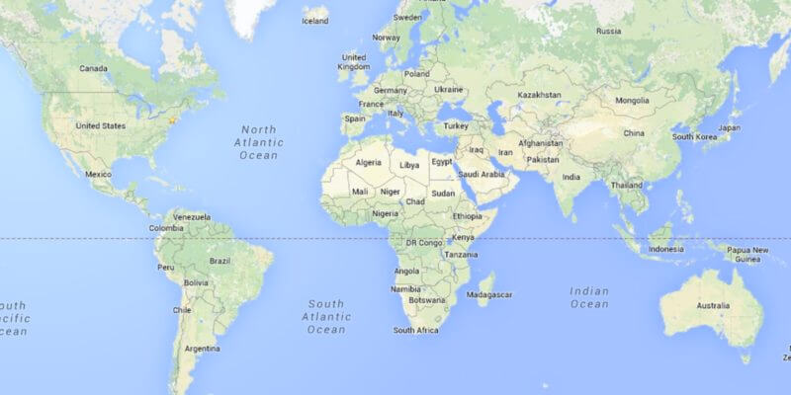
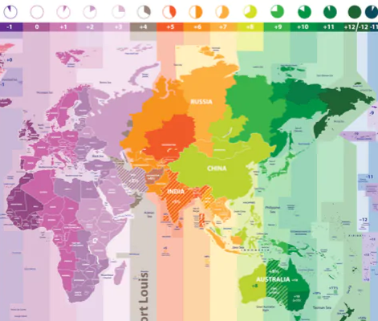
MAVIS CONSORTIUM
Project Structure
~10h time difference!

Slide 8
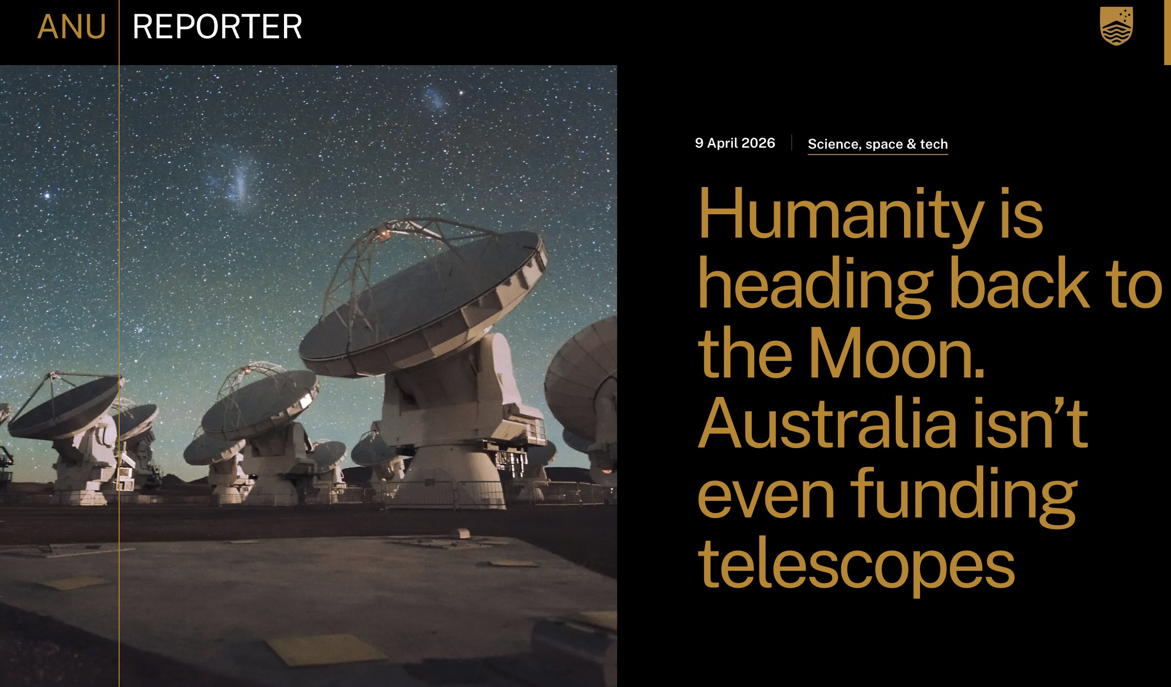


MAVIS CONSORTIUM
Project Structure
Australia’s Governament decided to not to pursue full membership with the ESO once the current Strategic Partnership ends in 2027
MAVIS AUS funding are independent of
Australia ESO membership

Slide 9
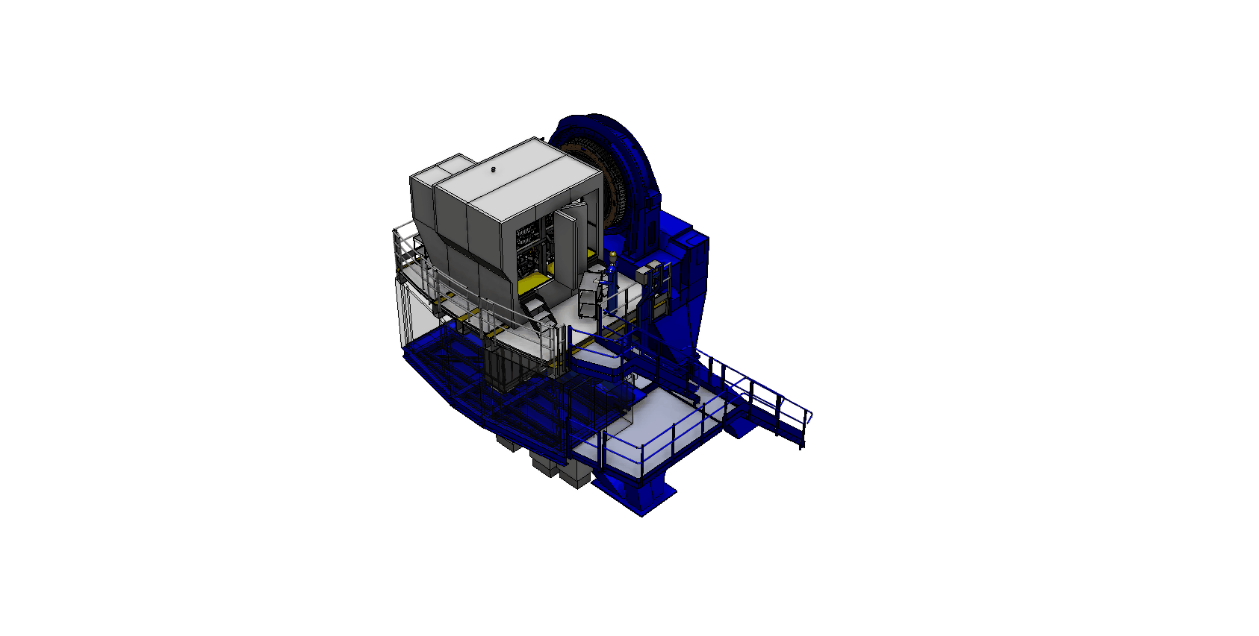

What is MAVIS
MAVIS in one slide
DSM
4LGSF
Uses VTL UT4 AO Facility
Existing deformable secondary (+2 post-focal DMs)
4x2 existing laser guide star facility
3 Near-IR NGS Wavefront Sensors
CAO
SSISTED
AO Module
Visible (VRI, UB goal)
30”x30” field of view corrected
FWHM ≈ 18mas (V band)
Strehl ratio ≈ 15% (V band)
Sky coverage ≈ 50% @ Gal. pole
ISIBLE
Credit ESO
IFU Spectrograph
image slicer IFU
25 mas and 50 mas spaxels
  2.5’’x3.6’’ and 5’’x7.2” FoV
R~5000 and ~12000
𝜆 = 370-950 nm
4 interchangeable VPH gratings
MAGER &
Imager
30”x30” FoV, 7.3 mas pixel
U-z bands (Diffraction limited V-z)
4Kx4K pixels
Wide + narrow band filters
V=29.5 in 1 hr (5 𝜎)
PECTROGRAPH

Slide 10
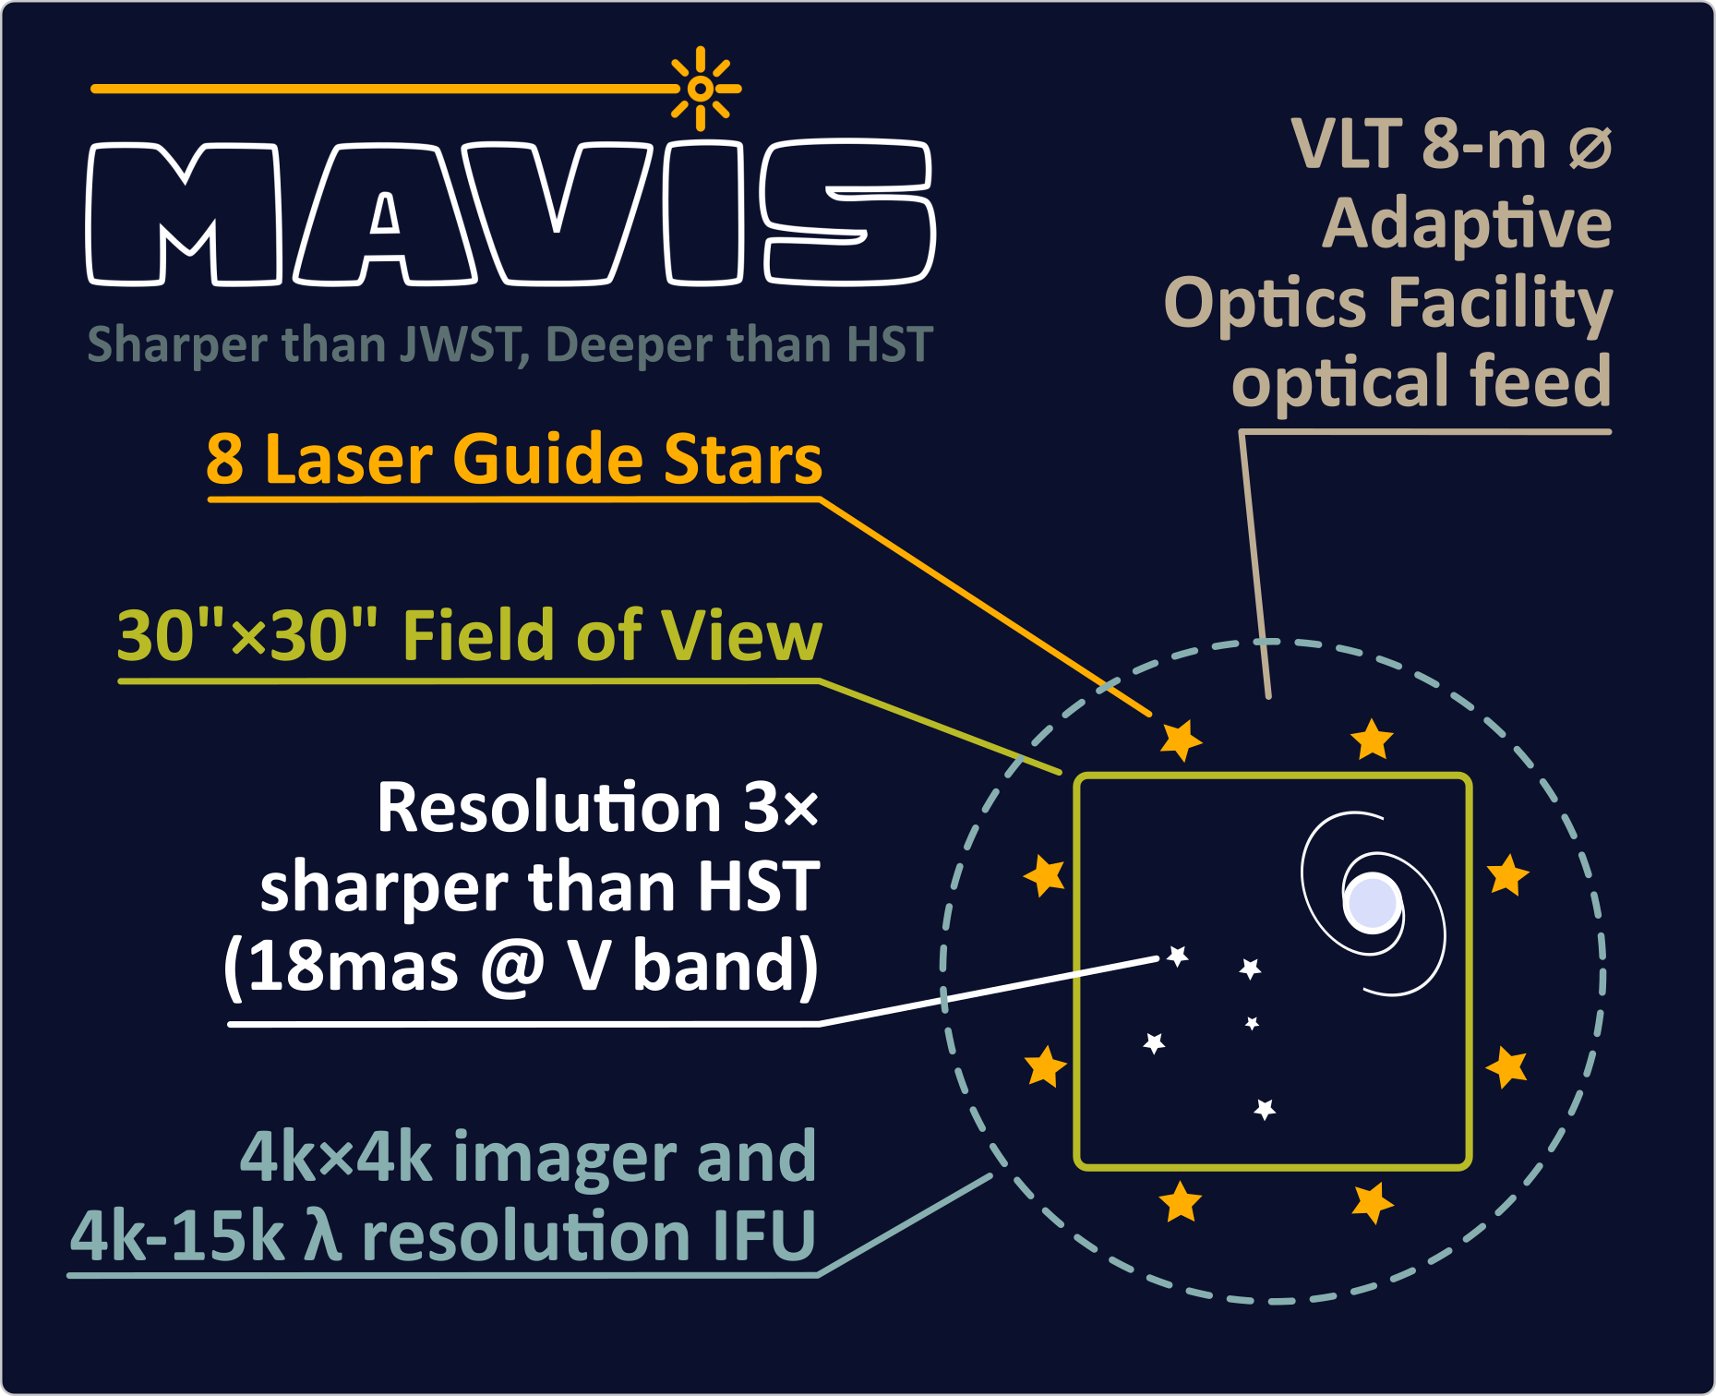
The MAVIS focal plane

Slide 11
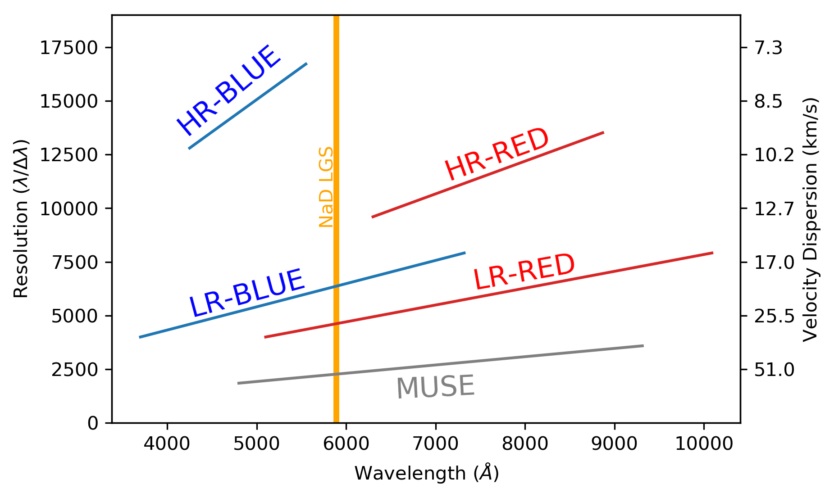
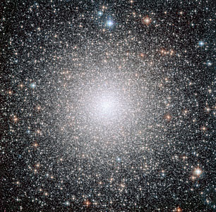
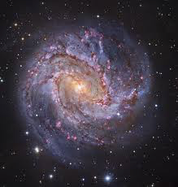
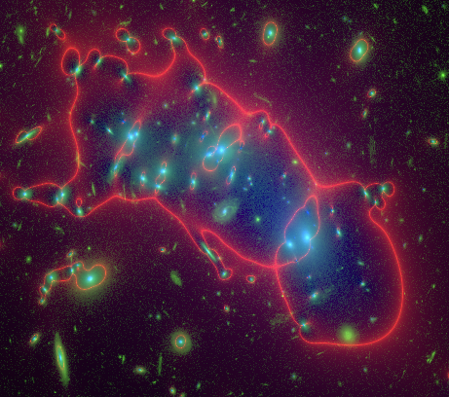
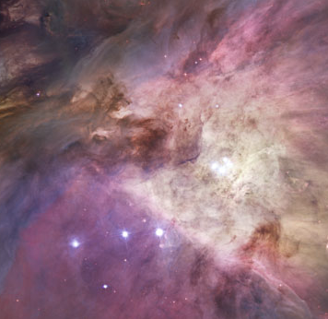
IFU Spectrograph
MAVIS components
Stellar abundances in crowded fields
Radial velocities of stars and gas < 1km/s
Evolution of ISM turbulence in galaxy disks
IMBHs
Ionised gas properties
Hot/Massive stars, young stellar populations
Extreme Metal Poor stars
Evolution of ISM chemistry
Stellar dynamics z<1
Ly⍺ sources at z>6.6
4 different gratings to cover the whole
3700-9500 Å band
optimized for different science requirements

Slide 12
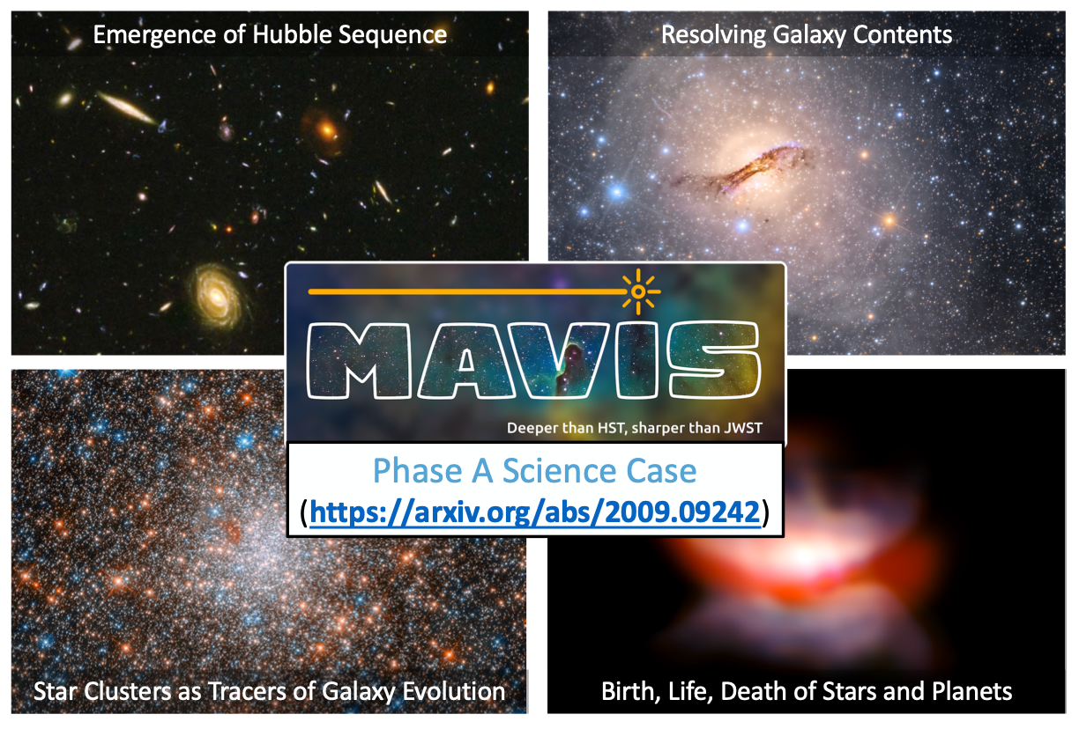
MAVIS Science

Slide 13
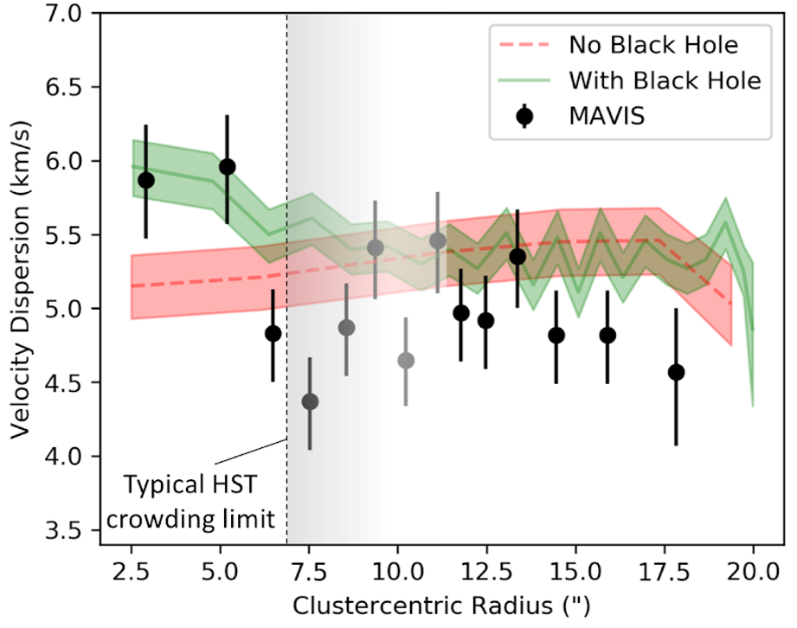
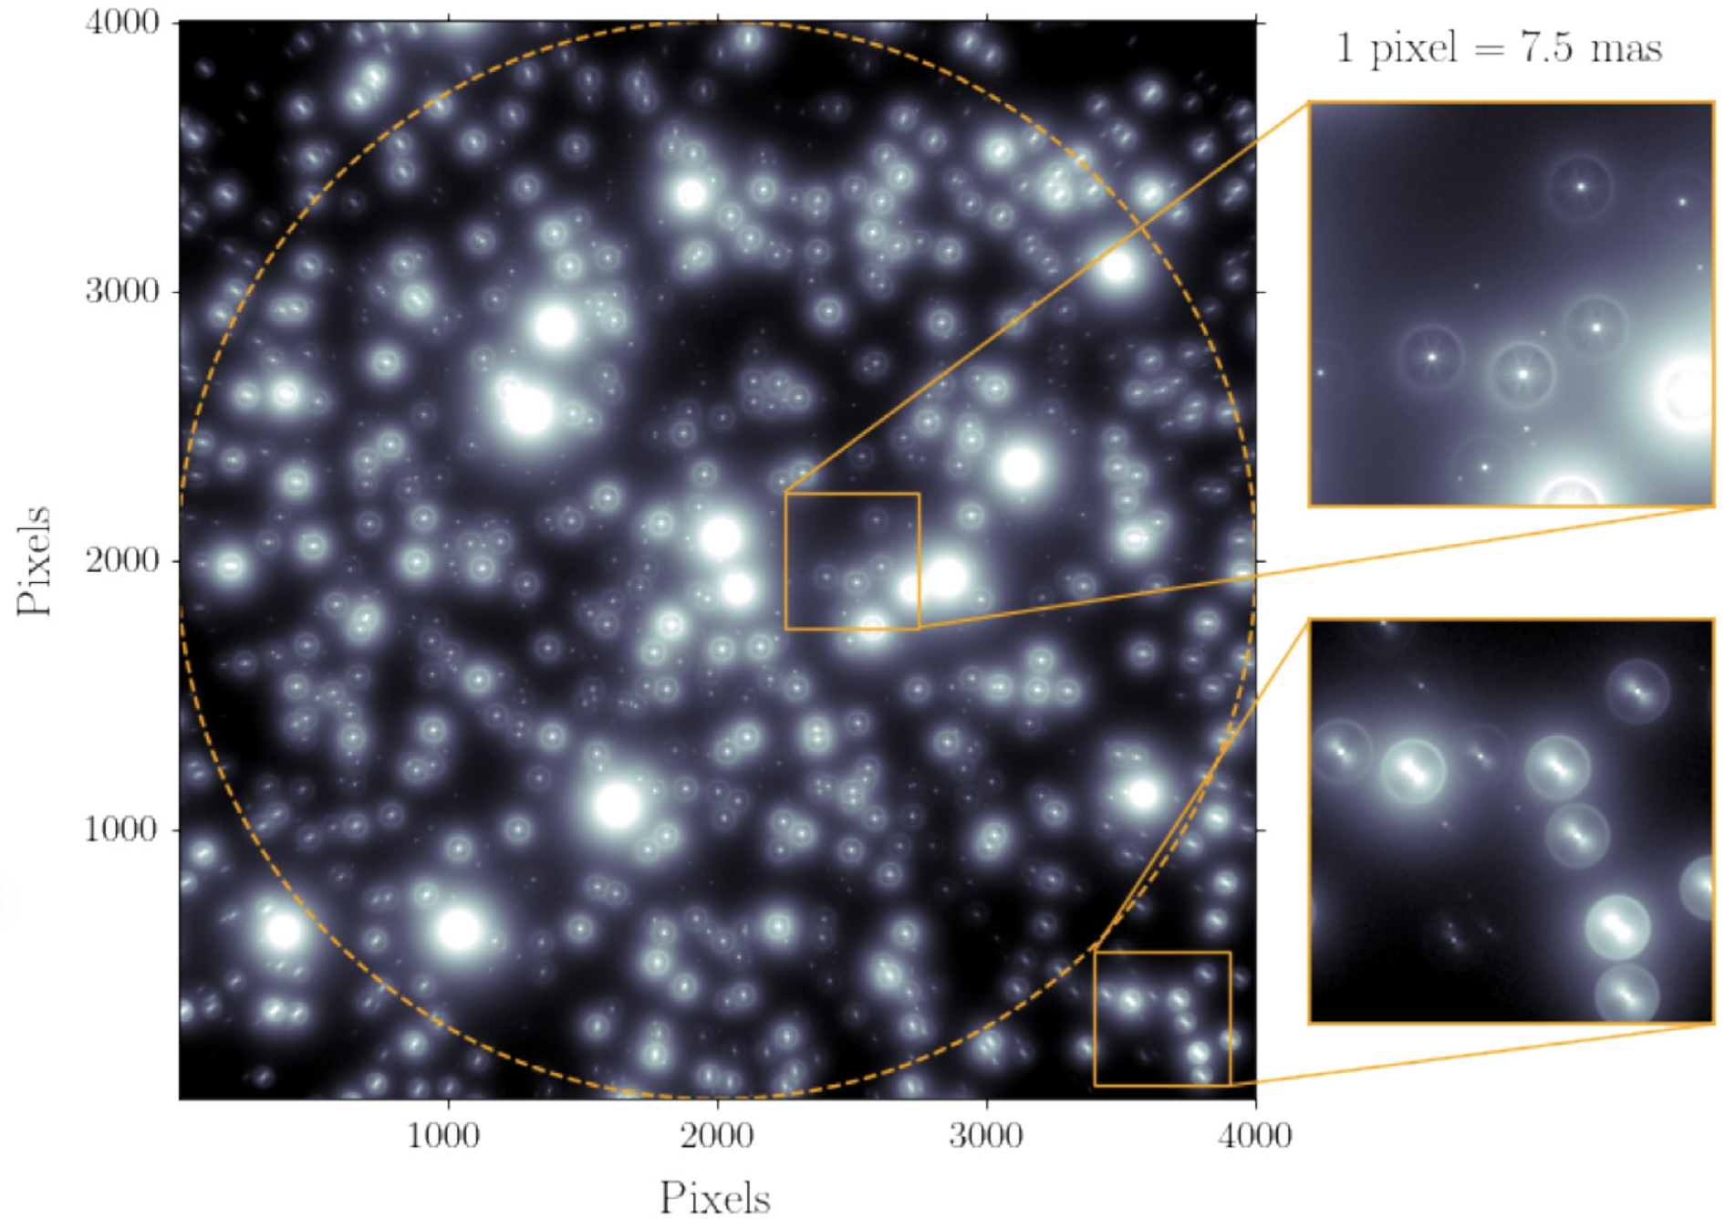
DETECTING INTERMEDIATE MASS BLACK HOLES
MAVIS Science
Cluster N-body Simulation: Baumgardt (2017)
Image Simulation and Analysis: Monty et al. (2021)
Dense star clusters are prime hunting ground for intermediate-mass black holes
HST crowding limit is typically larger than IMBH sphere of influence: MAVIS astrometry can break this limit
Constrains: instrument+PSF stability, astrometric calibration, PSF reconstruction

Slide 14
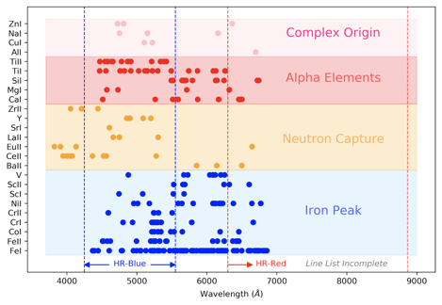
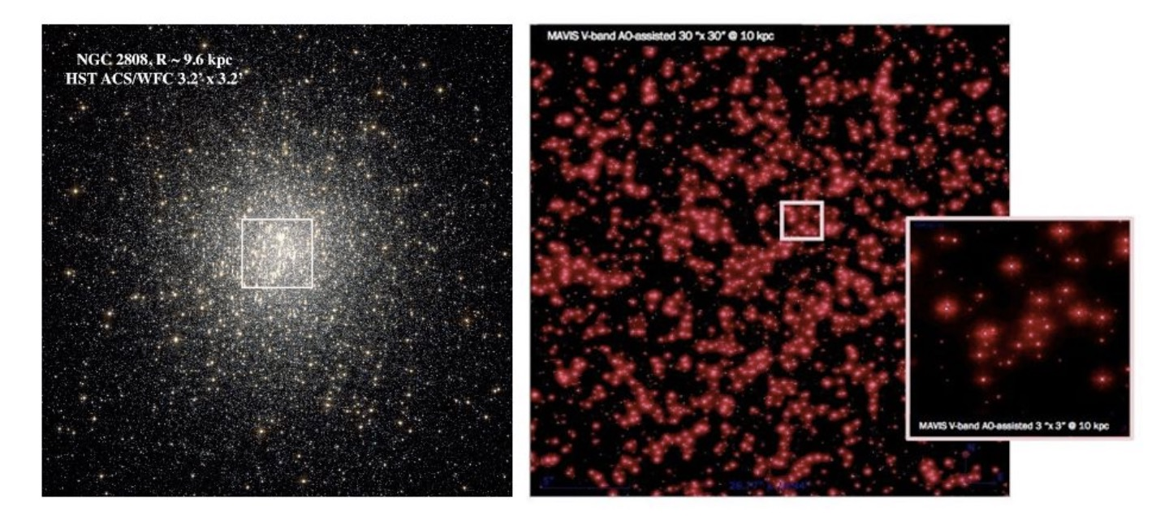
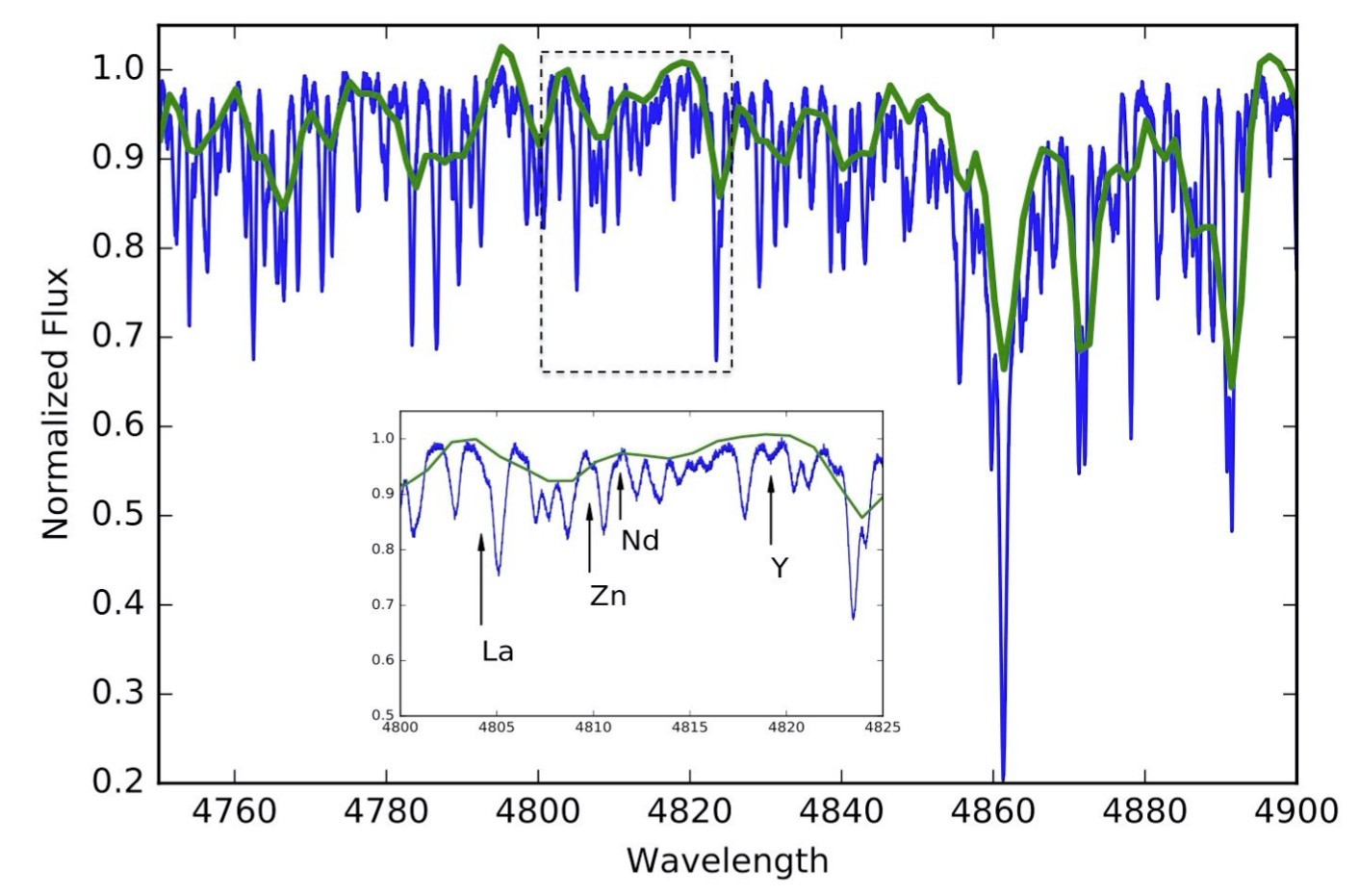
Globular clusters as tracers of galaxy evolution
MAVIS Science
MAVIS provides detailed chemical abundances of star cluster cores, oldest and most complex environment
HR Blue mode optimized for rich range of diagnostic abundances
Cannot be done at lower resolution (spatial or spectral)
MAVIS
MUSE

Slide 15
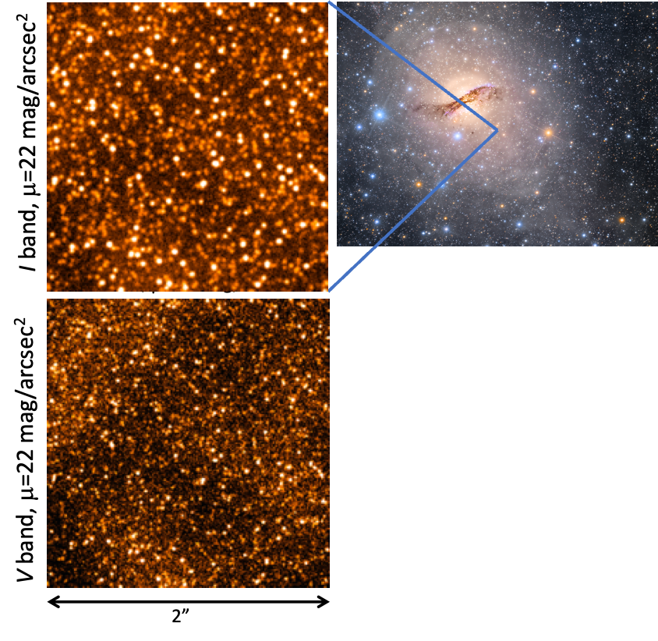
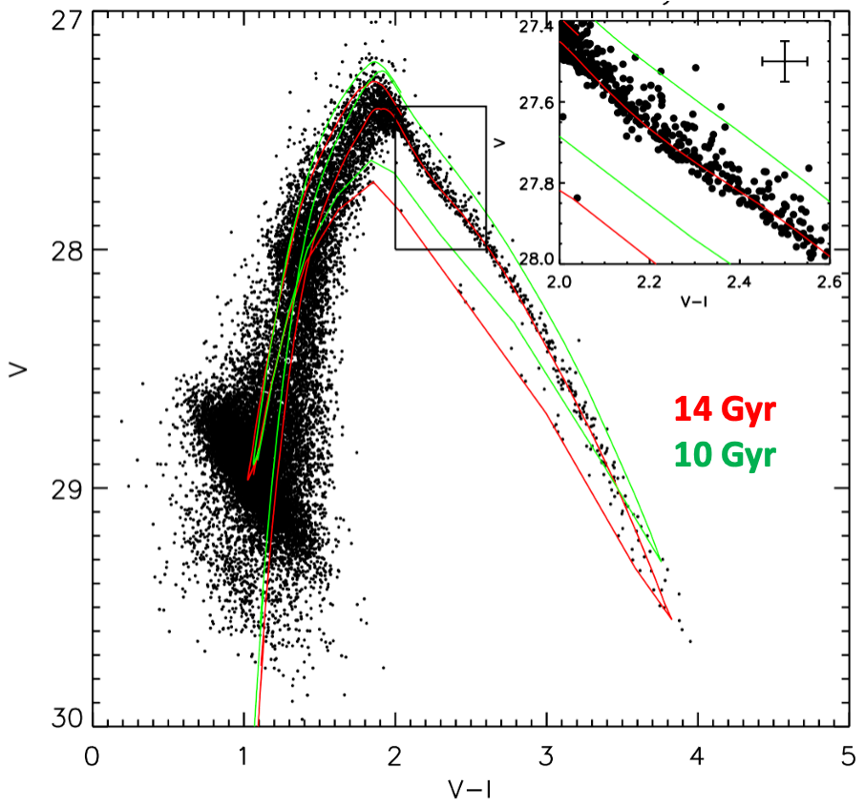
RESOLVED STELLAR POPULATIONS IN DISTANT GALAXIES
MAVIS Science
Resolved stellar populations can probe accurate star formation histories, even for ancient stars
MAVIS will detect T-RGB stars as far as the Virgo Cluster
Notes:
LeftandCentre:V​ -andI- band thumbnails of the more crowded 2Re pointing shown in Fig.3.3. Right: derived CMD from the full MAVIS field, showing that the 14 Gyr (red) and 10 Gyr (green) isochrones can be clearly distinguished. Such age fidelity from integrated light spectroscopy is prohibitively expensive in the lower-surface brightness outer regions, even with MUSE.

Slide 16
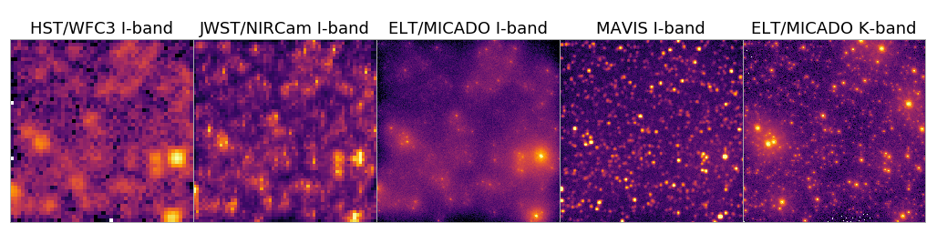
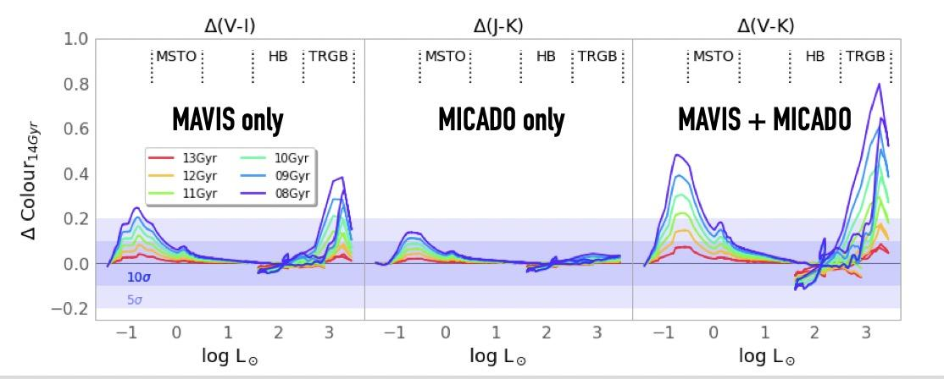
RESOLVED STELLAR POPULATIONS IN DISTANT GALAXIES
MAVIS Science
JWST and ELTs are not well-optimized for λ <1μm
MAVIS is crucial to provide optical coverage at matched angular resolution to ELT in the near-infrared
Sensitivity to Age

Slide 17
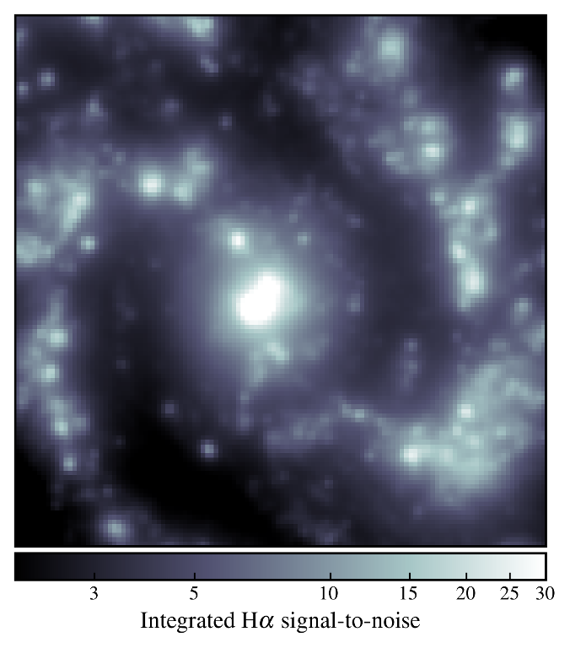
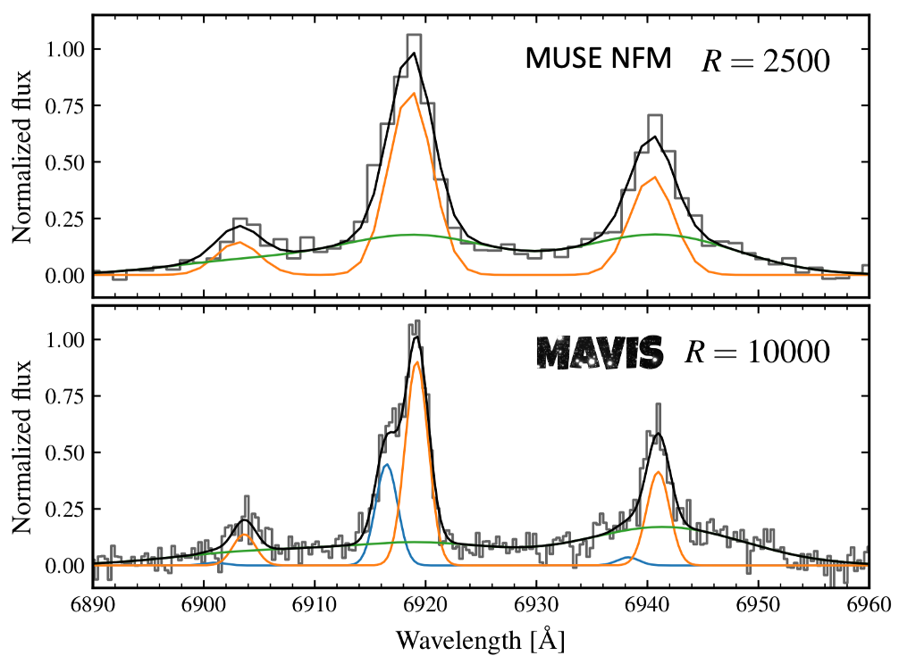
CHARACTERIZING ISM DYNAMICS OF GALAXIES AND AGN
MAVIS Science
Simulated z=0.3 spiral galaxy with MAVIS IFU
Credit: Trevor Mendel
Disks are much more ‘turbulent’ at early times
Dynamical turbulence? Outflows/winds? Beam smearing?

Slide 18
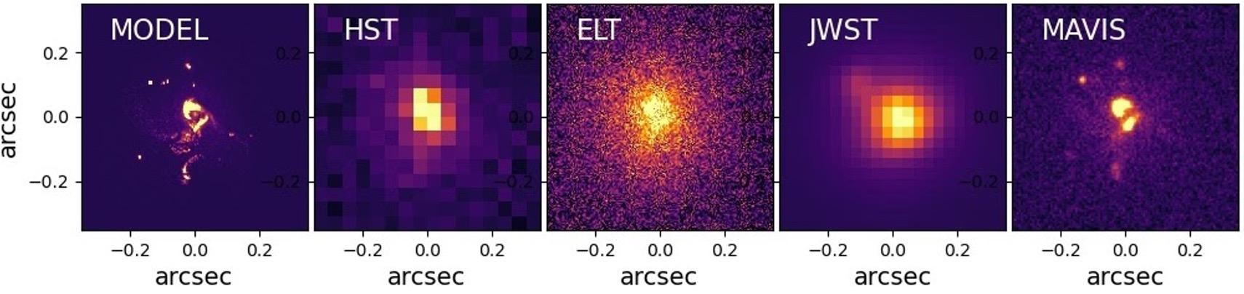
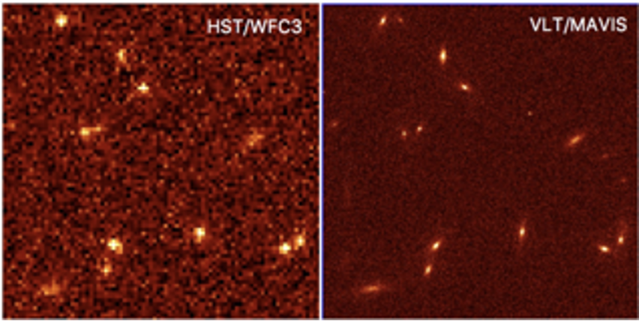
GALAXY REST-FRAME UV MORPHOLOGIES
MAVIS Science
I band imaging of a simulated galaxy at z~5 from Pallottini et al. (2017)
MAVIS will allow the deepest optical images ever taken
Crucial for understanding the UV morphology of the faintest galaxies at high redshift

Slide 19
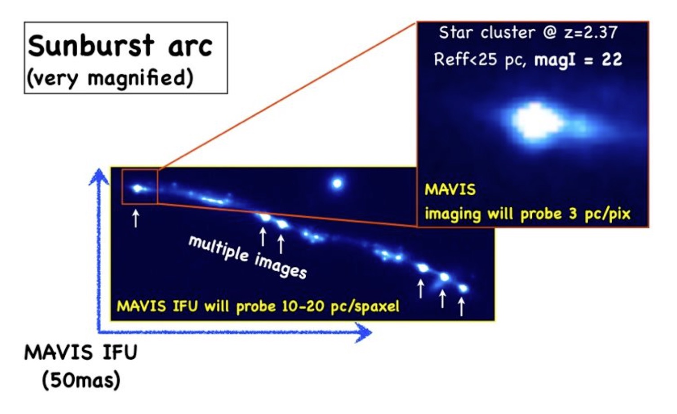
PROBING EPOCH OF REIONISATION WITH LENSING
MAVIS Science
Properties of first star clusters, via lensing
‘Leaky’ IGM in a LyC emitter at z = 3.2
Adapted from Vanzella et al. 2020.
MAVIS can detect UV flux from first star clusters at z~6 via lensing
MAVIS resolution reveals spatial and spectral structure of Lya sources to z~7
Important to understand sources powering reionization at higher redshifts

Slide 20
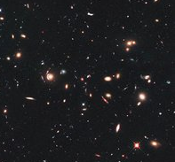
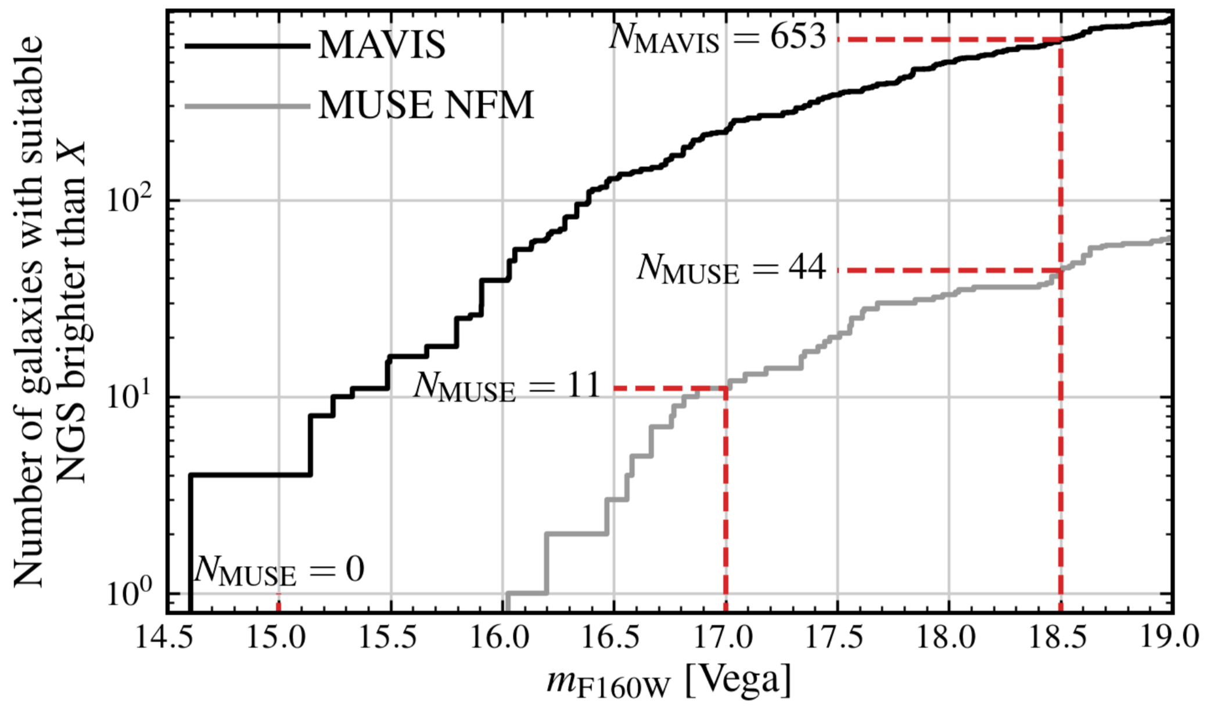
Sky Coverage
MAVIS Science
1’ portion of CANDELS UDF
Use Case: No. of observable intermediate-z galaxies in GOODS-S, COSMOS and UDS with MAVIS and MUSE-NFM as a function of (faintest) NGS magnitude
MAVIS sky coverage gives > 1 order of magnitude more targets
⇒ MAVIS makes statistical samples possible

Slide 21
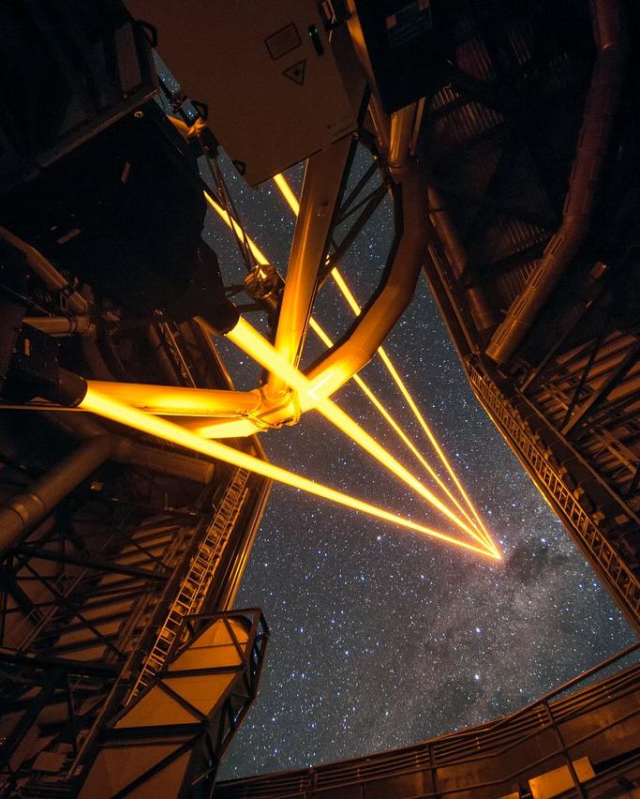
Timeline and GTO
Project Status
FDR in October 2025
First procurement starting in September
Estimated first light ~2031 (x1.5 Luca factor?)
150 GTO nights awarded to the consortium (~50/50 FTE Italy and Australia) + 44 extra night for spectrograph hardware to Astralis
GTO, Collaboration and Publication Policy under discussion:
  Shared programs among the consortium to maximise GTO scientific return
  PIships weighted based on GTO share of each partner
Notes:
3046

Slide 22
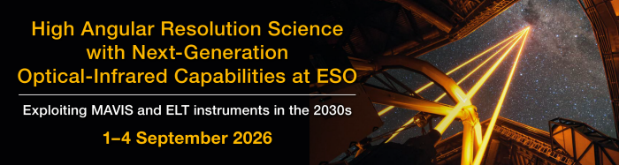

MAVIS+ELT conference at ESO
MAVIS and ELT complementarity
Abstract Submission Deadline: 12 July
Info: https://www.eso.org/sci/meetings/2026/MAVIS2026.html

Slide 23
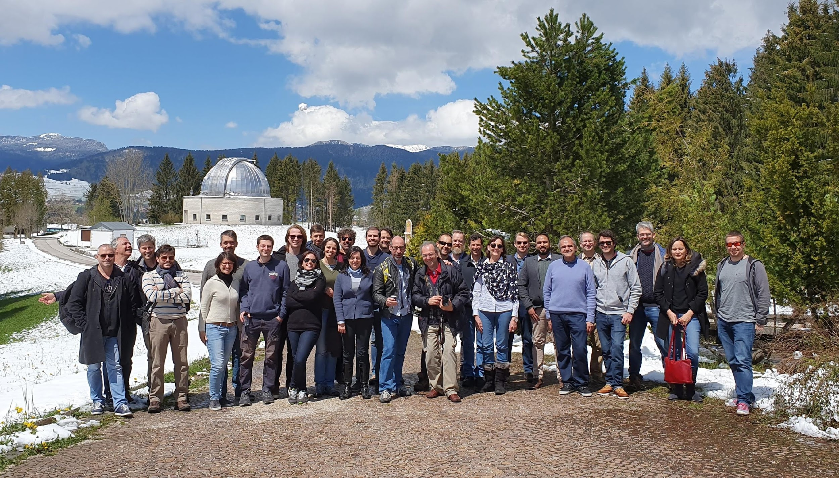
Conclusions
Diffraction limit optical imaging and spectroscopy is coming
A joint Australian, Italian and French effort in technology and science
A new discovery window: sharper than JWST, deeper than HST
A unique, multipurpose instrument, complementary to forthcoming ELT facilities
Expected first light ~2031
Interested? Want more info?
Science case: https://arxiv.org/abs/2009.09242
email: project-scientist@mavis-ao.org
richard.mcdermid@mq.edu.au giovanni.cresci@inaf.it

Slide 24

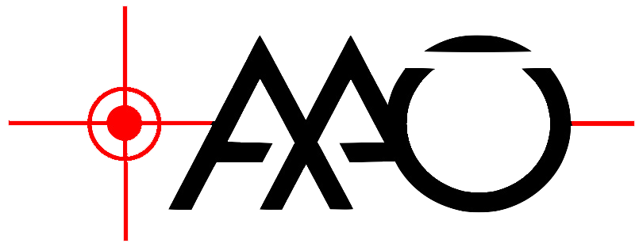





MAVIS CONSORTIUM
MAVIS Overview
PI: F. Rigaut
(Astralis-AITC)
(ASTRALIS
Instrumentation Consortium)
AO system engineering
& numerical simulations
Opto-mechanics
Instrument Software
NGS WFS
10h time difference!
Project Office (AITC)
LGS WFS, AO expertise
RTC & AO control
Post-focal instrumentation:
Imager, spectrograph,
IFU front-end
Observatory interfaces, LGSF, Deformable Mirrors
Post-processing
AO expertise

Slide 25
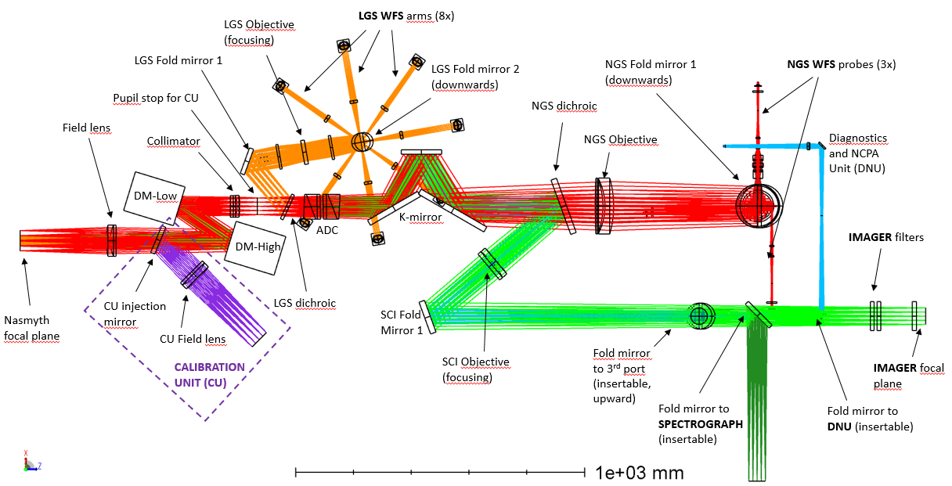
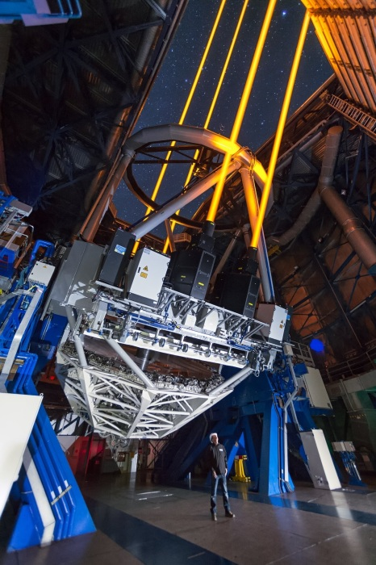
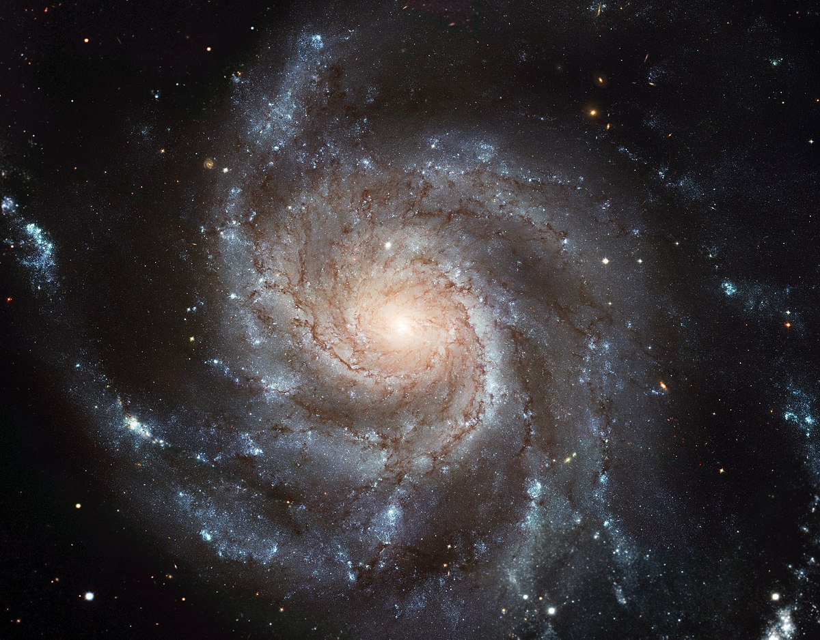
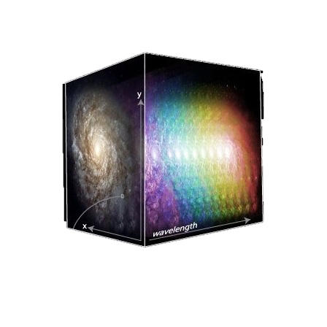
MAVIS – where the light goes
VLT Adaptive Optics Facility
Imager
IFU

Slide 26
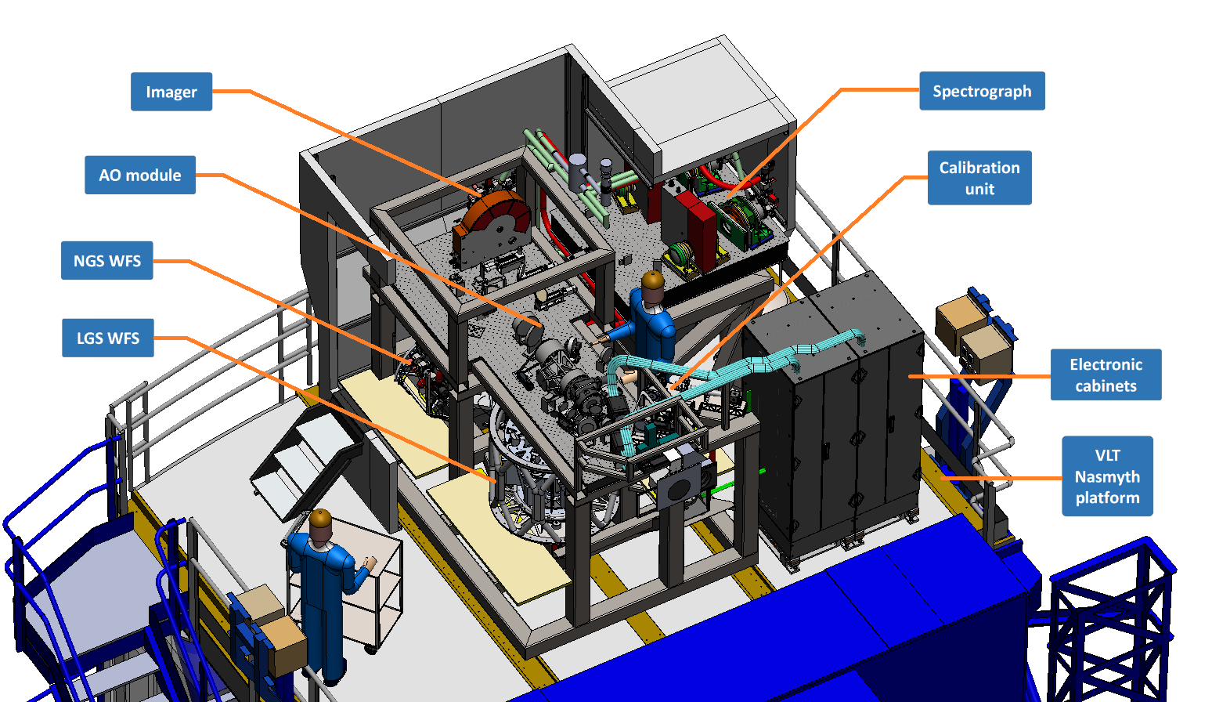
MAVIS Overview
8 LGSs WFS
40×40 sub-aps
r=17.5”
3 NIR NGSs WFS
1×1/2×2 sub-aps
patrol FoV r=60”
3 Deformable mirrors (DSM + 2 post focal DMs);
Each lasers splitted in 2 to get 8 laser sources

Slide 27
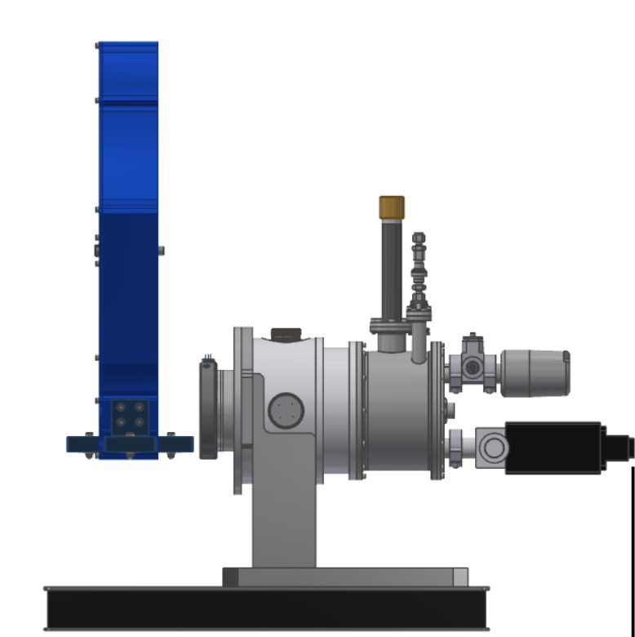
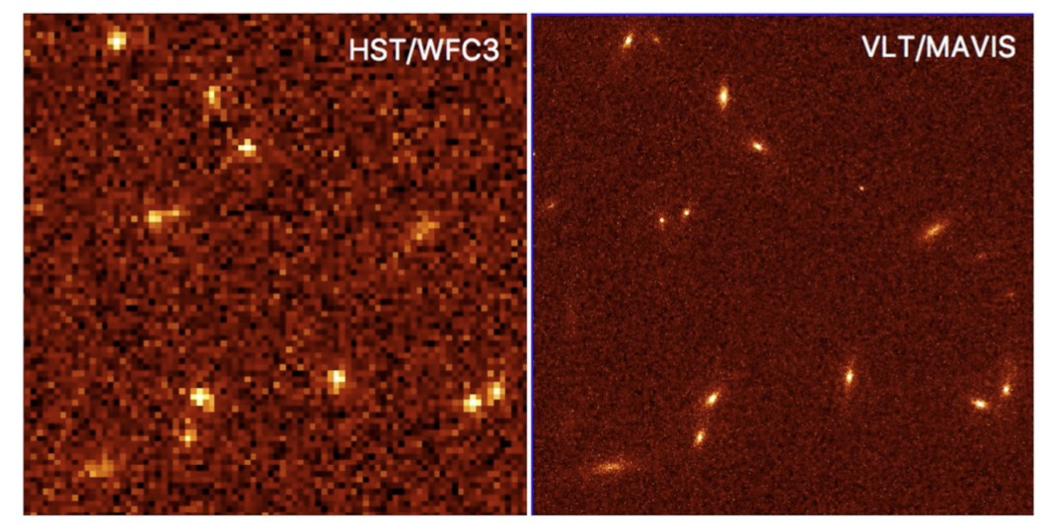
Imager
MAVIS components
30”x30” FoV with 7mas pixel (to sample diffraction limit at 550nm)
U-z coverage (Diffraction limited imaging V-z)
> 10% Strehl (goal 15%) at V band
50% sky coverage @ South GP for 15% encircled energy in 50 mas spaxel
5-sigma limiting mag in 1 hour V = 29
Wide + narrow band filters
In 10 hours, MAVIS can reach a 5σ limiting mag of ~30.4 AB in the I band.
​This is about 1 mag deeper than the HST UDF in i775 ​(96h)
A simulated MAVIS Deep Field
Notes:
The pixel size is chosen to sample properly the diffraction limit at 550 nm. The FWHM of a diffraction limited Airy pattern at 550 nm is 14.18 mas for an 8 m telescope, but in fact the effective PSF will be larger than this due to the effects of charge diffusion within the CCD (whereby some fraction of photoelectrons are collected in adjacent pixels due to scattering as the electrons move towards the pixel), and also residual tip-tilt errors.

Slide 28
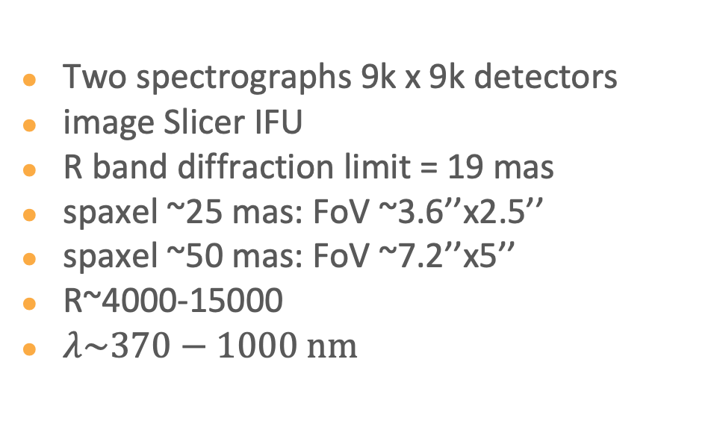


IFU Spectrograph
MAVIS components
Notes:
Volume phase holographic gratings are now being used extensively in astronomy because of their high diffraction efficiencies. VPH gratings are generally used in transmission. The diffraction is caused by a near-sinusoidal variation in refractive index perpendicular to the fringes (300-6000 lines/mm). For astronomy gratings, the active layer is typically 3-10 microns thick, which is sandwiched between glass substrates of a few millimetres in thickness. Prisms can be attached to reduce beam deviation (VPH grisms).

Slide 29

IFU Spectrograph
MAVIS components
Point source sensitivity estimates for MAVIS spectrograph modes
Includes chromatic PSF effects, assumes good conditions

Slide 30


Resolving complexity in distant galaxies
MAVIS Science
LMC as viewed from a large distance (48 Mpc)
LMC
0.4 “/pix
0.2 “/pix
0.1 ”/pix
45 mas/pix
7 mas/pix
(adapted from Kollmier et al. 2017)
No Adaptive Optics
Current AOF
Hubble Space Telescope
MAVIS

Slide 31

CHARACTERIZING ISM DYNAMICS OF DISK GALAXIES
MAVIS Science
Adapted from Wisnioski et al. 2015.
Simulated z=0.3 spiral galaxy with MAVIS IFU
Credit: Trevor Mendel
Time Since Big Bang (Gyr)
Disks are much more ‘turbulent’ at early times
Dynamical turbulence? Outflows/winds? Beam smearing?

Slide 32

MAVIS schedule
MAVIS Project
Passed Phase B April 2023, Final Design Review in Oct. 2025
first light expected Q3~2031
in line with ELT expectations
You are here!

