Slide 1

Project Management Challenges in ANDES: Italian Coordination and Leadership
-
P. Di Marcantonio (INAF-OATs) on behalf of ANDES Project

Slide 2

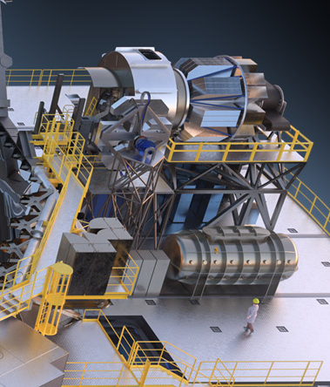

ELT instruments landscape
METIS
Imager L,M,N band
Single slit spectrograph
IFU @R=100,000
MOSAIC
Multi-obj. spectrograph
300 fibers + 8 IFUs
R=5000 – 20,000
0.4-1.8 μm
PCS
HARMONI
IFU spectrograph 0.8-2.5 μm
R from 3500 to ~10,000
Spaxels: 4mas to 25mas
MORFEO
MCAO module
Clients:
MICADO + HARMONI
2 extra DMs
MICADO
Imager 0.8-2.5 μm
FoV 53”x53” @4mas/pix and 20”x20” @1.5mas/pix
Single slit spectrograph
ANDES
High-res spectrograph
R>100,000
U to K
© ESO – J. Vernet

Slide 3
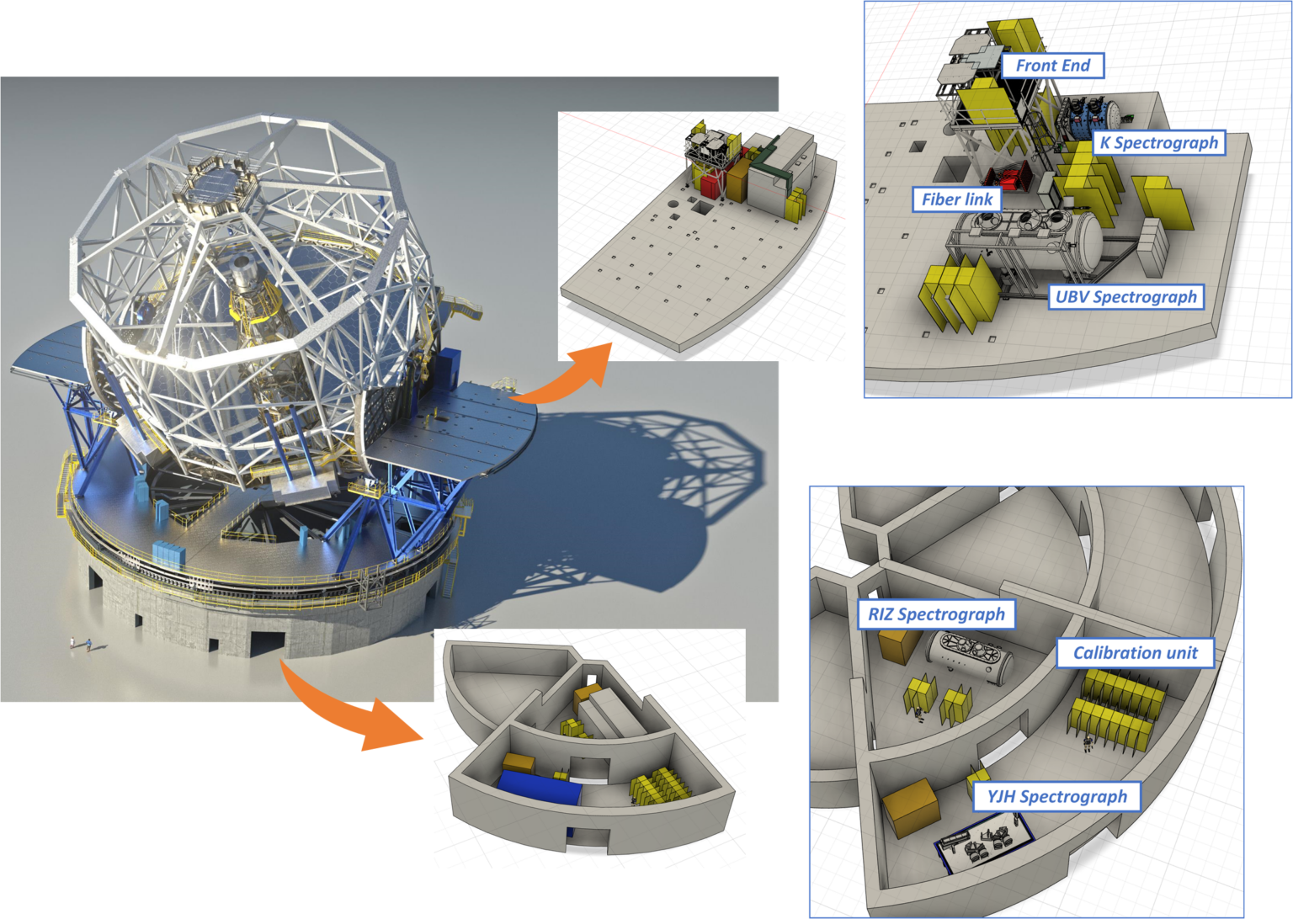
ANDES management challenges
Main challenges @PDR:
self-funded
no financial contribution from ESO; limited support in terms of personnel (PM, SE, IS)
broad scientific requirements
distributed multiple-instrument
  large consortium
  costs and resources issues

Slide 4
Project organisation: the Consortium
The ANDES Consortium is composed by 24 institutes from 13 countries.
Brazil: Federal Univ. of Rio Grande do Norte
Canada: Univ. De Montreal, Herzberg Astrophysics Victoria
Denmark: Univ. Copenhagen, Univ. Aarhus, Danish Tech. Univ.
France: LAM Marseille, LAGRANGE Nice, IPAG Grenoble,
IRAP/OMP Toulouse, LUPM Montpellier
Germany: AIP Potsdam, Univ. Göttingen, Landessternwarte Heidelberg, MPIA Heidelberg, Thüringer Landesternwarte Tautenburg, Univ. Hamburg
Italy: INAF Istituto Nazionale di AstroFisica (Lead)
Poland: Nicolaus Copernicus Univ. in Toruń
Portugal: Inst. Astrofísica e Ciências do Espaço, CAUP Porto, Lisbon
Spain: Inst. Astrofísica de Canarias (IAC), Inst. Astrofísica de Andalucía (IAA - CSIC), Centro de Astrobiología (CSIC-INTA) Madrid
Sweden: Uppsala Univ., Lunds Univ., Stockholm Univ.
Switzerland: Univ. de Genève, Univ. Bern
United Kingdom: Univ. of Cambridge, UK Astronomy Technology Centre, Heriot-Watt Univ.
USA: Univ. of Michigan

Slide 5
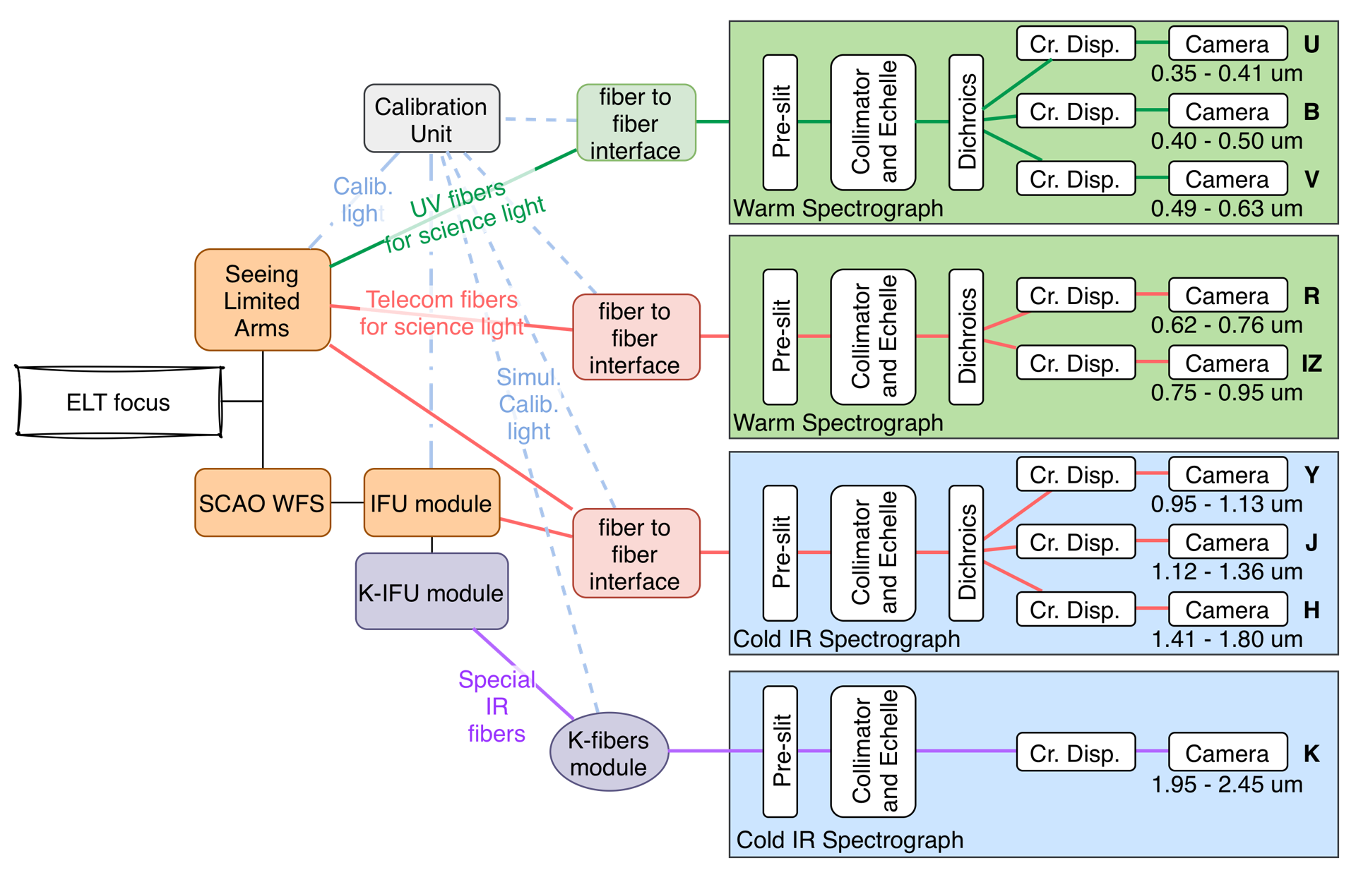
ANDES Inaf involvement
PI / Project Office
Inaf leader
FE
Pt leader
OABr
PM
Inaf leader
IS and SE/SYSTEM
Inaf leader
AO
Inaf leader
OAA
SW
Pt leader
OABr/OATs
OAA
FR / IFU
Inaf leader
OABr/OAA

Slide 6
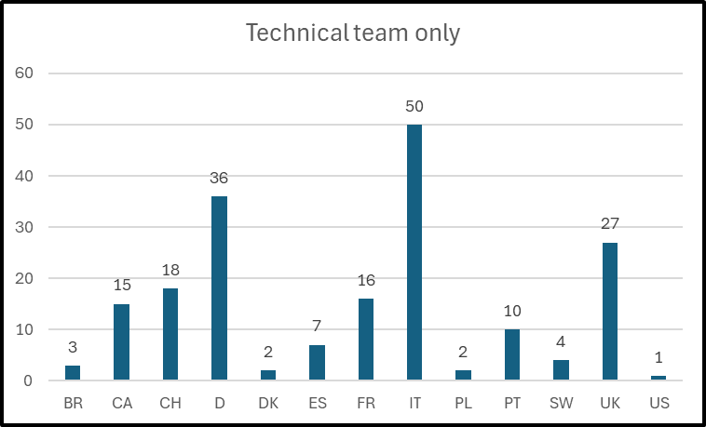
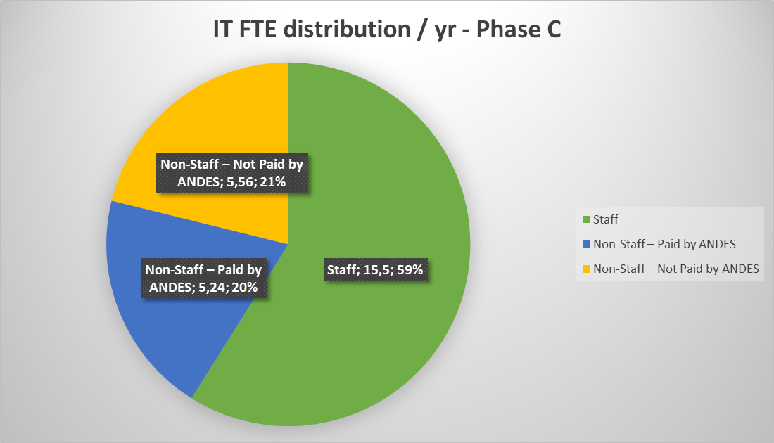
ANDES personnel (technical)
Technical personnel ~ 191

Slide 7
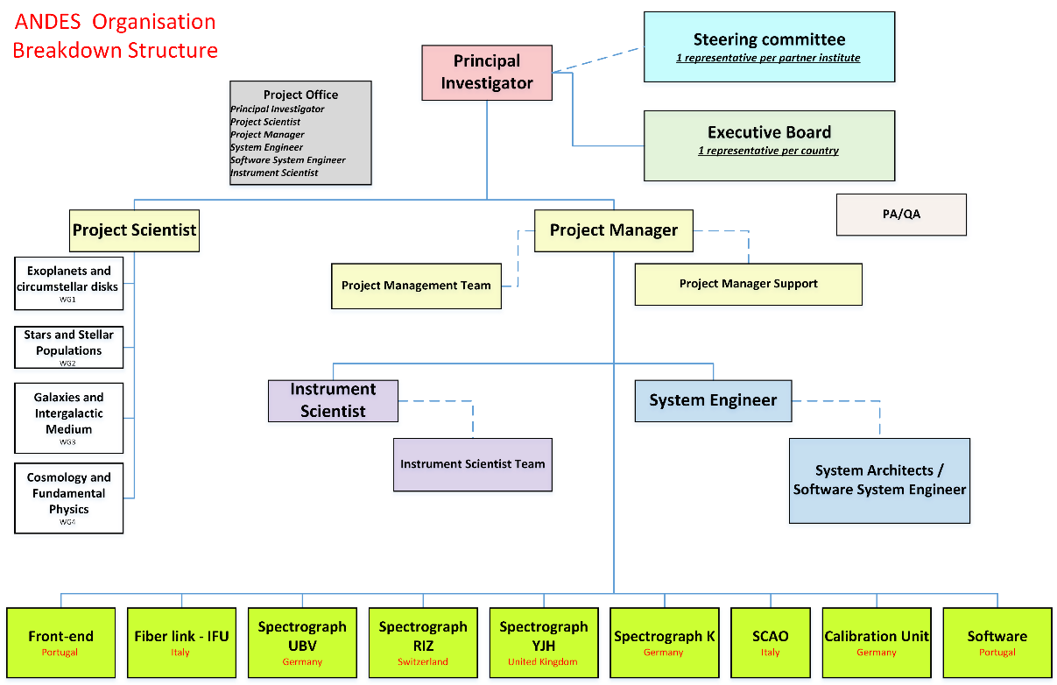
Project organisation: OBS
The ANDES OBS follows the typical organisation chart common in other astronomical projects and at ESO.
governance bodies at institute and at country level
coordinated teams
modularity
7

Slide 8
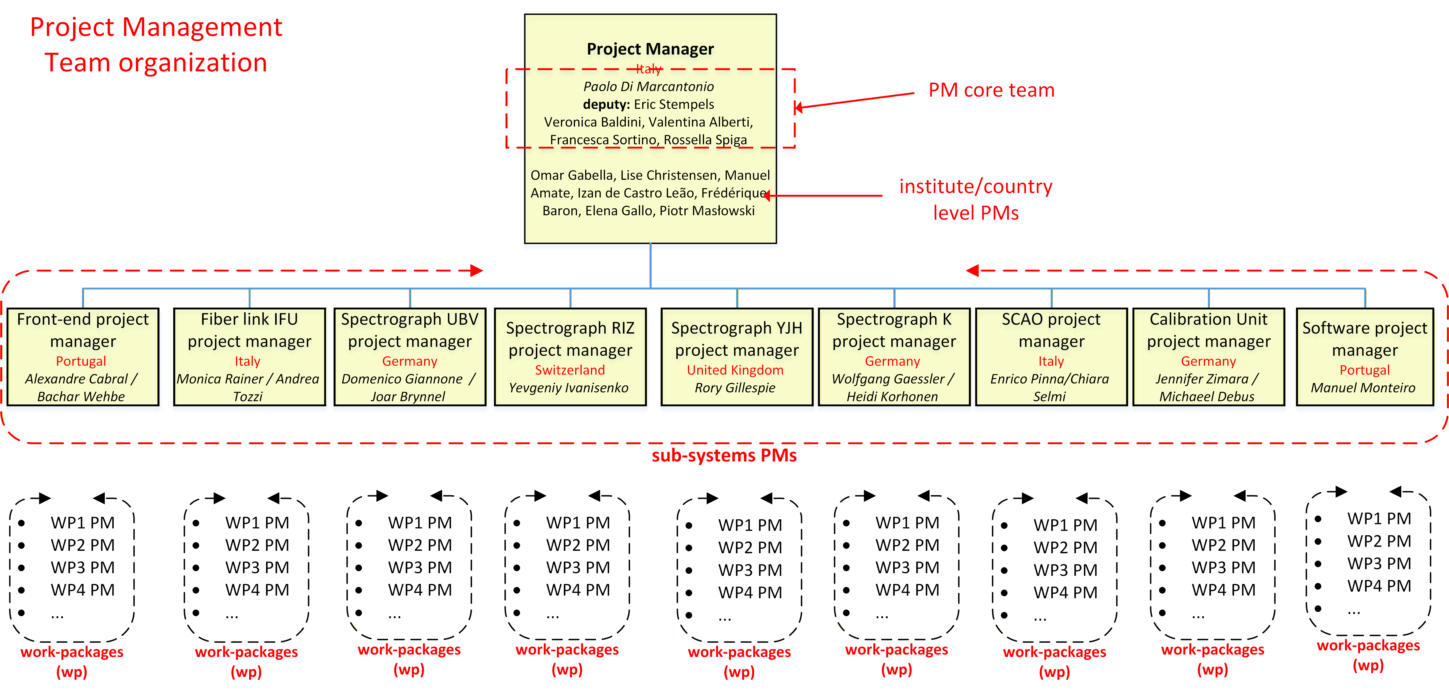
Project organisation: PM team

Slide 9
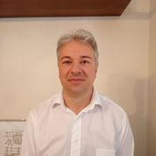

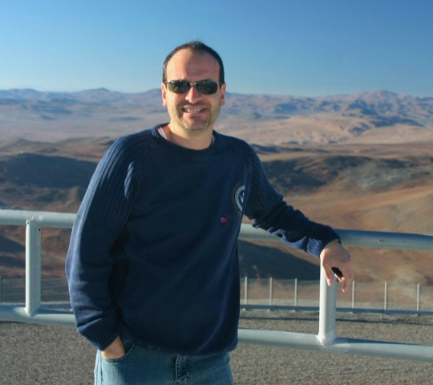

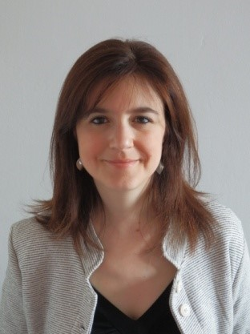

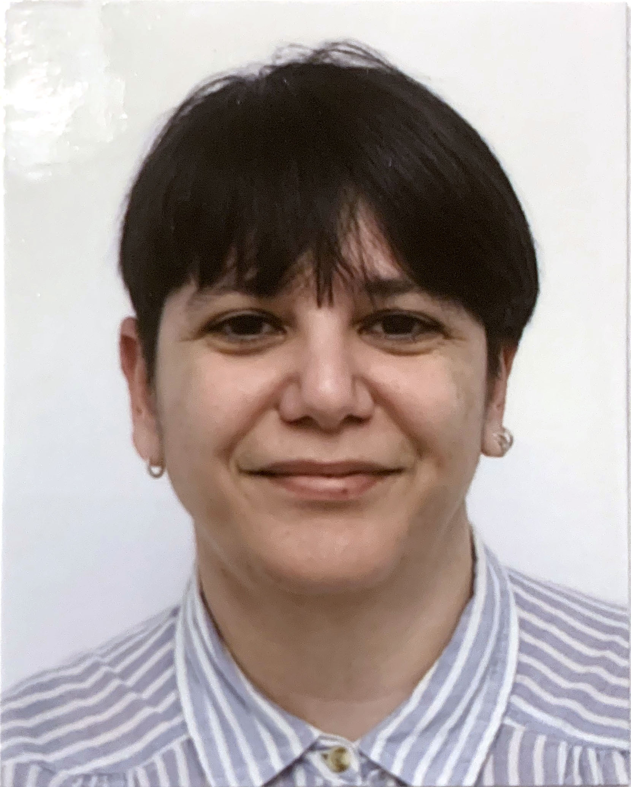
The ANDES PM core team
Paolo Di Marcantonio (PM)
Enrico Giro
(PA/QA)
Rossella Spiga
Communications
Eric Stempels (deputy PM)
Veronica Baldini
Configuration Management
Valentina Alberti
Tools Management
Francesca Sortino
Schedule Control
DEI & Sustainability

Slide 10
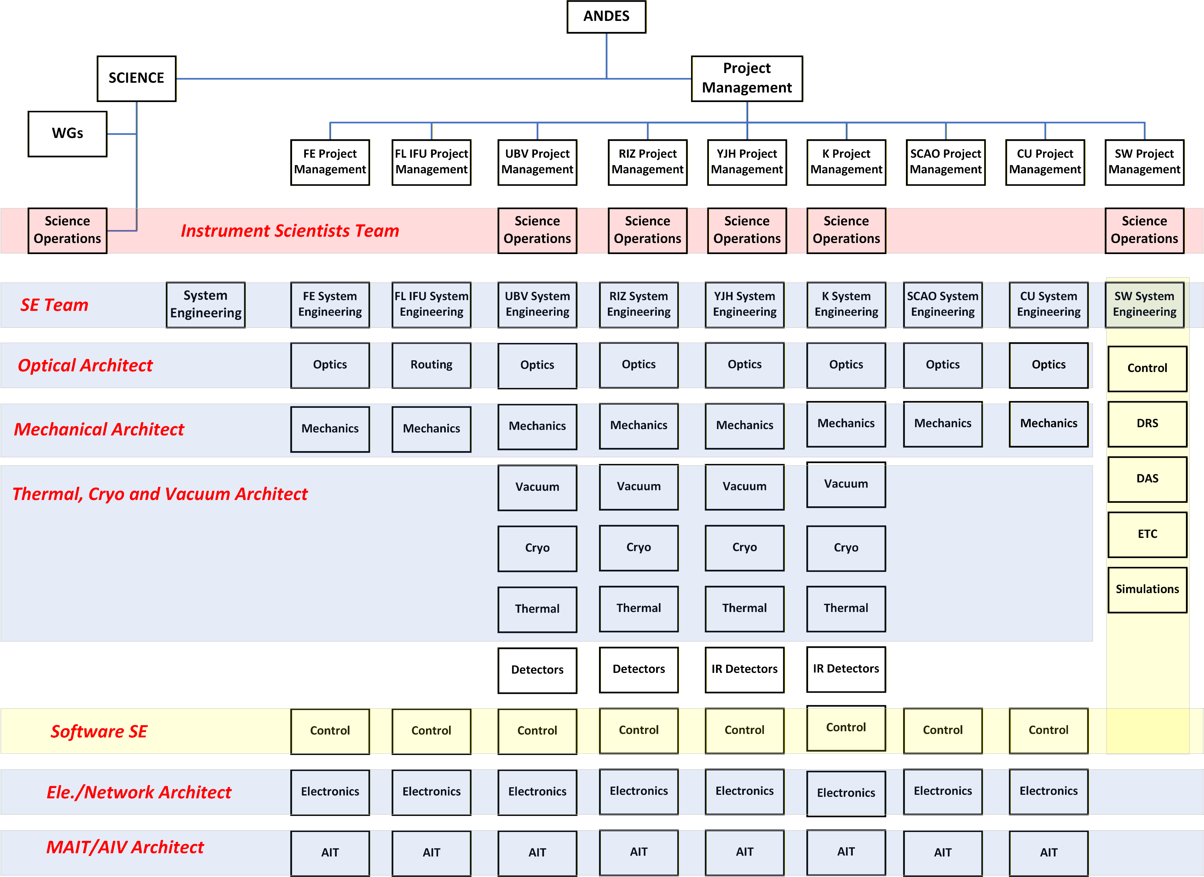
Project organisation: the role of system architects
+ Requirements architect
+ Interface architect
+ System modeling

Slide 11
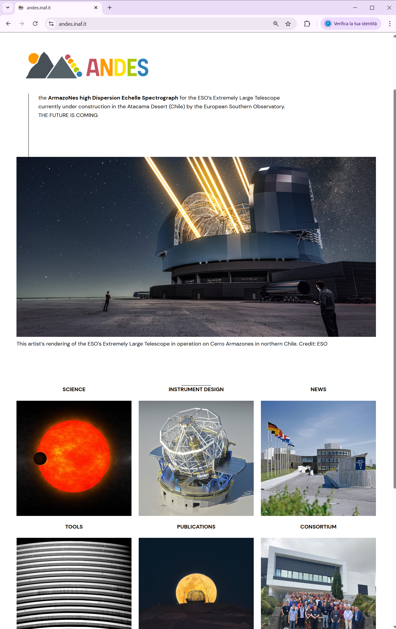




Project management tools
Fast and effective collaboration. Easy knowledge and info sharing and browsing.
https://andes.inaf.it
Communication | zoom/Teams/meet/…
Document sharing | INAF ownCloud
Document collaboration | Microsoft SharePoint / Google tools
Document management | Xerox DocuShare
Project ticketing systems | Atlassian Jira
Content Management System | Atlassian Confluence

Slide 12
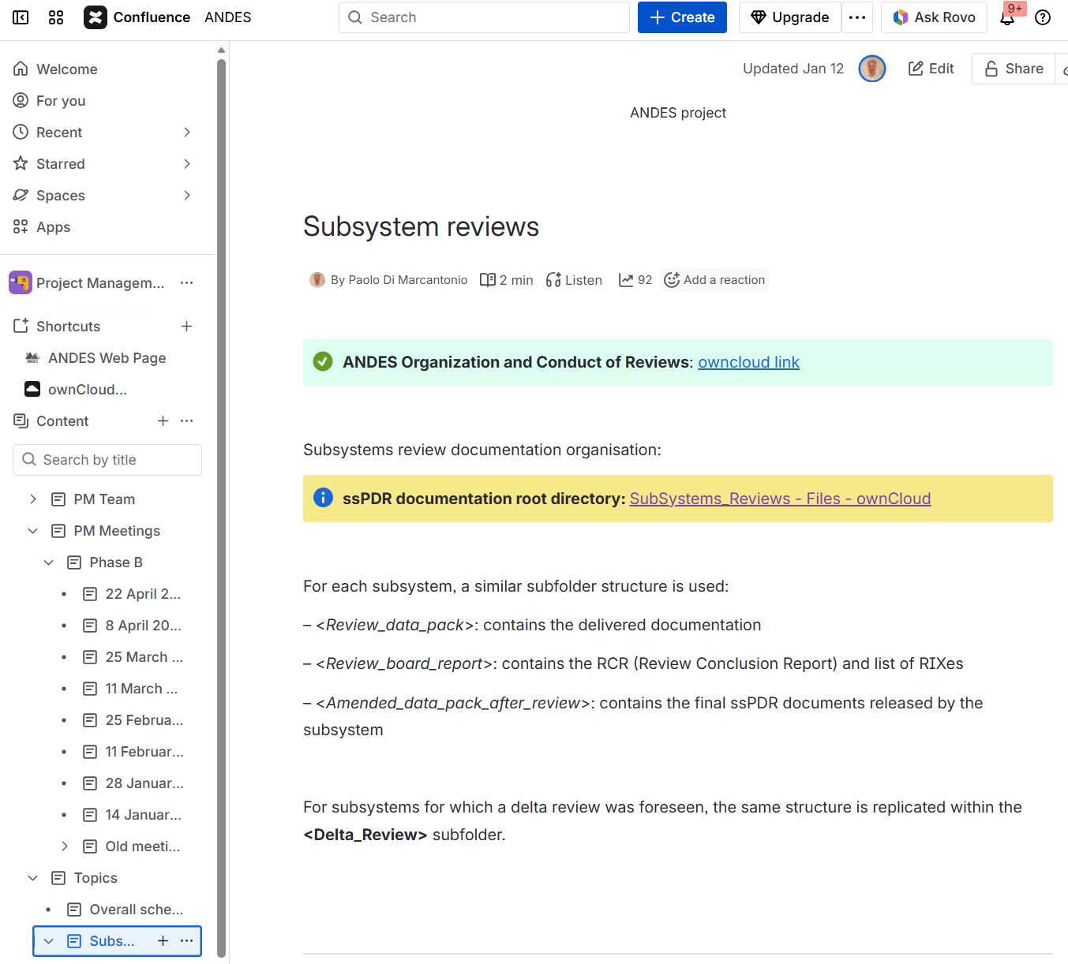
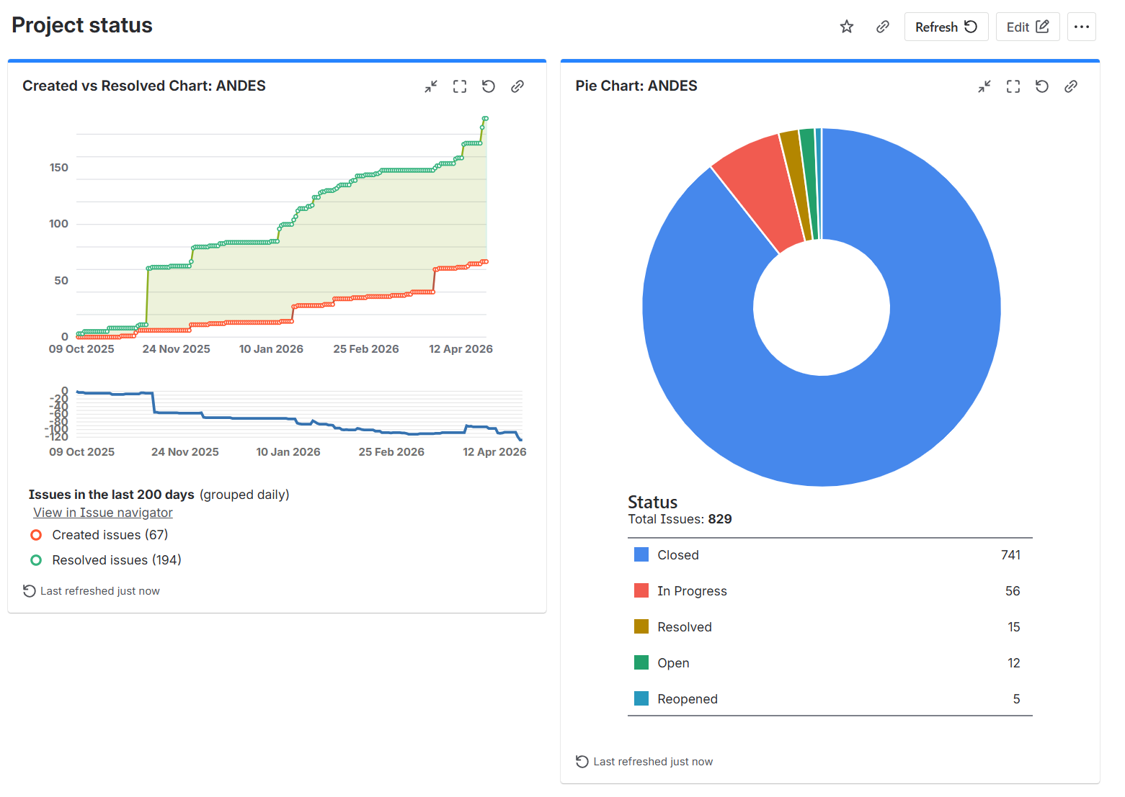
Project monitoring

Slide 13
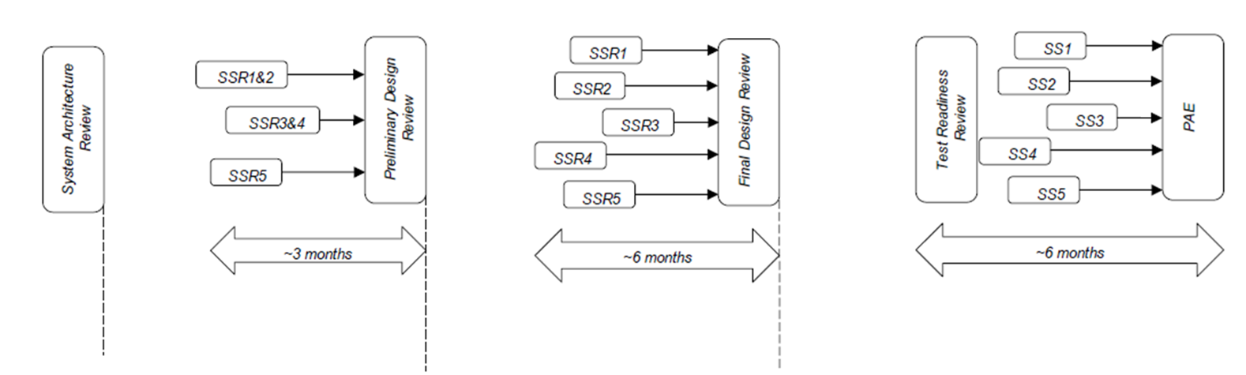
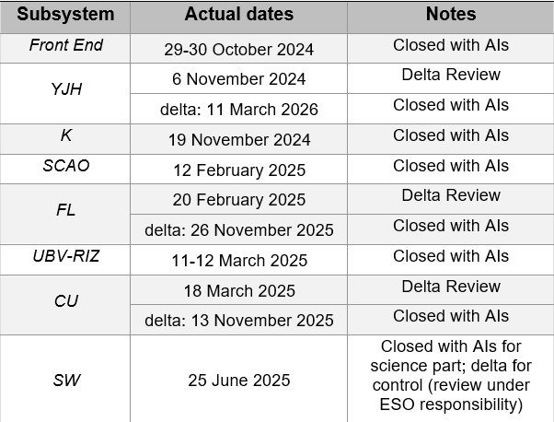
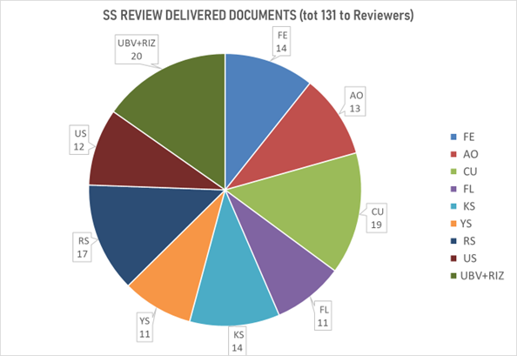
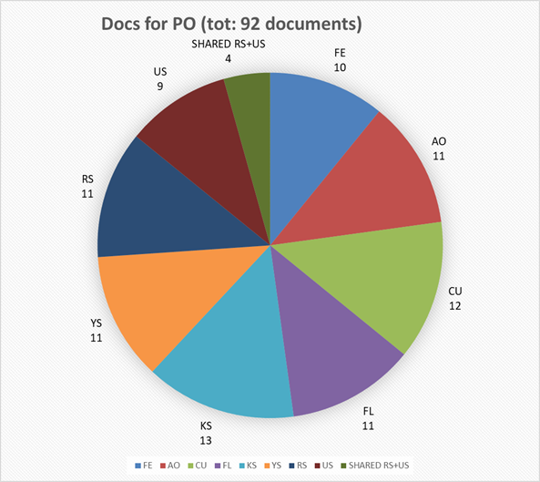
Project phases
Phase B
Phase C
Phase D

Slide 14
Subsystem reviews: lesson learned
Overall Strategy: The modular review process was successful and will be possibly retained for future phases.
Scheduling & Workload: Underestimated scope, led to delivery delays and bottlenecked internal pre-reviews by the project office.
System Boundaries: Reviewers encountered difficulties in fully contextualizing specific design choices due to a perceived lack of a comprehensive system-level view.
Design Homogeneity: Varying subsystem timelines resulted in uneven development maturity across different subsystems.
ESO Involvement:
ESO's official "Observer" status created ambiguity regarding the weight of their feedback.
Comments submitted outside the formal process and lack of dedicated ESO resources prevented proper assessment of the ESO received comments and lead in difficulties maintaining continuous oversight of the project's progress within ESO.

Slide 15
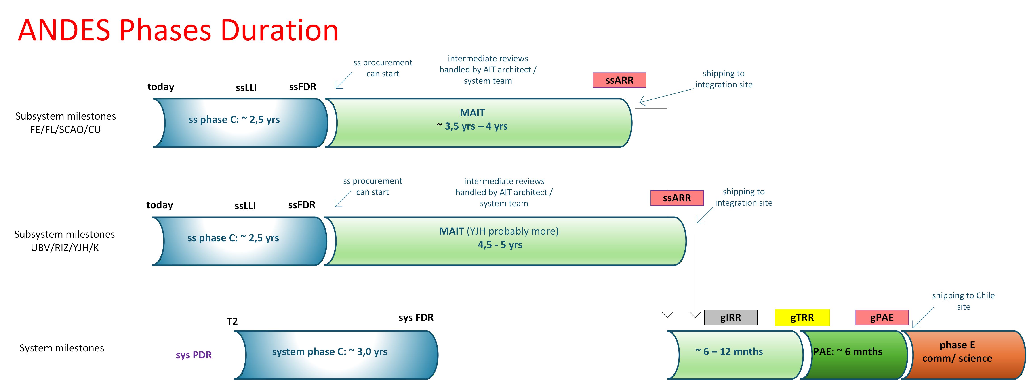
Phases timeline

Slide 16
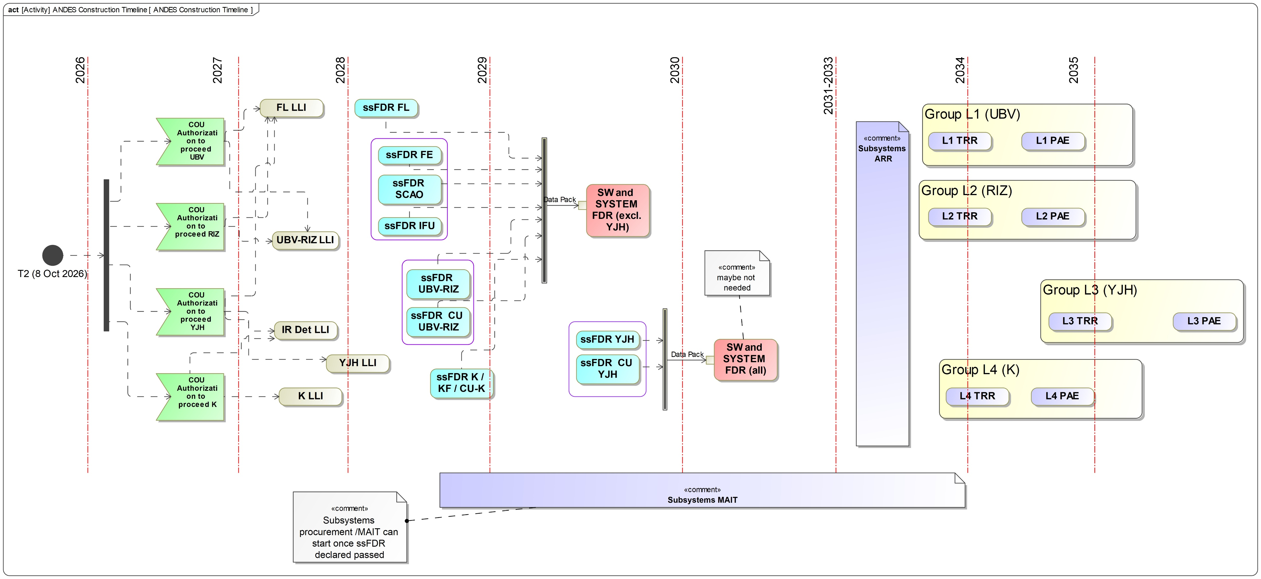
Construction timeline

Slide 17
ANDES Hardware Cost book

Slide 18
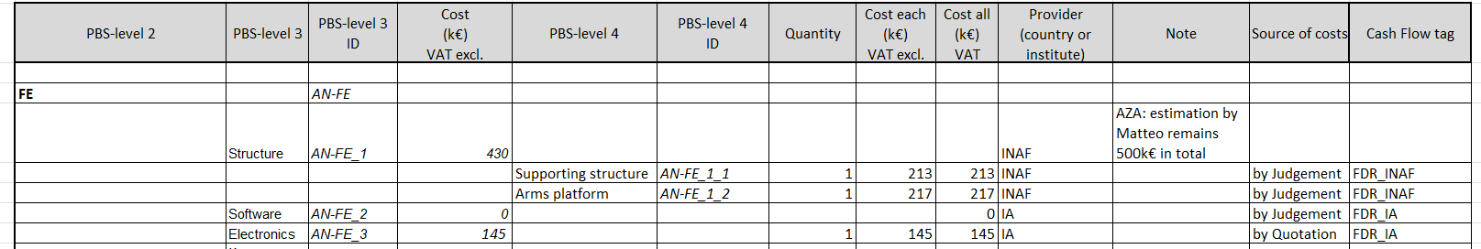
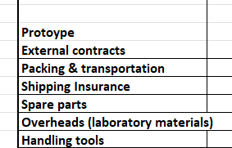
ANDES Hardware Cost book
for each item →associated costs
for each item →uncertainty
for each item →provider
items →linked to PBS; various levels
for each item →timeline
Additional costs not included in the PBS
Across ANDES, 900 items under configuration control !
ANDES total costs, excl. LFC and spare parts, but incl. VAT and 20% contingency
~65 M€ !

Slide 19
ANDES Resource plan

Slide 20
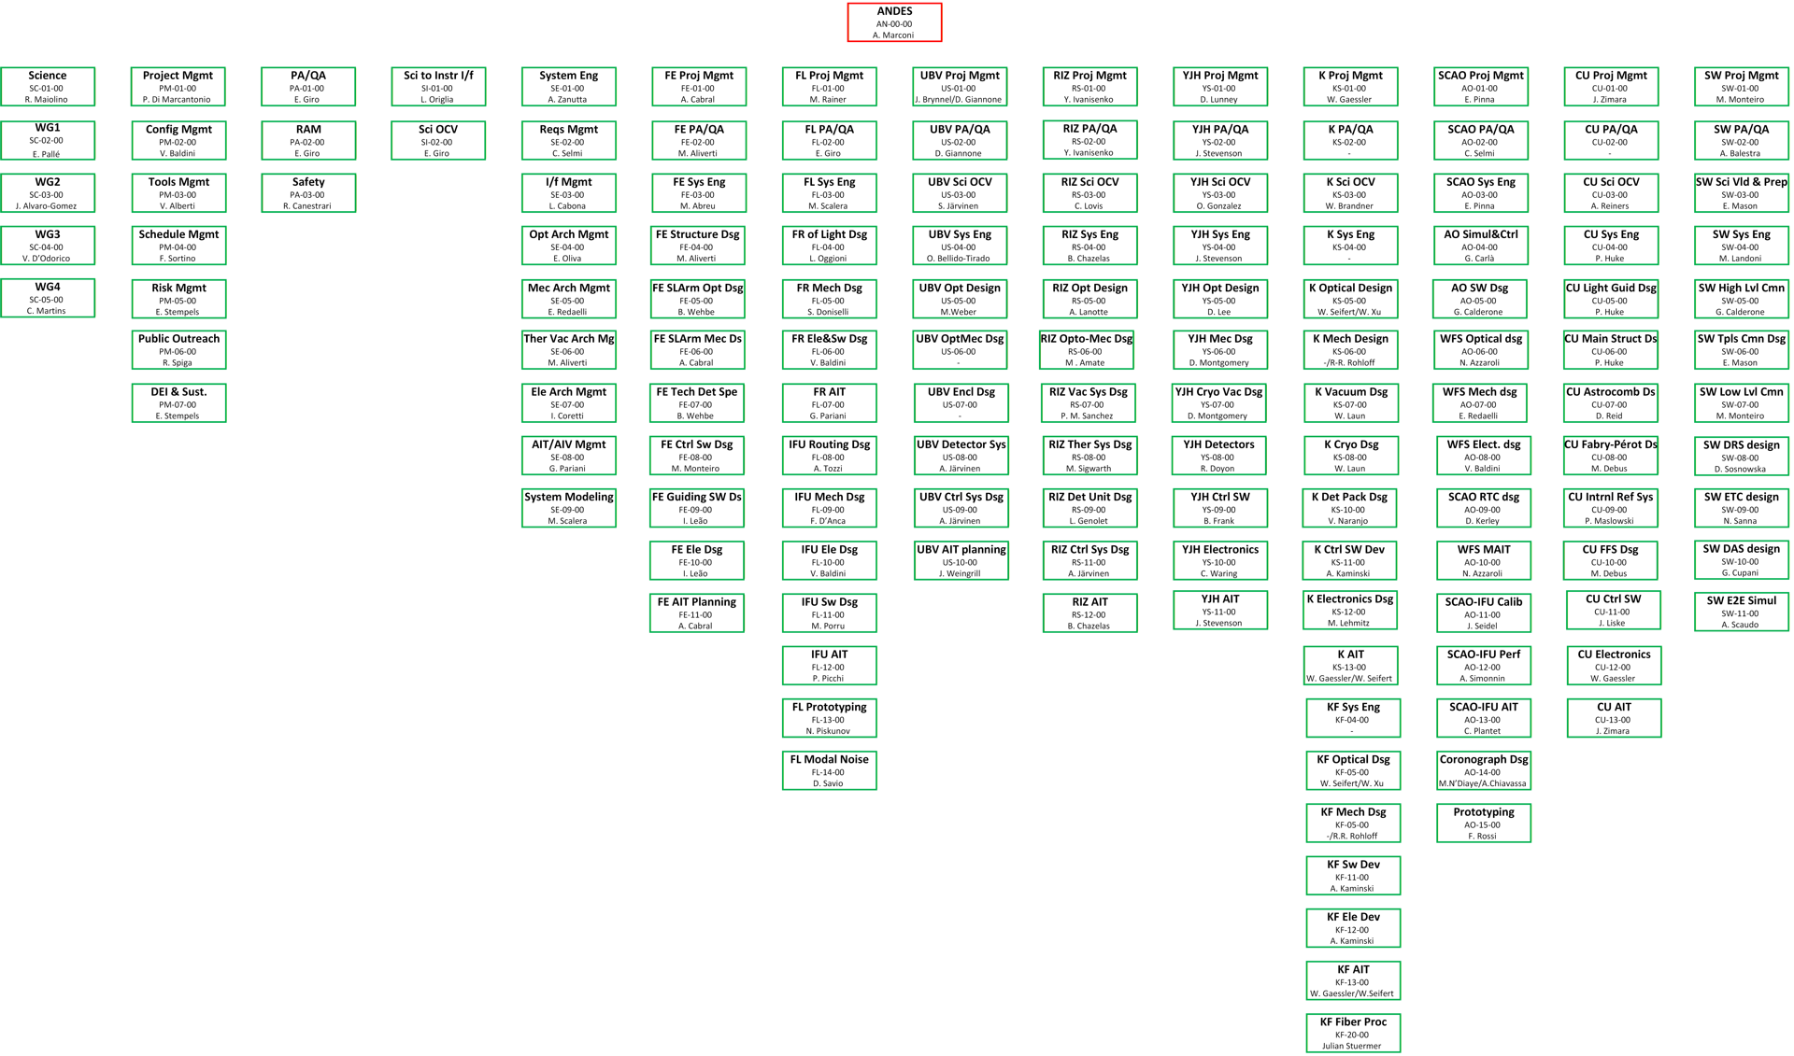
ANDES resources estimation
individual description, one per WP
ANDES has more than 120 WPs (level 1) !

Slide 21
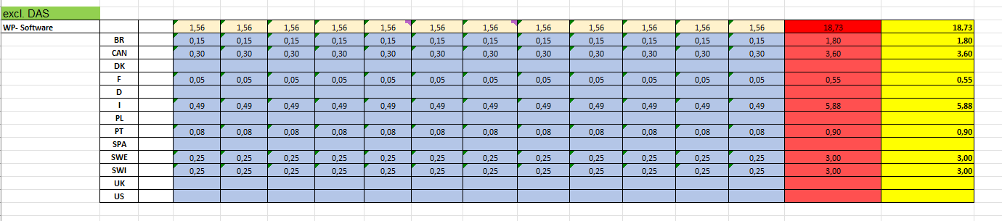
ANDES resources estimation (Phase C)
EXAMPLE
Currently paid on ANDES
  5 TD
  1 Fellow
  2 PhD
Needs (IT):
  +10 FTE/yr on top of the current staff level over a 10-year horizon
  suitable contracts to ensure continuous coverage and retain existing expertise

Slide 22
ANDES Timeline

Slide 23
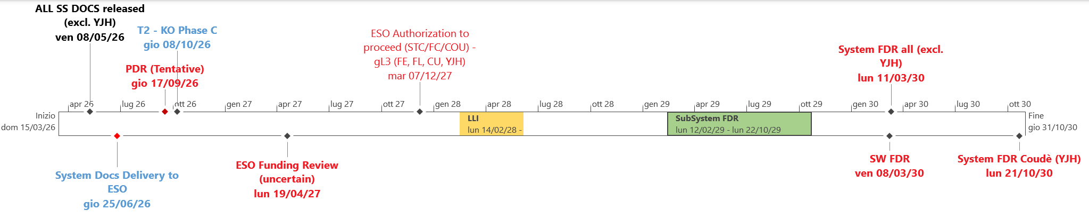
Phase C

Slide 24
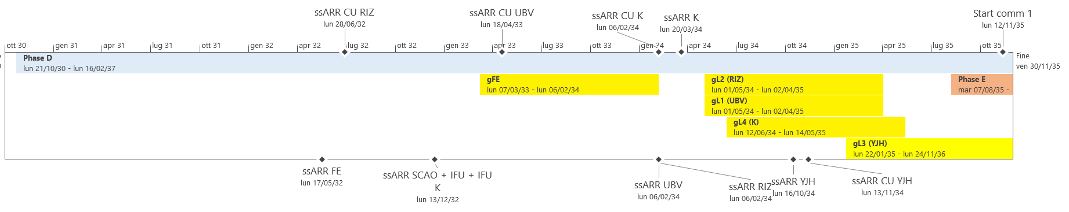
Phase D – E (MAIT – On sky)
Authorization to proceed (funding review) – 2027
long-lead items – 2028
subsystems FDR – 2029
system FDR – 2030
On sky: from 2035 (warm part) to 2037 (YJH)

Slide 25
Conclusions and way-forward
The project is progressing solidly, especially considering its self-funded nature and status as a non-first-generation instrument.
The large and potentially expanding size of our consortium requires dedicated, proactive attention from the project management team.
Strengthening the coordination and governance of the Project Office remains an important focus area.
Moving forward, closer alignment with ESO under a stable, mutually agreed-upon framework will be essential.
A thorough funding review is critical to ensuring the project's feasibility throughout its entire lifecycle.

Slide 26





































