Slide 1


Mechanical Alignment of Optical Systems: From ESPRESSO to ELT
Meeting on the ELT instrumentation with Italian guidance (MORFEO and ANDES)
Matteo Aliverti and Edoardo Redaelli on behalf of INAF Brera team
12/05/2026
INAF

Slide 2
OVERVIEW
Presentation Outline
1
Motivation
Why alignment accuracy is the critical driver for ELT-class instruments
2
ESPRESSO – Small Scale
CMM-based 6-DOF alignment, shim setting, contact-force & damage study
3
CMM Methodology Deep-Dive
Accuracy simulation, reference repeatability, probing damage thresholds
4
Scaling Up – MORFEO
Why CMM is not enough: introducing the Laser Tracker strategy
5
MORFEO – LT Strategy
SMR referencing, tracker placement optimisation, environmental corrections
6
MORFEO – Validation
Uncertainty model, comparison with tolerances, coverage results
7
Common Framework & Outlook
Scalability, ANDES fibre coupling, future ELT instruments

Slide 3




MOTIVATION
Mechanical Alignment Challenge at ELT Scale
Bigger telescopes → higher accuracy → more complex integration strategies
Scale
Accuracy
Complexity
Strategy
From 4-m class (1980s) to 30-m class (ELT): optics grow to 1-m class, instruments span tens of cubic metres.
µm positional tolerances required. Repair time is astronomically expensive. Alignment must succeed the first time.
Multi-mirror trains, deformable mirrors, active structures — iterative trial-and-error alignment is not viable.
A pre-defined, metrological, reproducible integration strategy is the key to reducing risk, cost, and schedule.

Slide 4
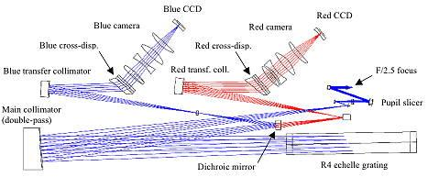
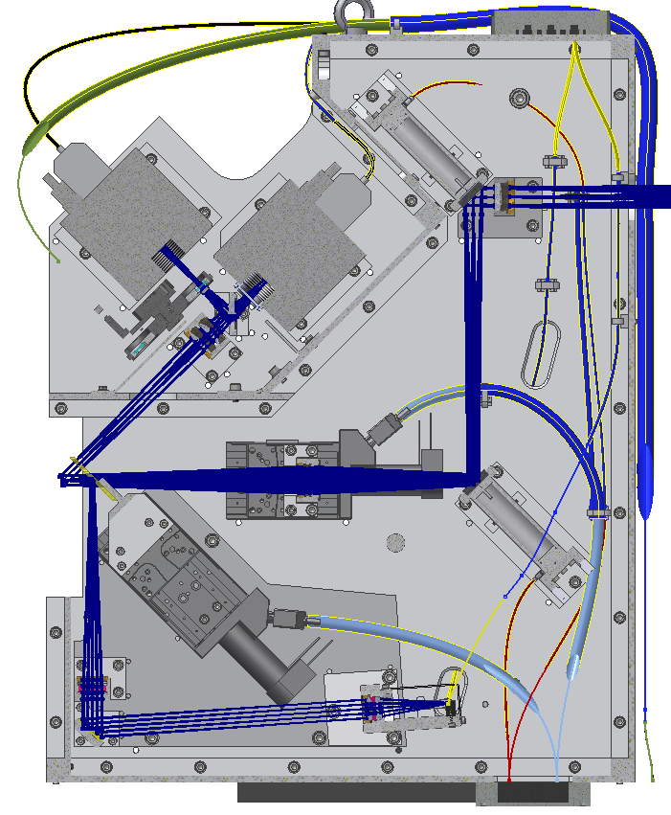
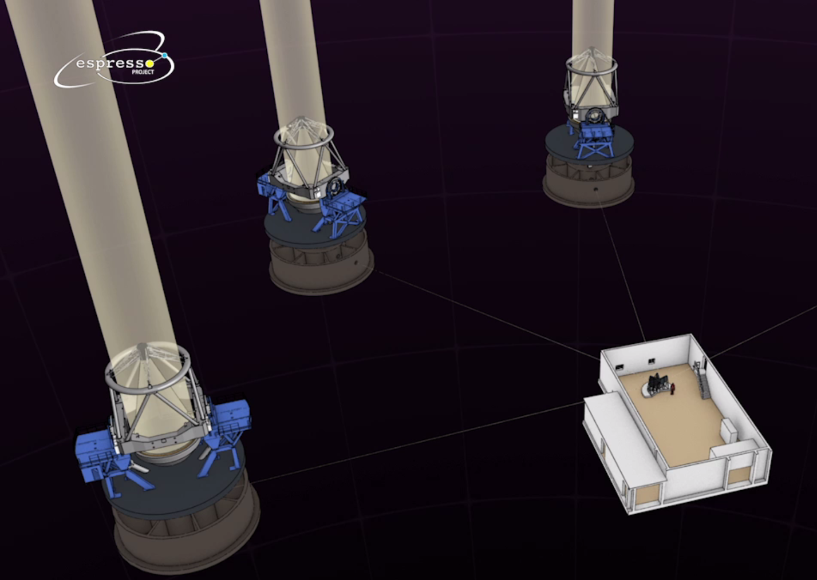
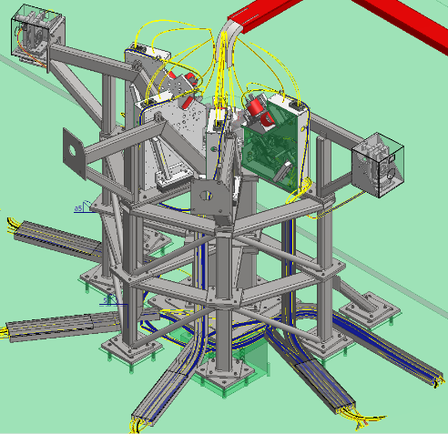
ESPRESSO
ESPRESSO @ VLT — The Starting Point
High-resolution spectrograph for radial velocity — towards 0.1 m/s
Echelle spectrograph
Fibre injection (+ scrambler)
380-780 nm wavelength range
Simultaneous calibration (ThAr)
Temperature controlled room (0.001 K)
Pressure controlled VV (0.001 mbar)
CFC cameras cooling
UTx
UT2
UT3
Fibre
UT1

Slide 5
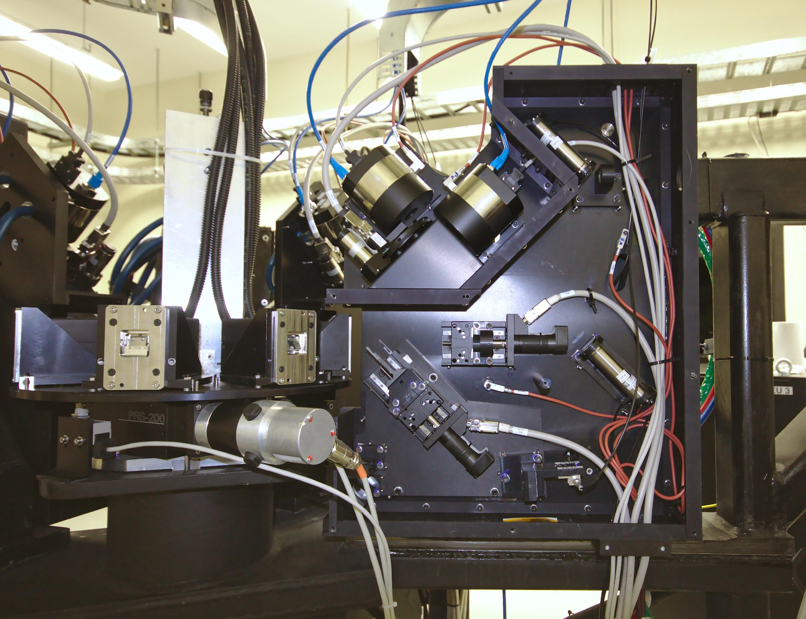

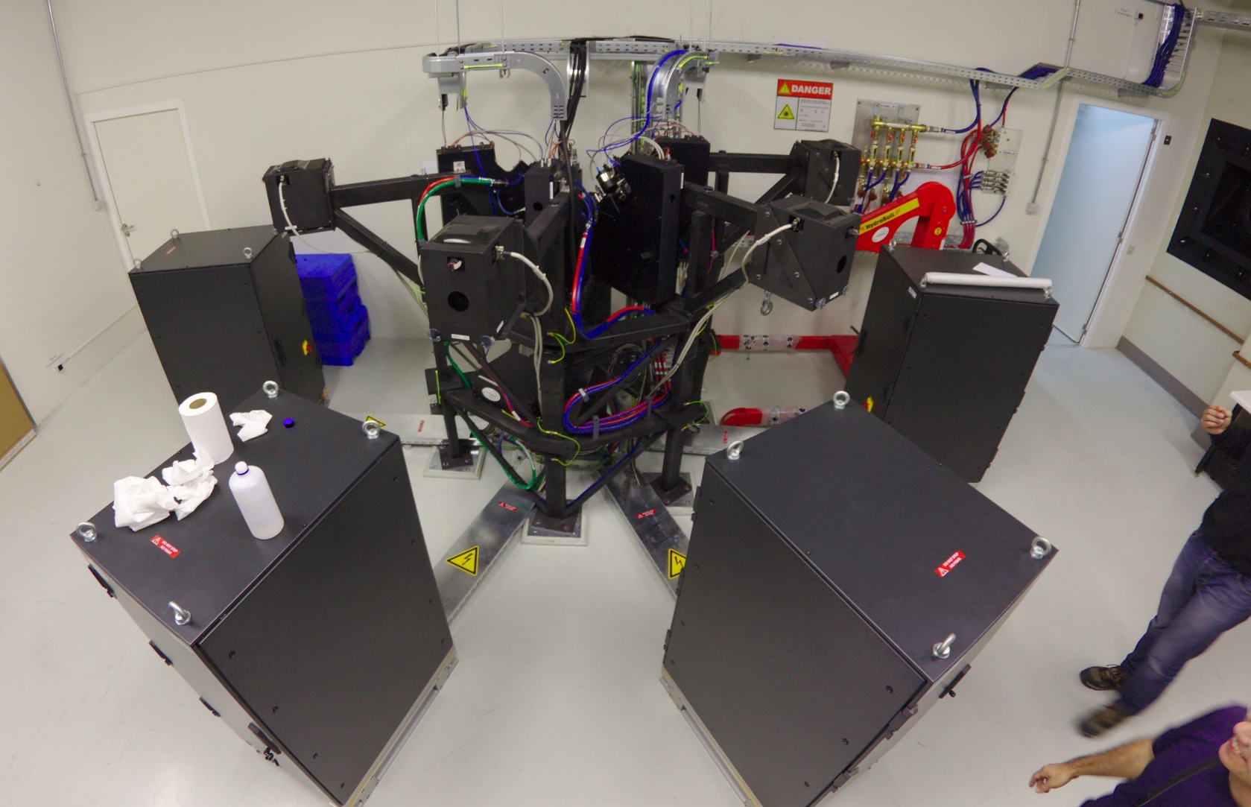
ESPRESSO
ESPRESSO @ VLT — The Starting Point
High-resolution spectrograph for radial velocity — towards 0.1 m/s
Instrument Context
The Alignment Problem
4+1 identical Front End Units (FEUs), one per VLT telescope
Traditional iterative strategies (interferometer-based, trial-and-error) were found to be too slow, inaccurate, and unrepeatable for ESPRESSO's tight tolerances and schedule constraints.
Injects starlight into single-mode fibres — alignment drives coupling efficiency
Temperature-controlled room (0.001 K), pressure-controlled vacuum vessel
New Approach
Mechanical stability is a primary performance driver — no re-alignment in operation
Dimensional characterisation of every optomechanical element with a CMM, followed by shim-setting to control all 6 degrees of freedom. Assembly in one deterministic step.
Optics at bench scale: ~50–200 mm diameter, housed in compact mounts

Slide 6
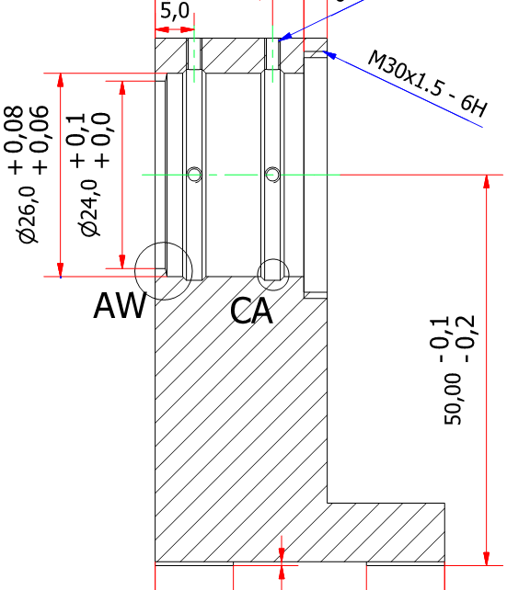
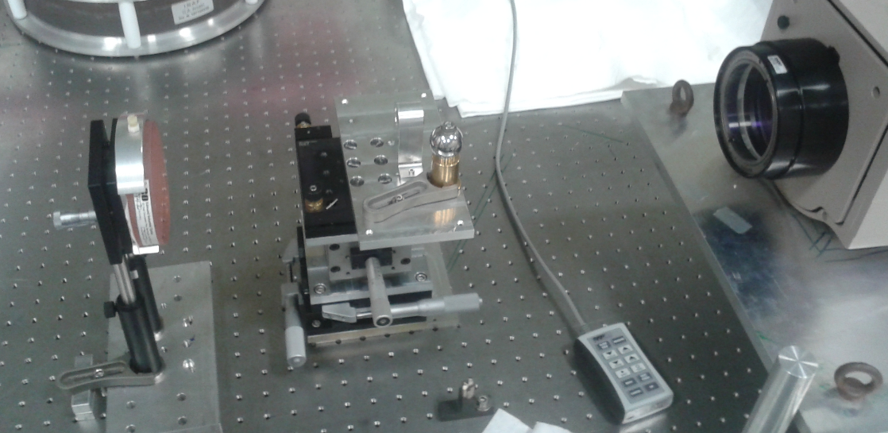
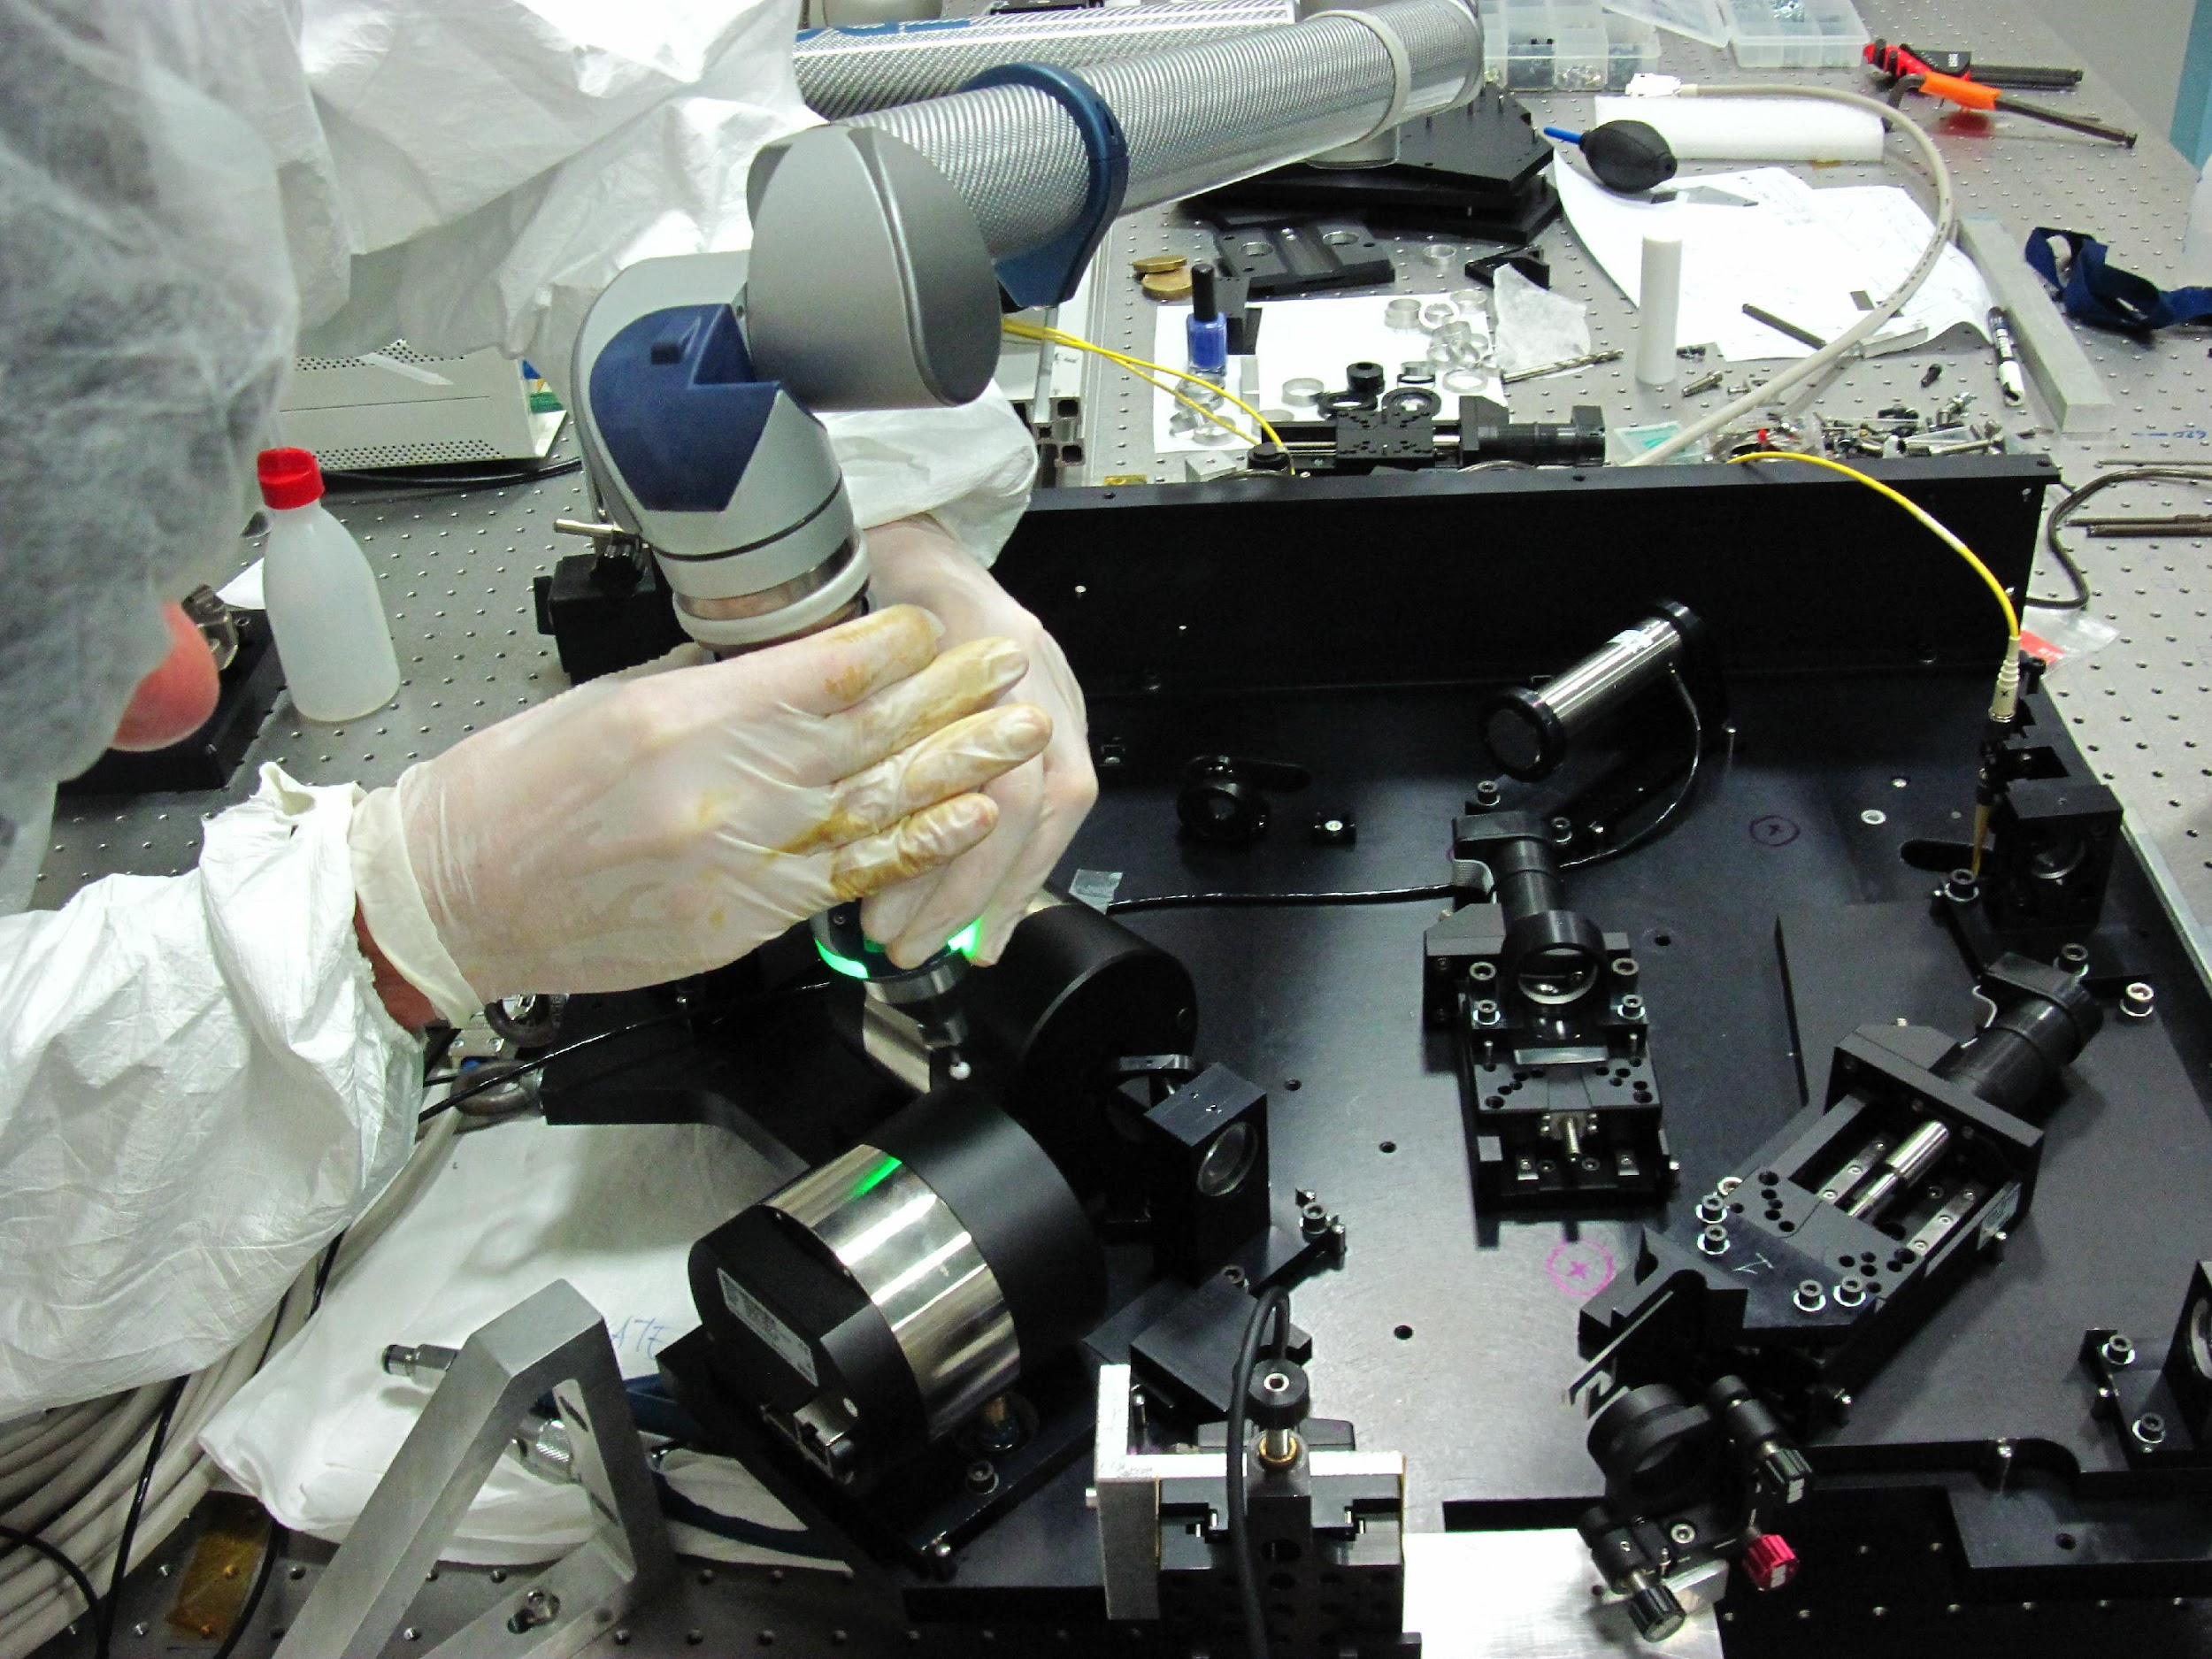
ESPRESSO – AACMM METHOD
AACMM-Based 6-DOF Alignment Procedure
Three methods evaluated — Method (c) selected as the baseline
(a)
(b)
(c)
No Characterisation
Interferometer Alignment
AACMM Characterisation
Elements placed at nominal position using interface dimensions. Result: field strongly decentred, poor image quality, uncontrolled systematic errors.
Each element aligned optically in front of interferometer; 6 reference points acquired. Extremely long process, tip-tilt / decentre ambiguity, accuracy limited by AACMM.
Every element fully characterised on CMM. 6 reference points acquired, Shims computed and set in one step. Selected as ESPRESSO baseline.
✗ Rejected
~ Marginal
✓ Selected
But

Slide 7
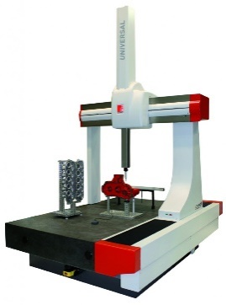

Mechanical Alignment
Followed scheme to determine the possibility to use the CMM as alignment tool
Alignment strategy
Scientific requirements
Optical design
Mechanical design
Scientific performances
Machine uncertainty
Sampling uncertainty
Raw accuracy prediction
Accuracy evaluation
Thermal uncertainty
Datum uncertainty
Zemax Sensitivity analysis
Accuracy prediction
…
Force evaluation
Damage evaluation
Damage prediction

Slide 8
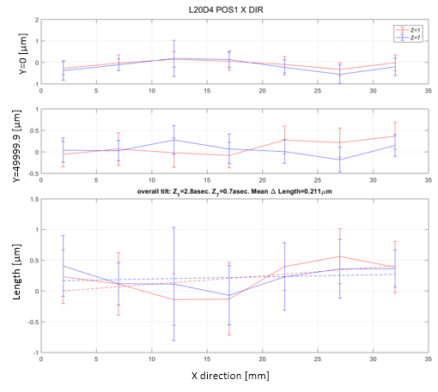
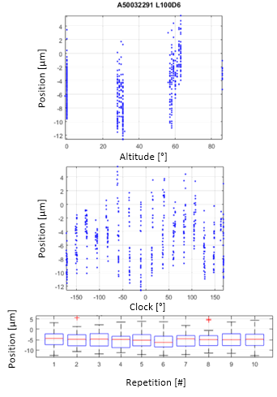
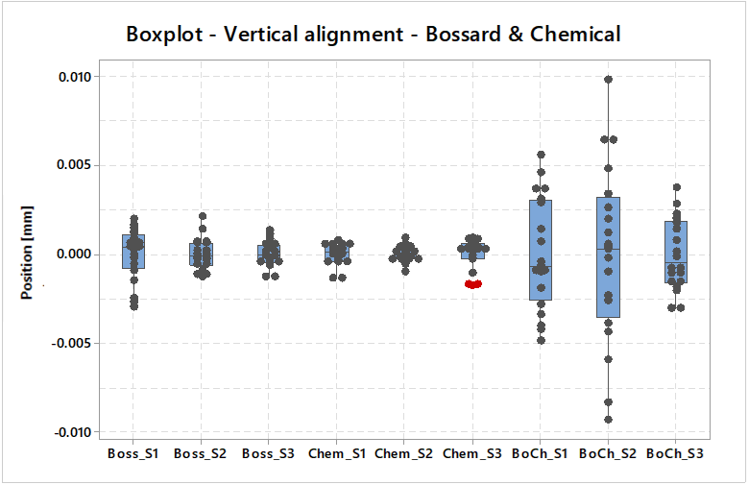
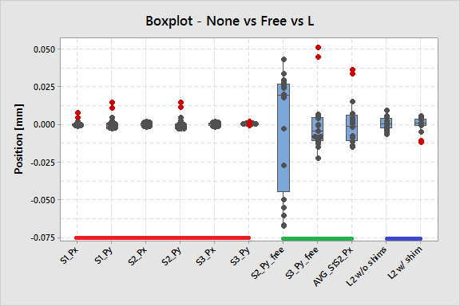
Machine Uncertainty
ESPRESSO – CMM DETAIL
Sampling Error
CMM Methodology: Accuracy, Forces & Damage
Understanding and controlling every source of uncertainty
Accuracy Simulation
Contact Force Model
Optical Damage Study
ISO 15530 uncertainty framework applied to CMM measurements
New theoretical model combining strain-gauge and kinematic sub-models
Materials tested: CaF₂, fused silica, borosilicate — uncoated and coated
Three contributions modelled: machine uncertainty, sampling uncertainty, thermal drift
Axial and radial force components characterised experimentally
Coatings: unprotected gold, protected gold (SiO₂), MgF₂ dielectric, Inconel
Monte Carlo simulation predicts alignment accuracy before assembly
Probe speed, clock position, and stylus geometry effects quantified
Hertzian contact and FEM models used to predict damage thresholds
Mounting/dismounting repeatability < 5 µm — negligible vs shim resolution
Validated against measurements — improved over existing literature models
Safe probing conditions established for all ESPRESSO optical materials

Slide 9
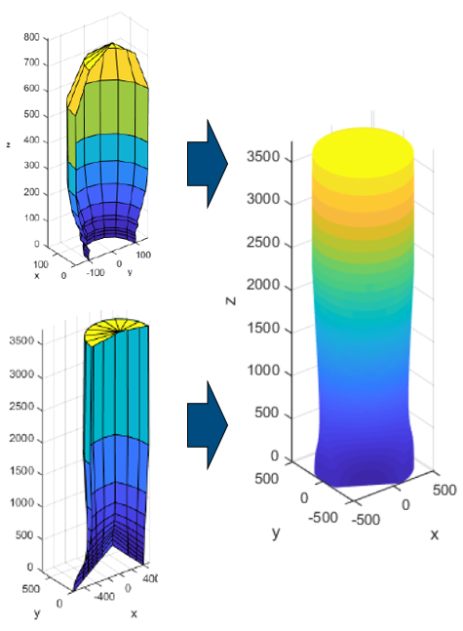
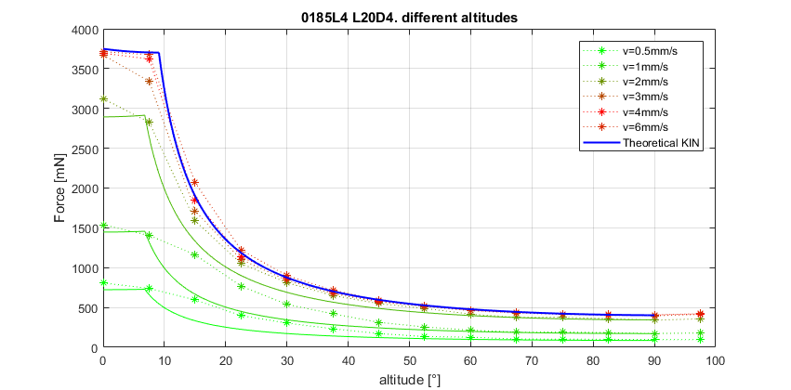
ESPRESSO – CMM DETAIL
CMM Methodology: Accuracy, Forces & Damage
Understanding and controlling every source of uncertainty
Accuracy Simulation
Contact Force Model
Optical Damage Study
ISO 15530 uncertainty framework applied to CMM measurements
New theoretical model combining strain-gauge and kinematic sub-models
Materials tested: CaF₂, fused silica, borosilicate — uncoated and coated
Three contributions modelled: machine uncertainty, sampling uncertainty, thermal drift
Axial and radial force components characterised experimentally
Coatings: unprotected gold, protected gold (SiO₂), MgF₂ dielectric, Inconel
Monte Carlo simulation predicts alignment accuracy before assembly
Probe speed, clock position, and stylus geometry effects quantified
Hertzian contact and FEM models used to predict damage thresholds
Mounting/dismounting repeatability < 5 µm — negligible vs shim resolution
Validated against measurements — improved over existing literature models
Safe probing conditions established for all ESPRESSO optical materials

Slide 10
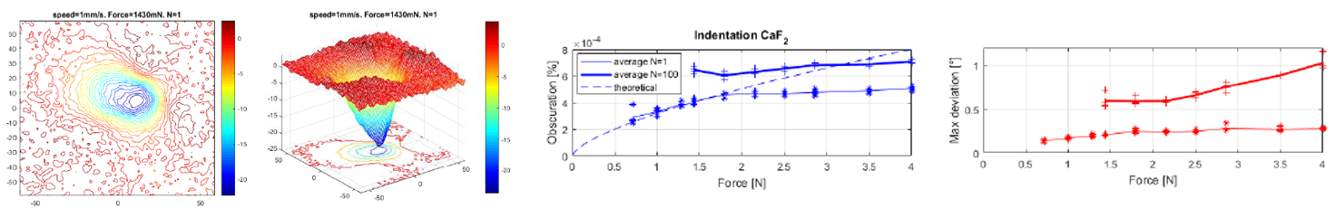
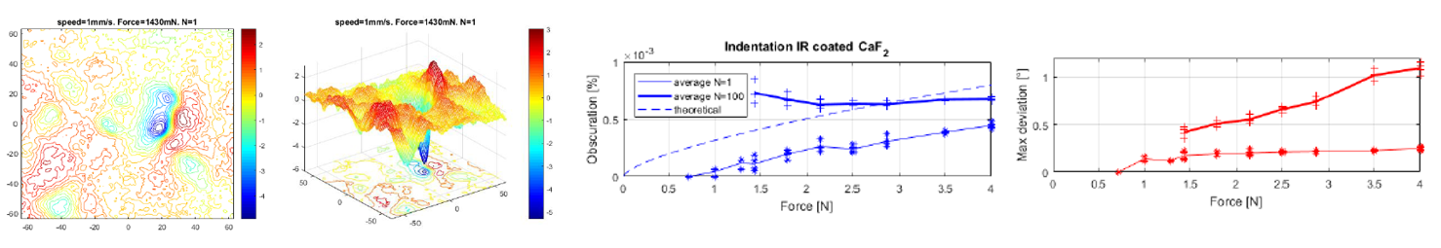
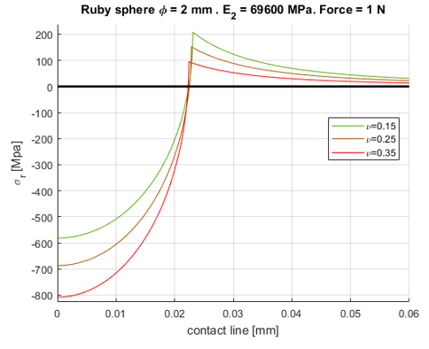
ESPRESSO – CMM DETAIL
CMM Methodology: Accuracy, Forces & Damage
Understanding and controlling every source of uncertainty
Accuracy Simulation
Contact Force Model
Optical Damage Study
ISO 15530 uncertainty framework applied to CMM measurements
New theoretical model combining strain-gauge and kinematic sub-models
Materials tested: CaF₂, fused silica, borosilicate — uncoated and coated
Three contributions modelled: machine uncertainty, sampling uncertainty, thermal drift
Axial and radial force components characterised experimentally
Coatings: unprotected gold, protected gold (SiO₂), MgF₂ dielectric, Inconel
Monte Carlo simulation predicts alignment accuracy before assembly
Probe speed, clock position, and stylus geometry effects quantified
Hertzian contact and FEM models used to predict damage thresholds
Mounting/dismounting repeatability < 5 µm — negligible vs shim resolution
Validated against measurements — improved over existing literature models
Safe probing conditions established for all ESPRESSO optical materials

Slide 11
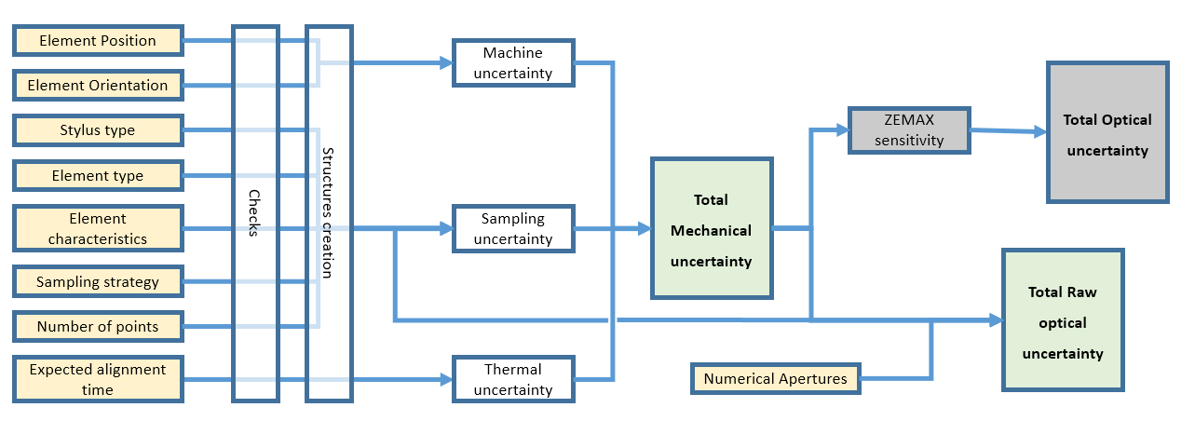
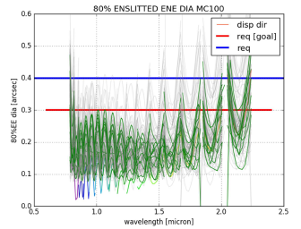
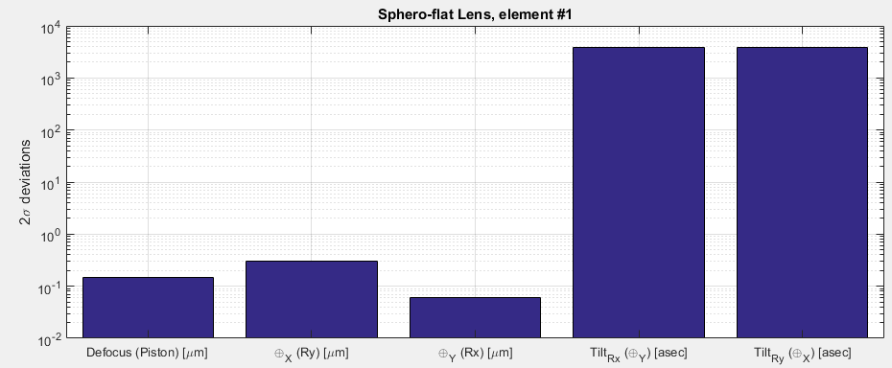
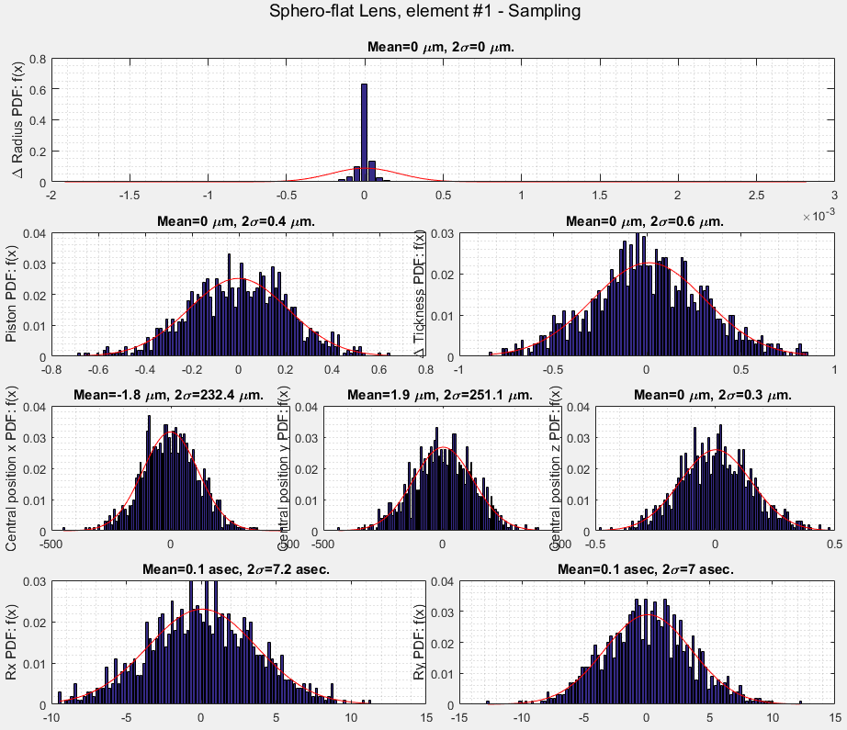
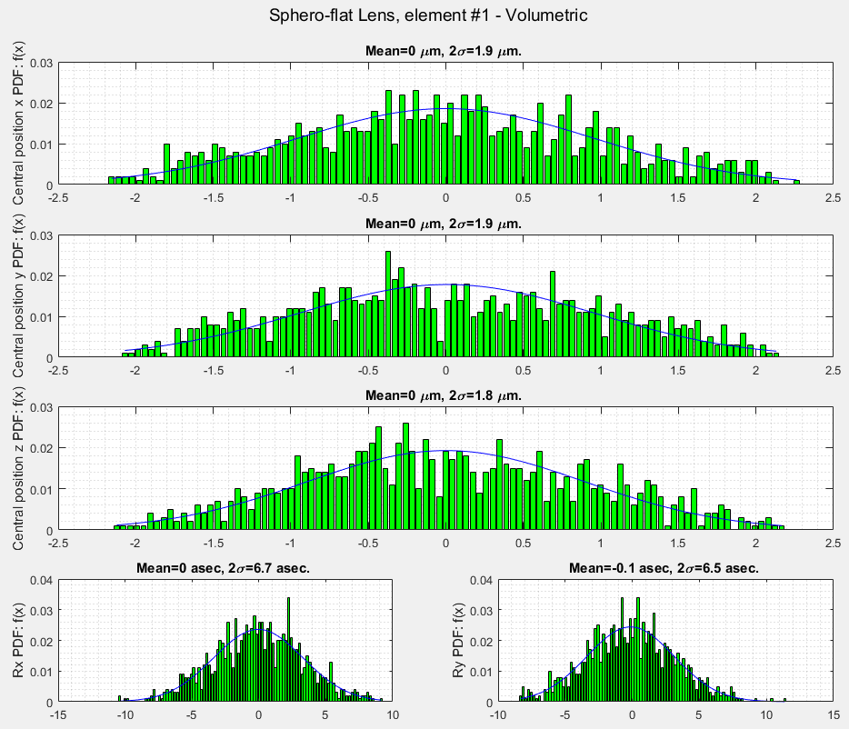
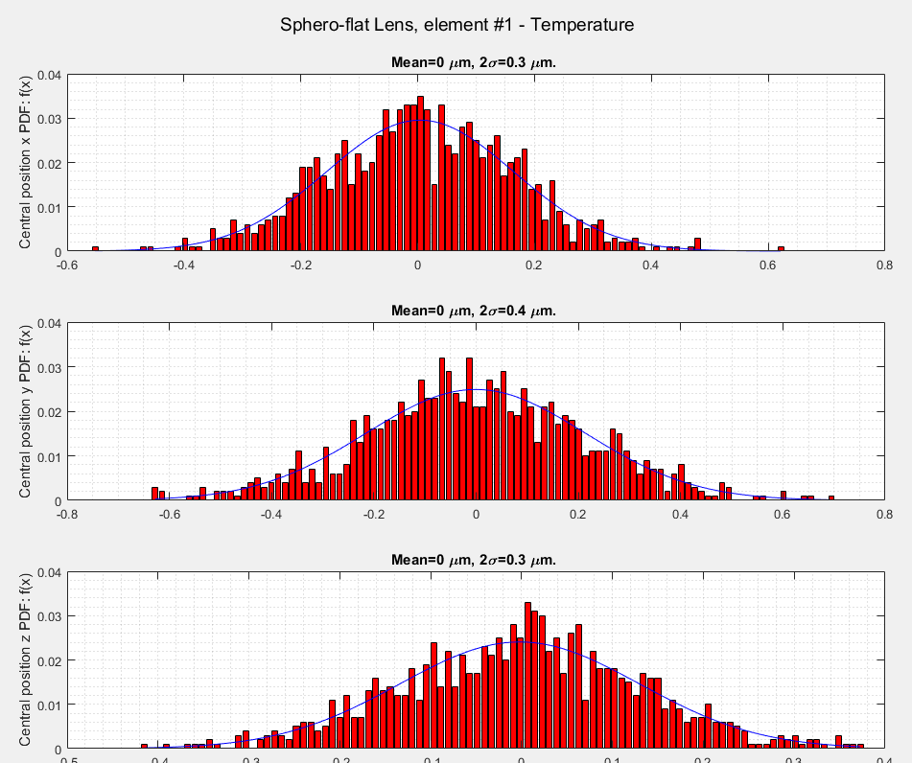
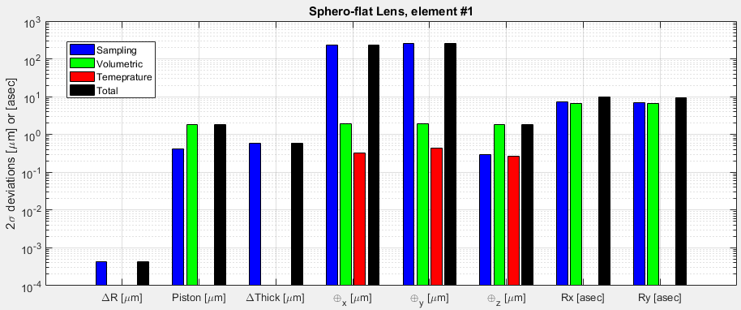
ESPRESSO – CMM DETAIL
Software structure
FP Position Defocus, FP tilt,…
ROC, Position, Rotation, Thickness,…

Slide 12
Why CMM Is No Longer Enough
Instrument
Optic size
Volume
Tolerance
Tool
ESPRESSO FEU
~300 × 200 mm
~0.1–0.5 m
20 µm
AACMM/CMM
MORFEO @ ELT
1-metre class
7 × 7 × 4 m
20–50 µm
LT?
The CMM has a measurement range of ~1 m — MORFEO spans 8×7×4 m. A Laser Tracker, capable of sub-50 µm measurements over tens of metres, is the natural successor. But the philosophy remains the same:
characterise every element metrologically → compute corrections → assemble in one deterministic step.

Slide 13
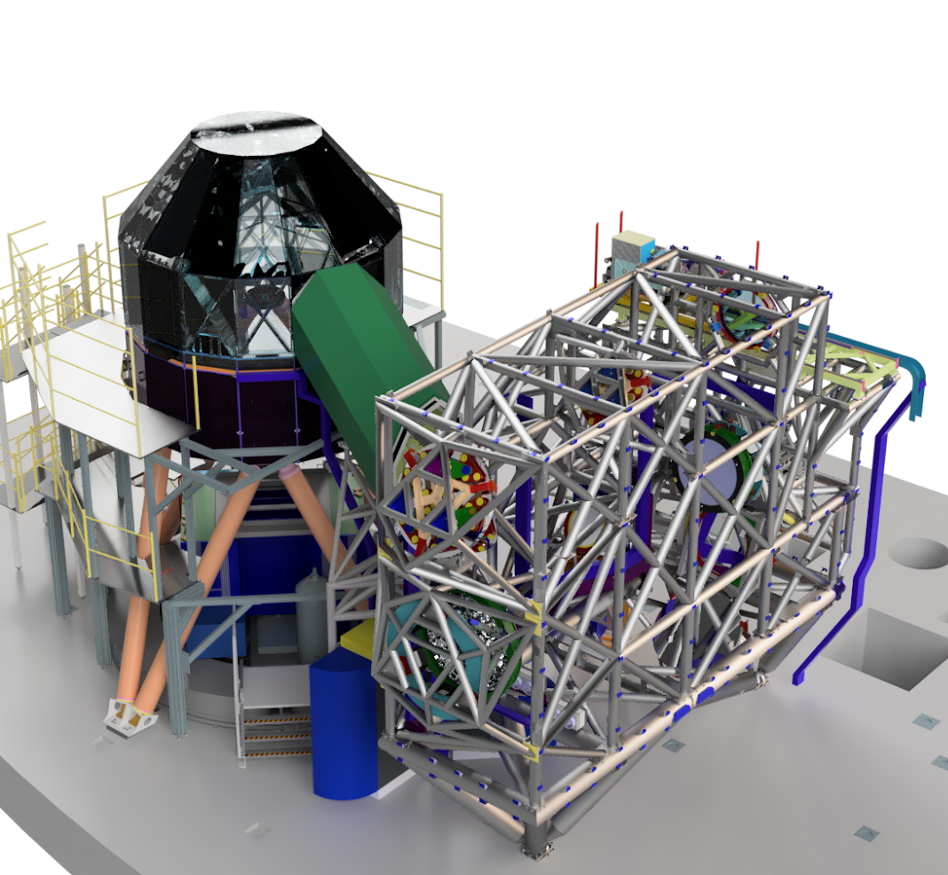
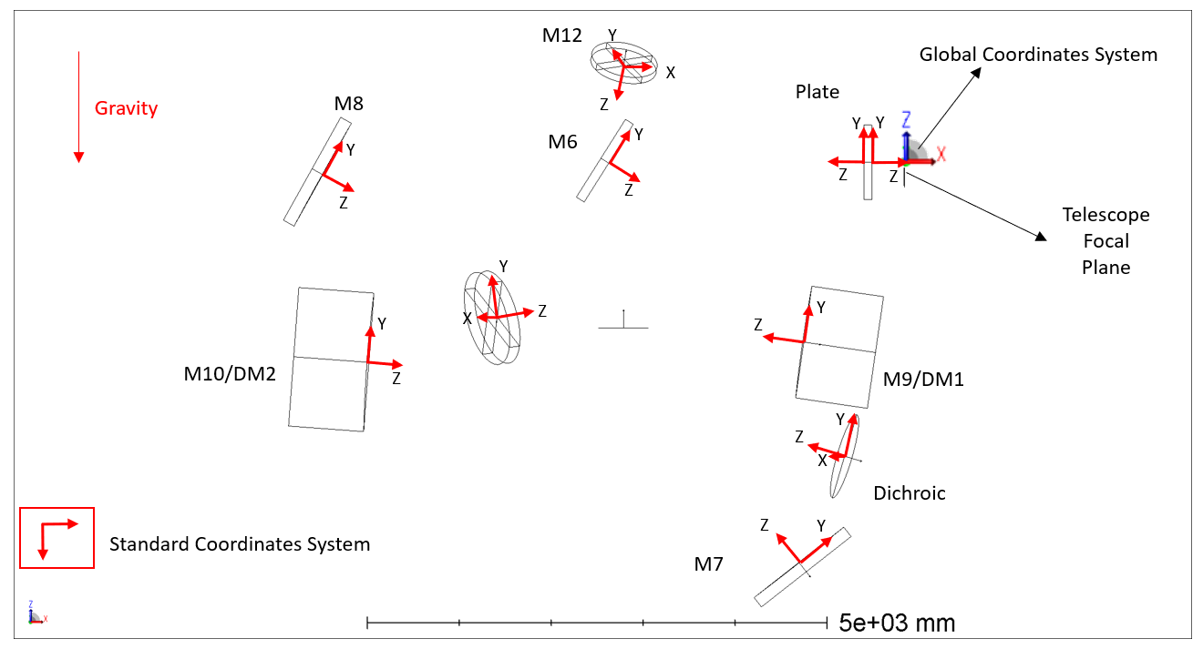


MORFEO @ ELT
MORFEO at the ELT
Multi-Conjugate Adaptive Optics module for MICADO — the world's largest AO instrument
MORFEO is the Italian-led MCAO module for the ELT. It feeds MICADO (near-IR imager) and a second instrument, working between 800 nm and 2450 nm. It represents a qualitative leap in size, complexity, and integration challenge.
800 – 2450 nm
~1-m class mirrors
8 × 4 × 7 m
7 mirrors (2 DM)
1 dichroic · 1 lens
Working range
Optic size
Volume
Optical train
Three mirror types in MORFEO each require a different referencing strategy:
Spherical mirrors (M9, M10) — measured via radius of curvature with LT + interferometer | Aspherical mirrors (M7, M8) — CGH + interferometer + SMR referencing | Flat mirrors (M6, DC, M11, M12) — normal vector via SMR reflection

Slide 14

MORFEO – LASER TRACKER
The Laser Tracker — Tool and Principle
A portable CMM for large volumes: two encoders + laser interferometer
How the LT Works
Why LT over CMM for MORFEO?
Measures the 3-D position of an SMR (corner-cube in metallic sphere) using two angular encoders and a laser distance measurement
CMM range ~1 m, MORFEO volume ~250 m³. The LT is transportable, can be repositioned within the instrument, and achieves comparable uncertainty at these scales.
Can be placed outside the optical path — does not occupy instrument volume during science
Measurement range: tens of metres at sub-50 µm uncertainty (k=2)
What Is New in This Work
Multiple LT stations can be combined via common SMR references to extend coverage and reduce uncertainty
Use of the LT not just for preliminary factory alignment but as an on-board system for monitoring and re-alignment throughout the instrument lifetime at the ELT. MORFEO is the largest adaptive optics instrument ever built.
SMR position relative to each optic's optical parameters characterised in advance via CMM

Slide 15
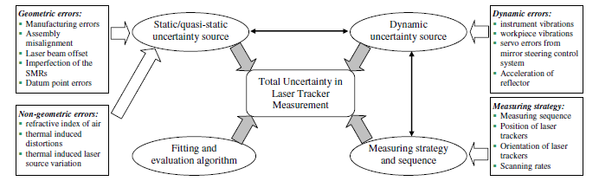
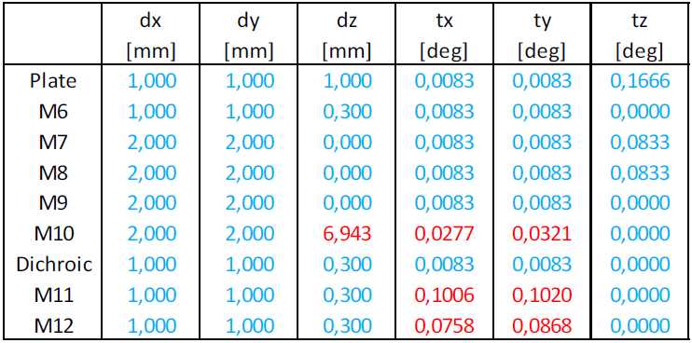
MORFEO – LASER TRACKER
Software structure
Uncertainty Evaluation
Alignment tolerance
Mechanical design
Alignment and monitoring strategy
Accuracy evaluation
Requirements
Optical design

Slide 16
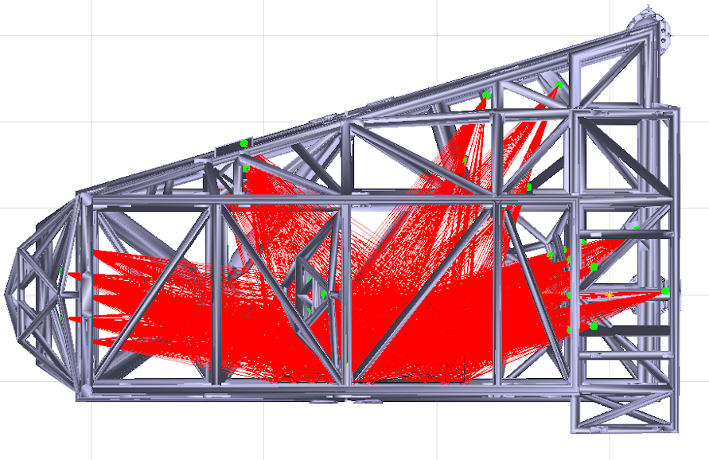
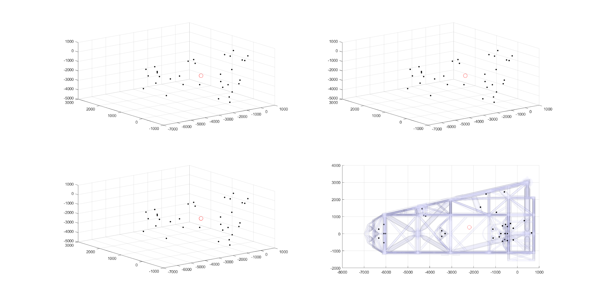
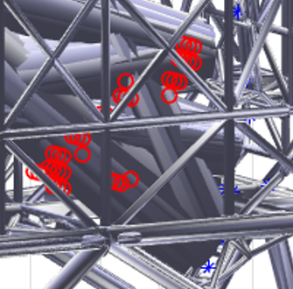
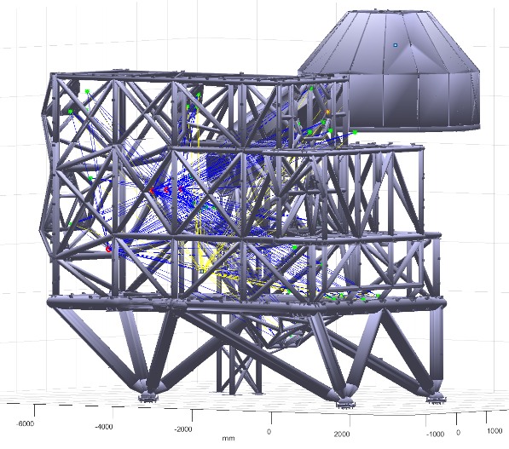
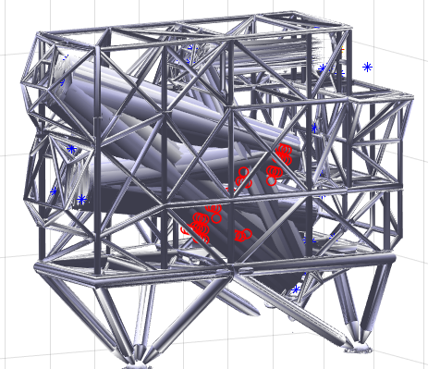
MORFEO – LT PLACEMENT
Tracker Placement Optimisation Software
Finding the best LT position inside MORFEO — a constrained optimisation problem
The LT must be placed inside the MORFEO structure such that all SMRs are simultaneously visible — avoiding collisions with structural members, the optical path, and respecting SMR field-of-view limits. This is solved as a brute-force optimisation over a 40 cm mesh.
Step 1 – Geometry Input
Step 2 – Constraint Check
3-D CAD model of MORFEO loaded. SMR positions and orientations on each optomechanical element defined. Instrument volume discretised
For each candidate position: (a) no collision with structure, (b) no vignetting of LT beam by structural members, (c) all SMR beams within 40° FOV of each SMR.
Step 3 – Optical Path BC
Step 4 – Output & Use
Optical path treated as a solid volume — LT cannot be placed inside it. Eliminates a large fraction of candidate positions that would physically block the beam.
Valid positions ranked by coverage. Two LT stations (LT1, LT2) identified with common SMR references to tie coordinate frames. Uncertainty reduces as common references increase.

Slide 17
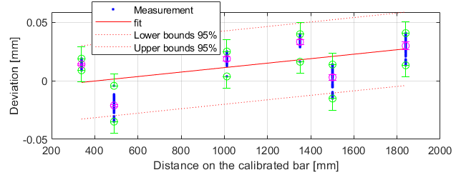
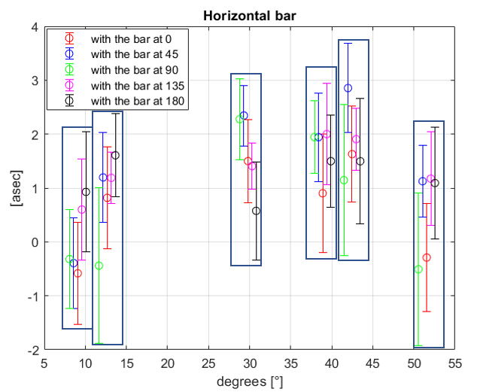
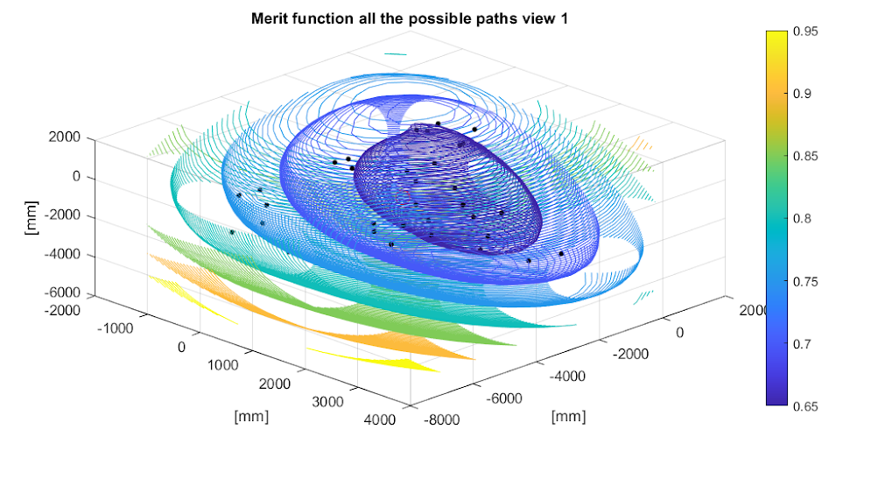
MORFEO – LT ACCURACY
Laser Tracker Characterisation & Error Model
Moving beyond MPE datasheet values — a dedicated experimental campaign
Kinematic Error Model
Experimental Tests
Environmental & SMR Effects
Reference bar (6 calibrated distances) used across all tests
LT kinematics described with decenter of azimuthal/elevation encoders, laser source decenter and focal distance, and axis tilts
Refractive index of air modelled with Ciddor / Edlén equations (T, P, humidity)
Angular segment test: bar measured at different azimuthal positions to map encoder non-uniformity
Standard ISO 10360-10:2016 defines the MPE-based (a priori) model — used as starting point
Linear temperature distribution assumed along beam path — PT100s monitor air in front of optics
Dedicated characterisation campaign builds a measured model to replace manufacturer data
Elevation test: vertical bar at several distances, temperature monitored with PT100 sensors
SMR characterisation: dihedral angle (affects max usable range) and centring error (affects pointing) measured and included in model
Radial test: horizontal bar at increasing distances to characterise ranging error

Slide 18
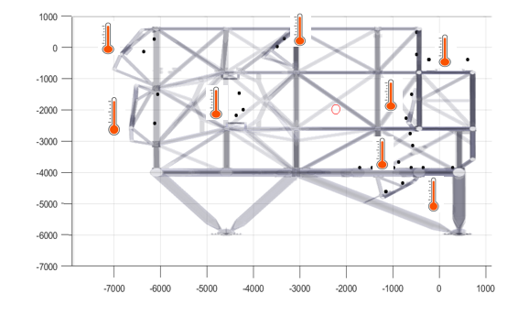
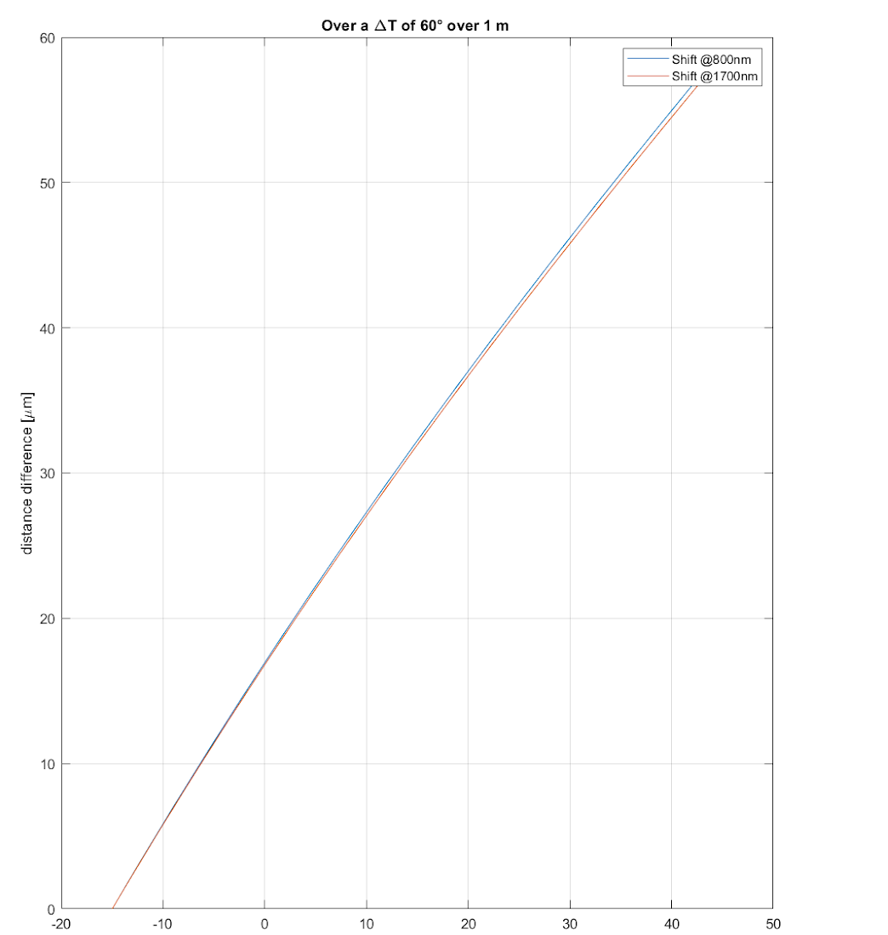
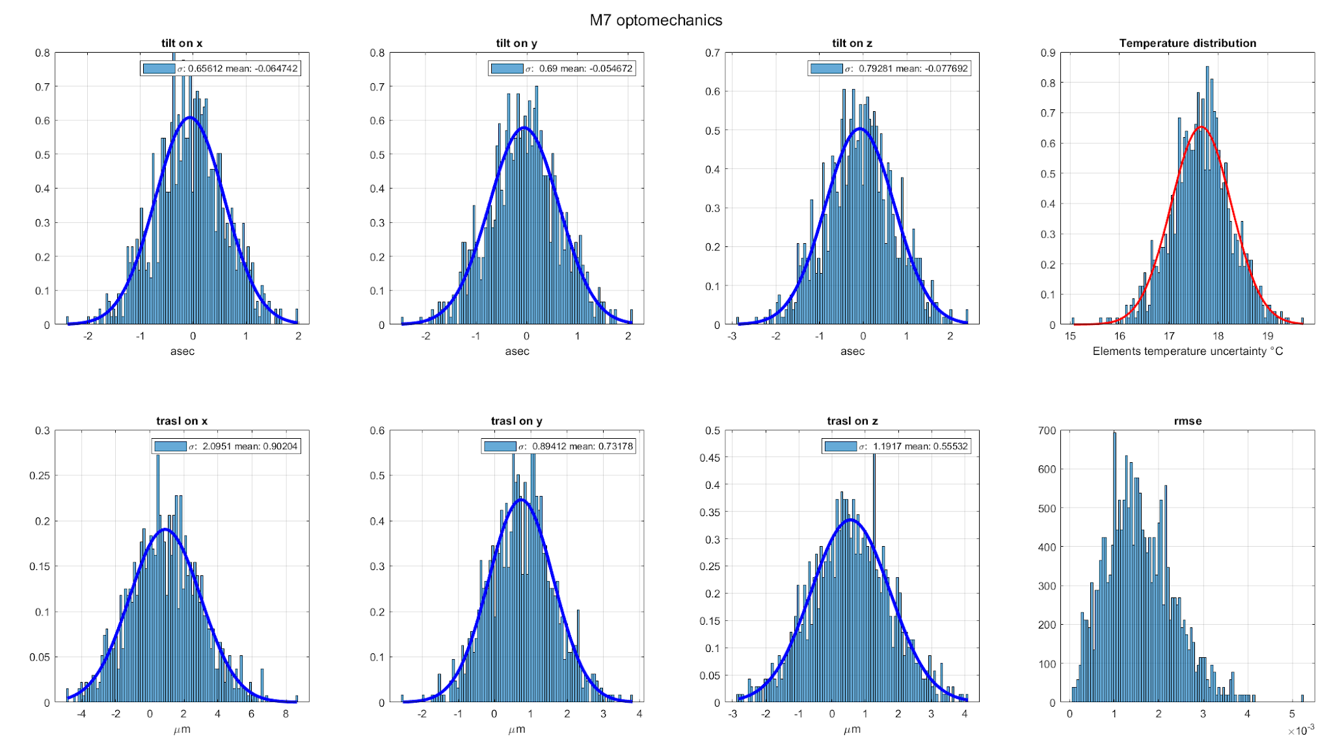
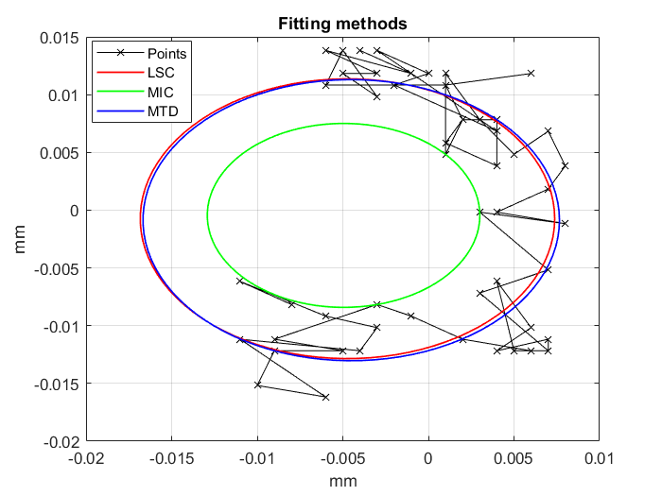
MORFEO – LT ACCURACY
Laser Tracker Characterisation & Error Model
Moving beyond MPE datasheet values — a dedicated experimental campaign
Kinematic Error Model
Experimental Tests
Environmental & SMR Effects
Reference bar (6 calibrated distances) used across all tests
LT kinematics described with decenter of azimuthal/elevation encoders, laser source decenter and focal distance, and axis tilts
Refractive index of air modelled with Ciddor / Edlén equations (T, P, humidity)
Angular segment test: bar measured at different azimuthal positions to map encoder non-uniformity
Standard ISO 10360-10:2016 defines the MPE-based (a priori) model — used as starting point
Linear temperature distribution assumed along beam path — PT100s monitor air in front of optics
Dedicated characterisation campaign builds a measured model to replace manufacturer data
Elevation test: vertical bar at several distances, temperature monitored with PT100 sensors
SMR characterisation: dihedral angle (affects max usable range) and centring error (affects pointing) measured and included in model
Radial test: horizontal bar at increasing distances to characterise ranging error

Slide 19
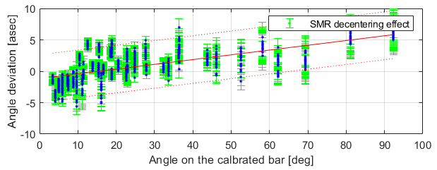
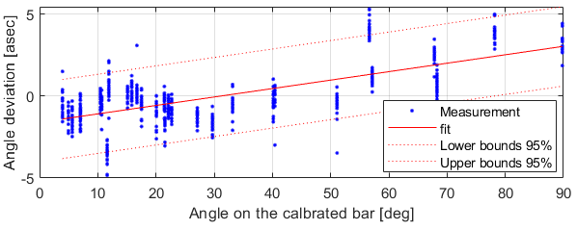
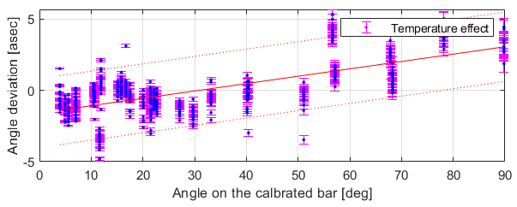
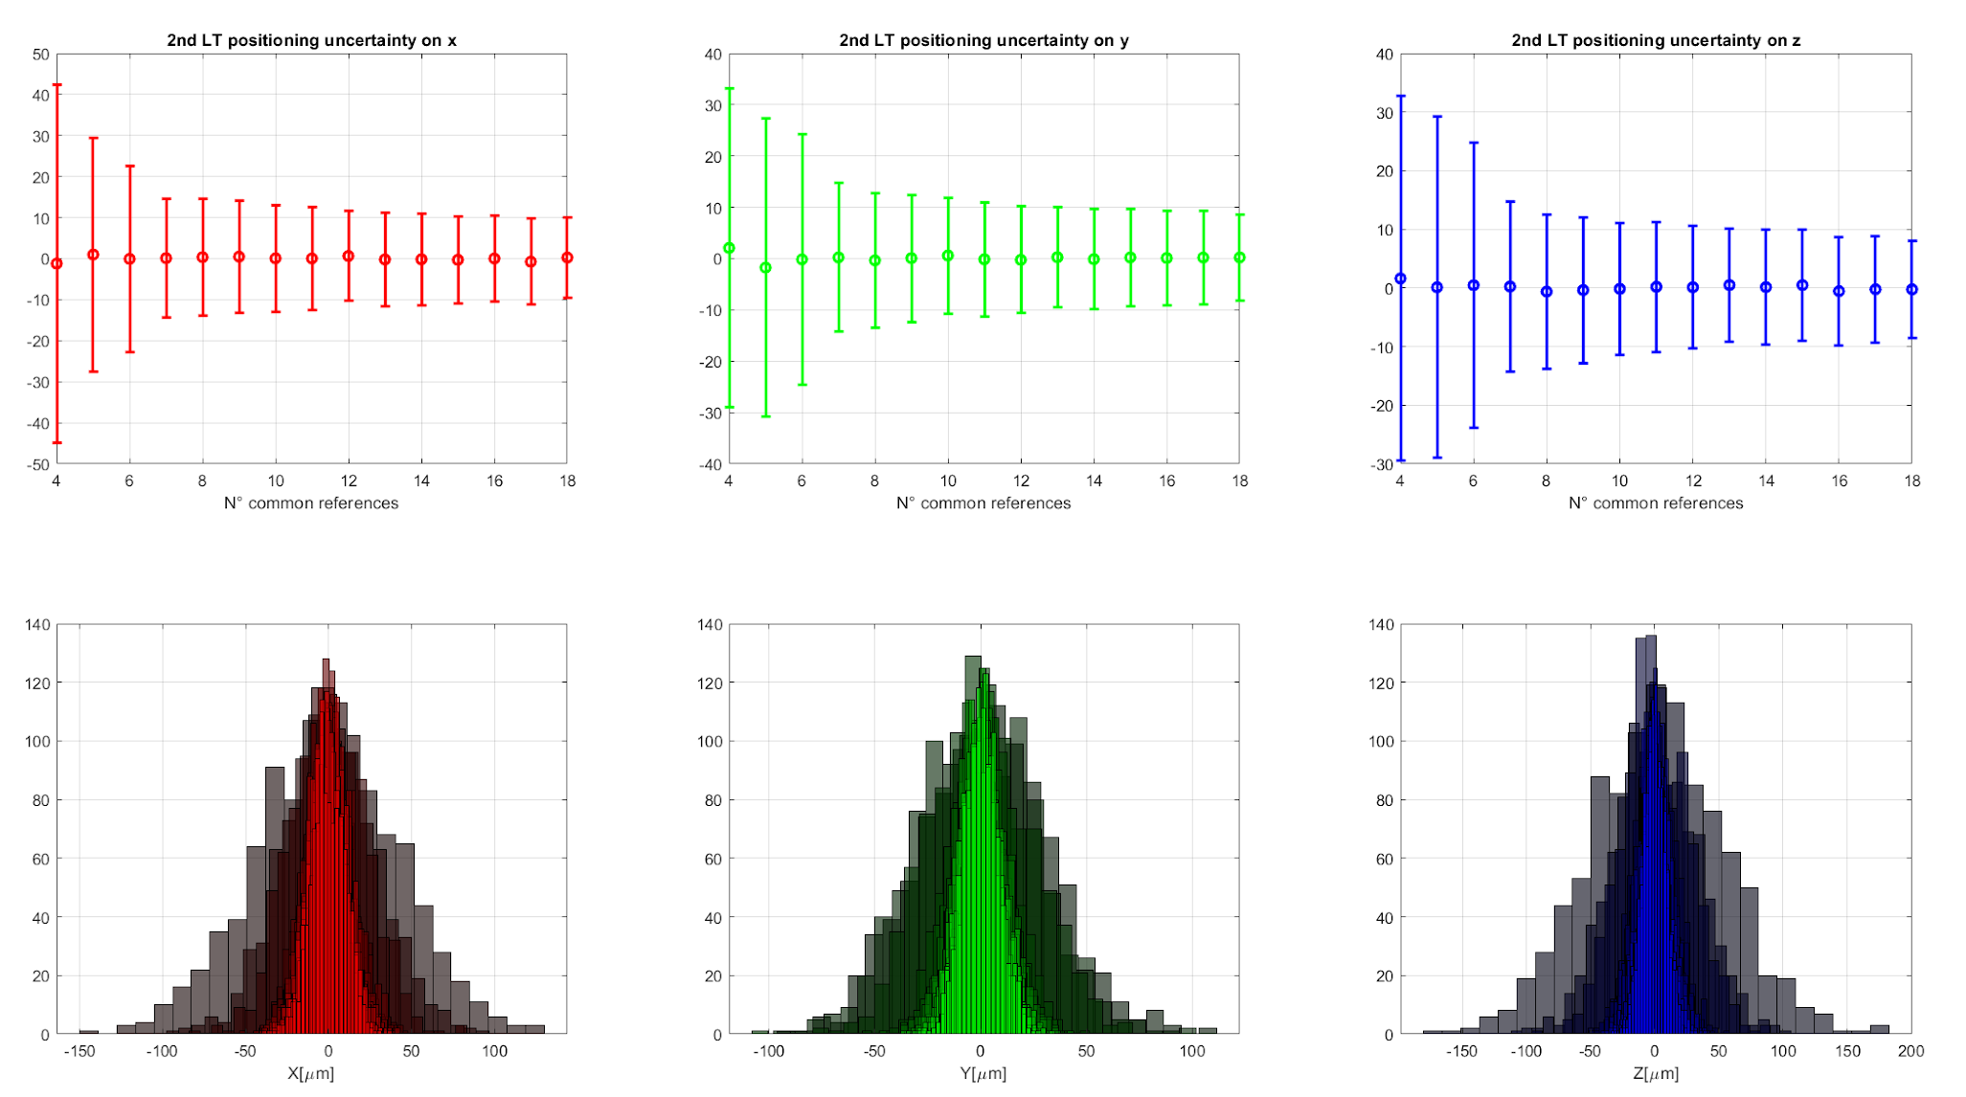
MORFEO – LASER TRACKER
Software structure
Uncertainty Evaluation
Alignment tolerance
Mechanical design
Alignment and monitoring strategy
Accuracy evaluation
Requirements
Optical design

Slide 20
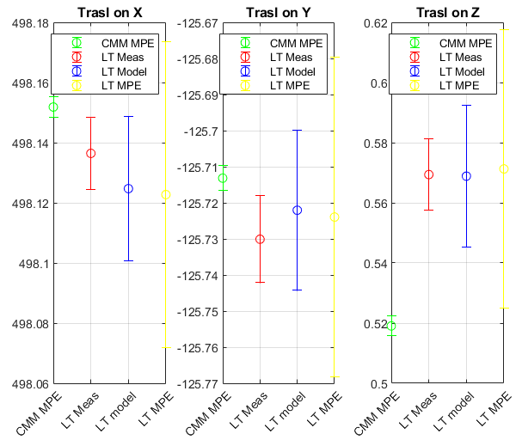
MORFEO – VALIDATION
Validation and Overall MORFEO Uncertainty
Dummy optomechanical element tested— coverage against tolerances
Coverage vs. Tolerances
Validation Approach
Element
Tol. (mm)
σ model
Coverage
A dummy optomechanical element with known geometry was measured simultaneously by the LT and by the CMM (used as ground truth).
Plate
1.0
~25 µm
97–100 %
M6
1.0
~25 µm
88–100 %
M7
2.0
~30 µm
77–100 %
M8
2.0
~30 µm
67–100 %
M9/DM1
2.0
~20 µm
88–100 %
M10/DM2
2.0
~20 µm
100 %

Slide 21
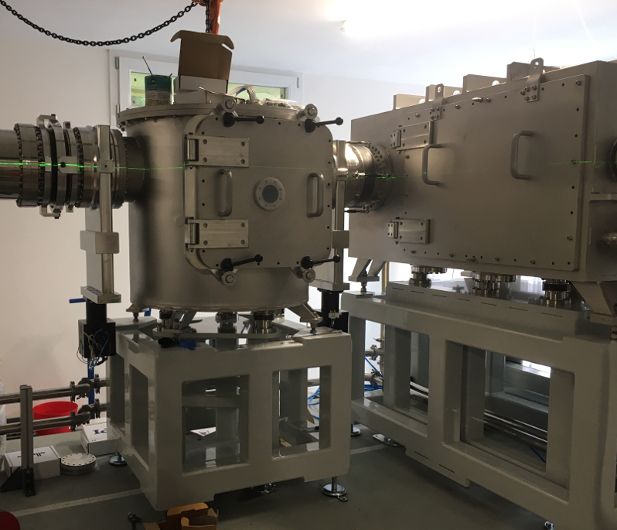
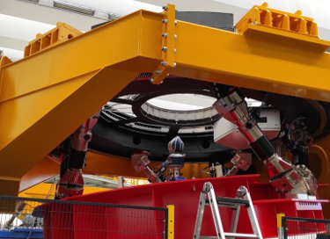
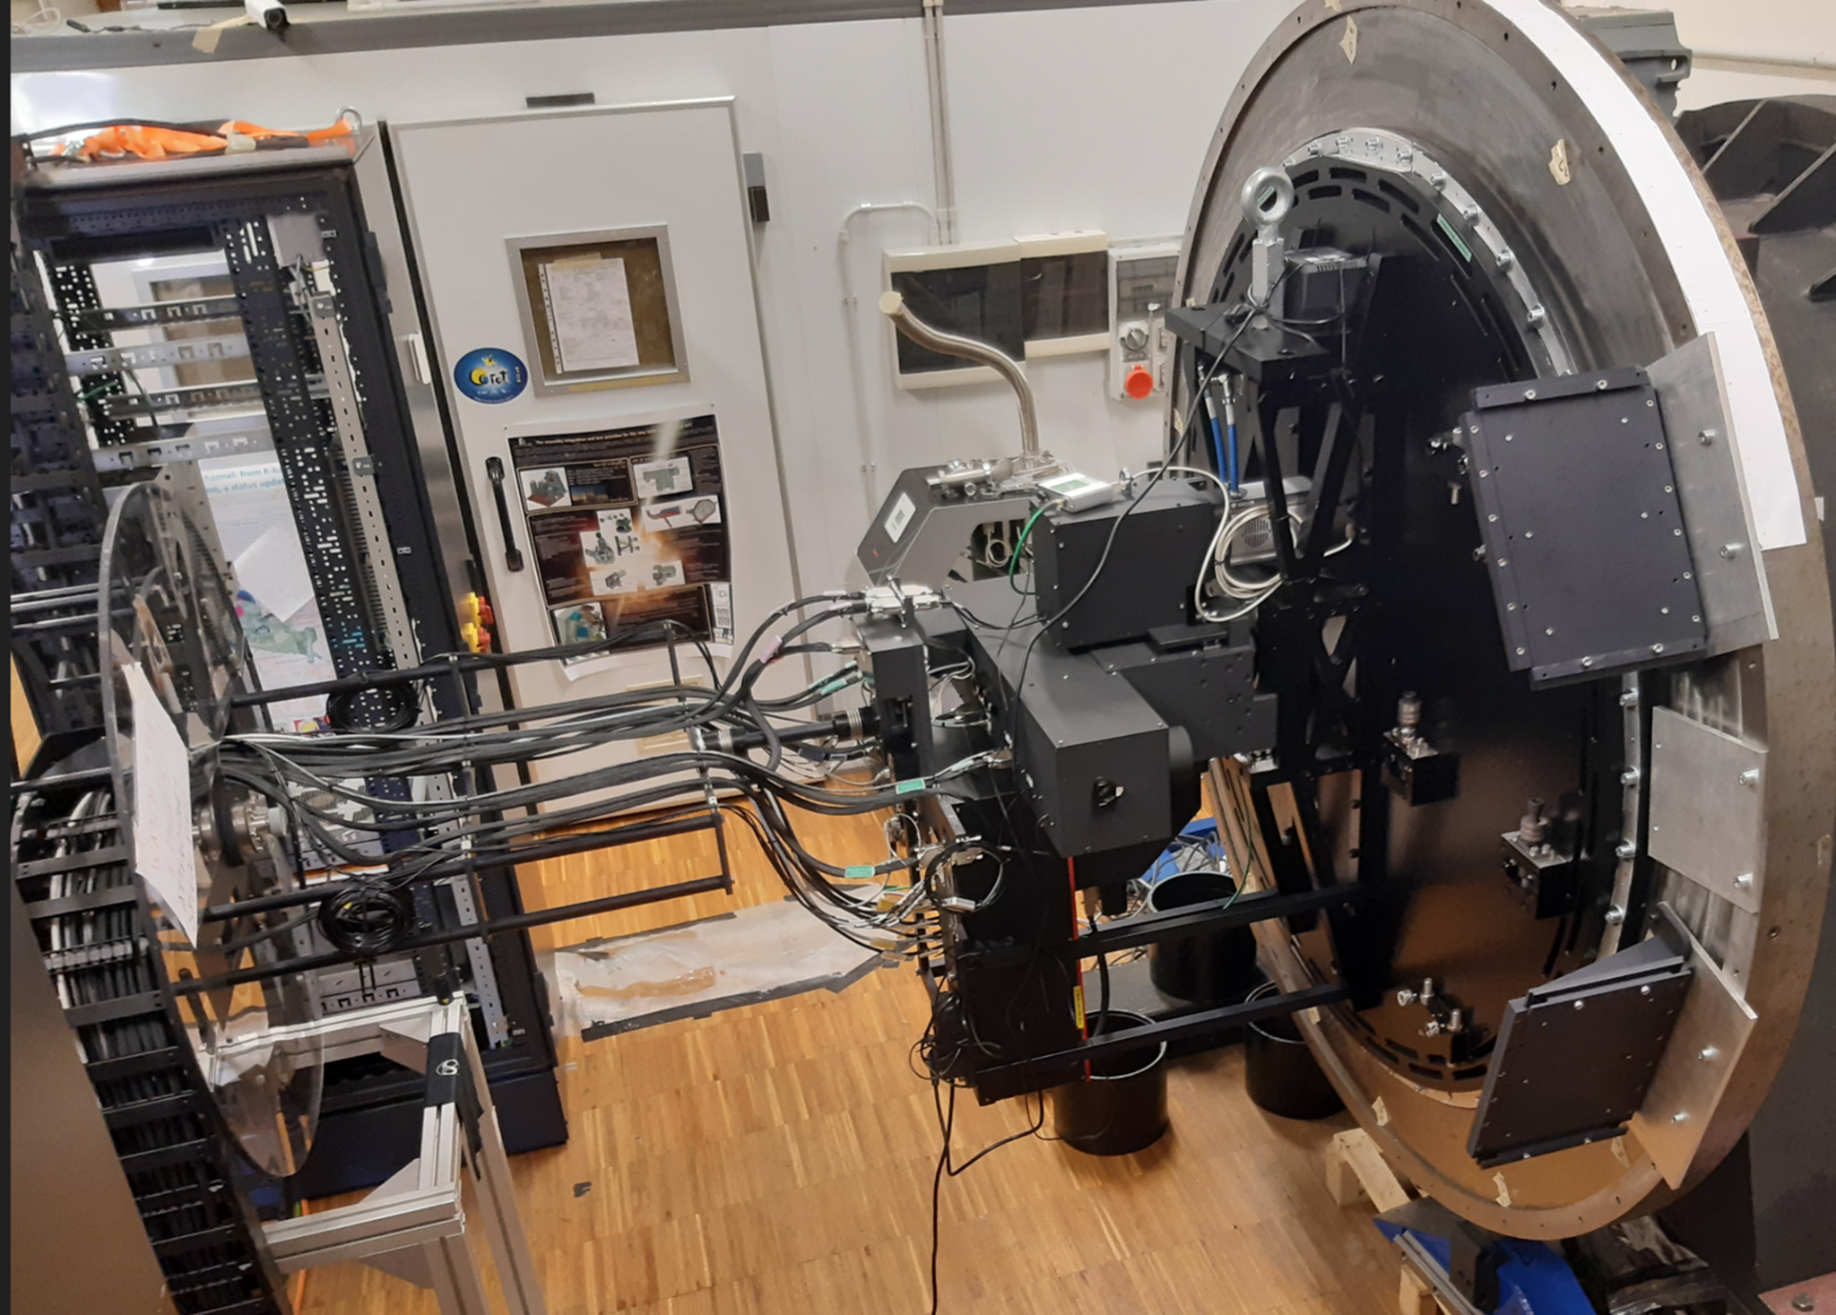






BEATRIX
M4
SOXS
CUBES
MAVIS
FRAMEWORK
The Common Thread: Metrology-Driven Alignment
One scalable philosophy — from VLT bench optics to ELT large-volume systems
ESPRESSO
(VLT)
MORFEO LOR
(ELT)
MORFEO Full
(ELT)
ANDES
(ELT)
CMM + shims
bench scale
CMM + shims
relay bench
Laser Tracker
8×7×4 m
CMM + LT
ESPRESSO
MORFEO LOR
MORFEO
ANDES
Scale: ~0.3 m (ESPRESSO FEU)
→
~1 m (LOR sub-assembly)
→
~250 m³ (MORFEO full)
Deterministic
Traceable
Reproducible
Scalable
One-step assembly, no iterative touch-up
Full metrology report for every element
Re-alignment same process at any phase
CMM for bench — LT for large volumes

Slide 22

OUTLOOK
Extensions: ANDES and Future Instruments
Adapting the framework for next-generation ELT instruments
ANDES —Alignment
High-resolution ELT spectrograph — alignment requirements driven by single-mode fibre coupling efficiency
All the subsystem require internal alignment possibly implemented with CMM or AACMM
The integration of all the subsystem will use the LT to be aligned to the PFS

Slide 23


CONCLUSIONS
Conclusions
ESPRESSO — CMM methodology proven
CMM interaction fully characterised
Deterministic 6-DOF alignment via shim-setting delivered all four Front End Units within spec. Assembly repeatability < 5 µm. First light achieved.
New theoretical model developed and validated. Safe probing conditions established for all optical materials and coatings used in ESPRESSO.
MORFEO — LT strategy developed & validated
A scalable, modular framework
Placement optimisation software, environmental corrections, and SMR characterisation combined into a validated uncertainty model. All elements meet tolerances.
From ~300 mm bench optics to 8×7×4 m instrument volumes — the same philosophy applies. Being extended to ANDES fibre coupling and positioned for all future ELT instruments.

Slide 24
Thank You
Questions & Discussion
ESPRESSO · MORFEO · ANDES …… All other possible instrument

