Slide 1



An introduction to
Multi-Layer Perceptron
and Convolutional Neural Network
Giuseppe Angora
INAF School of AI, Naples, April 14-17

Slide 2
Layout
Theory part (~2h):
Introduction to Perceptron, Multi-Layer Perceptron
Fundamental elements of Neural Network (e.g. Loss function, optimizer, activation functions)
-> Code examples (by using sk-learn and tensorflow packages, SL_Wen_afternoon.ipynb file)
Convolutional Neural Networks
-> Code examples (tensorflow package, SL_Wen_afternoon.ipynb file)
Autoencoders
-> Code examples (tensorflow package, SL_Wen_afternoon.ipynb file)
Coffee Break (~0.5h)
Hans-on session (~1h):
Several exercises (exercises.ipynb file)
to be solved independently (with solutions in solved_exercises.ipynb file)
File summary:
SL_Wen_afternoon.ipynb: examples of neural network implementation
exercises.ipynb: exercises for the hands-on session
solved_exercises.ipynb: (my) solution for the proposed exercises
INAF School of AI, Naples, April 14-17

Slide 3
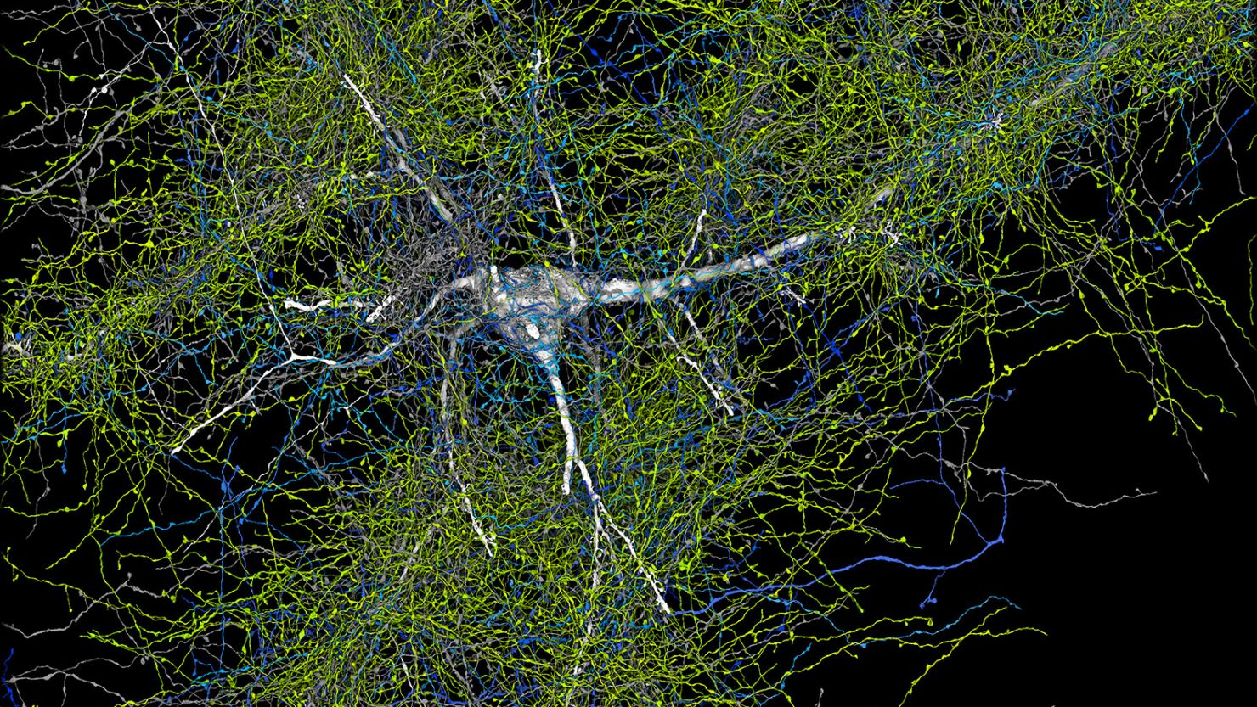
Starting from the biology
Shapson-Coe et al. 2024
INAF School of AI, Naples, April 14-17

Slide 4
Starting from the biology
In homo sapiens:
≥100G neurons
~1k neuron-neuron connections (up to 80k per neuron)
Propagation speed: (min: 500 mm/s – 100 m/s)
Data Volume ~1ZB (10²¹ byte)
~ 50M differential equations to represent a single neuron
Shapson-Coe et al. 2024
INAF School of AI, Naples, April 14-17

Slide 5
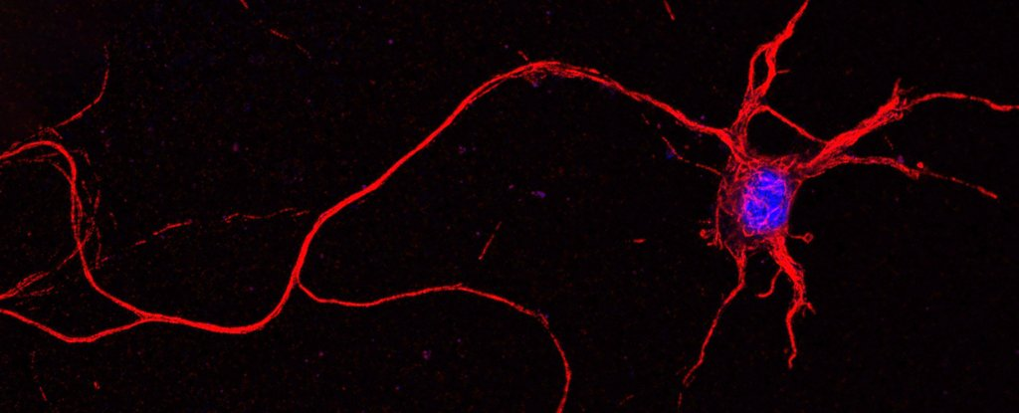
The Perceptron
…
INAF School of AI, Naples, April 14-17

Slide 6









The Perceptron
Hebbian behavior (Hebb, 1949):
The variation of the synaptic connection sensibility (with respect to a certain input signal) is correlated to the learning mechanism
$$x_{1}$$
$$w_{1}$$
$$x_{2}$$
$$w_{2}$$
$$x_{3}$$
$$w_{3}$$
…
$$w_{m}$$
$$x_{m}$$
$$b$$
INAF School of AI, Naples, April 14-17

Slide 7
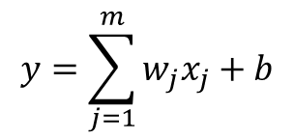
The Perceptron
Hebbian behavior (Hebb, 1949):
The variation of the synaptic connection sensibility (with respect to a certain input signal) is correlated to the learning mechanism
$$x_{1}$$
$$w_{1}$$
$$x_{2}$$
$$w_{2}$$
$$x_{3}$$
$$w_{3}$$
$$y=\sum_{j=1}^{m}{w_{j}x_{j}}+b$$
…
$$w_{m}$$
$$x_{m}$$
$$b$$
INAF School of AI, Naples, April 14-17

Slide 8
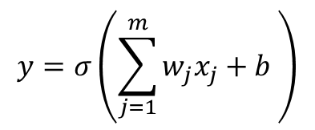
The Perceptron
$$x_{1}$$
Activation function (inspired by biology):
Impose a codomain;
Introduce non-linear elements.
Hebbian behavior (Hebb, 1949):
The variation of the synaptic connection sensibility (with respect to a certain input signal) is correlated to the learning mechanism
$$w_{1}$$
$$x_{2}$$
$$w_{2}$$
$$y=σ\left(\sum_{j=1}^{m}{w_{j}x_{j}}+b \right)$$
$$x_{3}$$
$$w_{3}$$
…
$$w_{m}$$
$$x_{m}$$
$$b$$
INAF School of AI, Naples, April 14-17

Slide 9
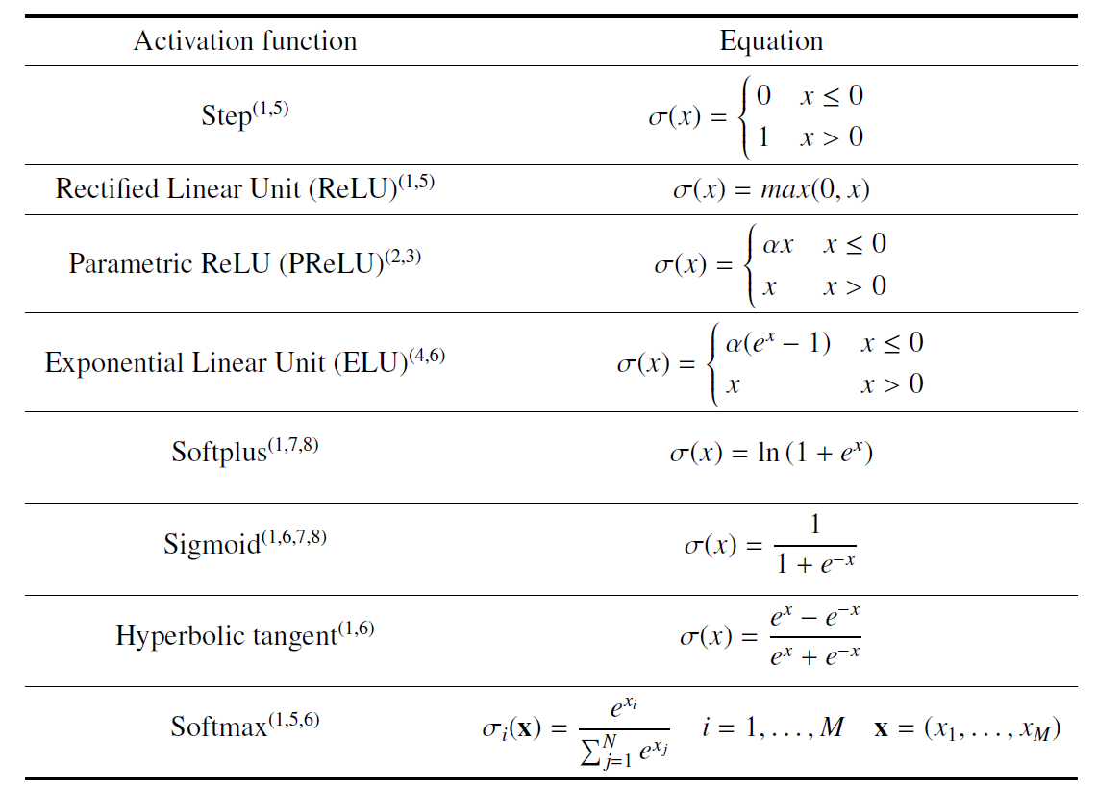
Activation functions
INAF School of AI, Naples, April 14-17

Slide 10
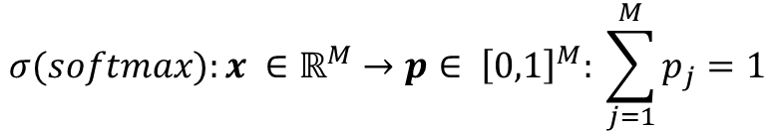
Activation functions
It is required for a classification problem
It maps floating values
into probabilities:
$$σ(softmax):x ∈{\text{ℝ}}^{M}→p∈ {\left[0,1\right]}^{M}: \sum_{j=1}^{M}{p_{j}}=1$$
INAF School of AI, Naples, April 14-17

Slide 11
The Perceptron
$$x_{1}$$
Activation function (inspired by biology):
Impose a codomain;
Introduce non-linear elements.
Hebbian behavior (Hebb, 1949):
The variation of the synaptic connection sensibility (with respect to a certain input signal) is correlated to the learning mechanism
$$w_{1}$$
$$x_{2}$$
$$w_{2}$$
$$y=σ\left(\sum_{j=1}^{m}{w_{j}x_{j}}+b \right)$$
$$x_{3}$$
$$w_{3}$$
…
$$w_{m}$$
$$x_{m}$$
$$b$$
INAF School of AI, Naples, April 14-17

Slide 12
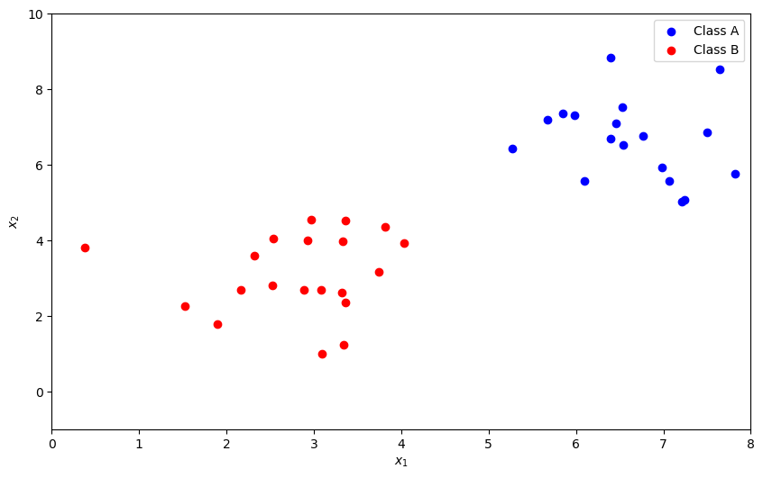
The Perceptron
Let’s suppose two point distributions (class A and B)
INAF School of AI, Naples, April 14-17

Slide 13


The Perceptron
Let’s suppose two point distributions (class A and B)
INAF School of AI, Naples, April 14-17

Slide 14
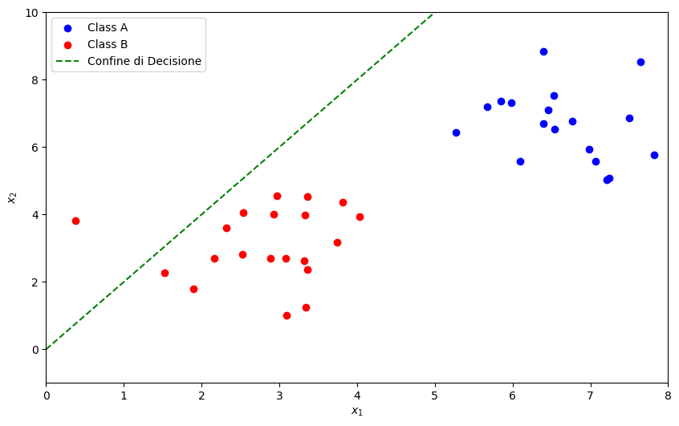

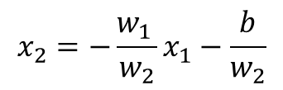

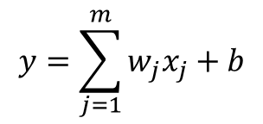
The Perceptron
Let’s suppose two point distributions (class A and B)
Separation line is initially random (i.e. random init for weights)
$$y=\sum_{j=1}^{m}{w_{j}x_{j}}+b$$
$$y=w_{1 }x_{1}+w_{2}x_{2}+b$$
In the $x_{1}$, $x_{2}$ plane (i.e., $y=0$)
$$x_{2}=−\frac{w_{1 }}{w_{2}}x_{1}−\frac{b}{w_{2}}$$
That is a line!
INAF School of AI, Naples, April 14-17

Slide 15
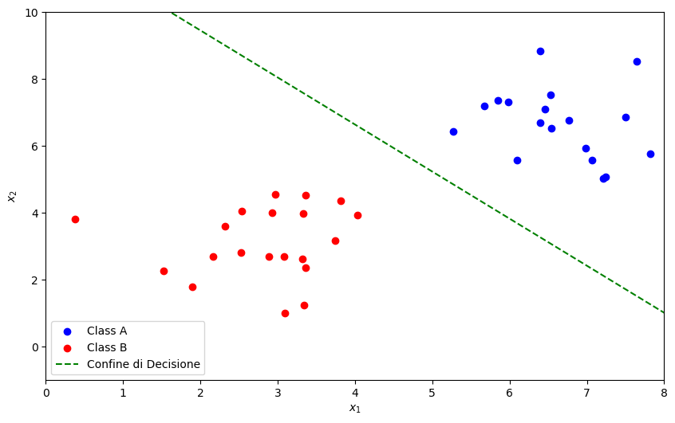
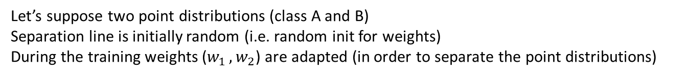
The Perceptron
Let’s suppose two point distributions (class A and B)
Separation line is initially random (i.e. random init for weights)
During the training weights ($w_{1 }, w_{2}$) are adapted (in order to separate the point distributions)
$$y=w_{1 }x_{1}+w_{2}x_{2}+b$$
$$x_{2}=−\frac{w_{1 }}{w_{2}}x_{1}−\frac{b}{w_{2}}$$
INAF School of AI, Naples, April 14-17

Slide 16




The loss functions
$$x_{1}$$
$$w_{1}$$
$$y=w_{1 }x_{1}+w_{2}x_{2}+b$$
The output is compared with the truth (i.e. the labels)
$$w_{2}$$
$$y ? \overline{y}$$
$$x_{2}$$
$$b$$
INAF School of AI, Naples, April 14-17

Slide 17
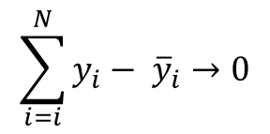
The loss functions
$$x_{1}$$
$$w_{1}$$
$$y=w_{1 }x_{1}+w_{2}x_{2}+b$$
The output is compared with the truth (i.e. the labels)
$$w_{2}$$
$$y ? \overline{y}$$
$$x_{2}$$
We are demanding that all the perceptron outputs are equal to the labels, i.e:
$$b$$
$$\sum_{i=i}^{N}{y_{i}− {\overline{y}}_{i}}→0$$
INAF School of AI, Naples, April 14-17

Slide 18
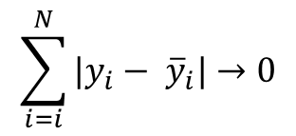
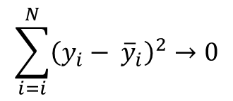
The loss functions
$$x_{1}$$
$$w_{1}$$
$$y=w_{1 }x_{1}+w_{2}x_{2}+b$$
The output is compared with the truth (i.e. the labels)
$$w_{2}$$
$$y ? \overline{y}$$
$$x_{2}$$
We are demanding that all the perceptron outputs are equal to the labels, i.e:
$$b$$
$$\sum_{i=i}^{N}{{\left(y_{i}− {\overline{y}}_{i}\right)}^{2}}→0$$
$$\sum_{i=i}^{N}{|y_{i}− {\overline{y}}_{i}|}→0$$
INAF School of AI, Naples, April 14-17

Slide 19
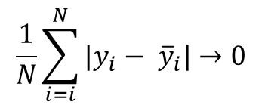
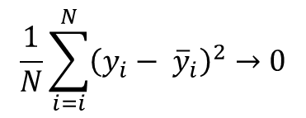
The loss functions
$$x_{1}$$
$$w_{1}$$
$$y=w_{1 }x_{1}+w_{2}x_{2}+b$$
The output is compared with the truth (i.e. the labels)
$$w_{2}$$
$$y ? \overline{y}$$
$$x_{2}$$
We are demanding that all the perceptron outputs are equal to the labels, i.e:
$$b$$
$$\frac{1}{N}\sum_{i=i}^{N}{{\left(y_{i}− {\overline{y}}_{i}\right)}^{2}}→0$$
Mean Square Error (MSE):
$$\frac{1}{N}\sum_{i=i}^{N}{|y_{i}− {\overline{y}}_{i}|}→0$$
Mean Absolute Error (MAE):
INAF School of AI, Naples, April 14-17

Slide 20
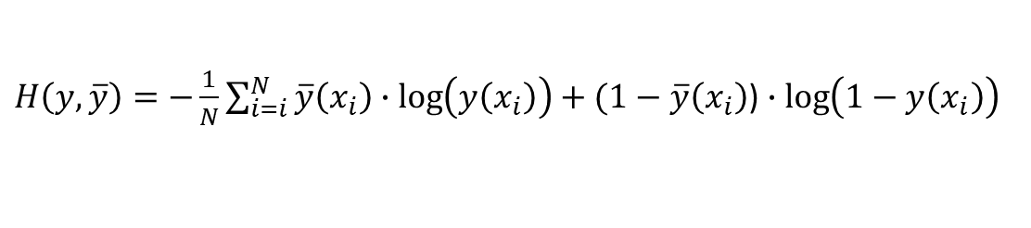
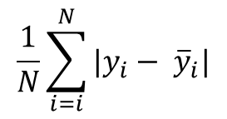
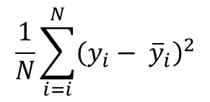
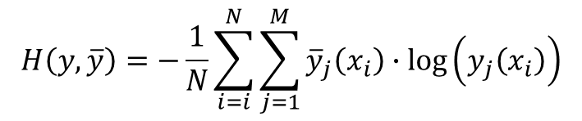
The loss functions
$$x_{1}$$
$$w_{1}$$
$$y=w_{1 }x_{1}+w_{2}x_{2}+b$$
The output is compared with the truth (i.e. the labels)
$$w_{2}$$
$$y ? \overline{y}$$
$$x_{2}$$
We are demanding that all the perceptron outputs are equal to the labels, i.e:
$$b$$
Binary cross-entropy:
$$\frac{1}{N}\sum_{i=i}^{N}{{\left(y_{i}− {\overline{y}}_{i}\right)}^{2}}$$
$H\left(y, \overline{y}\right)=−\frac{1}{N}\sum_{i=i}^{N}{\overline{y}\left(x_{i}\right)∙\log\left(y\left(x_{i}\right)\right)+(1−}$ $\overline{y}\left(x_{i}\right)$) $∙\log\left(1−y\left(x_{i}\right)\right)$
MSE:
M-class generalization:
$$\frac{1}{N}\sum_{i=i}^{N}{|y_{i}− {\overline{y}}_{i}|}$$
$$H\left(y, \overline{y}\right)=−\frac{1}{N}\sum_{i=i}^{N}{\sum_{j=1}^{M}{{\overline{y}}_{j}\left(x_{i}\right)∙\log\left(y_{j}\left(x_{i}\right)\right)}}$$
MAE:
INAF School of AI, Naples, April 14-17

Slide 21
The loss functions
$$x_{1}$$
$$w_{1}$$
$$y=w_{1 }x_{1}+w_{2}x_{2}+b$$
The output is compared with the truth (i.e. the labels)
$$w_{2}$$
$$y ? \overline{y}$$
$$x_{2}$$
We are demanding that all the perceptron outputs are equal to the labels, i.e:
$$b$$
Regression tasks
Binary cross-entropy:
$$\frac{1}{N}\sum_{i=i}^{N}{{\left(y_{i}− {\overline{y}}_{i}\right)}^{2}}$$
$H\left(y, \overline{y}\right)=−\frac{1}{N}\sum_{i=i}^{N}{\overline{y}\left(x_{i}\right)∙\log\left(y\left(x_{i}\right)\right)+(1−}$ $\overline{y}\left(x_{i}\right)$) $∙\log\left(1−y\left(x_{i}\right)\right)$
MSE:
Classification tasks
M-class generalization:
$$\frac{1}{N}\sum_{i=i}^{N}{|y_{i}− {\overline{y}}_{i}|}$$
$$H\left(y, \overline{y}\right)=−\frac{1}{N}\sum_{i=i}^{N}{\sum_{j=1}^{M}{{\overline{y}}_{j}\left(x_{i}\right)∙\log\left(y_{j}\left(x_{i}\right)\right)}}$$
MAE:
INAF School of AI, Naples, April 14-17

Slide 22

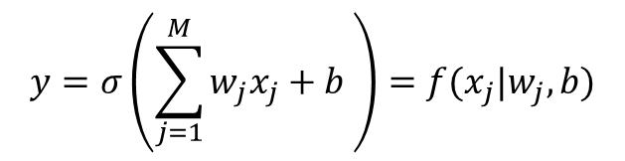





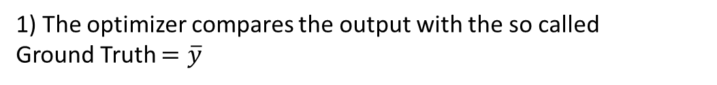



The Optimization: A Recap
$$x_{1}$$
$$w_{1}$$
$$x_{2}$$
$$w_{2}$$
$$y=σ\left(\sum_{j=1}^{M}{w_{j}x_{j}}+b \right)=f(x_{j}|w_{j}, b)$$
$$x_{3}$$
$$w_{3}$$
1) The optimizer compares the output with the so called
Ground Truth $=\overline{y}$
…
$$w_{M}$$
$$x_{m}$$
$$b$$
INAF School of AI, Naples, April 14-17

Slide 23

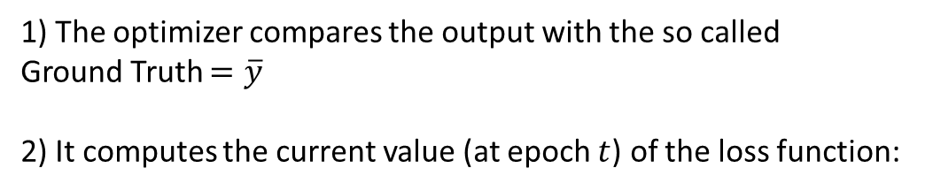
The Optimization: A Recap
$$x_{1}$$
$$w_{1}$$
$$x_{2}$$
$$w_{2}$$
$$y=σ\left(\sum_{j=1}^{M}{w_{j}x_{j}}+b \right)=f(x_{j}|w_{j}, b)$$
$$x_{3}$$
$$w_{3}$$
1) The optimizer compares the output with the so called
Ground Truth $=\overline{y}$
2) It computes the current value (at epoch $t$) of the loss function:
…
$$w_{M}$$
$$x_{m}$$
$$b$$
$C\left(y,\overline{y} \right|w_{j}^{(t)}, b^{(t)}$)
(e.g. MSE, MAE, Cross entropy)
INAF School of AI, Naples, April 14-17

Slide 24
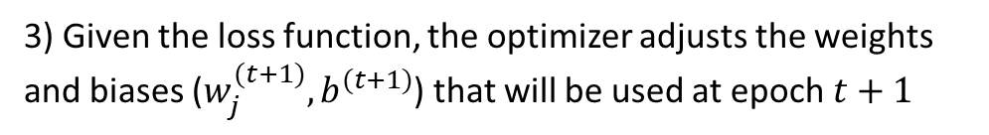
The Optimization: A Recap
$$x_{1}$$
$$w_{1}$$
$$x_{2}$$
$$w_{2}$$
$$y=σ\left(\sum_{j=1}^{M}{w_{j}x_{j}}+b \right)=f(x_{j}|w_{j}, b)$$
$$x_{3}$$
$$w_{3}$$
1) The optimizer compares the output with the so called
Ground Truth $=\overline{y}$
2) It computes the current value (at epoch $t$) of the loss function:
…
$$w_{M}$$
$$x_{m}$$
$$b$$
$C\left(y,\overline{y} \right|w_{j}^{(t)}, b^{(t)}$)
(e.g. MSE, MAE, Cross entropy)
3) Given the loss function, the optimizer adjusts the weights and biases ($w_{j}^{(t+1)}, b^{(t+1)}$) that will be used at epoch $t+1$
INAF School of AI, Naples, April 14-17

Slide 25
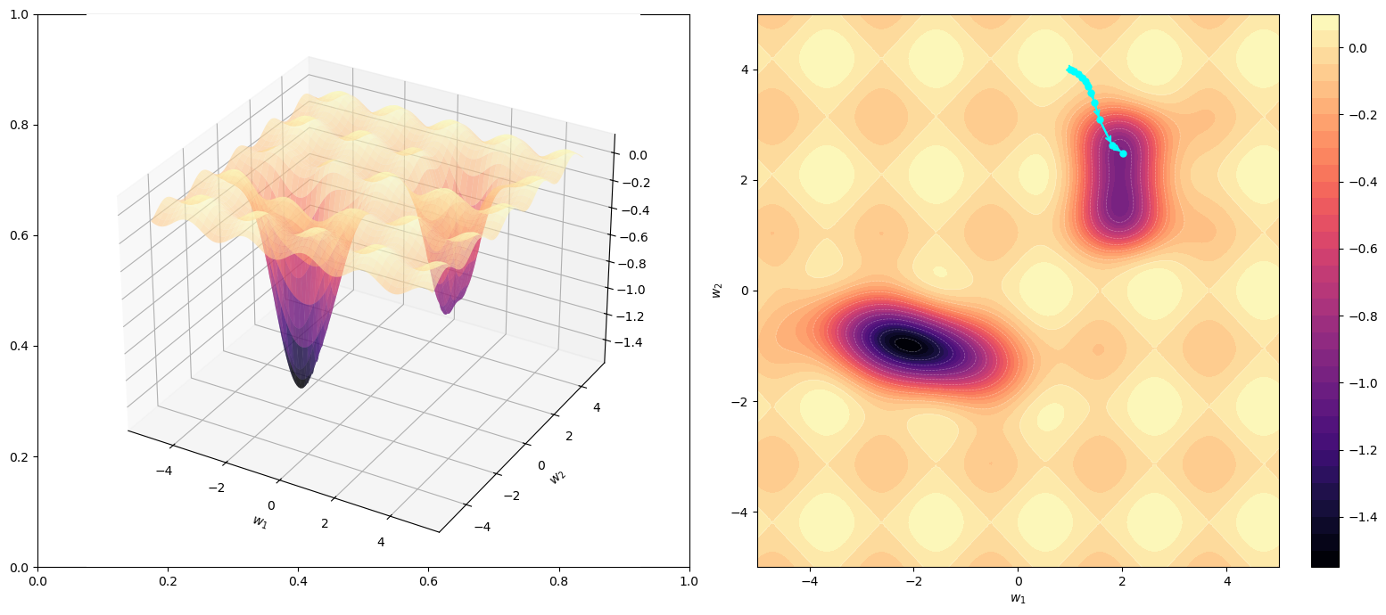


The Optimization
The simplest optimizer is the Stochastic Gradient Descent (SGD)
Let’s suppose this is the loss function:
+ Local Minima
+
+
2D projection
in the $w_{1},w_{2}$plane
x
x Global Minimum
INAF School of AI, Naples, April 14-17

Slide 26
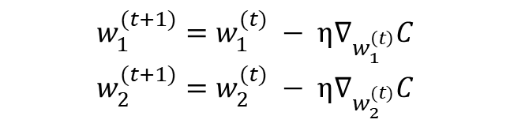


The Optimization
The simplest optimizer is the Stochastic Gradient Descent (SGD)
The SGD searches for a path toward the minimum, by computing the gradient of the loss function:
$C\left(y,\overline{y} \right|w_{1}^{(t)},w_{2}^{(t)}$)
+ Local Minima
$$∇_{w_{1}^{(t)}}C,∇_{w_{2}^{(t)}}C$$
+
SGD adaptation rule:
+
$$w_{1}^{(t+1)}=w_{1}^{(t)} − η∇_{w_{1}^{\left(t\right)}}C$$
$$w_{2}^{(t+1)}=w_{2}^{(t)} − η∇_{w_{2}^{(t)}}C$$
x
x Global Minimum
INAF School of AI, Naples, April 14-17

Slide 27
The Optimization
The simplest optimizer is the Stochastic Gradient Descent (SGD)
The SGD searches for a path toward the minimum, by computing the gradient of the loss function:
What could possibly go wrong?
$C\left(y,\overline{y} \right|w_{1}^{(t)},w_{2}^{(t)}$)
SGD Path
$$∇_{w_{1}^{(t)}}C,∇_{w_{2}^{(t)}}C$$
SGD adaptation rule:
$$w_{1}^{(t+1)}=w_{1}^{(t)} − η∇_{w_{1}^{\left(t\right)}}C$$
$$w_{2}^{(t+1)}=w_{2}^{(t)} − η∇_{w_{2}^{(t)}}C$$
INAF School of AI, Naples, April 14-17

Slide 28
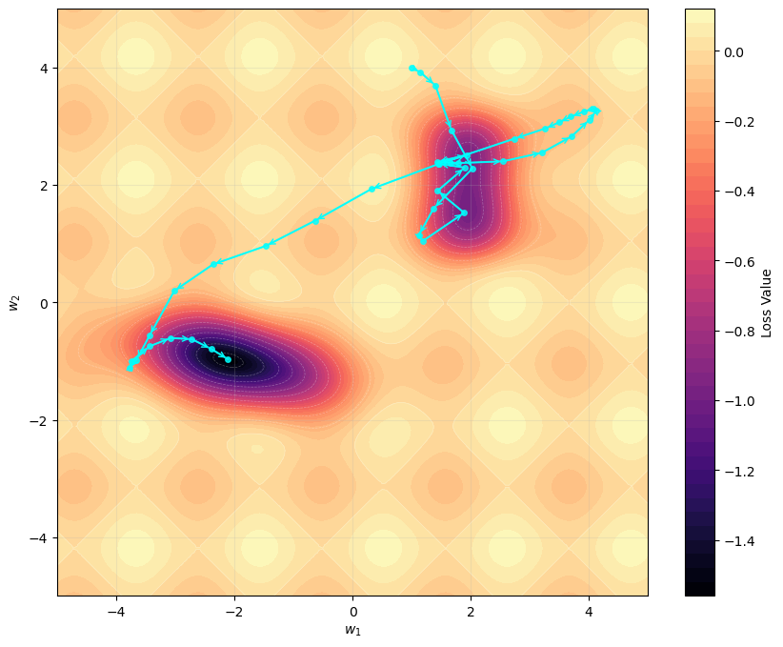




The Optimization
The simplest optimizer is the Stochastic Gradient Descent (SGD)
The SGD searches for a path toward the minimum, by computing the gradient of the loss function:
$C\left(y,\overline{y} \right|w_{j}^{(t)}$)
$∇_{w_{j}^{(t)}}C(w_{j}^{(t)}$)
NAG Path
SGD adaptation rule:
$$w_{j}^{(t+1)}=w_{j}^{(t)} − η∇_{w_{j}^{\left(t\right)}}C(w_{j}^{(t)}\text{)}$$
Nesterov Accelerated Gradient - NAG adaptation rule:
$$w_{j}^{(t+1)}=w_{j}^{(t)} − η∇_{w_{j}^{\left(t\right)}}C(w_{j}^{\left(t\right)}−γη∇_{w_{j}^{\left(t\right)}}C\text{)}$$
Nesterov momentum
INAF School of AI, Naples, April 14-17

Slide 29
The Optimization
A lot of Optimizers:
SGD (Stochastic Gradient Descent)
NAV (Nesterov Accelerated Gradient, i.e. SGD with Nesterov Momentum)
Adagrad (Adaptive Gradient Algorithm): automatic adaptation of the learning rate during the training
Adam (Adaptive Momentum Estimation): by using a decay memory of the past gradients, the adaptation is based on the mean and squared mean of the past gradients
L-BFGS (Limited-memory Broyden-Fletcher-Goldfar-Shanno): it estimates and uses the Hessian
Optimizer | Pro | Con
SGD | Easy, fast | Slow Convergence, local minima problem
NAG | Stable, tries to avoid local minima | Require manual synchronization of the learning rate
Adagrad | Not require learning rate reduction | Learning rate decays fast, it could “dye”
Adam | Fast, robust | Affected by local minima problem
L-BFGS | Extremely precise | Computational expensive, not suitable for very deep networks
INAF School of AI, Naples, April 14-17

Slide 30
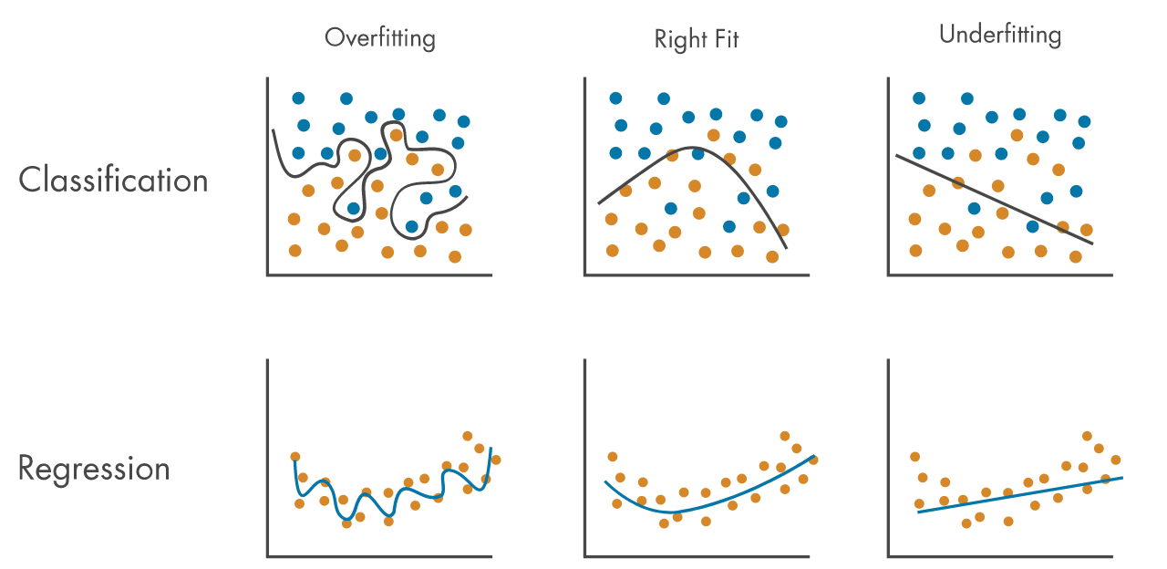
Regularization techniques
Overfitting: is the tendency of an algorithm to extract more information than necessary to capture the noise-less signal from the training set, which results to a hyper-specialization, preventing the gain of generalization.
Underfitting: is the condition that occurs when the model is not able to extract abstract properties during the training phase; in it could be the result of insufficient capacity, insufficient training, or insufficient information retention.
INAF School of AI, Naples, April 14-17

Slide 31
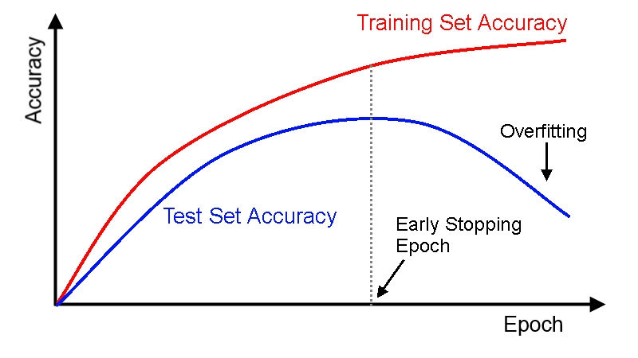
Regularization techniques
Overfitting: is the tendency of an algorithm to extract more information than necessary to capture the noise-less signal from the training set, which results to a hyper-specialization, preventing the gain of generalization.
Underfitting: is the condition that occurs when the model is not able to extract abstract properties during the training phase; in it could be the result of insufficient capacity, insufficient training, or insufficient information retention.
Underfitting and overfitting can be prevented with regularization techniques:
- Early stopping criteria;
- Best-model check point;
- Reducing the learning-rate (as a function of the epochs);
- Weight decay (a.k.a. L2 regularization)
- Dropout
- Intruding adversarial examples
- Many other approaches (see, e.g, Goodfellow +2016)
Train Set Accuracy
Overfitting
Test Set Accuracy
Early Stopping Epoch
Best-model check point
INAF School of AI, Naples, April 14-17

Slide 32
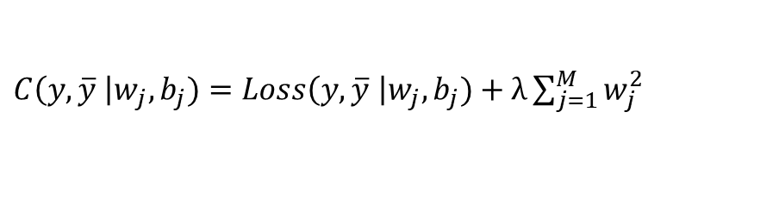
Regularization techniques
Overfitting: is the tendency of an algorithm to extract more information than necessary to capture the noise-less signal from the training set, which results to a hyper-specialization, preventing the gain of generalization.
Underfitting: is the condition that occurs when the model is not able to extract abstract properties during the training phase; in it could be the result of insufficient capacity, insufficient training, or insufficient information retention.
Underfitting and overfitting can be prevented with regularization techniques:
- Early stopping criteria;
- Best-model check point;
- Reducing the learning-rate (as a function of the epochs);
- Weight decay (a.k.a. L2 regularization)
- Dropout
- Intruding adversarial examples
- Many other approaches (see, e.g, Goodfellow +2016)
e.g. MAE, MSE, Cross-Entropy
L2-term
$C\left(y,\overline{y} \right|w_{j},b_{j})=Loss\left(y,\overline{y} \right|w_{j},b_{j})+λ\sum_{j=1}^{M}{w_{j}^{2}}$
INAF School of AI, Naples, April 14-17

Slide 33
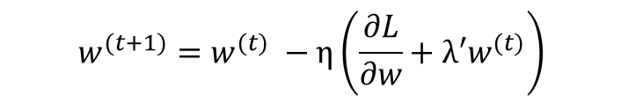
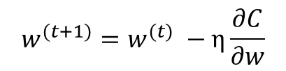

Regularization techniques
Overfitting: is the tendency of an algorithm to extract more information than necessary to capture the noise-less signal from the training set, which results to a hyper-specialization, preventing the gain of generalization.
Underfitting: is the condition that occurs when the model is not able to extract abstract properties during the training phase; in it could be the result of insufficient capacity, insufficient training, or insufficient information retention.
Underfitting and overfitting can be prevented with regularization techniques:
- Early stopping criteria;
- Best-model check point;
- Reducing the learning-rate (as a function of the epochs);
- Weight decay (a.k.a. L2 regularization)
- Dropout
- Intruding adversarial examples
- Many other approaches (see, e.g, Goodfellow +2016)
e.g. MAE, MSE, Cross-Entropy
L2-term
$C\left(y,\overline{y} \right|w_{j},b_{j})=Loss\left(y,\overline{y} \right|w_{j},b_{j})+λ\sum_{j=1}^{M}{w_{j}^{2}}$
$$\frac{∂C}{∂w}=\frac{∂L}{∂w}+2λw$$
$$w^{(t+1)}=w^{(t)} −η\frac{∂C}{∂w}$$
$$w^{(t+1)}=w^{(t)} −η\left(\frac{∂L}{∂w}+λ′w^{(t)}\right)$$
INAF School of AI, Naples, April 14-17

Slide 34

Regularization techniques
Overfitting: is the tendency of an algorithm to extract more information than necessary to capture the noise-less signal from the training set, which results to a hyper-specialization, preventing the gain of generalization.
Underfitting: is the condition that occurs when the model is not able to extract abstract properties during the training phase; in it could be the result of insufficient capacity, insufficient training, or insufficient information retention.
Underfitting and overfitting can be prevented with regularization techniques:
- Early stopping criteria;
- Best-model check point;
- Reducing the learning-rate (as a function of the epochs);
- Weight decay (a.k.a. L2 regularization)
- Dropout
- Intruding adversarial examples
- Many other approaches (see, e.g, Goodfellow +2016)
e.g. MAE, MSE, Cross-Entropy
L2-term
$C\left(y,\overline{y} \right|w_{j},b_{j})=Loss\left(y,\overline{y} \right|w_{j},b_{j})+λ\sum_{j=1}^{M}{w_{j}^{2}}$
$$\frac{∂C}{∂w}=\frac{∂L}{∂w}+2λw$$
$$w^{(t+1)}=w^{(t)} −η\frac{∂C}{∂w}$$
$$w^{(t+1)}={\left(1−ηλ^{′}\right)w}^{(t)} −η\frac{∂L}{∂w}$$
Decay term: weights contraction, before the gradient subtraction
INAF School of AI, Naples, April 14-17

Slide 35

Regularization techniques
Overfitting: is the tendency of an algorithm to extract more information than necessary to capture the noise-less signal from the training set, which results to a hyper-specialization, preventing the gain of generalization.
Underfitting: is the condition that occurs when the model is not able to extract abstract properties during the training phase; in it could be the result of insufficient capacity, insufficient training, or insufficient information retention.
Underfitting and overfitting can be prevented with regularization techniques:
- Early stopping criteria;
- Best-model check point;
- Reducing the learning-rate (as a function of the epochs);
- Weight decay (a.k.a. L2 regularization)
- Dropout
- Intruding adversarial examples
- Many other approaches (see, e.g, Goodfellow +2016)
e.g. MAE, MSE, Cross-Entropy
L2-term
$C\left(y,\overline{y} \right|w_{j},b_{j})=Loss\left(y,\overline{y} \right|w_{j},b_{j})+λ\sum_{j=1}^{M}{w_{j}^{2}}$
$$w^{(t+1)}={\left(1−ηλ^{′}\right)w}^{(t)} −η\frac{∂L}{∂w}$$
Weight Decay:
- the weights remain small, it prevents the network from overreacting to small changes in the input
- it encourages the network to distribute the weight more evenly
- smaller weights tend to keep the network in a more “linear” regime, making the learning curve smoother
INAF School of AI, Naples, April 14-17

Slide 36
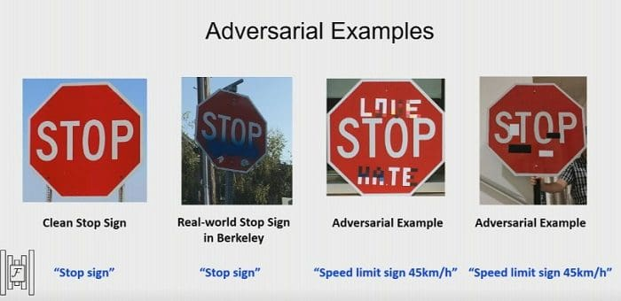
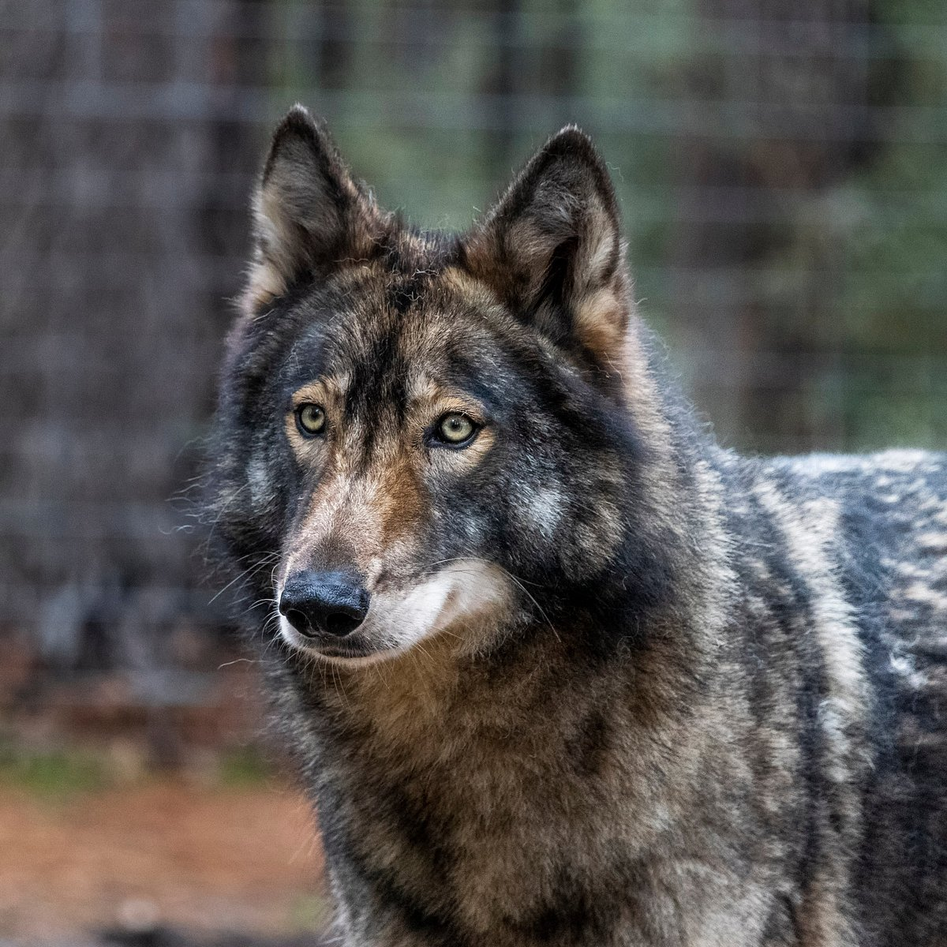
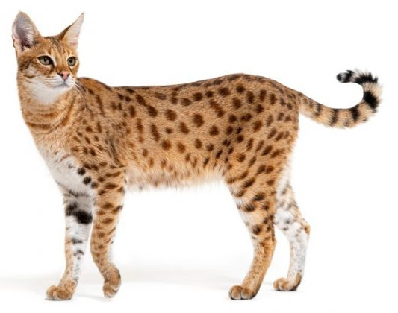
Regularization techniques
Overfitting: is the tendency of an algorithm to extract more information than necessary to capture the noise-less signal from the training set, which results to a hyper-specialization, preventing the gain of generalization.
Underfitting: is the condition that occurs when the model is not able to extract abstract properties during the training phase; in it could be the result of insufficient capacity, insufficient training, or insufficient information retention.
Underfitting and overfitting can be prevented with regularization techniques:
- Early stopping criteria;
- Best-model check point;
- Reducing the learning-rate (as a function of the epochs);
- Weight decay (a.k.a. L2 regularization)
- Dropout
- Intruding adversarial examples
- Many other approaches (see, e.g, Goodfellow +2016)
INAF School of AI, Naples, April 14-17

Slide 37
Regularization techniques
Overfitting: is the tendency of an algorithm to extract more information than necessary to capture the noise-less signal from the training set, which results to a hyper-specialization, preventing the gain of generalization.
Underfitting: is the condition that occurs when the model is not able to extract abstract properties during the training phase; in it could be the result of insufficient capacity, insufficient training, or insufficient information retention.
Underfitting and overfitting can be prevented with regularization techniques:
- Early stopping criteria;
- Best-model check point;
- Reducing the learning-rate (as a function of the epochs);
- Weight decay (a.k.a. L2 regularization)
- Dropout
- Intruding adversarial examples
- Many other approaches (see, e.g, Goodfellow +2016)
Adversarial examples in the dataset:
- Prevent hyper specialization on the training set
- Methods are trained on real world complex situations
INAF School of AI, Naples, April 14-17

Slide 38
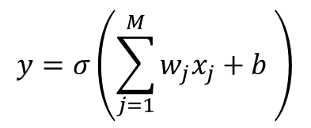
The Multi-Layer Perceptron
$$x_{1}$$
$$w_{1}$$
$$x_{2}$$
$$w_{2}$$
$$y=σ\left(\sum_{j=1}^{M}{w_{j}x_{j}}+b \right)$$
$$x_{3}$$
$$w_{3}$$
…
$$w_{M}$$
$$x_{m}$$
$$b$$
INAF School of AI, Naples, April 14-17

Slide 39

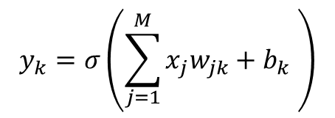










The Multi-Layer Perceptron
$$x_{1}$$
$$w_{1k}$$
$${\{neuron\}}_{k=1}^{L}$$
$$x_{2}$$
$$w_{2k}$$
$$y_{k}=σ\left(\sum_{j=1}^{M}{x_{j}w_{jk}}+b_{k} \right)$$
$$x_{3}$$
$$w_{3k}$$
$${neuron}_{k}$$
…
$$w_{mk}$$
$$x_{m}$$
$$b_{k}$$
INAF School of AI, Naples, April 14-17

Slide 40













The Multi-Layer Perceptron
Dense or fully-connected layer
Hidden Layer
$$x_{1}$$
$$w_{1k}$$
$${\{neuron\}}_{k=1}^{L}$$
Input layer
$$w_{11}$$
$$n_{1}$$
$$x_{2}$$
$$w_{2k}$$
$$y_{1}$$
$$y_{k}=σ\left(\sum_{j=1}^{M}{x_{j}w_{jk}}+b_{k} \right)$$
$$x_{1}$$
$$w_{21}$$
$$w_{31}$$
$$n_{2}$$
Output layer
$$x_{3}$$
$$w_{3k}$$
$${neuron}_{k}$$
$$y$$
$$x_{2}$$
…
$$n_{3}$$
$$x_{3}$$
$$w_{Mk}$$
$$x_{m}$$
$$b_{k}$$
$$n_{4}$$
INAF School of AI, Naples, April 14-17

Slide 41






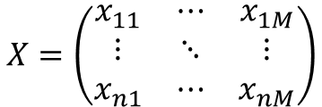


The Multi-Layer Perceptron
The input is represented as a matrix,
i.e. N samples, each of them is an M-dimensional vector, (N, M)
Dense or fully-connected layer
$$X=\left(\begin{matrix}x_{11} & ⋯ & x_{1M} \\ ⋮ & ⋱ & ⋮ \\ x_{n1} & ⋯ & x_{nM}\end{matrix}\right)$$
Input layer
$$n_{1}$$
$$x_{i1}$$
$$n_{2}$$
Output layer
$$x_{i2}$$
$$y_{i}$$
$$n_{3}$$
$$x_{i3}$$
$$n_{4}$$
INAF School of AI, Naples, April 14-17

Slide 42
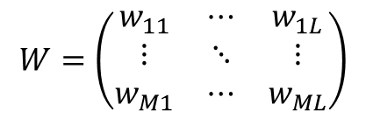
The Multi-Layer Perceptron
The input is represented as a matrix,
i.e. N samples, each of them is an m-dimensional vector, (N, M)
Dense or fully-connected layer
$$X=\left(\begin{matrix}x_{11} & ⋯ & x_{1M} \\ ⋮ & ⋱ & ⋮ \\ x_{n1} & ⋯ & x_{nM}\end{matrix}\right)$$
Input layer
$$n_{1}$$
$$x_{i1}$$
$$n_{2}$$
Output layer
Similarly, the weights can be represented as a matrix,
i.e. L neurons, each of them is a M-dimensional vector, (M, L)
$$x_{i2}$$
$$y_{i}$$
$$n_{3}$$
$$W=\left(\begin{matrix}w_{11} & ⋯ & w_{1L} \\ ⋮ & ⋱ & ⋮ \\ w_{M1} & ⋯ & w_{ML}\end{matrix}\right)$$
$$x_{i3}$$
$$n_{4}$$
INAF School of AI, Naples, April 14-17

Slide 43
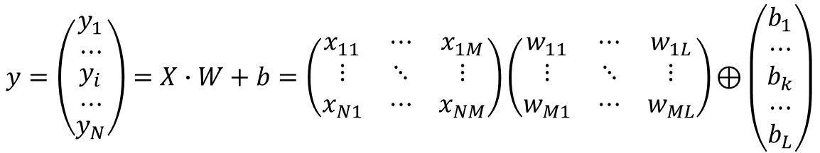
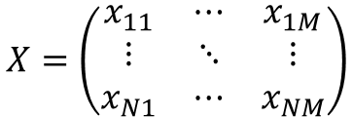
The Multi-Layer Perceptron
The input is represented as a matrix,
i.e. N samples, each of them is an m-dimensional vector, (N, M)
Dense or fully-connected layer
$$X=\left(\begin{matrix}x_{11} & ⋯ & x_{1M} \\ ⋮ & ⋱ & ⋮ \\ x_{N1} & ⋯ & x_{NM}\end{matrix}\right)$$
Input layer
$$n_{1}$$
$$x_{i1}$$
$$n_{2}$$
Output layer
Similarly, the weights can be represented as a matrix,
i.e. L neurons, each of them is a m-dimensional vector, (M, L)
$$x_{i2}$$
$$y_{i}$$
$$n_{3}$$
$$W=\left(\begin{matrix}w_{11} & ⋯ & w_{1L} \\ ⋮ & ⋱ & ⋮ \\ w_{M1} & ⋯ & w_{ML}\end{matrix}\right)$$
$$x_{i3}$$
$$n_{4}$$
Dense layer equation:
$$y=\left(\begin{matrix}\begin{aligned}y_{1} \\ ⋯\end{aligned} \\ \begin{aligned}y_{i} \\ ⋯\end{aligned} \\ y_{N}\end{matrix}\right)=X∙W+b=\left(\begin{matrix}x_{11} & ⋯ & x_{1M} \\ ⋮ & ⋱ & ⋮ \\ x_{N1} & ⋯ & x_{NM}\end{matrix}\right)\left(\begin{matrix}w_{11} & ⋯ & w_{1L} \\ ⋮ & ⋱ & ⋮ \\ w_{M1} & ⋯ & w_{ML}\end{matrix}\right)\text{⊕}\left(\begin{matrix}\begin{aligned}b_{1} \\ ⋯\end{aligned} \\ \begin{aligned}b_{k} \\ ⋯\end{aligned} \\ b_{L}\end{matrix}\right)$$
INAF School of AI, Naples, April 14-17

Slide 44


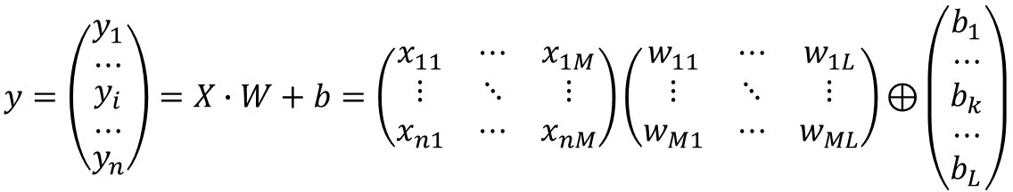

The Multi-Layer Perceptron
The input is represented as a matrix,
i.e. N samples, each of them is an m-dimensional vector, (N, M)
Dense or fully-connected layer
$$X=\left(\begin{matrix}x_{11} & ⋯ & x_{1M} \\ ⋮ & ⋱ & ⋮ \\ x_{n1} & ⋯ & x_{nM}\end{matrix}\right)$$
Input layer
$$n_{1}$$
$$x_{i1}$$
$$n_{2}$$
Output layer
Similarly, the weights can be represented as a matrix,
i.e. L neurons, each of them is a m-dimensional vector, (M, L)
$$x_{i2}$$
$$y_{i}$$
$$n_{3}$$
$$W=\left(\begin{matrix}w_{11} & ⋯ & w_{1L} \\ ⋮ & ⋱ & ⋮ \\ w_{M1} & ⋯ & w_{ML}\end{matrix}\right)$$
$$x_{i3}$$
$$n_{4}$$
Dense layer equation:
$$y=\left(\begin{matrix}\begin{aligned}y_{1} \\ ⋯\end{aligned} \\ \begin{aligned}y_{i} \\ ⋯\end{aligned} \\ y_{n}\end{matrix}\right)=X∙W+b=\left(\begin{matrix}x_{11} & ⋯ & x_{1M} \\ ⋮ & ⋱ & ⋮ \\ x_{n1} & ⋯ & x_{nM}\end{matrix}\right)\left(\begin{matrix}w_{11} & ⋯ & w_{1L} \\ ⋮ & ⋱ & ⋮ \\ w_{M1} & ⋯ & w_{ML}\end{matrix}\right)\text{⊕}\left(\begin{matrix}\begin{aligned}b_{1} \\ ⋯\end{aligned} \\ \begin{aligned}b_{k} \\ ⋯\end{aligned} \\ b_{L}\end{matrix}\right)$$
→
$y_{i}=x_{ij}w_{jk}\text{+}b_{k}$
$$y_{i}=σ\left(x_{ij}w_{jk}\text{+}b_{k}\right)$$
(by including the activation function, $σ$)
→
INAF School of AI, Naples, April 14-17

Slide 45











Adaptation mechanism: forward-backward propagation
$$X$$
Forward propagation
$$y=f(X|W^{\left(t\right)}, b^{(t)})$$
$$n_{1}$$
$$x_{i1}$$
$$n_{2}$$
$$y_{i1}$$
$$x_{i2}$$
$$n_{3}$$
$$y_{i2}$$
$$x_{i3}$$
$$n_{4}$$
INAF School of AI, Naples, April 14-17

Slide 46


Adaptation mechanism: forward-backward propagation
Forward propagation
Ground Truth
$$=\overline{y}$$
$$X$$
$$y=f(X|W^{\left(t\right)}, b^{(t)})$$
$C\left(y,\overline{y} \right|W^{\left(t\right)}, b^{(t)}$)
$$n_{1}$$
e.g. MSE, MAE, Cross entropy
$$x_{i1}$$
$$n_{2}$$
$$y_{i1}$$
$$x_{i2}$$
$$n_{3}$$
$$y_{i2}$$
$$x_{i3}$$
$$n_{4}$$
INAF School of AI, Naples, April 14-17

Slide 47

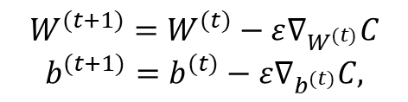
Adaptation mechanism: forward-backward propagation
Forward propagation
Ground Truth
$$=\overline{y}$$
$$X$$
$$y=f(X|W^{\left(t\right)}, b^{(t)})$$
$C\left(y,\overline{y} \right|W^{\left(t\right)}, b^{(t)}$)
$$n_{1}$$
$$x_{i1}$$
$$n_{2}$$
$$y_{i1}$$
$$x_{i2}$$
$$∇_{W^{(t)}}C,∇_{b^{(t)}}C$$
$$n_{3}$$
$$y_{i2}$$
$$x_{i3}$$
$$n_{4}$$
Backward propagation
$$W^{(t+1)}=W^{(t)}−ε∇_{W^{(t)}}C$$
$${b^{(t+1)}=b^{(t)}−ε∇}_{b^{(t)}}C,$$
INAF School of AI, Naples, April 14-17

Slide 48
Adaptation mechanism: forward-backward propagation
Forward propagation
Ground Truth
$$=\overline{y}$$
$$X$$
$$y=f(X|W^{\left(t\right)}, b^{(t)})$$
$C\left(y,\overline{y} \right|W^{\left(t\right)}, b^{(t)}$)
$$n_{1}$$
$$x_{i1}$$
$$n_{2}$$
$$y_{i1}$$
$$x_{i2}$$
$$∇_{W^{(t)}}C,∇_{b^{(t)}}C$$
$$n_{3}$$
$$y_{i2}$$
$$x_{i3}$$
$$n_{4}$$
Backward propagation
$$W^{(t+1)}=W^{(t)}−ε∇_{W^{(t)}}C$$
$${b^{(t+1)}=b^{(t)}−ε∇}_{b^{(t)}}C,$$
This the optimization process, based on which weights and biases are adapted.
INAF School of AI, Naples, April 14-17

Slide 49












The Multi-Layer Perceptron(s)
1st FC layer
2nd FC layer
Input layer
$$n_{1}$$
$$n_{1}$$
Output layer
$$x_{i1}$$
$$n_{2}$$
$$y_{i1}$$
$$x_{i2}$$
$$n_{2}$$
$$n_{3}$$
$$y_{i2}$$
$$x_{i3}$$
$$n_{3}$$
$$n_{4}$$
INAF School of AI, Naples, April 14-17

Slide 50















The Multi-Layer Perceptron(s)
1st FC layer
2nd FC layer
Input layer
$$n_{1}$$
$$n_{1}$$
Output layer
$$x_{i1}$$
$$n_{2}$$
$$y_{i1}$$
$$x_{i2}$$
$$n_{2}$$
$$n_{3}$$
$$y_{i2}$$
1st FC layer
2nd FC layer
3nd FC layer
$$x_{i3}$$
$$n_{1}$$
$$n_{3}$$
Input layer
$$n_{4}$$
$$n_{1}$$
$$n_{1}$$
Output layer
$$x_{i1}$$
$$n_{2}$$
$$y_{i1}$$
$$x_{i2}$$
$$n_{2}$$
$$n_{2}$$
$$n_{3}$$
$$y_{i2}$$
$$x_{i3}$$
$$n_{3}$$
$$n_{3}$$
$$n_{4}$$
INAF School of AI, Naples, April 14-17

Slide 51
The Multi-Layer Perceptron(s)
1st FC layer
2nd FC layer
Input layer
$$n_{1}$$
$$n_{1}$$
Output layer
$$x_{i1}$$
$$n_{2}$$
$$y_{i1}$$
$$x_{i2}$$
$$n_{2}$$
$$n_{3}$$
$$y_{i2}$$
1st FC layer
2nd FC layer
3nd FC layer
$$x_{i3}$$
$$n_{1}$$
$$n_{3}$$
Input layer
$$n_{4}$$
$$n_{1}$$
$$n_{1}$$
Output layer
$$x_{i1}$$
$$n_{2}$$
$$y_{i1}$$
$$x_{i2}$$
$$n_{2}$$
$$n_{2}$$
$$n_{3}$$
$$y_{i2}$$
What is the correct setting?
$$x_{i3}$$
$$n_{3}$$
$$n_{3}$$
$$n_{4}$$
INAF School of AI, Naples, April 14-17

Slide 52
The Multi-Layer Perceptron(s)
1st FC layer
2nd FC layer
Input layer
$$n_{1}$$
$$n_{1}$$
Output layer
$$x_{i1}$$
$$n_{2}$$
$$y_{i1}$$
$$x_{i2}$$
$$n_{2}$$
$$n_{3}$$
$$y_{i2}$$
1st FC layer
2nd FC layer
3nd FC layer
$$x_{i3}$$
$$n_{1}$$
$$n_{3}$$
Input layer
$$n_{4}$$
$$n_{1}$$
$$n_{1}$$
Output layer
$$x_{i1}$$
$$n_{2}$$
$$y_{i1}$$
$$x_{i2}$$
$$n_{2}$$
$$n_{2}$$
$$n_{3}$$
$$y_{i2}$$
What is the correct setting?
There is no a universally right answer…
Only empirical rules and… a theorem
$$x_{i3}$$
$$n_{3}$$
$$n_{3}$$
$$n_{4}$$
INAF School of AI, Naples, April 14-17

Slide 53
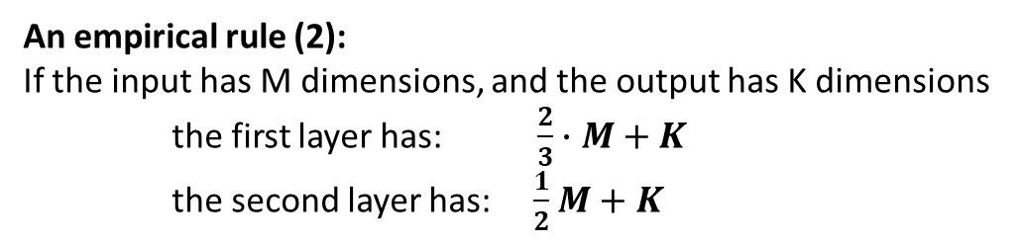
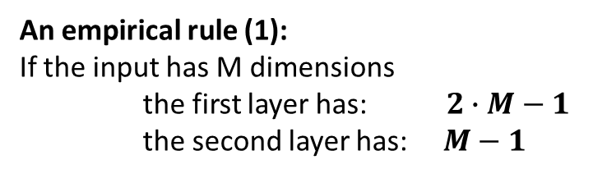
Hyper-parameter setup
Universal Approximation Theorem (applied to an MLP):
an MLP with one hidden layer can approximate any continuous function
(with a non-polynomial activation, e.g. ReLU, sigmoid)
Its corollary:
An MLP with any number of hidden layers can be approximated with an MLP composed by
only two hidden layers and an adequate number of neurons per layer
An empirical rule (1):
If the input has M dimensions
the first layer has: $2∙M−1$
the second layer has: $M−1$
An empirical rule (2):
If the input has M dimensions, and the output has K dimensions
the first layer has: $\frac{2}{3}∙M+K$
the second layer has: $\frac{1}{2}$ $M+K$
INAF School of AI, Naples, April 14-17

Slide 54
Hyper-parameter setup
Universal Approximation Theorem (applied to an MLP):
an MLP with one hidden layer can approximate any continuous function
(with a non-polynomial activation, e.g. ReLU, sigmoid)
Its corollary:
An MLP with any number of hidden layers can be approximated with an MLP composed by
only two hidden layers and an adequate number of neurons per layer
An empirical rule (1):
If the input has M dimensions
the first layer has: $2∙M−1$
the second layer has: $M−1$
An empirical rule (2):
If the input has M dimensions, and the output has K dimensions
the first layer has: $\frac{2}{3}∙M+K$
the second layer has: $\frac{1}{2}$ $M+K$
Hyper-parameter setup optimization:
- Grid search
- Bayes algorithm
- Genetic algorithm
- many others approaches
INAF School of AI, Naples, April 14-17

Slide 55
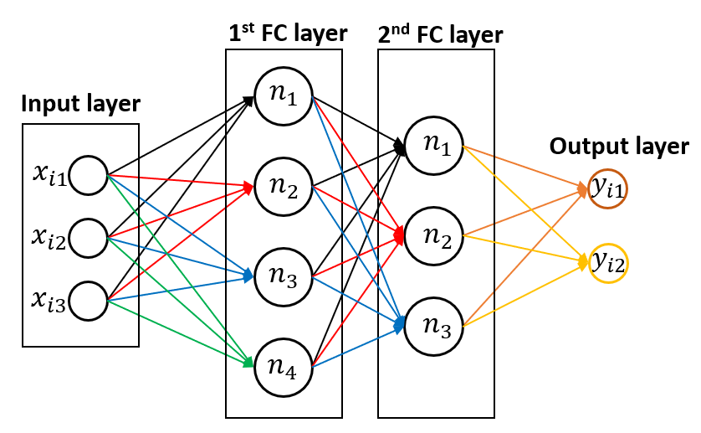
Compiling a network
Building the network architecture, e.g.:
define the number of hidden layers
the number of neuron per hidden layers,
the activation functions
the regularization technique(s)
Loss function (Supervised version):
a measure of the discrepancy between the model’s prediction and the target value
(it requires the setting of a learning rate and/or a learning rate decay rule)
Optimizers:
the algorithm that minimizes the loss function
by updating the weights and biases during the training
Metrics:
measures (different from the loss function) of the discrepancy between the model’s prediction and the target value
Example for a classification problem:
Loss function: Cross-Entropy
Metric: Accuracy
Optimizer: SGD
INAF School of AI, Naples, April 14-17

Slide 56
GO TO NOTEBOOK FOR THE MLP CODING INTRODUCTION
INAF School of AI, Naples, April 14-17

Slide 57
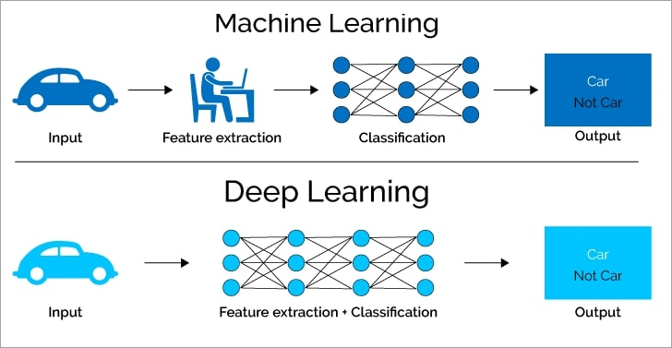
Deep Learning
There are several differences between machine learning and deep learning (as well as similarities). The main difference is their intrinsic capability of deep learning methods to automatically extract features (avoiding the feature computing and selection), thus they are suitable to process raw data.
INAF School of AI, Naples, April 14-17

Slide 58
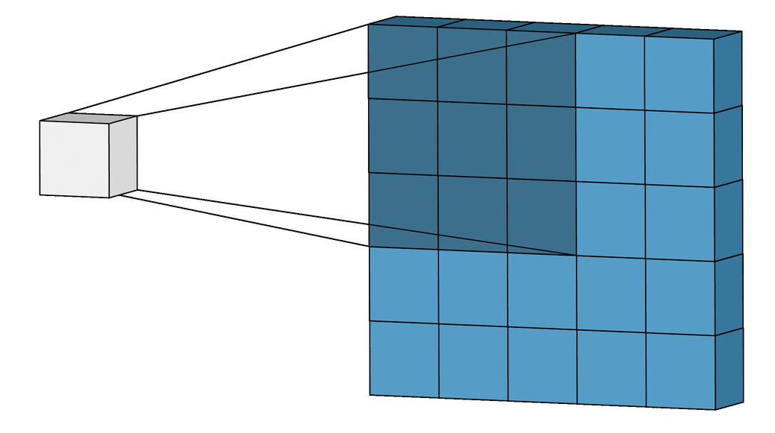

The element of Deep Learning methods: Convolution
In a convolutional neural network (CNN), convolutions replace the matrix products. The weights become filters (kernel), which suppress or emphasize some characteristics.
$$X∗W [l, n] =\sum_{k=1}^{K}{\sum_{m=1}^{M}{X\left[k, m\right]W[l−k, n−m]}}$$
Thus the same kernel processes the input → saving memory
Multiple kernels on the same input → each kernel act as “feature extractor”
INAF School of AI, Naples, April 14-17

Slide 59

The element of Deep Learning methods: Convolution
Convolution examples
INAF School of AI, Naples, April 14-17

Slide 60
The element of Deep Learning methods: Convolution
In a convolutional neural network (CNN), convolutions replace the matrix products. The weights become filters (kernel), which suppress or emphasize some characteristics.
$$X∗W [l, n] =\sum_{k=1}^{K}{\sum_{m=1}^{M}{X\left[k, m\right]W[l−k, n−m]}}$$
A convolution block can be represented with a set of hyperparameters:
Kernel size (typically 3x3, 5x5, sometimes 7x7)
Kernel dimension: the number of kernels (i.e. the number of convolutions), it determines the output dimension.
Strides: the step of the convolution
Padding: adding (or not) a zero pad out of the image, so that input and output shape correspond (we always assume padding = ‘same’).
We are going to represent a convolution operation with this box:
CONV2D (k1 x k2 x M, s)
s is the stride
k1, k2 are the kernel size
M is the kernel
dimension
INAF School of AI, Naples, April 14-17

Slide 61

The element of Deep Learning methods: Pooling
In a convolutional neural network (CNN), pooling operations (i.e. a subsampling) is used to propagate only the most important information, suppressing noise features and reducing the complexity.
Max pool
with 2x2 filters and stride 2
3.2
5.2
Average pool
with 2x2 filters and stride 2
2.0
2.0
INAF School of AI, Naples, April 14-17

Slide 62


The element of Deep Learning methods: Pooling
In a convolutional neural network (CNN), pooling operations (i.e. a subsampling) is used to propagate only the most important information, suppressing noise features and reducing the complexity.
INAF School of AI, Naples, April 14-17

Slide 63


The element of Deep Learning methods: Upsampling
Up-sampling is the opposite mechanism of Pooling. It resize the input by interpolating the ‘new’ pixel values.
Original image
2x Upsampling
4x Upsampling
INAF School of AI, Naples, April 14-17

Slide 64

The element of Deep Learning methods: Dropout
Dropout is regularization technique which randomly ‘drops out’ (i.e. deactivate) neurons during the training. This ‘connections pruning’ prevents neurons from relying one specific neighbors (a.k.a co-adaptation problem).
Standard Fully Connected
Network
After the dropout
INAF School of AI, Naples, April 14-17

Slide 65

Building a Convolutional Neural Network (CNN):
the simplest block of the chain
The simplest block in a CNN is chain like this:
CONV-1
CONV-2
…
Activation
function
CONV-n
Pool
Or, the activation function can be applied after each convolution (e.g. a ReLU):
CONV-1
(ReLU)
CONV-2
(ReLU)
…
CONV-n
(ReLU)
Pool
32 “images”
with same input shape
32 “images”
with half input shape
Input Layer
CONV2D
(3x3xM=32, s=1)
MaxPool2D
(2x2, s=1)
INAF School of AI, Naples, April 14-17

Slide 66
Building a Convolutional Neural Network (CNN):
the simplest block of the chain
The simplest block in a CNN is chain like this:
CONV-1
CONV-2
Activation
function
…
CONV-n
Pool
Or, the activation function can be applied after each convolution (e.g. a ReLU):
CONV-1
(ReLU)
CONV-2
(ReLU)
…
CONV-n
(ReLU)
The extracted set of (sub)images is called Feature Map (FM):
FMs (at the end of the training) represent the set of features the network automatically extracted to solve the problem
Pool
32 “images”
with same input shape
32 “images”
with half input shape
Input Layer
CONV2D
(3x3xM=32, s=1)
MaxPool2D
(2x2, s=1)
INAF School of AI, Naples, April 14-17

Slide 67
Building a Convolutional Neural Network (CNN):
INAF School of AI, Naples, April 14-17

Slide 68
Building a Convolutional Neural Network (CNN):
Feature extractor
INAF School of AI, Naples, April 14-17

Slide 69
Building a Convolutional Neural Network (CNN):
Feature extractor
Fully Connected (Dense) Layers
For the Classification / Regression task
INAF School of AI, Naples, April 14-17

Slide 70
Building a Convolutional Neural Network (CNN):
Input layer
(N, 64, 64, B)
CONV2D
(3x3x64, 1)
Output:
(32x32 x64)
MaxPool (2x2)
Leaky ReLU
INAF School of AI, Naples, April 14-17

Slide 71
Building a Convolutional Neural Network (CNN):
Output:
(16x16 x128)
Input layer
(N, 64, 64, B)
CONV2D
(3x3x64, 1)
CONV2D
(3x3x128, 1)
MaxPool (2x2)
Leaky ReLU
MaxPool (2x2)
Leaky ReLU
INAF School of AI, Naples, April 14-17

Slide 72
Building a Convolutional Neural Network (CNN):
CONV2D
(3x3x256, 1)
Output:
(8x8 x512)
Input layer
(N, 64, 64, B)
CONV2D
(3x3x64, 1)
CONV2D
(3x3x128, 1)
CONV2D
(3x3x256, 1)
MaxPool (2x2)
Leaky ReLU
MaxPool (2x2)
Leaky ReLU
CONV2D
(3x3x256, 1)
MaxPool (2x2)
Leaky ReLU
INAF School of AI, Naples, April 14-17

Slide 73
Building a Convolutional Neural Network (CNN):
CONV2D
(3x3x256, 1)
CONV2D
(3x3x512, 1)
CONV2D
(3x3x256, 1)
FM output:
2048
Input layer
(N, 64, 64, B)
CONV2D
(3x3x64, 1)
CONV2D
(3x3x128, 1)
CONV2D
(3x3x256, 1)
CONV2D
(3x3x512, 1)
CONV2D
(3x3x256, 1)
MaxPool (2x2)
Leaky ReLU
MaxPool (2x2)
Leaky ReLU
CONV2D
(3x3x256, 1)
CONV2D
(3x3x512, 1)
CONV2D
(3x3x256, 1)
MaxPool (2x2)
Leaky ReLU
MaxPool (2x2)
Leaky ReLU
MaxPool (2x2)
Leaky ReLU
INAF School of AI, Naples, April 14-17

Slide 74
Building a Convolutional Neural Network (CNN):
CONV2D
(3x3x256, 1)
CONV2D
(3x3x512, 1)
CONV2D
(3x3x256, 1)
FM output:
2048
Input layer
(N, 64, 64, B)
CONV2D
(3x3x64, 1)
CONV2D
(3x3x128, 1)
CONV2D
(3x3x256, 1)
CONV2D
(3x3x512, 1)
CONV2D
(3x3x256, 1)
Dense (4096)
MaxPool (2x2)
Leaky ReLU
MaxPool (2x2)
Leaky ReLU
Dense (4096)
CONV2D
(3x3x256, 1)
CONV2D
(3x3x512, 1)
CONV2D
(3x3x256, 1)
Output
Dense (2)
MaxPool (2x2)
Leaky ReLU
MaxPool (2x2)
Leaky ReLU
MaxPool (2x2)
Leaky ReLU
INAF School of AI, Naples, April 14-17

Slide 75

Deep Learning: Feature Maps
Feature extracted from after the first layer:
INAF School of AI, Naples, April 14-17

Slide 76
Deep Learning: Feature maps
Feature extracted from after the second layer:
INAF School of AI, Naples, April 14-17

Slide 77
Deep Learning: Feature maps
Feature extracted from after the last layer:
INAF School of AI, Naples, April 14-17

Slide 78
Deep Learning: Feature maps
Real image
(observed reality)
1st layer
2nd
3rd
4th
Last layer
Extracted images
(Coded in features)
Network depth
INAF School of AI, Naples, April 14-17

Slide 79

Deep Learning model(s): VGG
VGG: Visual Group Geometry network (Simonyan & Zisserman 2014):
- Only 3x3 kernel with stride 1
- ReLU activations after each convolution
- Three Dense Layers at the top
- Currently two VGG networks are available: VGG-16 and VGG-19
INAF School of AI, Naples, April 14-17

Slide 80




Deep Learning model(s): ResNet
ResNet: Residual Network (He+2014):
- It is based on the residual block
- A residual block, the network should learn, at least, the identity
- The identity learning exploits the so-called skip-connection
- It is one of the most performative CNN
- Currently there are tens of available ResNet
$$x$$
Conv – Activation – Max Pool
Layer
…
Conv – Activation – Max Pool
Layer
$$F(x)$$
+
$$F\left(x\right)+x$$
INAF School of AI, Naples, April 14-17

Slide 81


Deep Learning model(s): Inception Network
Inception Network (Szegedy+2015):
- It is based on the inception block
- This block performs a sort of hyper-parameters optimization
- Multi-output network: FC layers are set at different depths (auxiliar outputs)
- Weighted loss function between the ‘real’ output and the auxiliar ones
Inception Block
INAF School of AI, Naples, April 14-17

Slide 82
GO TO NOTEBOOK FOR THE CNN CODING INTRODUCTION
INAF School of AI, Naples, April 14-17

Slide 83


Autoencoder (in a nutshell)
Deep Autoencoder (Hinton+2006):
- Autoencoders are self-learning algorithms (i.e. they learn to map a function: $ℝ^{n}→ℝ^{n}$)
- By using the same space as input and output, autoencoders find a embedded space that represents the input
- They can be used as denoiser, image-generation, data-imputation, image-segmentation, upscaling
- They also act as anomaly detectors
ENCODER
DECODER
Chain of Conv, Activation, Pooling
It maps the input into a Feature Map vector
Chain of Conv, Activation, Up-sampling
It maps the Feature Map vector into the input
INAF School of AI, Naples, April 14-17

Slide 84
Autoencoder (in a nutshell)
Deep Autoencoder (Hinton+2006):
- Autoencoders are self-learning algorithms (i.e. they learn to map a function: $ℝ^{n}→ℝ^{n}$)
- By using the same space as input and output, autoencoders find a embedded space that represents the input
- They can be used as denoiser, image-generation, data-imputation, image-segmentation, upscaling
- They also act as anomaly detectors
ENCODER
DECODER
The latent space is a set a values which represents the input
The Decoder uses the latent space to
reconstruct the input
Chain of Conv, Activation, Pooling
It maps the input into a Feature Map vector
Chain of Conv, Activation, Up-sampling
It maps the Feature Map vector into the input
INAF School of AI, Naples, April 14-17

Slide 85
GO TO NOTEBOOK FOR THE AUTOENCORE CODING INTRODUCTION
INAF School of AI, Naples, April 14-17

Slide 86
INAF School of AI, Naples, April 14-17

Slide 87
FIGURES USED IN THE NOTEBOOKS
INAF School of AI, Naples, April 14-17

Slide 88

LeNet Like network
(N, 3*3*64)=
=(N, 576)
Extractor
(Flatten)
Dense (10)
Dropout (0.5)
MaxPool(2x2)
MaxPool(2x2)
Dense (1024)
CONV2D (3x3x16, 1)
CONV2D (3x3x32, 1)
CONV2D (3x3x64, 1)
MaxPool(2x2)
ReLU
ReLU
ReLU
(N, 28, 28, 1)
(N, 14, 14, 16)
(N, 7, 7, 32)
(N, 3, 3, 64)
Output
INAF School of AI, Naples, April 14-17

Slide 89
VGG network
INPUT
CONV2D (3x3xM, 1)
BLOCK₁ (NC₁, M₁, p₁)
CONV2D (3x3xM, 1)
BLOCK
(NC, M, p)
≡
xNC
BLOCK₂ (NC₂, M₂, p₂)
…
xNB
…
CONV2D (3x3xM, 1)
BLOCK_{NB} (NC_{NB}, M_{NB}, p_{NB})
MaxPool (p)
Extractor
Leaky ReLU
Dense (HN)
Dropout (dp)
Dense (out shape)
output
INAF School of AI, Naples, April 14-17

Slide 90
Extractor + RF
INPUT
INPUT
BLOCK₁ (NC₁, M₁, p₁)
xNB
BLOCK₂ (NC₂, M₂, p₂)
Feature maps
Extractor
BLOCK_{NB} (NC_{NB}, M_{NB}, p_{NB})
Extractor
Dense (HN)
Random Forest (sk-learn)
Dropout (dp)
Dense (out shape)
output
output
INAF School of AI, Naples, April 14-17

Slide 91
Multi Output CNN
INPUT
BLOCK₁ (NC₁, M₁, p₁)
xNB
BLOCK₂ (NC₂, M₂, p₂)
BLOCK_{NB} (NC_{NB}, M_{NB}, p_{NB})
Extractor
Dense (HN)
Dropout (dp)
Dense
(cls shape:10)
Dense
(rgr shape:10)
Classification
output
Regression
output
INAF School of AI, Naples, April 14-17

Slide 92

Simplified Autoencoder
Input
(N, 28, 28, 1)
Encoded Input
Representation
Output
(N, 28, 28, 1)
(Decoded)
MaxPool(2x2)
MaxPool(2x2)
UpSampling(2x2)
UpSampling(2x2)
CONV2D (3x3x32, 1), ReLU
CONV2D (3x3x16, 1), ReLU
CONV2D (3x3x16, 1), ReLU
CONV2D (3x3x32, 1), ReLU
CONV2D (3x3x16, 1), ReLU
CONV2D (3x3x16, 1), ReLU
CONV2D (3x3x32, 1), ReLU
CONV2D (3x3x32, 1), ReLU
CONV2D (3x3x1, 1), ReLU
Target
INAF School of AI, Naples, April 14-17

Slide 93
Simplified Resnet like
Input (N, 28, 28, 1)
CONV2D (3x3x32, 1) + ReLU
CONV2D (3x3x32, 1), ReLU
CONV2D (3x3x64, 1) + ReLU
CONV2D (3x3x32, 1)
CONV2D (3x3x64, 1), ReLU
CONV2D (3x3x128, 1) + ReLU
+
CONV2D (3x3x64, 1)
CONV2D (3x3x128, 1) + ReLU
ReLU
+
Global Average Pool(2x2)
MaxPool(2x2)
ReLU
Dense (10)
MaxPool(2x2)
Output
INAF School of AI, Naples, April 14-17

Slide 94
Simplified ResneXt like
CONV2D (3x3x64, 1) + ReLU
Input (N, 28, 28, 1)
CONV2D
(3x3xG, 1)
ReLU
CONV2D
(3x3xG, 1)
ReLU
CONV2D
(3x3xG, 1)
ReLU
CONV2D
(3x3xG, 1)
ReLU
CONV2D (3x3x32, 1) + ReLU
CONV2D
(3x3xF, 1)
ReLU
CONV2D
(3x3xF, 1)
ReLU
CONV2D
(3x3xF, 1)
ReLU
CONV2D
(3x3xF, 1)
ReLU
CONV2D
(3x3xG, 1)
CONV2D
(3x3xG, 1)
CONV2D
(3x3xG, 1)
CONV2D
(3x3xG, 1)
CONV2D
(3x3xF, 1)
CONV2D
(3x3xF, 1)
CONV2D
(3x3xF, 1)
CONV2D
(3x3xF, 1)
Concatenate
Concatenate
+
CONV2D (3x3x128, 1) + ReLU
+
ReLU
CONV2D (3x3x128, 1) + ReLU
MaxPool(2x2)
ReLU
Global Average Pool(2x2)
MaxPool(2x2)
Dense (10)
Output
INAF School of AI, Naples, April 14-17

Slide 95
Simplified Inception network (dual-outputs)
Input (N, 28, 28, 1)
CONV2D (3x3x64, 1) + ReLU
MaxPool(2x2)
Branch 1x1
Branch 3x3
Branch 5x5
Branch pooling
CONV2D (1x1xF1, 1), ReLU
CONV2D (1x1xF2, 1), ReLU
CONV2D (1x1xF4, 1), ReLU
MaxPool(3x3), pad=‘same’
Inception Module
CONV2D (3x3xF3, 1), ReLU
CONV2D (5x5xF5, 1), ReLU
CONV2D (1x1xF6, 1), ReLU
Concatenate
Global Average Pooling
CONV2D (3x3x64, 1) + ReLU
Dense
MaxPool(2x2)
Auxiliar Output
CONV2D (1x1xG1, 1), ReLU
CONV2D (1x1xG2, 1), ReLU
CONV2D (1x1xG4, 1), ReLU
MaxPool(3x3), pad=‘same’
Inception Module
CONV2D (3x3xG3, 1), ReLU
CONV2D (5x5xG5, 1), ReLU
CONV2D (1x1xG6, 1), ReLU
Concatenate
Global Average Pooling
Dense
Main Output
INAF School of AI, Naples, April 14-17

Slide 96
Channel-by-Channel (four-outputs)
Input (N, 28, 28, 3)
Channel Split
CONV2D (3x3xF₁)
ReLU
Ch1
Ch2
Ch3
Concatenate
BLOCK
(N, 3x3, F₁ , …, F_{N})
CONV2D (3x3xF₂)
ReLU
BLOCK Ch1
(N, F₁ , …, F_{N})
BLOCK Ch2
(N, G₁ , …, G_{N})
BLOCK Ch3
(N, H₁ , …, H_{N})
CONV2D (3x3x64)
ReLU
≡
xN
…
CONV2D (3x3xF_{N})
ReLU
CONV2D (3x3x64)
ReLU
BLOCK Ch1
(N, F’₁ , …, F’_{N})
BLOCK Ch2
(N, G’₁ , …, G’_{N})
BLOCK Ch3
(N, H’₁ , …, H’_{N})
MaxPool (2)
MaxPool (2)
Flatten
Flatten
Flatten
Dense (128)
Dense (128)
Dense (128)
Dense (128)
Dense (10)
Dense (10)
Dense (10)
Dense (10)
Output
Glomerated
Output Ch1
Output Ch2
Output Ch3
INAF School of AI, Naples, April 14-17

