Slide 1
Characterisation of H4RG-15 detectors for ground based astronomy in the era of ELTs
Naidu Bezawada, Derek Ives
and ESO Detector Group,
European Southern Observatory, Garching, Germany
Notes:
I know that this is an IR detectors in space workshop, however the European Southern Observatory was asked to participate and give a presentation of our IR astronomical detector experience.
I think the IR characteristics I will describe are very similar to what you see on the space side, same issues, same performance, similar detectors.. We are users of the detectors, builders of detector systems, not detector designers so I will describe what we see but hopefully give you some pointers to maybe some of the underlying design issues. I am going to specifically talk about our H4RG-15 detector experience but as you will see we have experience of many other detector families. Most people know the characteristics of the HAWAII family of detectors and therefore I do not present those results, rather the issues we face. As an aside on ground we are not driven to use ASICS as controllers and in fact we have designed our own controller NGCII.

Slide 2
ELT first and second generation instruments
  MICADO – Imager/Spectrometer – details to follow, first light instrument (9xH4RG, 1-2.5 um) – Focus on this
  HARMONI – Integral Field Spectrometer, first light instrument but being rescoped and delayed (9 x H4RG, 1-2.5 um)
  METIS – imager and spectrometer – first light instrument (5xH2RG, Geosnap and SAPHIRA, 3-13 um)
  MORFEO - Multiconjugate adaptive Optics Relay For ELT Observations, feeds MICADO and HARMONI etc
  (development of AO Cameras and detectors, L3CCDs, LVSM and SAPHIRA)
  MOSAIC – Spectrometer, second generation instrument (CCDs and H4RGs, 0.4 – 2.5 um)
  ANDES – very high resolution spectrometer, second generation instrument (CCDs and H4RGs, 0.4 – 1.9 um)
S. Ramsay et al., Progress along the E-ELT instrumentation roadmap,
https://doi.org/10.1117/12.2232407
Notes:
I just wanted to say what ELT instruments we are building and why we have a need for these astronomical detectors. We have 4 first generation instruments, including MORFEO, which is an AO feed to 2 instruments ( I think that MORFEO is actually being led here in Bologna). We also have METIS which is much longer wavelength, 3-13 um and does not use H4RG detectors but H2RGs with 5.3 um material similar to those in the JWST as well as SAPHIRA and GeSanp. . For those interested I do say on this slide what detectors each instrument uses. The main point of the talk is the H4RG detectors in their 15 um pixel size compared to the Nancy Grace Roman telescope which has the H4RG with 10 um pixels.
We also have purchased standard devices using standard manufacturing processes for example for persistence the build process is similar to H2RGs and use the 2,5 um cut-off material.
Both HARMONI and MICADO will use 9 of these detectors, HARMONI is a IFU spectrograph and MICADO which I will focus on is mostly an imager (with a spectroscopy mode probably used 10 % of its oberserving time).
We have also started the second generation of ELT instruments which are MOSAIC and ANDES, they will both use CCDs and large format IR detectors.
As an aside we recently did a comparison of CMOS versus CCDs for the MOSAIC project and at least for MOSAIC the CCDs were the winners.

Slide 3
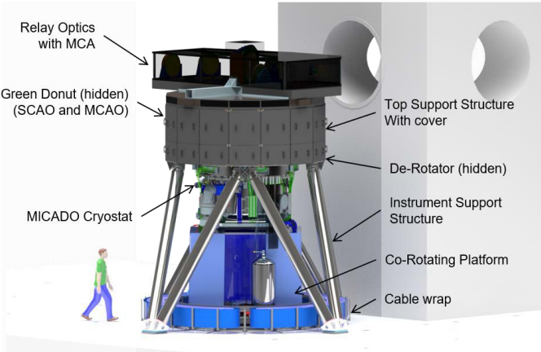
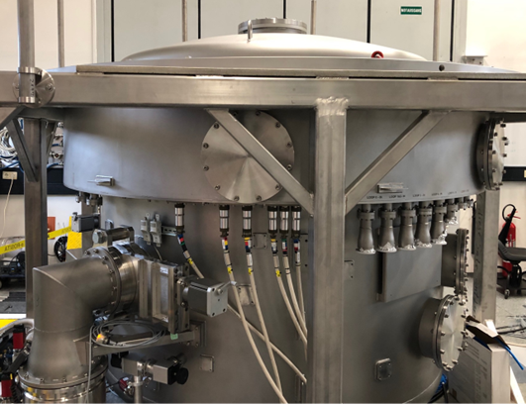
MICADO Instrument
  Multi-conjugated AO Imaging Camera for Deep Observations
  Diffraction limited imaging capability on ELT
  Optimised to work with field corrected AO module MORFEO and in a stand-alone mode using SCAO
  Standard imaging, astrometry, high contrast imaging and spectroscopy
  1.5mas over 19x19 arcsec, 4.0mas over 51x51 arcsec field of view
  Similar sensitivity to JWST, at x6 higher resolution
MICADO | ELT | ESO
E. Sturm et al., The MICADO first light imager for the ELT: overview and current status,
https://doi.org/10.1117/12.3017752
Notes:
As this is a detector workshop, I only have 1 slide on the one instrument, MICADO where I will describe its detectors in more detail. MICADO is a mosaic of 9 x IR detectors, more detail in a minute. It is mostly an AO corrected imager (using MORFEO as its input from the telescope – with different plate scales. Other details are on the slide. It is well advanced with the complete cryostat manufactured, it together with the dummy detector module are doing their first cool-down, as I speak. As a side note, the size of all these instruments is huge, see the scale drawing above in the slide.

Slide 4
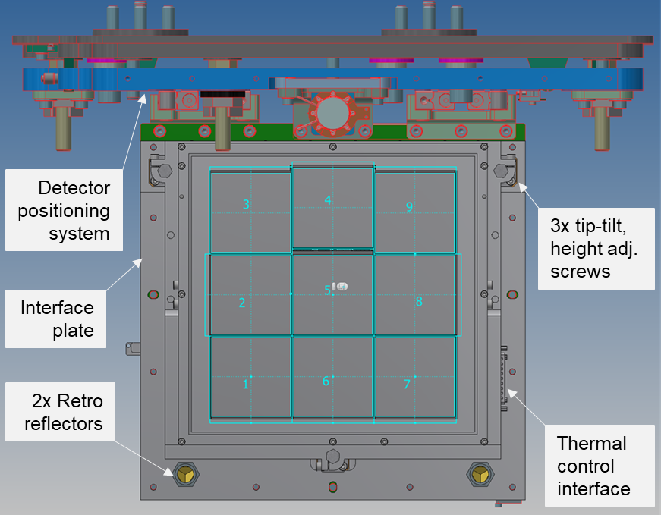
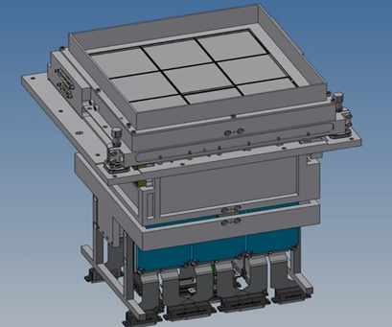
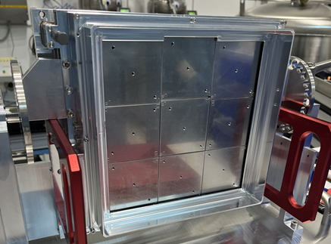
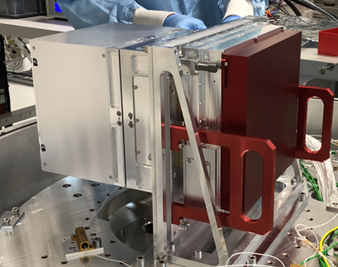
MICADO Focal Plane
  Mosaic of 3x3 H4RG-15, 2.5µm cut-off detectors, mounted on an Invar baseplate
  3-point tip-tilt adjust mounting screws
  Mounted on a detector positioning system, that allows for further tip-tilt and focus adjustments in the instrument
  Operating temperature 82K (liquid nitrogen cooled)
N. Bezawada et al., The MICADO first light imager for the ELT:
Overview of the near infrared mosaic detector subsystem, https://doi.org/10.1117/12.3020079
Detector Unit with dummy detectors
Detector Unit with dummy masses under cryo-test
Notes:
MICADO will use 9 H4RG-15 detectors in a 3x3 mosaic as shown in the slide. These detectors are not fully 4 edge buttable so to minimize the spacing their orientation changes depending on their position in the mosaic. We have recently completed the testing of the 10 detectors including 1 engineering device, many of the details to follow in the rest of this talk.
For those who don’t know we use our own controller NGCII rather than SIDECAR or some other ASIC. This controller is warm and sits about 4-5 metres away from the detectors. A discussion on the controller is a whole other talk, why we went down that route etc.
Finally, we have recently thermally tested the mosaic plate for the mounting of the 9 detectors and we hope to mount the first EG device by summer of this year and the remainder by end of 2027. Because we have our own controller then we need electronics cold and close to the detectors but this is something we have been doing at ESO for a long time and it is low risk.

Slide 5
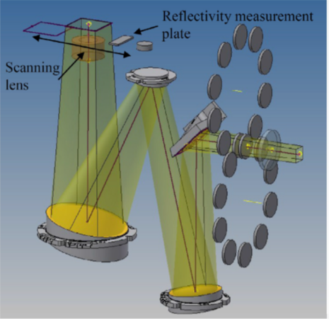
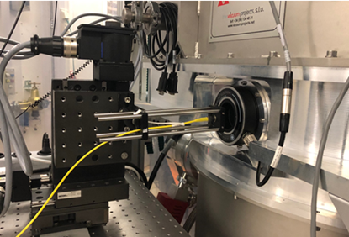
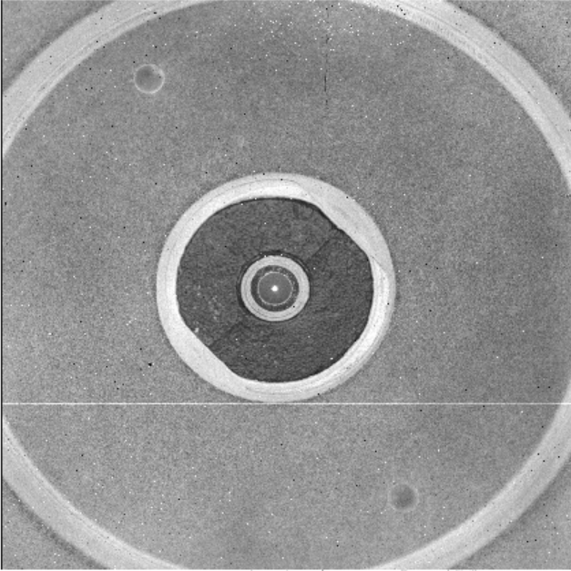
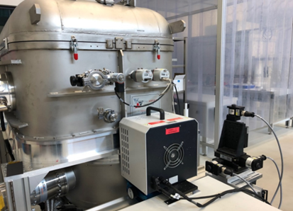
Detector Operation and Test Facility
  FIAT – developed at ESO, conjugated object, image focal planes, 66mm square field of view
  Low background, astronomical passband filters, ND filters, narrow band filters etc.
  Detector operating temperature range 30K – 130K
  Operated in 32-channel, slow buffered output mode, at 200kHz pixel rate
  Detectors characterised at 40K to 85K (baseline temperature for HARMONI Instrument is 40K)
Image of a 1-inch fiber adapter on a H4RG-15
J. L. Lizon et al., A new test facility for the E-ELT infrared detector program https://doi.org/10.1117/12.2231635
Notes:
Just one more slide before we get into detector details. We wanted to test all detectors for MICADO and HARMONI in exactly the same way so we developed a test facility called FIAT to allow us to do this. It is really an observatory class instrument (imager) which allows us to do the full gauntlet of detector testing in a controlled manner, for example, QE, darks, noise, linearity and detector cut-off. The data is also available on the ESO archive so any astronomer can download and process the data, useful for the data pipeline people.
We see the graphics for the FIAT in the slide where we have a conjugated warm focus allowing us to install blackbodies, or fibres etc in front of the window. The facility then has multiple astronomical filters, ND filters and then a TMA with a multiplication factor of ~ x2.4 to take the beam to the detector. In front of the detector we have a cold shutter to do dark tests.

Slide 6
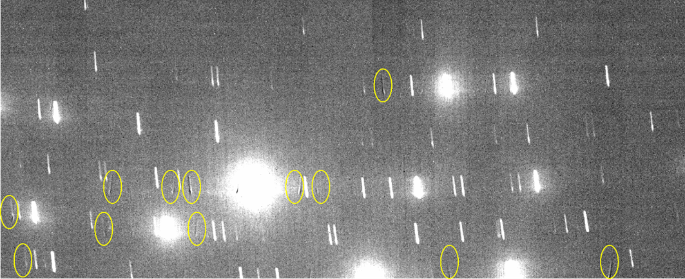
Detectors operated in unbuffered mode - Issues
  Was ESO standard mode for years, simplicity of operation
  High output impedance results in electrical crosstalk – difficult to deal with in the pipeline
  Can’t run faster as outputs have limited drive capability
H4RG-15 unbuffered output mode
Crosstalk in unbuffered mode (in a H2RG) – astronomical image
Notes:
At long last I get to the detector testing and characterization.
For a long time ESO used the H2RG unbuffered mode (decision made before my time) because it was hoped that it would give the lowest noise performance. The graphic shows how this is connected. This means that the detector has to drive from the pixel any off chip circuitry. The pixel drive has high impedance and therefore cannot run fast and is prone to crosstalk from capacitive coupling. This is clearly seen in an H2RG used in one of our VLT instruments where bright lines have AC cross talk on other outputs.. As stated in the slide this is very difficult to deal with in an astronomical pipeline. For H4RGs we decided to go down the buffered route as part of a VLT project called MOONS which has already been delivered to Paranal. We did check the noise and drive issues in both buffered and unbuffered mode and saw all the advantages to running in buffered mode. The H2RGs and H4RGs are capable of both this buffered and unbuffered mode of operation but for buffered mode more complexity is required.

Slide 7
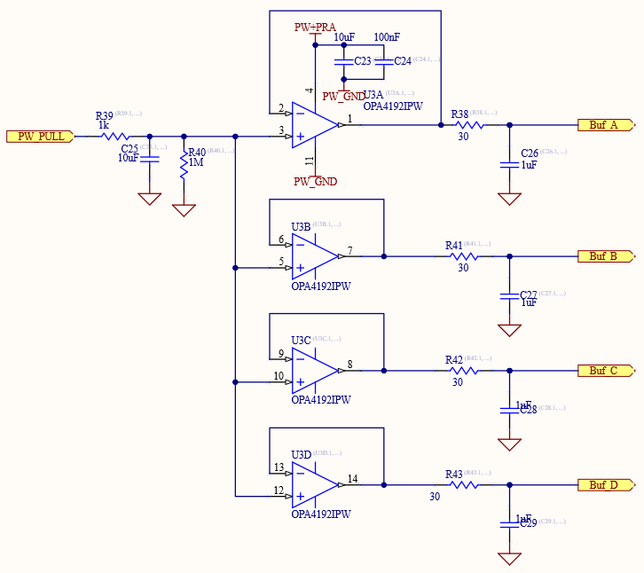
Buffered or Unbuffered operation
Choose output type for detector
Low impedance supply per output
Main issue is extra circuitry, minimum of op-amp + resistor per output
However not a problem for our cryogenic preamplifier
Notes:
To run in buffered mode requires one low impedance driver and a 20K resistor per output. For MICADO we only use 32 outputs (64 possible) so we need 32 extra op-amps and 32 resistors. However because we already have electronics close to the detector it is easy to add these simple supplies per output. This is all show in the slide. We now use the PMOS buffered output set to 3.3V with the resistor as shown and program the device accordingly. The detector can easily be programmed for the different modes.

Slide 8
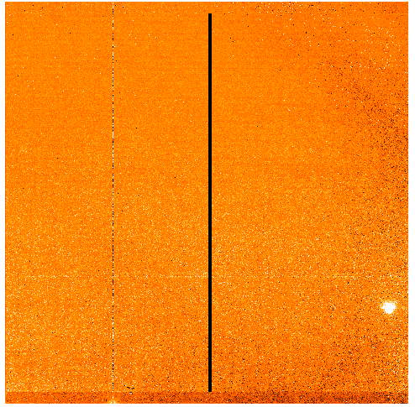
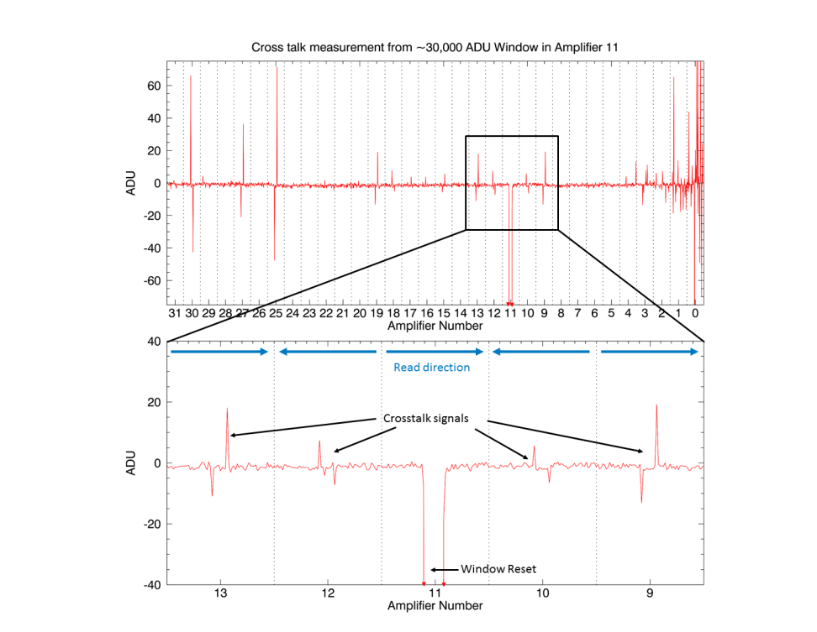
Cross talk method – window reset – repeat 32 or 64 times
Windowed region
held in reset
Positioned on one
output at a time
Top: 1D plot produced. Bottom: Zoom of amplifier 11 and its nearest neighbours.
The crosstalk signal is seen as spikes in single columns. The noise on the far right of the
top plot is due to defects on this engineering grade device and is not due to crosstalk.
E. George et al., “A fast method of crosstalk characterisation for HxRG detectors”, arXiv:1808.00790, 02.08.2018
Notes:
Where is this all leading to, we will see in a minute.
Further to this and a while ago now, we came up with a method of measuring this cross-talk in both buffered and unbuffered mode by resetting windows in each of the 32 outputs and using a flat-field images to subtract from them. We can then average the reset windows to improve the SNR and come up with a plot and shown on the slide on the left. We repeat this for all the 32 outputs and measure the cross-talk as seen on the plot on the right.

Slide 9
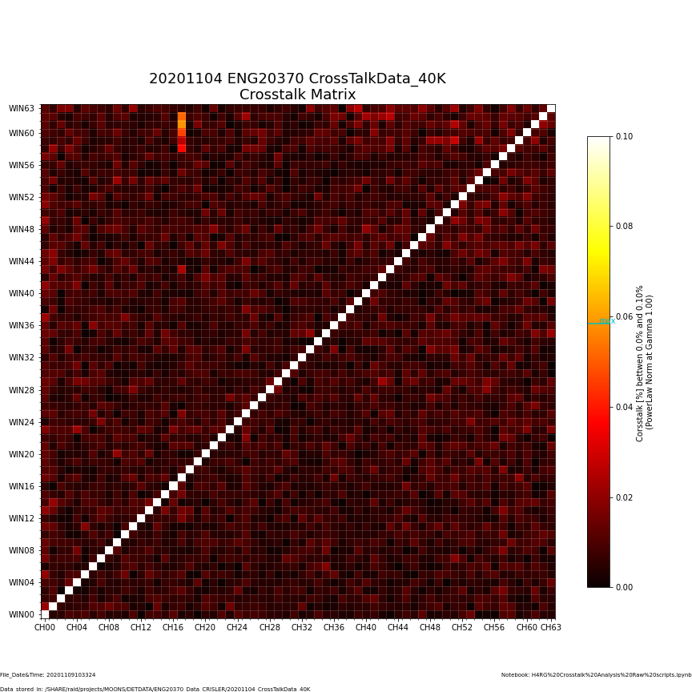
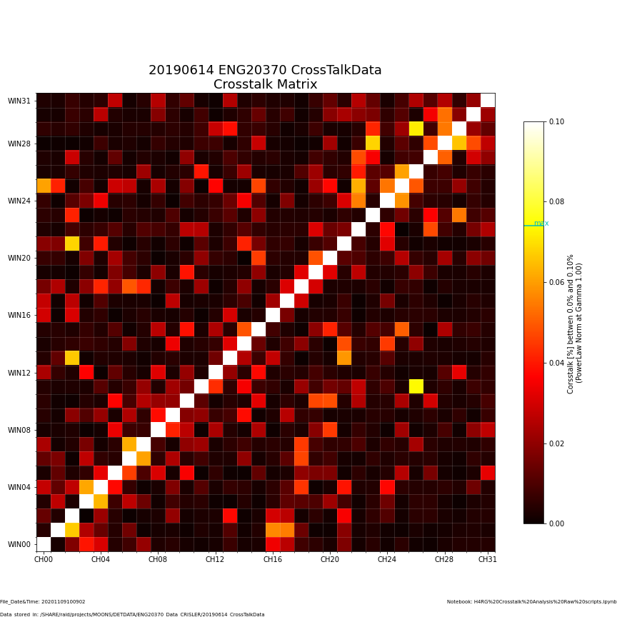
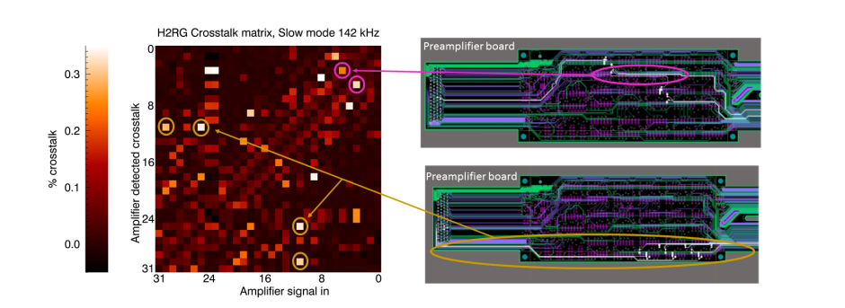
Measuring AC Coupling
64 Buffered outputs
32 unbuffered outputs
E. George et al., “A fast method of crosstalk characterisation for HxRG detectors”, arXiv:1808.00790, 02.08.2018
Notes:
Finally we can process all the data and come up with a 2D FITS image which shows the cross-talk from any output to other outputs. The slide shows the results of when we used all 64 outputs in buffered mode compared to 32 outputs in unbuffered mode, all else being equal. We clearly see that the buffers really help to reduce the cross-talk. In the early days of this development we also saw crosstalk which was not only detector related but there was additional crosstalk. We narrowed this down to capacitive coupling in our electronics and now have designed this out accordingly. For many spectroscopy applications we want to do as meany reads up the ramp in the exposure time available so better to us 64 outputs rather than 32 to readout twice as fast.

Slide 10
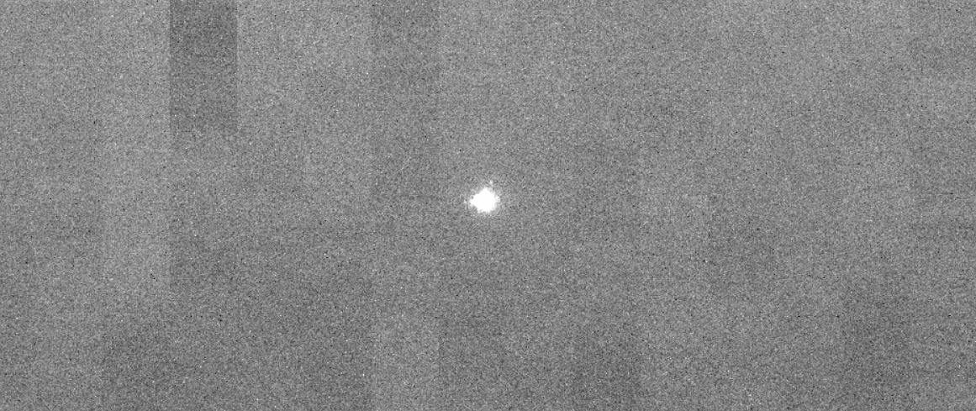
Buffered Mode of Operation
  Low output impedance - negligible electrical crosstalk between readout channels – higher drive capability, low unit cell current and fast readout (up 300 kHz pixel rate) with similar noise performance
H4RG-15 buffered output mode (PMOS)
No electrical crosstalk between readout channels (spot at half full well capacity) – lab image
N. Bezawada et al., Performance advantages of buffered output mode operation of HxRG near infrared detectors
https://doi.org/10.1117/12.2562635
Notes:
As a final test we projected a spot/star onto a single channel of the detector and ran the detector out in normal astronomical mode. We then looked to see if there was any additional cross-talk to other outputs. From our analysis and the image shown then clearly the cross-talk issue has gone. This is now our default mode for all future H2RG and H4RG detectors. So we typically run at 200 kpixels/second with seeing any issues of noise or frequency response etc.
However on H4RG-15s we discovered a problem with running these buffers and this is new bit to this conference. On H2RGs we do not see this problem as we have tested these detectors in exactly the same way as the H4RG-15 devices.
For SIDECAR then I believe that they also use buffers but at least on H2RGs no problem is seen and all the advantages of the buffers are made. I
However don’t know if there is a problem with H4RG-10 devices ?

Slide 11
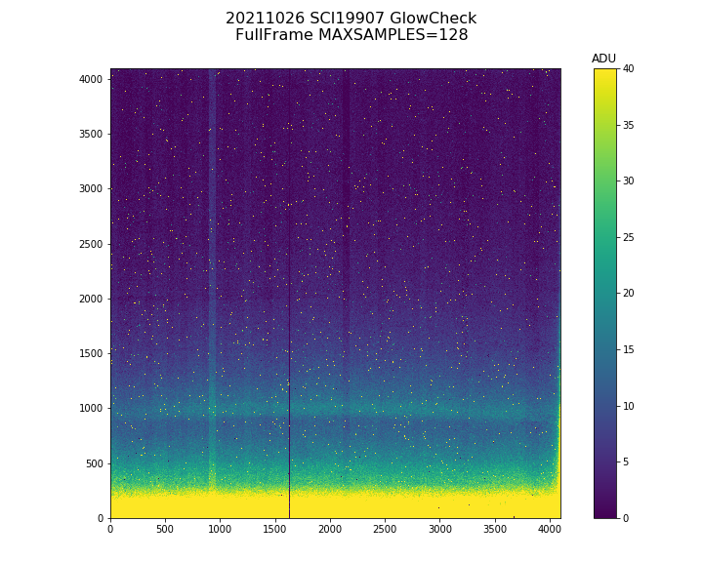
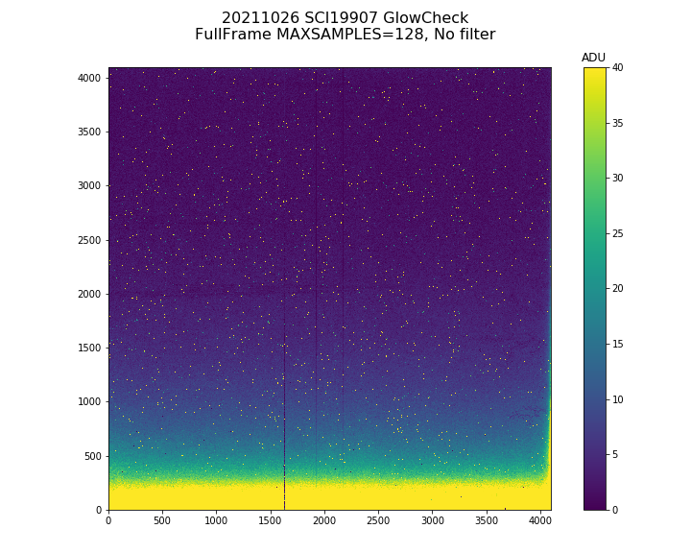
300s exposure, filter vs no filter above detector
VLT Instrument MOONS results (4xH4RG-15)
With filter
Without filter
Glow seen from the buffers
11
Notes:
So what is the problem ? For H4RG-15 devices it is optical glow from the buffers seen at the bottom of the device where the buffers are placed. The noise from this glow can be dominate in the glow region of the detector.
We put a lot of effort into this showing that it really was glow and not some other artifact from the detector. In the early days of these devices before MICADO we build an instrument called MOONS for the VLT using 4 of these devices and on MOONS we ran first in unbuffered mode and then in buffered mode on the same devices so we could see that the issue was to do with the buffers.
Further to this, MOONS is a 1.9 um instrument but we use 2.5 um cut-off devices. We therefore mounted a filter in front of the detectors and very close to the detectors. We clearly see on the image on the left that the glow from the detector has been reflected by the filter back onto the detector and now covers more of the detector, the image on the right is without filter and we do not see this reflection.

Slide 12
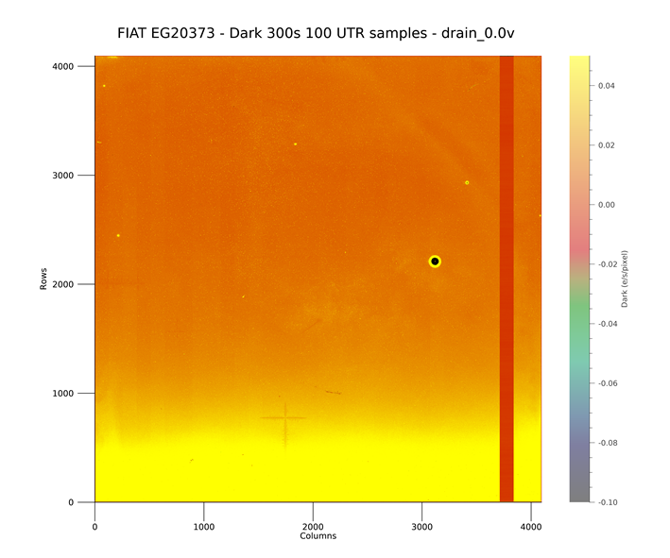
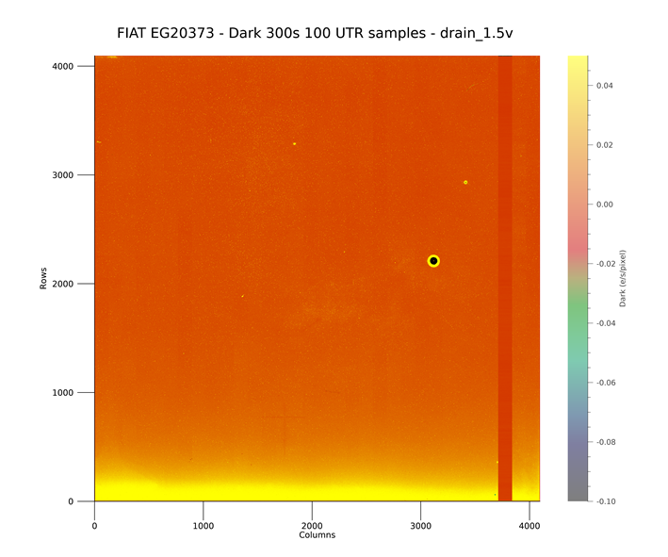
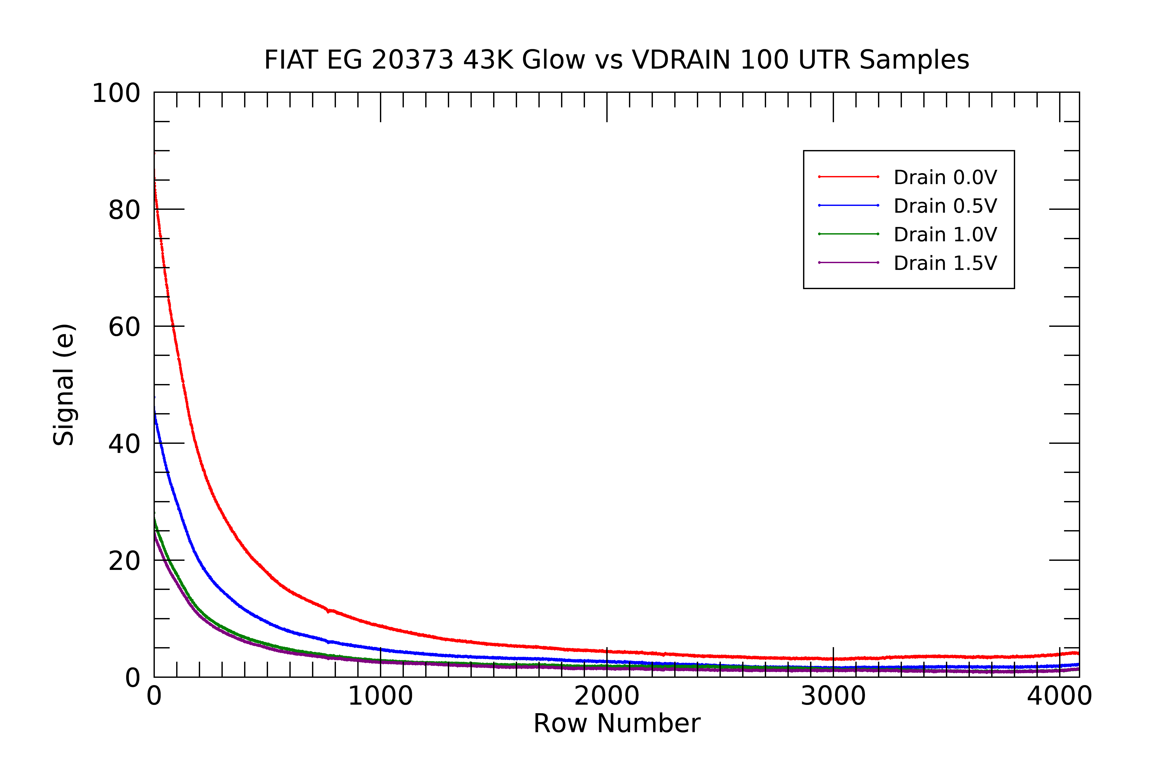
Output Buffer Glow
  Almost one-fourth of the array at the bottom is affected by the output buffer glow
  Higher drain supply reduced the glow by a factor of 4 without any adverse effects on full well, linearity, pixel speed, crosstalk etc.
Output drain at 0V
Output drain at 1.5V
N. Bezawada et al., Output buffer glow and its mitigation in H4RG-15 detectors, Vol 10(2), JATIS, 2024
https://doi.org/10.1117/1.JATIS.10.2.026007
Notes:
As the slide says for typical MICADO images and their required integration time then the glow could be an issue. This is clearly seen in the image of the slide to the left where the noise of the glow is an issue, especially for long Up The Ramp exposures where a noise of 5 e- rms is typical.
So in the last year we put much effort into reducing that glow, mostly by taking the drain of the PMOS FETs to 1.5V rather than 0V as is typical. This has reduced the current to the buffers and thus the glow. Since the glow is mostly a function of exposure time.
The minimization of this glow by reducing the unit cell current is clearly seen in the middle image and the plot to the right where we have increased the DRAIN supply from 0V to 1.5V and then measured the glow. In all other regards the buffers and detector still work in terms of full well, noise etc.

Slide 13
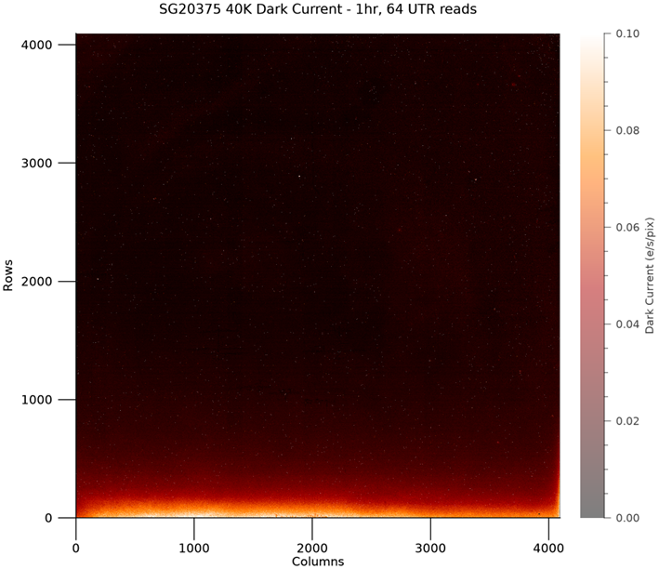
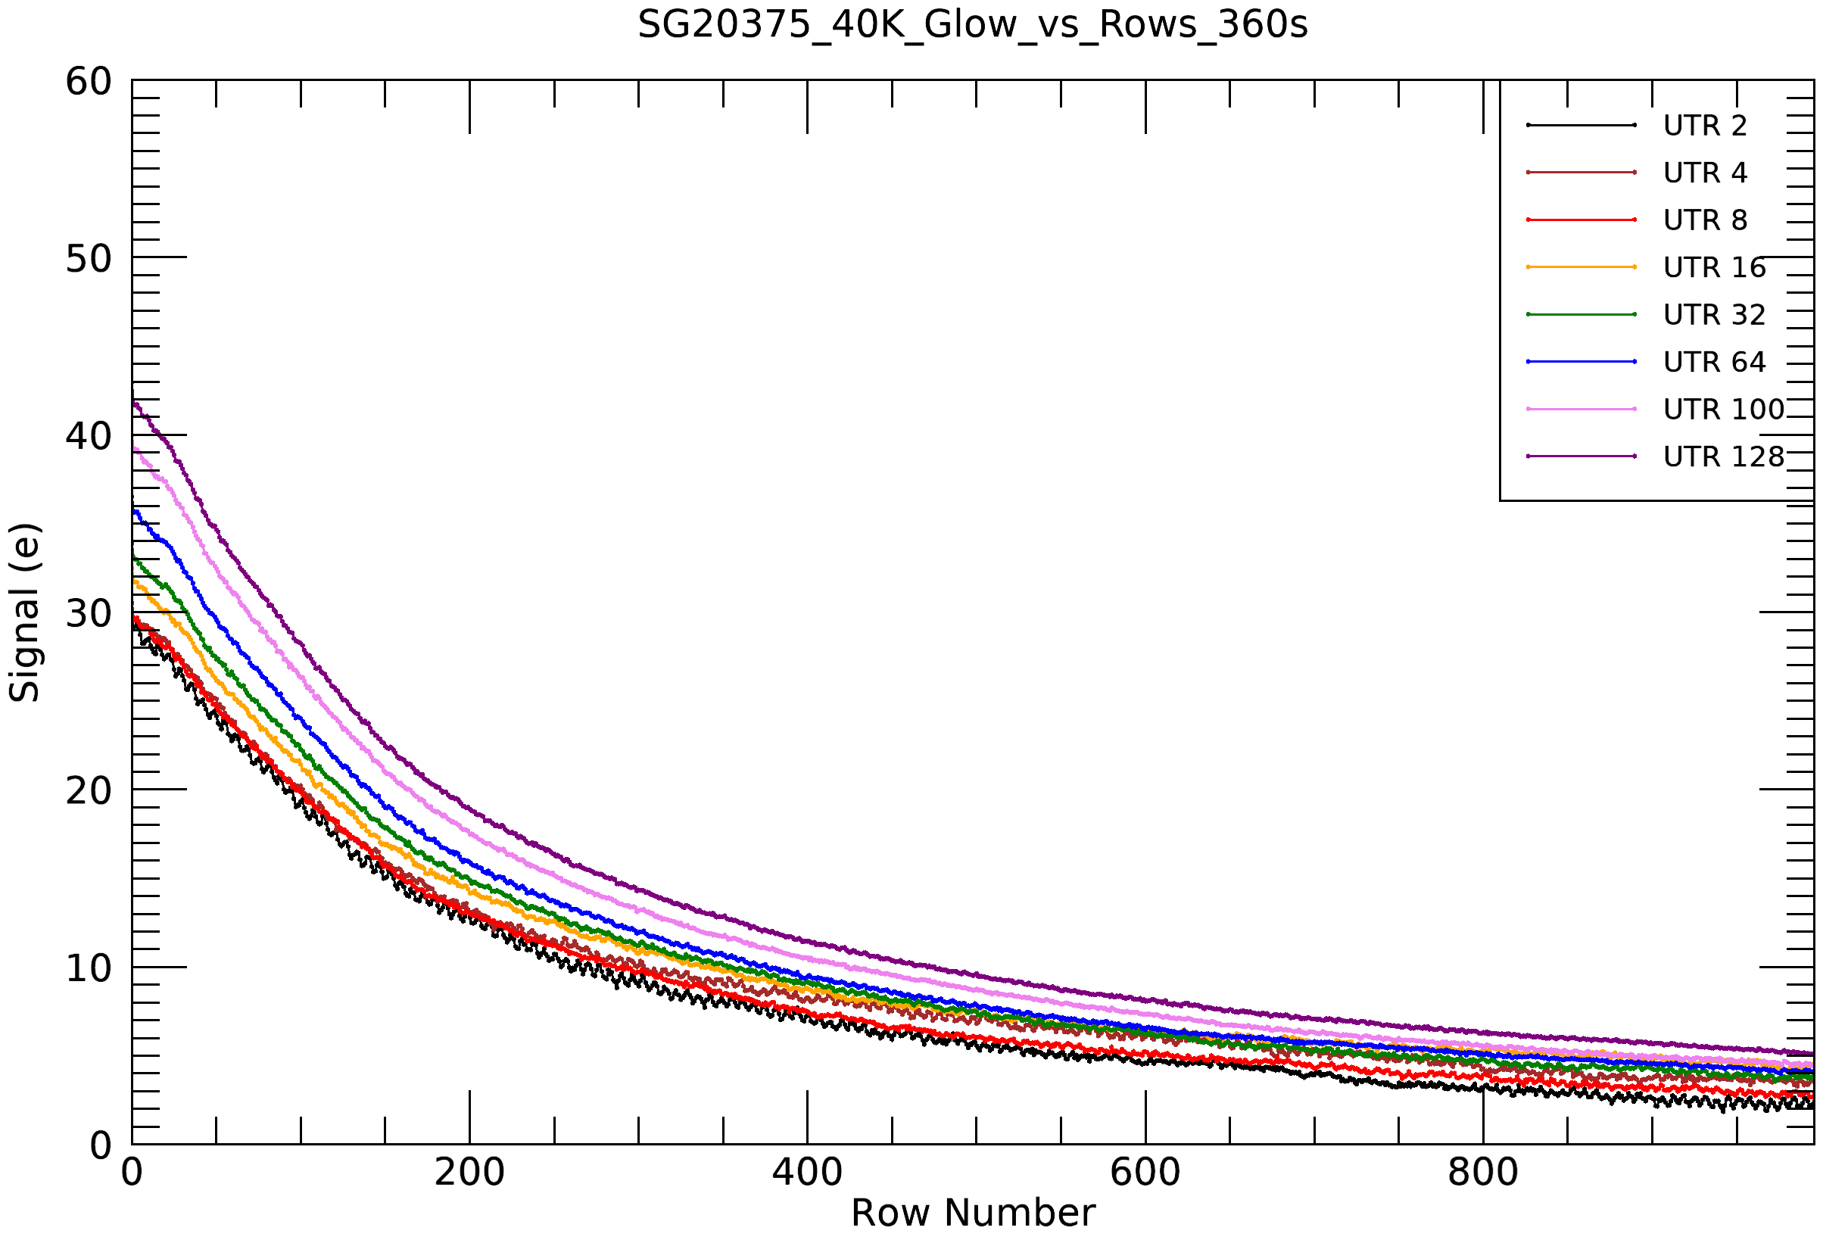
Glow in H4RG-15 with Rev-A ROIC
  A few hundred rows are still affected by the glow even after optimisation of buffer drain supply
H4RG-15, Rev-A ROIC
Notes:
Mostly the glow is a function of the integration time as already stated but there is a small element of glow per read also from the buffers. This is seen in the plot where the glow per time is now about 30 e for a 360s exposure a 2 reads but for the same integration time and 128 reads we get ~ 40e. This is all for Rev A of the ROIC.
Now we spoke at length to TIS about all of this and kept them informed of our testing etc. and they agreed that the buffers were the source of the glow. Since they still had many devices to deliver and were running out of Rev A ROICs they decided to implement some changes to try and fix the glow before procuring more ROICs for more devices.

Slide 14
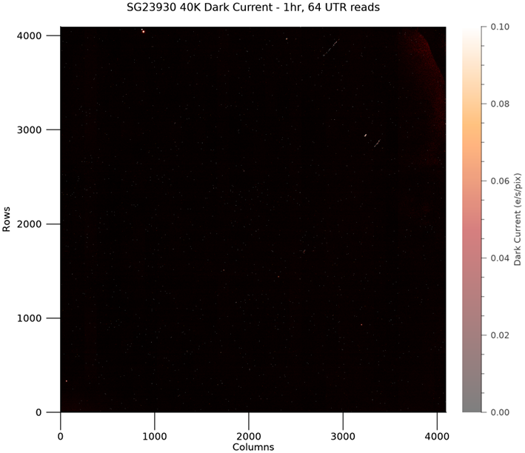
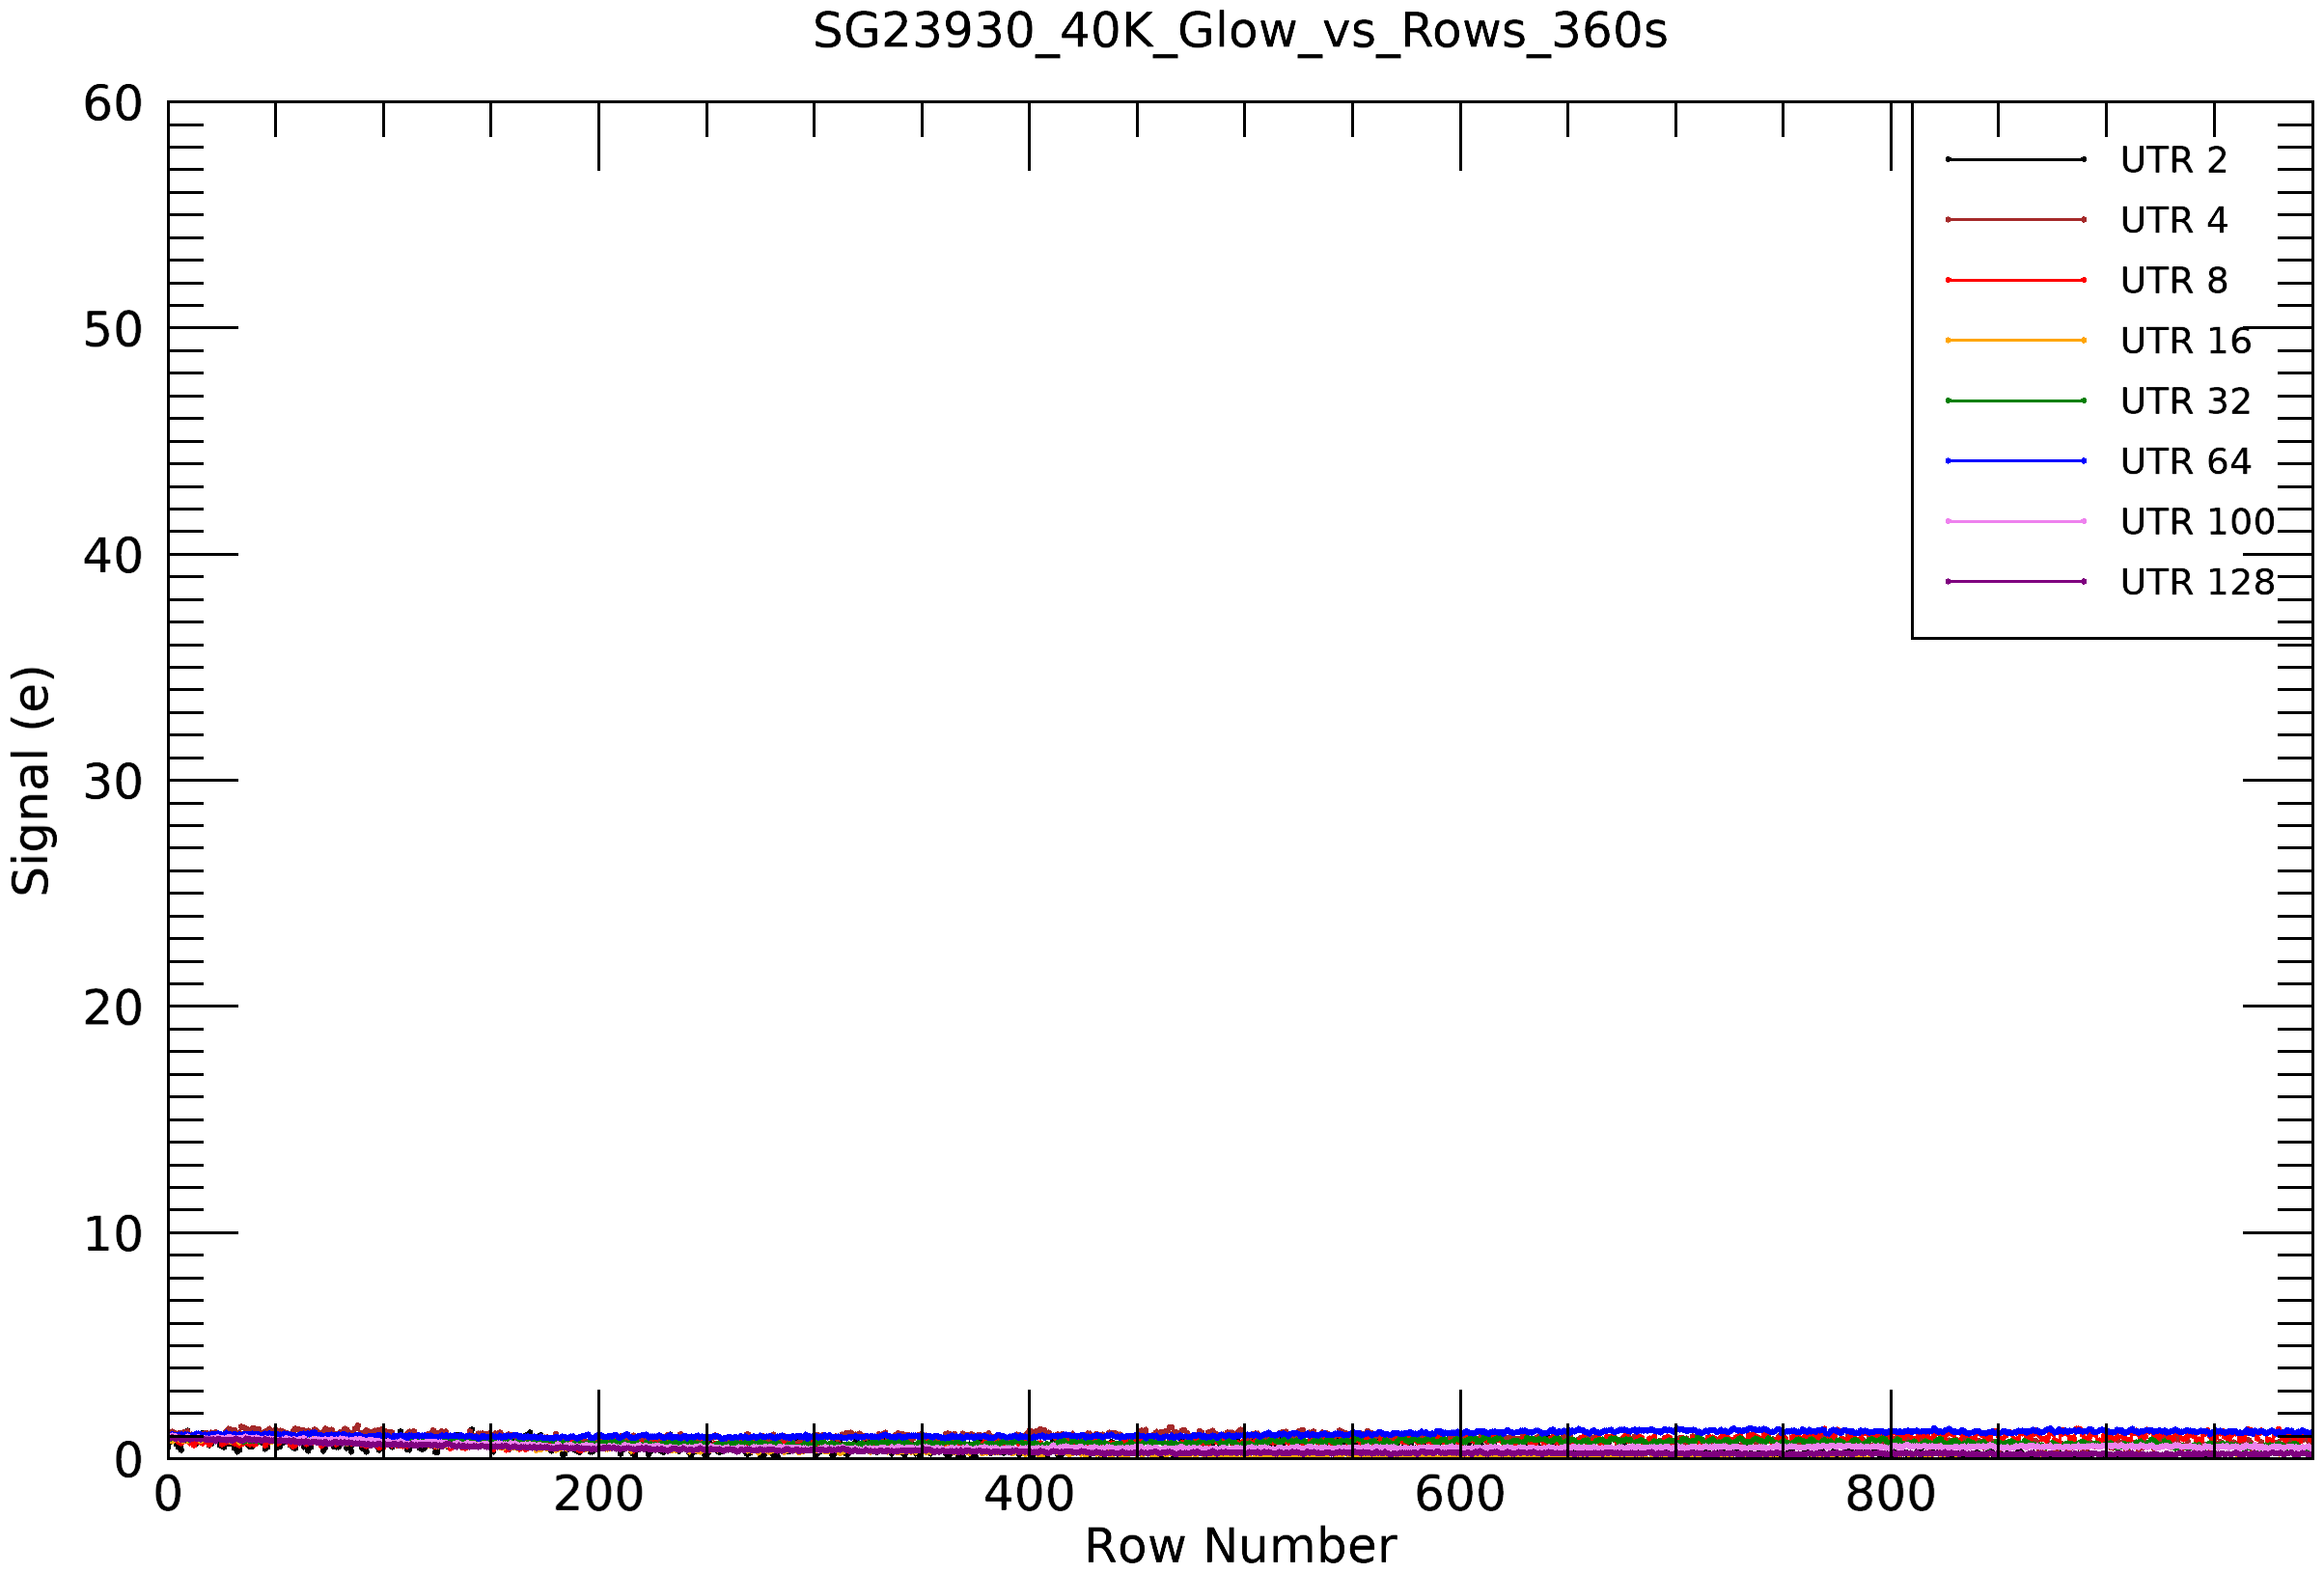
Glow Issue Fixed in Rev-B ROIC !!
  Thanks to Teledyne, the Rev-B ROIC addressed glow issue is now fixed,
  Also floating deselected columns and improved pad metallisation fixed
H4RG-15, Rev-B ROIC
Notes:
This led them to producing a Revision B of the ROIC where they implemented changes to fix the glow as well as other changes such as pull-downs on deselected columns and other changes which they could not tell us about. The Glow from the buffers is now fixed on the new revision of the ROIC.
For MICADO we already had 6 devices with ROIC-A delivered so will have to live with the glow for these devices. However for the last 3 devices they have been delivered with Revision B of the ROIC and as clearly seen from the slides the glow has gone away completely. This will now be their standard ROIC for future detector deliveries.

Slide 15
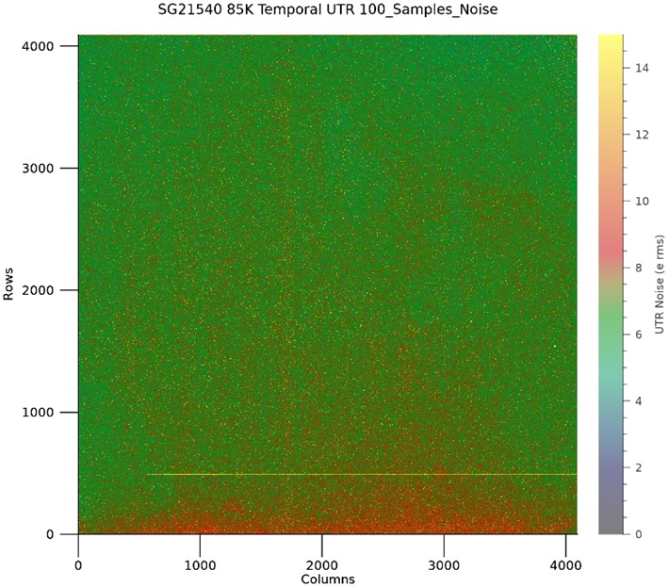
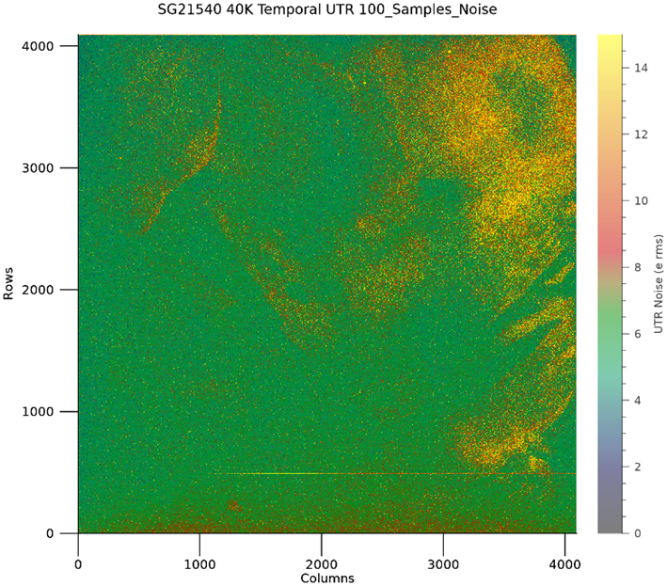
High Contact Resistance Pixels
Seen on some detectors, affecting performance at lower operating temperature!
  High contact resistance pixels on SG21540 (Rev. B ROIC) ?
Total noise 300s, 100 samples, 85K
Total noise 300s, 100 samples, 40K
Notes:
Now for other characteristics of these detectors. High contact resistance !
We have seen this issue in 3 out of 15 devices so far. If we look at the TIS datapacks then they do not see the issue.
A question for TIS can they measure such a characteristic using the PECs or with the devices themselves.
I am reporting is high contact resistance between the diode and the ROIC. We will see more on the next few slides. However how does this manifest itself and why is it not seen by TIS. In our setup we test all detectors from 85K, the MICADO temperature (which is LN2 cooled) down to 40K in steps of 10K or so. We had originally hoped to run the HARMONI devices at 40K as this is the temperature we operate most H2RG detectors and it was a default for us. In our experience this temperature gives the lowest read noise and lowest number of cosmetics and this also pans out in the test of all the detectors up to now. However more to be said later. The main issue is the UTR read noise where we typically achieve 5 e- rms. However, we see that the noise goes up as we cool down this particular detector, seen in the slides. So at 40K and 300s exposure with 100 UTRs we have areas where the noise is typically 12-14 e- rather than 5-6 e- rms.

Slide 16
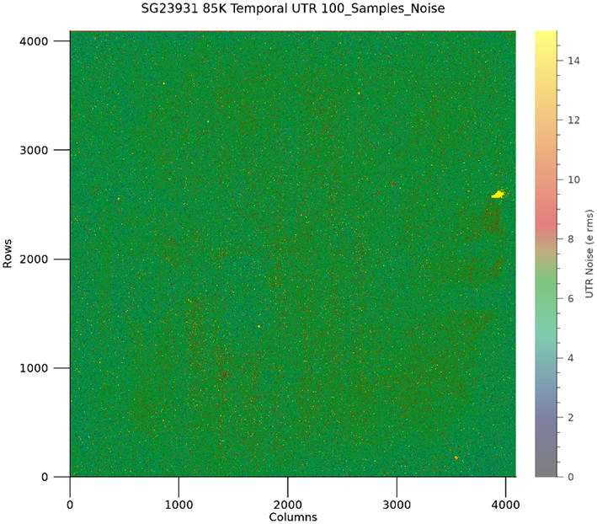
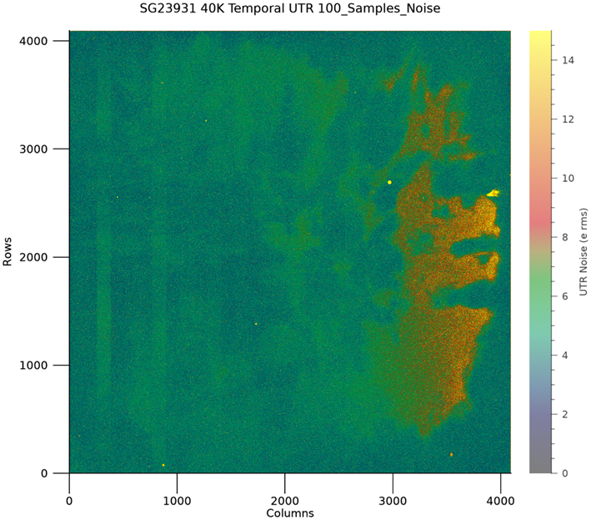
High Contact Resistance Pixels
High contact resistance pixels prominent at 40K !
  High contact resistance pixels on SG23931 (Rev. A ROIC) – not a revision issue !
Total noise 300s, 100 samples, 85K
Total noise 300s, 100 samples, 40K
Notes:
From our testing we see this in both Revision A and B of the ROIC so we know it is not the changes made to the ROIC that are the problem.
It just so happens that NASA reported similar issues for their H4RG-10 devices for the NRG telescope.
Also they referenced a paper in a journal not typically read by us which described most things that we were seeing.
So we are seeing an effect that others have seen and it is not new, except for us.

Slide 17
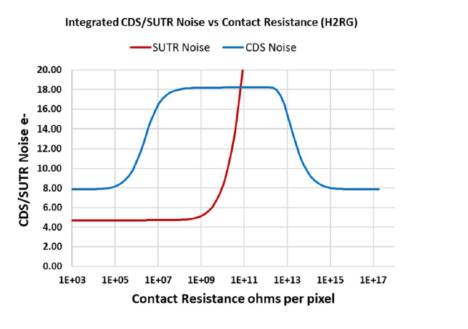
High Contact Resistance Pixels – What are they?
High series resistance in Giga Ohms !
  They have high series resistance between the metal contact and the p-type material
  The resistance can be high in giga ohm range!
Courtesy – Eric Piquette, Teledyne Imaging Systems
Eric Piquette, Effect of contact resistance on shortwave infrared focal plane array noise, Journal of Electronic Materials (2024) 53:5858-5864, https://doi.org/10.1007/s11664-024-11296-2
Notes:
NASA referenced a paper that highlighted this problem.
In this paper Eric Piquette describes high contact resistance between the ROIC and the diodes via the mettalisation and the indium bump bonds. I do not want to go into the details of this now, those interested can read the paper but with his modelling and what he describes in what we see. So low noise for simple CDS but higher than expected noise for UTR, long integrations. The paper is referenced on this slide. We surmise that the high contact resistance is a function of temperature since we only really see the effect at colder temperatures of 40K, initially we did not really look for it between 40K and 85K but for this conference I have gone back over old data to see if there is a correlation between contact resistance and temperature.

Slide 18
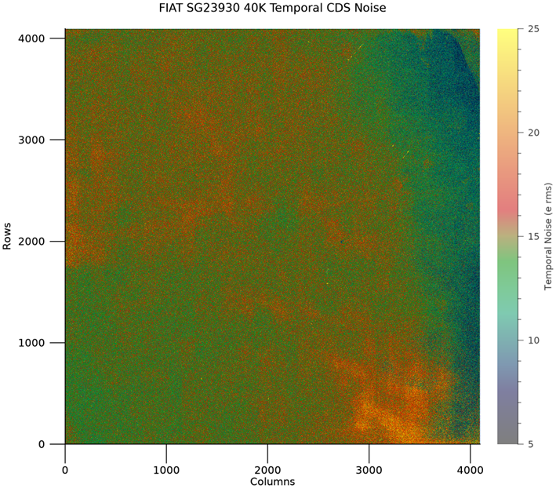
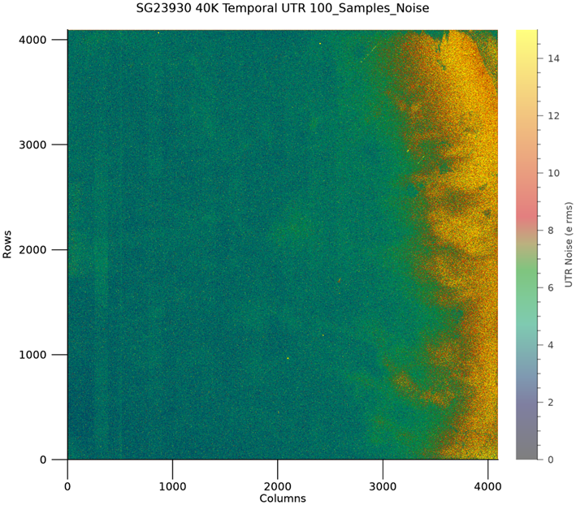
Effects of High Contact Resistance Pixels
High contact resistance pixels show up as low CDS noise but high UTR noise !
  Low CDS noise, but high UTR noise - SG23930 (Rev. B ROIC)
Temporal CDS Noise, 85K
Temporal UTR Noise, 300s, 100 samples, 40K
Notes:
Just to confirm the theory , this slide shows the CDS noise as nominal at 85K but the UTR noise is high at 40K.
Typically for our first 8-9 devices, we did not see this problem. We have CDS noises < 15 e-rms and UTR noise of ~ 5-6 e- rms. Now the UTR noise for some regions was much higher at 12-14 e- rms but our suspicion was that it was a function of temperature.

Slide 19





Effects of High Contact Resistance Pixels with Temperature
Higher noise region
2-D Noise maps
of H4RG-15 detectors
80K
40K
45K
60K
85K
Notes:
To confirm that the contact resistance issue is a function of temperature we had tested 1 detector from 40K to 85K and have noise images. See the movie in the slide.

Slide 20
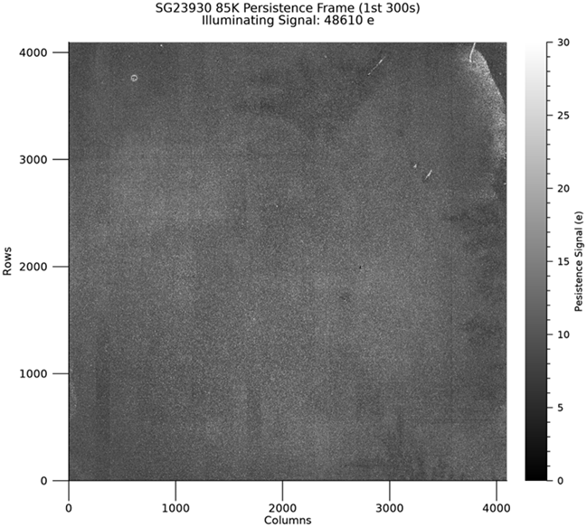
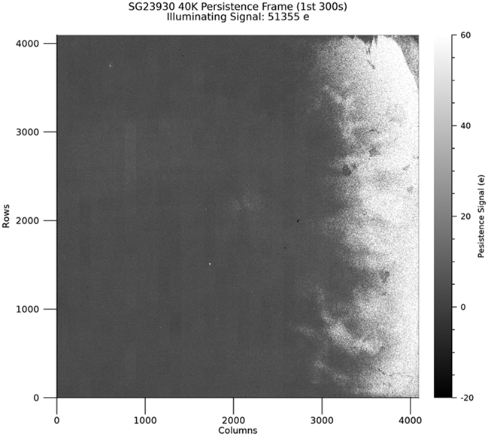
Effects of High Contact Resistance Pixels
Other effects - Higher persistence !
  Persistence signal in 1st 300s dark after an illumination ramp to about 50ke in 300s exposure
  Very low array persistence at 85K, but higher at 40K for the region of the high contact resistance pixels
Low persistence, 85K
Higher persistence for high contact resistance pixels at 40K
Notes:
Of course we also need to look at other issues with the high contact resistance, for example using our persistence algorithm we see that the persistence is higher at 40K rather than 80K and in exactly the same regions as the high contact resistance.

Slide 21
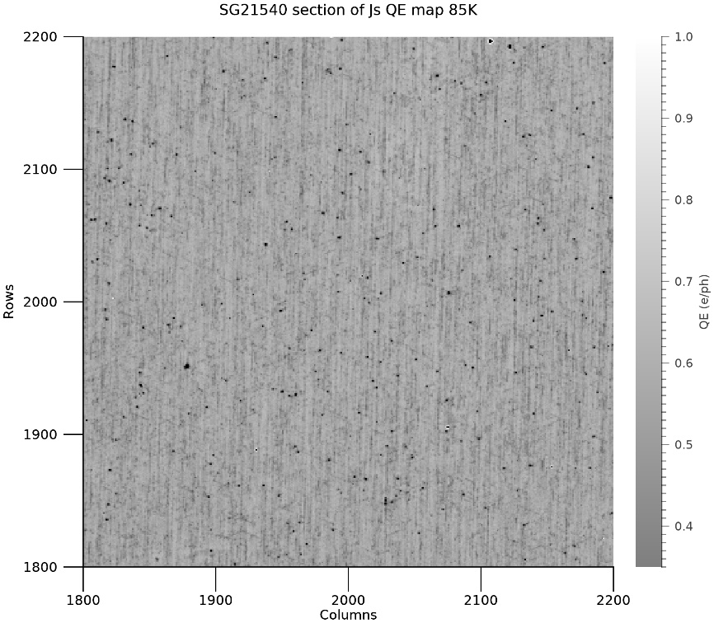
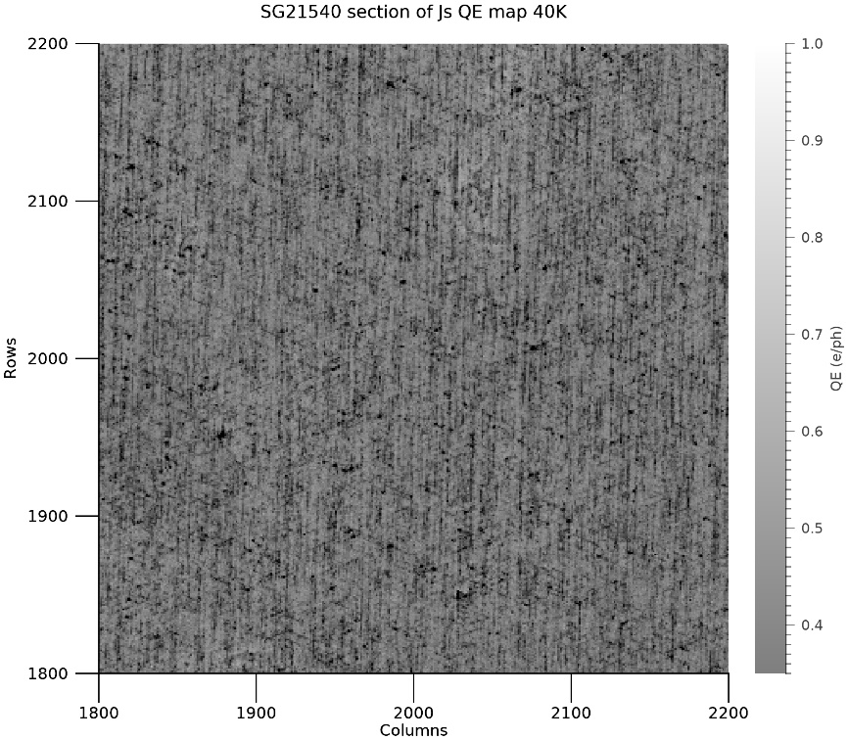
Some Detectors Show Strong Crosshatch at 40K
Crosshatch pattern prominent at 40K, also strong in shorter wavebands !
  Crosshatch prominent on some detectors, stronger at 40K and in shorter wavebands !
  QE variations seen! – Lattice stress at lower temperatures?
Light crosshatch pattern, 85K
Prominent crosshatch pattern, 40K
Notes:
Now for something completely different. Again with temperature we see that the cross-hatch pattern seen on some devices is worse at 40K compared to to 85K. The slide show these 2 temperatures using a J band flat and we also see that the QE in the J band for this device with the cross-hatch pattern is lower than the same device at 85K.

Slide 22
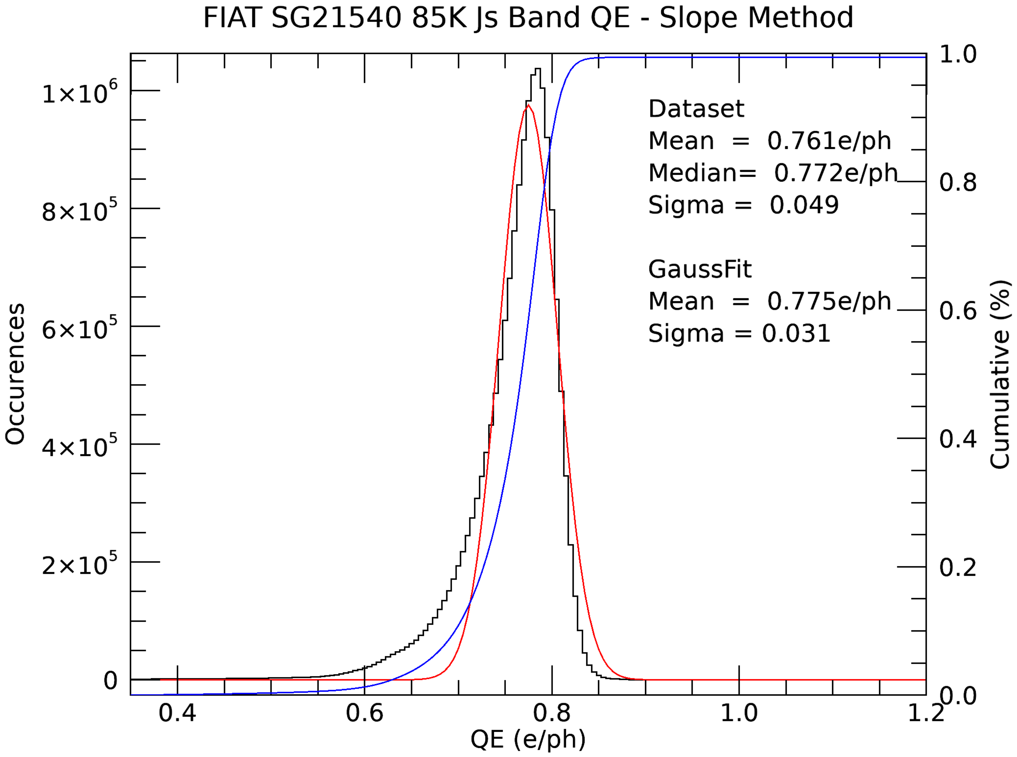
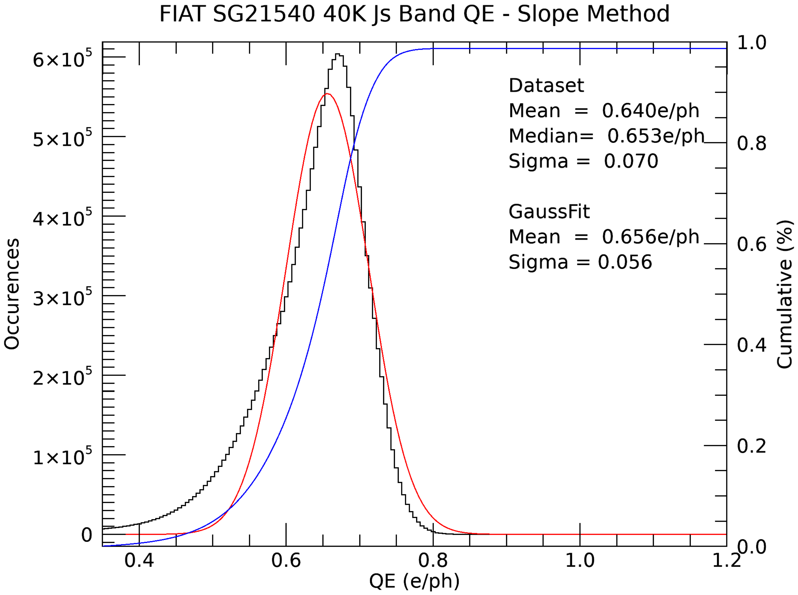
Most Detectors show Strong Crosshatch 40K
Crosshatch pattern affects QE and PRNU at 40K!
  The QE dependency is stronger at lower operating temperature on the devices with strong crosshatch pattern
  The dependency is even stronger at short wavelengths with temperature
JS band QE, 85K
Js band QE, 40K
Notes:
Looking at this in more detail we seen that the median QE changes from ~ 77% at 85K to only 65% at 4K. This is clearly seen from the 2 histograms, everything else is the same except the operating temperature. Also from the plots we clearly see that the PRNU (Pixel Response Non Uniformity) is also lower at the lower temperature.

Slide 23
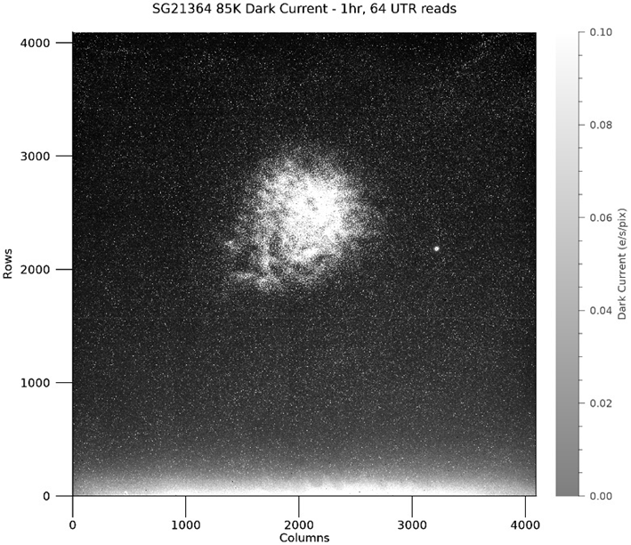
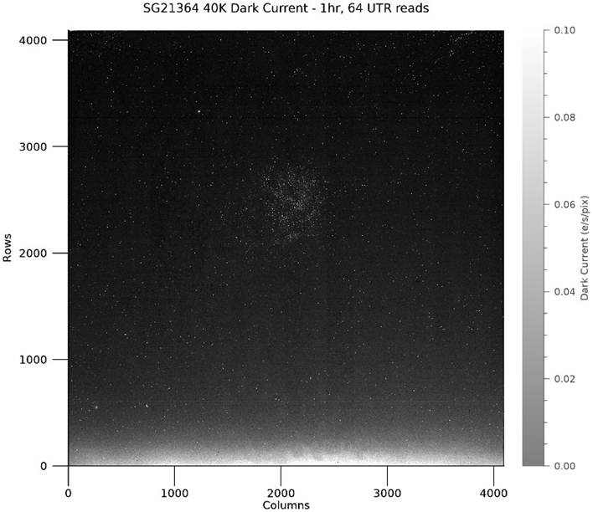
Some Detectors Perform Better at 40K
Some detectors perform better at 40K ! No stability or High contact resistance pixels issues!
  Good performance at 85K, low noise CDS (11.3e rms) UTR noise (4.9e rms), even better at 40K
Dark bitmap, 85K
Dark bitmap, 40K
Notes:
So, for the HARMONI instrument and because of our H2RG experience we wanted to operate the detectors at 40K. MICADO had chosen LN2 for operational reasons so we had to test the detectors at 2 temperatures which was fortuitous for us as otherwise we would just have ran all the devices at 40K. On the MOONS instrument we ran the 4 devices at 40K without seeing too many issues with the cross-hatch pattern and did not see the contact resistance problem. From the device we see above in the slide we see that for 40K operation cosmetically is better than at 85K.

Slide 24
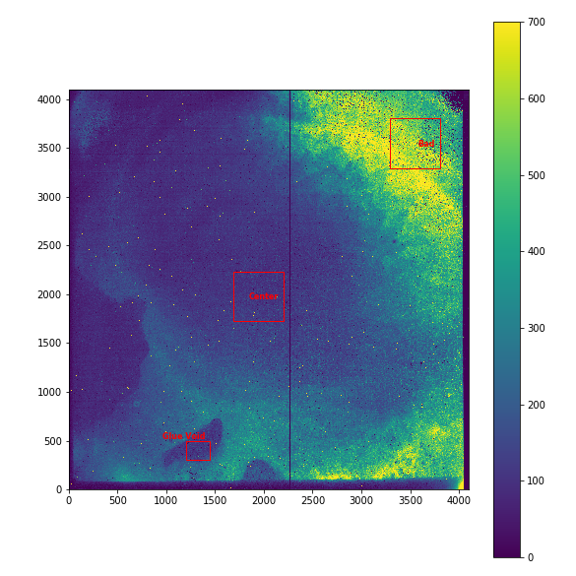
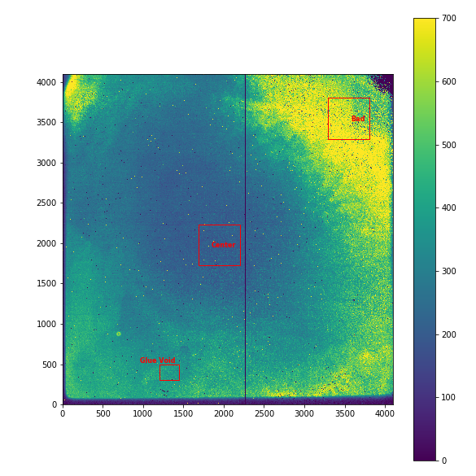
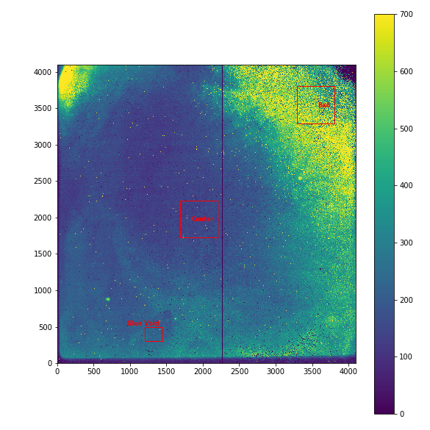
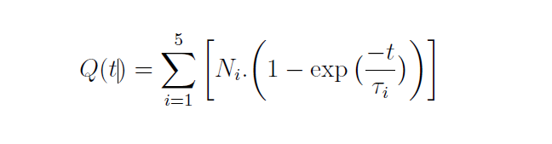
Persistence Maps at 40K, 65K and 80K
ESO method to determine persistence
Flash LED
Wait 10000s for equilibrium
Reset Detector
Readout, NDR at log spaced intervals for 14 hours
Allows sampling of persistence at different time constants
Q(t) is trapped charge
Ƭi is time constant for i
Ni is maximum charge trapped for Ƭi
Notes:
We all know about persistence and the ESO method of testing for it. In doing this talk I wondered by TIS were not seeing the high contact resistance issues seen by us. I know that they test at only 77K but since we believed that contact resistance changes with temperature then there at least should have been a hint of that. Sure enough when revisit their test reports and more importantly the test mages they send us we do see in their persistence maps a definite hint of contact resistance issues.

Slide 25
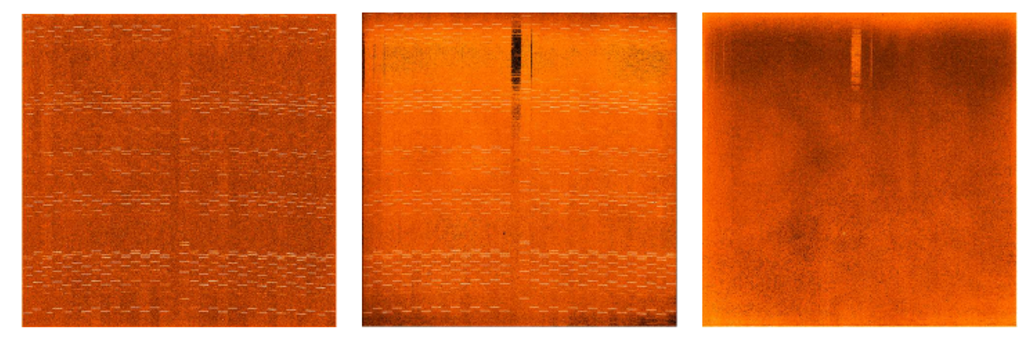
Persistence images with ERIS detector and correction model
Persistence images taken with ERIS detector.
Left, shows dark image affected by previous lamp exposures.
Middle, persistence model.
Right, corrected dark image using persistence model.
https://indico.cern.ch/event/1026001/contributions/4385935/attachments/2265614/3846668/DeMo_Persistence_MNeeser.pdf - presentation from Mark Neeser at ESO.
Notes:
At ESO we do have a pipeline option now to reduce the persistence from our lab data. We supply the pipeline people with the 5 time constants per pixel and they also know what had happened previously to the detector in terms of field etc. From that they can come up with a correction image to minimize the persistence. Here we have an image from ERIS a system we delivered a few years ago and is now in astronomy use at the telescope. On the left is the persistence image of arc lamps. The middle image shows our model and the right image is the corrected image.

Slide 26
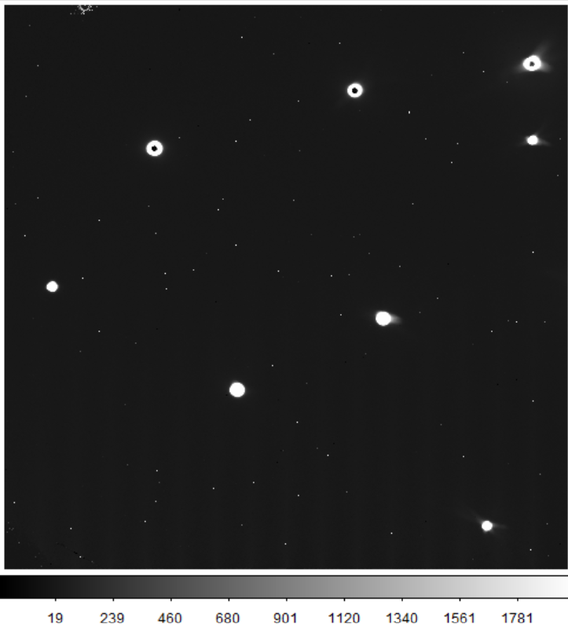
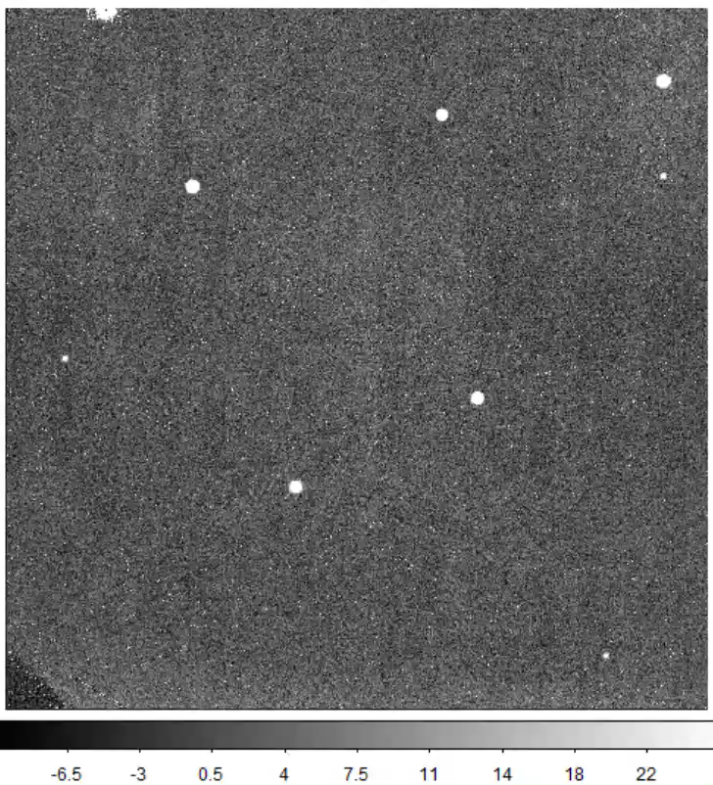
Interleaved Multiple Window Resets
A mask with pinholes manufactured to project bright spots onto the detector.
CDS INT frame from 10 DITs (2.6s DIT)
(without window resets)
Persistence in subsequent 60s UTR frames
(after the CDS exposure on the left)
Notes:
Because of persistence issues we wanted to reset really bright objects whilst integrating the exposure time for hundreds of seconds and reading up the ramp. As a test we had a mask cut, shown on the left which project “stars” onto the detector and which saturated quite quickly. The image on the right is then the persistence image of these stars taken with an image in the dark and read out every 60s. We clearly see the image persistence.

Slide 27
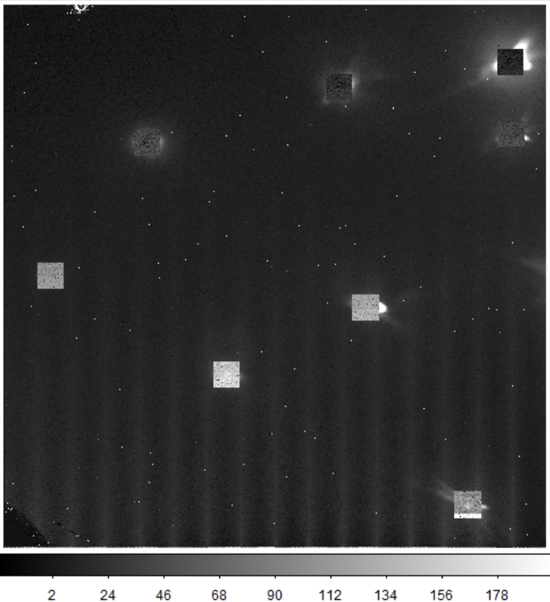

Interleaved Multiple Window Resets
Interleaved window resets avoid persistence from bright spots!
CDS INT frame from 10 DITs (2.6s DIT)
(with interleaved multiple window resets, every 128 rows)
Persistence in subsequent 60s UTR frames
(after the CDS exposure on the left)
Notes:
However we then implemented a mode where we can reset up to N windows (10 for MICADO) interleaved with science readout. So typically we read 128 rows non-destructively then go to the windows and reset them then read another 128 rows and repeat until the detector is fully readout. We then repeat this who process for the number of reads we do non-destructively. The image on the left is where we rese the windows over the stars. On the right we have a repeat image which no longer shows the persistence.

Slide 28


Offset Switching Pixels
Neighbours of some hot pixels switch offsets during integration!
Switching hot pixel neighbors
Notes:
Finally 2 other issues that we have recently seen. In one issue when we are reading non-destructively up the ramps sometimes pixels near hot pixels are also integrating, they then step downwards by a few thousand counts in one image but then continue to read up the ramp. Our line fitting shows this as a negative ramp rather than a positive one and the pixels look dark. We do know that this is a function of cell drain current and frame readout time but since there are only a few thousand of pixels like this in 16M we do not do anything at present.

Slide 29


Random Bright Pixels with Dark Shadows
These random events last a few days after a cooldown!
  Pixel values in a 3x3 box around such bright pixels over 100 UTR frames shown below
  Disappear after a few days at the operating temperature
Notes:
Likewise we have another issue where pixels perform is a similar fashion to described previously but then after a few days at operating temperature the problem disappears and the pixels then appear as normal unless we cool the detector down further then the pixels re-appear, however if we warm up we do not see the problem. The main point though is that after a few says these problem pixels disappear,. This is probably a lattice stress issue.

Slide 30






Overview of Key Performance Parameters at 85K
ROIC-B has much lower dark current !
Notes:
When I did this presentation we had data for 8 devices and the main highlights of these detectors are given here. There are many other features and issues that we have to content with that has not been described such as detector stability. In that case we have to throw images away before reading up the ramp. Because MICADO is a mosaic of 9 detectors then we have to run the devices identically so we will run the devices as per the worst device in the mosaic. If that device needs dummy frames then others will have it also even though they are very stable. We do this to minimize any non-synchronization issues between the detectors.

Slide 31
Summary
MICADO detectors will be operated at 82K (nominal) in buffered mode (PMOS)
Thanks to Teledyne! Output buffer glow on H4RG-15 is fixed in Rev-B ROIC !!
High contact resistance pixels on three detectors - affect array performance at lower operating temperature
Crosshatch stronger at lower operating temperature and short wavelengths
Offset switching pixels, bright pixels with dark shadows
Performance overview of the eight detectors tested so far presented !
Many other effects not mentioned, for example, stability
Each detector needs to be highly optimised
Notes:
Finally – the conclusion.

Slide 32

Naidu Bezawada and Derek Ives
ESO, Garching, Germany
Thanks to Teledyne Imaging systems for
the H4RG-15 detectors
@ESOAstronomy
@esoastronomy
@ESO
european-southern-observatory
@ESOobservatory

