Slide 1

Technology Development at
Markury Scientific:
Detectors, ASICs & Electronics
Markus Loose
March 10, 2026

Slide 2
Outline
ASIC Status and Developments
  SIDECAR ASIC
  ACADIA ASIC
  FALCON ASIC
Improving Detector Performance
Control Electronics
  MCE – 32 ASICs in parallel
  MACIE – Generic ASIC controller card

Slide 3
ASICs for
Scientific Detectors

Slide 4
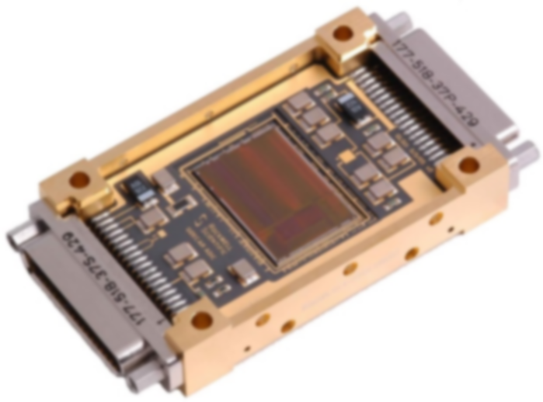
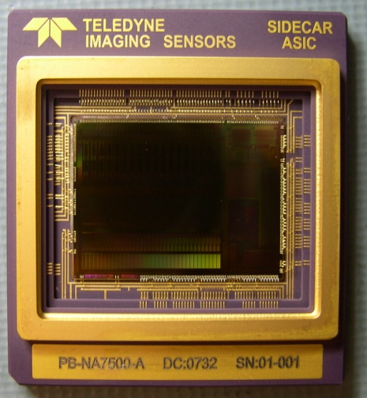
SIDECAR ASIC
SIDECAR: System for Image Digitization, Enhancement, Control And Retrieval
36 analog input channels, each channel provides:
  500 kHz A/D conversion with 16 bit resolution
  10 MHz A/D conversion with 12 bit resolution
  gain = 0 dB …. 27 dB in steps of 3 dB
  optional low-pass filter and current source (as source follower load)
20 analog output channels, each channel provides:
  programmable output voltage and driver strength
  programmable current source or current sink
  internal reference generation (bandgap or vdd)
32 digital I/O channels to generate clock patterns, each channel provides:
  input / output / highohmic, selectable output driver strength and polarity
  pattern generator (16 bit pattern) independent of microcontroller
  programmable delay (1ns - 250µs)
16 bit low-power microprocessor core (single event upset proof)
  responsible for timing generation and data processing
  16 kwords program memory (32 kByte) and 8 kwords data memory (16 kByte)
  36 kwords ADC data memory, 24 bit per word (108 kByte)
  additional array processor for adding, shifting and multiplying on all 36 data channels in parallel
JWST package (cryo)
HST package (ambient)

Slide 5
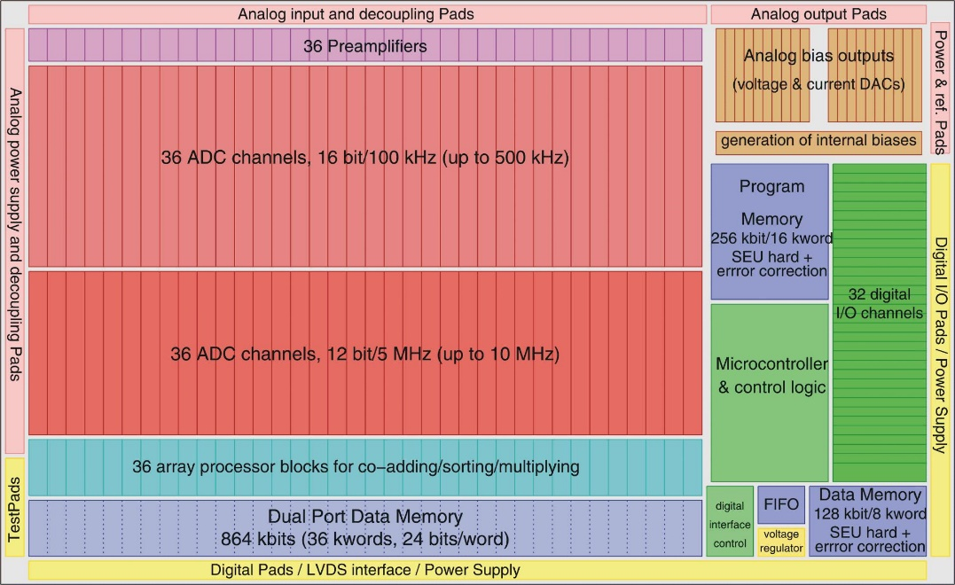
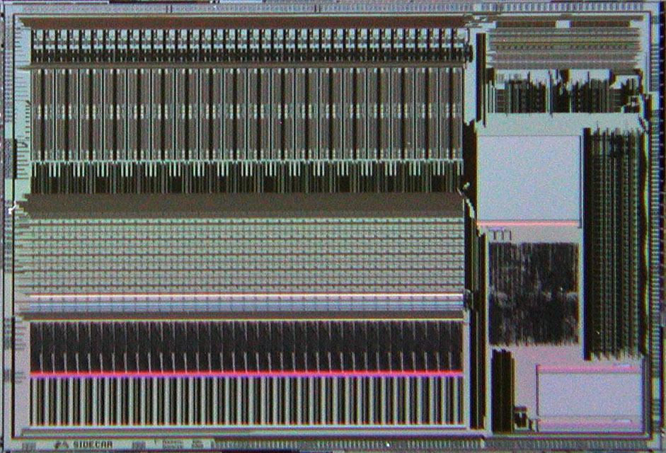
ASIC Floorplan and Micrograph
14.5 mm
22 mm

Slide 6
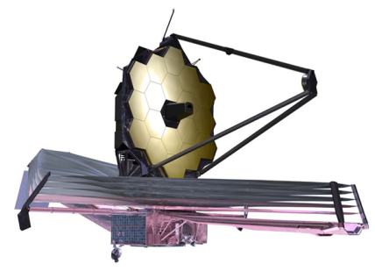
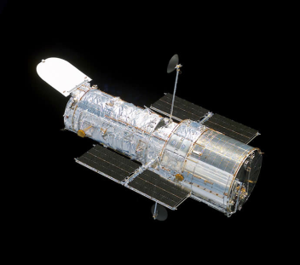
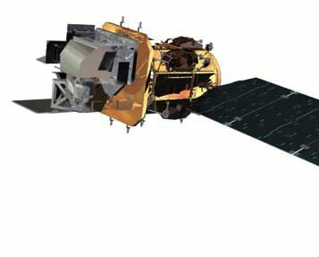
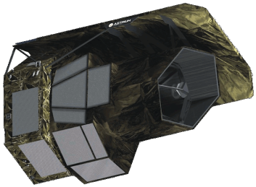
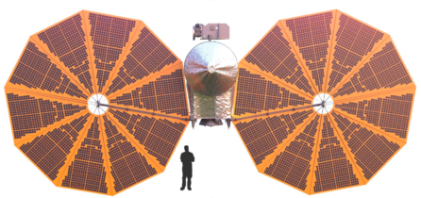
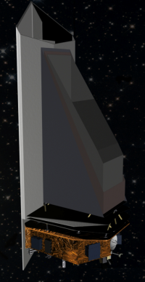
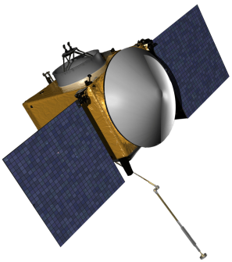
Missions Employing SIDECAR ASICs
James Webb Space Telescope
  NIRCam, NIRSpec, FGS/NIRISS instruments, 15 H2RG detectors, launched in 2021
Hubble Space Telescope
  ACS (Advanced Camera for Surveys), CCD detector, launched in 2009
Landsat Data Continuity Mission 8 & 9
  TIRS & TIRS2 instrument, QWIP detector, launched in 2013 & 2021
OSIRIS-REx Asteroid Mission
  OVIRS instrument, H1RG IR detector, launched in 2016
Lucy (Trojan Jupiter Asteroids)
  L’Ralph instrument, H2RG (IR), STA CCD (visible), launched in 2021
Euclid
  NISP instrument, 16 H2RG detectors, launched in 2023
PACE (Plankton, Aerosol, Cloud, ocean Ecosystem)
  OCI instrument, 16/16 individual photodiodes, launched in 2024
NEO Surveyor (Near-Earth Object Surveyor)
  8 longwave H2RGs, planned launch in 2027
ARIEL (Atmospheric Remote-sensing Infrared Exoplanet Large-survey)
  FGS instrument, H2RG detector, planned launch in 2029
ARRAKIHS (Remnants of Accreted galaxies, Dark Matter, Galaxy Formation)
  Single instrument, two H2RGs & SIDECARs, planned launch in 2030
JWST
LDCM
HST
NEO
Surveyor
Lucy
Euclid
OSIRIS-REx

Slide 7
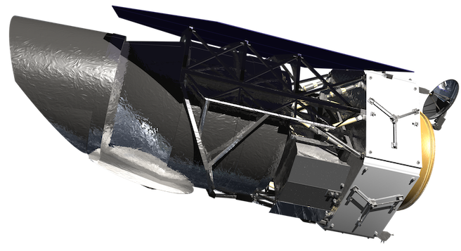
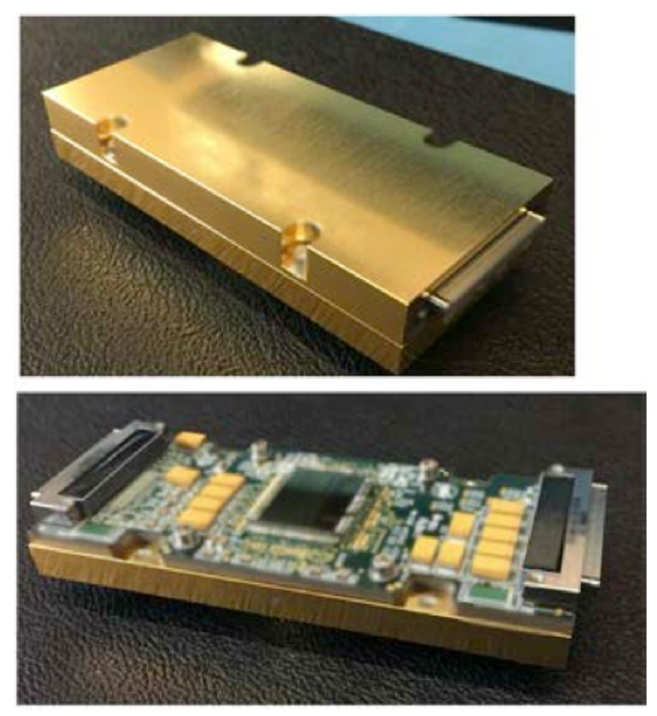
ACADIA – Next Generation ASIC
ASIC for Control And Digitization of Imagers for Astronomy
Developed for the Nancy Grace Roman Telescope (RST) to provide improvements:
  Lower noise on bias voltages and currents
  Higher signal-to-noise ratio in digitization chain (Preamps & ADCs)
  Some RST specific capabilities like on-the-fly bright pixel detection
40 Digitization Channels, each providing
  Pre-amplifier with programmable gain, bandwidth, and feedback type (resistive or capacitive)
  16-bit ADC, up to 1 MHz sample rate (3 – 5 MHz at 14-bit)
  Digital processing capability for adding/multiplying and threshold detection
24 Analog bias outputs
  12-bit Digital-to-Analog Converters with configurable output buffer
  Programmable current sources
  Internal bandgap for reference voltage (operational across full temperature range)
32 Clock Inputs/Outputs
Custom Sequencer for Timing Generation
  Programmable timing patterns with 47 simultaneous signals (32 external, 15 internal)
  Small set of instructions achieves fast learning curve and easy programming
  Dedicated support structures like timers, DMA engines, and FIFO
  Open Source Microcontroller (MSP430) for applications that require more complex operations
Packaged ACADIA

Slide 8
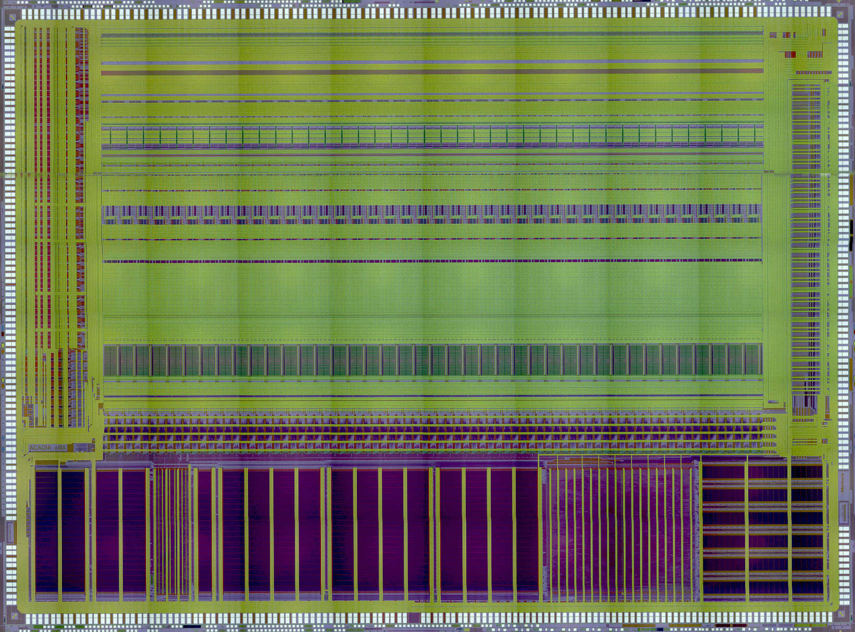
ACADIA Floorplan
Block Diagram
Micrograph (stitched from multiple smaller images)
Die size: 20.5mm x 15.1mm

Slide 9
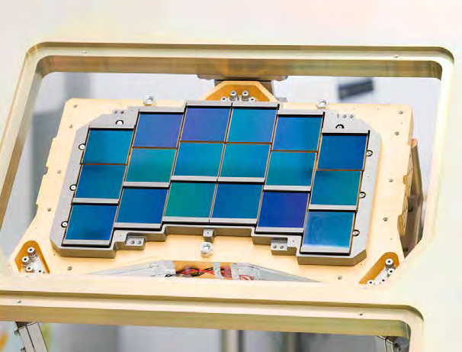
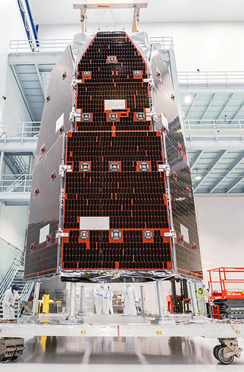
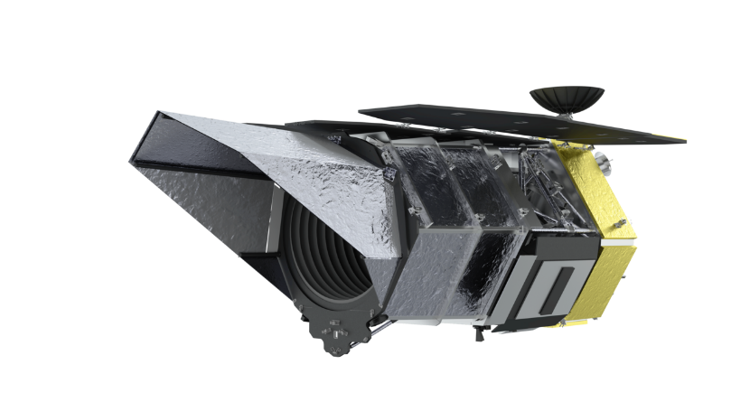
ACADIA ASIC Status
ACADIA ASIC fully integrated into Roman Space Telescope (RST)
  18 H4RG detectors in WFI (Wide Field Instrument)
  18 ACADIA ASICs
  RST is in final integration and verification stages
  Launch scheduled for September 2026
A new (final) revision has been completed
  Improved some ADC DNL shortcomings
  Fixed a handful of minor digital and analog issues
  Limited testing so far, but everything looks good
ACADIA beyond Roman
  NASA GSFC will use left-over ACADIAs for some smaller missions
  Progress has been slow due to limited funding
Next important milestones
  Habitable World Observatory is moving ahead strongly
    ACADIA considered as detector controller
  Develop lower cost ground-based packaged version
    Interest from ground-based observatories
    No time frame yet due to funding uncertainty

Slide 10
Preamp & ADC Combined Noise Comparison
ACADIA (ADC Test Chip data)
  ADC noise: 1.1 ADU (67µV)
  Preamp noise (gain 16): 8.2µV
SIDECAR ASIC (HST test data)
  ADC noise: 2.6 ADU (150µV)
  Preamp noise (gain 16): 18µV

Slide 11


Voltage Bias Noise
ACADIA Design (ADC Test Chip data)
  Bias buffer noise: 6.8µV
SIDECAR ASIC (HST test data)
  Bias buffer noise: 35µV

Slide 12
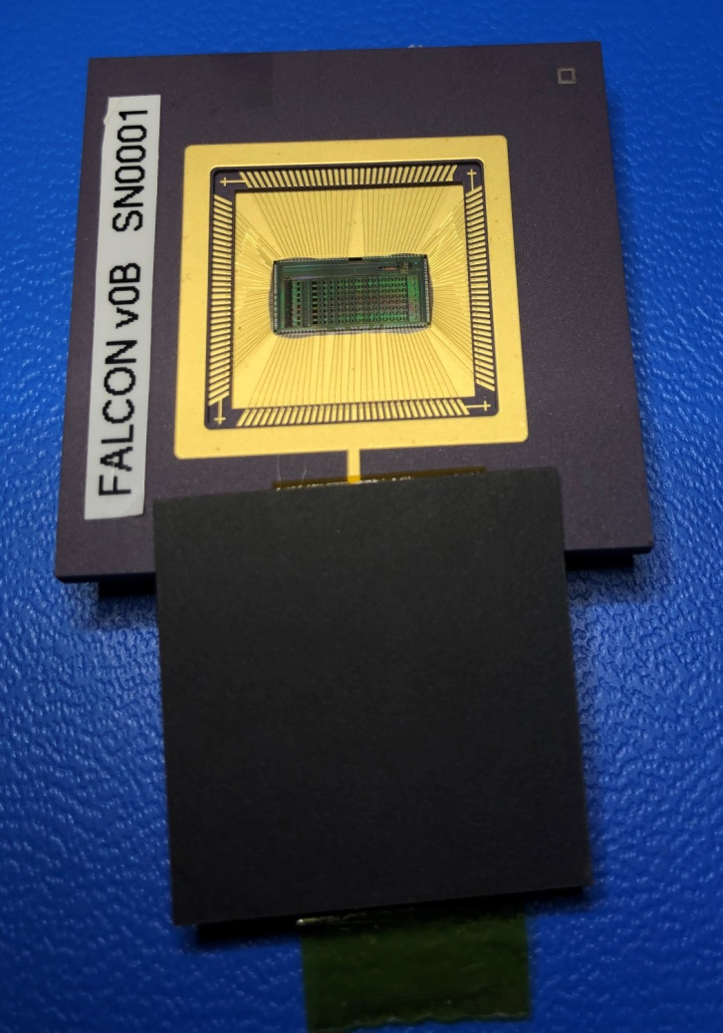
FALCON – ASIC for Fast Readout Rates
Fast Analog-to-digital Low-noise CONverter
Analog-to-Digital Converter, 8 channels on chip
  14-bit resolution
  minimum 12.5MHz sampling rate
  > +/-1V minimum differential input range (= 2V single-ended input range)
  > 12bit ENOB (Effective Number of Bits)
  < 75mW power consumption per channel
Programmable Gain Preamp, one preamp per ADC channel
  Single-ended to differential conversion
  Configurable gain from - 6dB to 24dB in steps of 3dB
  Configurable bandwidth and noise filter
  < 25mW power consumption
Bias Generator
  Programmable Bias Voltages (ADC references, preamp references)
  Programmable Bias Currents (ADC biases, preamp biases)
  Programmable Bias Generation for external use (e.g. detector)
SPI Interface for configuration control
High Speed Data Interface for ADC data output (incl. PLL for fast clock generation)
FALCON ASIC in test package

Slide 13


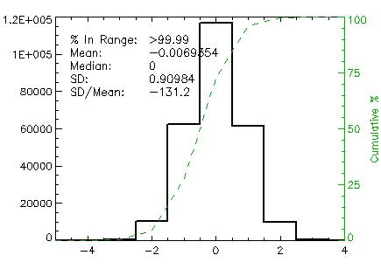
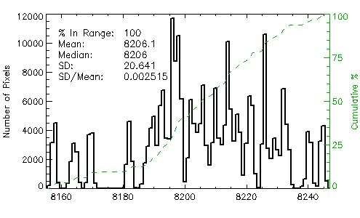
Shorted Input Results from 4x FALCON (32 channels)
Single frame
Data is captured on all 32 channels in parallels
Noise is measured by subtracting two frames, to compensate for channel-to-channel offset
  Computed noise has to be divided by sqrt(2)
Preamp gain 1
Difference between 2 Frames
Noise: 0.643 LSB
Input referred: 157µV

Slide 14
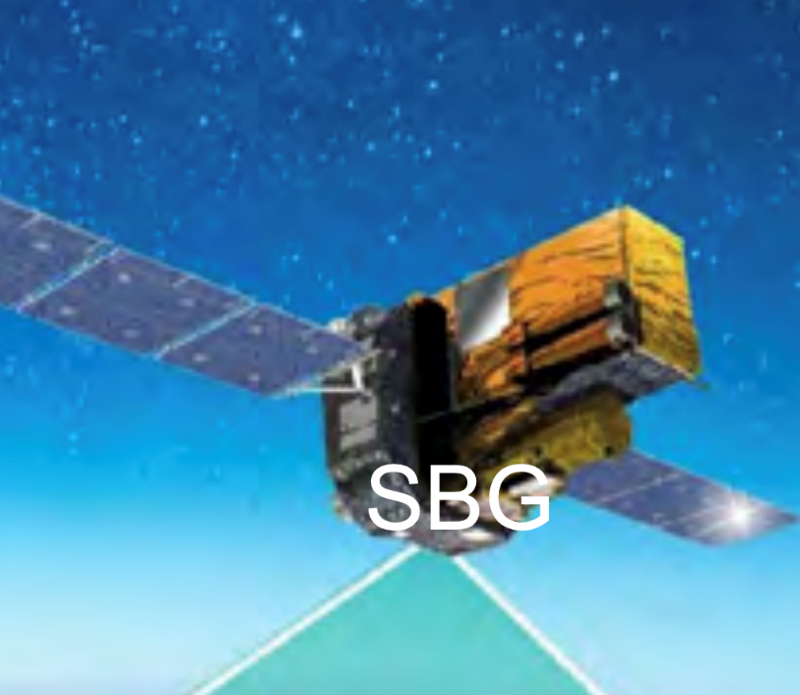
FALCON ASIC Development Status
Final design completed and verified
  meets all requirements
Flight packaging and qualification performed by JPL/NASA
Implemented into SBG mission (Surface Biology and Geology)
  SBG development has halted in June 2025 due to funding stop
use of FALCON ASIC in other missions being considered by NASA/JPL
  Generic space-qualified multi-channel ADC with built-in preamp
  Generic sensor controller (not just imaging)

Slide 15
Improving Detector Performance
Optimized Readout Techniques

Slide 16
Exploring Increase in Readout Speed
SCALES: New spectrograph under development for the Keck Observatory
  Slicer Combined with Array of Lenslets for Exoplanet Spectroscopy
Uses residual JWST detector assets
  H2RG with only 4 output channels accessible
  10.5s frame time at nominal 100 kHz readout speed
  Only slow mode, no fast mode possible
Optimal instrument performance requires significantly faster frames rates
  Examine performance behavior for increased readout speed
  200kHz – 1MHz have been evaluated before (e.g. MAJIS instrument on JUICE mission), but faster speeds are less explored
Investigate and optimize pixel rates at 1 MHz and beyond
  Use slow buffered mode of the H2RG
  Operate detector using SIDECAR ASIC fast mode ADCs (up to 10 MHz sample rate)

Slide 17
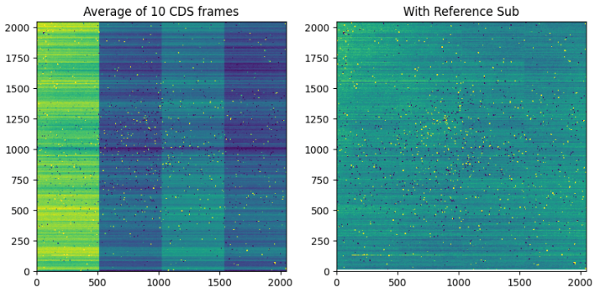
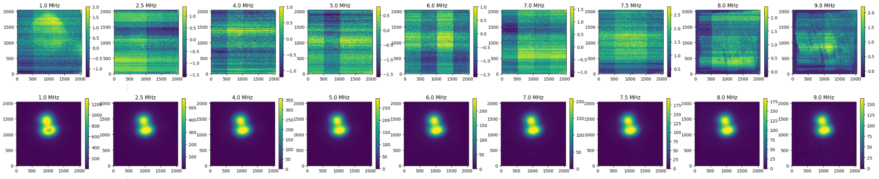
Test Results with Increased Readout Speed
10 CDS average at 1.2 MHz pixel rate
Results* from IFS detector channel
CDS noise calculated using 10 averaged frames
Reference pixel subtraction is applied, but not optimized
Read noise does not significantly increase up to 1.8 MHz pixel rate
* Data provided by Peyton Penac/UCLA
Pixel rate [MHz] | Noise† [DN] | Noise† [e-]
1.0 | 0.598 | 3.432
1.5 | 0.675 | 3.875
1.6 | 0.676 | 3.880
1.8 | 0.656 | 3.765
Without RefPix subtraction
With RefPix subtraction
†Multi-CDS average
1 MHz
2.5 MHz
4.0 MHz
5.0 MHz
6.0 MHz
7.0 MHz
7.5 MHz
8.0 MHz
9.0 MHz
CDS, no illumination (dark)
CDS, Pinhole illumination

Slide 18
Improving Duty Cycle and Dynamic Range
NEO Surveyer – H2RG:
  Mapping of near-earth objects
  Long-wave detector (10µm)
  Background will saturate detector within a few seconds
Mode of operation:
  Do not use SUTR due to low duty cycle for short ramps
  Instead, use interleaved CDS with close to 100% duty cycle
  Read – Reset – Read per row
  Separate reset and read rows by some number of rows
    to mitigate IPC
    to allow for short exposure time on first read (as low as a few ms)

Slide 19
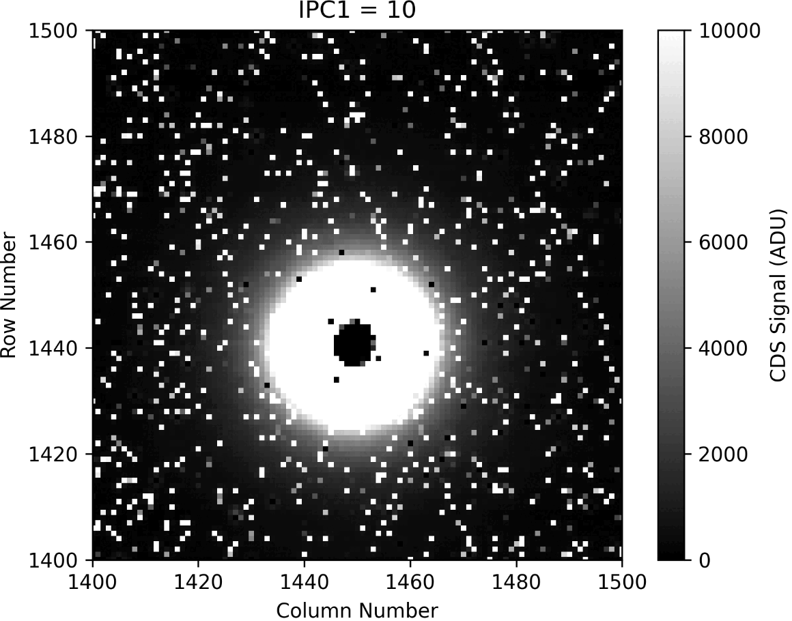
Test Results from NEO Surveyor ConOps
Demonstration of Short Exposure Time
  Example shows a detector region with PET (photo-emissive defect)
  IPC separation between reset and read row is continually varied from 10 rows to 100 rows.
Image shows CDS frame between first read and second read of the same interleaved frame
  Pixels in the center are brightest, already saturated by the first read.
  Inner black circle gets larger with integration time since more pixels are saturated by the first read
Data provided by Greg Zengilowski/UCLA & NEOS team

Slide 20
Windowing with Low Noise
ARIEL – ESA mission for remote sensing of exoplanets’ atmospheres
  Two instruments: AIRS – H1RG, FGS – H2RG
  Both need fast frame rates at high signal-to-noise
  Use window mode to reduce number of rows and/or columns
Disadvantage of Window Mode:
  Reference pixels usually not inside the window
  No common mode noise correction possible in post processing
  No preamp offset correction possible (if ASIC is used)
Solution examined for AIRS:
  Read multiple windows where reference pixel in the same rows and columns as the science window will be included
FGS uses similar approach:
  Vertical window with multiple sections
  No horizontal window, always read full rows

Slide 21
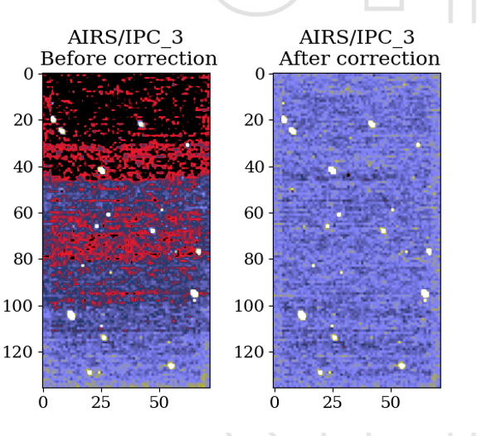
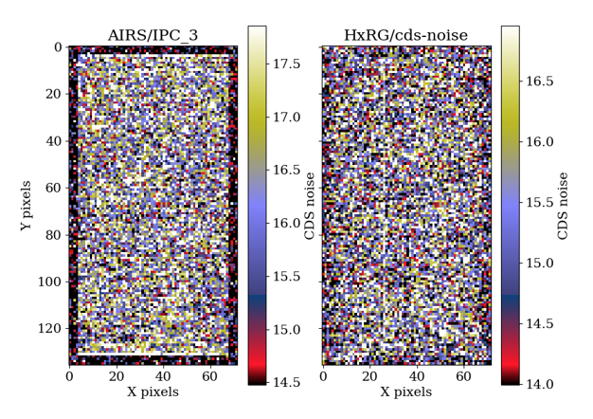
Test Data from ARIEL-AIRS Window Mode
CDS Noise Comparison of AIRS Window Mode vs. Standard HxRG Window Mode (no ref pixels)
Reference pixel correction applied
using outer 4 rows/columns in both cases
CDS Noise Comparison of AIRS Window Mode with and without vertical reference pixel correction
Data on this chart provided by Luc Boucher/ESTEC/ESA

Slide 22
Guide Mode Implementation
RST uses “true” guide mode
  Use the same detectors simultaneously for science and for guiding
Full frame readout is split into individual blocks of equal size, each containing a specific number of rows (e.g. 128, 256, …)
Between full field blocks, read, reset, and read the guide window
  Integration time is given by read time of full field block
  Allows for CDS of guide window data (low read noise)
H4RG detector
with blocks of 512 rows marked for illustration
Block 1 (e.g. 512 rows)
Block 2
Block 3
Block 4
Guide window
Block 5
Block 6
Block 7
Block 8
Readout sequence:
Block 1
Block 2
…
Block 8

Slide 23
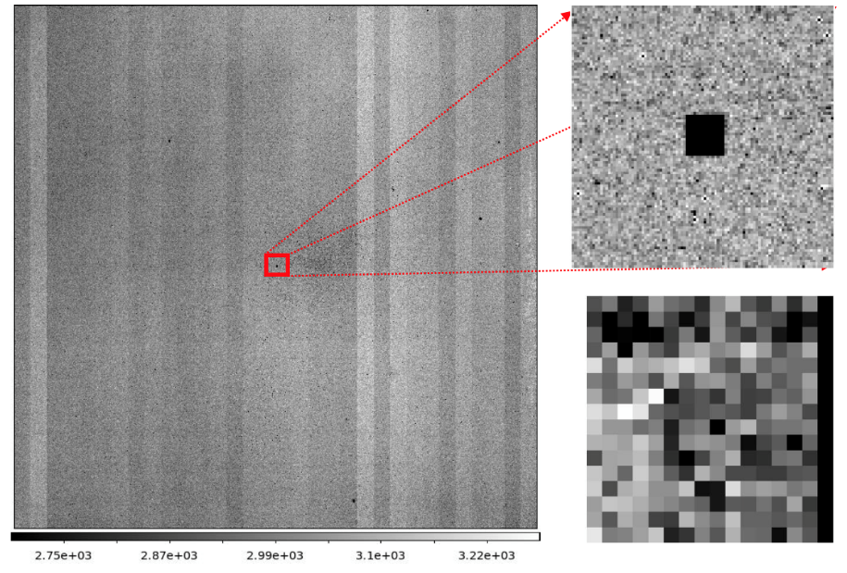
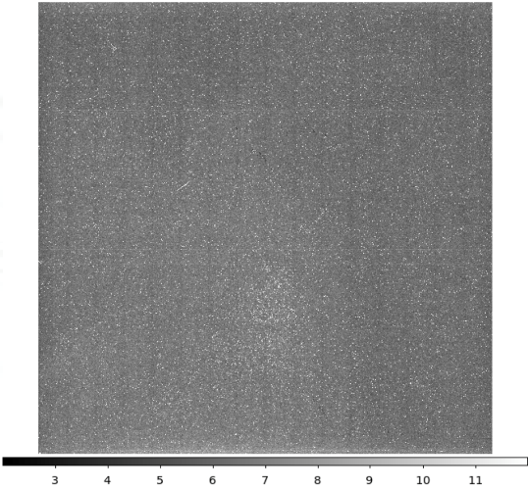
Guide Mode Data Without Artifacts
Guide mode has been examined and implemented occasionally in the past (for ground-based instruments)
  A key issue has been the crosstalk onto full field rows or columns at the guide window location
  Special attention has to be given to the clock pattern details to avoid artifacts
For RST, an extenstive study was carried out to measure and optimize the guide mode clocking scheme to reduce or eliminate any crosstalk
  The results show that it is possible to implement guide mode without any noise impact to the science data
Noise Map from 100 Exposures.
No guide window artifacts
Double CDS Full Frame Image
Zoomed view around guide window
Raw guide window data (16 x 16)
Data was collected by the DCL at GSFC/NASA

Slide 24
Simplified Guide Mode
ARRAKHIS - ESA mission to study dark matter and galaxy formation
  Under development for launch in 2030
  Uses H2RG with Sample-Up-The-Ramp baseline clocking
Guiding performed using the science detector, but applies simplified scheme
  Use only full field data (no window data), and calculate CDS of subsequent frames for small guide window regions
  Guide windows located on bright stars to have enough signal from frame to frame
  Reset guide windows periodically between full field frames to prevent saturation
Prototype implementation has been successfully tested by ESA using custom SIDECAR ASIC firmware

Slide 25
Control Electronics

Slide 26
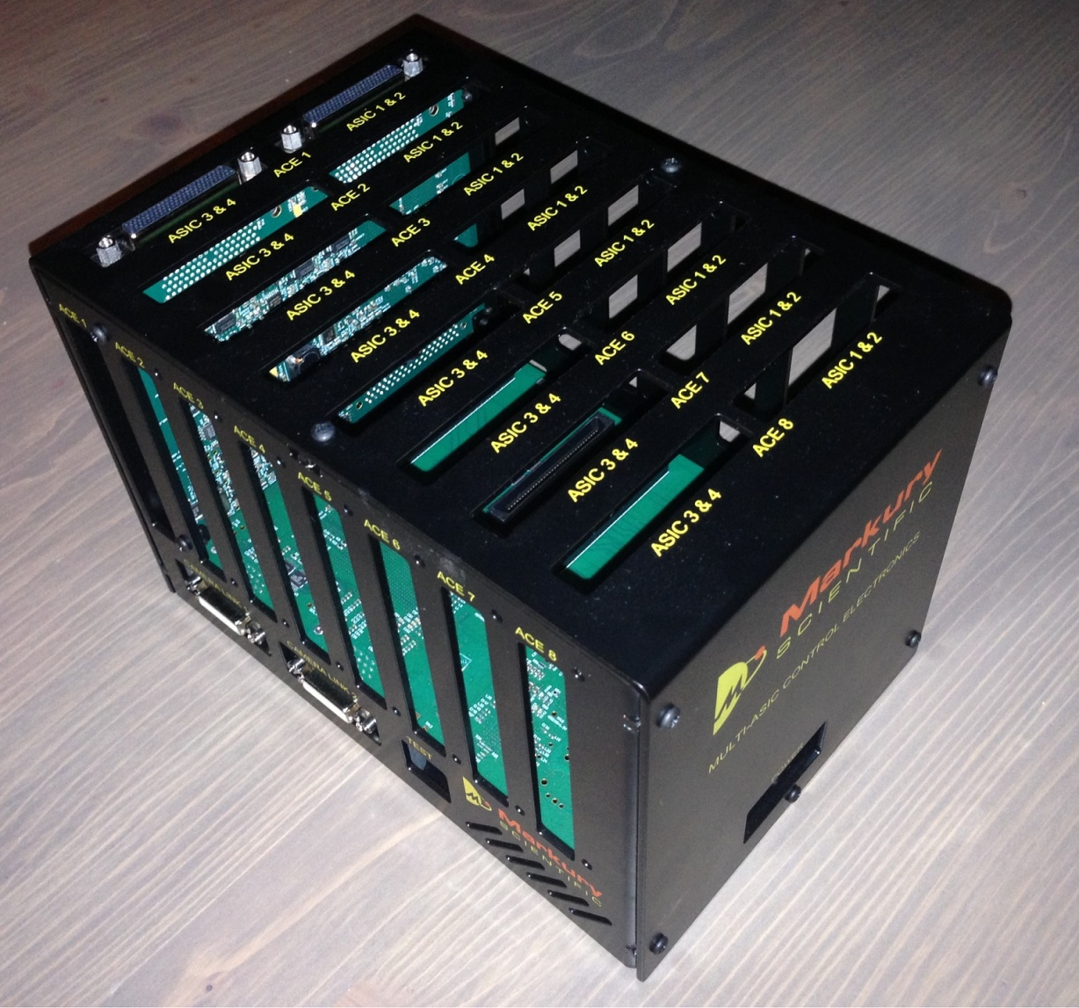
MCE - Multi-ASIC Control Electronics
Camera Link Acquisition System
  Can operate up to 32 ASICs in parallel
  Compatible with SIDECAR and ACADIA ASICs
  Individually programmable supplies (voltage, current limit, voltage limit)
  Integrated measurement functions of supply voltage levels and current consumption
  Software support for Linux and Windows
In use for several applications
  Euclid H2RG/SIDECAR ASIC: 16 ASICs/H2RGs in parallel
  RST detector & ASIC testing
  Successfully operated full RST focal plane array with 18 ACADIA ASICs and 18 detectors

Slide 27
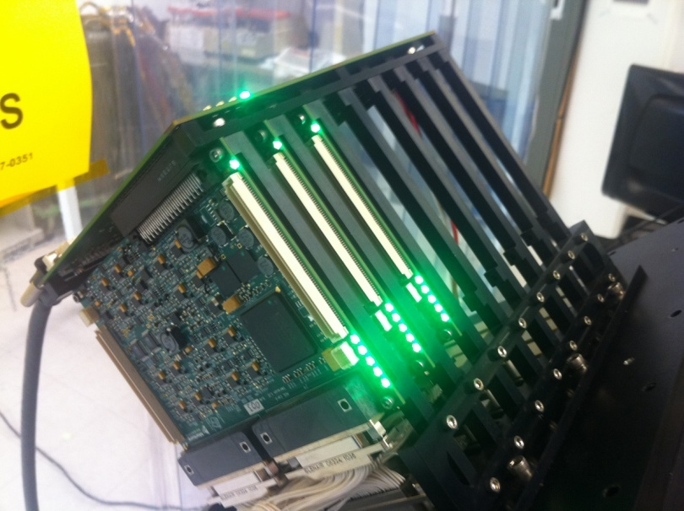
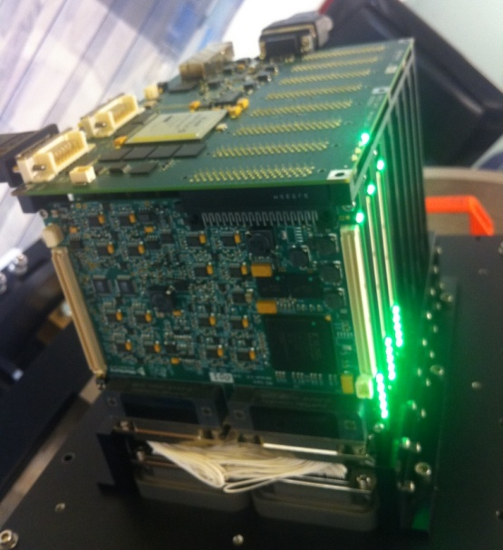
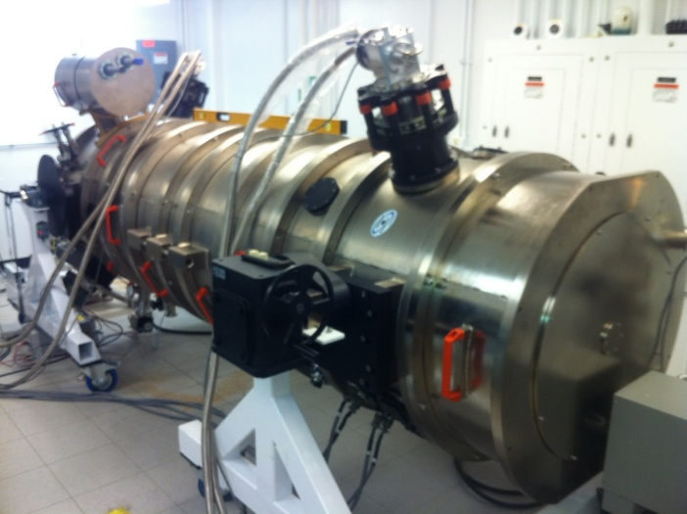
Multi-ASIC Control Electronics in Operation
Roman Space Telescope test cryostat drive electronics
  1 MAICE card
  3 ACE cards (driving 4 ASICs each for a total of 12 SIDECAR ASICs)

Slide 28
MACIE – Multi-purpose ASIC Control and Interface Electronics
Single-board controller card
  Gigabit Ethernet Interface
  USB 3.0 Interface
  Camera Link Interface
  Compatible with SIDECAR and ACADIA ASICs
  Individually programmable supplies (voltage, current limit, voltage limit)
  Integrated measurement functions of supply voltage levels and current consumption
  Operates up to 2 ASICs per board
  Software support for Linux and Windows

Slide 29
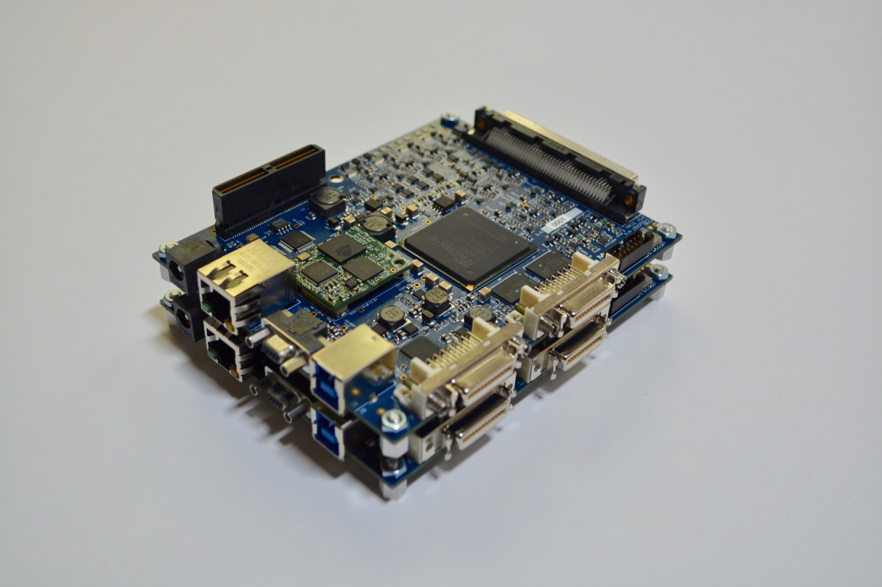
Multi-MACIE Options & MACIE Kit
Dual stacked MACIE Cards
(for up to 4 ASICs)
Standard Single-ASIC MACIE Kit
(MACIE card, SAM adapter, power cable)

Slide 30
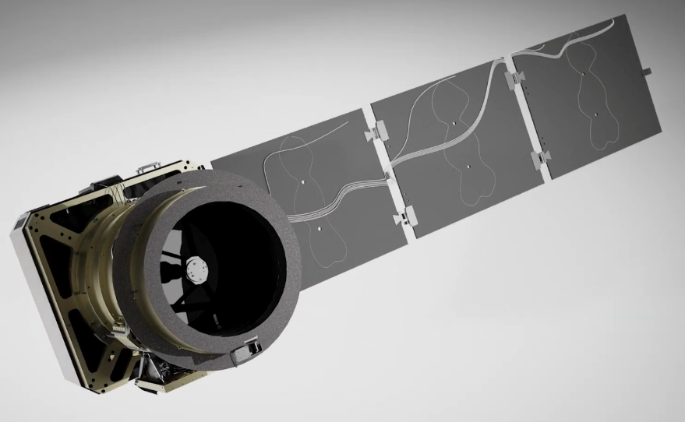
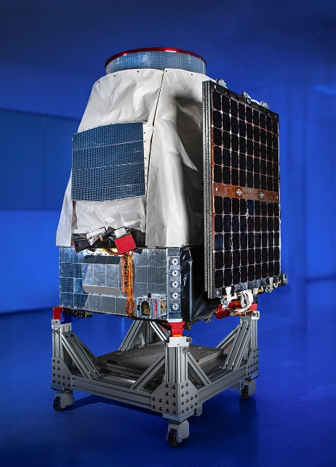
MACIE in Space
Although developed primarily for ground-based operation, the MACIE controller can be deployed in space
Pandora (NASA Small Satellite)
  Studying atmospheres of exoplanets
  Uses JWST residual H2RG & SIDECAR
  Launched in Jan 2026 (2 months in space)
MACIE Card controls ASIC & Detector
  USB connection to embedded computer system
  API libraries adapted to ARM processor
  Off-the-shelf low cost solution if reliability requirements are less stringent

Slide 31
Thank you

