Slide 1
Reaching the ultimate read noise with an advanced pipeline (JWST)
Michael Regan and Eddie Bergeron
And the GARDEN team

Slide 2
The GARDEN Survey
GARDEN’s goal is to investigate 56 galaxies in the range of Z ~ 1 – 6
  We know little of the details of these very young galaxies
    lookback of 8 billion to 13 billion years ago
  Goal is to measure stellar and gas spectra over the galaxies
  This requires deep exposures with time on source of 10 - 60 hours for each NIRSpec slit
  These deep exposures reveal the weaknesses in the JWST pipeline.

Slide 3
GARDEN Observations are the deepest observations taken with JWST
Each 2-hour exposure is split into three 40-minute integrations
Each Micro-shutter Array (MSA) configuration has five-dithered exposures
Components of flux in spectra:
  “Dark Current” ~8 electrons per thousand seconds
  Zodiacal Light ~ 3 electrons per thousand seconds
  Galaxy Continuum ~5 electrons per thousand seconds
CDS read noise ~13 electrons

Slide 4
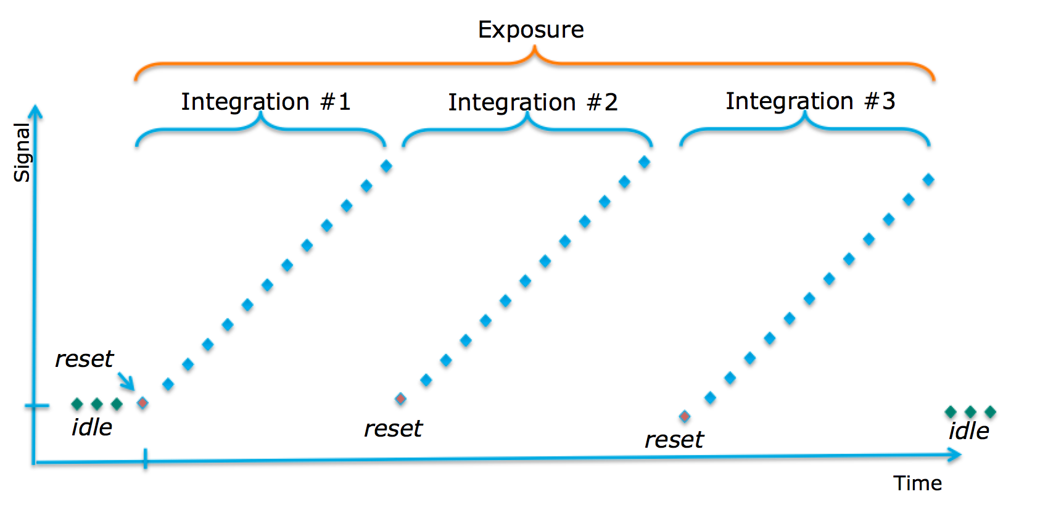
Each GARDEN exposure has three 40-minute integrations for a total of two hours.

Slide 5
Cosmic Ray impact over one detector in one exposure

Slide 6
A zoomed is showing that about 2/3 of the pixels have been hit by a cosmic ray.

Slide 7
Primary Challenges
Persistence from cosmic rays and snowballs
Unmasked bad pixels
Thermal instability
Amplifier issues (1/f and other effects)
Incorrect methods to develop reference files:
  Read noise incorrectly derived
  Confusion due to multiple reference files masking bad pixels

Slide 8
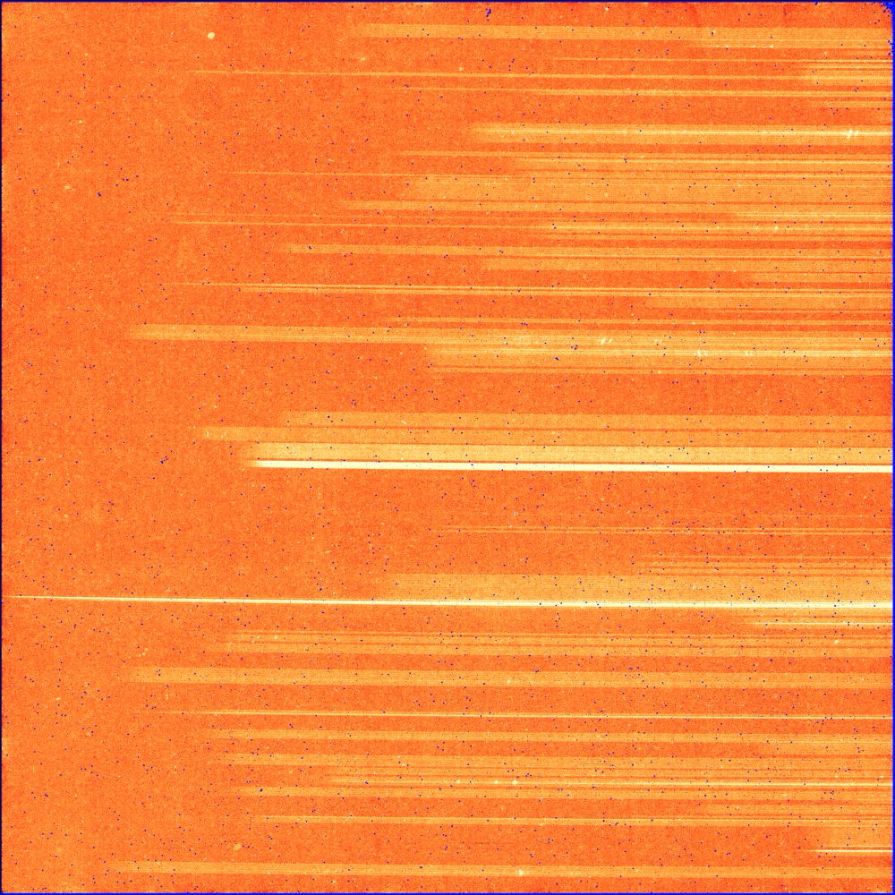
Before and after corrections

Slide 9
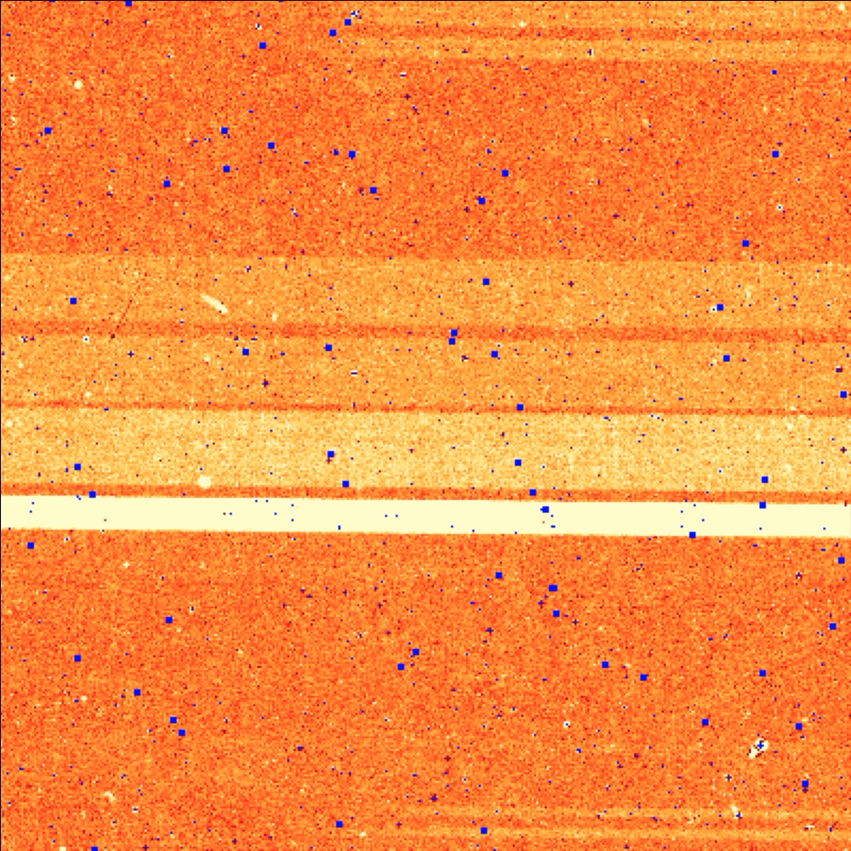
Before and after corrections

Slide 10
Detector 1 Pipeline –
Removes detector effects
Red borders are updated files or pipeline steps
Thick borders are new steps

Slide 11
Persistence

Slide 12
Persistence Model
Reset/Idle
Charge is lost
Time 1
End of Exposure
Start of exposure
Flash of charge
Long delay after flash
Pixel Reset
-
-
-
-
-
-
-
-
Mobile electrons
-
-
-
-
-
-
-
-
-
-
-
-
-
-
-
-
Persistence in next integration
-
-
Empty Electron Depletion Region
Depletion Region
+
+
+
+
+
+
+
+
+
+
+
+
+
+
+
+
+
+
+
+
+
+
+
+
+
+
Mobile holes
Filled Hole Trap
Time
Regan and Bergeron 2017
2027 Smith, R. et al 2008

Slide 13
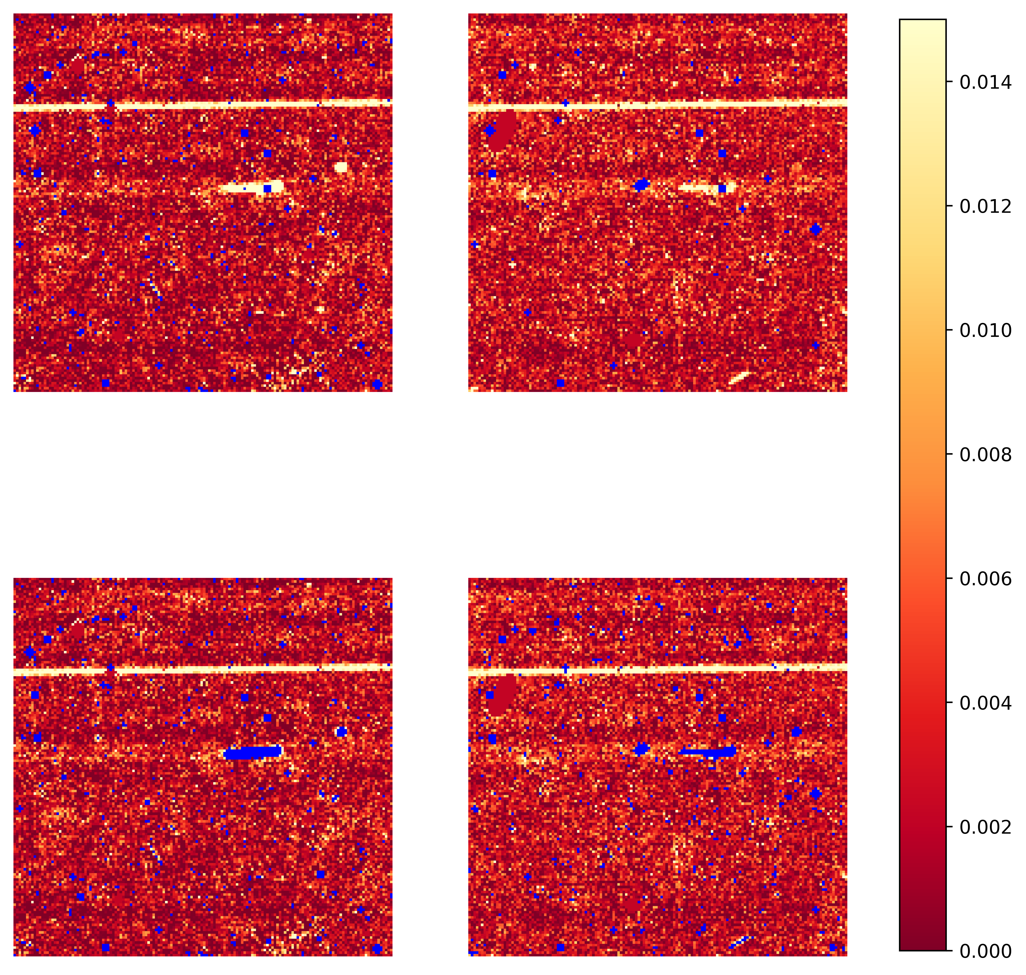
Saturation persistence from the first Integration
Elliptical snowball residual persistence shows up in the 2nd and 3rd integrations
No flagging
Integration 2
Integration 3
Flagging the pixels that were saturated removes the residual persistence
With flagging

Slide 14
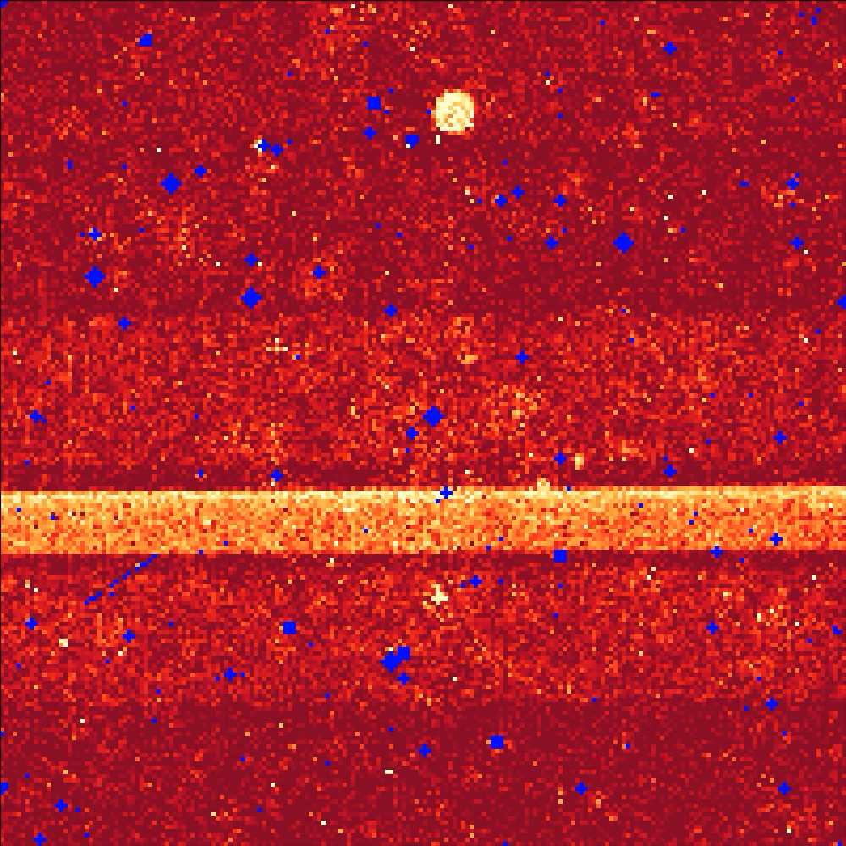
Saturated Snowball Persistence between Exposures
The white circles are the residual saturation persistence from the previous exposure

Slide 15
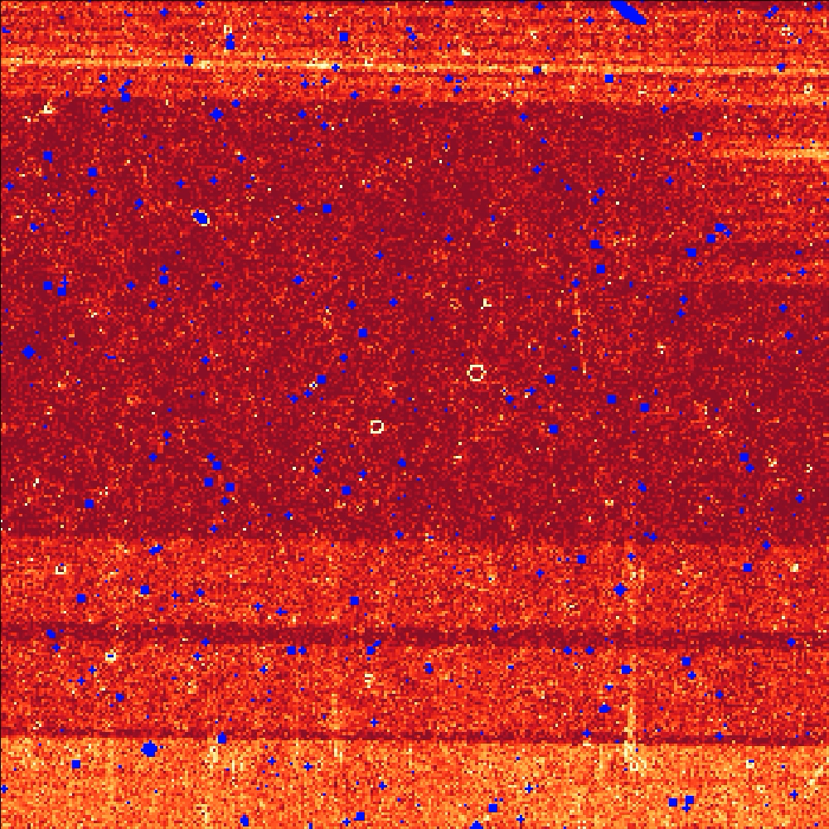
First group snowball flagging
The white rings are the
saturated outer regions of
snowballs in the first group
Inserting a blank group
before the first group allows
snowballs in the first group to be detected.

Slide 16
Persistence from non-saturated cosmic rays

Slide 17
The longer the charge is on the pixel, the greater the persistence magnitude

Slide 18
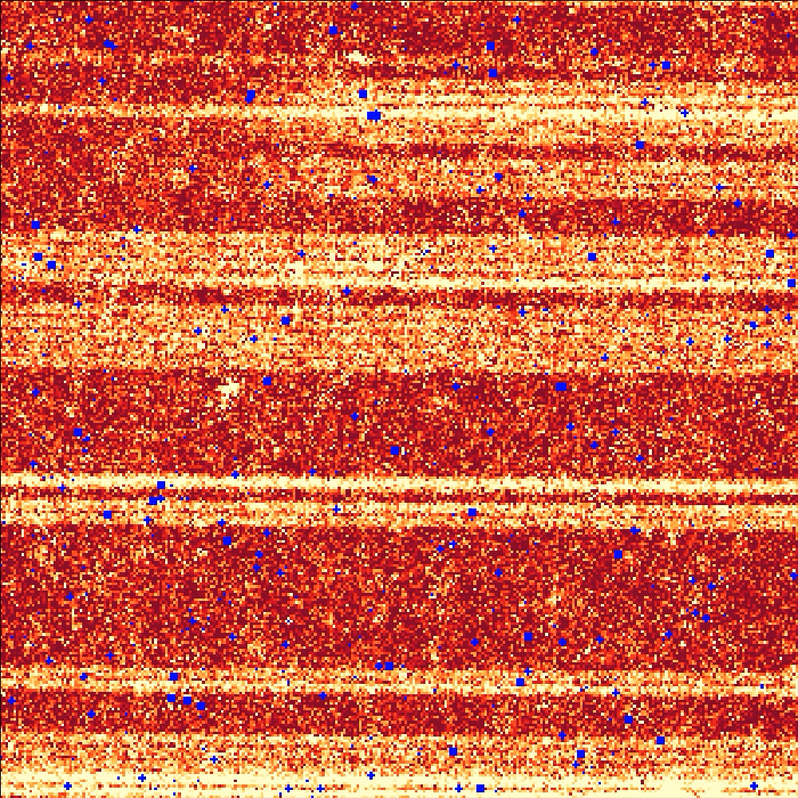
Persistence from non-saturated cosmic rays

Slide 19
Reference File Updates

Slide 20
Dark Current and bad pixel masks:
Dark Current Median rate of 60 exposures

Slide 21
Dark Current and bad pixel masks:
Short dark – Long Dark

Slide 22
Dark Current and bad pixel masks:
Darksubdark replacing negative values with long values and high rate pixels flagged

Slide 23
Adding light to the image

Slide 24
Final Masking

Slide 25
Incorrect Read Noise Reference File
Pipeline step uses one reference file for all values of grouped frames.
Just divides by the square root of the number of frames per group
Red are read noise values using just dividing by sqrt(5)
Blue are read noise values averaging five frames into a group and then measuring the read noise.

Slide 26
Random Telegraph Noise (RTN)
Single Sample
Averaged into 5 frame groups

Slide 27
Picture Frame Thermal Response

Slide 28
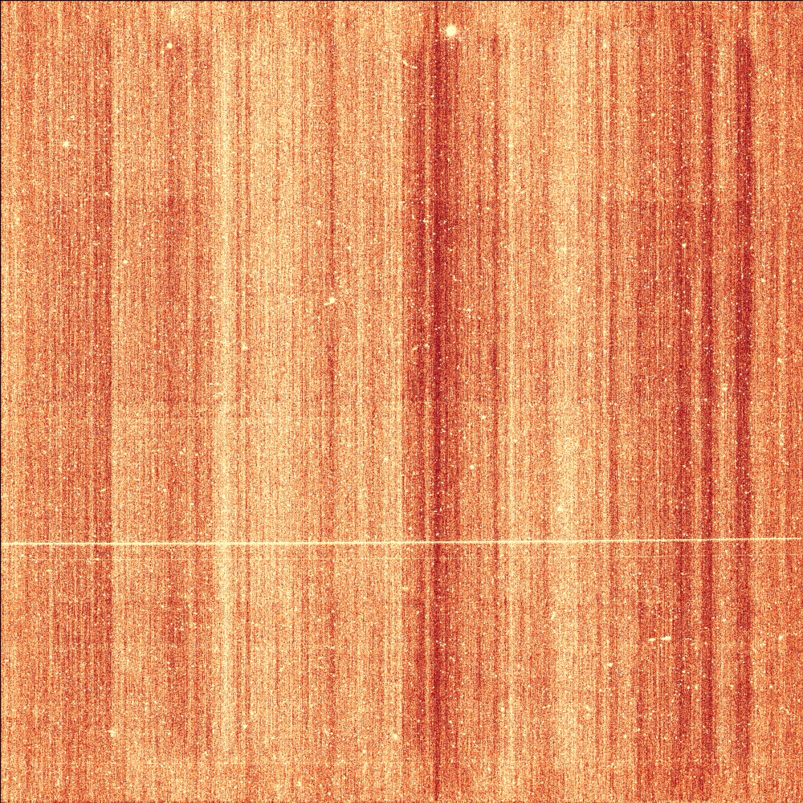
Differences between groups after Jump Step

Slide 29
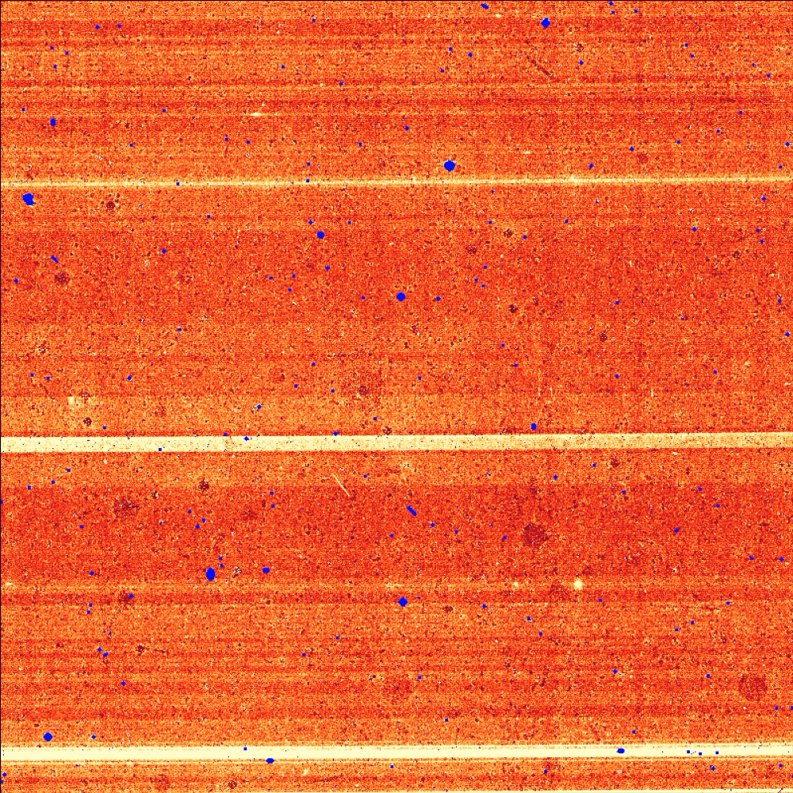
Correcting for thermal bias effects

Slide 30
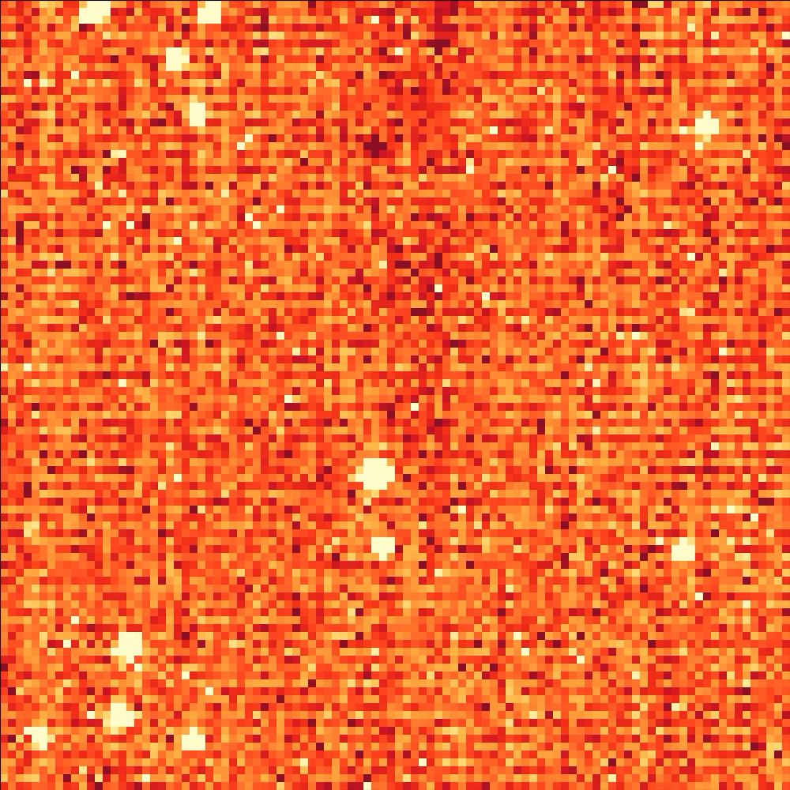
Other amplifier effects : Even/Odd Diff

Slide 31
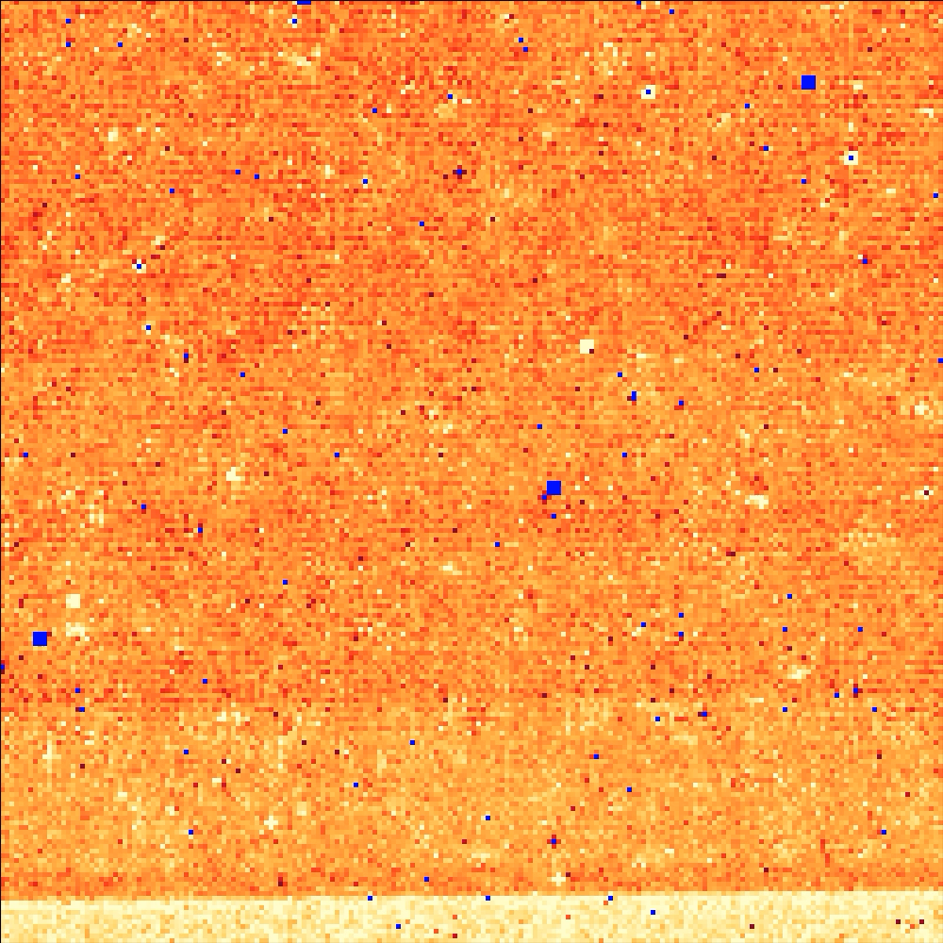
Other amplifier effects : Even/odd rate

Slide 32
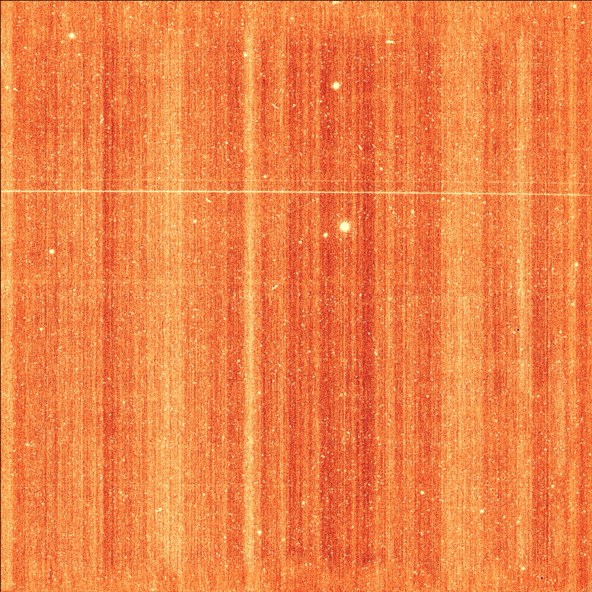
Other amplifier effects :
1/f correction to differences

Slide 33
The 1/f correction over-subtracts the flux. We correct this by bringing the unilluminated region to zero.
Red is the column medians before
Previous corrections
Blue is the column medians after
adding back in the missing flux

Slide 34
Comparison of Baseline with our Corrections

Slide 35
A single exposure in the unilluminated region of the detector.

Slide 36
Dithered images before and after corrections

Slide 37
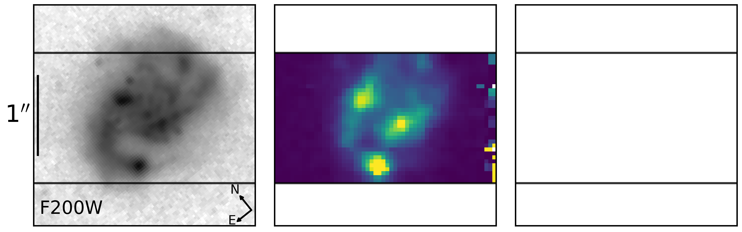
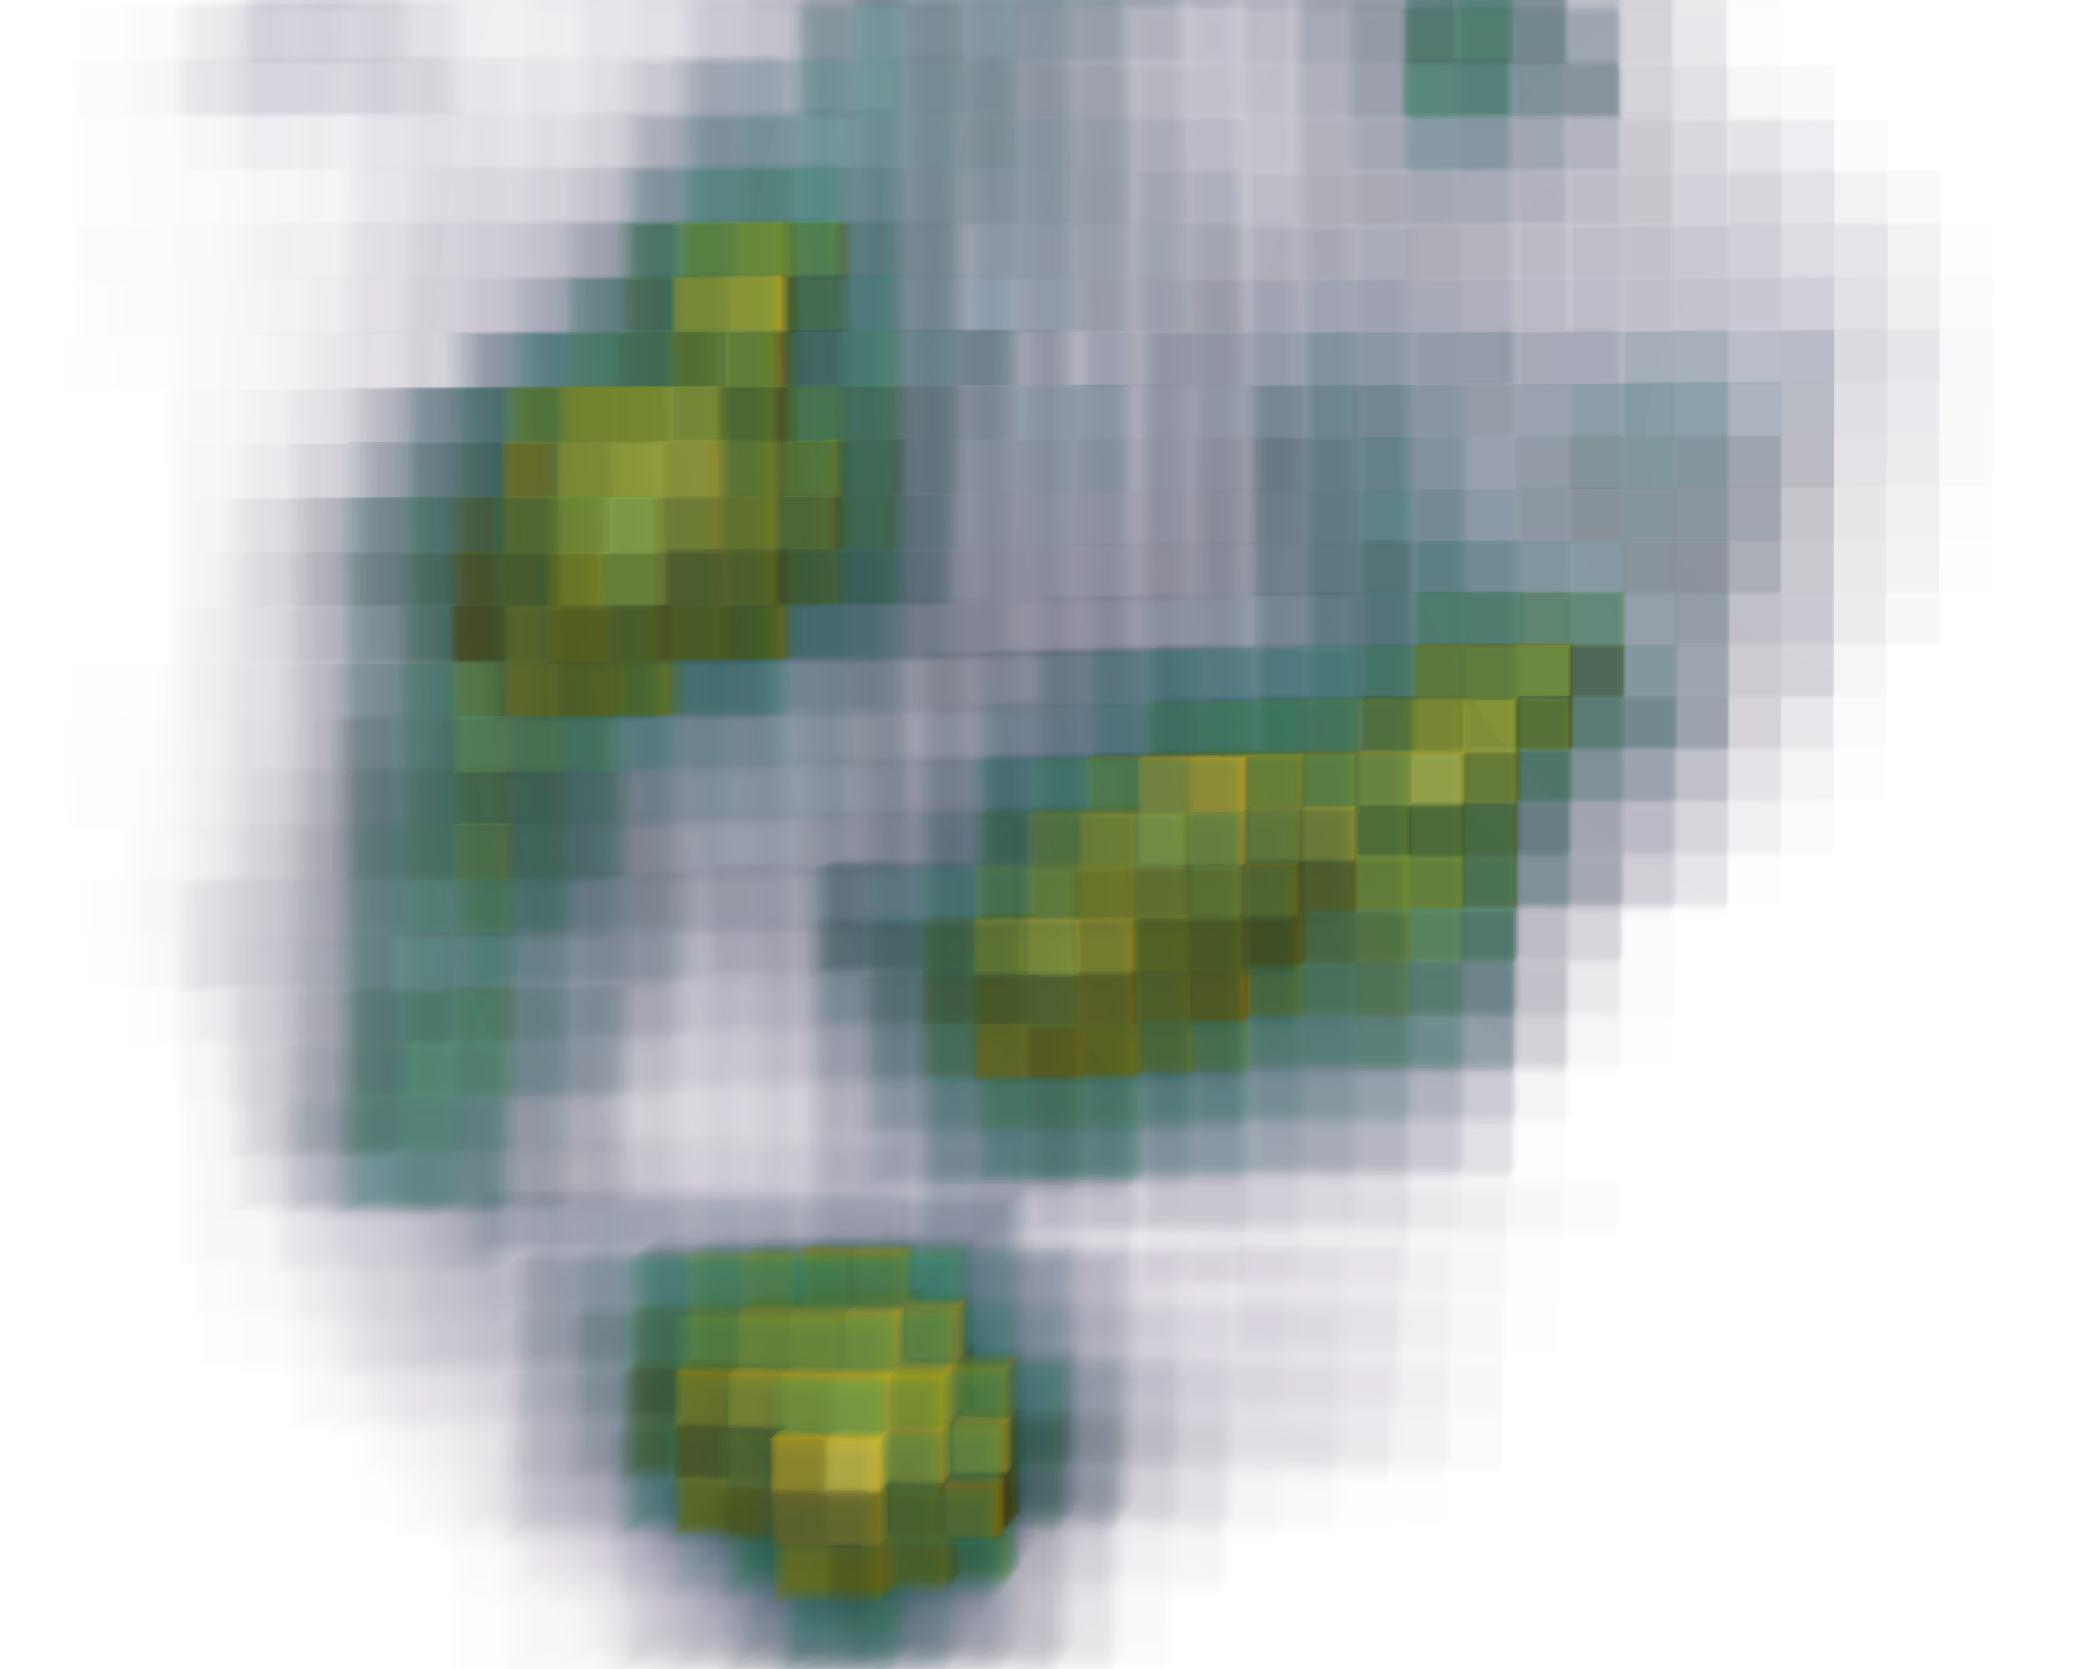
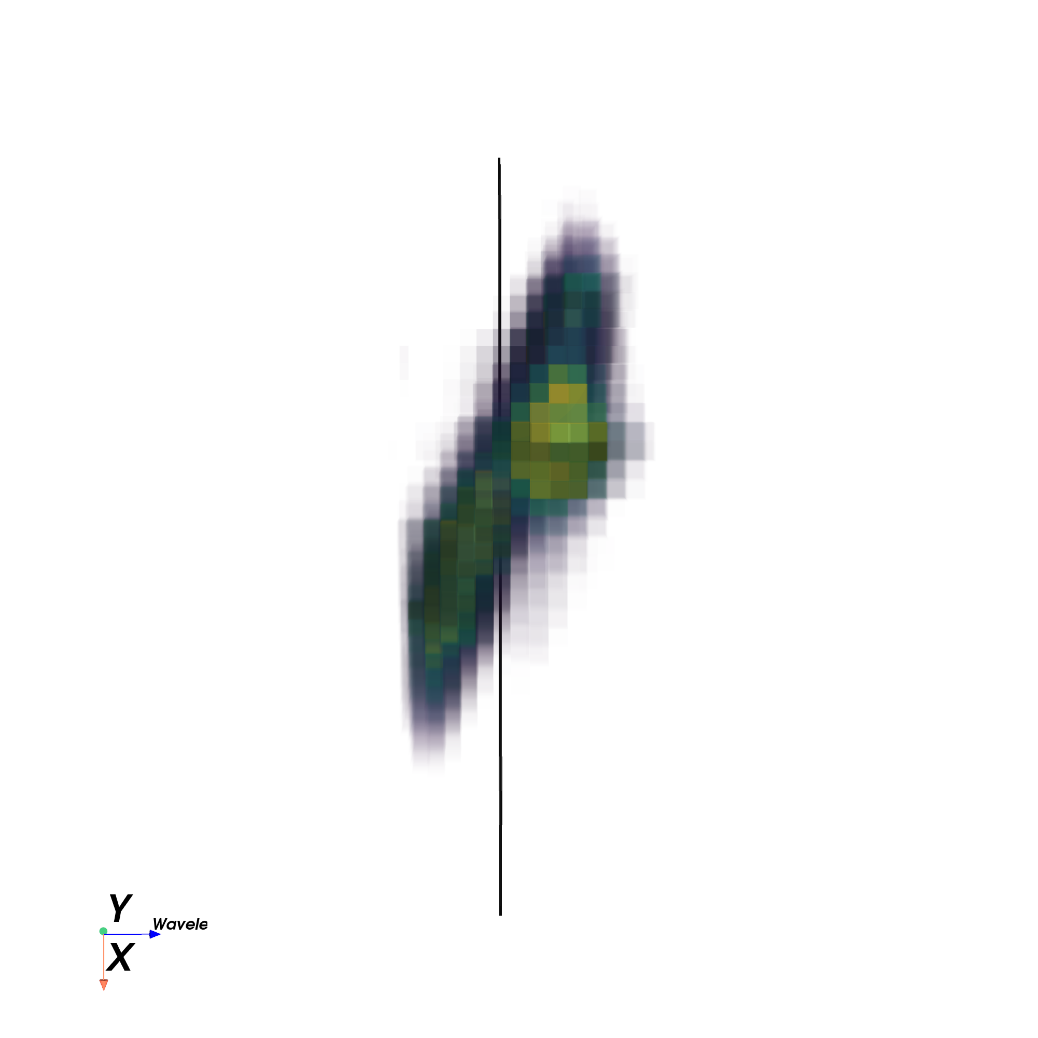
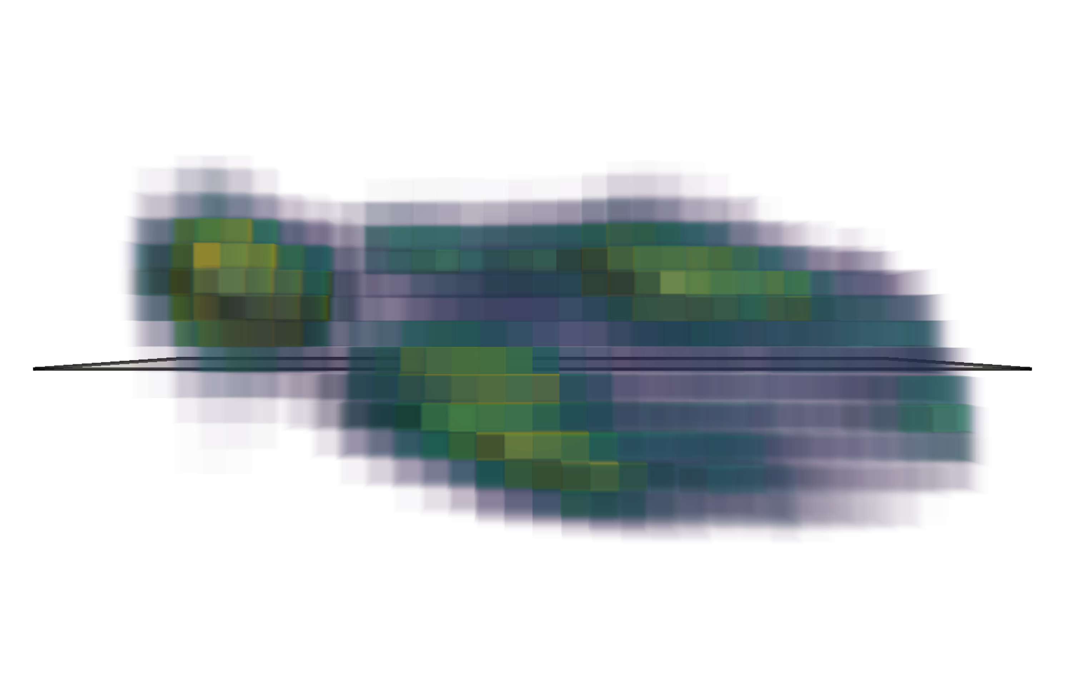
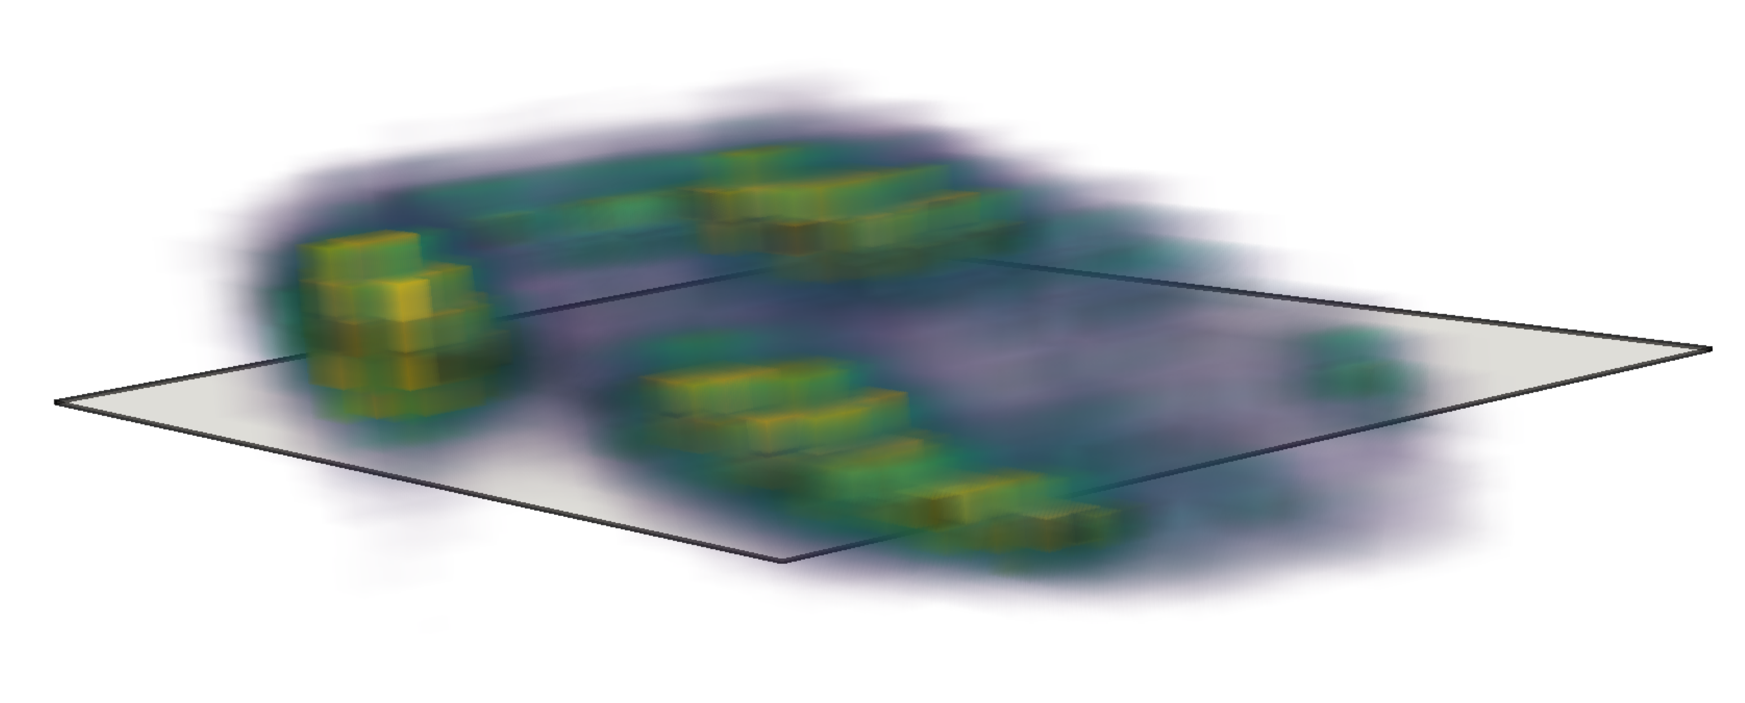
H alpha and NII in CANDELS 9474, Z = 2.1274
spatial y
H⍺ line map
λ
spatial x
spatial x
λ
λ
V_{rot} = 0 km s⁻¹
spatial y
spatial y
λ
spatial x
spatial y
spatial x

Slide 38
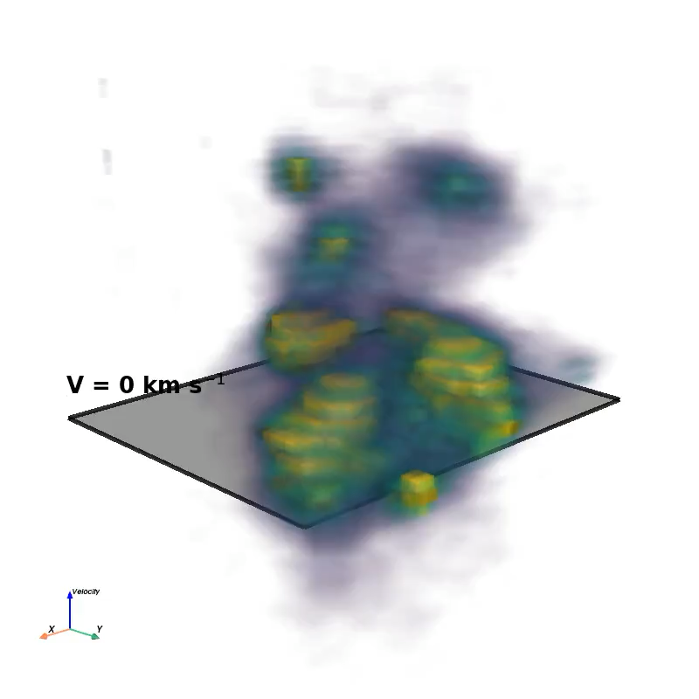
H alpha and NII in CANDELS 9474, Z = 2.1274
Mulcahey et al 2026, in prep

Slide 39
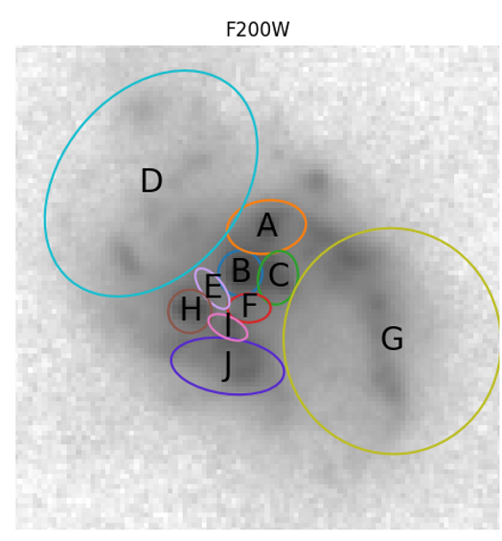
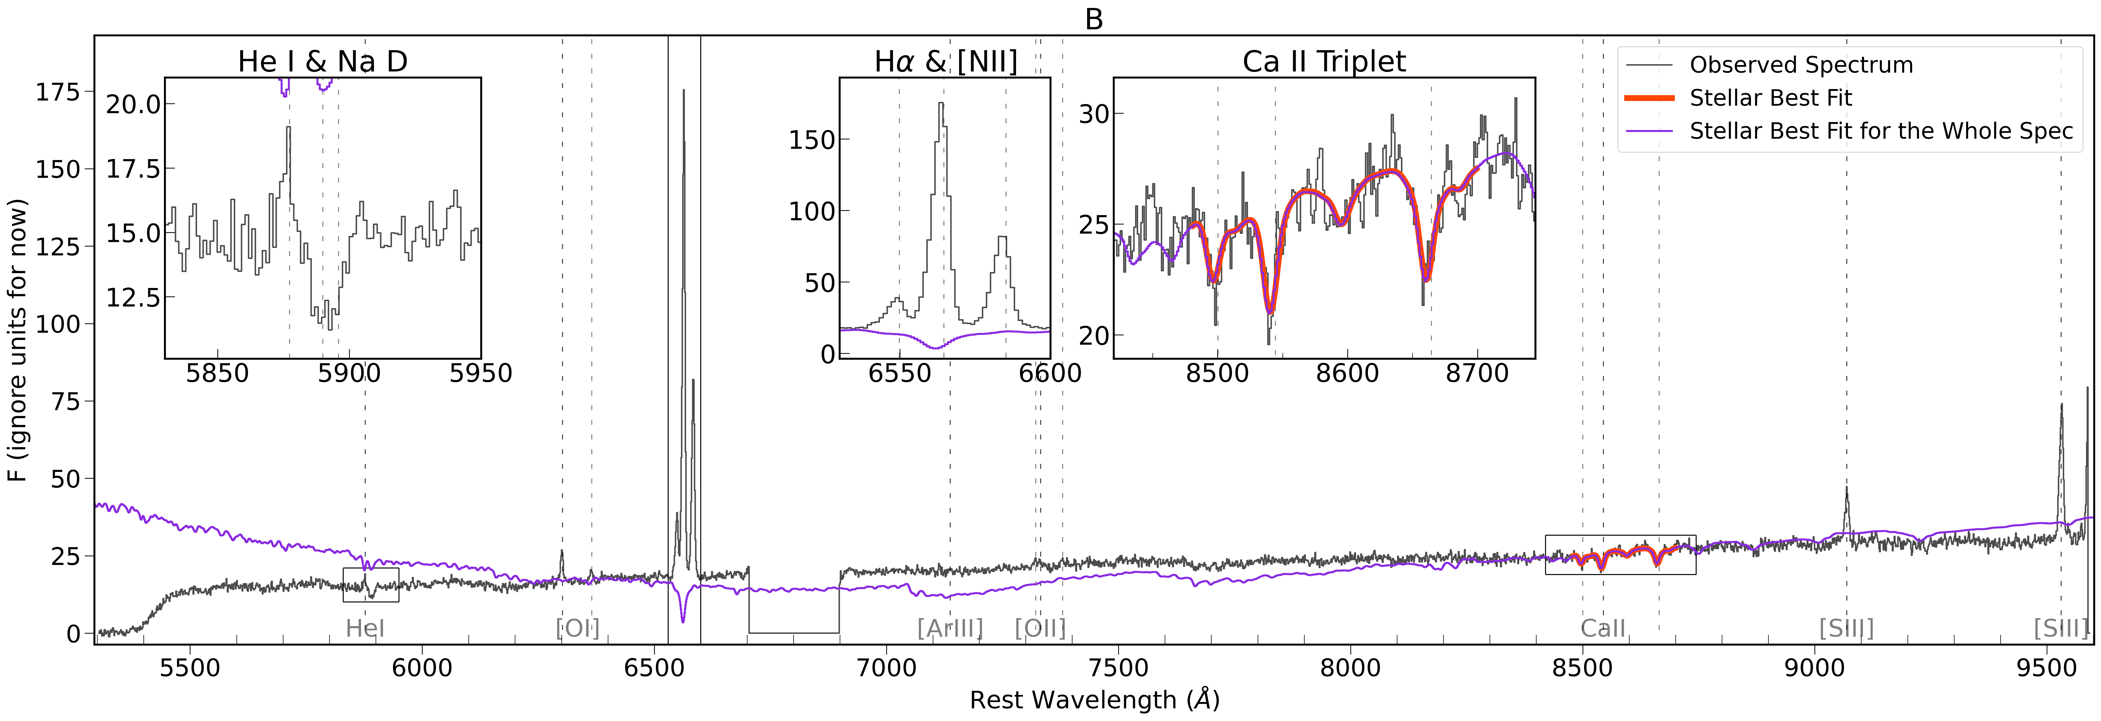
CANDELS 12624, Z=1.9974
Sukay et al 2026, in prep

Slide 40
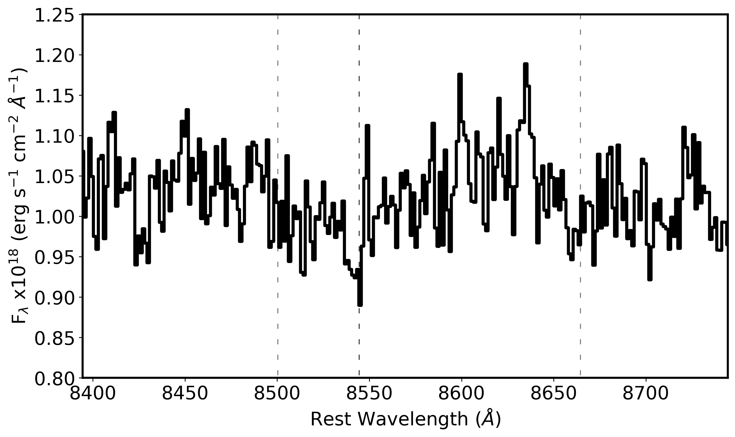
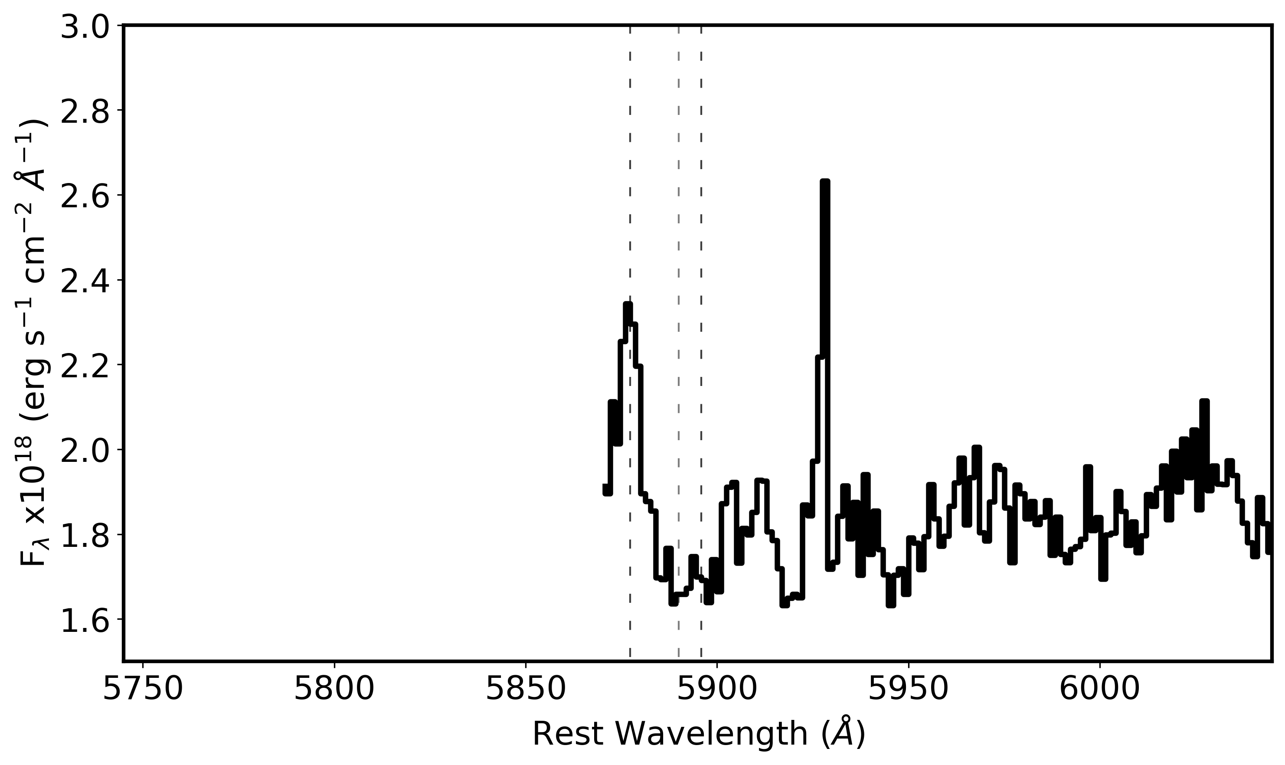
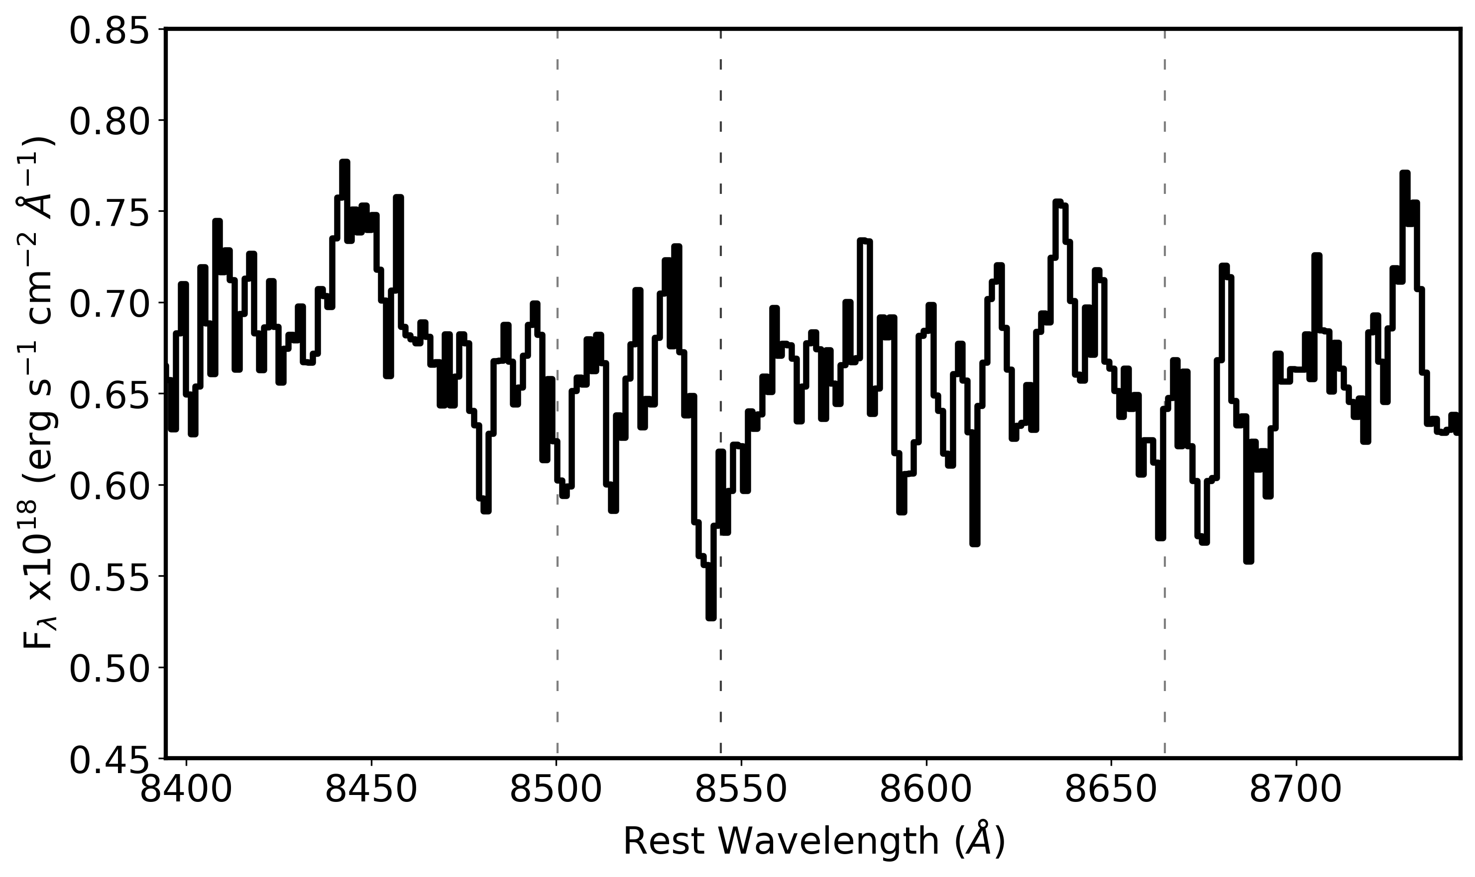
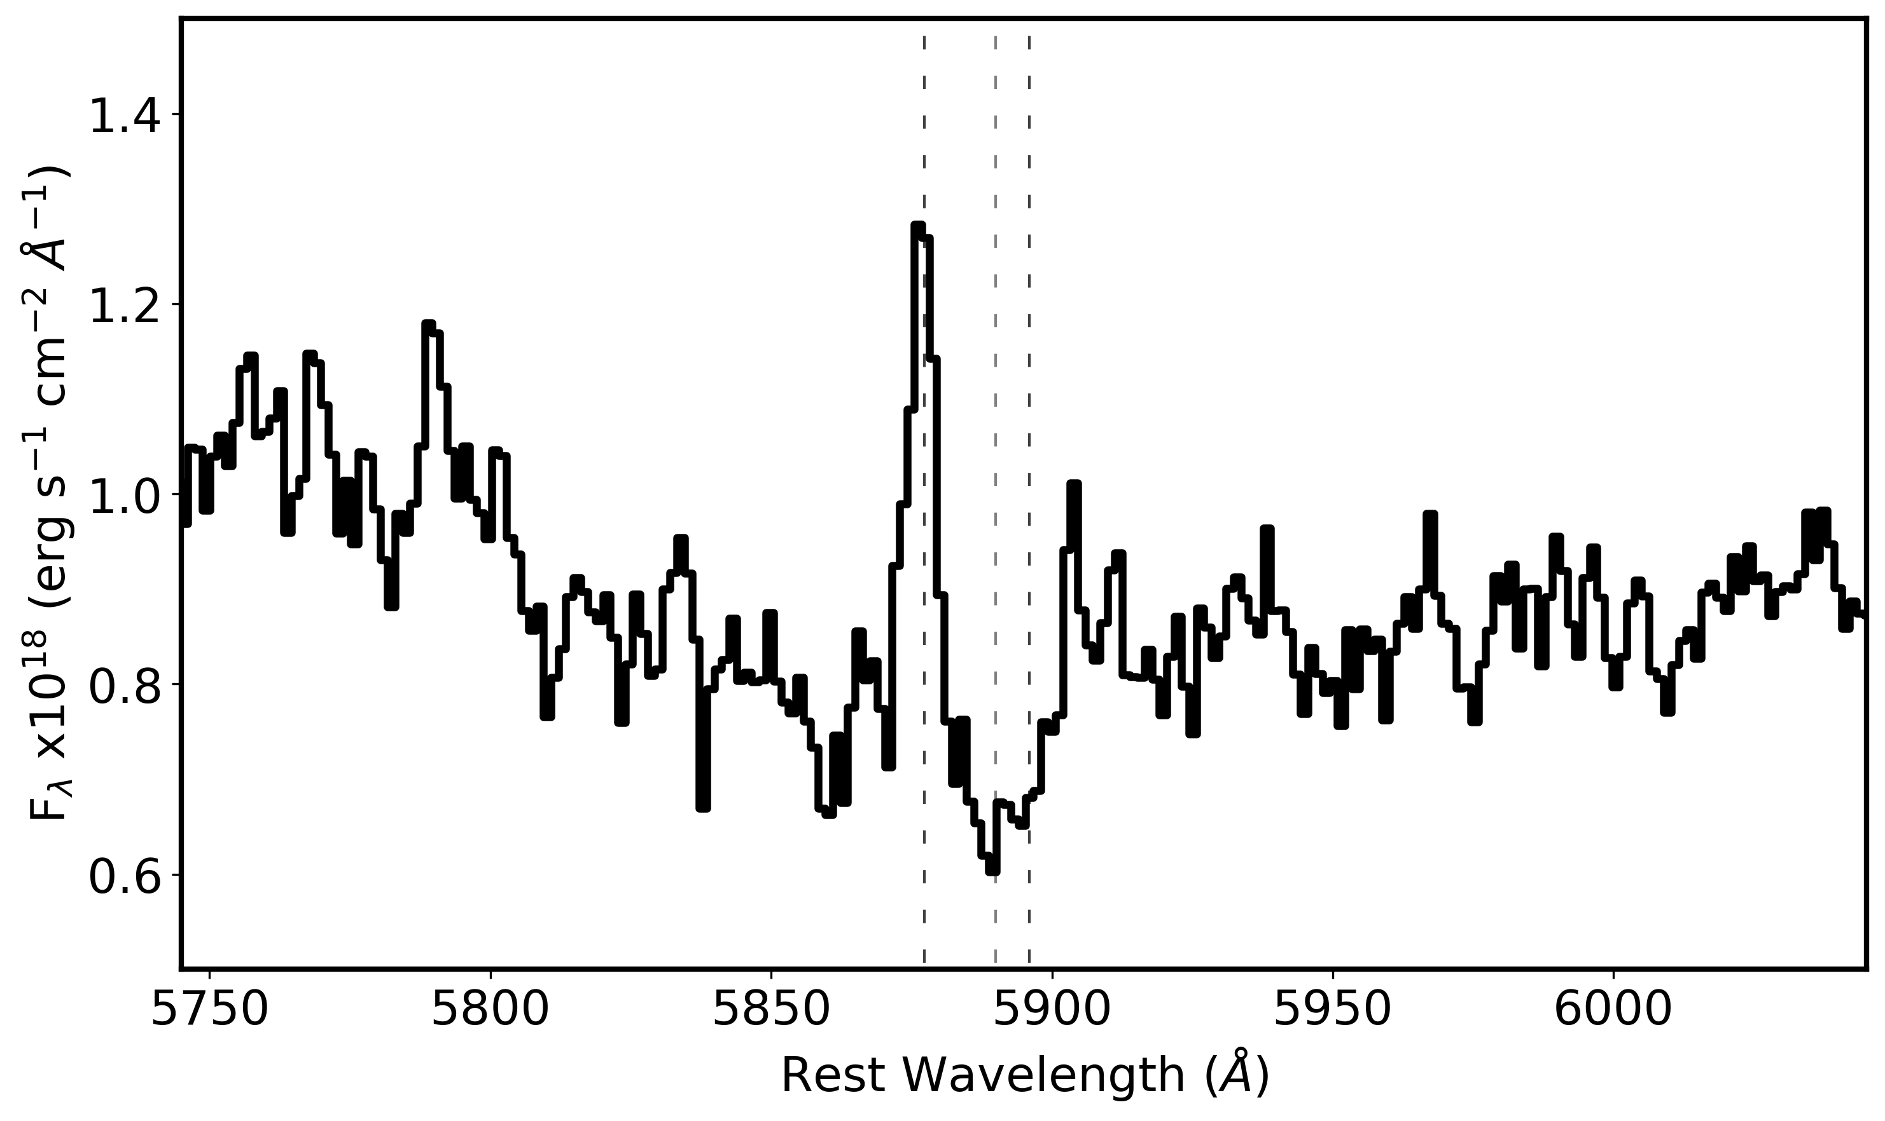
CANDELS 12624, Z=1.9974
Before
After

Slide 41
Future Work
Improve Cosmic Ray persistence by using the magnitude and timing to optimize masking
Improve Dark Current bad pixel masking by limiting time scale of bad pixel detection to time of observations
Investigate Increasing the number of integrations within an exposure (shorter integrations)
  The 40-minute integration time leads to long term persistence
  More integrations yields more resets which switches from trap capture to trap decay

Slide 42
Conclusions
There is a lot of signal available in JWST images that can be recovered.
Up-the-ramp provides a lot of information that provides flexability.
A big mirror can be misleading
Persistence is a pain

Slide 43
Saturation propagation between exposures

Slide 44
Bias in Picture Frame

Slide 45
Other Corrections
Open pixels were not flagged
Small amplifier jumps in exposures
Sigma clipping to find cosmic rays

