Slide 1
Avalanche Photodiodes (APDs) testing at ESA/ESTEC
Vincent Affatato, Dennis Breeveld, Sander Blommaert, Luc Boucher, Frédéric Lemmel, Jean Le Graet, Eloy Hernandez, Malik Mansour, Thibaut Prod’homme, Conor Robinson, Erik Ryman, Peter Verhoeve
11/03/2026

Slide 2
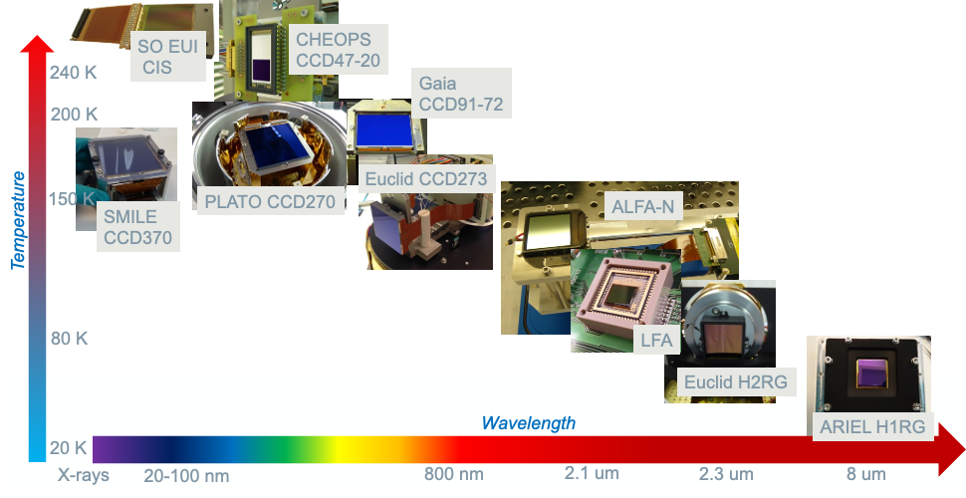
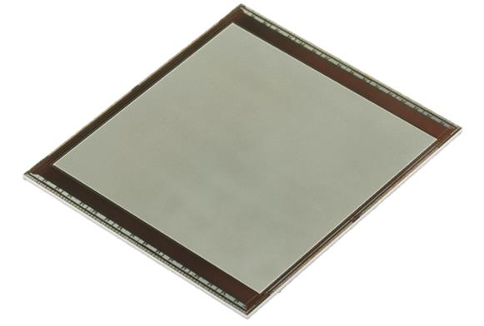
SCI-FIV Lab: Characterized FPAs in the last years
ESA SCI-FIV Payload Technology Validation
➔ Support for Future Science Missions
IBEX

Slide 3
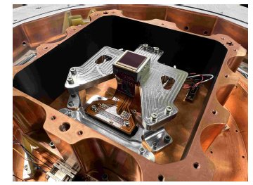
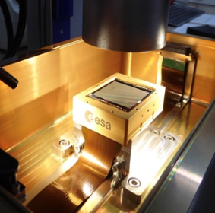

Technology background
Saphira
320 x 256 or 512 x 512 pixels
Used as wavefront sensor for the VLT on Mount Paranal in Chile.
Ike Pono
1k x 1k or 2k x 2k
Developed in collaboration with University of Hawai’i and NASA. First large format LmAPD array optimised for good performance with glow and read noise.
IBEX
2k x 2k
Developed in collaboration with ESA. Large format array optimised for dark current performance.
GOAL:
Develop a large format NIR detector for ultra-low background applications (e.g. direct exoplanet detection) enabling single photon detection
BONUS:
Increase European technological capabilities in this sector

Slide 4
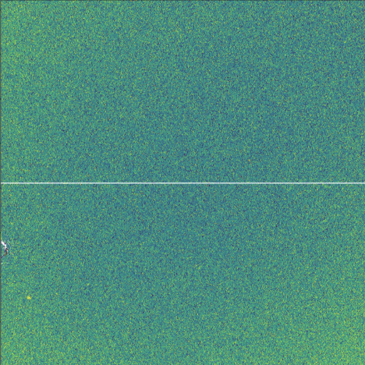

The IBEX detector
Nominal temperature: 80 K
Geometrical features
2048 x 2048 pixels
16 / 8 / 4 channels
8 reference rows
Performance requirements
Dark current:
< 3 e-/p/s (at gain = 10)
Readout noise:
< 10 e- rms
CHC:
>100k e-
Glow:
?
Avalanche gain:
1 – 40
Cut-off:
> 2.5 $μm$
Readout / Reset capabilities
Read reset read
Interleaved
Pixel by pixel, Line by line
Windowed
Timing parameters
Clock sampling at 270 kHz
Nominal detector readout in 1 s

Slide 5
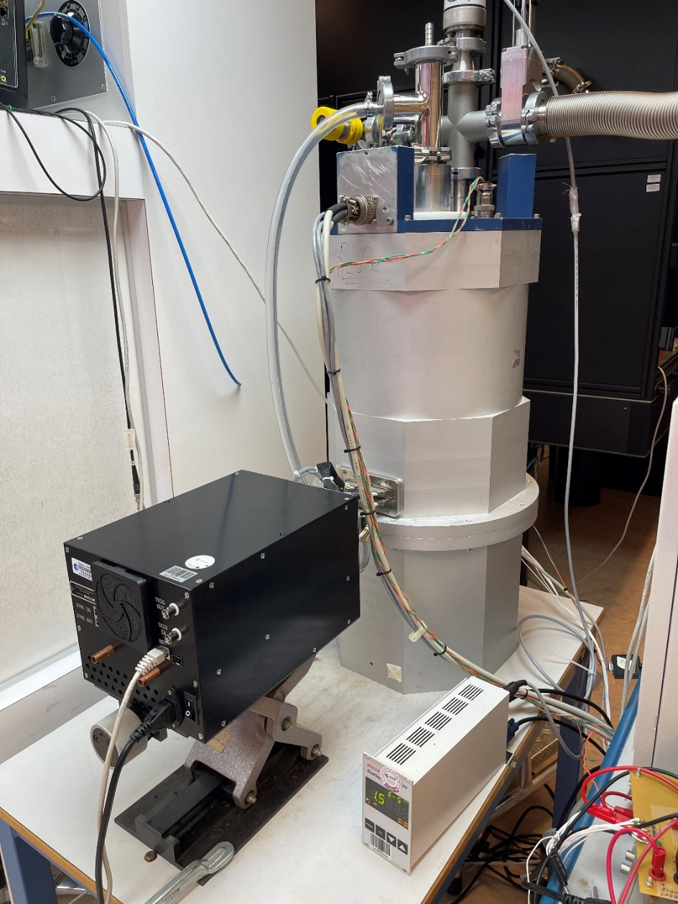
Cryostat Configurations
2
FWA - ND and
bandpass 80K
LAPD
86K
Cryo LEDs
200K
4
2 Flex
Cables
1
CPE
ARCHON
2
3
Simplified block diagram:
Cryo-Illumination
R2-D2
3
4
FWA - ND and
bandpass 80K
1
Aktar Cap
LAPD
86K
Cryo LEDs
200K
2 Flex
Cables
CPE
ARCHON
Simplified block diagram:
Dark Configuration

Slide 6
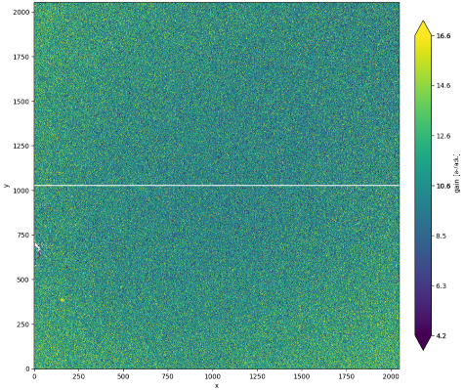
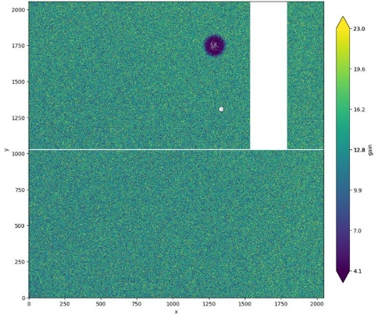
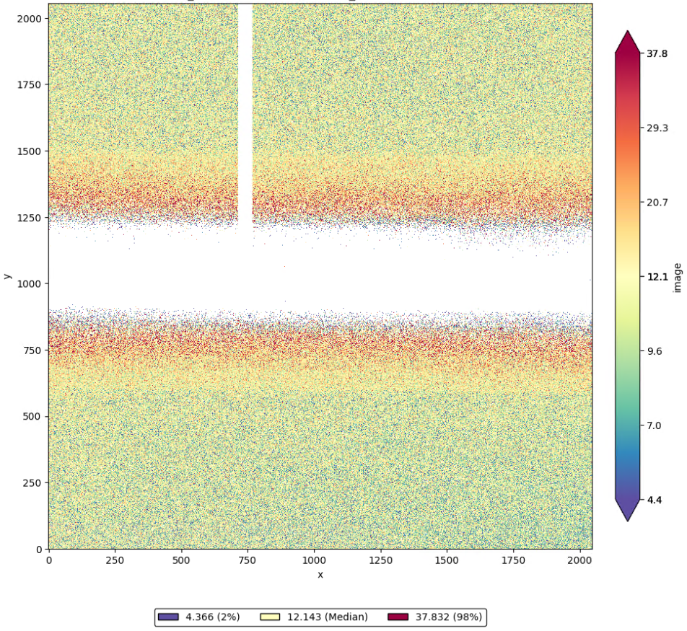
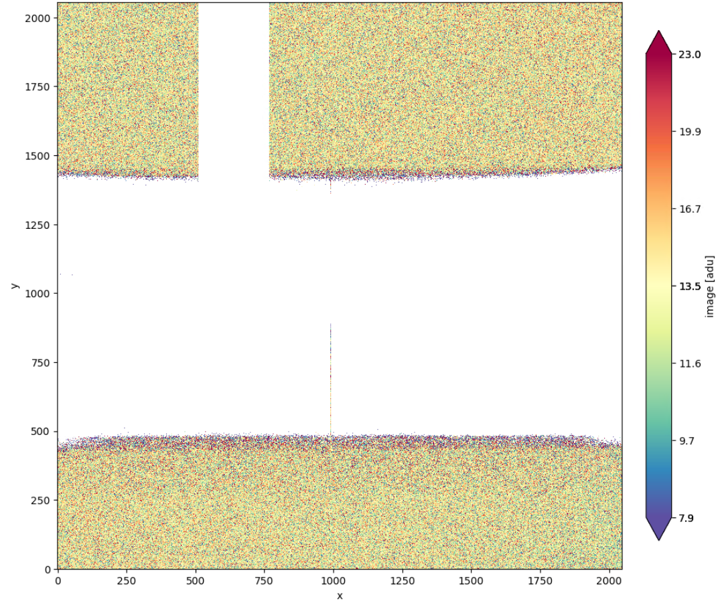
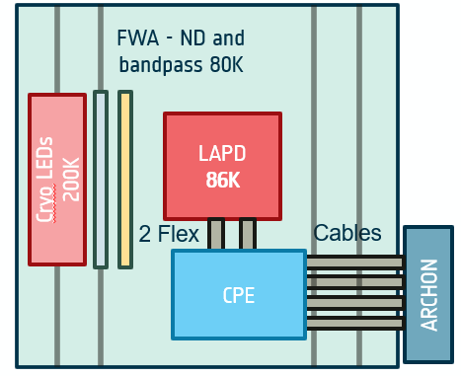
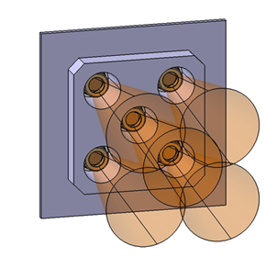
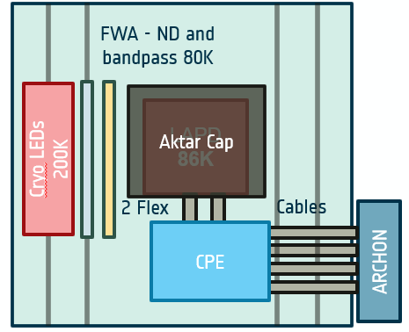
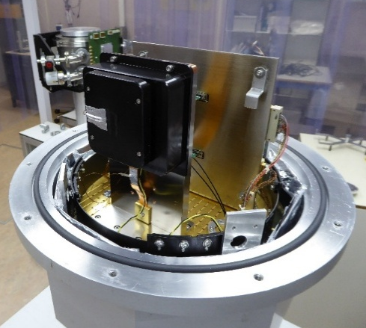
Functionality characterization - Overview
Characterized Devices
Cryo-Illumination → PTC and Avalanche Gain
Dark configuration → Dark current, RON, Glow

Slide 7
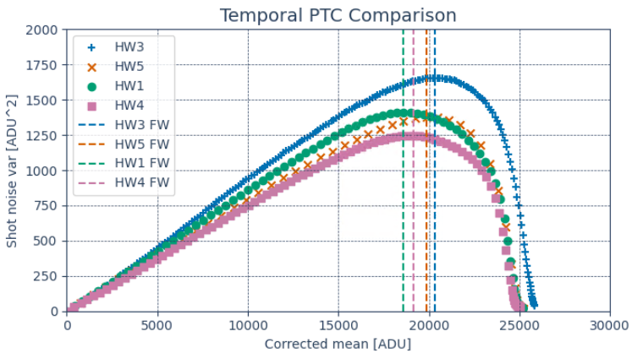
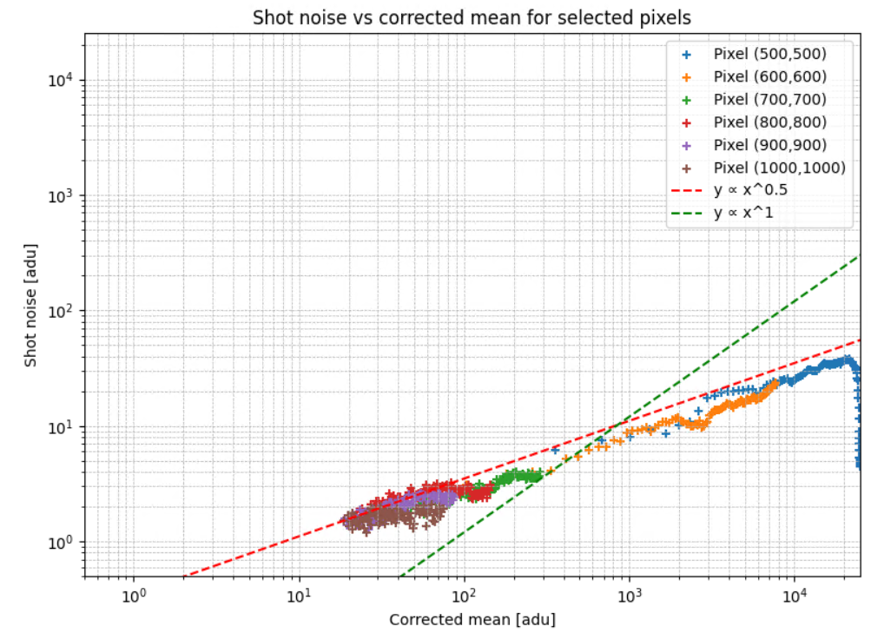
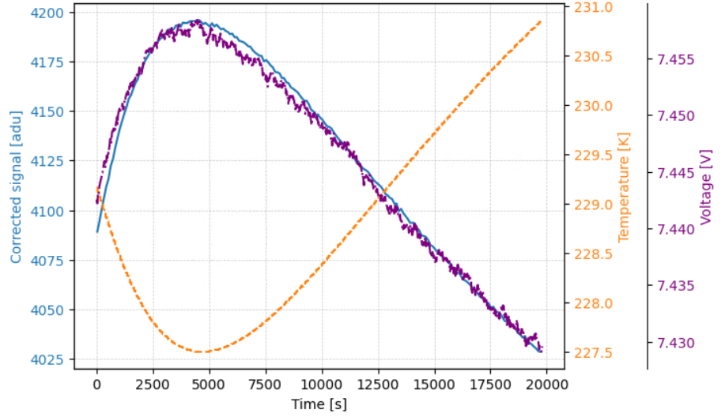
Functionality characterization - PTC
Differential temporal approach
Frame subtraction across the ramps, evaluation of residual shot noise
HW | Median log-log slope | CCF [e-/adu] | Sense node capacitance [fF] | FW var [ke-]
1 | 0.524 | 12.1 | 27.3 | 225
3 | 0.546 | 10.6 | 24.0 | 215
4 | 0.512 | 13.6 | 30.6 | 260
5 | 0.503 | 12.9 | 29.0 | 255
Estimated by LUK:
27.5

Slide 8
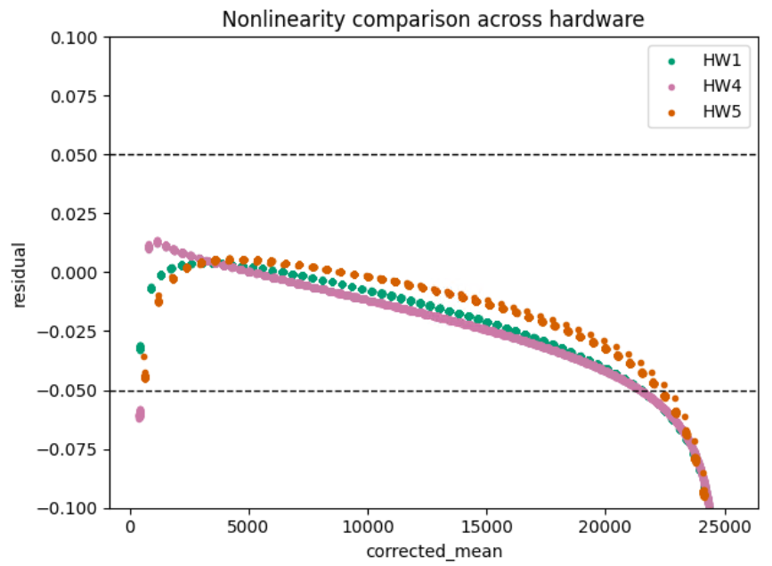
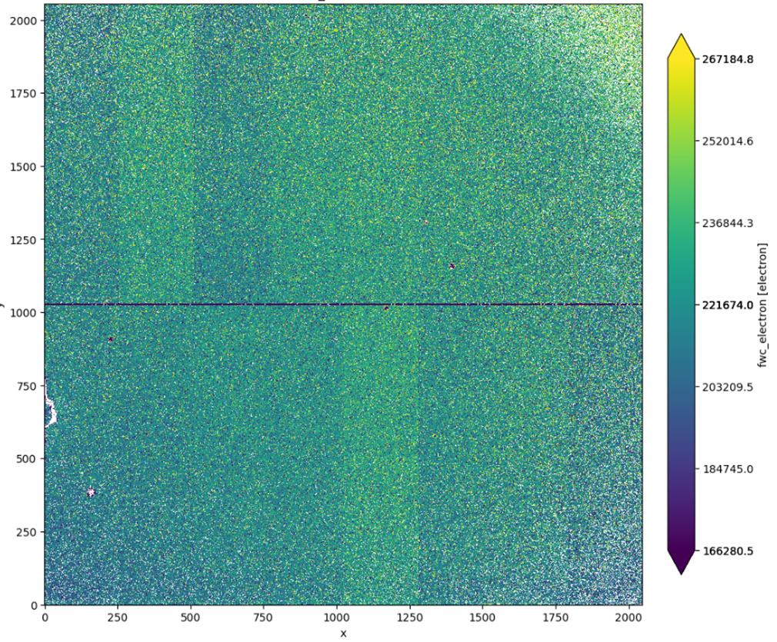
Functionality characterization – Linearity and CHC
[adu]
HW | CCF [e-/adu] | FW var [ke-] | FW linearity [ke-]
1 | 12.1 | 225 | 260
3 | 10.6 | 215 | 220
4 | 13.6 | 260 | 290
5 | 12.9 | 255 | 295
CHC >> 100 ke- from requirement

Slide 9
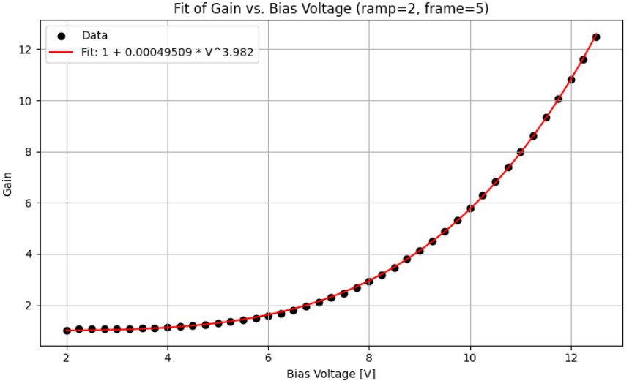
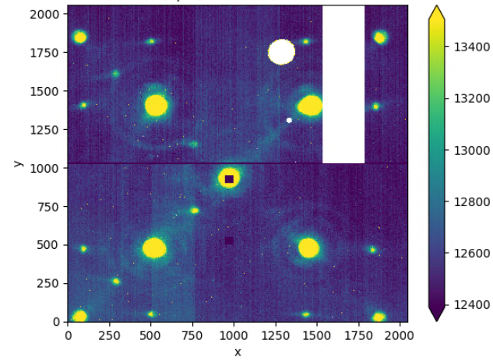
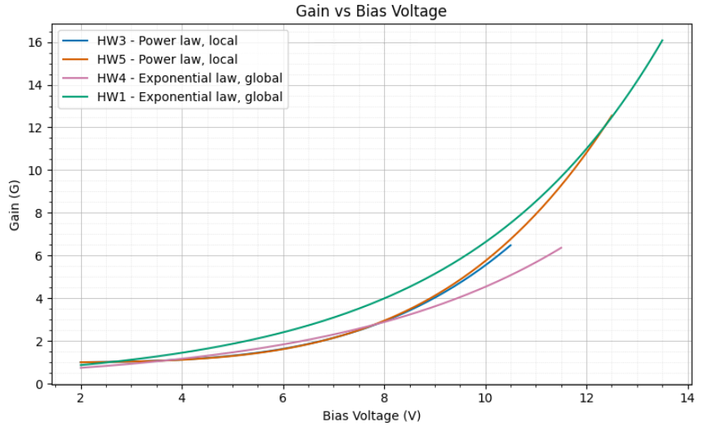
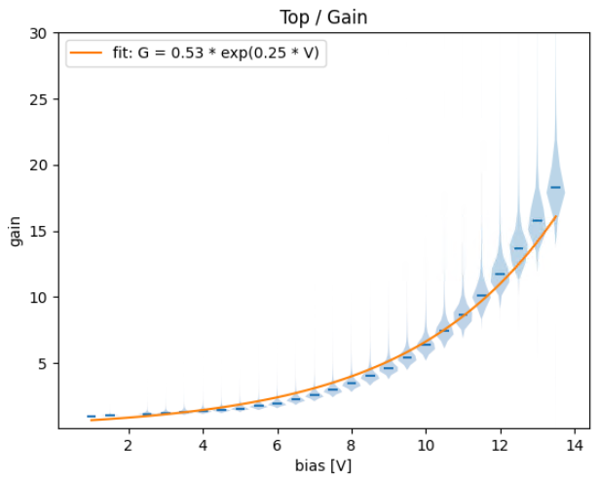
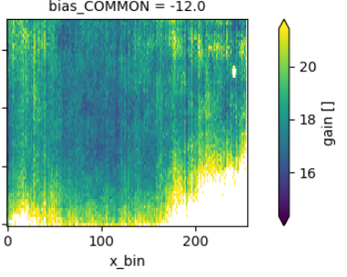


Functionality characterization – Avalanche gain
b = 3.85, 3.98
Ike Pono = 3.01
fit
data
Power law $G=1+aV^{b}$
Avalanche gain << requirement (40)
Detector or controller?
Exp. law $G=ae^{bV}$
b = 0.253, 0.225
Ike Pono = 0.255
LUK = 0.3
y_bin
data

Slide 10
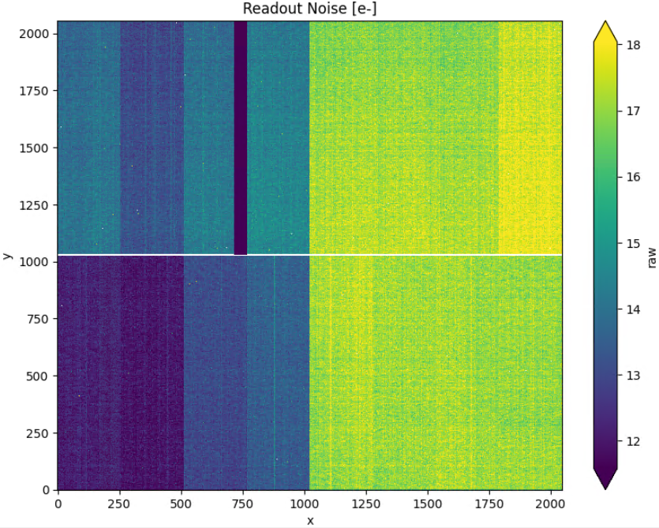
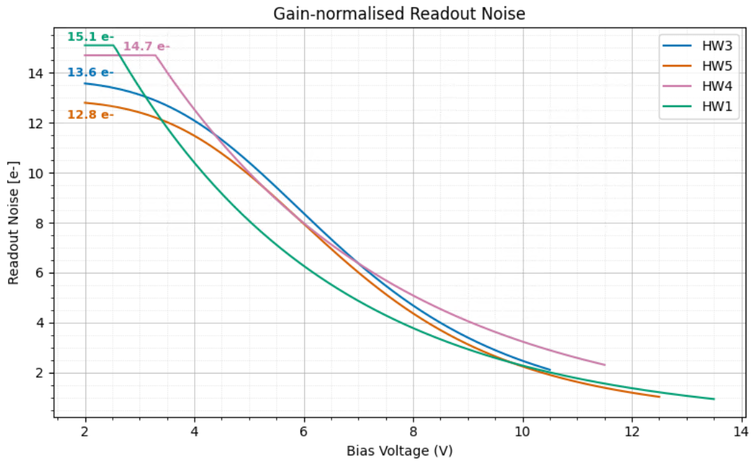
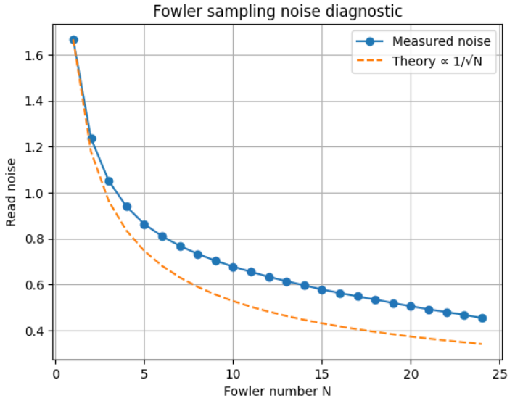
Functionality characterization – Readout Noise
CDS readout noise
Pair subtraction up the ramp, statistical evaluation based on each pair in different ramps
Left – right bias
Readout noise higher than 10 e- requirement
E.g. HW1:
1 e- RON
with 14 ke- FW
[adu]
Fowler approach

Slide 11
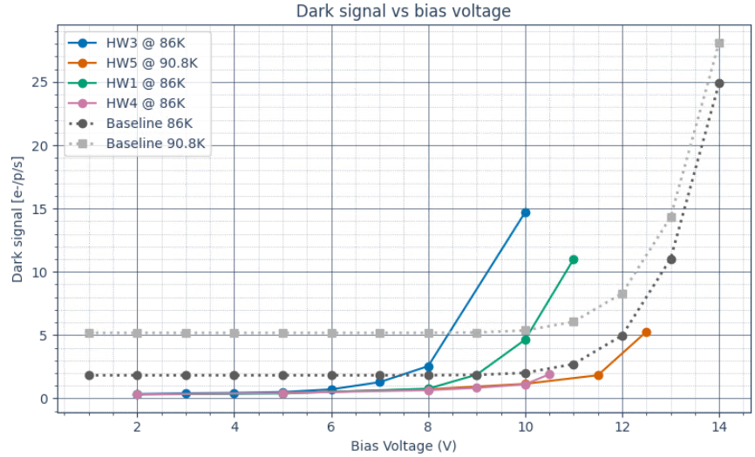
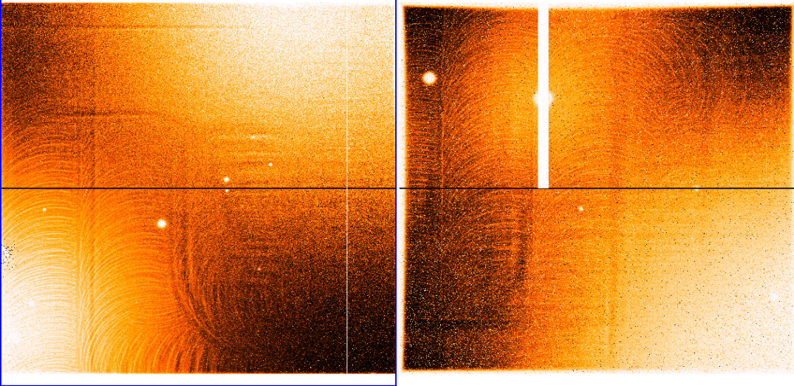
Functionality characterization – Dark Signal (1)
Dark ramps
4h acquisitions, continuously running but sampling only one frame per minute
Self-generated glow, back reflected on the cap surface
Dark current seems to be below 2 e- at gain = 10

Slide 12
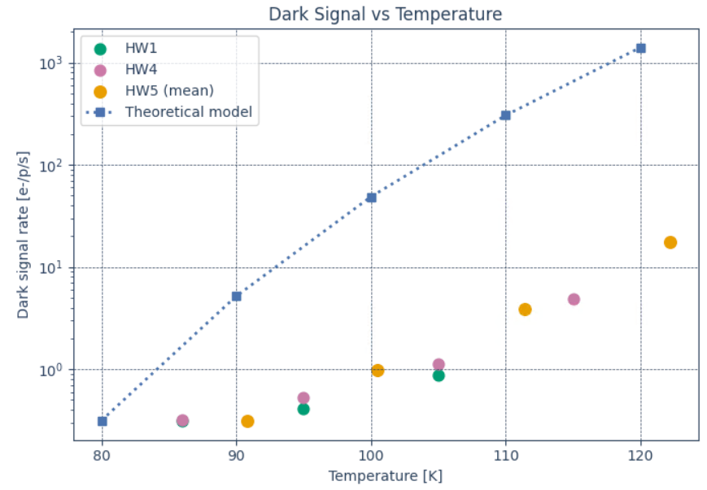
Functionality characterization – Dark Signal (2)
Missing measurements at higher temperatures to evaluate physical phenomena causing dark signal generation
Plateau?

Slide 13

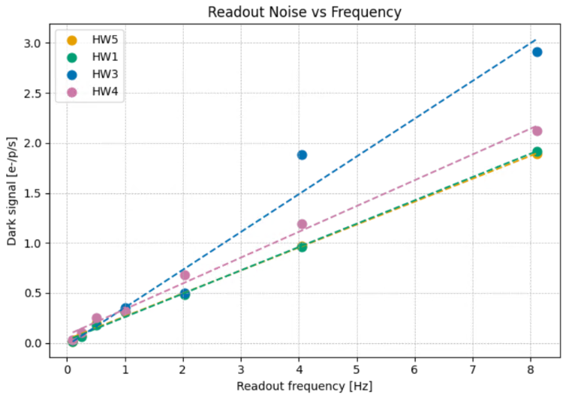

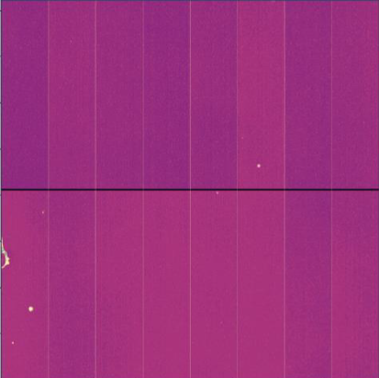



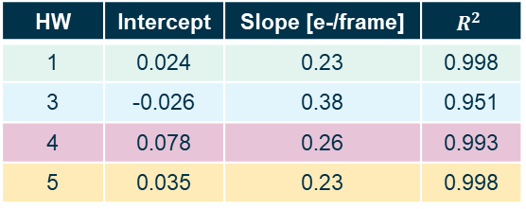
Functionality characterization – Glow
Glow ramps
2h acquisitions, continuously running but sampling only one frame per minute at different SF rates
Frame Rate
1 Hz
0.5, 0.25, 0.1 Hz
Full frame, but after the clocking a buffer time of 1, 4, or 9 seconds is implemented
2 Hz
4 Hz
8 Hz
Glow
contribution
HW | Intercept | Slope [e-/frame] | $$R^{2}$$
1 | 0.024 | 0.23 | 0.998
3 | -0.026 | 0.38 | 0.951
4 | 0.078 | 0.26 | 0.993
5 | 0.035 | 0.23 | 0.998
Glow seems to be the dominant contribution for dark signal
Theoretical dark current

Slide 14
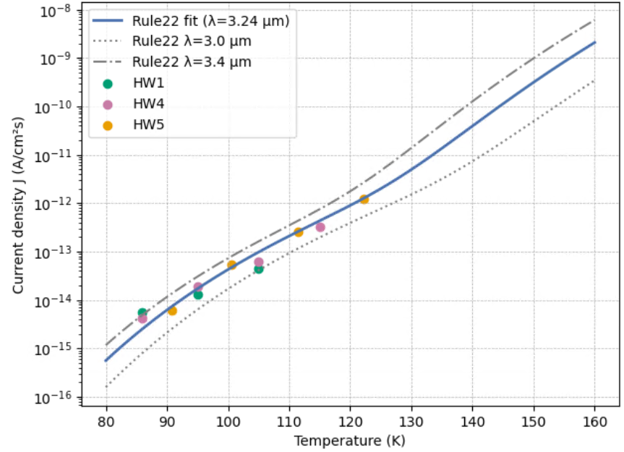
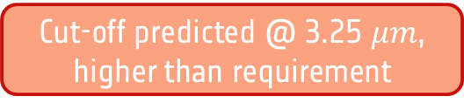

Functionality characterization – Dark Signal (2) continued
Missing measurements at higher temperatures to evaluate physical phenomena causing dark signal generation
Correcting for the glow at low T
Applying Rule22 fit [Zandian 2023], we can estimate the cut-off wavelength ($R^{2 }=0.943$)
Plateau?
Cut-off predicted @ 3.25 $μm$, higher than requirement

Slide 15
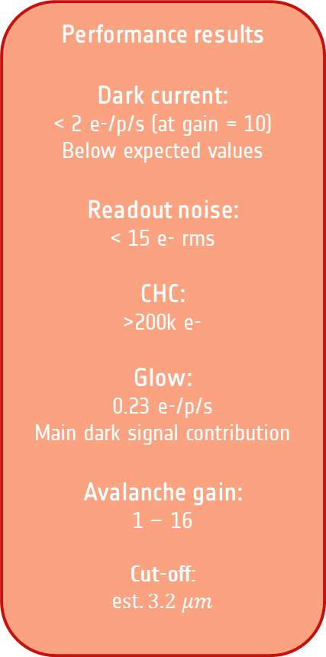

Functionality characterization – Summary
Performance results
Dark current:
< 2 e-/p/s (at gain = 10)
Below expected values
Readout noise:
< 15 e- rms
CHC:
>200k e-
Glow:
0.23 e-/p/s
Main dark signal contribution
Avalanche gain:
1 – 16
Cut-off:
e$st. 3.2 μm$
Performance requirements
Dark current:
< 3 e-/p/s (at gain = 10)
Readout noise:
< 10 e- rms
CHC:
>100k e-
Glow:
?
Avalanche gain:
1 – 40
Cut-off:
> 2.5 $μm$
High T?
Left – right bias
Fowler approach
Breakdown?
Controller?
Reference pixels correction?

Slide 16








Next Steps - Collaborations
LAPD community
Characterization Institute –
Characterizing HW5 and preparing proton campaign
Characterization Institute
–
Characterizing HW1 to get prepared for IBEX follow-up and on-sky demonstration
Max Planck Institute
–
Testing compatibility between IBEX and ALFA-c ASIC for the ASIDES mission
Technical Officer – Characterization Institute
Manufacturer
–
Delivering IBEX follow-up this year

Slide 17
Next steps - Tests
RTS
Inter Pixel Capacitance
Cross Talk
Gain stability
Increase the TRL to make LmAPD a key technology for future European scientific missions
Temperature sensitivity
Excess Noise
PRNU
Radiation sensitivity
Quantum Efficiency
Persistence

