Slide 1
H1RG readout procedures for MAJIS, the VIS-IR imaging spectrometer of JUICE: description and impact on instrument performance
Poulet F., Langevin Y.
IRIS Calibration and Performance Workshop 2026

Slide 2
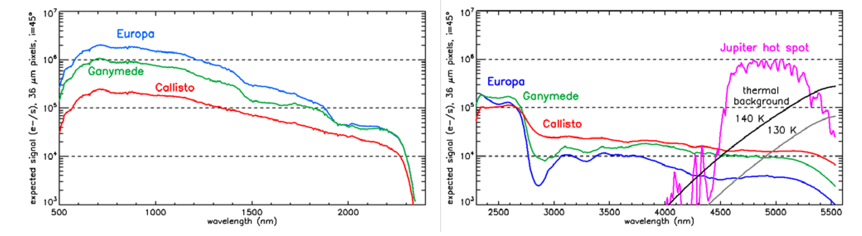
Detector Drivers
High level drivers:
Broad spectral range
Harsh radiation environments ➔ onboard despiking procedure consisting in splitting the integration time into series of sub-integrations
Both low photon flux targets (rings, exosphere, organics) and high flux targets (satellite reflectance in the VIS, high thermal background, Jupiter hot spots)
  Quite different from that of deep survey astrophysical missions
  Sub-integration times from 100 ms or less to a few seconds
Parameter | Value | Comments
Spectral range VISNIR | 0.50 – 2.35 µm
Spectral range IR | 2.28 – 5.56 µm
Number of spectels per channel | 508 | Up to 640 by TC, Spectral editing, Spectral binning x2 or x4 by TC
Number of pixels along FOV for both channels | 400 | Spatial binning x2 or x4 by TC Windowing functionality
Spikes (e-/s) | IR: 2.56 VISNIR 1.88 IR: 0.096 VISNIR: 0.06 | Europa Ganymede

Slide 3
Teledyne detector selection
Chroma first candidate but eventually excluded because of the pedestal and low TRL
Teledyne/H1RG detector family HxRG:
  high TRL and space heritage
  optimized for low-signal detection and long integration time
Key parameters to be assessed:
  Readout noise
  Dark current
  Full well depth
  Linearity
  Readout speed
  Pedestal
  …

Slide 4
Teledyne detector selection
Chroma first candidate but eventually excluded because of the pedestal and low TRL
Teledyne/H1RG detector family HxRG:
  high TRL and space heritage
  optimized for low-signal detection and long integration time
Key parameters to be assessed:
  Readout noise
  Dark current
  Full well depth
  Linearity
  Readout speed
  Pedestal
  …
Instrument/mission-specific constraints:
Limited power ➔ Passive thermal control (85-95K)
Extreme signal dynamics ➔ Variable integration time
Radiation-induced transients ➔ On-board despiking requiring short time integration (100 ms or less)
Very limited data volume ➔ Windowing, spectral and spatial binning functionalities
+

Slide 5
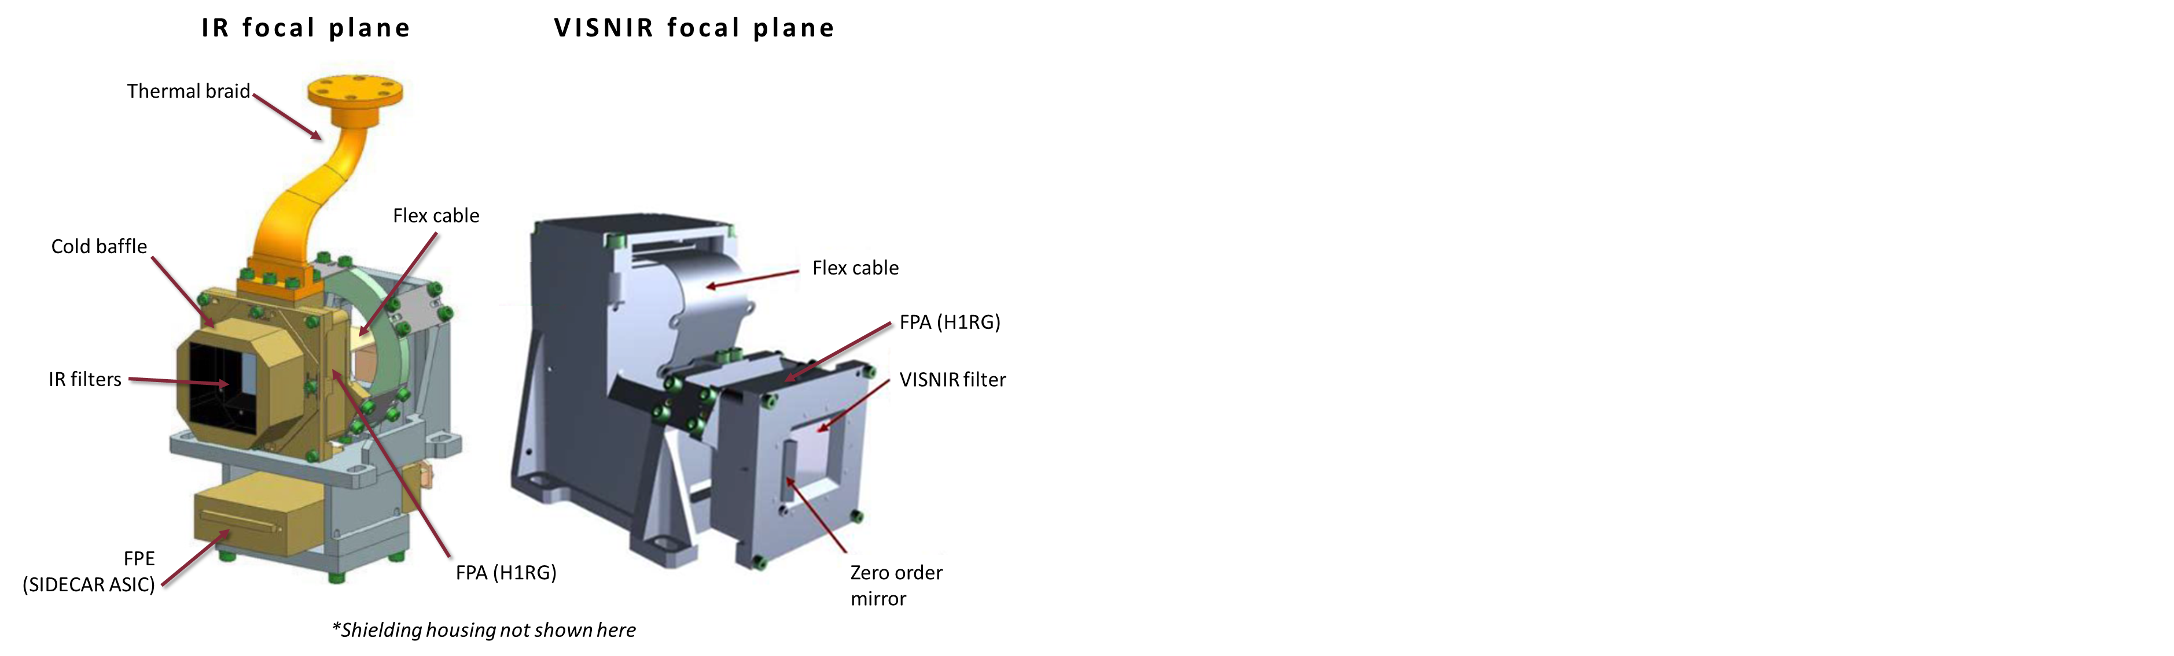
Teledyne detector selection
Chroma first candidate but eventually excluded because of the pedestal and low TRL
Teledyne/H1RG detector family HxRG:
  high TRL and space heritage
  optimized for low-signal detection and long integration time
Key parameters to select FS and FM:
  Readout noise
  Dark current
  Full well depth
  Dynamic range
  Readout speed
  Pedestal
  Radiation dose
Instrument/mission-specific constraints:
Limited power ➔ Passive thermal control (85-95K)
Extreme signal dynamics ➔ Variable integration time
Radiation-induced transients ➔ On-board despiking requiring short time integration (100 ms or less)
Very limited data volume ➔ Windowing, spectral and spatial binning functionalities
+

Slide 6
Main data acquisition strategies
Correlated Double Sampling (CDS)
Series of short sub-integrations
Windowed readout (800 or less pixels) for optimized duty cycle
Readout modes resulting from trade-offs between noise, saturation, integration time and duty cycle (see next slides)

Slide 7
Focal Plane Electronics (FPE) & readout modes
The Focal Plane Electronics (FPE) performs spatial windowing by reading a selectable number of detector rows and converting the video signal into digital numbers
Readout of the MAJIS detectors is performed by a SIDECAR ASIC (heritage Euclid/NISP), with a set of microcodes provided by Teledyne as the starting base for MAJIS specific developments
Readout modes:
  H1RG Detector Readout: uses 16 parallel channels; standard astrophysics readout at 100 kHz with 16-bit ADC to achieve lowest noise
  CDS consists in reading out the detector twice: one readout is performed for each line immediately after reset (“reset-read” readout) to get the lowest readout noise. The second readout is initiated after an interval corresponding to the integration time. Signal = second minus first; minimum integration time 717 ms (full detector), 560 ms (MAJIS FOV)
    ➔ 100 kHz CDS solution selected for MAJIS long integration times
  Fast Readout Challenge: Initial “Fast” mode at 5 MHz met timing requirements (<15 ms/frame) but had higher noise and was unreliable at 90 K
  1 MHz CDS solution: Teledyne + MAJIS developed reliable 1 MHz readout with CDS; integration times 71.7 ms (full) / 56 ms (MAJIS FOV), satisfying MAJIS short sub-integration constraints
  To support the higher sampling rate, ADC resolution is reduced from 16 bits to 12 bits per channel

Slide 8
CDS issues and mitigations (1)
CDS readout:
  digital range must match detector analog range
  offset bias (~30% full well) ensures all values positive
During detector characterization, offset bias tuned to minimize readout noise while maintaining good dynamic range
In-flight adjustment: bias can be changed via telemetry to handle electronic drift in Jupiter’s environment.
IR FM detector at 75 K Integration time of 800 ms
100 kHz readout
Signal (DN)

Slide 9
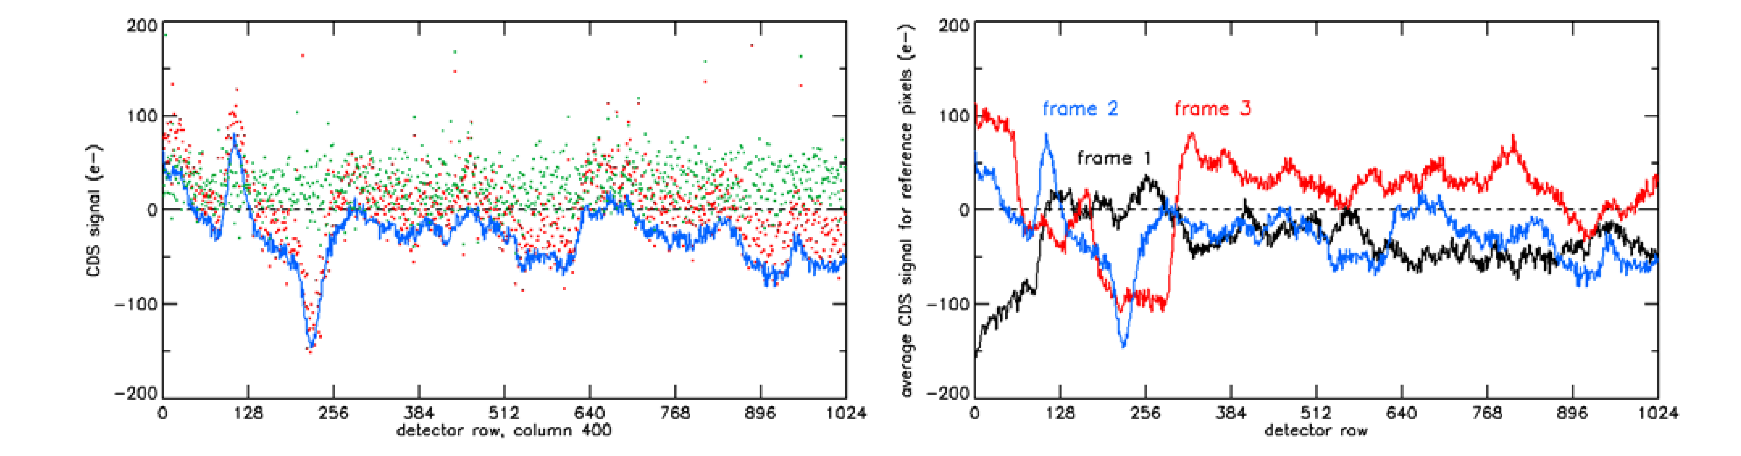
CDS issues and mitigations (2)
Low signal levels: First and second readouts produce signals much larger than the actual measured signal and readout noise
Subtraction sensitivity: Minor variations in readout efficiency can strongly affect precision
Impact on accuracy: Differences between readouts are also observed and affect measurement accuracy after CDS subtraction
Row Correction: averaging values from the 8 non-connected physical pixels at the beginning and end of a row, then subtracting this average from the actual signal for connected pixels in the same row
Dark before row correction
Dark after row correction
Average of the 8 reference pixels

Slide 10
CDS issues and mitigations (3)
Dynamic Range & Reset-Read: Full well depth measurements require first readout immediately after row reset; “reset-read” and “read-reset” procedures implemented to maintain precision and enable on-board despiking.
Latency constraint resulting from spikes:
  Latency must be avoided for on-board despiking, otherwise a spike would affect two consecutive sub-integrations instead of one.
  Reset timing adjustment: the reset duration before the first readout (“reset-read”) was increased.
  Additional reset step: a row reset after the second readout (“read-reset”) ensures each row is reset twice between 2 CDS measurements.
Reset Anomaly Mitigation:
  Single preamplifier reset + “drop” readout sequence reduce variations in CDS measurements from reset anomaly, particularly for the first integration
  Impact on Duty Cycle: At 1 MHz readout, mitigation has negligible effect; at 100 kHz, “drop” CDS reduces duty cycle but timing constraints are compatible with sub-integration requirements.
100 kHz
1MHz

Slide 11
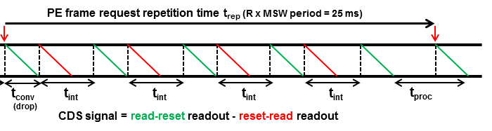
Chronogram at 1 MHz of an acquisition constituted of 4 sub-frames with an integration time t_{int}
Reset Anomaly Mitigation

Slide 12
CDS issues and mitigations (4)
Reset anomaly produces channel-dependent offsets when readout occurs shortly after reset ➔ affects accuracy at low signal
Some of 16 channels show large negative offsets (~150–200 e⁻), much larger than the readout noise, leading to biased measurements despite good precision.
These offsets are specific to readout channels and stable over time, with little dependence on temperature or signal level.
Reference rows were not used to correct this issue
Selected mitigation:
  subtract a reference frame acquired with the shutter closed and the same integration time
  This approach removes reset anomaly bias, dark current, and thermal background, and is applied on-board to improve data uniformity before compression.
  Frequent shutter-closed measurements are taken to track variations of dark current and thermal background with detector temperature.
Total signal (black)
Signal “shutter closed” (red)
“shutter closed” subtracted signal (green)

Slide 13
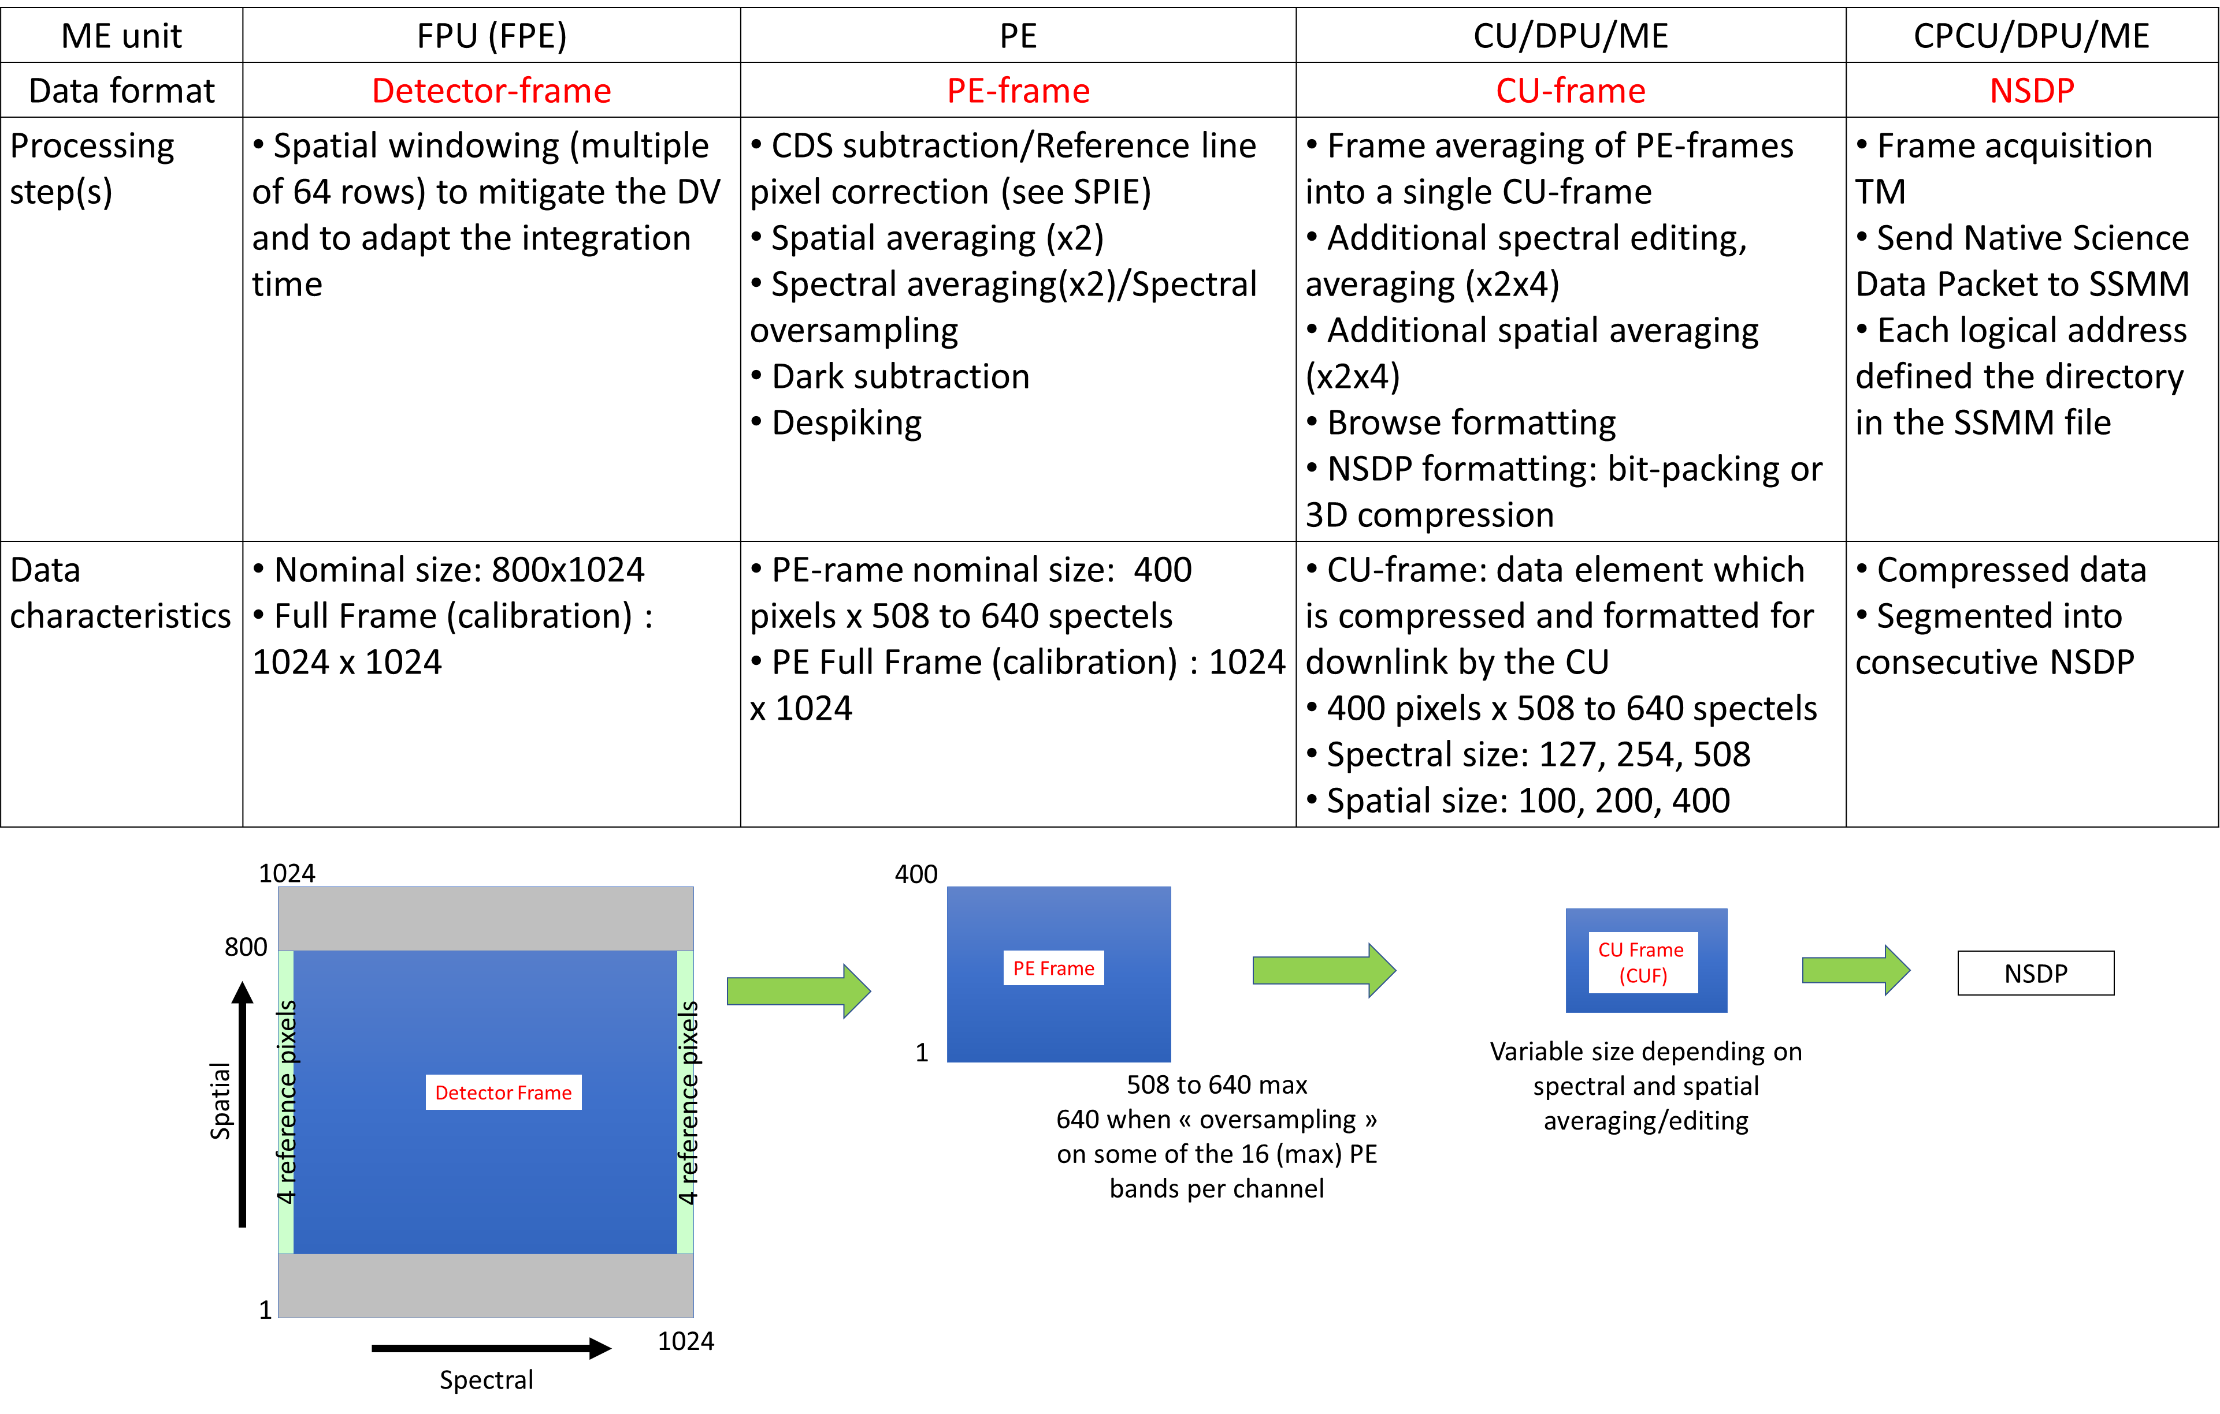
Overview of the data on-board pipeline as a function of the electronic units involved in the processing

Slide 14
MAJIS case study
MAJIS/JUICE as a representative system-level example
Constraints:
  Extreme signal dynamics
  Radiation-induced transients
  Windowing, binning, on-board despiking
Adoption of 1 MHz CDS with minimal microcode changes to cover 75% of scientific observations
On-board despiking based on sub-integration statistics
Selection of lowest, least-contaminated samples
Row correction using reference pixels
Precision consistent with noise models
Langevin et al. H1RG readout procedures for MAJIS, the VIS/NIR imaging spectrometer of JUICE: impacts on the performances, Proc. SPIE 12180 – Space Telescopes and Instrumentation: Optical, Infrared, and Millimeter Wave (2020)
Poulet et al., Moons And Jupiter Imaging Spectrometer (MAJIS) on Jupiter Icy Moons Explorer (JUICE), Space Sci. rev. (2024)

Slide 15
Detector Characterization
Ground characterization activities:
Readout noise
Linearity
Quantum efficiency
Dark current
Identification of reset anomaly and channel-dependent offsets
End-to-end, mission-representative testing
Validation of windowing and drop-frame strategies
Assessment of reset anomaly mitigation schemes
Systematic acquisition of shutter-closed reference data
Poulet et al., Calibration of the Moons And Jupiter Imaging Spectrometer (MAJIS): Introduction to the special collection and summary of the performances. Review of Scientific Instruments (2024)

Slide 16
Detector performance at 18 µm pixel
Haffoud et al. MAJIS VIS-NIR channel: Performances of the Focal Plane Unit - Flight Model, Proc. SPIE 12180 – Space Telescopes and Instrumentation: Optical, Infrared, and Millimeter Wave (2022)
Carter et al. MAJIS IR channel: 3) performance of the focal plane unit, Proc. SPIE 12180 – Space Telescopes and Instrumentation: Optical, Infrared, and Millimeter Wave (2022)

Slide 17
In-flight Calibration & Performance
Frequent monitoring of dark current and thermal background
Tracking detector and electronics drifts
Propagation of detector systematics through calibration pipelines
Performance preservation over mission lifetime

Slide 18
Lessons Learned
Readout strategy is as critical as detector selection
Reset anomaly mitigation must be addressed early thanks to EM detector
Shutter-based calibration enables accuracy at low signal levels
Guidance for future infrared missions with extreme constraints

