Slide 1

Preparing for the ARIEL System-level cryo-test campaign
Yannis Argyriou
KU Leuven, Belgium
on behalf of ARIEL team
12/03/26
ioannis.argyriou@kuleuven.be
Notes:
Opening act for my colleagues >_<

Slide 2
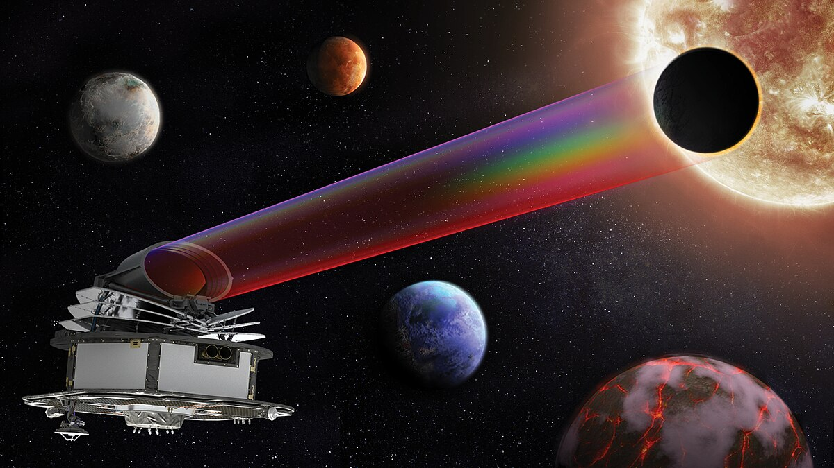
Table of contents
Intro and the A-Team
The ARIEL system (refresher)
Instrument level testing summary
Integrated System level testing
Conclusions
Notes:
Extra material: Lessons learned JWST-MIRI

Slide 3
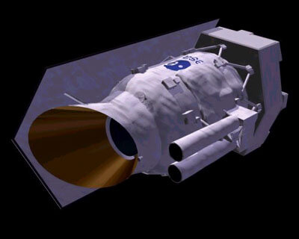
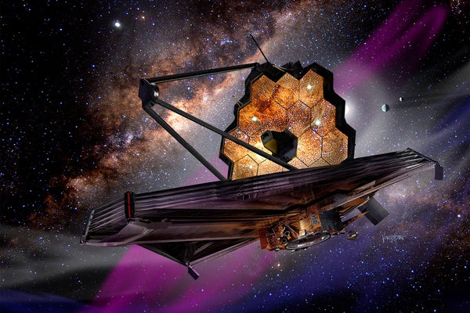
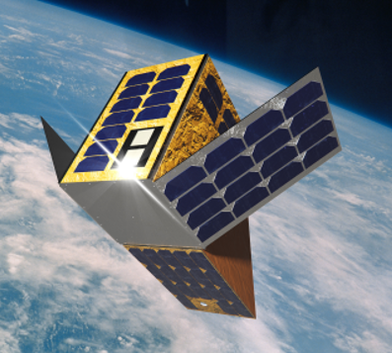

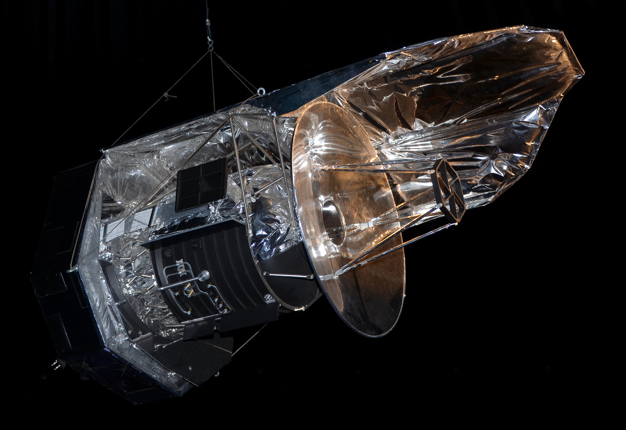
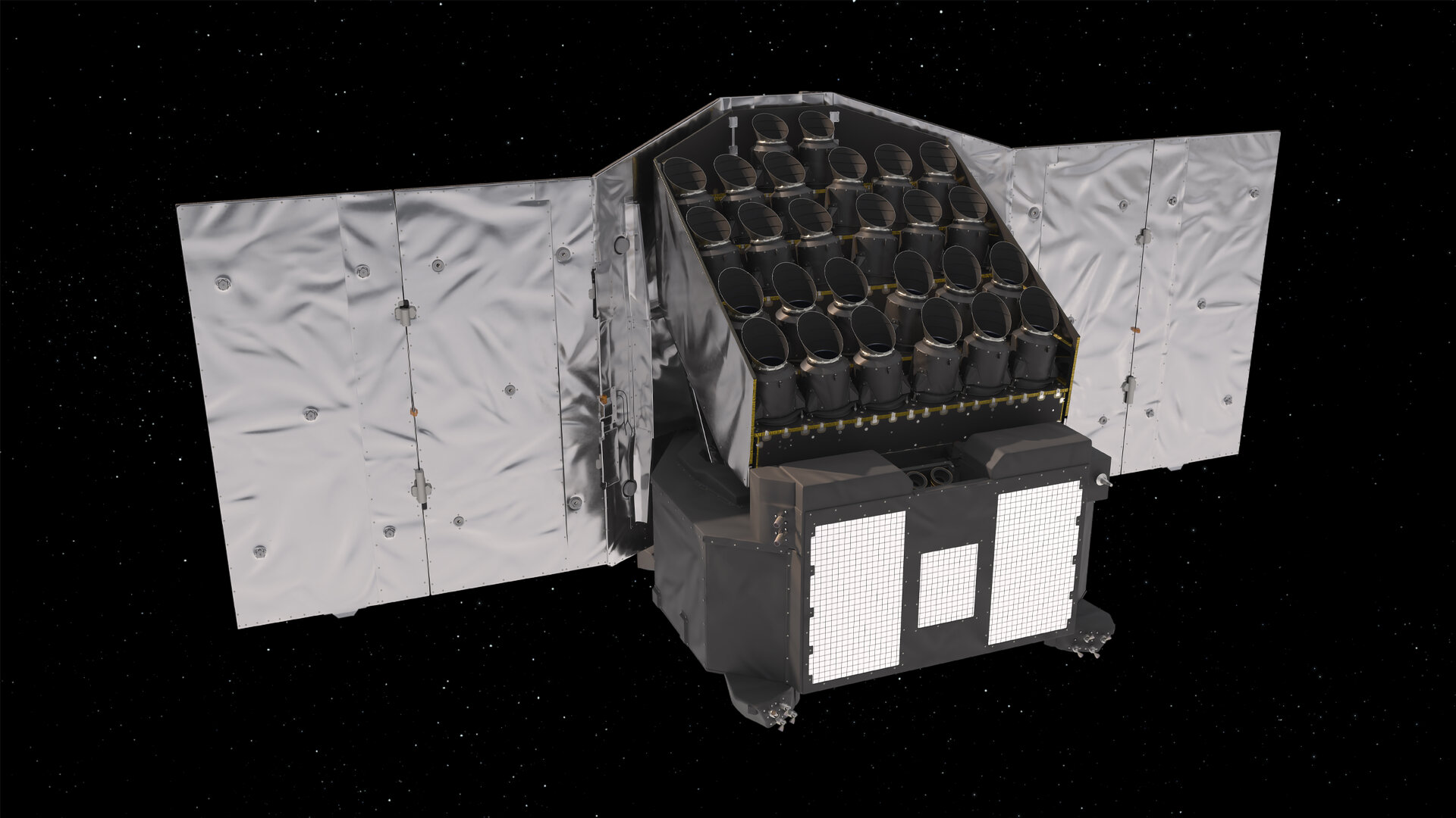
Intro: KU Leuven 30+ years in space mission calibration and AIT
ESA ISO mission
NASA-ESA-CSA JWST
CubeSpec@KUL
NASA-ESA Habitable Worlds
1995→
2026→
ESA Herschel space observatory
ESA PLATO mission
ESA ARIEL mission

Slide 4
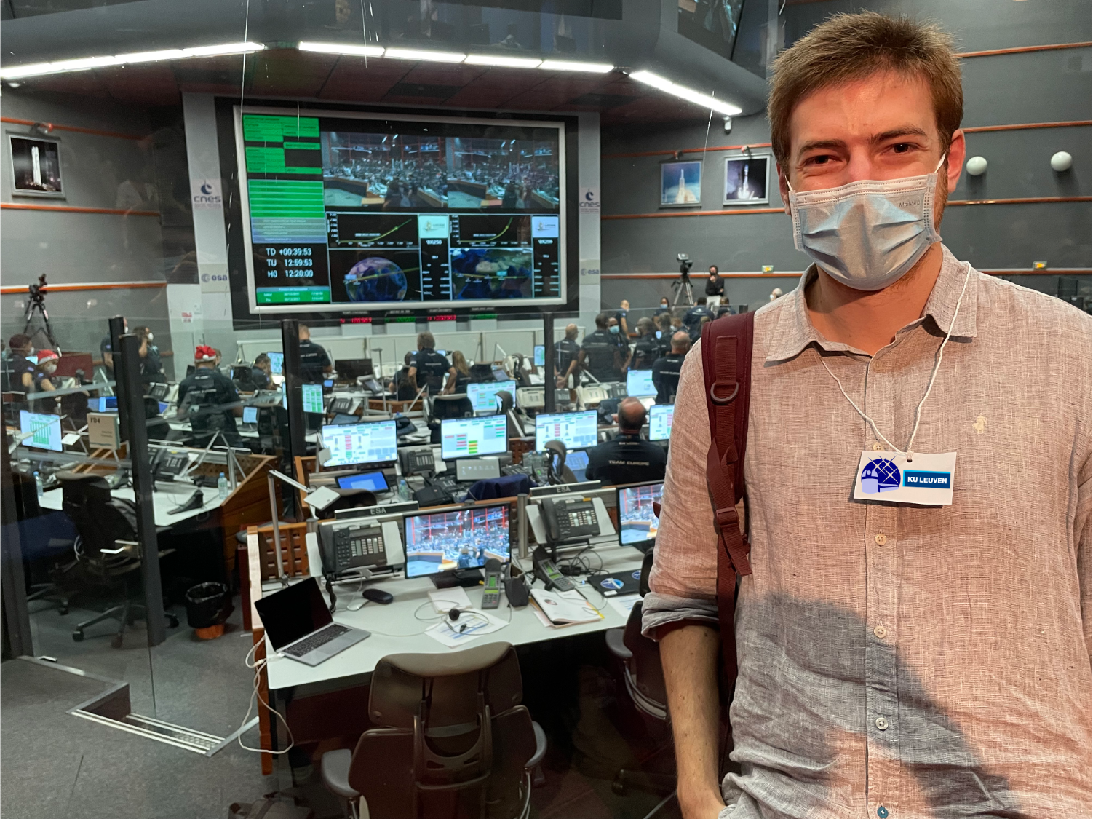

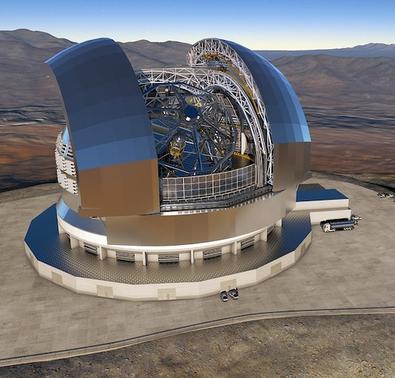

Intro: My journey so far
ARIEL Calibration Lead
(mid-23 – now)
JWST-MIRI MRS Instrument Scientist
(2016-now)
ELT-METIS AIT Performance Lead
(mid-23 – now)

Slide 5
Intro: My journey so far
ARIEL Calibration Lead
(mid-23 – now)
JWST-MIRI MRS Instrument Scientist
(2016-now)
ELT-METIS AIT Performance Lead
(mid-23 – now)

Slide 6
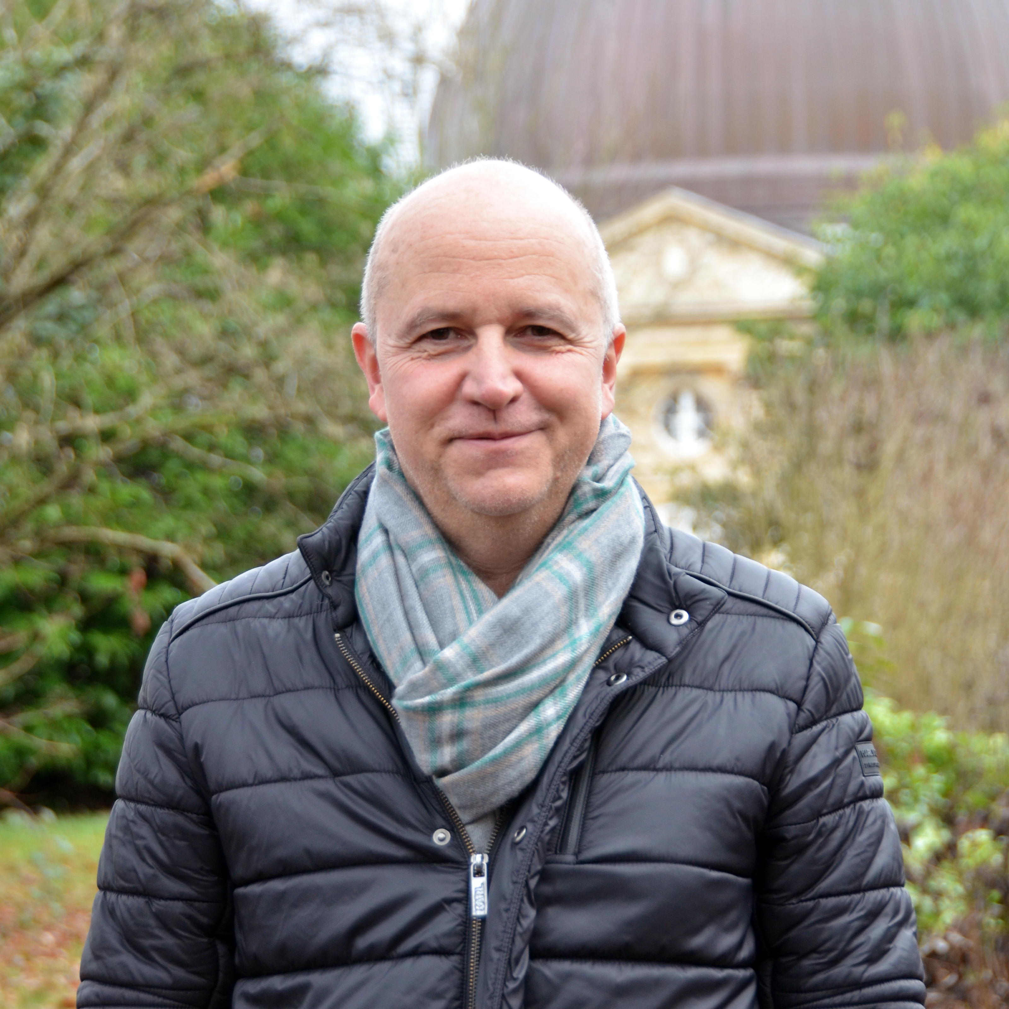





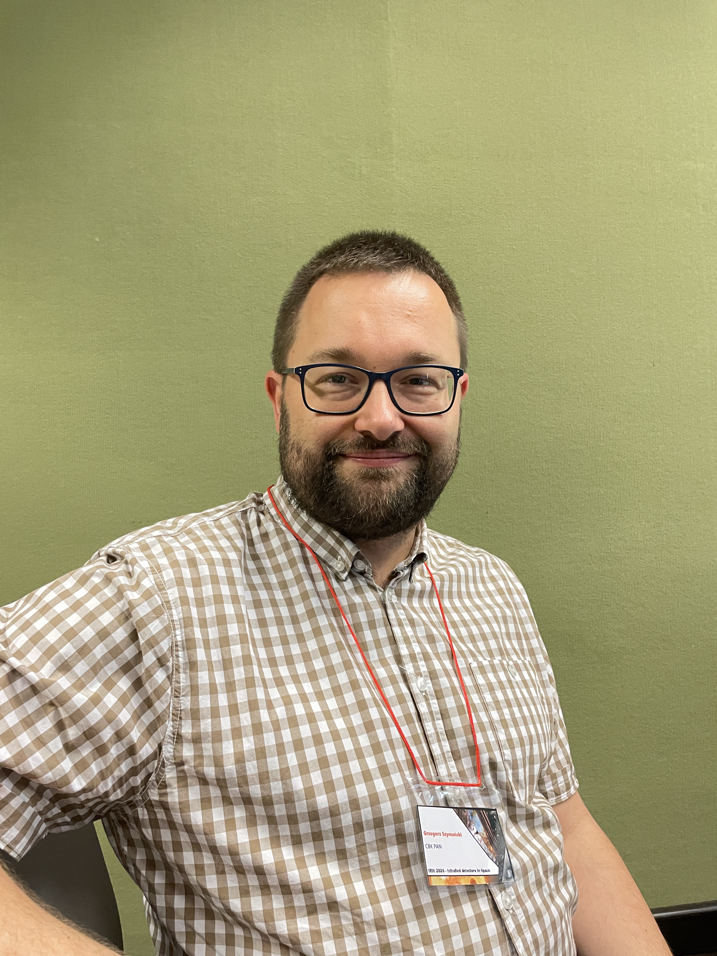
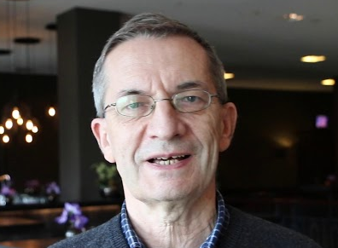
Intro: The A-Team
AIRS instrument-level test team (Paris, France)
FGS instrument-level test team (Warsaw, Poland)
Jean-Michel Reess,
LIRA
Eitan Pechevis,
LIRA
Jérôme Amiaux,
CEA
Thibault Pichon,
CEA
Christophe Cossou,
CEA
Clara Bataillon,
CEA
Grzegorz Szymański, CBK
Mirek Rataj, CBK

Slide 7
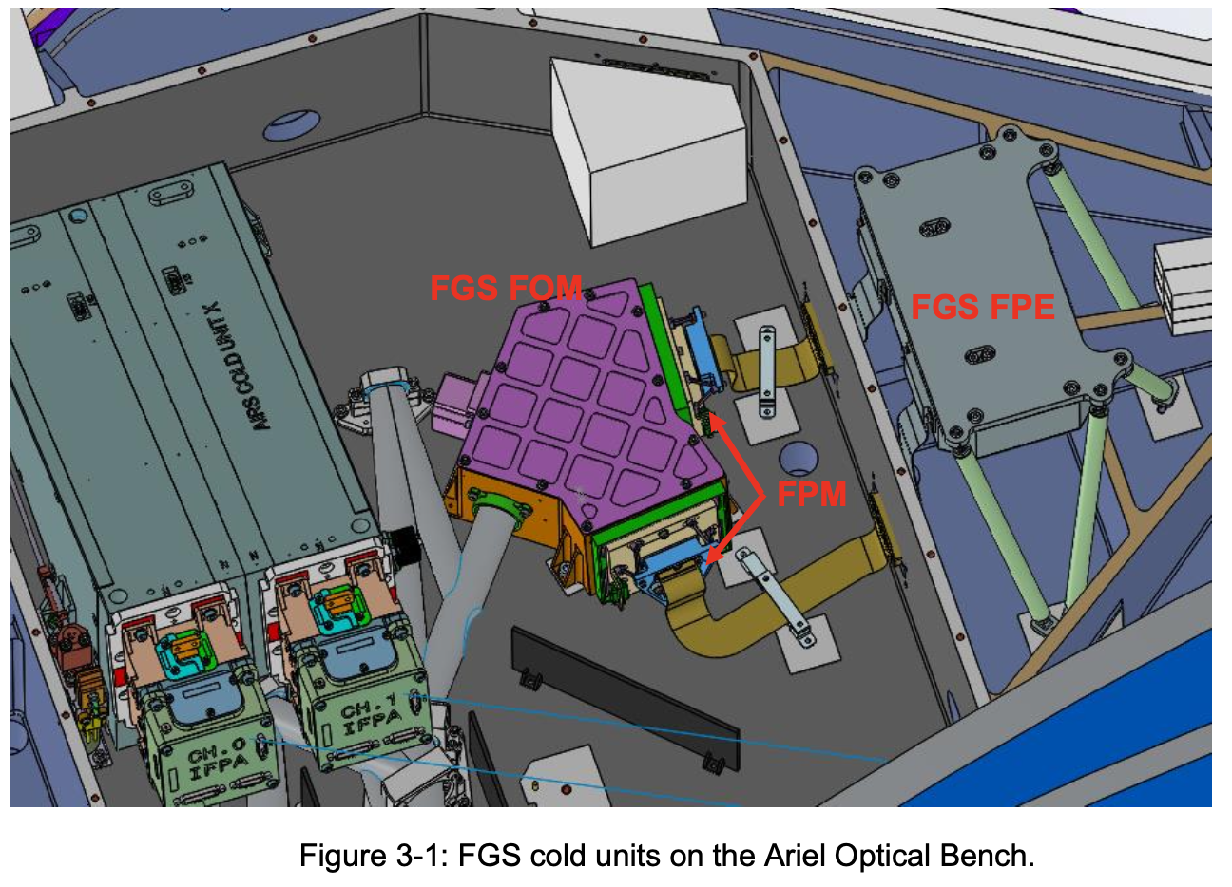
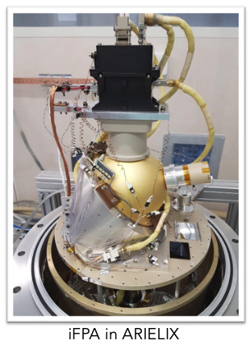
Intro: The A-Team
Presentation on FGS characterization by Grzegorz Szymański after this talk.
Presentation by Clara Bataillon on AIRS characterization at 10:20 today after FGS presentation.
Grzegorz Szymański,
CBK
Clara Bataillon,
CEA

Slide 8
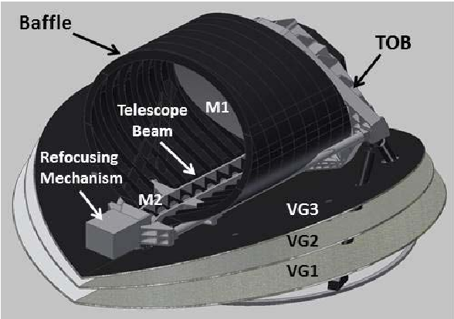
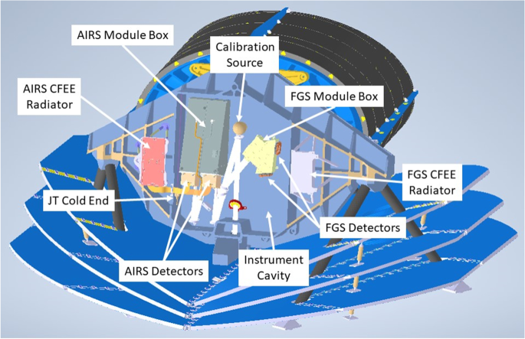
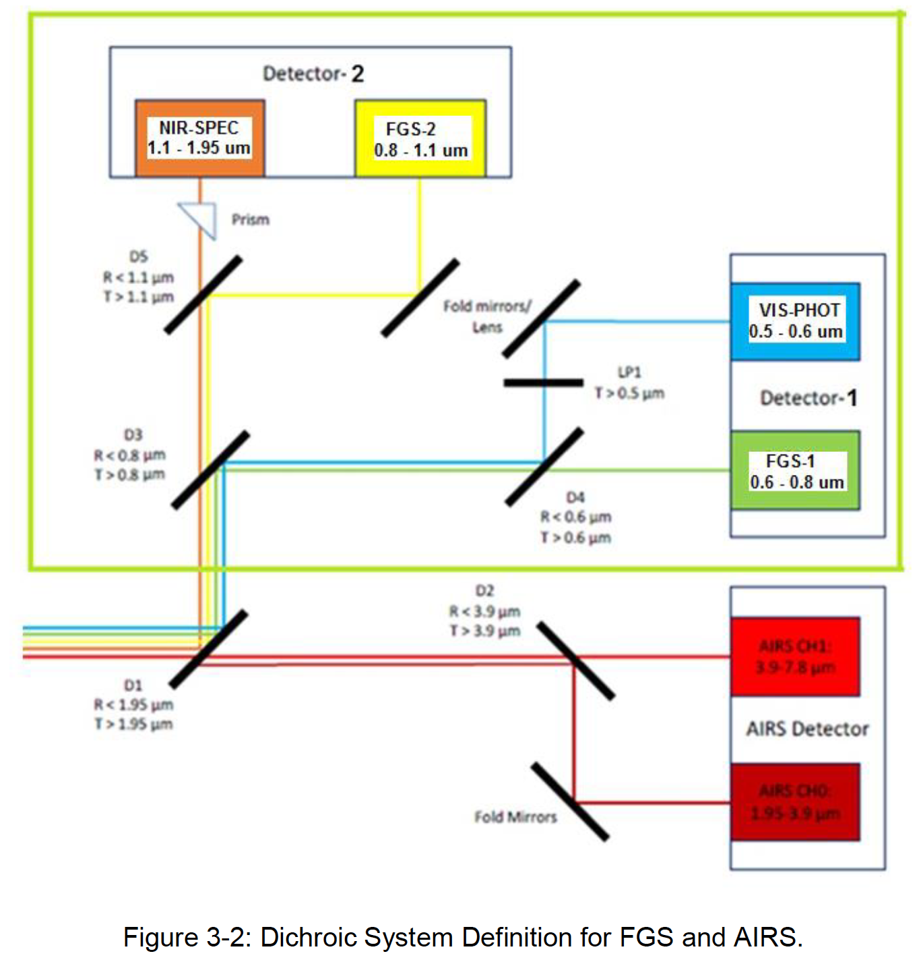
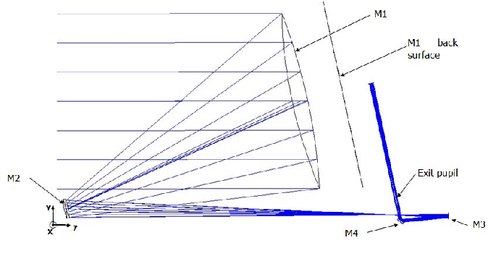
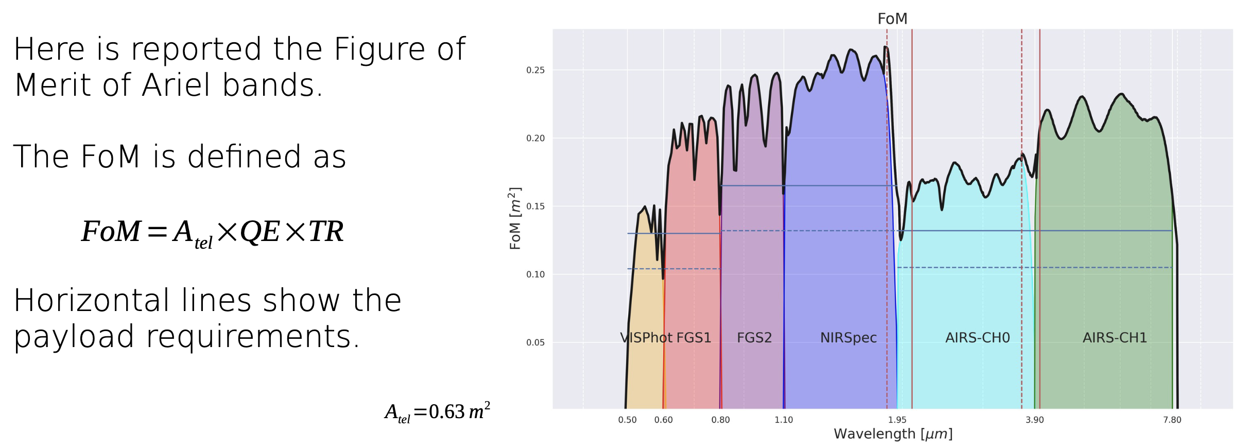
The ARIEL System (refresher)
Orbit: Sun-Earth L2 (JWST/GAIA)
Elliptical M1: 1.1 x 0.7 metres
Instrumentation:
5 dichroics →→
3 phot channels (0.5-1.1μm)
3 spectrometers (1.1-7.8μm)
Detectors: MCT arrays

Slide 9
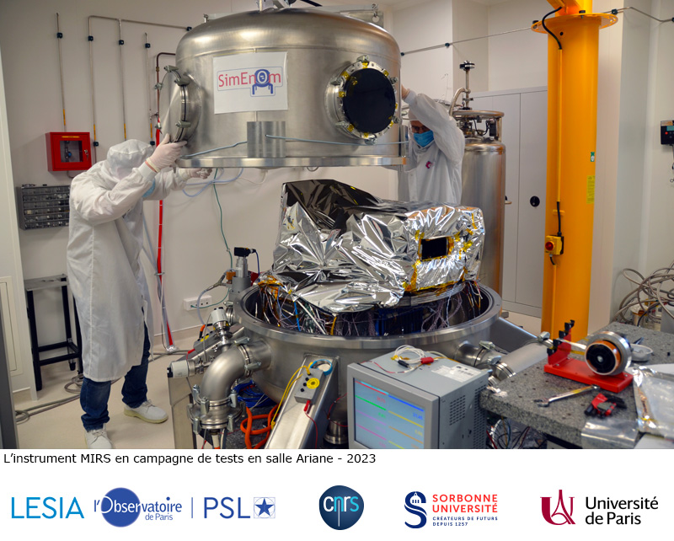
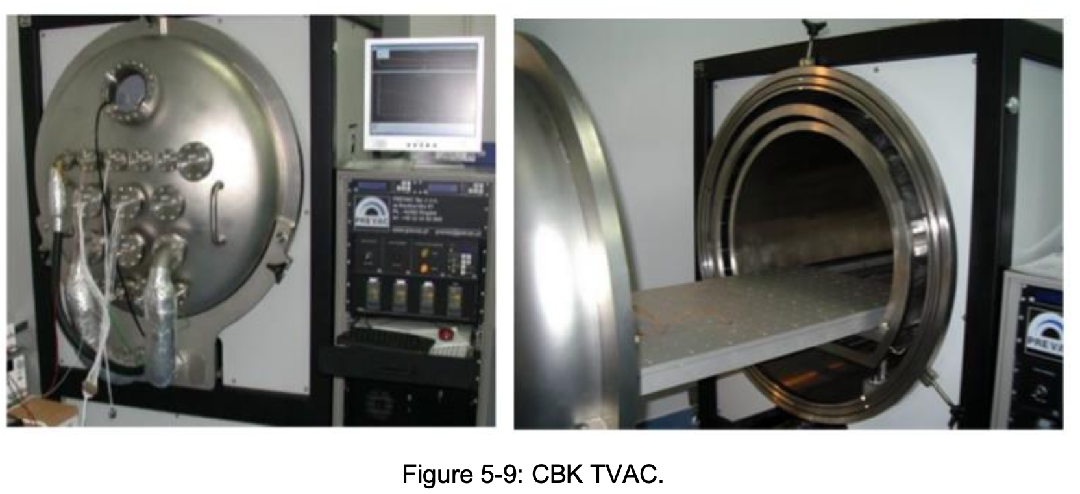
Instrument level testing summary
AIRS instrument testing to take place in SimEnOm test chamber @LIRA (formerly LESIA) in Meudon,
Paris (iCDR happening now!)
FGS instrument testing to take place
@CBK, Warsaw (iCDR end-25’)
CBK TVAC chamber (1m³ volume)
Notes:
FGS TVAC figure from ARIEL-CBK-INST-PL-001

Slide 10
Instrument level testing summary
Instrument-level testing is critical to derive calibration solutions that will be our go-to reference until launch and during commissioning. It is the longest test campaign (~months versus ~days for integrated system performance testing), following the long detector tests.
No sci instrument-only test campaign with instruments, common optical bench, dichroics and M3+mirrors. Full Integrated System with M1+M2 test will suffer from large aberrations on M1 due to gravity in combination with an M1 quarter-aperture illumination.
➔Instrument-level activities to derive calibration products, Integrated System test campaign to check validity of calibration.
Notes:
FGS TVAC figure from ARIEL-CBK-INST-PL-001

Slide 11
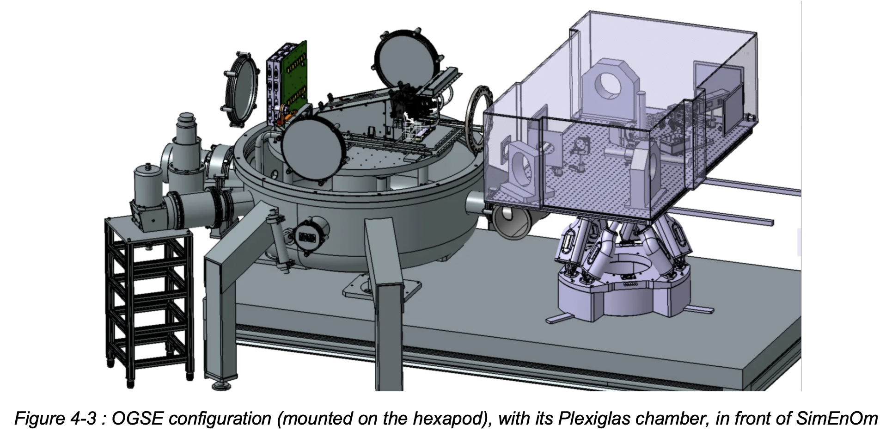
Instrument level testing summary - AIRS
Knowledge of relative pointing between channels better than 1/10th of a pixel (1σ) – Rel pointing with FGS during system-level testing
Wavelength solution accuracy better than 1/3rd spectral bin
CH0: 1.95-3.9μm, CH1: 3.9-7.8μm
Ext: 1.75-4μm, & 3.65-7.8μm
R>=100 below 3.9um
R>= 30 above 3.9um

Slide 12
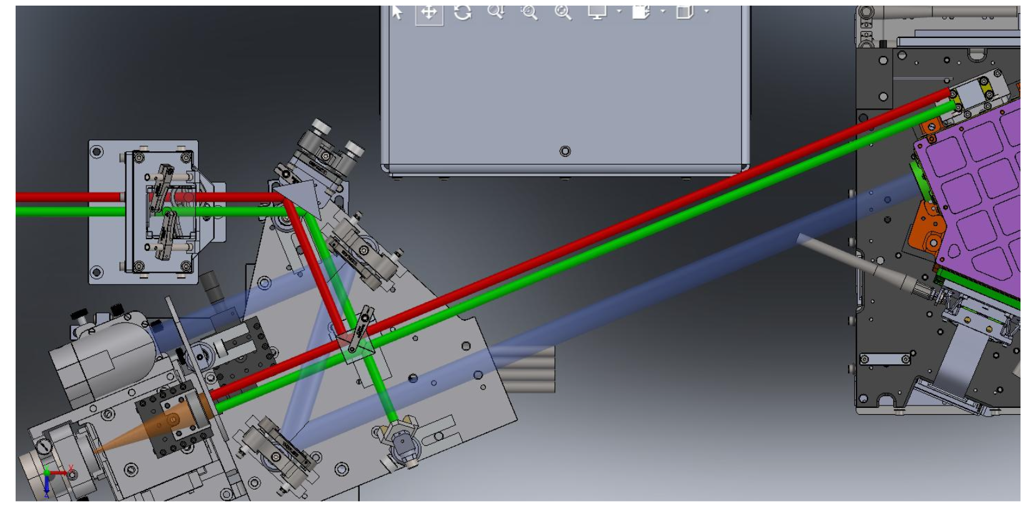
Instrument level testing summary - FGS
Knowledge of relative pointing between channels better than 1/10th of a pixel (1σ) – Rel pointing with AIRS during system-level testing
VISPHOT: 0.5-0.6um, FGS1: 0.6-0.8um, FGS2: 0.8-1.1um,
NIRSpec: 1.1-1.95um
Gain per pixel known better
than 10% 1σ.
Flat field better than 0.5% 1σ
(monochromatic=challenging).
OGSE, FGS Control Unit and FGS

Slide 13
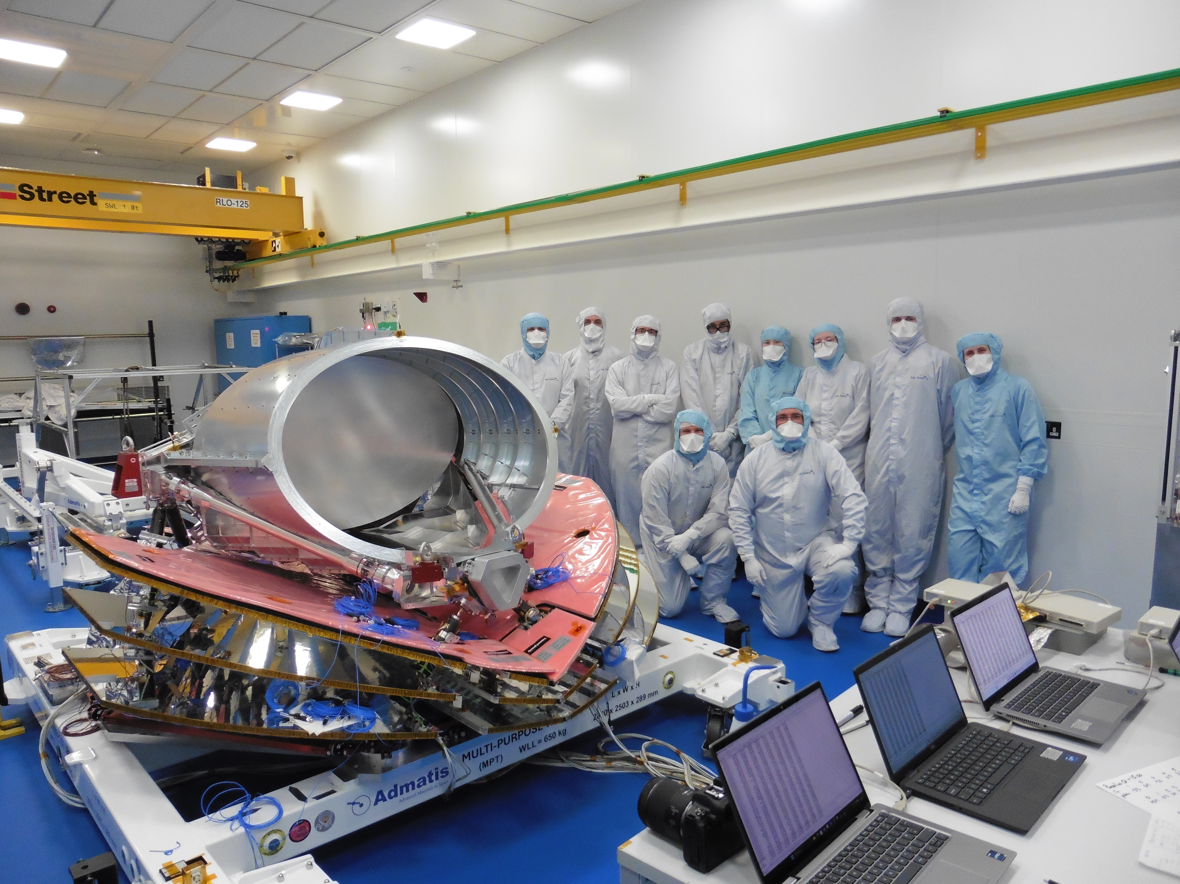
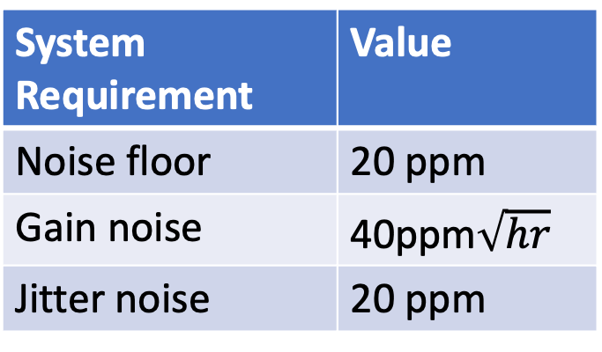
Integrated System-level testing
Integration of all sub-systems at RAL Space, UK
Reminder: No integrated science
instrument module (“ISIM”) test
campaign à-la-Webb
Dedicated OGSE with stringent
stability requirements.
System Requirement | Value
Noise floor | 20 ppm
Gain noise | 40ppm$\sqrt{hr}$
Jitter noise | 20 ppm
Happy ARIEL STM and happy RAL team
November 24, 2025

Slide 14

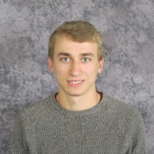


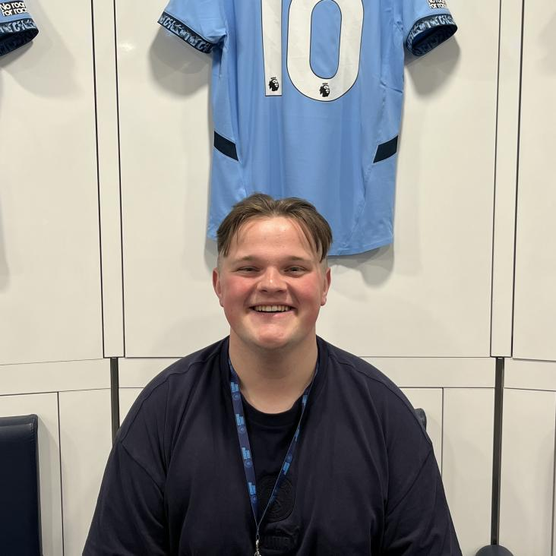
Integrated System-level testing – The A’-team
The OGSE used for the System-level testing is developed and built in Oxford, UK, by these wonderful people
Robert Spry
Jake Hutchison
Rebecca Holleb
Neil Bowles
Adam Wilkinson

Slide 15
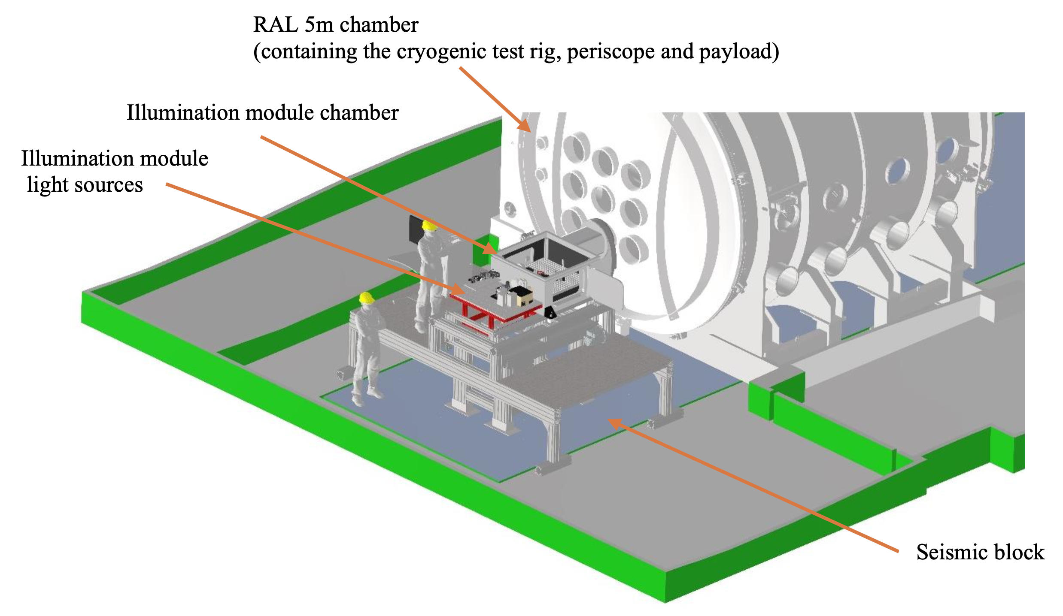
Integrated System-level testing – The facility at RAL

Slide 16
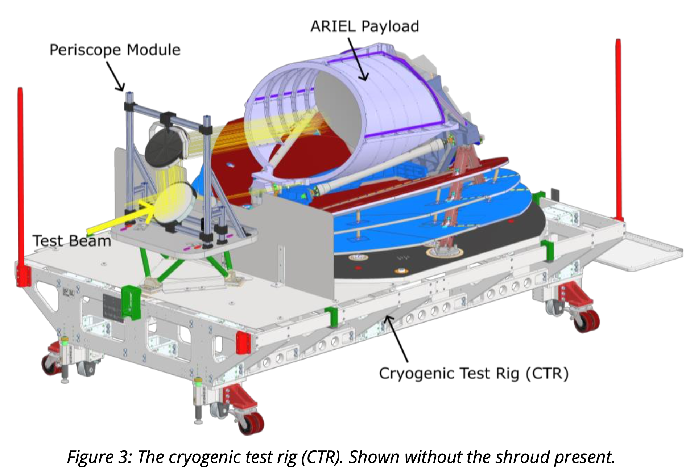
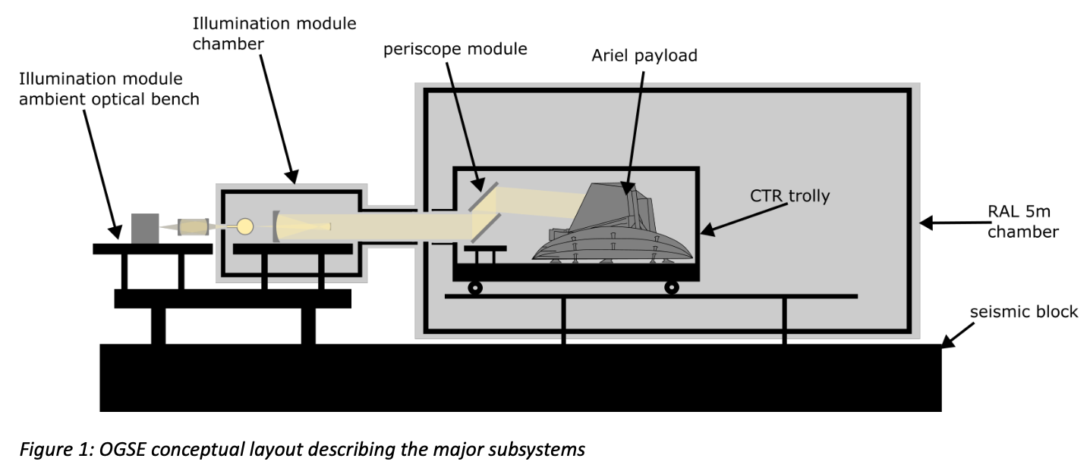
Integrated System-level testing – The facility at RAL
S/C configuration parallel to ground, i.e.
perpendicular to gravity vector (keep in
mind for later).

Slide 17
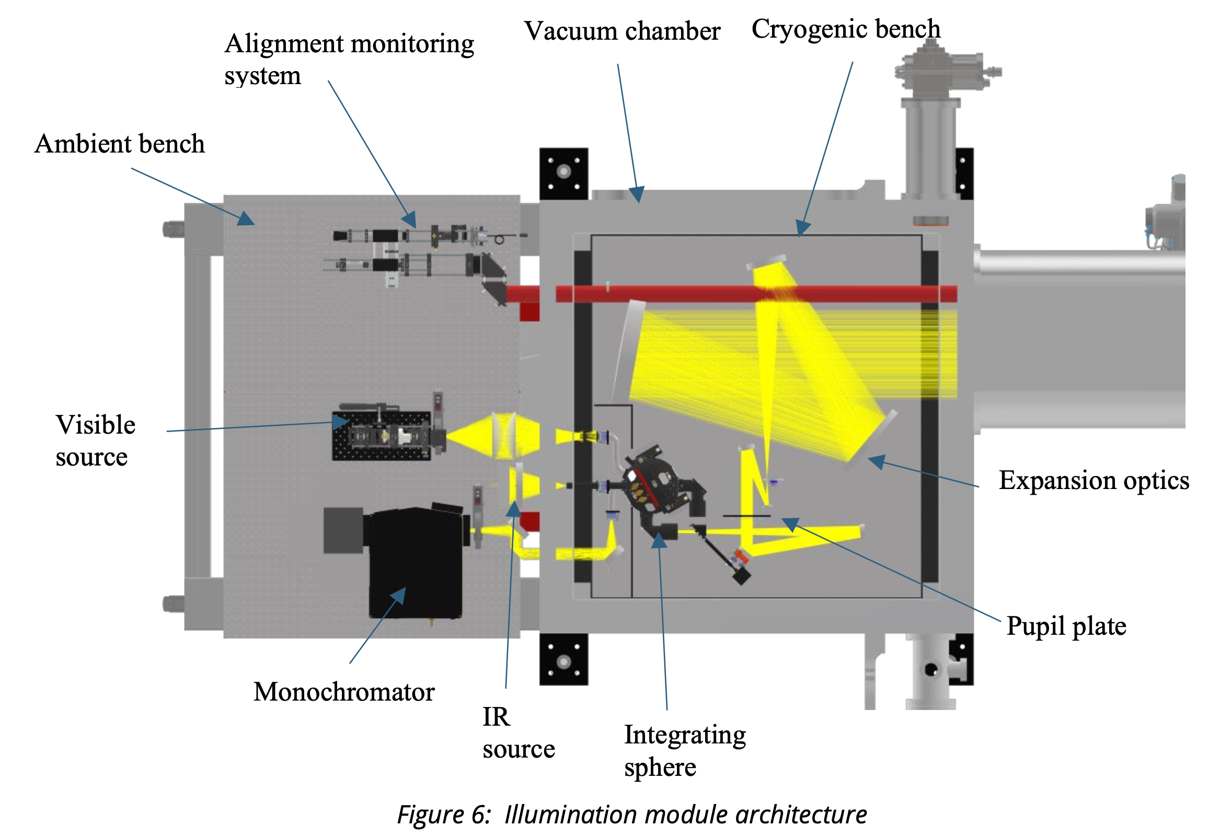
Integrated System-level testing – The OGSE
BB source VIS-IR, flux limits:
-HD 219134 (K=3.2mag)
-GJ 1214 (K=8.8mag)
Monochromator VIS-IR
Two reference detectors
inside integrating sphere
Alignment camera will
constantly take images
during TVAC campaign

Slide 18
Integrated System-level testing – Requirement Verification
STOP analysis produces WFE maps that can be converted to PSF cubes injectable in ExoSim (Mugnai, Bocchieri et al.).
Shape of ground PSF affects accuracy of centroid positions for relative FGS/AIRS alignment.
In-flight: Full aperture (200 nm) + 0g
AIRS-CH0
AIRS-CH1
FGS1
FGS2
VISPHOT
On-ground: Flight shims + quarter aperture + 1g
Notes:
Results from simulations (e.g. wavecal and pencil PSF) ➔ System level checks give part of the story (they might match the expectation based on theoretical degrading of requirements for gravity and quarter-aperture, but they do not tell us if we have it right in case there is a problem, i.e. no probing power)
+ PIP plate for temperature variation (thermoelastic effects)

Slide 19
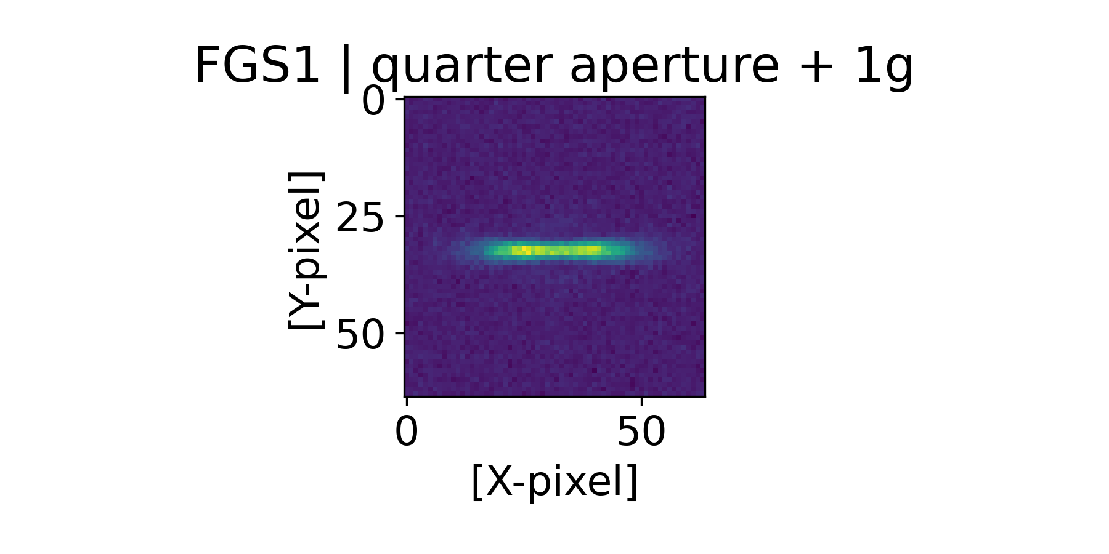
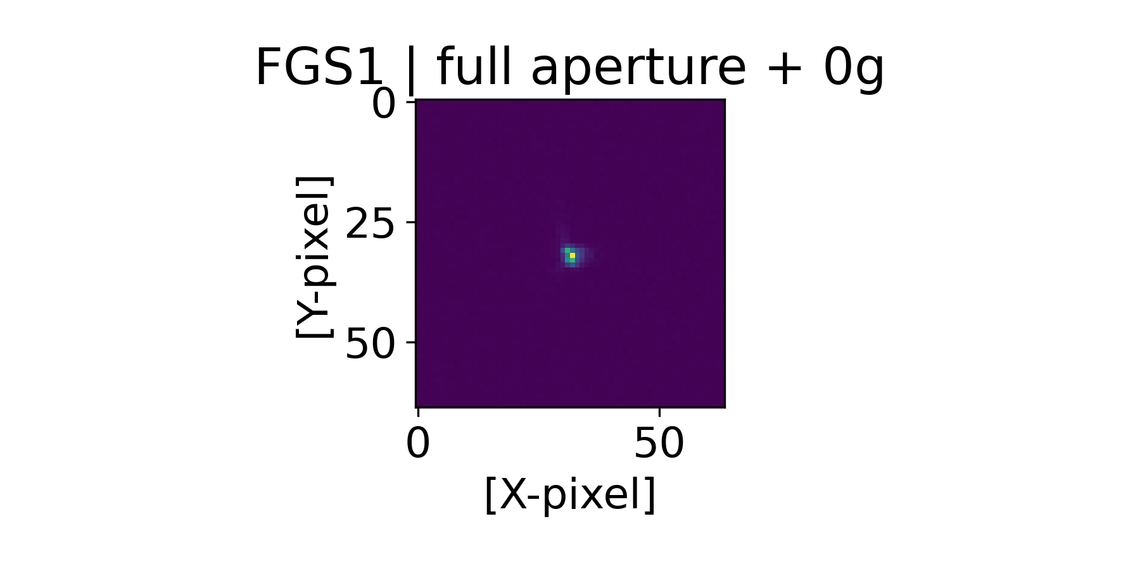
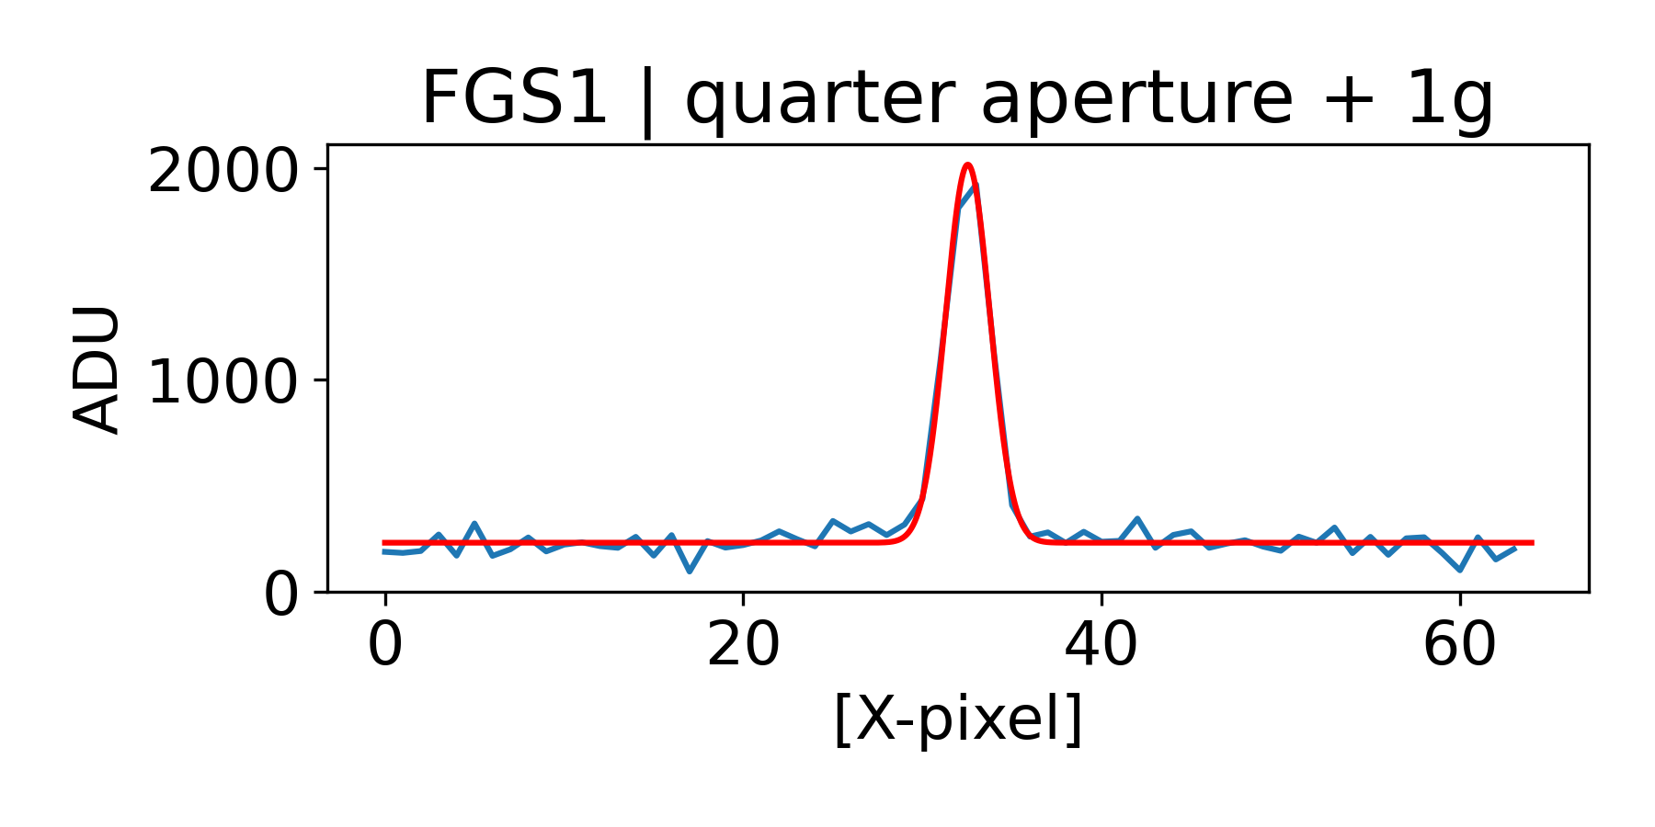
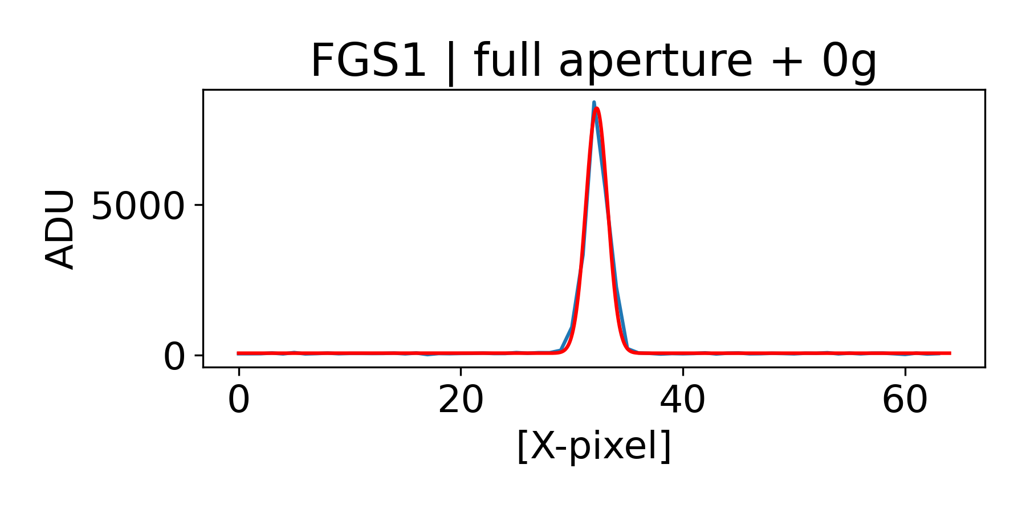
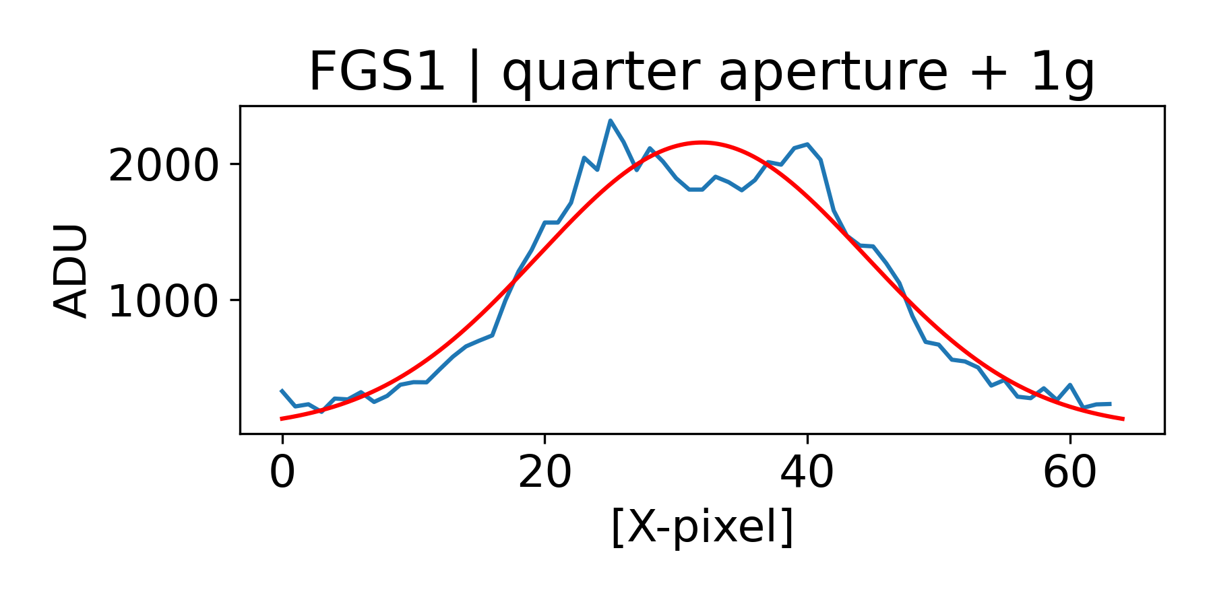
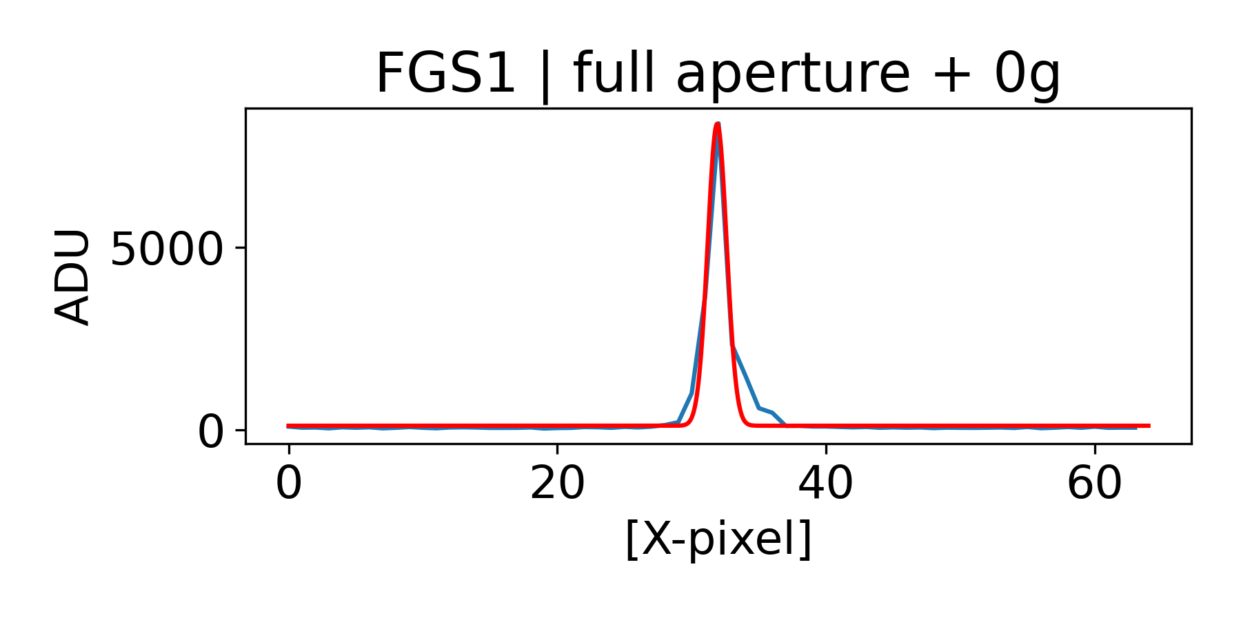
Integrated System-level testing – Requirement Verification
Relative alignment
verification
implications
➔Not enough M2 range
➔ Looking at
shimming
solutions
σ_{x}= 1.2 pixels
σ_{x}= 1.0 pixels
σ_{y} = 12.4 pix
σ_{y} = 0.7 pix

Slide 20
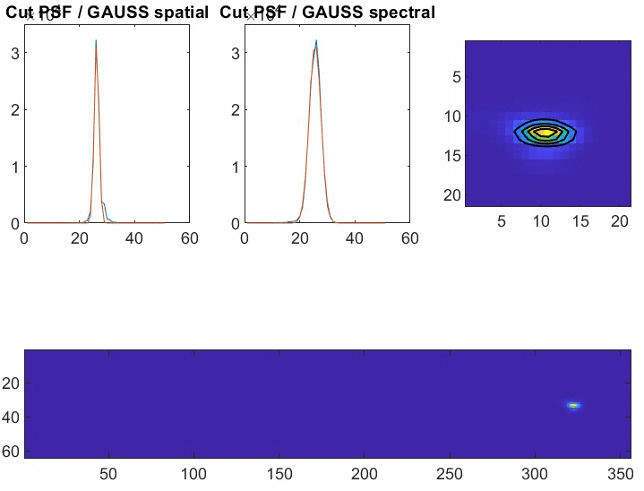

Integrated System-level testing – Requirement Verification on behalf of Jérôme Amiaux (CEA) and Jean-Michel Reess (LIRA)
In-flight
performance

Slide 21
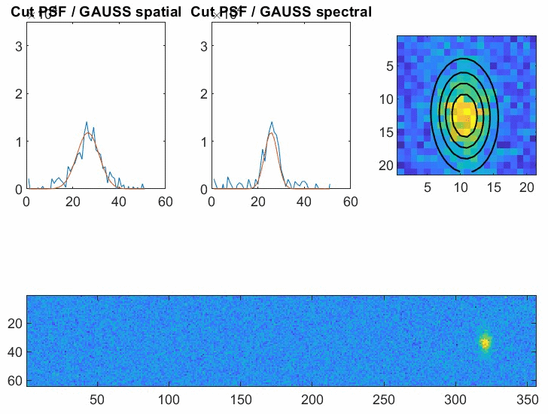
Integrated System-level testing – Requirement Verification on behalf of Jérôme Amiaux (CEA) and Jean-Michel Reess (LIRA)
Ground
performance

Slide 22
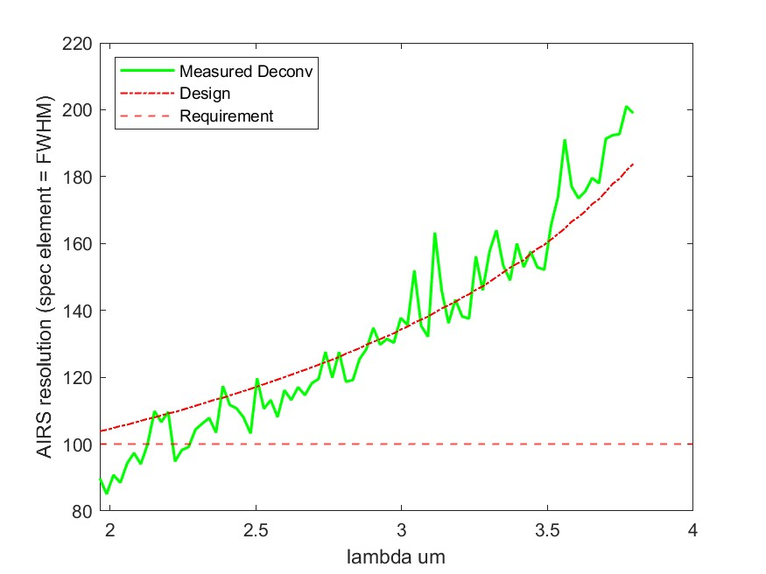
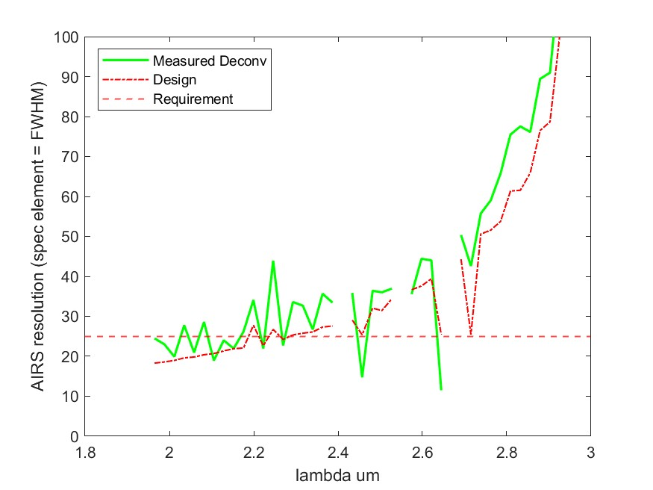
Integrated System-level testing – Requirement Verification on behalf of Jérôme Amiaux (CEA) and Jean-Michel Reess (LIRA)
Spectral resolution AIRS CH0
In-flight performance
Ground performance
➔ PASS/FAIL criteria reflect degraded performance expectations but
degeneracies in case of issues

Slide 23
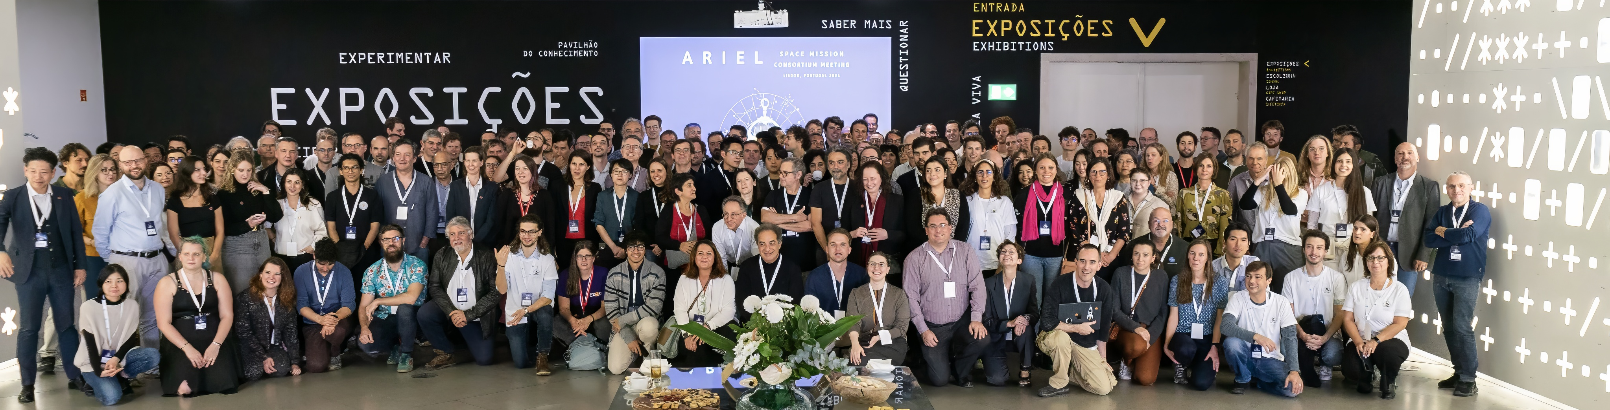
Conclusions
System-level testing will certainly be challenging (⬄ exciting!)
The results from the instrument-level testing will set baseline for calibration solutions / cal products from ground to flight.
Shimming (hardware) solutions being looked into to compensate for pencil-like PSF.
All teams hard at work to make the mission successful (so many people have not been credited, but everyone deserves praise).
ARIEL Consortium Meeting
Lisbon ‘24

