Slide 1
Leonardo UK developments
Matthew Hicks
Leonardo UK Ltd, First Avenue, Millbrook Ind. Estate, Southampton, SO15 0LG, UK
InfraRed detectors In Space (IRIS 2026) Workshop, INAF OAS Bologna 10-12 March 2026

Slide 2
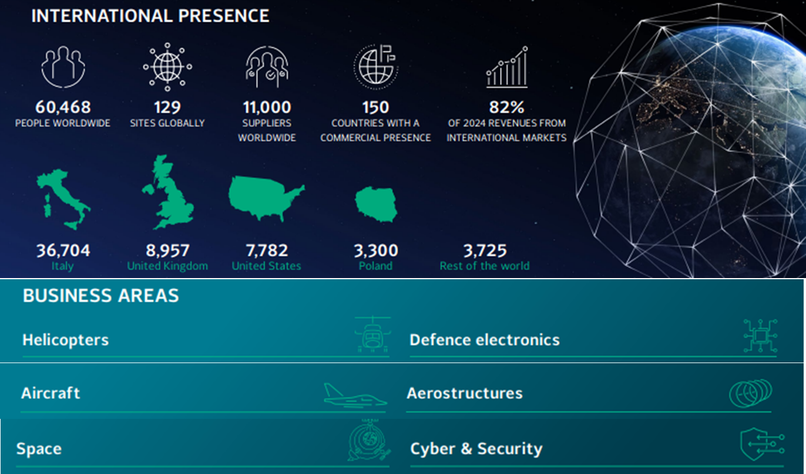
HgCdTe
Notes:
Silicon losses

Slide 3
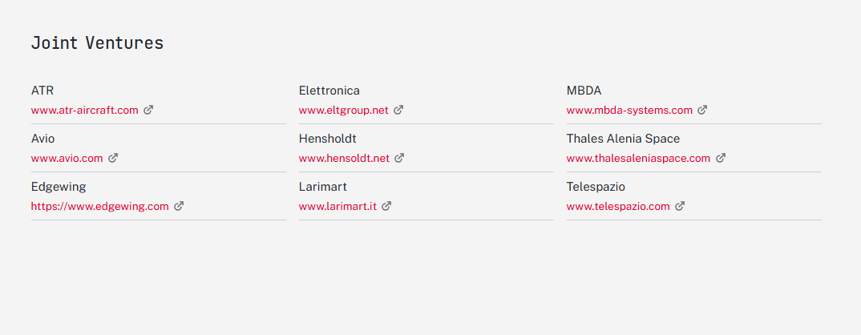
30%
65%
25%
HgCdTe
19%
25.1%
33%
33.3%
90%
67%
Notes:
Silicon losses

Slide 4

Notes:
Silicon losses

Slide 5
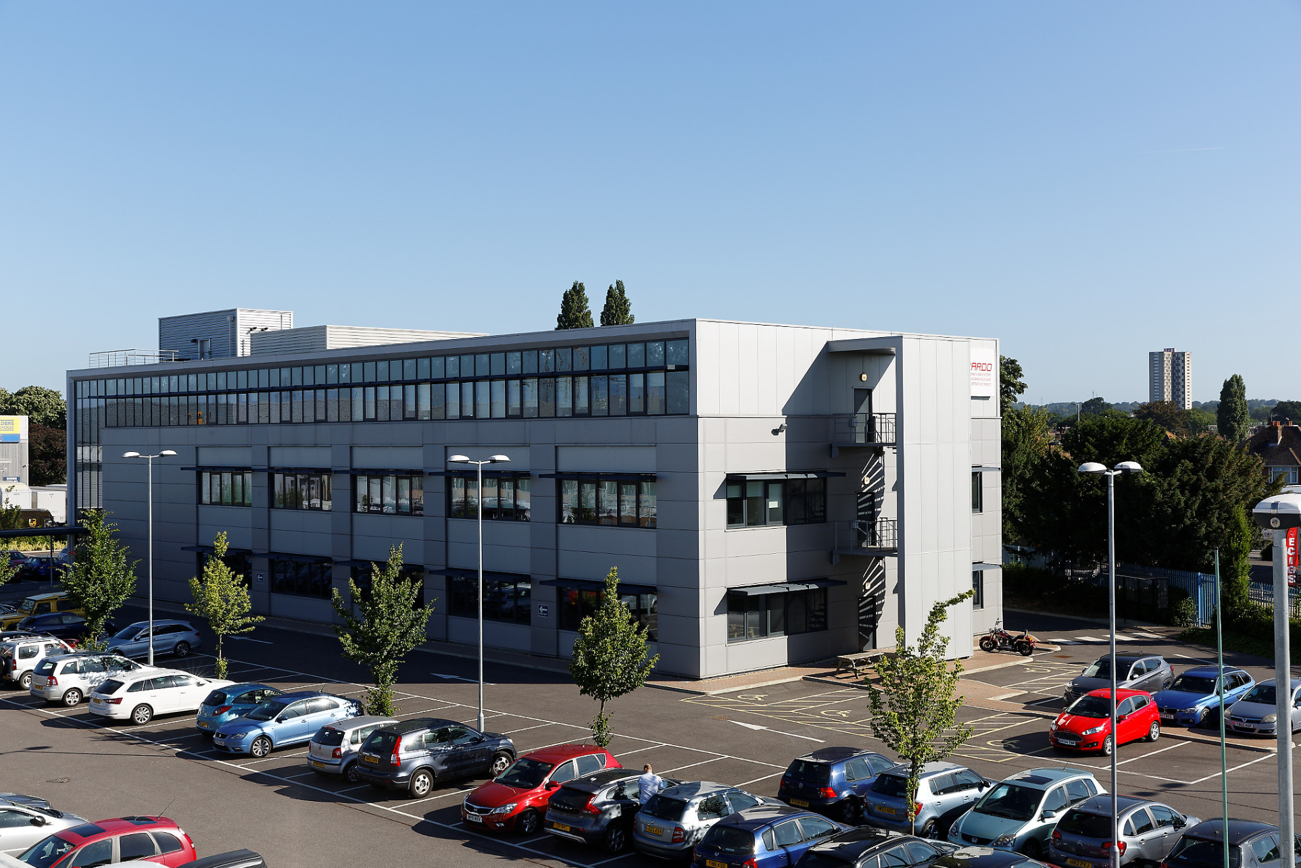
Infrared Detectors Southampton UK
World leader in design, development and manufacture of high-performance infrared detectors
75 year heritage in R&D and manufacture of IR Detectors
Fully integrated capability from material growth to volume manufacture
>230 employees including world leading scientists
3000m² clean rooms (including class 100)
Infrared sensitive material growth specialising in 2 detector technologies
Supplying a diverse range of markets and applications
High performance cooled Mercury Cadmium Telluride (MCT)
Focal Plane Array detectors
Thermal imaging
Missile guidance
Space and Astronomy
  Single element Deuterated L-AlanineTriglycine Sulphate (DLATGS)
  pyroelectric detectors
Infrared spectroscopy
Space and Astronomy

Slide 6
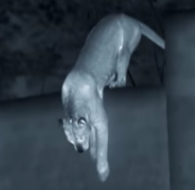
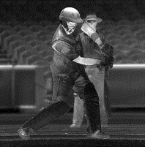
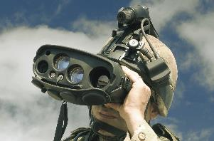
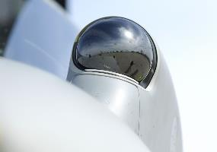
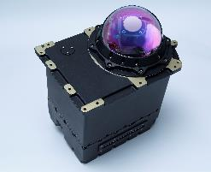
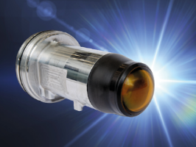
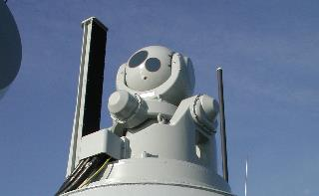
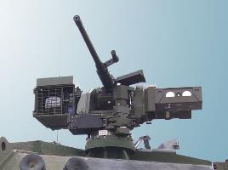
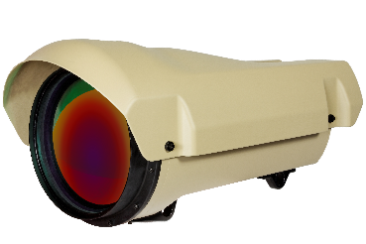
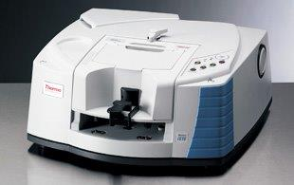
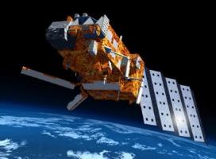
Leonardo UK - Detector Capability
Wide ranging applications
Thermal Imaging
Handheld imagers
Airborne tracking
DIRCM
Missile Seekers
Long Range Surveillance cameras
Infrared spectroscopy
Naval IRST
Vehicle Sighting
Space and Astronomy
Science business area
Notes:
Thermal Imaging
Handheld thermal imagers
UAV imagers
Surveillance
Airborne tracking systems
Naval IRST
Commanders/gunners/aiming sights
Remote operated weapon stations
Fire control stations
Missile Guidance
Infrared spectroscopy
Space flight programmes
Astronomy

Slide 7
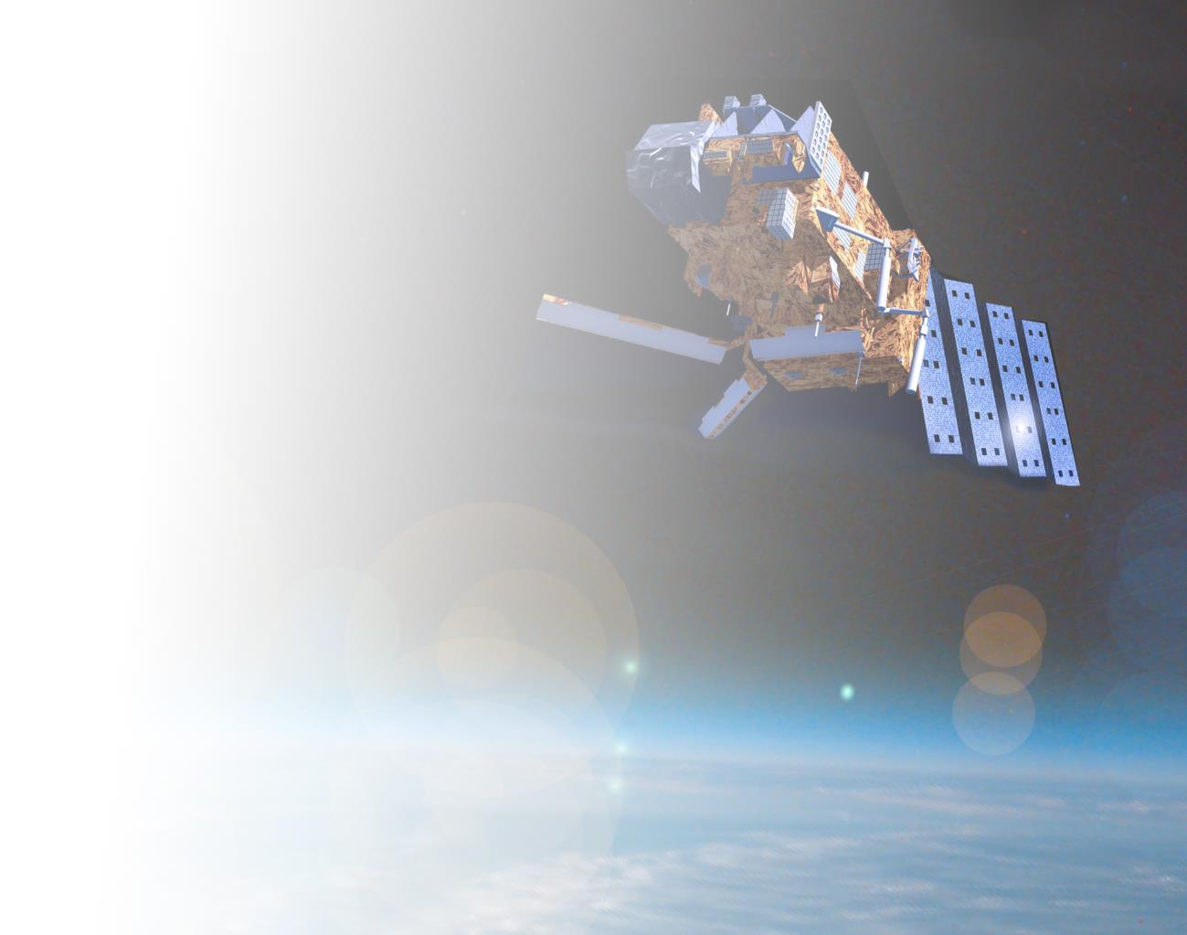
Flight Heritage (by launch date)
Selective chopper radiometer
Nimbus 5 for NASA in collaboration with University of Oxford
Horizon sensor – X4 Miranda Earth Satellite UK/USA
IR spin scan radiometer
Synchronous meteorological satellite for Hughes Corporation
Meteosat 1st generation
ATSR (Along track scanning radiometer) – UARS for RAL
PMIRR (Pressure modulated infra red radiometer)
Mars Mariner for University of Oxford
STRV2 – 2 colour PV array for DERA/BMDO
BIRD (bispectral integrated detector cooler assembly) for DLR
MIPAS (Michelson interferometer for passive atmospheric sounding)
Envisat for ESA
2003 Raytheon Mini TES on NASA’s Mars Spirit and Opportunity Rovers
SEVIRI (Spinning Enhanced Visible and InfraRed Imager)
Meteosat 2nd generation (MSG)
OSIRIS-REx thermal emission spectrometer (OTES)
NASA asteroid sample return mission
GOSAT 2 - Greenhouse Gas Observing Satellite-2 FTIR – JAXA mission
UAE Planetary Science Mission – Study of climate and atmosphere
    NASA LUCY mission to Jupiter’s Trojan asteroids
    2023 SSTL Darkcarb High resolution mid-wave infra-red (MWIR) imager (SatVu)
  2024 PACE Earth science Ocean Colour Instrument for NASA
  2025 IASI NG Meteorological and atmospheric science mission for CNES
  2027 ESA FORUM Far-infrared Outgoing Radiation Understanding and Monitoring FTIR
  2028 Himawari 10 Sounder
Notes:
Silicon losses

Slide 8
Future Missions pull
Earth Observation
Sounders / Radiometers
  High Frame Rate Sounders > 4KHz frame rates
  VLW Detectors to replace Gen 1 MCT >15μm
  Dark Current - Rule 7 adherence
  Radiation Hard ROICs
  Long Mission Life (Coolers)
  Challenging S/N ratios in the MWIR
Imaging
  Larger Formats
  Lower SWaP & Cost (Dual use detectors)
LiDar / OComms
  Fast Response MCT 1550nm
  Fast Response MCT 1064nm
Astronomy
Ground Based Larger format 2D SWIR - 15μm pitch
Space Based Larger format 2D SWIR - 10μm pitch
3 side Buttability
Photon counting APD
“Zero dark current”
Low Glow
Notes:
Silicon losses

Slide 9

Future Missions – Earth Observation
Sounders
  High Frame Rate Sounders > 4kHz frame rates
    ME1210 developed in 2025 under ESA contract
    4.5Khz Frame rate
    32/16 Outputs
    NIRCA (Ideas) Compatible
    Programable CHC with Max > 600 Me-
    256x256 (72μm Macro Pixel) 1024x1024 18μm sub Pixel
    Pixel deselection & Binning control through SPI
  Radiation Hard ROIC’s
    ME1210 designed with a Radiation hard cell Library
    ME951 IASI NG TRL9 (Full Radiation Campaign + Flight)
    ME1230 IBEX 4M 2kx2k Radiation Campaign planned in 2026
  Long Mission Life (Coolers)
    Work Paused on Pulse tube IDCA following CAIRT deselect
Notes:
Silicon losses

Slide 10

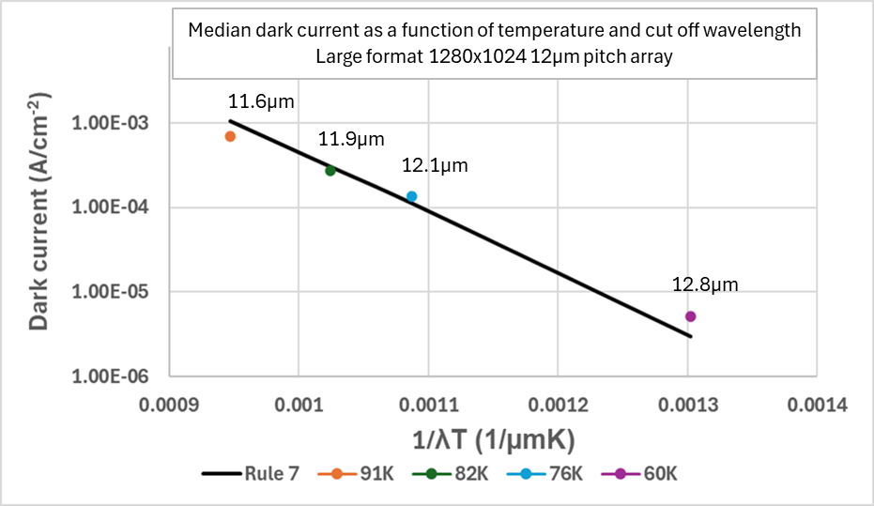
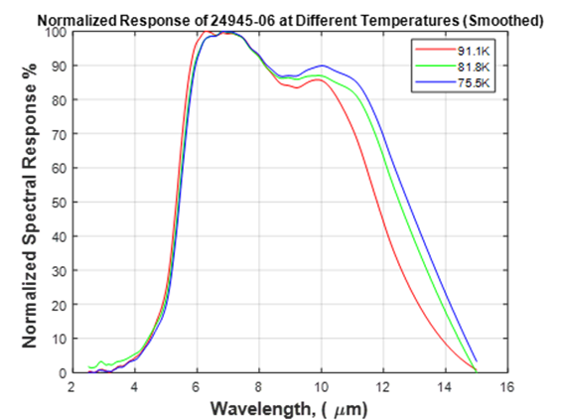
Future Missions – Earth Observation
Sounders
  VLW Detectors to replace Gen 1 MCT >15μm
  Dark Current - Rule 7 adherence
Temperature (K) | Cut-on Wavelength (µm) | Cut-off Wavelength (µm)
91.1 | 5.33 | 11.79
81.8 | 5.40 | 12.51
75.5 | 5.43 | 12.79
Leonardo Long wave infrared detectors status, Mittal V et al IRSA, Toulouse 2025
Notes:
Silicon losses

Slide 11

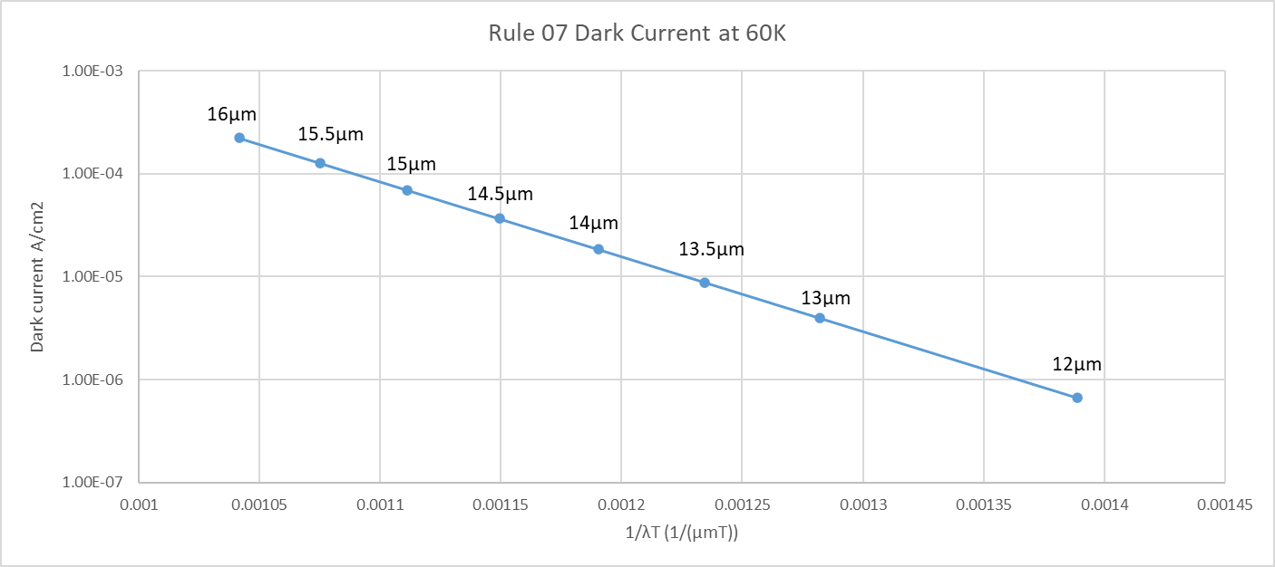
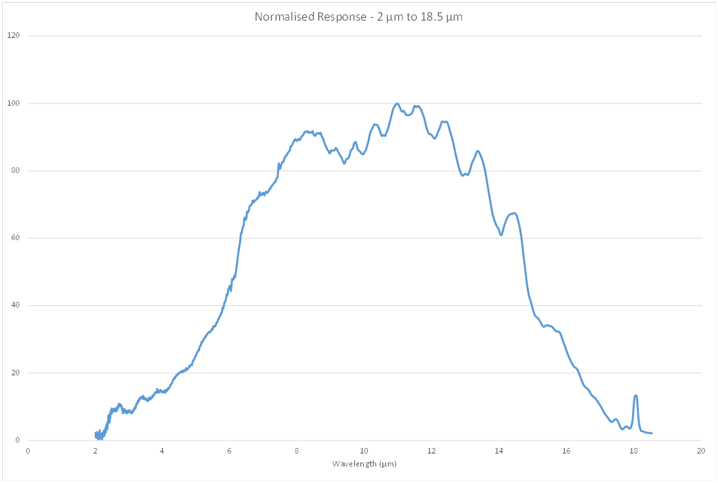
Future Missions – Earth Observation
Sounders
  VLW Detectors to replace Gen 1 MCT >15μm
  Dark Current - Rule 7 adherence
Normalised response at 80K
Leonardo internal development 2025
80K Spectral measurement of material targeting > 16um at 60K
Notes:
Silicon losses

Slide 12
Future Missions – Earth Observation
Sounders
  Challenging S/N ratios in the MWIR
  2025 internal program expanding on SW-APD technology to push toward Mid-Wave InfraRed (MWIR) band (3 – 5 μm)
Example Applications of MW-APDs:
Improved performance in low flux terrestrial environments (e.g. aircraft against a cold sky)
Use of MW imagers in space and astronomy – APD gain enhances MWIR imaging for low flux conditions
Improved SNR in photon-rich environments (standard MW imaging) – a modest APD gain can be used to improve SNR without saturating an array
Result
Unprecedented gains in linear mode MW-APDs
Gain of 100 shown at highest bias of 17.7 V
Moderate gain of 10 achieved at ~11V
Gain independent of stare time (expected)
Leonardo UK development of linear mode Mid-Infrared wavelength APD array technology for high speed, high gain 2D imaging applications Charlie Turner et al SPIE PW 2026
Notes:
Silicon losses

Slide 13

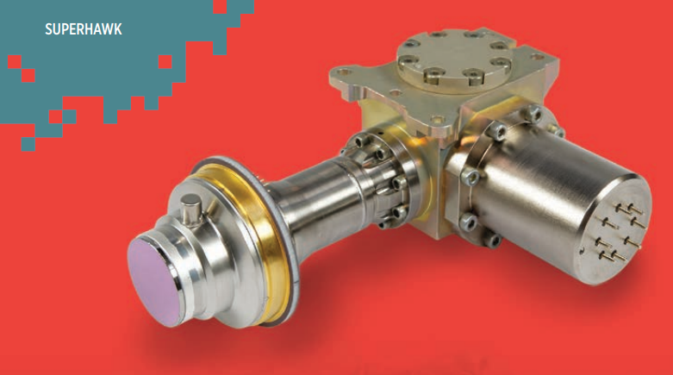
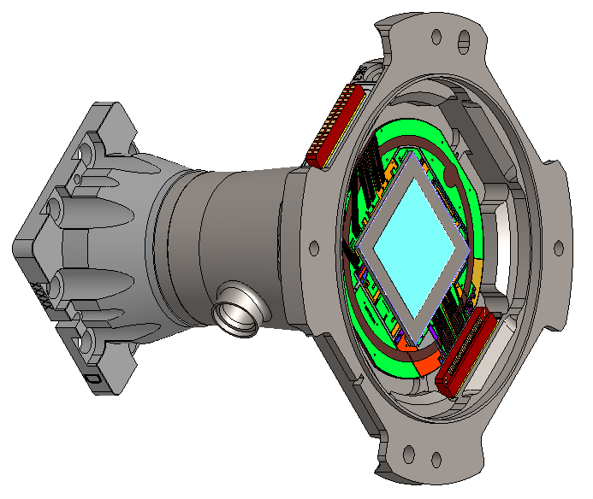
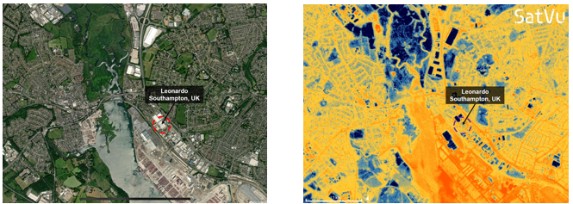
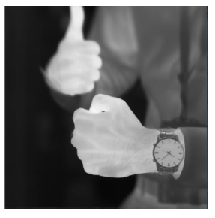
Future Missions – Earth Observation
Imaging
  Larger Formats
  Lower SWaP & Cost (Dual use detectors)
SuperHawk MWIR
8μm 1280x1024
8 output
120Hz Frame Rate
SuperHawk 2K MWIR
8μm 2048x2048
16 output
60Hz Frame Rate
Images courtesy SatVu 2024
Available Q1 2027
Notes:
Silicon losses

Slide 14
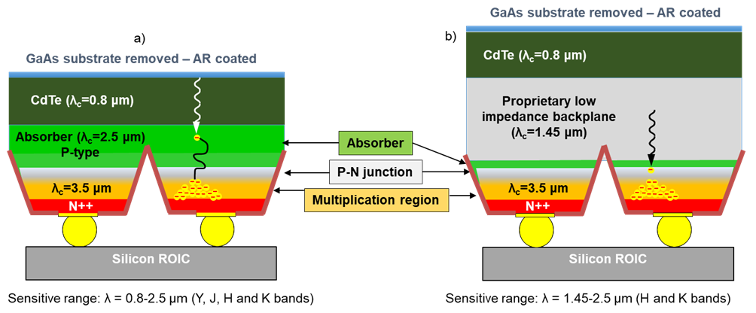
Future Missions – Earth Observation
LiDar / OComms
  Fast Response MCT 1550nm
Aerospace Corp characterized the material on a lead out, they where able to measure pulses at >10GHz reliably
Leonardo UK high performance shortwave APDs for astronomy, Ian Baker, Matthew Hicks et al, Proc Vol Infrared sensors, devices and applications XIII, 1268702 (2023). https://doi.org/10.1117/12.2679478
Notes:
Silicon losses

Slide 15

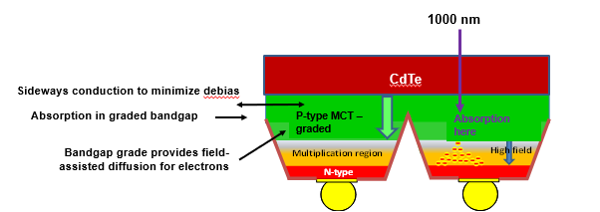
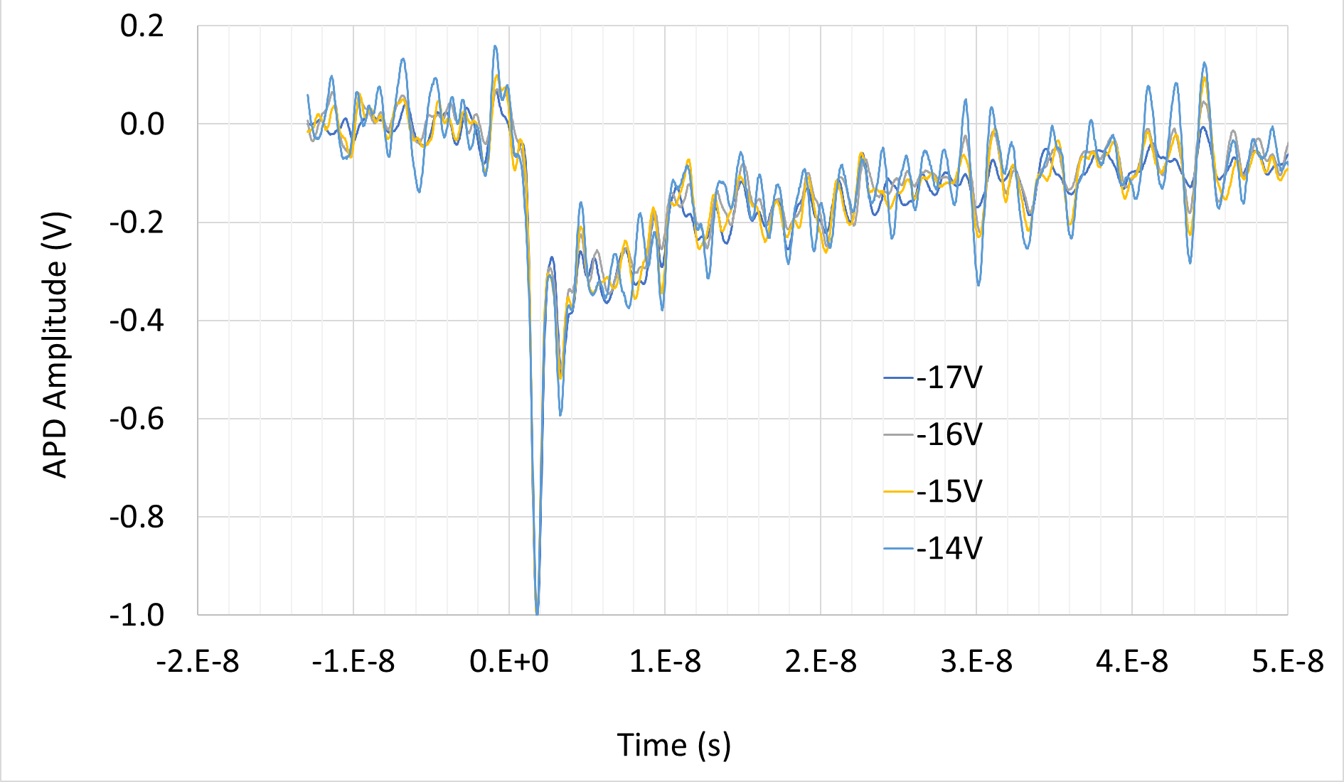
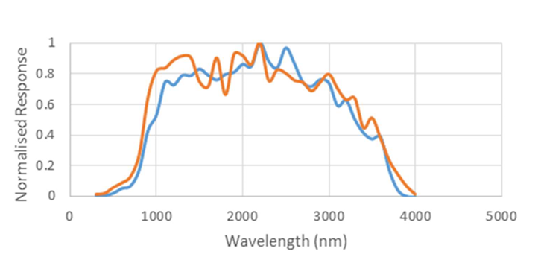
Future Missions – Earth Observation
LiDar / OComms
  Fast Response MCT 1000nm
Pulse response with 1.06μm
Spectral response demonstrated below 1μm
Characterization of High Speed SAPHIRA HgCdTe Avalanche Photodiodes for Space Lidar Applications Guangning Yang, Xiaoli Sun, Wei Lu, Ian Baker, Matthew Hicks, Chris Maxey, and Sachidananda R. Babu II-VI Workshop 2025
Notes:
Silicon losses

Slide 16


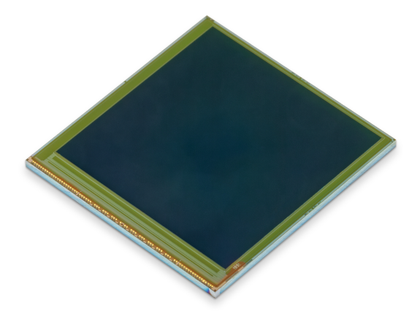
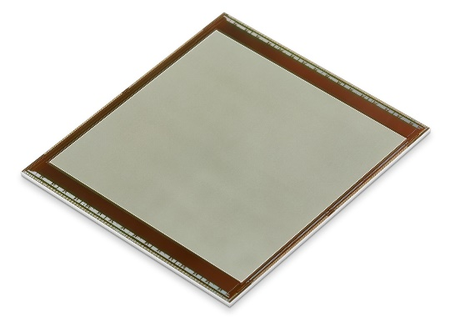
Future Missions - Astronomy
Ground Based Larger formats 2D SWIR - 15um pitch
3 side Buttability
Ike Pono
1K x 1K 15µm
ME1071
16 Channel
30Hz full frame rate
Rad Hard
3 Side Buttable
NASA Funded
IBEX4M
2K x 2K 15µm
ME1230
16 Channel
1Hz full frame rate
Rad Hard
2 Side Buttable
ESA Funded
Ike Pono
2K x 2K 15µm
32 Channel
60Hz full frame rate
Rad Hard
3 Side Buttable
NASA Funded
Ike Pono 4kx4k 15µm
64 Channel 60Hz full frame rate
Rad Hard
3 Side Buttable
Planned ‘28
Available Now
Available Q2 ‘27
Available Q4 ‘26
Notes:
Silicon losses

Slide 17
Future Missions - Astronomy
Space Based Larger format 2D SWIR - 10μm pitch
3 side Buttability
Ike Pono 4kx4k 10µm
64 Channel 60Hz full frame rate
Rad Hard
3 Side Buttable
Planned ‘28
Notes:
Silicon losses

Slide 18
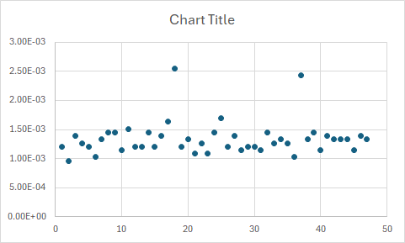
Future Missions - Astronomy
Photon counting APD
Leonardo demonstration of single photon detection, 2025.
Uses APD gain to move single photon above ROIC read noise
“Zero dark current”
  Measured by University of Hawaii~3 e⁻/pixel/kilo second at 65K and 60K (test kit limited)
Low Glow
  ROIC glow characterised on ME1071 @ 0.08 e⁻/pixel/frame
  Future ROICs have further enhancement to reduce glow:-
    Additional ROIC shielding
    Enhanced Anti-Blooming
1.2mV
1.25mV
Notes:
Silicon losses

Slide 19
Matthew Hicks
Vinita Mittal
Capability Manager Science, Space and Astronomy
Systems Engineer
+44 7876 454283
+44 7860 393306
matthew.hicks@leonardo.com
vinita.mittal@leonardo.com

