Slide 1



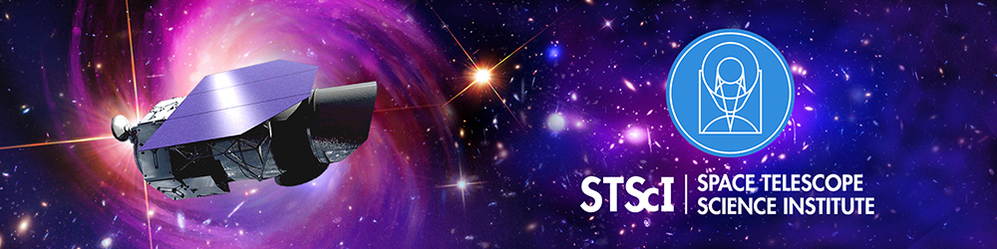
The Roman Space Telescope
A Mission for the Community by the Community
Timothy D. Brandt
Associate Astronomer, Space Telescope Science Institute
on behalf of the Science Operations Center and the Mission
+++ The Community:
Partner Infrastructure Teams
Roman Wide Field Science Teams
Roman Science Collaboration

Slide 2
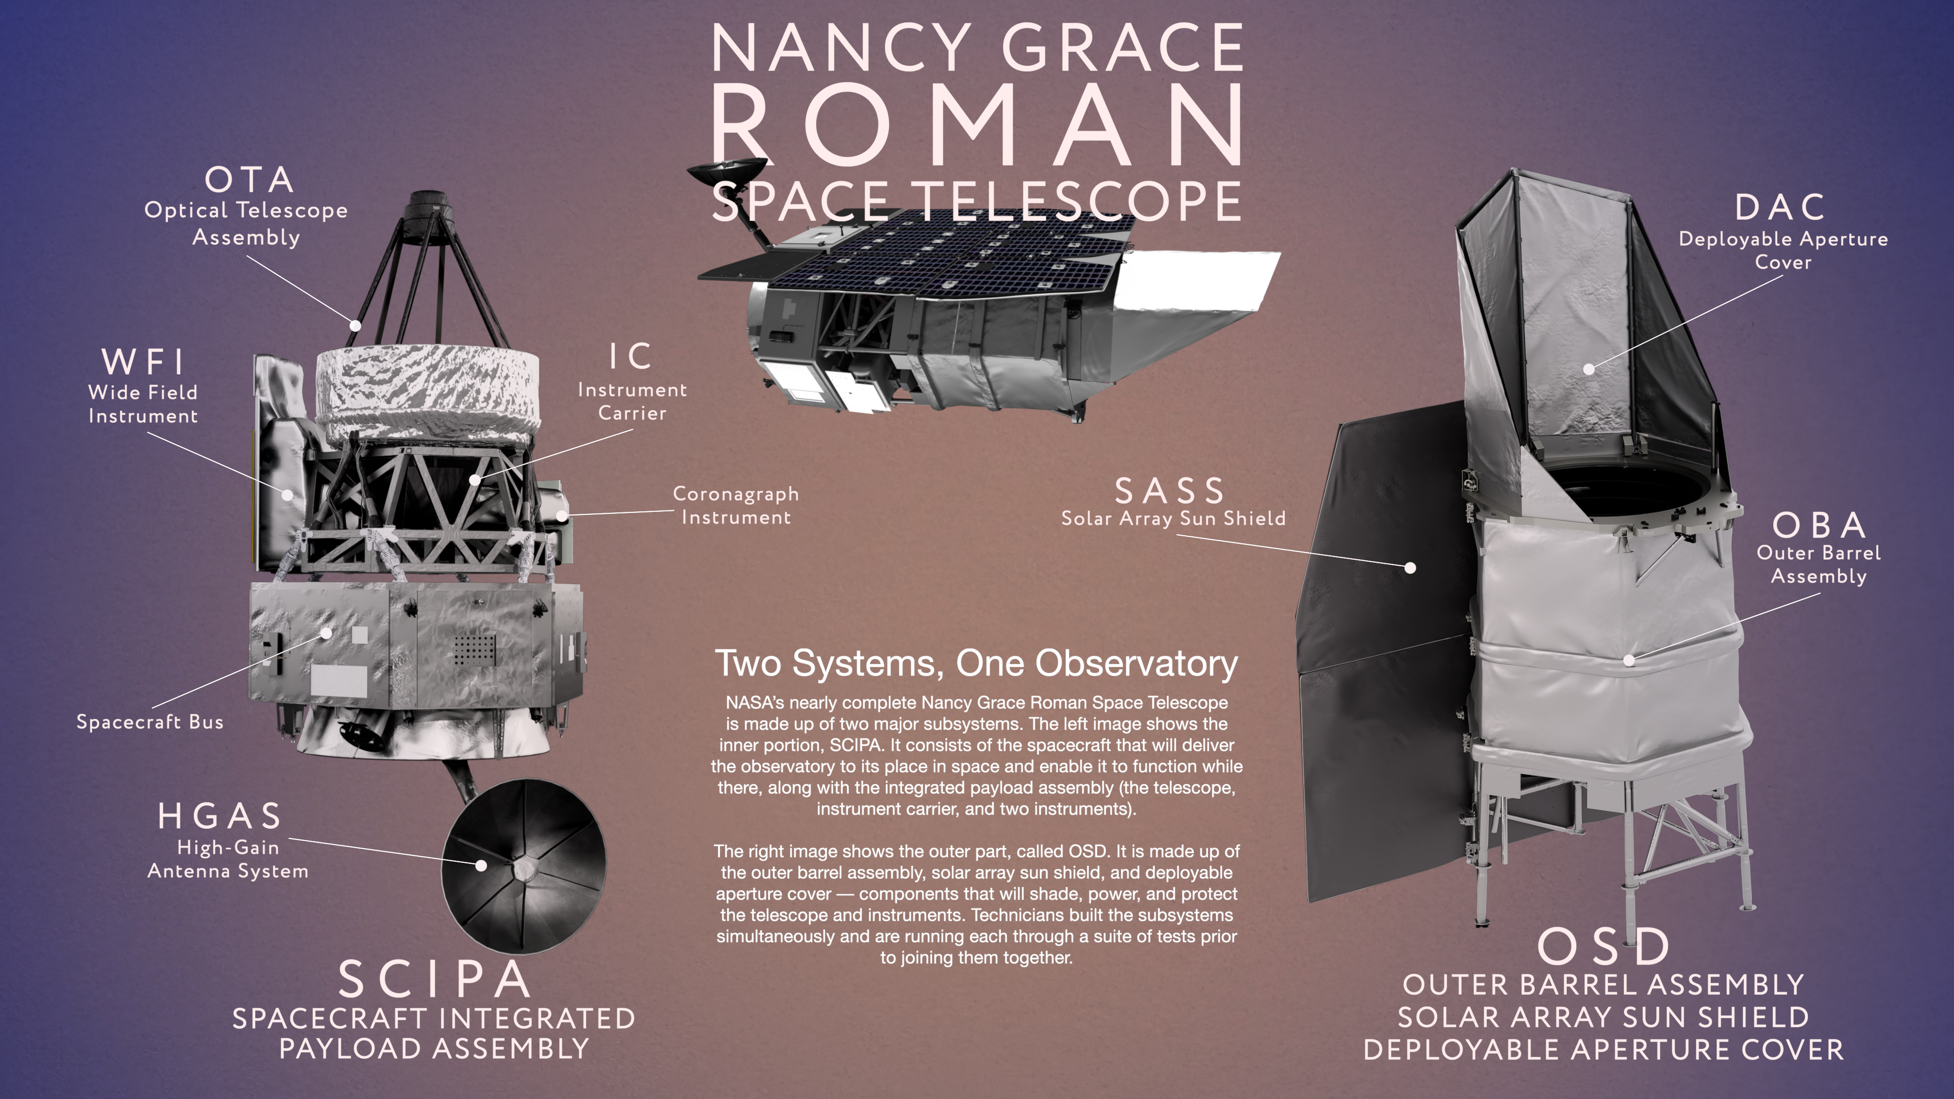

Slide 4
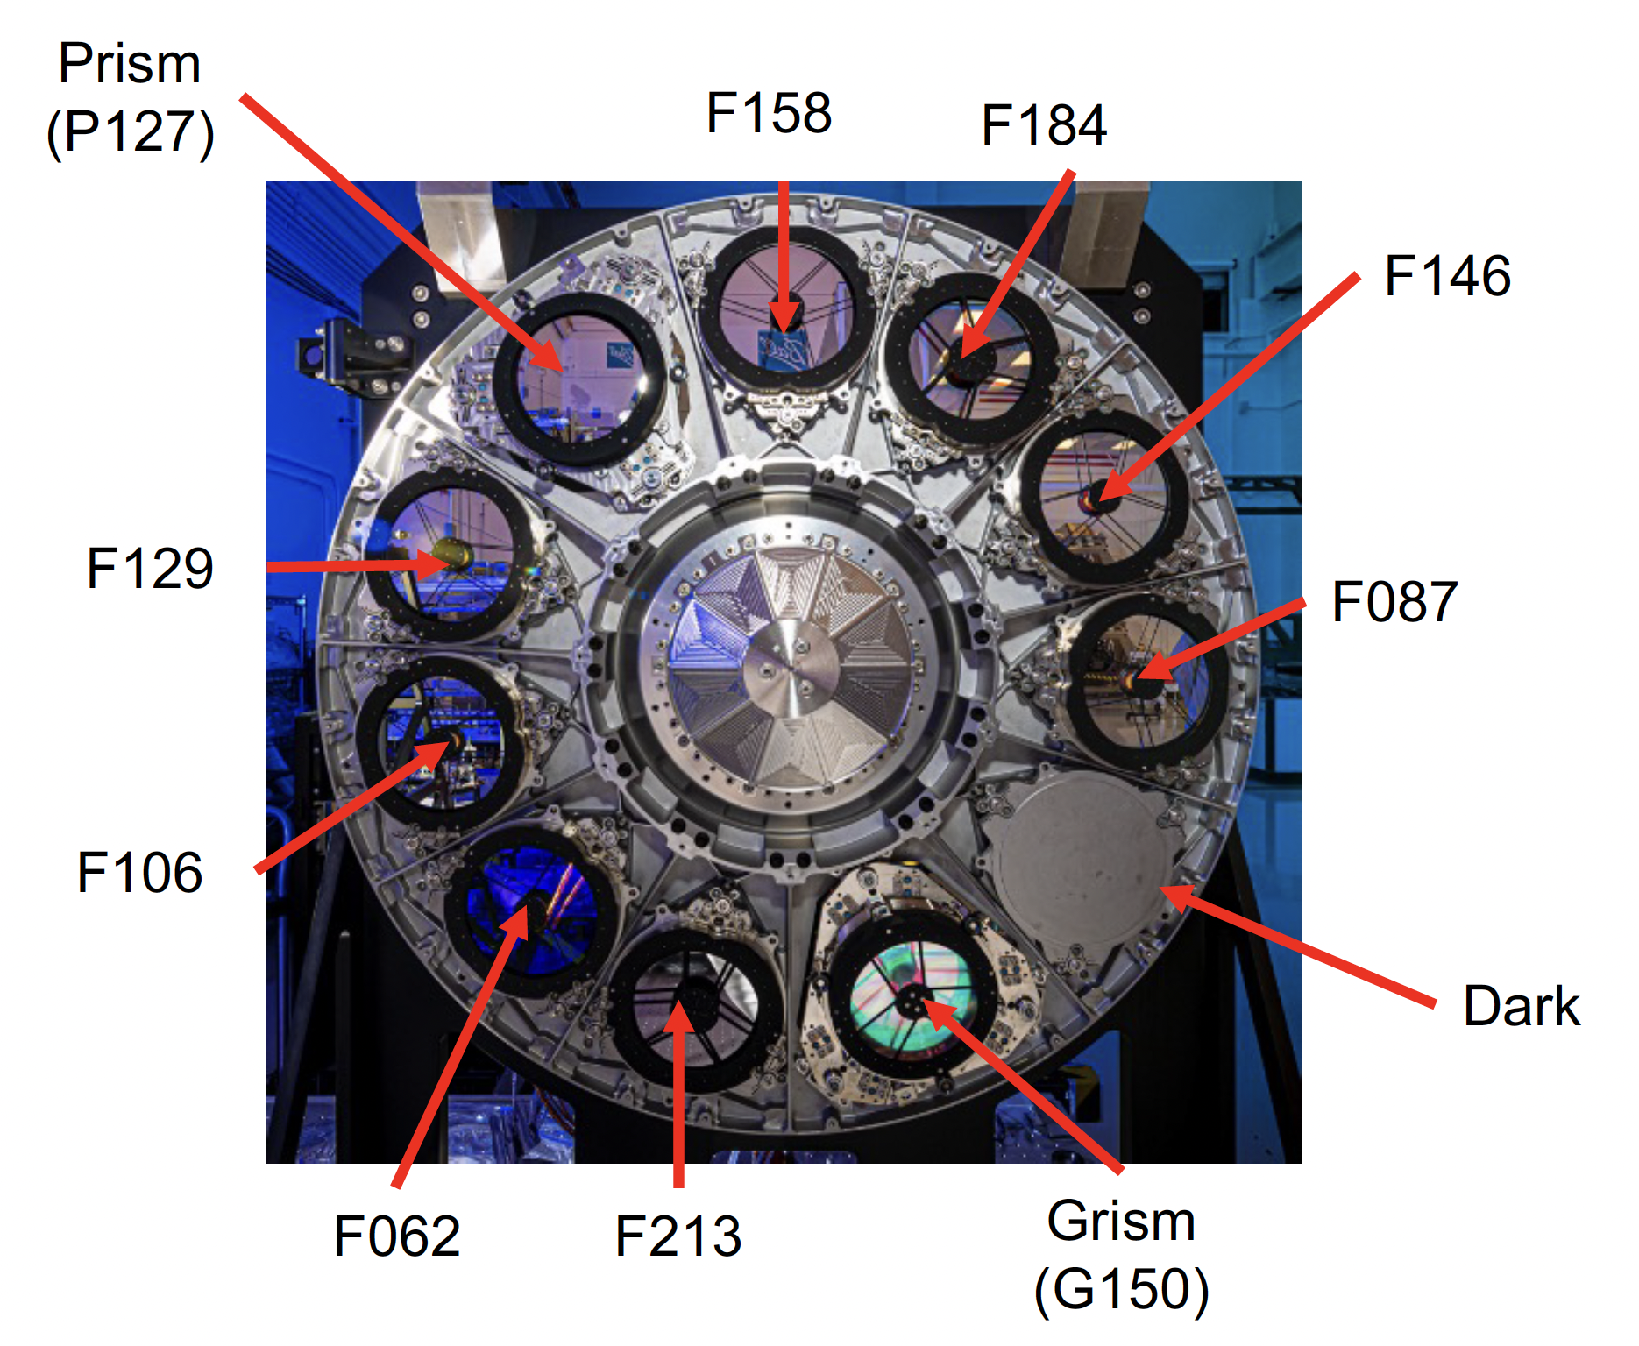
Filter Wheel
Schlieder et al. 2024

Slide 5
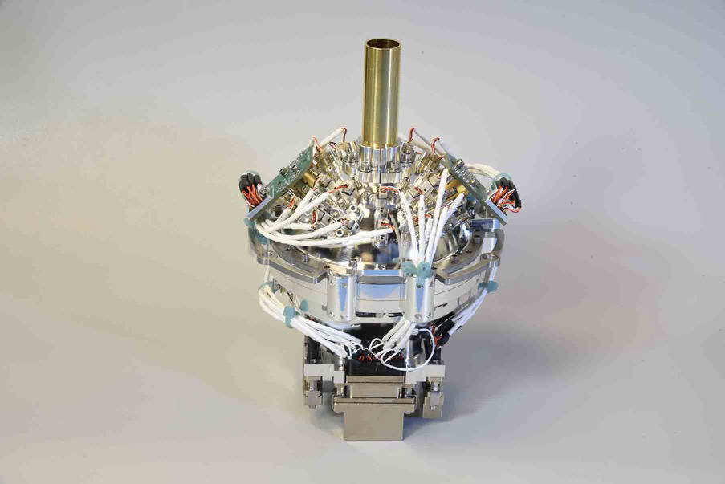
Calibration System
Schlieder et al. 2024

Slide 6
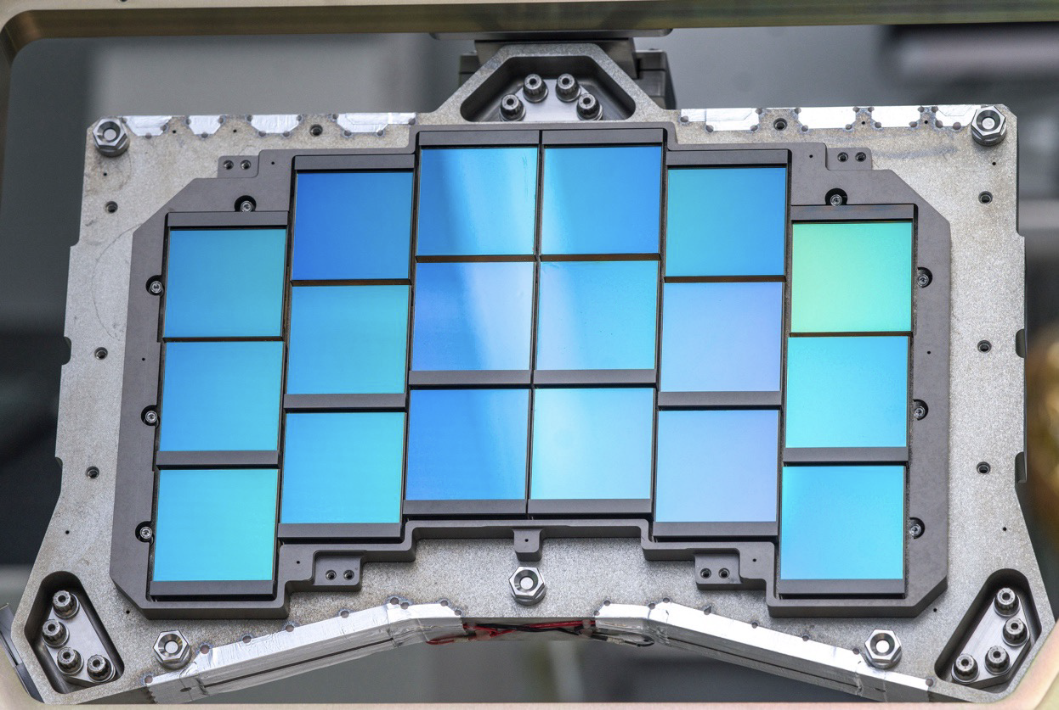
Focal Plane Array
Schlieder et al. 2024

Slide 7
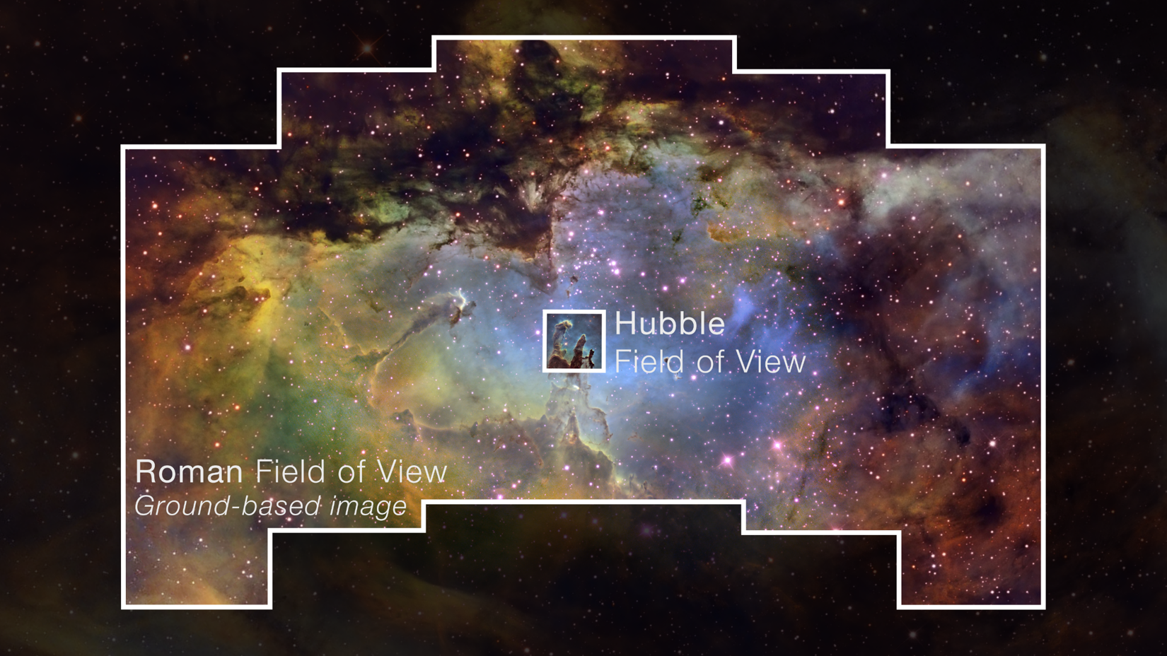

Wide Field
Instrument

Slide 8



Slide 9



Slide 10



Slide 11
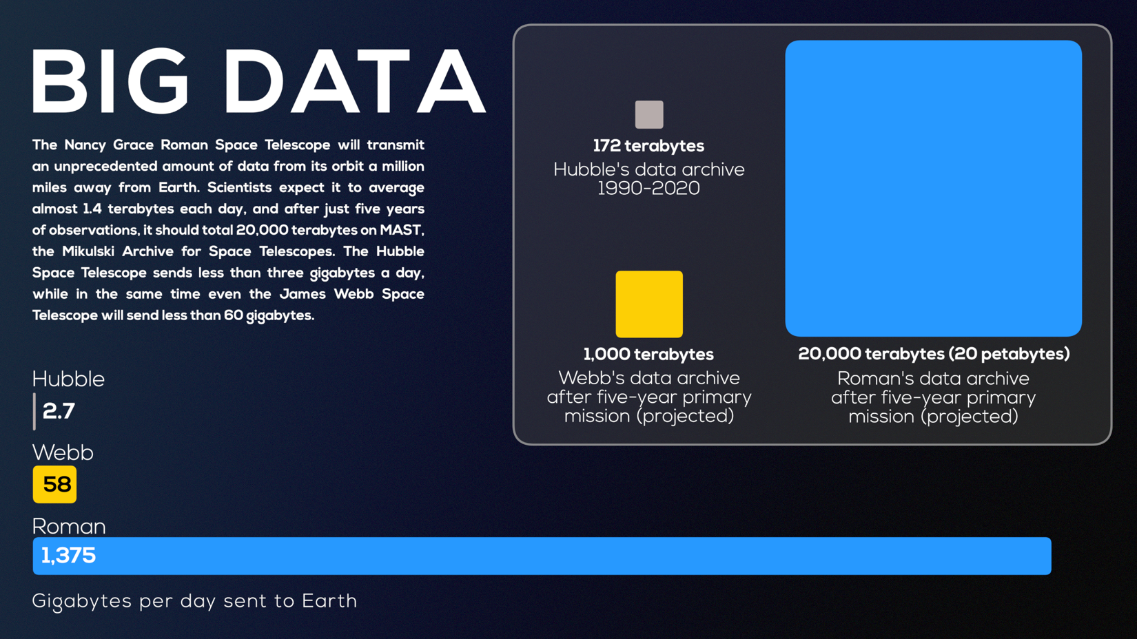

Slide 12
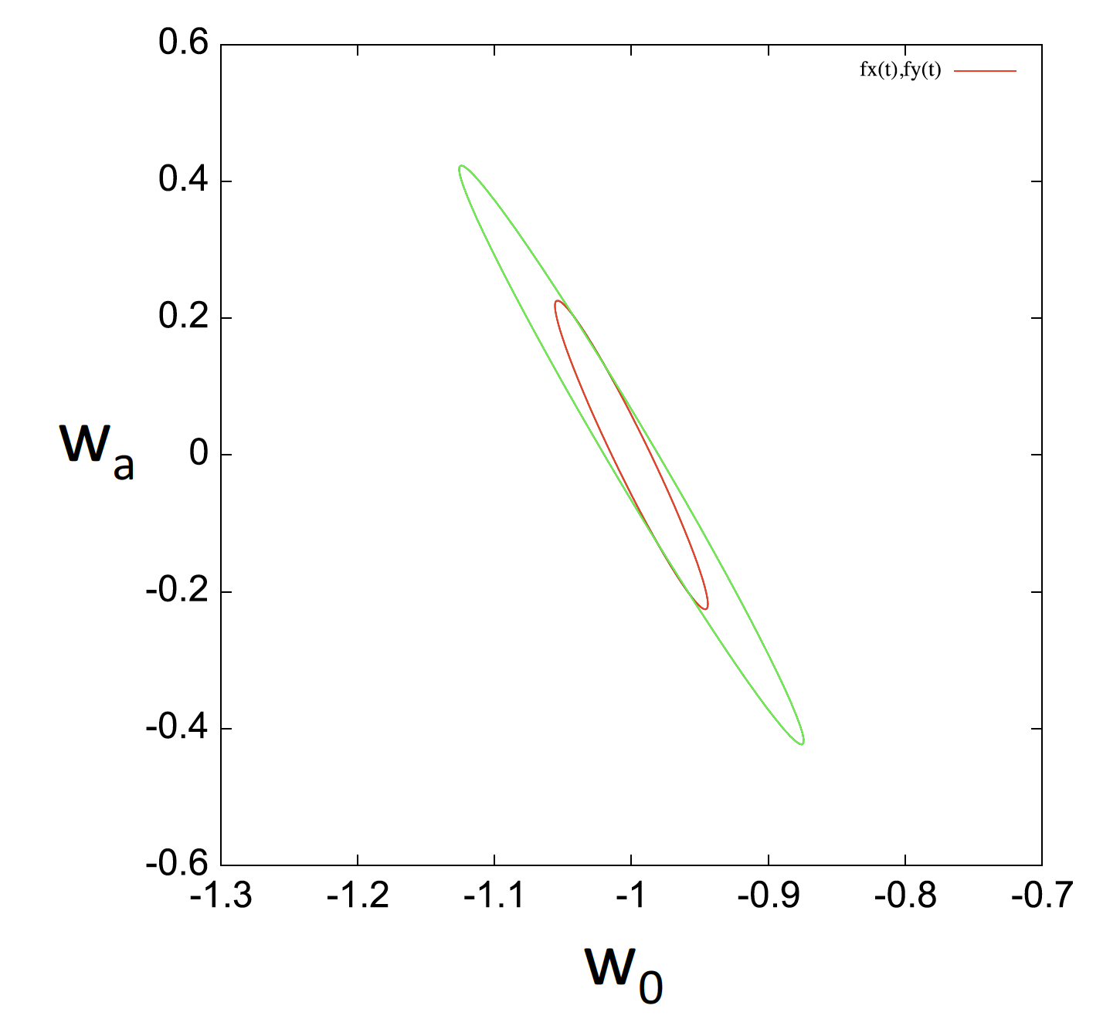
Big, Well-Defined Goals
Roman will measure:
Distribution of mass in the Universe
Universe’s expansion and expansion history
Demographics of planets down to ~Mars mass
Object: make the error bars as small as possible
Spergel et al. (2015)

Slide 13
A Fundamental Change for NASA Flagship Missions
HST: four current instruments (ACS, COS, WFC3, STIS)
JWST: four instruments (MIRI, NIRISS, NIRCam, NIRSPEC)
NGRST: one core instrument (WFI), one tech demo (CGI)
Large pre-planned surveys replace disparate observing programs
Roman-WFI: only one core moving part (a filter wheel), 300 Mpixels.
Science requires, instrumental simplicity enables extreme precision.
Heavy lifting falls to detector characterization.

Slide 14
18 H4RG-10 detectors, 301,989,888 pixels. Too much data.
Some reads will be averaged on-board into resultants.

Slide 15
Detector gremlins and personalities
Correlated noise
Jumps and cosmic rays
Nonlinearity (classic and count-rate dependent)
Electronic gain
Pixel sensitivity/pixel area
Transient signals after reset
Interpixel capacitance
Persistence
Burn-in
Brighter-fatter effect
Thin film ice
All due to work by:
Eric Switzer
Stephanie Cheung
Thushara Perera
Bernie Rauscher
Greg Mosby
Tathagatha Pal
Analia Cillis
Jeff Kruk
Stefano Casertano
Dan Kelly
Sarah Betti
Javier Sanchez
… and many more

Slide 16
Persistence follows a nice 1/t power law

Slide 17
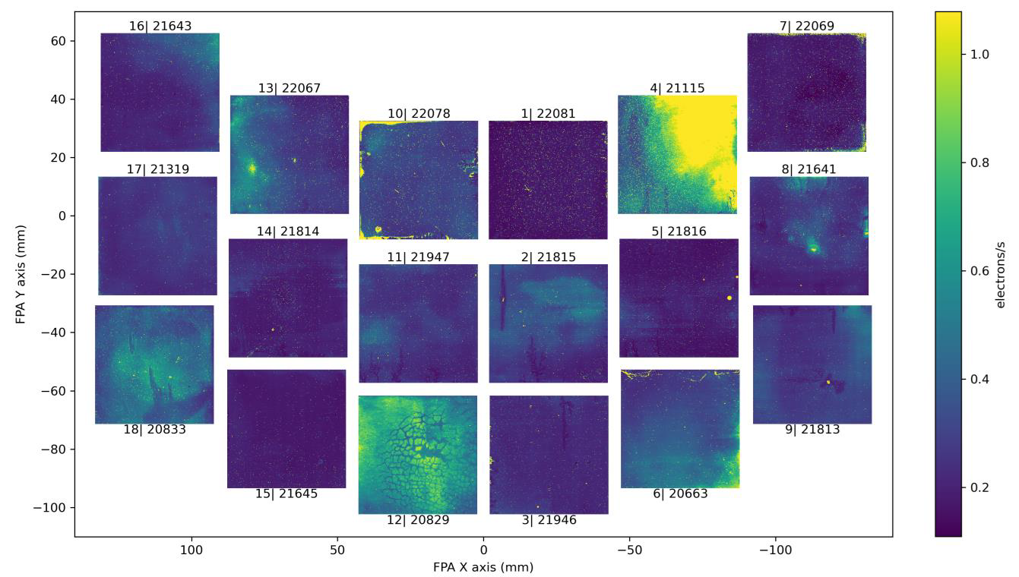
Average persistence from 1-11 minutes after illuminating to 155 ke-
FPA Handbook, Cheung et al.

Slide 18
Example: integral nonlinearity (from the analog-to-digital converter)
Lab tests on Roman detector
electronics: known (sinsoidal)
voltage in, measure signal out.
Difference between data and
model (apart from clipping at 0,
65535) is integral nonlinearity

Slide 19
Example: integral nonlinearity (from the analog-to-digital converter)
Lab tests on Roman detector
electronics: known (sinsoidal)
voltage in, measure signal out.
Difference between data and
model (apart from clipping at 0,
65535) is integral nonlinearity

Slide 20
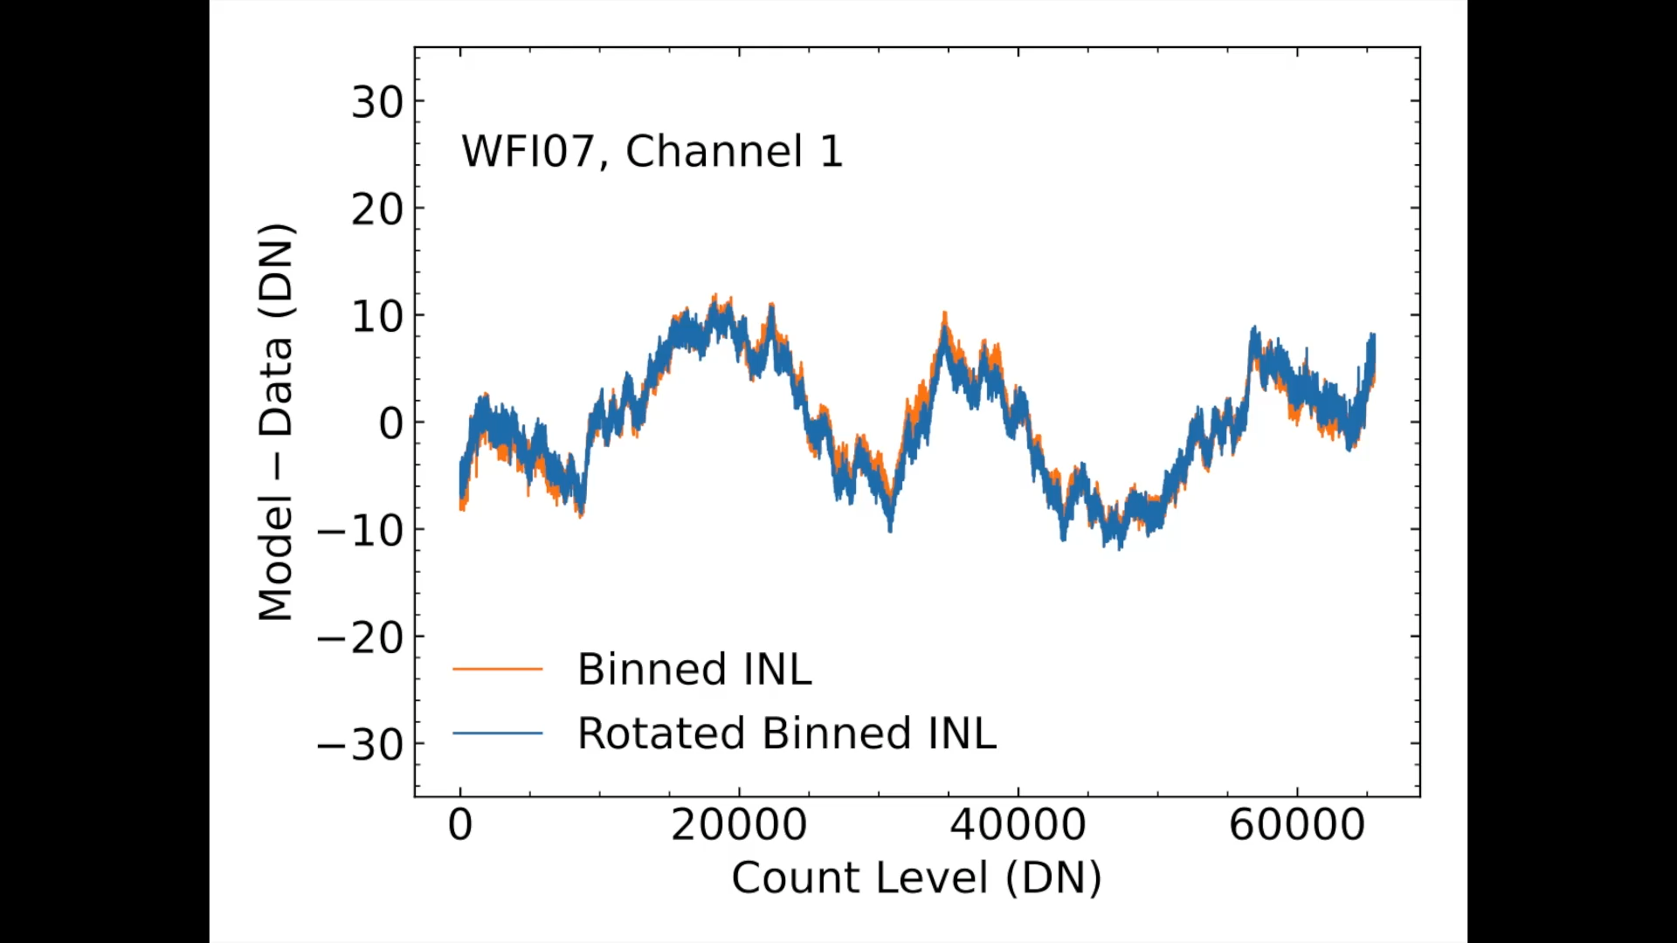

Integral nonlinearity (INL) is:
Highly structured
Symmetric about 32768 (= 2¹⁵)
Unique to each readout channel
(c.f. Loose et al. 2018)

Slide 21
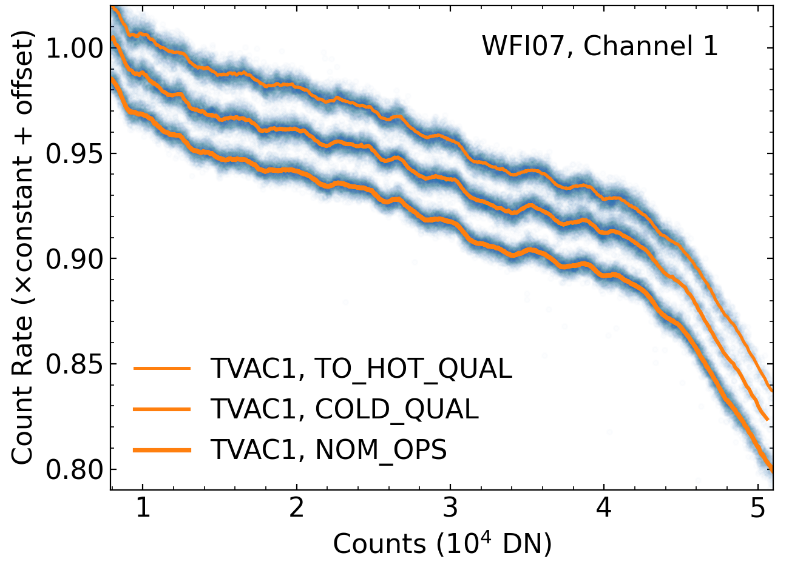
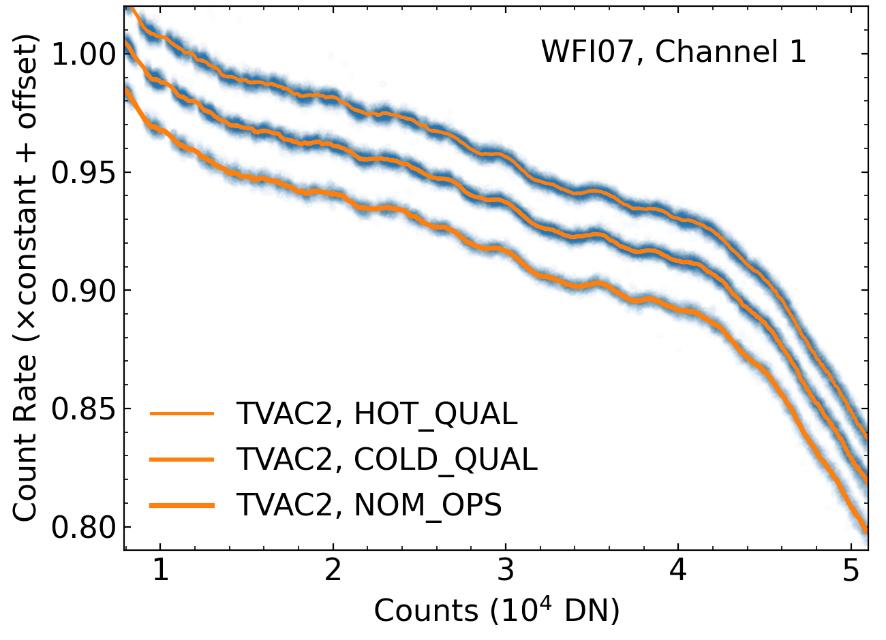
Raw Read-to-Read Count Differences in Flatfield Images

Slide 22
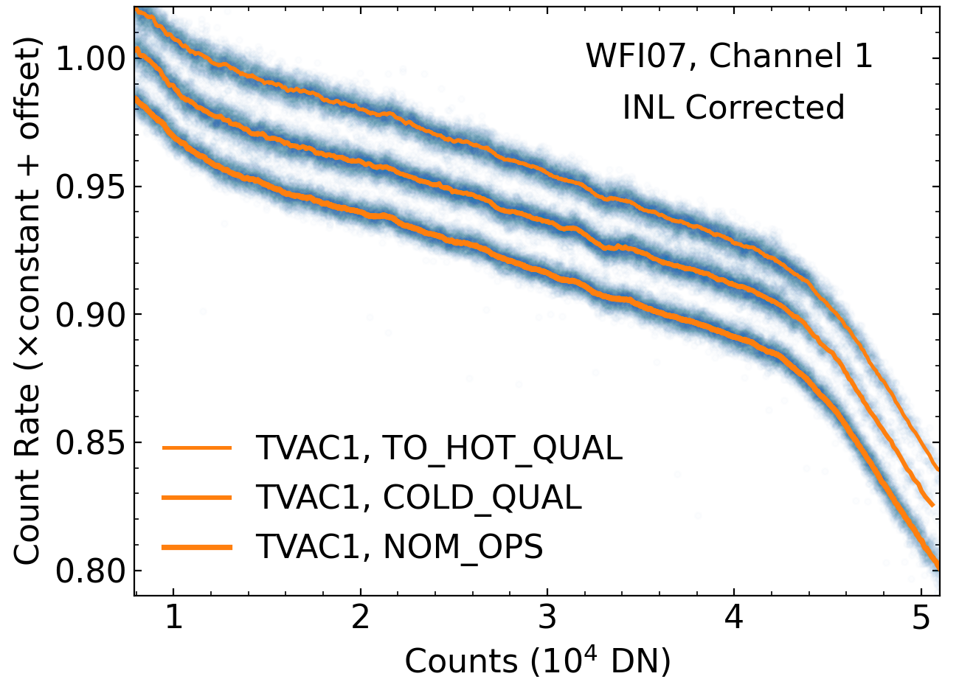
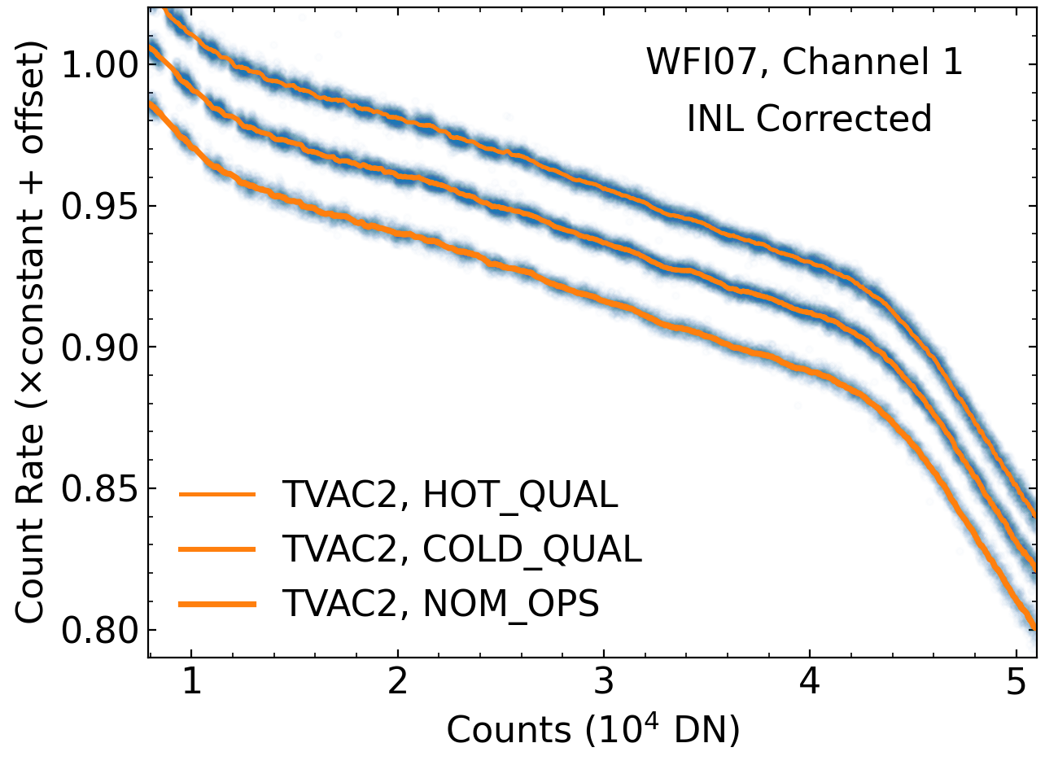
INL-Corrected Read-to-Read Count Differences in Flatfield Images

Slide 23
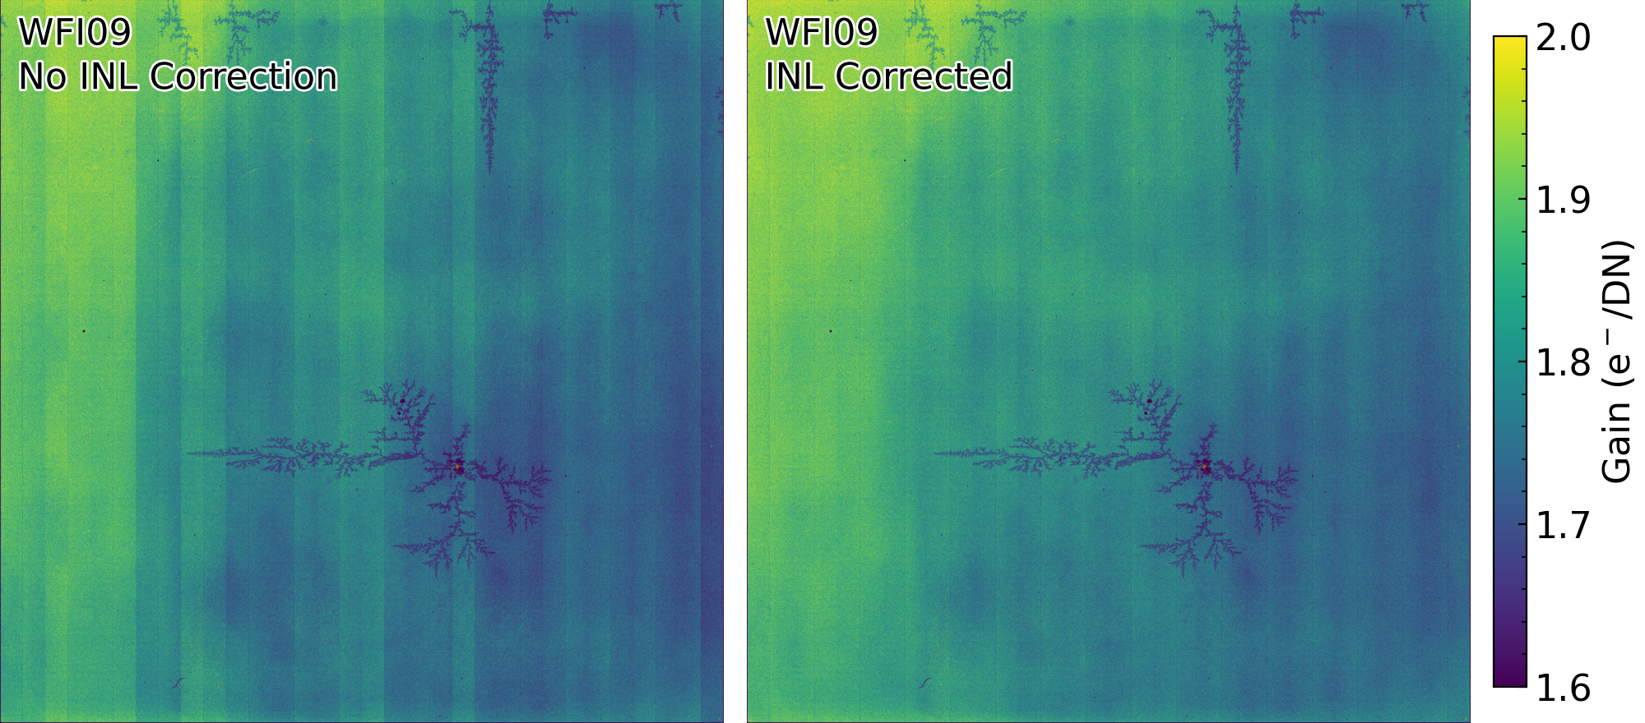
Significant Impacts on Gain and Classic Nonlinearity

Slide 24
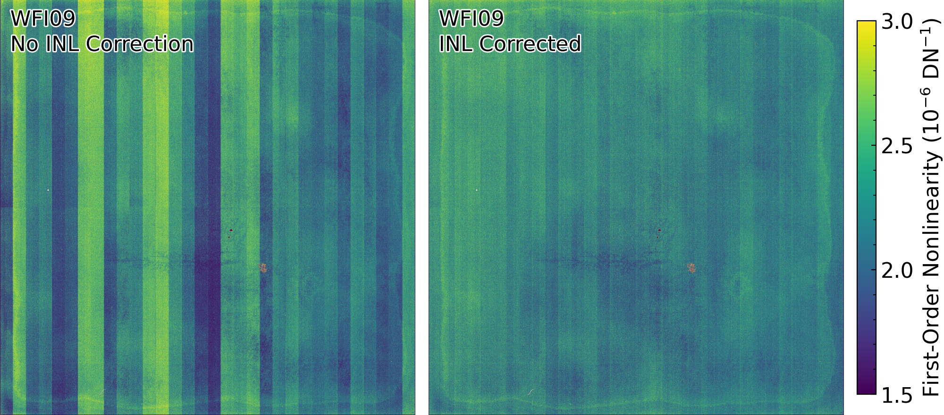
Significant Impacts on Gain and Classic Nonlinearity

Slide 25

How do we apply the correction with on-board read averaging?
$$\left\langle f\left(x\right)\right\rangle ≠f\left(\left\langle x\right\rangle \right)$$

Slide 26

How do we apply the correction with group averaging?
$$\left\langle f\left(x\right)\right\rangle ≠f\left(\left\langle x\right\rangle \right)$$
Iterative approach:
Perform a nonlinearity correction to the first and last reads (which are not averaged)
Estimate the counts in each read, including the averaged ones
Adjust the estimated counts to match the read-averaged values
Apply nonlinearity corrections to the refined estimates of the counts in each read
Average the nonlinearity corrections by resultant

Slide 27
Current Status
Good progress and/or solution found (bold=on ADS):
Tentative path forward:
Losing sleep; I hope to learn from all of you:
Nonlinearity
Electronic gain
Ramp fitting
Jump detection
Pixel area/sensitivity
Transient signals
Correlated noise
Interpixel Capacitance
Persistence
Thin-film Ice
Brighter-fatter effect
Other new and wonderful things?

Slide 28
Backup slides

Slide 29
Nonlinearity

Slide 30
Nonlinearity

Slide 31
Nonlinearity

Slide 32
Burn-in

Slide 33
Ramp fitting
See Brandt 2024a, b, published in PASP
Possible to write down, minimize chi squared pixel-by-pixel with (nearly) the right covariance matrix
Mitigates subtle biases in fitted count rates
Enables likelihood ratio tests for jump detection

Slide 34
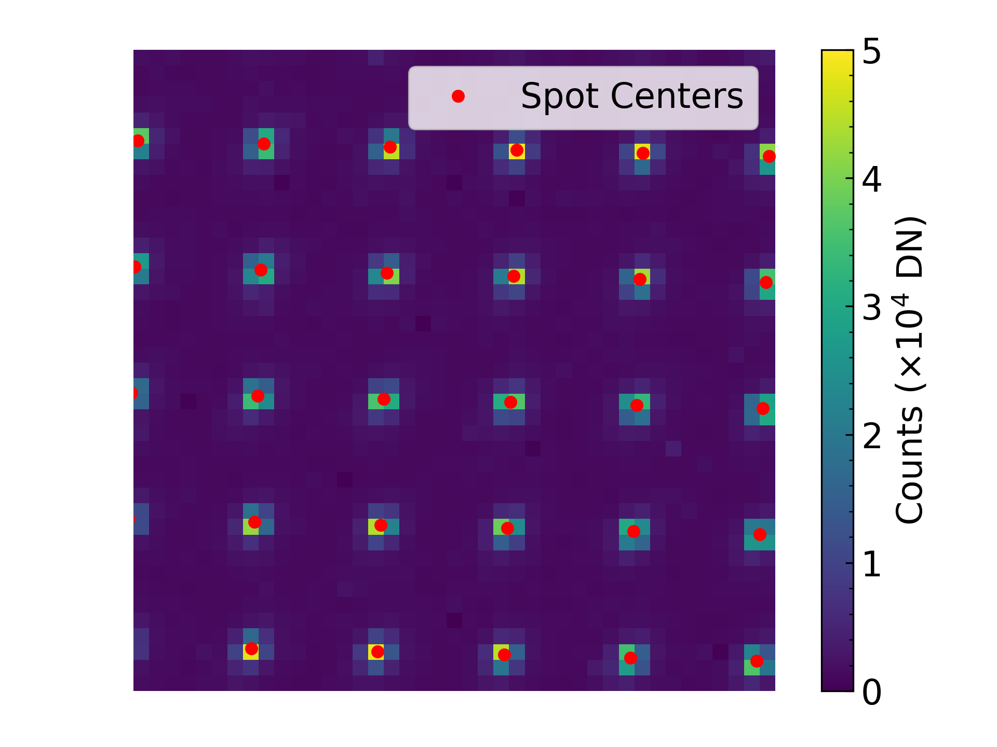
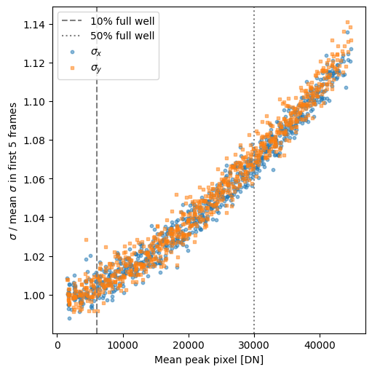
Brighter-fatter

Slide 35
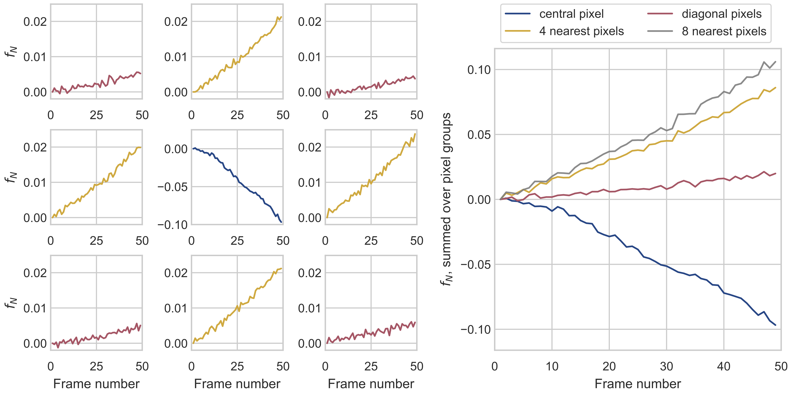
Brighter-fatter

Slide 36
Transient signals

Slide 37
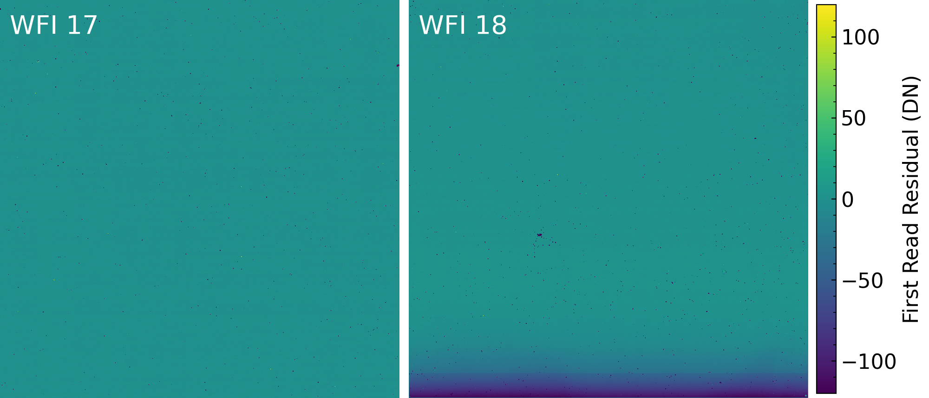
Transient signals

Slide 38
Transient signals

