Slide 1
The Moons And Jupiter Imaging Spectrometer (MAJIS) on ESA/JUICE
F. Poulet and MAJIS team
IRIS Calibration and Performance Workshop 2026

Slide 2
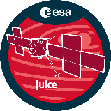




























JUICE science themes: broad & interdisciplinary
Emergence of habitable worlds around gas giants
  Ganymede as a planetary object & potential habitat
  Europa’s recently active zones
  Callisto as a remnant of the early Jovian system
The Jupiter system as a model for gas giants
  Jovian atmosphere
  Jovian magnetosphere
  Jovian satellite & ring system
  Complex system interactions

Slide 3
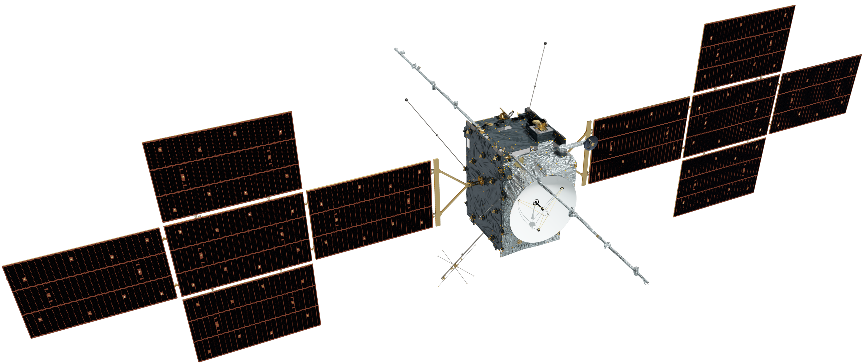
JUICE S/C overview
UVS
JANUS
MAJIS
GALA
SWI
  Spacecraft dry mass: 2450 kg
  Propellant tank capacity: 3650 kg
  Launch mass: ~6.1 tonnes
  Solar array power: ~790 W at end-of-life
  On-board memory: 1.25 Tbits at end-of-life
  Data rate: > 1.4 Gbits/day
  Communications round-trip: ~90 minutes
Langmuir probes x 4
PEP sensors
(nadir side)
3GM: KaT+USO
(in vault)
Medium gain antenna
High gain antenna
Solar panels
(85 m² total)
RIME antenna
PEP sensors
(zenith side)
MAG boom
3 x J-MAG sensors
2 x RPWI sensors

Slide 4
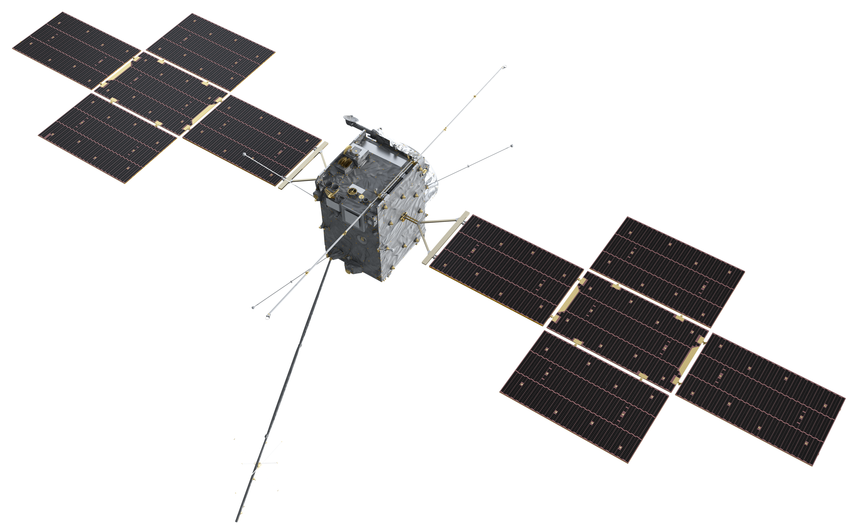
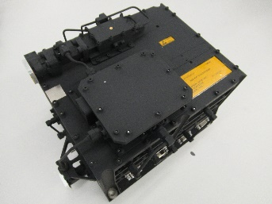
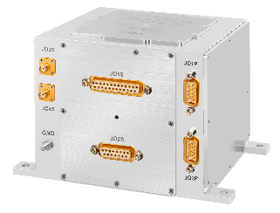
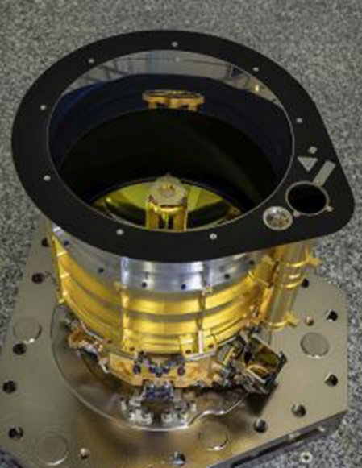
Geophysics instruments
RIME ice-penetrating radar
  Subsurface structure of icy moons to 9km depth
3GM radio science
  Study of the gravity fields & interiors of icy moons, ephemerides of moons, structures of atmospheres & ionospheres of Jupiter, its moons, torus, & rings
GALA laser altimeter
  Tidal deformation of Ganymede, topography of surfaces of icy moons
Transponder
Ultrastable oscillator
PRIDE radio interferometry
  Precise determination of spacecraft position & ephemerides of moons via VLBI

Slide 5
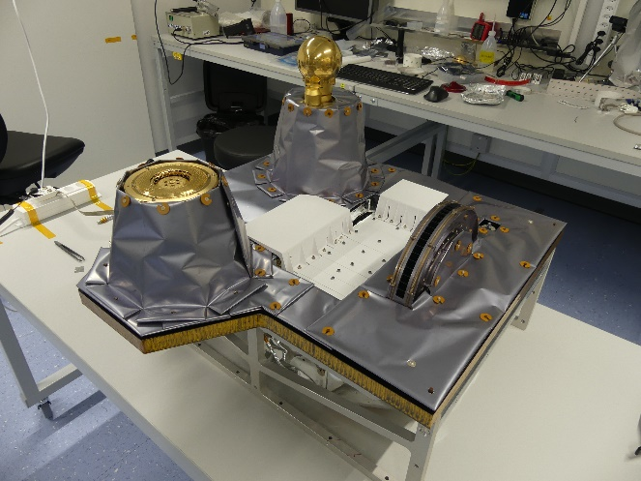
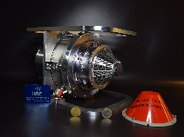
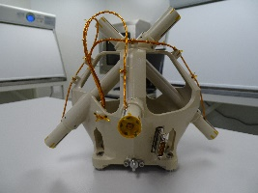
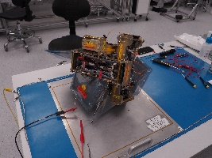
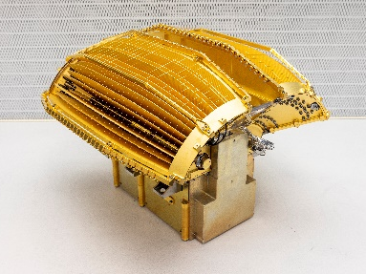
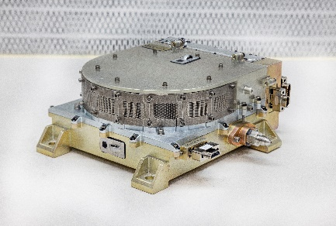
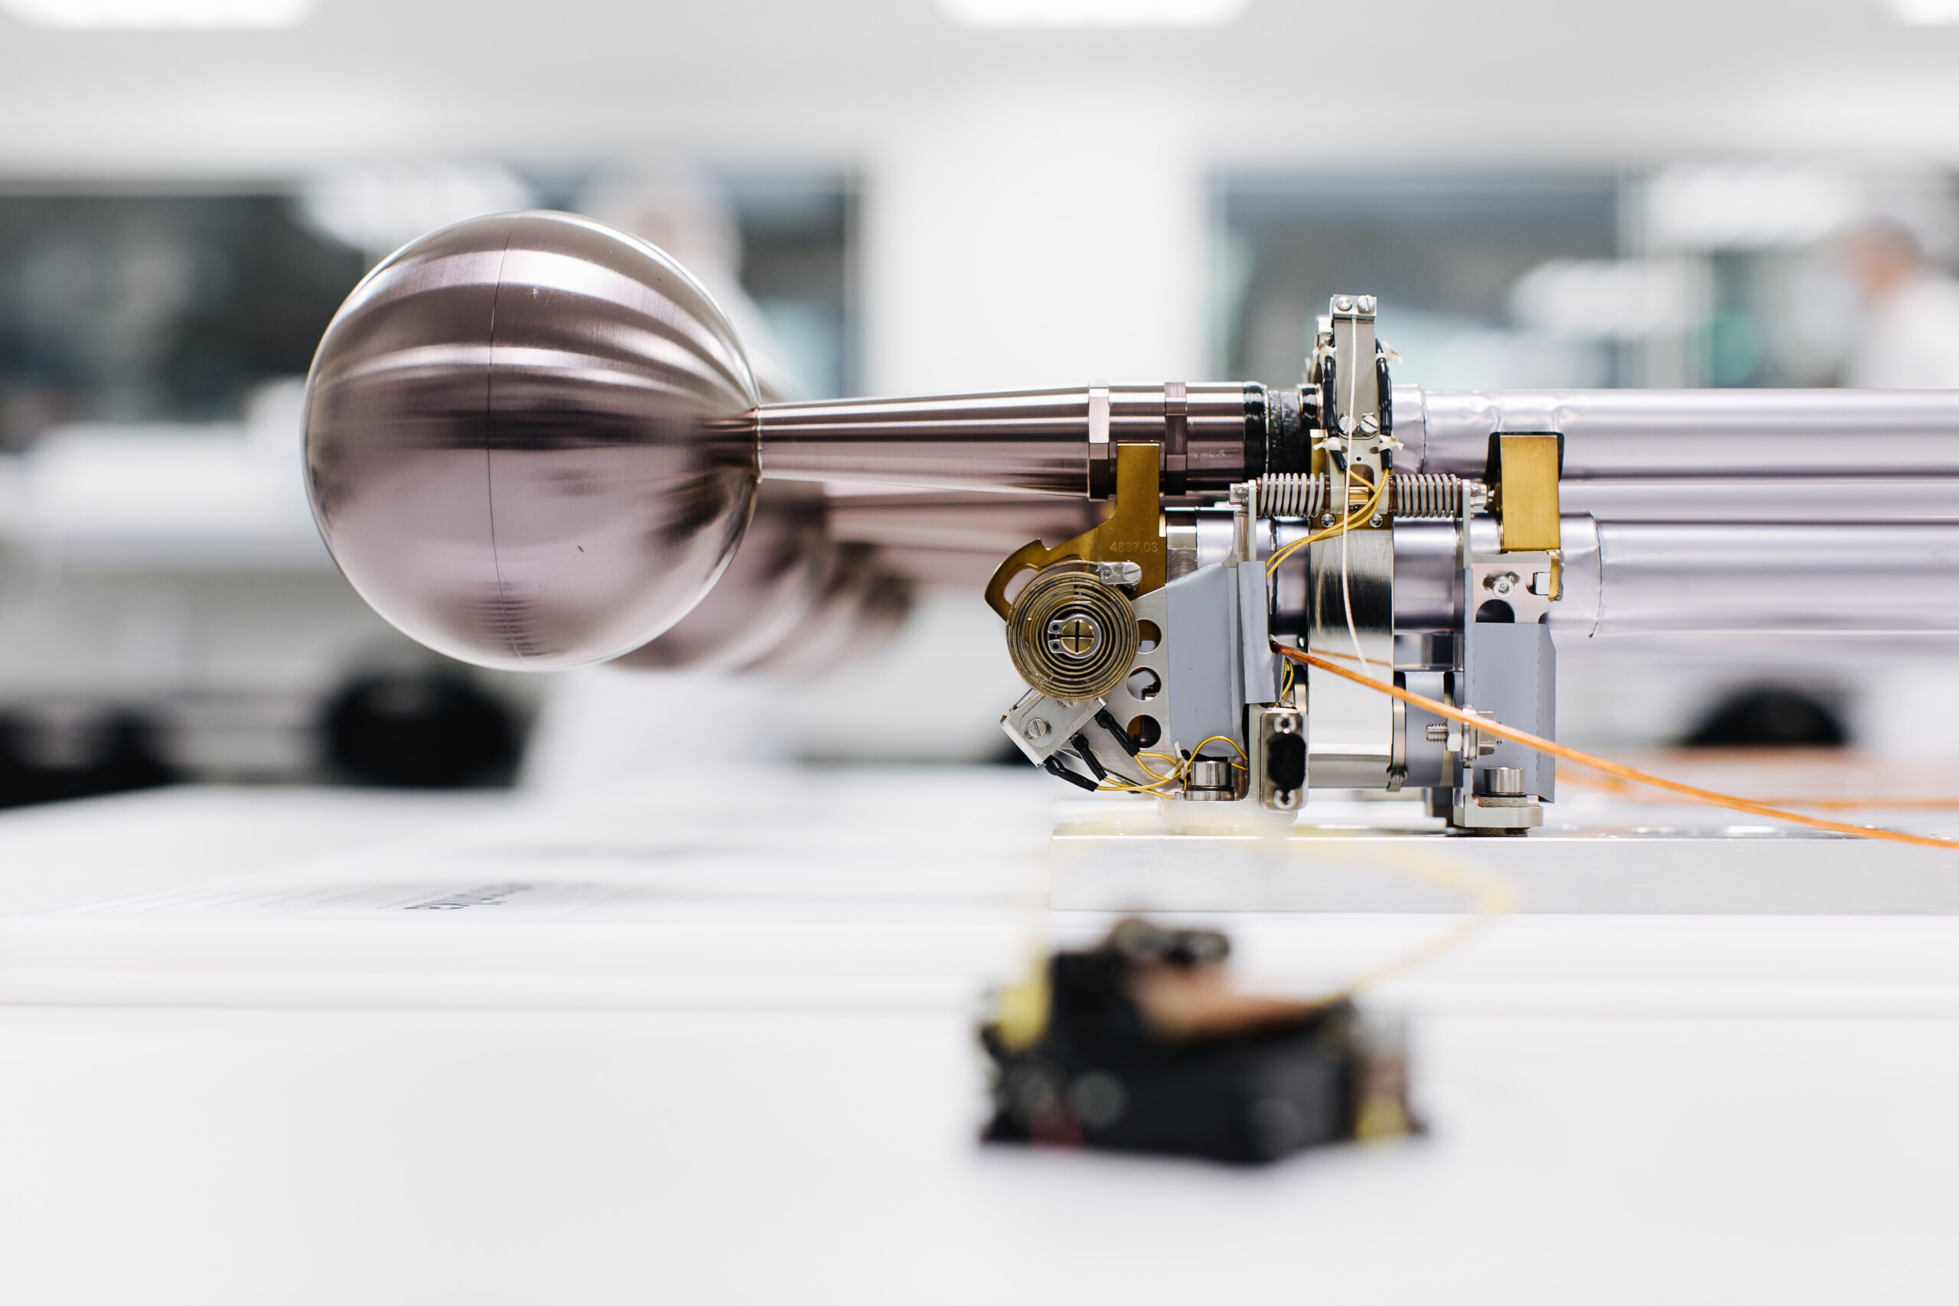
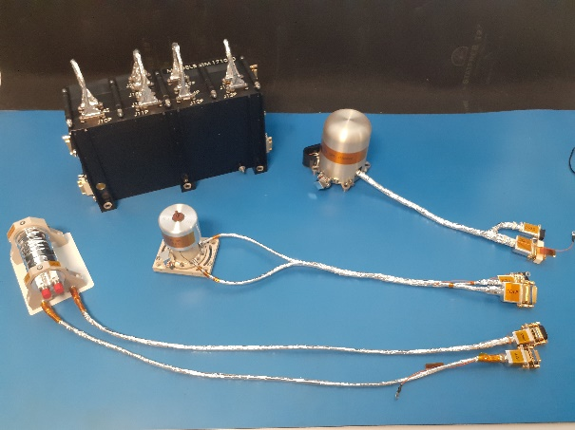
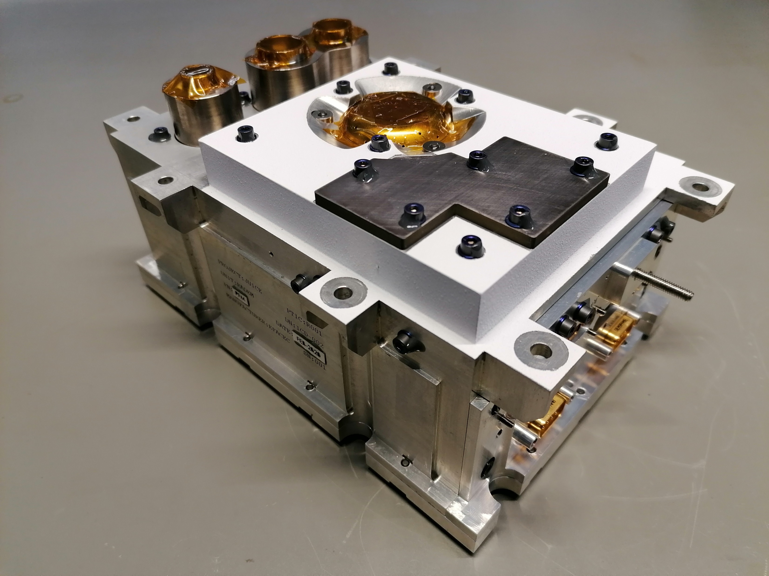
In situ instruments
PEP particle environment package
  Space environment in the Jovian system via electrons, ions, neutrals, energetic neutrals
RPWI radio & plasma waves
  Radio emission & plasma environment of Jupiter & its icy moons
J-MAG magnetometer
  Jovian & Ganymede magnetic fields, subsurface oceans of icy moons
RADEM radiation monitor

Slide 6
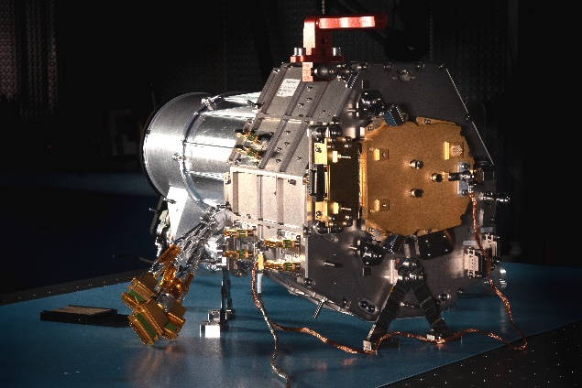
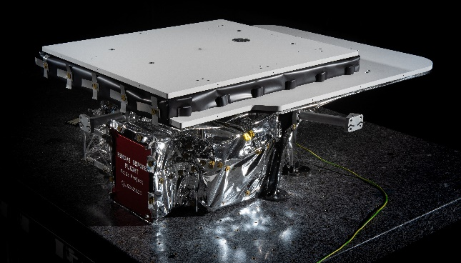
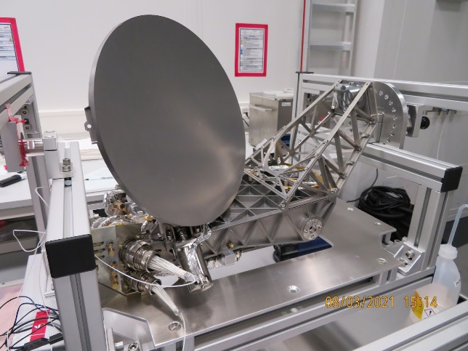
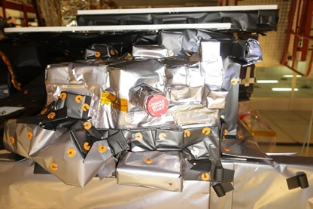
Remote sensing instruments
JANUS camera
  Geology of icy moons, Io monitoring, Jovian atmosphere, dust rings, minor moons
MAJIS vis-IR imaging spectrometer
  Composition of icy moon surfaces & atmospheres, Io, Jovian atmosphere, dust rings, minor moons
Sub-mm wave instrument (SWI)
  Jupiter’s stratosphere & troposphere, atmospheres & surface of icy moons
UV spectrometer (UVS)
  Composition of icy moon atmospheres, Jovian & Ganymede aurorae, Jovian atmosphere

Slide 7
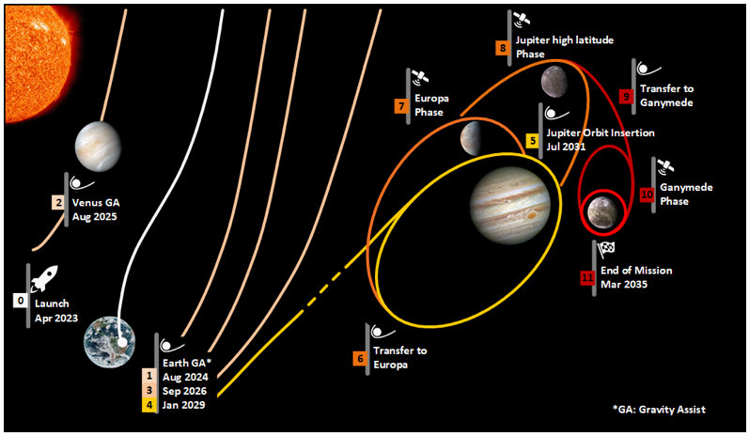
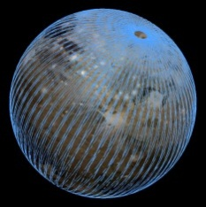
Mission overview
  Tour (07/2031, ~3.5 years) including 8 F/Bs of Ganymede, 21 of Callisto, 2 of Europa
  High-phase inclination (>33°)
  Ganymede orbital phase
Ganymede orbital phase (9 months)
GCO5000
GCO500
GCO200
GEO
GEO

Slide 8
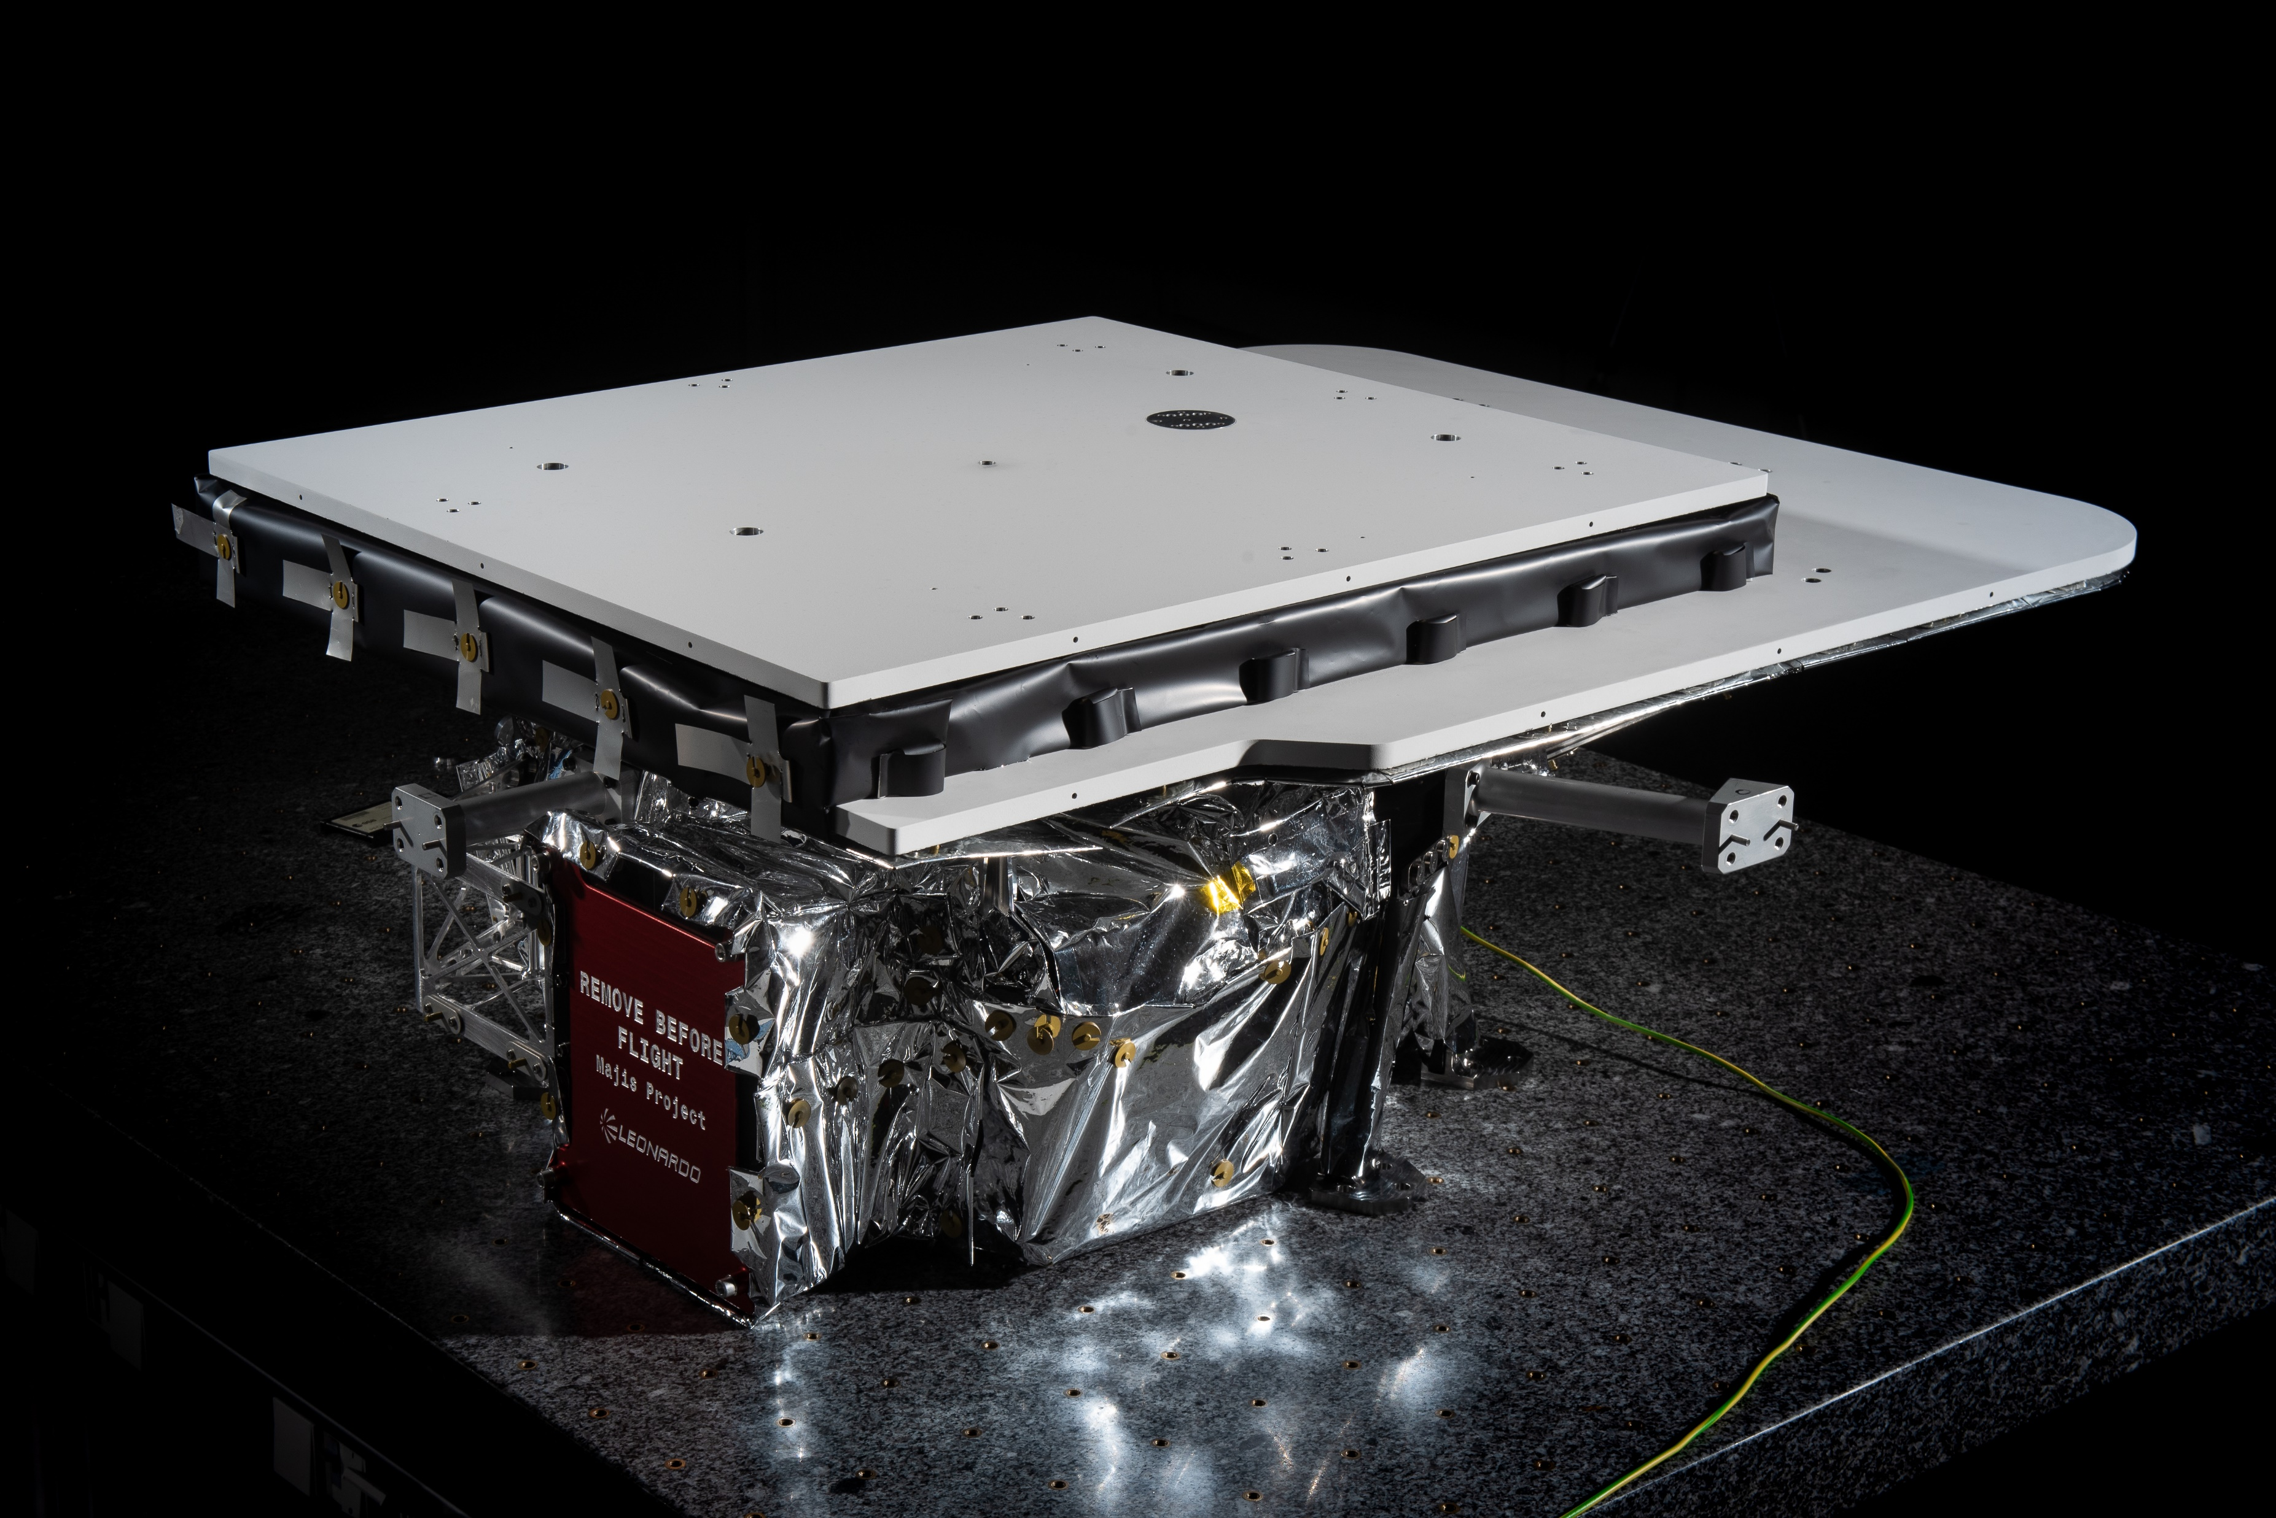
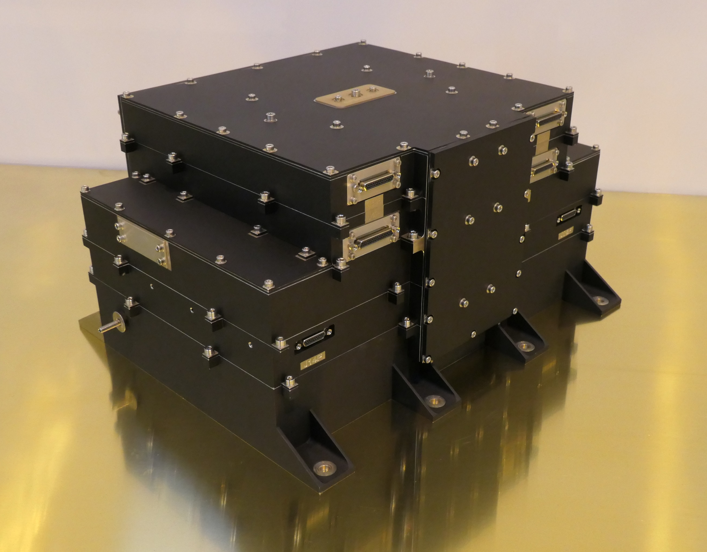
MAJIS overview
Optical Head
Dimensions: 912x765x356 mm³, 41 kg
Parameter | Value | Comments
Spectral range VISNIR | 0.50 – 2.35 µm
Spectral range IR | 2.28 – 5.56 µm
Spectral sampling VISNIR | < 4 nm
Spectral sampling IR | < 7 nm
Number of spectels per channel | 508 | Up to 640 by TC, Spectral editing, Spectral binning x2 or x4 by TC
FOV | 0.06 rad x150 µrad | 30 km x 75 m during GCO500
Number of pixels along FOV for both channels | 400 | Spatial binning x2 or x4 by TC Windowing functionality
Scanning mechanism | ±4° | Motion compensation
Power | 26 W | Calibration mode: 35W
Main electronics
Dimensions: 320 x 249 x 161 mm³, 8.2kg
Poulet et al. SSR 2024 https://link.springer.com/article/10.1007/s11214-024-01057-2

Slide 9
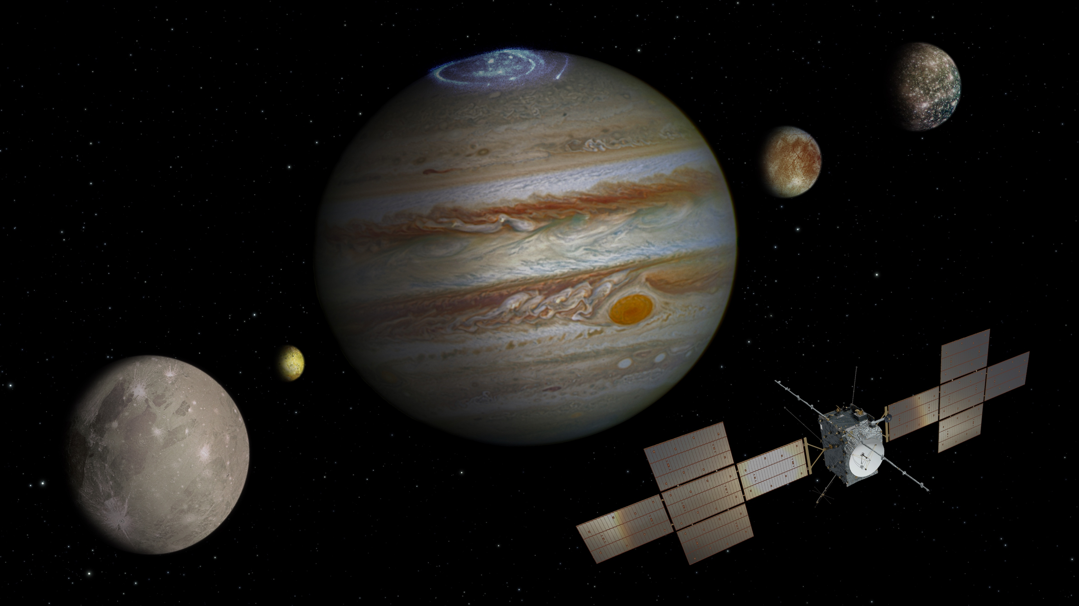
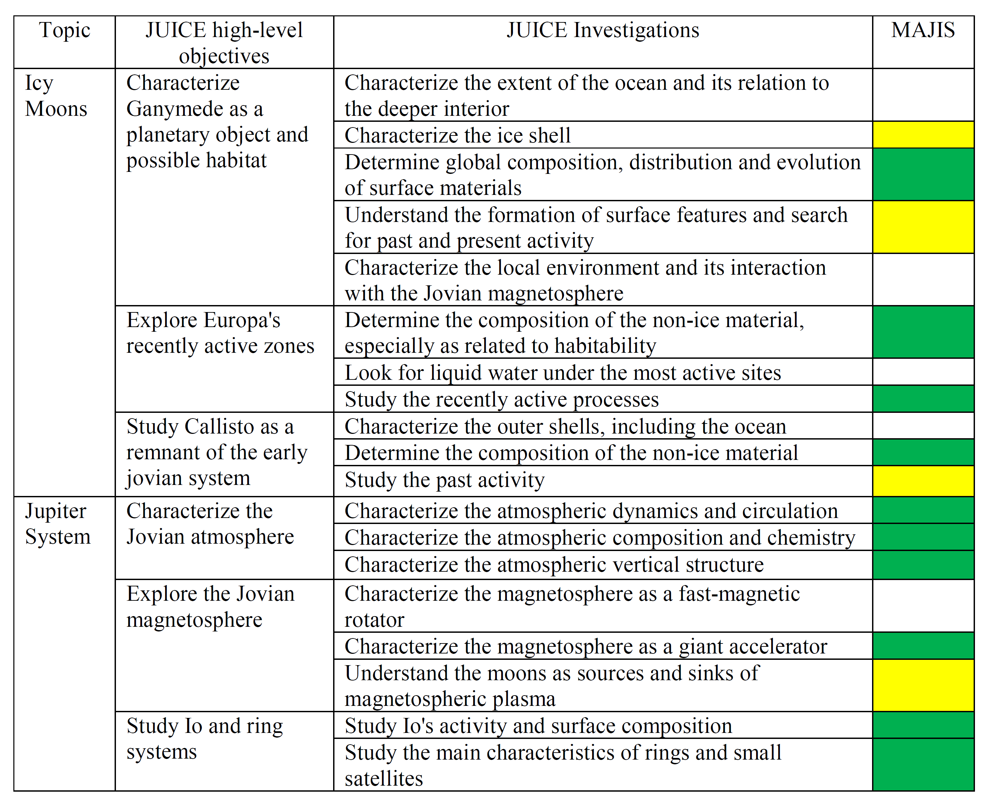
MAJIS is « primary » for 9 / 18 investigations
Primary
Icy moons
Supporting
Jupiter system

Slide 10
Main design constraints
IR detector with cut-off at 5.56 µm
  Dark current (IR <90 K)
  Thermal contribution of the instrument (OH <130 K)
Power limitation due to solar panels at 5 a.u.
Highly variable radiation doses are expected around Jupiter
  high energy electrons (most frequent events) from 0.5 to 3 MeV
  high energy protons
Degradation of the coating of the optical elements
Detectors
  Potential increase of the dark current
  Spikes
Degradation of main electronics components
- Passive cooling
- Low conductance bipods
- Passive spot shielding
- On-board despiking procedure

Slide 11
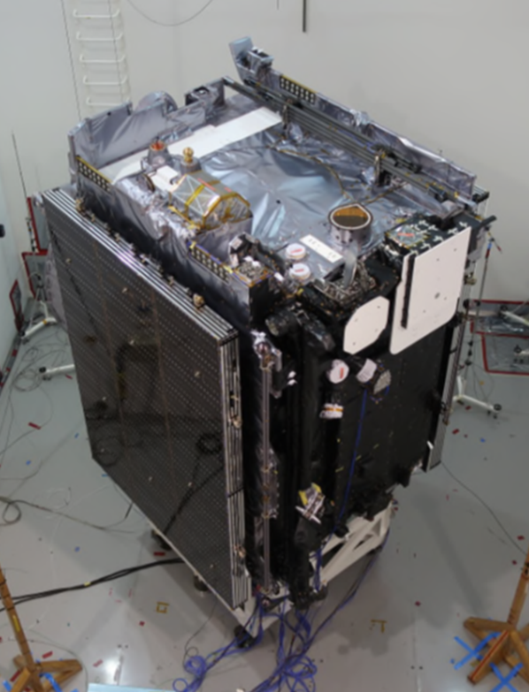
Overview
Nadir (Z_sc)
MAJIS OH

Slide 12
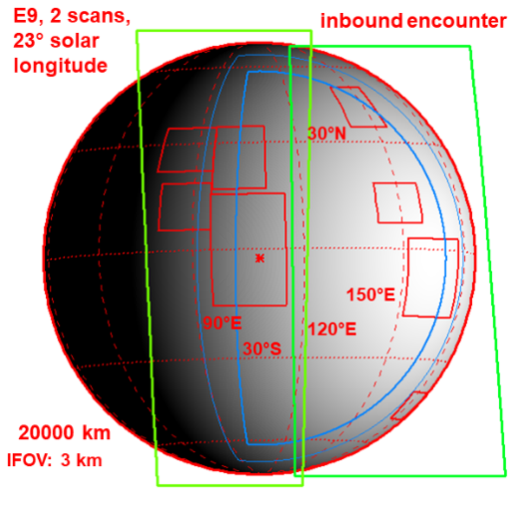
Observation modes
Pushbroom:
  Scan mirror is not activated: rest (boresight) position
  Cross-slit motion provided by a spacecraft slew
  Repetition time = dwell time (time needed to cross the projected IFOV, taking into account detector binning)
Scan/pointing implemented by the scanning mirror (± 4°LOS)
  Cross-slit motion provided by the scan mirror
  Repetition time defined from SNR / available time constraints
Motion compensation
  Close to satellites, the dwell time is far too short (Europa F/B: 18 msec)
  The scanning mirror rotates back, LOS remains ~560 ms over each IFOV

Slide 13
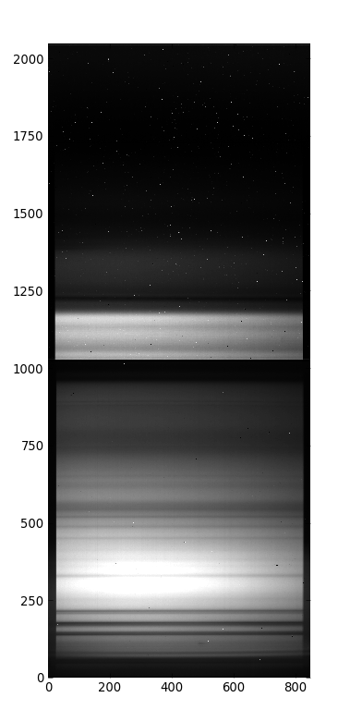
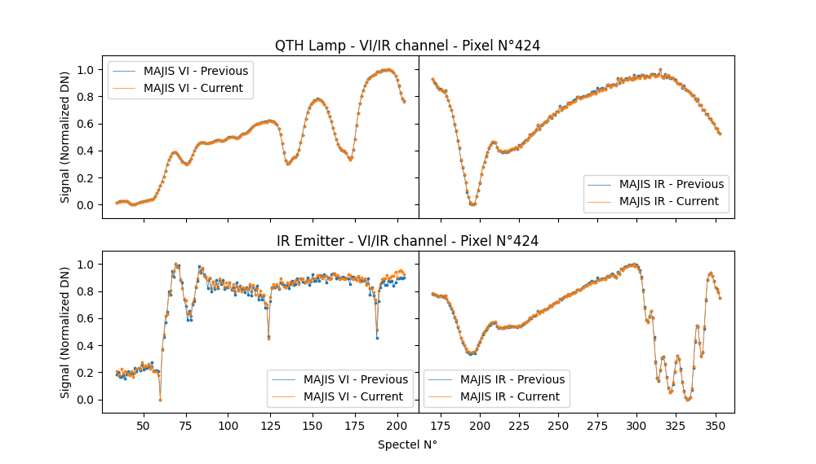
Internal Calibration Unit
Spectels
Samples

Slide 14
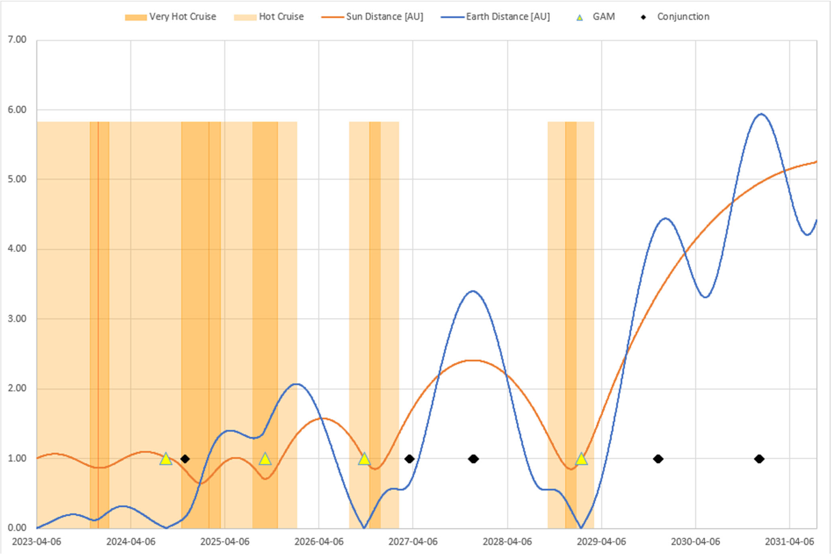
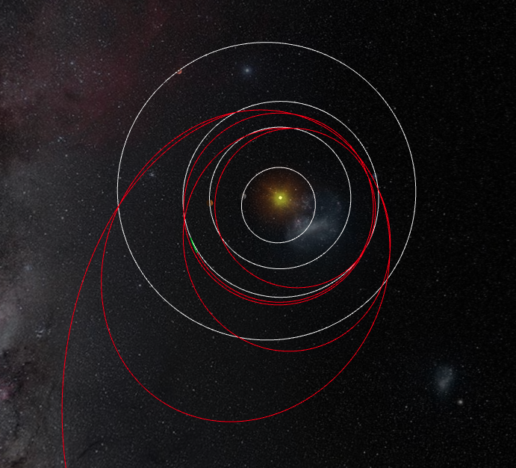
Cruise events
checkout
EGA-3 17/1/29
VGA 31/8/25
EGA-2 28/9/26
Lunar Earth GA
LEGA-1 19-20/8/24
Payload checkouts
Star field observations
Planetary flybys
3I/Atlas
Launch (2023)
Today
(a third of the cruise)
Jupiter insertion (2031)

Slide 15
Cruise events
checkout
EGA-3 17/1/29
VGA 31/8/25
EGA-2 28/9/26
Lunar Earth GA
LEGA-1 19-20/8/24
Payload checkouts
Star field observations
Planetary flybys
3I/Atlas
Launch (2023)
Today
(a third of the cruise)
Jupiter insertion (2031)
  Validating the in-flight performance (radiometric, spectral, spatial, geometric, straylight, contamination, on-board S/W, thermal behavior) + Science opportunities

Slide 16
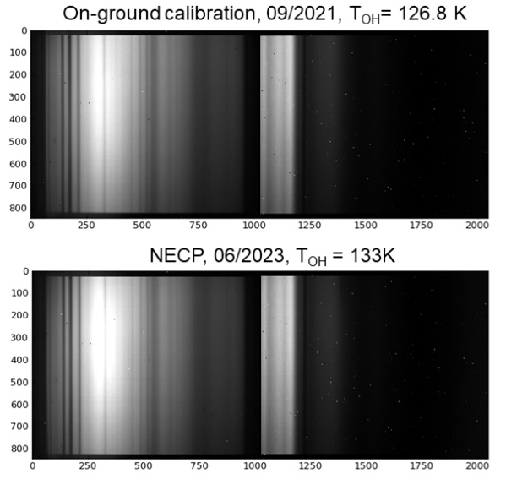
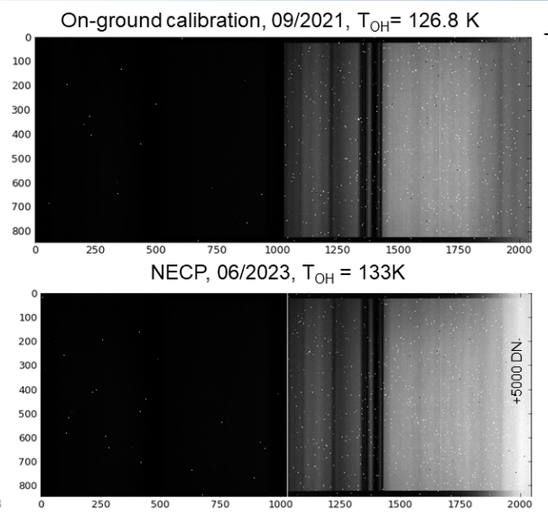
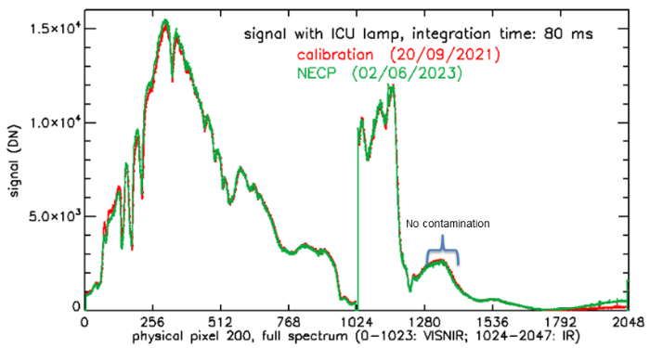
Payload checkouts and Cruise events
VISNIR channel
IR channel
NECP, Payload Checkout #1 (January 2024),PC2 (July 2024), PC3 (March 2025), PC4 (February 2026): MAJIS works nominally on the nominal and redundant electronics using Internal Calibration Unit (ICU) measurements
Earth-Moon flyby (19-20 August 2024) major milestone to assess the in-flight performances with two spatially resolved external sources
3I/Atlas (November 2025, data received 2 weeks ago) major opportunity to check low signal readout mode (similar to exospheres, rings during the nominal science)

Slide 17
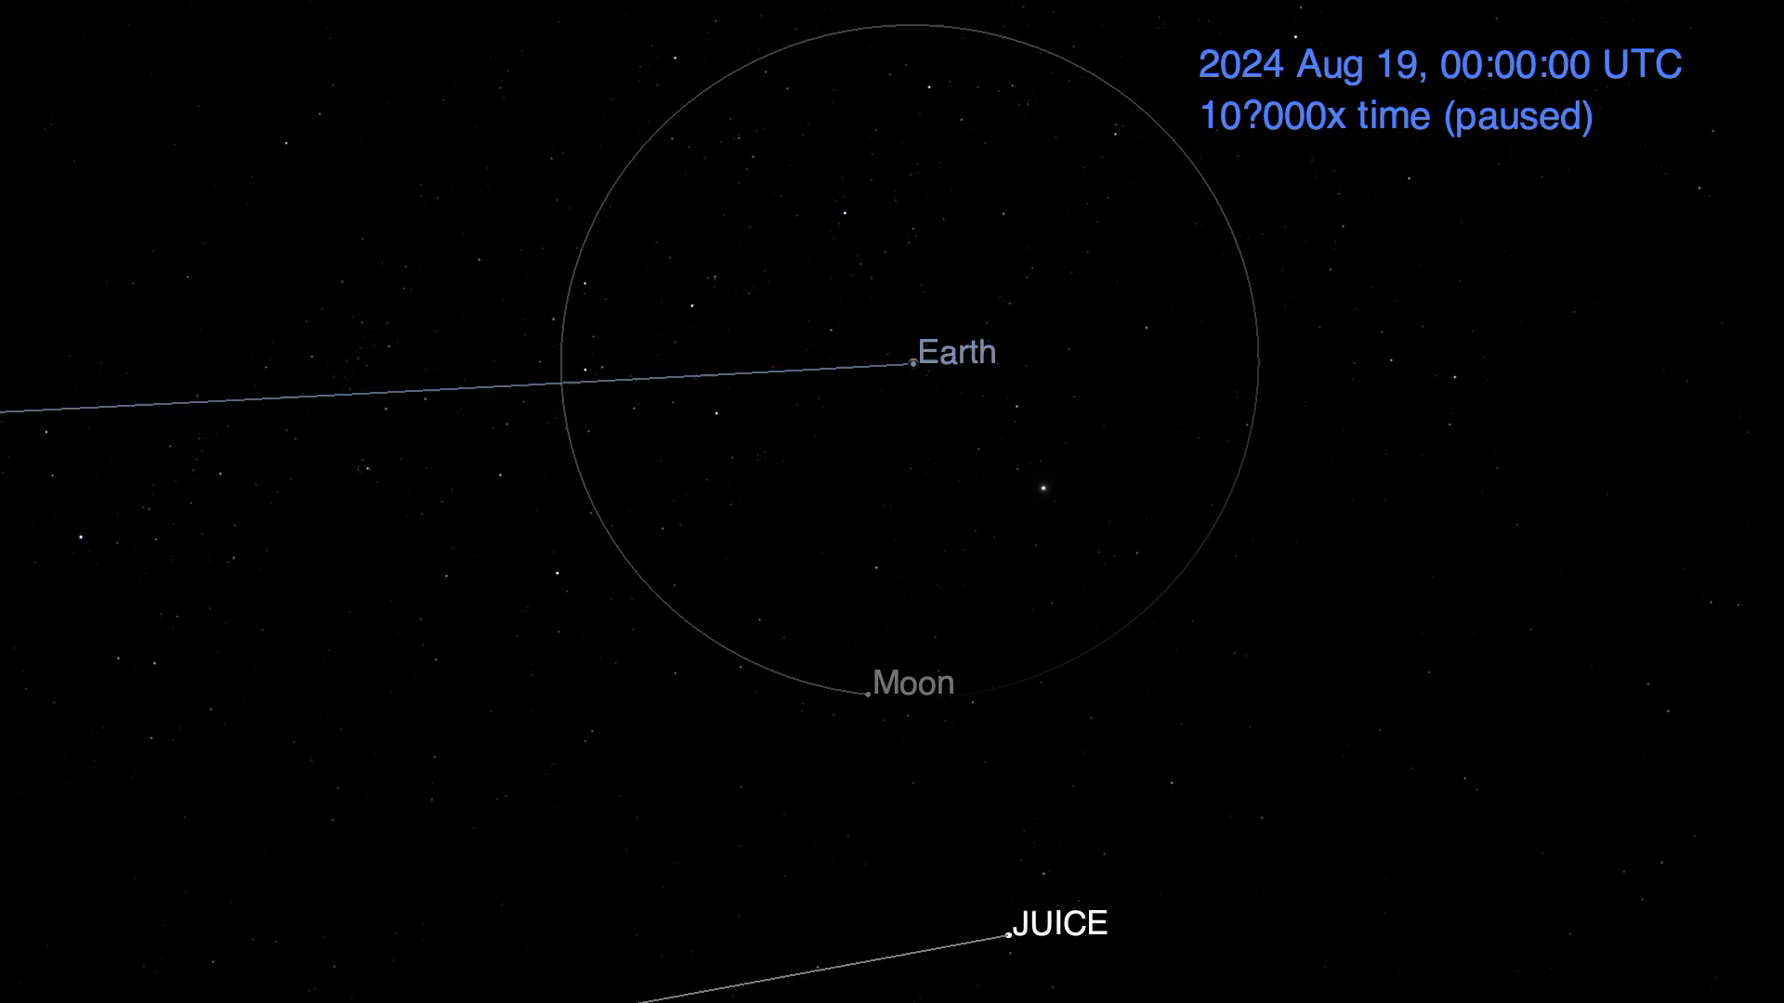
Lunar Earth Gravitational Assist on August 19/20, 2024
First-ever dual planetary flyby

Slide 18
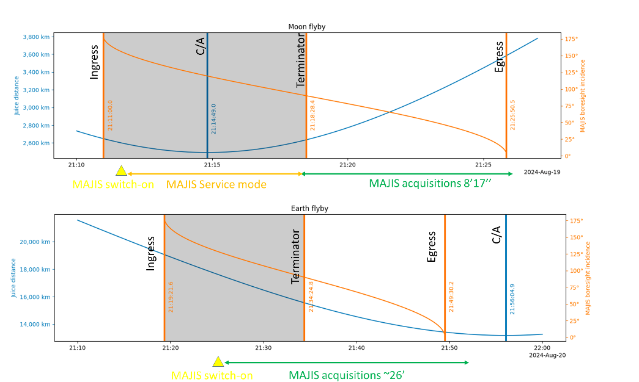
Operational constraints due to hot cruise conditions
S/C continuously protected from high solar flux and elevated temperatures, by orienting the HGA toward the Sun ➔ Observation opportunity occurred during a quite short time window only when the boresight of MAJIS crossed the Moon and Earth surfaces
5 MAJIS cubes
19 MAJIS cubes

Slide 19
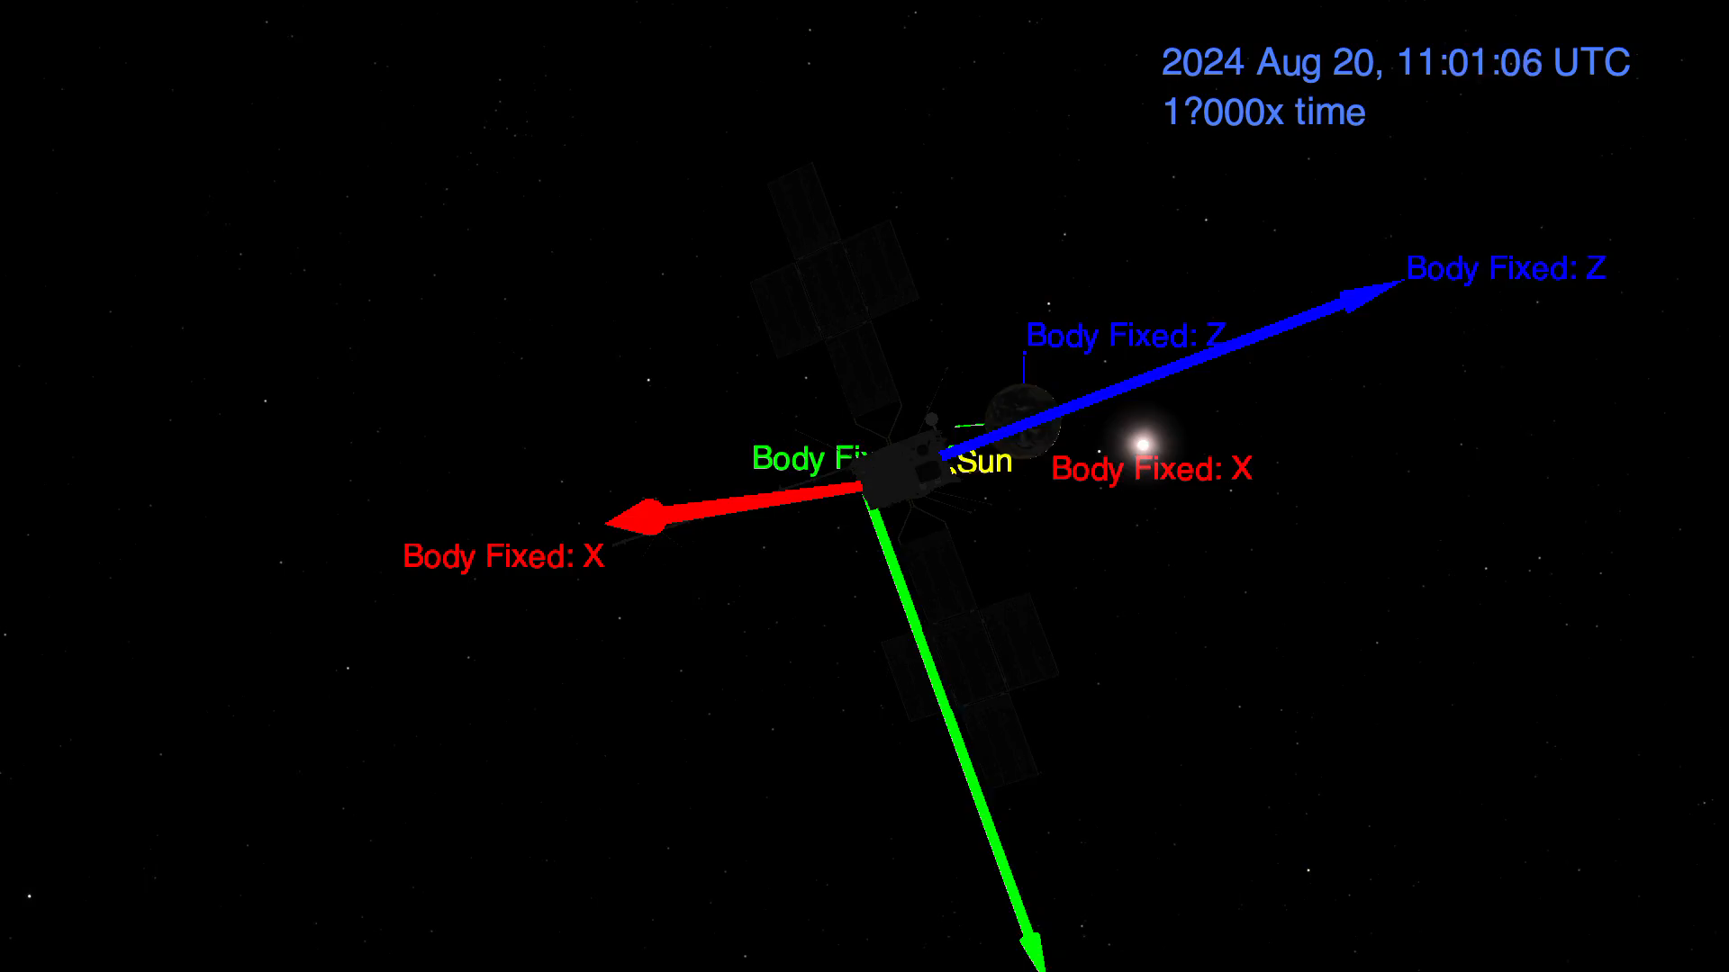
Earth Flyby on August 20, 2024
MAJIS boresight = Z axis

Slide 20
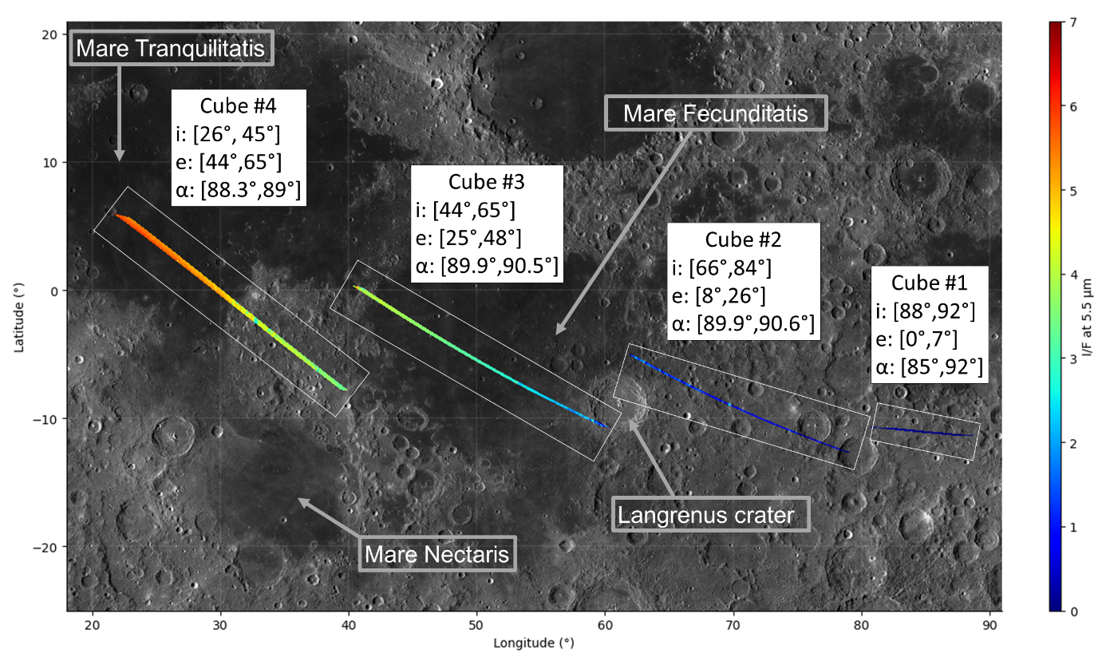
Moon flyby: MAJIS footprints
FOV windowing (64 pixels instead of nominal 400) to mitigate the signal saturation (Moon and Earth are very bright target for MAJIS !)
Sample various types of terrains (mare, highlands, crater rim,…) with a spatial sampling between 130 and 350 m
Incidence angle: from 92° to 26°

Slide 21
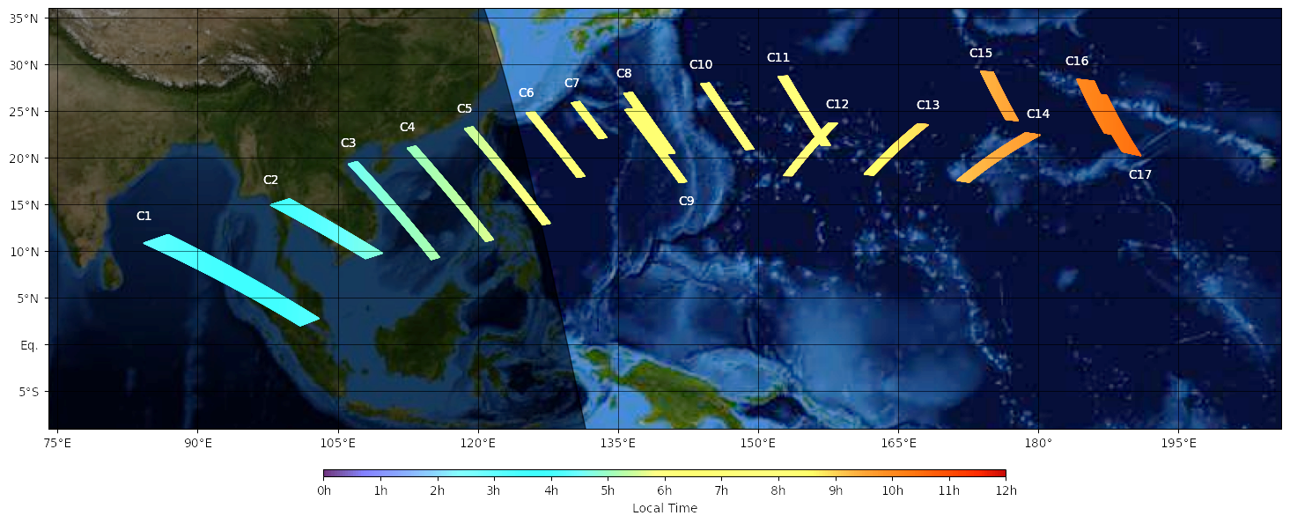
Earth flyby: MAJIS footprints
Spatial sampling from 1 to 3 km

Slide 22
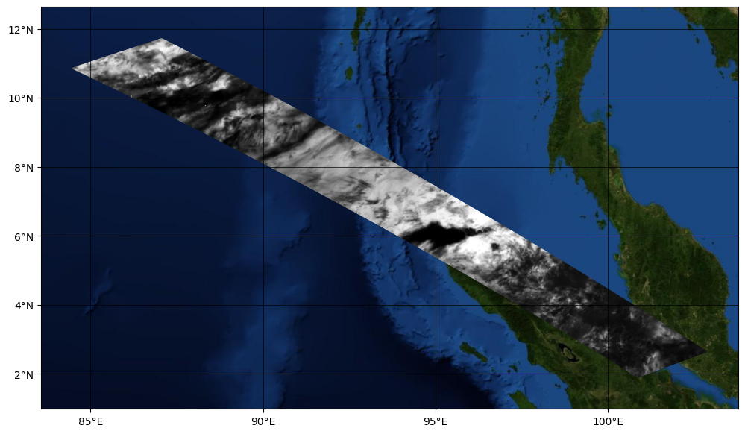
Earth flyby: MAJIS footprints
Pixel resolution from 1 to 3 km
IR
Malesia
Sumatra

Slide 23
LEGA data analyses
The Moon-Earth flyby observations of MAJIS provided a unique and first insight into the instrument performance in a real operative field

Slide 24
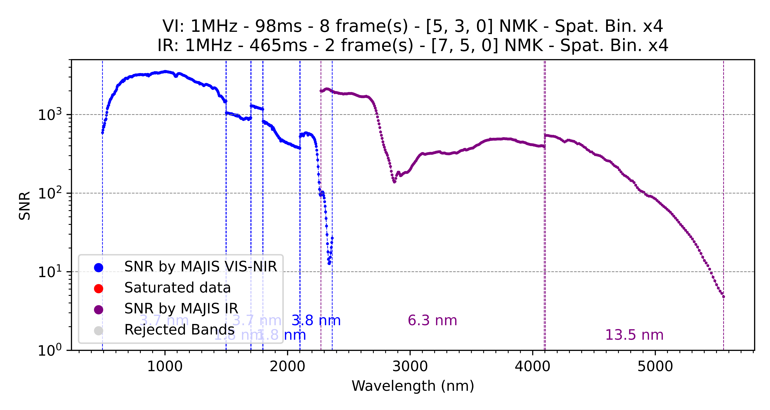
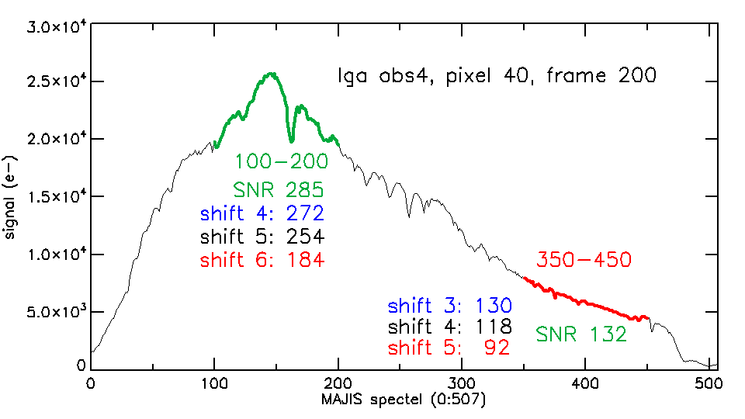
LEGA data analyses: SNR performance
Ganymede observation simulation
Moon observation
SNR in line with expected performance
Extrapolation to Ganymede indicates SNR in the range of 100-3000

Slide 25
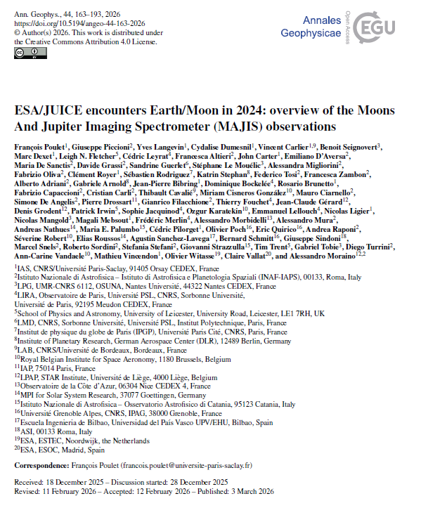
LEGA data analyses
The Moon-Earth flyby observations of MAJIS provided a unique and first insight into the instrument performance in a real operative field
Besides the importance for the calibration and performance verification, the data also offers
  very interesting science investigations (in spite of the limited spatial coverage)
  contextualization of possible science at Jupiter
Poulet et al. Ann. Geo. (2026)
+ 5 other MAJIS papers (submitted)

Slide 26
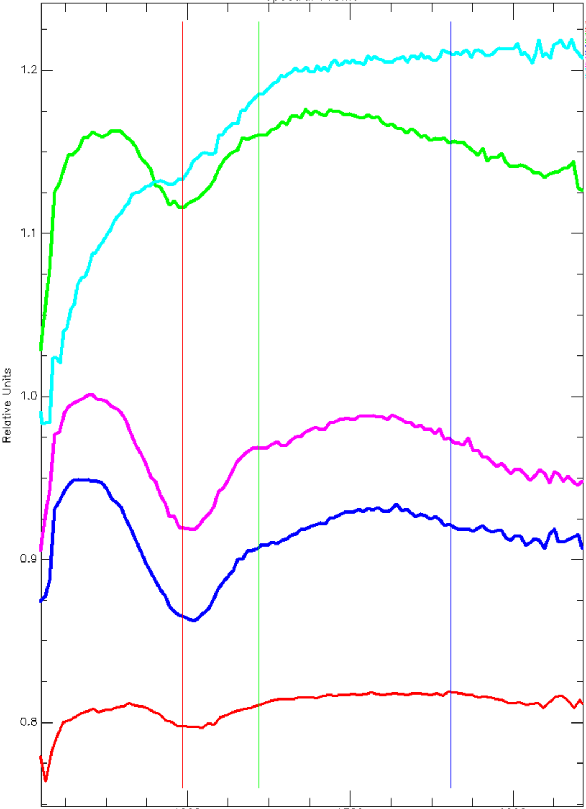
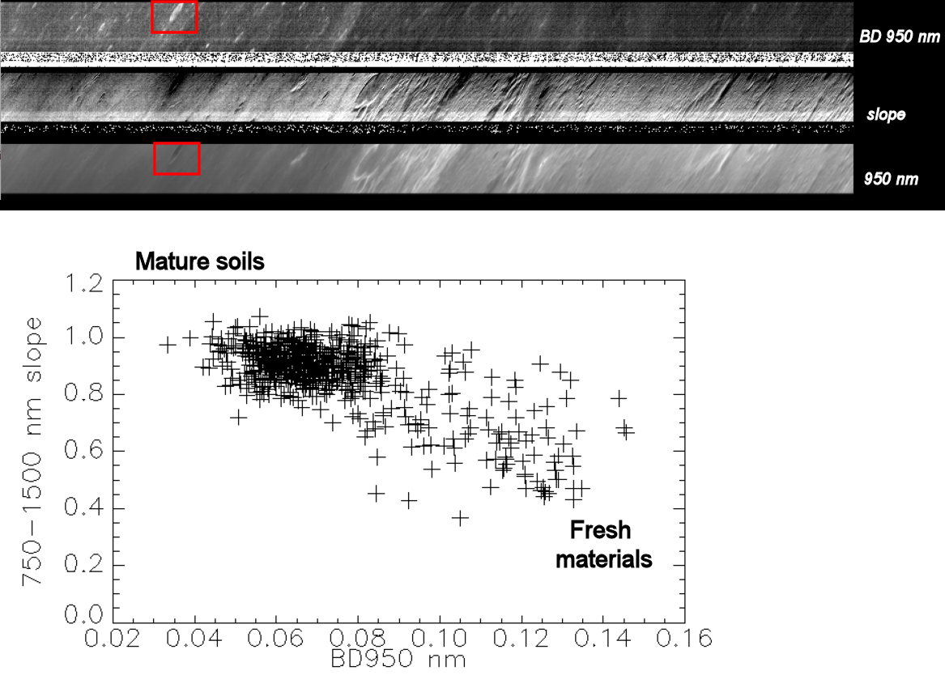
Moon flyby data analyses: mineralogy in the VISIR
    Identify and map spectral mafic units with the VISNIR channel
    Derive spectral maturity and correlation with other spectral parameters
Pyroxene + Olivine
Identification of a km-sized fresh crater
Band depth @ 950 nm
#1
Pyroxene
Maturity index
Reflectance
1000
1500
2000
Wavelength (nm)

Slide 27
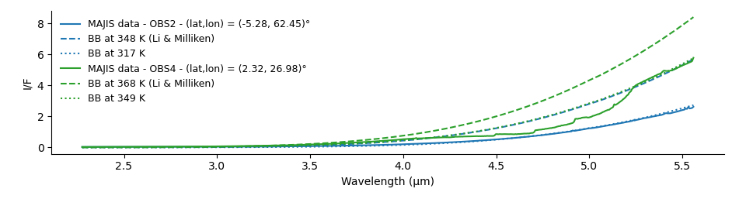
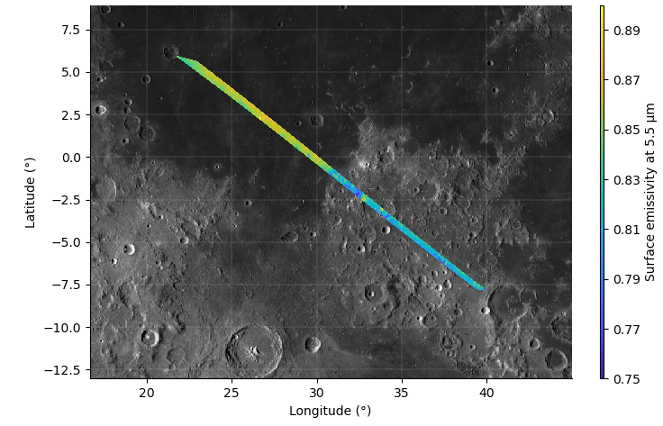
Moon flyby data analyses: thermal assessment in the IR
    Planck function dominated the signal in the IR channel ➔Map diurnal temperature variations using the spectral range 3.0–5.5 µm
    Derive spectral emissivity (3.0–5.5 µm) and its dependence on surface texture for the first time ➔ Increase in emissivity over mare regions (Müller et al. 2021)

Slide 28
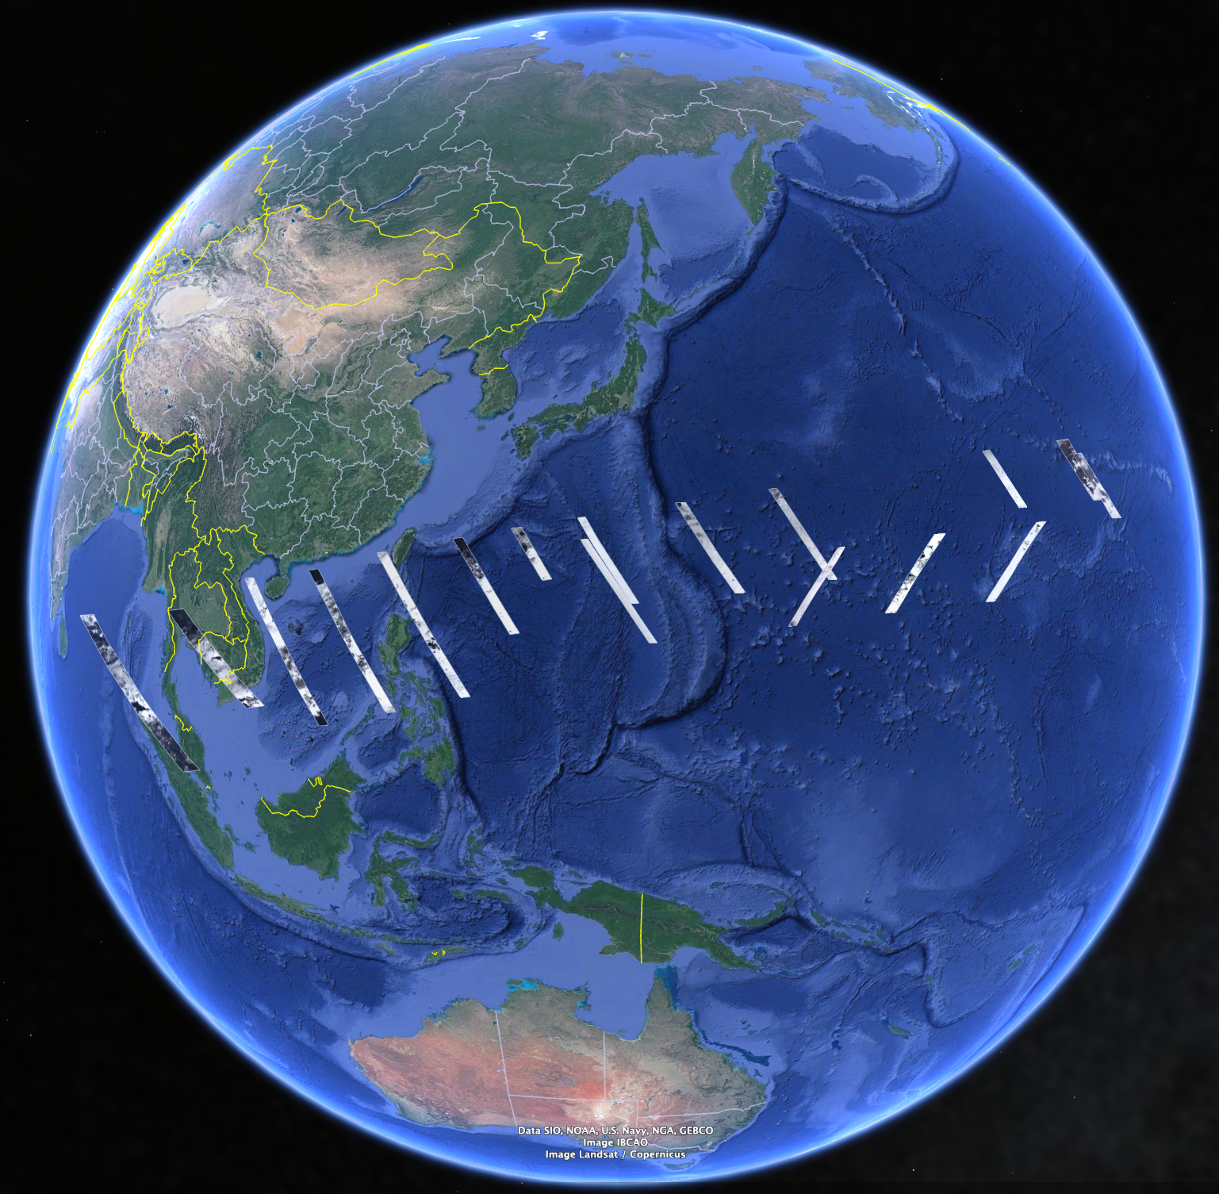
Earth flyby data analyses
The data opens also to very interesting science investigations for Earth atmosphere in spite of the very limited spatial and temporal coverage

Slide 29
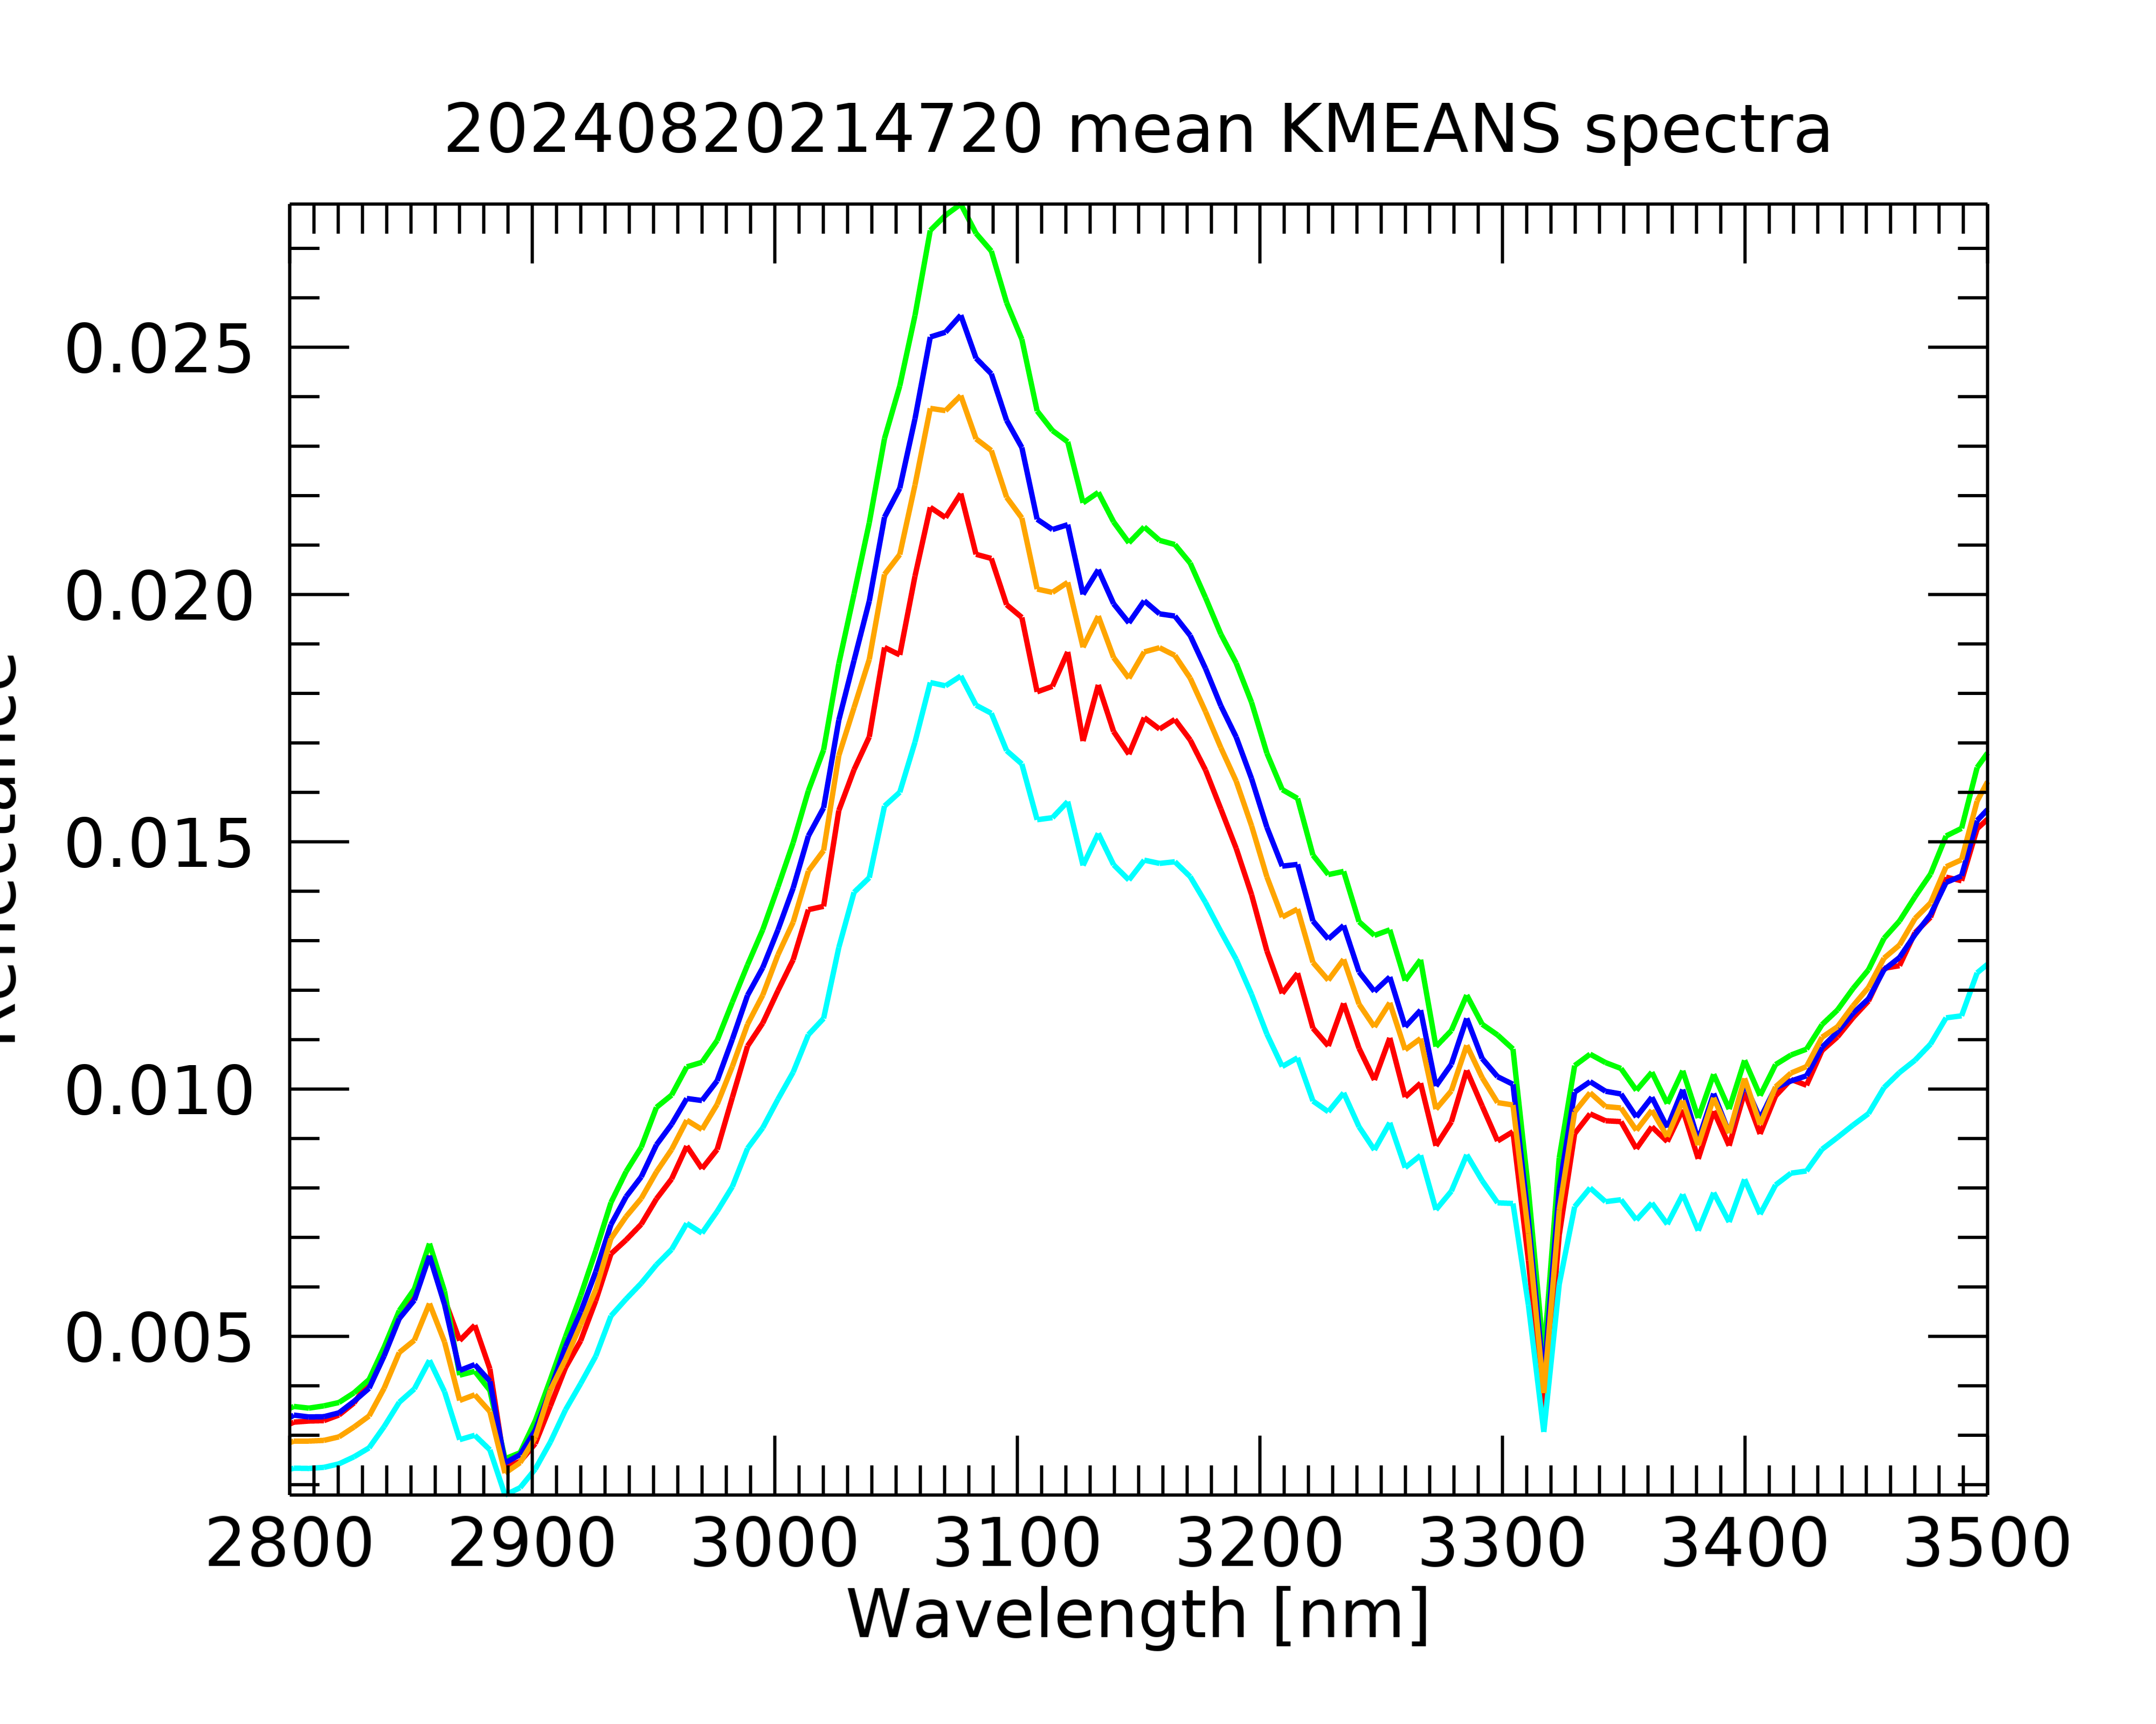
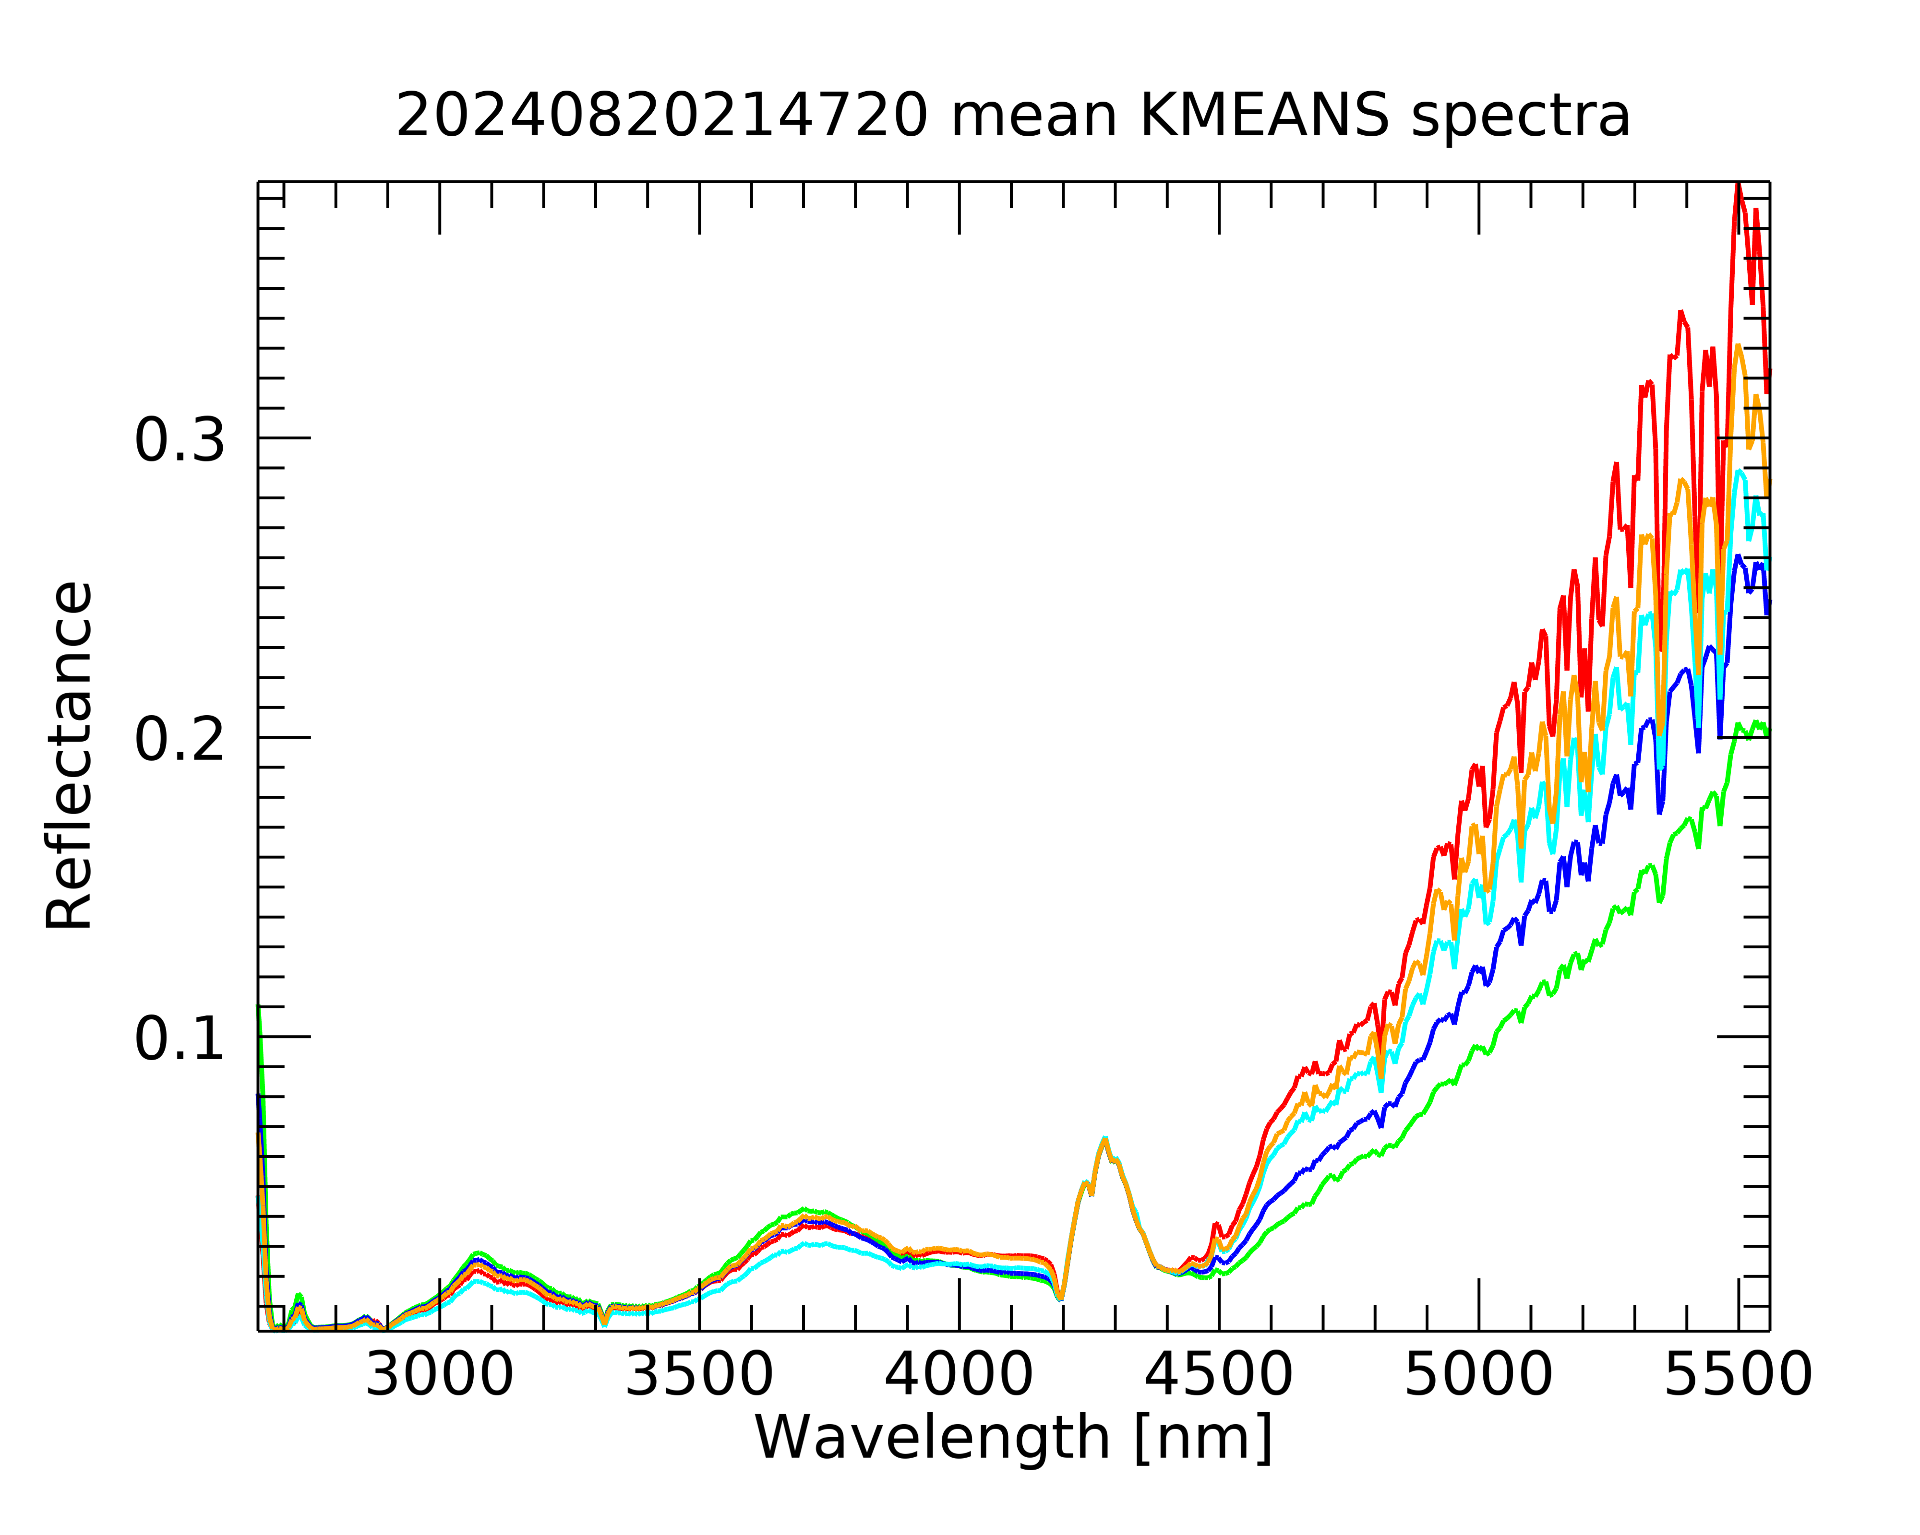


Earth flyby data analyses: cloud properties
ICE CRYSTALLINITY
ICE OPACITY / CLOUD TOP
Map of cloud top altitude (km)
MAJIS RGB map
Thermal intensity
Shadow
Fresnel peaks
Spectral slope
Ice boundaries
Identification of areas dominated by water ice clouds (convective plumes)
Cloud top altitude based on the O₂ 760 nm band depth or water ice reflectance peak ➔ 10-17 km depending on the plumes
Vertical extension based on the projected shadows is ~9 km above the surrounding cloud layer

Slide 30



Earth flyby data analyses: cloud properties
Clouds Forward Model
H₂O ice
Parameter | DECK 1 H₂O ice | DECK 2 H₂O ice
r_{eff} [μm] | 20 | 0.01
τ_{2.5} | > 20 | < 10⁻³
top [km] | 15 | unconstrained
model
MAJIS data
Liquid H₂O
Parameter | DECK 1 H₂O liquid | DECK 2 featureless (we used H₂O ice)
r_{eff} [μm] | 1 | 1
τ_{2.5} | 1.5 | < 10⁻²
top [km] | 1 | 11
Spectral modeling (MITRA) highlights the clouds microphysical properties
Some spectra require the presence of 2 layers of ice of different microphysics
Promising in enabling accurate retrievals of physical properties of icy satellites surfaces
model
MAJIS data

Slide 31



Earth flyby data analyses: lightening detection
Several emissions in the visible range were identified
The observed lines are attributable to atomic O and N and possibly H ➔ First spectroscopic detection from space of lightning flashes at night
Lightning from the edges of a thick thunderstorm

Slide 32

Earth flyby: comparison with other datasets
Exciting comparison with several instruments (IASI, PRISMA, Enmap, TROPOMI) and RT model
PRISMA (0.4-2.5 µm)
IASI (3.63-15.5 µm)
TROPOMI (bands 4,5,6,7,8)
ENMAP (0.3-2.5 µm)
RT models (4A, NEMESIS, MITRA, …)

Slide 33



Earth flyby: comparison with other datasets
Specular reflection
Excellent agreement with Enmap, PRISMA and IASI near-simultaneous observations in terms of spectral shapes, positions and radiance levels

Slide 34
Go JUICE !
Go MAJIS !

