Slide 1
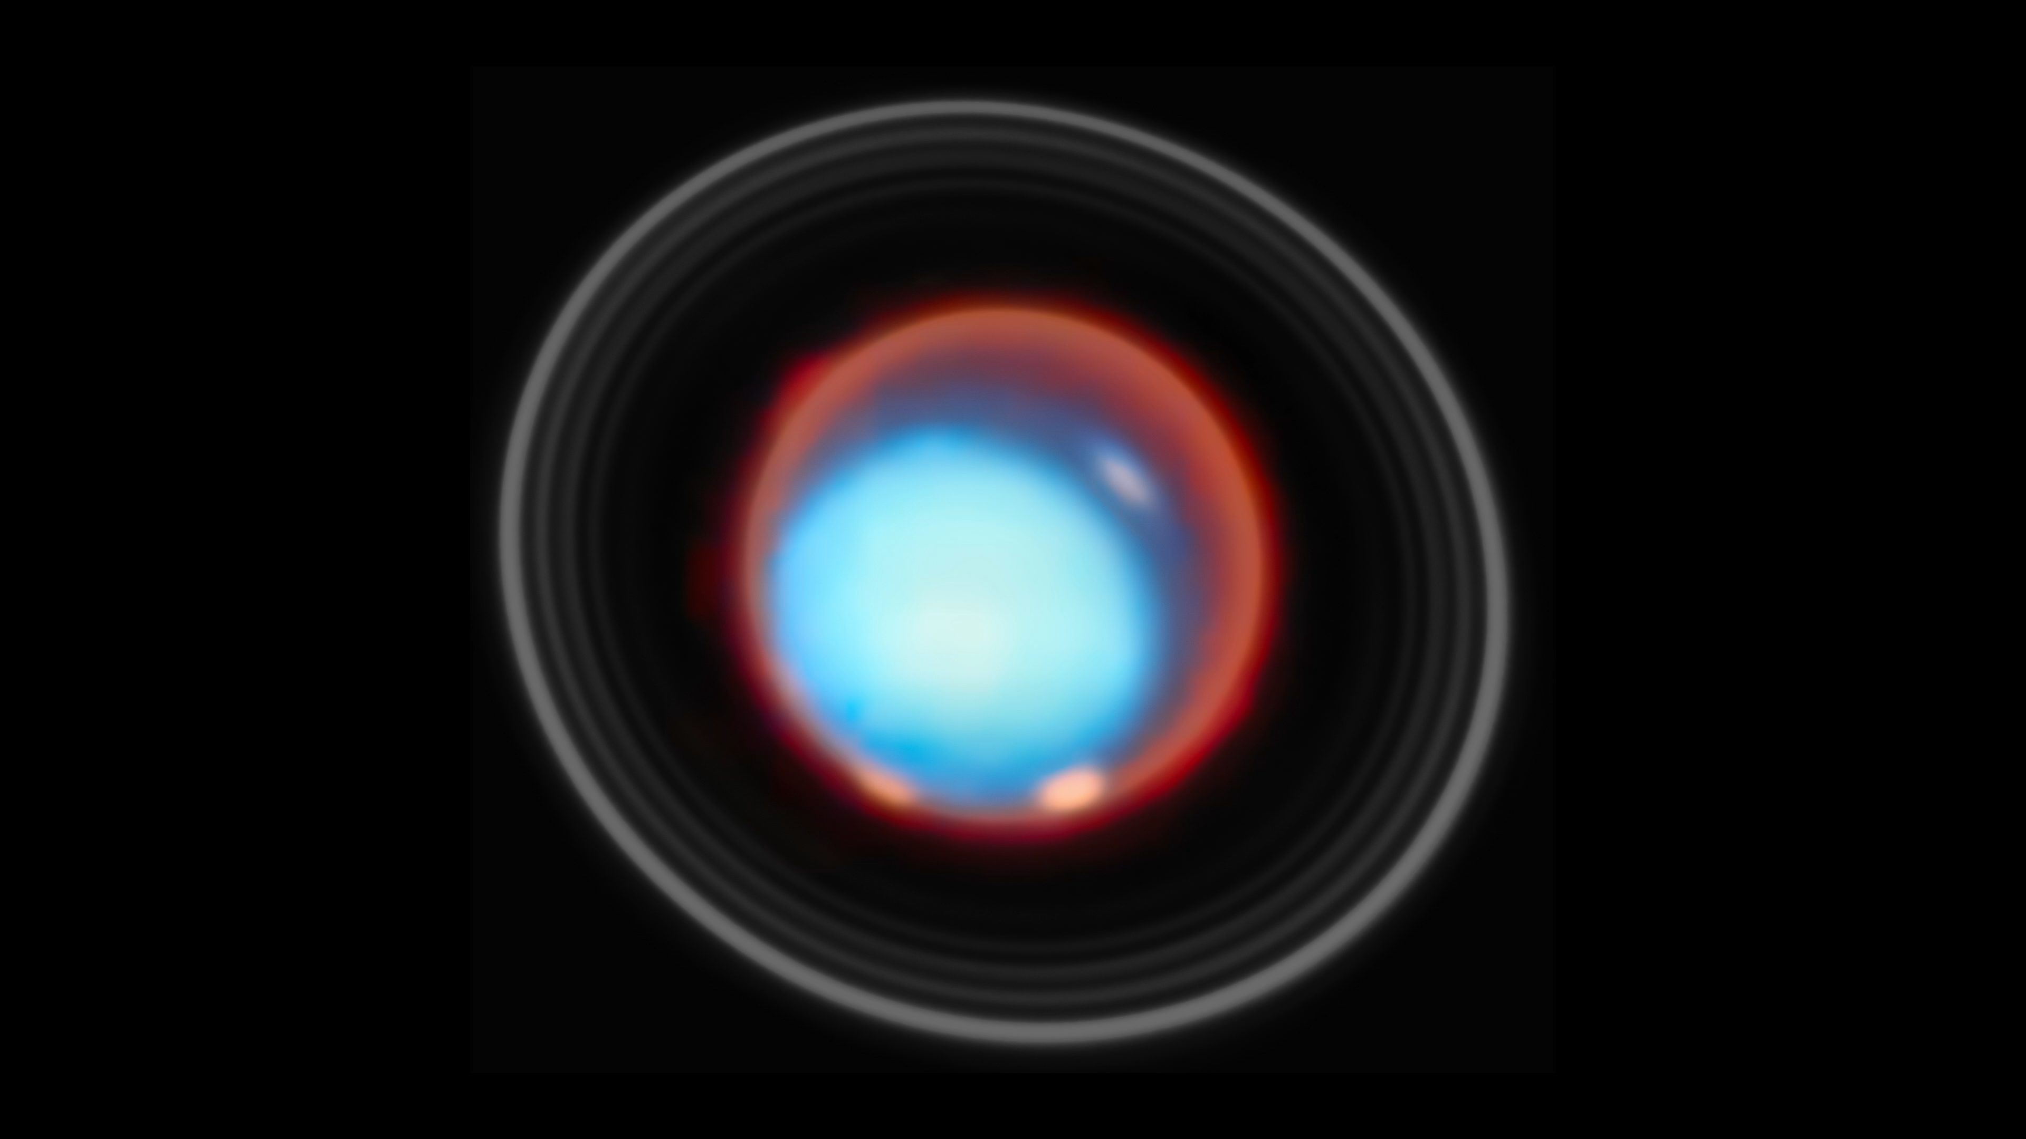
Beyond Expectations:
JWST Status and Outlook
Tom Brown (STScI)
Map of Uranus’s Upper Atmosphere
NASA/ESA/SCA JWST/NIRSpec IFU
Study Lead:
Paola Tiranti (Northumbria U., UK)
Program Principal Investigator:
Henrik Melin (Northumbria U., UK)
Visualization:
Mahdi Zamani (ESA/Webb)

Slide 2
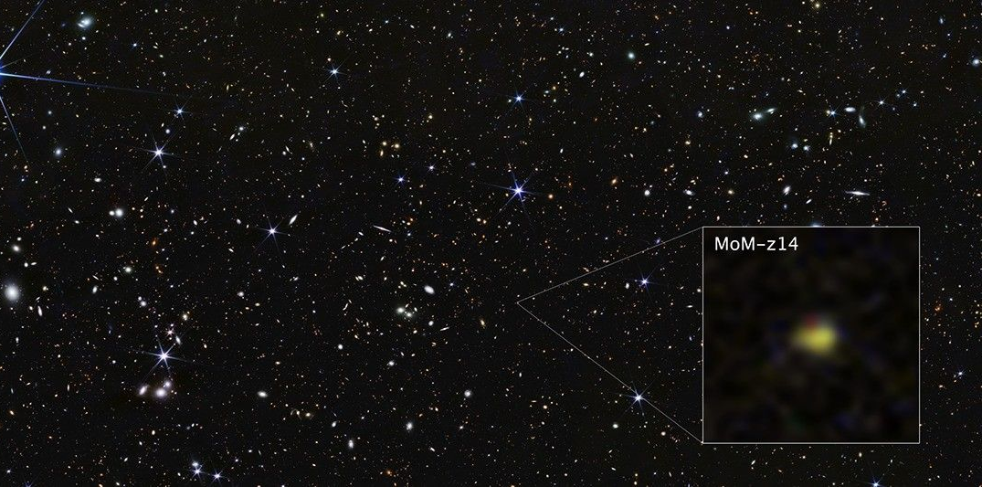
Summary
Webb Pushes Boundaries of Observable Universe Closer to Big Bang
(NASA and ESA press releases 28-Jan-2026)
Spectacular science across all of astronomy
  1,025+ refereed papers published in 2025 (2,200+ since launch)
  Significant time going into high-z (~25%) and exoplanets (~30%)
    Rocky Worlds Director’s Discretionary Time program spending
    500 hours Webb and 250 orbits Hubble searching for atmospheres
    on rocky exoplanets in M-dwarf systems
Webb demand continues to break records
  Record-breaking 2900+ proposals for Cycle 5
  Oversubscription of ~13:1
  Good response to new capabilities
We are still early in the life of this incredible mission
  Expecting 20+ years of science operations
  Observatory and instruments are all performing far better than expectations
  JWST will be the most complex and capable observatory for years to come
  Capabilities, demand, and scientific output growing every year
  Detector operations and calibration have been
  steadily evolving and improving
A Cosmic Miracle: A Remarkably Luminous Galaxy at
z_{spec} = 14.44 Confirmed with JWST (Naidu+2026, OJA; arXiv:2505.11263)

Slide 3
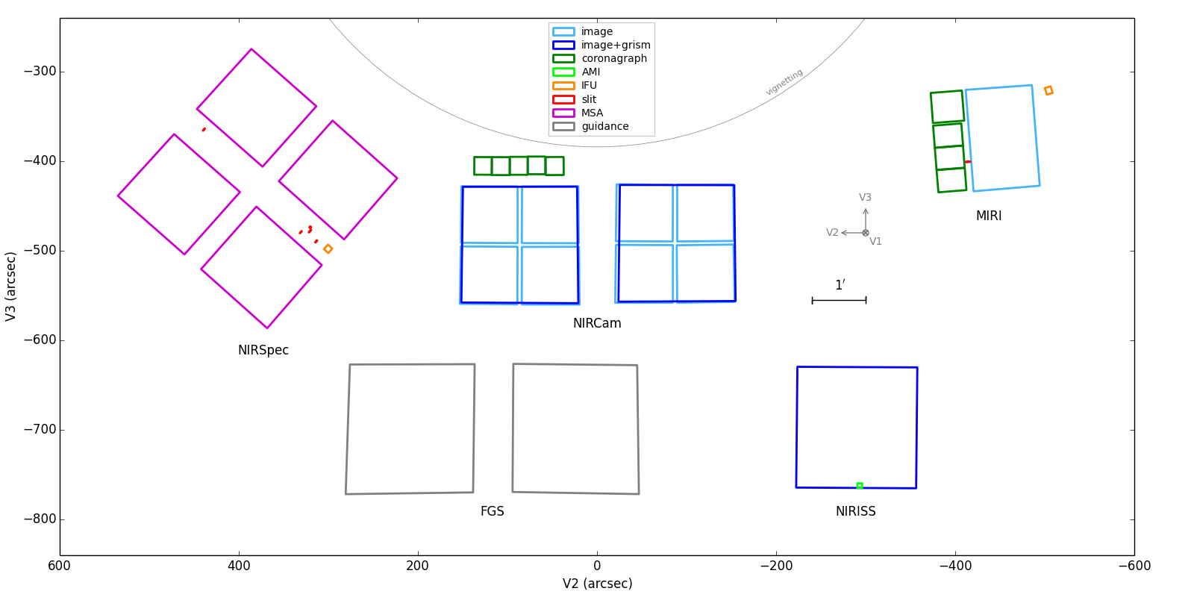
JWST’s 18 Detectors
Near-IR: 15 detectors (Teledyne HgCdTe H2RG 2048x2048),
each controlled via dedicated SIDECAR ASIC
Mid-IR: 3 detectors (Raytheon Vision Systems Si:As 1024x1024)
1 imaging (5 – 28 μm)
2 spectroscopy (5 – 28 μm)
8 short-λ (0.6 – 2.3 μm)
2 long-λ (2.4 – 5 μm)
2 @ 0.6 – 5 μm
2 @ 0.6 – 5 μm
1 @ 0.6 – 5 μm

Slide 4
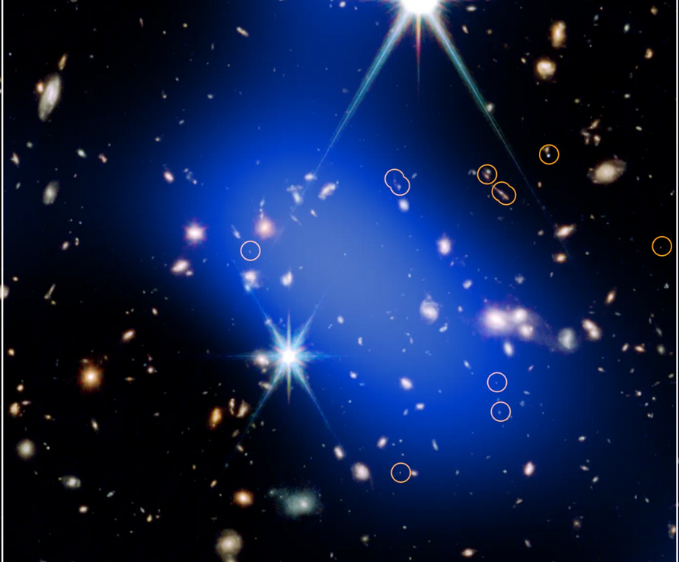
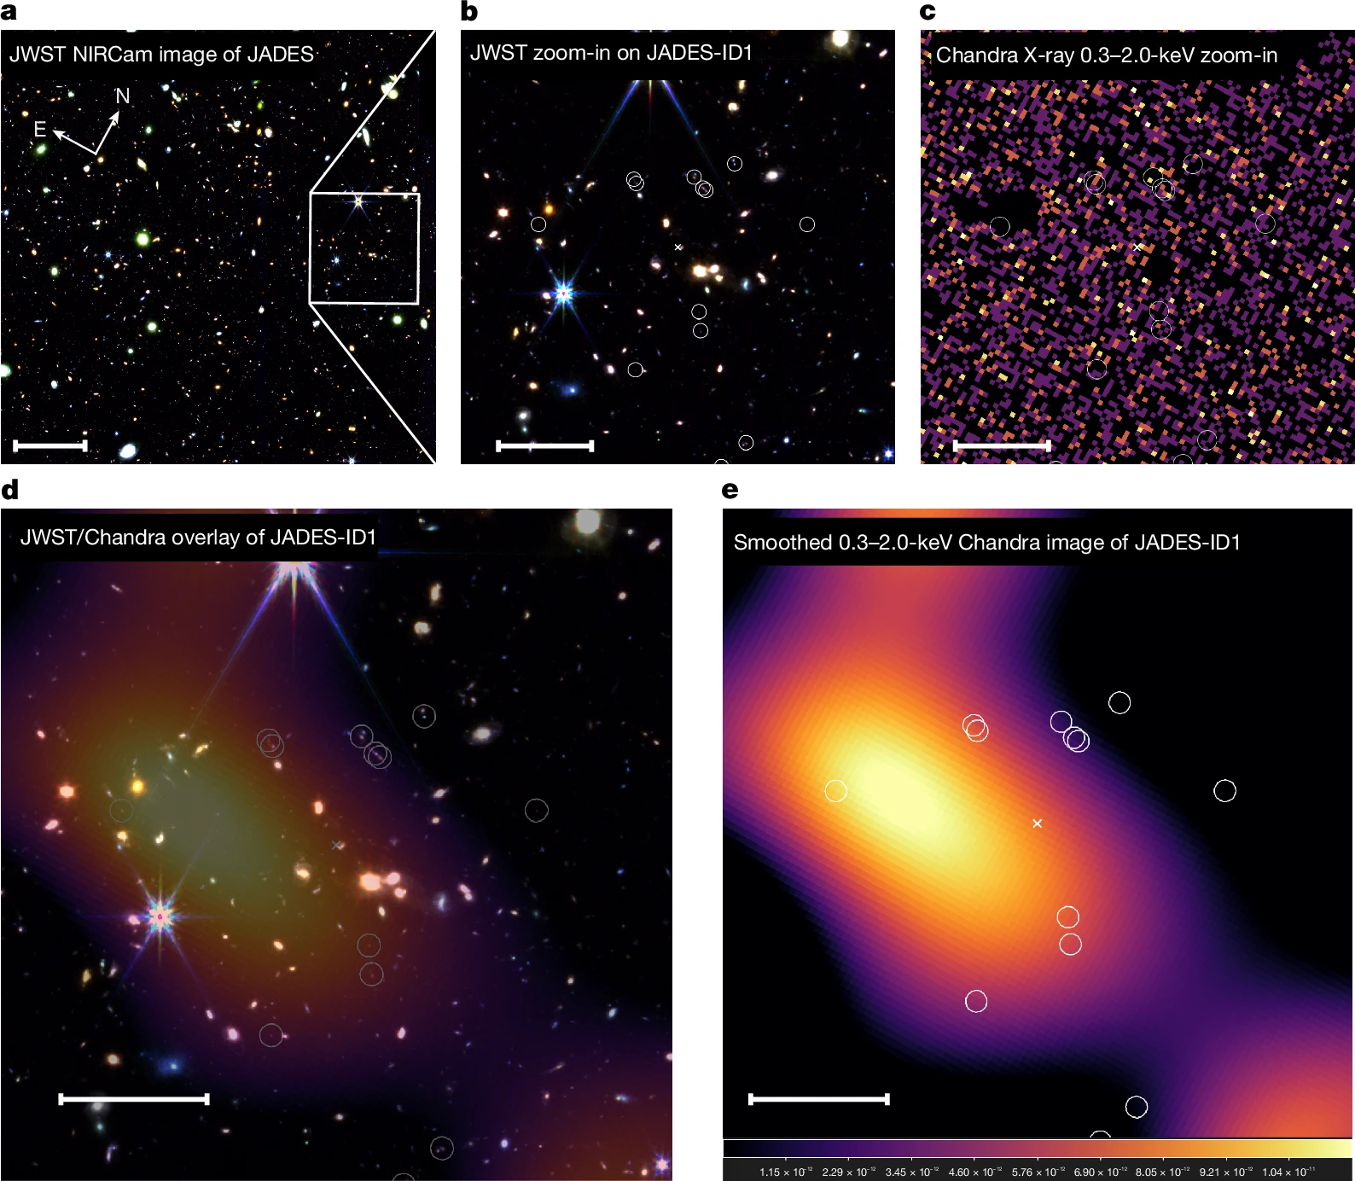
Enabling Transformative Science Across the Entire Field
Webb is revealing the rapid evolution of the early universe
NASA Telescopes Spot Surprisingly Mature Cluster in Early Universe
press release at nasa.gov (28-Jan-2026)
An X-ray-emitting protocluster at z ≈ 5.7 reveals rapid structure growth
Bogdán+2026 (Nature, 649, 1134)

Slide 5
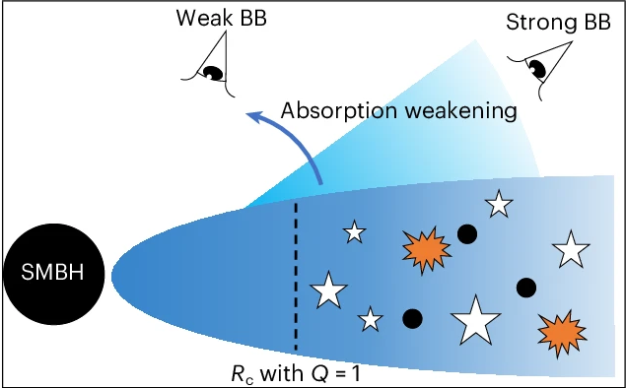
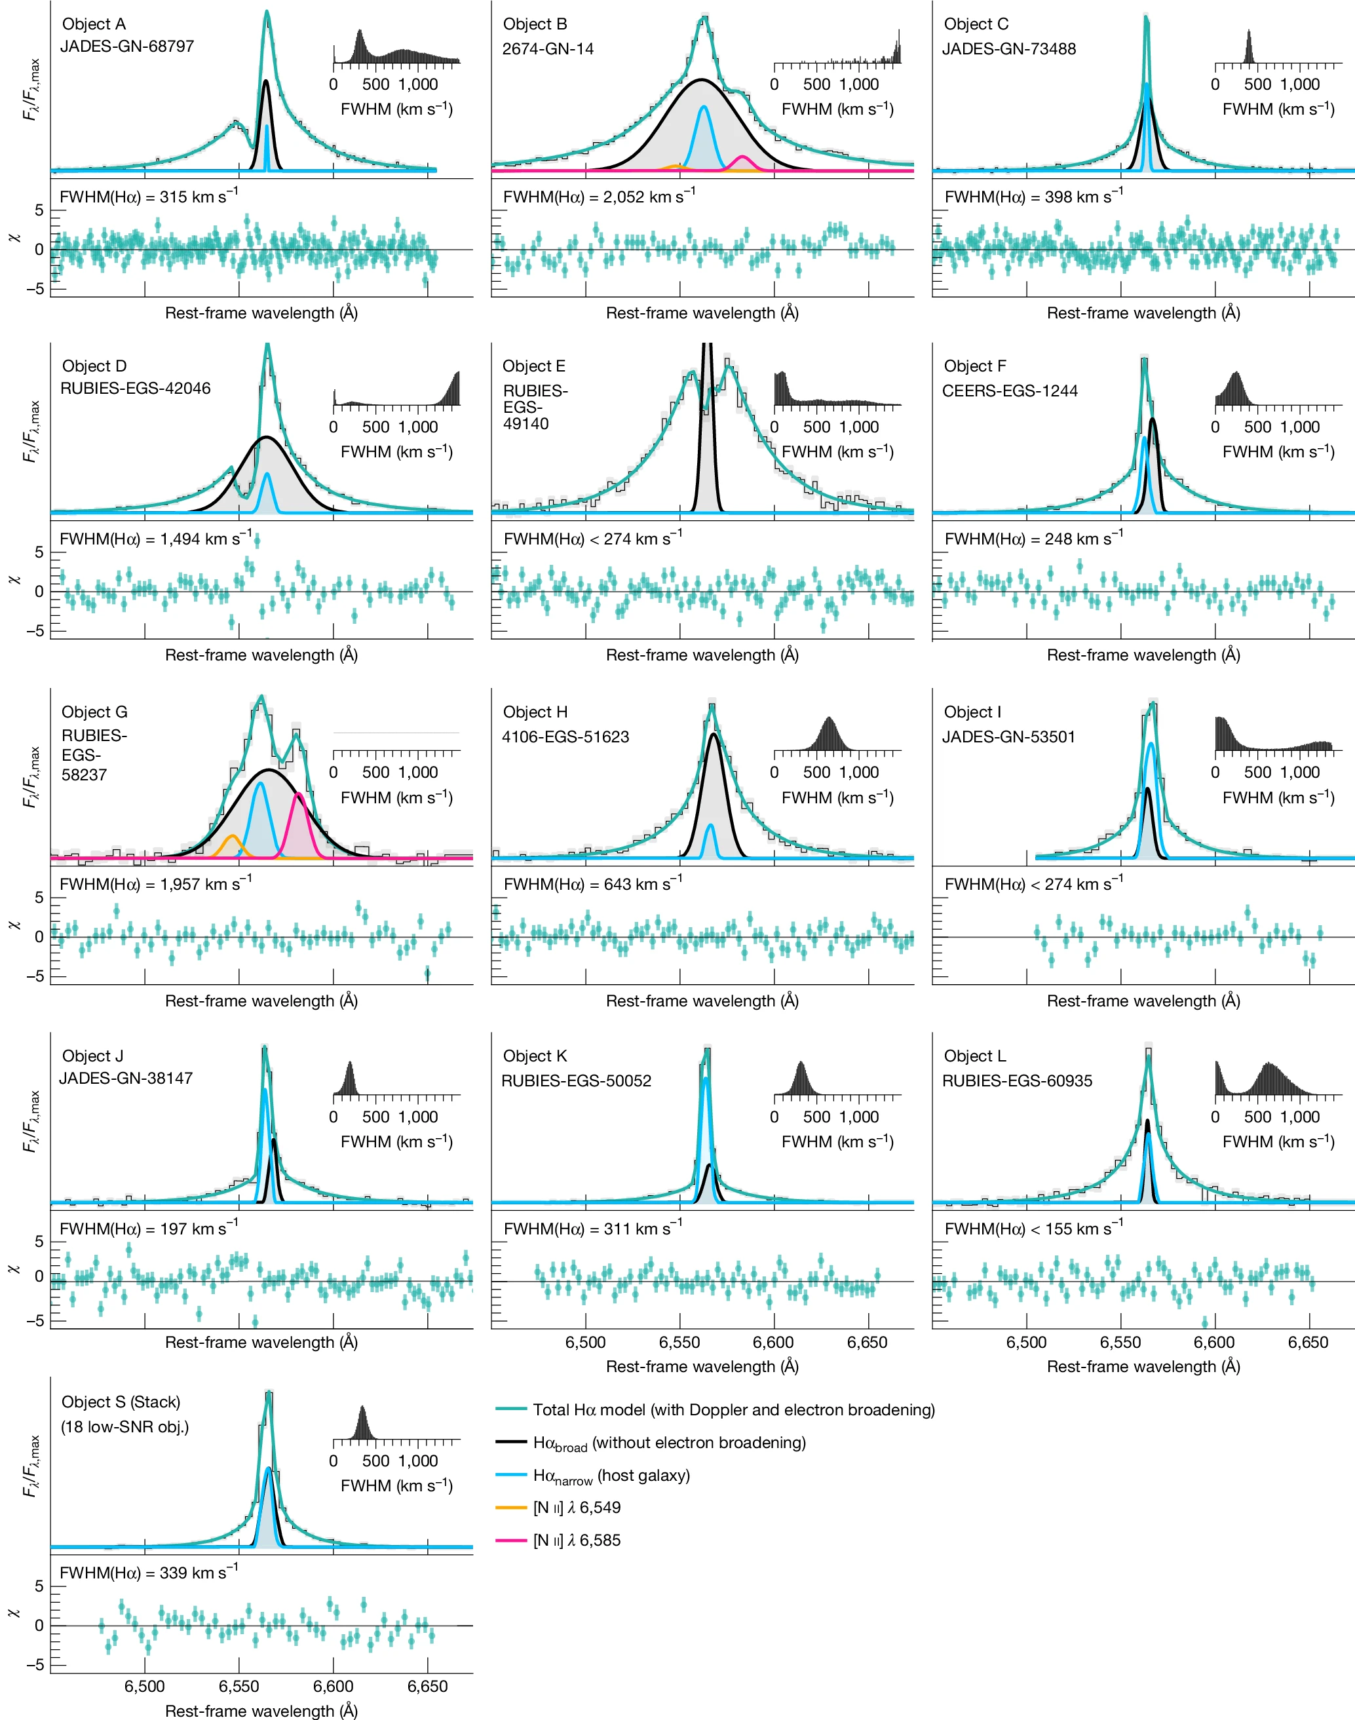
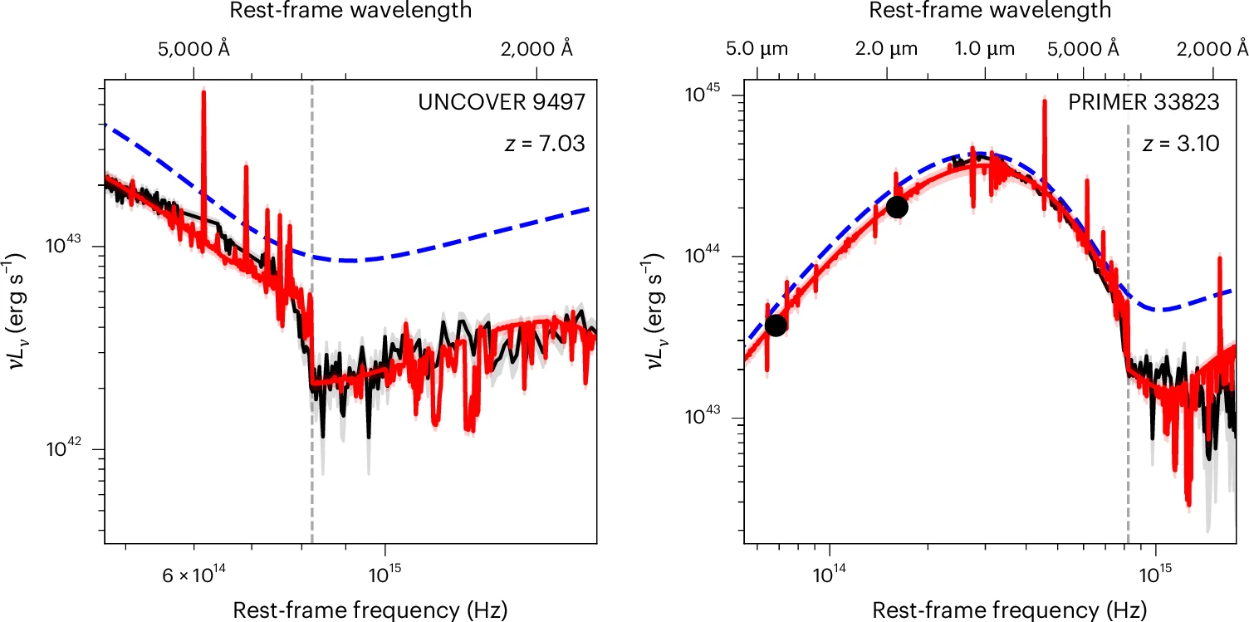
Enabling Transformative Science Across the Entire Field
Webb observations led to the discovery of a new galaxy class (Little Red Dots)
Studies are now exploring the physics of their early super-massive black holes
…
…
…
Little red dots as young supermassive black holes in dense ionized cocoons
Ruskakov+2026 (Nature, 649, 574)
The composite spectrum of little red dots from a standard inner disk and an unstable outer disk
Zhang+2026 (Nature Astronomy, in press)

Slide 6
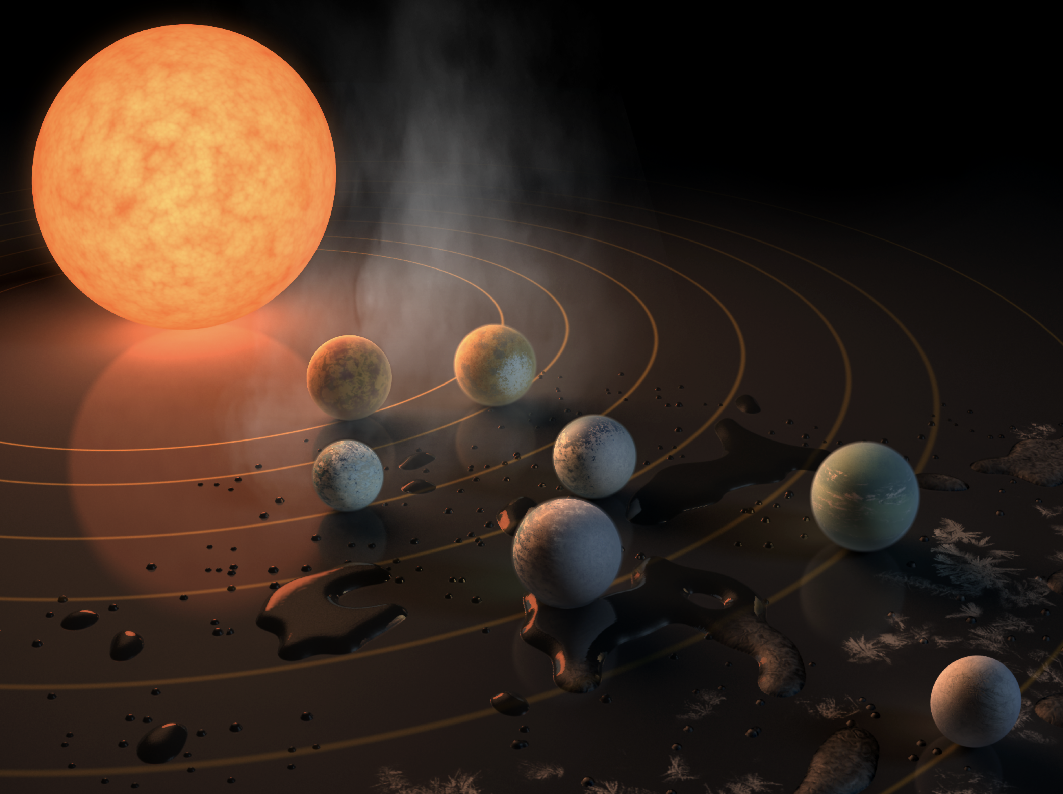
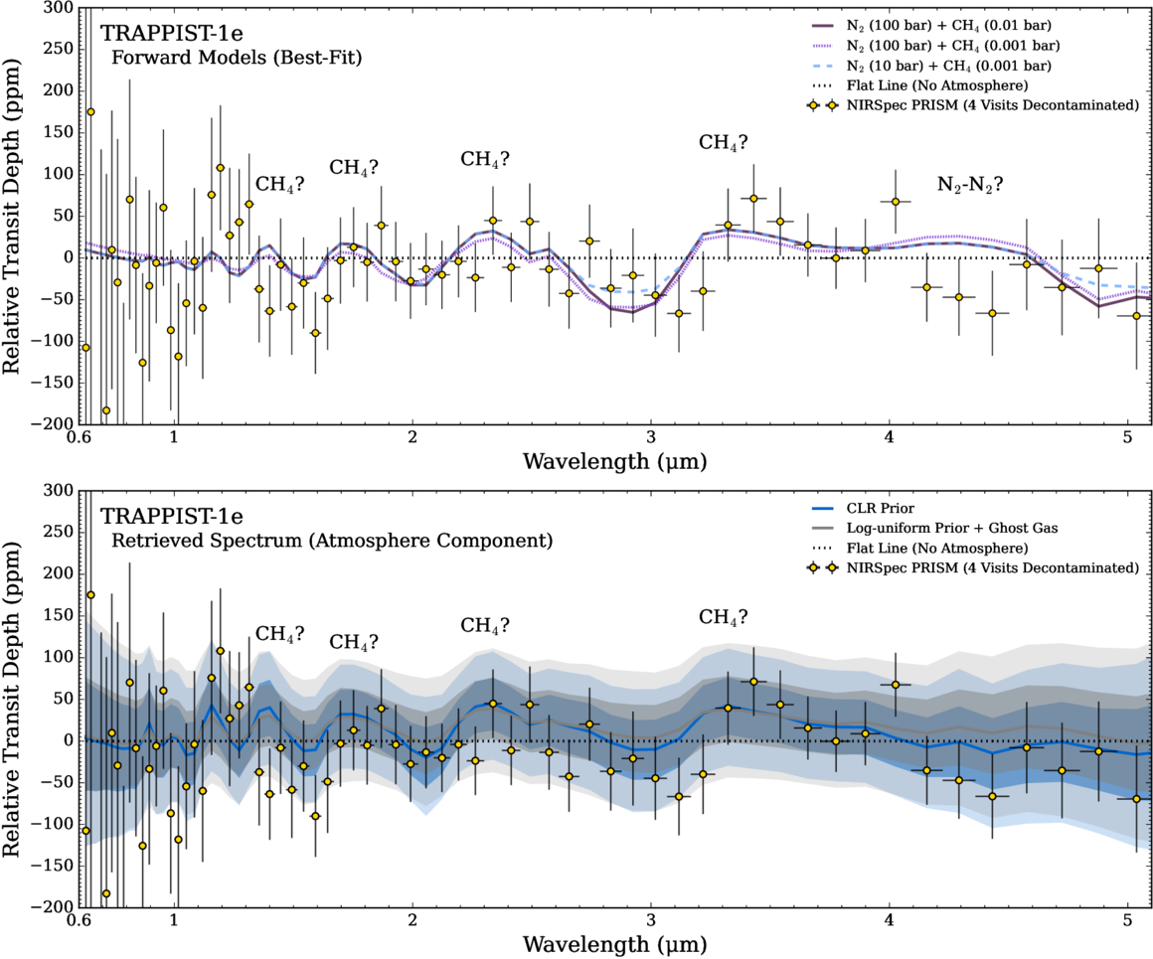
Enabling Transformative Science Across the Entire Field
JWST observations of the TRAPPIST-1 system are motivating dozen of papers to date
JWST-TST DREAMS: Secondary Atmosphere Constraints for the Habitable Zone Planet TRAPPIST-1e
Gilden+2025 (ApJL, 990, 53)
TRAPPIST-1 system
(artist rendition)
TRAPPIST-1c
no thick atmosphere
TRAPPIST-1e
no thick H₂ atmosphere
TRAPPIST-1b
no atmosphere
TRAPPIST-1g
analysis underway
TRAPPIST-1d
no thick H₂ atmosphere
TRAPPIST-1f
analysis underway
TRAPPIST-1h
analysis underway

Slide 7
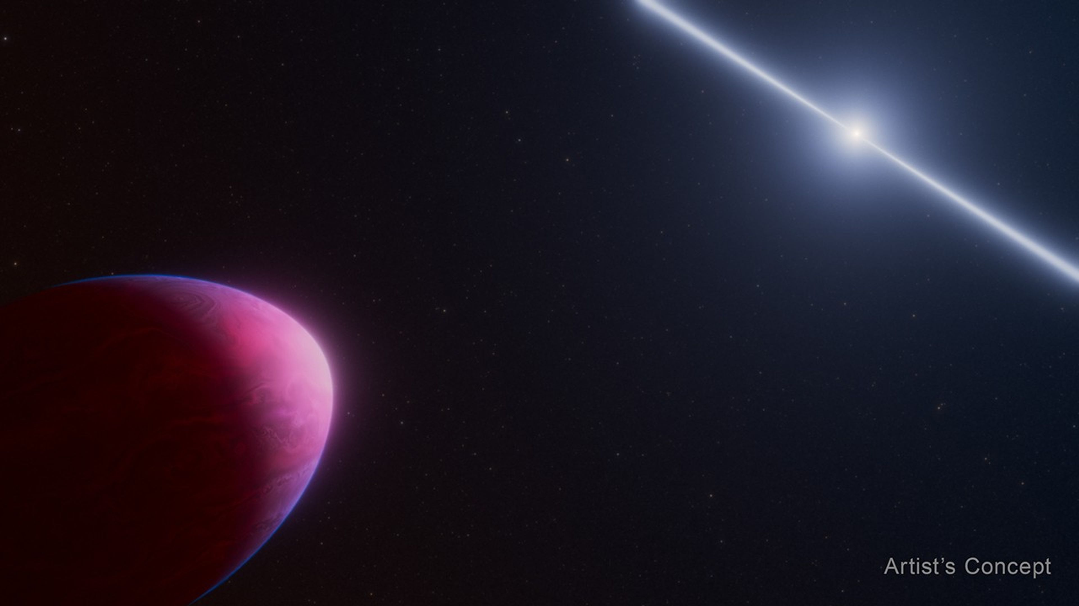
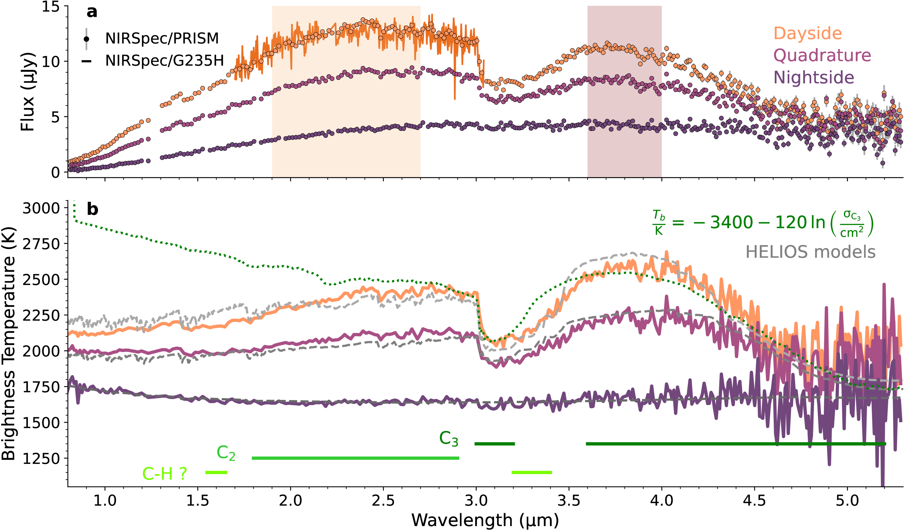
Enabling Transformative Science Across the Entire Field
Webb is exploring exoplanets in exotic environments
NASA’s Webb Observes Exoplanet Whose Composition Defies Explanation
press release on nasa.gov (16-Dec-2026)
A Carbon-rich Atmosphere on a Windy Pulsar Planet
Zhang+2026 (ApJL, 995, L64)

Slide 8
Enabling Transformative Science Across the Entire Field
Webb is constraining atmospheric compositions on sub-Neptune exoplanets
Near-IR
Mid-IR
A JWST Transmission Spectrum of the Temperate Sub-Neptune TOI-732 c
Rigby+2025 (ApJL, 95, 70)

Slide 9
Science Program
Cycle 4 observations well underway, expecting 50% complete by 14-Mar-2026
Cycle 5
  Call for Proposals issued 1-Aug-2025, with proposal deadline of 15-Oct-2025
  Record response: 2,900+ proposals and 13:1 oversubscription
  Implemented changes to ease burden on reviewers and staff
  Telescope Allocation Committee met 2 – 12 Feb 2026
  Award notifications mid-to-late March 2026
  Good community response to new features in this call:
    MIRI Wide-field slitless spectroscopy (see upcoming slide slide)
    New Long-Term Monitoring (up to 5 cycles) and Roman Preparatory Science initiative
    NIRCam coordinated parallels with NIRSpec IFU as prime instrument
    Moving target shadow observations (see upcoming slide)
    Multi-stripe readout to enable brighter targets for NIRISS Single Object Slitless Spectroscopy (see upcoming slide)
Cycle 6
Call for Proposals will be issued 20-Jul-2026, with proposal deadline 30-Sep-2026
Moved 2 weeks earlier in response to NASA direction to avoid fiscal year boundary and potential government shutdown

Slide 10
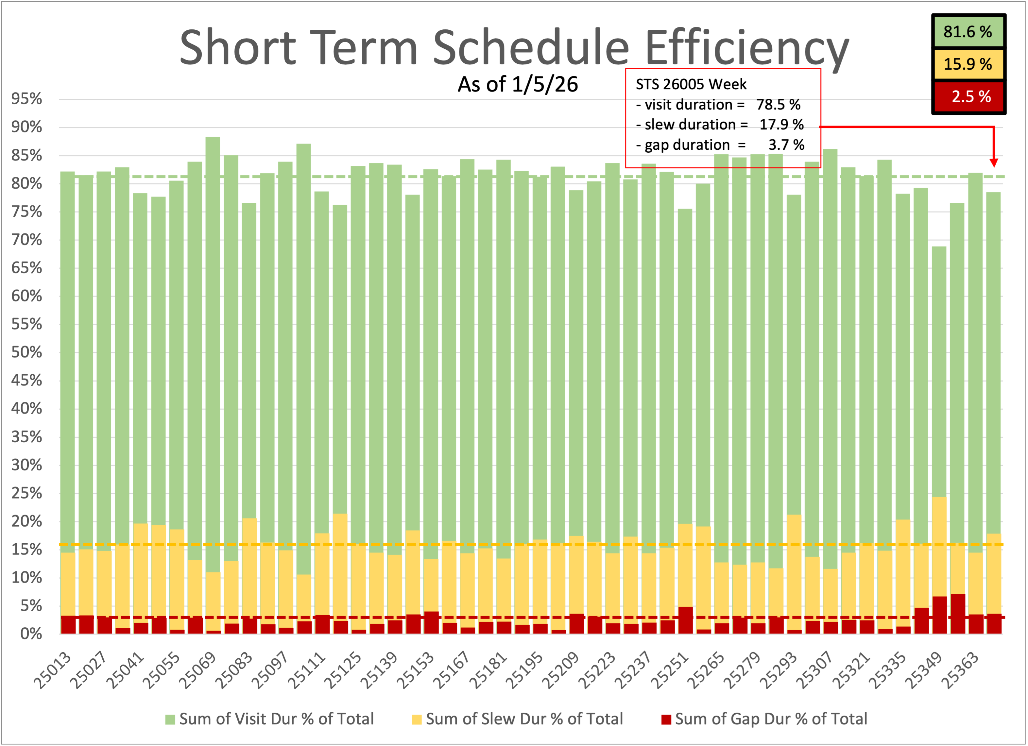
Webb Performance Exceeding Expectations
  Longer lifetime: 20+ yrs for propellant, spacecraft, mirror, instruments
  requirement: 5-10 years
  Less frequent orbit maintenance: 42-day cadence
  requirement: 21 days
  Wavefront sensing: every 4 days
  Wavefront control: every 12+ weeks
  requirements: 2 days and 2 weeks
  Superior image quality: wavefront error of ∼70 nm
  requirement: 150 nm
  Image quality has >80% probability of meeting
  requirements through 2045
  Line-of-sight jitter: <1 mas
  requirement: ≤7 mas
  Faster tracking of moving targets: >100 mas/s
  requirement: ≥30 mas/s
  High guide-star acquisition success rate: 98% in C4
  requirement: 89% probability (fixed targets)
JWST wavefront error, measured and corrected
M. Lallo (STScI)

Slide 11
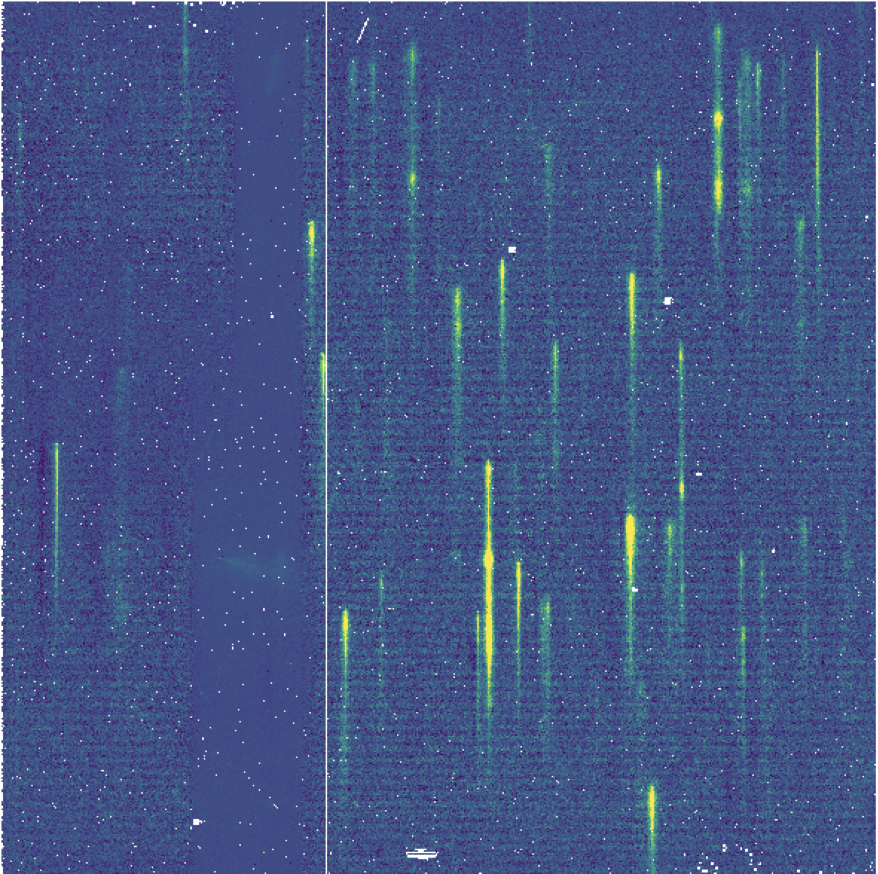
New Cycle 5 Capability: MIRI Wide-Field Slitless Spectroscopy
Uncharted observational parameter space
Documented in JDox
First test observation looks great
Calibration pipeline development underway
Prime capability (only) in Cycle 5
Planned for Cycle 6
  Obtain NIRCam imaging as coordinated parallel
  Use MIRI WFSS as pure parallel (attached later)
S. Kendrew (STScI)

Slide 12
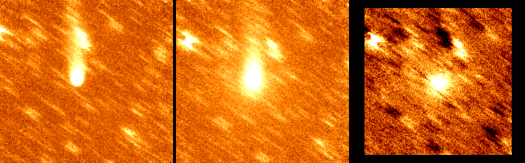
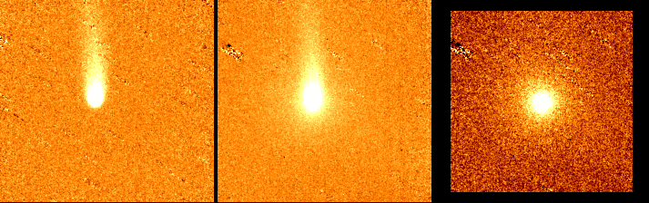
New Cycle 5 Capability: Shadow Observations for Moving Targets
Without shadow observations
Allows subtraction of smeared background stars in moving target observations by repeating the observation after the target has moved out of the field
Complicated because JWST dynamically adjusts the execution timeline
Particularly useful for faint, extended targets
(e.g., comets)
NIRCam imaging implementation in final stages
(work ongoing for other instrument modes)
3.6 μm
4.5 μm
Difference (gas)
With shadow observations
Left: Example of shadow observations with Spitzer imaging of a comet. Top is the analysis without shadow observations; bottom is the analysis with shadow observations.
Comet observation from Kelley et al. Spitzer Program ID 10164
M. Boyer (STScI)

Slide 13
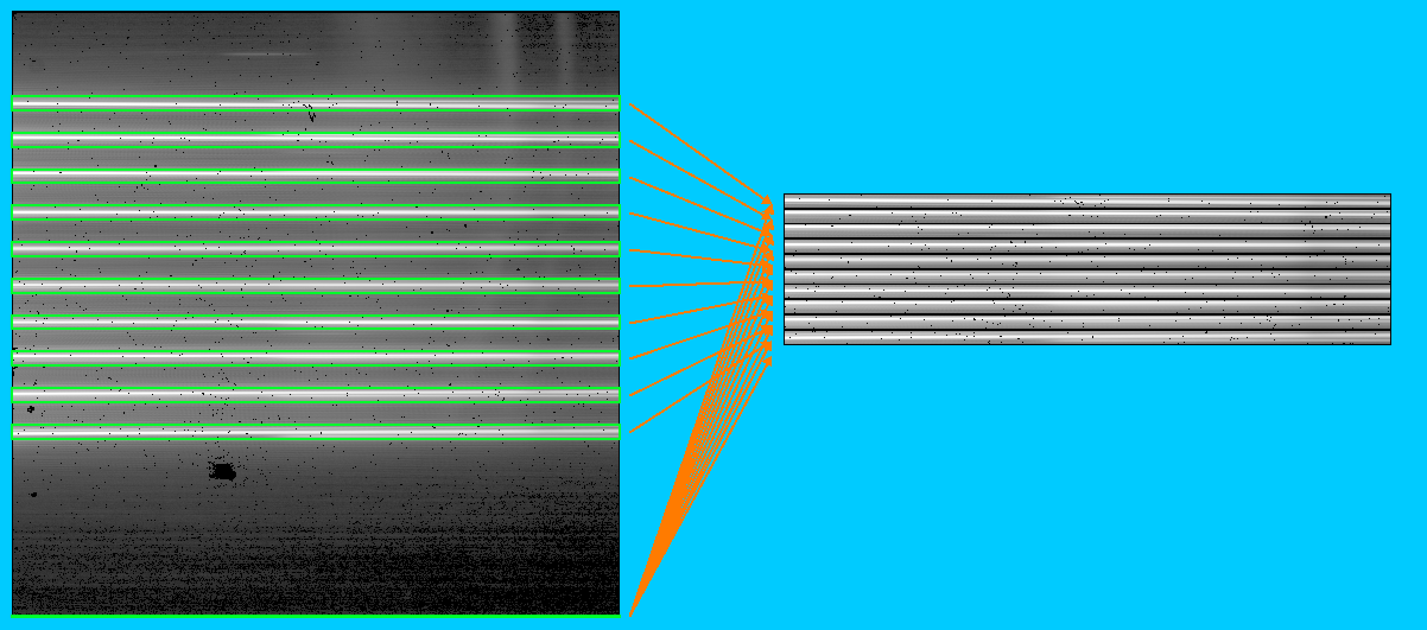
New Capabilities in Cycle 4 and Beyond: Multistripe
Evolving Detector Operations via SIDECAR ASIC
Cycle 4 began rollout of new “multistripe” detector mode to near-IR instruments
Multistripe – substripe
  reads & packages disjoint regions into single frame
Multistripe – superstripe
  shifts subarray location after each integration
  maps a larger region
Multistripe reads reference pixels at detector edge before science pixels in frame
Cycle 4: NIRCam Grism Time Series enhancement
Cycle 5: NIRISS SOSS exoplanet enhancement
Cycle 6: NIRSpec prism exoplanet up next
NIRCam Imaging up next
E. Bergeron (STScI)
Multistripe-substripe
Efficiently reads and packages disjoint spectra and reference pixels into a smaller single frame
Conceived by E. Bergeron (STScI)
Implemented for flight by NASA/GSFC
Valuable testing help from Karl Misselt
(Steward Obs., NIRCam team)

Slide 14
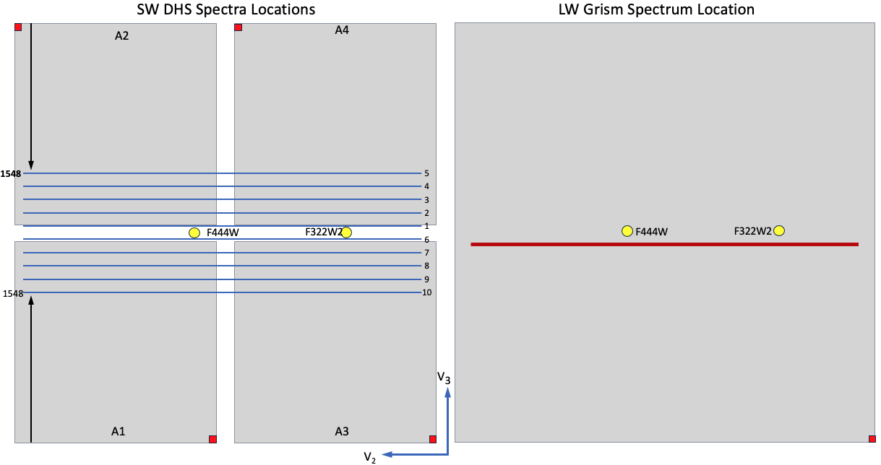
New Cycle 4 Capability: NIRCam Shortwave Grism Time-Series Mode
Evolving Detector Operations via SIDECAR ASIC
Uses Dispersed Hartmann Sensor (DHS)* to obtain
short-λ (0.6 – 2.3 μm) time-series observations (TSO) taken simultaneously with long-λ (2.4 – 5 μm) TSO
Broader wavelength coverage helps break exoplanet model degeneracies
Multi-stripe capability efficiently reads and packages disjoint spectral regions into single frame
Reduces frame time by skipping uninteresting pixels
Enables observations of brighter sources without saturation
Implementation underway to enable observations in the current cycle (Cycle 4)
*DHS used to phase mirrors during commissioning
M. Boyer (STScI)
Location of 10 DHS spectra on short-λ detector (left) taken simultaneously with long-λ spectrum (right)
Short-λ spectra can be read in separate subarrays

Slide 15
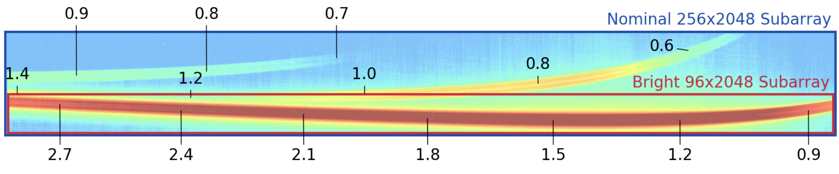
New “Superstripe” Detector Mode in Cycle 5
Evolving Detector Operations via SIDECAR ASIC
  Use with NIRISS Single-Object Slitless Spectroscopy (SOSS)
  Superstripe obtains complete integration for each stripe before shifting to next stripe
  Smaller stripes have shorter frame times, enabling brighter targets without saturation
  Dramatically improved bright limit at the expense of duty cycle:
  J ∼ 3.5 mag for smallest stripe size
  Enables observations of exoplanets transiting bright stars (all known hosts)
P. Goudfrooij (STScI)

Slide 16
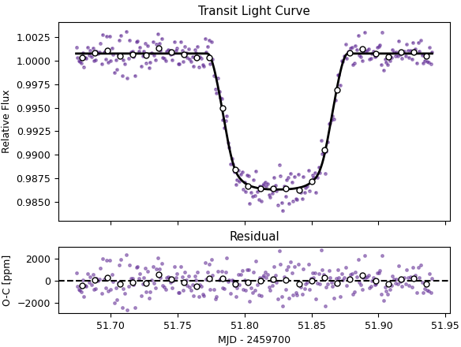
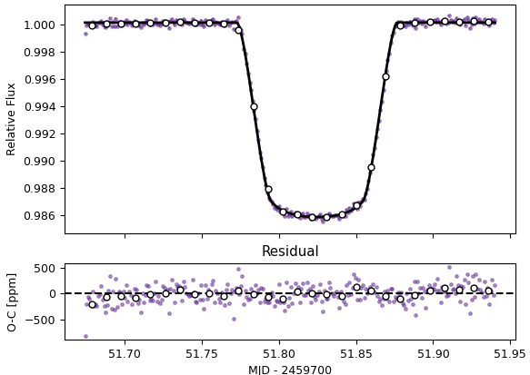
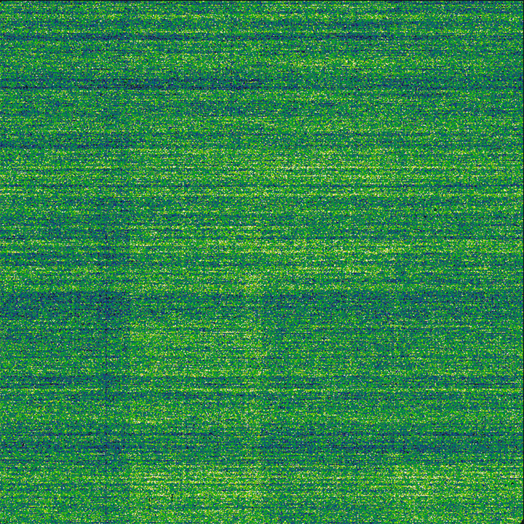
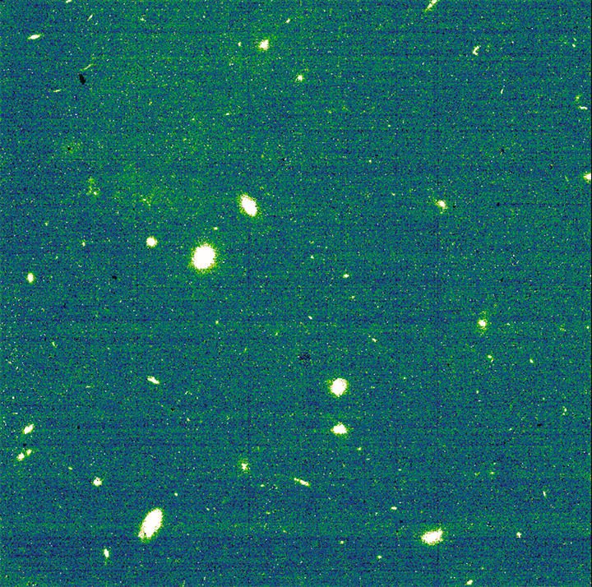
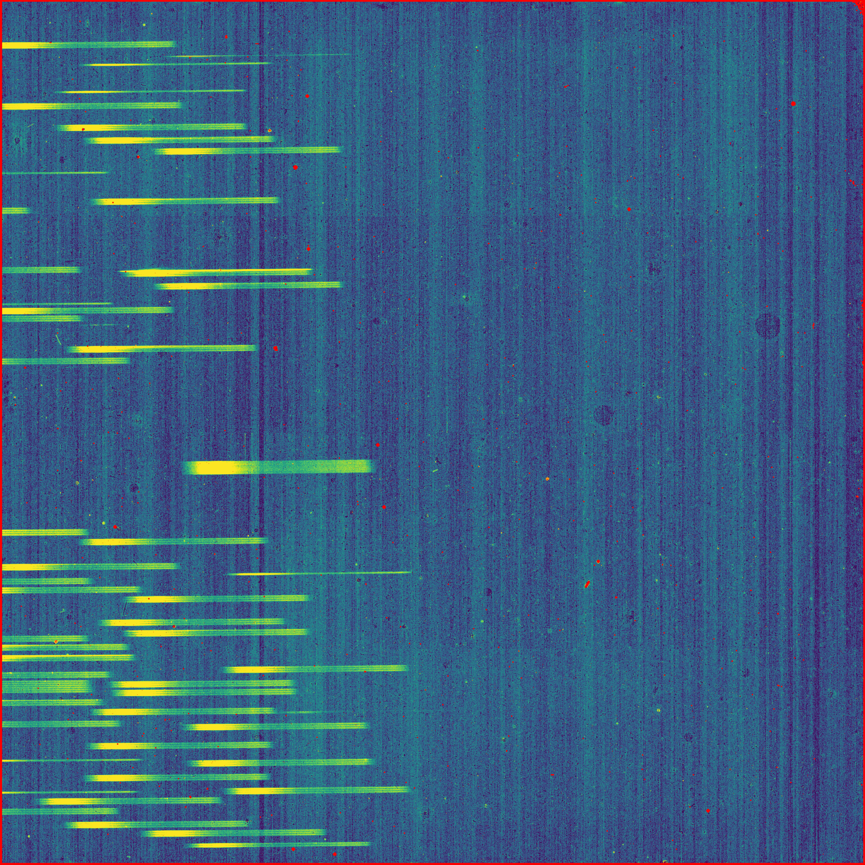
Correction for 1/f Noise
Improving Mitigation of Detector Artifacts
NIRISS Single-Object Slitless Spectroscopy
  JWST’s near-IR detectors experience correlated noise
  Obvious stripes in exposures in frames and groups of frames
    Stripes are in fast-read direction
  Calibration Pipeline Build 11.1 (Sep 2024) introduced optional step (clean_flicker_noise) to mitigate 1/f noise
  Build 12.0 (Aug 2025) improved the correction
    B. Rauscher (NASA/GSFC) determined optimal reference pixel kernels
    Correction does not depend upon scene
    Correction is now the default for NIRSpec (non-IRS²) and NIRCam
  Build 12.3 (May 2026) will provide 1/f correction for NIRISS SOSS (right)
D. Law
(STScI)
R. Cooper (STScI)

Slide 17
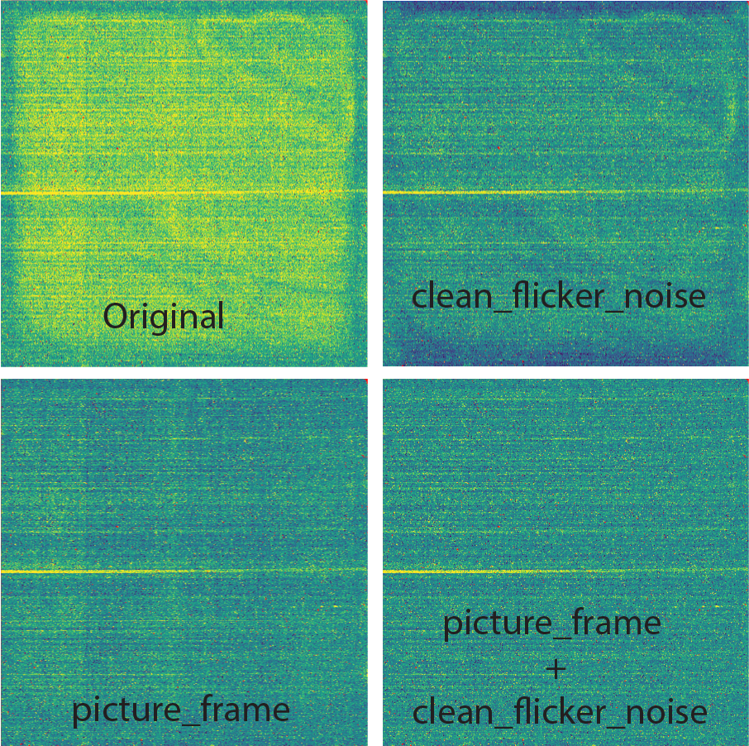
Correction for Picture Frame
Improving Mitigation of Detector Artifacts
1/f noise
signal
  Small thermal transients in the NIRSpec detectors produce “picture frame” artifacts that bias the 1/f noise correction and the recovered fluxes
    Mostly due to switching IRS² mode
    Smaller transients when starting new exposure
    Also, small random variations because detector cannot be controlled at the milli-Kelvin level
  Optional picture-frame correction coming in pipeline build 12.3 (May 2026)
D. Law (STScI)

Slide 18
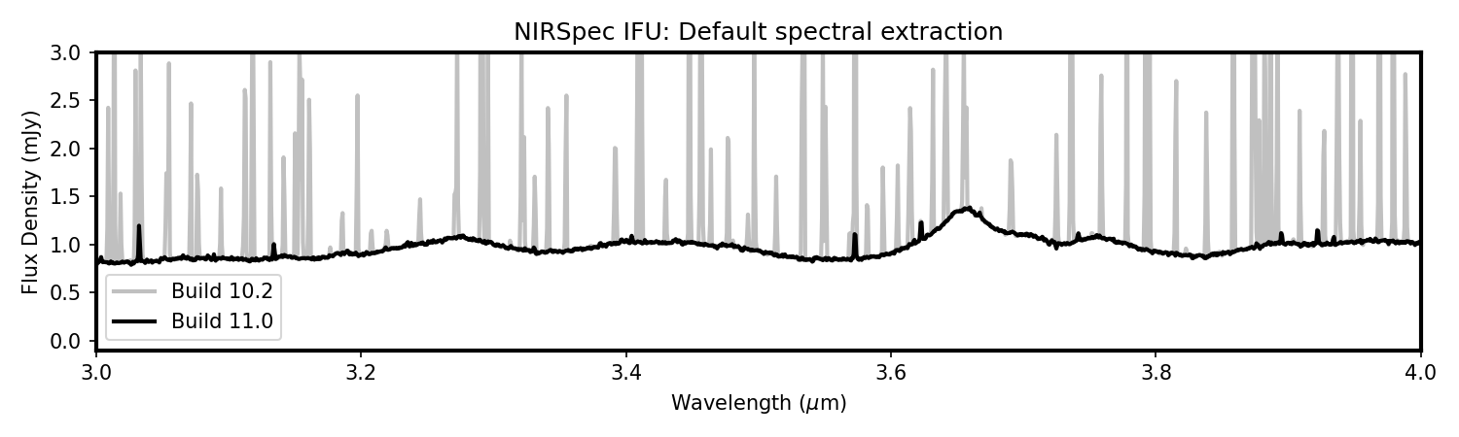
Correction for Cosmic Rays
Improving Mitigation of Detector Artifacts
D. Law (STScI)
  JWST can coadd frames into “groups” to fit within downlink bandwidth
  Identification of saturation can be challenging in grouped readouts
  Cosmic rays saturating in Group 2 can be distinct from simple saturation
  Can be dominant type of bad pixel in extracted spectrum
  Pipeline build 11.0 (June 2024) implemented saturation checks that accounted for group-averaging algorithms

Slide 19
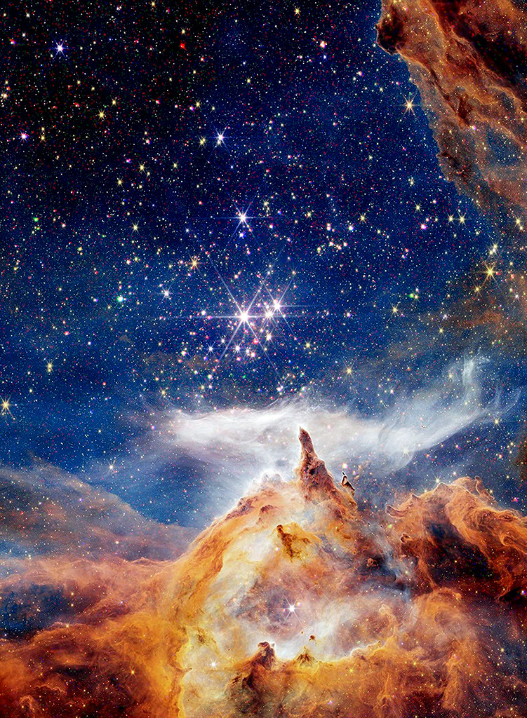
Summary
NGC 6357
Webb + Chandra
(nasa.gov press release)
Science impact is accelerating
Demand is accelerating
Performance exceeds expectations
Detector operations and calibration are evolving & improving

