Slide 1

An Overview of Three Decades of Infrared Detectors in Space
Massimo Robberto
Space Telescope Science Institute
Johns Hopkins University

Slide 2
Why Infrared Astronomy
Star formation occurs in dusty environments
Cosmological redshift
Cool objects radiate mostly in IR
Why IR from Space
Earth's atmosphere absorbs most IR
Earths atmosphere emits in the VIS-IR windows
300K thermal background mitigated or remoed
Notes:
nfrared detectors opened new astrophysical regimes.

Slide 3
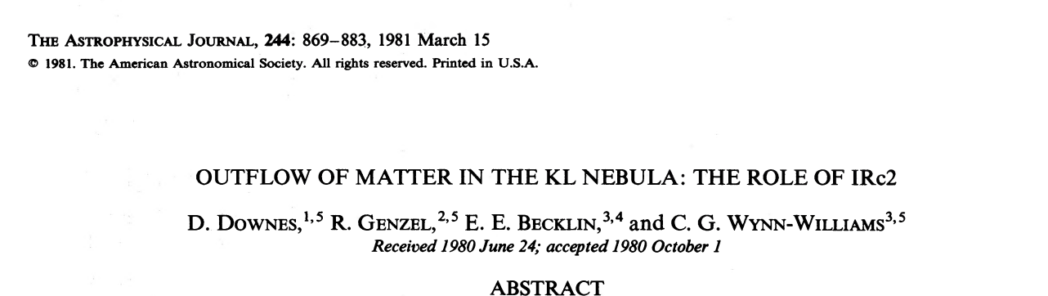
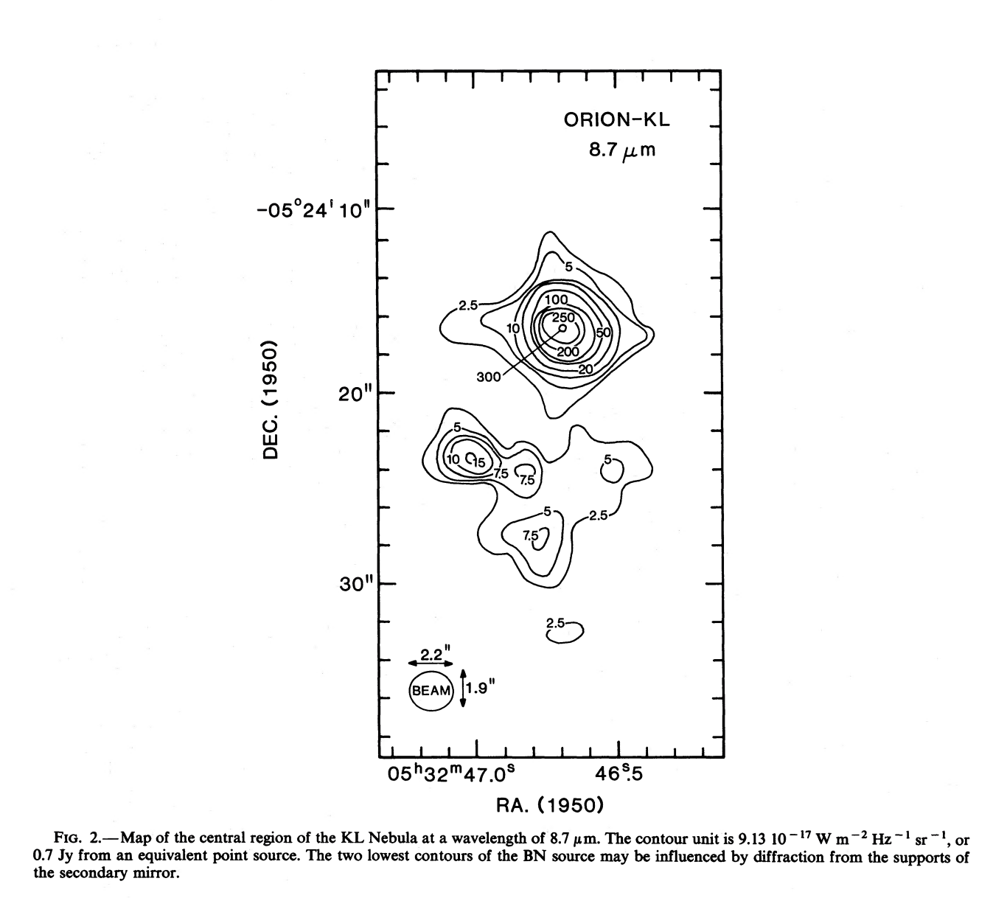

Early Infrared Detectors (pre-1986)
Pre-history:
Single element detectors
Small linear arrays
Mechanical scanning systems
Limitations:
Slow mapping
Limited imaging capability
“Chopping and Nodding”
“Bustrophedic Mapping”
Notes:
ESO NIRSPEC: 32 InSb diodes

Slide 4
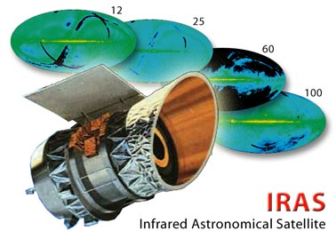
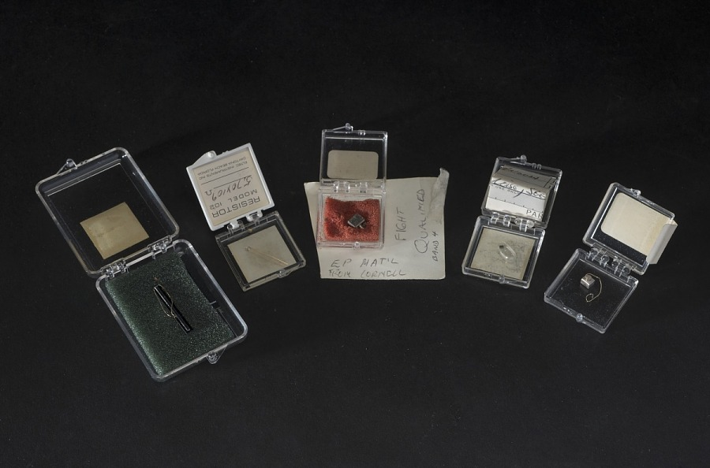
IRAS (Infrared Astronomical Satellite, 1983)
IRAS Detectors
Air and Space
Museum Collection
Washington, DC
Detector Type: Discrete, single-element detectors arranged in linear strips.
Technology: 62 detectors (mostly Silicon and Germanium based) that scanned the sky to build maps
Maker: Rockwell ~1980-1981

Slide 5
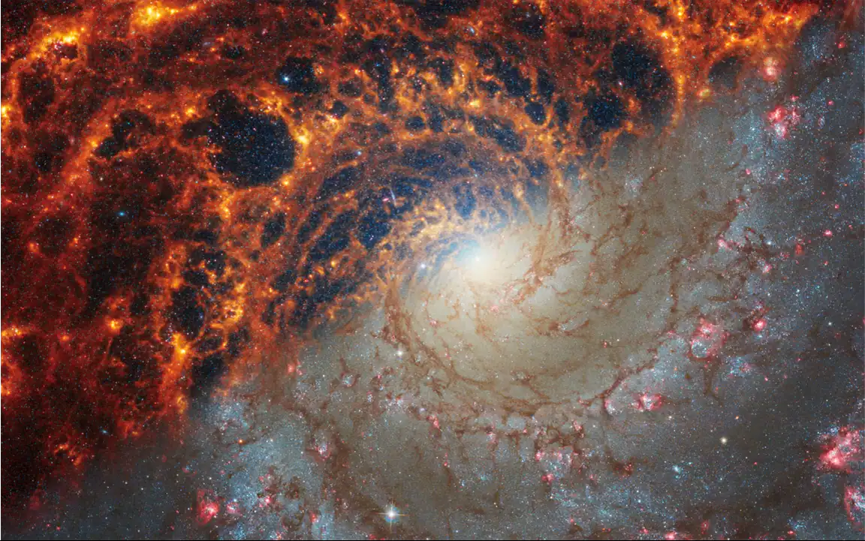
Orion Molecular Clouds
Janice Lee (STScI), Thomas Williams (Oxford), and the PHANGS team

Slide 6
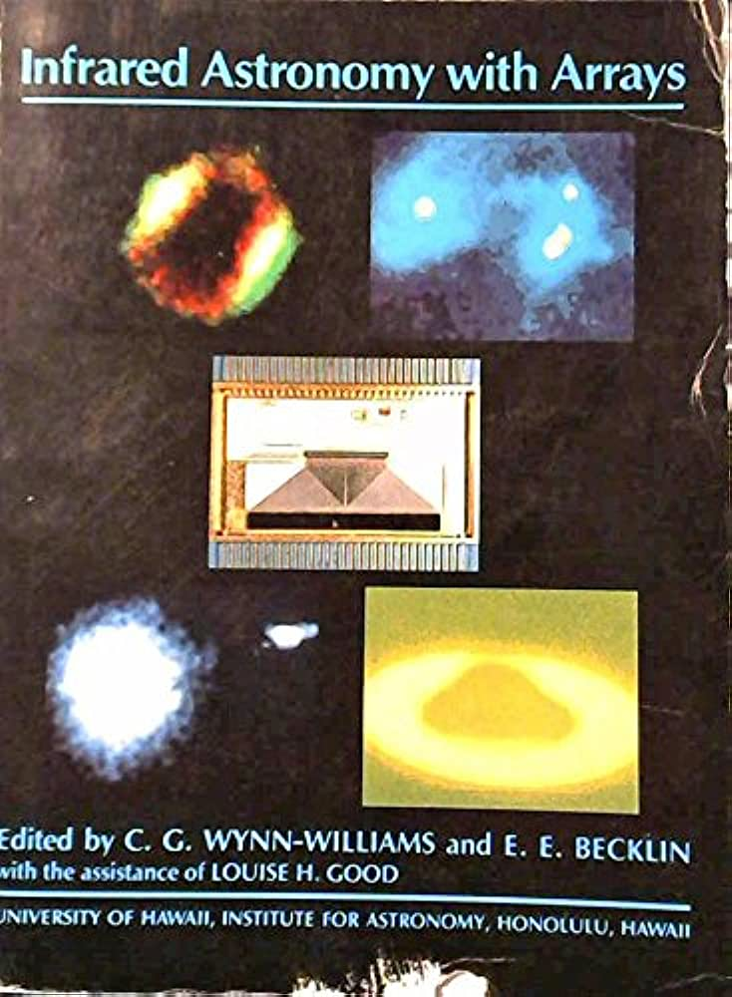
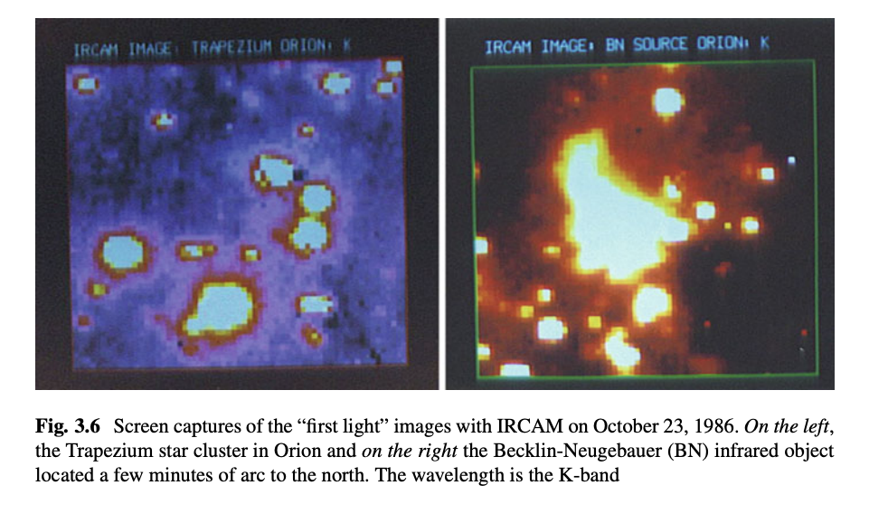
Mid 80’s: the first generation
1983: InSb 32x32 (SBRC Raytheon)
1986: Si:Ga, SiAs 10x64 (Rockwell)
1986/87: InSb, Si:Ga 58x62 (SBRC Raytheon)
University of Hawaii, Institute for Astronomy, 1987
I. Mc Lean “The IRCAM Revolution” in Thirty Years of Astronomical Discovery with UKIRT, Astrophysics and Space Science Proceedings 37, A. Adamson et al. (eds.)

Slide 7
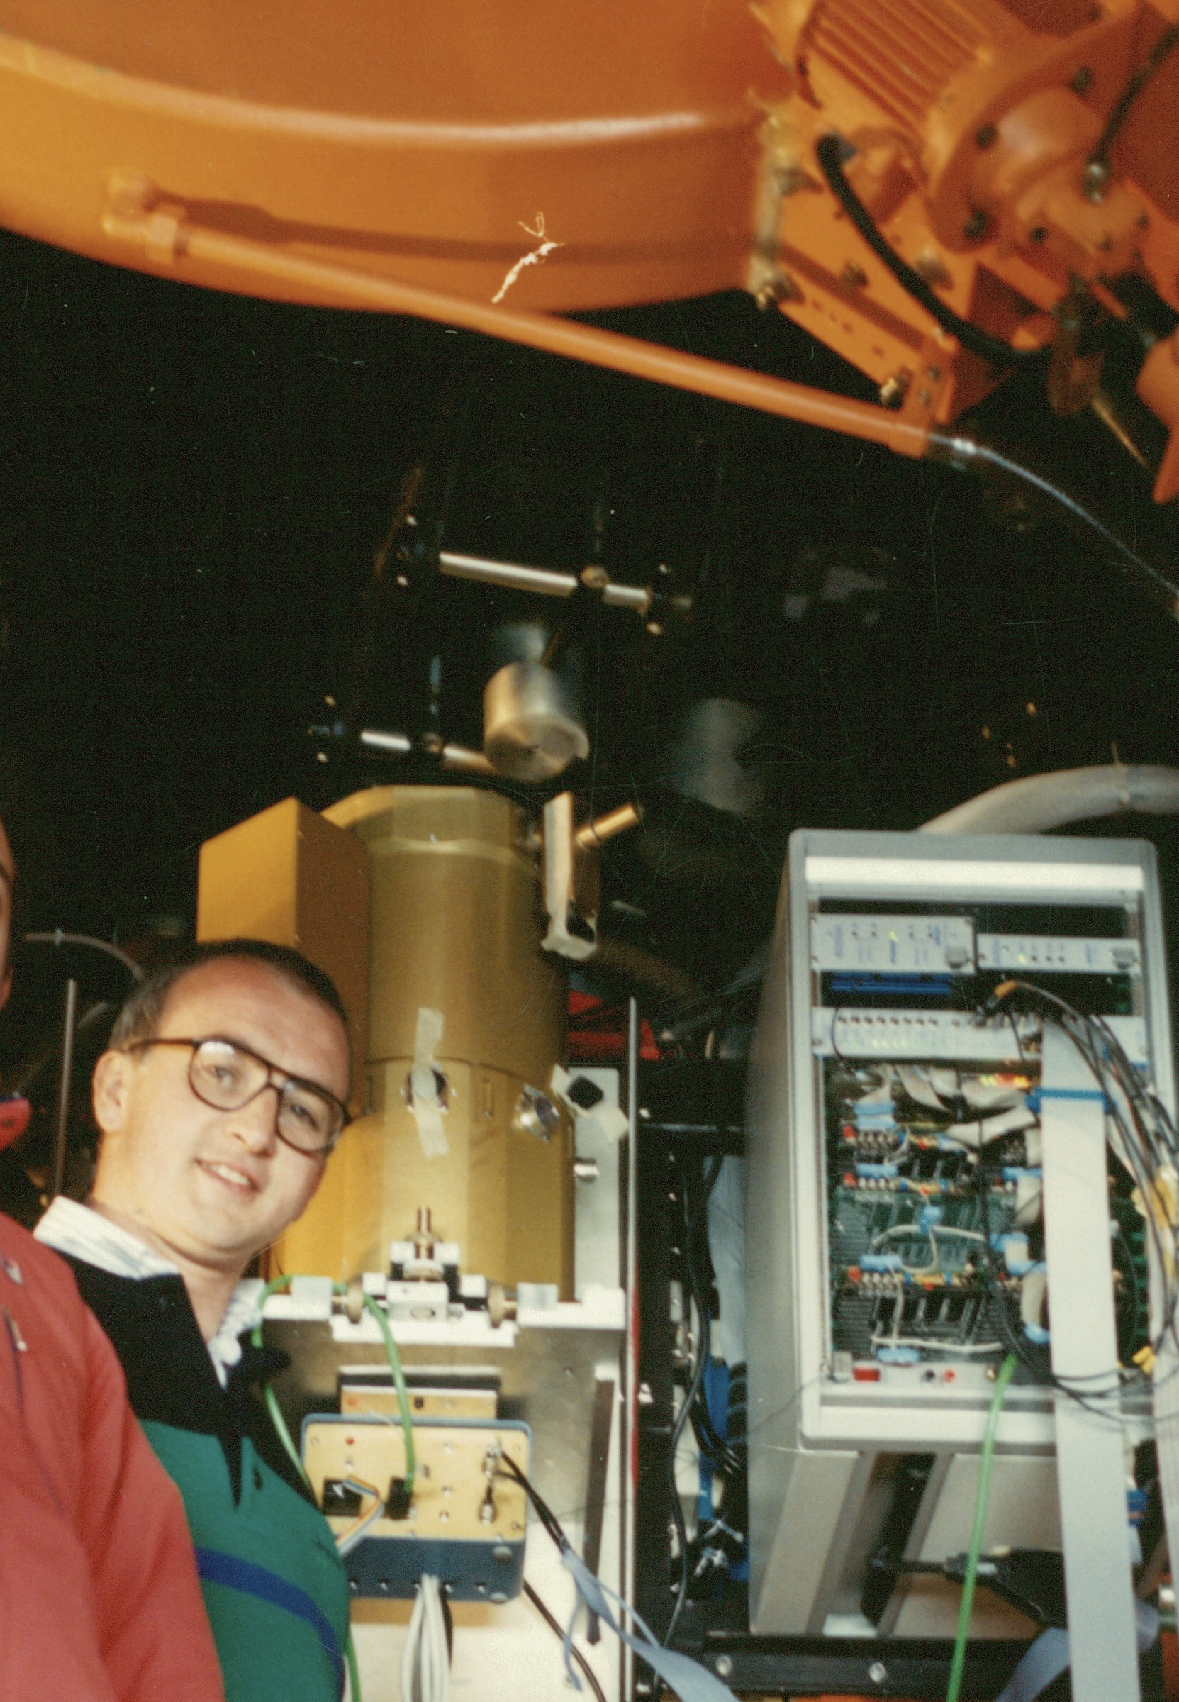
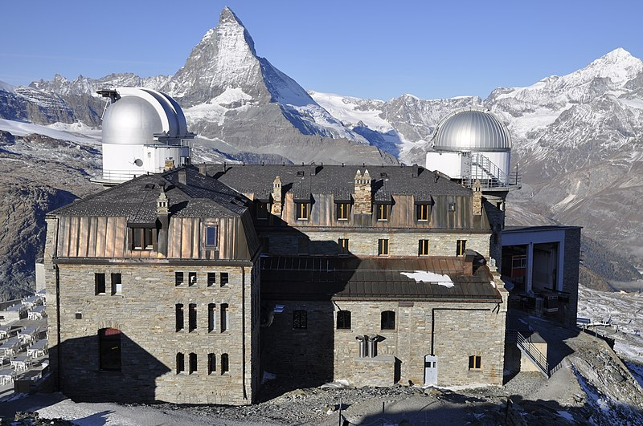
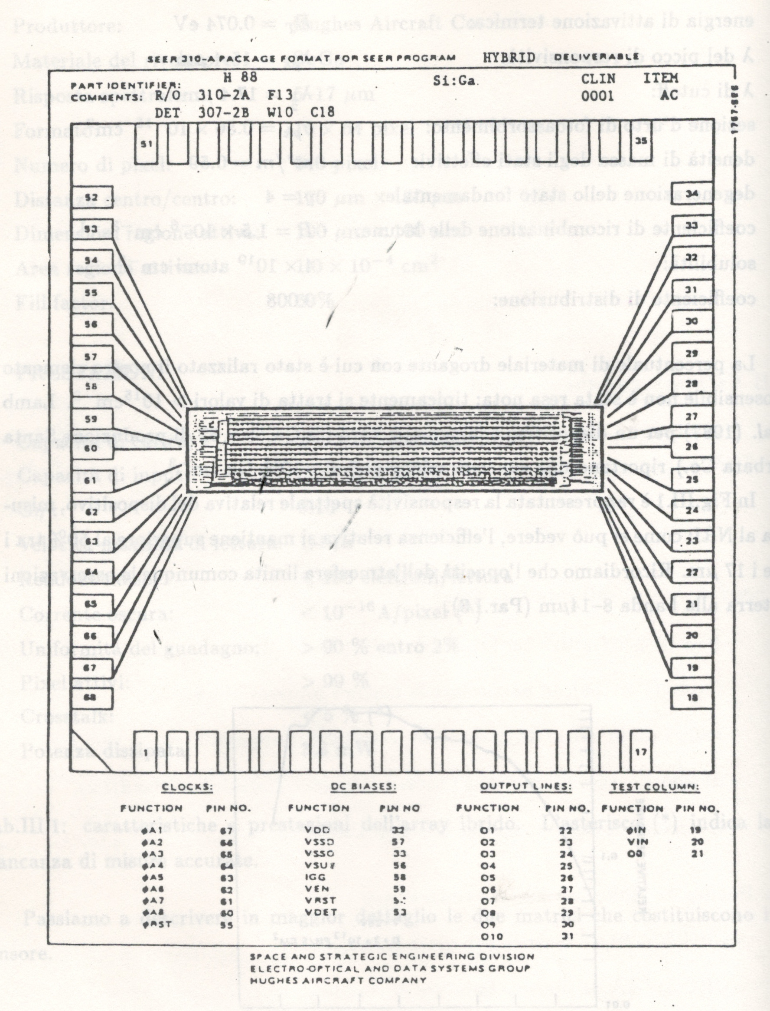
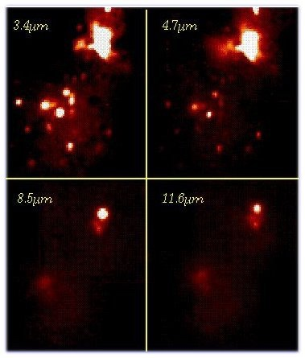
TIRCAM: 1986 - 1994
Pioneering projects in Italy
at the TIRGO 1.5m telescope
TC-MIRC
1994-1998
Two channels
MIR Camera
- InSb 58x62
- Si:Ga 58x62
Rockewell 10x64 Si:Ga

Slide 8
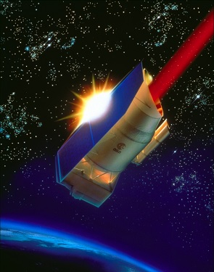

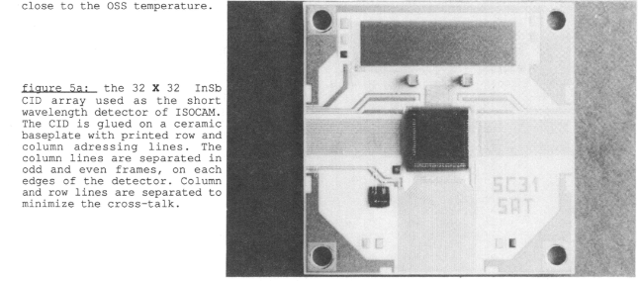
ISO (Infrared Space Observatory, 1995–1998)
SPIE Proceedings Volume 1130, New Technologies for Astronomy; (1989)
Detector Type: Early-generation 2d arrays.
Technology: 32x32 pixel InSb (CID, 1000 e/pix RON) and Si:Ga (In-bumped to Si Mux, 300e/pix RON)
Maker: SAT & CEA-LETI (France)

Slide 9
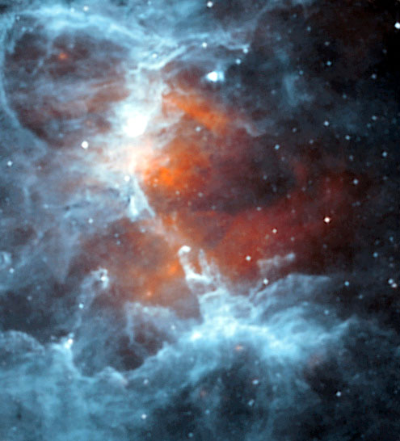
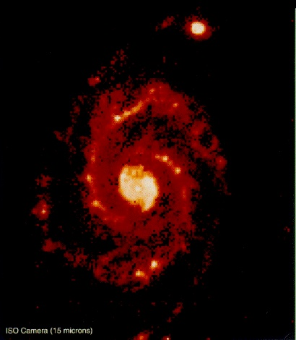
ISOCAM gallery
M16
M51
Pilbratt et al. A&A333,L9 (1998)

Slide 10
IR Arrays: the 1990s boom
Hybrid Detector Architecture
Direct Readout with Source Follower
Non-Destructive Read: Fowler, SUTR sampling
HgCdTe (tunable!) and InSb photodiodes
Increasingly larger format
128 × 128
256 × 256
… early 1K x 1K
Rapid Growth and adoption by major observatories

Slide 11
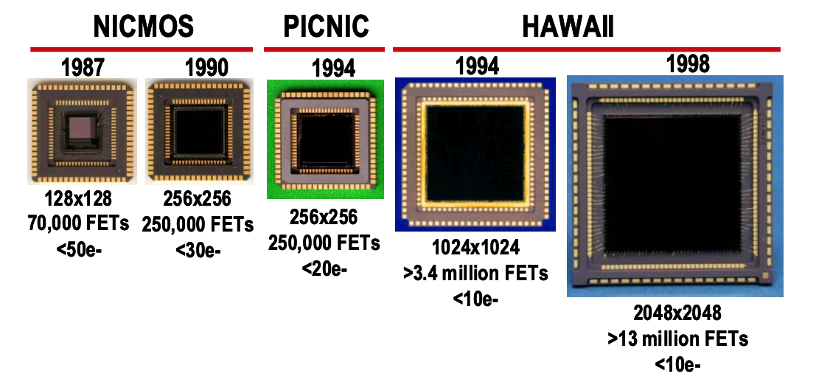
Family Portraits: Rockwell/Teledyne

Slide 12
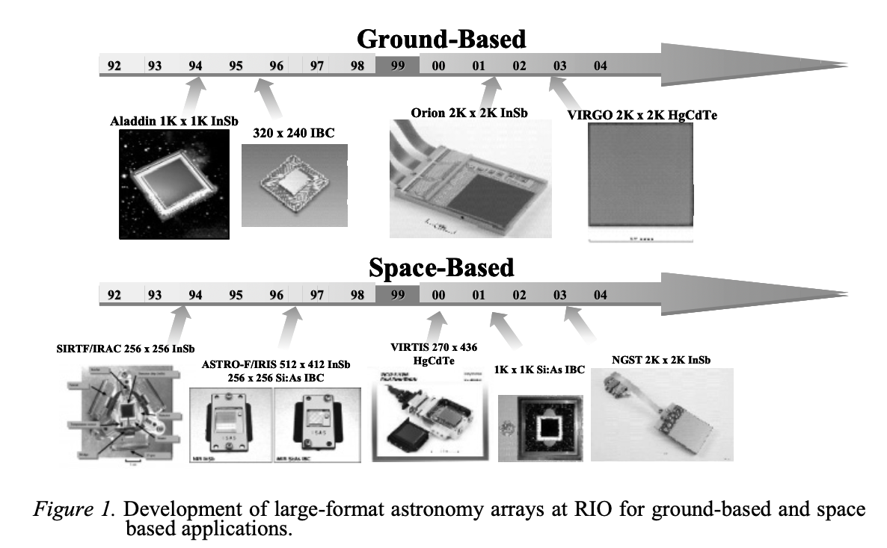
SBRC - Raytheon
Ando et al., in “Scientific Detectors for Astronomy”, P.Amico, J. W. Beletic & J.E. Beletic eds., Springer (2004)

Slide 13
NASA enters the game IR from space poses hard requirements
Challenges:
Extremely LOW signal flux
Thermal backgrounds LOW
Electronics and Thermal: STABLE
Cosmic Ray Environment
Key parameters:
High Quantum efficiency
Ultra-Low Read noise
Virtually Zero Dark current
Stability (allows calibration)

Slide 14
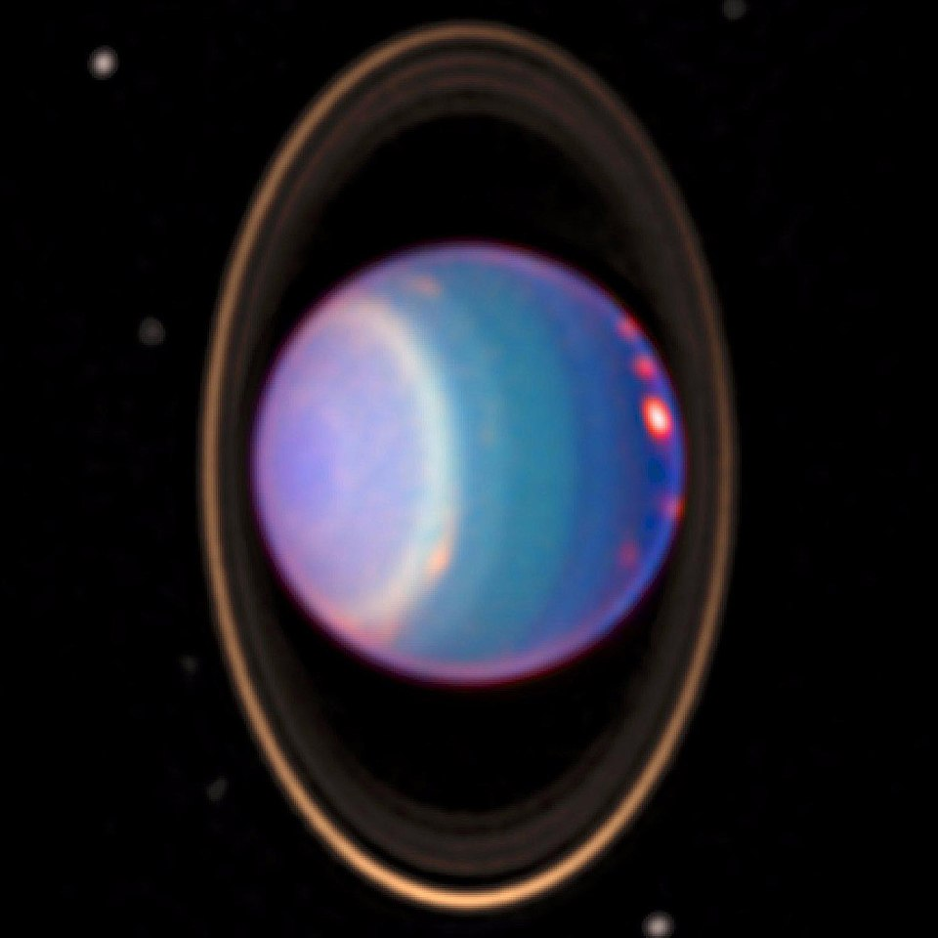
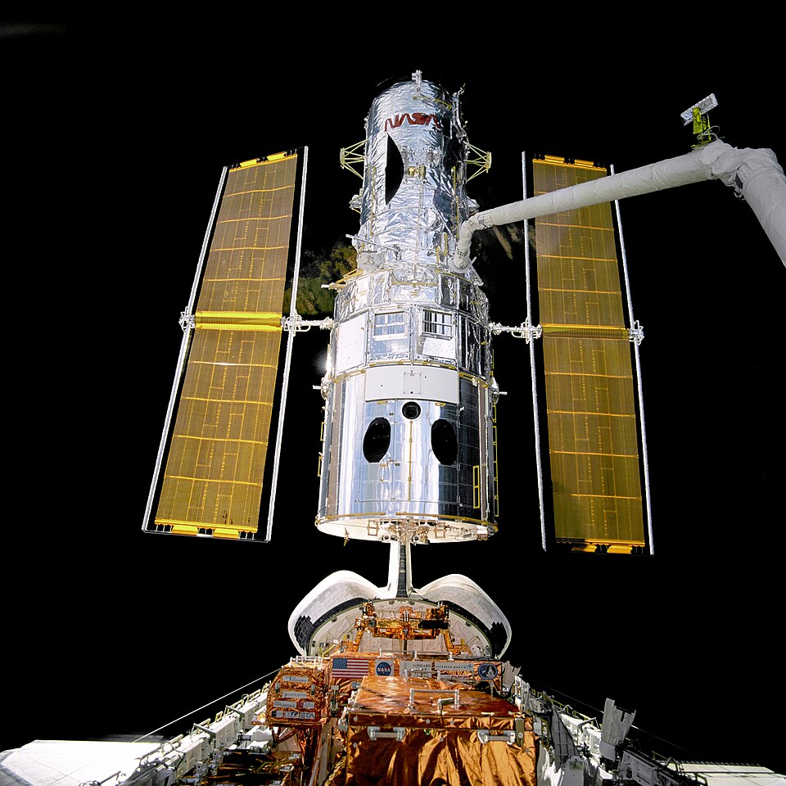
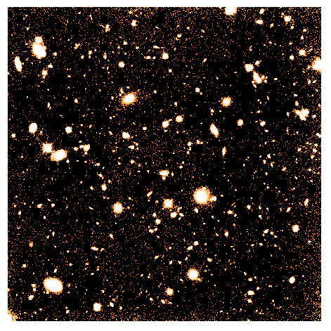
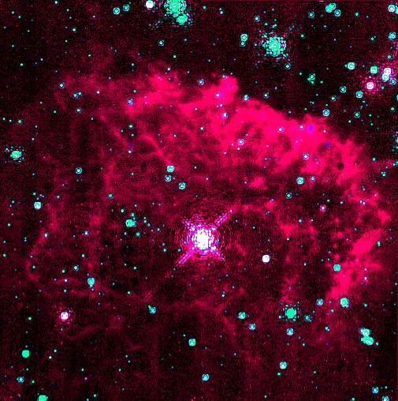
HST/NICMOS (1997-2008)
NICMOS3 256 x 256 (1-2.4micron)
HgCdTe on Sapphire (PACE)
30e CDS RON
77K operation
https://gerbil.phys.uvic.ca/~gwyn/MMM/nicmos.html

Slide 15
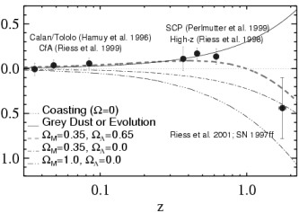
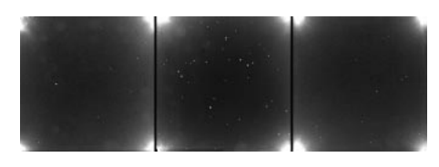
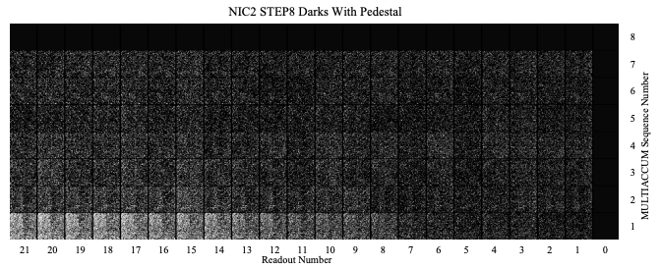
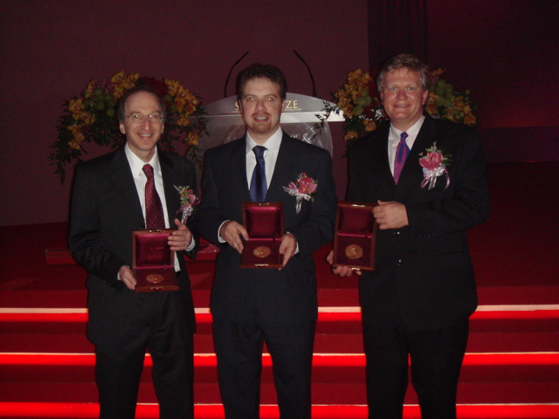
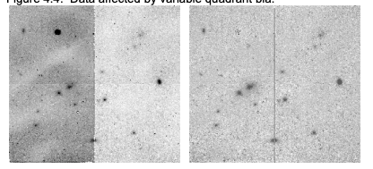
Despite issues… exceptional discoveries!
Amplifier Glow
Pedestal
Fluctuations
Quadrant-to-quadrant
fluctuation
Notes:
PACE-I (Producible Alternative to CdTe for Epitaxy), Sapphire has excellent CTE matching to Si MUX

Slide 16
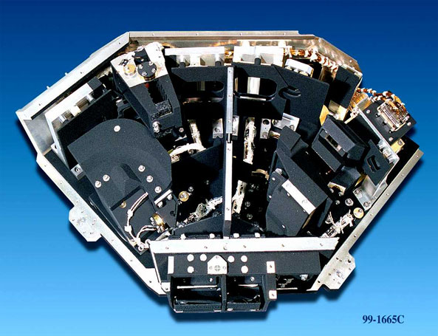
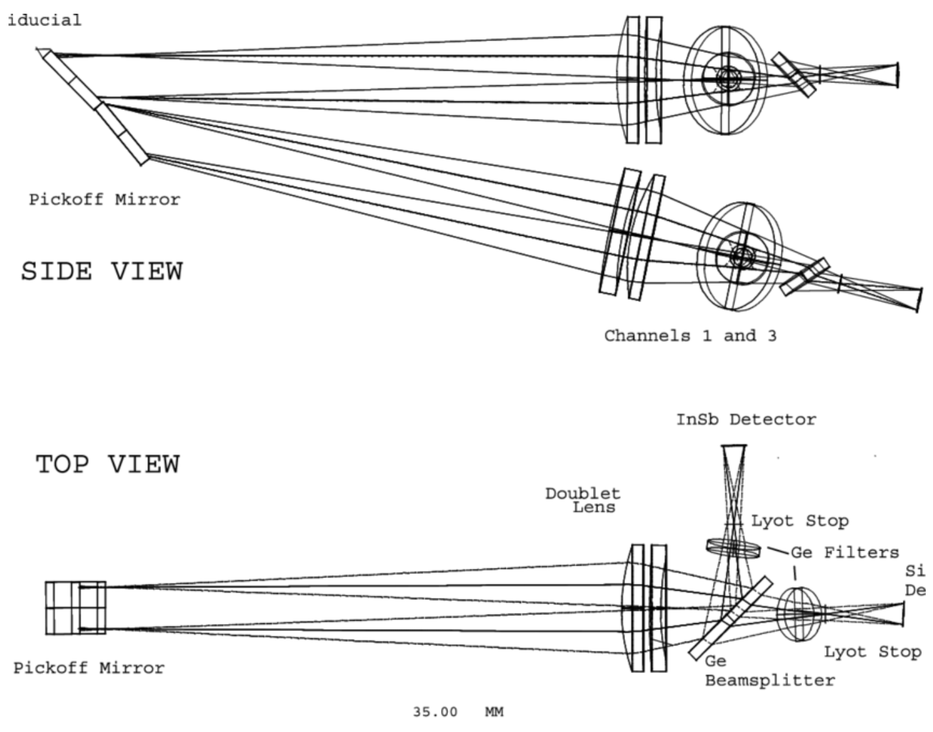
In the Mid-IR: Spitzer (2003-2020)
IRAC: 3.6, 4.5, 5.8, and 8 microns
- InSb 256 x 256
- SiGa 256 x 256
- in parallel,
- dual instrument
(adjacent fields)

Slide 17
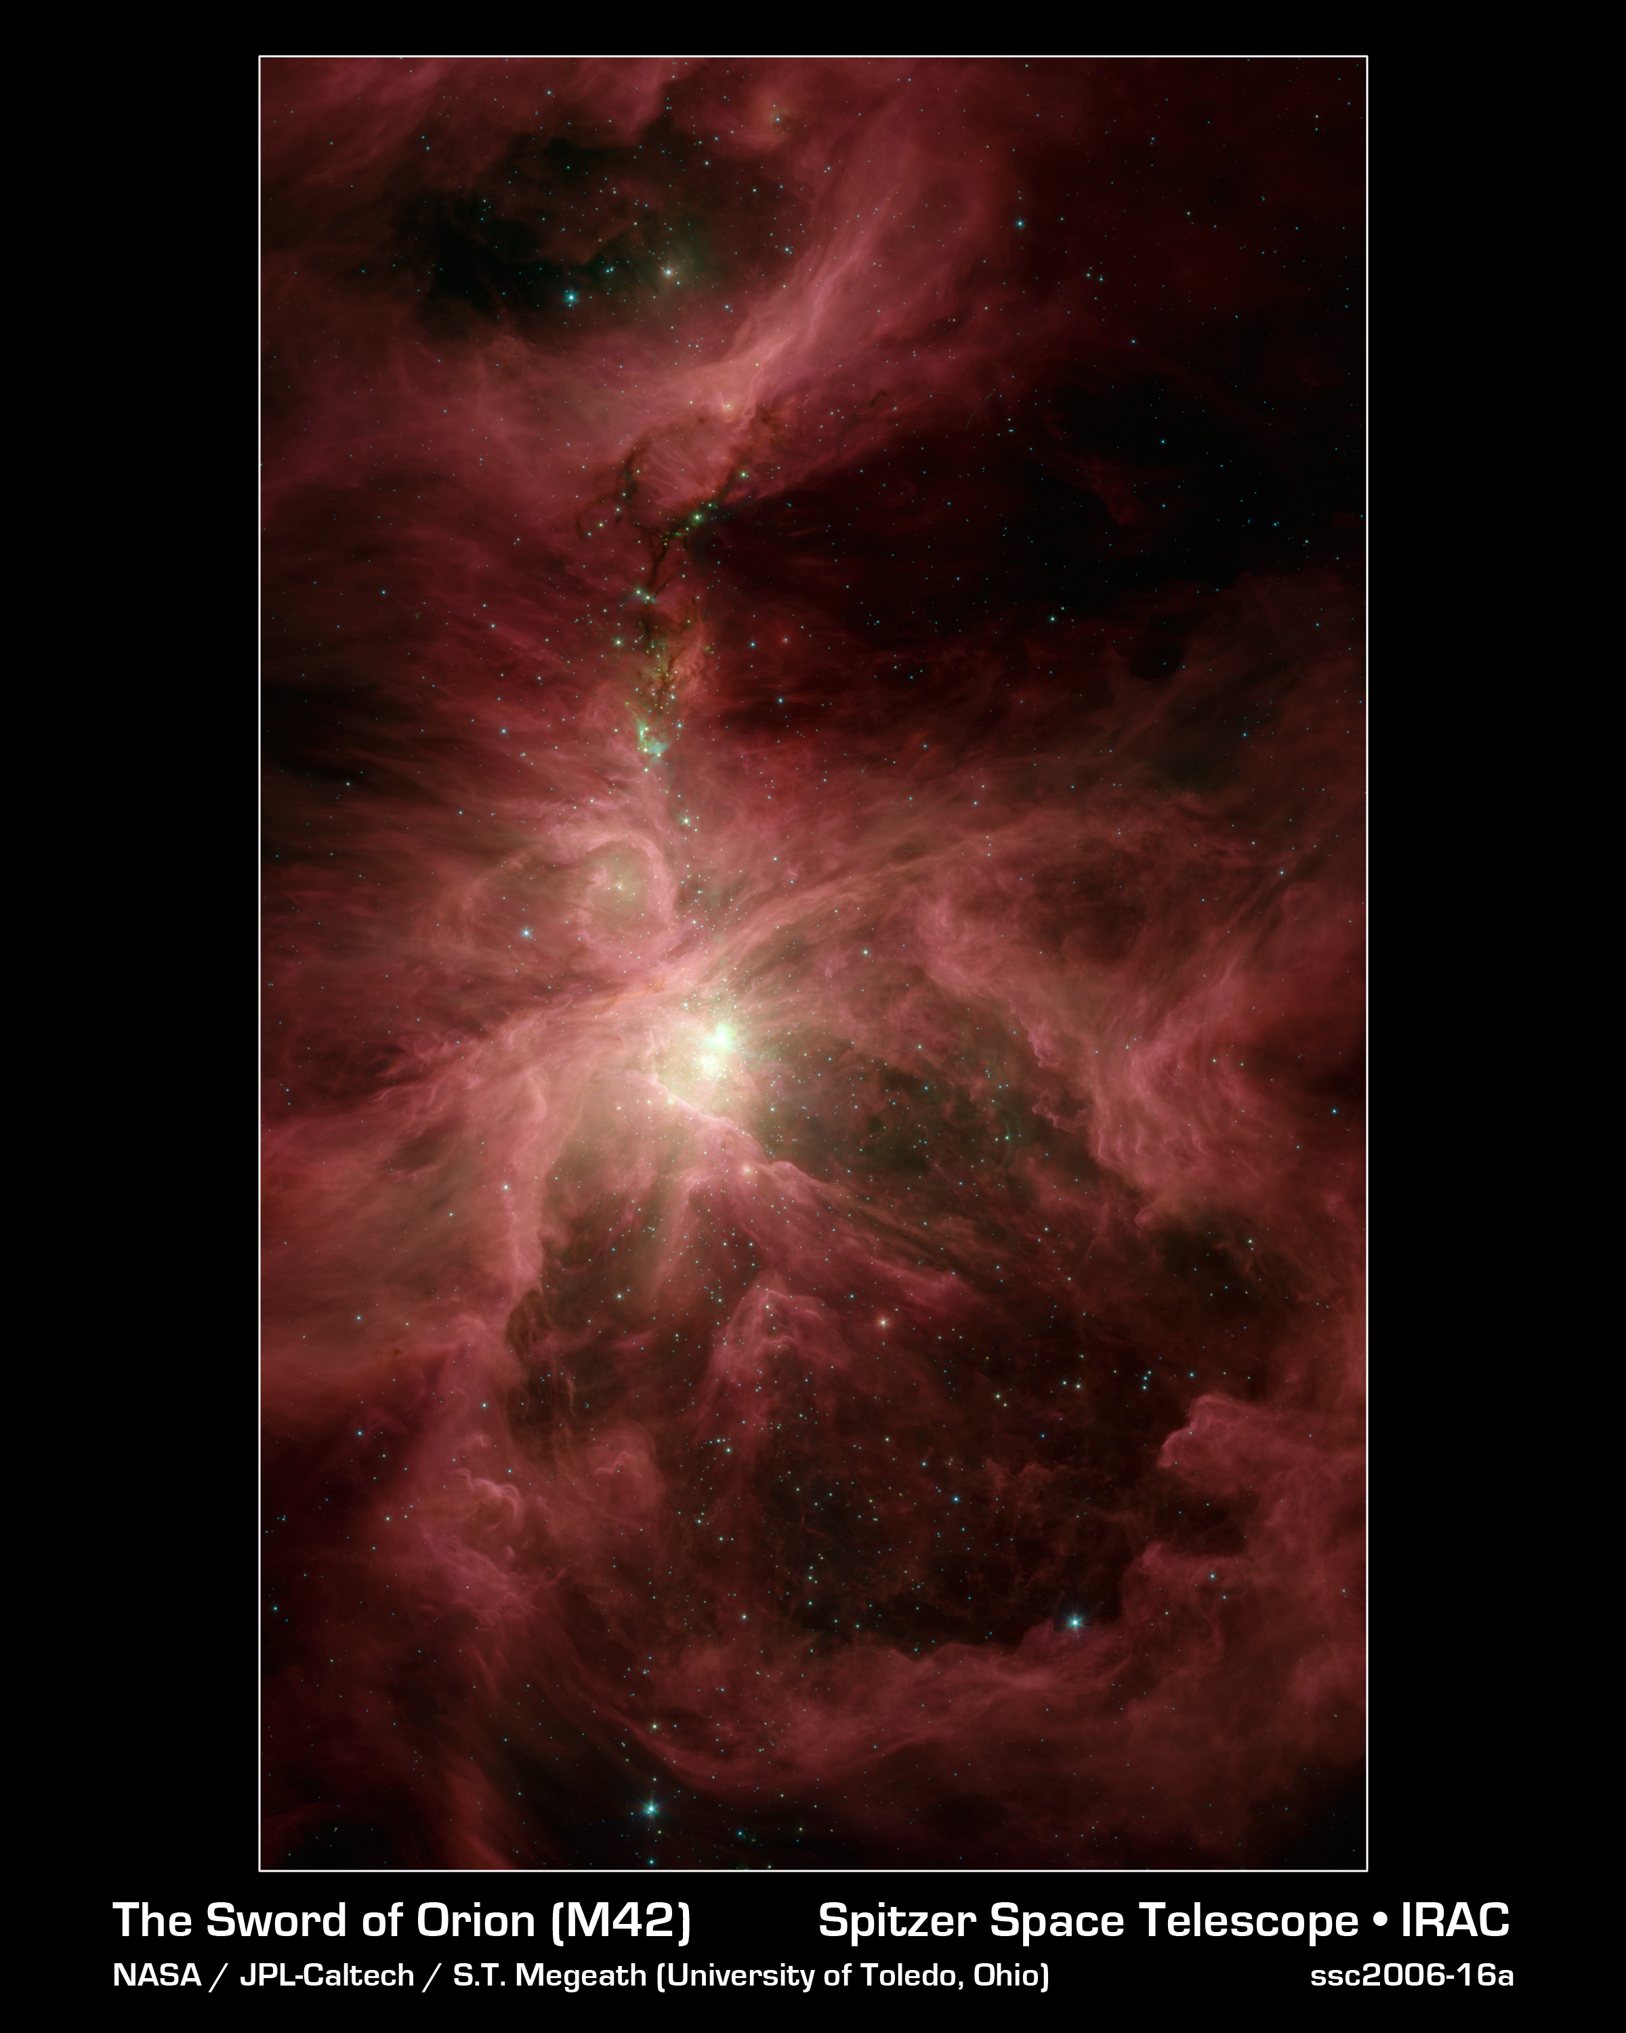
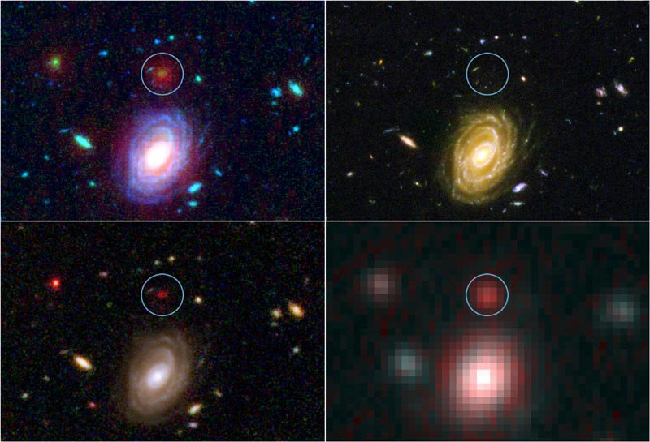
Spitzer Science highlights

Slide 18
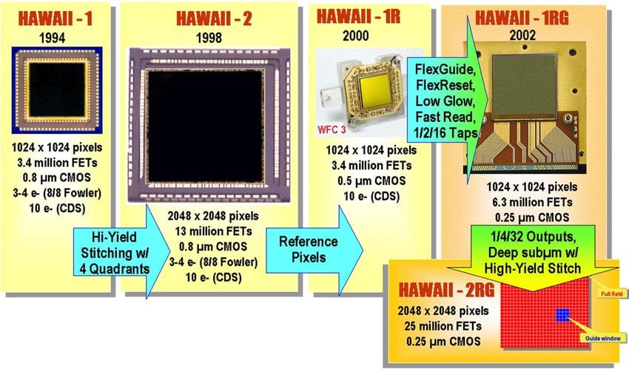
Lessons learned drive progress

Slide 19
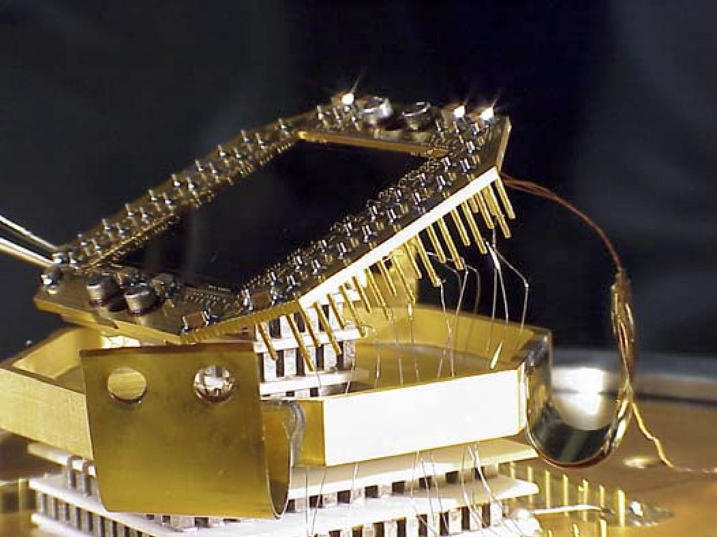
HST/Wide Field Camera 3-IR` - detector development 2000-2004 - launched 2009… ongoing!
Hawaii -1R (0.6 – 1.72micron)
HgCdTe on ZnCdTe
MBE grown
T ~150K
Reference Pixels
Amp-Glow mitigation
Rad-induced luminescence
Substrate removal (“thinning”)
Sensivity down to 0.4micron
24e CDS RON

Slide 20
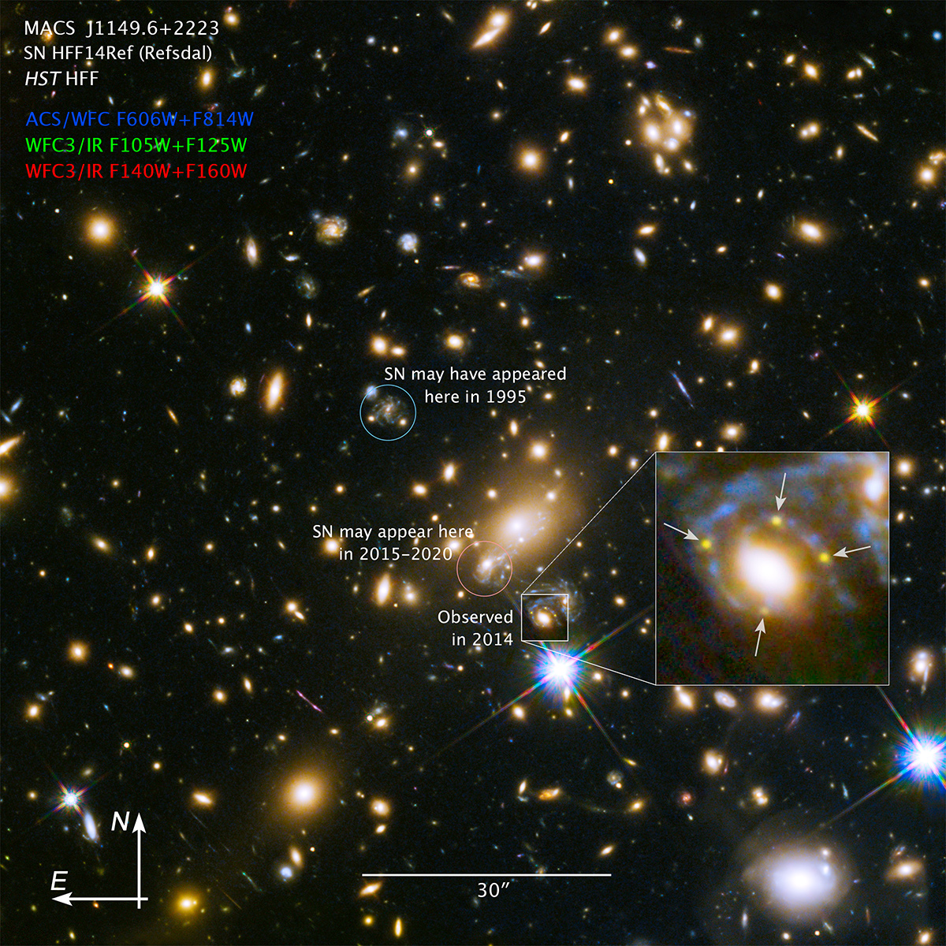
We learned more and more…
Persistence/latency
Flux dependent non-linearity
1/f noise limittions
Interpixel capacitance
...
Notes:
Westerlund 2

Slide 21



Wise/Neowise (2009-present) Herschel (2009-2014)
PACS Camera 51-220micron
2 x Bolometer arrays (4/8 x 16x16 format)
2 x Ge:Ga photoconductor array (16x25 format)
Four bands: 3.4, 4.6, 12.0 and 22.2 μm
HgCdTe 1Kx1K and Si:As 1Kx1K

Slide 22
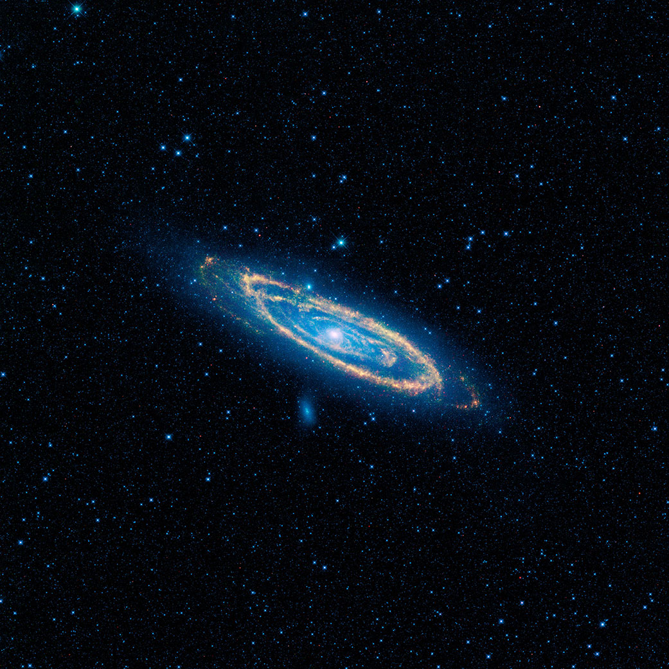
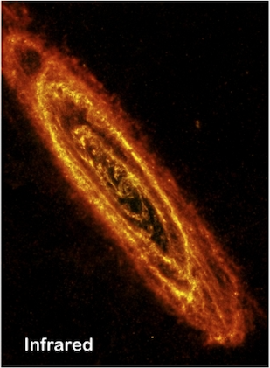
Andromeda with WISE and Herchel
Notes:
Herschel image with SOURE @250 micron.
WISE used all four of its infrared detectors to capture this picture: 3.4- and 4.6-micron light is blue; 12-micron light is green; and 22-micron light is red.

Slide 23
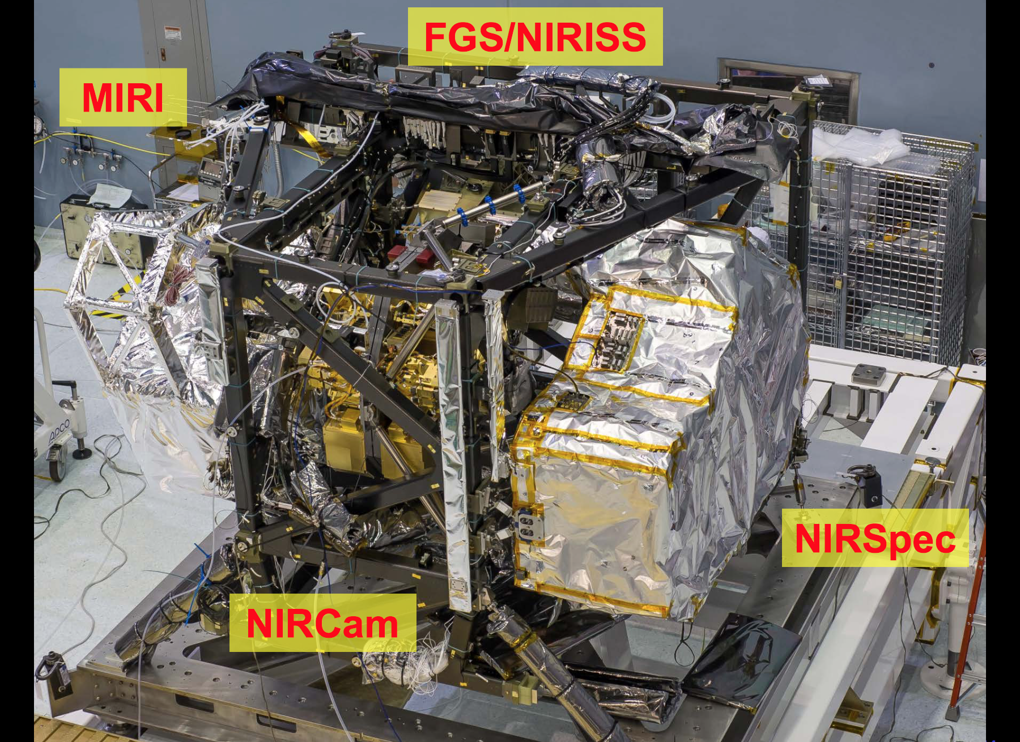
The JWST Era
Near-IR instruments:
NIRCam: 10 detectors
NIRSpec: 2 detectors
NIRISS: 1 detector
FGS: 2 detectors
+ Sidecar ASICS
Mid-IR:
MIRI: 3 detectors

Slide 24
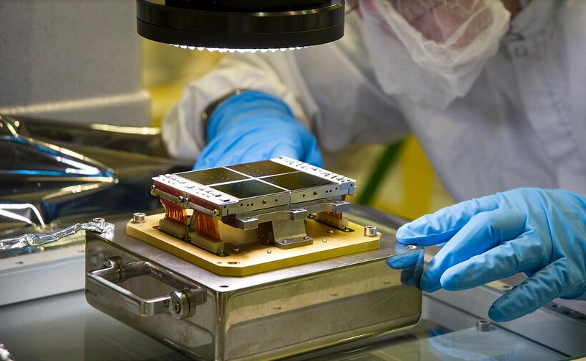
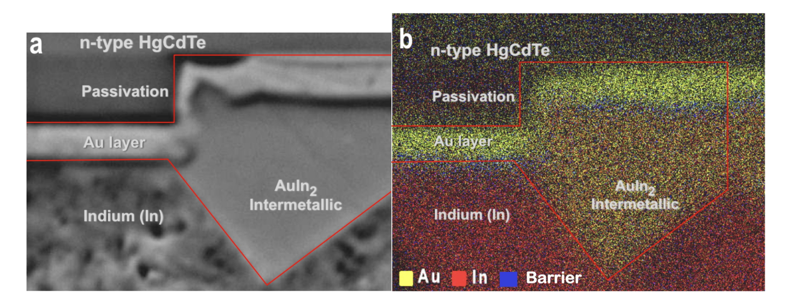
Hawaii 2-RG
2048×2048 HgCdTe
High QE (>80%)
Very low noise
0.25 um technology
Guide Mode: 32x32subarray at 100Hz
IRS2 very low noise readout (ask Bernie)
1/4/32 outputs => read time 42/10.5/1.3s
Low Power (60microW/channel)
Buttable on 3 sides
Gained more profound understanding of metallurgy
James Webb Space Telescope ( JWST ) Detector Degradation Failure Review Board
(ask Jim and Bernie for details)

Slide 25
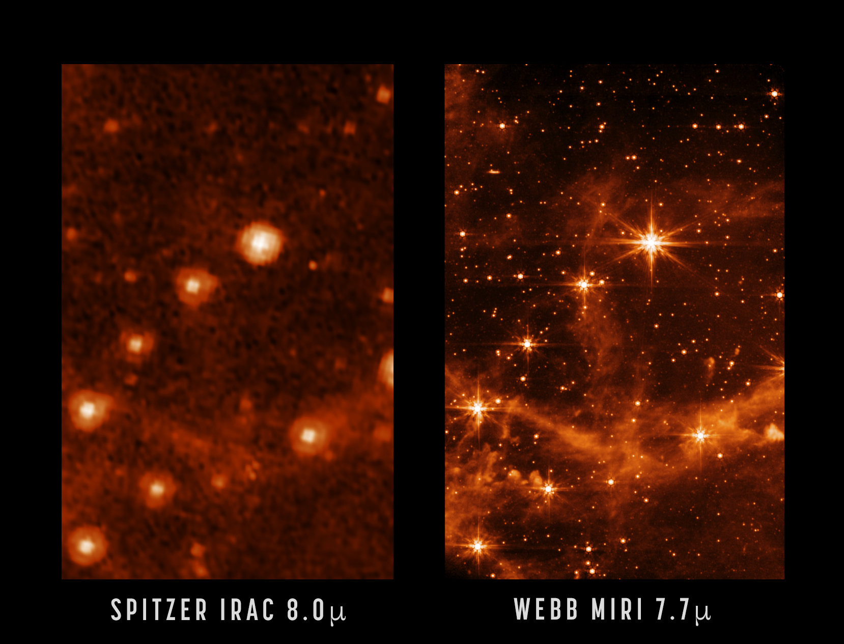
MIRI Detectors
Raytheon Vision System (Spitzer/IRAC heritage)
Si:As detectors
1024x1024 active pixels, 25um pitch
4+4 columns of reference pixels at the sides
4 output channels, 3s read time
Wavelength range: 5–28 μm
Operating temperature: ~7 K
=> M. Regan talk
JWST is (6.5/0.85)⁴ = 3,419 times faster than Spizer

Slide 26
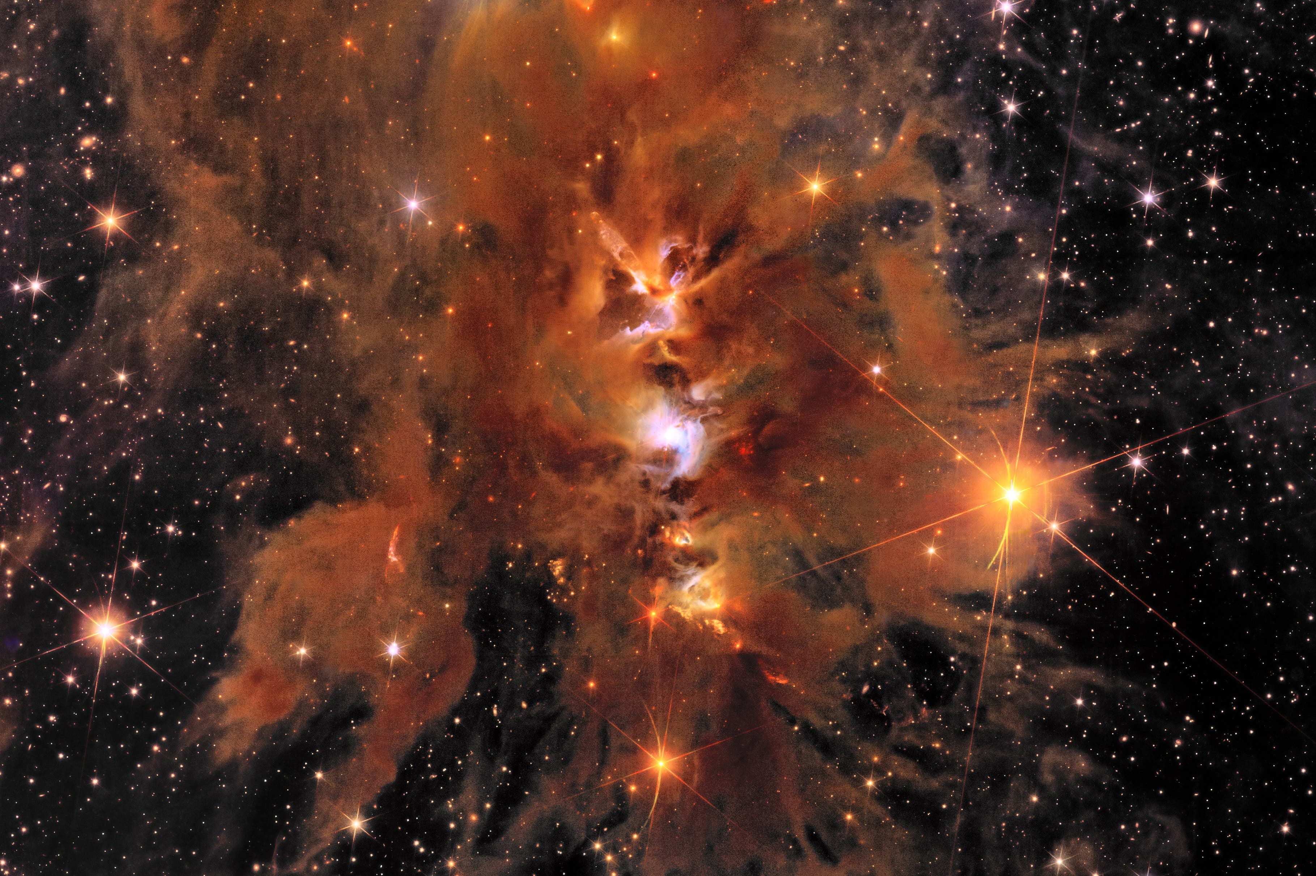
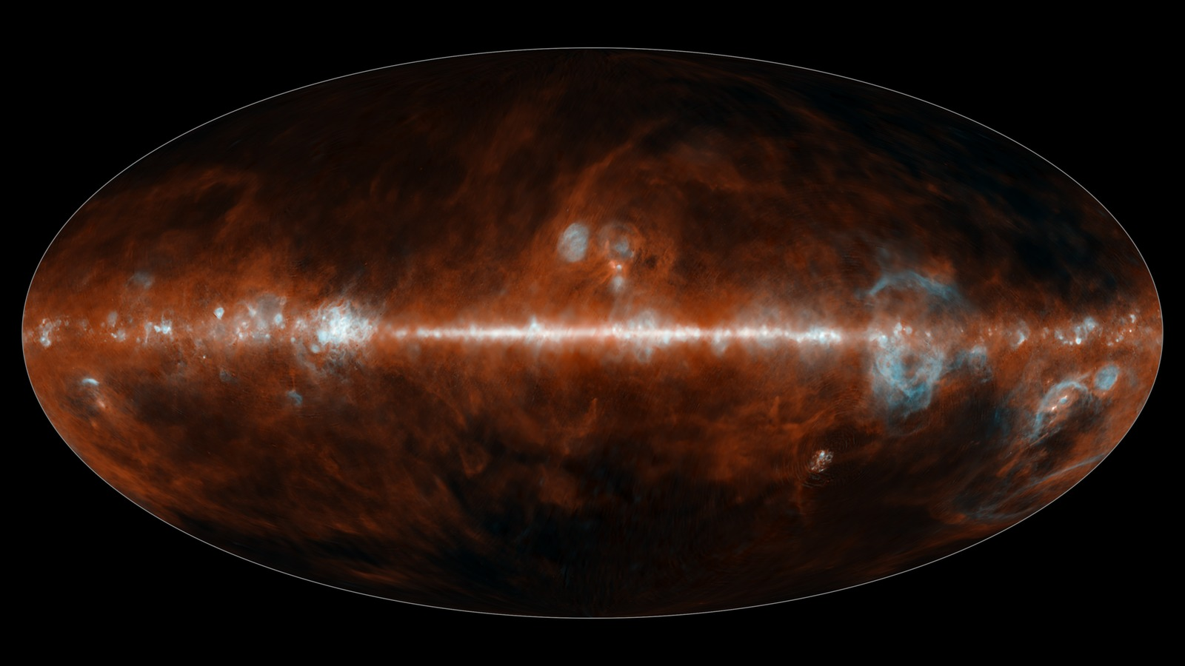
The current Hi-2RG generation
Euclid
SPHEREX
16x Hawaii-2RG 2.3 µm
3x Hawaii-2RG 2.5 µm 3x Hawaii-2RG 5.3 µm

Slide 27
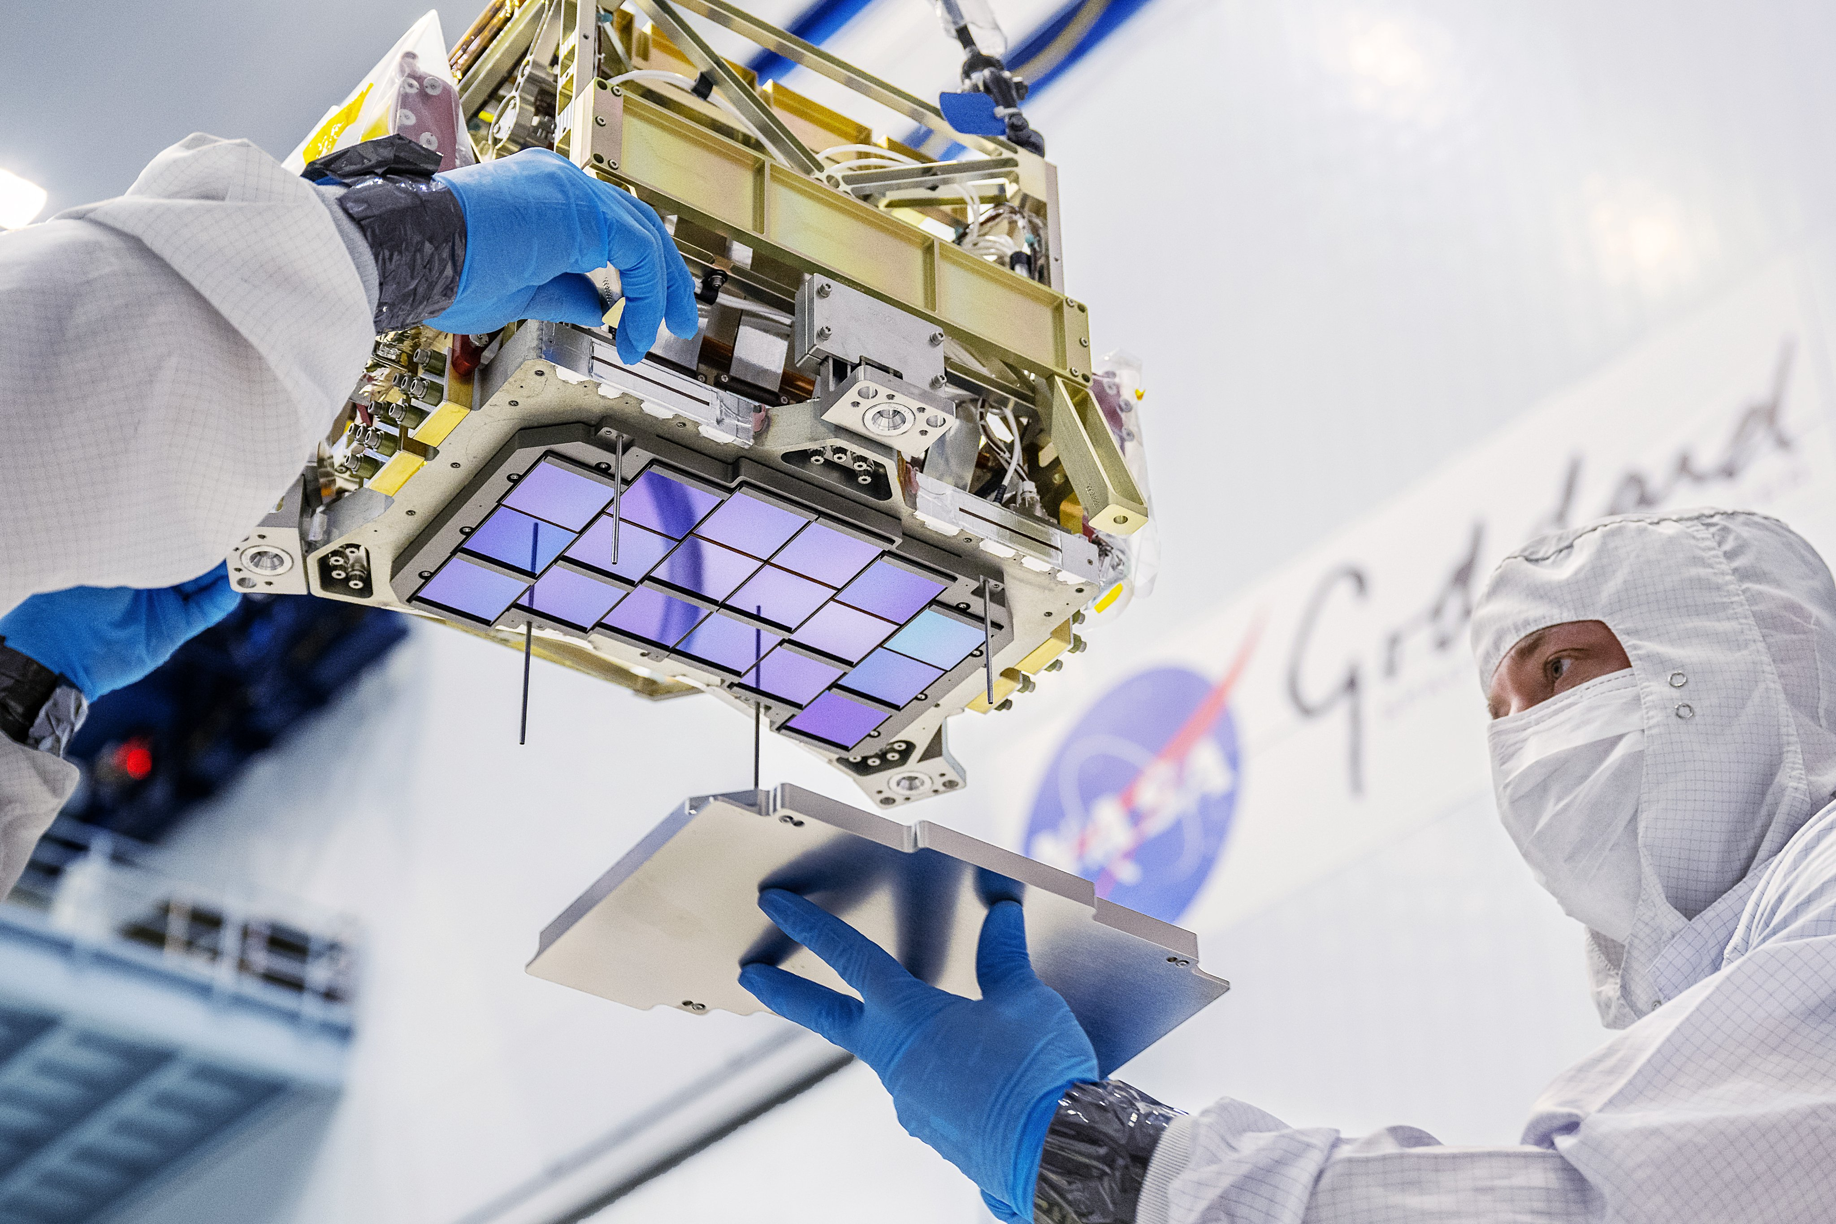
Entering the 4K era
Nancy Grace Roman Space Telescope
Future dedicated IR missions
future large panchromatic observatory
=> Habitable World Observatory
Roman: 18 Teledyne H4RG

Slide 28


This meeting
Tackling increasingly harder requirements to deliver transformational science

Slide 29
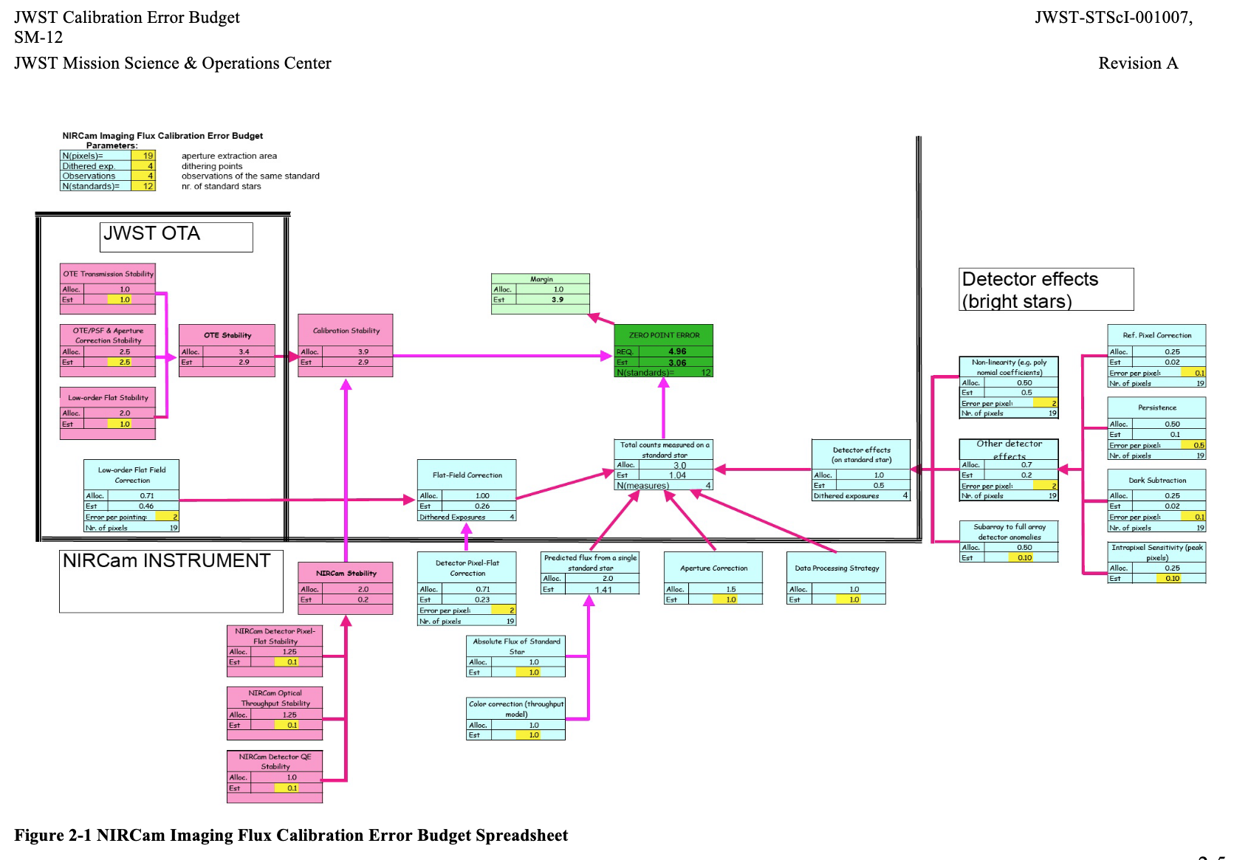
The importance of an ERROR BUDGET

Slide 31
Conclusion: we went a long way
From 32x32 → megapixel focal planes
Impact:
- transformed fundamental physics and astrophysics
enabled search for exo-Earths, life elsewhere in the Universe
Our journey continues… the best has to come!

Slide 32
Ancillary slides

Slide 33
Why Infrared Astronomy
Star formation occurs in dusty environments
Notes:
nfrared detectors opened new astrophysical regimes.

Slide 34
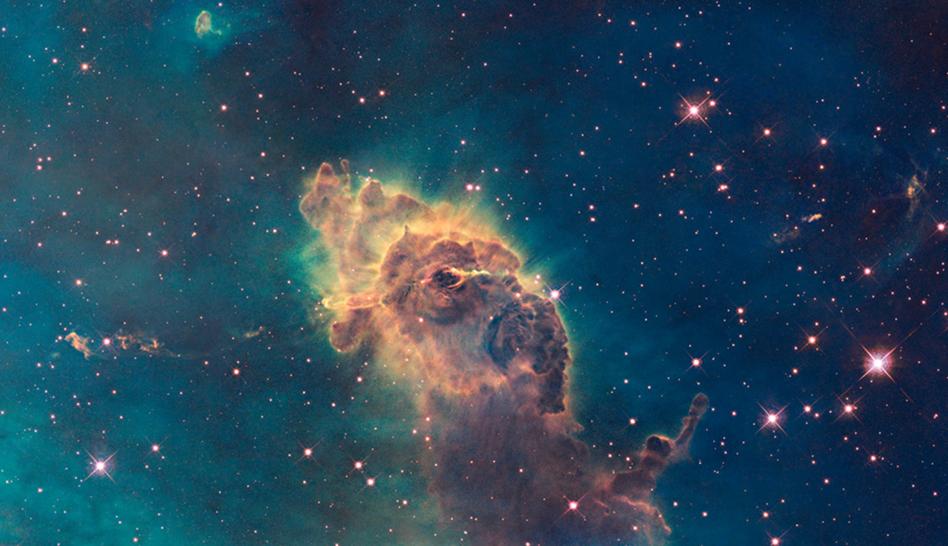
Looking through the dust

Slide 35
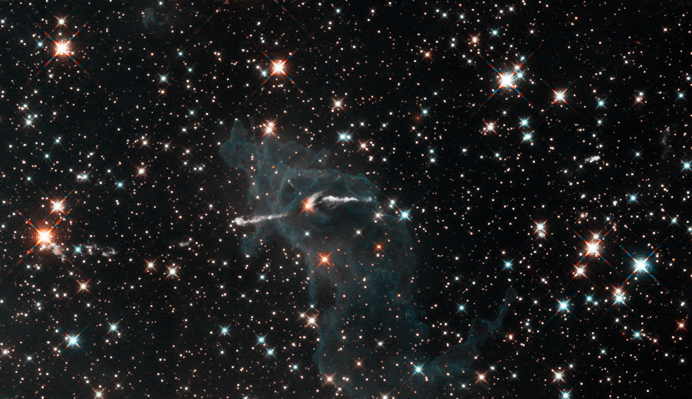
Looking through the dust

Slide 36
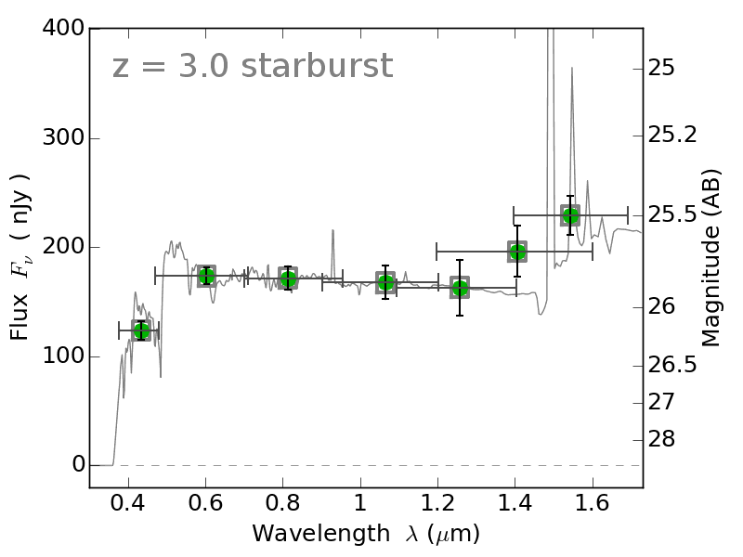
Why Infrared Astronomy
Star formation occurs in dusty environments
High-redshift galaxies are redshifted into IR
Notes:
nfrared detectors opened new astrophysical regimes.

Slide 37
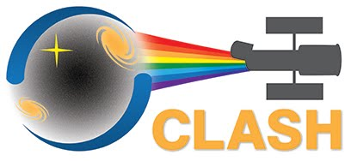
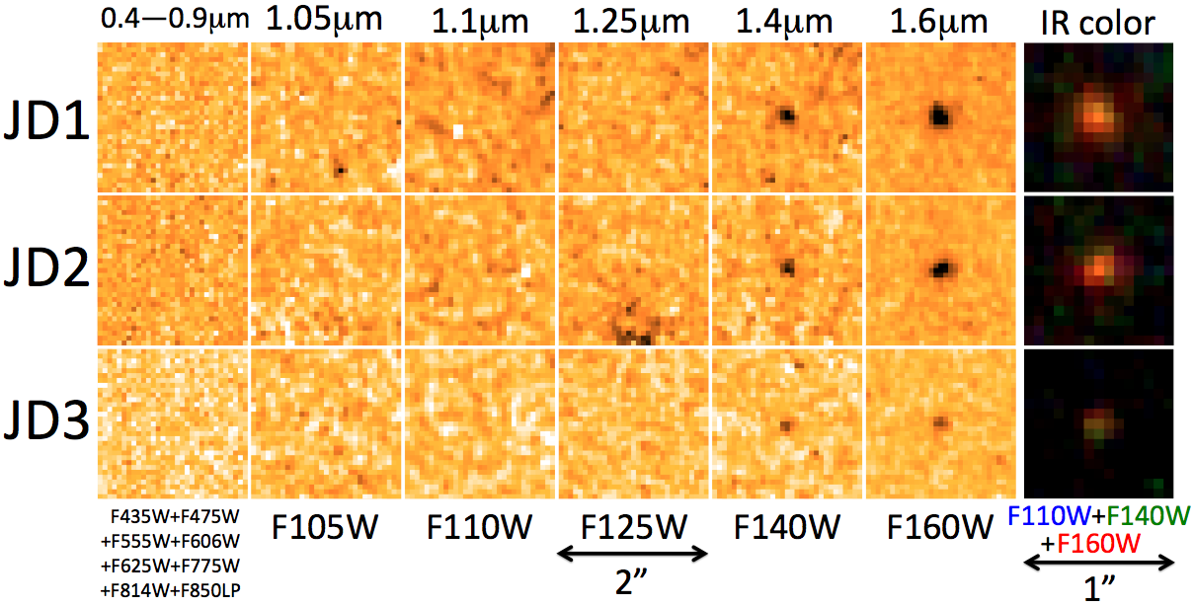
Hubble “J-band dropout”
J-band
JD = “J-band dropout”
26.9 AB
25.9 AB
6σ
12σ
27.2 AB
26.1 AB
7σ
15σ
27.9 AB
27.3 AB
6σ
10σ
Coe et al. (2013)
Notes:
(skip remaining notes)
=====
TITLE
These are the magnitudes and detection significances in the two reddest filters.
It drops out of detection in the J-band F125W and all bluer filters.
(0:30)

Slide 38
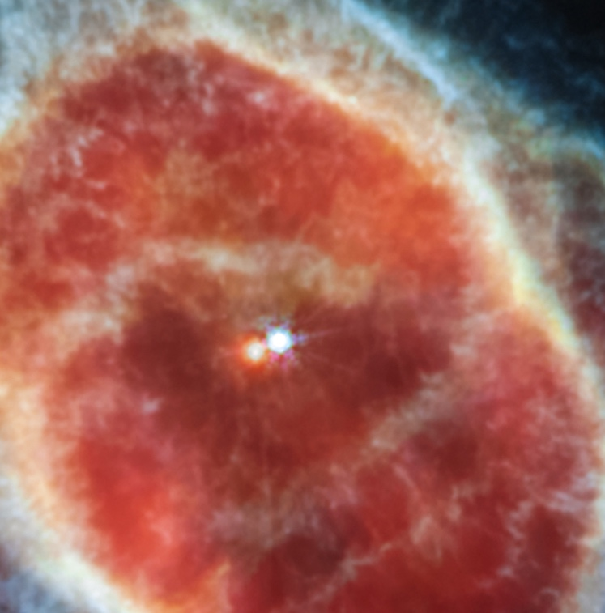
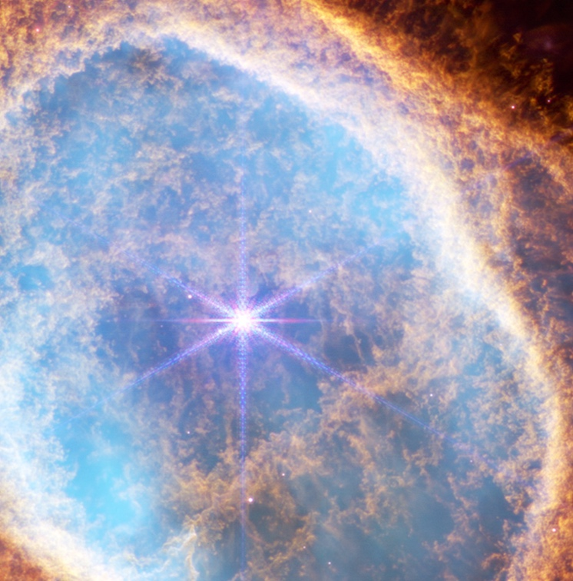
Why Infrared Astronomy
Star formation occurs in dusty environments
High-redshift galaxies are redshifted into IR
Cool objects radiate mostly in IR:
Notes:
nfrared detectors opened new astrophysical regimes.

Slide 39





Why Space
Earth's atmosphere absorbs most IR
Earths atmosphere emits in the VIS-IR windows
Thermal background dominates observations
1-2.5$μm$
3$.0μm$
Notes:
Space telescopes are essential

Slide 40


Slide 41

Size matters…

