Slide 1
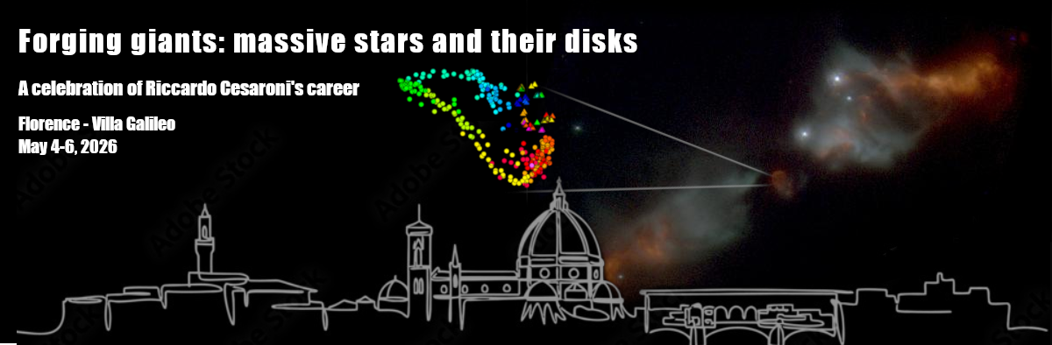

Slide 2
Rimpatriata di amici

Slide 3
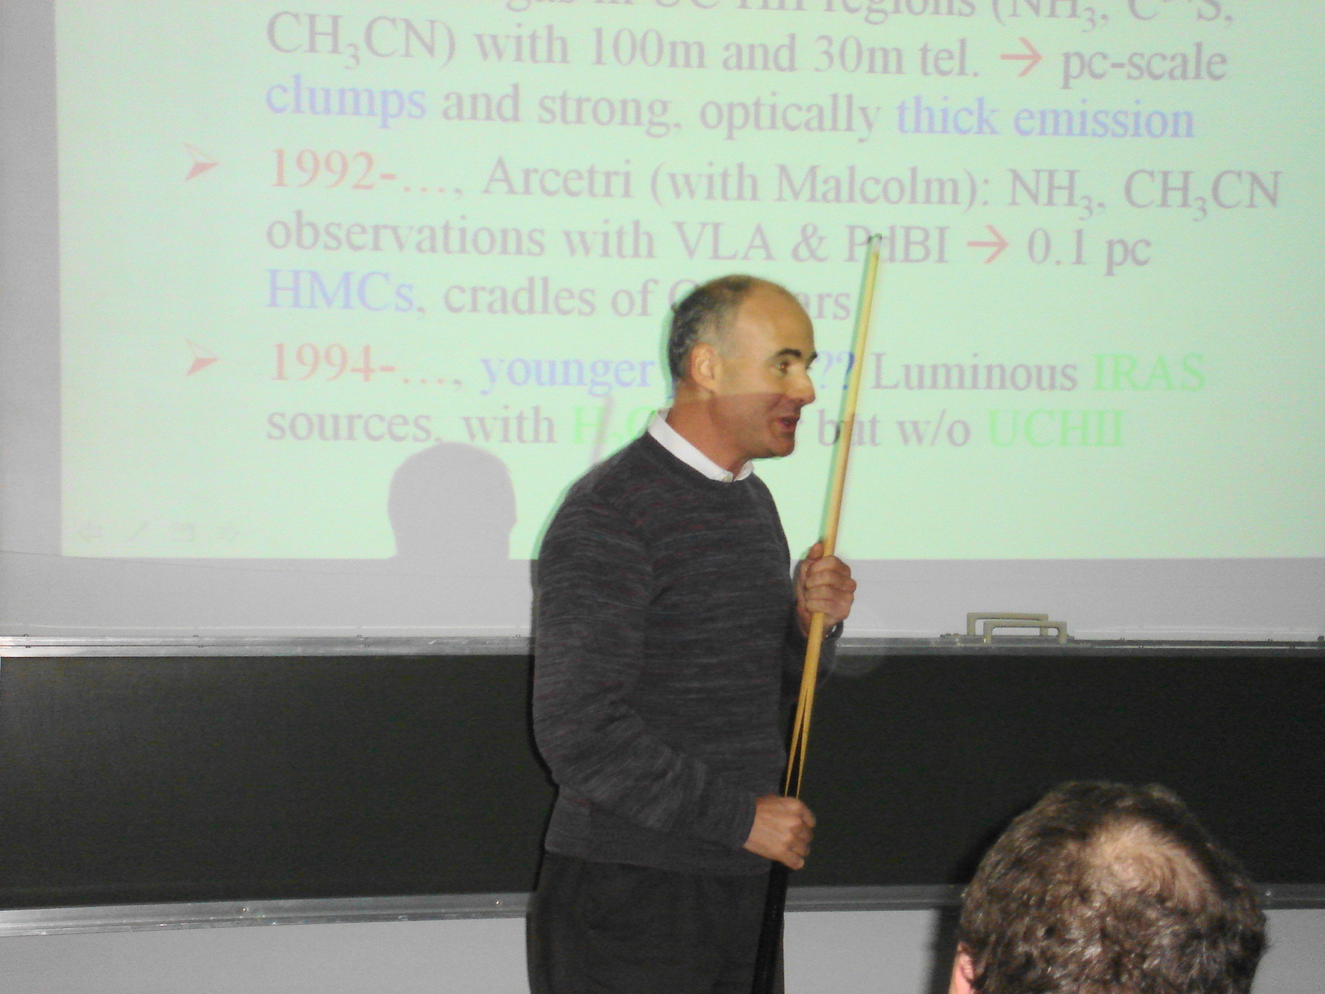
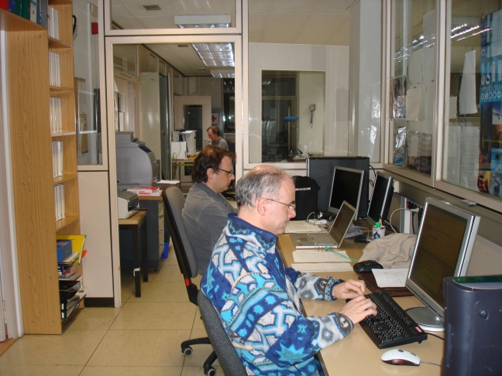
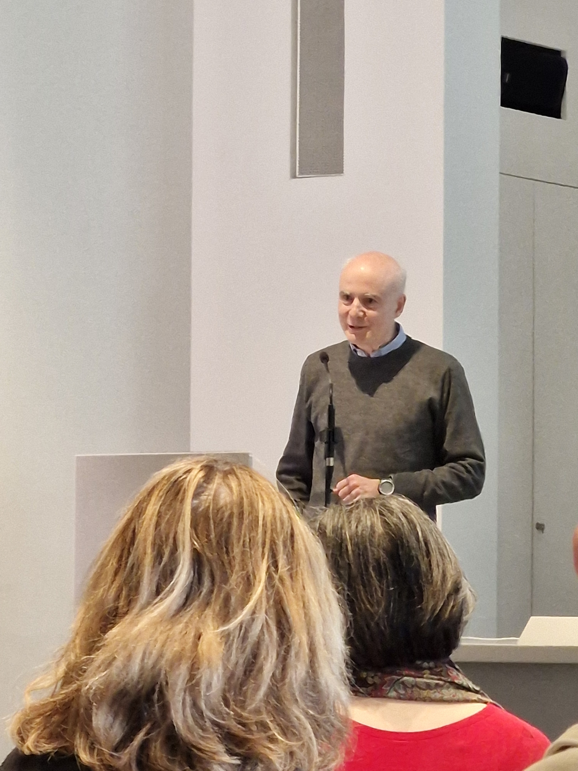
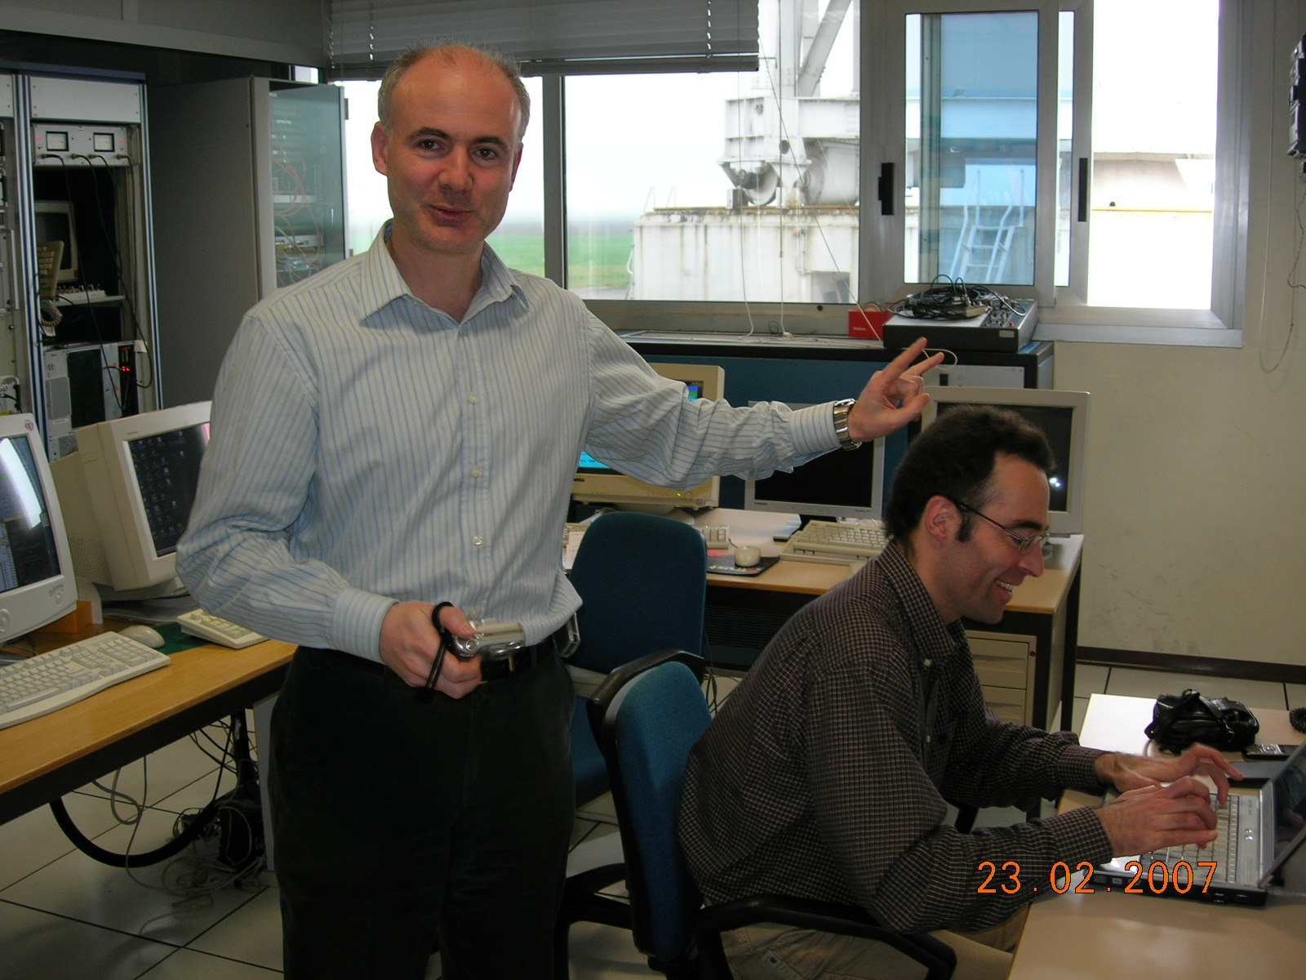

Slide 4
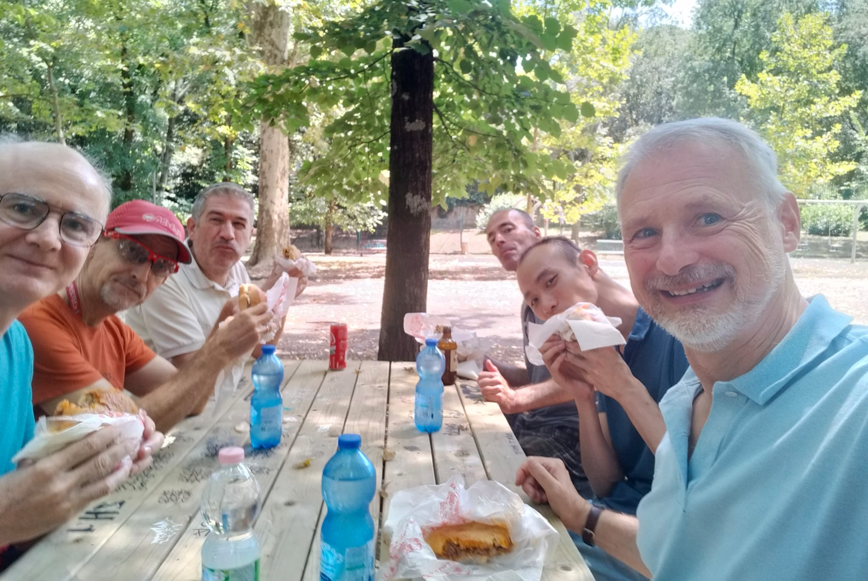
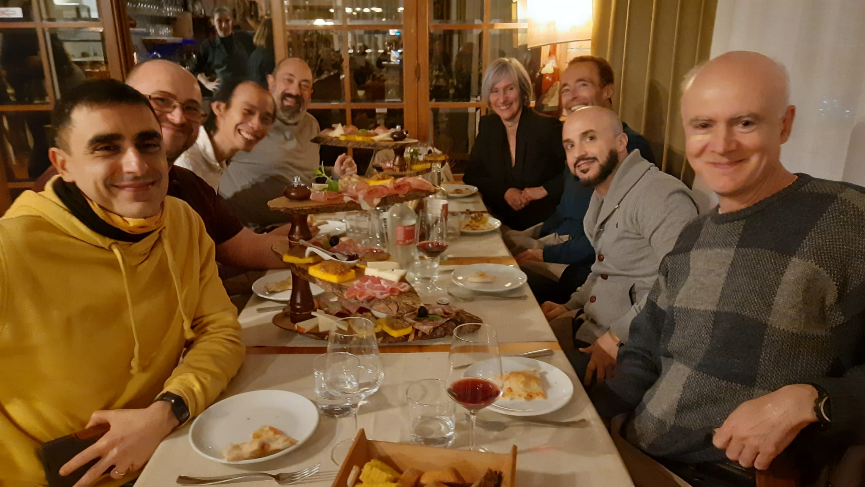
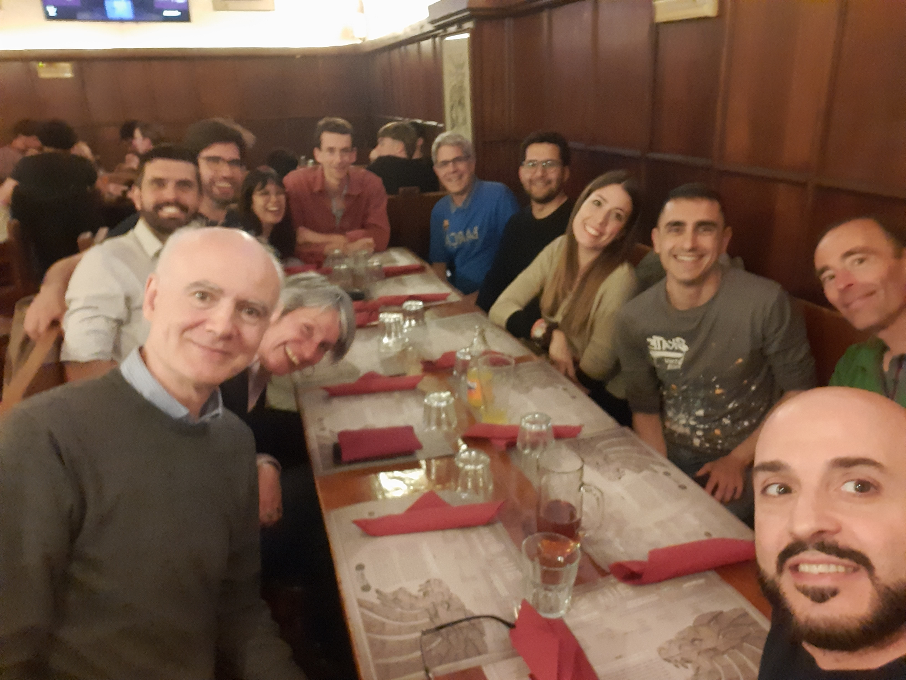
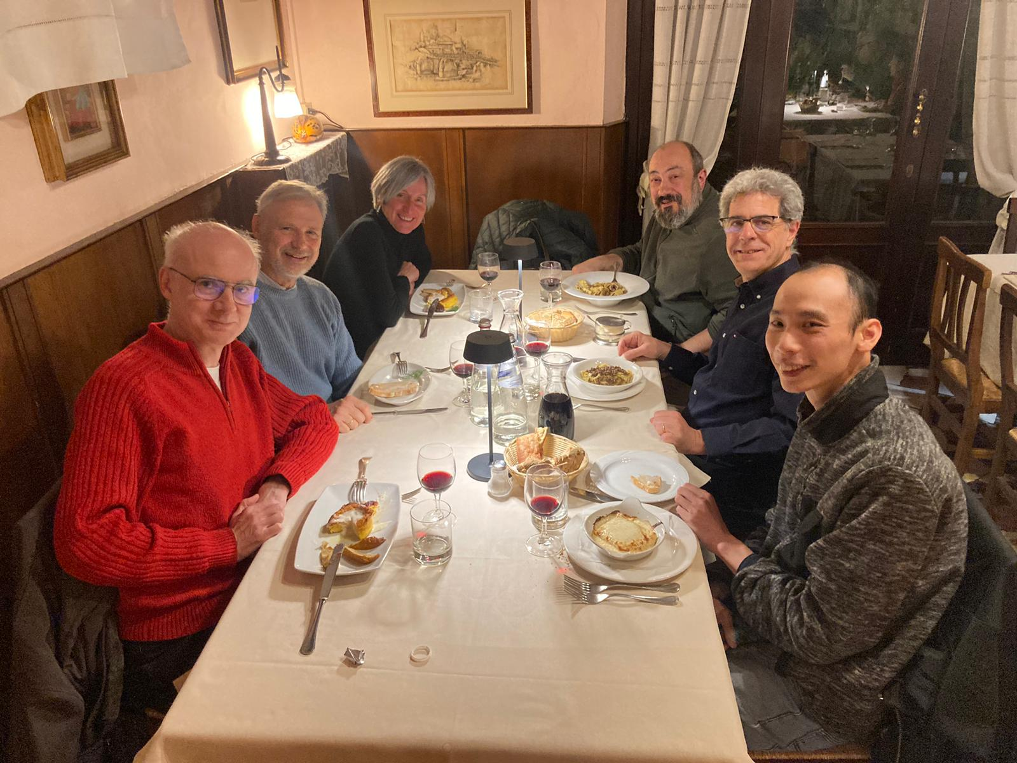
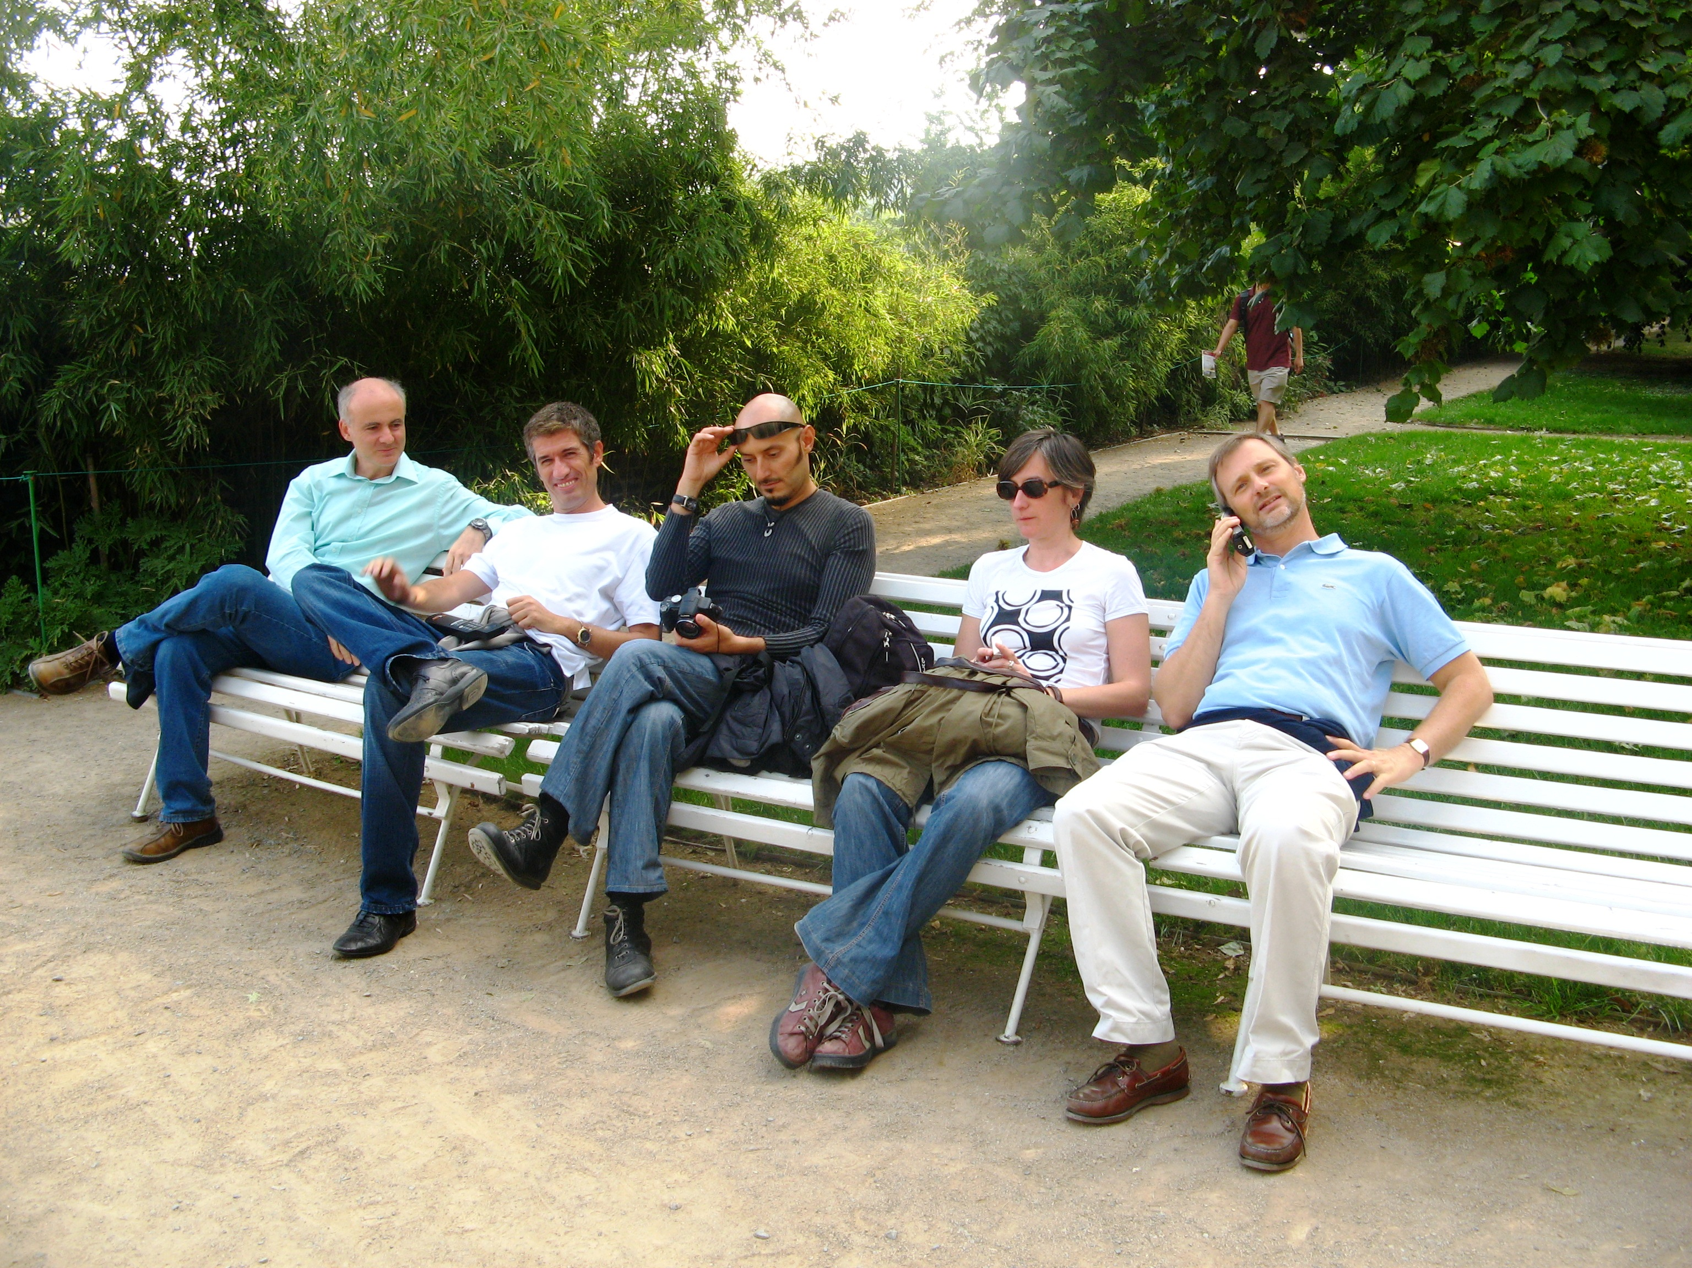
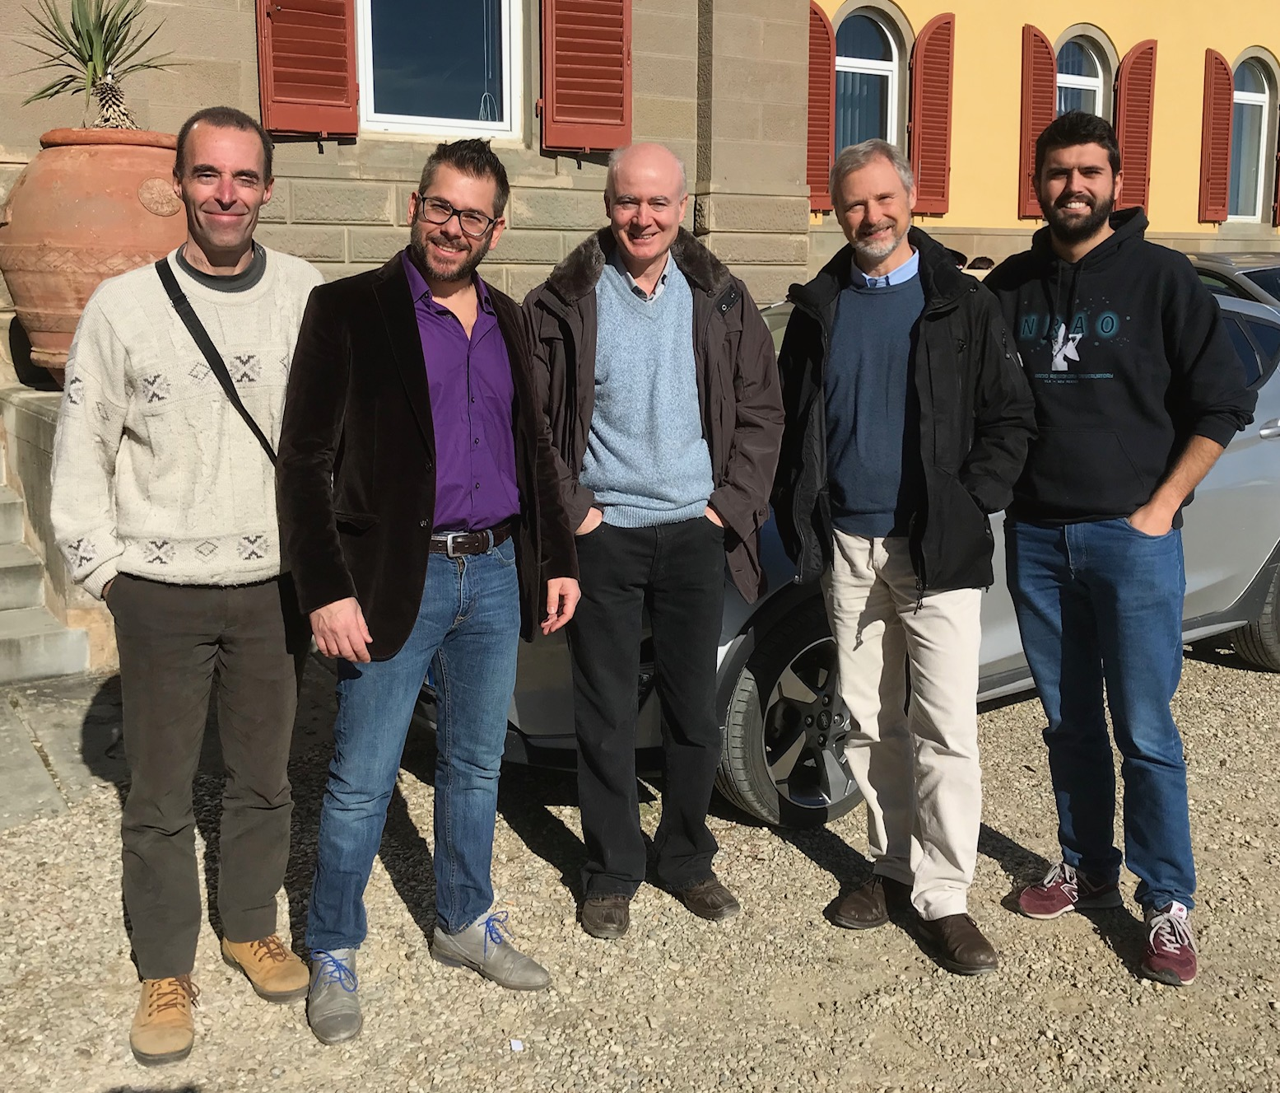
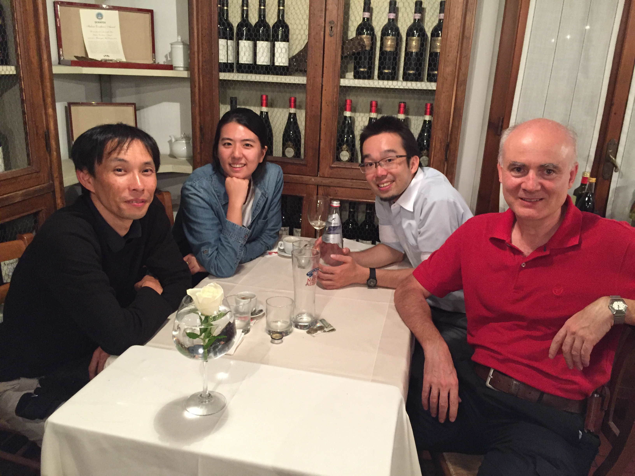
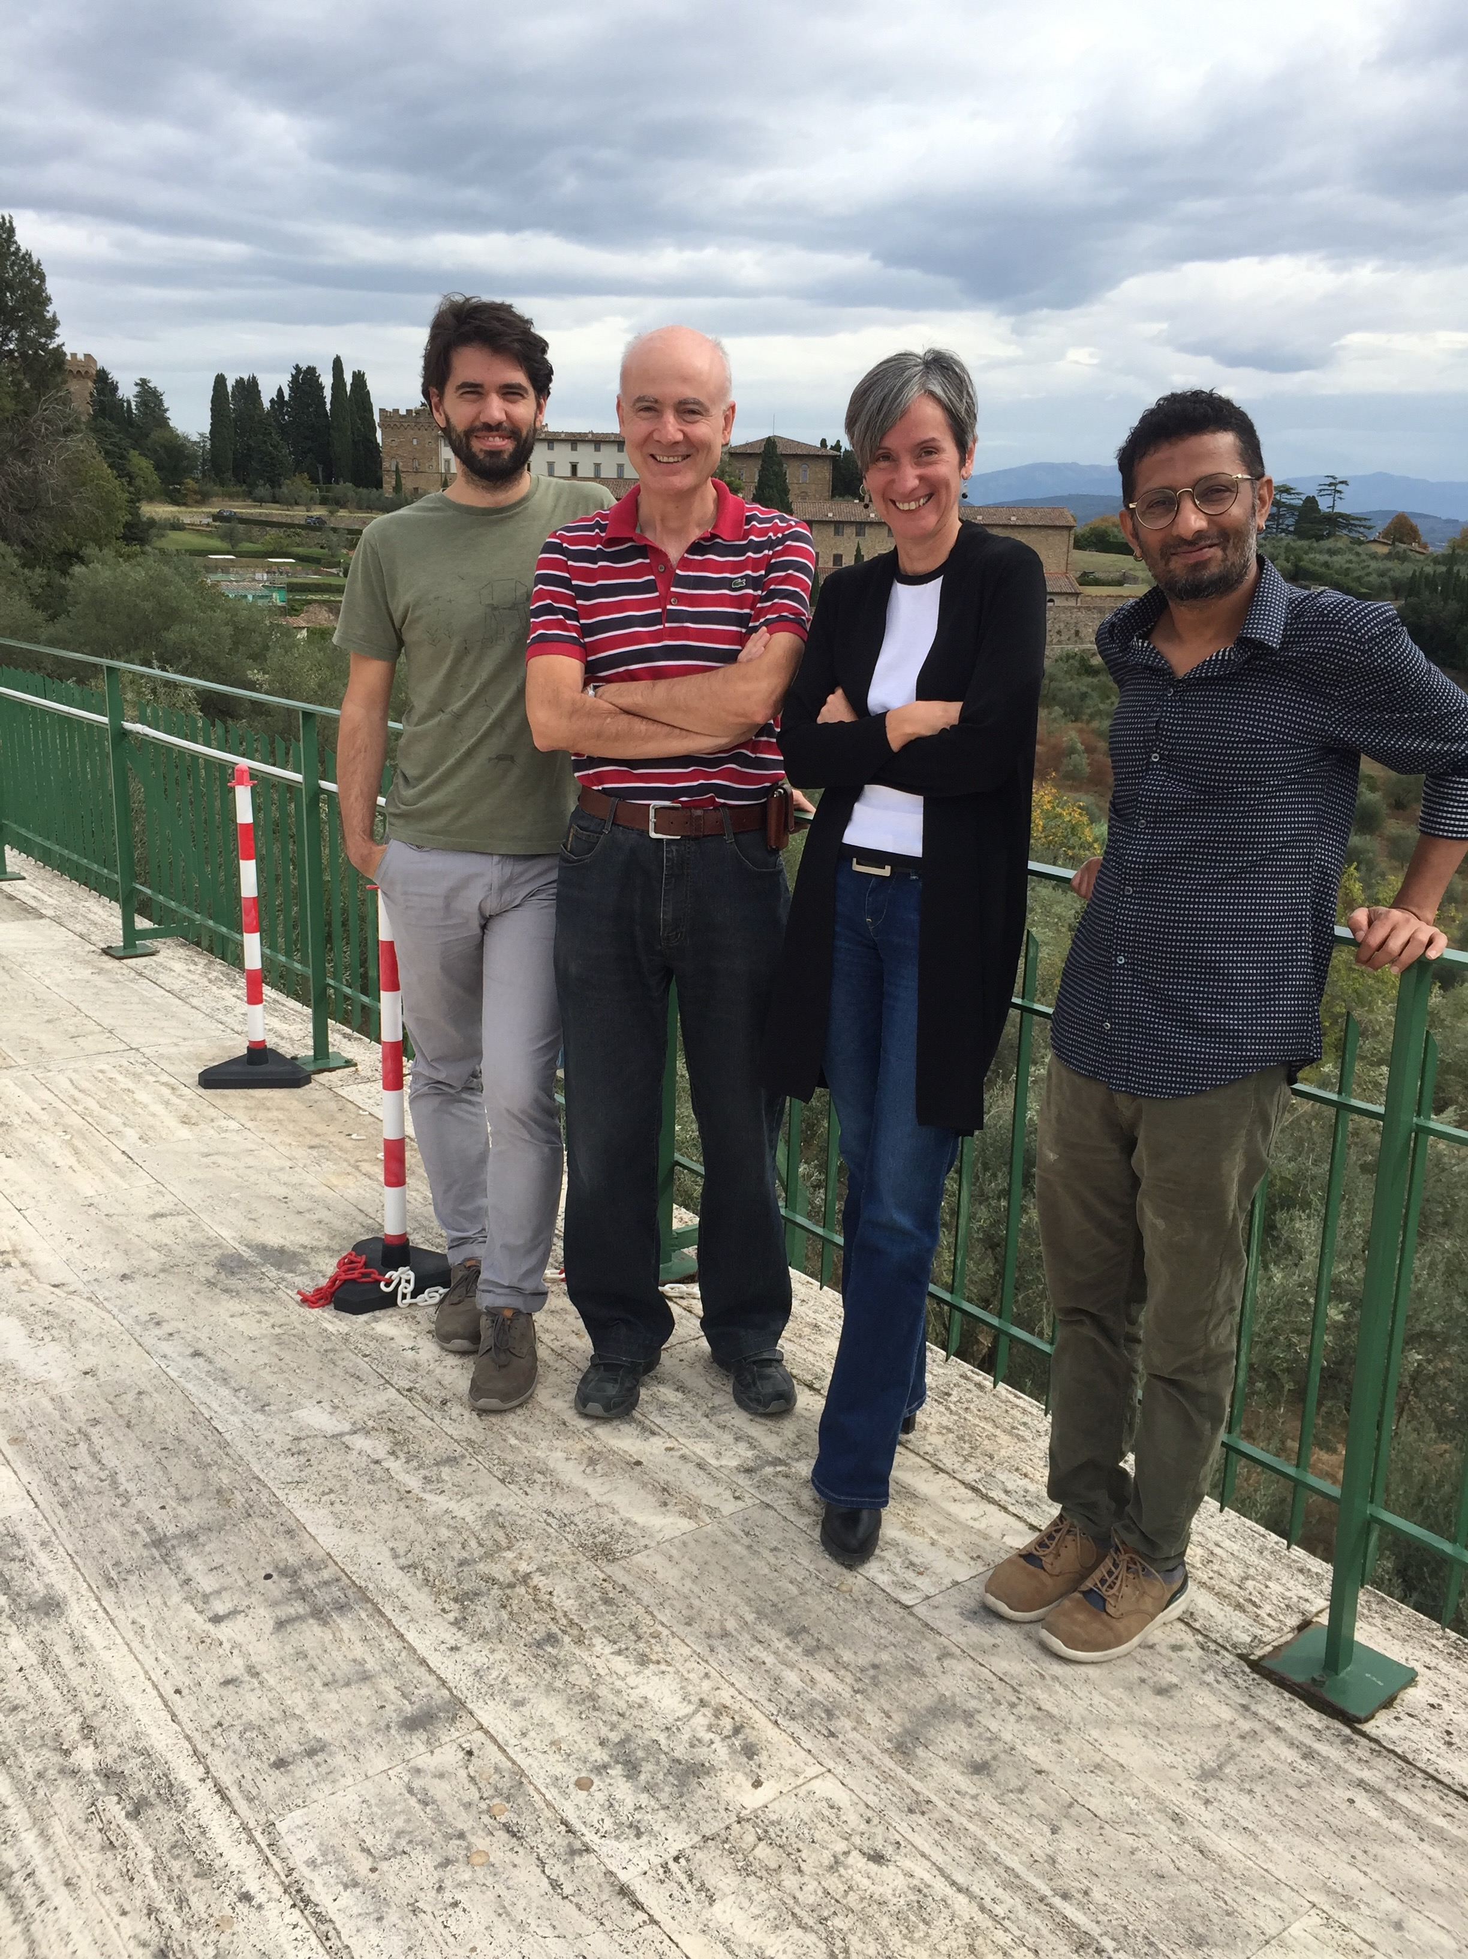
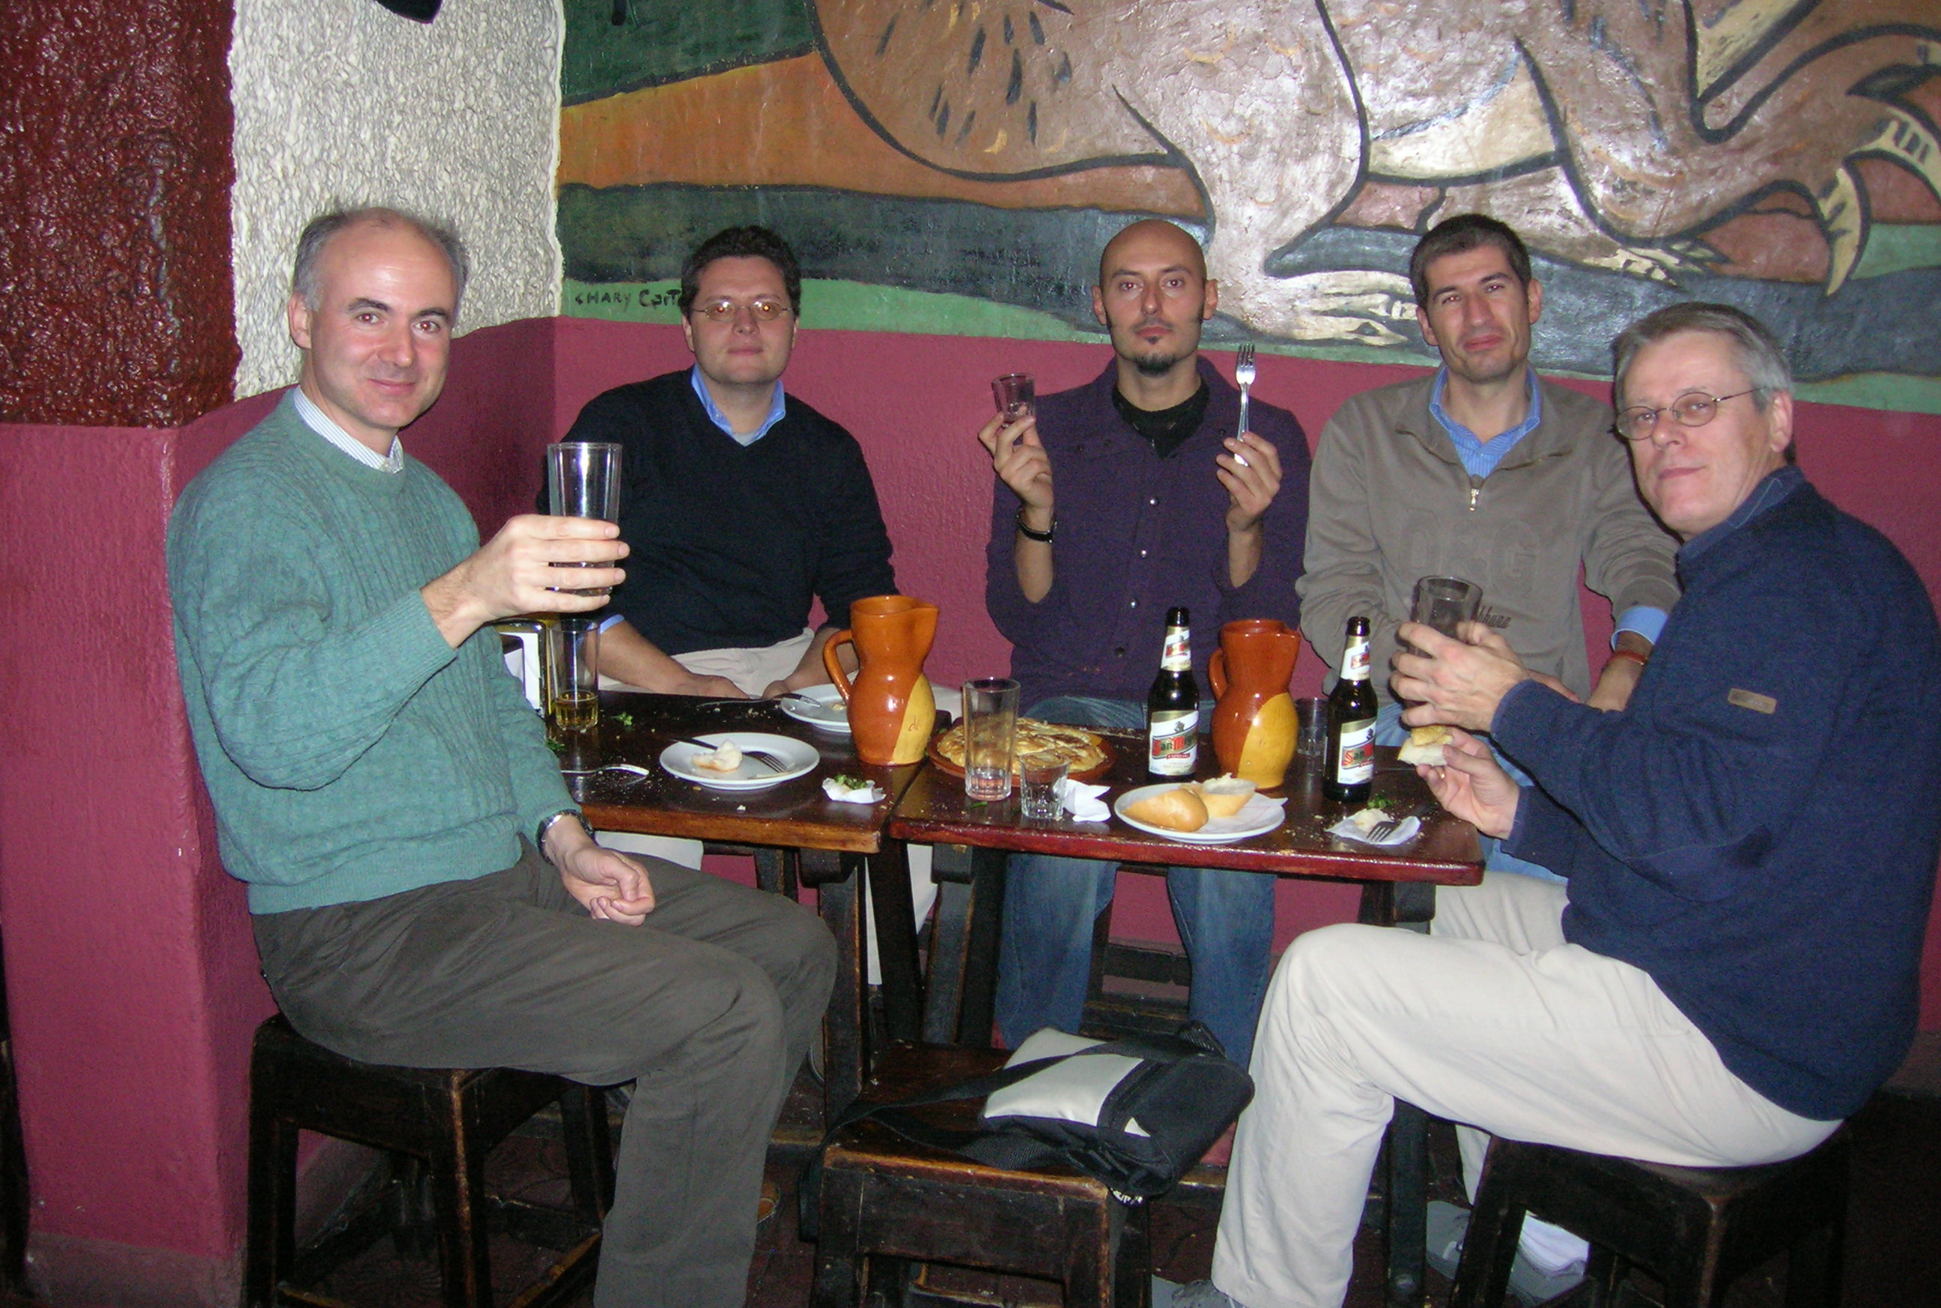
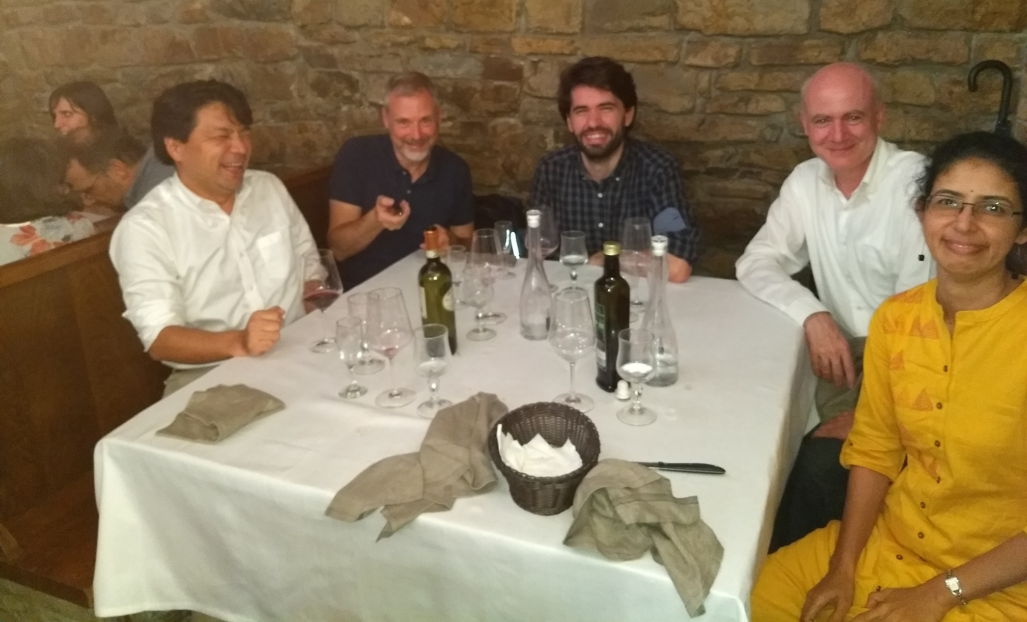
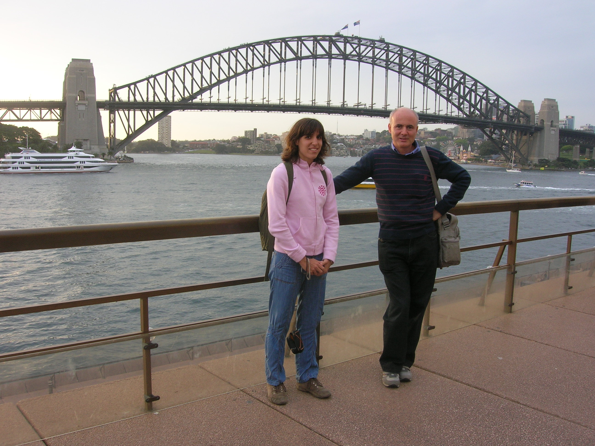
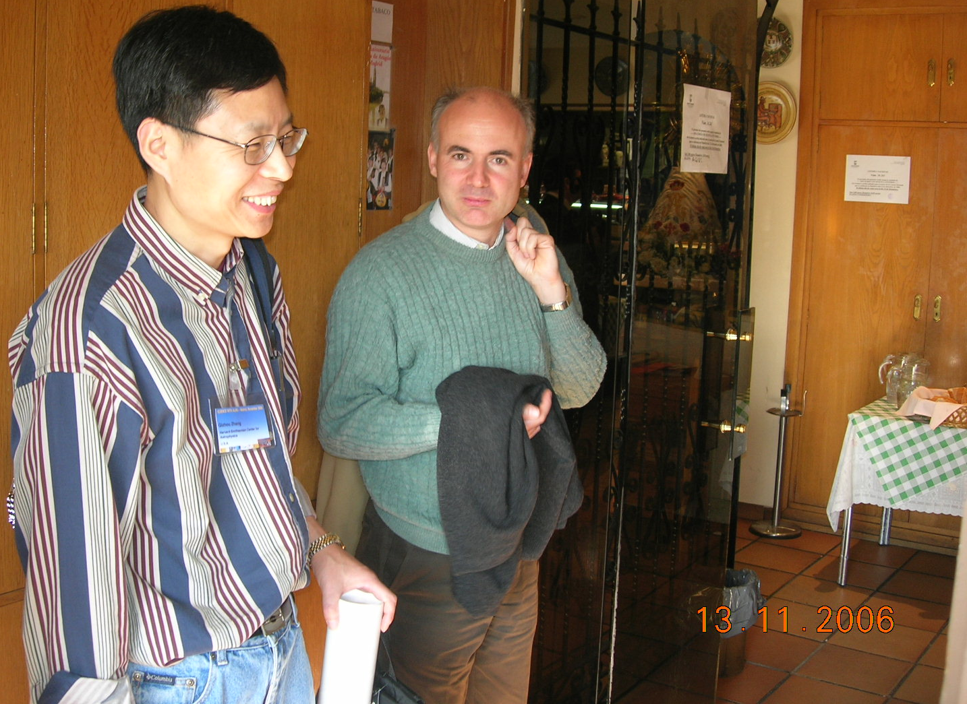
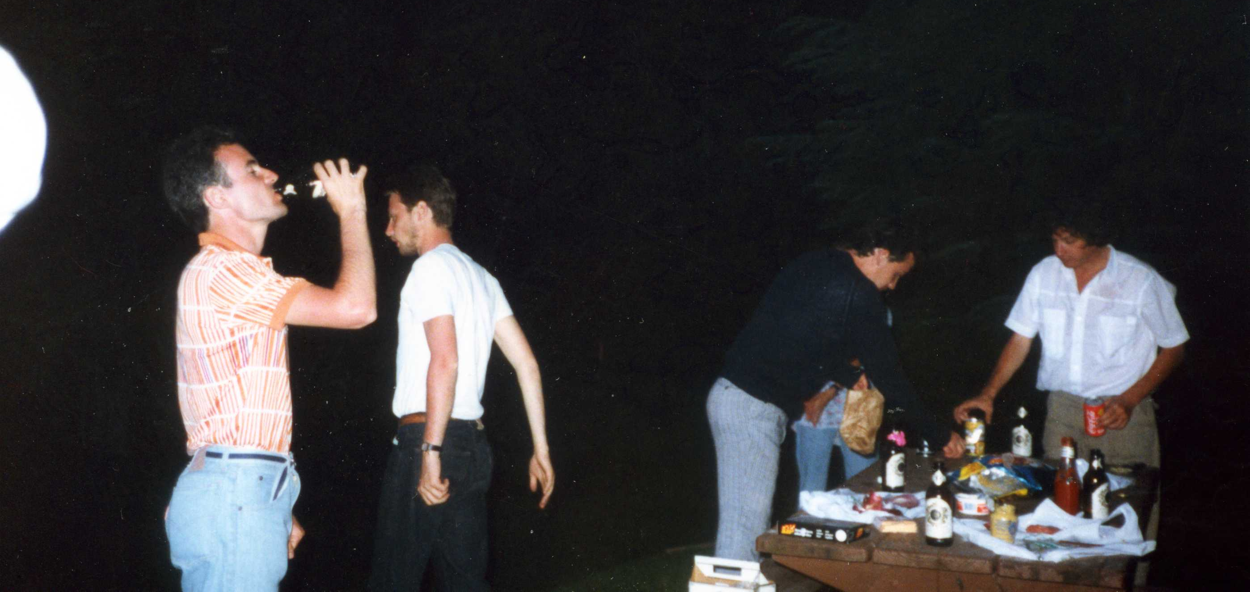

Slide 5
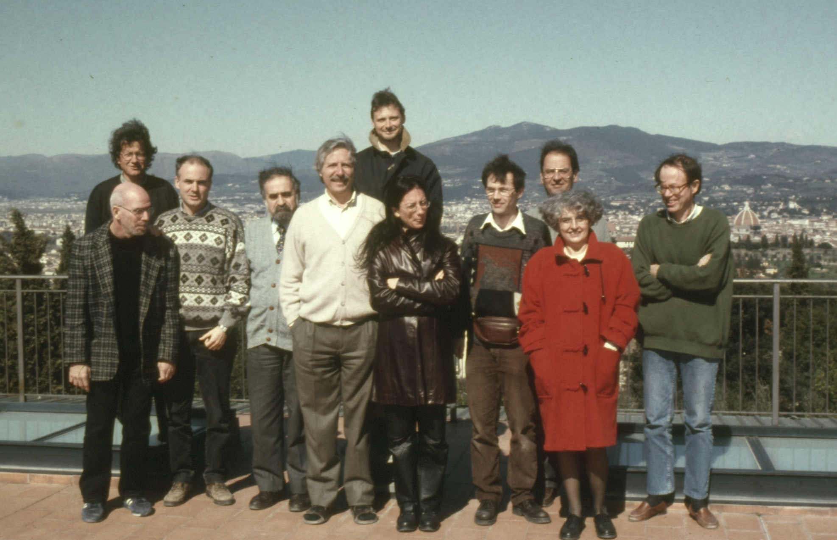

Slide 6
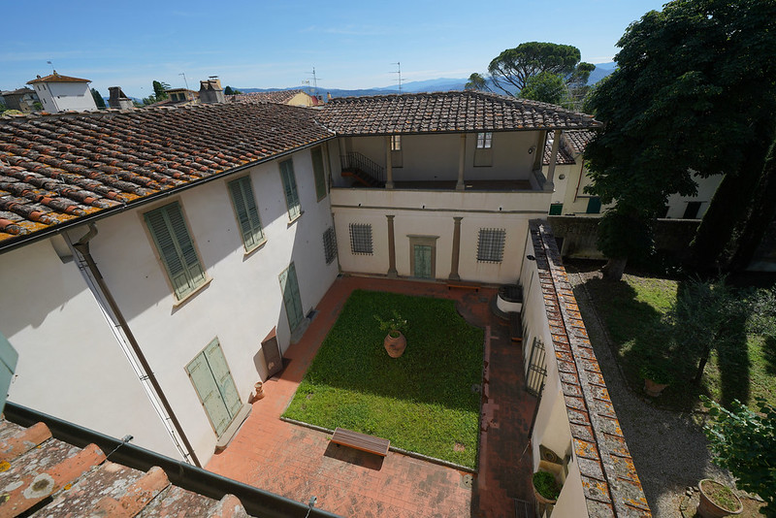
Villa Galileo
Villa Galileo is the home where Galileo spent the last part of his life, confined to house arrest by the condemnation of the Holy Office of 1633. Part of an estate called "Il Gioiello", the Villa, since 1920 National Monument, belongs to the State Property, historical and artistic sector.
Galileo rented the Villa in 1631, driven by his daughter Virginia, a nun with the name of Sister Maria Celeste, together with her younger sister, in the monastery of San Matteo, just 300 meters away.
It was in the Villa that it originated, for his first print run in 1632, the manuscript of the Dialogo sopra i due massimi sistemi del mondo (Dialogue above the two greatest systems of the world), seized after a few months and subsequently republished in Holland. Within these same walls, Galileo completed his last major work, the Discorsi e dimostrazioni matematiche intorno a due nuove scienze (Discourses and mathematical demonstrations around two new sciences), published in 1638 in Holland when Galileo had already become completely blind.
Galileo died at the Villa on 8 January 1642 and was buried in a secondary room in the Basilica of Santa Croce with no solemn celebrations.

Slide 7
