Slide 1



The disk and the jet
of the massive protostar W75N(B)-VLA3
Álvaro Sánchez-Monge
– Institut de Ciències de l’Espai (ICE-CSIC) –
together with
J.F. Gómez – J.M. Torrelles – S. Curiel – J.M. Girart – G. Surcis
C. Carrasco-González – G. Anglada – G.A. Fuller – C. Goddi
W.H.T. Vlemmings – A.R. Rodríguez-Kamenetzky
H.J. van Langevelde – J.-S. Kim – S.-W. Kim – J. Cantó

Slide 2
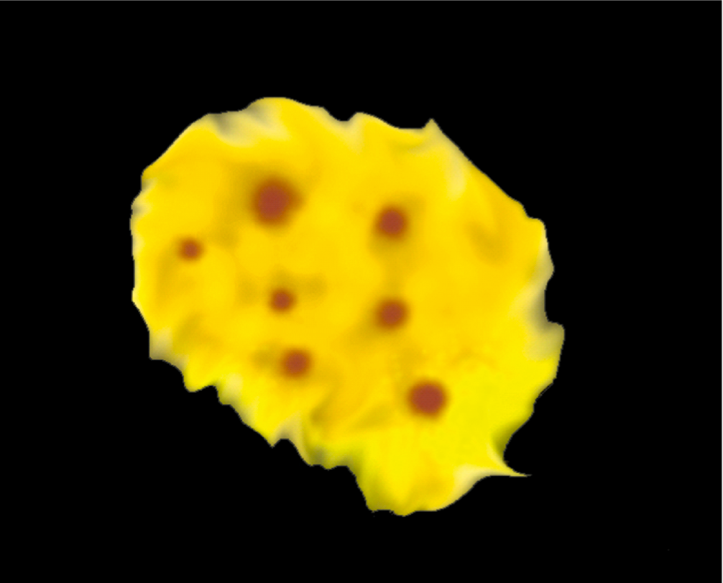
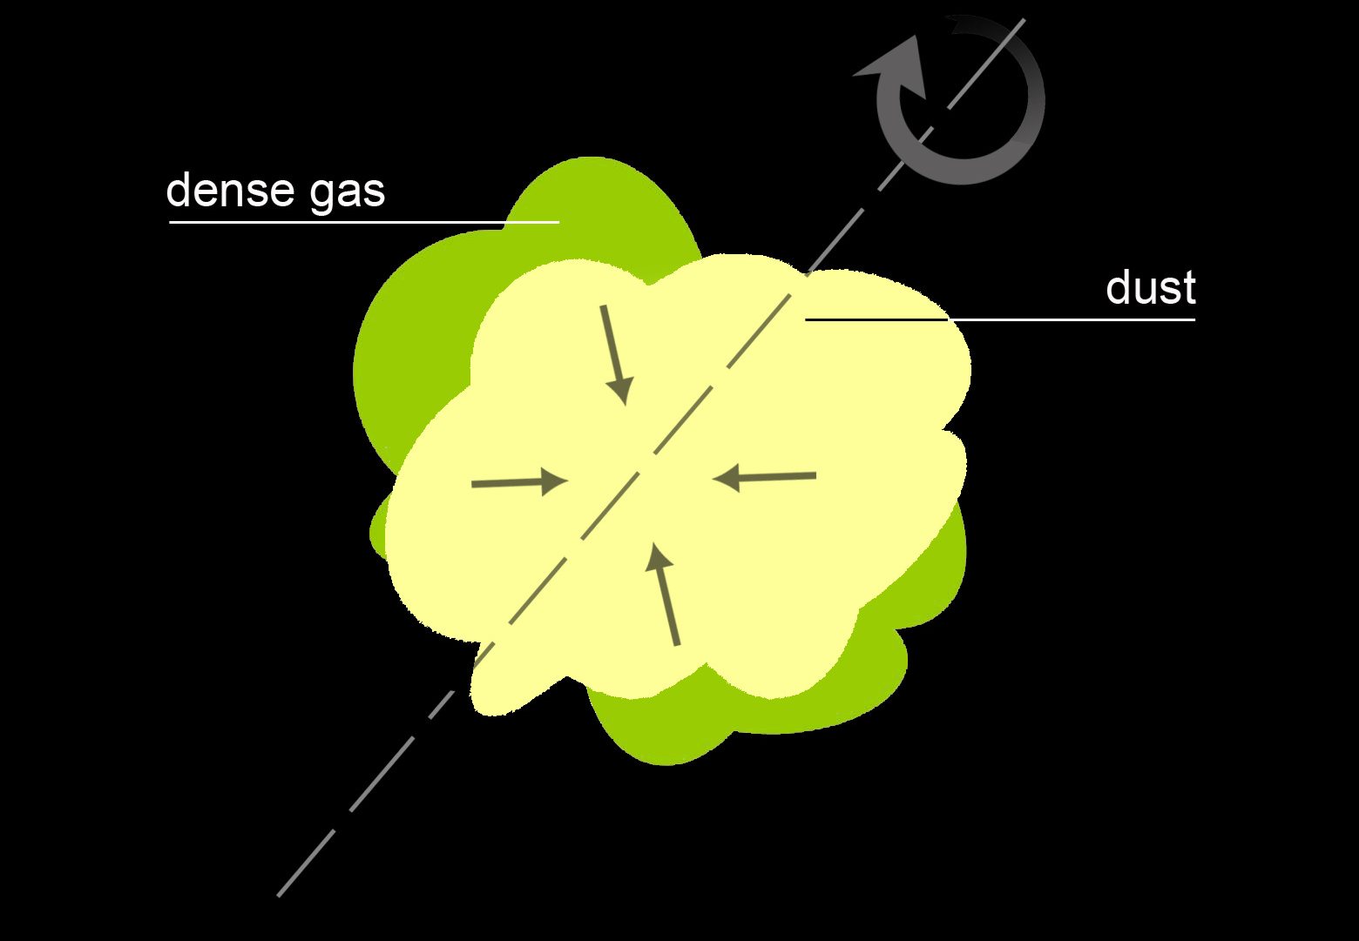
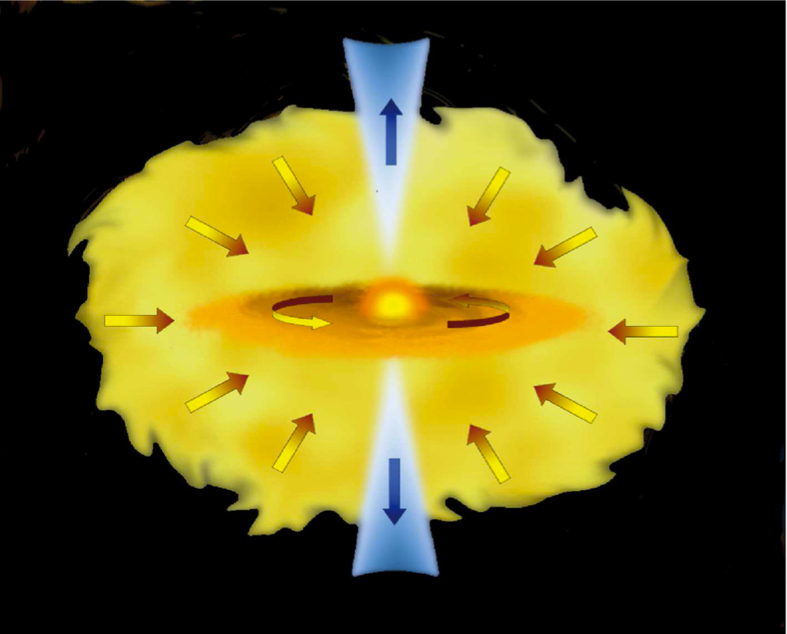
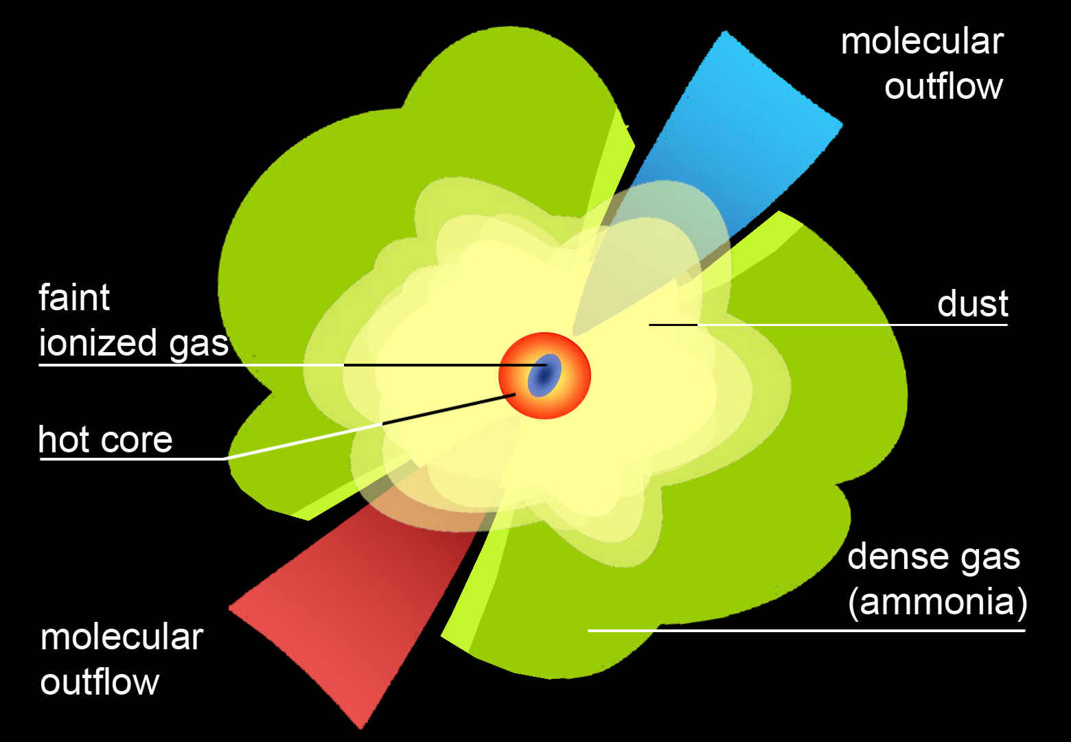
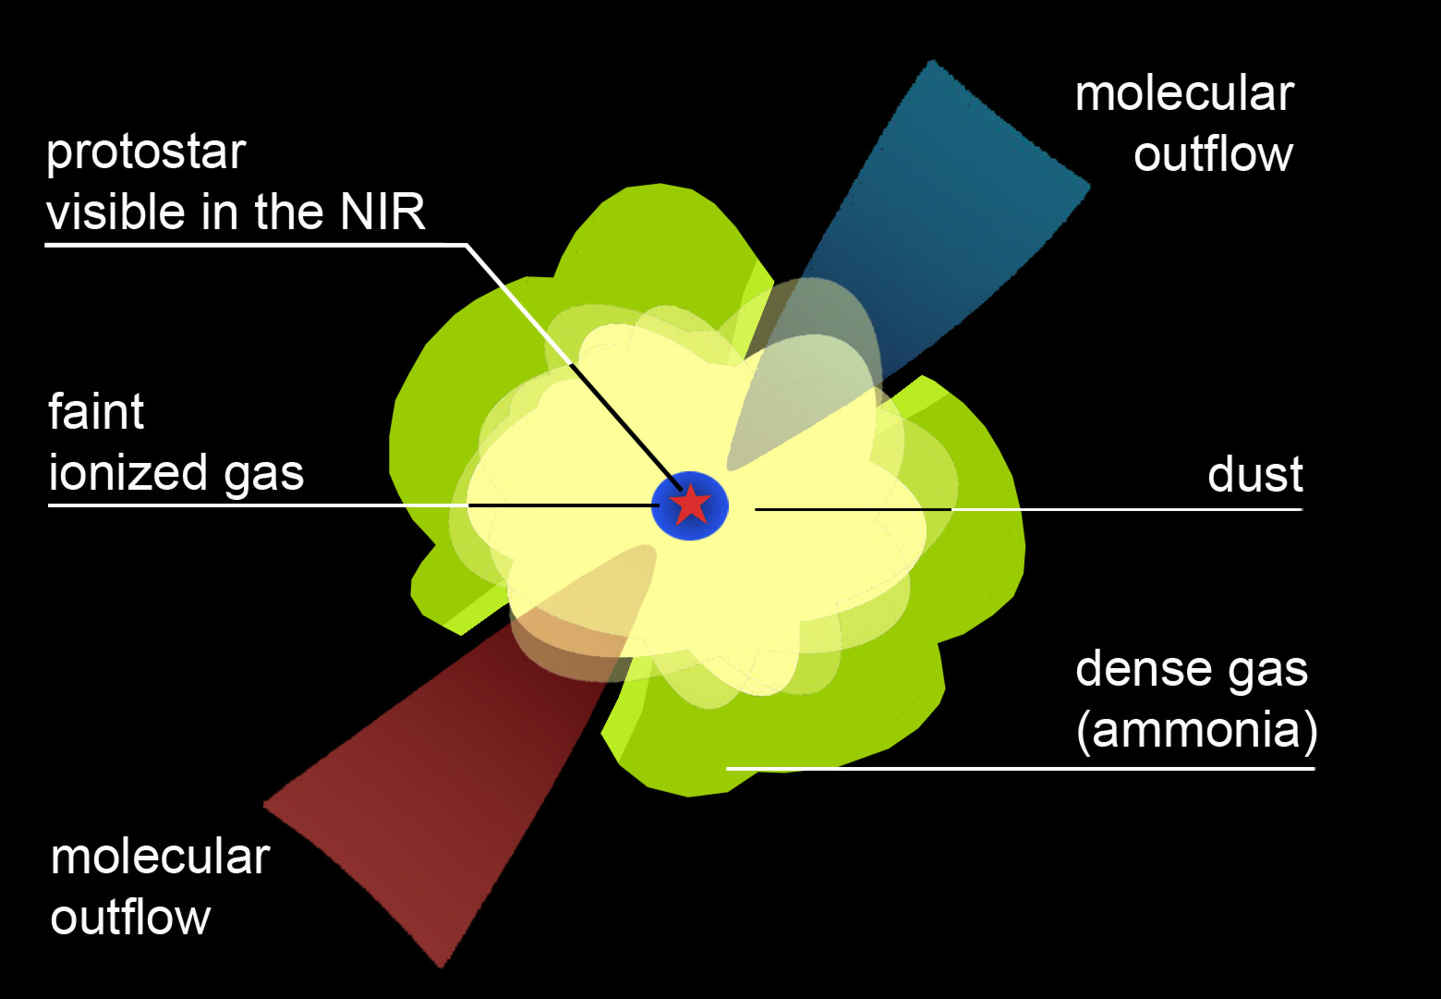
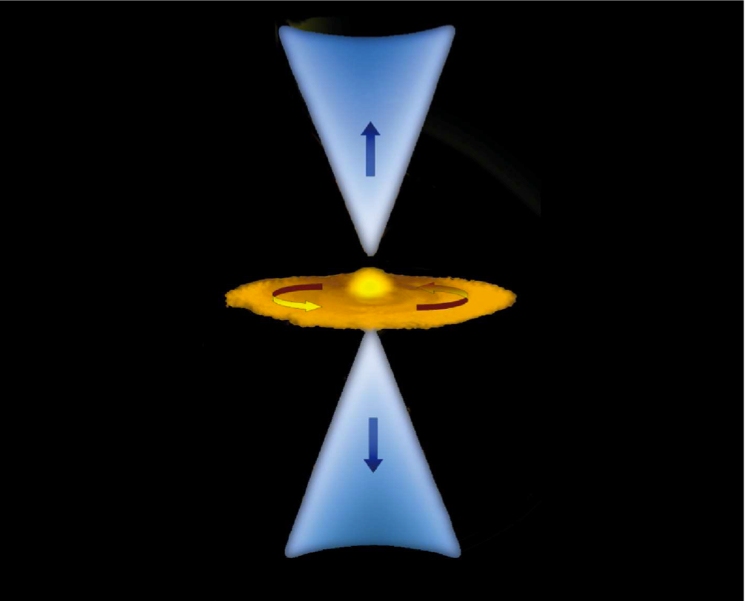
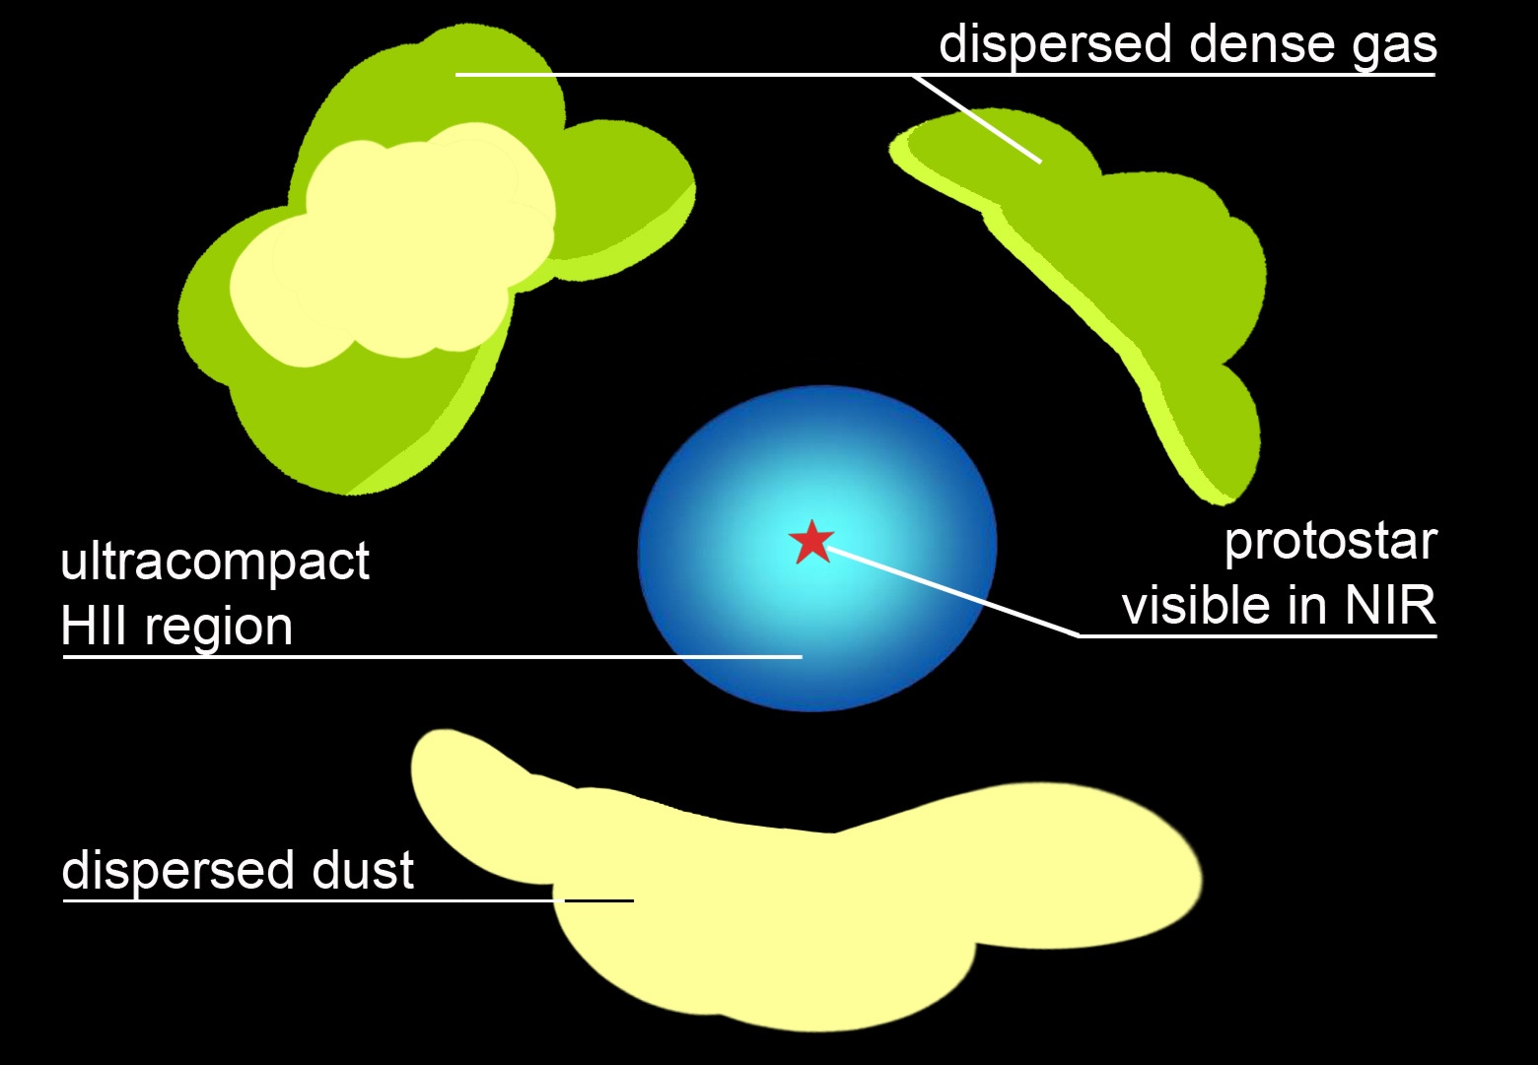
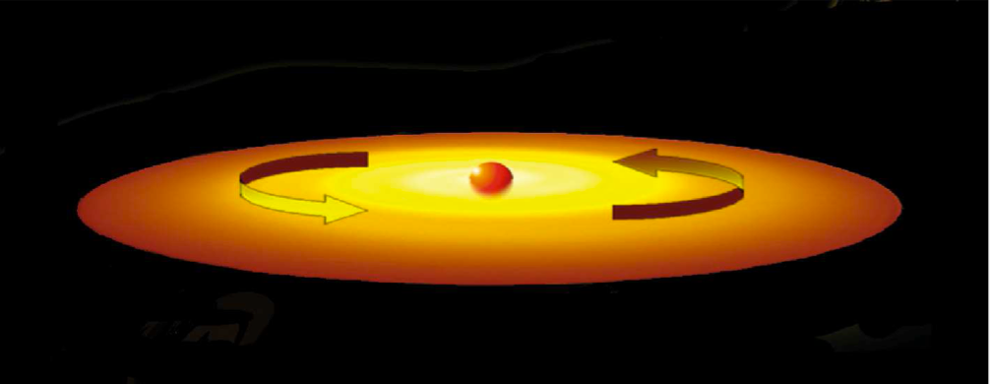
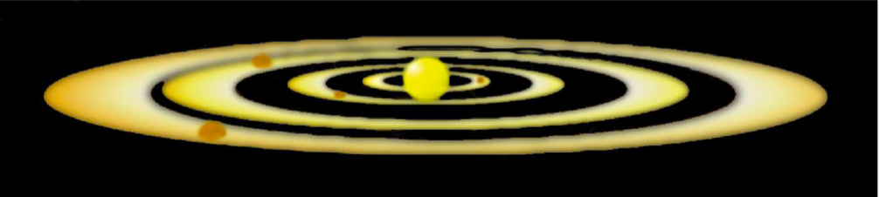
low-mass
high-mass
starless IRDCs, massive quiescent clumps,
dense cores (lines and dust), disks? opt / NIR / MIR / FIR / submm / mm / cm
protostellar dense cores, disks, masers,
outflows and jets
opt / NIR / MIR / FIR / submm / mm / cm
ZAMS[pre-UCHII] hot molecular cores, disks
outflows/jets, masers, HCHII regions
opt / NIR / MIR / FIR / submm / mm / cm
Courtesy of L.Carbonaro and M.T. Beltrán
ZAMS[UCHII] UCHII and compact HII regions,
masers, disks?, outflows?
opt / NIR / MIR / FIR / submm / mm / cm
Image by B. Sánchez and R. Delgado
final star massive star or cluster, HII regions
opt / NIR / MIR / FIR / submm / mm / cm

Slide 3
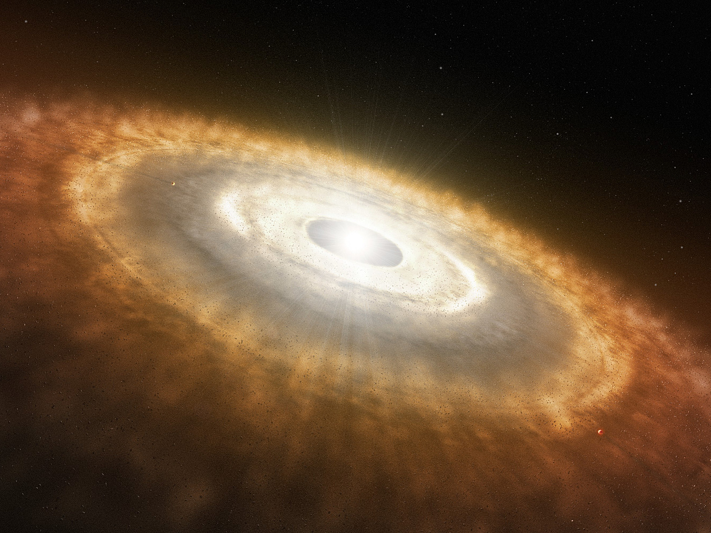

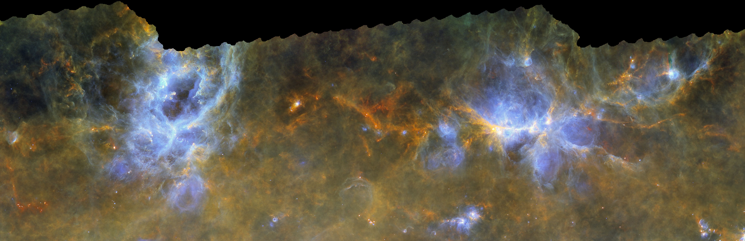


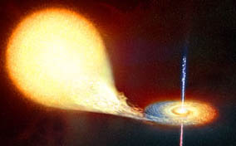
Going back to 2006 …
Interstellar medium is cool… there are clouds and high-mass stars are weird, how do they form?
Robert Estalella
Which topic for a PhD in astrophysics?
Josep M. Paredes
Micro-quasars, accretion disks, stars eating stars …
really high energy events!

Slide 4




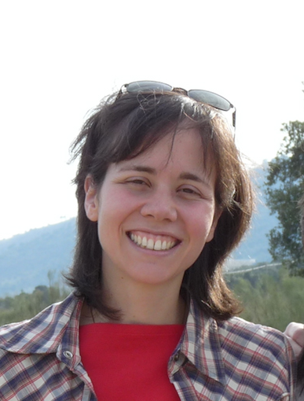
PhD thesis 2007 - 2010
Interstellar medium is cool… there are clouds and high-mass stars are weird, how do they form?
Robert Estalella
Luis Felipe
Rodríguez
Josep Miquel Girart
Riccardo
a.k.a. “il Cesa”
Stan Kurtz
Aina Palau

Slide 5
low-mass
high-mass
starless IRDCs, massive quiescent clumps,
dense cores (lines and dust), disks? opt / NIR / MIR / FIR / submm / mm / cm
protostellar dense cores, disks, masers,
outflows and jets
opt / NIR / MIR / FIR / submm / mm / cm
ZAMS[pre-UCHII] hot molecular cores, disks
outflows/jets, masers, HCHII regions
opt / NIR / MIR / FIR / submm / mm / cm
Courtesy of L.Carbonaro and M.T. Beltrán
ZAMS[UCHII] UCHII and compact HII regions,
masers, disks?, outflows?
opt / NIR / MIR / FIR / submm / mm / cm
Image credit: B. Sánchez and R. Delgado
final star massive star or cluster, HII regions
opt / NIR / MIR / FIR / submm / mm / cm

Slide 6
low-mass
high-mass
starless IRDCs, massive quiescent clumps,
dense cores (lines and dust), disks? opt / NIR / MIR / FIR / submm / mm / cm
protostellar dense cores, disks, masers,
outflows and jets
opt / NIR / MIR / FIR / submm / mm / cm
ZAMS[pre-UCHII] hot molecular cores, disks
outflows/jets, masers, HCHII regions
opt / NIR / MIR / FIR / submm / mm / cm
Courtesy of L.Carbonaro and M.T. Beltrán
ZAMS[UCHII] UCHII and compact HII regions,
masers, disks?, outflows?
opt / NIR / MIR / FIR / submm / mm / cm
Image credit: B. Sánchez and R. Delgado
final star massive star or cluster, HII regions
opt / NIR / MIR / FIR / submm / mm / cm

Slide 7
low-mass
high-mass
starless IRDCs, massive quiescent clumps,
dense cores (lines and dust), disks? opt / NIR / MIR / FIR / submm / mm / cm
protostellar dense cores, disks, masers,
outflows and jets
opt / NIR / MIR / FIR / submm / mm / cm
ZAMS[pre-UCHII] hot molecular cores, disks
outflows/jets, masers, HCHII regions
opt / NIR / MIR / FIR / submm / mm / cm
Courtesy of L.Carbonaro and M.T. Beltrán
ZAMS[UCHII] UCHII and compact HII regions,
masers, disks?, outflows?
opt / NIR / MIR / FIR / submm / mm / cm
Image credit: B. Sánchez and R. Delgado
final star massive star or cluster, HII regions
opt / NIR / MIR / FIR / submm / mm / cm

Slide 8
low-mass
high-mass
starless IRDCs, massive quiescent clumps,
dense cores (lines and dust), disks? opt / NIR / MIR / FIR / submm / mm / cm
protostellar dense cores, disks, masers,
outflows and jets
opt / NIR / MIR / FIR / submm / mm / cm
ZAMS[pre-UCHII] hot molecular cores, disks
outflows/jets, masers, HCHII regions
opt / NIR / MIR / FIR / submm / mm / cm
Courtesy of L.Carbonaro and M.T. Beltrán
ZAMS[UCHII] UCHII and compact HII regions,
masers, disks?, outflows?
opt / NIR / MIR / FIR / submm / mm / cm
Image credit: B. Sánchez and R. Delgado
final star massive star or cluster, HII regions
opt / NIR / MIR / FIR / submm / mm / cm

Slide 9
low-mass
high-mass
starless IRDCs, massive quiescent clumps,
dense cores (lines and dust), disks? opt / NIR / MIR / FIR / submm / mm / cm
protostellar dense cores, disks, masers,
outflows and jets
opt / NIR / MIR / FIR / submm / mm / cm
ZAMS[pre-UCHII] hot molecular cores, disks
outflows/jets, masers, HCHII regions
opt / NIR / MIR / FIR / submm / mm / cm
Courtesy of L.Carbonaro and M.T. Beltrán
ZAMS[UCHII] UCHII and compact HII regions,
masers, disks?, outflows?
opt / NIR / MIR / FIR / submm / mm / cm
Image credit: B. Sánchez and R. Delgado
final star massive star or cluster, HII regions
opt / NIR / MIR / FIR / submm / mm / cm

Slide 10
low-mass
high-mass
starless IRDCs, massive quiescent clumps,
dense cores (lines and dust), disks? opt / NIR / MIR / FIR / submm / mm / cm
protostellar dense cores, disks, masers,
outflows and jets
opt / NIR / MIR / FIR / submm / mm / cm
ZAMS[pre-UCHII] hot molecular cores, disks
outflows/jets, masers, HCHII regions
opt / NIR / MIR / FIR / submm / mm / cm
Courtesy of L.Carbonaro and M.T. Beltrán
ZAMS[UCHII] UCHII and compact HII regions,
masers, disks?, outflows?
opt / NIR / MIR / FIR / submm / mm / cm
Image credit: B. Sánchez and R. Delgado
final star massive star or cluster, HII regions
opt / NIR / MIR / FIR / submm / mm / cm

Slide 11
low-mass
high-mass
starless IRDCs, massive quiescent clumps,
dense cores (lines and dust), disks? opt / NIR / MIR / FIR / submm / mm / cm
protostellar dense cores, disks, masers,
outflows and jets
opt / NIR / MIR / FIR / submm / mm / cm
ZAMS[pre-UCHII] hot molecular cores, disks
outflows/jets, masers, HCHII regions
opt / NIR / MIR / FIR / submm / mm / cm
Courtesy of L.Carbonaro and M.T. Beltrán
ZAMS[UCHII] UCHII and compact HII regions,
masers, disks?, outflows?
opt / NIR / MIR / FIR / submm / mm / cm
Image credit: B. Sánchez and R. Delgado
final star massive star or cluster, HII regions
opt / NIR / MIR / FIR / submm / mm / cm

Slide 12
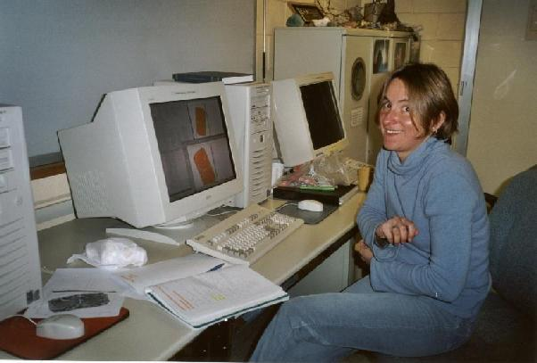
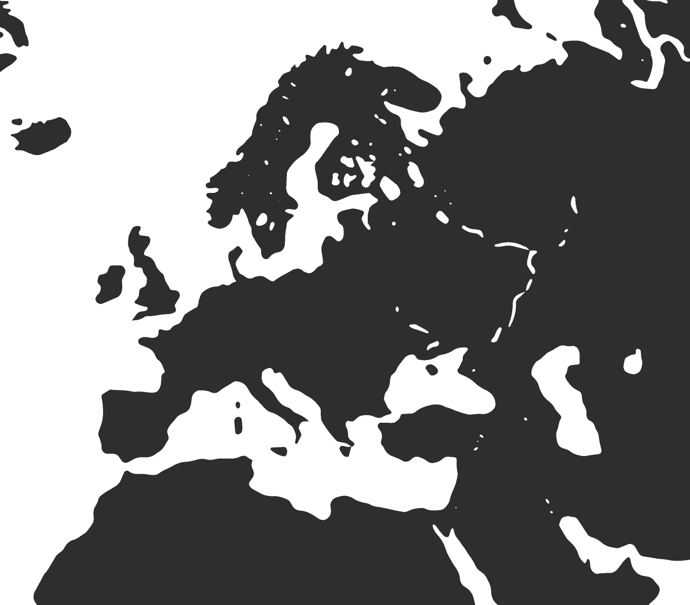

March 2011 – starting my postdoc at Arcetri

Slide 13
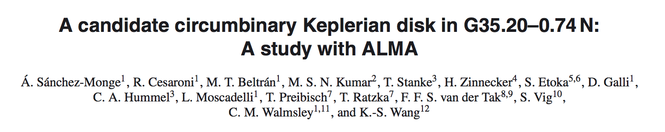
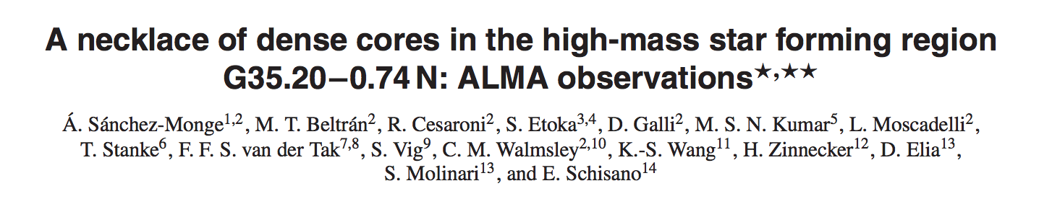
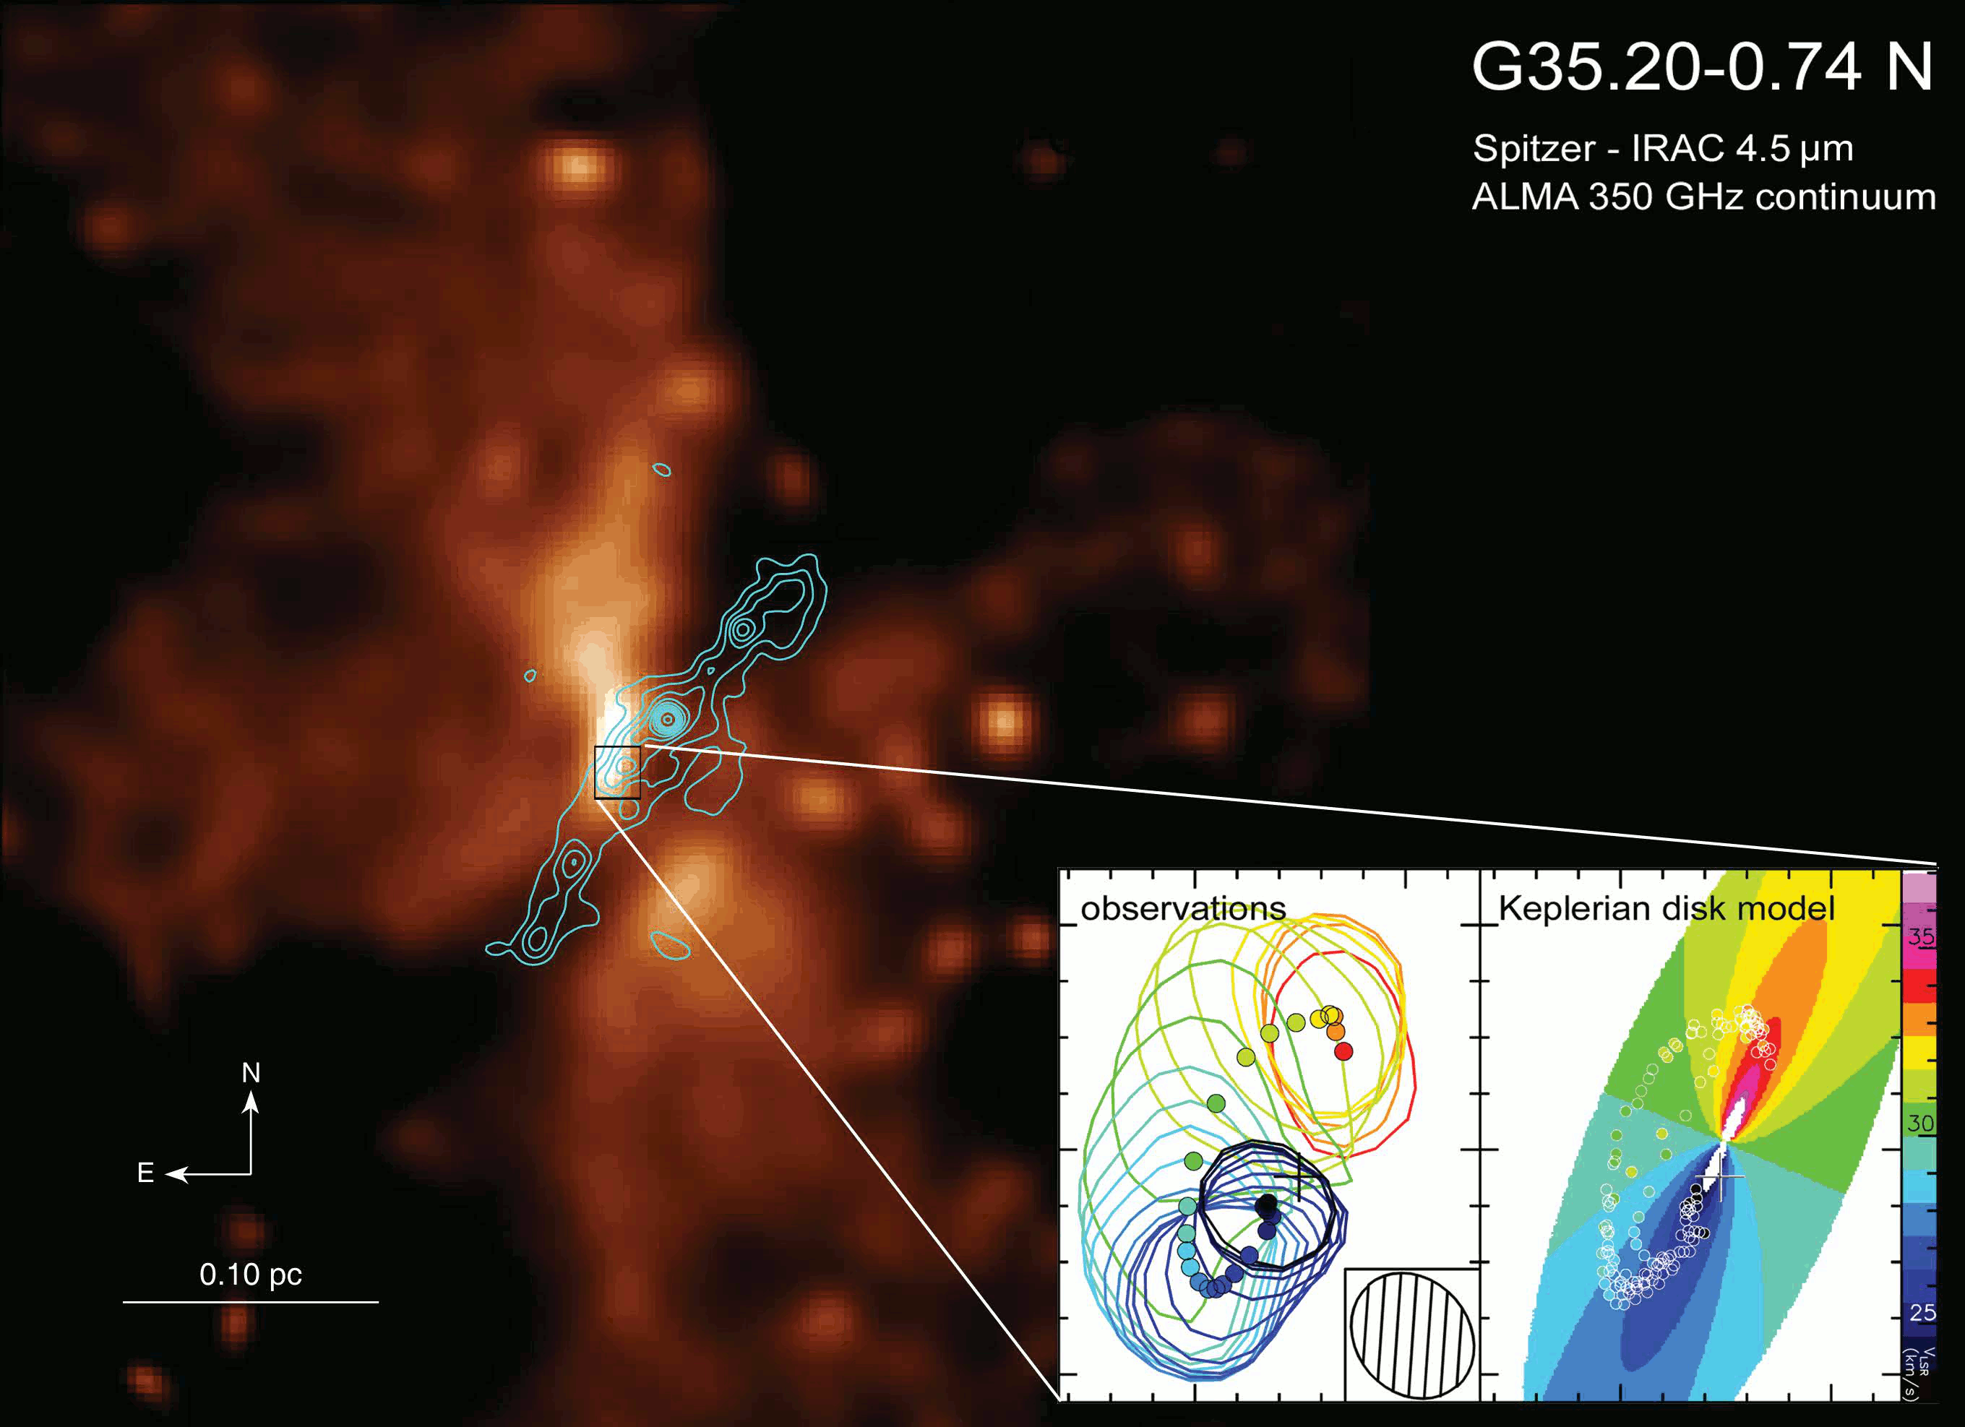
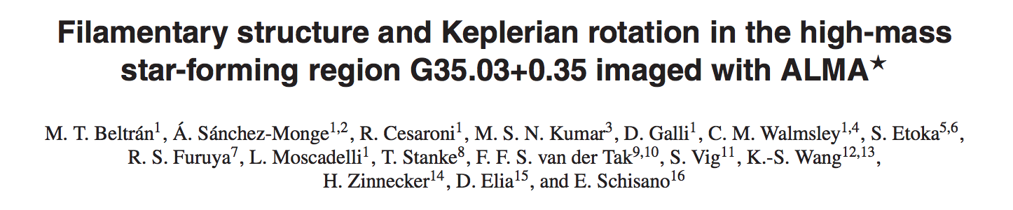
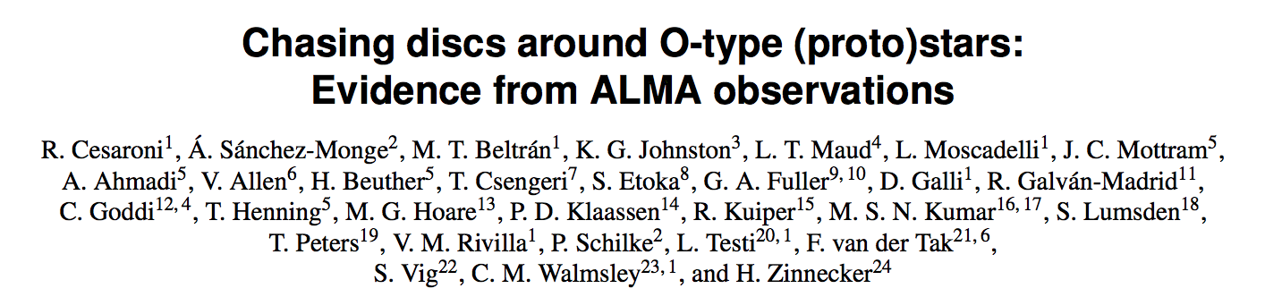
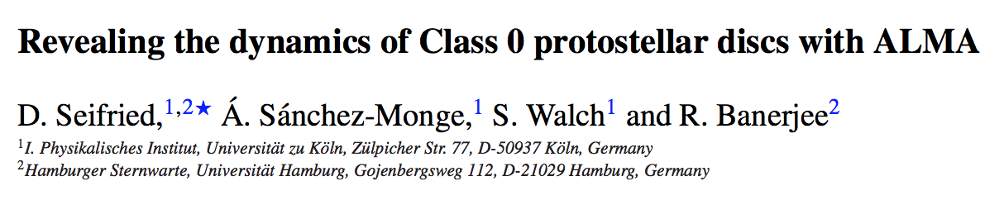
March 2011 – starting my postdoc at Arcetri

Slide 14
Some memories from my stay in Arcetri (with Riccardo)…

Slide 15
Osservatorio Astrofisico di Arcetri
Towards Galileo’s Villa
Main building
Mensa
Radio building
Telescopio Amici
Amazing views

Slide 16
Mensa

Slide 17
Mensa

Slide 18

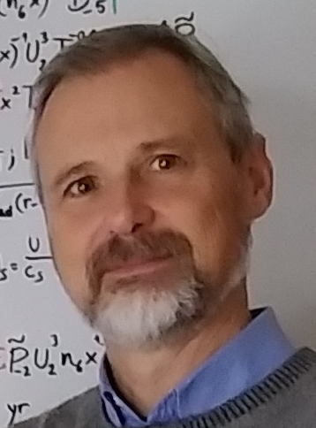

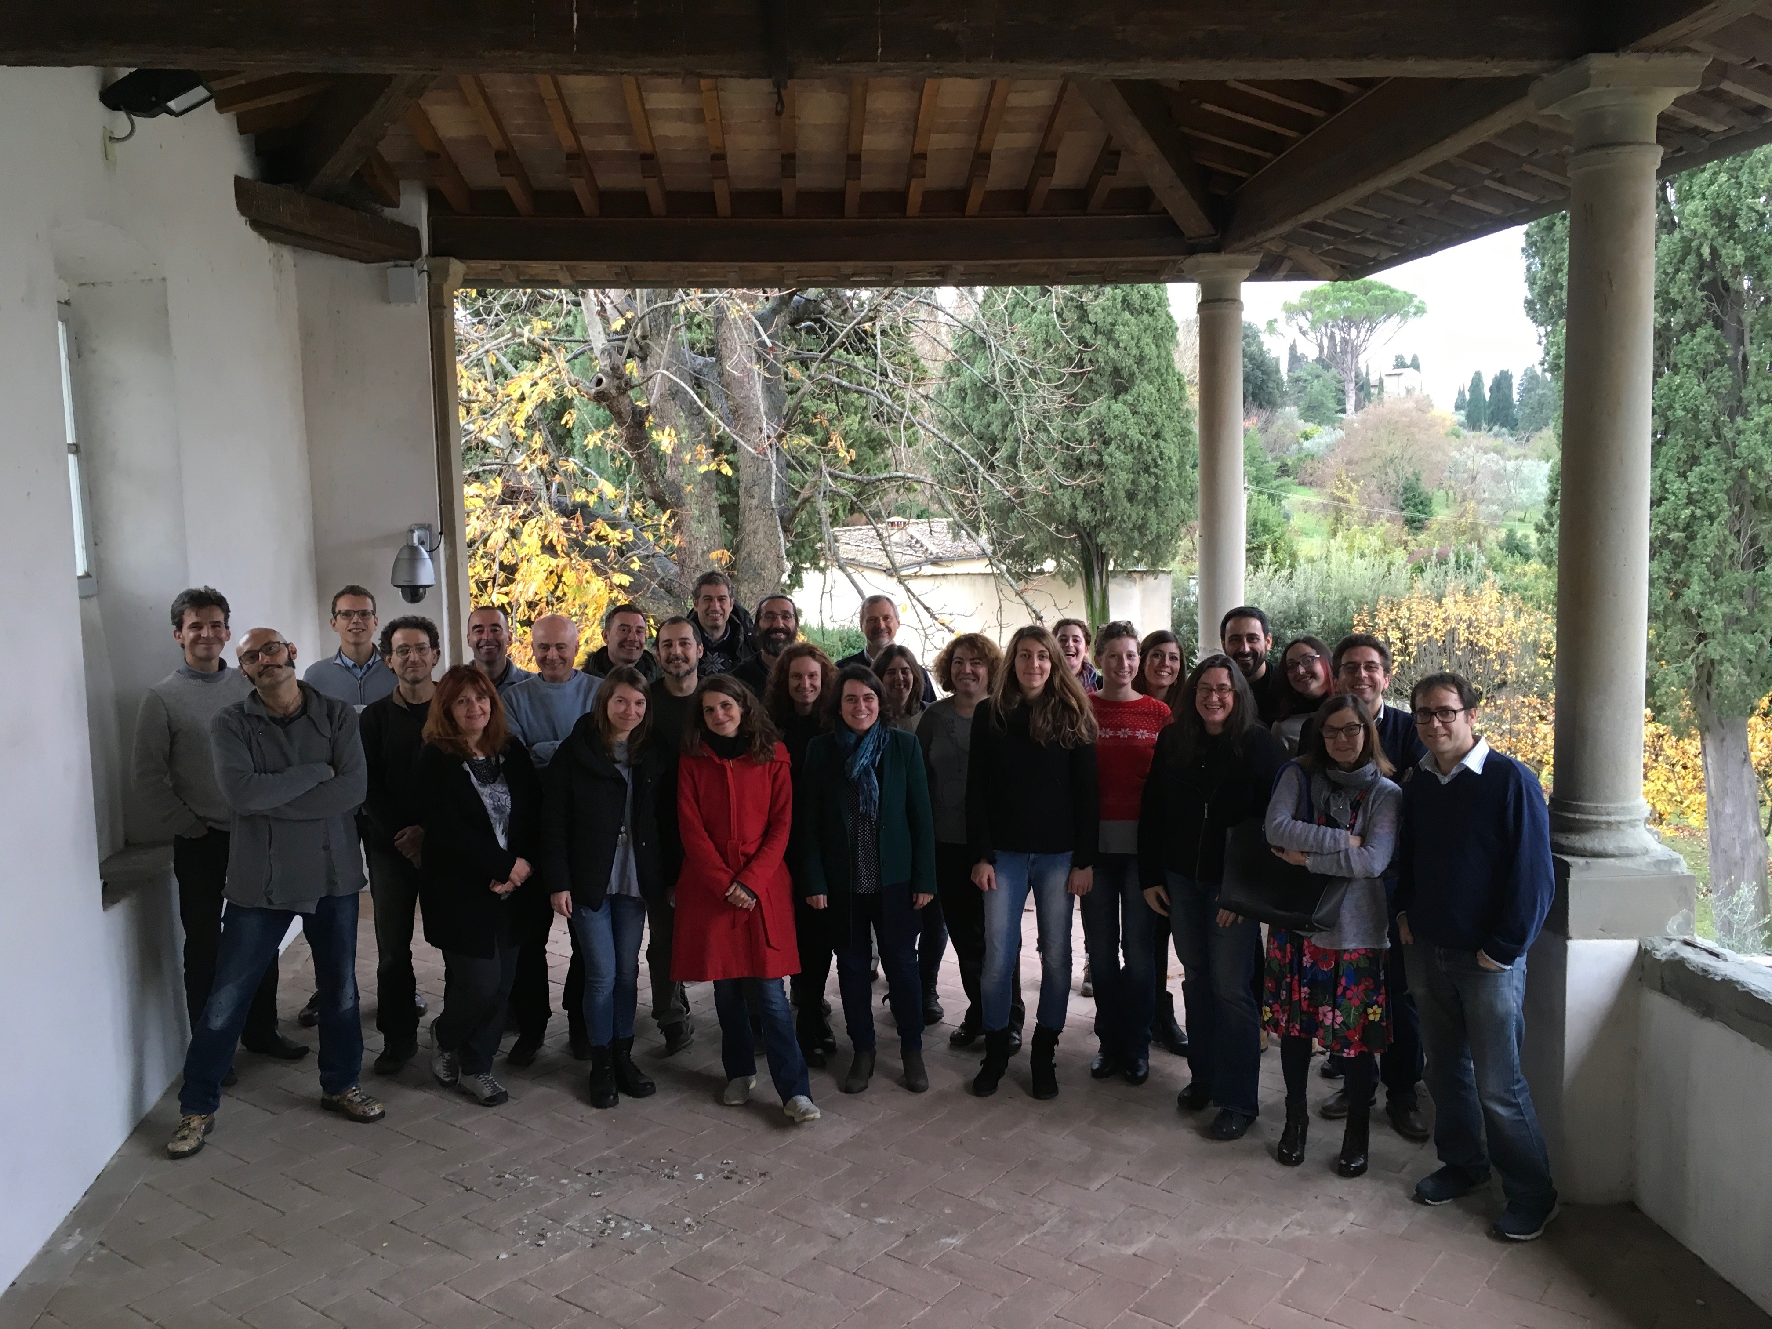

Slide 19



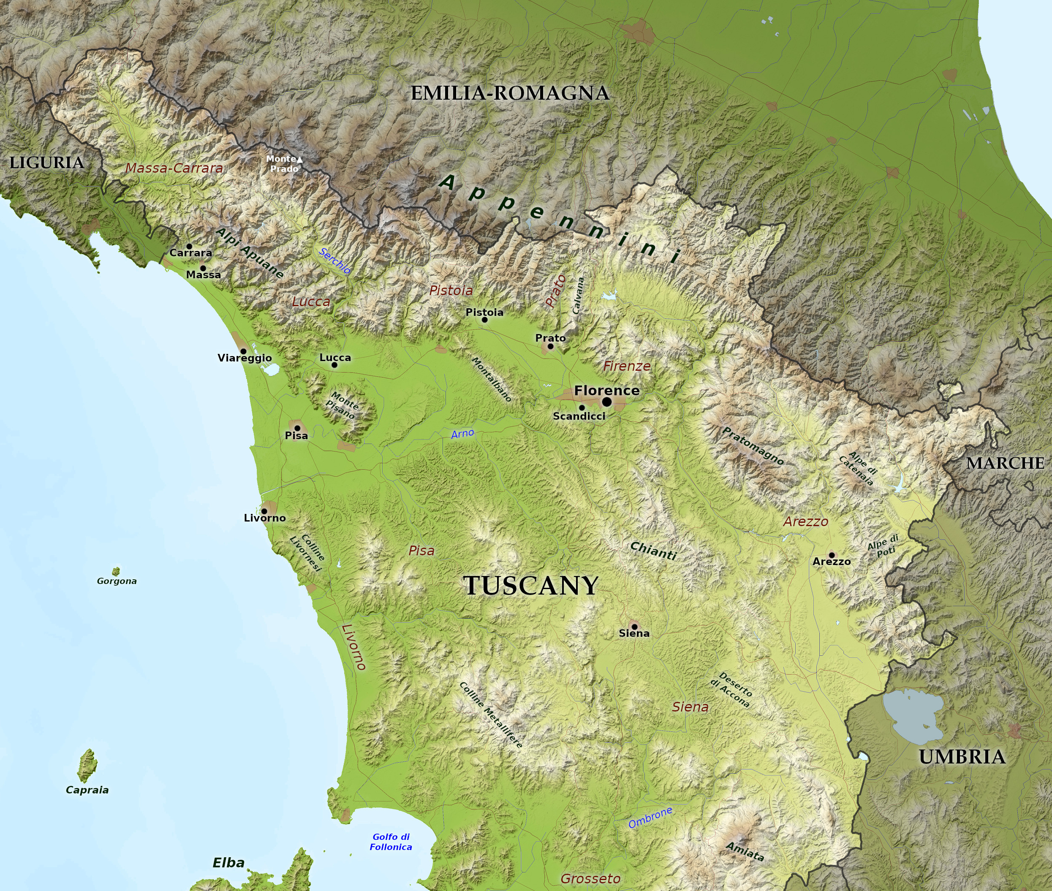

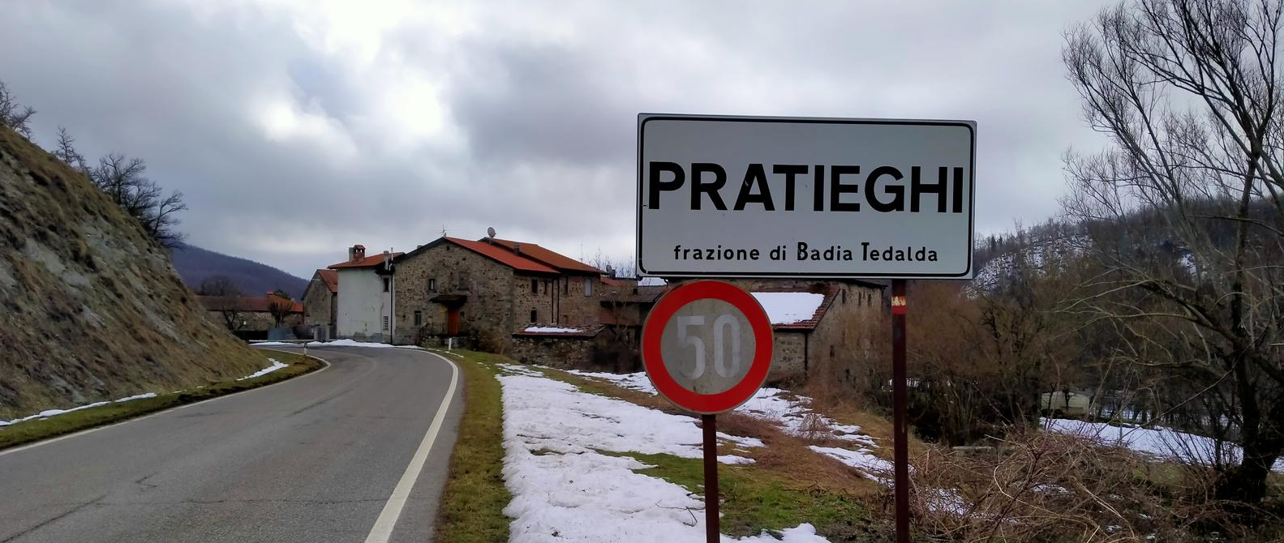






Firenze
Pisa
Arezzo
Siena

Slide 20
Some memories from my stay in Arcetri (with Riccardo)…
… bicycle tours

Slide 21



Slide 23
Buff! I am dying.
Tomorrow, I will not be
able to move

Slide 24



Slide 26
Some memories from my stay in Arcetri (with Riccardo)…
… working time

Slide 28
Radio building

Slide 32
Ok, I have the class file loaded …
… what was the name of the variable that allowed you to look at <INSERT ANYTHING>

Slide 33
… you know what,
let’s ask Riccardo

Slide 34
Riccardo, do you have a minute?
What is the name in GILDAS to look at <INSERT ANYTHING> once you have the class file loaded?

Slide 35
Sure! Come in
The name of the variable is <INSERT CORRECT ANSWER>
Great! Thanks!
I have the impression that the name are changing through the GILDAS versions
Maybe Roberto Neri can confirm this,
but I have always thought that Riccardo is the secret developer of GILDAS

Slide 36
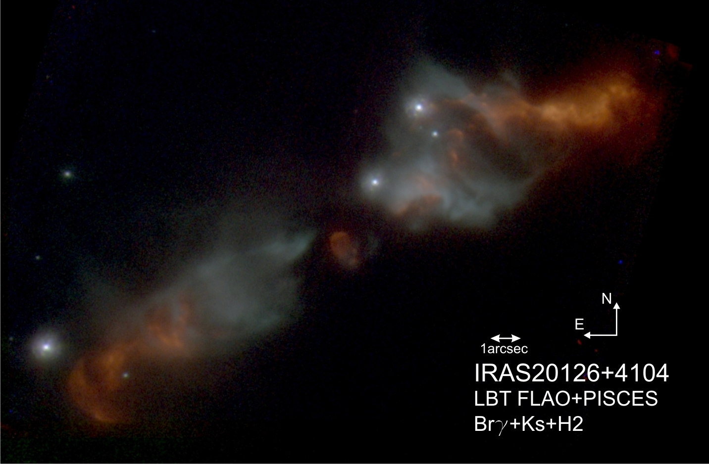
By the way, let me show you the new images of
IRAS 20126+4104
Have you found out that it is
a distant galaxy instead of YSO? ☺

Slide 37
How do you say this word <INSERT WORD> in Spanish?
We do not have to mix AVISPA con OVISPO
Have you seen these <INSERT FUNNY IMAGES/TEXTS>

Slide 38
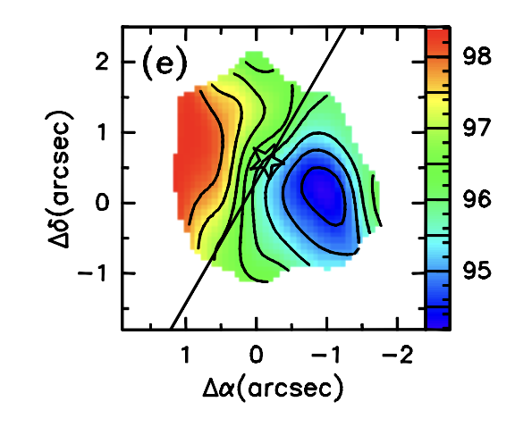
Nice, do you also see infall signatures in the spectral lines?
I can help with processing some data, or preparing scripts if necessary
Look at the new data of G31 !

Slide 39
Let me show you the last bicycle route that I did on Sunday
By the way, this Sunday we could go to <INSERT PLACE IN TUSCANY>
Sure, I am in!
My poor legs

Slide 40
I think it is time to go home
Before going home,
let me tell you about the new results that we have found

Slide 41

The disk and the jet
of the massive protostar IRAS 20126+4104
W75N(B)-VLA3

Slide 42
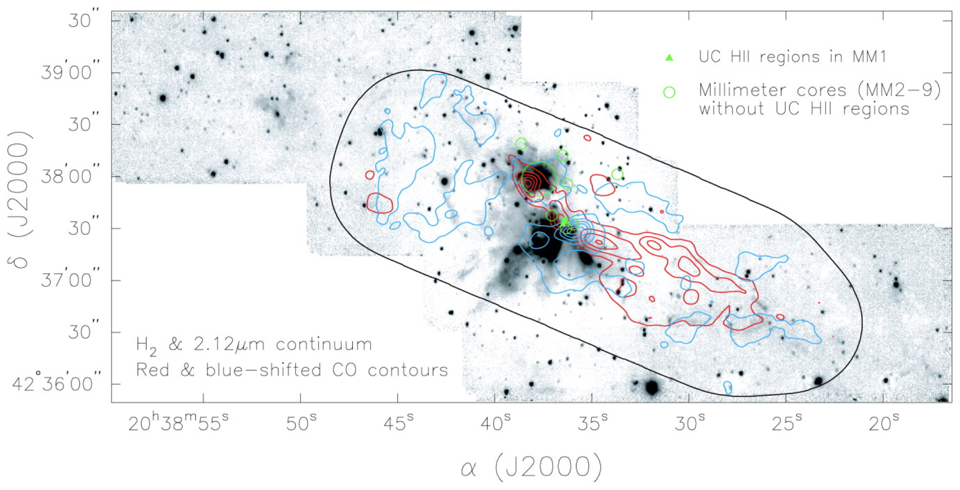
W75N star forming complex
Distance: 1.3 kpc
Luminosity: 10⁵ L⊙
Large and massive molecular outflow
Rich maser activity: H₂O, CH₃OH, OH masers
The properties of W75N are similar to your source
IRAS 20126+4104
is more isolated
Haschick+1981; Hunter+1994; Torrelles+1997; Minier+2000; Slysh+2002; Hutawarakorn+2002; Shepherd+2003; Persi+2003; Surcis+2009, 2023; Carrasco-Gonzalez+2010; Kim+2013; Rodriguez-Kamenetzky+2020; …
W75N (B)
W75N (A)

Slide 43
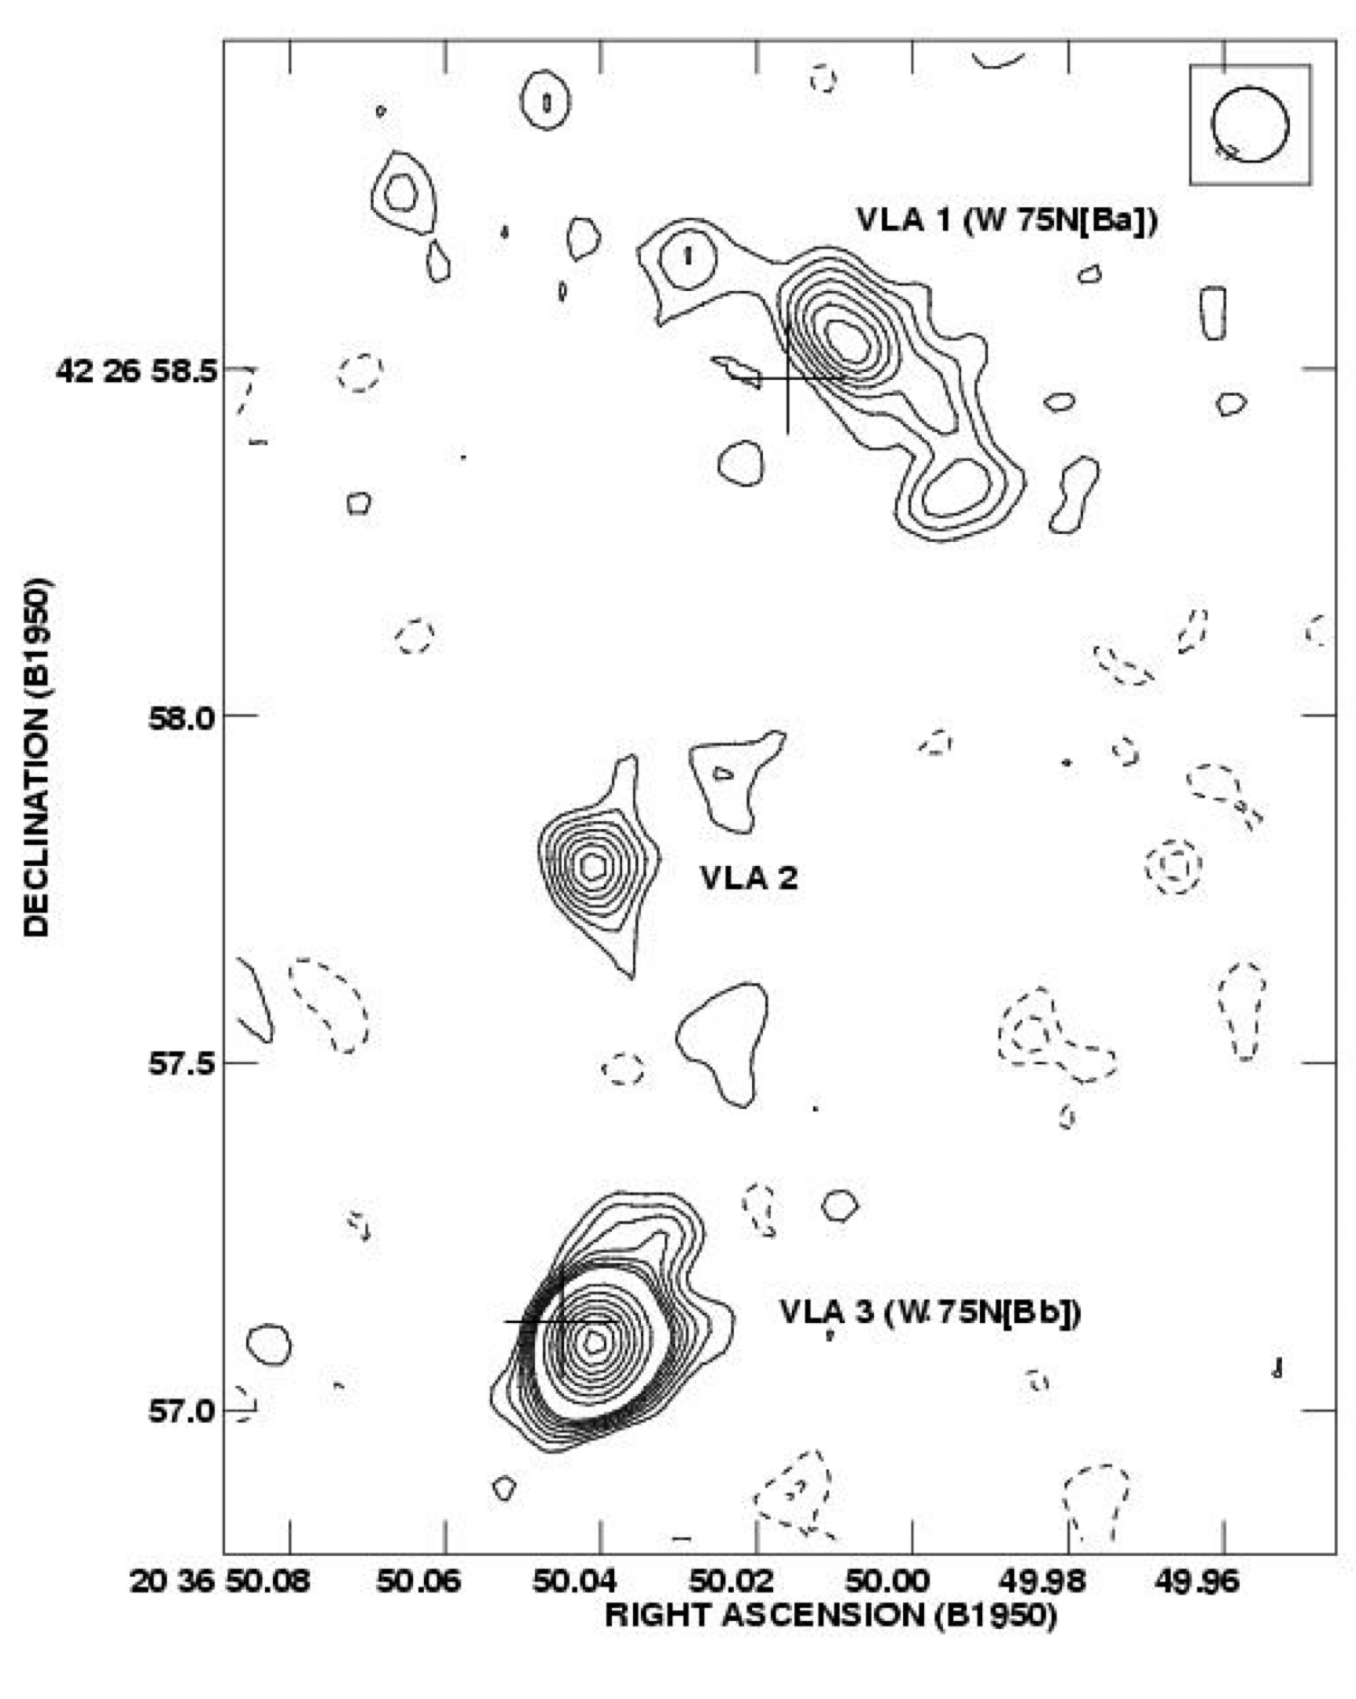
W75N star forming complex
Distance: 1.4 kpc
Luminosity: 10⁵ L⊙
Large and massive molecular outflow
Rich maser activity: H₂O, CH₃OH, OH masers
W75N (B)
Haschick+1981; Hunter+1994; Torrelles+1997; Minier+2000; Slysh+2002; Hutawarakorn+2002; Shepherd+2003; Persi+2003; Surcis+2009, 2023; Carrasco-Gonzalez+2010; Kim+2013; Rodriguez-Kamenetzky+2020; …
There are already 3 sources in radio
True, but they are interesting, let’s see

Slide 44
W75N (B)
Interesting maser motions,
different for each source
VLA 1
[ see Ciriaco’s and Chema’s talks ]
VLA 2
Nice, there are lots of masers!
This is for “il Mosca”
Torrelles+1997, 2003; Carrasco-Gonzalez+2010; Rodriguez-Kamenetzky+2020; …

Slide 45
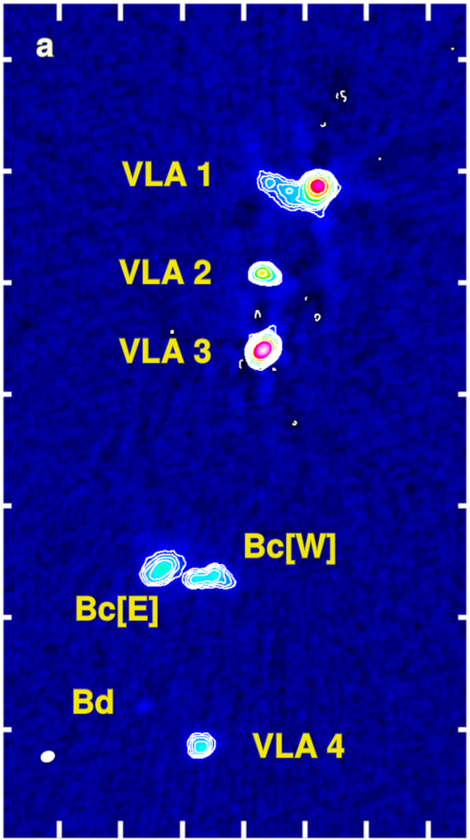
VLA sensitive observations
detected additional compact sources
… with proper motions (about 100 km/s)
most likely ejected from VLA3 source
Torrelles+1997, 2003; Carrasco-Gonzalez+2010; Rodriguez-Kamenetzky+2020; …

Slide 46
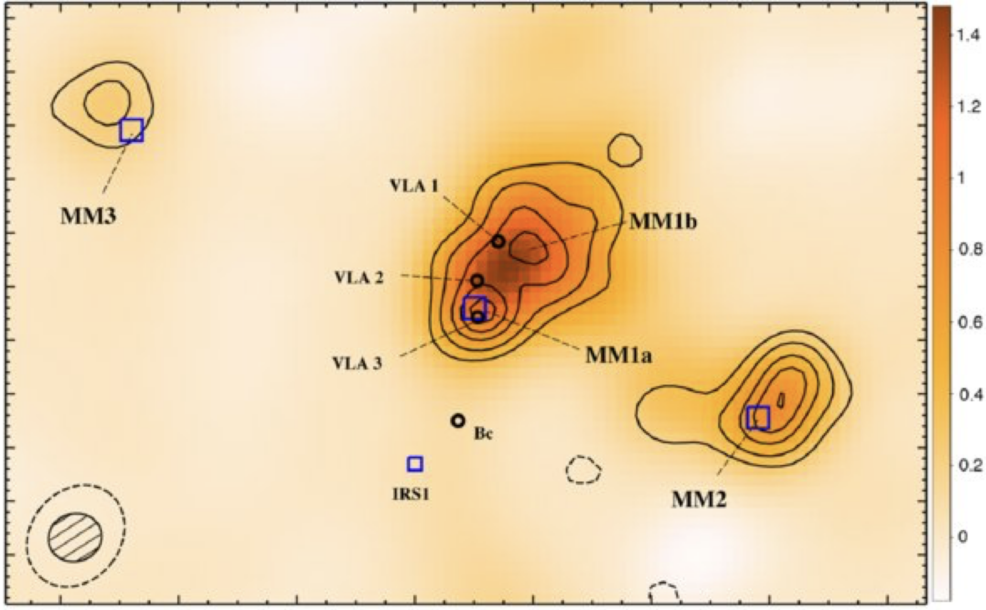
SMA 1 mm continuum observations (at 1.5 arcsec)
Minh, Su, Chen, Liu, Yan, Kim (2010)

Slide 47
SMA 1 mm continuum observations (at 1.5 arcsec)
ALMA 1 mm continuum emission (at 0.12 arcsec), with SNR > 1000
ALMA data revealed:
Cluster of 40+ compact cores
Most of them low-mass
Three main sources coincident with VLA1, VLA2 and VLA3
Gómez, Torrelles, Girart, … Goddi, … Sánchez-Monge (2023)
Minh, Su, Chen, Liu, Yan, Kim (2010)

Slide 48
ALMA 1 mm continuum emission (at 0.12 arcsec), with SNR > 1000
Gómez, Torrelles, Girart, … Goddi, … Sánchez-Monge (2023)

Slide 49
W75N(B)-VLA3 1 mm continuum emission
total flux at 1 mm: about 150 mJy
25 mJy from free-free (extrapolated from radiojet)
125 mJy from dust
M_{dust+gas} about 0.43 – 1.74 M⊙ (assuming 200 – 50 K)
effective circular radius about 300 au
Sánchez-Monge, Gómez, Torrelles, …, Girart, …, Goddi et al (2025)

Slide 50
Blue lines highlight species studied in SM+2025
Look! There is even your favorite molecule
Broad spectral window
(low resolution : 20 km/s)
… but you have covered only one line of CH₃CN
Sánchez-Monge, Gómez, Torrelles, …, Girart, …, Goddi et al (2025)

Slide 51
SiO (5-4) emission : tentative velocity gradient in the direction of the VLA radiojet (and proper motions)
Sánchez-Monge, Gómez, Torrelles, …, Girart, …, Goddi et al (2025)

Slide 52
0th moment
(integrated intensity)
1st moment
(velocity field)
SO₂ v₂=1
(E_{up} = 1012 K)
A rotating disk!
HC₃N
(E_{up} = 130 K)
Sánchez-Monge, Gómez, Torrelles, …, Girart, …, Goddi et al (2025)

Slide 53
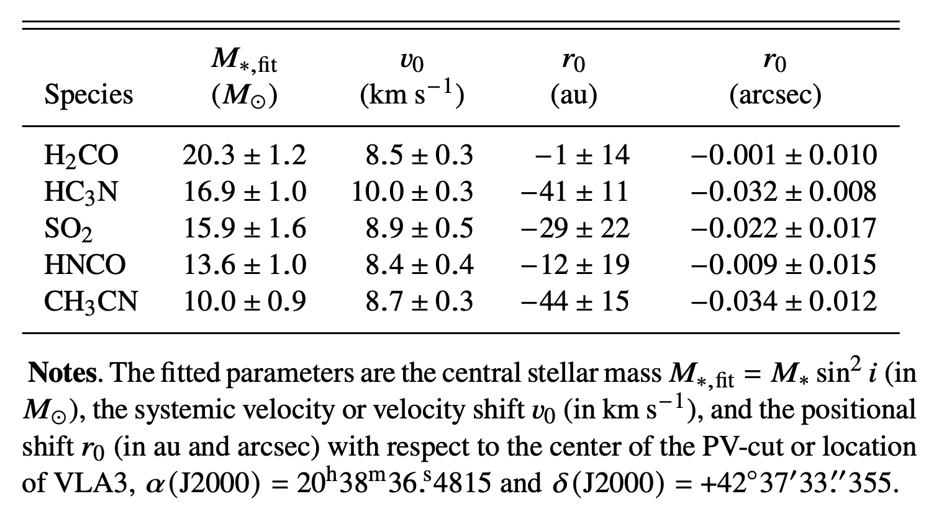
M_{star} about 16 ± 4 M⊙ (conservative value assuming i=90 deg)
… compare with M_{dust+gas} = 0.43-1.74 M⊙, and radius of 300 au
The velocity field is consistent with the “butterfly” pv-plot
Sánchez-Monge, Gómez, Torrelles, …, Girart, …, Goddi et al (2025)

Slide 54
massive toroids
LM / IM disks
HM disks

Slide 55
similar radii and M_{gas}/M_{star} for disks around all stars
High resolution observations show that these disks may be stable
recreation of the plots presented in Beltrán & de Wit 2016
adding disks observed at high-resolution
around massive protostars
Good choice plots !
toroids: M_{gas} < M_{star}
disks: M_{gas} > M_{star}
HM disks appear to be dynamically-regulated
(contrary to massive toroids)
HM disks appear to be stable

Slide 56
Going back to the spectral lines….
Radio recombination lines!
… chemistry ?

Slide 57
Here comes the interesting part!
Very broad H30α line: FWHM = 98 ± 10 km/s
H30α emission spanning from -150 to +150 km/s
H30α flux density: 36 mJy (after excluding line contamination)

Slide 58
Here comes the interesting part!
Very broad H30α line: FWHM = 98 ± 10 km/s
H30α emission spanning from -150 to +150 km/s
H30α flux density: 36 mJy (after excluding line contamination)
How do we create such a broad RRL ?
HII regions: RRLs have typical widths of 20 km/s
HCHII regions: RRLs have FWHM of 50 km/s at cm
30 km/s at mm
Rotation from an ionized disk
RRLs from a protostellar jet / wind

Slide 59
Very broad H30α line: FWHM = 98 ± 10 km/s
H30α emission spanning from -150 to +150 km/s
H30α flux density: 36 mJy (after excluding line contamination)
How do we create such a broad RRL ?
HII regions: RRLs have typical widths of 20 km/s
HCHII regions: RRLs have FWHM of 50 km/s at cm
30 km/s at mm
Rotation from an ionized disk
RRLs from a protostellar jet / wind

Slide 60
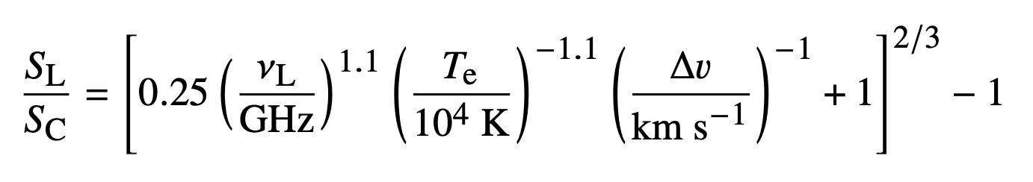
Expected line-to-continuum flux for RRLs
from thermal protostellar jets [Anglada et al 2018]:
Very broad H30α line: FWHM = 98 ± 10 km/s
H30α emission spanning from -150 to +150 km/s
H30α flux density: 36 mJy (after excluding line contamination)
How do we create such a broad RRL ?
HII regions: RRLs have typical widths of 20 km/s
HCHII regions: RRLs have FWHM of 50 km/s at cm
30 km/s at mm
Rotation from an ionized disk
RRLs from a protostellar jet / wind
25 mJy
232 GHz
10⁴ K
100 km/s
Expected H30α flux: 37 mJy
Potential first detection of a
thermal RRL towards a protostellar jet
High spectral resolution is needed:
… to confirm large FWHM
… to better remove contaminants
Additional RRLs are needed:
… to determine physical parameters of the jet!

Slide 61
W75N(B) – VLA 3
300 au
large-scale envelope
or accretion streamer
Interesting source…
but I will keep looking at
IRAS 20126+4104
thermal radio jet
with RRLs !
central massive star with mass 16 M⦿
apparent cavity
around central star
Keplerian-like disk
with mass 0.43-1.74 M⦿
location of
bright peak
Sánchez-Monge, Gómez, Torrelles, …, Girart, …, Goddi et al (2025)

Slide 62
These were the results of VLA3, but wait to hear about VLA2 from Chema

Slide 63

Ciao Riccardo, in the next talk
I will present more nice results from this region
These were the results of VLA3, but wait to hear about VLA2 from Chema

Slide 64


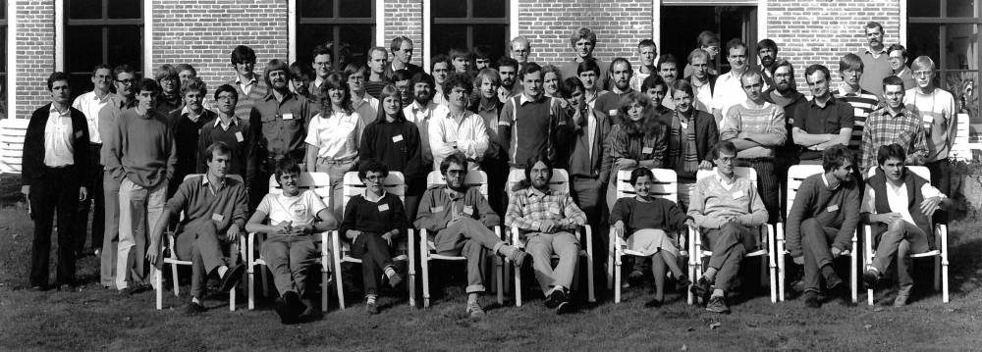
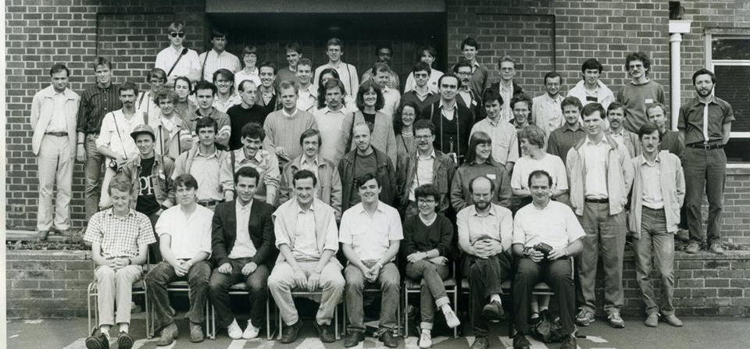
Gracias Ric!
Gracias Cesa!
Gracias Riccardo!
YERAC 1986
YERAC 1998

