Slide 1
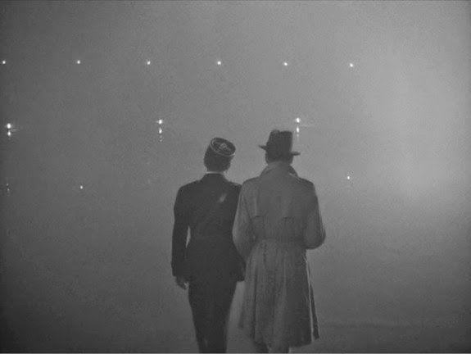




Slide 2
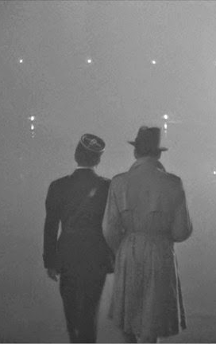

Rick: “I think this is the beginning of a beautiful friendship”

Slide 3




Summer of 1987

Slide 4
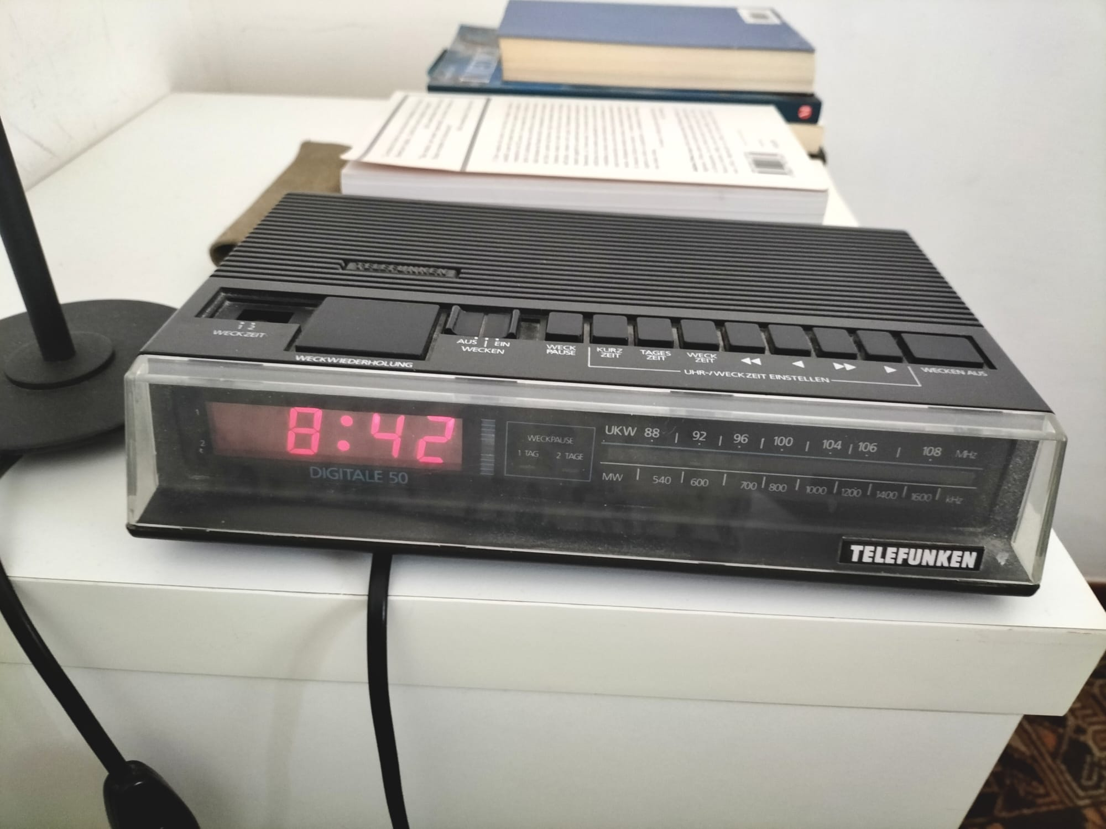

Slide 5


RETIRED!
Summer of 2027

Slide 6
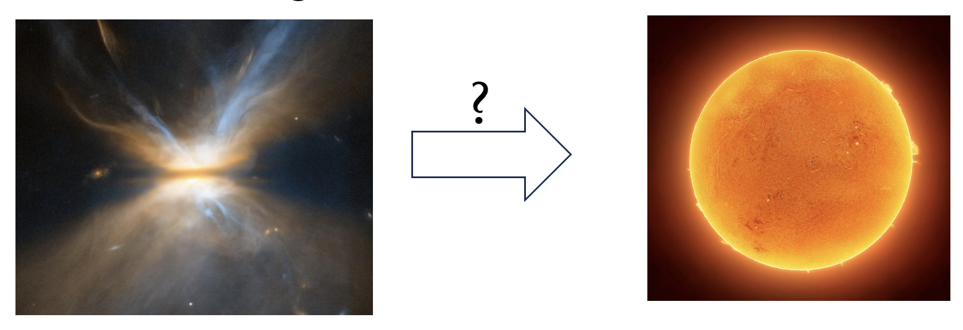
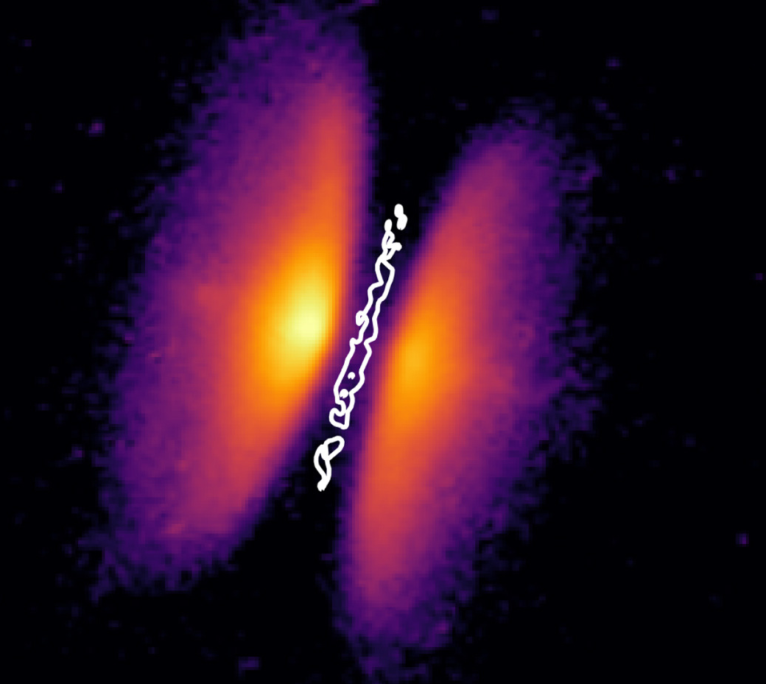
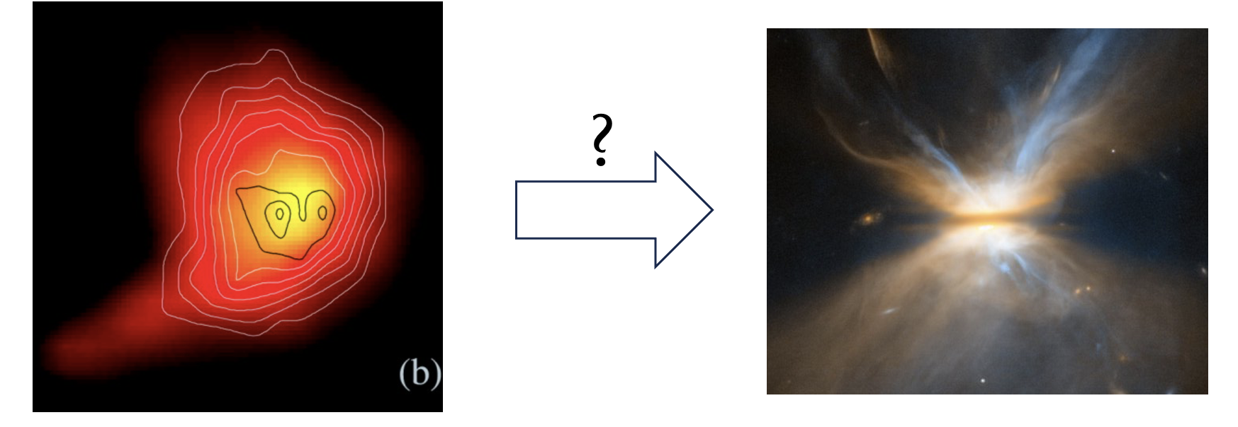


And things that are flat become round?
Why things that are round(ish) become flat?

Slide 7

Macroscales and microscales
Macroscale features dominate astrophysical observables (dynamics, energetics, etc...)
But these features are controlled through microscale physical processes (and transport coefficients) that mediate the flow of
  momentum (viscosity )
  heat (thermal conductivity )
  electric current (electrical conductivity or electrical resistivity )
Macro- and micro-scales are coupled
Consequences:
Physical processes are inter-dependent
Benefits often come with side effects, sometimes unexpected

Slide 8
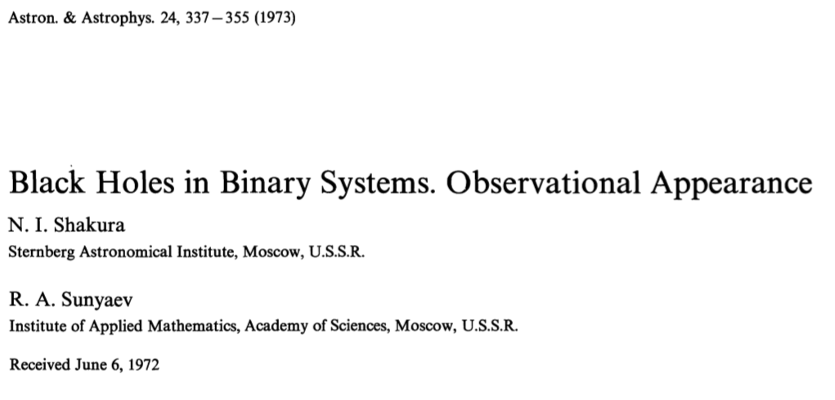
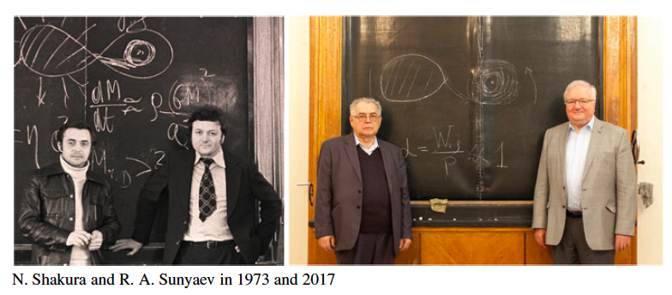
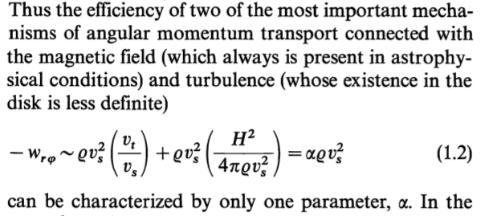
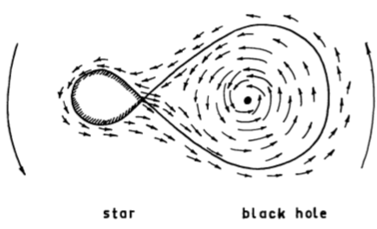

(13,447 cit.)
X-ray binary

Slide 9
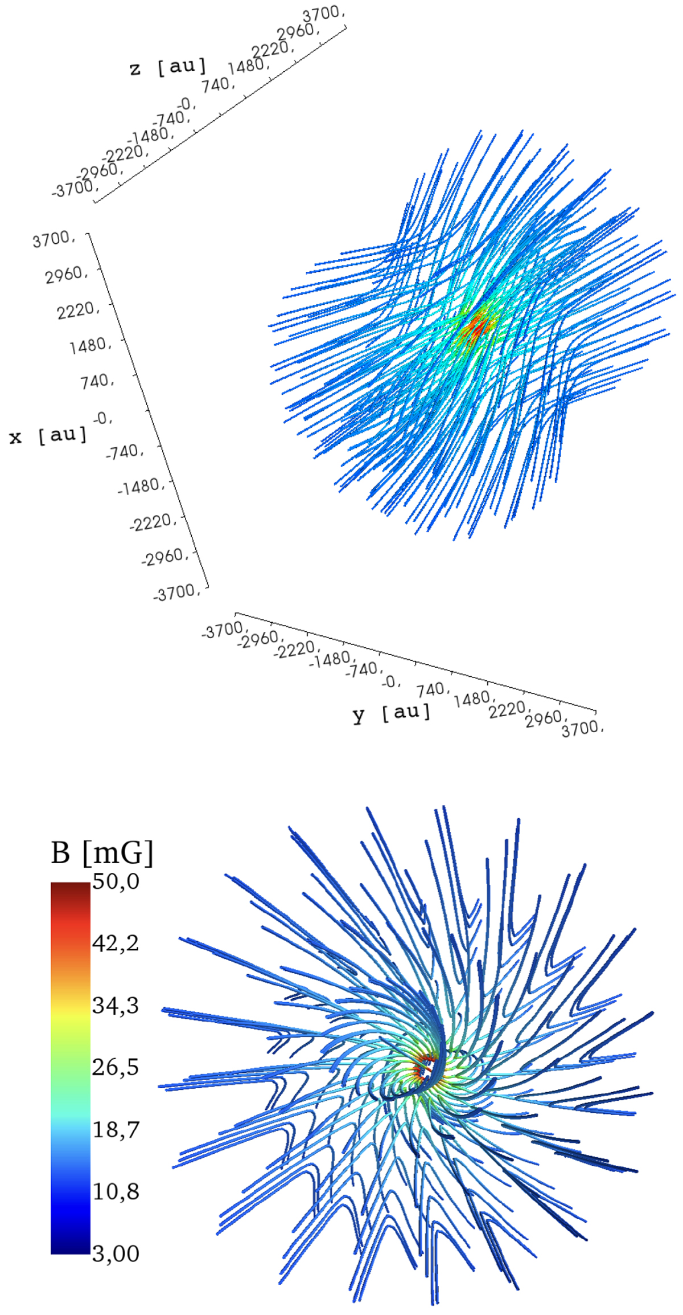
model B-field in G31.41+0.31 (Beltrán et al. 2019)
Effect of magnetic stresses during cloud collapse
Magnetic field →
→ large magnetic stresses on infalling envelope
Complete removal of angular momentum around the protostar → catastrophic magnetic braking

Slide 10
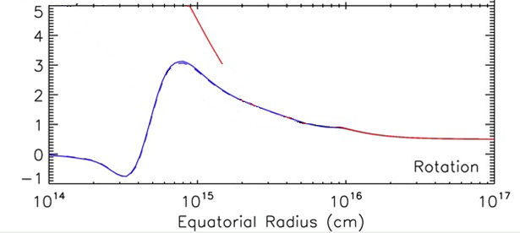
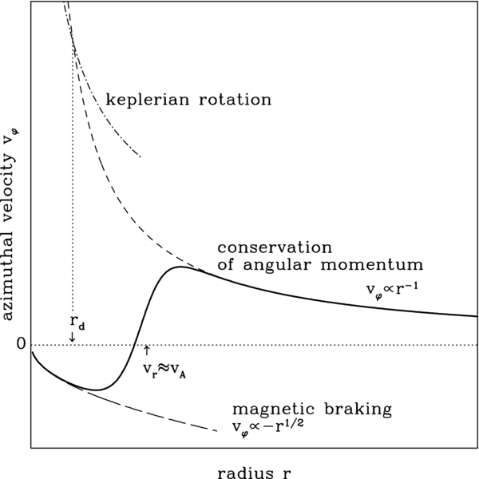

Mellon & Li (2009)
keplerian rotation
v_{φ}
Galli et al. (2006)
Several possible solutions. Most natural one: gas-field decoupling by non-ideal MHD effects
Brings into play microphysics: chemistry, dust grain evolution, cosmic-ray ionization, etc.
from dust polarization maps of hot molecular cores at ~10³ au scale (Beltrán et al. 2019, 2024)
magnetic stresses dominate
angular momentum is conserved

Slide 11
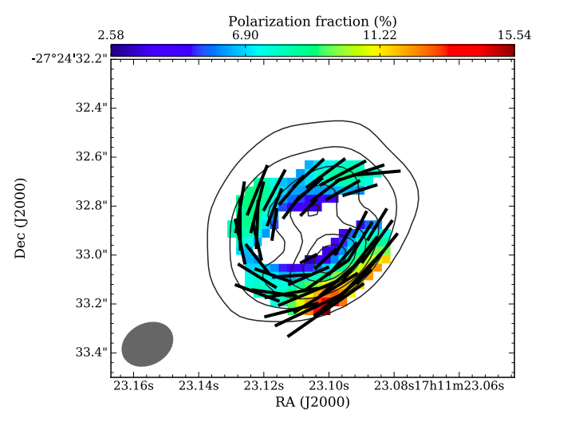
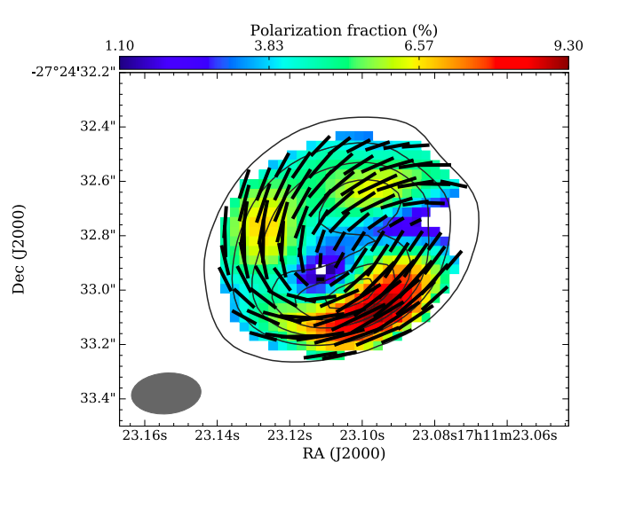
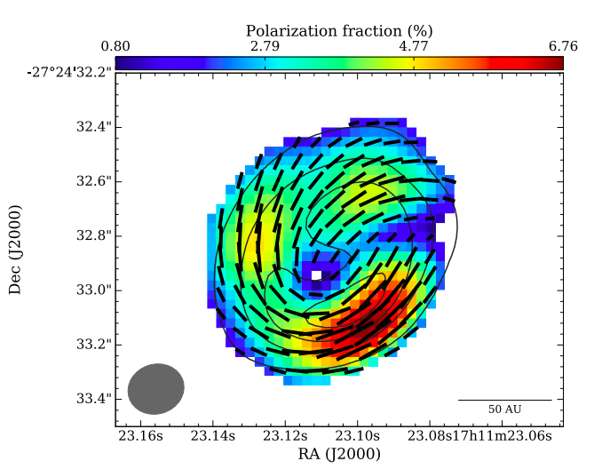
Measuring B in disks: I. Dust continuum polarization
Detected with ALMA, but self-scattering (Kataoka et al. 2017), alignment with the radiation anisotropy (Tazaki et al. 2017), gas drag (Lin et al. 2024), strongly affect (or dominate) the polarization signature
The best candidate: circumbinary disk BHB07-11 (Alves et al. 2018)
Band 3
Band 6
Band 7
50 au
polarization pattern wavelength-independent
twisting of B-field consistent with sense of rotation
expected pattern of mixed of poloidal/toroidal magnetic field

Slide 12
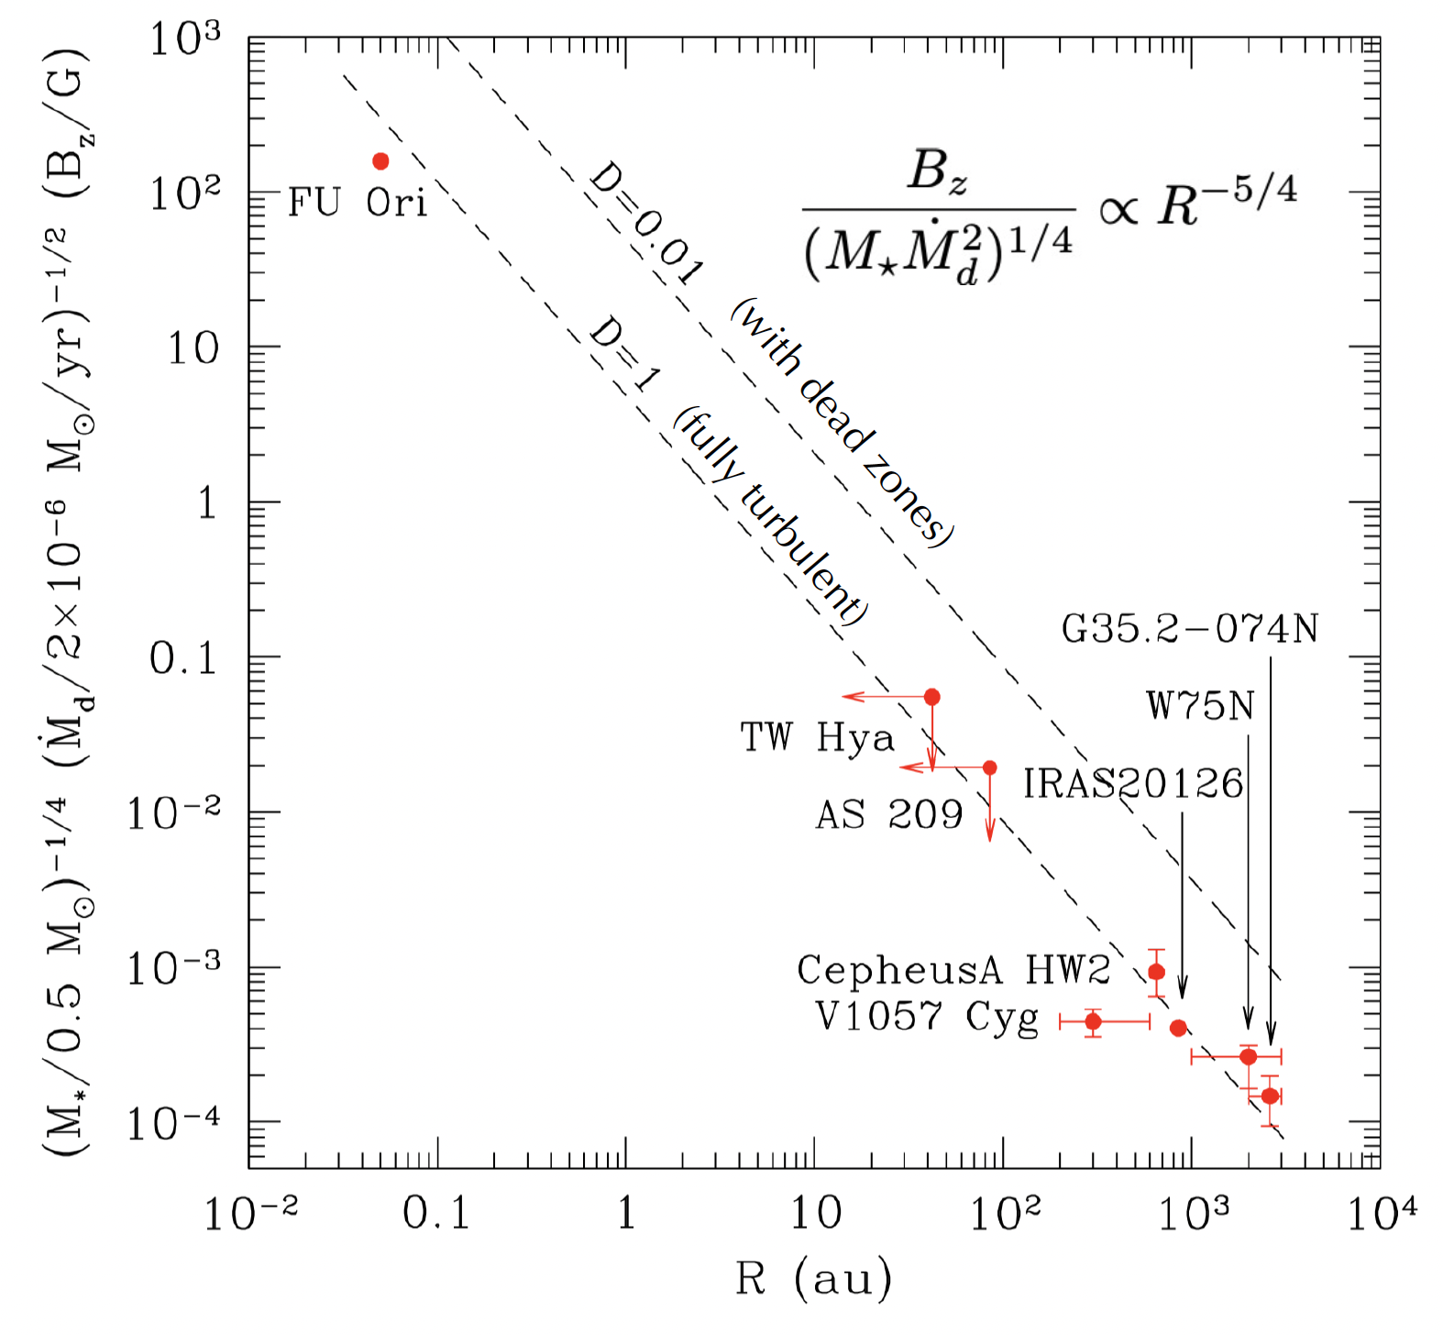
Measuring B in disks: II. CN, OH, CH₃OH
Shu et al. (2007)
Donati et al. (2005)
Vlemmings et al. (2019)
Lankhaar & Teague (2023)
Harrison et al. (2021)
Vlemmings et al. (2010)
Winnberg et al. (1981)
Edris et al. (2005)
Hutawarakorn et al. (2002)
Hutawarakorn & Cohen (1999)

Slide 13
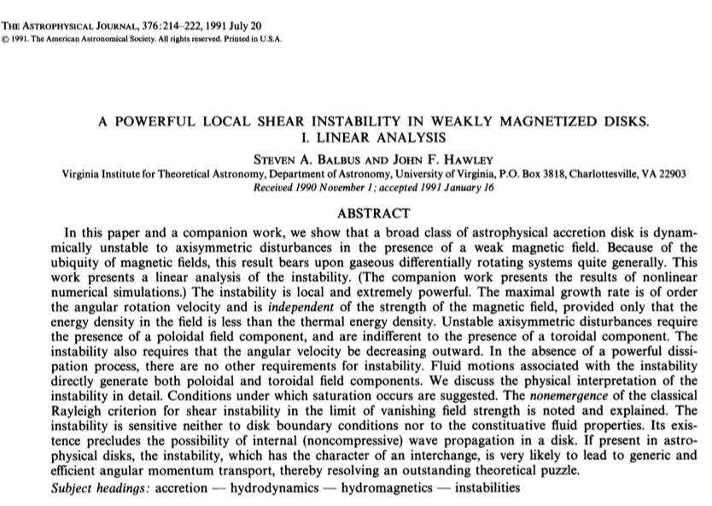
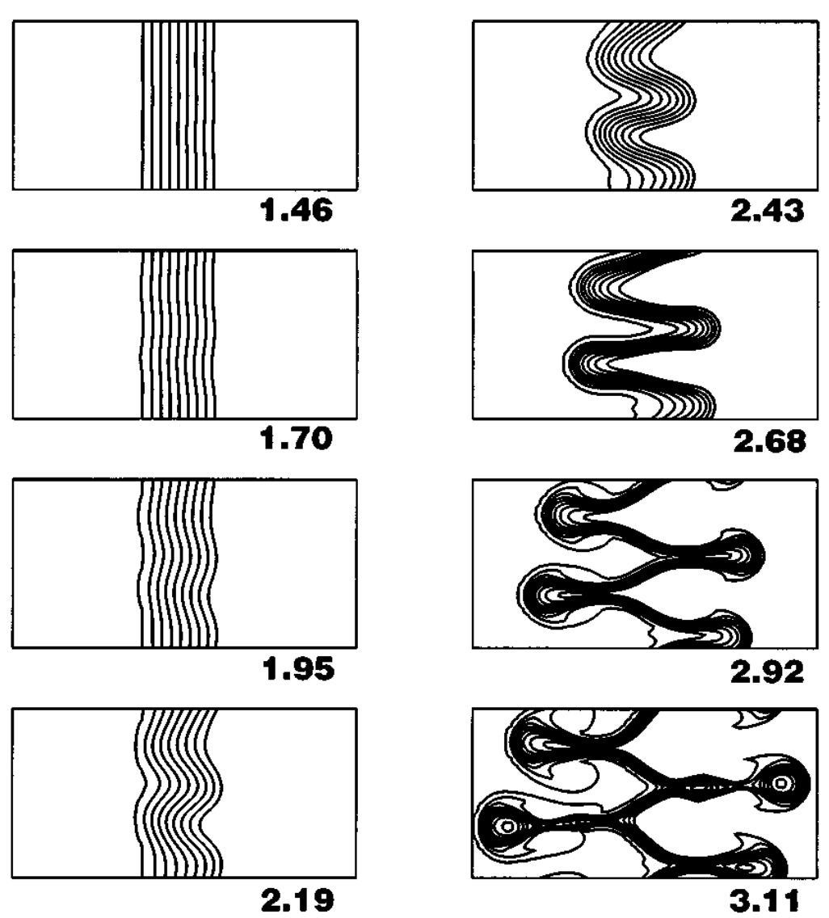



time evolution of magnetic perturbations
Evgeny Velikhov
Subramanyan Chandrasekhar
Magnetized disks can be turbulent. Need only:
sub-thermal magnetic field (β >1)
angular velocity decreasing outwards
growth rate ~ ¾ Ω → fast!
But: is B coupled to the gas? It depends on the ionization fraction in the disk
John Hawley
Steven Balbus

Slide 14


Modeling the ionization fraction in disks
locally accelerated energetic particles
T-Tauriosphere
stellar jet
flares
Galactic CRs
dead zone
hot corona
B field
X-rays
FUV ionization layer
FUV
X-ray ionization layer
T-Tauri
star
CR ionization layer
stellar CRs
thermal ionization
zone
jet internal shock
Marco Padovani
jet bow shock
Valentin Brunn

Slide 15





In conclusion: Rick, we need more beer...

Slide 16


HAPPY RIDING, RICK!
“NEVER UNDERESTIMATE AN OLD MAN WITH A BICYCLE”

