Slide 1
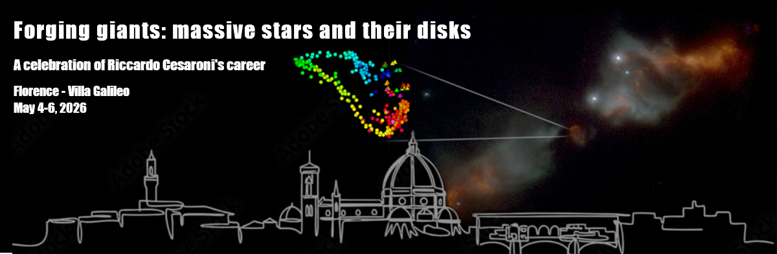
Conclusion Remarks

Slide 2
Highlights
Supernova remnants (Rino Bandiera)
Main fields of research: outflows and astrochemistry (Roberto Neri)
Riccardo is a philosopher (Sarita Vig)
Francesco’s hidden past as chemist (Francesco Fontani)
Riccardo’s wedding present (Daniele Galli)
Riccardo is the secret developer of GILDAS (Álvaro Sánchez-Monge)

Slide 3
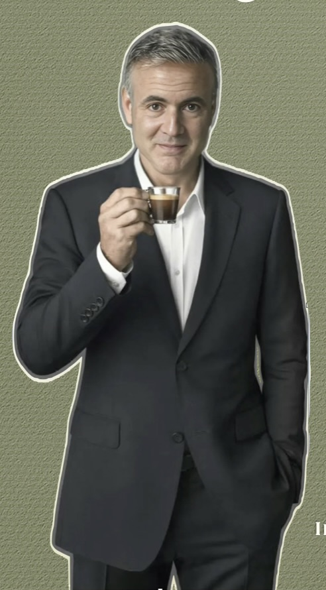
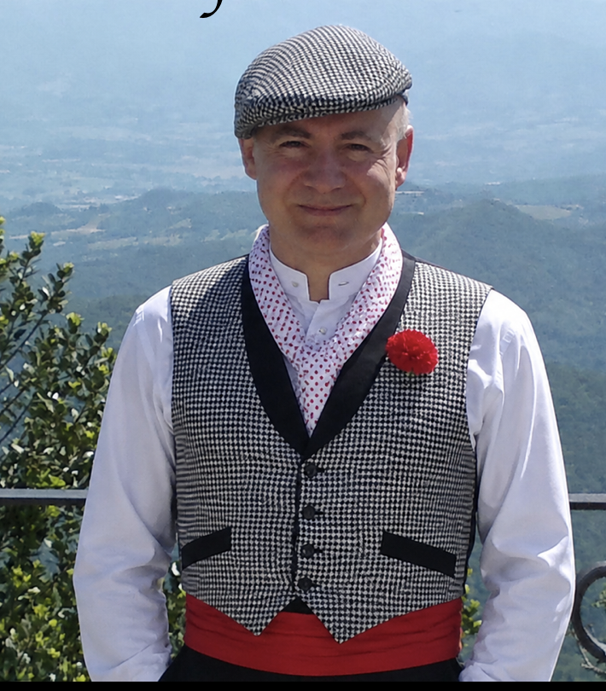
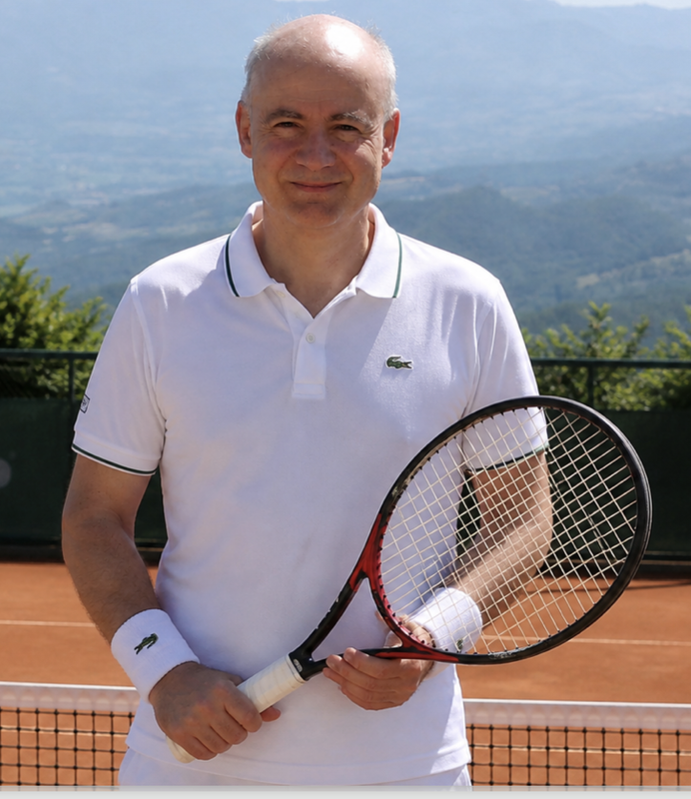
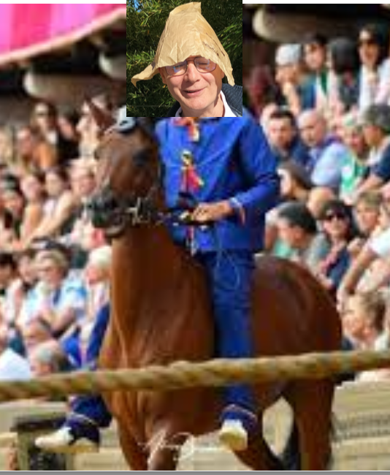

Slide 4
