Slide 1

«The Central Role of Database Management System Technologies in Astronomical Archives»
USC-C General Assembly
Trieste 09-13 MArzo 2026
Best practices and adaptive technology matching with Polyglot Persitence
Author: Stefano Gallozzi

Slide 2
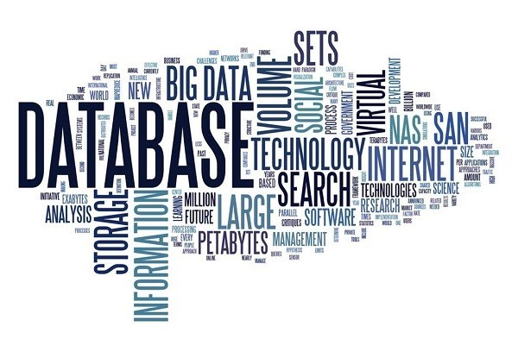
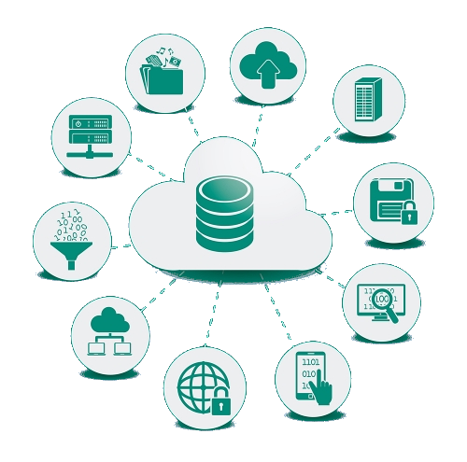
What DATABASES ARE?

Slide 3
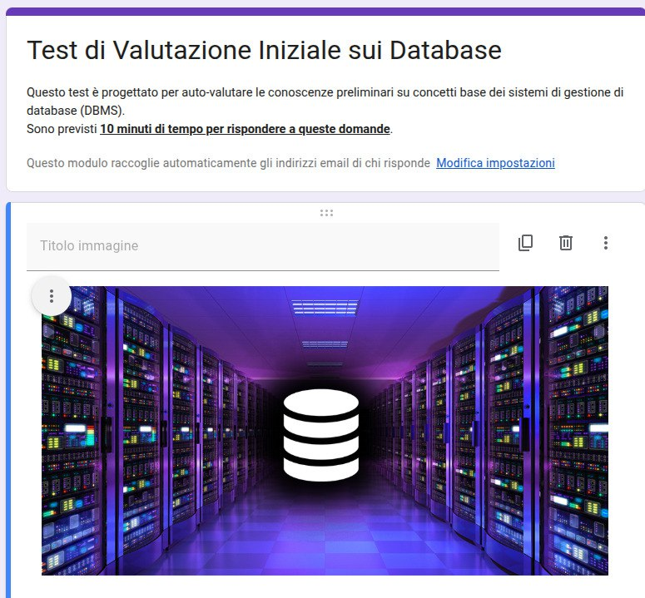
Databases Initial
Statistic Test
https://forms.gle/HZbU1BsNn7uR1isQ6
10 minuti

Slide 4
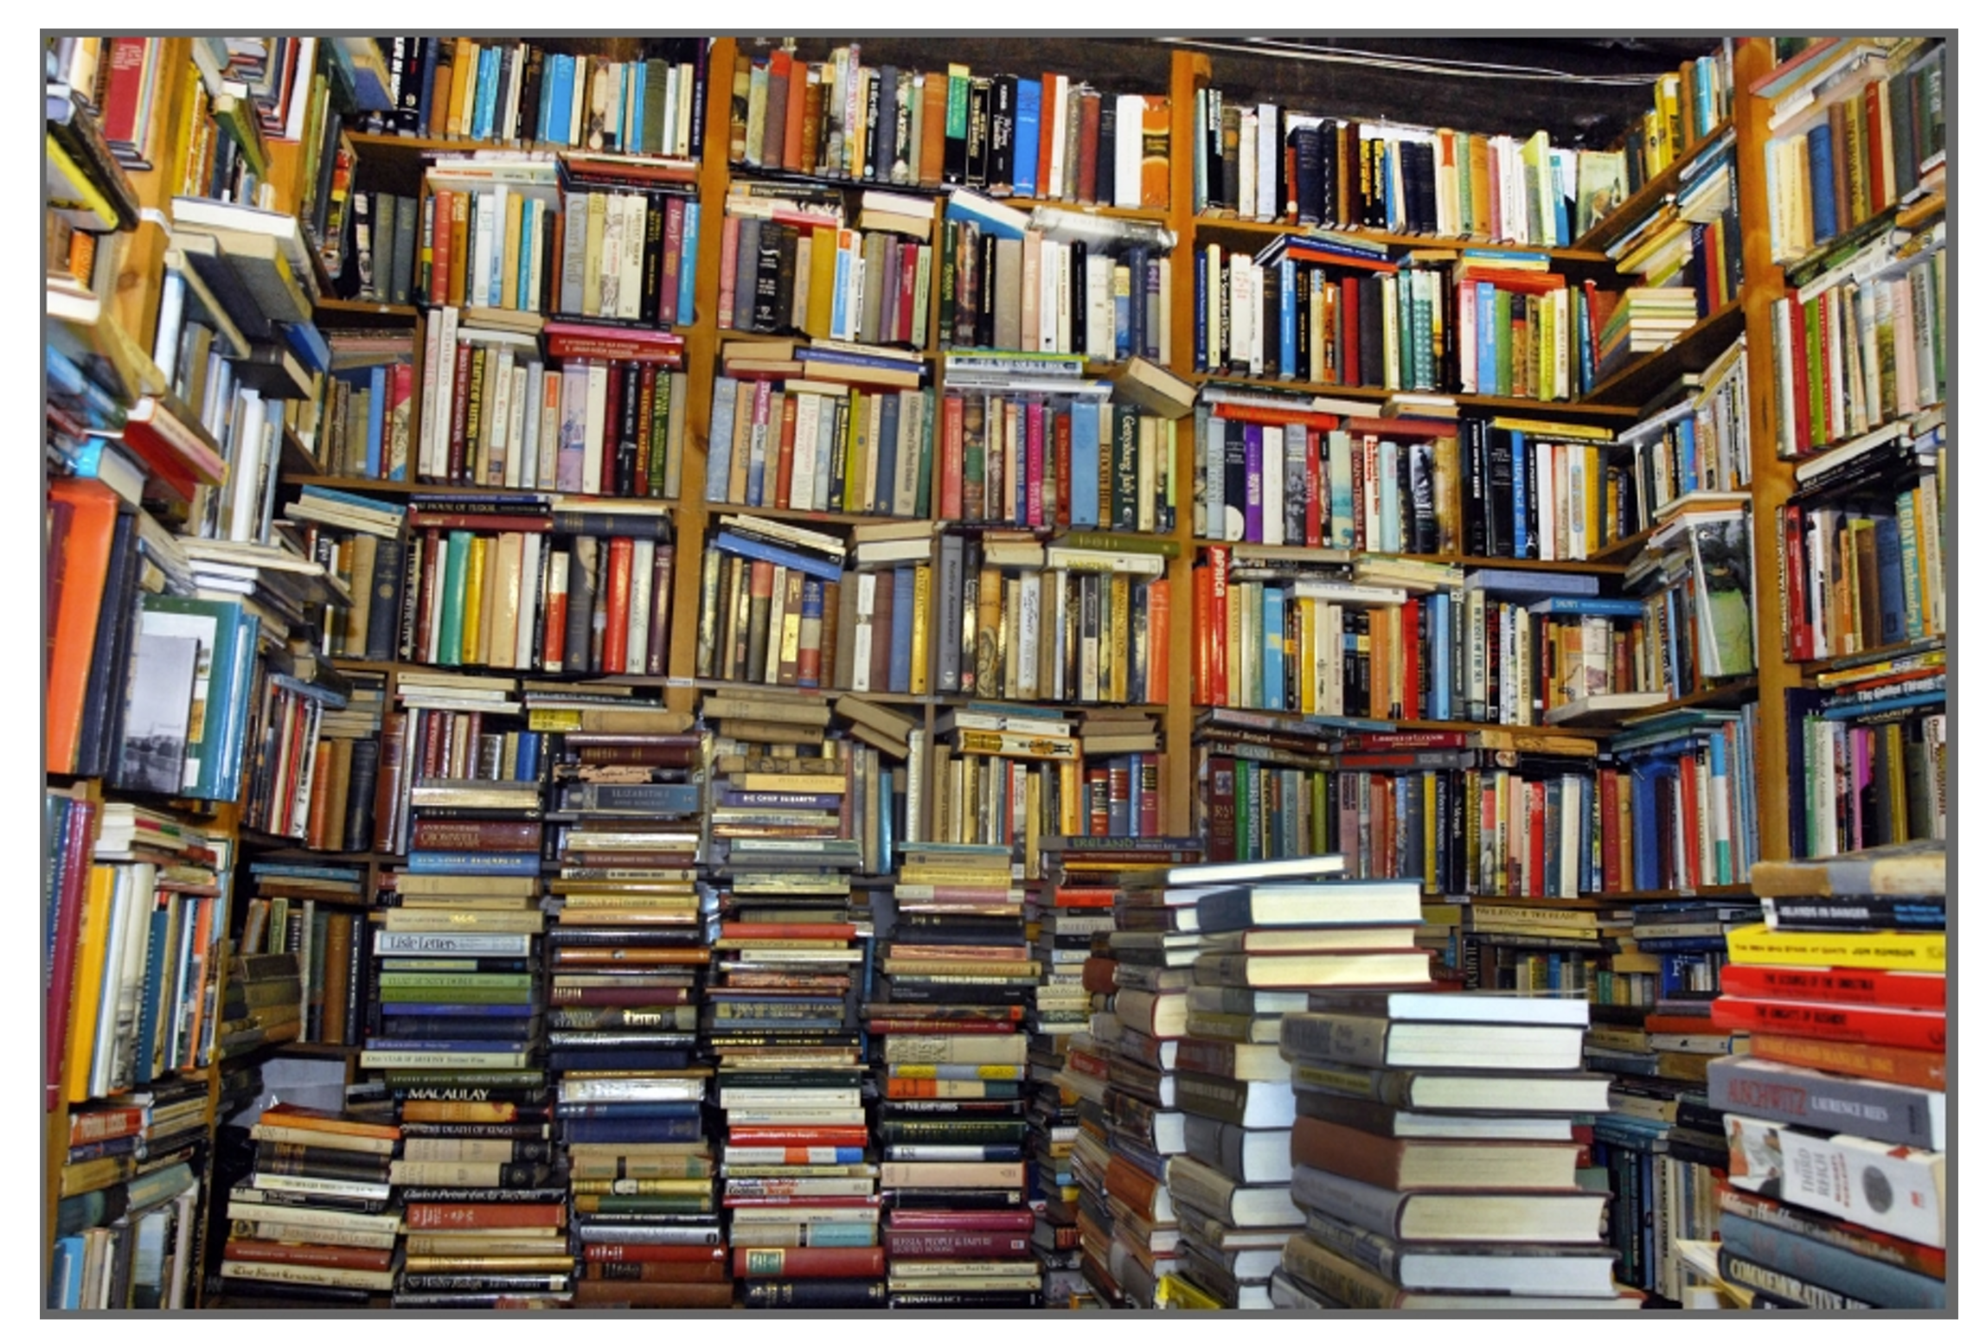
What DATABASES ARE?
A database is an organized collection of data, designed to store, search, update, and manage information efficiently using a computer.
A simple way to think of it ia as a
very well-organized digital archive
DBs are Used for:
store data (file-catalogs, names, emails, orders, grades, photos, etc.)
quickly find information (based on descriptors)
update data easily
keep data secure

Slide 5
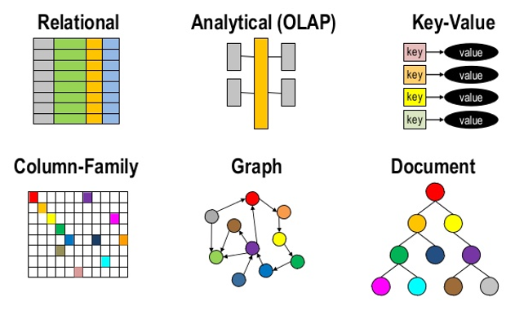
Databases: feasible choices
Different DB Families
Fixed-Schema Relational DBs
Schemaless – Not Only Relational

Slide 6
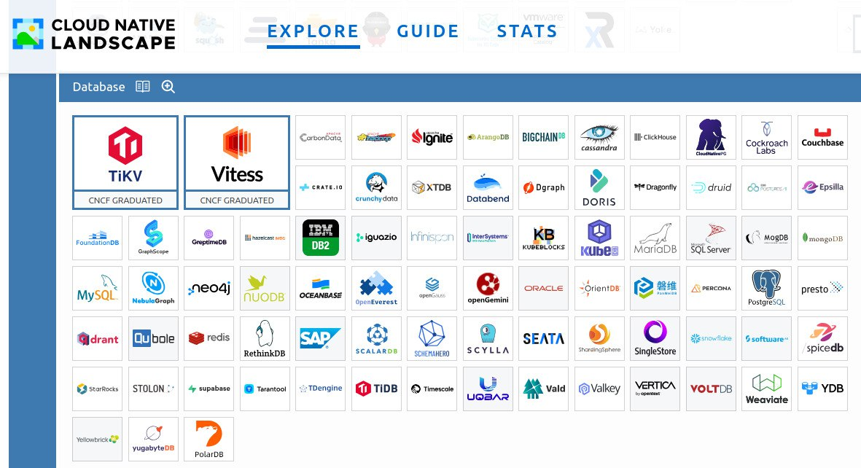
Databases: feasible choices
https://landscape.cncf.io/

Slide 7
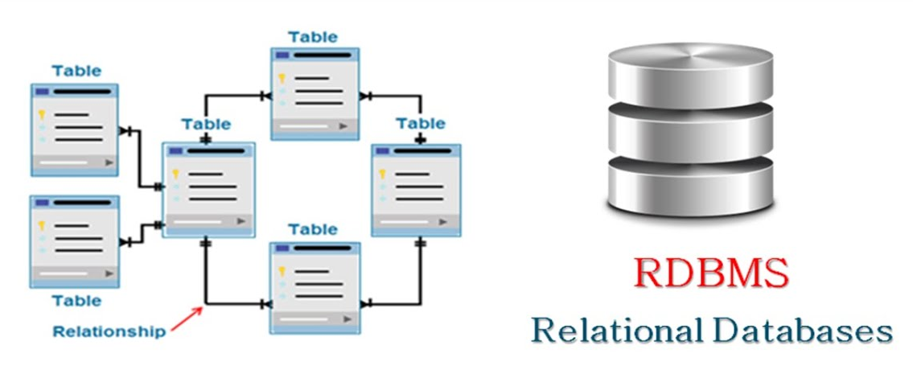
Relational Family DBs
ACID Transactions (Atomicity, Consistence, Isolation e Durability)
Different tables gather together by relations of keys and other external intermediate tables

Slide 8
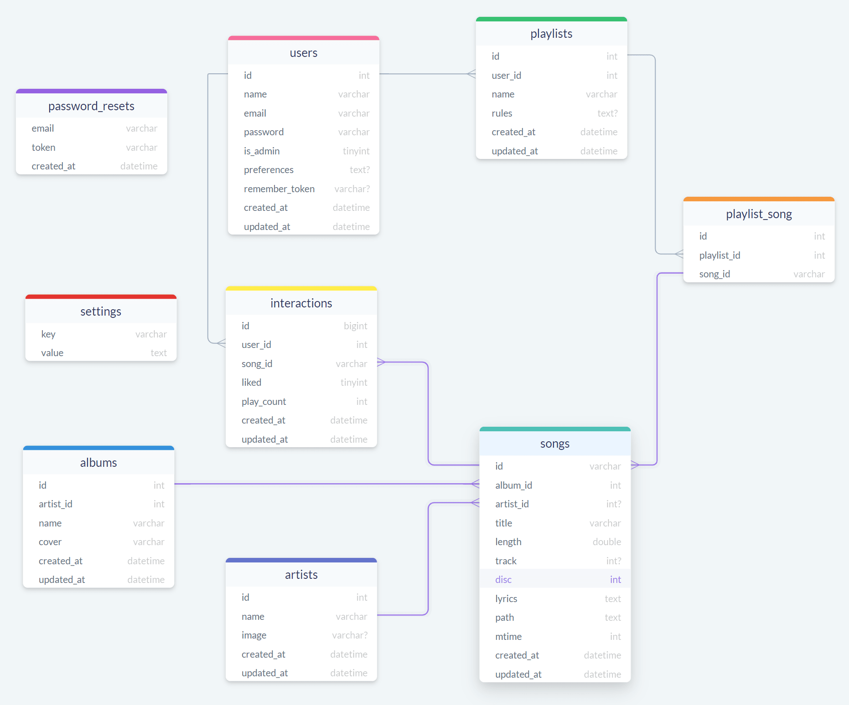
Relational Family DBs
ACID Transactions (Atomicity, Consistence, Isolation e Durability)
Different tables gather together by relations of keys and other external intermediate tables

Slide 9
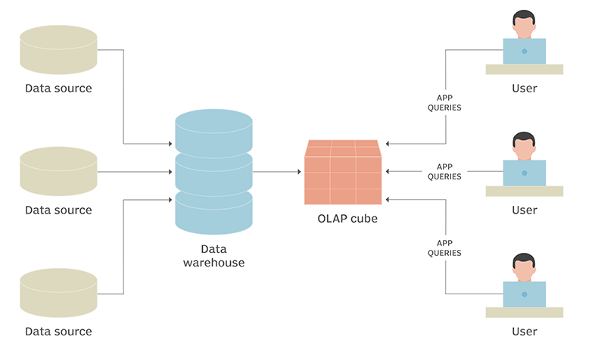
OnLineAnalitycalProcessing (OLAP) DBs
Relational
query
Multidimensional “Cubes”, MOLAP
FQL = Fauna Query Language
→ Functional Expressions,
return arrays (M)OLAP of objects
selective extraction on the fly of several data sets to identify any particular trends at higher level

Slide 10
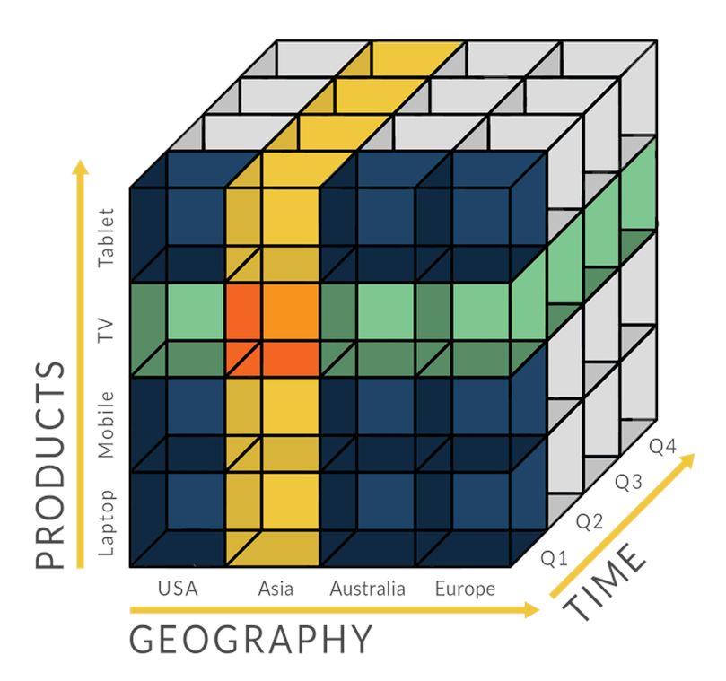
OnLineAnalitycalProcessing (OLAP) DBs
selective extraction on the fly of several data sets to identify any particular trends at higher level

Slide 11
Relational Family DBs
Structured Query Languages (Examples: mySQL, Postgres, Oracle, …)
Simple query:
SELECT * FROM nome_tabella WHERE id=1 ORDER BY id GROUP BY id …
Complex query:
( SELECT u.id AS user_id, u.name, u.email, COUNT(DISTINCT o.id) AS total_orders,
SUM(o.total_amount) AS total_spent, c.name AS top_category FROM users u
JOIN orders o ON u.id = o.user_id
JOIN order_items oi ON o.id = oi.order_id
JOIN products p ON oi.product_id = p.id
JOIN categories c ON p.category_id = c.id WHERE o.status = 'completed'
GROUP BY u.id, u.name, u.email, c.name HAVING SUM(o.total_amount) > 1000 )
UNION
( SELECT u.id AS user_id, u.name, u.email, 0 AS total_orders, 0 AS total_spent, NULL AS top_category FROM users u
LEFT JOIN orders o ON u.id = o.user_id WHERE o.id IS NULL );
… … … INSERT – ALTER - CHANGE – DROP - DELETE … … …

Slide 12
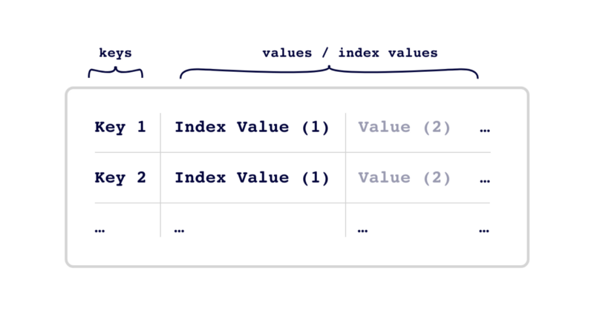
Key-Value Family DBs
datasets are stored in key-value pair and can be sinle or complex

Slide 13
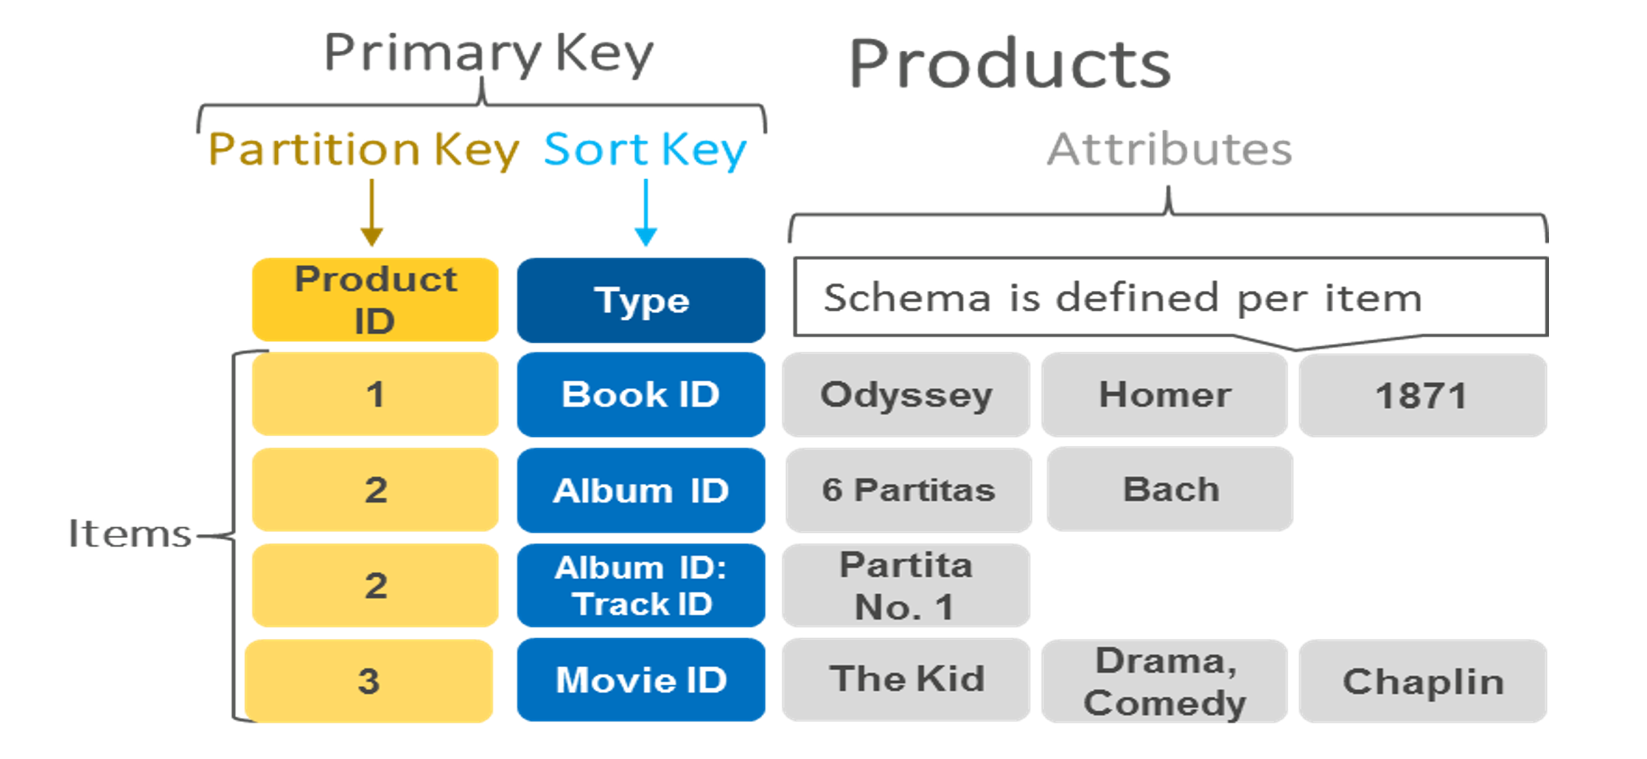
Key-Value Family DBs
datasets are stored in key-value pair and can be sinle or complex

Slide 14
Key-Value Family DBs
Hash based Queries (Examples: Voldemort, Redis, Riak, DynamoDB, …)
Common Usage & Queries:
HSET user:1 name «Mario Rossi» email «mario.rossi@email.it» country «IT»
HGETALL user:1 (prende tutti i dati dell’utente)
HGET user:1 email (prende solo la email)
---
HSET order:1001 user_id 1 total 250 status «completed»
SADD user:1:orders 1001
-> SMEMBERS user:1:orders (-> risultato: 1001)
Complex query (using JSON Structures):
JSON.SET user:1 $ ‘{«name»:«Mario Rossi», «age»:30,«country»:«IT», «orders»:[1001,1002]}’
JSON.GET user:1 -> risultato: { «name»: «Mario Rossi»,
«age»: 30,
«country»: «IT»,
«orders»: [1001, 1002] }
JSON.GET user:1 $.name -> risultato: [«Mario Rossi»]
N.B. La struttura dati e’ semplice -> non esistono JOIN o UNION ecc…

Slide 15
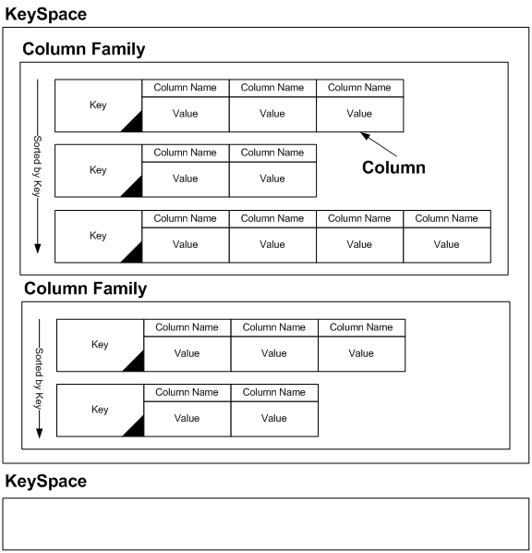
Columns Family DBs
big tables of data (even NULL) with columns treated independly and aggregated at any need

Slide 16
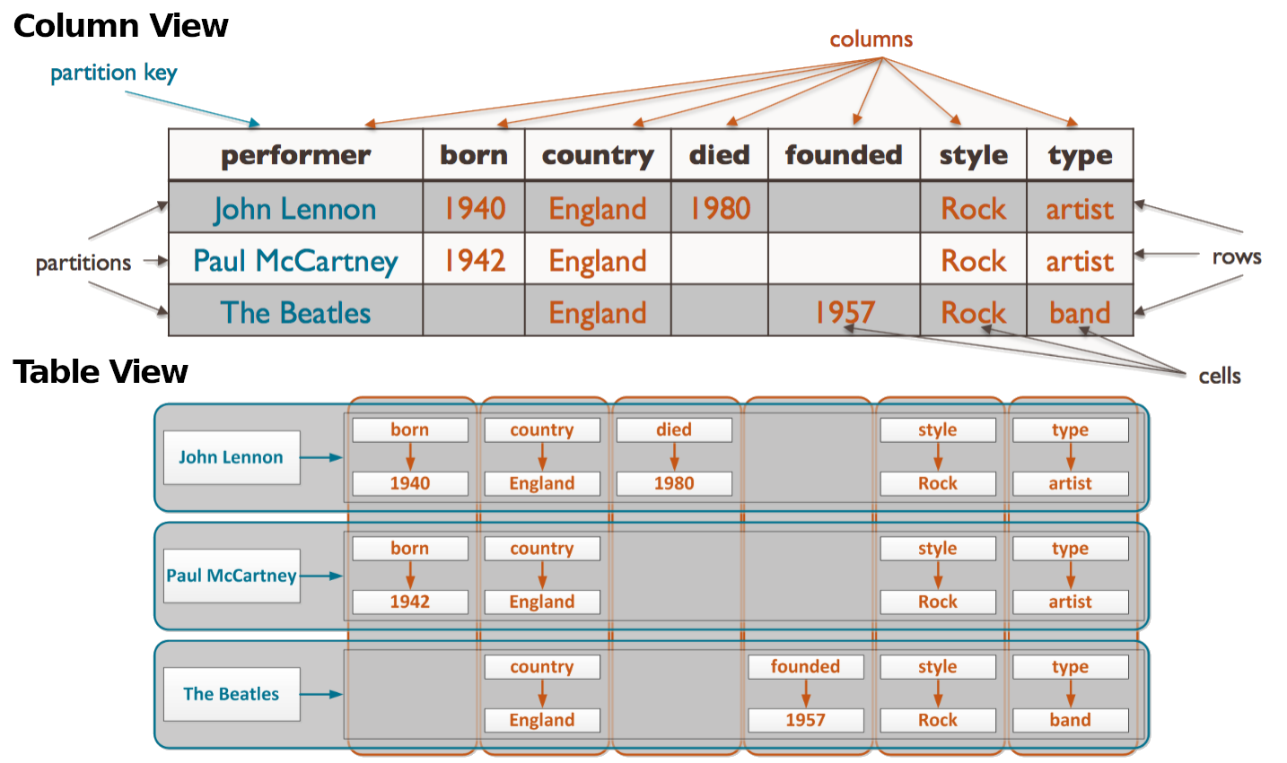
Columns Family DBs
big tables of data (even NULL) with columns treated independly and aggregated at any need

Slide 17
Columns Family DBs
SQL-like Queries (Examples: Cassandra, HBase, BigTable, AzureCosmosDB, …)
Common Usage & Queries:
CREATE KEYSPACE ecommerce WITH replication = {'class': 'SimpleStrategy', 'replication_factor': 1};
CREATE TABLE ecommerce.orders ( user_id int, order_id int, date date,
total decimal, status text, PRIMARY KEY (user_id, order_id) )
WITH CLUSTERING ORDER BY (order_id DESC);
---
INSERT INTO ecommerce.orders (user_id, order_id, date, total, status)
VALUES (1, 1001, '2026-01-01', 250, 'completed’);
---
SELECT order_id, total, status FROM ecommerce.orders WHERE user_id = 1
AND status = 'completed';
N.B. La struttura dati e’ piu’ complessa di un hash ma sempre molto
basilare e semplice -> non supportano JOIN o UNION ecc…

Slide 18
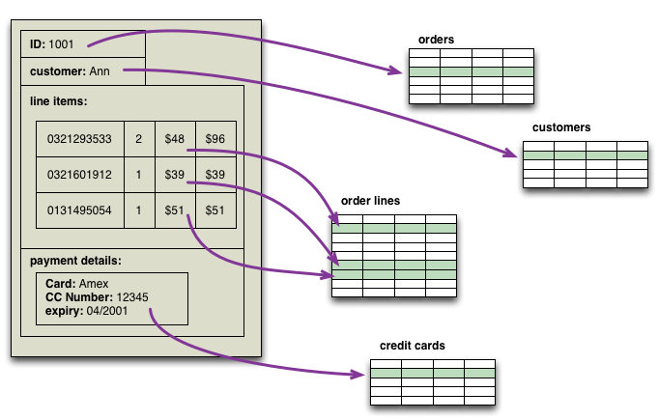
Document Family DBs
data are coherent, put together in “documents” and grouped in “collections/bukets of documents”

Slide 19
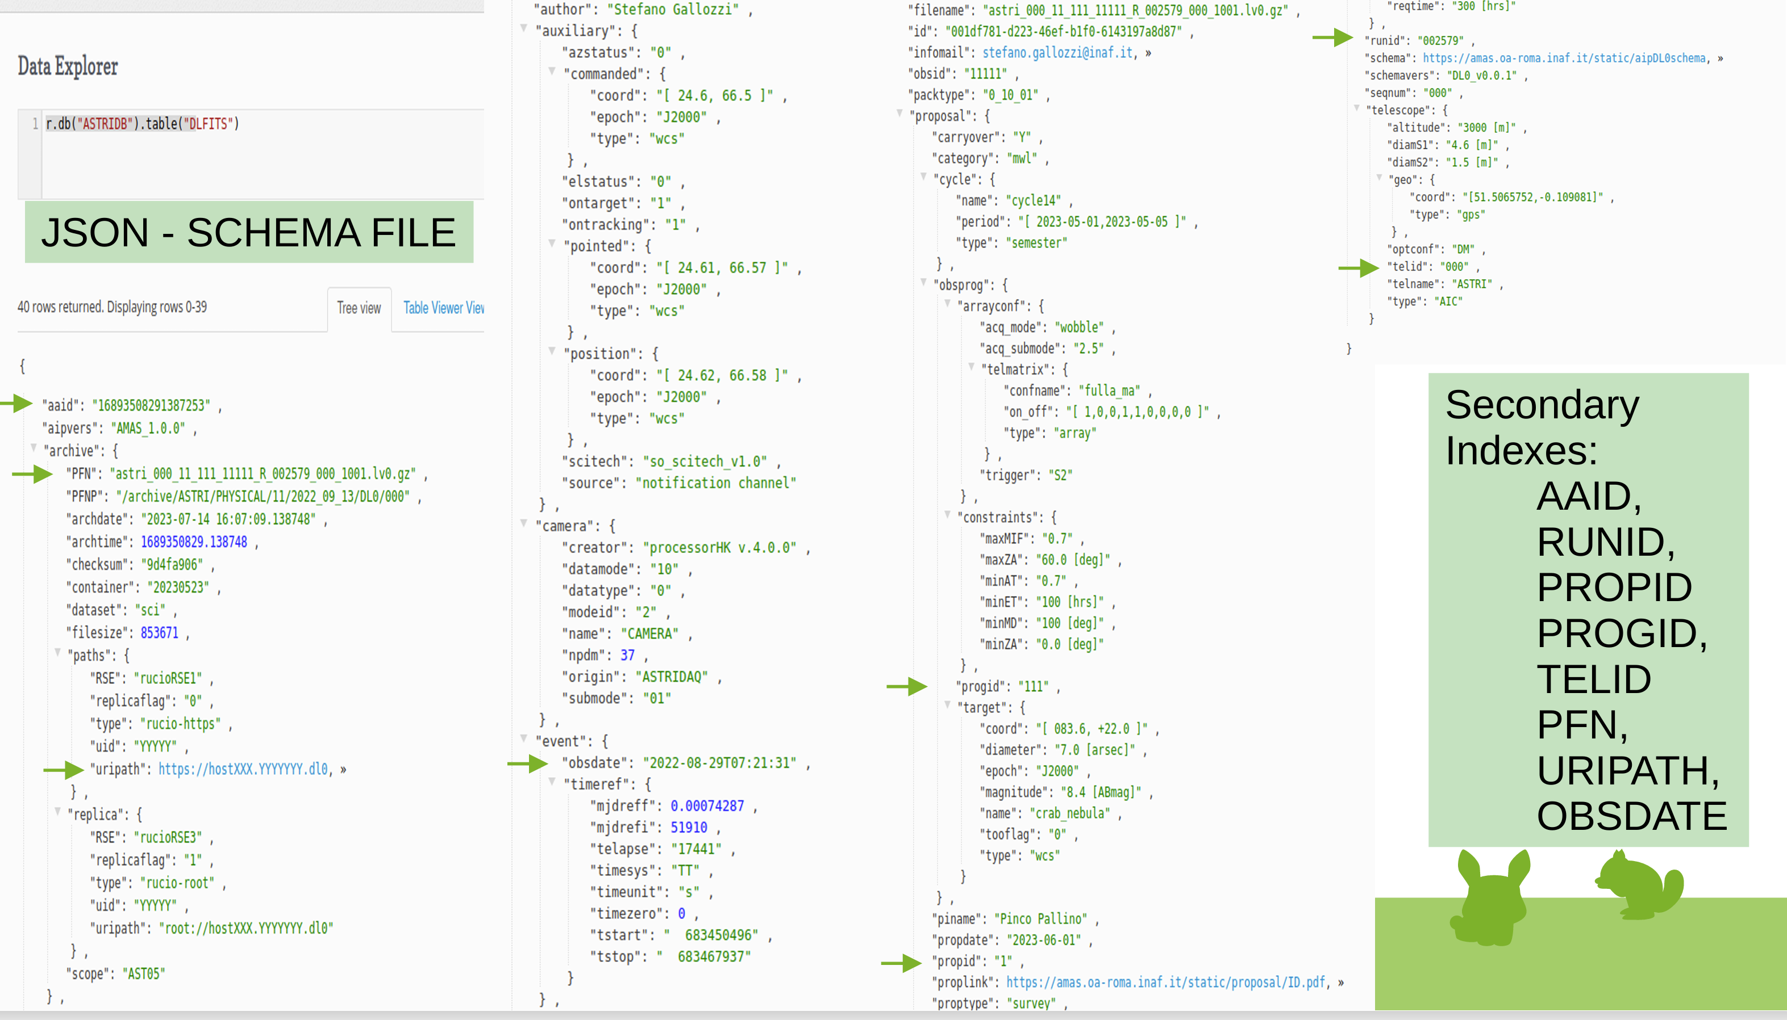
Document Family DBs
data are coherent, put together in “documents” and grouped in “collections/bukets of documents”

Slide 20
Document Oriented Family DBs
Queries (Examples: Mongo, CouchBase, RethinkDB, CouchDB, …)
Common Usage & Queries on JSON Structure:
{ "_id": 1, "name": "Mario Rossi", "email": "mario@email.it", "age": 30, "country": "IT", "orders": [ {"id": 1001, "total": 250, "status": "completed"}, {"id": 1002, "total": 150, "status": "completed"} ] }
db.users.find({ "orders": { $elemMatch: {status: "completed", total: {$gt: 200}} } })
db.users.find().sort({age: 1}).limit(5)
db.users.aggregate([ {$match: {country: "IT"}}, {$unwind: "$orders"},
{$group: { _id: "$_id", name: {$first: "$name"},
total_spent: {$sum: "$orders.total"} }} ])
N.B. Vedremo il caso d’uso di RethinkDB
Possibilita’ di eseguire funzioni analitiche sui dati durante le query ecc…

Slide 21
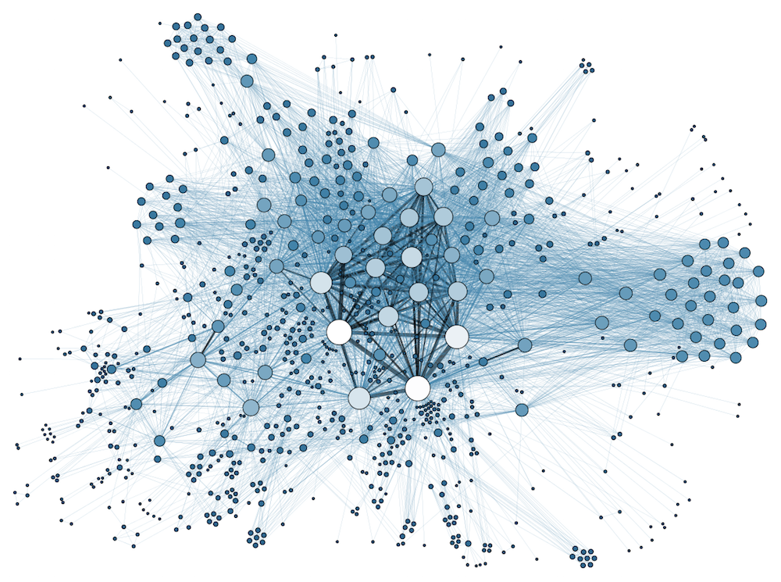
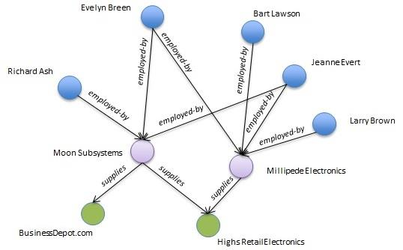
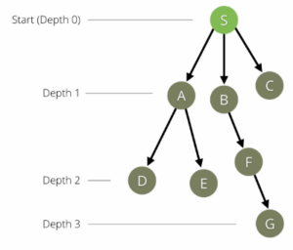
Graph Family DBs
Fast Increase
In Complexity
DAG, Directed Acyclic Graph
(for workload Management Sys)
data ”node” structures link together by arrows, meaning “relations” and “operations” among nodes

Slide 22
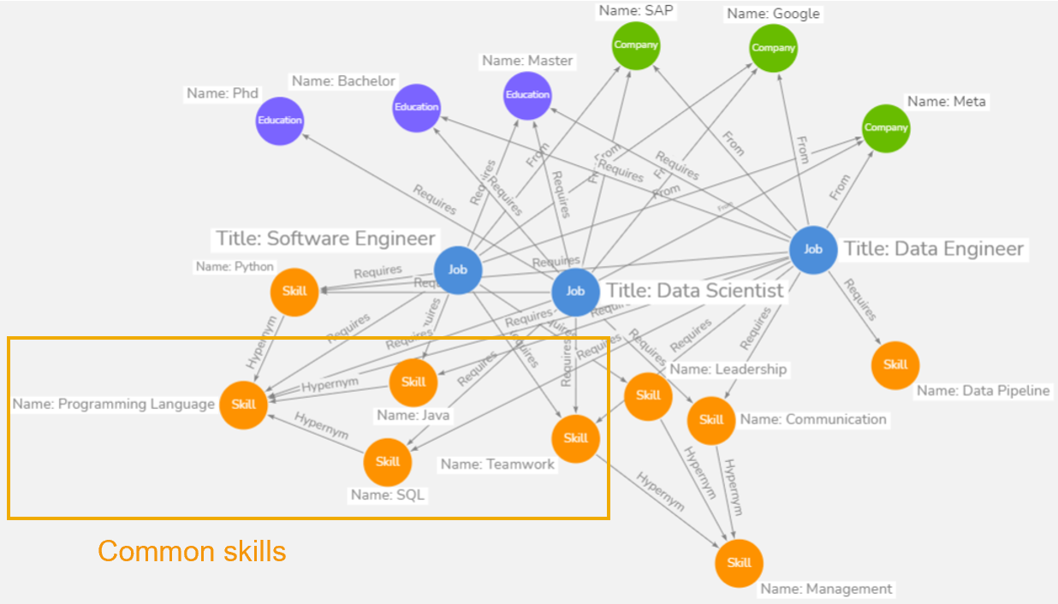
Graph Family DBs
Fast Increase
In Complexity
DAG, Directed Acyclic Graph
(for workload Management Sys)
data ”node” structures link together by arrows, meaning “relations” and “operations” among nodes

Slide 23
Graph Family DBs
Queries (Examples: Neo4j, Dgraph, ArangoDB, OrientDB, …)
Common Usage & Queries on JSON Structure:
CREATE (alice:Person {name: 'Alice', age: 30})
CREATE (bob:Person {name: 'Bob', age: 25})
CREATE (carol:Person {name: 'Carol', age: 27})
CREATE (alice)-[:FRIEND]->(bob)
CREATE (bob)-[:FRIEND]->(carol);
Trova gli amici di amici di Alice:
MATCH (alice:Person {name: 'Alice'})-[:FRIEND]->(friend)-[:FRIEND]->(foaf)
RETURN foaf.name AS friend_of_friend
----
(Alice)-[:HA_VISTO]->(Matrix)
(Bob)-[:HA_VISTO]->(Matrix)
(Bob)-[:HA_VISTO]->(Inception)
(Alice)-[:HA_VISTO]->(Inception)
Consigliami film che utenti
simili a me hanno visto (ma io no):
MATCH (me:User {name:"Alice"})-[:SIMILE_A]->(other)-[:HA_VISTO]->(movie)
WHERE NOT (me)-[:HA_VISTO]->(movie)
RETURN movie
Alice e Bob hanno visto molti film in comune:
(Alice)-[:SIMILE_A {score: 0.82}]->(Bob)
Calcolo utenti con almeno 2 film in comune:
MATCH (u1:User)-[:HA_VISTO]->(m:Movie)<-[:HA_VISTO]-(u2:User)
WHERE u1 <> u2 WITH u1, u2, count(m) AS filmComuni
WHERE filmComuni >= 2 MERGE (u1)-[r:SIMILE_A]->(u2)
SET r.score = filmComuni
N.B. Possibilita’ di creare funzioni analitiche sulle relazioni…

Slide 24
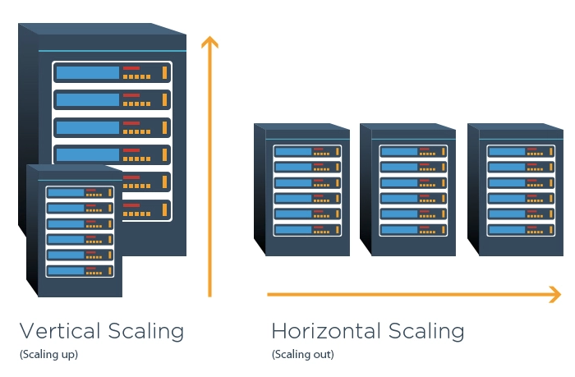
Scale-up _vs_ Scale-out centralized vs distribuited
DB Service Scaling
What about increasing a working system?
Two Choices
add nodes
(computing/storage/memory)
with same performances
change hardware with
more powerful
→ better performances

Slide 25
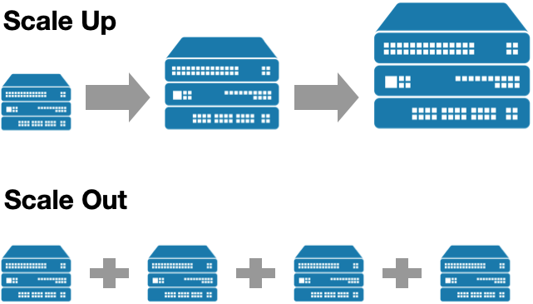
Scale-up _vs_ Scale-out centralized vs distribuited
DB Service Scaling
When a project foresees scalability
of any resource/characteristic during
years the only choice is SCALE-OUT
→ maintain same performances
→ redundacy is added
→ system becomes no-SPOF
→ the cost is lower

Slide 26
Clustering, Sharding and and Replication
PROBLEM | LIMITS & WHAT TO DO | SOLUTION
Scale Data Size | Approaching the maximum server capacity → distribute tables and databases across multiple machines (nodes) | Clustering
Scale Read Requests | A DB server can process a maximum number of requests → reduce the number of requests made | Caching Layer and Replication → distribute request traffic among replicas
Scale Write Requests | Split writes among multiple instances → split table records across multiple shards/containers | Data Partitioning and Sharding
Provide High Availability | Avoid SPOF → make services independent by crashes | Data Replication

Slide 27
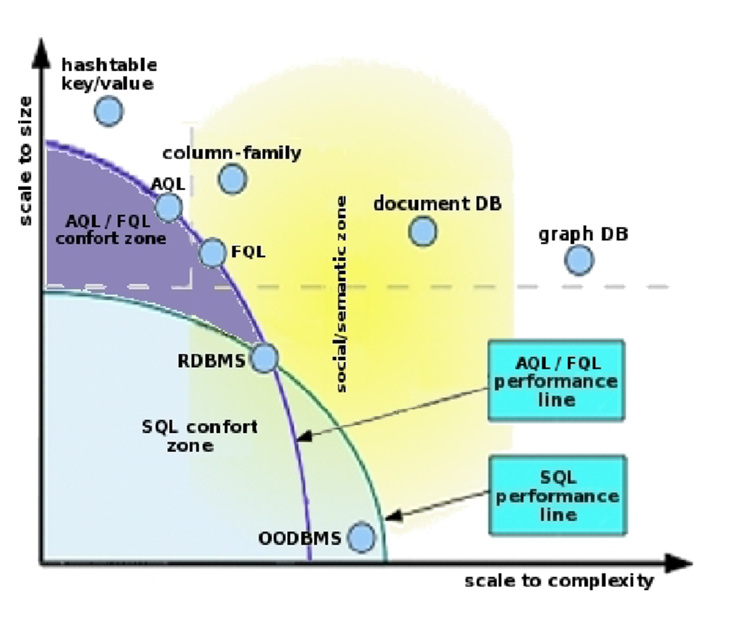
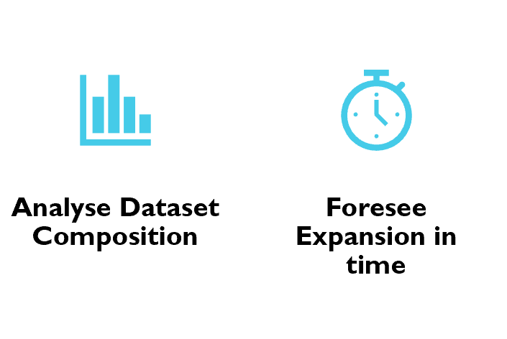
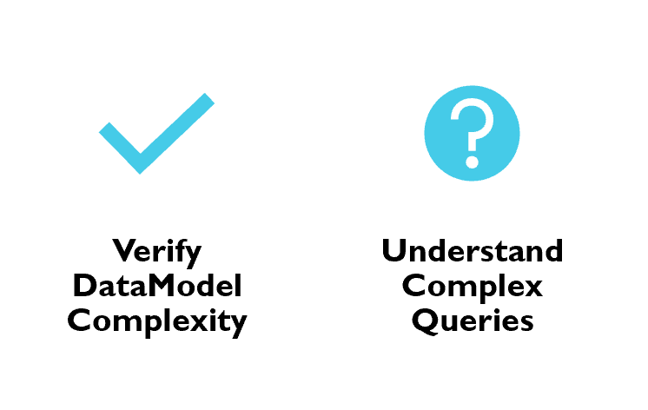
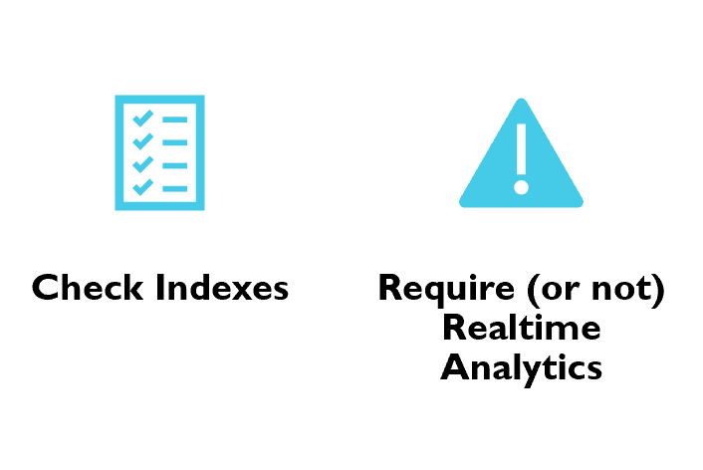
DBs Scalability

Slide 28
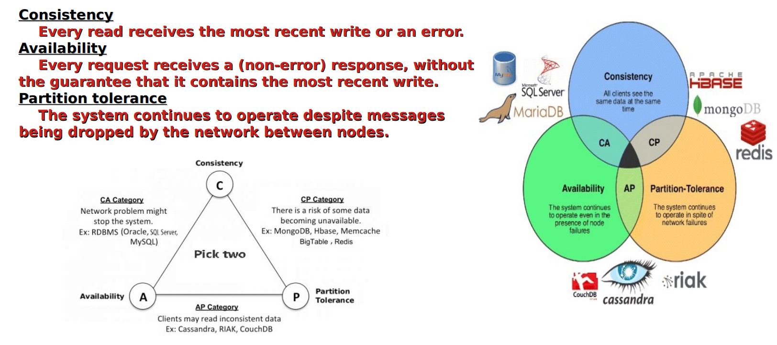
Distributed – Social / Semantic DBs
the CAP Theorem
C=Consistency is guaranteed by WORM paradigm!

Slide 29




HOW TO FIND THE BEST DATABASE for YOUR DATA?
Which DATA?
(DataModel Structure)
Who Produce DATA?
(DATA Producer)
Where DATA are?
How to Transfer DATA?
How to ACCESS?
(Use Cases)
Who Consume DATA?
(Data Consumer)
Which Auth&Authz?
Which Access Protocols?
How Frequently?
(Read/Write/Update)
Real Time Access or Delayed / Asynchronus?
Pipelines?
Jobs/DAG, HPC/HTC?

Slide 30
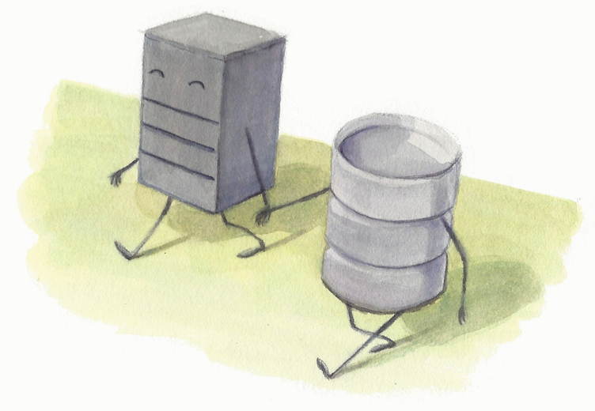
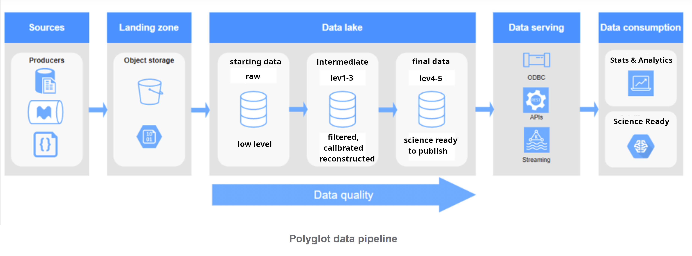
POLYGLOT PERSISTENCE #1

Slide 31
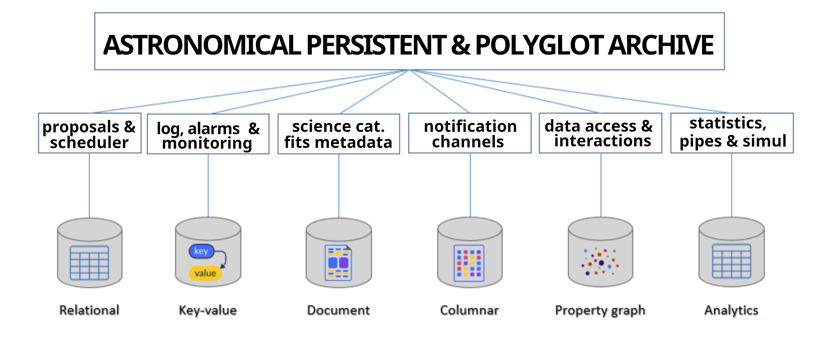
POLYGLOT PERSISTENCE #2

Slide 32
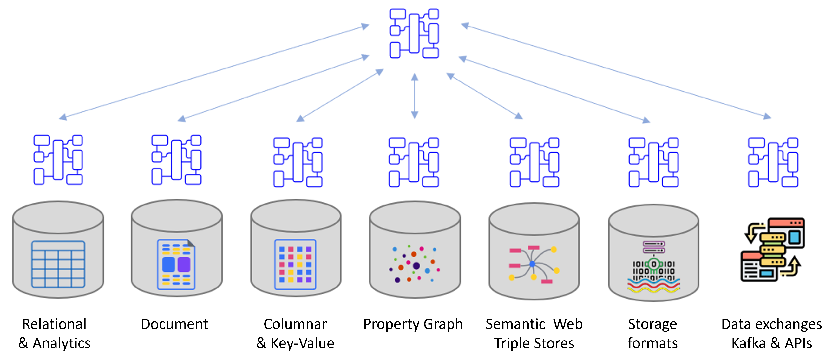
POLYGLOT PERSISTENCE - Technical implementations #1
?

Slide 33
POLYGLOT PERSISTENCE - Technical implementations #1
Log/Alarms
Notification
Channels &
Monitoring
Interactions
&
Data Access
Calib/Pipes
Statistics
Simulations
Distributed
Archival &
Storage
Proposals
Science
Metadata
Fits Metadata
File Catalogs
AGGREGATOR

Slide 34
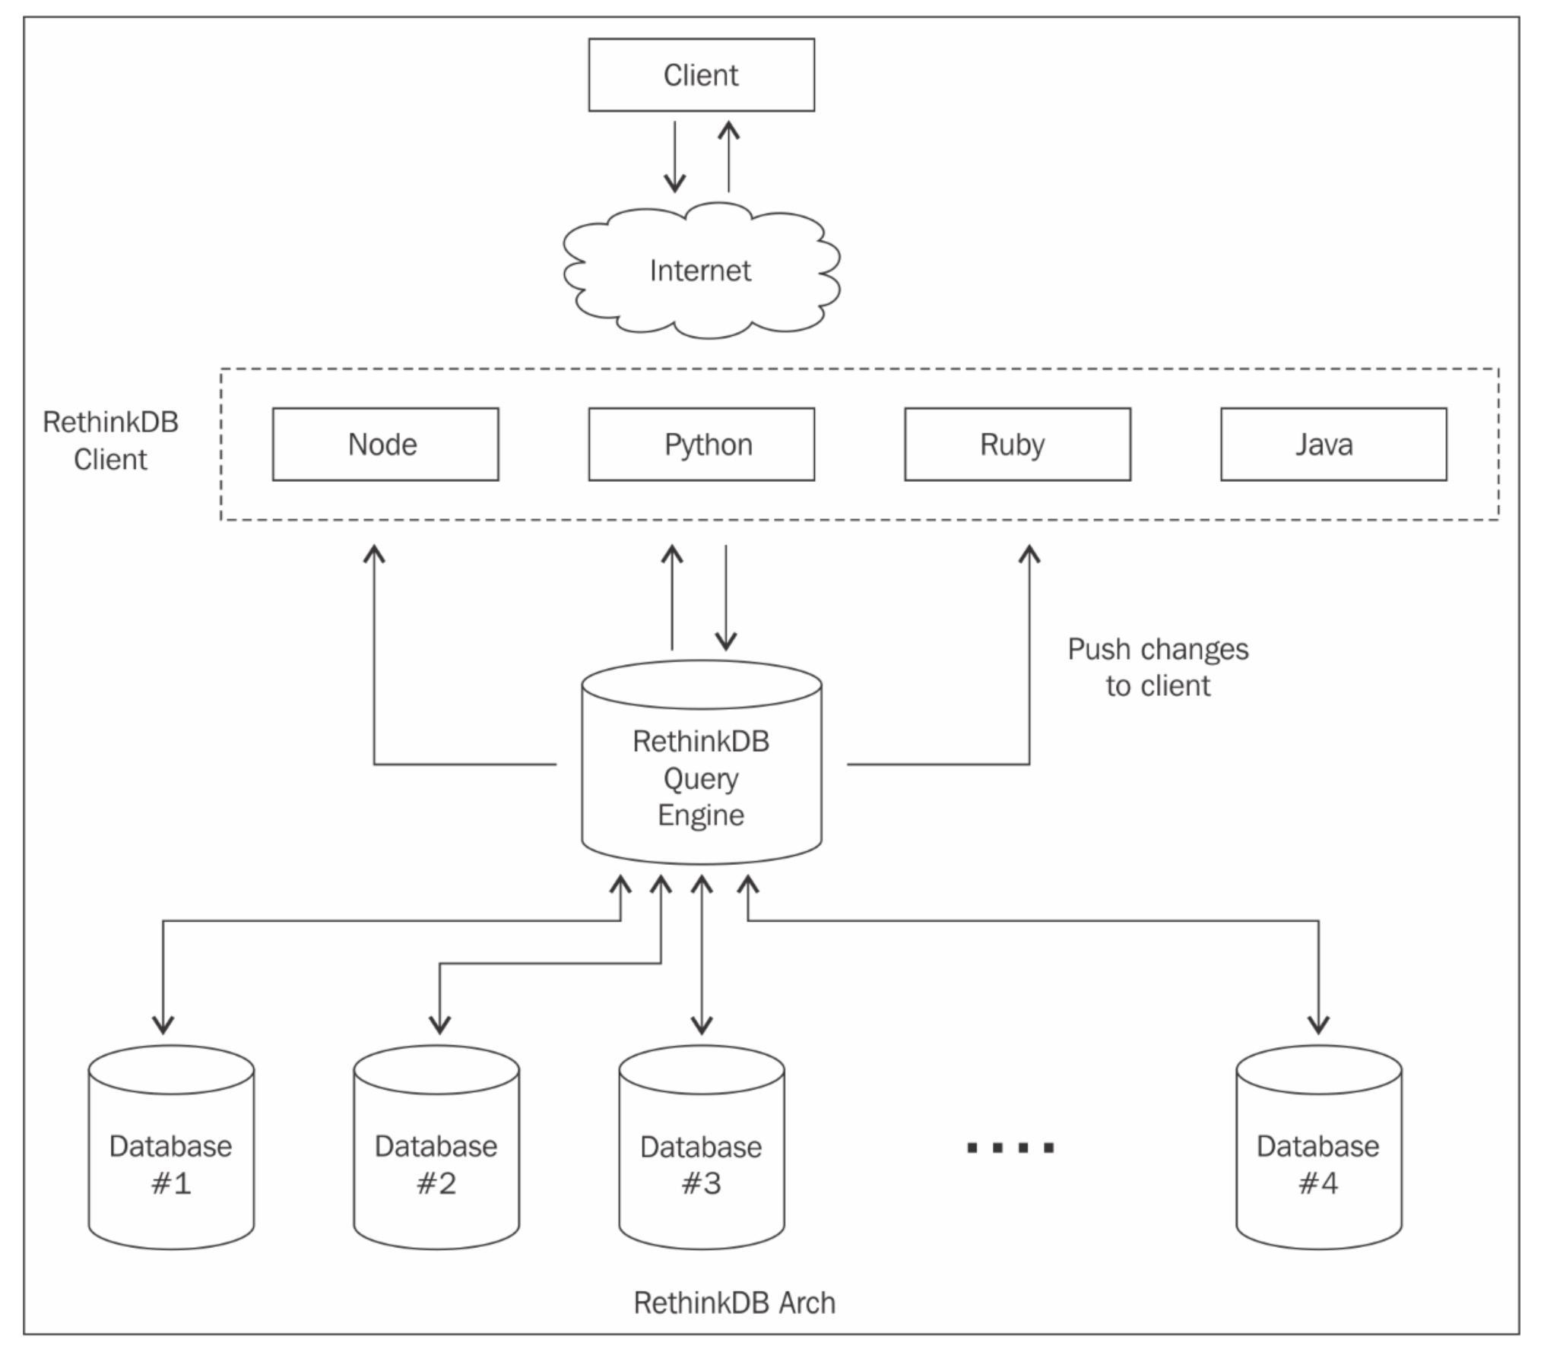
POLYGLOT PERSISTENCE - Technical implementations #2
Different DBs connect to a single Distributed Cluster with real time functionalities.
(i.e. RethinkDB )
Distributed Cluster
as a server
Where CLIENTs
Can establish a persitent connection with change-Feed feature.

Slide 35
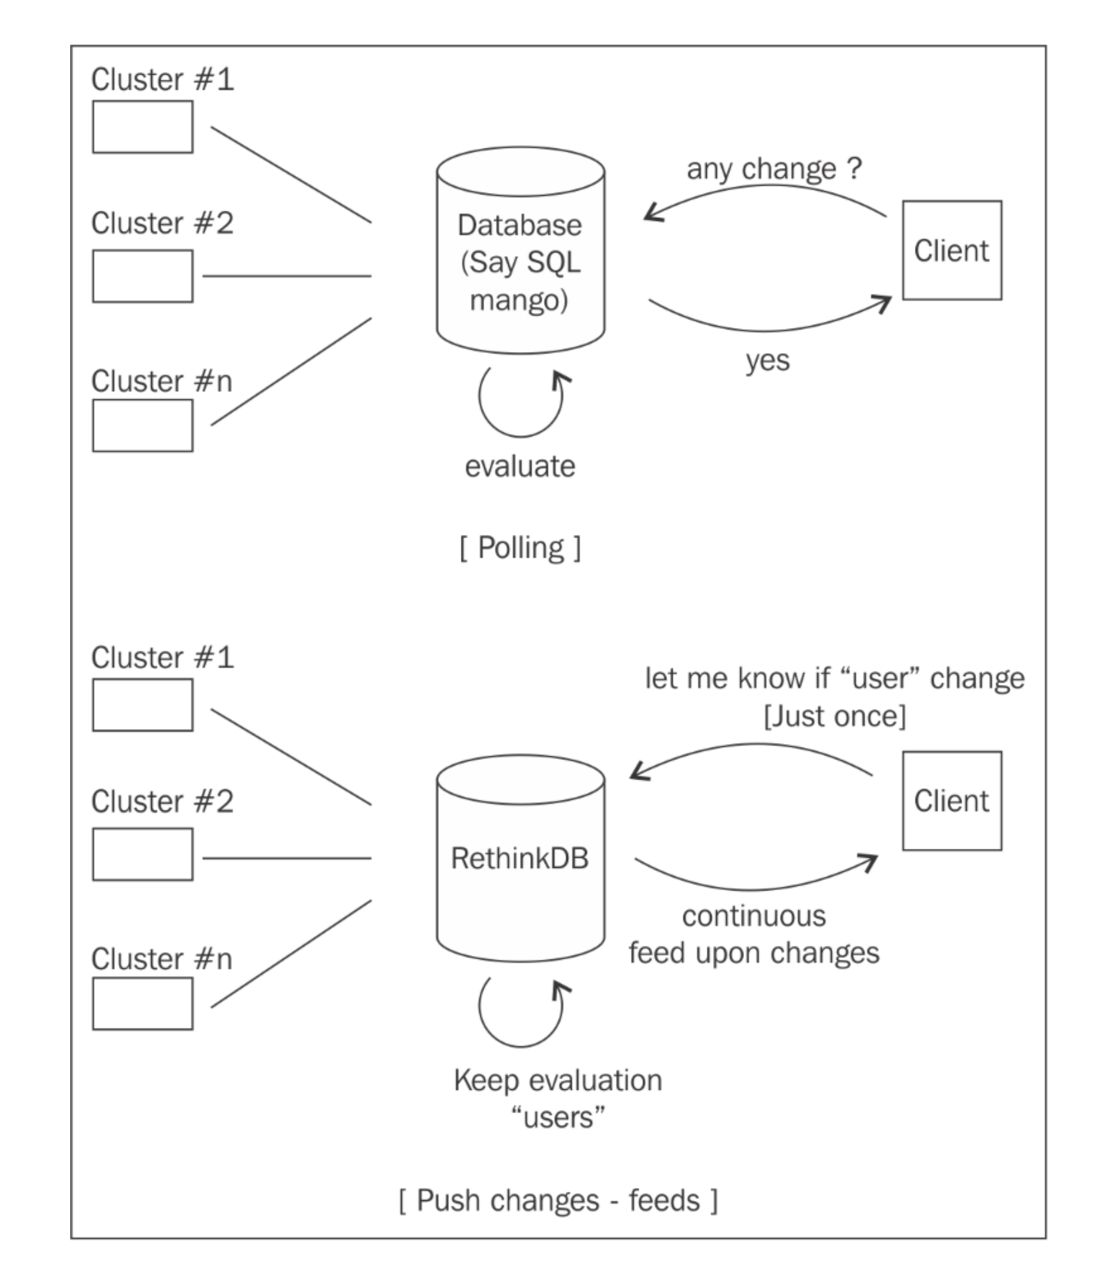
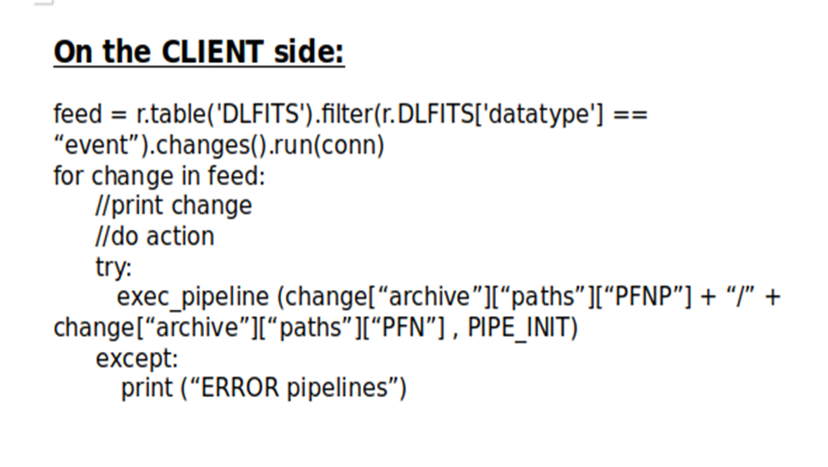
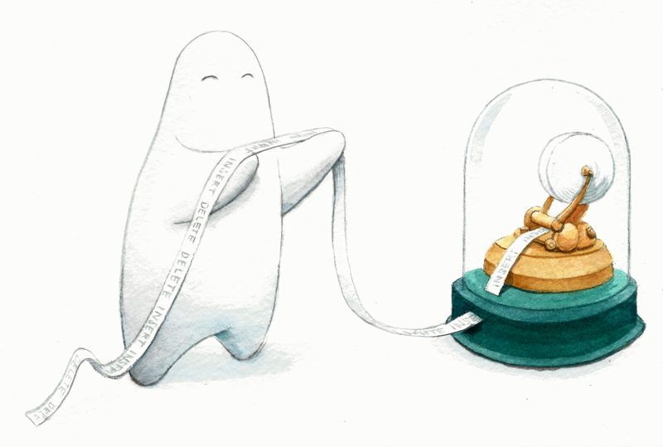
POLYGLOT PERSISTENCE – TRIGGERING ACTIONS (change FEED)
polling _vs_ change-feed

Slide 36
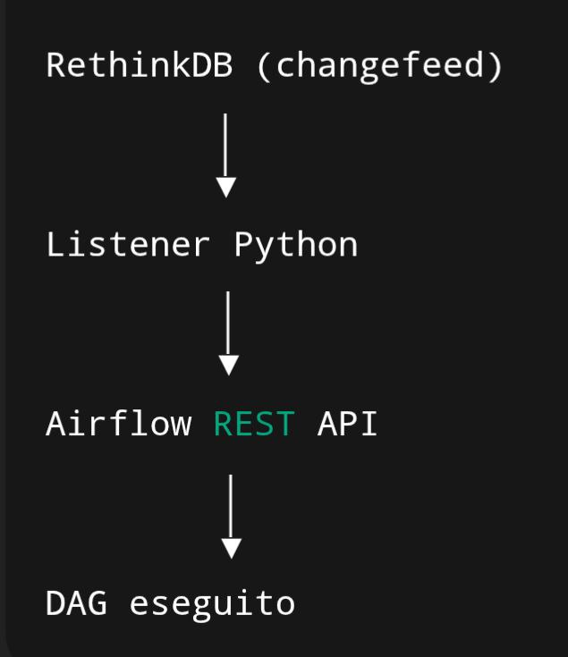
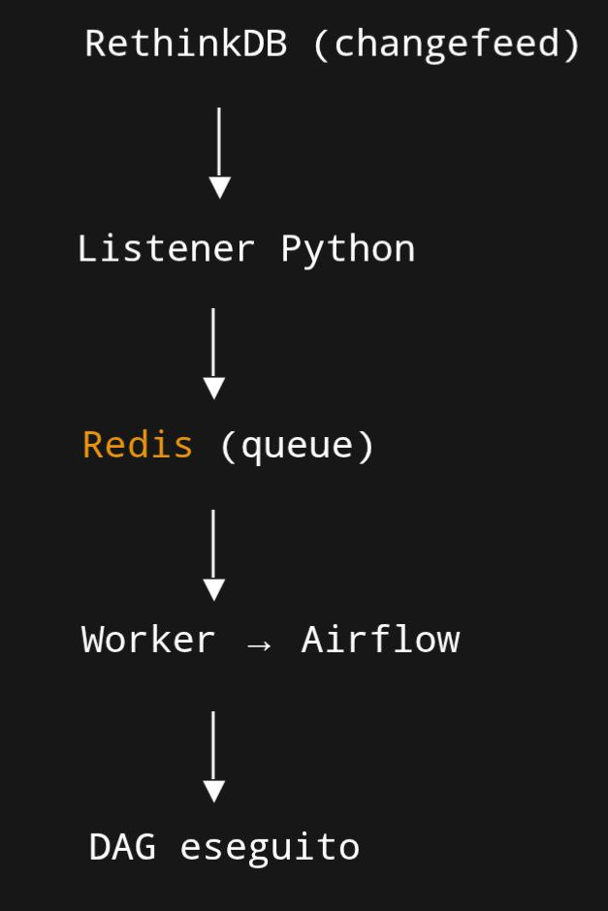
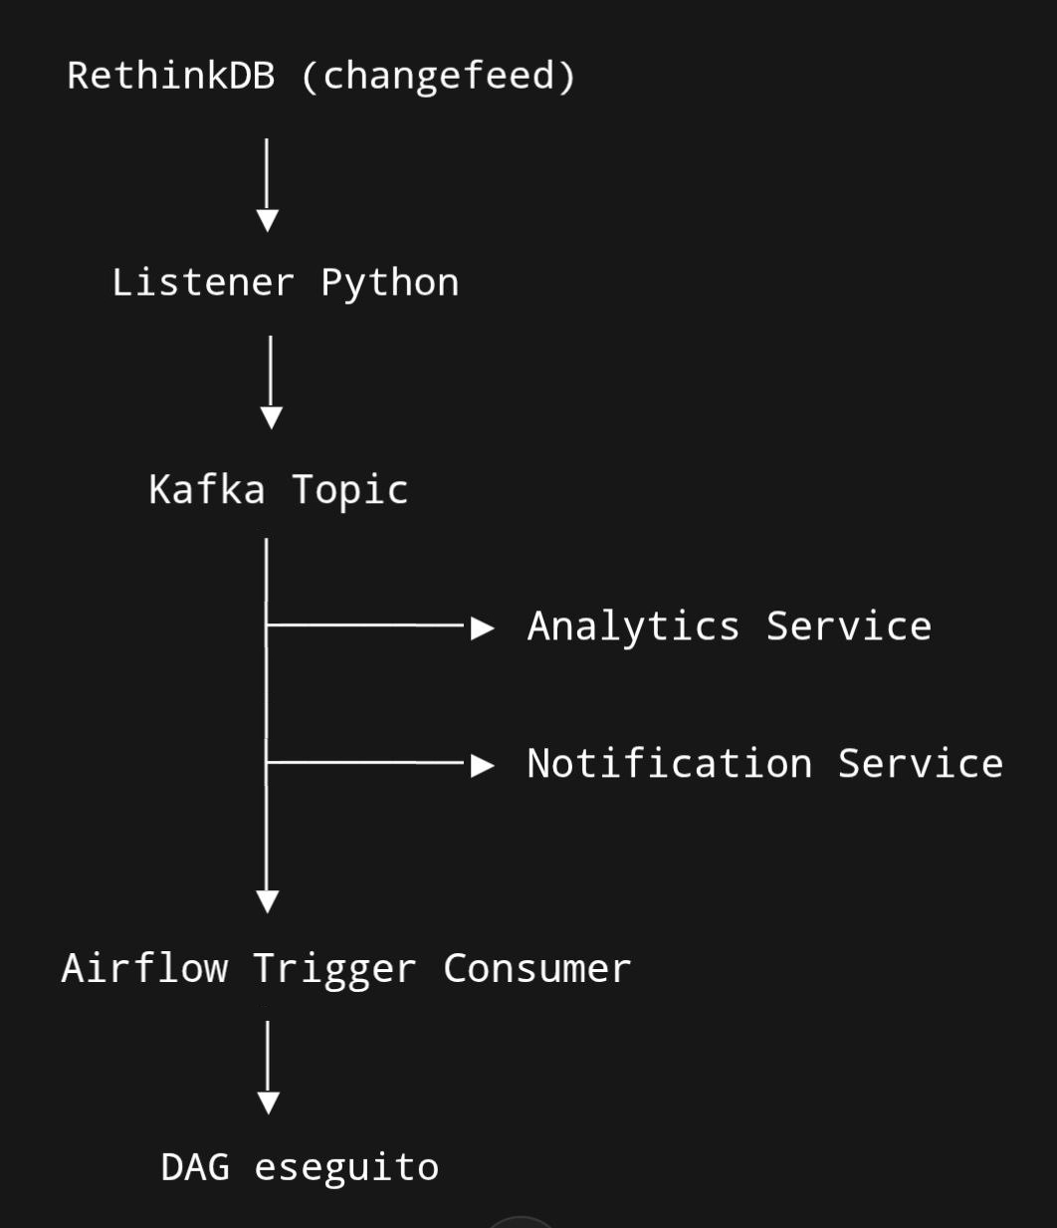
POLYGLOT PERSISTENCE – TRIGGERING ACTIONS (change FEED)
change-feed implementation & Pipelines Automatization

Slide 37

POLYGLOT PERSISTENCE – A STEP FORWARD (MWL DB) #1
Observatory
Science Ready
Metadata

Slide 38

POLYGLOT PERSISTENCE – A STEP FORWARD (MWL DB) #2
GammaRay Astronomy
CTAO, MAGIC, ASTRI-Miniarray, …
Radio Astronomy
ALMA, SRT, SKA…
Other…
(ground based and space)
DATA LAKE EXTRACTOR AND AGGREGATOR
Multidimensional
Array / Matrix
MOLAP

Slide 39
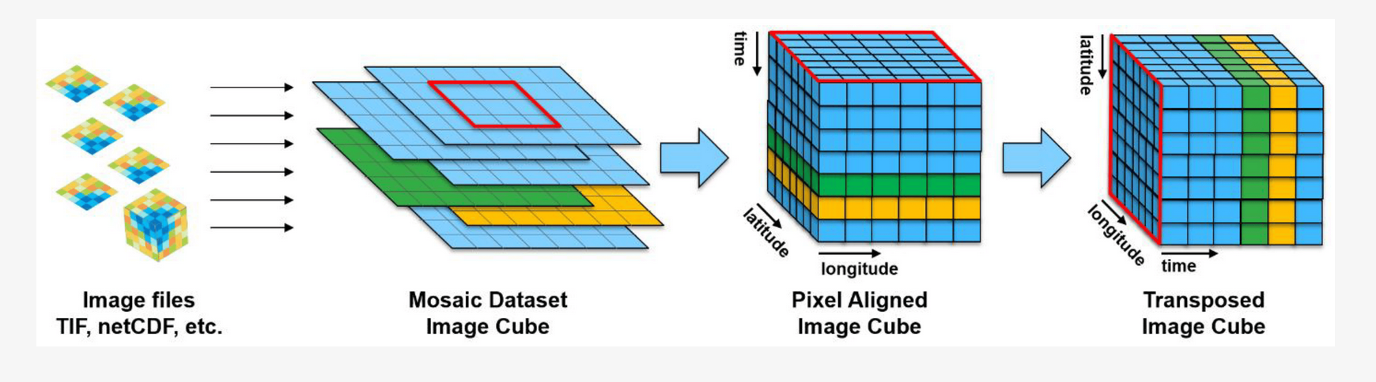
POLYGLOT PERSISTENCE – A STEP FORWARD (MWL DB) #3
DATA CUBE AGGREGATION

Slide 40
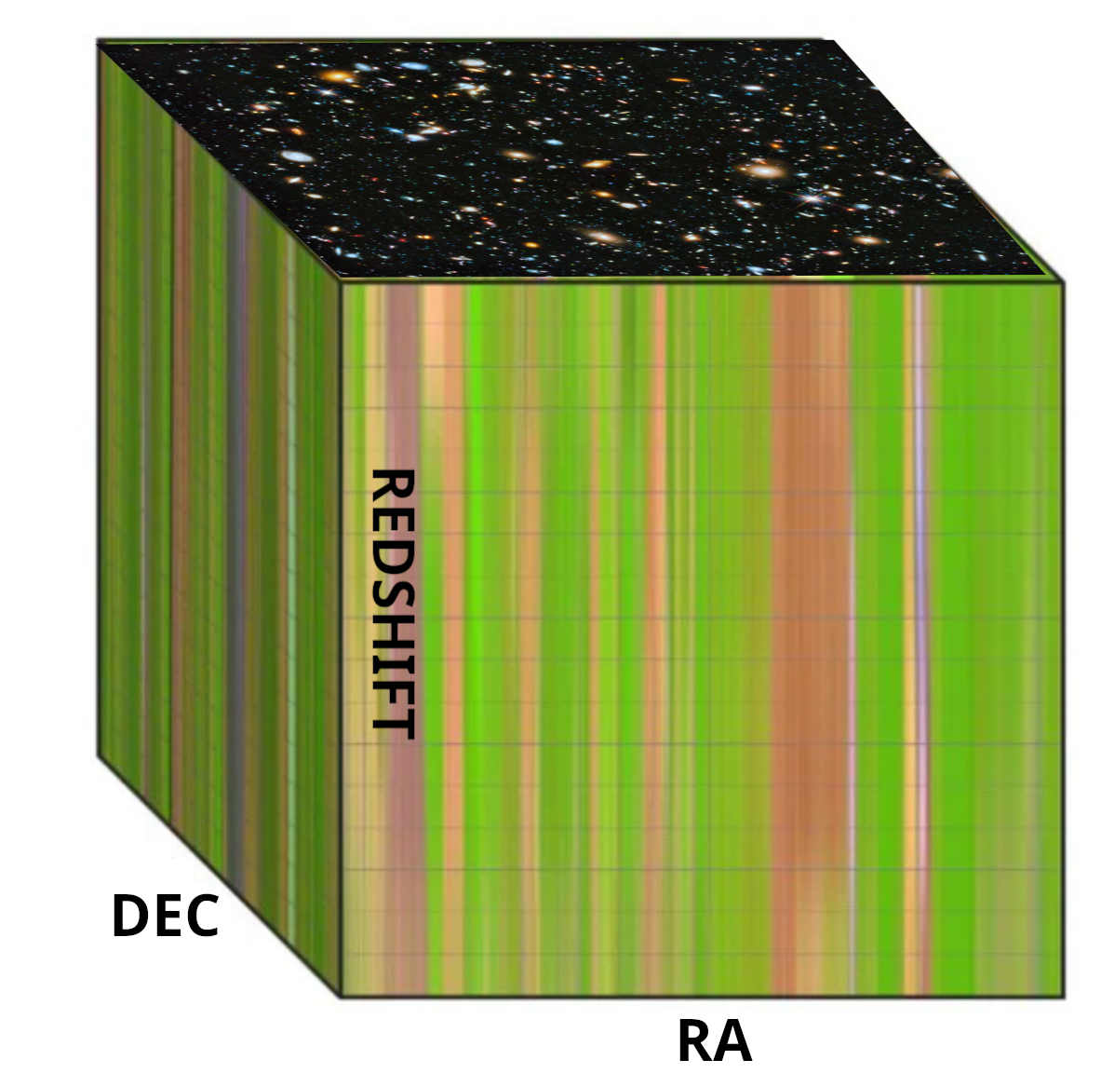
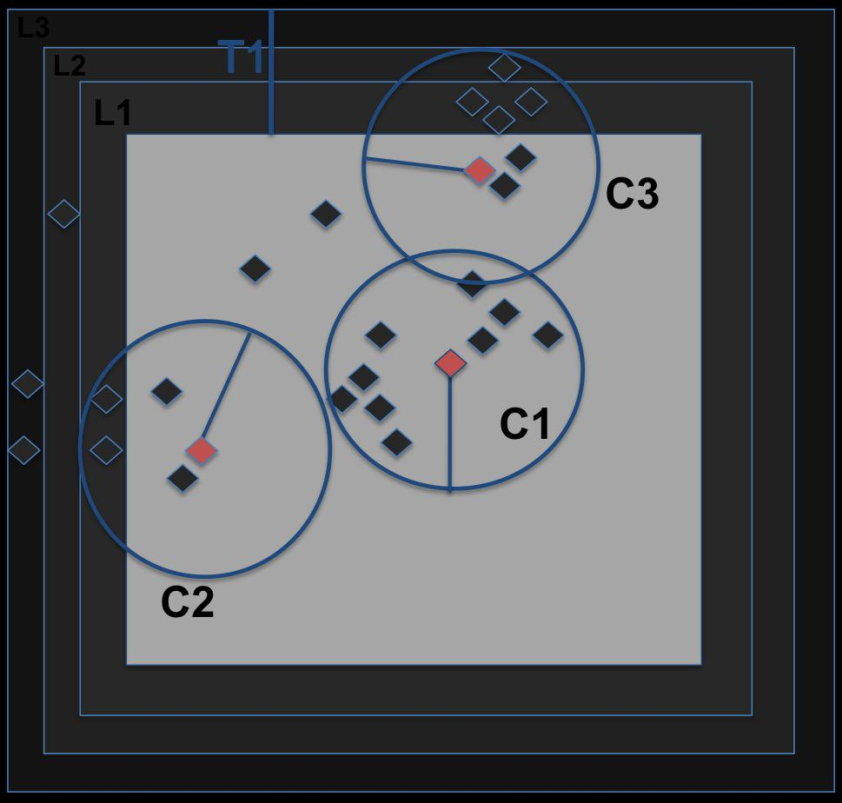
POLYGLOT PERSISTENCE – A STEP FORWARD (MWL DB) #4
Cone Search

Slide 41
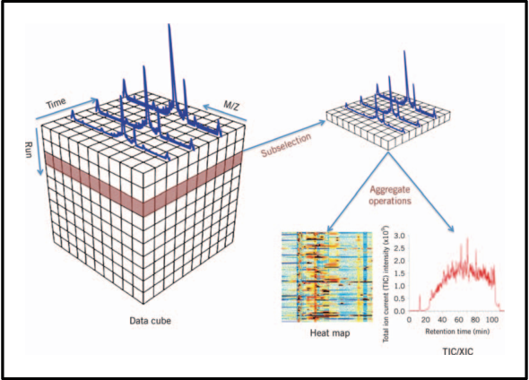
POLYGLOT PERSISTENCE – A STEP FORWARD (MWL DB) #5
I Data Cube possono essere di qualsiasi tipo ed anche MultiDimensionali (N>3 Dimensioni)
ConeSearch puo’ restituire:
Es. Spettri in RA/DEC
Immagini RA/DEC per Filtro
e/o per Lunghezza d’Onda e/o In funzione di Redshift e in funzione della risoluzione Angolare ecc…

Slide 42
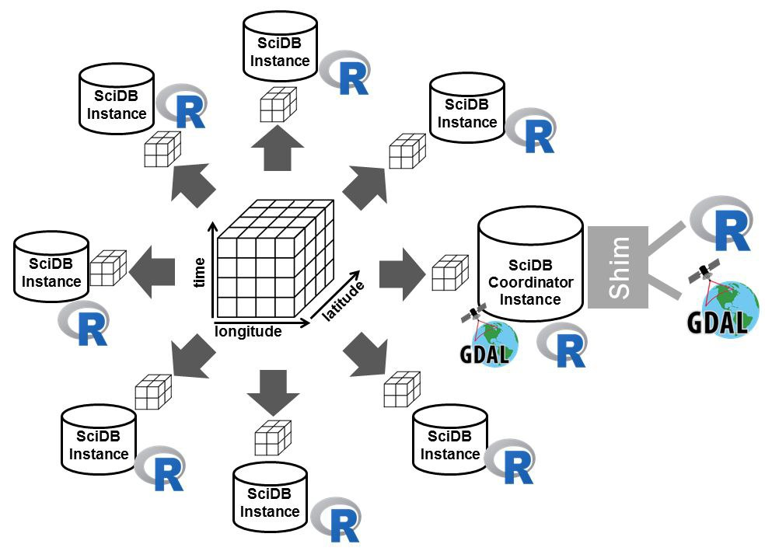
POLYGLOT PERSISTENCE – SCIDB, AQL, FQL & ADQL #1
Similar approach: Sci-DB
Used to aggregate MOLAP with Array Query Language (AQL) to provide access through Astronomical Data Query Language (ADQL, i.e VirtualObservatory)
with extraction functions given by Functional Query Language (FQL)

Slide 43
POLYGLOT PERSISTENCE – SCIDB, AQL, FQL & ADQL #2
1) Struttura in SciDB (array MOLAP):
sky_cube[ra, dec, redshift] -> intensity
2) Funzione di Aggregazione AQL in SciDB:
aggregate(
filter(sky_cube,
ra > 150 AND ra < 151 AND
dec > 2 AND dec < 3),
avg(intensity)
)
Astronomer Execute ADQL query
Create a 3Dcube
SCIDB translates ADQL queries in 3d Cube
AQL aggregate filtered query into MOLAP data-cube
Select Sky cube
Calc. Average Intensity
FQL performs Functions & Analytics on MOLAP Data-Cube
Output to Astronomer

Slide 44
POLYGLOT PERSISTENCE – SCIDB, AQL, FQL & ADQL #2
3) ADQL selection Example
SELECT AVG(intensity)
FROM sky_cube
WHERE 1=CONTAINS(
POINT('ICRS', ra, dec),
CIRCLE('ICRS', 150.5, 2.5, 0.5)
)
4) Example of FQL Example to process data:
extract_spectrum(sky_cube, ra, dec)
avg_over_time(
extract_region(sky_cube, ra_range, dec_range)
)
Astronomer Execute ADQL query
Execute a ADQL query
SCIDB translates ADQL queries in 3d Cube
AQL aggregate filtered query into MOLAP data-cube
FQL performs Functions & Analytics on MOLAP Data-Cube
Extract a Spectrum
from Sky RA/DEC
Output to Astronomer

Slide 45
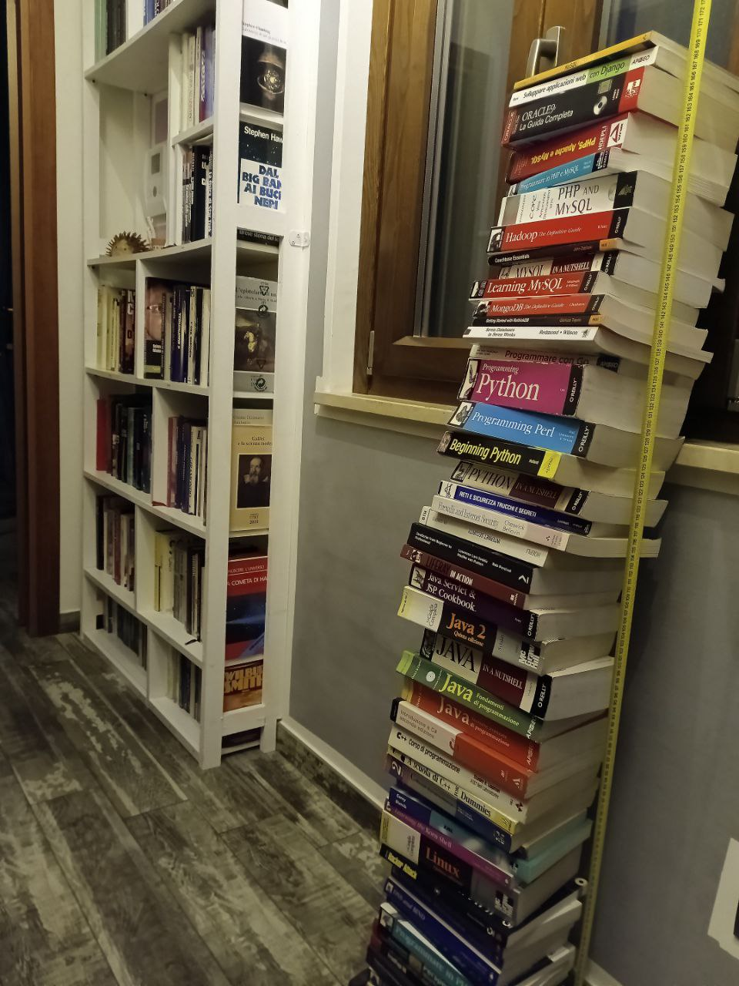
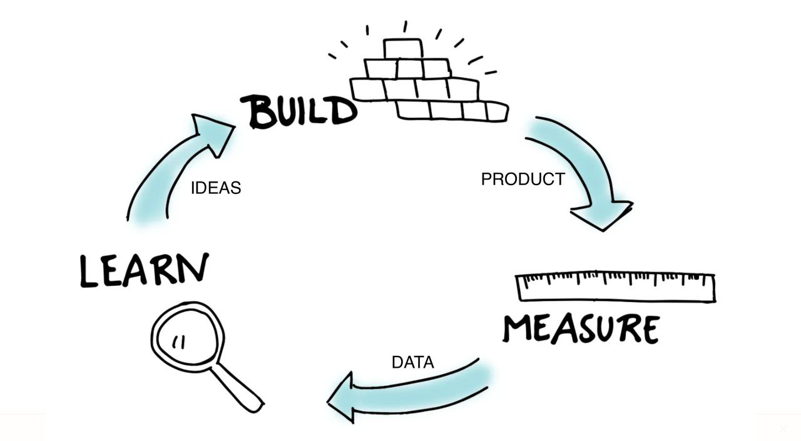
1st Part CONCLUSION

Slide 46
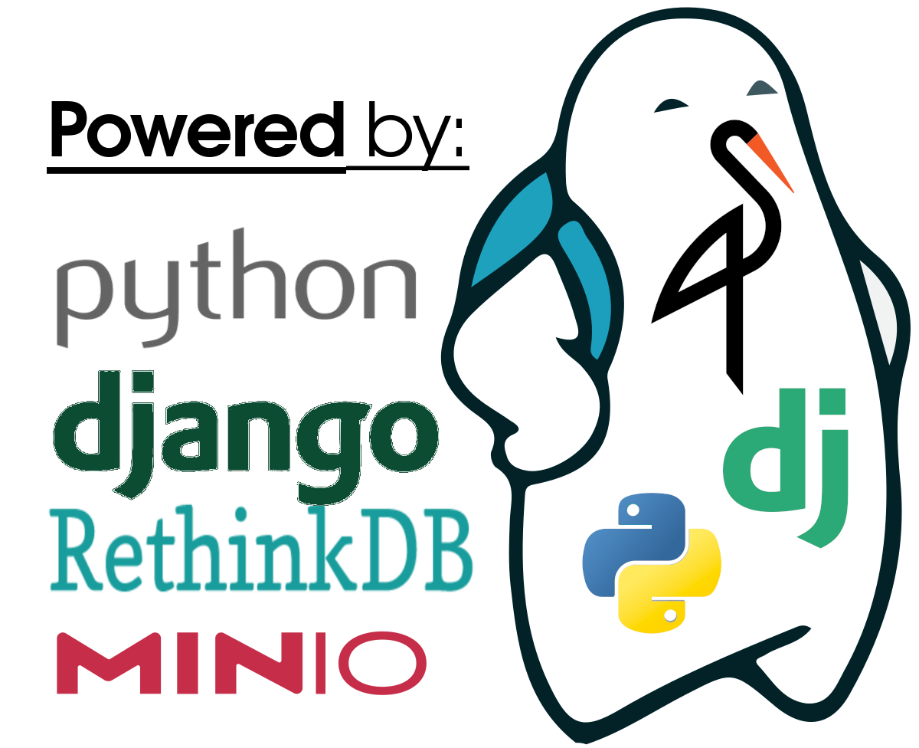
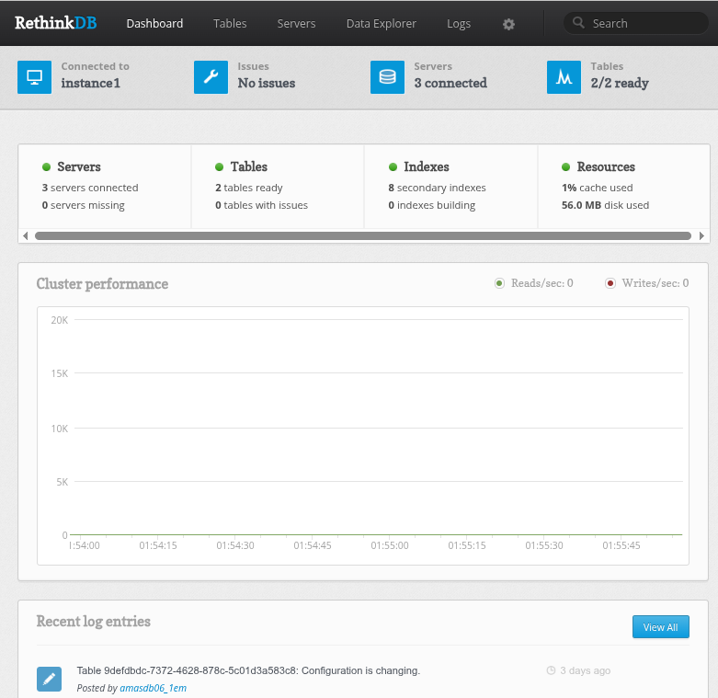
PRACTICAL USE-CASE
Download the CaseStudy:
RethinkDB Demonstrator

Slide 47
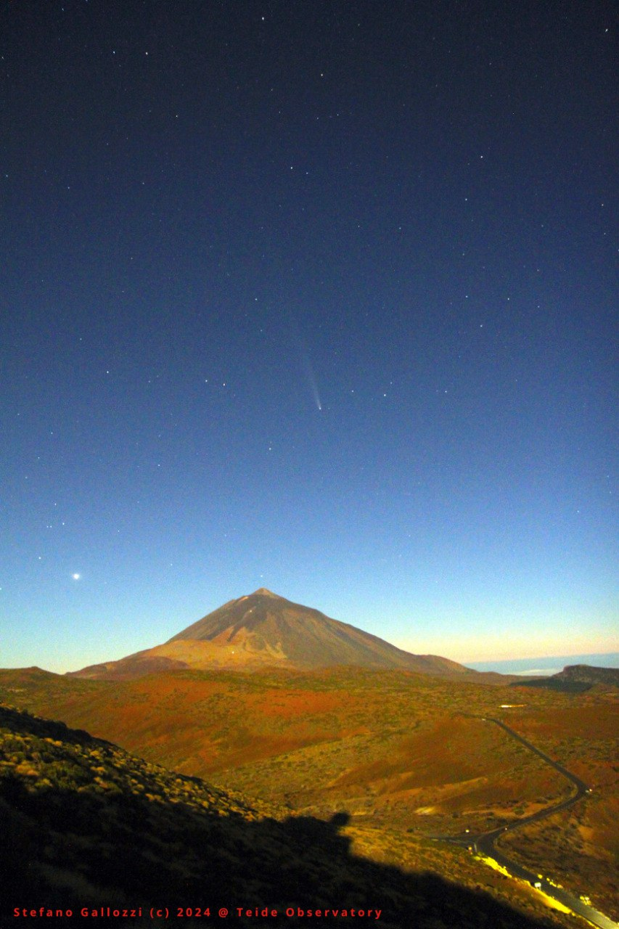

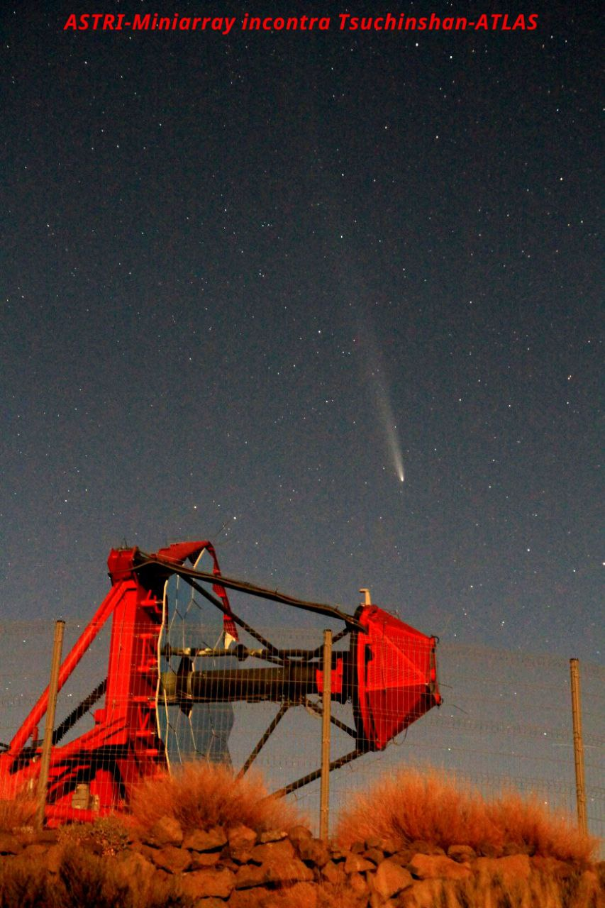
Thanks for your attention!

