Slide 1
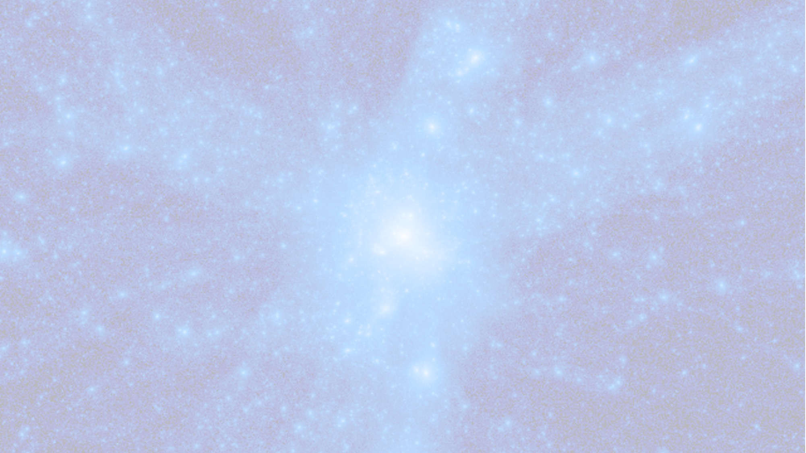




HPC & Big Data @ UniTS
Stefano Borgani
Dept. of Physics - University of Trieste
INAF – Astronomical Observatory of Trieste
ICSC - National Center for HPC, Big Data and Quantum Computing
1. HPC & large simulations of cosmic structures @ DF-UniTS
- Collaboration with INAF-OATs
- ICSC Spoke-3 and beyond
2. HPC @ Dept. of Physics : activities in Spoke-2 and Spoke-7
3. HPC @ UniTS at large: activities in Spoke-7
Talk @ INAF USC-C Assembly - Trieste March 9th - 13th 2026

Slide 2
Who are we and what do we do?
Franklin Aldas (INAF-TS) Paramita Barai (INAF-TS) Veronica Biffi (INAF-TS) Stefano Borgani (UniTS, INAF-TS) Tiago Castro (INAF-TS, Univ. São Paulo) Alice Damiano (INAF-TS) Michela Esposito (SISSA) Alessandra Fumagalli (INAF-TS) David Goz (INAF-TS) Gianluigi Granato (INAF-TS) Giovanni Lacopo (INAF-TS) | Marius Lepinzan (INAF-TS) Pierluigi Monaco (UniTS, INAF-TS) Giuseppe Murante (INAF-TS) Antonio Ragagnin (INAF-TS) Cinthia Ragone-Figueroa (U.Cordoba, INAF-TS) Elena Rasia (U.Michigan, INAF-TS) Alex Saro (UniTS, INAF-TS) Tommaso Tarchi (INAF-TS) Giuliano Taffoni (INAF-TS) Luca Tornatore (INAF-TS) Milena Valentini (UniTS, INAF-TS)
z < 10
LPT approximate simulation: Pinocchio (see talk by P. Monaco) – Euclid
N-body simulations: OpenGadget3 (see talk by L. Tornatore) – Euclid
Hydrodynamical simulations: OpenGadget3 – Euclid, galaxy formation
Computational Resources: CINECA (Leonardo Booster & DCGP), Pleiadi
O(10⁷) core-h/year (ISCRA, EuroHPC, ICSC)
Storage: DRES-CINECA, IA2: ~400 TB

Slide 3
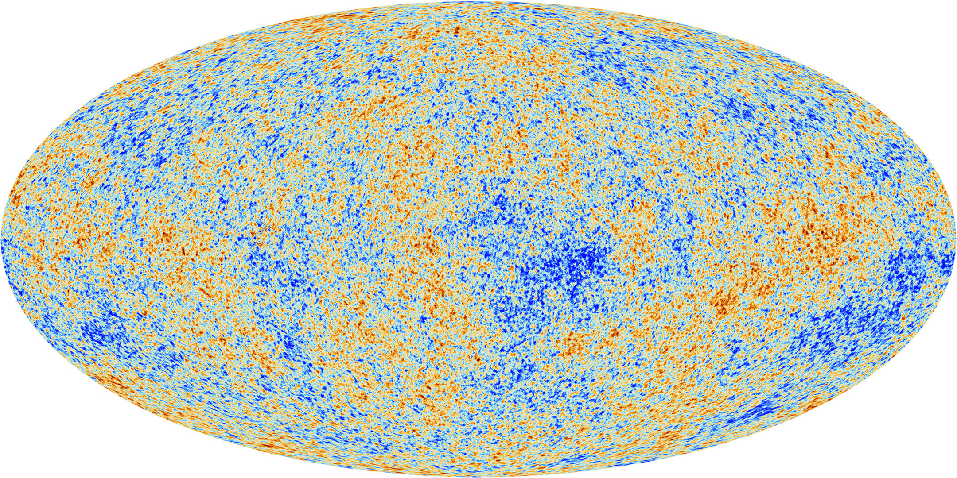
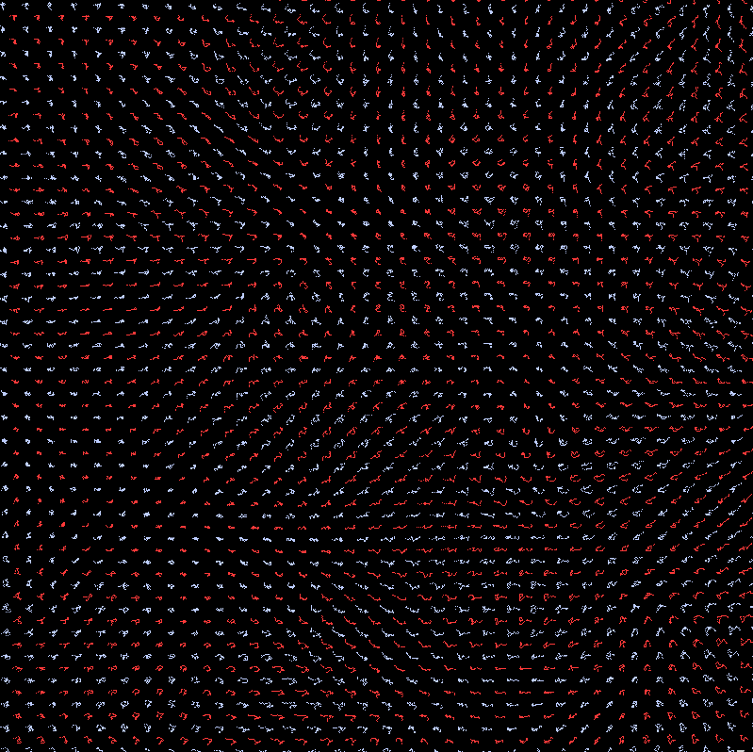
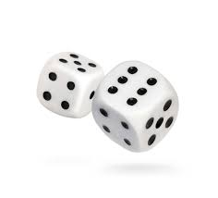
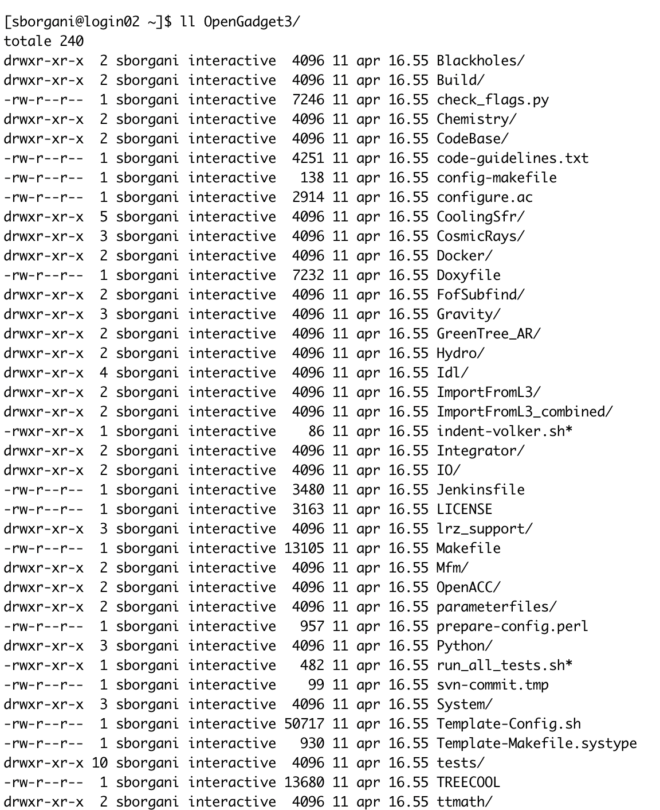
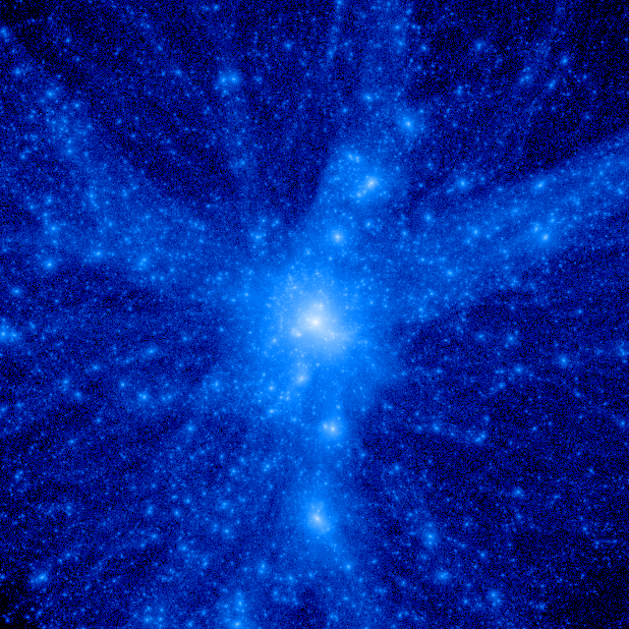
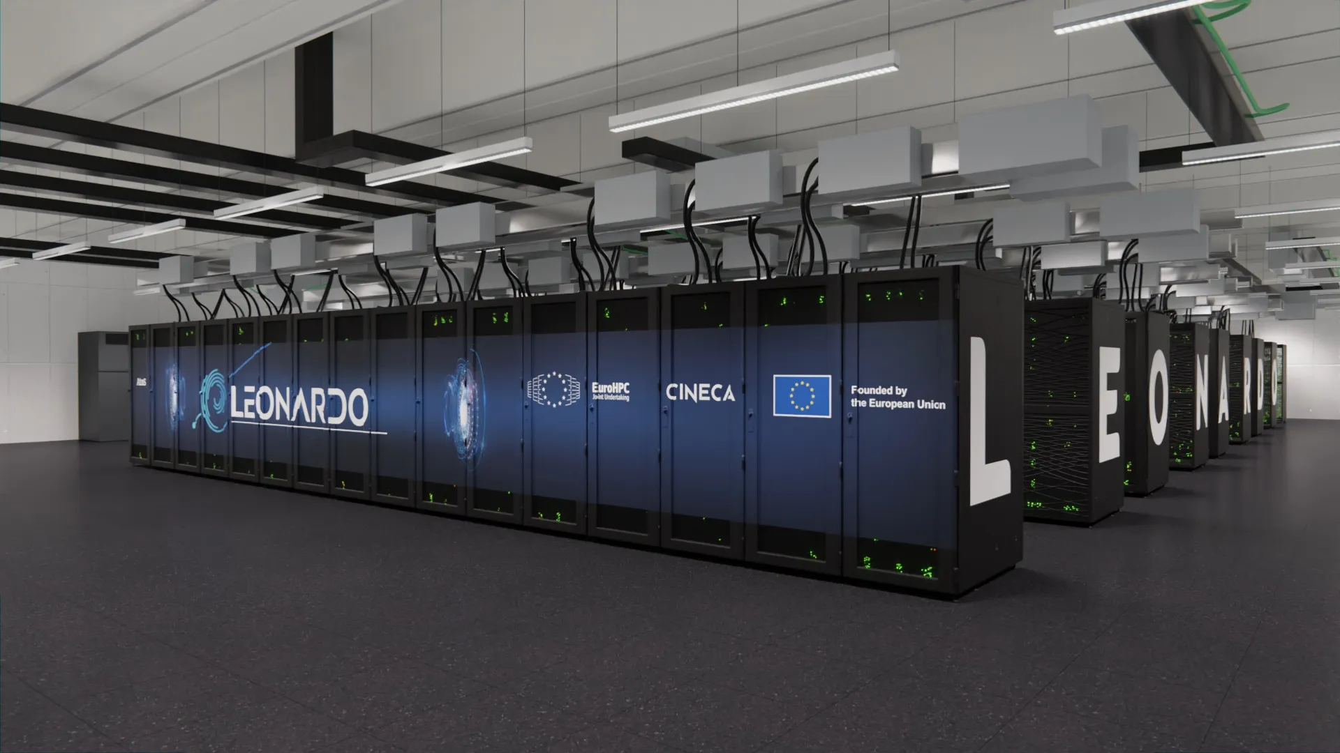
What is a cosmological simulation?
380.000 years after the Big Bang
Present-day Universe 13.5 billion years after the Big Bang

Slide 4
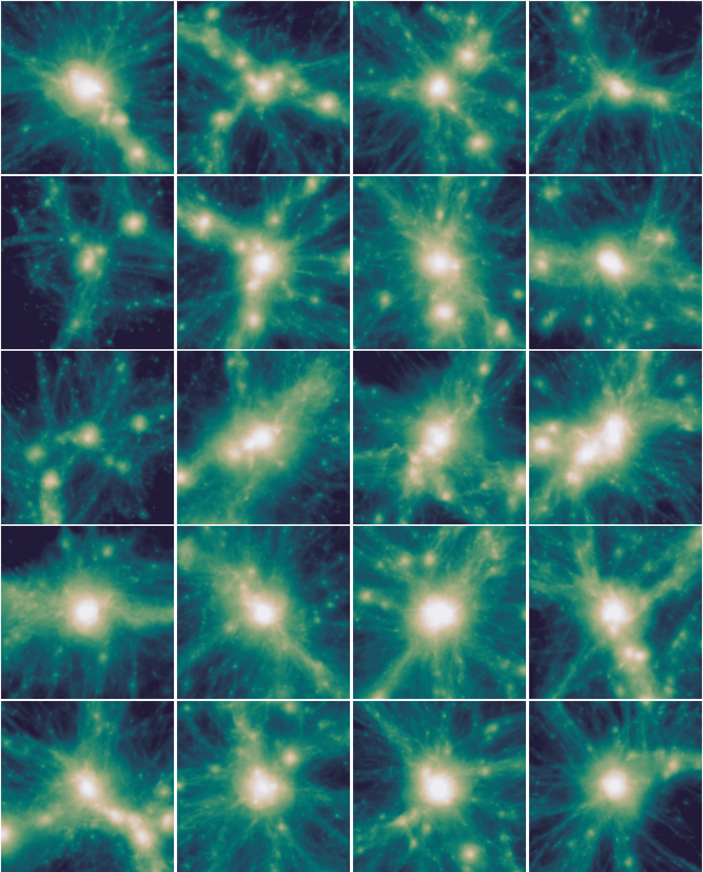
What is a N-body + hydro code ?
Courtesy: A. Damiano
Example of OpenGADGET3 code (Dolag+26; Tornatore+26)
Collab. With USM/LMU - See talk by L. Tornatore
Gravity solver: TreeCode (short) + ParticleMesh (long)
Hydro solver:
to integrate fluid Euler Equations
1. Smoothed Particle Hydrodynamics
2. Meshless Finite Mass (MFM)
+ Higher-order kernels, “Wake-up” for time-step of gas particles, Time-dependent artificial viscosity, Artificial thermal diffusion, Plasma Effects
Additional (Astro)physics:
Radiative Cooling, Star Formation, SN feedback, Chemical enrichment, dust formation and evolution, SMBH evolution (spin, dynamical friction), AGN feedback (thermal and kinetic), non-equilibrium chemistry, MHD, cosmic rays + ….
Parallelism: Hybrid MPI/OpenMP/OpenACC

Slide 5
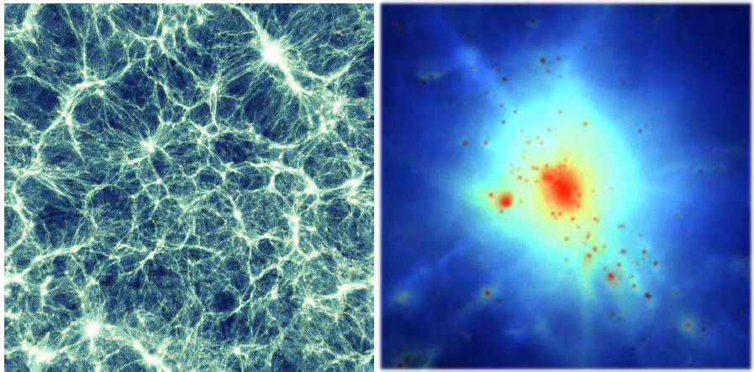
The first “big splash”
40 k CPU-h on IBM-Power4 @ CINECA ; First INAF-CINECA agreement for supercomputing resources
2 x 480³ DM + gas particles in a 192 h⁻¹ Mpc ; full physics
Back in 2003....
SB+04; Murante+05

Slide 6
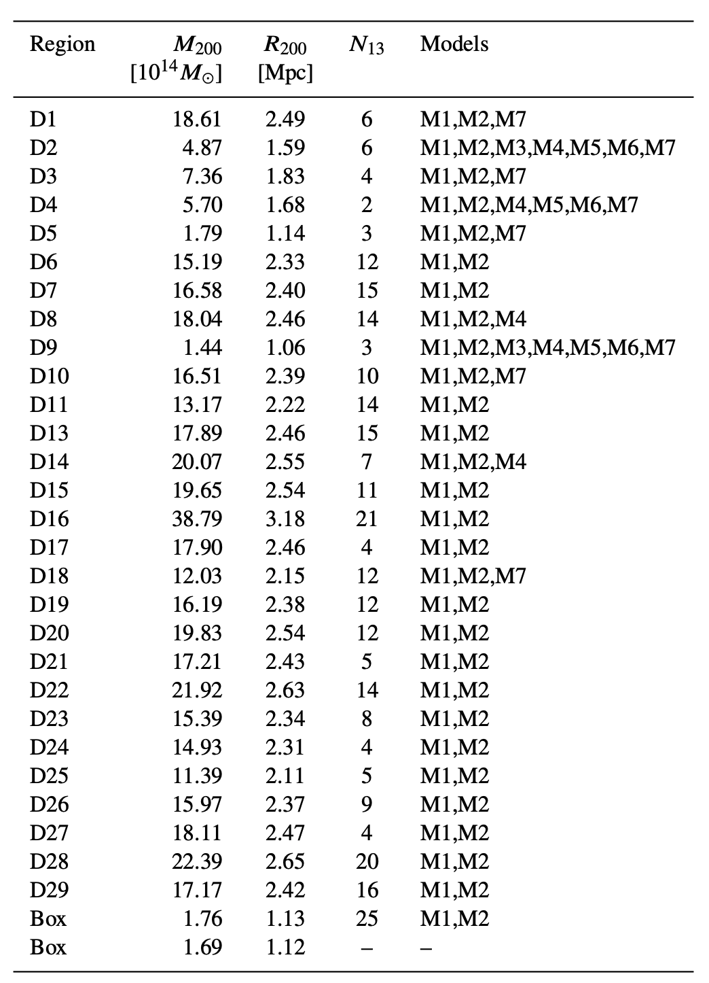
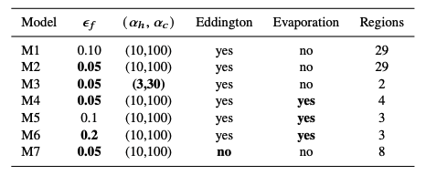
High-res simulations of galaxy clusters
A KSP supported by ICSC (Esposito+25; SB+26, Damiano+26, Rasia+26, …)
Changing the BH feedback efficiency 𝜀_{f}: fraction of BH radiated energy which is thermally coupled to the surrounding gas
Changing the ’’boost factor’’ by which Bondi accretion is multiplied for the cold and the hot accretions modes
Removing the Eddington limit
Allow BH feedback to evaporate the cold clouds in the multi-phase particles (see talk by A. Damiano)
➔ Total of 336 halos with M₂₀₀>1.5x10¹³ M⦿ in a complete set
➔ Total of 78 regions simulated, with an average cost of
200 kcore/h per region

Slide 7
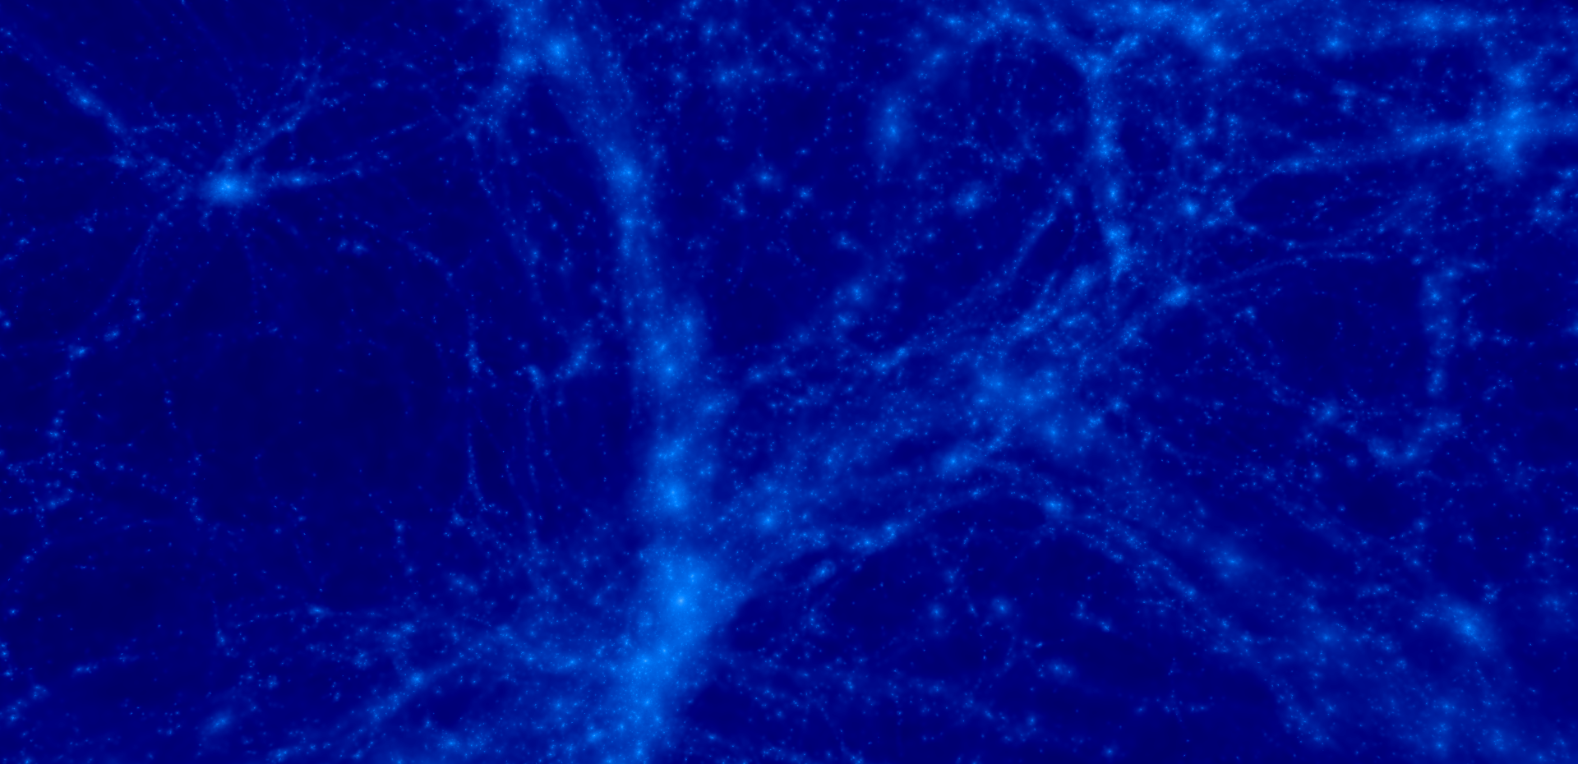
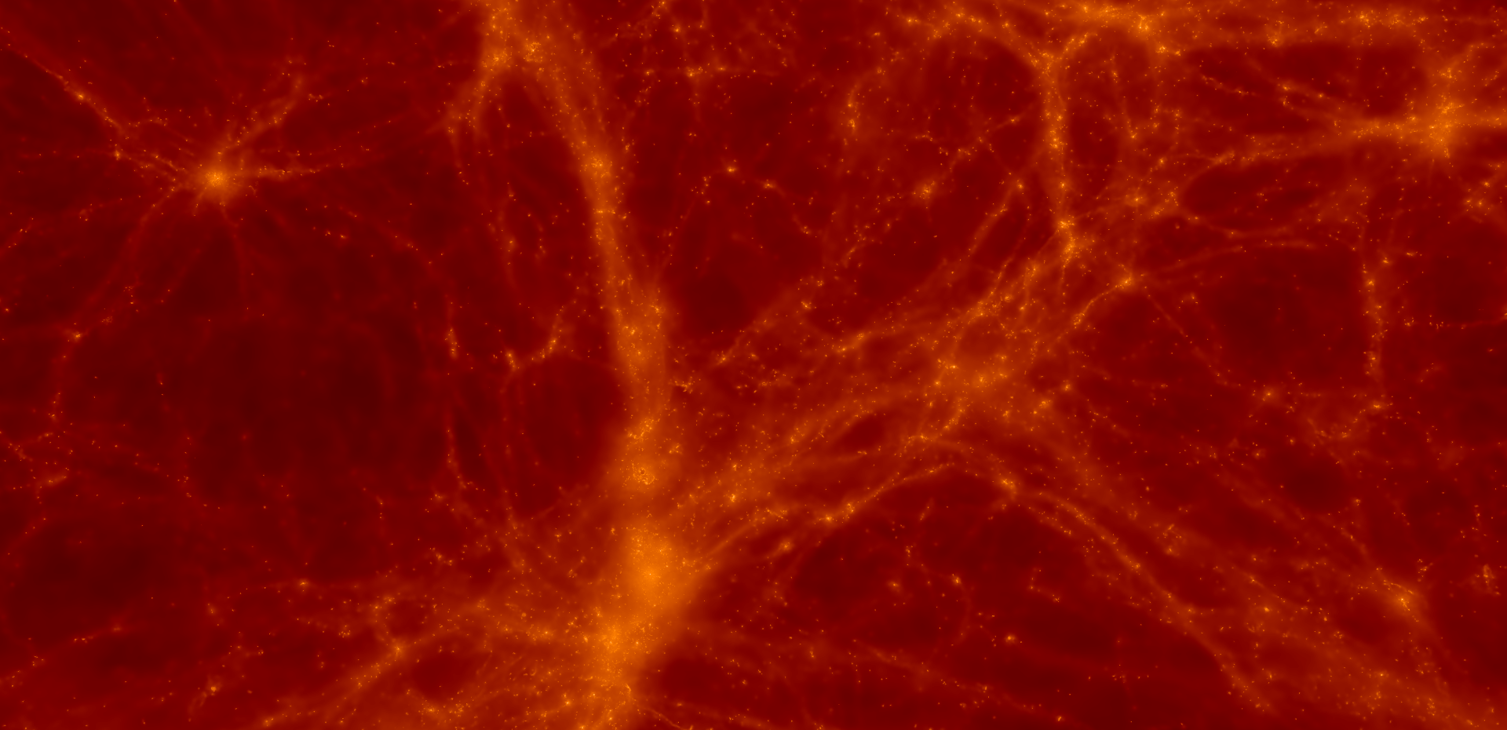
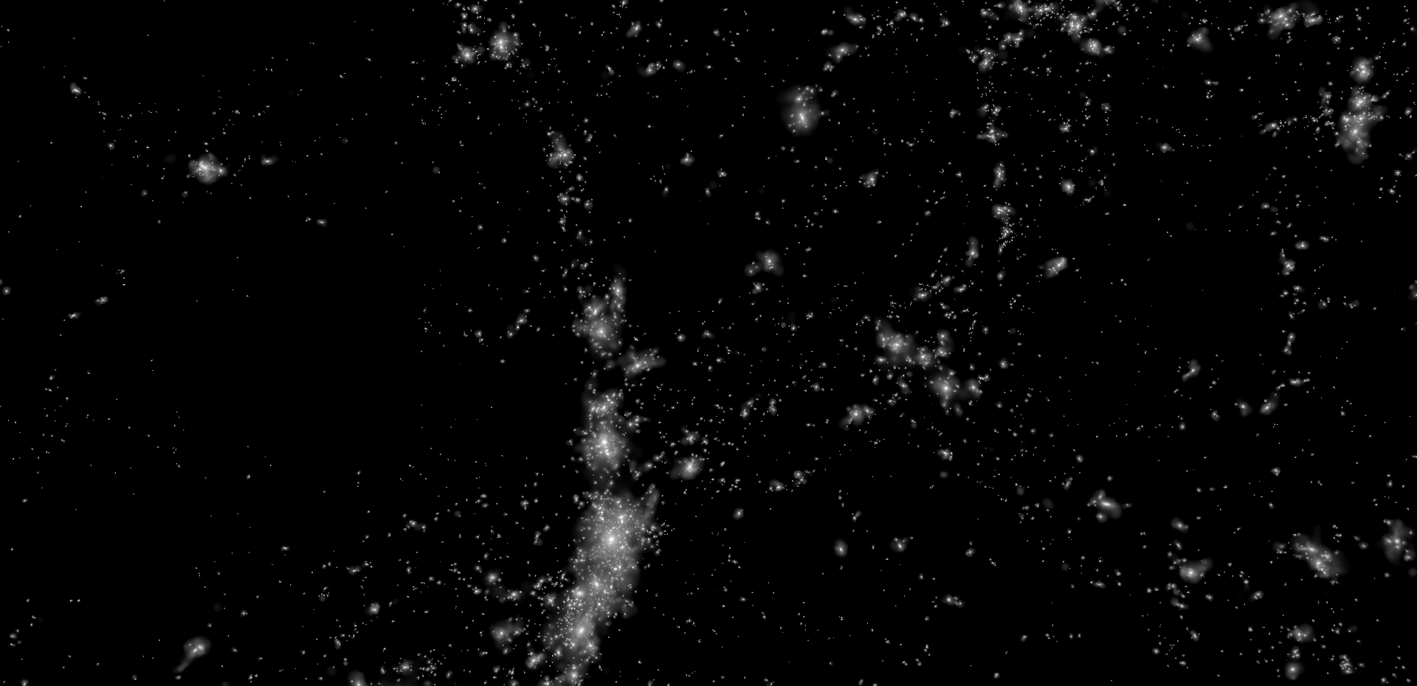
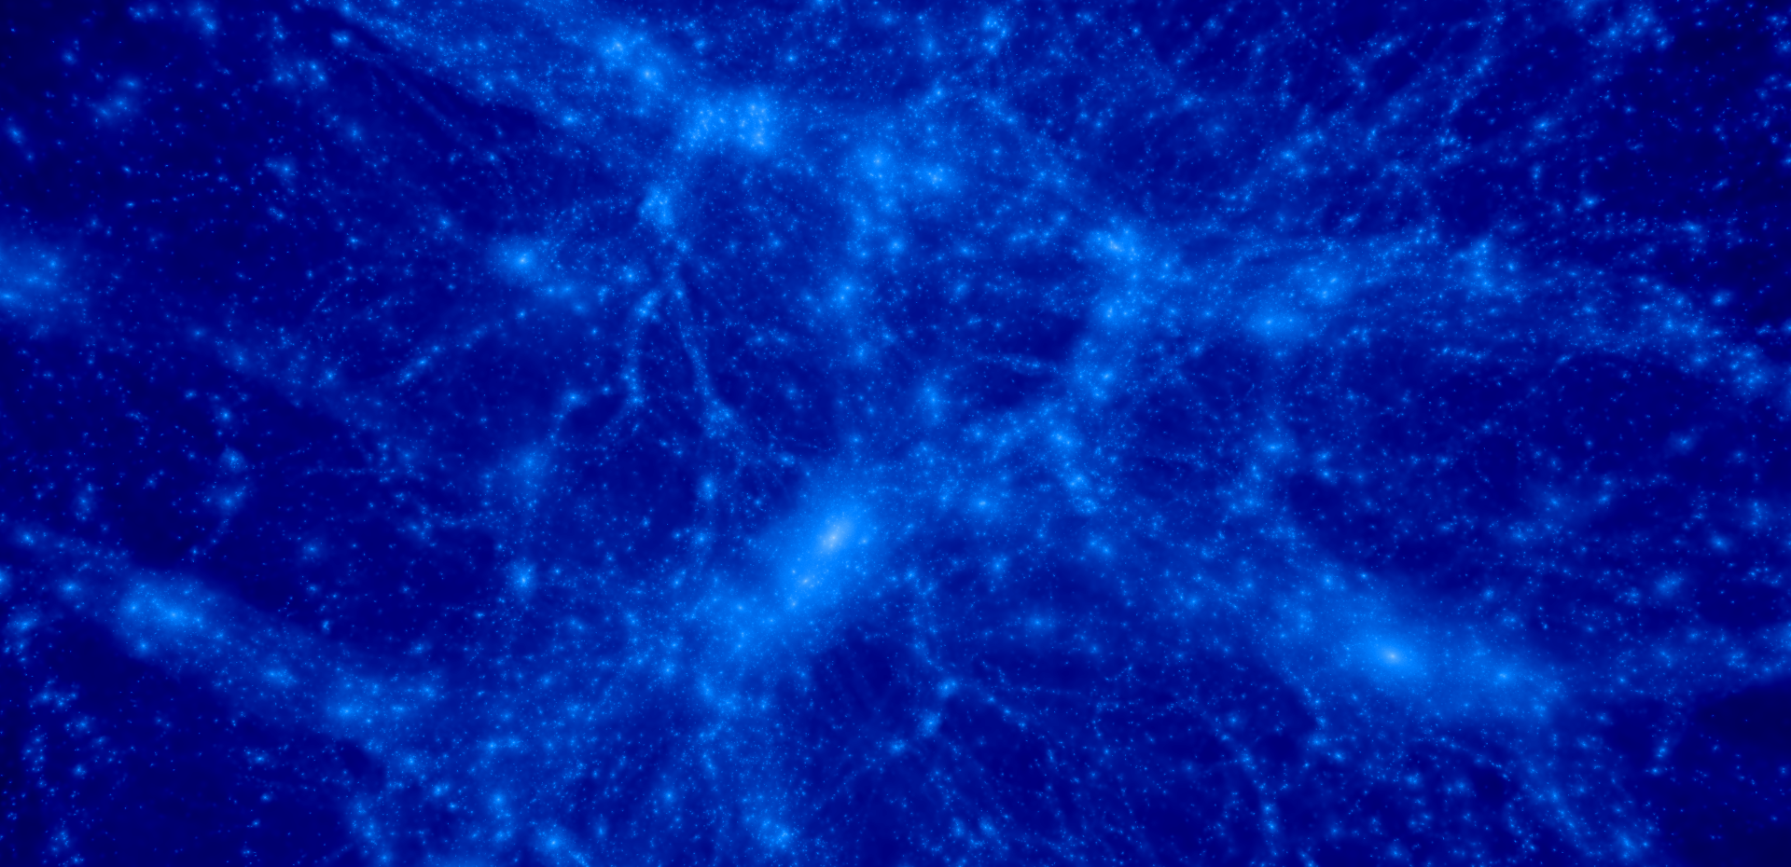
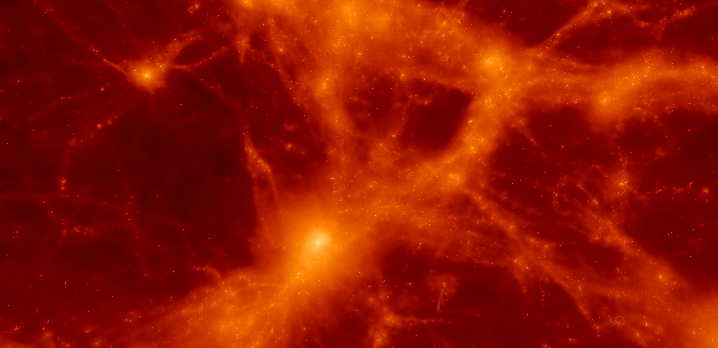
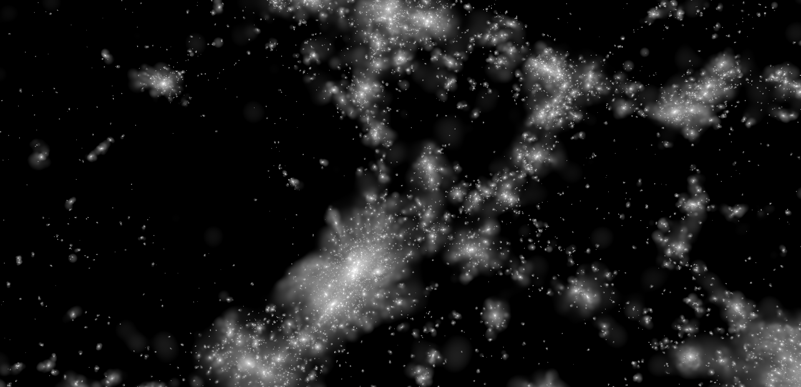
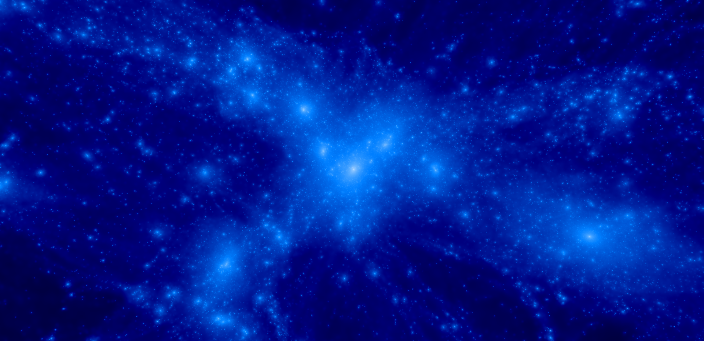
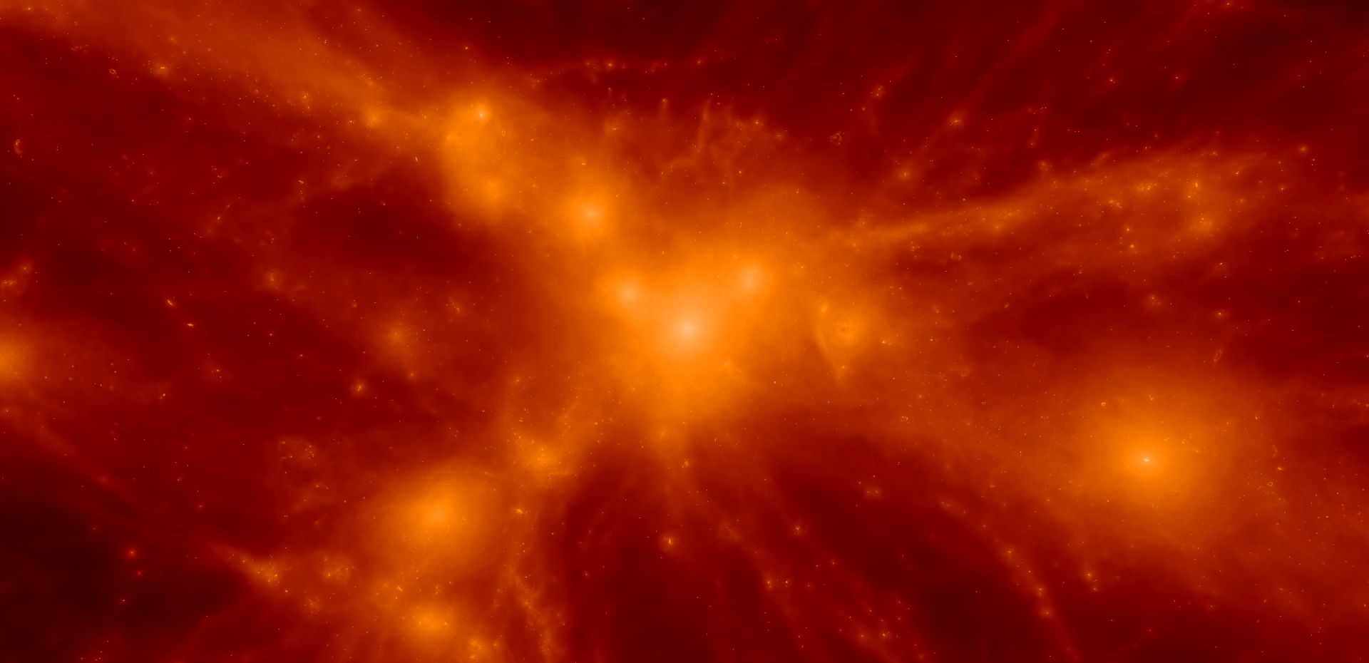
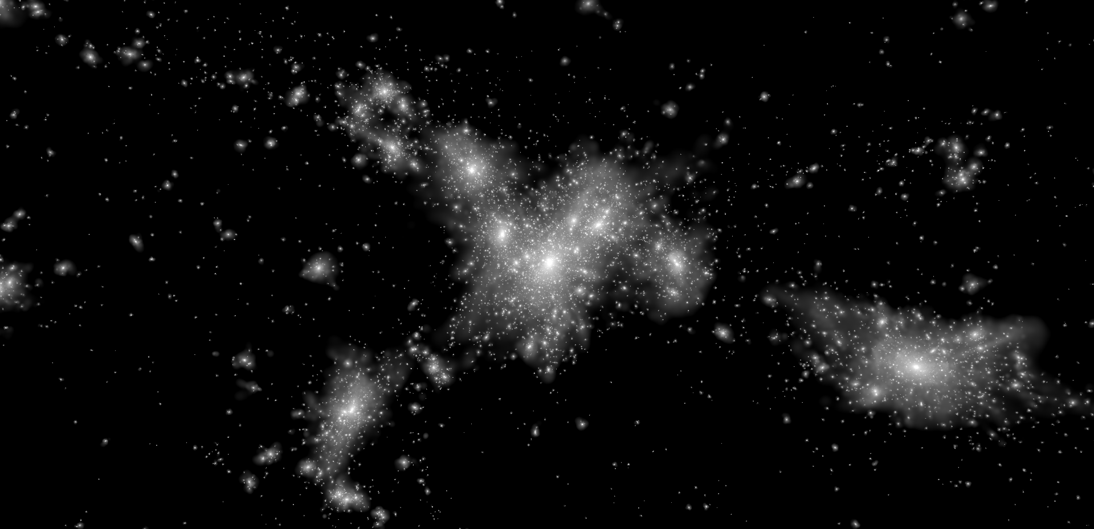
Dianoga Simulations
DM
GAS
STARS
z=2
z=2
z=2
z=1
z=1
z=1
z=0
z=0
z=0

Slide 8
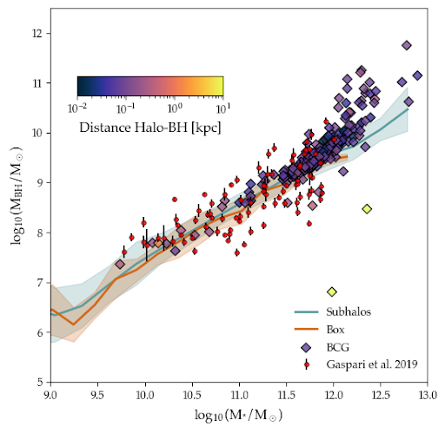
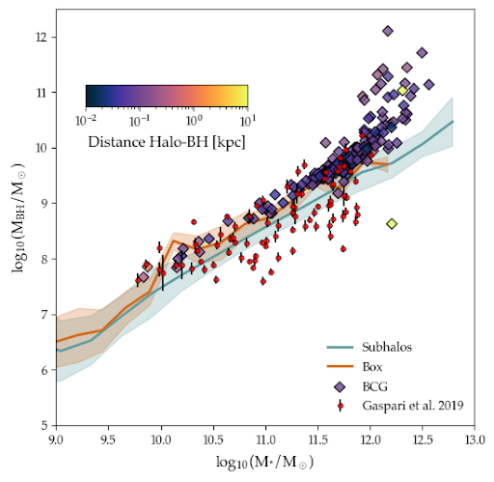
Tuning a model of AGN feedback
(SB+2026; Damiano+2026)
➔ Adjust the parameters of feedback to reproduce the observed scaling between SMBH masses and host stellar masses
➔ Bulk of the BH population in a “main sequence”
➔ Overmassive BHs in the most massive BCGs
➔ Result of sporadic runaway accretion episodes
𝜀_{f} = 0.1
𝜀_{f} = 0.05

Slide 9
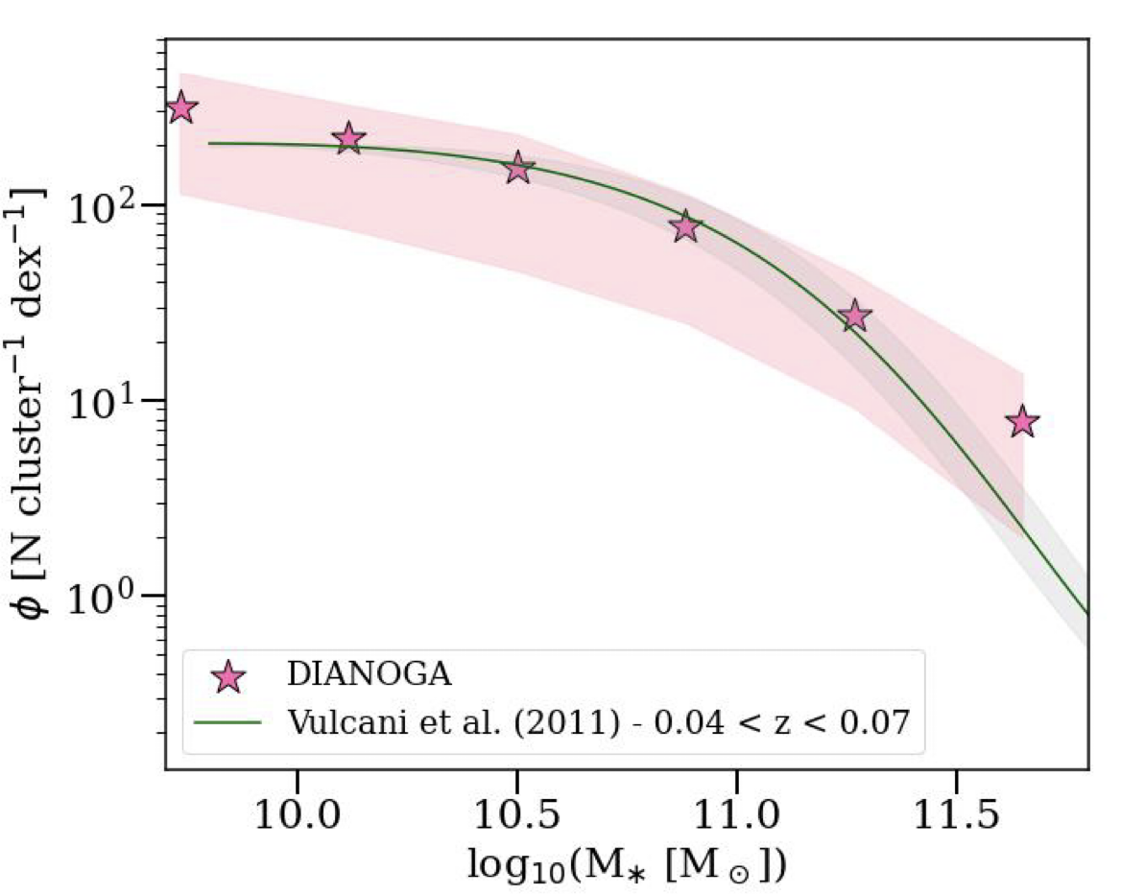
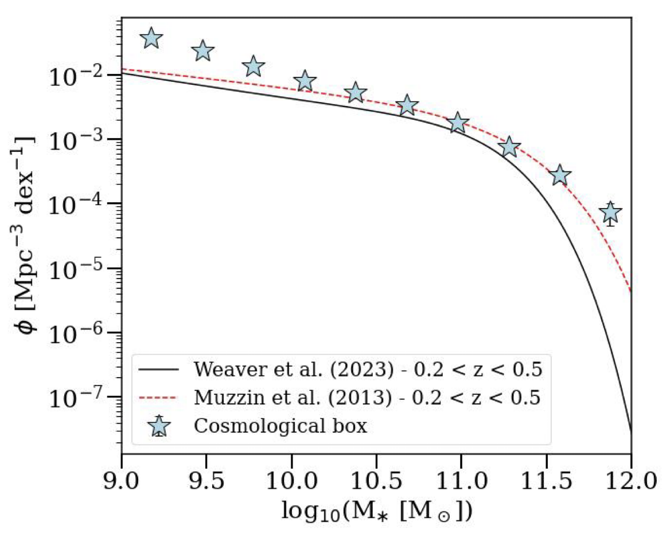
Tuning a model of AGN feedback
(Esposito+25 ; SB+26)
(Bassini et al. 2021)
➔ Predict the (almost) correct SMF of cluster galaxies in the field …
➔ …. and in clusters

Slide 10
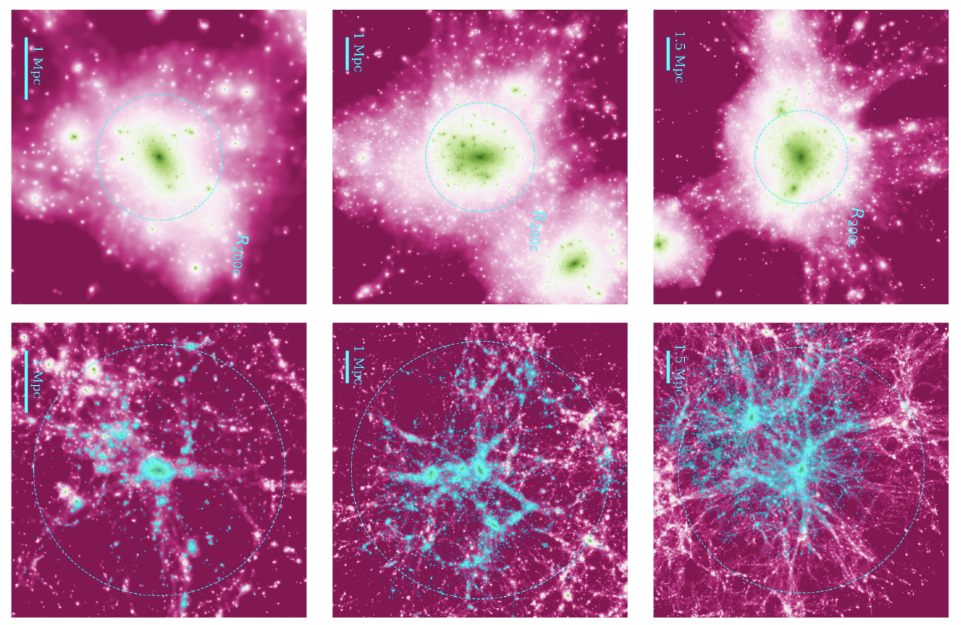
On the properties of simulated proto-clusters
➜ Clusters at z=0 and z=2.2 (Esposito et al. 2025; INAF PhD Fellowship)
M_{200c} = 2 x 10¹⁴ M☉
M_{200c} = 9 x 10¹⁴ M☉
M_{200c} = 2 x 10¹⁵ M☉

Slide 11
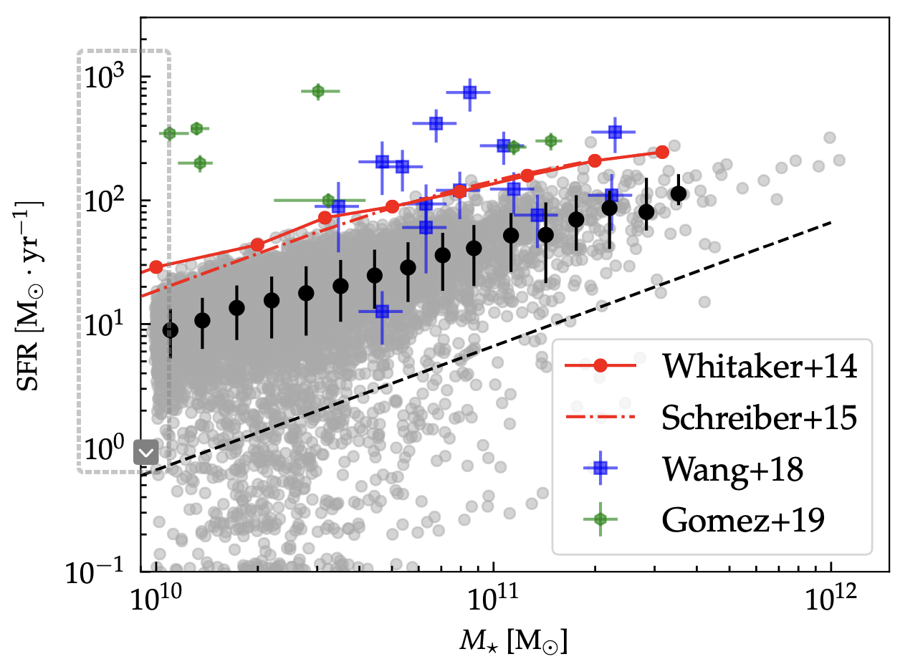
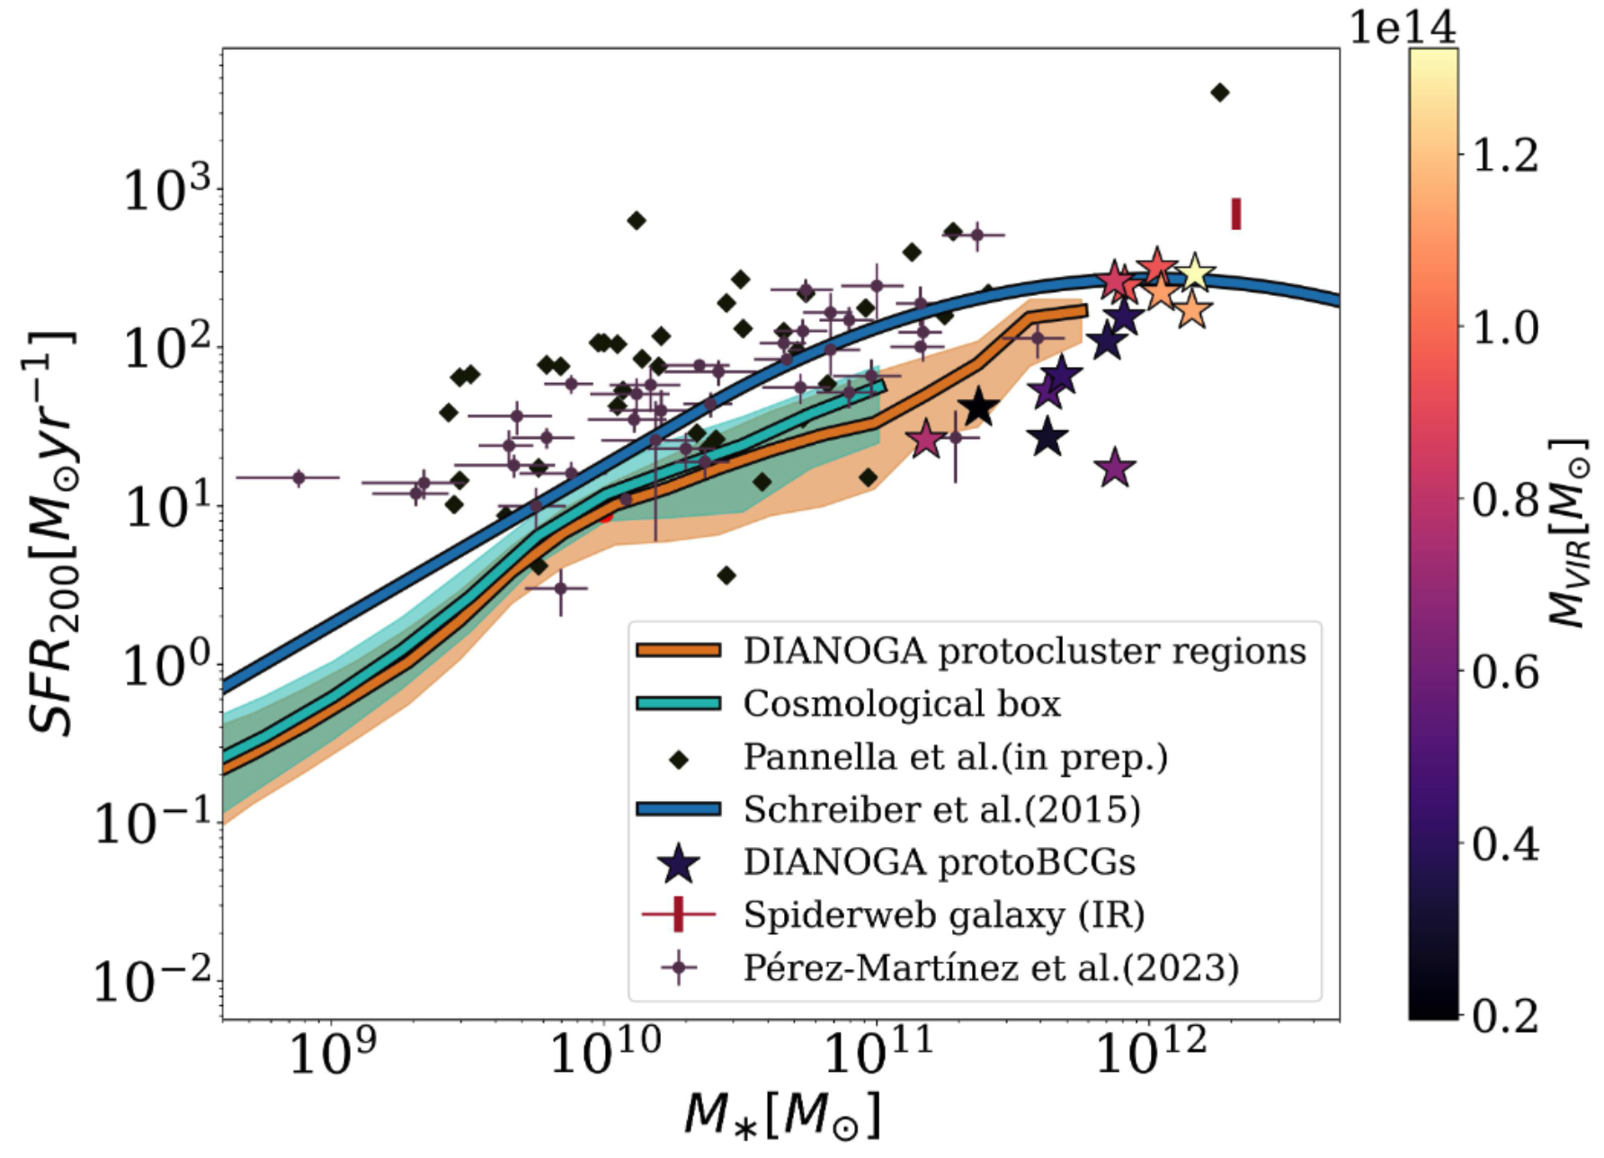
Star formation in proto-cluster regions
(Esposito et al. 2025) – INAF PhD Fellowship
➜ Model-prediction of the main sequence at z=2.2 below the observed one, both in the field and in protocluster
➜ Result almost independent of the adopted model of SF
➜ SFR of the Spiderweb much reduced when including FIR data (Seymour+2012; Drouart+2014), besides UV dust-corrected fluxes (Pannella+ 2026, in prep)
➜ ’’Only’’ a factor 2-3 above simulation predictions
Notes:
BASSINI+2020: Star formation rate as a function of galaxy stellar mass at z 2:3. Red solid and dashed lines are observational data from Whitaker et al. (2014) and Schreiber et al. (2015), respectively. Green hexagons and blue squares are galaxies from the protoclusters of Gómez-Guijarro et al. (2019) and the cluster of Wang et al. (2018), respectively. Grey points are galaxies in our simulations. Black dashed line fix the distinction between active and passive galaxies (Pacifici et al. 2016). Black points represent median values of star forming galaxies with 16th and 84th percentiles. Both SFRs and stellar masses are computed considering a 3D aperture of 30 pkpc.

Slide 12
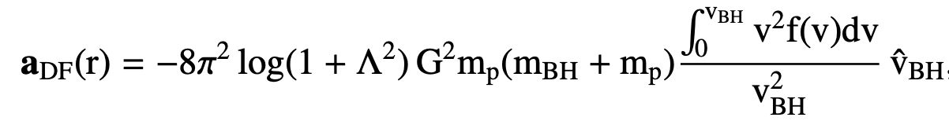
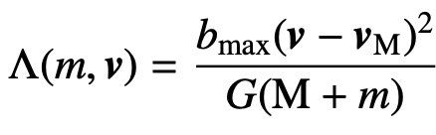
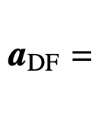
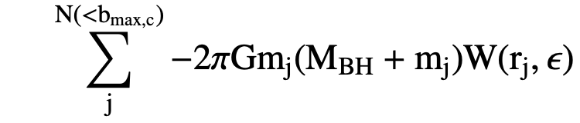
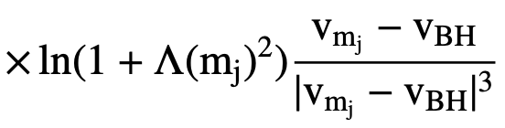
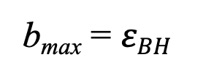
Unresolved dynamical friction & BH orbits
Damiano+2024, 2025 (ICSC PhD Fellowship)
➔ Correct for the unresolved DF by accounting for the individual contributions of neighboring particles (i.e. within softening) to the force acting on the BH.
Binney & Tremaine say:
b_{max} = 𝜀$BH$
➔ Assuming that the phase-space density below within 𝜀$BH$ is approximated as a sum of the discrete contributions from neighbour particles
➔

Slide 13
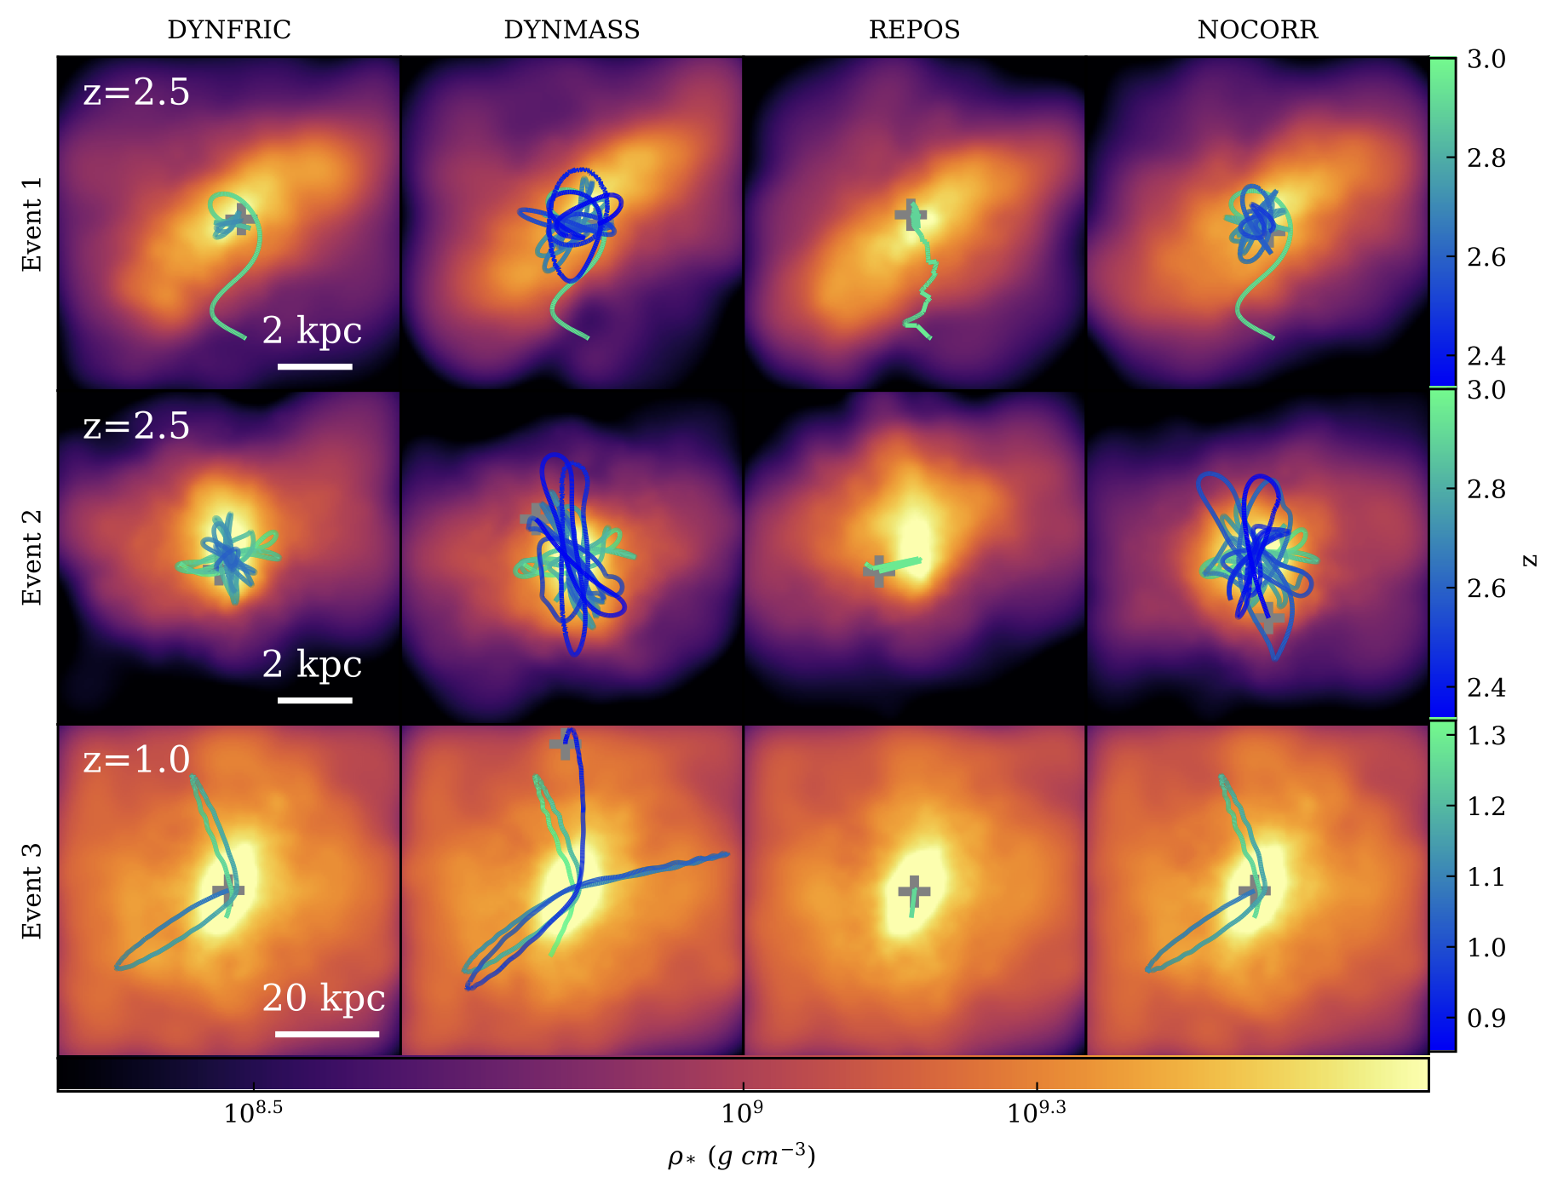
Unresolved dynamical friction & BH orbits
Alternative ad-hoc prescription:
Large dynamical mass: enhance by hand the BH dynamical mass at seeding to amplify the resolved DF
➔ Significant change in the local
potential
Continuous repositioning: at every time-step pin the BH on the local minumum of the potential
➔ Merging time-scales completely
wrong
➔ Significant implications for the
MBH-MBH merger events (as GW
sources)
Damiano+2024, 2025a,b - ICSC PhD Fellowship

Slide 14
Simulations based on approximate methods
(a) Lagrangian Perturbation Theory:
displacements are computed only once in
Lagrangian coordinates (1 time-step)
e.g. PeakPatch (Bond & Myers 1996)
Pinocchio (Monaco+2002)
(b) Approximate Particle-Mesh N-body (or
augmented LPT) solvers
➔ Unlike PM, maintain large-scale accuracy
with few tens of time-steps
e.g. COLA (Tassev+2003)
FastPM (Feng+2016)
➔ Much faster than N-body
➔ Not suited to follow explicitly
non-linear evolution of
perturbations
➔ Well suited to describe halo
distributions at large scales
Applications:
Fast generation of mocks and PLCs
Measurements of cosmic (co-) variances

Slide 15

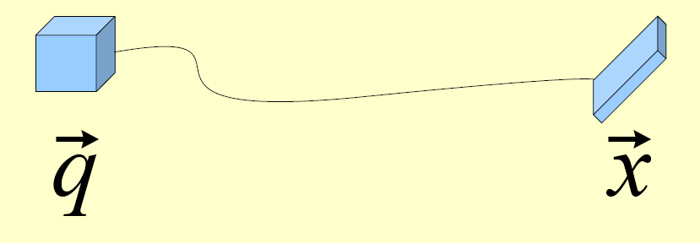
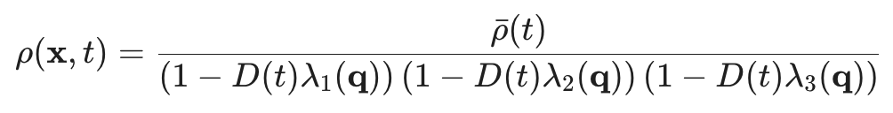

How does Pinocchio work ?
(Monaco+2002, 2013; Munari+2017)
Generation of a linear density field on a regular grid
Computation of collapse time (FMAX) using an ellipsoidal model based on LPT
Fragmentation of the collapsed medium for halo identification
Creation of halo catalogs (box and light cones) moving halos with 3LPT
NGenIC code
FFTs + custom solver
Custom algorithm
Courtesy M. Lepinzan
ICSC Italian Research Center on High-Performance Computing, Big Data and Quantum Computing
Missione 4 • Istruzione e Ricerca
Notes:
Template e guide lines

Slide 16
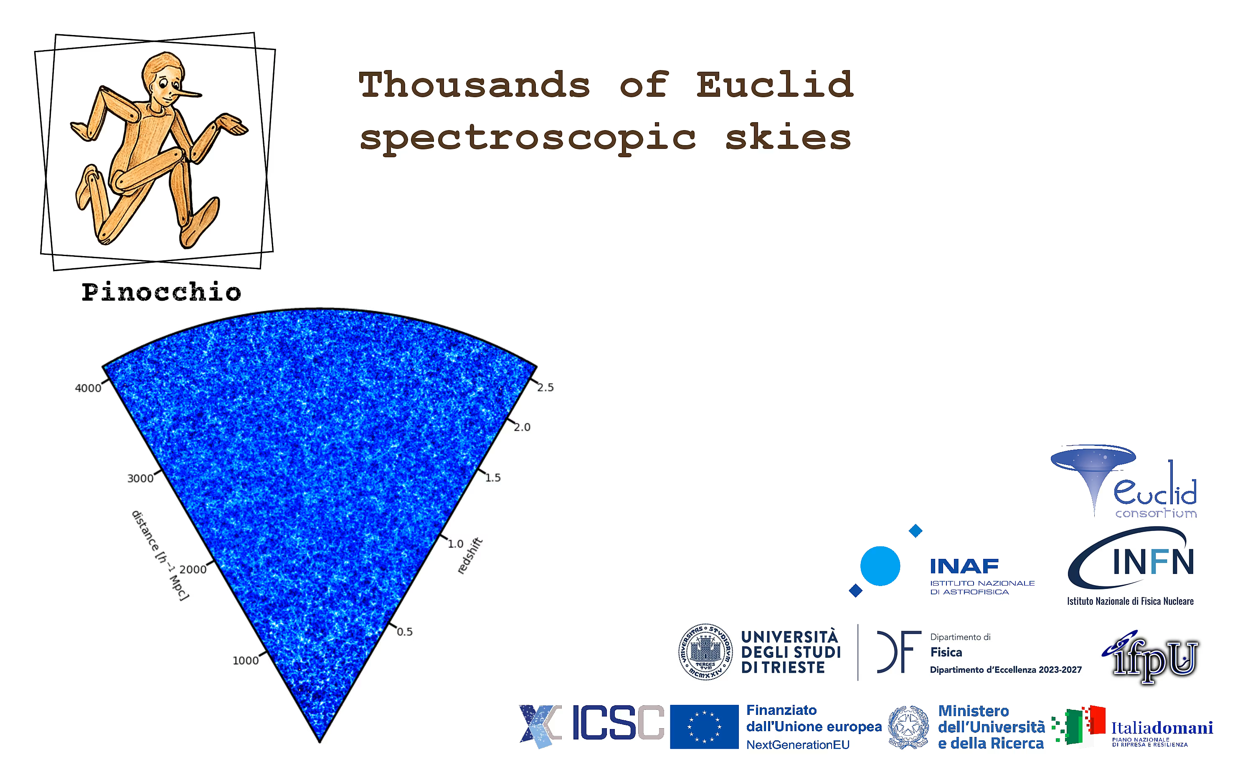
Courtesy P. Monaco

Slide 17
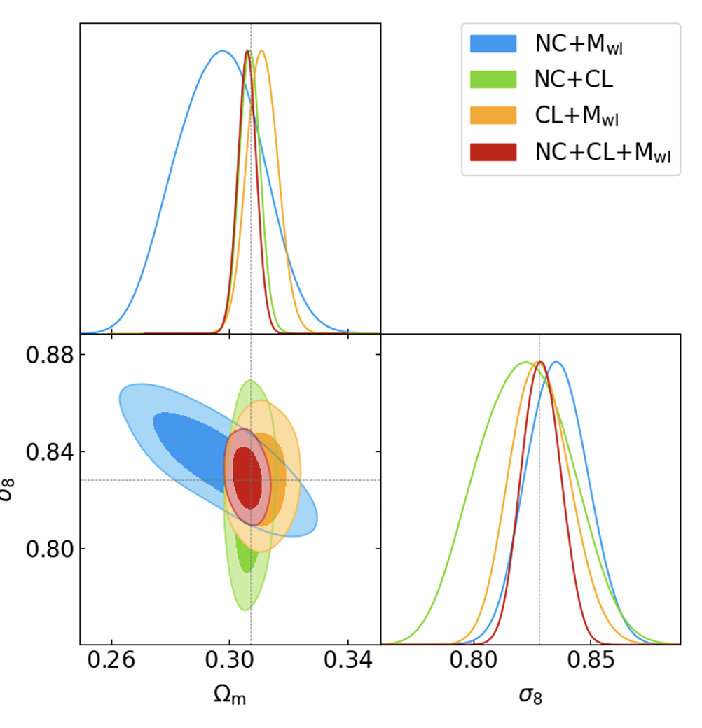
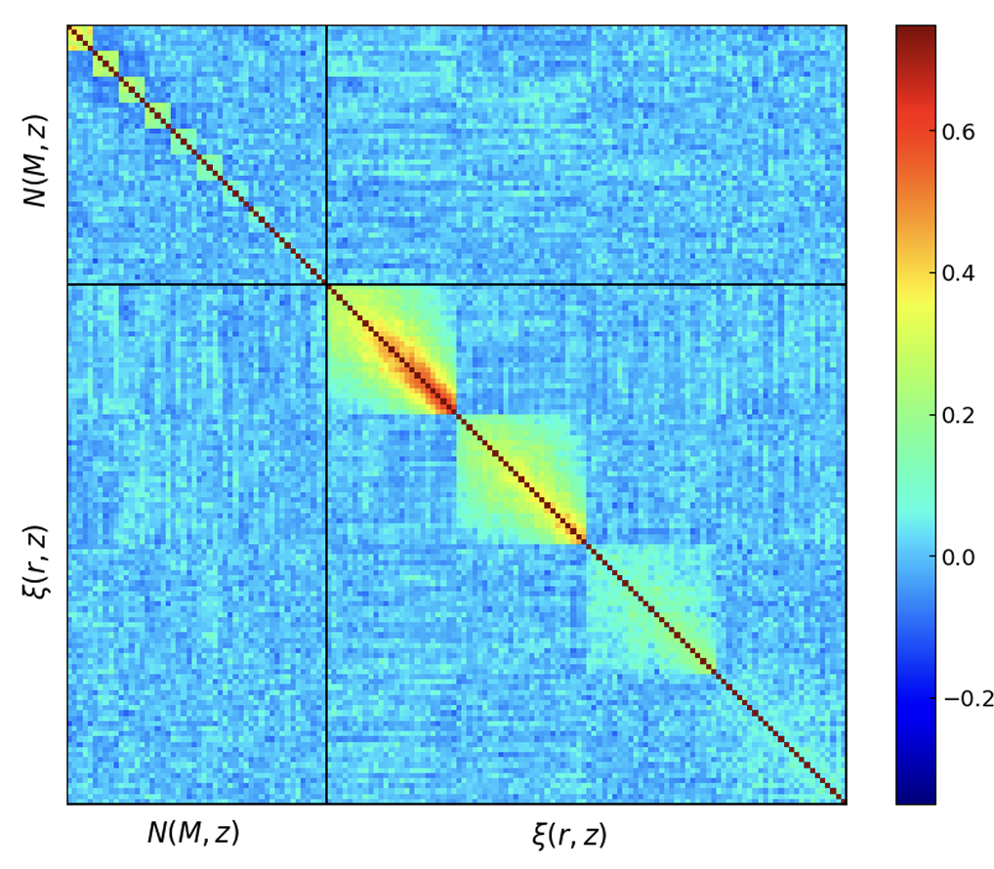
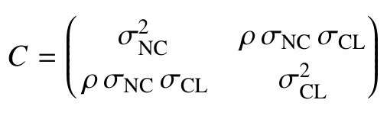

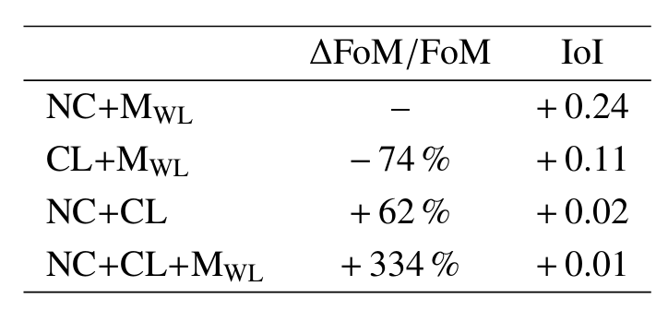
Joint Covariance of Cluster Counts and 2PCF
(Euclid: Fumagalli+2025b)
➔ Covariance matrix from 1000 60° wide PLCs
extracted from boxes L = 3870 h⁻¹ Mpc
➔ Combination of number counts and 2ptCF:
impact on cosmological posteriors
➔ Counts and clustering are two independent
probes
➔ Combining counts and clustering increases the
FoM by about 300% with respect to counts
alone

Slide 18
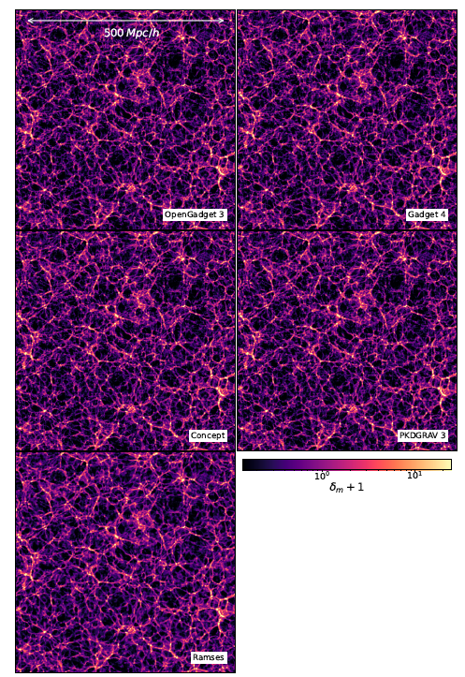
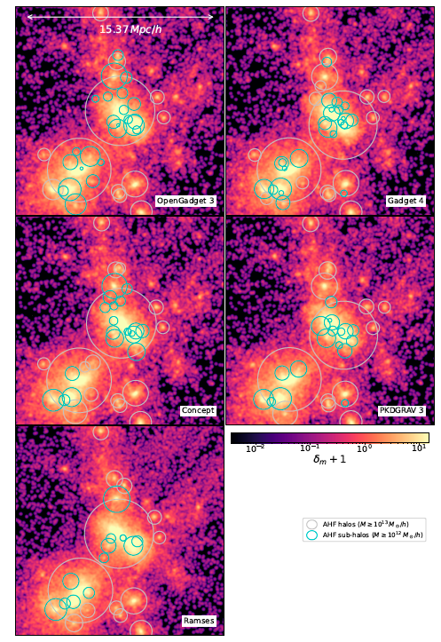
N-BODY - Euclid: robusteness of HMF calibration
(Euclid: Castro+2023; PRIN-PNRR TD at INAF – PI: UniTS)
➜ Robustness of the HMF calibration against:
Choice of the N-body code
Accuracy of integration within a given N-body code
Mass and force resolution
Halo/sub-halo finder
Initial conditions: LPT order and z_{in}
Chaos and ’’Butterfly Effect’’
➜ To verify to what precision a universal HMF fitting
can be provided:
Scale-free initial conditions
Cosmological power spectra
➜ Alternative approach: calibrate an emulator (e.g.
McClintok+2019; Bocquet+2020; Chen & Yu 2025)

Slide 19
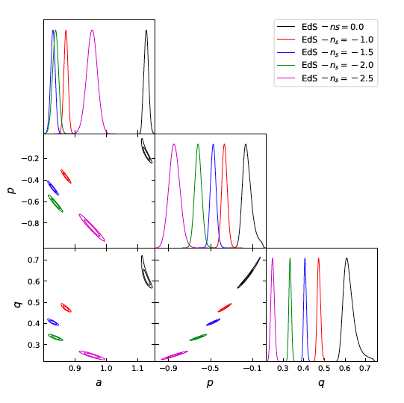
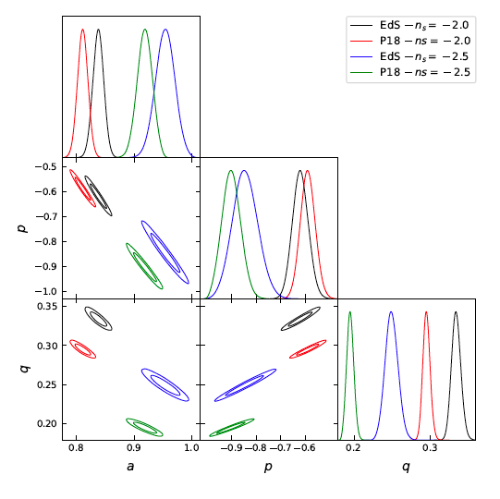


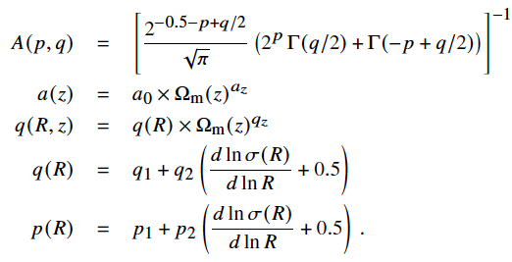
Toward a Universal HMF
Effect of expansion
Effect of P(k) shape
(Euclid: Castro+2023)
From Bhattacharya+2011:
ST99; D16
➜ Use AETHIOLOGY to calibrate the dependence
on redshift and P(k) shape of a(z), p(R), q(R,z)
Notes:
1° fig
2° fig:

Slide 20
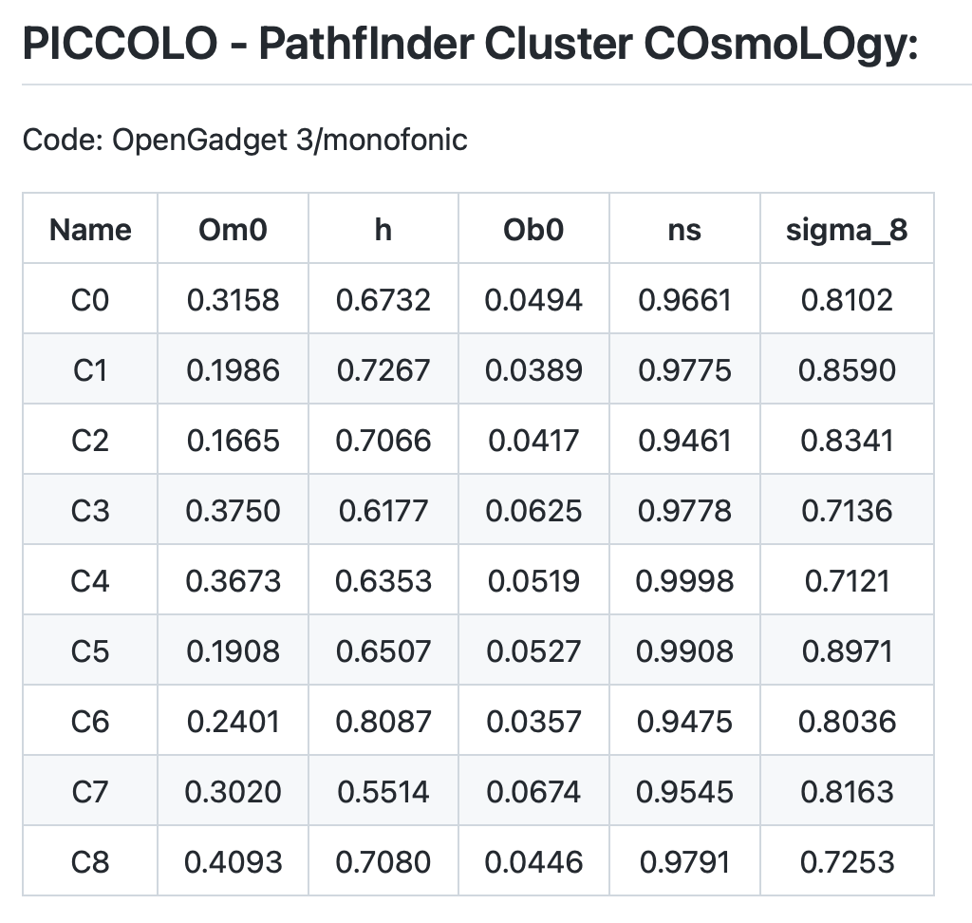
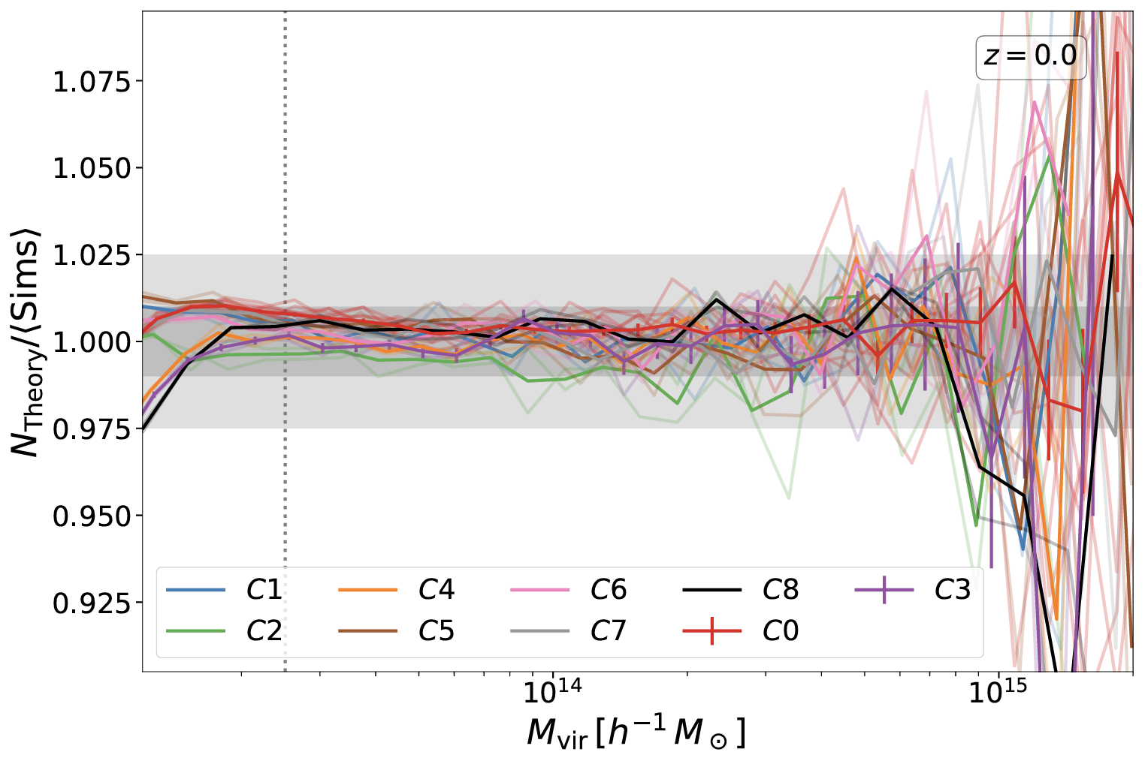
N-BODY - Euclid: A 1% precise HMF
(Euclid: Castro+2023; PRIN-PNRR TD at INAF – PI: UniTS)
L=2 h⁻¹Gpc ; N_{p}=2048³
10 realizations for C0, 2 for the other models
Notes:
1° fig
2° fig:

Slide 21
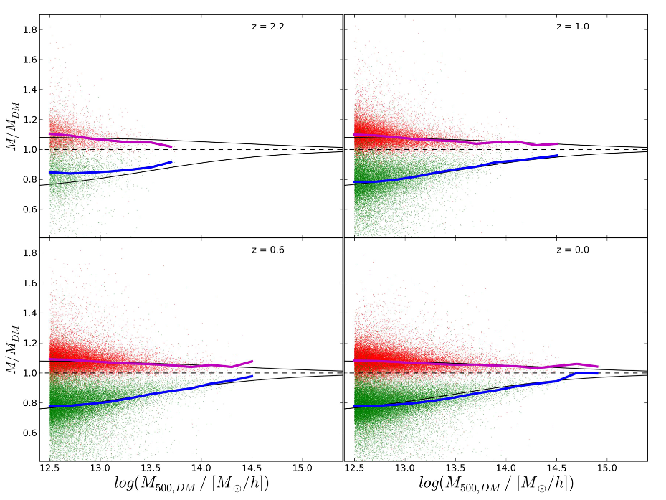
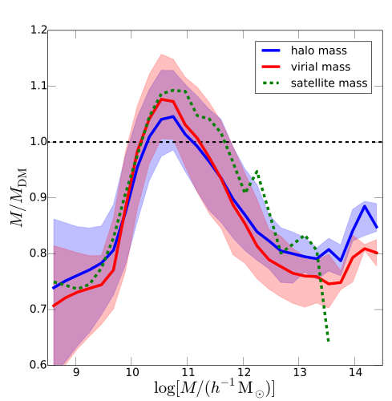




Impact of baryons on the HMF
Cui+2014: Gadget-3
Vogelsberger+14 : AREPO
Schaller+14: GADGET-3 (Eagle)
Martizzi+14 : RAMSES
Velliscig+14 : GADGET-3 (OWLS)
Bocquet+16 : GADGET-3 (Magneticum)
Notes:
SLIDE MODIFICATA!!!!!

Slide 22

HYDRO - Euclid: Impact of baryons on the HMF
Q: How do we know the baryonic correction to
be applied to observed cluster masses?
Castro+2021; Castro+2024
Based on the Magneticum Simulations (Dolag+2025)
➜ 5-10% reduction of halo masses induced by the
effect of baryons (see also Cui+2015;
Velliscig+2016; Bouquet+2016; ….)
➜ Effect slightly larger at lower redshift
➜ Mass reduction inversely correlated with the
baryon fraction
Notes:
1° fig: Scatter plot of the ratio of masses M200c of matched halos identified in the Hydro and DMO version of Box 2, as a function of M200c for the Hydro simulation, at three different red- shifts. The color code is for the ratio between the baryon fraction of each single halo within R200c and the median baryon fraction for halos of the same mass. The solid red curves mark the median value of the mass ration, with the red-shaded regions encompass- ing the 16th-84th percentiles. The solid vertical line denotes the Box 2 minimum halo mass cut presented in Table 1. Halos in the two simulations have been matched selecting the pairs that are closest to each other.
2° fig: Number density of halos per log-interval of halo mass as a function of the halo mass in our simulations, at different redshifts (as reported in the legend). The top and bottom panels show results at ∆ = 200m and 200c, respectively. Solid (dotted) lines are the best-fit for the Hydro (DMO) runs. For the sake of a better readability alternate results for mass bins of the Hydro (points) and DMO (crosses) simulations.

Slide 23

Efficient GW transient detections (LVK Coll. - Spoke-2 at DF)
Unmodeled methods like coherent WaveBurst (cWB) are used to detect generic gravitational-wave transients (GWT), but they can also be applied to well-modeled GW signals such as those originating from compact binary coalescences (CBC). Overall, our project aimed at improving the efficiency of cWB.
What we achieved:
In-depth study of the wavelet-based part of cWB. We were able to greatly improve the performance of other methods of continuous wavelet inversion (see this paper and the related code). In the future, we plan to use this method to replace the current WDM-wavelet-based code in cWB.
We contributed to the development of the PycWB code, a Python+C++ version of the cWB C++ code which is modular and easily extensible. While the new code already achieves a better performance with respect to the older code, we are still working on GPU extensions of the code. The PycWB code is publicly available on this github repository.
Exploratory results on the use of symbolic regression applied to cWB data. In this part of the project we aim at performing symbolic regression on cWB waveform reconstructions of CBCs to obtain the relevant CBC parameters.
Performance of the Qp transform and of the standard Q transform on GW150914 data, plus comparison between a PE reconstruction and the Qp reconstruction.
Courtesy: E. Milotti
Notes:
In LVK ci sono due tipi principali di analisi dei transienti gravitazionali, le analisi Bayesiane basate su modelli teorici delle forme d’onda e le analisi generiche basate sulla presenza di eccesso di energia coerente su più rivelatori (non basate su modelli). cWB è la pipeline unmodeled più importante, quella che tra l’altro è stata la prima ad osservare GW150914 (il primo segnale gravitazionale). Nello studio su wavelets continue abbiamo trovato un metodo per rendere la rappresentazione wavelet meno sparsa (energia concentrata in meno pixel e quindi migliorando il rapporto segnale/rumore); PycWB rappresenta un progresso significativo per la modularità, portabilità, efficienza e comprensione dei metodi utilizzati; la regressione simbolica è una metodologia che cerca automaticamente espressioni analitiche adatte a modellare i dati (e quindi consente di costruire “al volo” modelli fenomenologici dei dati).

Slide 24


Vertex reconstruction at LHC (CMS Collab. - Spoke-2 at DF)
Courtesy: E. Milotti
The number of reconstructed vertices as a function of the number of pile-up (PU) vertices for real and fake vertices
MIP Timing Detector (MTD) : 4D vertex reconstruction with Graph Neural Networks.
The reconstruction of interaction vertices in High Energy Physics (HEP) experiments is a very demanding task. The association of the large outflow of outgoing particles to produce a sensible output turns out to be a combinatorial task, which is particularly difficult to solve in the presence of event pile-up.
Here, we use timing information with 30 – 40 ps resolution from MTD to separate vertices that overlap in space. This is shorter than the typical time spread of pp collisions (180 – 200 ps).
Real Vertices
Our 4D vertexing algorithm shows significant improvement in separating close by vertices, see CMS-DP-2024-085
However, incorporating Machine Learning architectures for track clustering particularly under high pileup conditions, can further improve performance.
We use Graph Neural Network (GNNs) that are well-suited for track clustering and identifying track time/mass hypothesis.
Fake Vertices
Real Vertices
Fake Vertices
Notes:
L’analisi delle tracce in CMS e negli altri rivelatori con tracciamento in LHC è complicata dalla vicinanza in tempo delle collisioni e dal gran numero di collisioni contemporanee. La ricostruzione dei vertici di interazione va fatta identificando le particelle associate alle tracce, e dato che ci sono molte centinaia di tracce, il problema è combinatorio con molti vincoli (i 4-impulsi associati alle tracce ricostruite per un vertice devono obbedire alla conservazione del quadrimpulso, etc.). Il pile-up è rappresentato dal gran numero di vertici da ricostruire tutti insieme. In questa ricerca di CMS si usa HPC + ML per affrontare questo difficile problema di ricostruzione.

Slide 25


Materials simulations (Spoke 7 at DF)
ab-initio quantum mechanical calculations
(very accurate, for systems of limited size)
using
molecular dynamics with classical empirical potentials
(large scale, but not very accurate or transferable)
Example: Nitrogen molecule impinging on (pristine or defected) graphene-coated alumina.
Example: Molecular layer of cobalt tetra-pyridyl porphyrins on graphene: a) optimized model, b) electron density rearrangement due to graphene- molecular layer interaction c,d) experimental and e) simulated scanning tunnelling microscopy images.
simulations performed on the CINECA Leonardo supercomputer
Courtesy: M. Peressi
Notes:
Lo studio di materiali a livello atomistico si affronta tipicamente con due approcci complementari: 1) uno cosiddetto “ab-initio”, risolvendo numericamente equazioni basate sulla meccanica quantistica, che permette di trattare con risorse HPC sistemi dell’ordine max 10^3 atomi; 2) l’altro si basa su potenziali interatomici classici, è meno accurato ma utile per affrontare sistemi ben piu’ grandi e seguirli nella loro dinamica.

Slide 26

Machine learning approach for materials simulations (Spoke 7 at DF)
Courtesy: M. Peressi
bridging the gap between ab-initio methods and empirical potentials:
generation of NNIP (Neural-Network Interatomic Potentials) for large scale applications
trained through active learning on several small structures studied with ab-initio quantum mechanical simulations
AiiDA TrainsPot: AUTOMATED, OPEN-SOURCE, USER-FRIENDLY WORKFLOW developed in-house (https://arxiv.org/abs/2509.11703)
Example of HPC resources for NNIPs for transition metal dichalcogenides: dataset with ~7000 structures of ~102 atoms each one, obtained with 12 active learning cycle: total 11000 GPU hours (~84% for ab-initio calculations) including:
∼ 1.2 GPU hours for each ab-initio calculation
∼ 25 GPU hours for training
∼ 0.1 GPU hours for molecular dynamics
Simulations performed on the CINECA Leonardo supercomputer
Notes:
Negli ultimi anni una terza via è emersa, grazie a sviluppi di algoritmi e a risorse di calcolo piu’ potenti: generare potenziali interatomici che possono essere usati con la dinamica molecolare classica, ma sono ben piu’ accurati perchè “istruiti” (con tecniche di machine learning e reti neurali) su tanti calcoli su sistemi piu’ piccoli affrontati con la meccanica quantistica. La figura mostra il workflow messo a punto e reso pubblico dal gruppo di ricerca UniTS+SISSA all’interno di Spoke 7 e IG collegati.

Slide 27

Theoretical & Computational Chemistry (Spoke-7 at DSCF)
Courtesy: M. Stener

Slide 28

Molecular Biology and Nanotechnology Lab (Spoke-7 at DIA)
Courtesy: M. Stener

Slide 29

Bora HPC cluster @ DF-UniTS
Courtesy: D. Coslovich
Bora is the HPC cluster of the Department of Physics (DF) at the University of Trieste
Funded by the Department of Excellence grant of the MUR (2023-2027)
Hybrid and extensible computing infrastructure:
  CPU, FAT and GPU nodes
  216 cores, 2.3TB RAM, 100 Tb HD, 2 x A30 + upcoming extension
Suitable for
  development/test of software before large-scale deployment
  familiarizing students with an HPC environment
  small-scale projects by students and young researchers @DF
Contacts:
D. Coslovich, M. Costanzi, G. Principe

Slide 30

AI and HPC education @ UniTS
Courtesy: L. Bortolussi
~100 freshers/yr
~50 freshers/yr
~15 freshers/yr

Slide 31
Programmatics & take-home messages
DF-UniTS & INAF-OATs: an established tradition of collaboration in Computational Astrophysics
    Solid scientific collaborations
    Coordinated participation to funding projects: EU (e.g. Euro-HPC) and national (ICSC, PRIN)
    PhD-level training: co-supervision and co-funding of PhD fellowships
    Training at undergrad level: co-supervision of student, teaching, mentoring, tutoring
UniTS & INAF: A virtuous example of mutual benefit (not only in HPC & Big Data)
    Access to computing infrastructures and data-storage facilities
    Training of a next generation scientists and technologists expert in HPC & Big Data
    ➜ not optional for the future of astrophysics and for a high-profile role of INAF in one of the most strategic directions of societal and economic development
    Possibility to collaborate on the definition of strategies and priorities for education and training

Slide 32

Programmatics & take-home messages
DF-UniTS @ INAF-OATs: well-established tradition of collaboration in Computational Astrophysics
    Solid scientific collaborations
    Coordinated participation to funding projects (EU and national)
    PhD-level training: co-supervision and co-funding of PhD fellowships
    Training at undergrad level: co-supervision of student, teaching, mentoring, tutoring, ….
UniTS & INAF: A virtuous example of mutual benefit from full synergy (not only in HPC & Big Data)
    Access to computing infrastructures and data-storage facilities
    Training of a next generation scientists and technologists expert in HPC & Big Data
    ➜ not optional for the future of astrophysics and for a high-profile role of INAF in one of the
    most strategic directions of societal and economic development
    Possibility to collaborate on the definition of strategies and priorities for education and training

