Slide 1

DevOps practises
within the Square Kilometre Array (SKA) software ecosystem
M. Di Carlo (OAAb) and SKA System team
USC-C General Assembly, Trieste, Savoia Excelsior Palace

Slide 2
Square Kilometre Array (SKA) Observatory (SKAO)
International scientific infrastructure
Two radio interferometers (South Africa & Australia)
Global Headquarters (UK)
Highly distributed teams
Complex software + hardware integration
Construction phase ending ~2027

Slide 3
Why DevOps in SKAO?
Challenges:
Distributed international teams
High reliability requirements
Continuous integration of multiple subsystems
Complex deployment environments
Need for reproducibility
Long lifecycle infrastructure
DevOps became necessary, not optional.

Slide 4
DevOps Architecture Overview
→ Containerization
→ GitLab and CI/CD Pipelines
→ Kubernetes Clusters
→ Monitoring & Logging Stack

Slide 5
Containerization
SKA == set of elements == a set software modules
For each module there is (at least) one repository
For each repository there is (at least) one container image (convenient way to package up applications and preconfigured server environments)
For security reason base images are provided (updated every 3 months)
Kubernetes (k8s) for container orchestration (kubernetes.io)
Helm for packaging SKA k8s applications (helm.sh)
  Tool for managing Kubernetes charts
  Chart is a the set of information for running a Kubernetes application
  A chart can have dependencies → integration charts
For each sub-system there must be an helm chart for running it in k8s

Slide 6
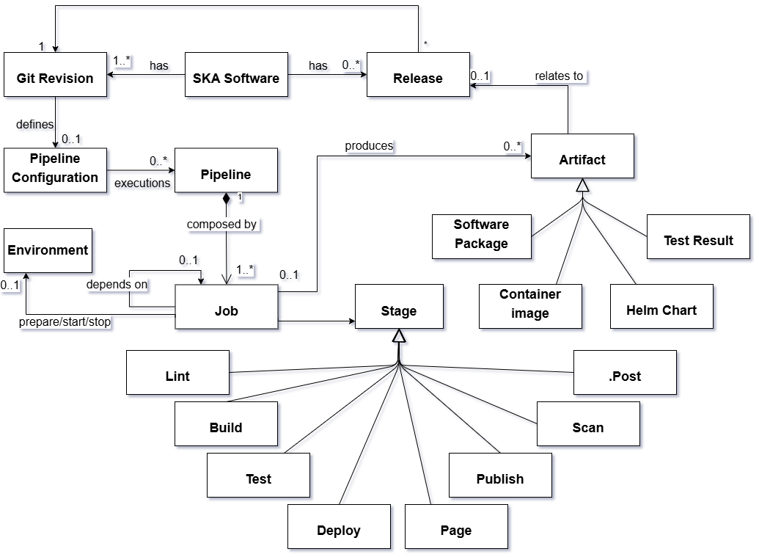
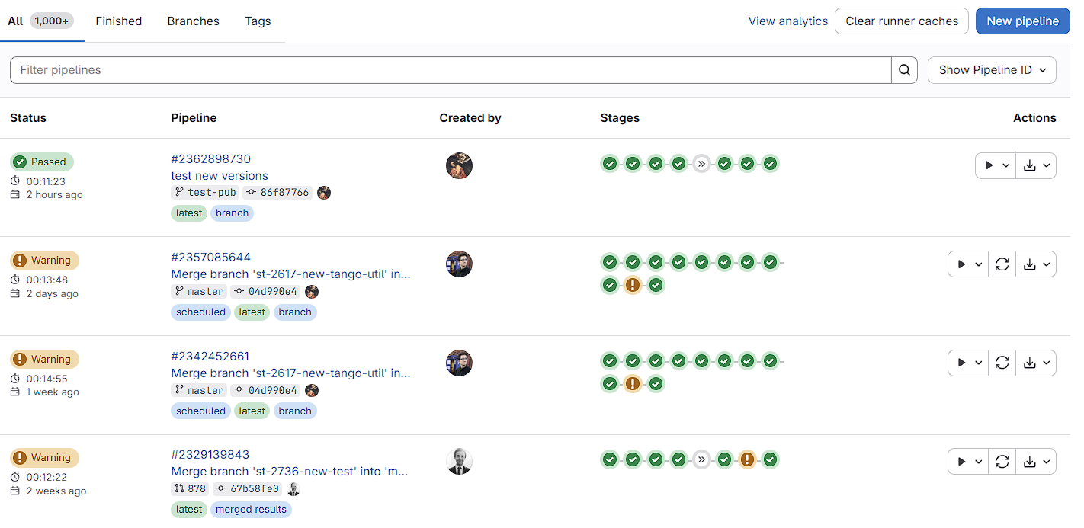
Gitlab

Slide 7
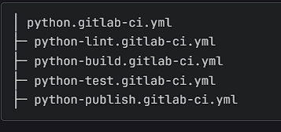
Pipeline machinery: templates-repository
Gitlab repository that holds the common job templates used by the pipelines in the SKA Projects.
Developed to provide common functionality across SKAO CI/CD by calling the make targets residing in ska-cicd-makefile repository.
DevSecOps Lifecycle
Lint → Build → Test → Scan → Package → Release → Deploy
Each artefact type has its own template file in <artefact-type>.gitlab-ci.yml which includes available steps
Developers can choose the k8s cluster where the application will be installed.

Slide 8
Pipeline machinery: templates-repository
Example:
include:
- project: 'ska-telescope/templates-repository'
file: 'gitlab-ci/includes/oci-image.gitlab-ci.yml’
- project: 'ska-telescope/templates-repository'
file: 'gitlab-ci/includes/python.gitlab-ci.yml’
- project: 'ska-telescope/templates-repository'
file: 'gitlab-ci/includes/notebook.gitlab-ci.yml’
- project: 'ska-telescope/templates-repository'
file: 'gitlab-ci/includes/helm-chart.gitlab-ci.yml’
- project: 'ska-telescope/templates-repository'
file: 'gitlab-ci/includes/docs.gitlab-ci.yml’
- project: 'ska-telescope/templates-repository'
file: 'gitlab-ci/includes/finaliser.gitlab-ci.yml’
- project: 'ska-telescope/templates-repository'
file: 'gitlab-ci/includes/k8s.gitlab-ci.yml’
- project: 'ska-telescope/templates-repository'
file: 'gitlab-ci/includes/release.gitlab-ci.yml’
- project: 'ska-telescope/templates-repository'
file: 'gitlab-ci/includes/deploy.gitlab-ci.yml'
image: $SKA_K8S_TOOLS_BUILD_DEPLOY
stages:
- lint
- build
- scan
- test
- deploy
- integration
- staging
- pages
- publish
Includes the packages that are needed to run the common CI/CD jobs in SKAO Pipeline Machinery. It has common tools such as git, bash, curl, wget, zip, ssh, jq, docker, kubectl, helm, poetry, conan, etc.
Repository: ska-telescope/ska-cicd-k8s-tools

Slide 9
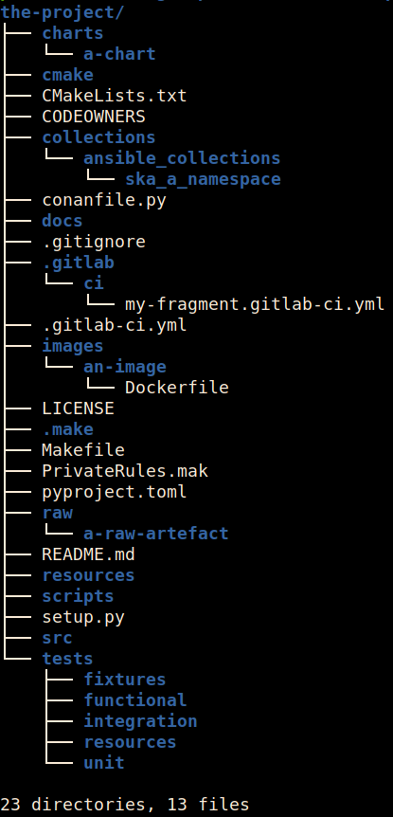
Pipeline machinery: makefile
Designed to be used both standalone - within an SKA project - and in conjunction with the standard GitLab CI pipeline templates
Contain a set of common targets that standardise the processing and handling of: linting, building, testing, packaging, releasing, publishing for artefacts for Python, OCI Images, Helm Charts, Raw files, RPM packages, Sphinx docs, Conan, BDD tests and Ansible Collections.
Assume a standard structure for the repository

Slide 10
Pipeline machinery: makefile
# Build a new Docker image for the project:
$ make oci-build
[...]
[+] Building 111.7s (14/14) FINISHED
[...]
$ make python-test
=================================== test session starts ====================================
platform linux -- Python 3.10.6, pytest-7.4.0, pluggy-1.2.0 -- /home/ubuntu/.cache/pypoetry/virtualenvs/ska-tango-examples-Wsi0kqW7-py3.10/bin/python
cachedir: .pytest_cache
metadata: {'Python': '3.10.6', 'Platform': 'Linux-5.10.16.3-microsoft-standard-WSL2-x86_64-with-glibc2.35', 'Packages': {'pytest': '7.4.0', 'pluggy': '1.2.0'}, 'Plugins': {'forked': '1.6.0', 'bdd': '4.1.0', 'json-report': '1.5.0', 'anyio': '3.6.2', 'repeat': '0.9.1', 'timeout': '2.1.0', 'mock': '3.11.1', 'xdist': '2.5.0', 'metadata': '3.0.0', 'cov': '2.12.1', 'nbmake': '1.4.3'}}
rootdir: /home/ubuntu/ska-tango-examples/tests
configfile: pytest.ini
plugins: forked-1.6.0, bdd-4.1.0, json-report-1.5.0, anyio-3.6.2, repeat-0.9.1, timeout-2.1.0, mock-3.11.1, xdist-2.5.0, metadata-3.0.0, cov-2.12.1, nbmake-1.4.3
collected 62 items / 6 deselected / 56 selected
[...]
PROJECT = ska-tango-examples
KUBE_NAMESPACE ?= ska-tango-examples
HELM_CHART ?= test-parent
# include OCI Images support
include .make/oci.mk
# include k8s support
include .make/k8s.mk
# include Helm Chart support
include .make/helm.mk
# Include Python support
include .make/python.mk
# include raw support
include .make/raw.mk
# include core make support
include .make/base.mk
# include your own private variables for custom deployment configuration
-include PrivateRules.mak

Slide 11
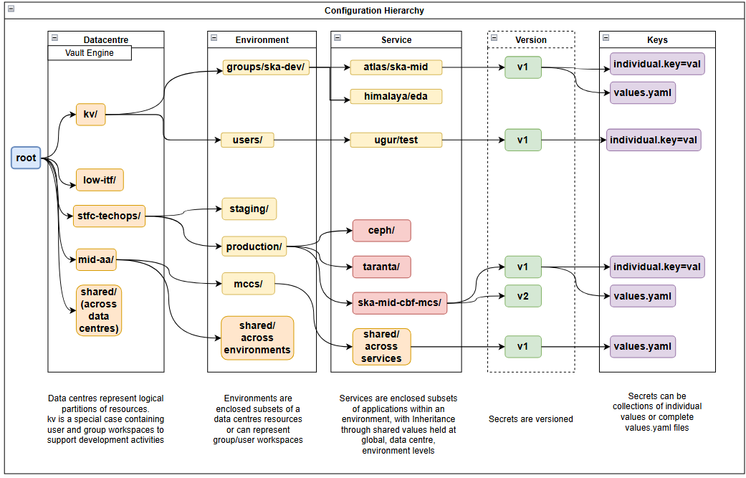
Application configuration management
Vault by Hashicorp is the chosen secure highly available configuration database chosen to house SKAO Application Configuration (hosted in AWS)

Slide 12
Central Artefact Repository (CAR)
Content management system for software artefacts delivered in their published form
Makes it possible to publish and retrieve the artefacts using the native tools, processes and protocols commonly associated with the related programming language and/or language based framework.
The Artefacts are versioned, and decorated with extensible metadata that is used to help manage the life cycle of the Artefacts.
Provides APIs and reporting interfaces to provide integration into extended DevSecOps processes such as CI/CD, BoM and dependency management, license management, provenance, vulnerability scanning and release management.
Provides controlled access to Artefacts through IAM, and offers notary features for provenance through TLS/SSL and signatures.

Slide 13
Central Artefact Repository (CAR)
CAR is composed of three main components:
Nexus for “package-style” artefacts:
  Helm charts, PyPI (wheels/sdist), Conan (C/C++), NPM (Node), APT (Debian), YUM (Fedora)
Harbor for “OCI-style” artefacts:
  OCI container images, OCI artefacts (e.g., ORAS-style payloads) for generic binary artefact storage
Binary Artefact Repository (BAR) provides the API + UI layer to manage and expose binary artefacts (and related OCI artefacts) in a more user-friendly way
Only gitlab pipeline publish job can push to CAR!

Slide 14
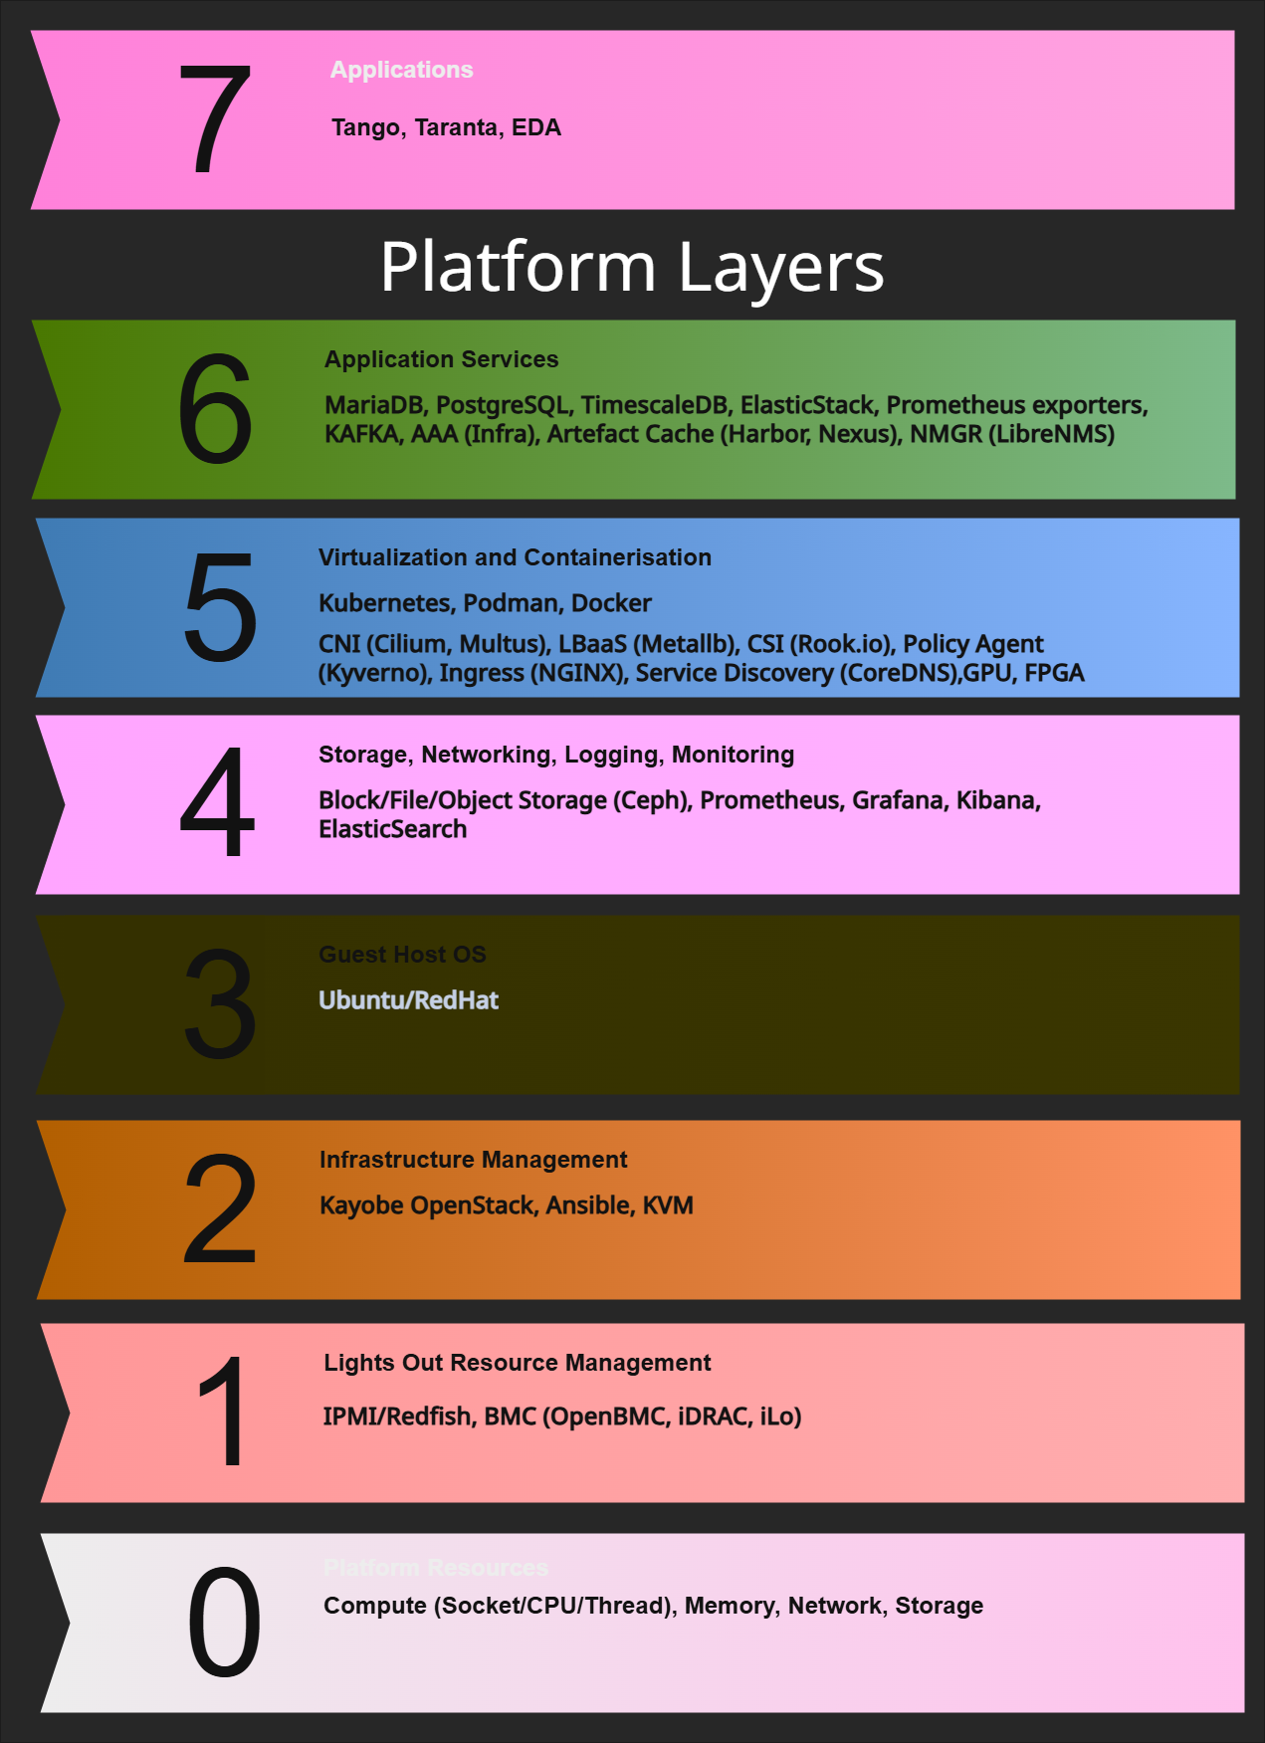
Software stack

Slide 15
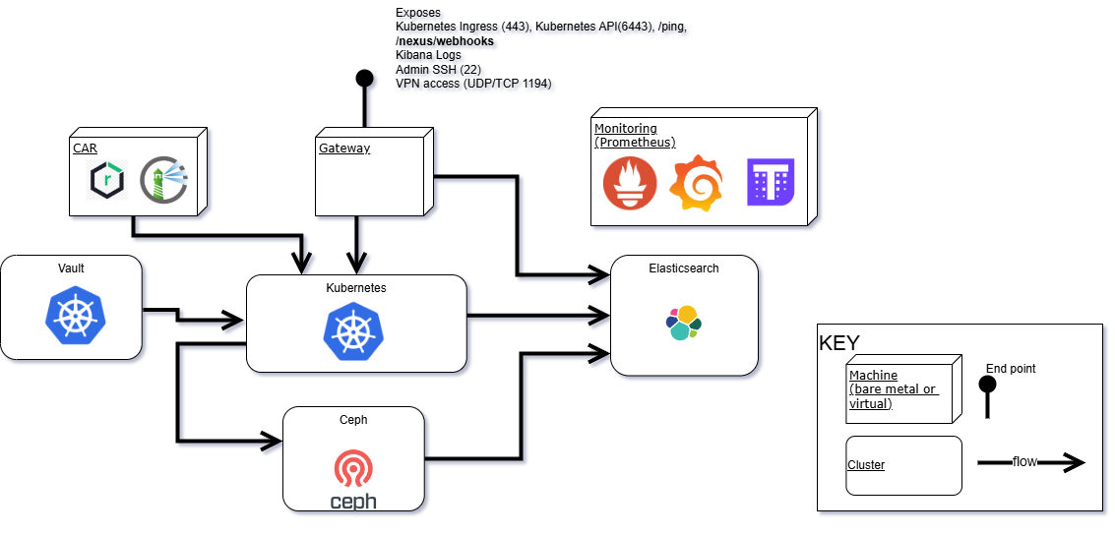
Infrastructure footprint (layers 3-4-5)

Slide 16
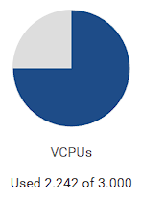
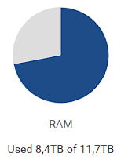
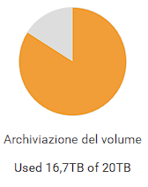
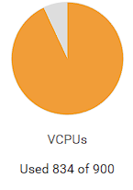
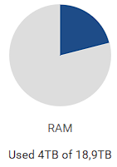
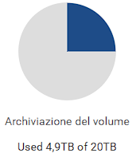
The infrastructure (for CI-CD)
Science and Technology Facilities Council (STFC)
Openstack layer, UK contribution to the project
TechOps
TechSDH&P
AWS
7 EKS Clusters
47 EC2 instances
28 S3 buckets
Notes:
The Science and Technology Facilities Council (STFC) is a council^{[2]} of UK Research and Innovation (UKRI), a non-departmental public body sponsored by the Department for Science, Innovation and Technology, that carries out research in science and engineering, and funds UK research in areas including particle physics, nuclear physics, space science and astronomy (both ground-based and space-based).

Slide 17
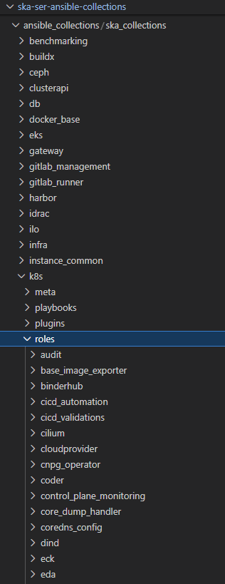
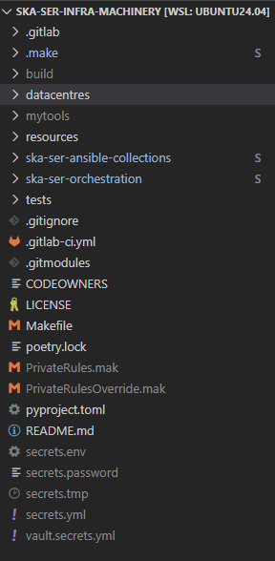
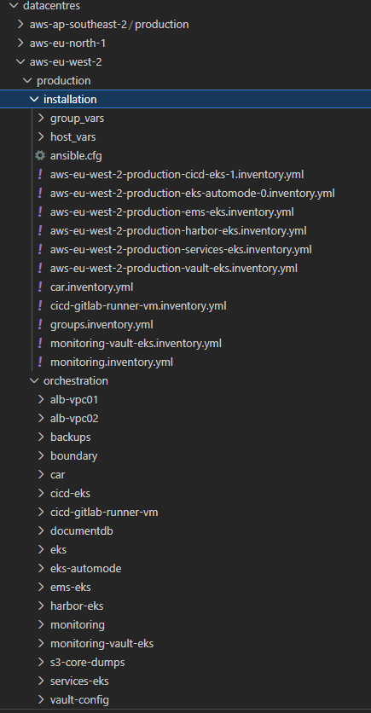
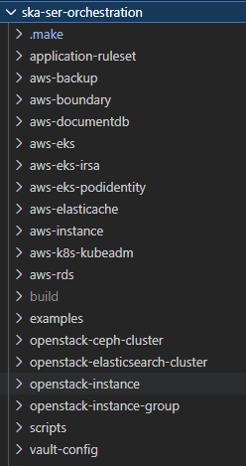
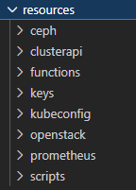
Software Defined infrastructure: build clusters

Slide 18
Observability Stack
Monitoring
  Prometheus
  Thanos (long-term metrics)
Visualisation
  Grafana
Logging
  Elasticsearch
  Kibana
Alerting & Incident Management
  Alertmanager
  Grafana OnCall

Slide 19
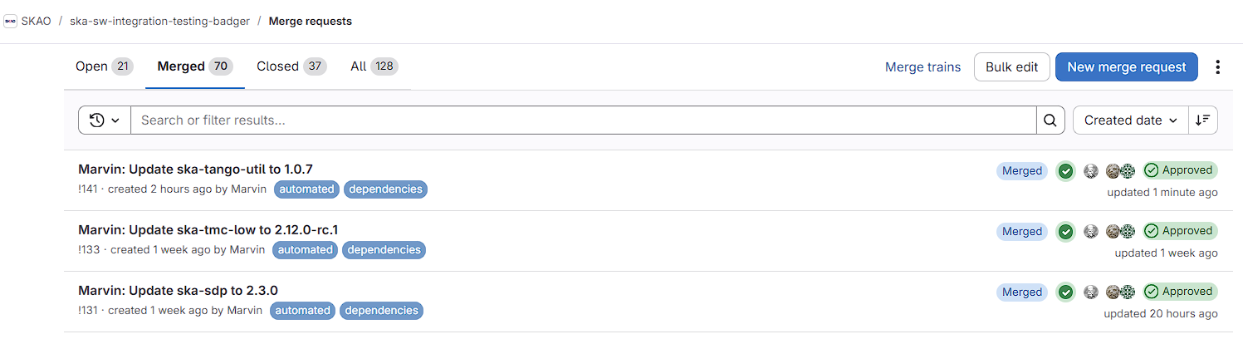
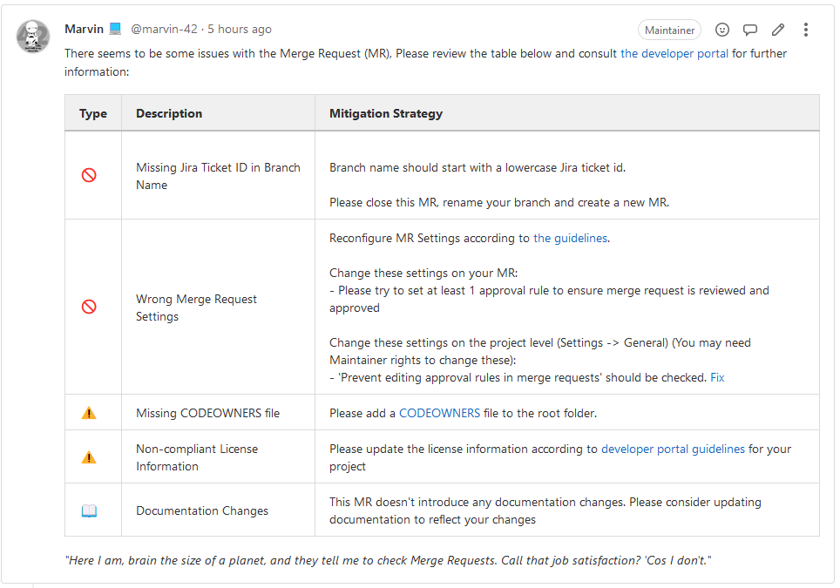
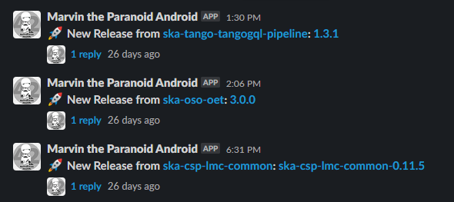
Marvin
To ensure that all best practices are followed by SKA developers an AI, called Marvin, has been implemented in order to perform quality checks on Gitlab merge requests and validation on artefacts publication
Using webhooks from Gitlab and Nexus, Marvin performs its checks but also informs developers on what is happening like new releases

Slide 20
~2018
First Manual Cluster Setup with 3 control plane + 5 worker nodes
Timeline
Dec 2019
First MVP Deployed via CD
Mar 2026
Core dump collector service
July 2020
Move CI/CD into the cluster from VM/Shell runners
Jun 2026
Support UV in pipelines
New Ubuntu LTS version
Better management of cluster resources
AAA
June 2021
Move Logging and Monitoring to Containers
Sept 2021
Centralised Logging and Monitoring (Multi Cluster Integration)
Nov 2021
Automation of SDLC for all projects
Feb 2022
Automated Environment Provisioning and tear-down
Mar 2023
Move to ClusterAPI (allow multiple cluster creation with ease)
Oct 2023
Temp move all CI/CD to AWS and back
Oct 2024
Permanent backup CI/CD in AWS
Jul 2025
Cluster on-demand for large scale test
20

Slide 21


Thank You
Ing. Matteo Di Carlo INAF - OAAb
matteo.dicarlo@inaf.it

