Slide 1

GG
IZG
Ground-based
Instrument Control Software:
SOXS and co.
Davide Ricci INAF-OAPD
USC-C General Assembly
Trieste, 9-13/03/2026
The OAPD Instrument Control Software team:
A. Baruffolo, B. Salasnich, D. Ricci, E. Costa, F. Laudisio, S. Lampitelli, A. Lorenzetto, C. Di Prospero, D. Diretto

Slide 2
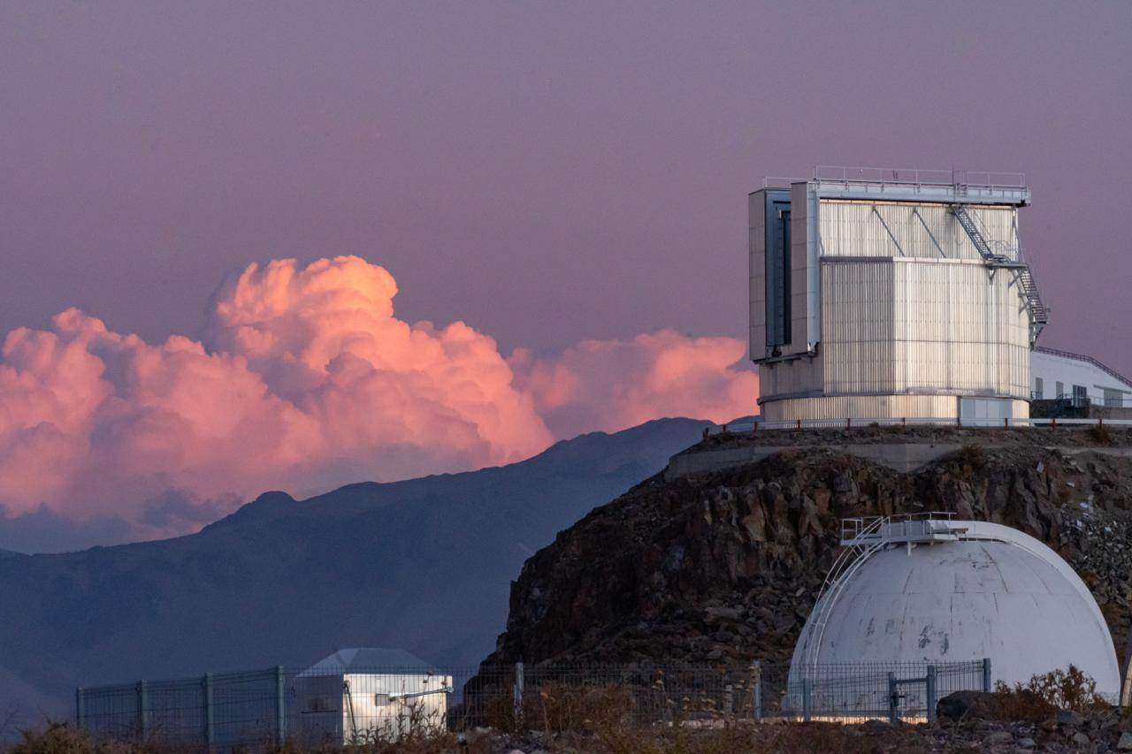
foto: S. Savarese

Slide 3
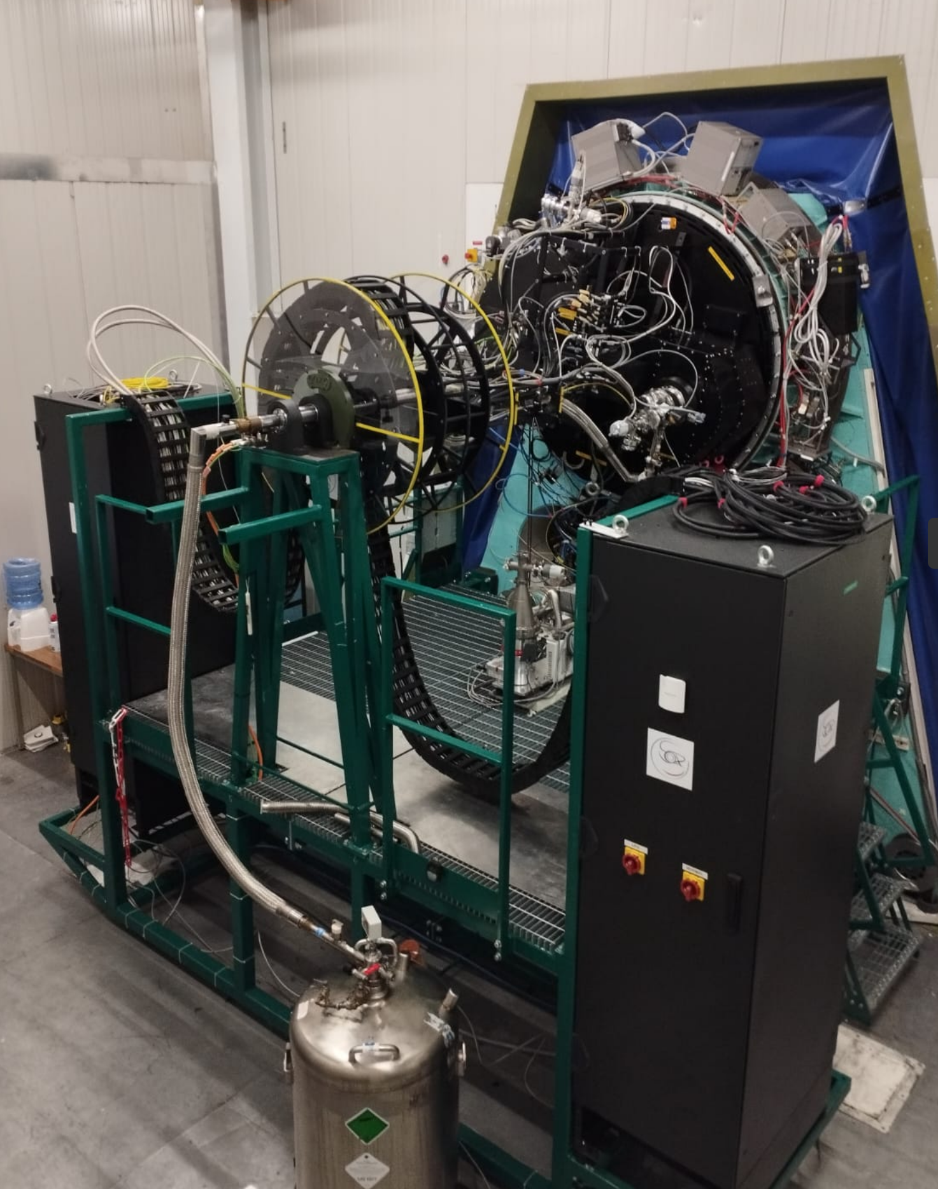

Slide 4
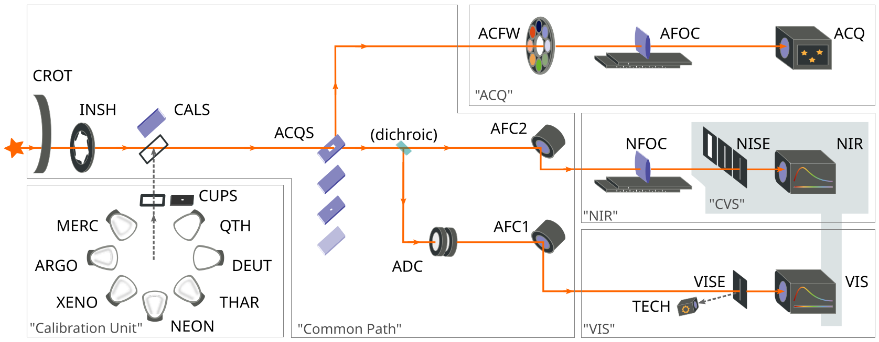
SOXS schematic view
Implemented using VLT2024
Interfacing with NTT (VLT2010)
Custom Python scheduler
Custom Python pipeline soxpipe
https://github.com/thespacedoctor/soxspipe
Special devices:
  NISE
  AFC
  CROT
“Special detector”:
  Acquisition Camera

Slide 5
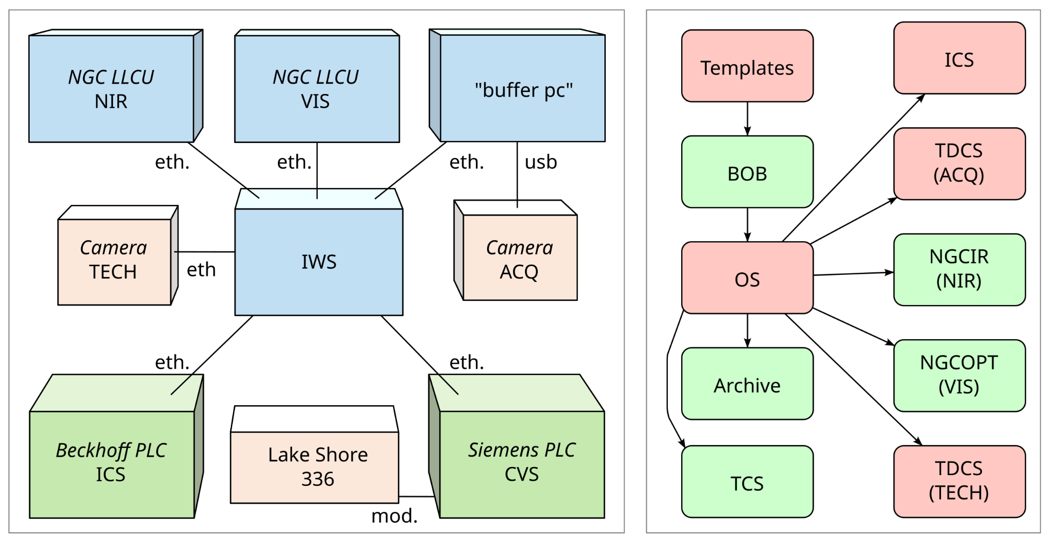
Network architecture and Software architecture

Slide 6
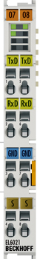
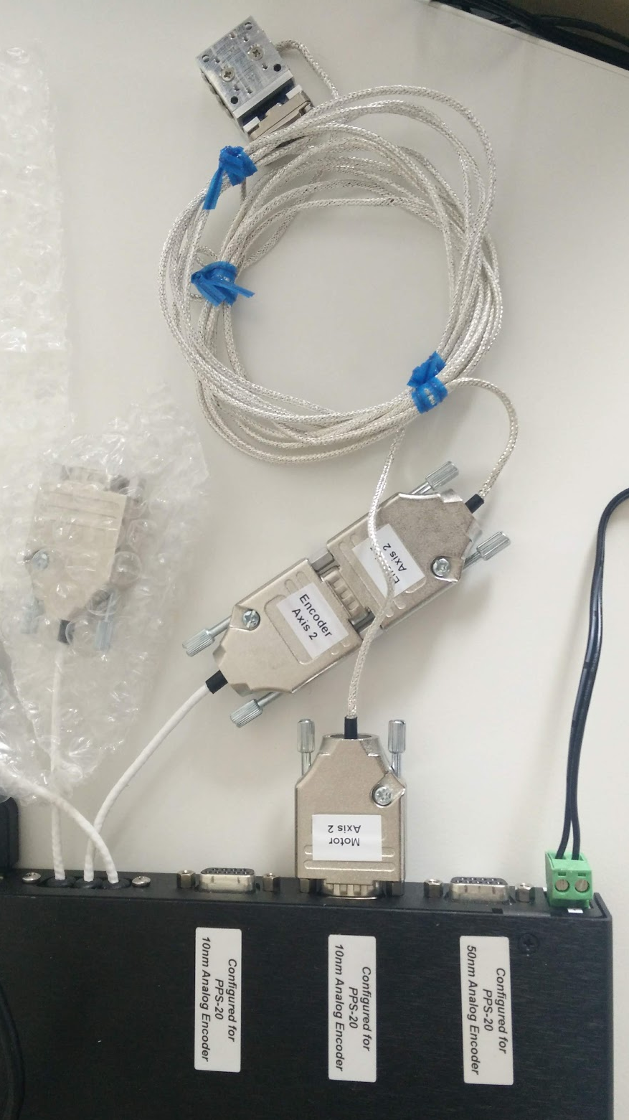
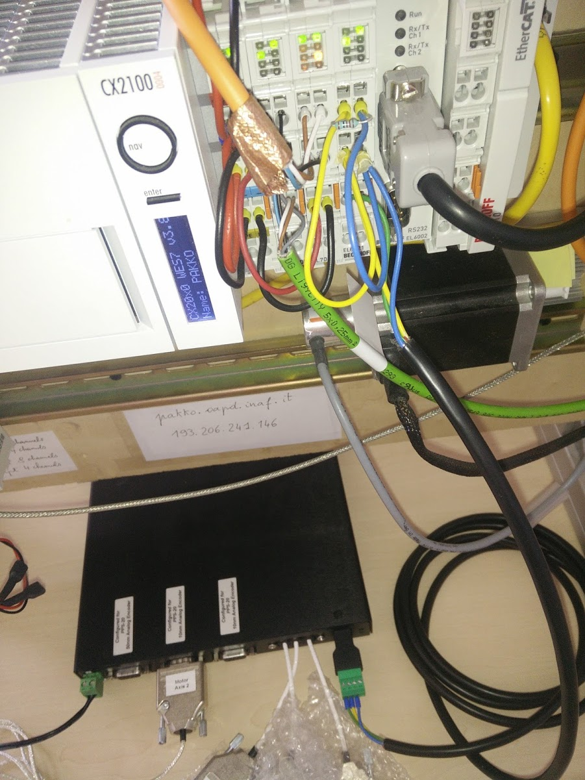

NISE: Near Infrared Slit Exchanger
PPS-20 piezo device
Initially Micronix controller MMC-103
  PLC module EL6023 (Serial interface RS485)
Then Micronix controller MMC-110
  PLC module EL6001 (Serial interface RS232)
Special Device sxinise INS module developed and tested.
Function Block in “NISE TwinCAT Solution”

Slide 7
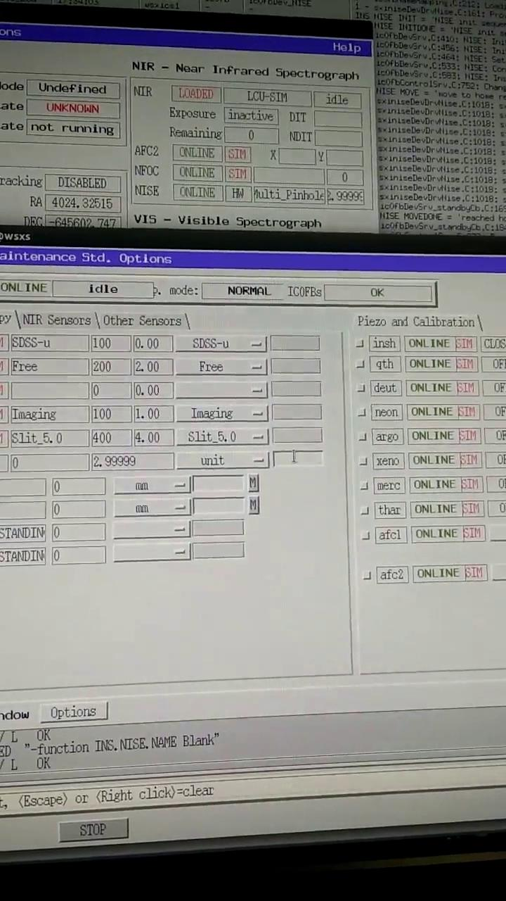
controller →[RS232] → PLC → [opcua]→IWS

Slide 8
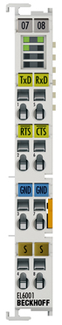
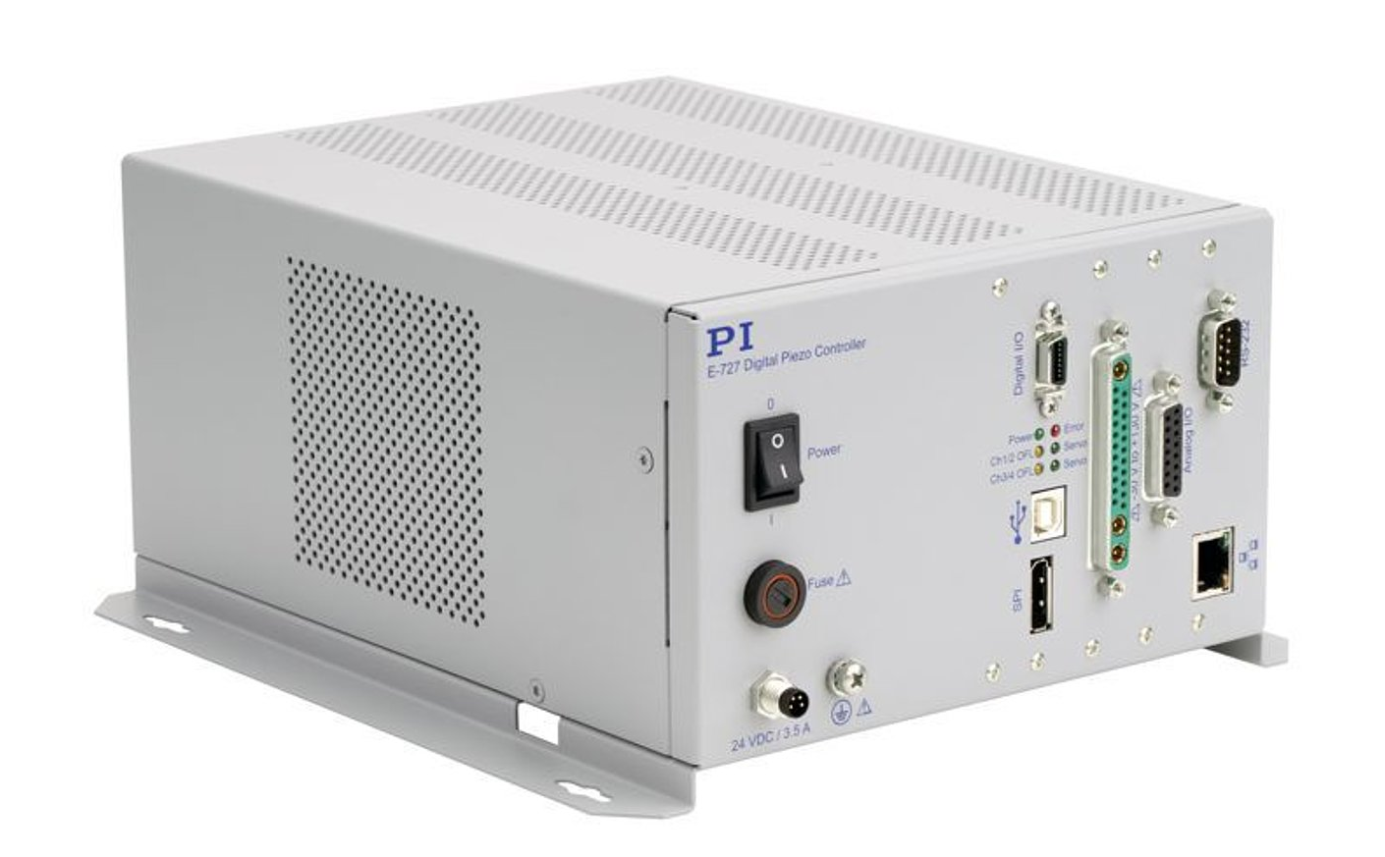
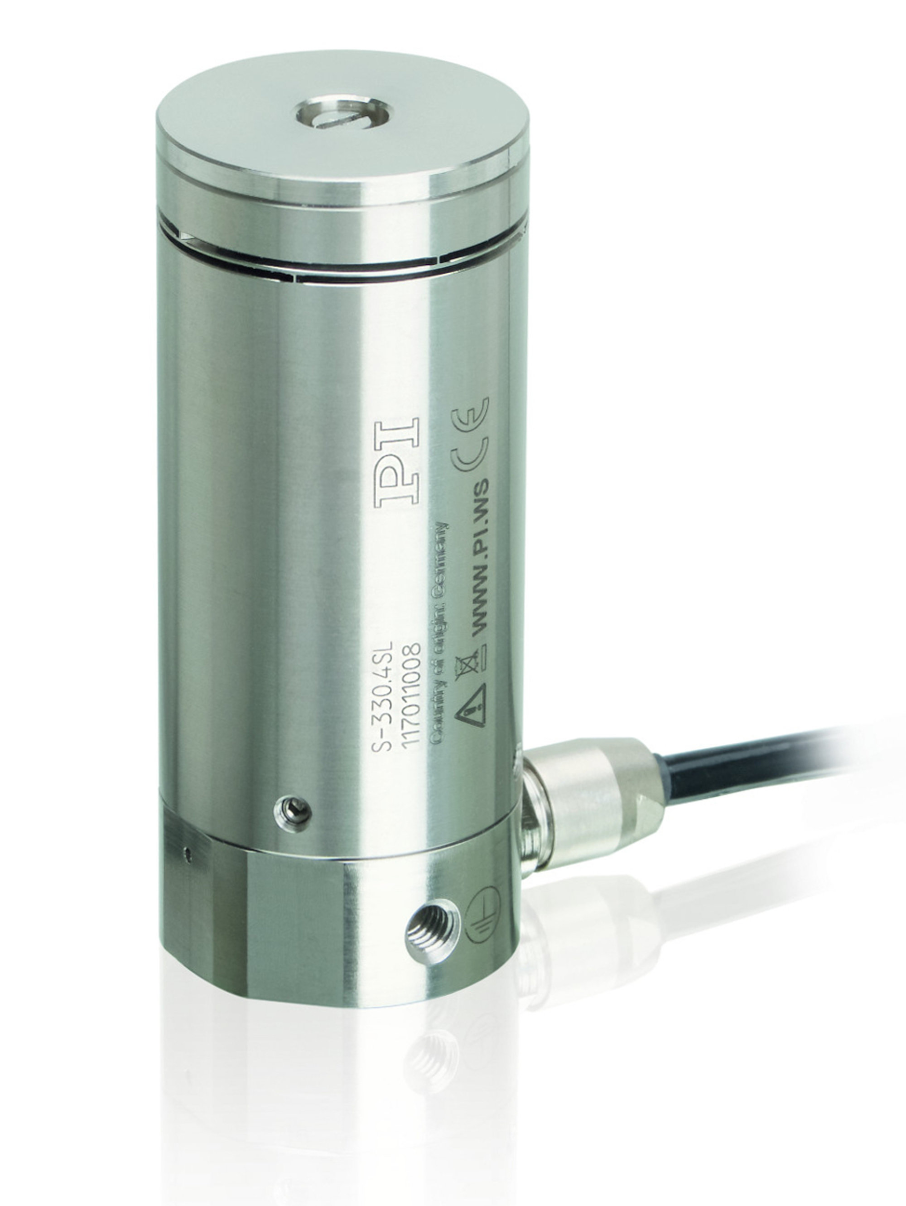
AFC: Active Flexure Compensator
import serial
def send(cmd):
finish = serial.LF
newline = b' ' + finish
with serial.Serial(
'/dev/ttyS0', 115200) as ser:
ser.timeout = 0.1
ser.write(cmd.encode() + finish)
line = newline
while line[-2:] == newline:
line += ser.readline() or finish
return line
S-330 piezo device
E-727 PI controller
EL6001 PLC module (Serial interface RS232)
Tested using PI software under Windows;
Tested using custom python3 software.
Special device developed in VLTSW

Slide 9
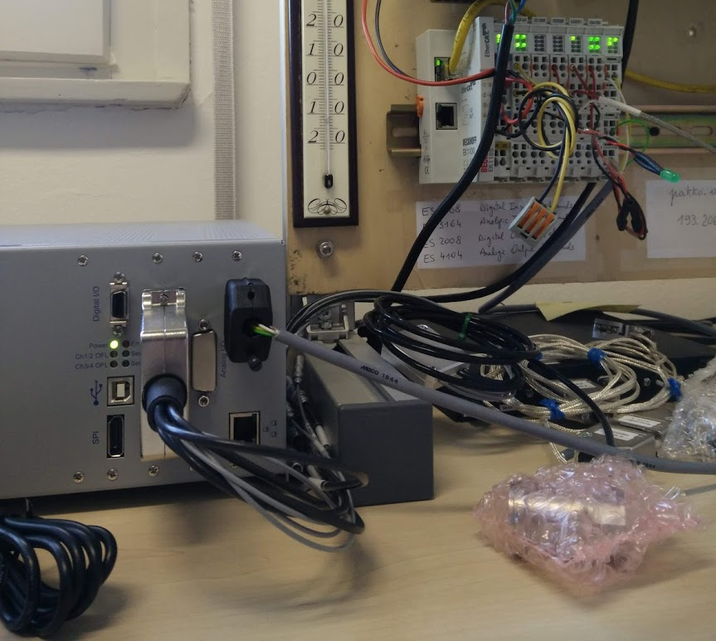
AFC: Active Flexure Compensator
As for NISE, tested in PLC test bench
Function Block FB_AFC developed at PLC level (TwinCAT)
Special Device sxiafc INS developed at IWS level.
AUTO mode based on Lookup table

Slide 10
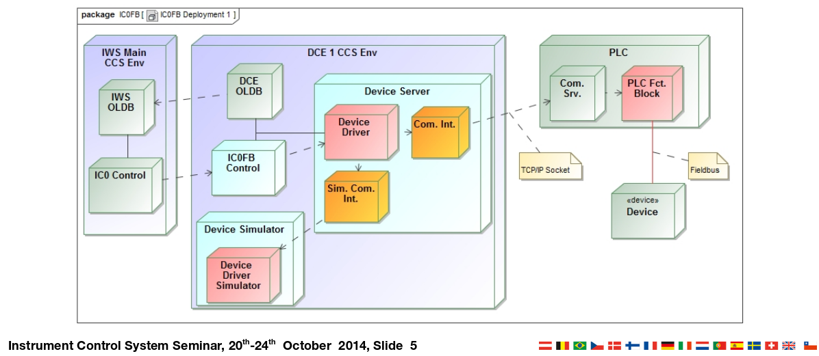
Special devices deployment
sxinise, sxiafc modules
  Simulated
  Not simulated
sxiniseControl
sxiafcControl
sxiniseSimControl
FB_NISE
sxiafcSimControl
FB_AFC

Slide 11
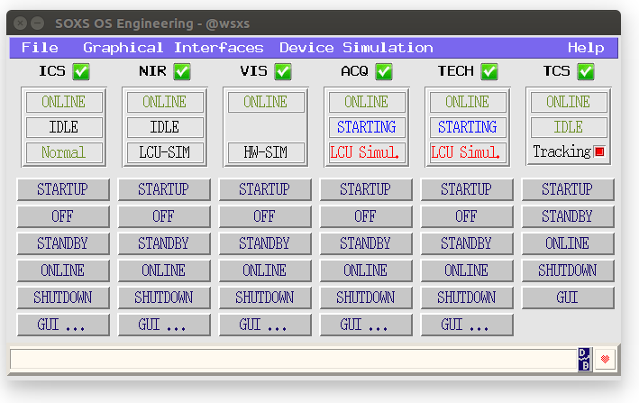
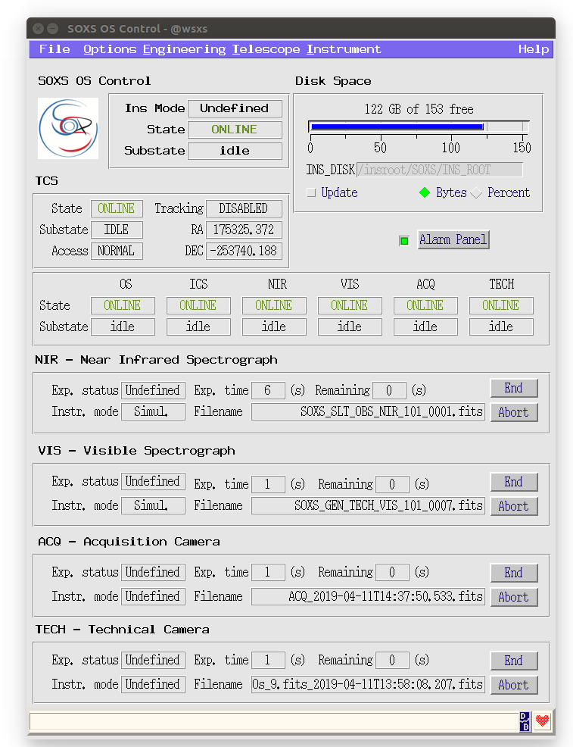
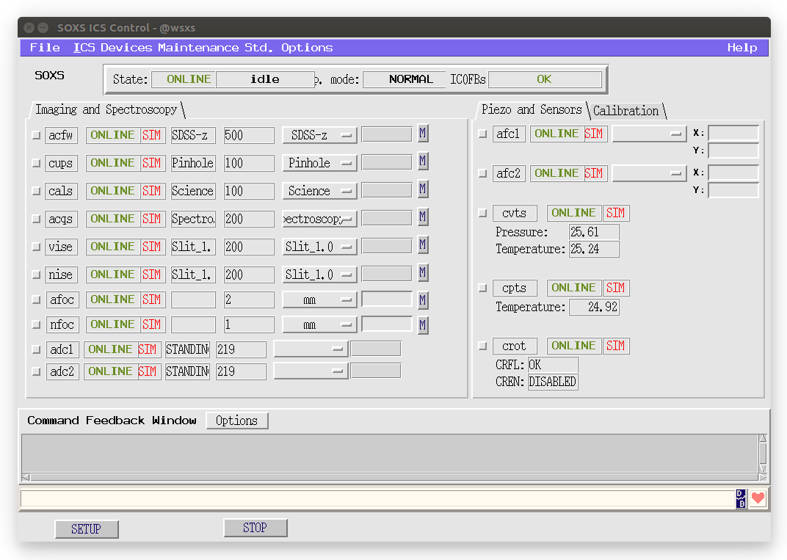

Slide 12
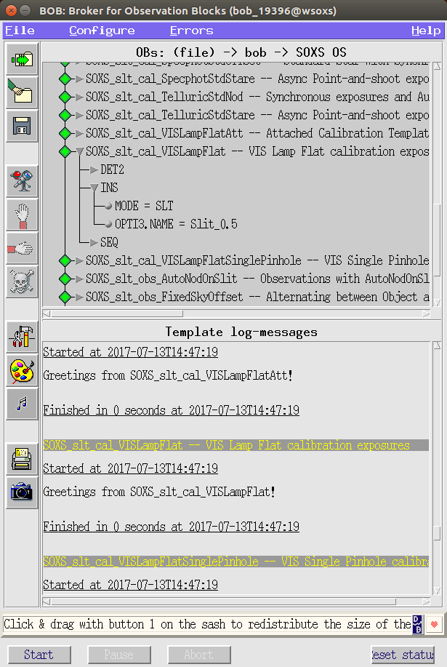
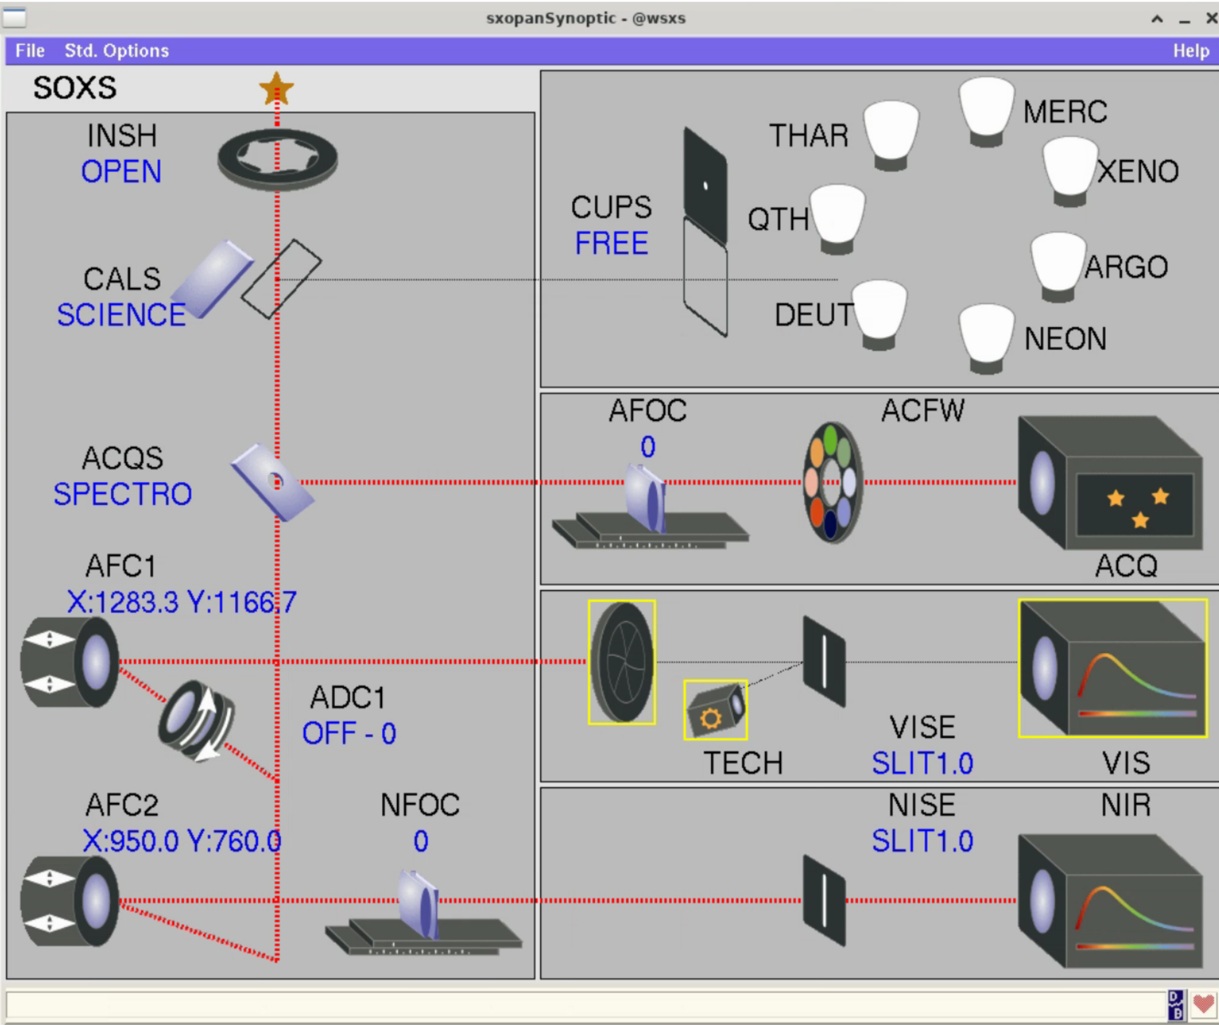

Slide 13
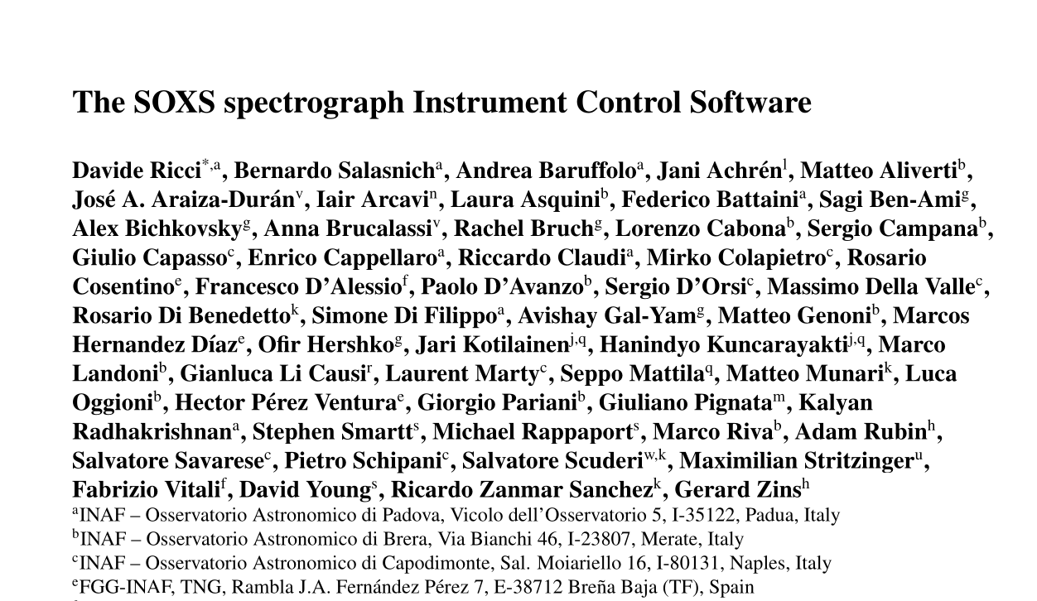
SOXS INS Publications
2024SPIE13101E..2GR The SOXS instrument control software approaching the PAE
2020SPIE11452E..2QR Development status of the SOXS instrument control software
2018SPIE10707E..1GR Architecture of the SOXS instrument control software
(In total, ~50 SOXS publications)
JATIS referred paper
submitted!

Slide 14

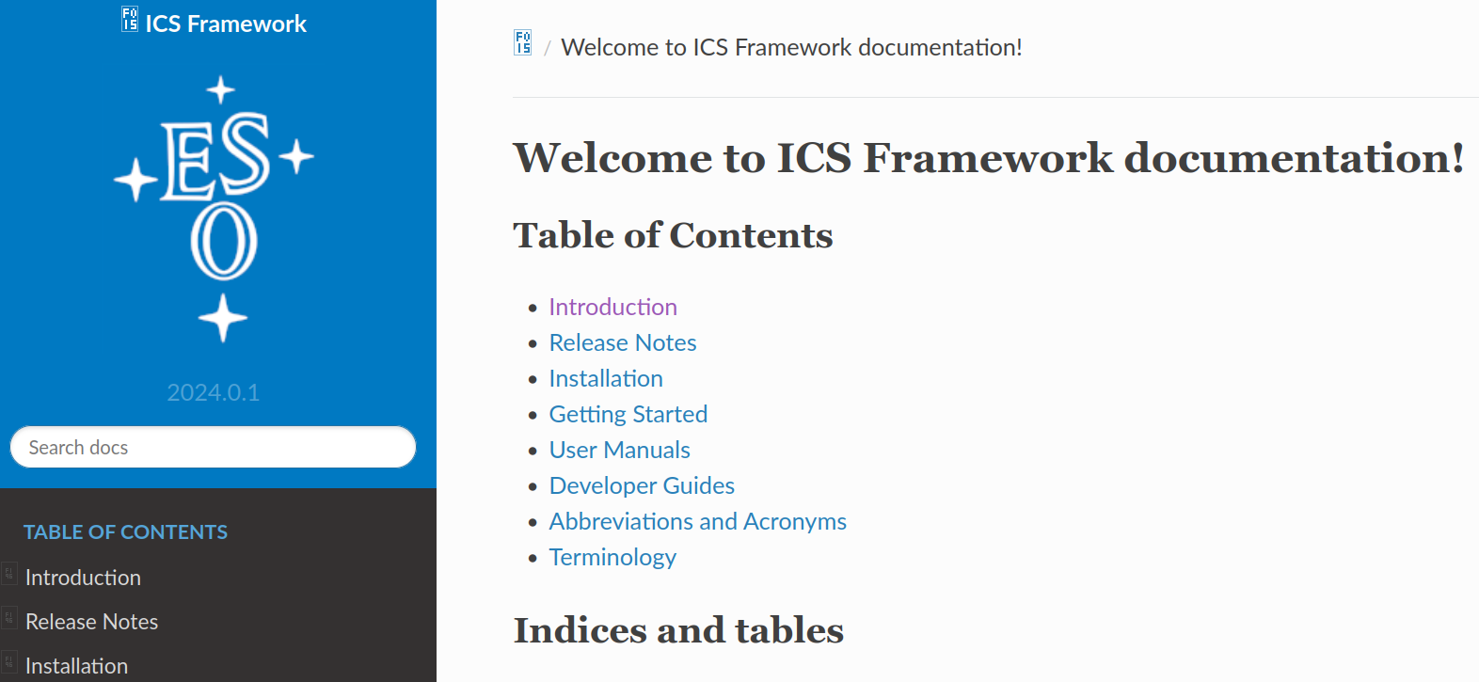


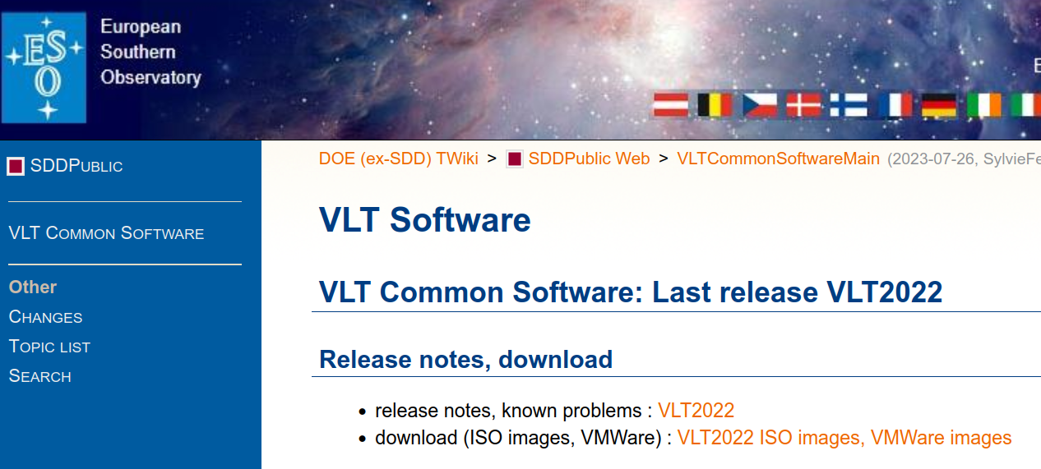


OAPD projects
MORFEO ICSS @ELT, towards Final Design Review
Multiconjugate adaptive Optics Relay For ELT Observations
MORFEO RTC @ELT, passing Final Design Review
MAVIS @VLT, towards Final Design Review
MAVIS - MCAO-Assisted Visible Imager and Spectrograph
SOXS @NTT, towards Preliminary Acceptance in Chile
Son Of X-Shooter
ERIS @VLT, currently in operation!
Enhanced Resolution Imager (SPIFFIER) and Spectrograph (NIX), with AO.
SHARK-NIR @LBT, currently in early science phase!
Extreme-AO for High Contrast Imaging in the NIR
not dependent on ESO frameworks

Slide 15

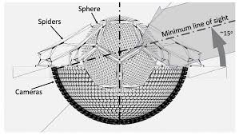
OAPD new projects… and future projects?
Ekarus - Adaptive optics at Asiago Ekar site using Papyrus (ex OHP)
https://ui.adsabs.harvard.edu/abs/2023aoel.confE..13F/abstract
LBCMOS - Upgrading LBC @ LBT with a CMOS
https://spie.org/AS/conferencedetails/astronomy-ground-based-instrumentation#3100633
MezzoCielo - A whole sky 1m telescope close to the Einstein Telescope site
https://ui.adsabs.harvard.edu/#abs/2024SPIE13094E..33R/abstract
HRMOS - High-Res Multi-Object Spectrograph, will be proposed for VLT2030 roadmap
https://ui.adsabs.harvard.edu/abs/2023arXiv231208270M/abstract

Slide 16
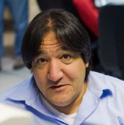
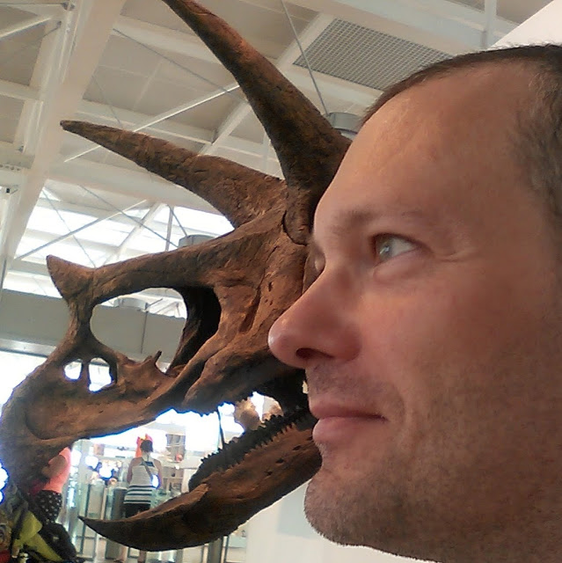
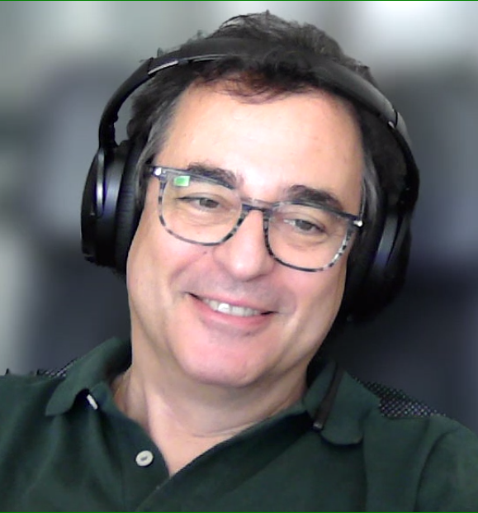
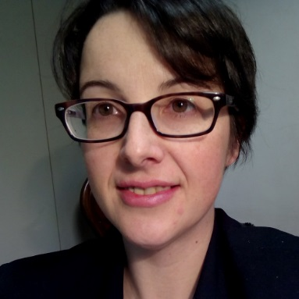
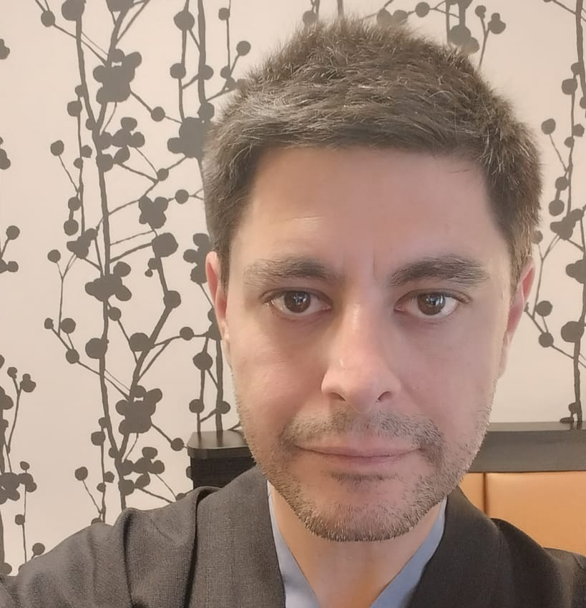
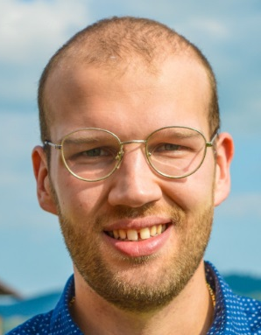
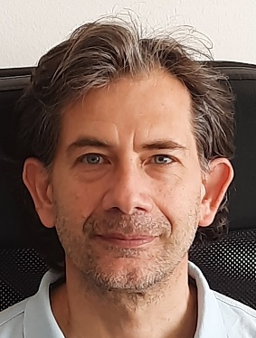
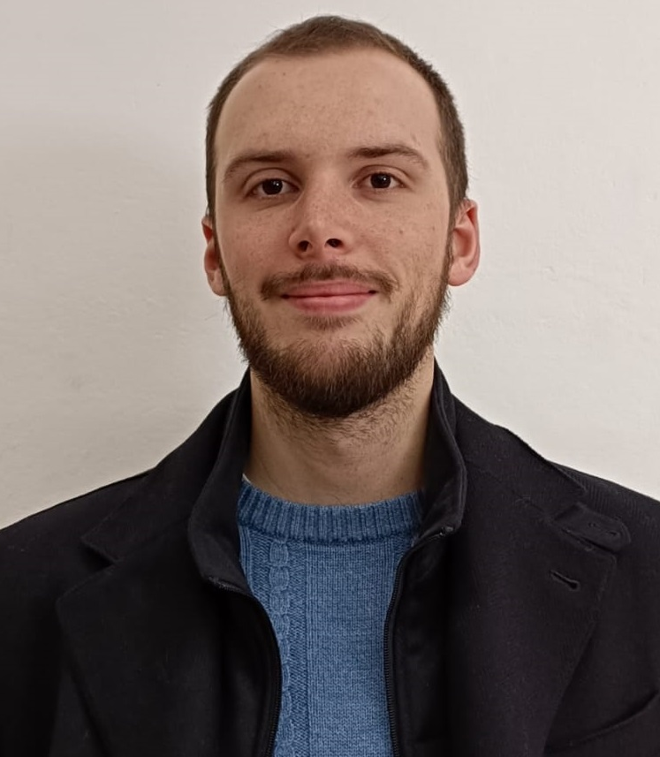
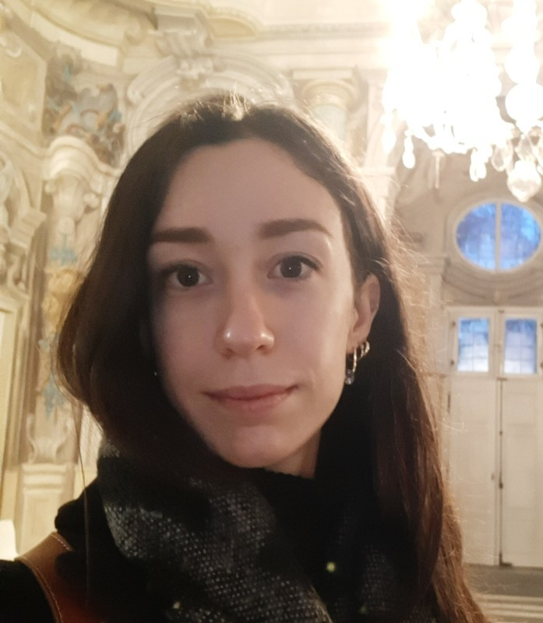
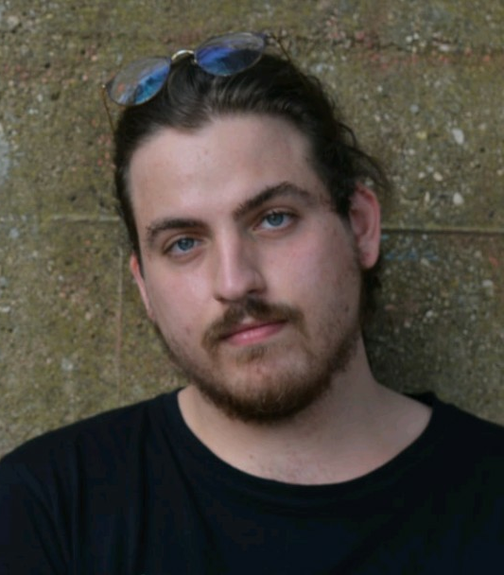
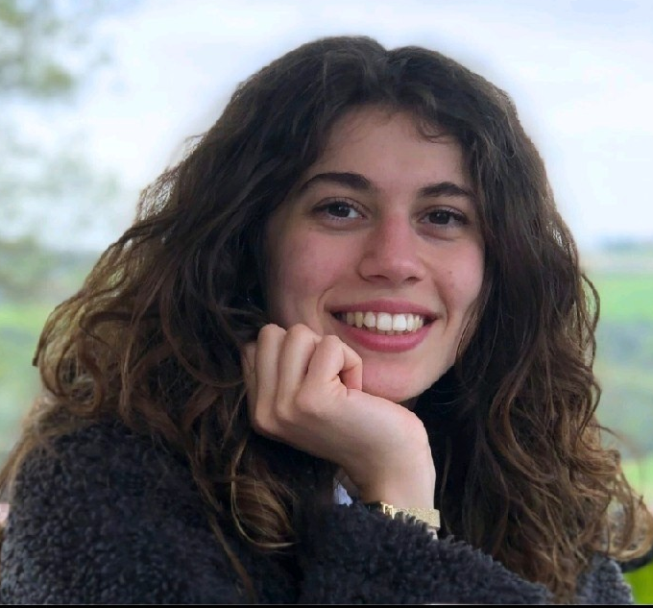
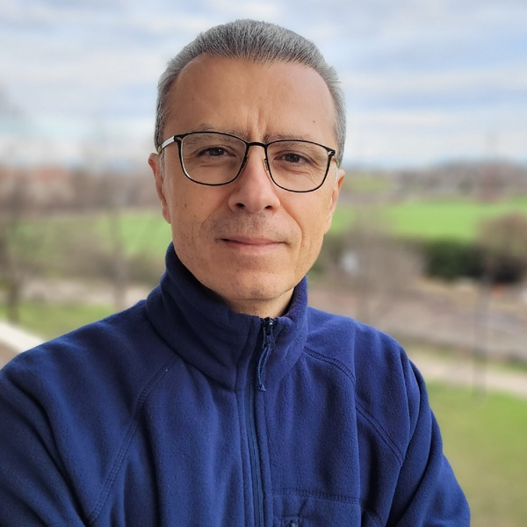
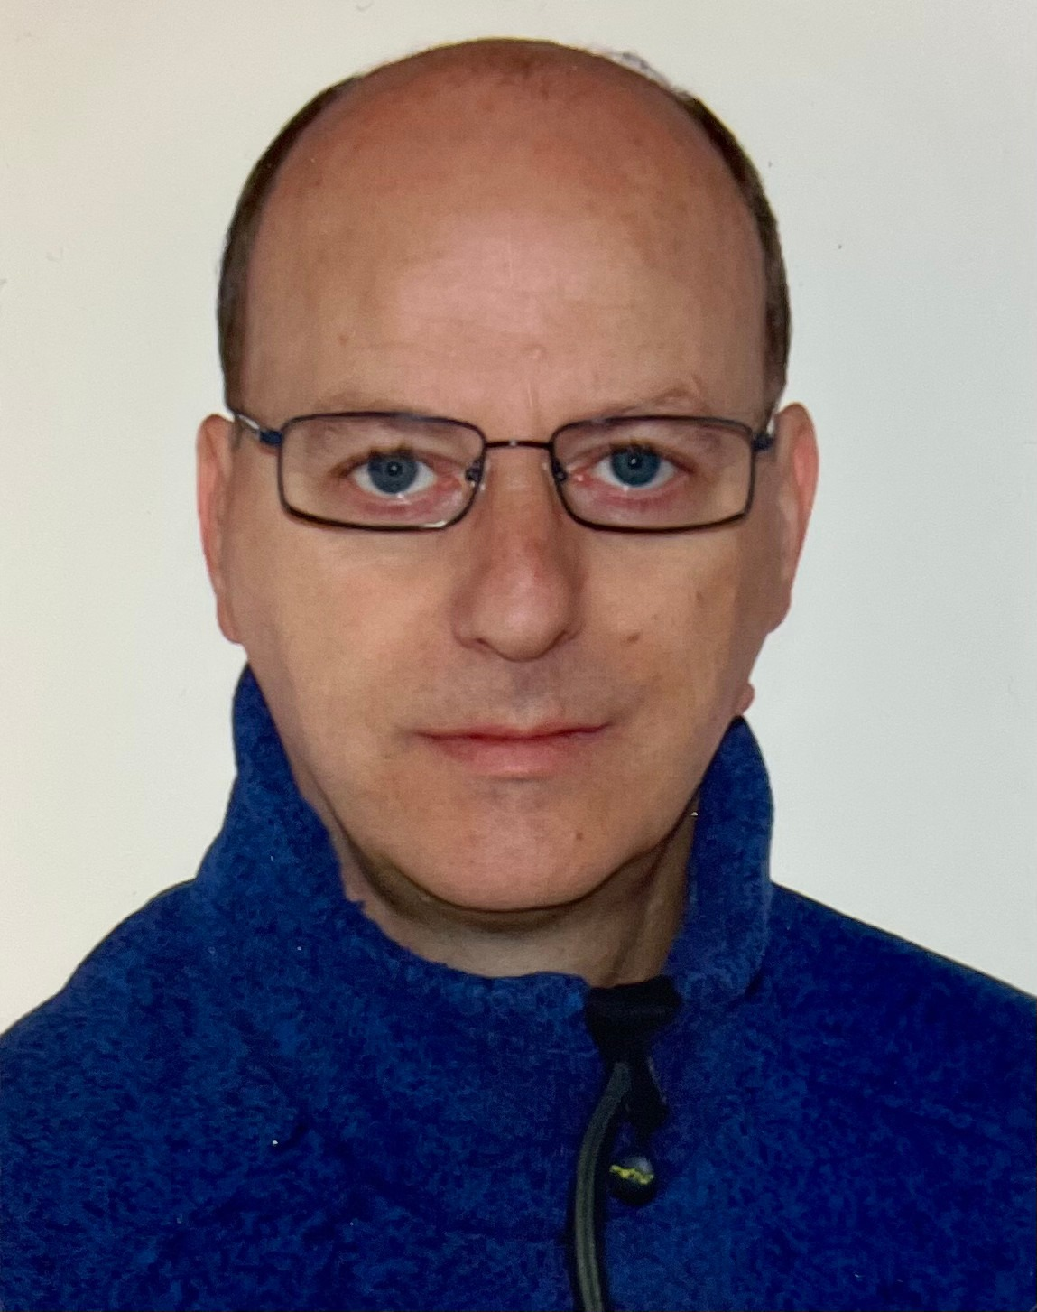
SOXS Control Software team @ OAPD
Software Quality Assurance:
Andrea Balestra,
Rosanna Sordo
SPHERE’s first light team:
Andrea Baruffolo,
Bernardo Salasnich
Joined for SOXS, SHARK (LBT), MAVIS:
Davide Ricci,
Elia Costa
↑ also involved in Model-Based System Eng. (MORFEO, MAVIS, CUBES, ANDES+PLATO)
Joined for MORFEO ICSS, SHARK (LBT):
Fulvio Laudisio,
Alessandro Lorenzetto
IT support:
Amedeo Petrella,
Danilo Selvestrel
Joined for MORFEO ICSS and RTC:
Salvatore Lampitelli,
Chiara Di Prospero,
Daphne Diretto

Slide 17
SOXS Control Software team @ OAPD
Software Quality Assurance:
Andrea Balestra, Rosanna Sordo
SPHERE’s first light team:
Andrea Baruffolo,
Bernardo Salasnich
Joined for SOXS, SHARK (LBT), MAVIS:
Davide Ricci,
Elia Costa
↑ also involved in Model Based System Engineering (MORFEO,
MAVIS, CUBES, ANDES + PLATO)
Joined for MORFEO ICSS, SHARK (LBT):
Fulvio Laudisio,
Alessandro Lorenzetto
IT support:
Amedeo Petrella,
Danilo Selvestrel
Joined for MORFEO ICSS and RTC:
Salvatore Lampitelli,
Chiara Di Prospero,
Daphne Diretto

Slide 18
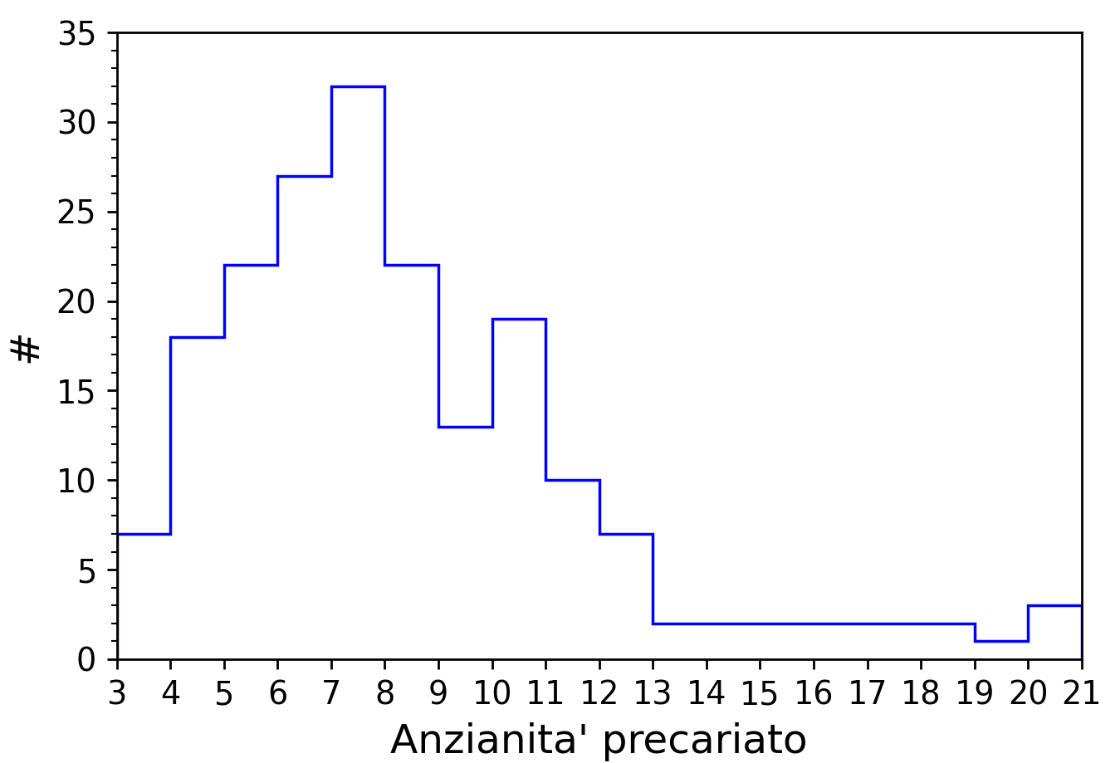
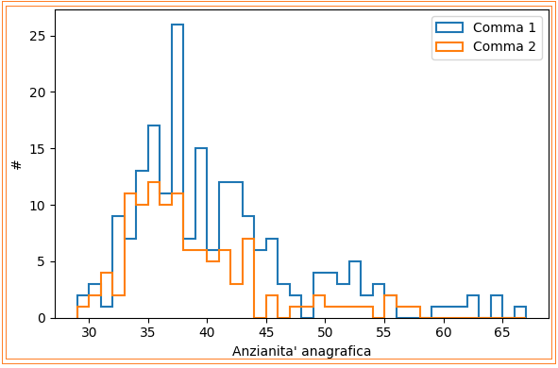


La situazione del personale precario in INAF è INSOSTENIBILE!
1.200 Tempo Indeterminato Vs 650 precari: più di 1 precario ogni 2 persone di ruolo
In media 8 anni di esperienza post-dottorato
Età media 40 anni
Dei 650, 287 possono essere stabilizzati:
173 tramite chiamata diretta (comma 1)
114 tramite concorsi riservati (comma 2)
Plot di un campione rappresentativo dei precari INAF al 31/12/2024
Entro l’anno, l’attuale situazione determinerà l’esodo di > 100 lavoratori altamente qualificati e il MUR se ne lava le mani
È URGENTE che INAF PROCEDA ORA con le STABILIZZAZIONI TRAMITE MADIA: unica soluzione per questa emergenza
Molti colleghi (972) hanno già firmato, per sostenerci e aggiungere il nome alla lista del QR,
contattaci a retestabilizzandi1.inaf@gmail.com

