Slide 1
Metis status and science so far
Marco Romoli, Roberto Susino & the Metis Team
February 11, 2026
10th Metis Workshop – Torino – February 11-13, 2026

Slide 2
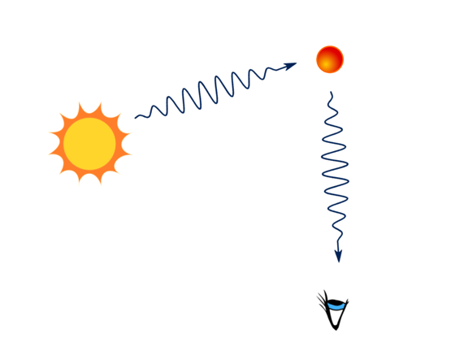
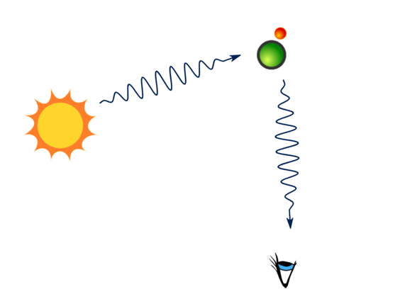
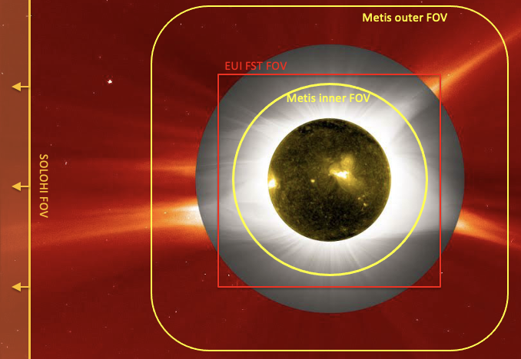
Metis: the Solar Orbiter coronagraph
Metis is an externally-occulted coronagraph designed to provide full imaging of the extended corona in:
total and polarised visible-light brightness (580-640 nm)
UV H I Lyman-α line (121.6 ± 10 nm)
3.4°
e⁻
Lα
H I
K-corona B, pB
Lα
2.9°
Thomson scattering
Resonant scattering
1.6°

Slide 3
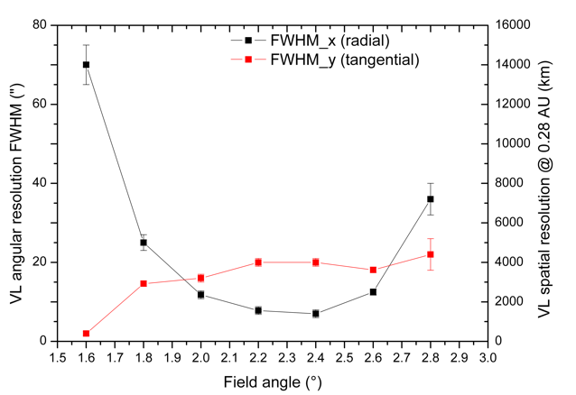
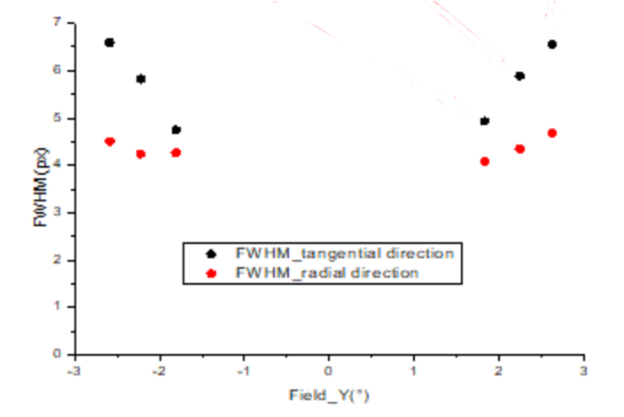
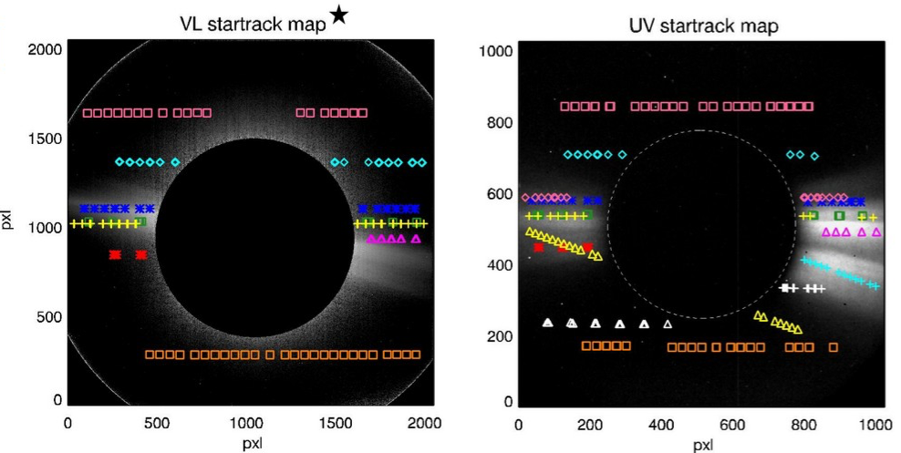
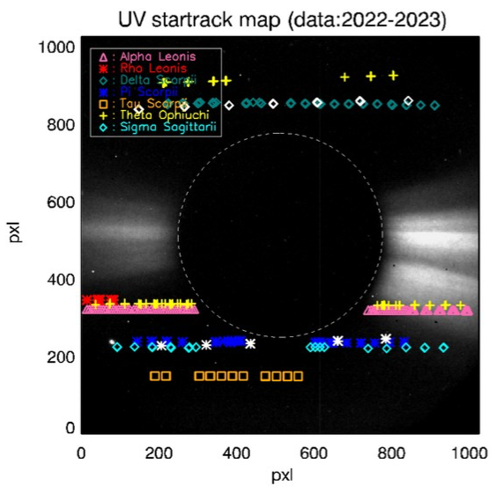
Metis performance
Spatial & temporal resolutions
Spatial resolution: checked in-flight with star observations
Temporal resolution:
UV > 1s limited by count rate VL > 60s in pB, > 20s in B, > 1s in fixed polarization
Radiometric calibration
Radiometric calibration performed on ground is checked periodically using bright stars, with dedicated observations
Specs resolution
Specs resolution
Cruise
Cruise
Pixel size
Pixel size
VL < 2 px
UV between 4 and 7 px
De Leo+2024
De Leo+2025
NMP

Slide 4
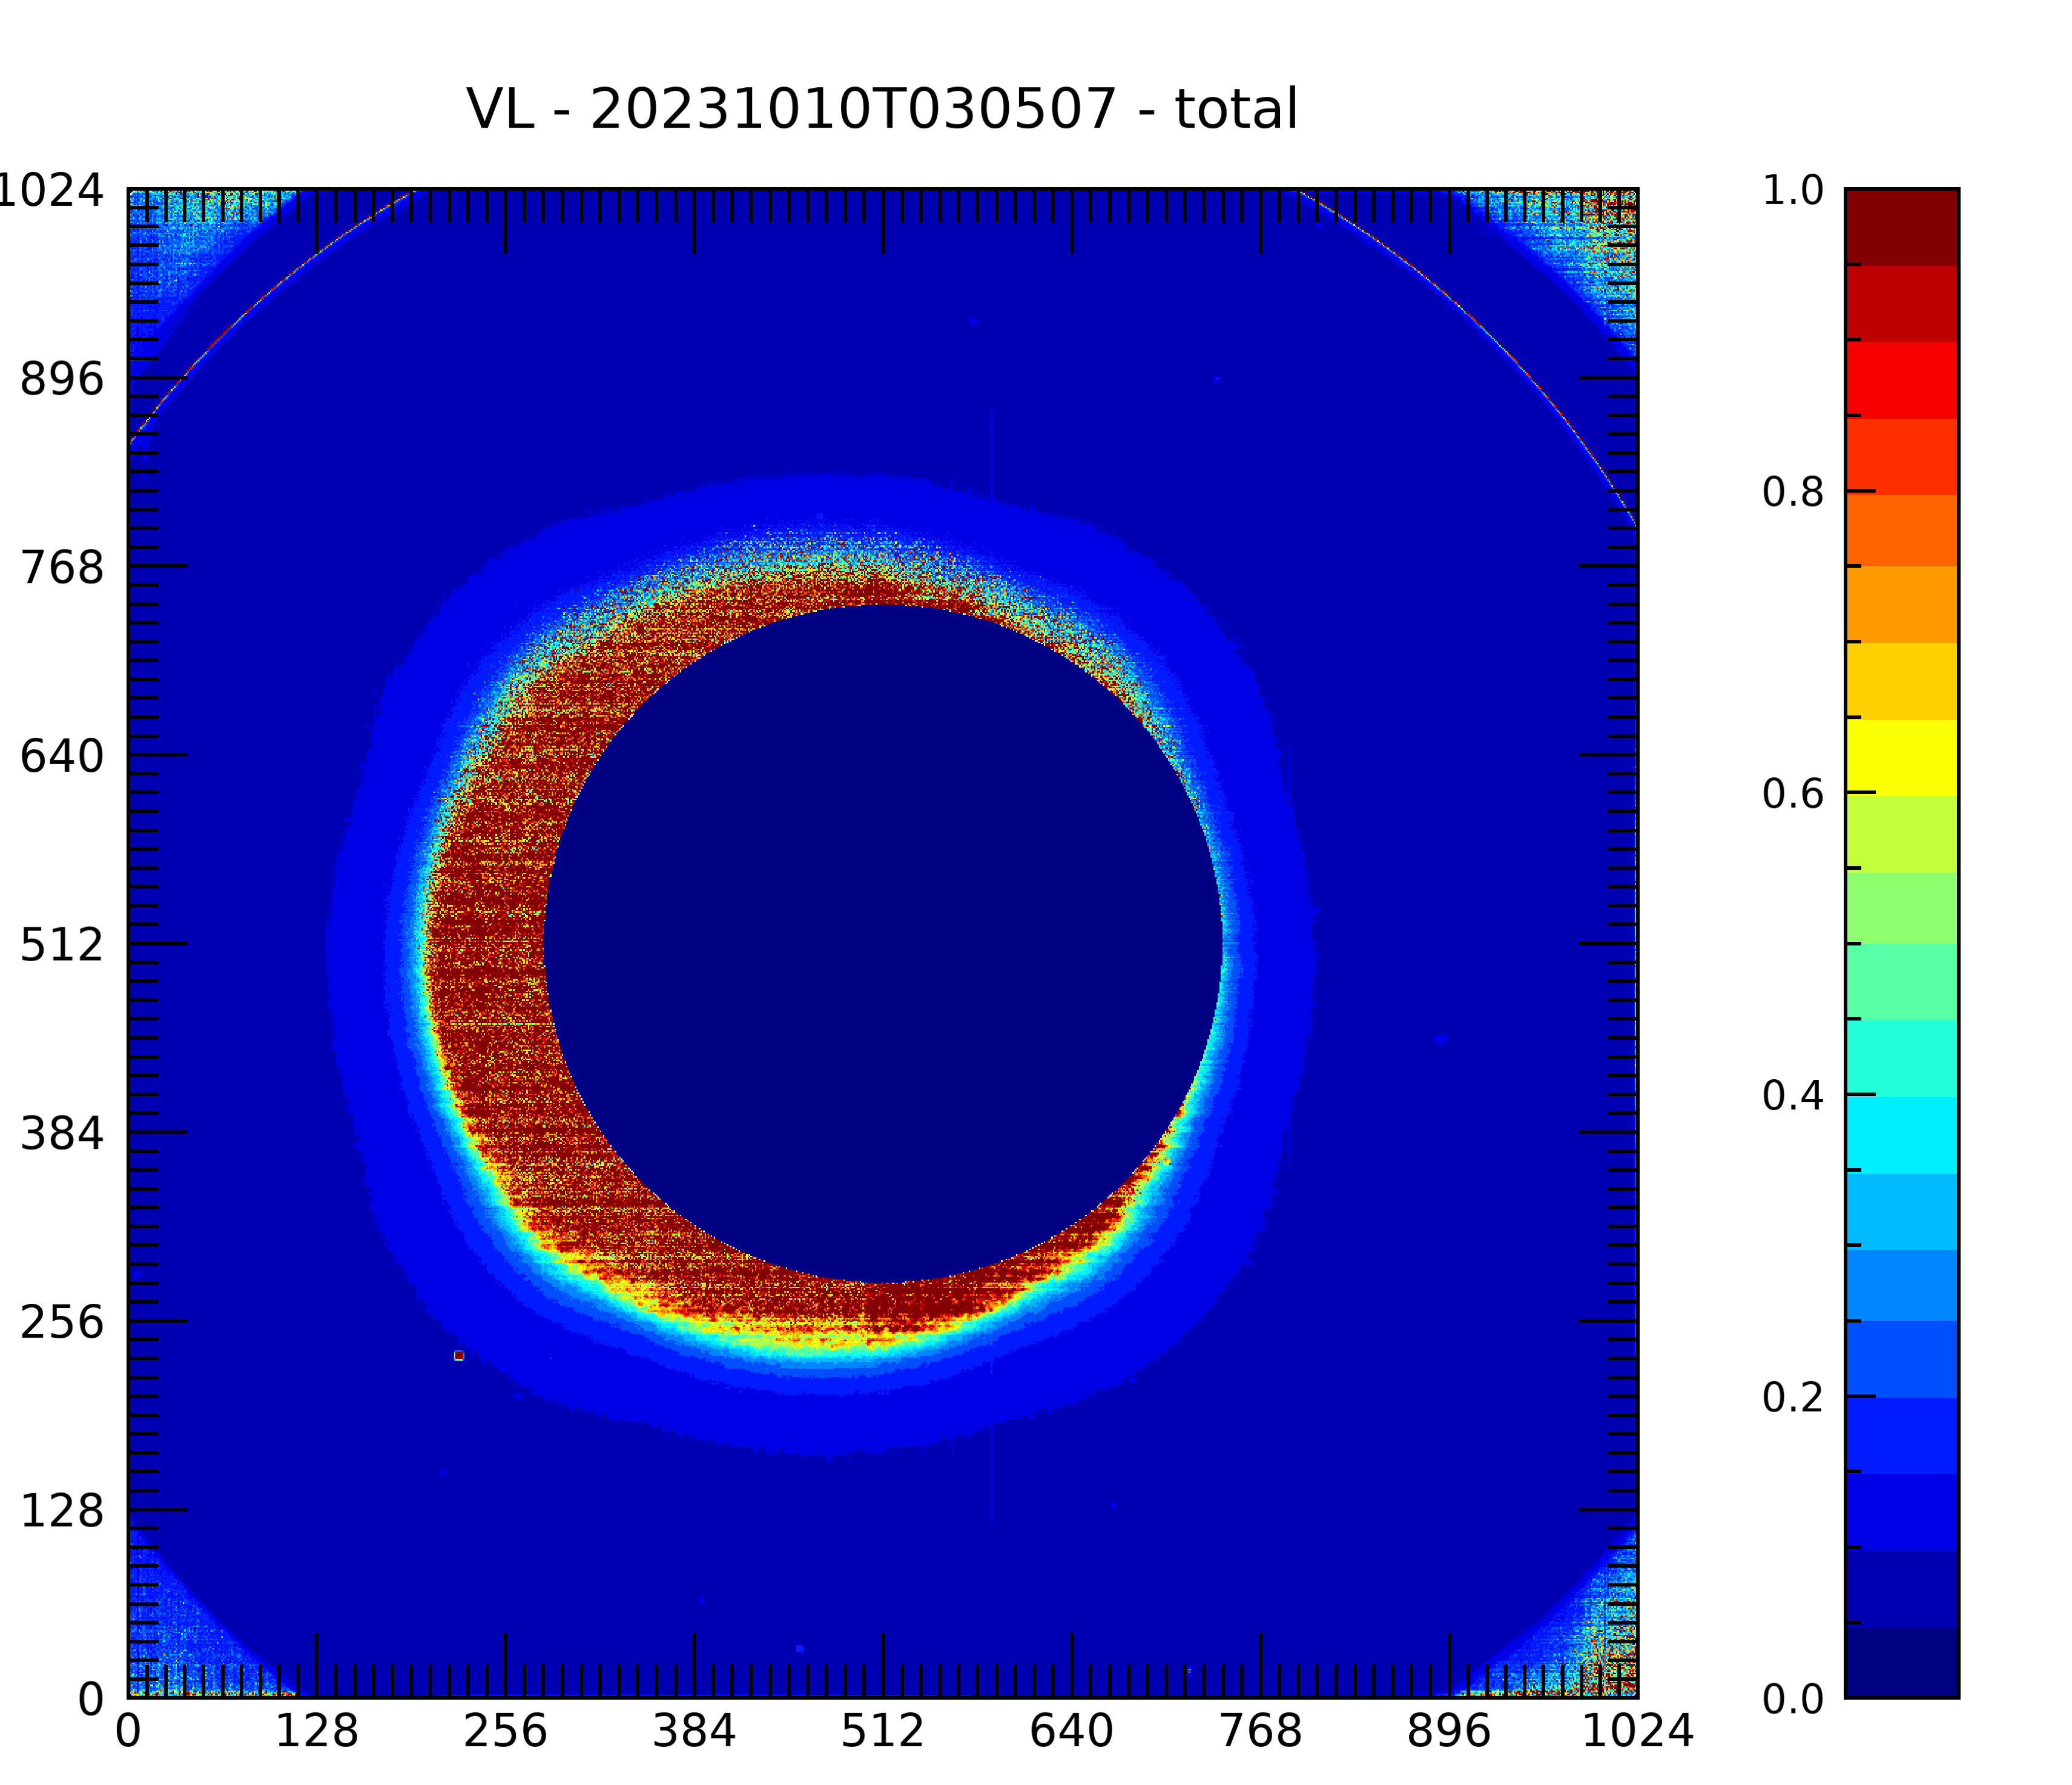
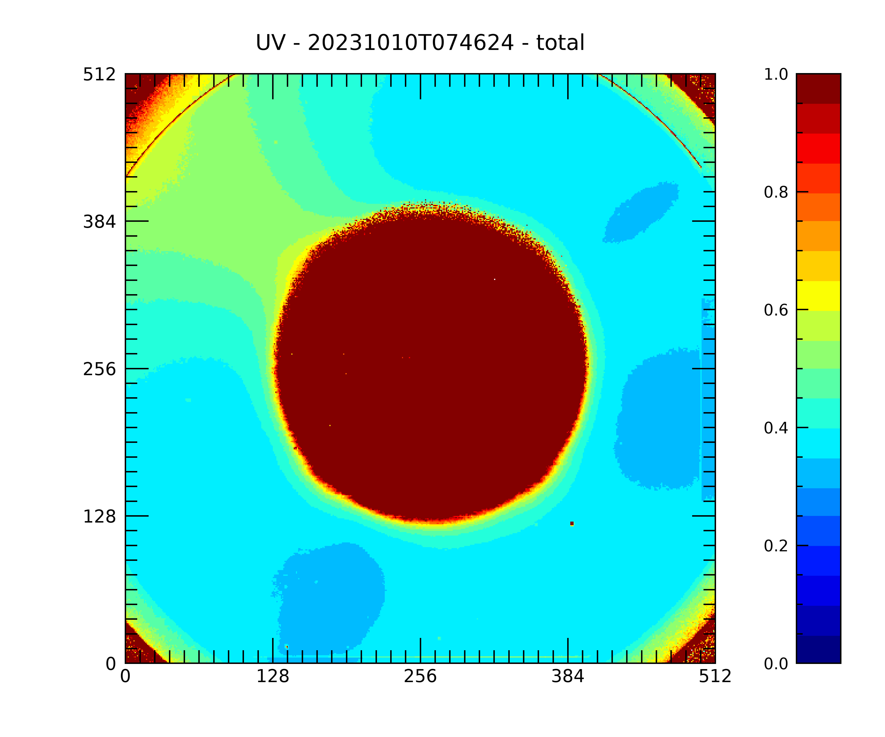
Radiometric calibration update
A major revision of Metis radiometric calibration was performed, yielding a factor reduction of ~ 1.4 for the VL and of ~ 1.18 for the UV data, due to:
correction in vignetting function normalizing factor (VL, UV)
stellar photometry (VL)
disk Mean Solar Brightness (MSB) normalizing factor (VL)
Metis Data Release 2.0 FITS data contain updated error matrices:
the error matrix calculation has been reviewed and updated taking into account statistical and systematic errors:
the statistical relative error matrix will be included in each FITS file
the systematic relative error matrix (mainly due to to the radiometric calibration) will be provided in a calibration package
the total relative error matrix is Err_{tot} = Err_{stat} + Err_{syst}
Example of Err_{tot} at 0.3 au

Slide 5
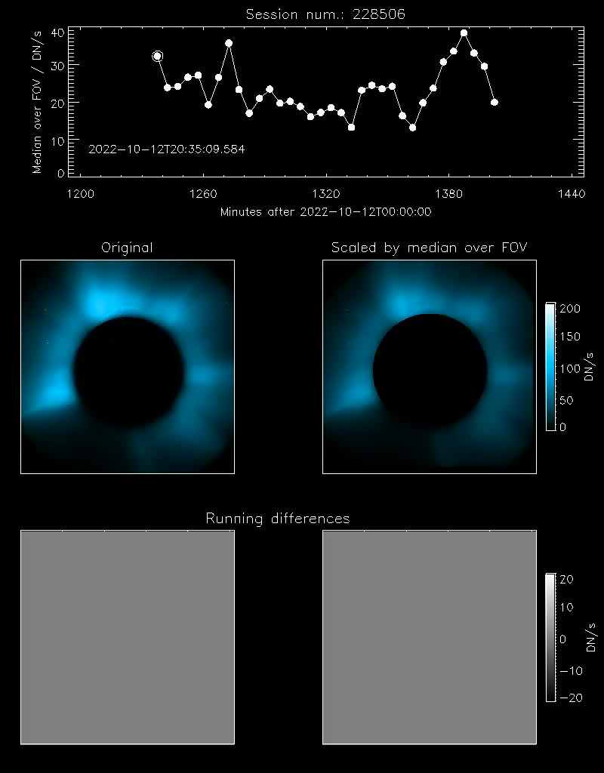
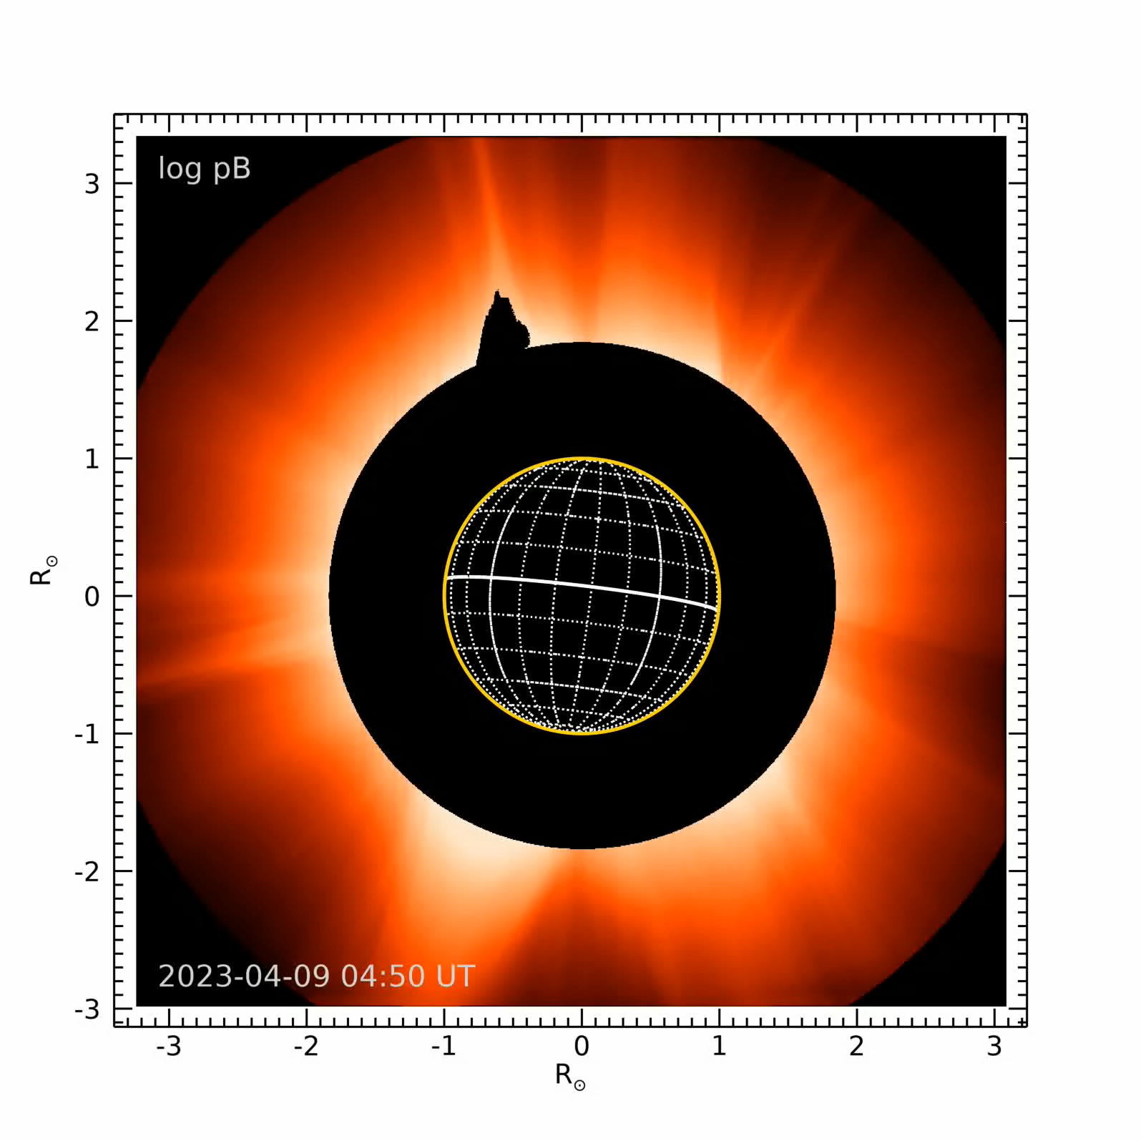
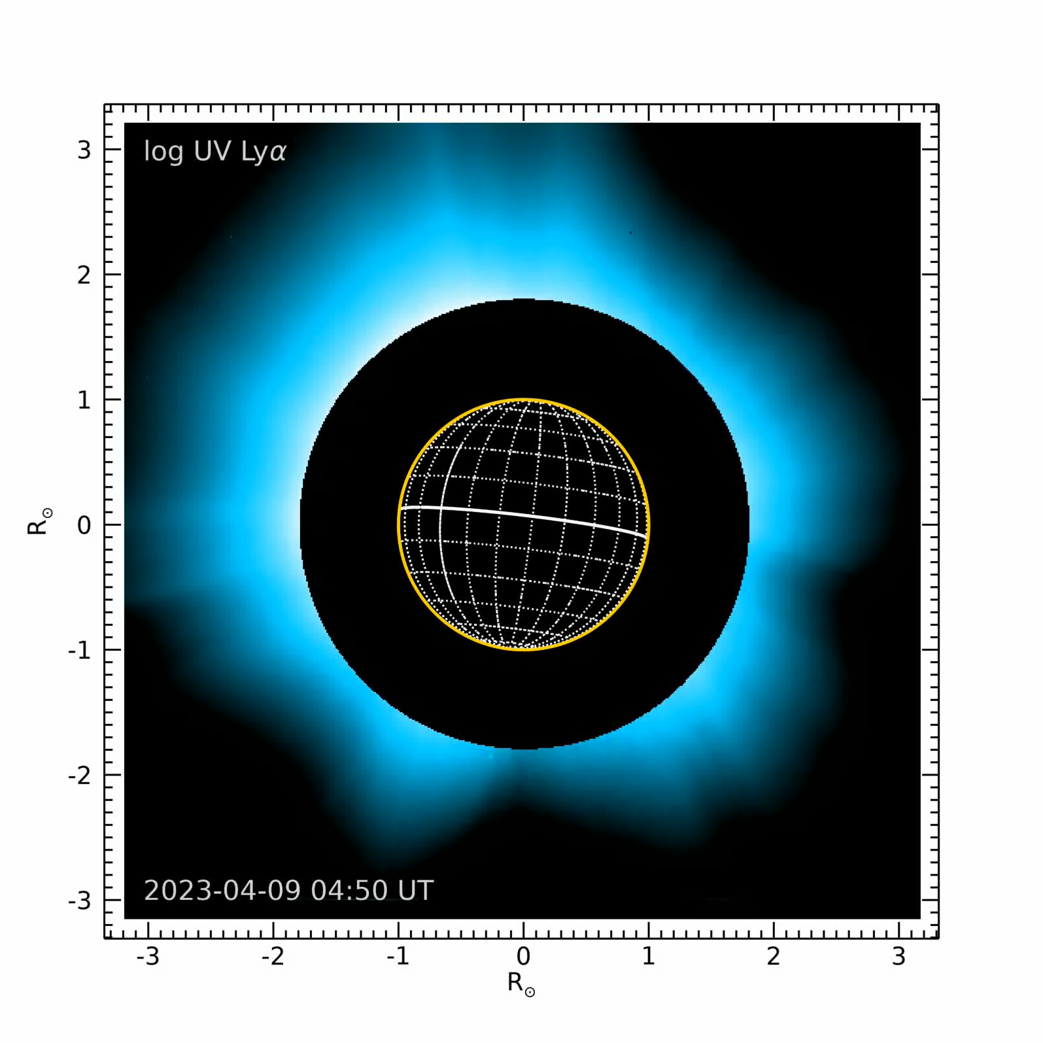
UVD anomaly
The UV detector displays a variable radiometric behaviour with periodic fluctuations in intensity
A deep investigation to understand and eventually correct the issue is in progress
Some tests carried out in mid 2025 are being analysed but the UVD still presents an anomalous behaviour
Courtesy of V. Andretta
Courtesy of V. Andretta

Slide 6

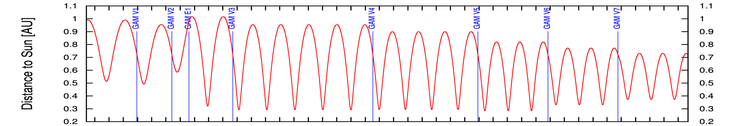
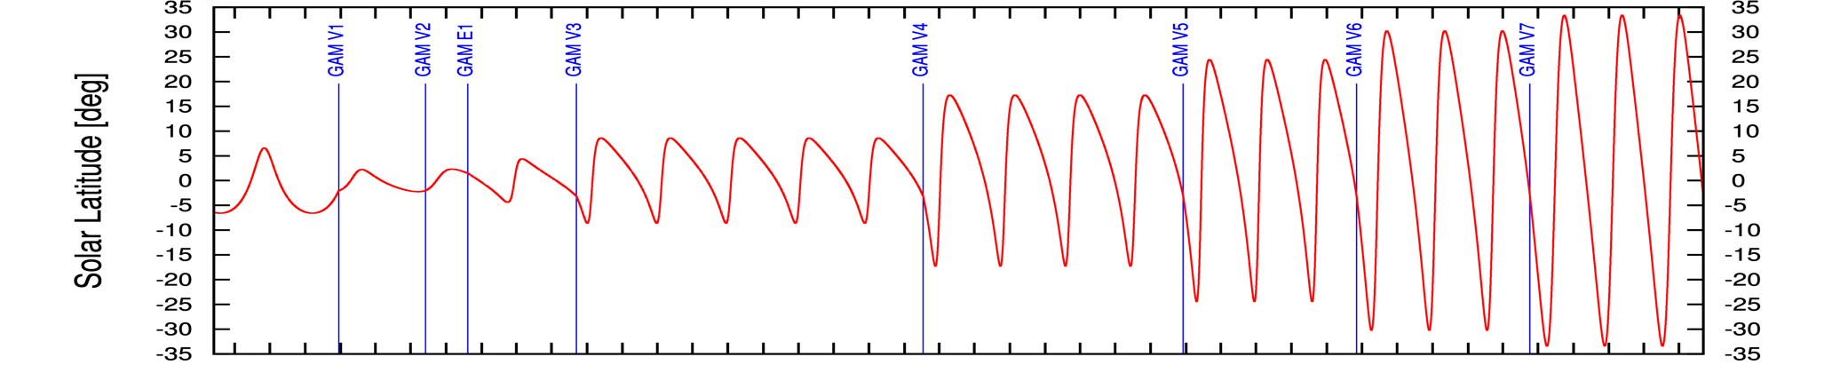
Solar Orbiter mission: where we are
Cruise
Nominal Mission
Extended Mission
In-situ instruments are operating 24/7
3 Remote-Sensing Windows of ~10 days each per ~6-month orbit, around perihelia, min./max. latitude and other interesting configurations
Plus: regular remote-sensing synoptic observations
±17° in Feb 2025
Notes:
Min. latitude - Perihelion - Max. Latitude
2024 MAR 24 2024 APR 04 2024 APR 28
-7.99 deg. 0.29 AU 7.99 deg.
2024 SEP 20 2024 SEP 30 2024 OCT 25
-7.99 deg. 0.29 AU 7.99 deg.
2025 MAR 22 2025 MAR 31 2025 APR 28
-16.8 deg. 0.29 AU 16.8 deg.
2025 SEP 07 2025 SEP 16 2025 OCT 14
-16.8 deg. 0.29 AU 16.8 deg.
2026 FEB 22 2026 MAR 03 2026 MAR 31
-16.8 deg. 0.29 AU 16.8 deg.
2026 AUG 10 2026 AUG 19 2026 SEP 16
-16.8 deg. 0.29 AU 16.8 deg.
2027 JAN 28 2027 FEB 06 2027 MAR 02
-23.5 deg. 0.28 AU 23.5 deg.
2027 JUN 27 2027 JUL 06 2027 JUL 29
-23.5 deg. 0.28 AU 23.5 deg.
2027 NOV 23 2027 DEC 03 2027 DEC 26
-23.5 deg. 0.28 AU 23.5 deg.
2028 APR 25 2028 MAY 07 2028 JUN 03
-29.6 deg. 0.32 AU 29.6 deg.
2028 SEP 22 2028 OCT 04 2028 OCT 31
-29.5 deg. 0.32 AU 29.6 deg.
2029 FEB 18 2029 MAR 03 2029 MAR 30
-29.6 deg. 0.32 AU 29.6 deg.
2029 JUL 23 2029 AUG 11 2029 SEP 06
-32.9 deg. 0.37 AU 33.0 deg.
2029 DEC 20 2030 JAN 08 2030 FEB 03
-33.0 deg. 0.37 AU 33.0 deg.
2030 MAY 19 2030 JUN 06 2030 JUL 03
-33.0 deg. 0.37 AU 33.0 deg.
——-
Venus GAM on:
2020 DEC 27
2021 AUG 09
2022 SEP 04
2025 FEB 18
2026 DEC 24
2028 MAR 18
2029 JUN 10
2030 SEP 02

Slide 7
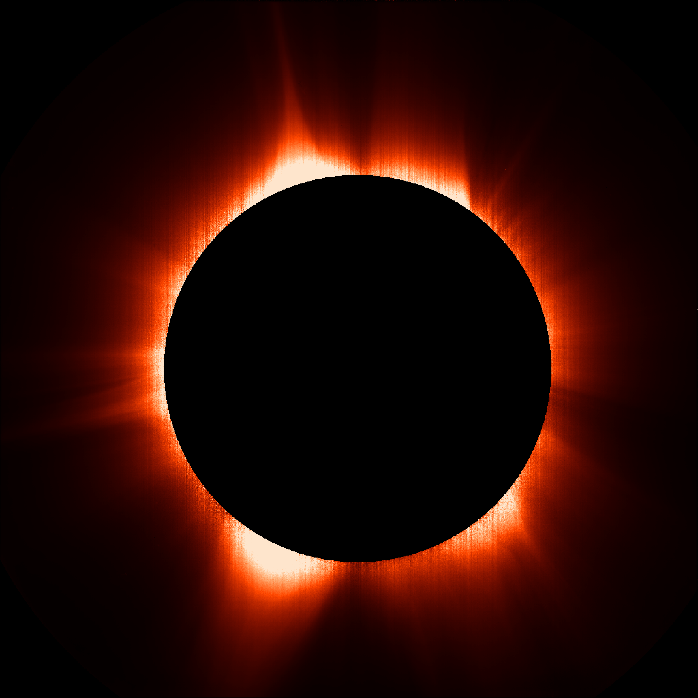
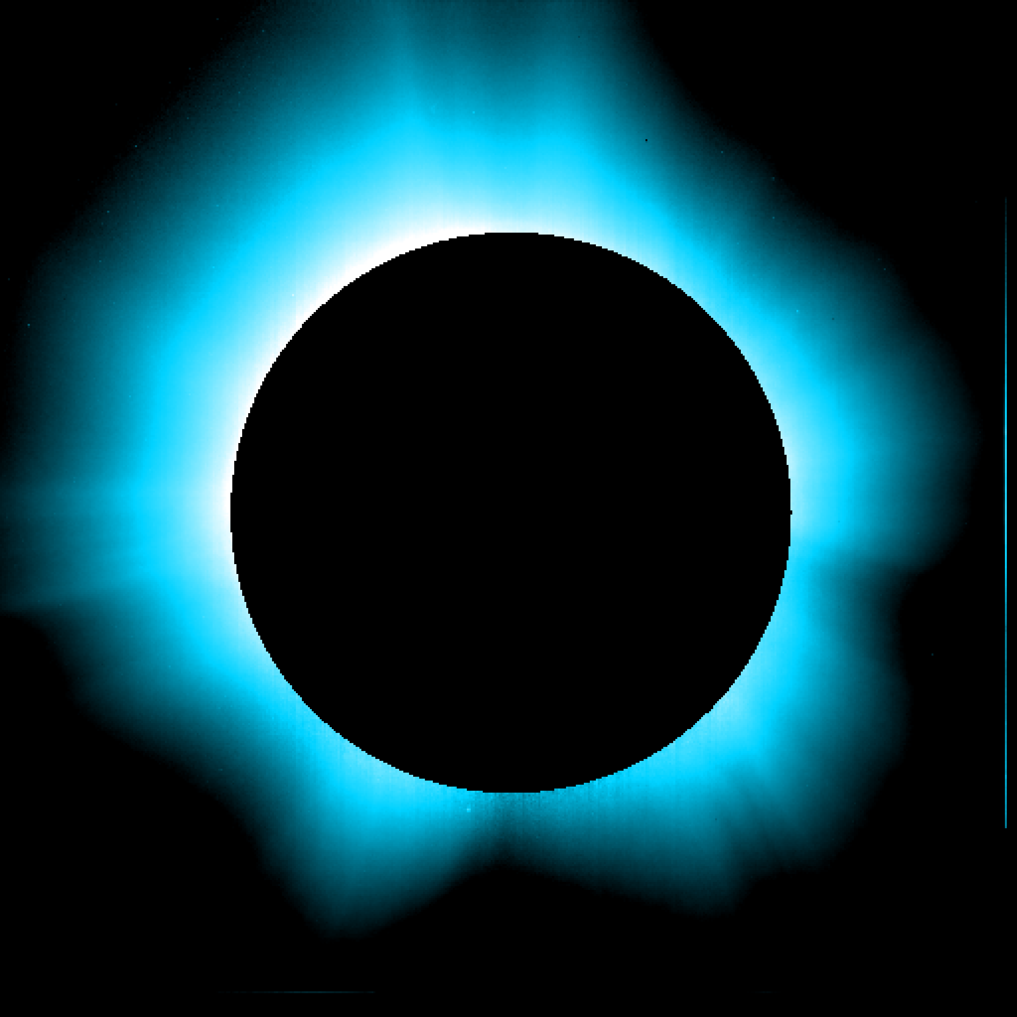
Metis science
Understanding coronal mass ejections (CMEs): propagation and evolution, physical parameters inside all features of the eruption (CME front, flux rope, shock front, eruptive prominence, current sheet and/or blobs)
Andretta+2021, Bemporad+2022, Heinzel+2023, Niembro+2023, Mierla+2023, Zimbardo+2023, Rodriguez+2023, Bemporad+2024, Frassati+2024, Russano+2024, Bemporad+2025, Amato+2026 submitted, Russano+2026 submitted, Jejčič+2026 submitted
Solar wind velocity on the plane of the sky by means of the Doppler dimming technique in several coronal structures (streamers, coronal holes, full corona)
Romoli+2021, Capuano+2021, Antonucci+2023, Telloni+2023, Ngampoopun+2025, Giordano+2025, Rivera+2026 in preparation
VL cosmic ray matrices to monitor the galactic and solar proton flux during the solar cycle
Grimani+2021, 2023, 2024, 2026
VL imaging
UV imaging
Solar system objects: comets, asteroids
Bemporad+2023, Corso+2026 in preparation
F-corona
UV stars
Structure and dynamics of the full corona: magnetic field morphology, steady coronal features
Vasquez+2023, 2024, Abbo+2025
Unprecedented temporal cadence (> 1s) and spatial resolution (> 5000 km)
Synergy with space and ground based assets
(PSP, SOHO, STEREO, DKIST, and more)
Electron density fluctuations observed in the VL, propagating blobs, and wave structures at different frequencies
Ventura+2023, Andretta+2025, Romano+2025, Ventura+2026 submitted, Andretta+2026 in preparation
Evolution of the coronal dynamic and thermal state into the heliosphere (PSP quadrature)
Telloni+2021, 2022, 2023
Switchbacks in the solar magnetic field
Telloni+2023

Slide 8
Metis scientific outcome

Slide 9
Solar Orbiter mission: where we are going
Cruise
Nominal Mission
Extended Mission
More perihelia at 0.29 au
±24° in Jan 2027
±30° in Apr 2028
±33° in Jul 2029
Notes:
Min. latitude - Perihelion - Max. Latitude
2024 MAR 24 2024 APR 04 2024 APR 28
-7.99 deg. 0.29 AU 7.99 deg.
2024 SEP 20 2024 SEP 30 2024 OCT 25
-7.99 deg. 0.29 AU 7.99 deg.
2025 MAR 22 2025 MAR 31 2025 APR 28
-16.8 deg. 0.29 AU 16.8 deg.
2025 SEP 07 2025 SEP 16 2025 OCT 14
-16.8 deg. 0.29 AU 16.8 deg.
2026 FEB 22 2026 MAR 03 2026 MAR 31
-16.8 deg. 0.29 AU 16.8 deg.
2026 AUG 10 2026 AUG 19 2026 SEP 16
-16.8 deg. 0.29 AU 16.8 deg.
2027 JAN 28 2027 FEB 06 2027 MAR 02
-23.5 deg. 0.28 AU 23.5 deg.
2027 JUN 27 2027 JUL 06 2027 JUL 29
-23.5 deg. 0.28 AU 23.5 deg.
2027 NOV 23 2027 DEC 03 2027 DEC 26
-23.5 deg. 0.28 AU 23.5 deg.
2028 APR 25 2028 MAY 07 2028 JUN 03
-29.6 deg. 0.32 AU 29.6 deg.
2028 SEP 22 2028 OCT 04 2028 OCT 31
-29.5 deg. 0.32 AU 29.6 deg.
2029 FEB 18 2029 MAR 03 2029 MAR 30
-29.6 deg. 0.32 AU 29.6 deg.
2029 JUL 23 2029 AUG 11 2029 SEP 06
-32.9 deg. 0.37 AU 33.0 deg.
2029 DEC 20 2030 JAN 08 2030 FEB 03
-33.0 deg. 0.37 AU 33.0 deg.
2030 MAY 19 2030 JUN 06 2030 JUL 03
-33.0 deg. 0.37 AU 33.0 deg.
——-
Venus GAM on:
2020 DEC 27
2021 AUG 09
2022 SEP 04
2025 FEB 18
2026 DEC 24
2028 MAR 18
2029 JUN 10
2030 SEP 02

Slide 10
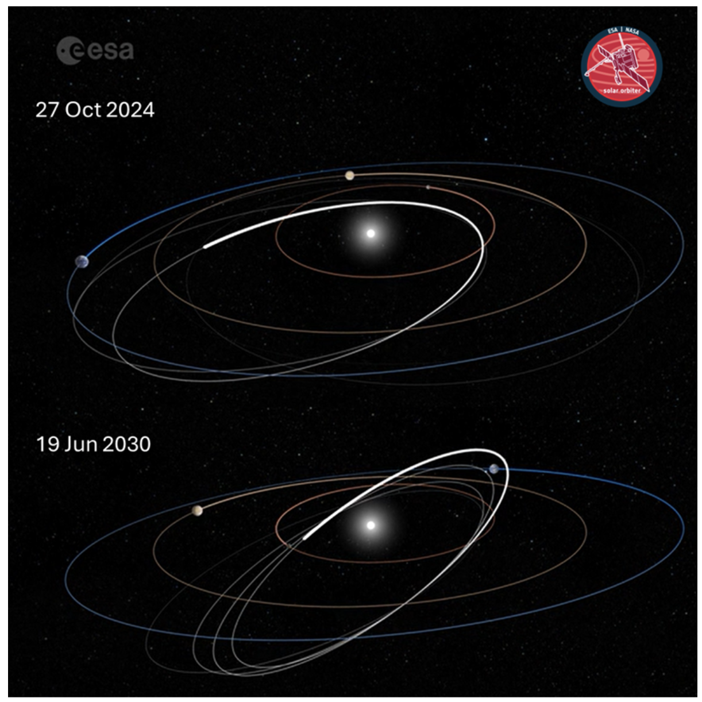
Out-of-ecliptic science
The out-of-ecliptic vantage point offers the opportunity to observe for the first time the corona from mid-latitudes and to investigate:
the longitudinal extent of coronal features and solar wind and correlations with possible longitudinal patterns related to the magnetic field polarity
the longitudinal structure of propagating CMEs and correlation with their geo-effectiveness
the galactic cosmic rays modulation out-of-ecliptic
Ideas and contributions are very welcome!

Slide 11
Metis priorities for 2026
Proposed Observing Programs (SOOPs)
Pole-to-Pole (Coord. A. Burtovoi):
latitudinal scan of solar corona for morphology, 3D latitudinal tomography, and F-corona
cosmic rays pole-to-pole scan
Density-Fluctuations (Coord. V. Andretta):
high-cadence observations (< 1 min) across and away from perihelia (distance ~ 0.35 au), to observe the corona up or above 4 solar radii
Eruption-Watch (Coord. C. Sasso & Y. De Leo):
observations of latitudinal structure of CMEs, combination of medium and high-cadence observations
Coronal-Hole-Boundary-Expansion (Coord. R. Susino & A. Giunta):
new “flavour” with simultaneous observations by Metis and SPICE above 0.5 au
Coronal-He-Abundance (Coord. V. Andretta & F. Auchère):
Metis + EUI in coronagraphic mode above 0.45 au
Probe-Quadrature (Coord. A. Liberatore):
in-situ and remote-sensing observations of the solar wind

Slide 12
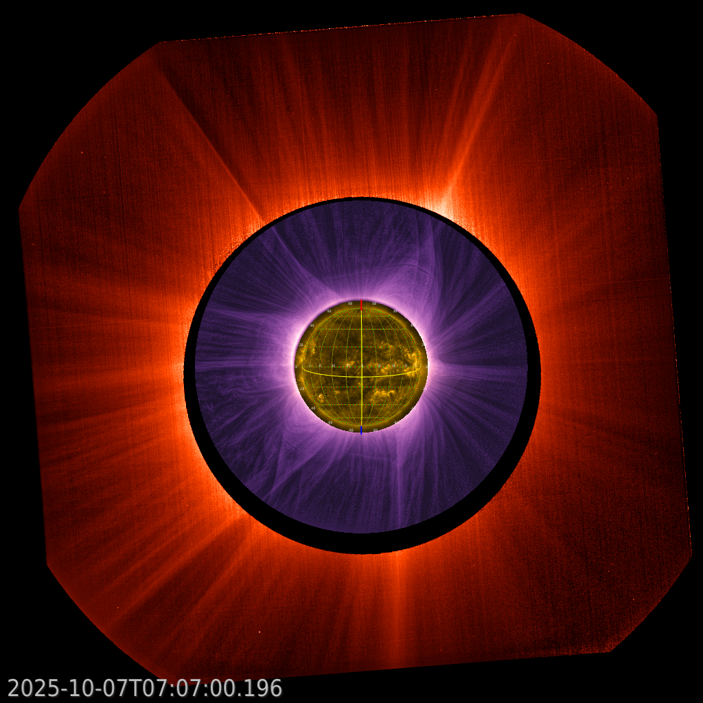
Metis priorities for 2026
Coordinated observations across the Sun-Earth line
Metis/PROBA-3 – coronagraphic observations extending from close to the limb to the outer FOV of Metis:
12-16 Aug 2025 (superior conjunction)
14-18 Sep 2025 (quadrature with ASPIICS + PSP)
4-9 Oct 2025 (inferior conjunction)
18-24 Jan 2026 (within 10 degrees from inferior conjunction)
Metis/PUNCH – observations for cross-calibration:
10 Jan 2026 (within 10 degrees from inferior conjunction)
Metis + ASPIICS + EUI 174

Slide 13
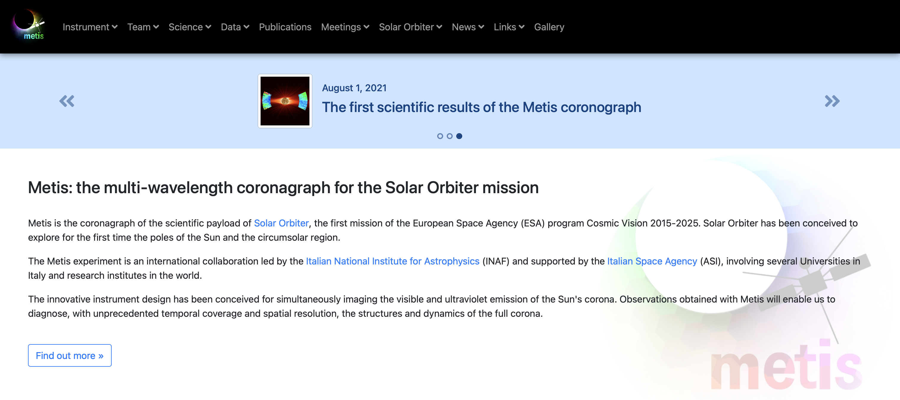
Metis website
www.metis.oato.inaf.it

Slide 14
Thank you!

