Slide 1
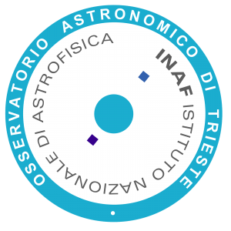


Preliminary characterization of the Metis ultraviolet Point Spread Function
Chiara Casini
Co-authors: Paolo Chioetto; Fabio Frassetto; Alain Jody Corso; Antony Herald; Federico Landini; Marco Romoli; Paola Zuppella; Vania Da Deppo and the Metis Team
C. Casini - 10th Metis Workshop

Slide 2

Outline
Context : calibration stars crossing Metis Field Of View
Preprocessing routine and stellar extraction
Calibration stars
Spatial and temporal coverage
PSF results
Stellar profiles in Field of View
Aberration characterization
Conclusion & Perspectives
3
4
C. Casini - 10th Metis Workshop
1

Slide 3
Subdark Correction
Background Subtraction Process:
Subdark images with DIT-matched integration times include bias correction from occulted corner regions for short-timescale bias variation.
3
Enables accurate background subtraction for precise PSF measurements
4
C. Casini - 10th Metis Workshop
2

Slide 4
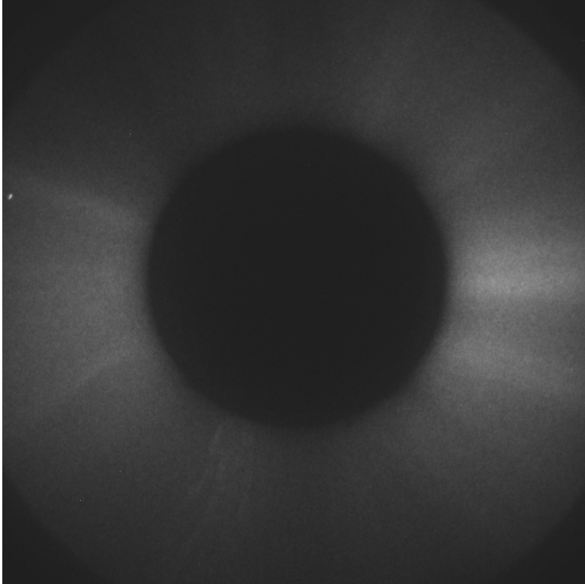
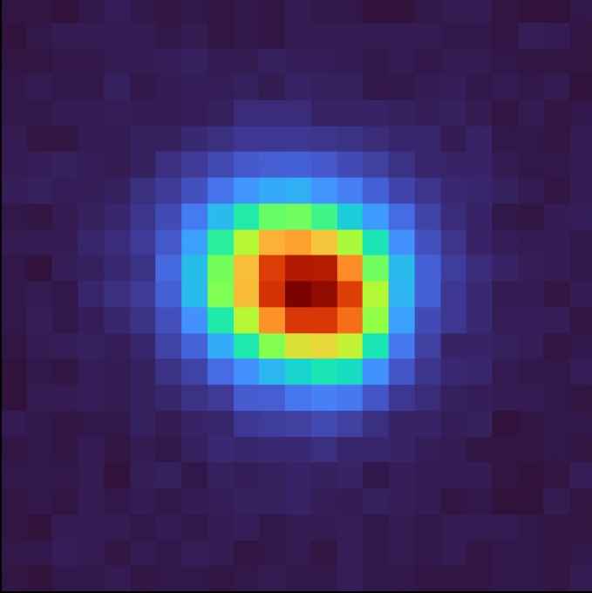
Stellar Cutout Extraction
Individual stellar images extracted from full-frame METIS images (UV and VL)
Process
Star detection via peak finding (through Spice Kernel + Symbad Catalogue)
Centroid refinement ± 3 pixels
Cutout window extraction (Size: 23 pixels)
SELECTED Period: June 2022 - March 2024 • UV band • Vmag < 5.0 • No binning, NDIT1 = 1
C. Casini - 10th Metis Workshop
3

Slide 5
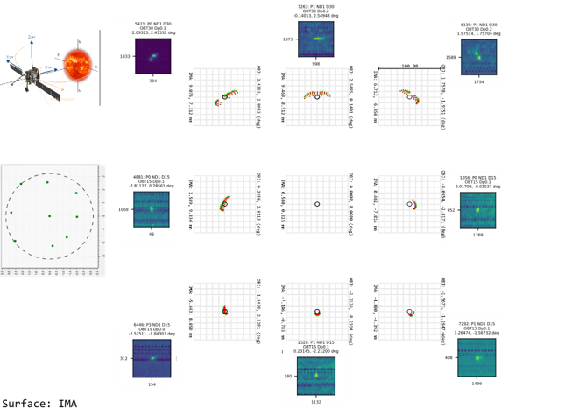
Star Distribution Across Field
PSF is splitted when the light interact
with the spider.
Split of the light, impact on the correct detection of the:
Corona’s Temperature
Corona’s Density
It’s important a right correction
C. Casini - 10th Metis Workshop
4

Slide 6
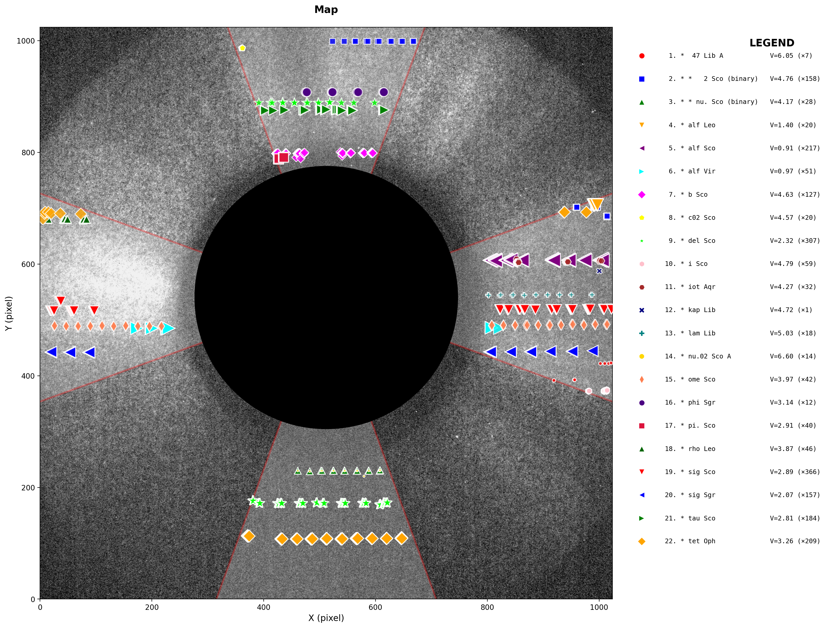
Star Distribution Across Field (No Spider)
Top 5 Stars
🥇 sig Sco
366
🥈 del Sco
307
🥉 alf Sco
217
• tet Oph
209
• tau Sco
184
1283 positions visualized
C. Casini - 10th Metis Workshop
5

Slide 7
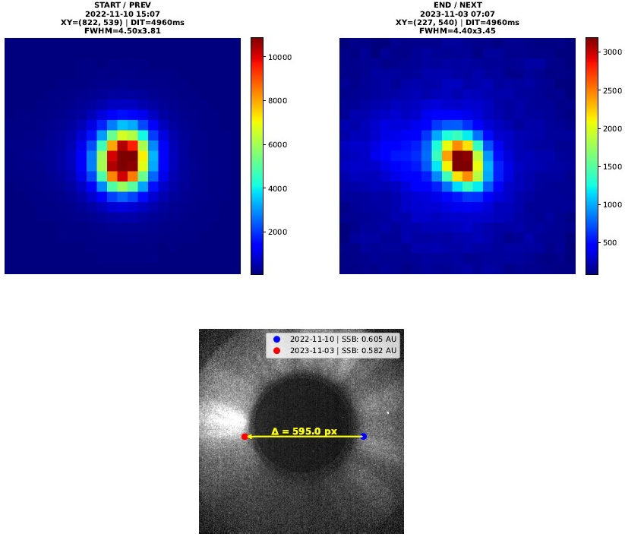
Spatial and Temporal Coverage 1/3
* Alf Vir
Δt=357 days
Different location
Distance:
Solar Orbiter - Solar System Baricenter
C. Casini - 10th Metis Workshop
7

Slide 8
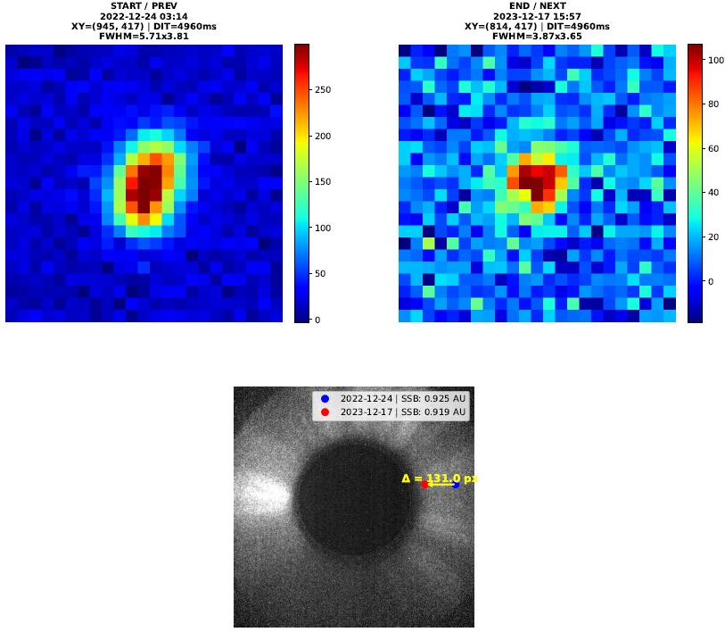
Spatial and Temporal Coverage 2/3
* Alf Sco
Δt=358 days
Similar location
Distance:
Solar Orbiter - Solar System Baricenter = 0.006 AU
C. Casini - 10th Metis Workshop
8

Slide 9
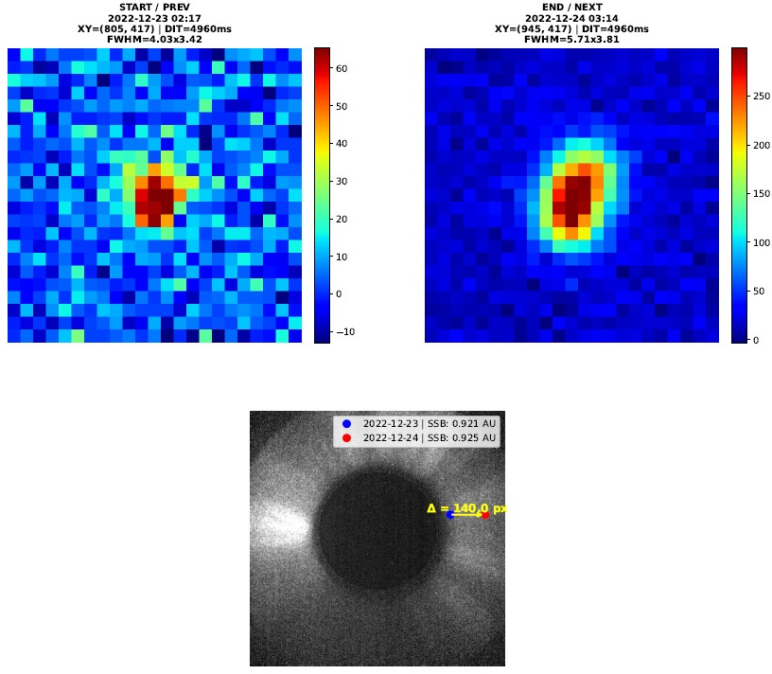
Spatial and Temporal Coverage 3/3
* Alf Sco
Δt=1 days
Similar location
Distance:
Solar Orbiter - Solar System Baricenter = 0.003 AU
C. Casini - 10th Metis Workshop
9

Slide 10
PSF/FWHM: Richardson-Lucy Deconvolution
Methodology
1. Wiener deconvolution
Extract real PSF from each observation vs. ideal Gaussian (FWHM = 4 px)
2. Richardson-Lucy (30 iter.)
Re-deconvolve star with recovered PSF
3. Reconstruction check
Instrumental ⊗ Corrected Star ≈ Original
Iterative deconvolution algorithm to improve PSF measurements and characterize the instrument PSF from observed stellar images
Original (cutout)= Instrumental ⨂ Star
C. Casini - 10th Metis Workshop
10

Slide 11
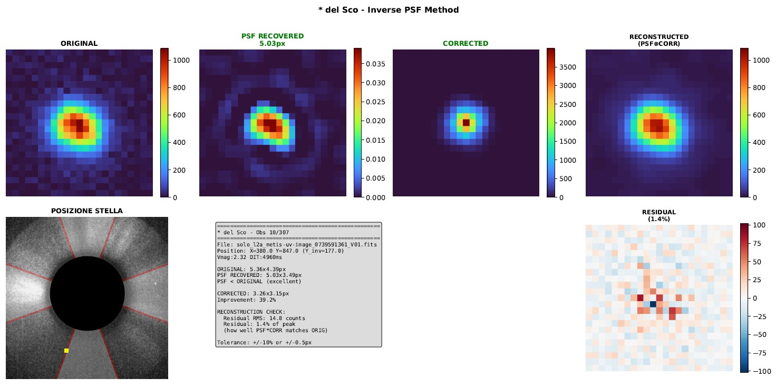
Richardson-Lucy Results
Example deconvolution results showing PSF improvement 1/4
* Del Sco
PSF Recovered:
Instrumental
Corrected:
Star
Reconstructed
C. Casini - 10th Metis Workshop
11

Slide 12
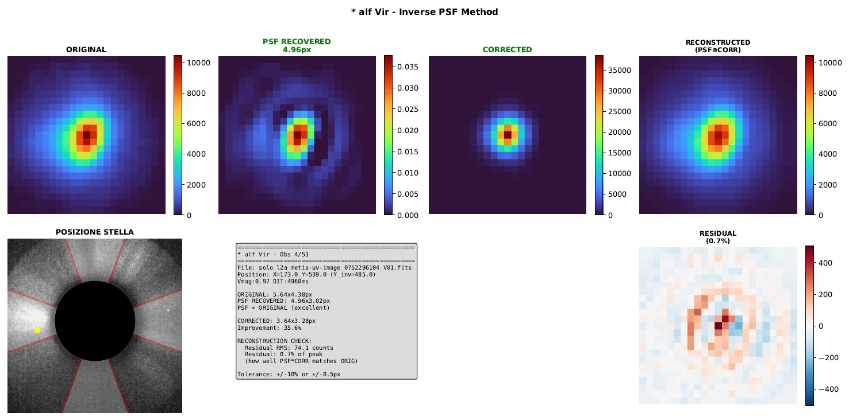
Richardson-Lucy Results
Example deconvolution results showing PSF improvement 2/4
* Alf Vir
PSF Recovered:
Instrumental
Corrected:
Star
Reconstructed
C. Casini - 10th Metis Workshop
12

Slide 13
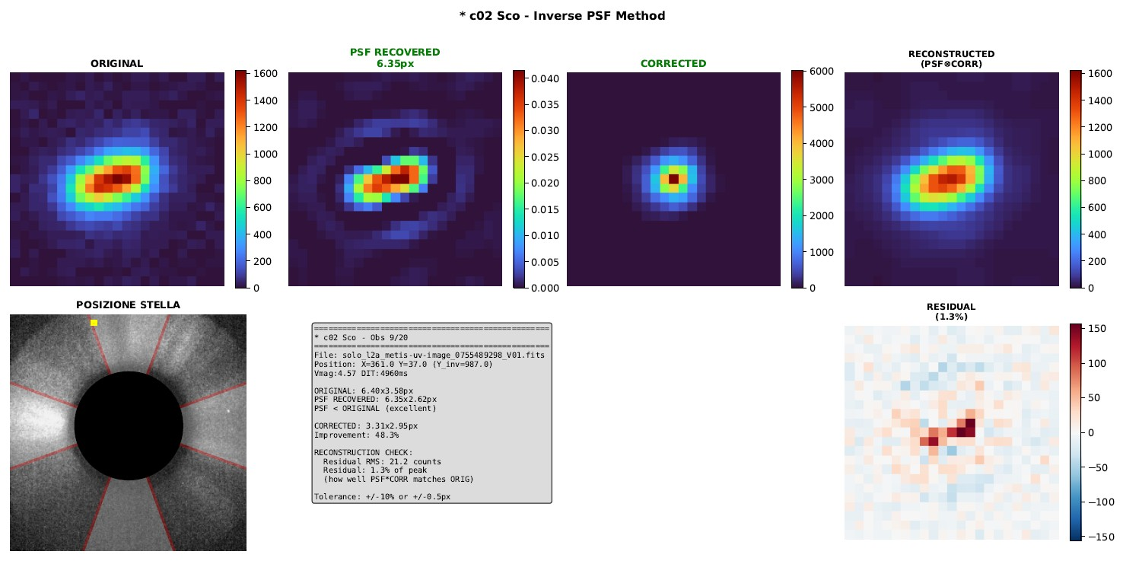
Richardson-Lucy Results
Example deconvolution results showing PSF improvement 3/4
* C02 Sco
PSF Recovered:
Instrumental
Corrected:
Star
Reconstructed
C. Casini - 10th Metis Workshop
13

Slide 14
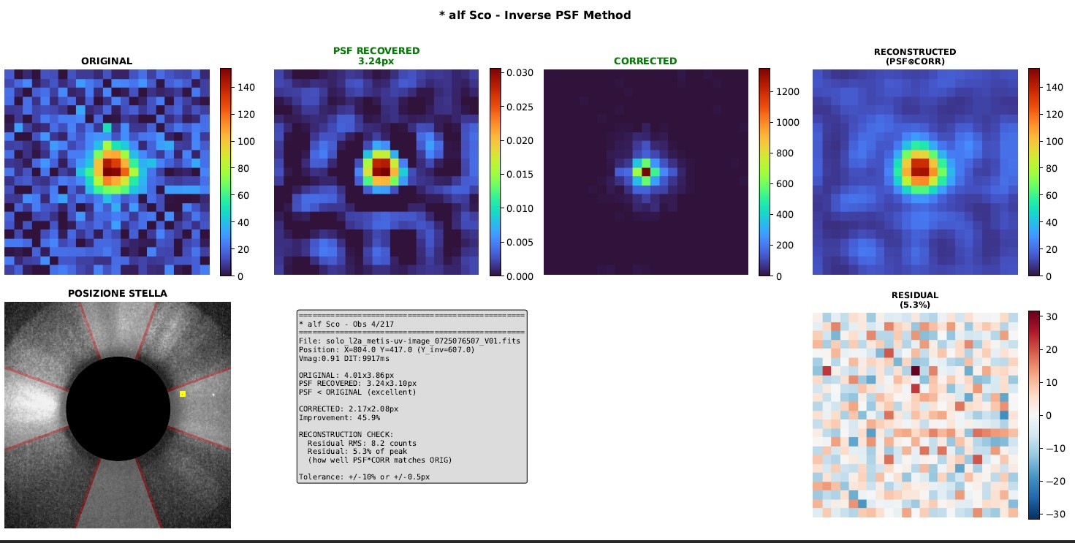
Richardson-Lucy Results
Example deconvolution results showing PSF improvement 4/4
* Alf Sco
PSF Recovered:
Instrumental
Corrected:
Star
Reconstructed
C. Casini - 10th Metis Workshop
14

Slide 15
PSF/FWHM: Richardson-Lucy Deconvolution
Key Results
• 22 unique stars
• 31 total PDFs for each star
• Split for >150 obs
• 2000 observations
Dataset Overview
2000
1942
22
Original Obs
After Filters
Unique Stars
C. Casini - 10th Metis Workshop
15

Slide 16
Zernike Polynomial Parameters
What are Zernike Polynomials?
Orthogonal polynomials on a unit circle providing a mathematical framework to describe wavefront aberrations in optical systems.
Key Aberration Types
Z4: Defocus
Radially symmetric blur
Z3, Z5: Astigmatism
Directional elongation (0° & 45°)
Z7, Z8: Coma
Comet-like distortion (X & Y)
Z12: Spherical
Radial aberration variation
Method: Derived from instrumental PSF by fitting PSF shape to Zernike decompositions
C. Casini - 10th Metis Workshop
16

Slide 17
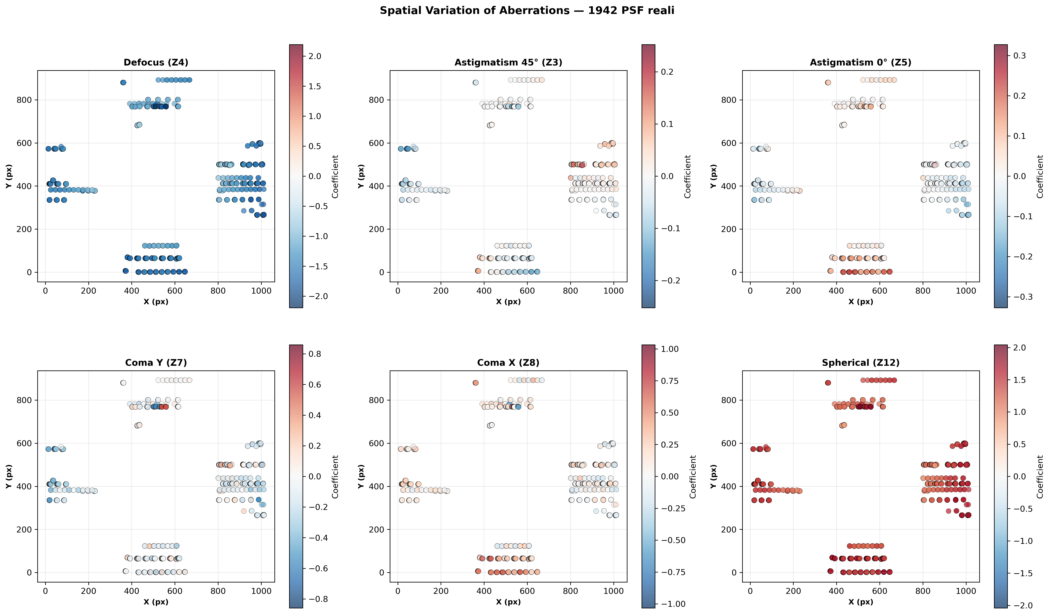
Measured Zernike Coefficients (1)
Dominant aberrations: Defocus and Spherical aberration
C. Casini - 10th Metis Workshop
17

Slide 18
Conclusions
Main Results
✓
Richardson-Lucy deconvolution is a good method to know Metis instrument PSF
✓
The original cutout and the reconstructed are similar with a difference between 8 - 20 %
✓
Complete instrumental PSF characterization across 2000 observations
✓
Spatial aberration variations identified (defocus, astigmatism, coma, spherical)
C. Casini - 10th Metis Workshop
18

Slide 19
Future Perspectives
1
PSF Modeling using zemax
Try to minimize the noise around the stars
2
Cross-Validation
Comparison with other METIS observations (increase the temporal coverture)
3
PSF Maps
We can try to create a map that correct the aberration on the Metis UV channel
4
Algorithm Optimization
Refinement & alternative deconvolution methods (using LLM)
C. Casini - 10th Metis Workshop
19

Slide 20
Thank You!
Thanks!
Questions?
C. Casini - 10th Metis Workshop

Slide 21
Thank You!
Questions?
C. Casini - 10th Metis Workshop
16

Slide 22
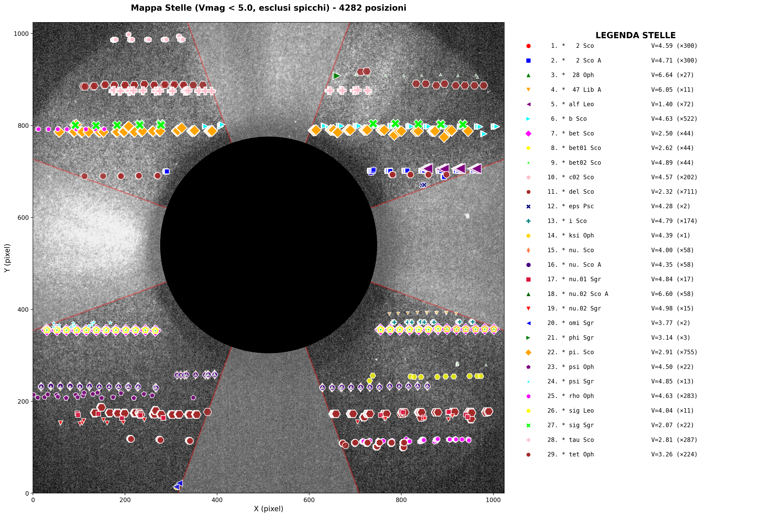
Star Distribution Across Field (Spider)
C. Casini - 10th Metis Workshop
6

Slide 23
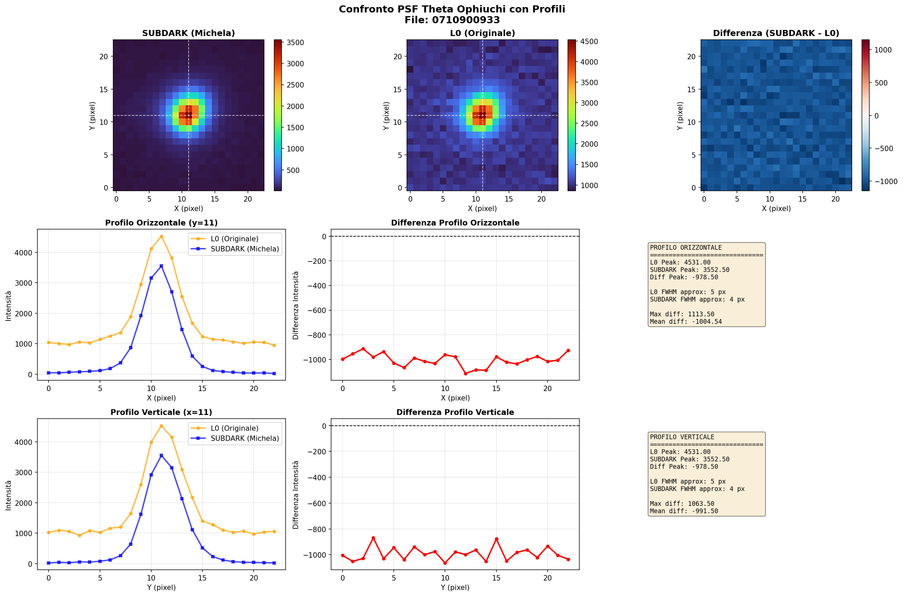
Thank You!
Questions?
C. Casini - 10th Metis Workshop
16

