Slide 1

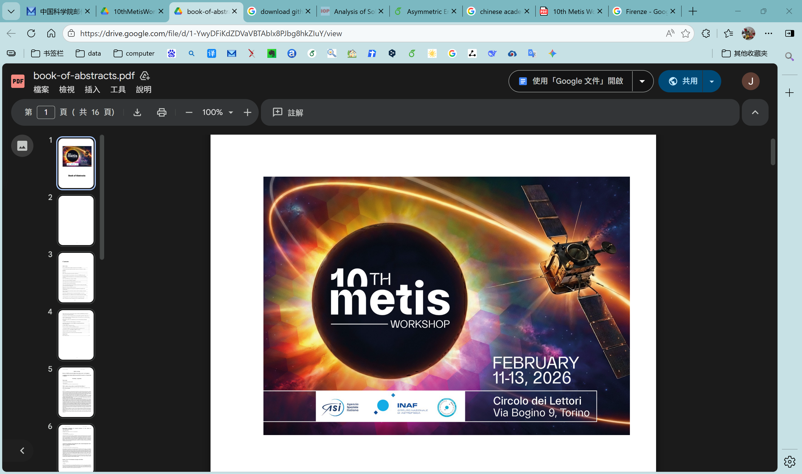

Asymmetric Eruption and Nonradial Propagation of a Solar Filament
Jianchao Xue*, Li Feng*, Jun Chen*, Marco Romoli**
*Purple Mountain Observatory, CAS, Nanjing, China
**University of Firenze, Florence, Italy
Torino, 2026-02

Slide 2
00
Table of contents
Introduction
- Solar eruption mechanisms
- Asymmetric eruptions, nonradial propagation, & their causes
Observations
Results
- Uniqueness of the filament eruption event
- Asymmetric eruption precursors
- nonradial propagation with CME
Discussion & summary

Slide 3
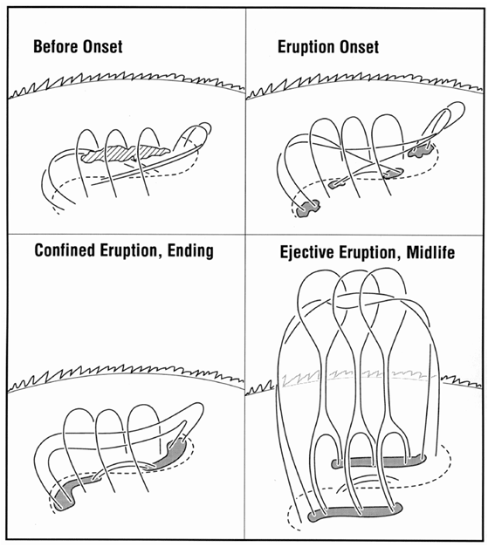
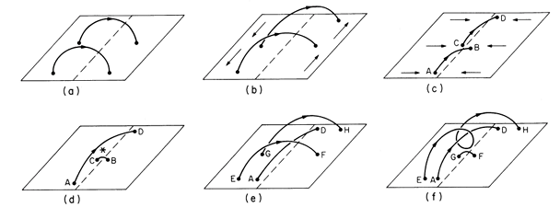
01
Introduction
Solar eruption mechanisms:
(Green et al. 2018)
Trigger:
Enhancing current in the core fields
Weaking the overlying magnetic field
Driver:
Torus instability (catastrophe)
Resistive magnetic reconnection
Flux cancellation (van Ballegooijen & Martens 1989)
Tether-cutting (Moore et al. 2001)
Notes:
As an example, shearing motion along with magnetic flux cancellation can convert arcade field to the helical field, and contribute to the formation and eruption of magnetic flux ropes. In the tether-cutting model, the flux cancellation convert the overlying magnetic field to the core field, so both the two trigger conditions are fulfilled. Whether the eruption is successful depends on the driver.

Slide 4
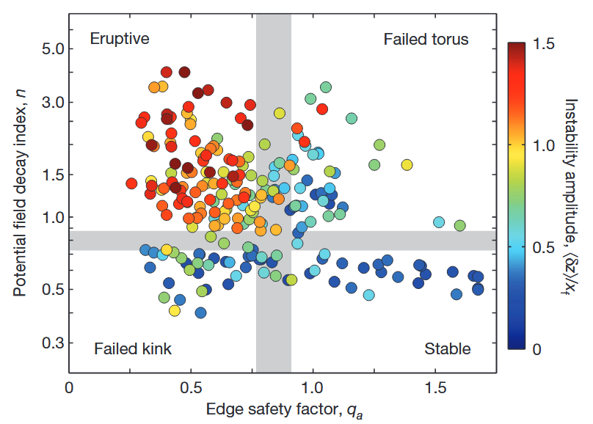
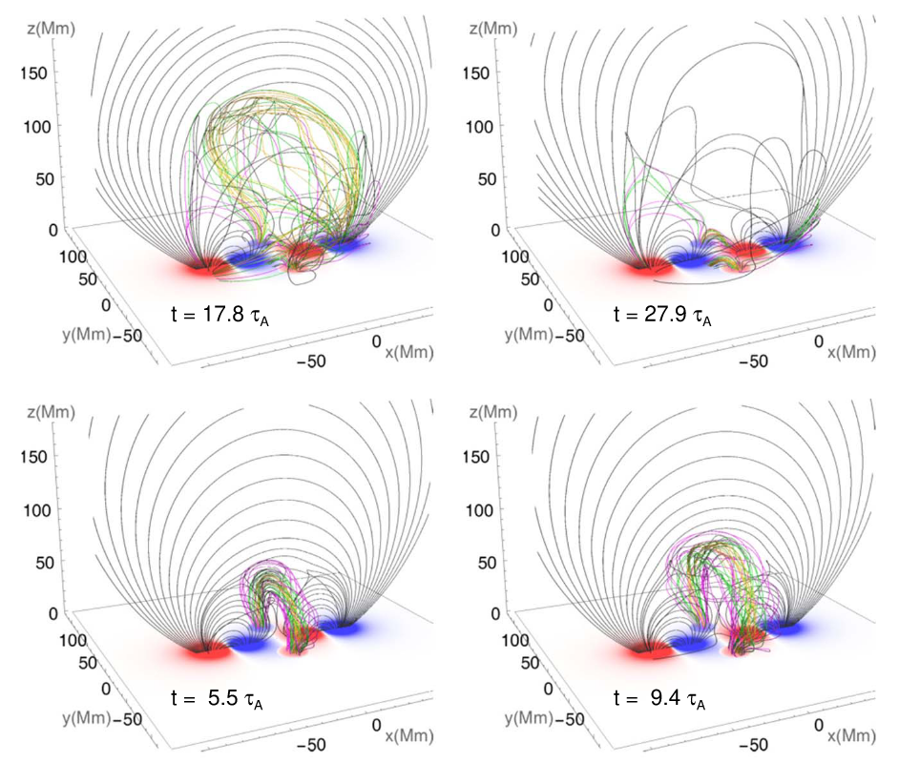

01
Introduction
Torus instability:
(Kliem & Tӧrӧk 2006)
Strapping force due to external poloidal magnetic field decreases faster with increasing R than the hoop force.
(Myers et al. 2015)
Decay index:
$$n=\frac{\text{dln}B_{\text{ep}}(R)}{\text{dln}R}$$
Critical value: 1.5 (circular), 1 (straight)
Failed torus-unstable regimes:
Confined by external toroidal field
Destruction of the flux rope
The flux rope enters the breakout reconnection
(Chen, J. et al. 2023)
Notes:
Note that the decay index only described the decay of overlying magnetic field, if we only consider the expansion of a magnetic flux rope. But magnetic flux ropes have different performance in solar eruptions, so there are some failed-torus regimes, It means that even though the decay index is larger than the critical value, the eruption could be failed. The first regime is that a torus-unstable flux rope can be confined by the external toroidal field, corresponding to the kink-stable flux rope.

Slide 5
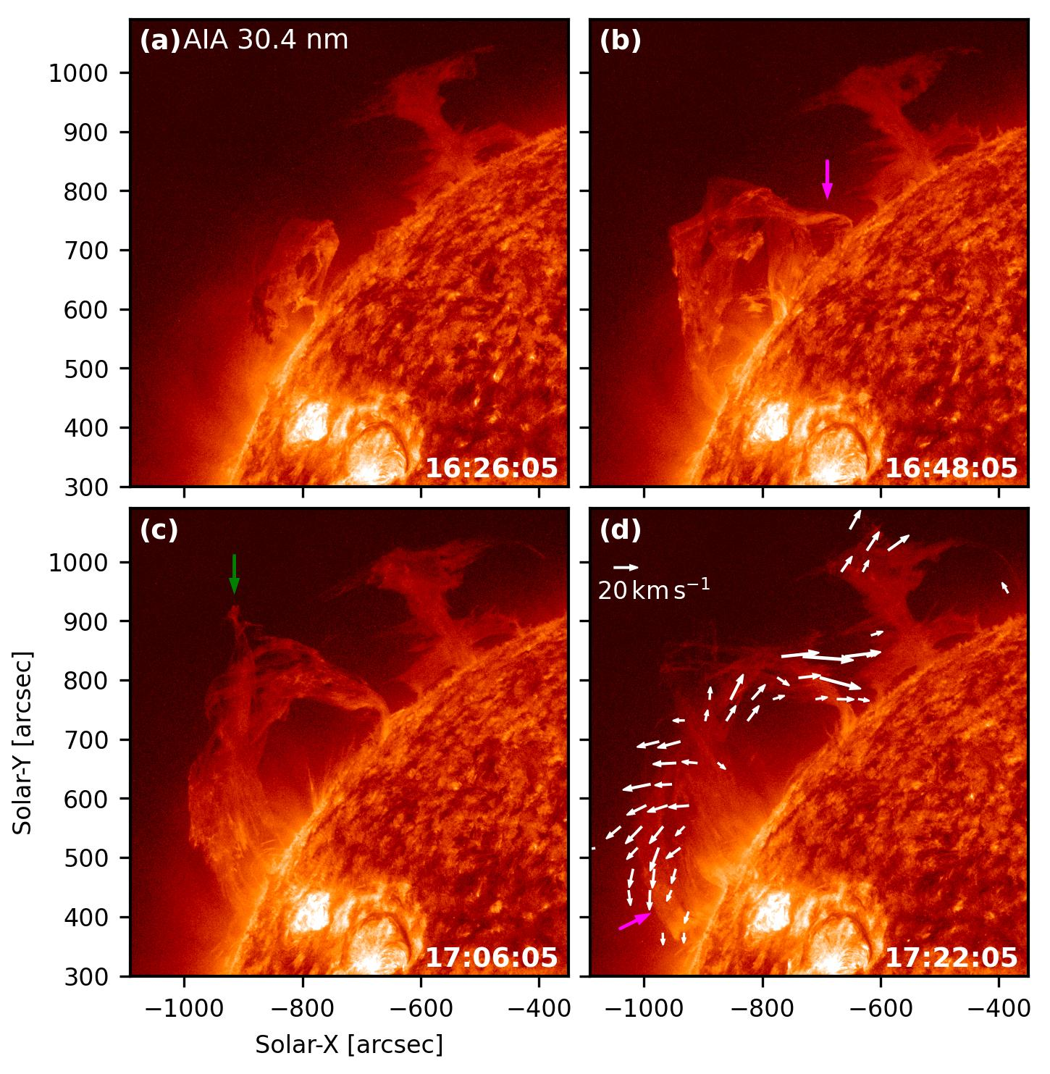
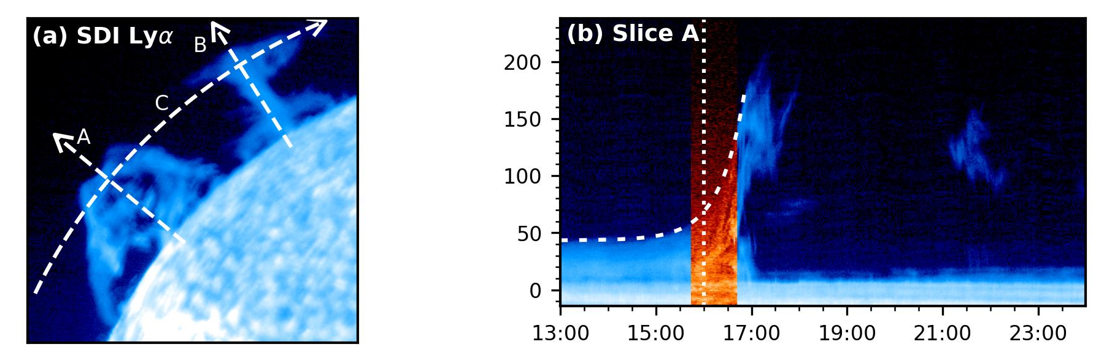
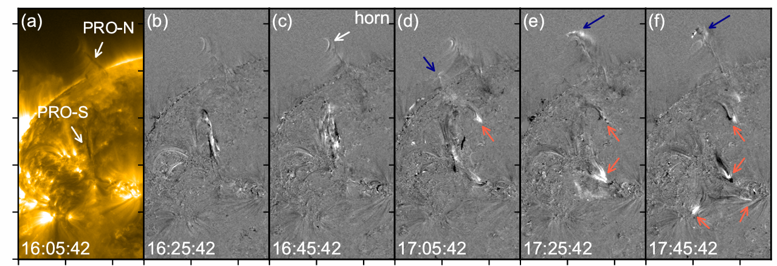
01
Introduction
Destruction of an erupting prominence:
Both core field and overlying field are important!
(Xue, J. et al. 2024)
Notes:
As an example, shearing motion along with magnetic flux cancellation can convert arcade field to the helical field, and contribute to the formation and eruption of magnetic flux ropes. In the tether-cutting model, the flux cancellation convert the overlying magnetic field to the core field, so both the two trigger conditions are fulfilled. Whether the eruption is successful depends on the driver.

Slide 6
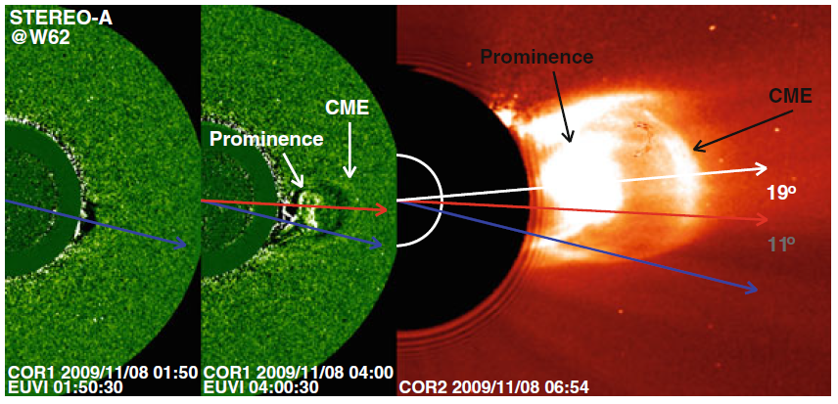
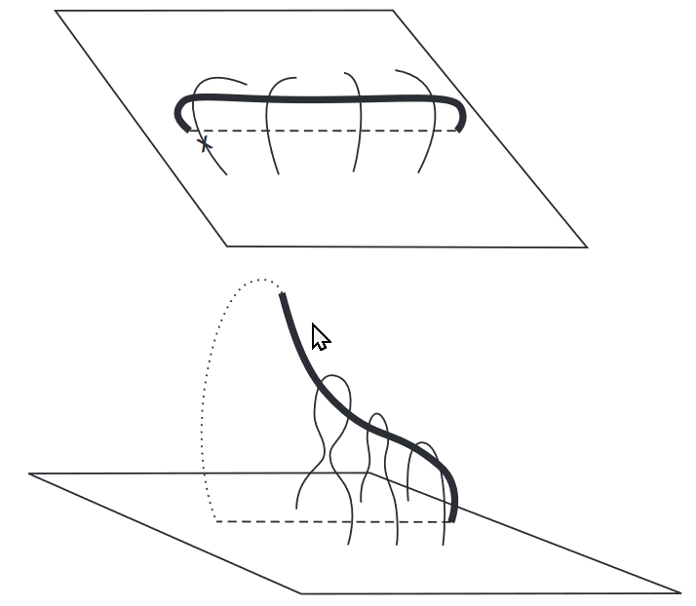
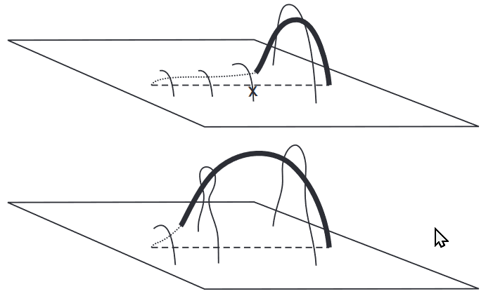
01
Introduction
Asymmetric eruptions:
Nonradial propagations:
One leg anchored and the other active
Whipping-like and zipping-like eruptions
(Liu, R. et al. 2009)
Equatorward deflection (Gopalswamy et al. 2015)
They are important:
Understanding eruption mechanisms
Forecasting space weather
McCauley et al. 2015:
48 % of eruptions are symmetric, 38 % are asymmetric, and 14 % are indeterminable.
Notes:
As an example, shearing motion along with magnetic flux cancellation can convert arcade field to the helical field, and contribute to the formation and eruption of magnetic flux ropes. In the tether-cutting model, the flux cancellation convert the overlying magnetic field to the core field, so both the two trigger conditions are fulfilled. Whether the eruption is successful depends on the driver.

Slide 7
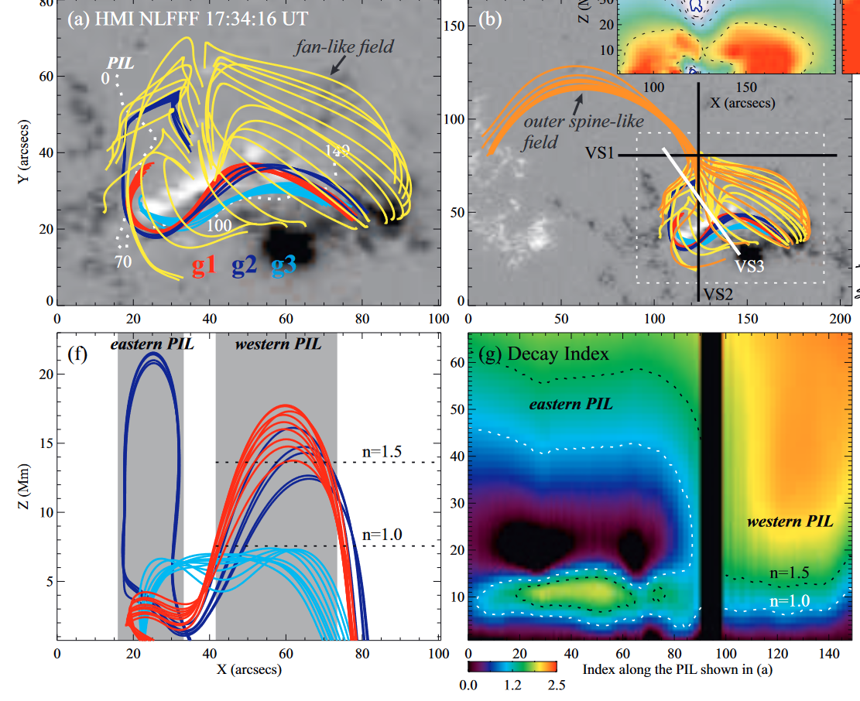
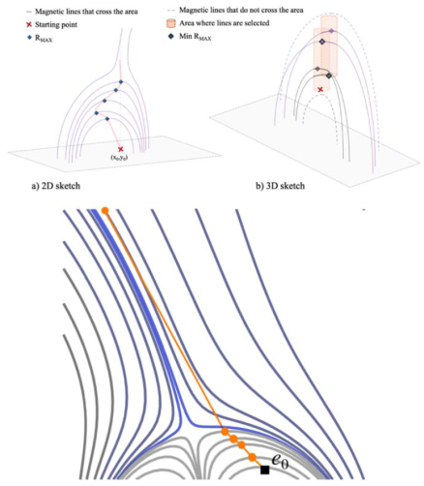
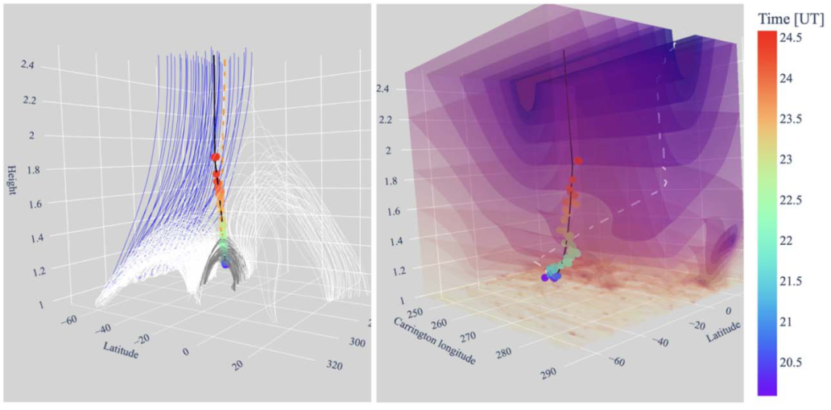
01
Introduction
Causes of asymmetric eruptions:
Causes of nonradial propagation:
Asymmetric overlying field (Liu, C. et al. 2015)
Breakout reconnection (Li, H. et al. 2016)
Tether release (Liu, R. et al. 2009)
Large-scale magnetic environment:
Coronal holes (Panasenco et al. 2013)
Active regions (Wang, R. et al. 2015)
Magnetic pressure (Shen, C. et al. 2011)
Magnetic geometry (Sahade et al. 2025)
Observed path
Geometry
Gradient path
Erupting part has a larger decay index
(Liu, C. et al. 2015)
Better predicts path by geometry
(Sahade et al. 2025)

Slide 8
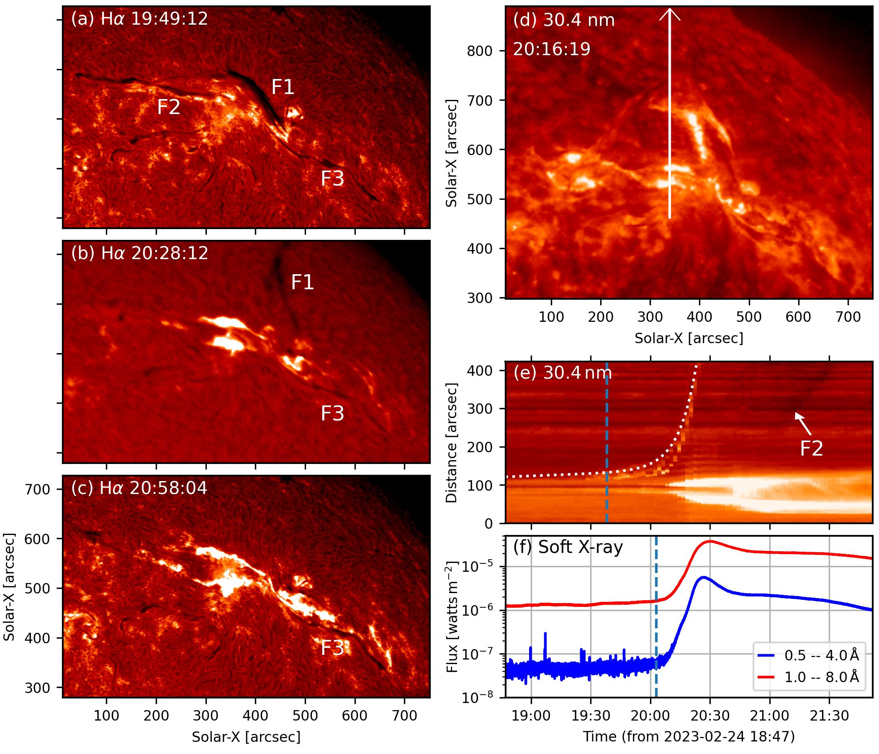
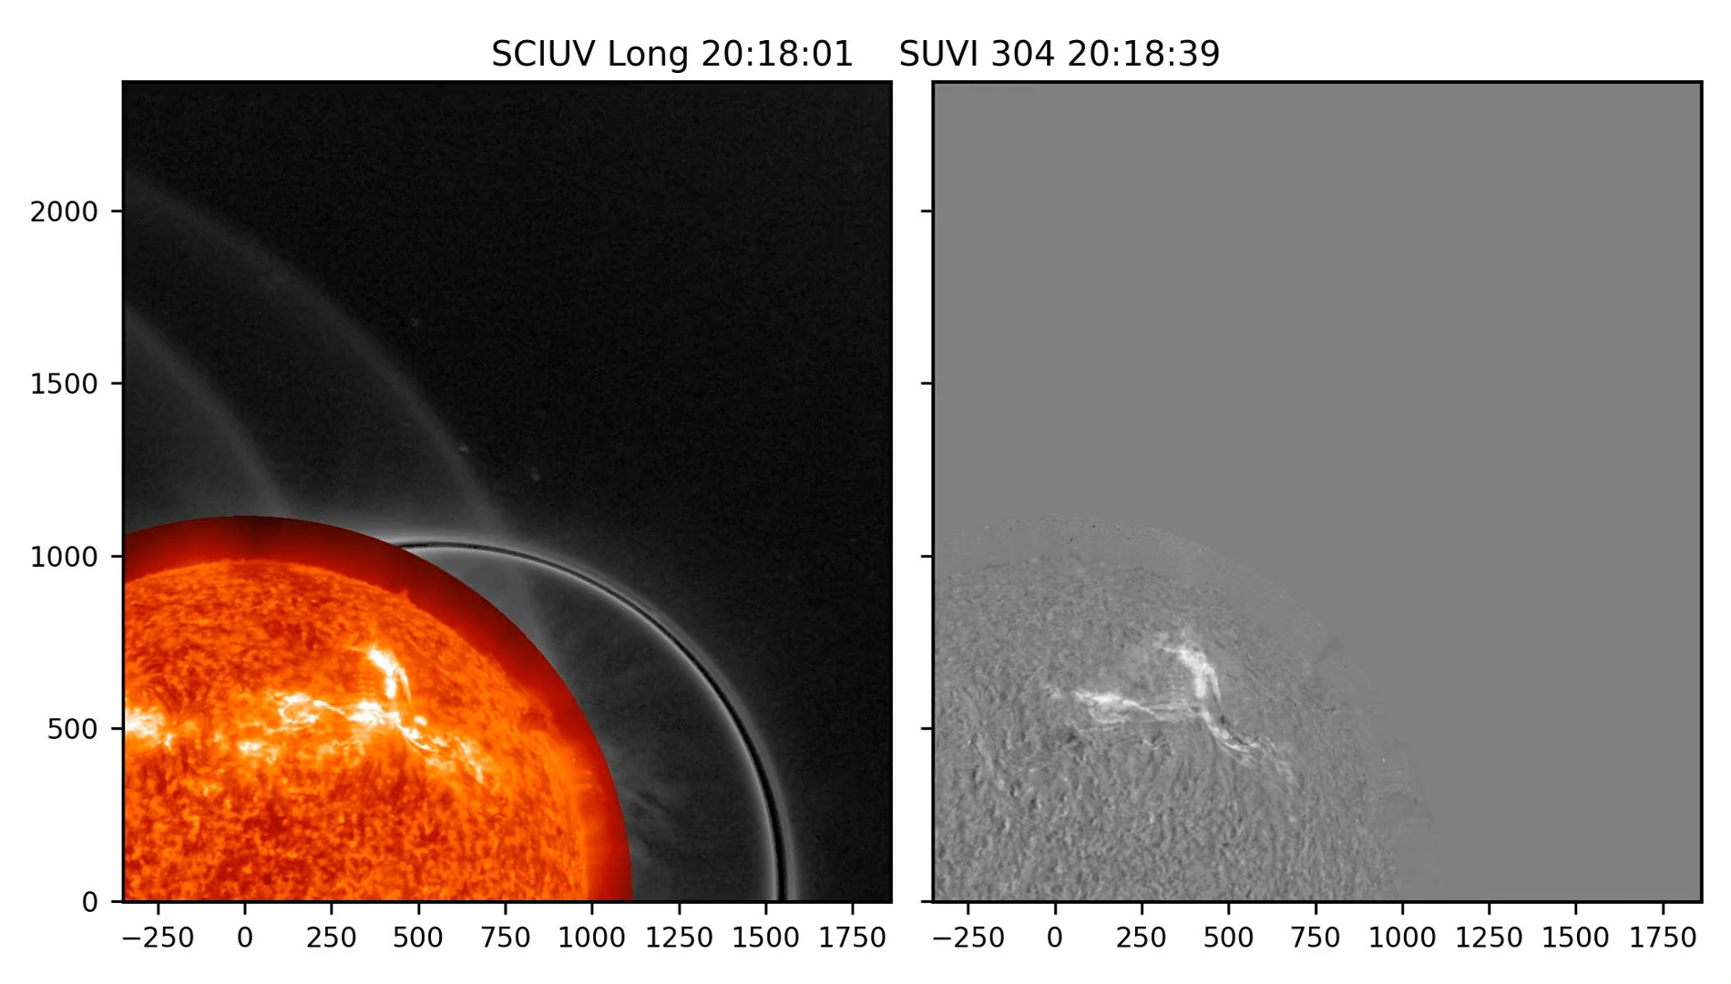
02
Purpose & Observations
Role of core fields in asymmetric eruptions
Relationship between asymmetric eruption & nonradial propagation
Observations:
M3.7 flare
CME 1336 km/s
ASO-S/LST/SCIUV
Solar Orbiter/Metis
SOHO/LASCO
CHASE
IRIS
SDO/AIA
GOES/SUVI

Slide 9
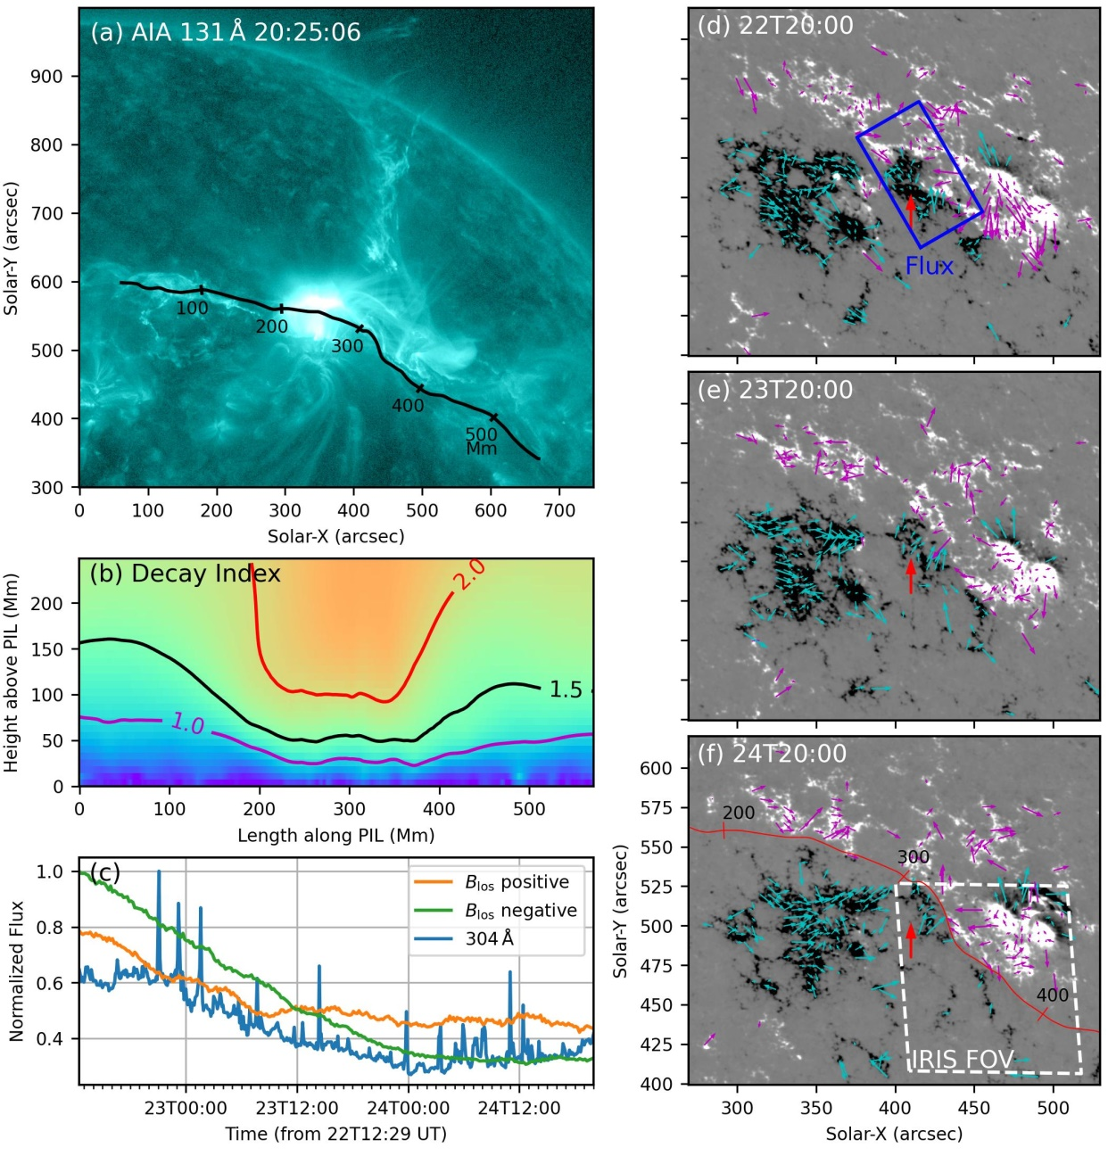
03
Results
Flare kernel locates below erupting filament (EF)
Cause of the asymmetric eruption?
Torus instability?
Magnetic flux cancellation?
Uniqueness:
Decay index was almost asymmetric
Flux cancellation occurred below confined part

Slide 10
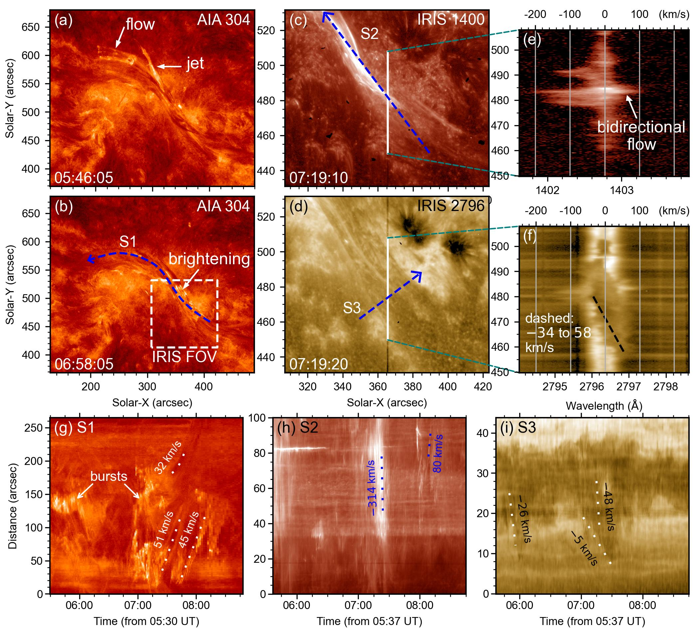
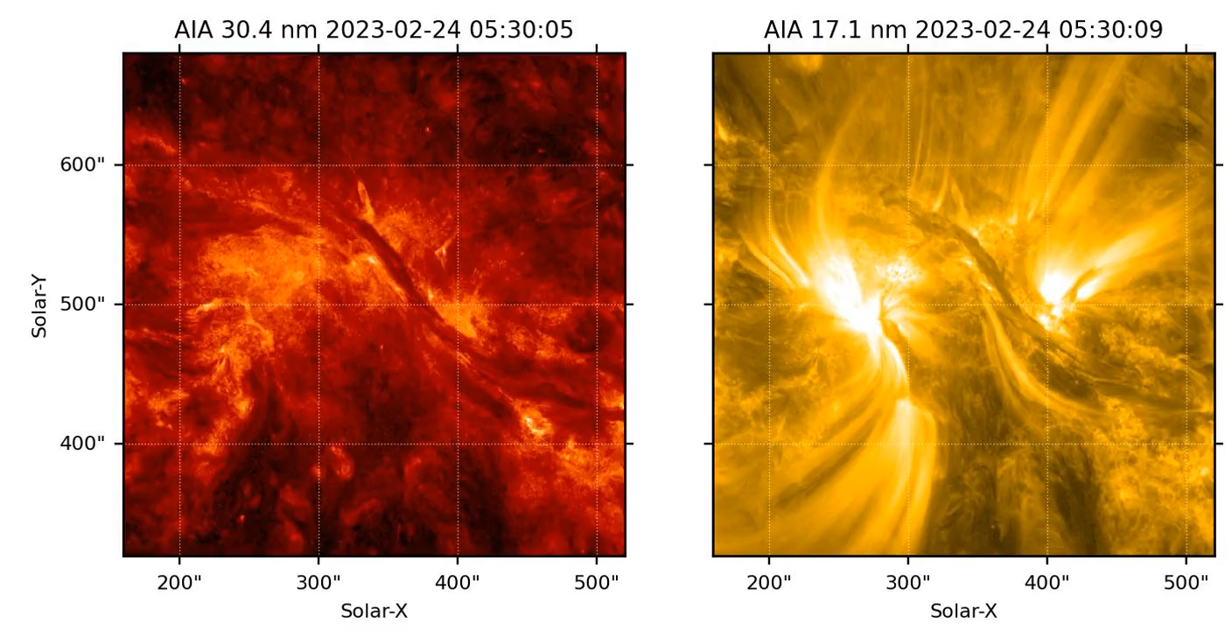
03
Results
Bursts and flows:
Bursts drove flows from confined part to the eruptive part.
Notes:
As an example, shearing motion along with magnetic flux cancellation can convert arcade field to the helical field, and contribute to the formation and eruption of magnetic flux ropes. In the tether-cutting model, the flux cancellation convert the overlying magnetic field to the core field, so both the two trigger conditions are fulfilled. Whether the eruption is successful depends on the driver.

Slide 11
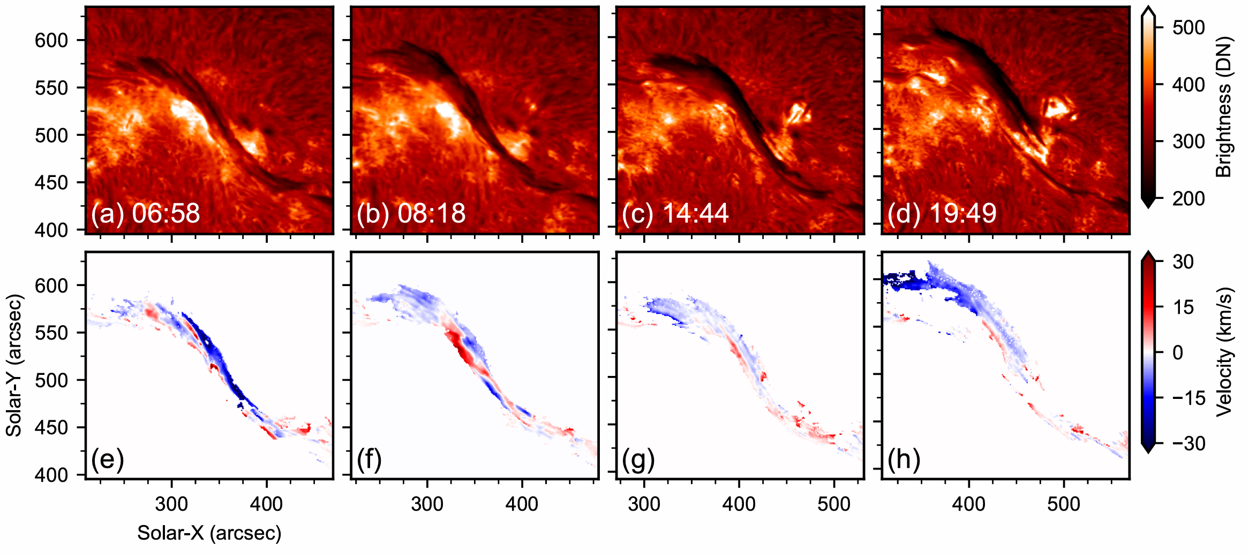
03
Results
Precursors of the asymmetric eruption:
CHASE observations
Eruptive part:
Larger cross-section
More dynamic flows
Continuous blueshift
Eastward flows were mainly blueshifted
Returning flows were mainly redshifted
Notes:
As an example, shearing motion along with magnetic flux cancellation can convert arcade field to the helical field, and contribute to the formation and eruption of magnetic flux ropes. In the tether-cutting model, the flux cancellation convert the overlying magnetic field to the core field, so both the two trigger conditions are fulfilled. Whether the eruption is successful depends on the driver.

Slide 12
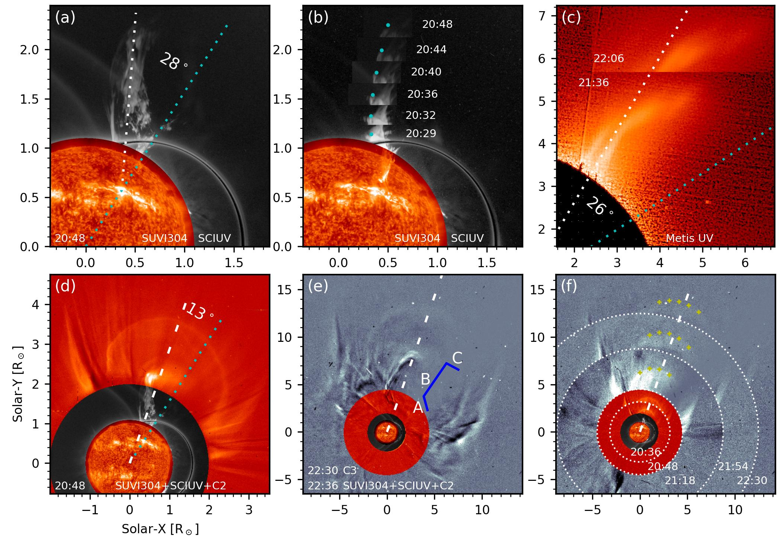
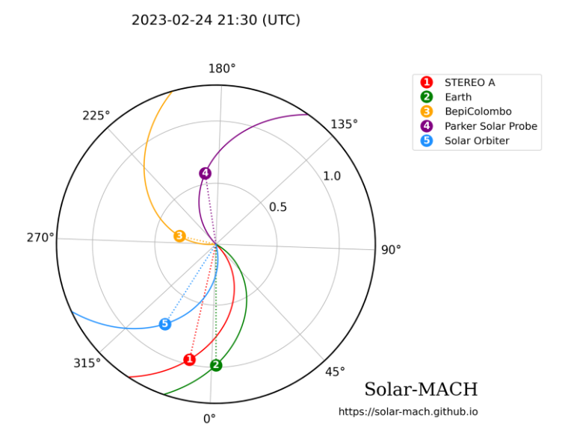
03
Results
Nonradial propagation:
EF was initially poleward, consistent with the asymmetric eruption
EF propagated nonradially, from poleward to CME
CME propagated radially
The shape of the EF in (e) depicted its trajectory

Slide 13
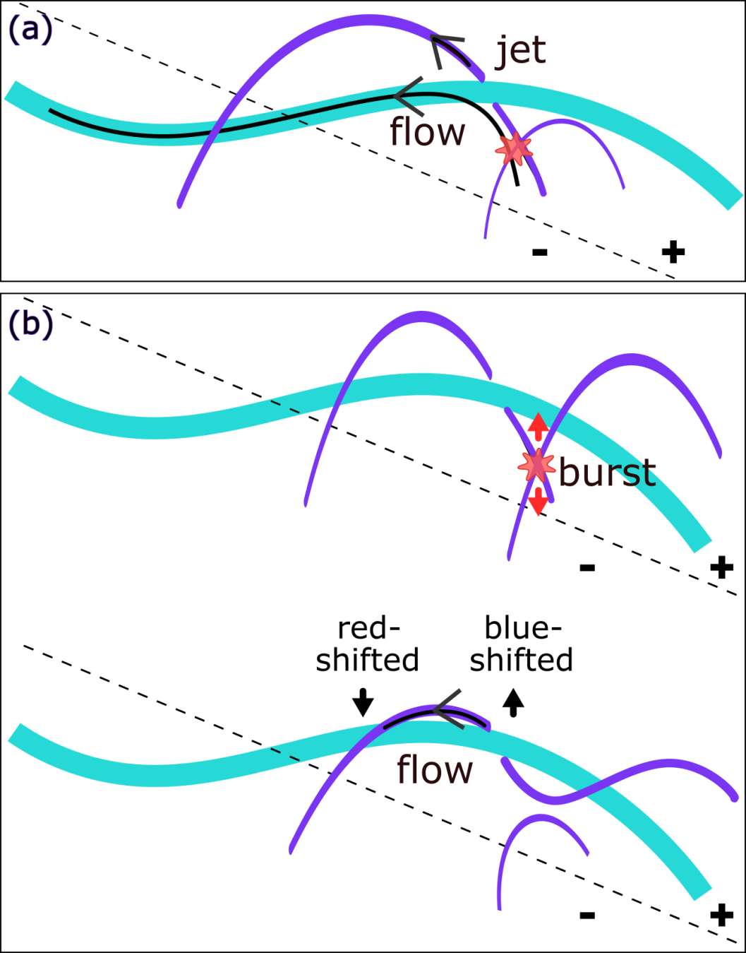
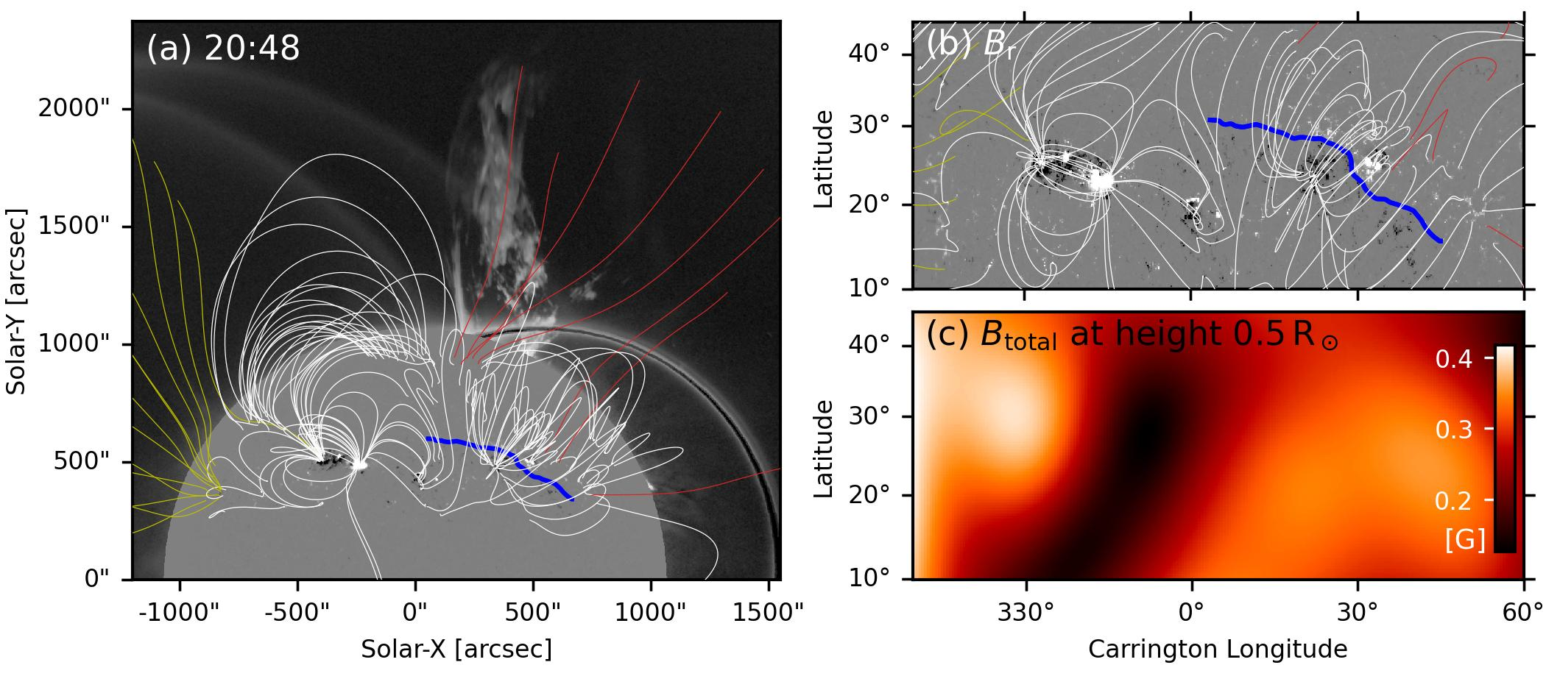
04
Discussion
Cause of the asymmetric eruption:
Cause of the nonradial propagation:
Bursts enhanced the filament asymmetry:
supply hot plasma, magnetic flux, & helicity
Initially related to the asymmetric eruption
Then following CME as a part of the CME
Relationship between the asymmetry eruption, nonradial propagation, and the magnetic fields?
Is the formation of CME front driven by EF?
Notes:
The curved shape of EF reflected local magnetic geometry?
Can the eruption path be predicted by potential field?

Slide 14
04
Summary
1. We analyzed an asymmetric solar eruption and its nonradial propagation.
For the asymmetric eruption:
2. The decay index was symmetric, bursts occurred below the confined part.
3. The cause should be due to asymmetry of the core field, and the bursts enhanced the asymmetry.
4. The role of magnetic environment should be further explore:
for intermediate filaments, whether the legs near the sunspots tend to be confined?
For the nonradial propagation:
5. Initially coincided with the asymmetric eruption, gradually aligned with the CME.
6. The relationship between the CME front and core?

