Slide 1





















Coronal polarised brightness measured by Solar Orbiter/Metis within solar cycle 25
M. Romoli¹, E. Arra¹, A. Burtovoi¹, S. Giordano², R. Susino²
¹Dip. di Fisica e Astronomia, Università di Firenze
²INAF – Osservatorio Astrofisico di Torino
10th Metis Workshop, Torino, February 11-13, 2025

Slide 2
Summary
Measuring the electron density in the middle corona
Metis data from ascending phase and maximum phase of solar cycle 25
Comparison with literature measurements

Slide 3
Measuring the electron density in the middle corona
The most direct method in the middle corona(1.5 – 6 R⊙) is to invert the K-corona brightness produced by the Thomson scattering by free electrons and measured with ground and space based coronagraphs.
Spherical symmetry:
Separation K-corona from F-corona with pB (Van de Hulst, 1950, Saito, 1977)
From B data (Hayes+, 2001)
Structure of the corona:
From Solar Rotational Tomography (SRT) (Frazin, 2000; Vasquez+ 2024, 2025), that can be helped by multi point-of-view observations (LASCO, STEREO, Solar Orbiter)
From MHD simulations (Downs, 2021)

Slide 4
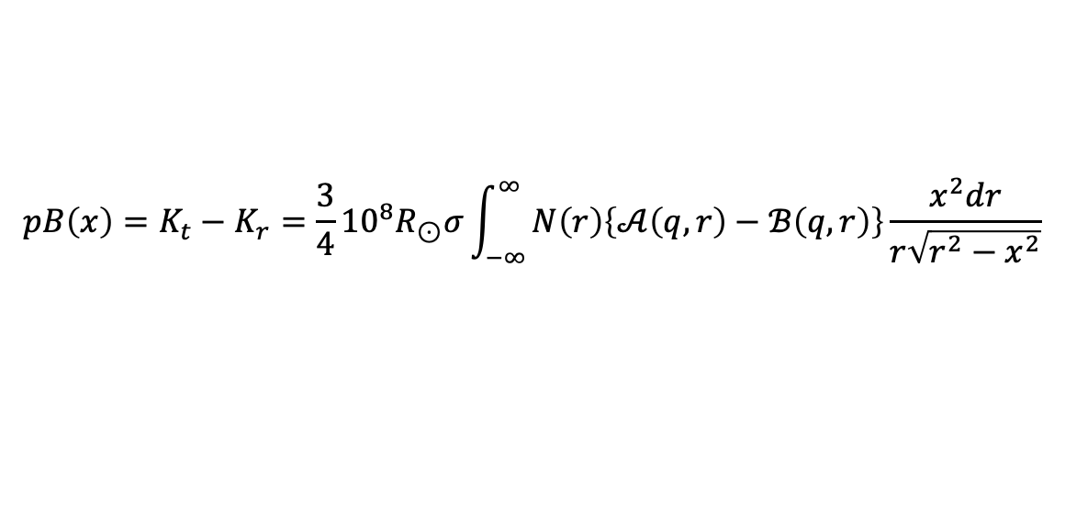
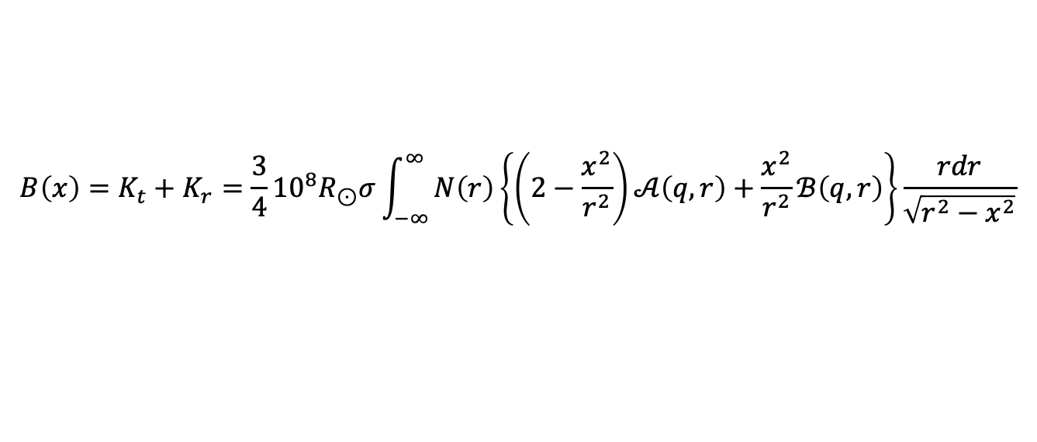
K-corona
$$B\left(x\right)=K_{t}+K_{r}=\frac{3}{4}{10}^{8}R_{⊙}σ\int_{−∞}^{∞}{N\left(r\right)\left\{\left(2−\frac{x^{2}}{r^{2}}\right)𝒜\left(q,r\right)+\frac{x^{2}}{r^{2}}ℬ\left(q,r\right)\right\}\frac{rdr}{\sqrt{r^{2}−x^{2}}}}$$
$$pB\left(x\right)=K_{t}−K_{r}=\frac{3}{4}{10}^{8}R_{⊙}σ\int_{−∞}^{∞}{N\left(r\right)\left\{𝒜\left(q,r\right)−ℬ\left(q,r\right)\right\}\frac{x^{2}dr}{r\sqrt{r^{2}−x^{2}}}}$$
x
Where B and pB are in Mean Solar Brightness (${\overline{B}}_{⊙})$
r
𝜃
The value of ${\overline{B}}_{⊙}$depends on the instrument bandpass
K_{t}
The measured total brightness consists of
K-corona + F-corona and the instrumental stray light
K_{r}
Van de Hulst, 1950

Slide 5
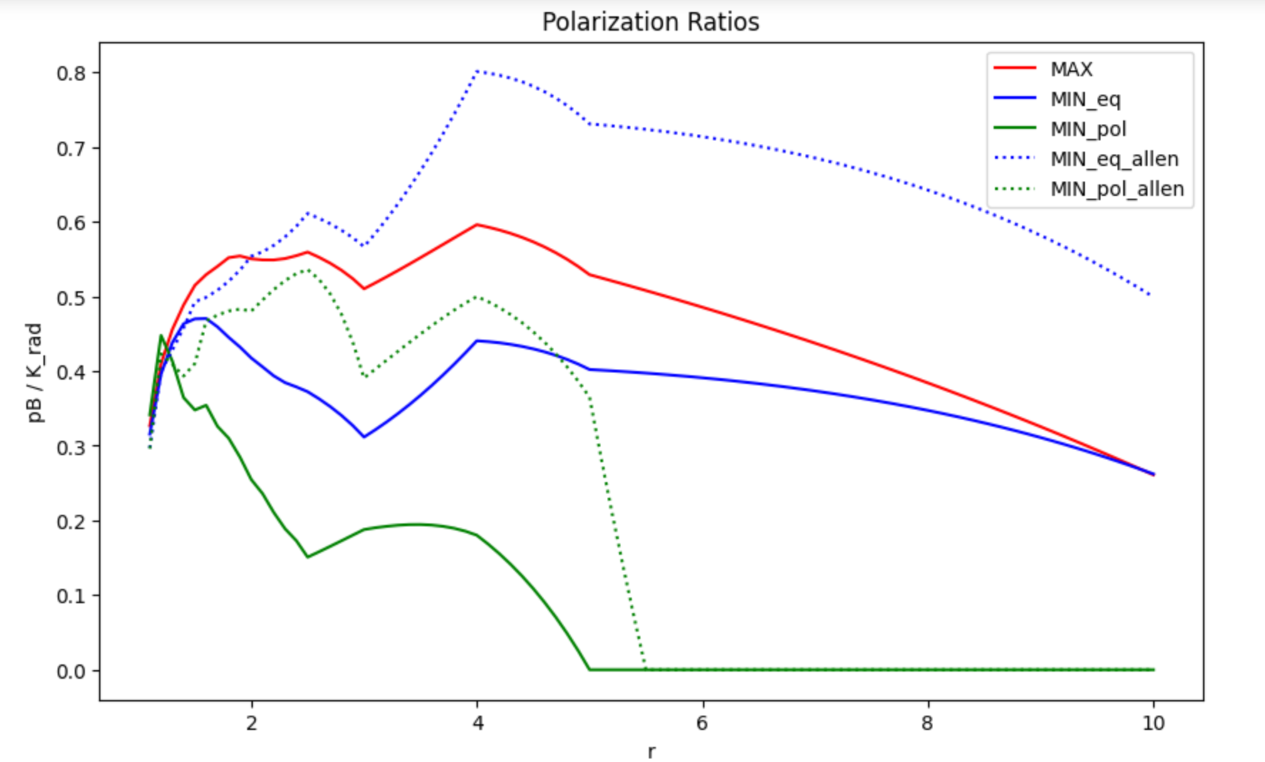
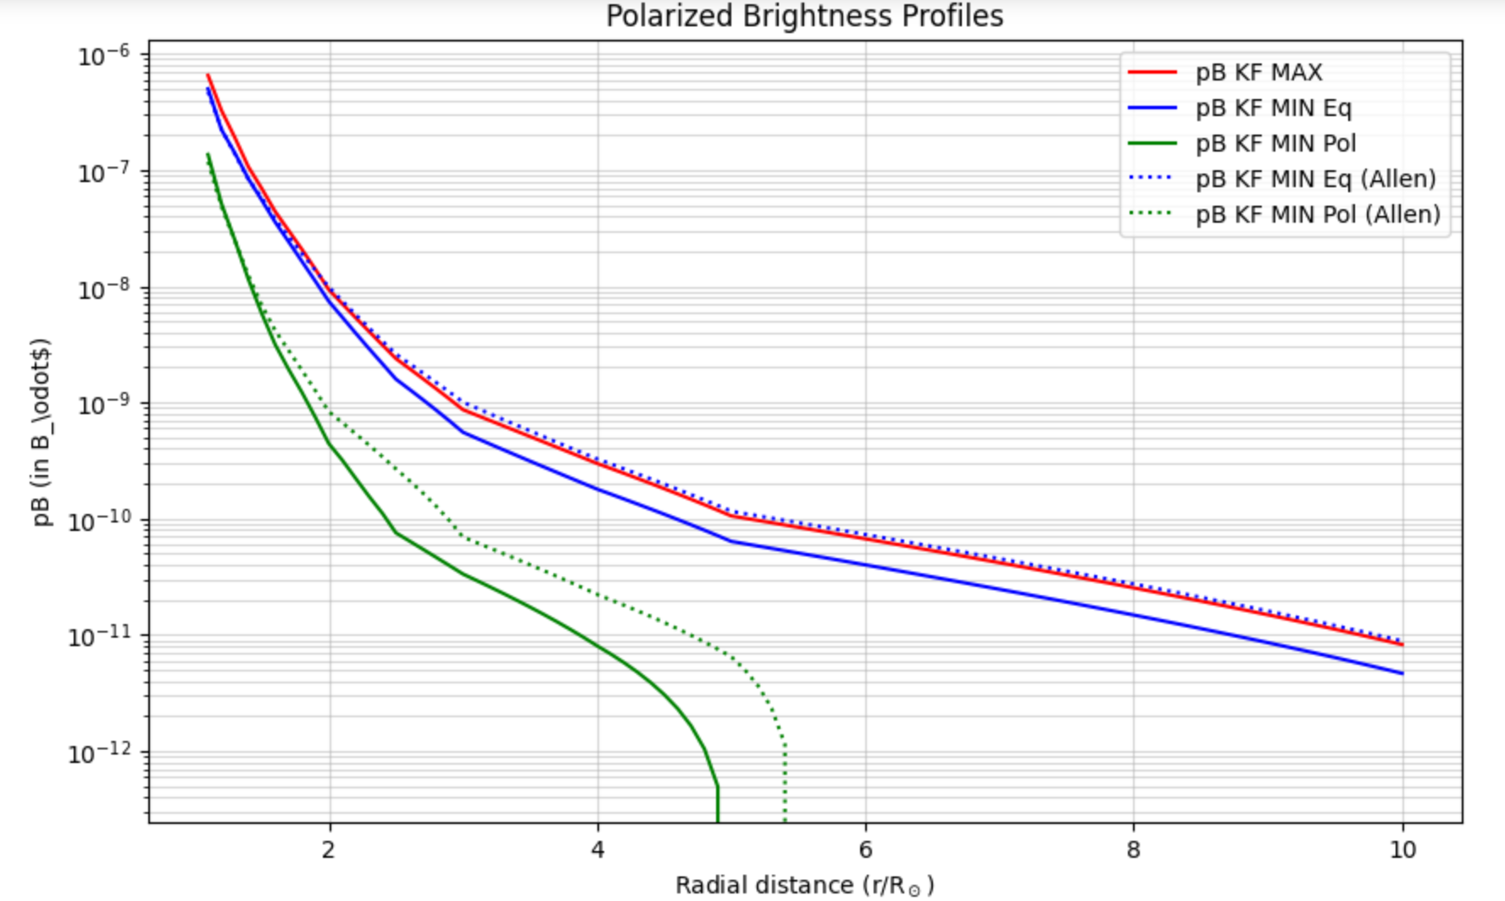
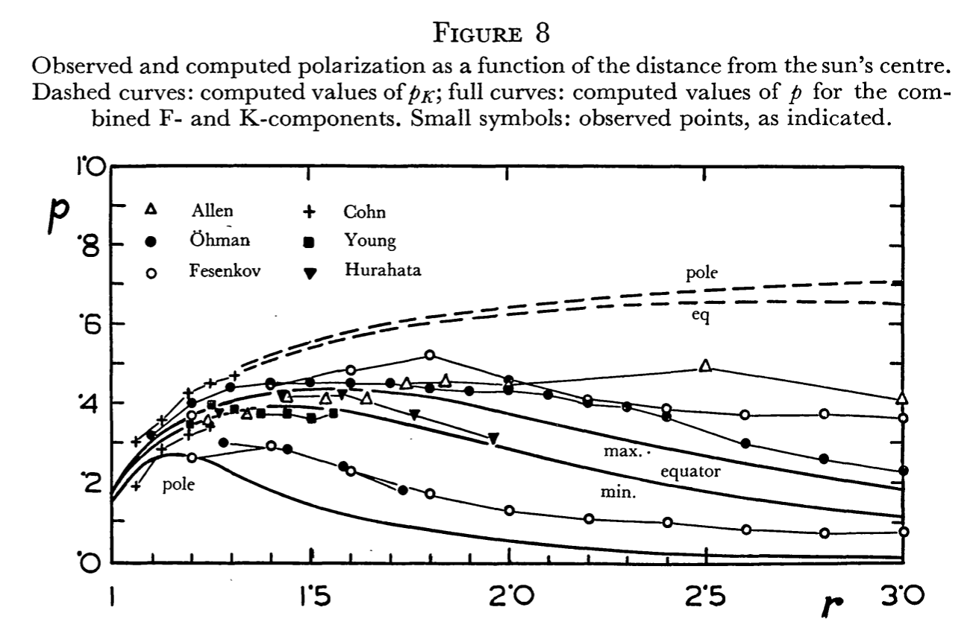
Allen (2000)
Allen’s Astrophysical quantities provides tables containing
estimated K- and F- corona as a function of heliocentric height, and a table with the polarization percentage p% = pB/(K+F)
van de Hulst (1950) fig.8

Slide 6
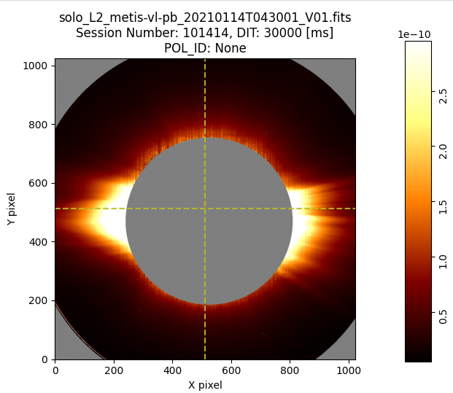
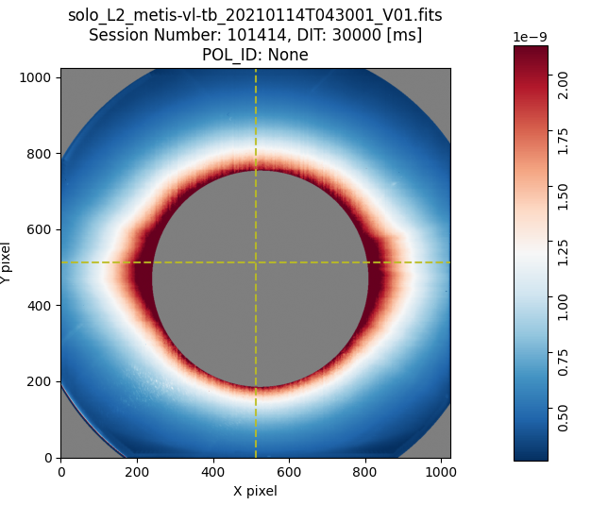
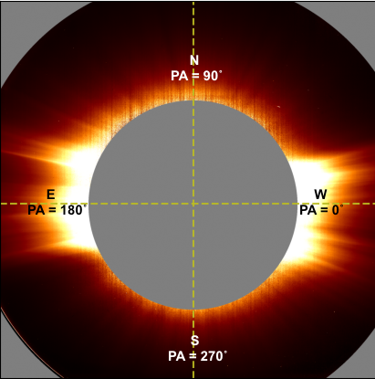
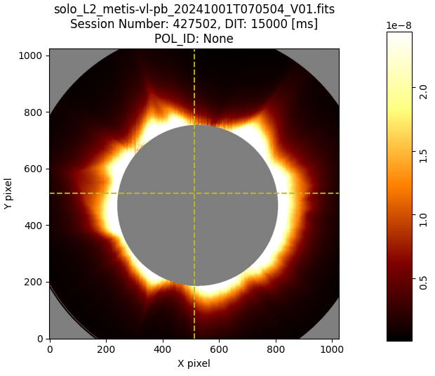
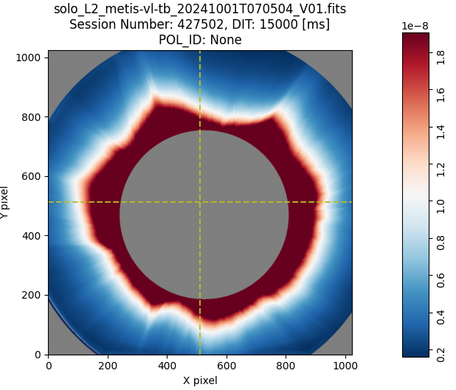
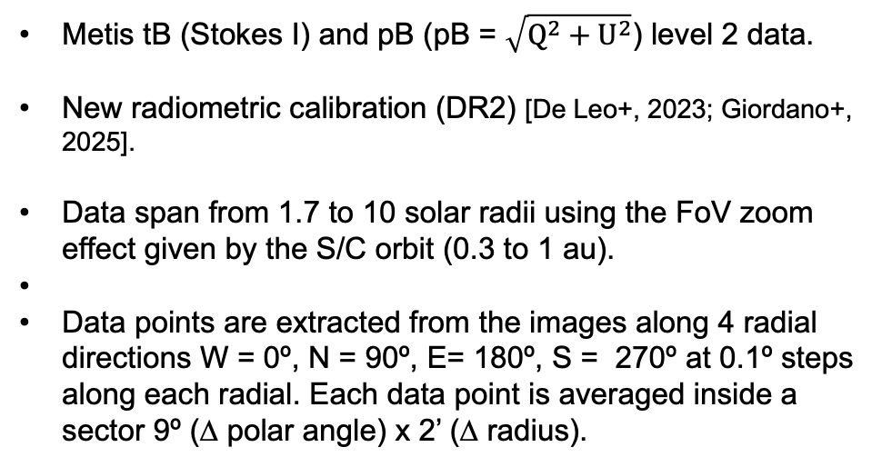
Metis VL data
Metis tB (Stokes I) and pB (pB = $\sqrt{Q^{2}+U^{2}}$) level 2 data.
New radiometric calibration (DR2) [De Leo+, 2023; Giordano+, 2025].
Data span from 1.7 to 10 solar radii using the FoV zoom effect given by the S/C orbit (0.3 to 1 au).
Data points are extracted from the images along 4 radial directions W = 0º, N = 90º, E= 180º, S = 270º at 0.1º steps along each radial. Each data point is averaged inside a sector 9º (∆ polar angle) x 2’ (∆ radius).
Minimum 2020-22
Miaximum 2024

Slide 7
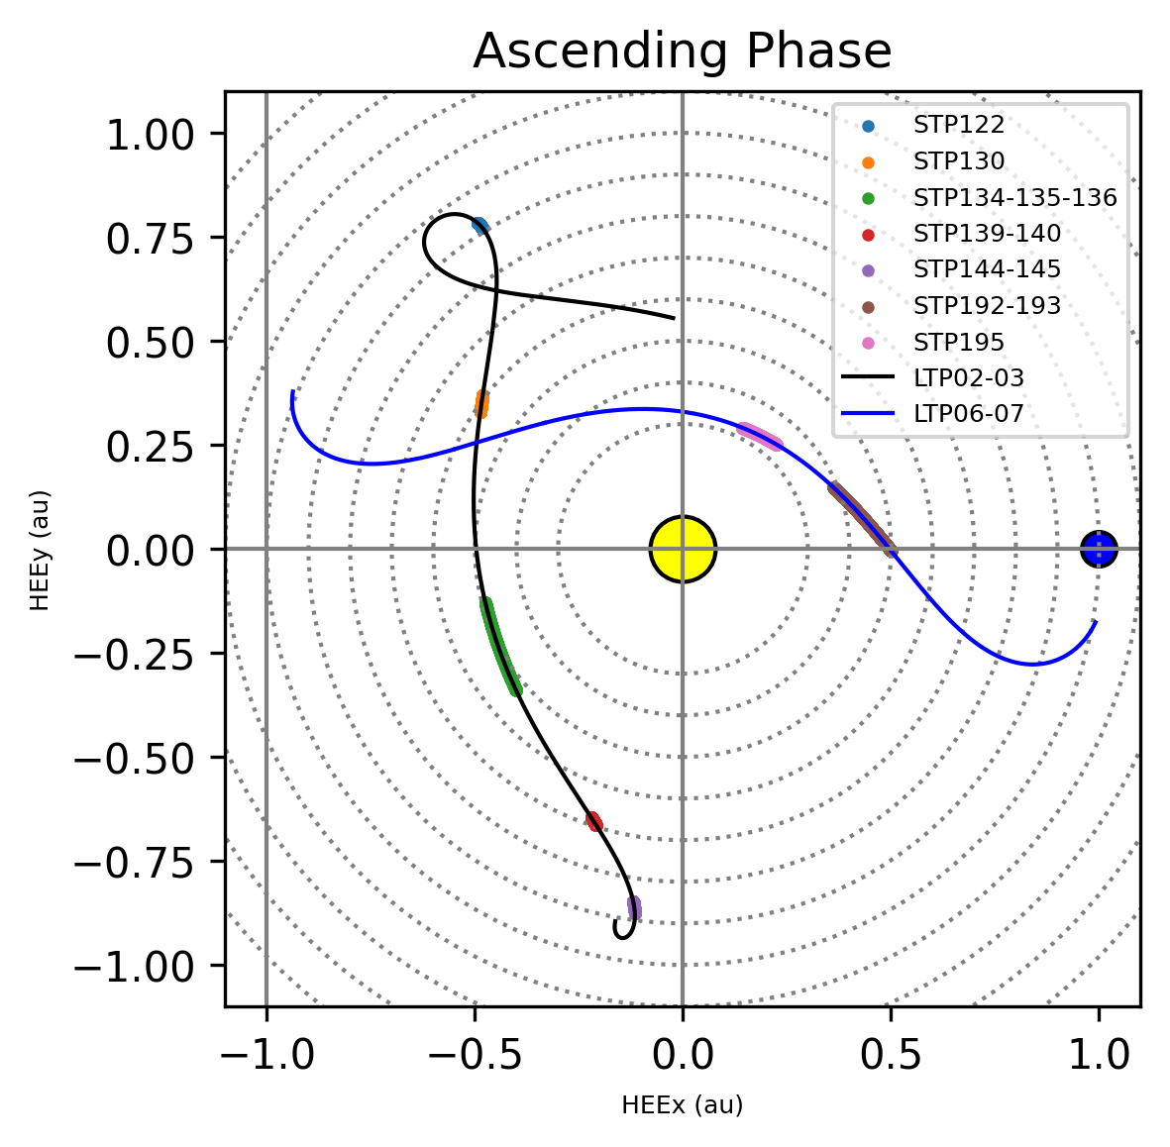
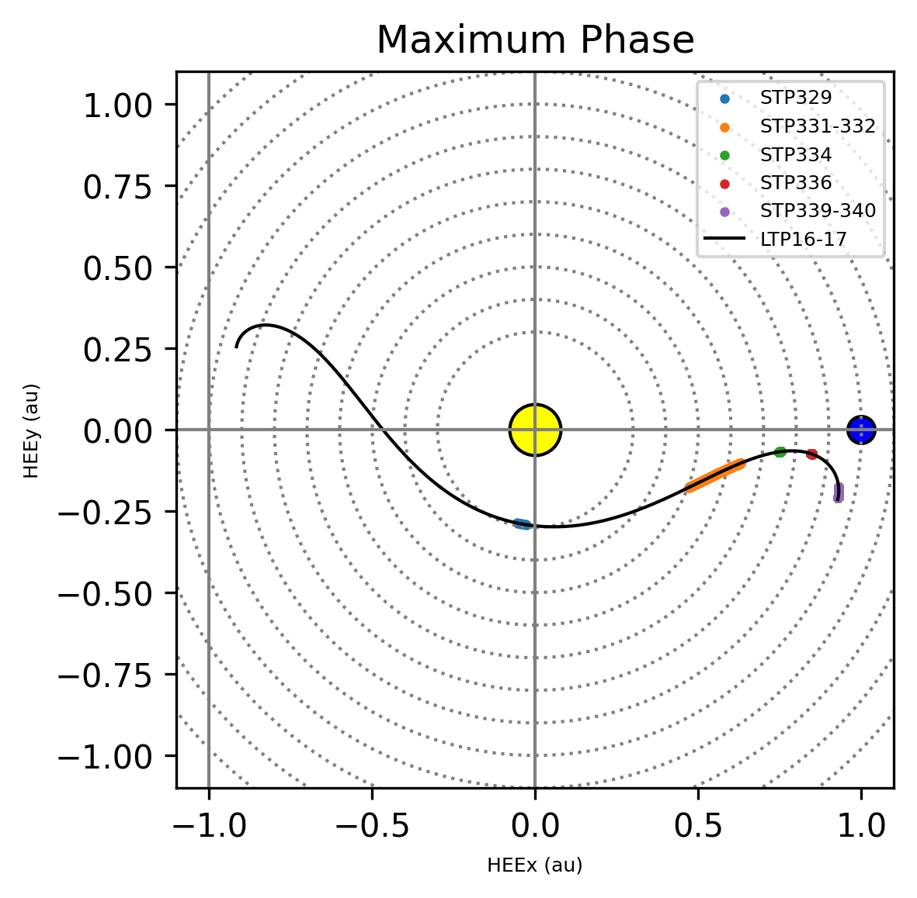
Metis VL data
Ascending phase of cycle 2020-2022
STP | Time interval | Images N.
122 | 18/11-22/11/2020 | 100
130 | 14/1-17/1/2021 | 22
134-135-136 | 12/2/-24/2/2021 | 414
139-140 | 21/3-23/3/2021 | 118
144-145 | 21/4-28/4/2021 | 262
192-193 | 7/3-16/3/2022 | 87
195 | 22/3-25/3/2022 | 144
Solar cycle maximum 2024
STP | Time interval | Images N.
329 | 1/10/2024 | 528
331-332 | 21/10-1/11/2024 | 586
334 | 12/11-13/11/2024 | 80
336 | 25/11-26/11/2024 | 171
339-340 | 22/12-29/12/2024 | 576

Slide 8
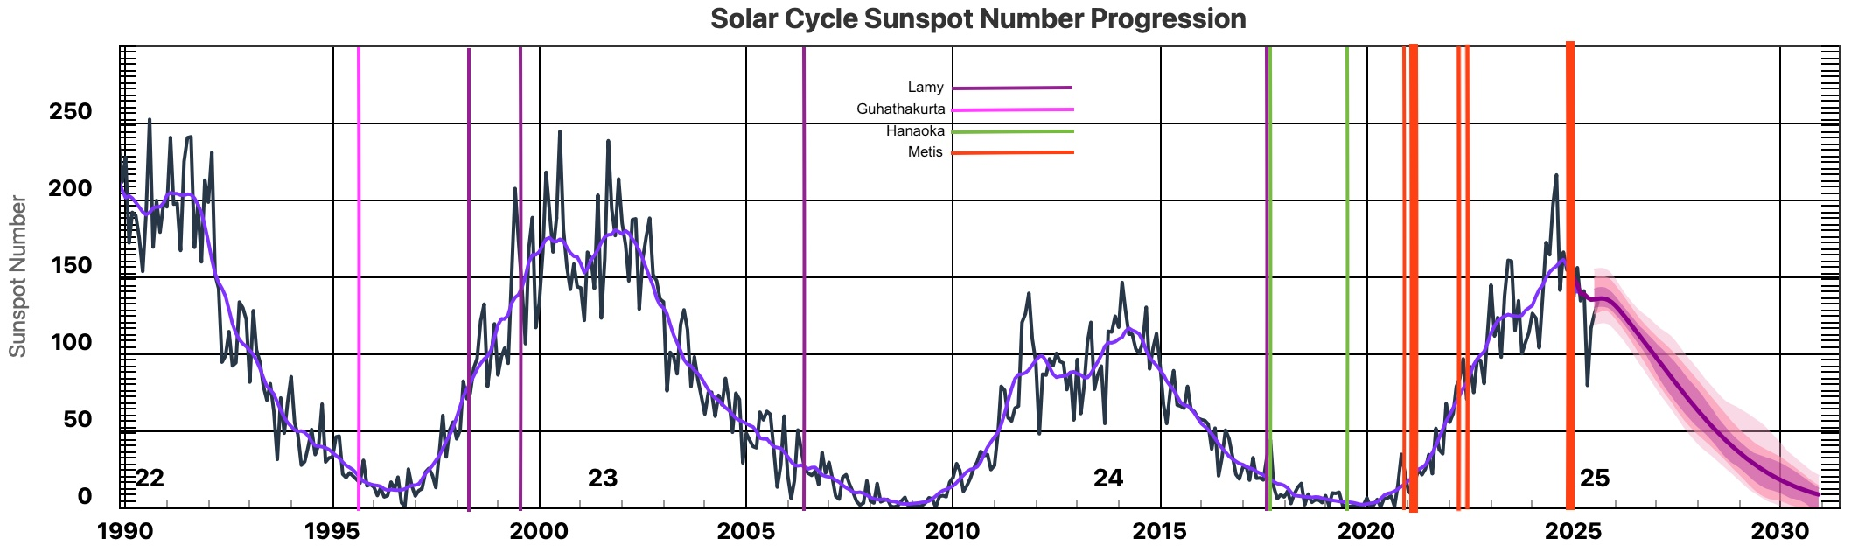
Data comparison
UVCS/WLC
https://www.swpc.noaa.gov/products/solar-cycle-progression
Metis data are compared with the following data:
Guhathakurta&Fischer (1998) from NASA Spartan 201-03 coronagraph,
Lamy+ (2020) SOHO/LASCO-C2 coronagraph simultaneously with 4 solar eclipses (1998, 1999, 2006, 2017); solar eclipses from Allen&Cox (2000), Hanaoka(2021), Koutchmy+(1997) and van de Hulst (1950).
UVCS/WLC data Giordano+(2026, in prep).

Slide 9
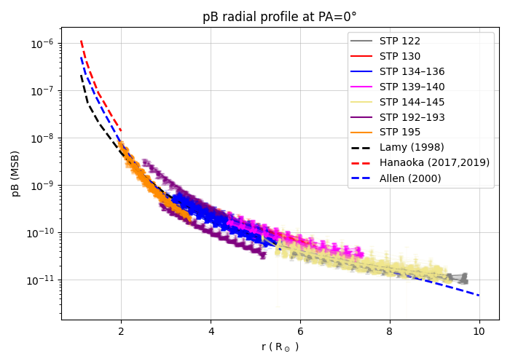
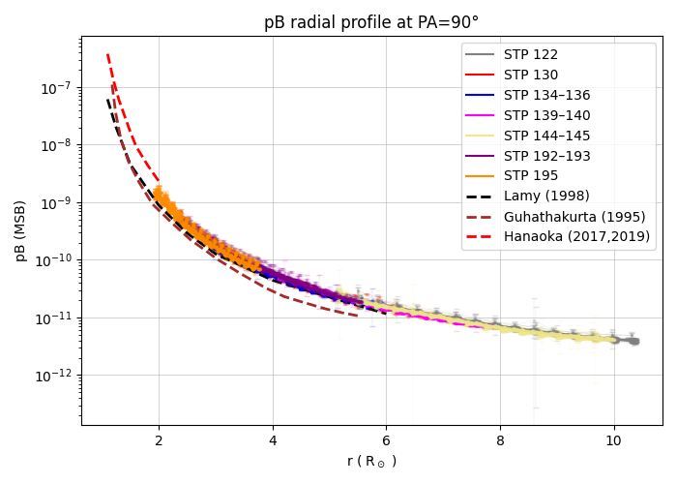
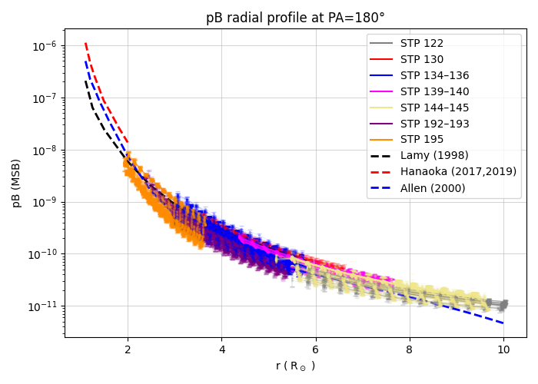
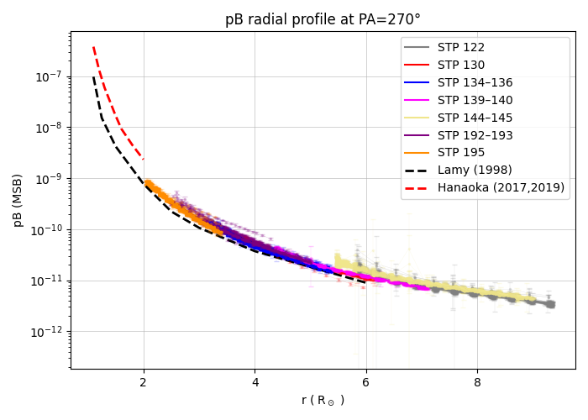
Polarized brightness
(pB)
Pole
Ascending phase
of cycle 2020-2022
West
North
East
South
Pole

Slide 10
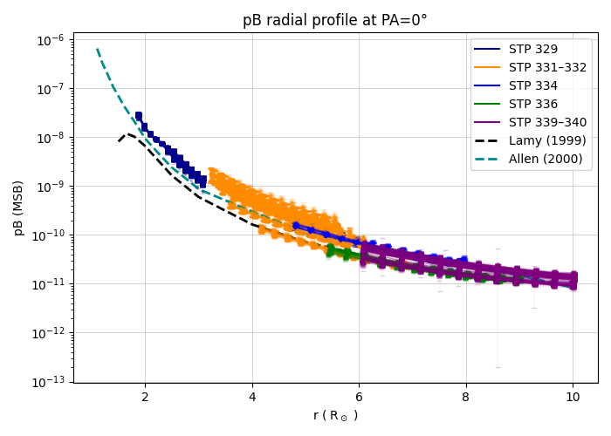
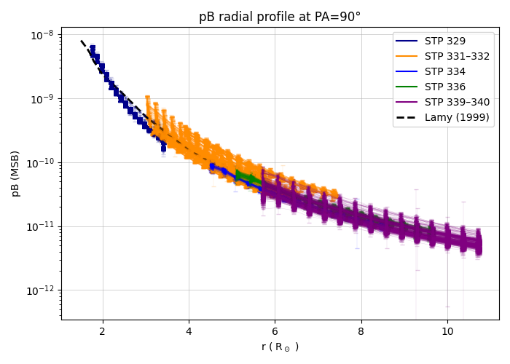
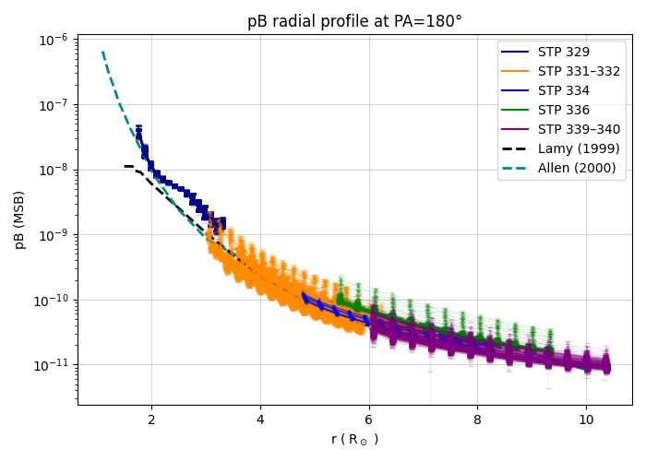
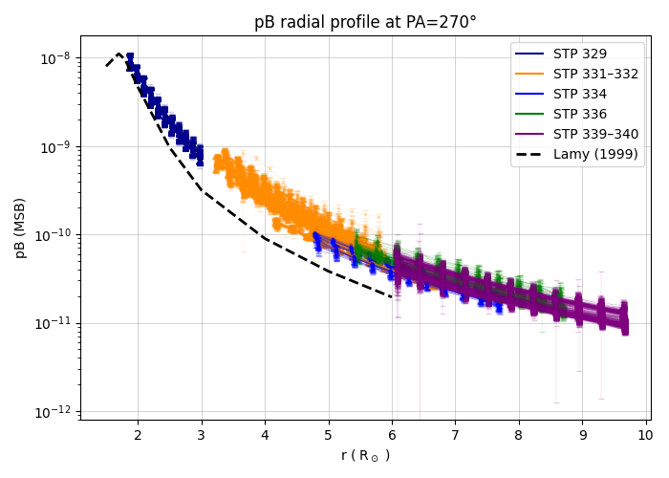
Polarized brightness
(pB)
Solar cycle
maximum 2024
West
North
East
South
Pole

Slide 11
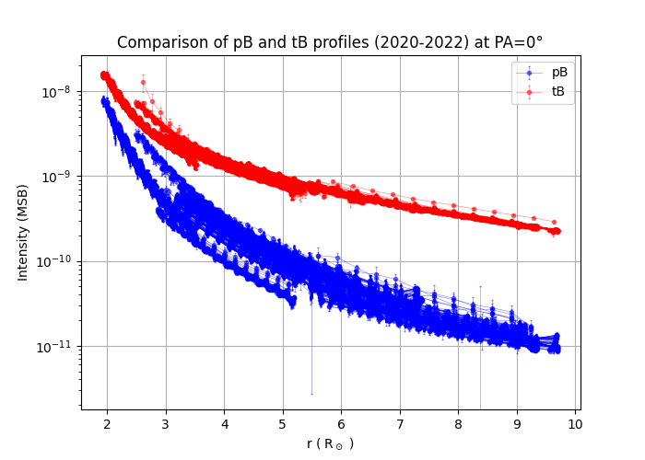
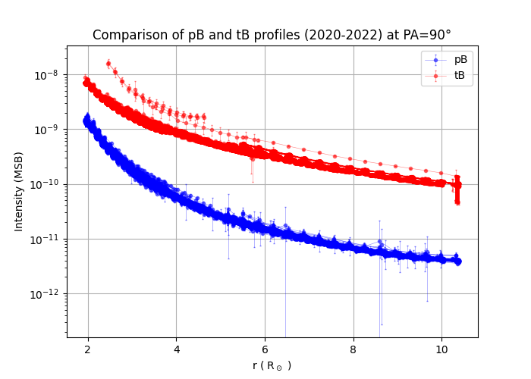
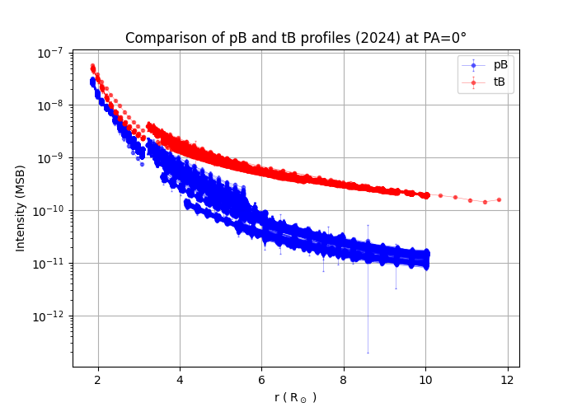
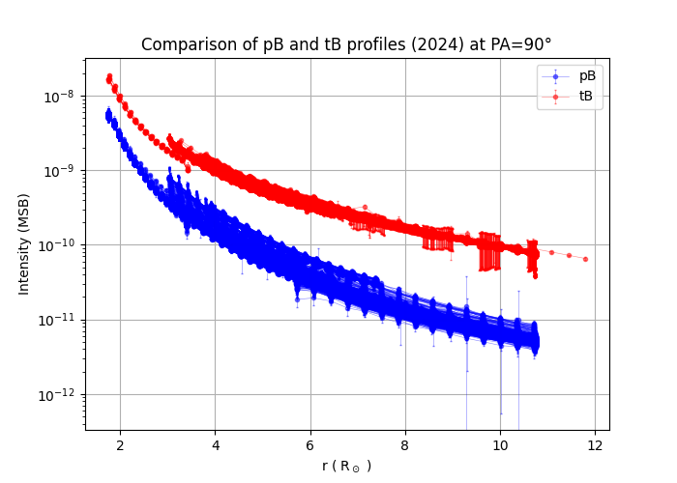
Ascending phase of cycle 2020-2022
Solar cycle
pB vs tB
comparison
West
North
Solar cycle maximum 2024
West
North

Slide 12
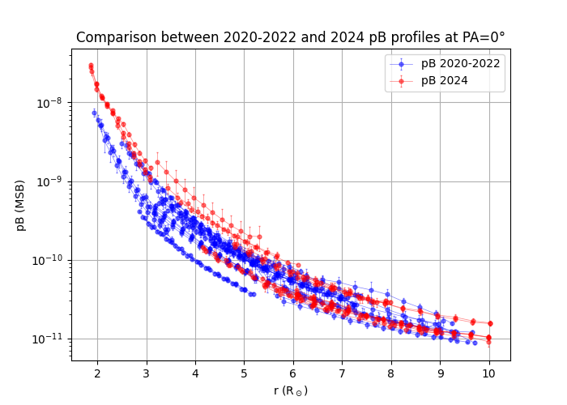
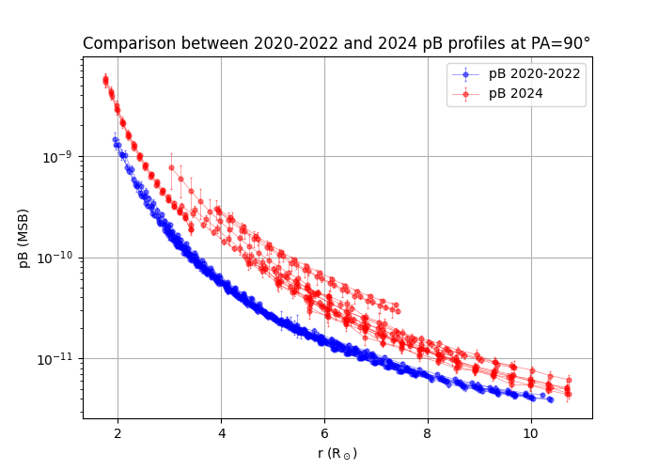
Solar cycle phase pB comparison
West
North

Slide 13
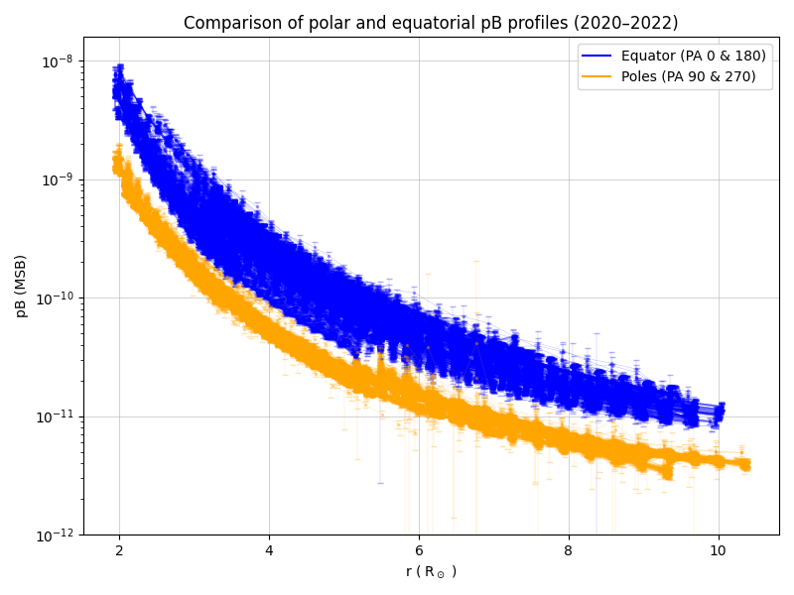
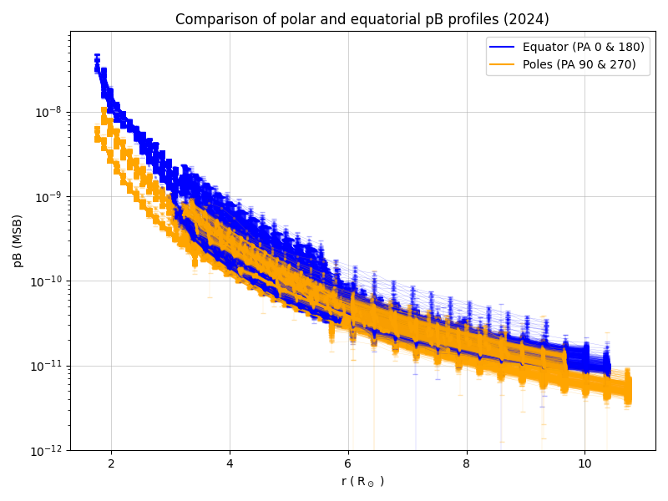
Solar cycle pB pole vs equator comparison

Slide 14
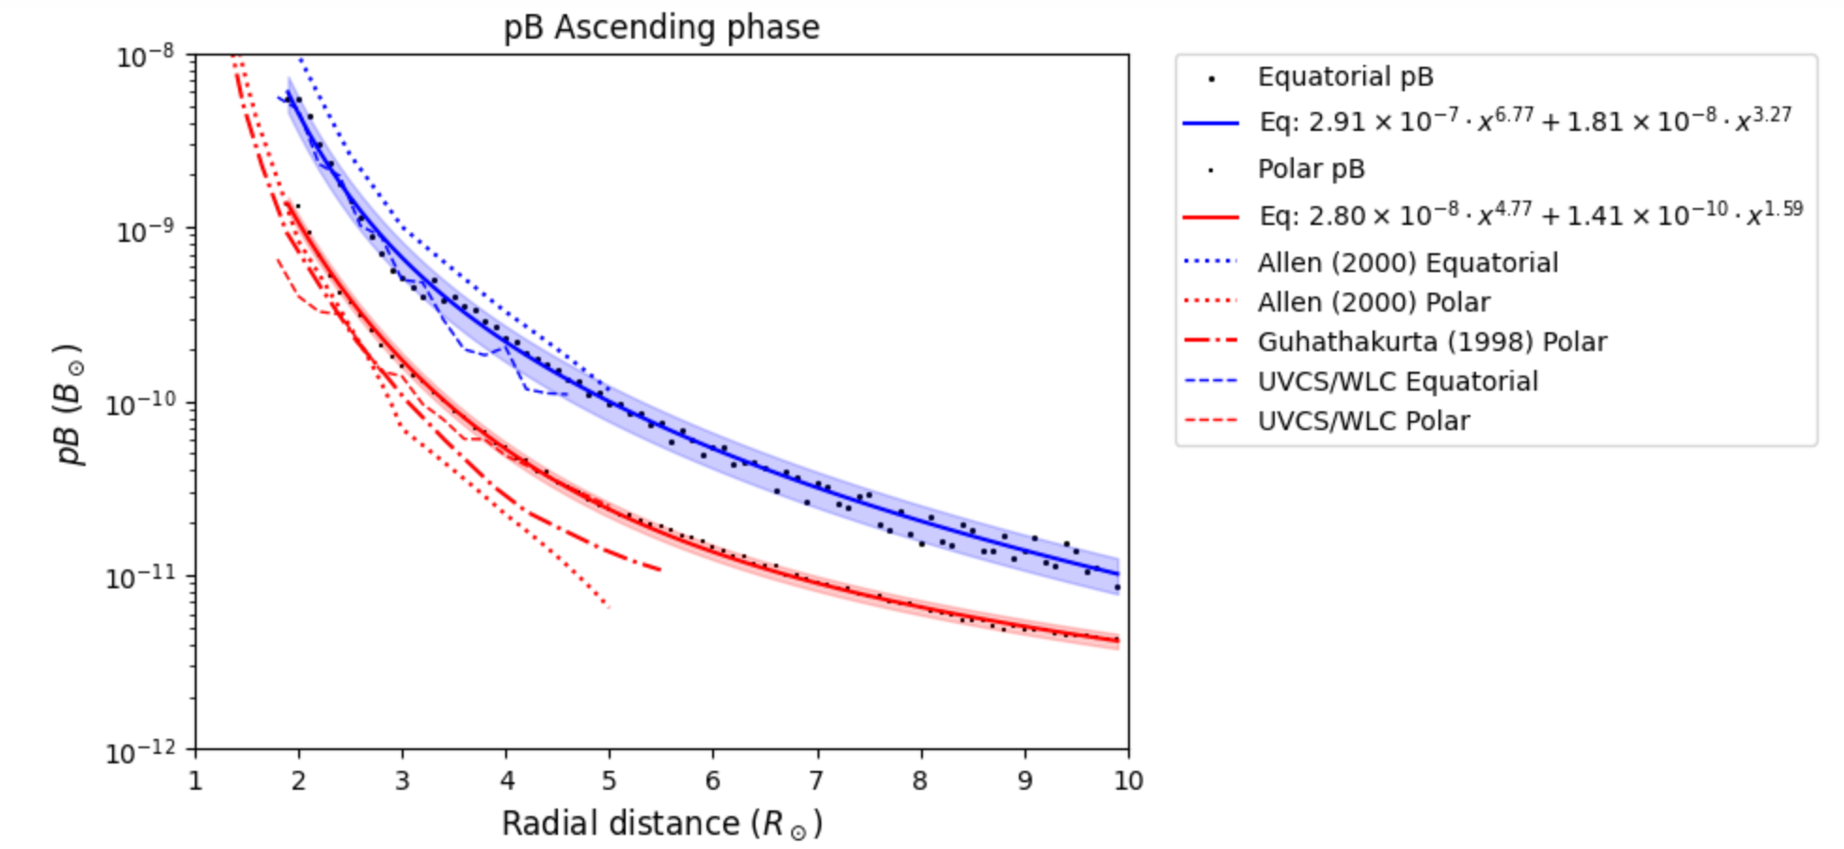
pB ascending phase (cycle 25)

Slide 15
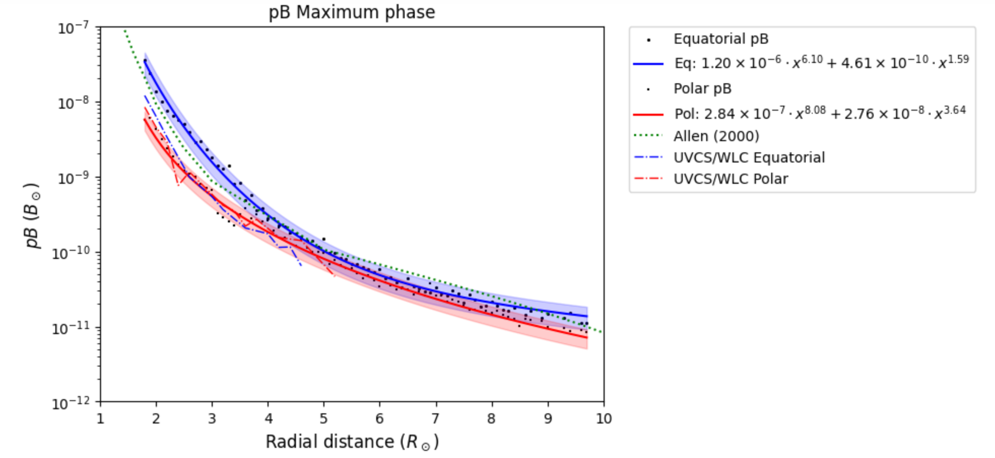
pB maximum phase (cycle 25)

Slide 16
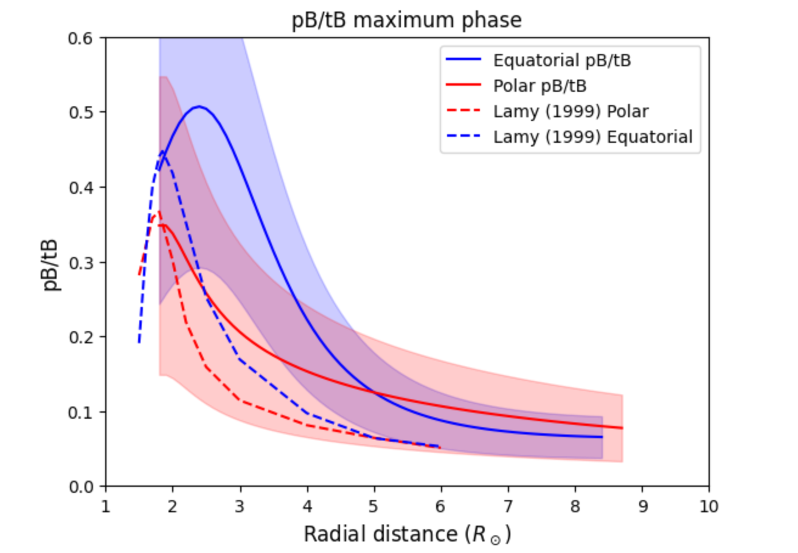
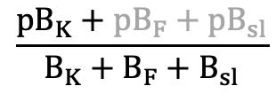
pB maximum phase
$$\frac{{pB}_{K}+{pB}_{F}+{pB}_{sl}}{B_{K}+B_{F}+B_{sl}}$$
$$\$\backslash frac\{pB_K + pB_F + pB_\{sl\}\}\{B_K+B_F+B_\{sl\}\}\$$$

Slide 17
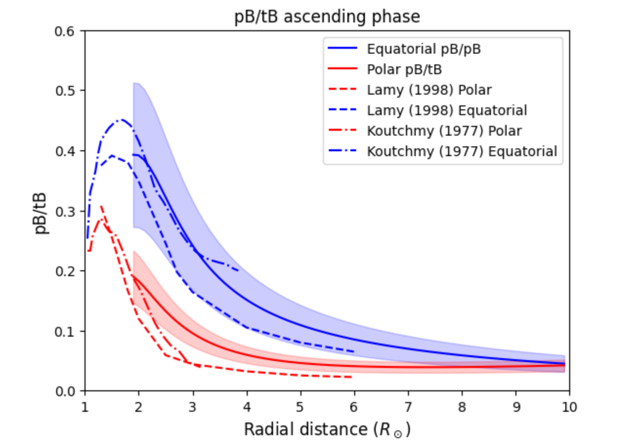
pB/tB ascending phase
$$\frac{{pB}_{K}+{pB}_{F}+{pB}_{sl}}{B_{K}+B_{F}+B_{sl}}$$

Slide 18
Operating VL oronagraphs
SOHO: Lasco C2 and C3 (1995)
STEREO-A: Secchi/Cor2 (2008)
Solar Orbiter: Metis (2020)
Aditya L1: Visible Emission Line Coronagraph (VELC) (2023)
Proba3: ASPIICS (2024)
CODEX Coronal Diagnostics Experiment ISS coronagraph (2024)
PUNCH: Polarimeter to Unify the Corona and the Heliosphere (2025)
GOES19-CCOR1: Space Weather Conditions NOAA (
Notes:
Disk imagers SDO EUI HINODE SPICEessential for soirces

Slide 19
Conclusions
Electron density maps can be directly derived from Metis pB maps. When these are combined with HI Lyman-α maps, solar wind velocity can be obtained via the Doppler dimming technique [Giordano+ 2025].
Additionally, the time evolution of pB offers insights into potential asymmetries in the polar magnetic field, an indicator for predicting solar cycle intensity [Bhowmik, 2019].
This preliminary study provides a temporal evolution of Metis data for the first time. Integrating Metis measurements with data from other space coronagraphs, including SOHO/LASCO and STEREO/SECCHI, will enable coverage of the past three solar cycles.

Slide 20
Conclusions
Increase the statistics in different phases of the cycle and at different polar angles for Metis data.
Further comparison on a statistical significative amount of data will be performed on LASCO/C2 data and COR2 data in order to determine the average pB of the solar corona, providing a new baseline for this critical parameter.
The aim is to achieve an agreed value of pB during the solar cycle at polar and equatorial latitudes among all VL coronagraphs.

