Slide 1

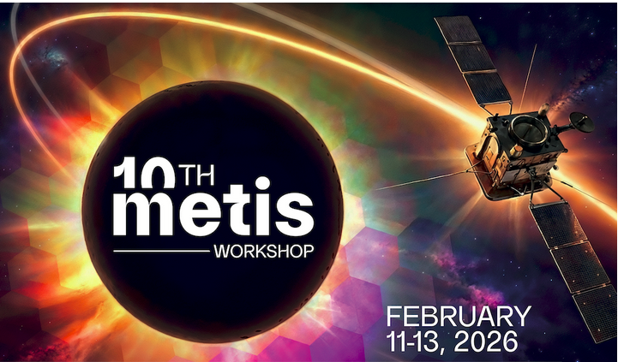
Probing Solar Wind Origins and Coronal Parameters through PSP–Solar Orbiter Quadrature and Corotation Studies (Preliminary)
Dr. Pawan Kumar
Postdoctoral Fellow (University of Florence)
Collaborators:
Prof. Marco Romoli (University of Florence)
Prof. S. Giordano (INAF – Torino)
Prof. Andrea Verdini (University of Florence)

Slide 2
Motivation
The solar wind originates in the low and extended solar corona, where its generation and acceleration take place.
Despite decades of observations and modeling, the physical mechanisms responsible for its formation and acceleration are still not fully understood (A. A. Vidotto 2021).
Remote-sensing instruments observe low and extended solar corona through emitted and scattered radiation, while in-situ spacecraft measure the solar wind only after it has evolved far from the Sun.
As a result, coronal structures and in-situ wind streams are connected only indirectly, through magnetic mapping and modeling assumptions, introducing substantial uncertainty in identifying solar-wind sources and acceleration processes.
What we can do for improvement and reliability?
To understand how specific coronal conditions give rise to specific solar-wind streams, the possible approach is that the origin of the plasma sampled by spacecraft is seen by the coronagraph on the plane of the sky.

Slide 3
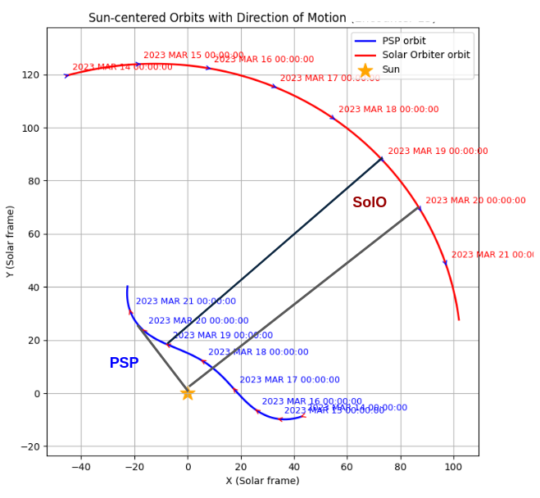
Consideration of PSP and Solar Orbiter (SolO) corotation quadrature geometric scenario
Parker Solar Probe (PSP) provides in-situ measurements of plasma properties and solar-wind speed along its trajectory, sampling the heliosphere from about ∼9R⊙​ out to 1 AU.
Solar Orbiter (SolO) Metis coronagraph observes the extended corona in visible light and in H I Ly-α simultaneously and provide information on coronal structure, electron density, and outflow in the solar-wind acceleration region (~1.7R⊙ to 10R⊙).
corotation - quadrature
PSP–Solar Orbiter quadrature and corotation configurations provide a practical means to study the solar wind from low corona to far away assuming the source remains stationary.
Solar radius

Slide 4
Importance of Quadrature
PSP and SolO quadrature (90 deg) gives the unique opportunity where PSP samples plasma while SolO observes its coronal source.
This geometry minimizes projection and line-of-sight ambiguity. It allows near-simultaneous observation of the same solar wind stream.
Importance of Corotation
PSP can remains magnetically connected to the same solar region for this time period i.e., if the coronal magnetic morphology is stable do not undergoes to fast changes.
The same coronal source feeds PSP over an extended time. Enables time-resolved tracking of wind formation. Reduces uncertainty in magnetic connectivity.

Slide 5
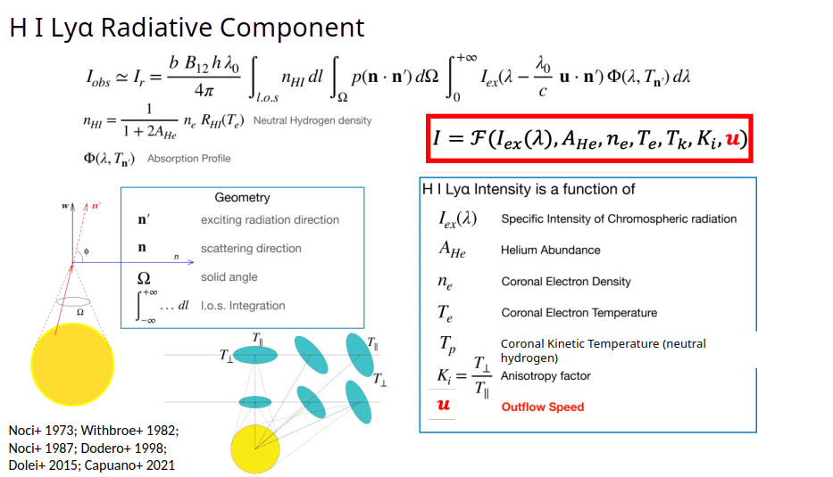
Doppler Dimming Effect (Computation of solar wind speed in lower corona from Metis data)
Intensity spectrum from lower atmosphere
B12 is the Einstein coefficient

Slide 6
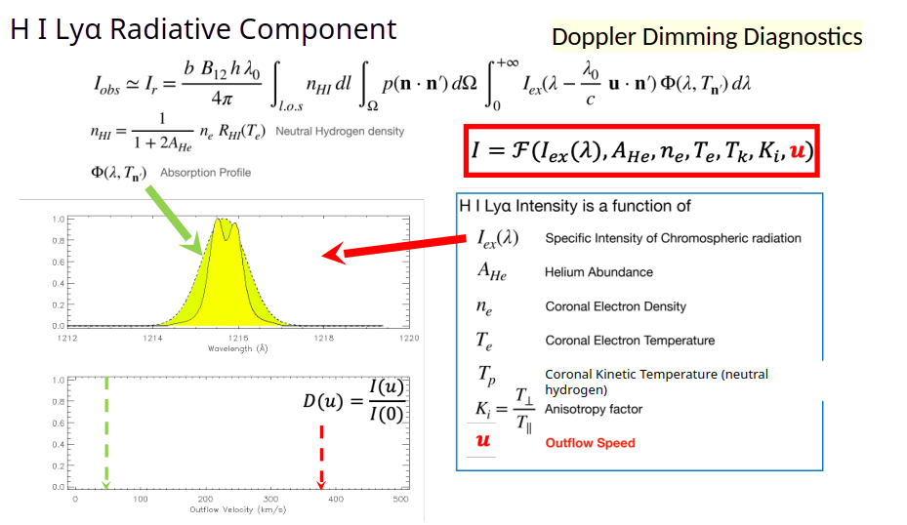

Slide 7
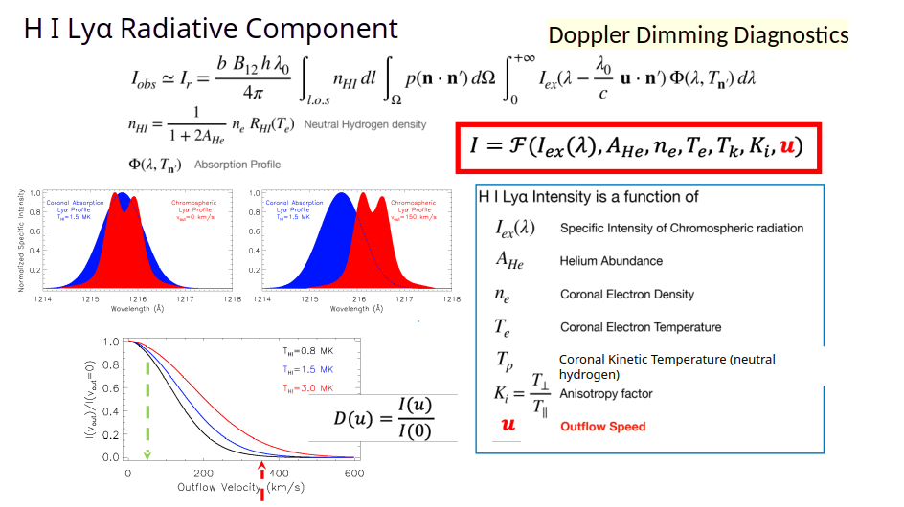

Slide 8
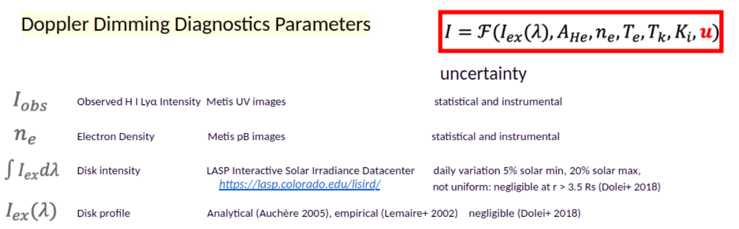
Te electron temperature Gibson et al. 1999
Tk Kinetic temperature ~1 MK (const.)
Ki Anoistropy 1 to 2
AHe Helium abundance Typically 10%

Slide 9
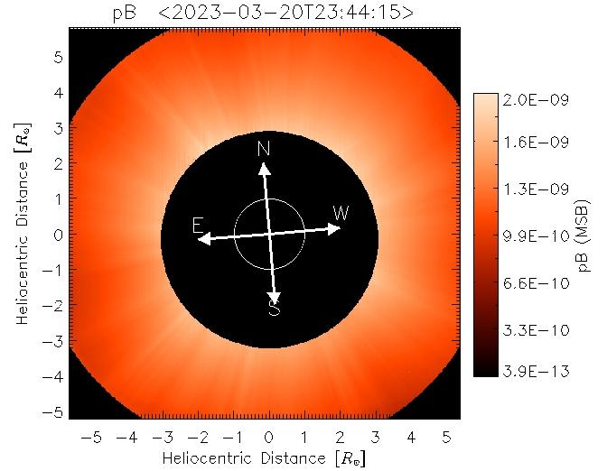
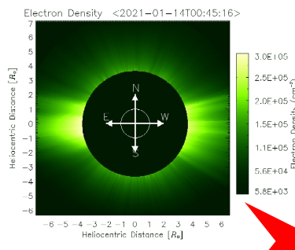
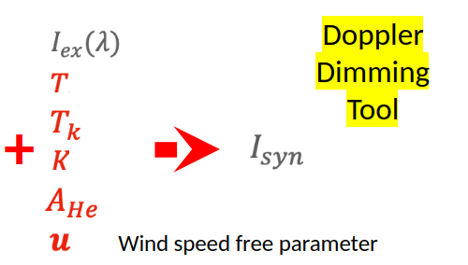
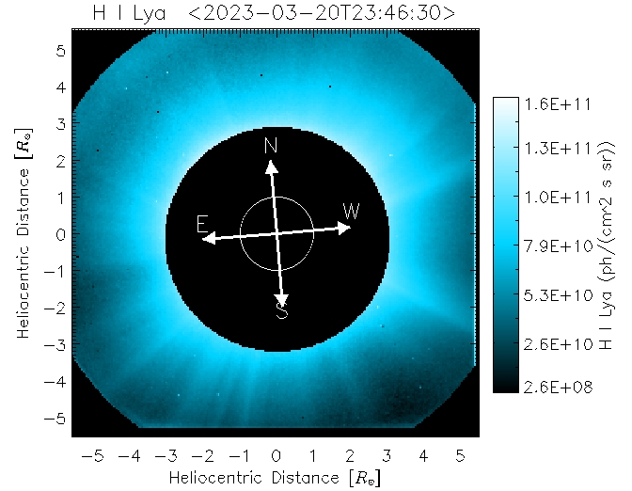
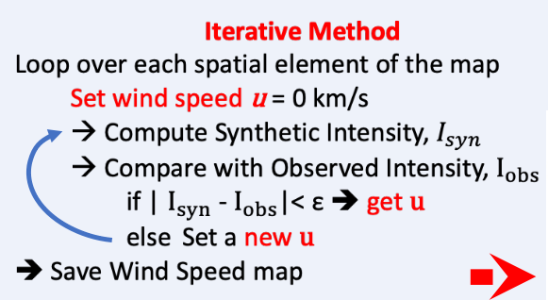
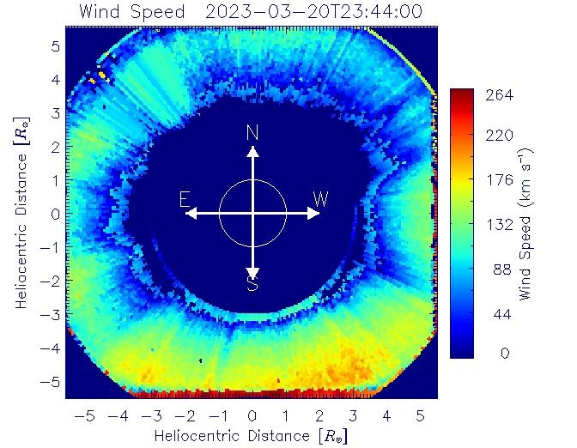

Slide 10
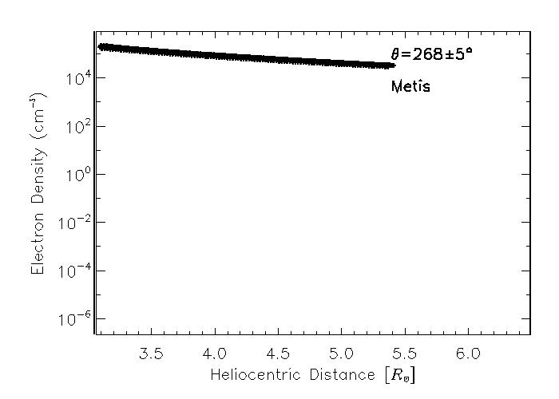
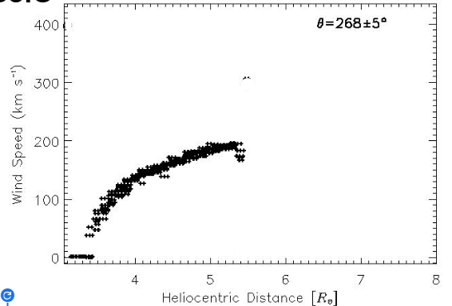
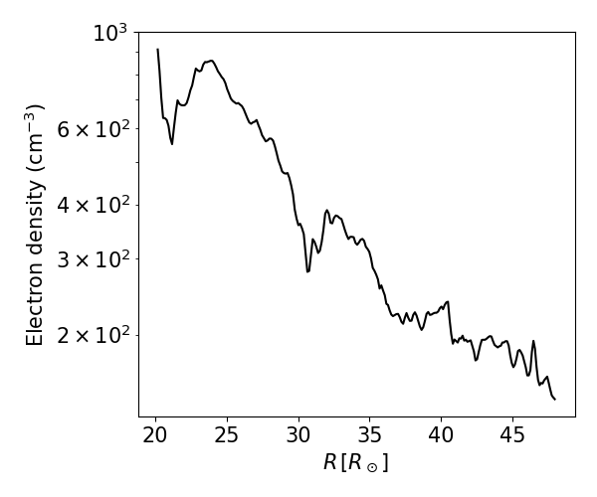
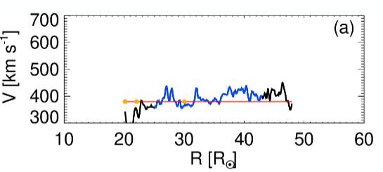
Preliminary Results from SolO
PSP
Preliminary Results from PSP

Slide 11
Summary
The measurement of the solar wind speed is crucial for studying the mechanisms of wind acceleration and for defining the environment in which CMEs expand.
PSP–Solar Orbiter quadrature and corotation configurations allow remote sensing of the coronal source region and in-situ sampling of the magnetically connected solar-wind stream.
This can provide the most direct observational linkage currently possible between solar-wind formation and its heliospheric evolution.
Thank You

Slide 12
