Slide 1
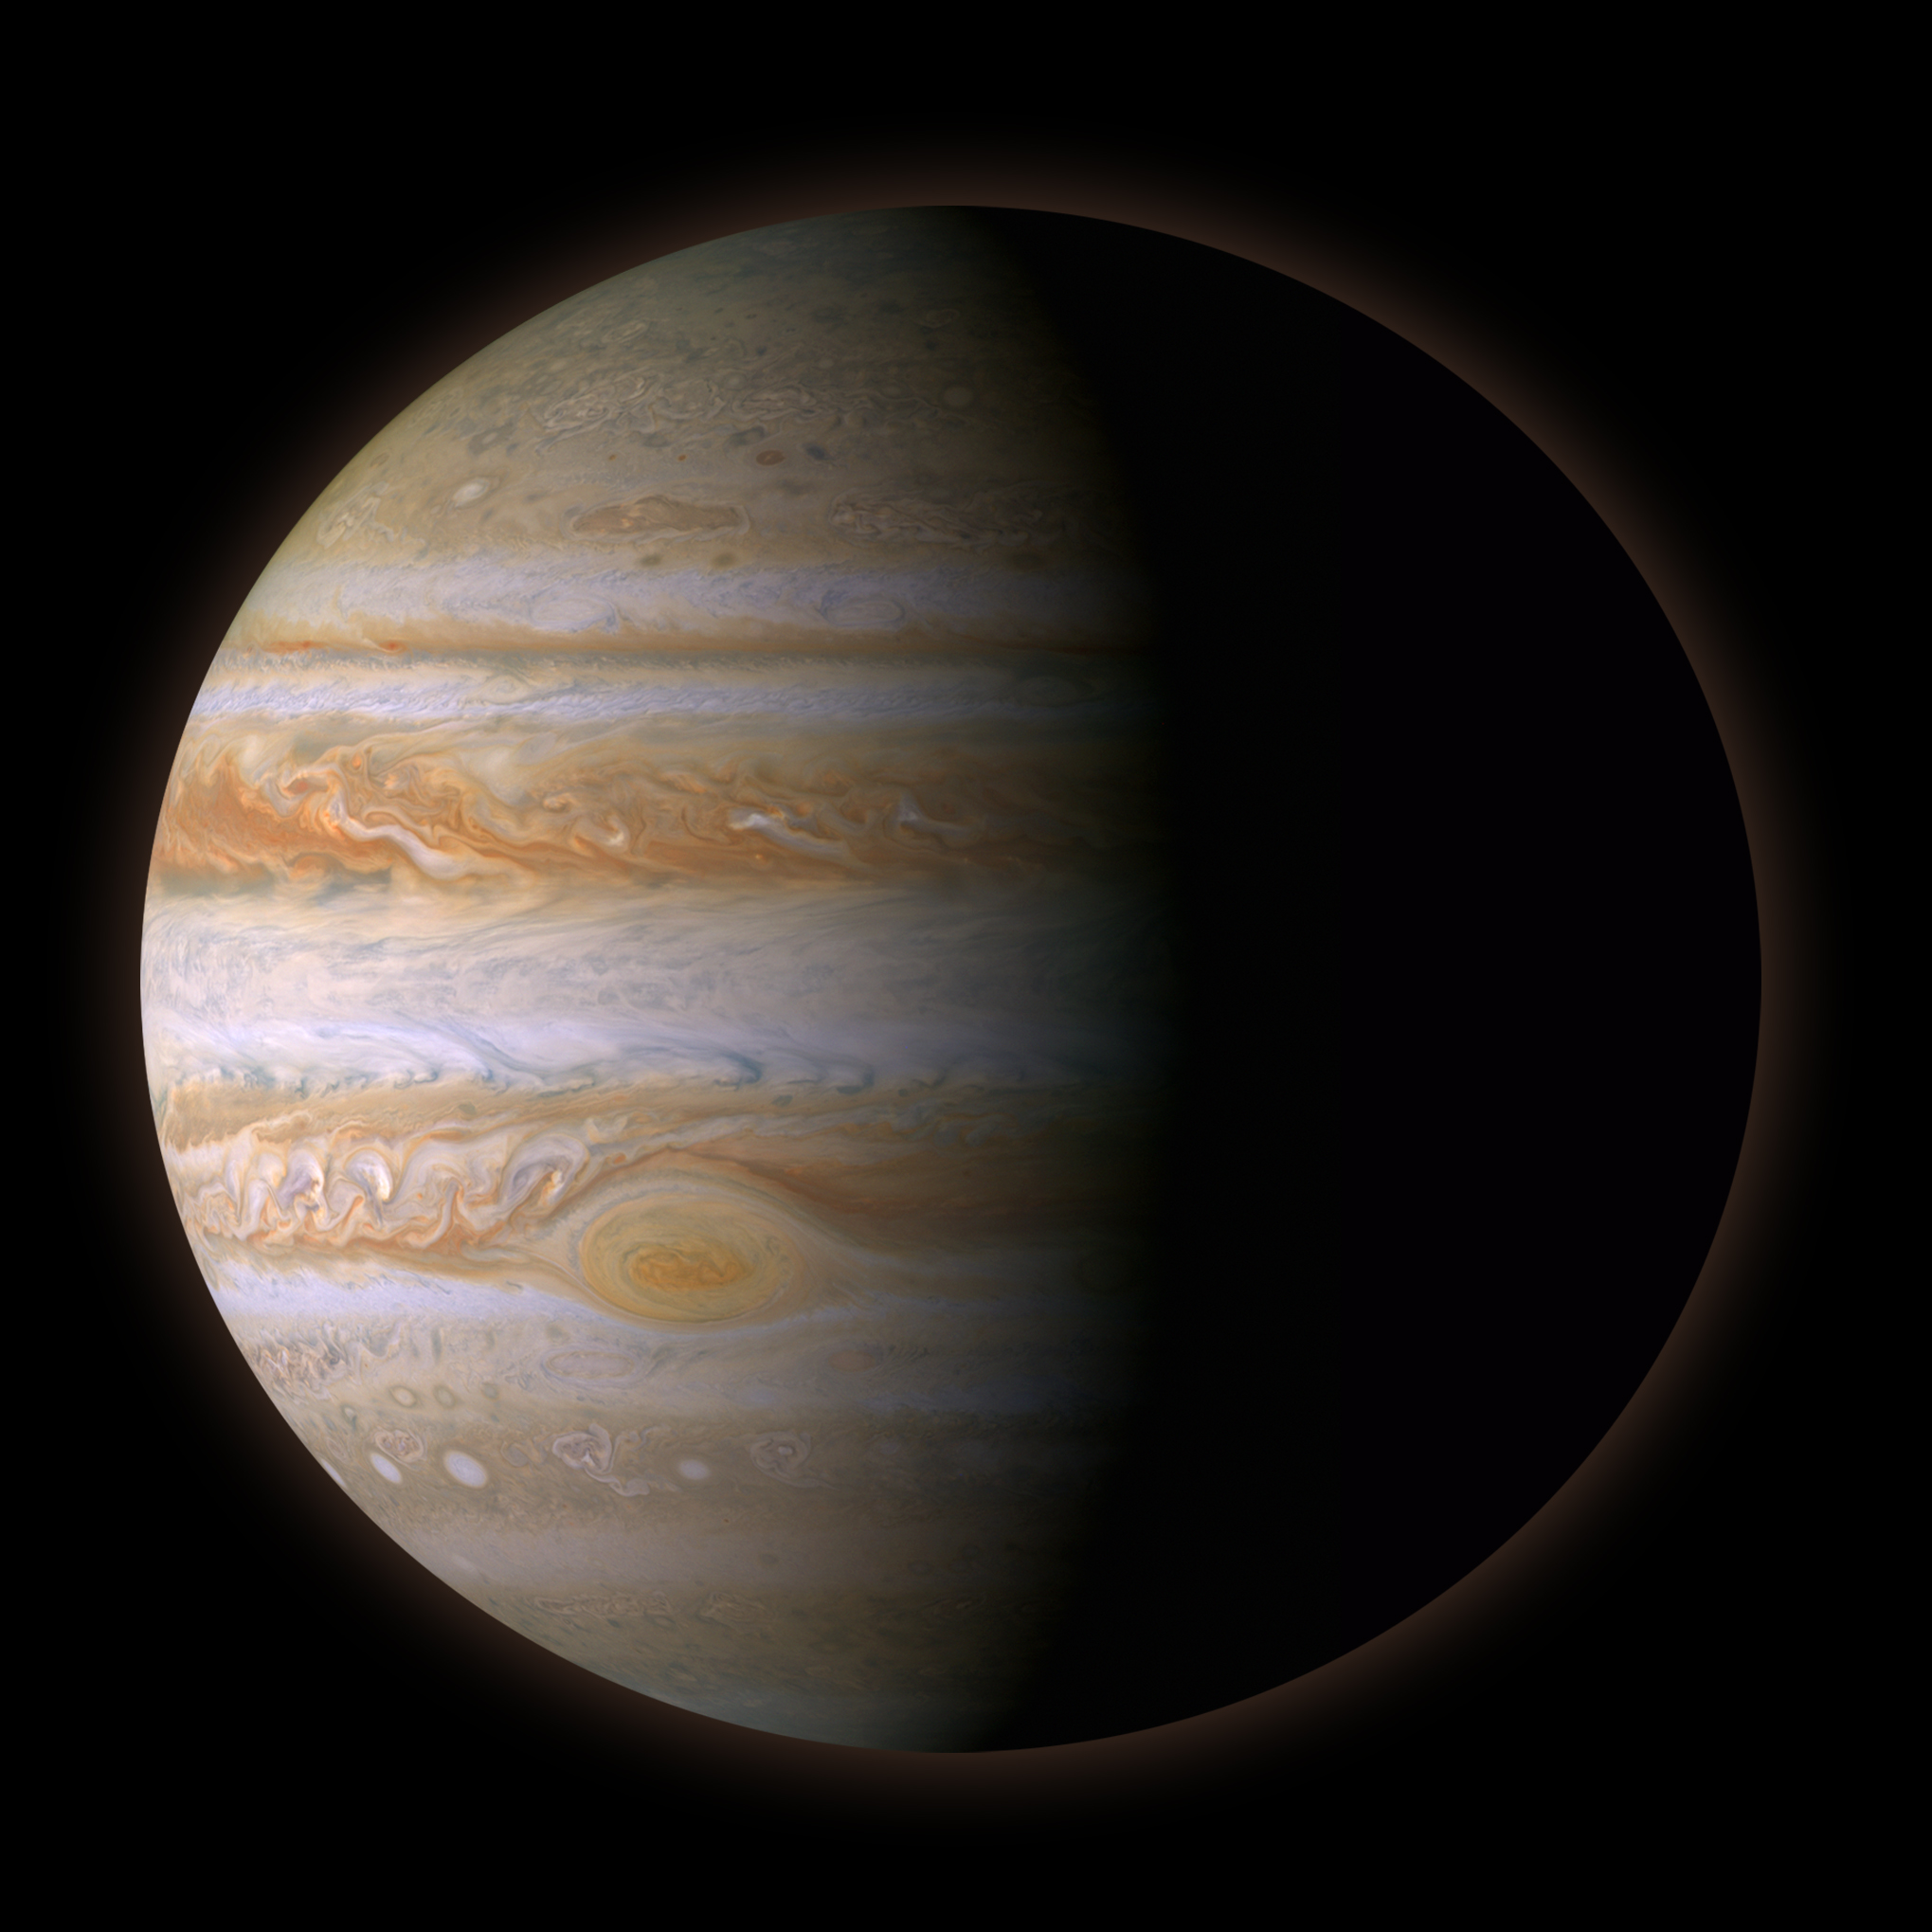

The Impact of Jupiter-like planets on the potential habitability of exoEarths
Jonti Horner
jonti.horner@unisq.edu.au
http://jontihorner.com
@JontiHorner
Jupiters and exoEarths
25/03/2026
Notes:
1

Slide 2
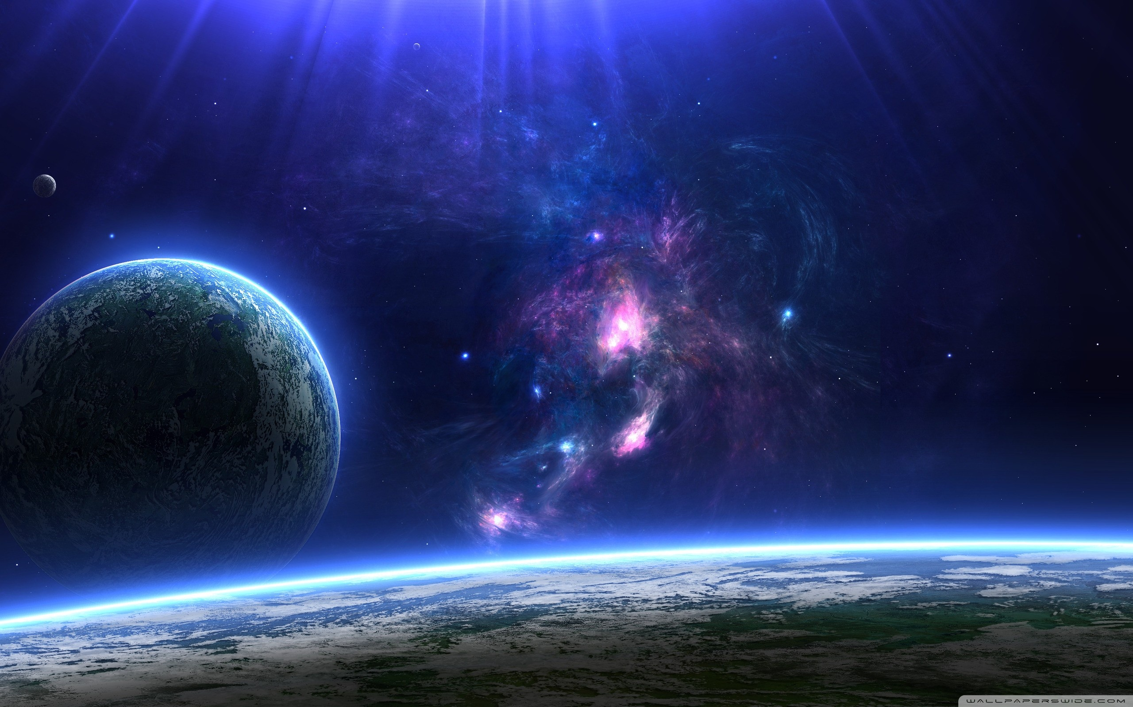

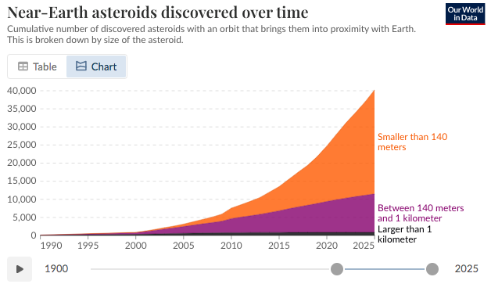
A basic law of Astronomy:
Where we discover one object, we soon find hundreds, thousands…
Jupiters and exoEarths
25/03/2026
Notes:
2

Slide 3
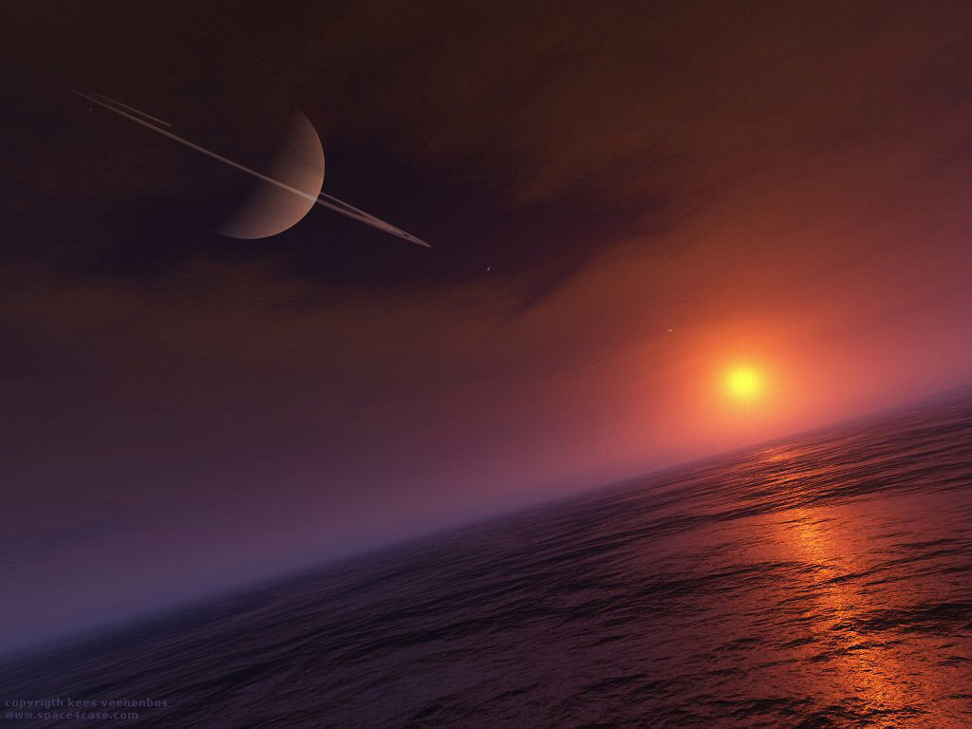

How should we choose which exo-Earth to target in the search for life?
  Galactic Influences
  Stellar Influences
  The Influence of the Planetary System
  The Planet Itself…
Horner & Jones, 2010, IJA, 9, 273
Jupiters and exoEarths
25/03/2026
Notes:
3

Slide 4
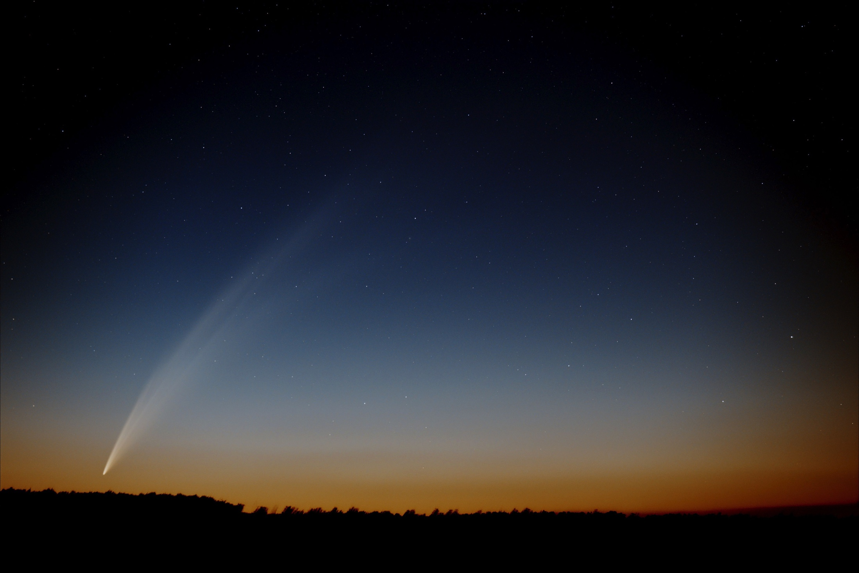
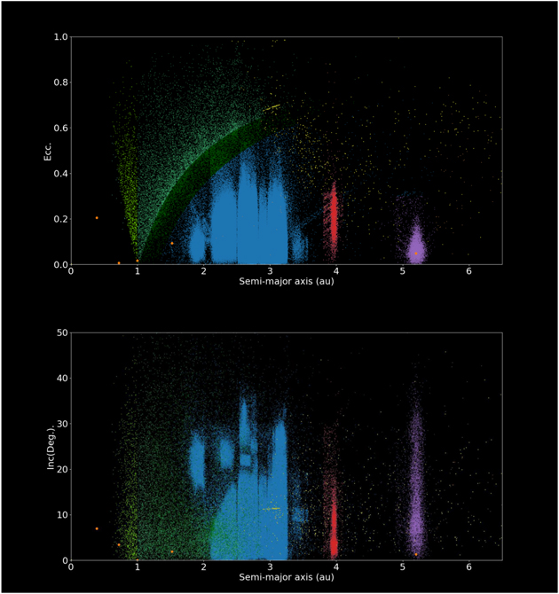
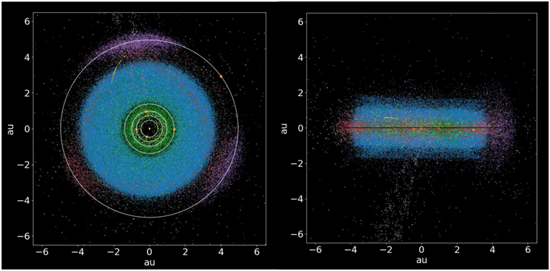
The Solar System – one system, exquisite detail
Horner et al., 2020, PASP, 132, 2001
Jupiters and exoEarths
25/03/2026
Notes:
4

Slide 5
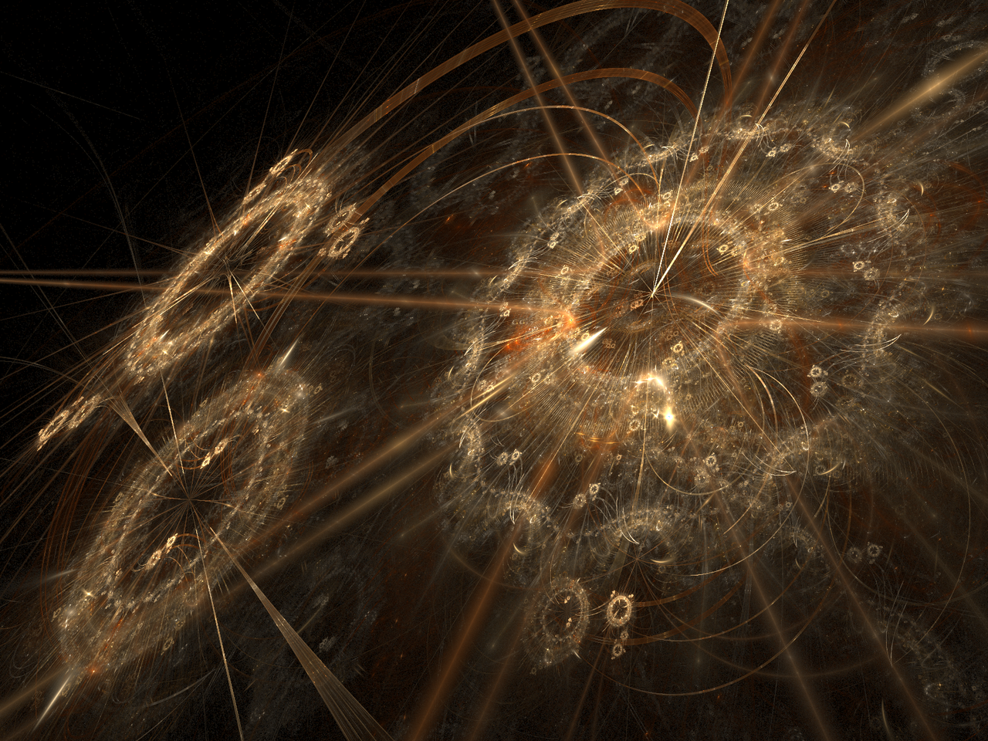
Modelling Dynamical Influences – a clockwork universe
Mercury: Chambers, 1999, MNRAS, 304, 793
Jupiters and exoEarths
25/03/2026
Notes:
5

Slide 6
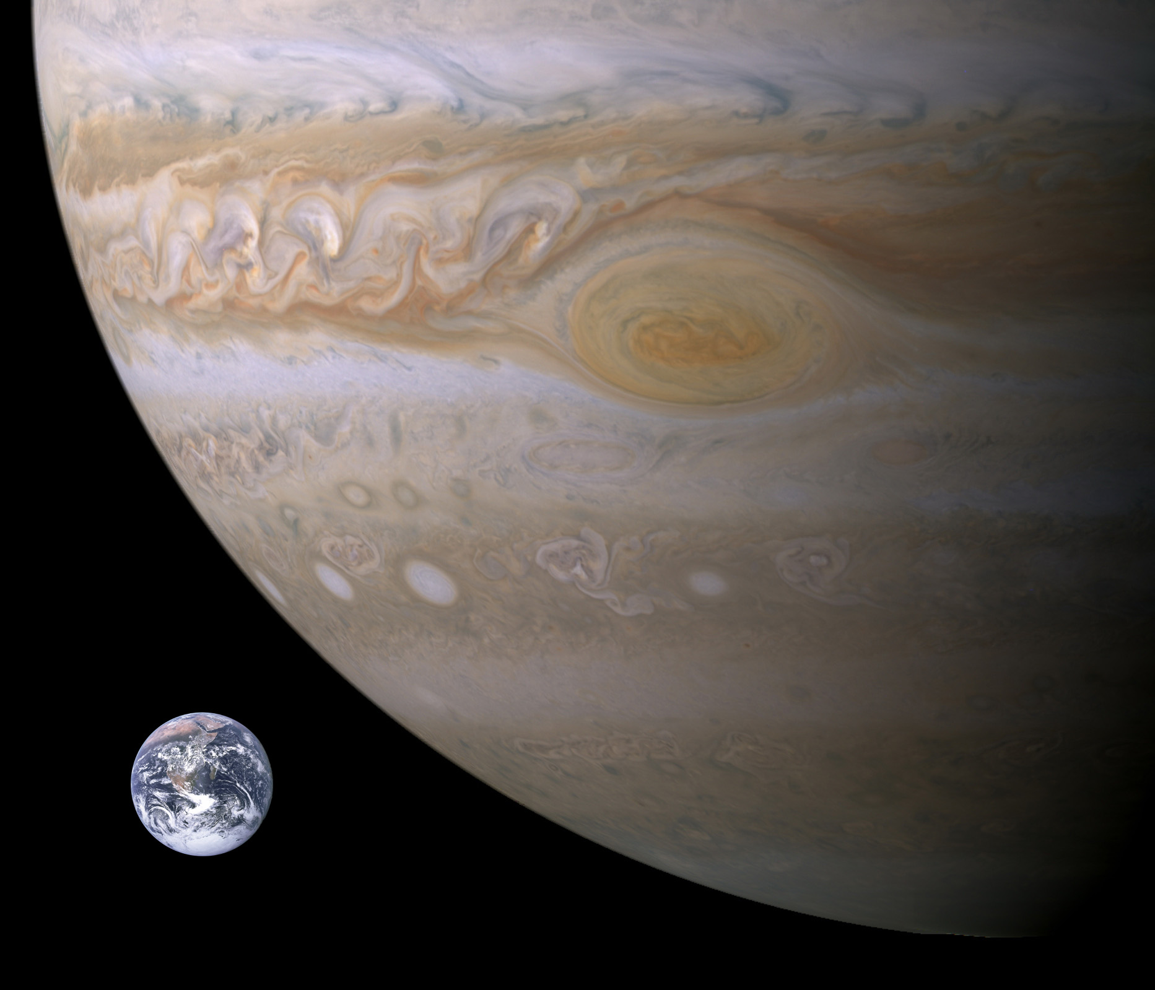
Jupiter – Friend or Foe?
“Eventually, Jupiter's immense gravity caused it to act as a shield for Earth, protecting Earth from being overly bombarded. Without the particular size and placement of Jupiter, Earth could still be subjected to intense pummelling by asteroids and comets, and life may not have been able to develop as it did.”
Jupiters and exoEarths
25/03/2026

Slide 7
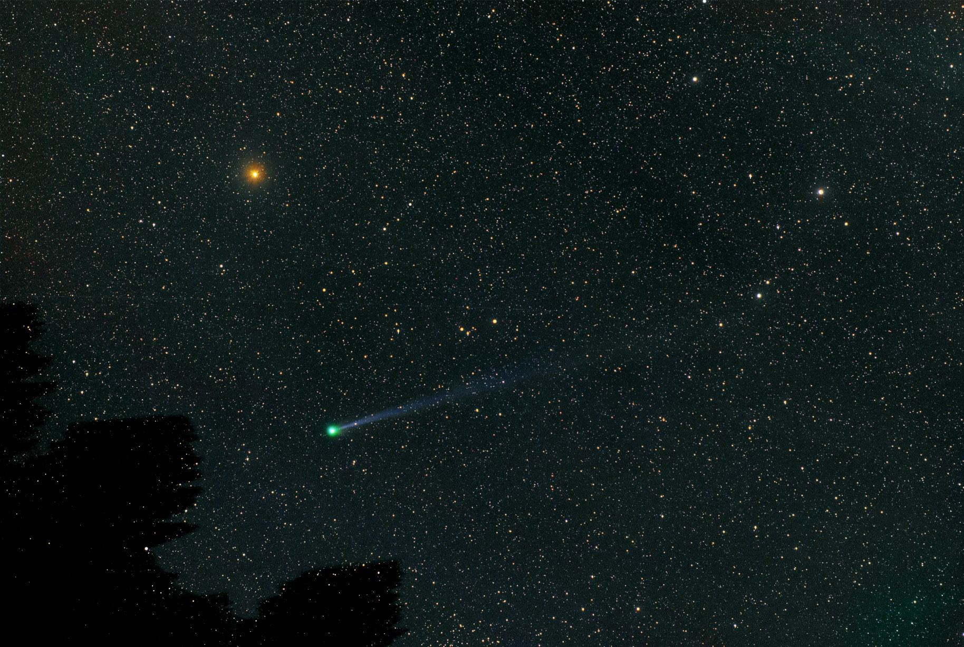
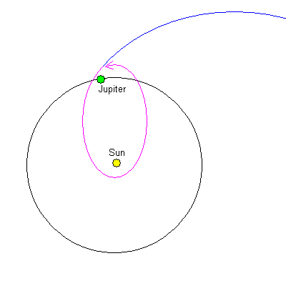
Comet Lexell – planetary pinball
Jupiters and exoEarths
25/03/2026

Slide 8
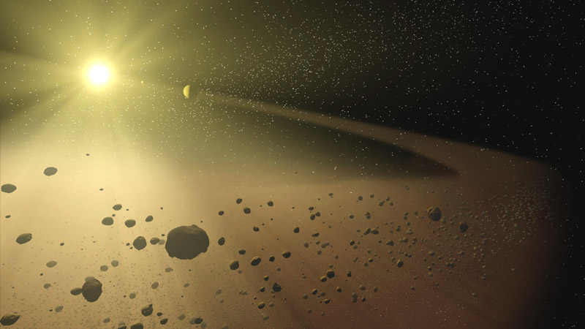
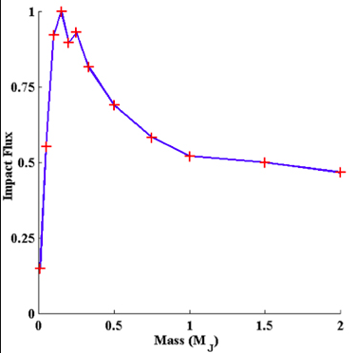
Test #1 – The Asteroids
Horner & Jones, 2008, IJA, 7, 251
Jupiters and exoEarths
25/03/2026

Slide 9
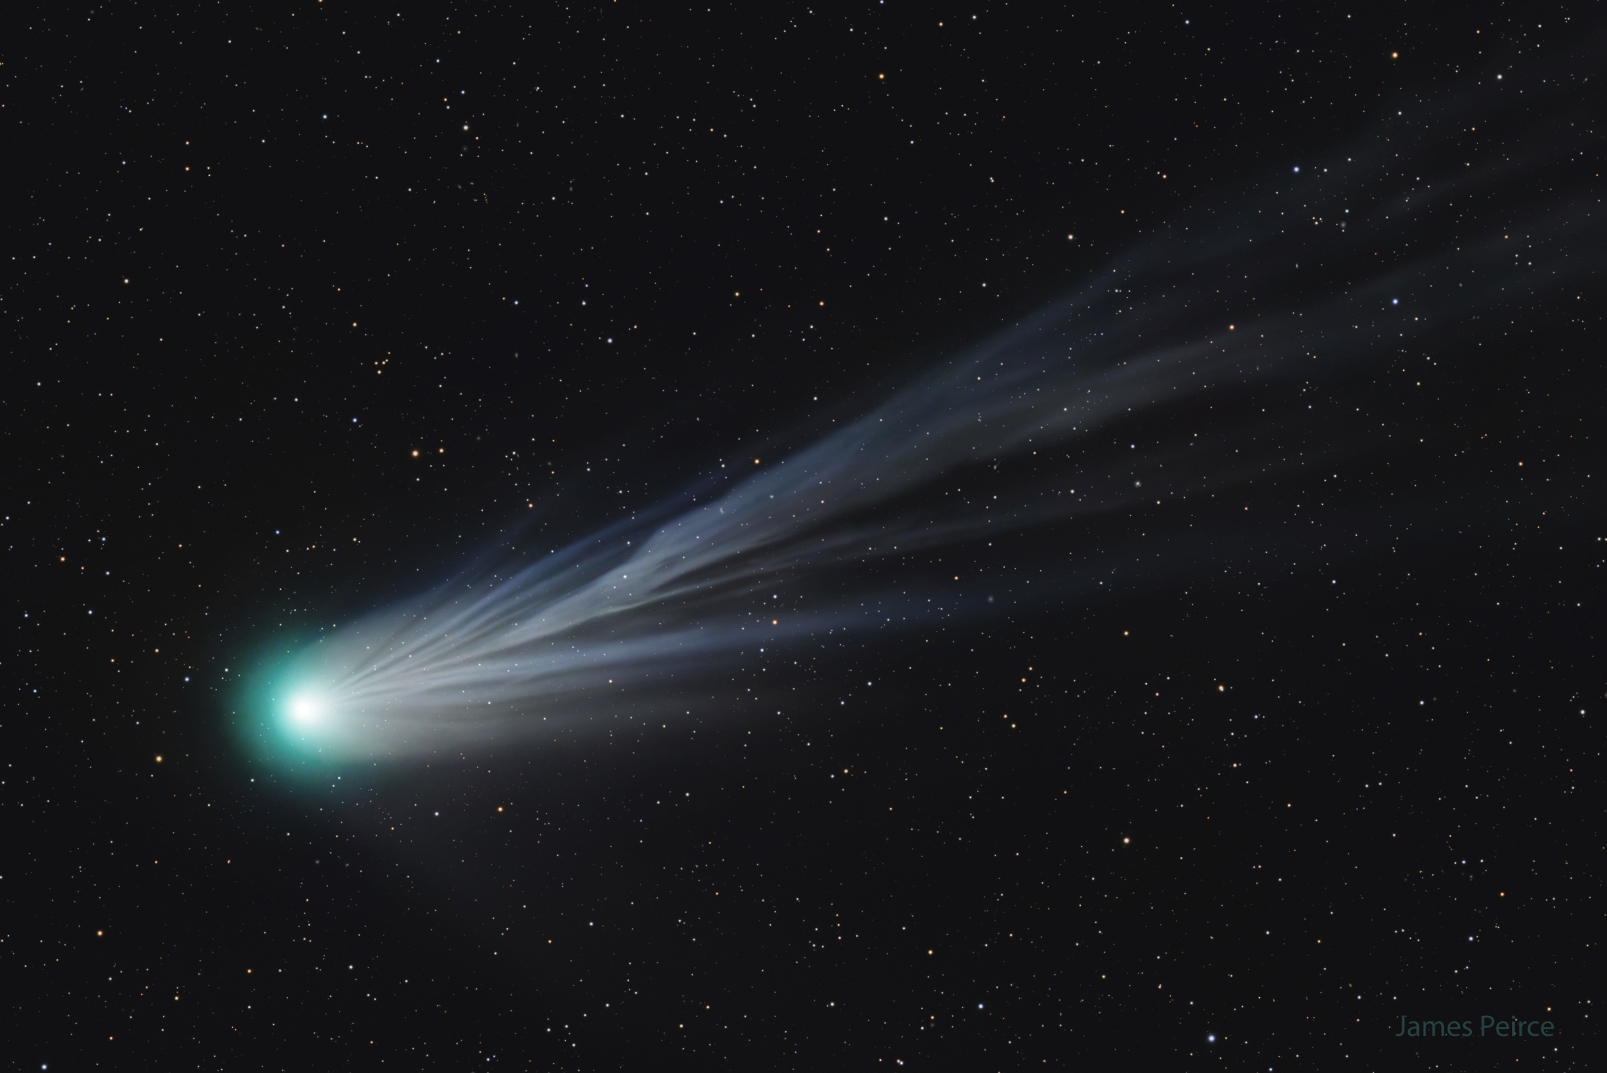
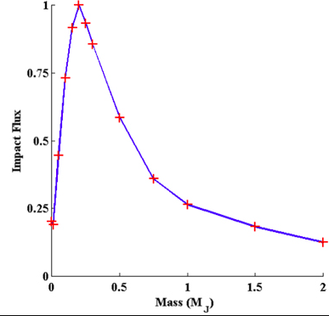
Test #2: The Centaurs
Horner & Jones, 2009, IJA, 8, 75
Jupiters and exoEarths
25/03/2026

Slide 10
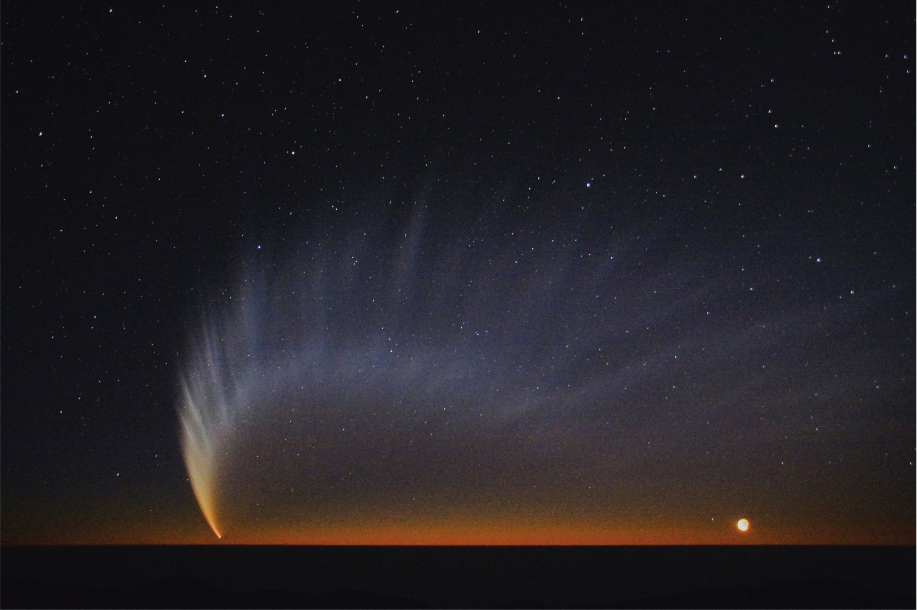
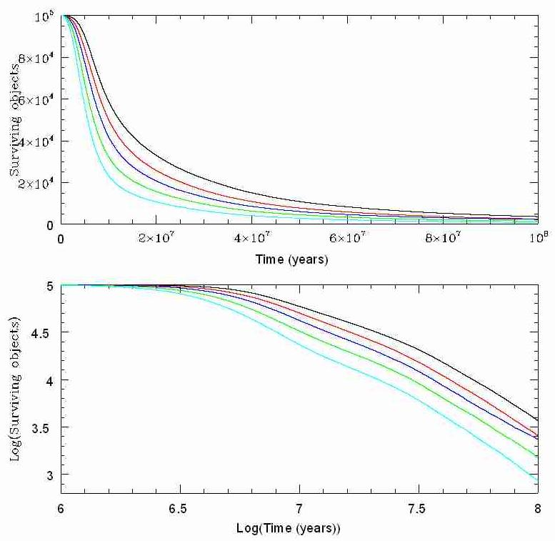
Test #3: The Oort Cloud Comets
Horner, Jones & Chambers, 2010, IJA, 9, 1
Jupiters and exoEarths
25/03/2026

Slide 11
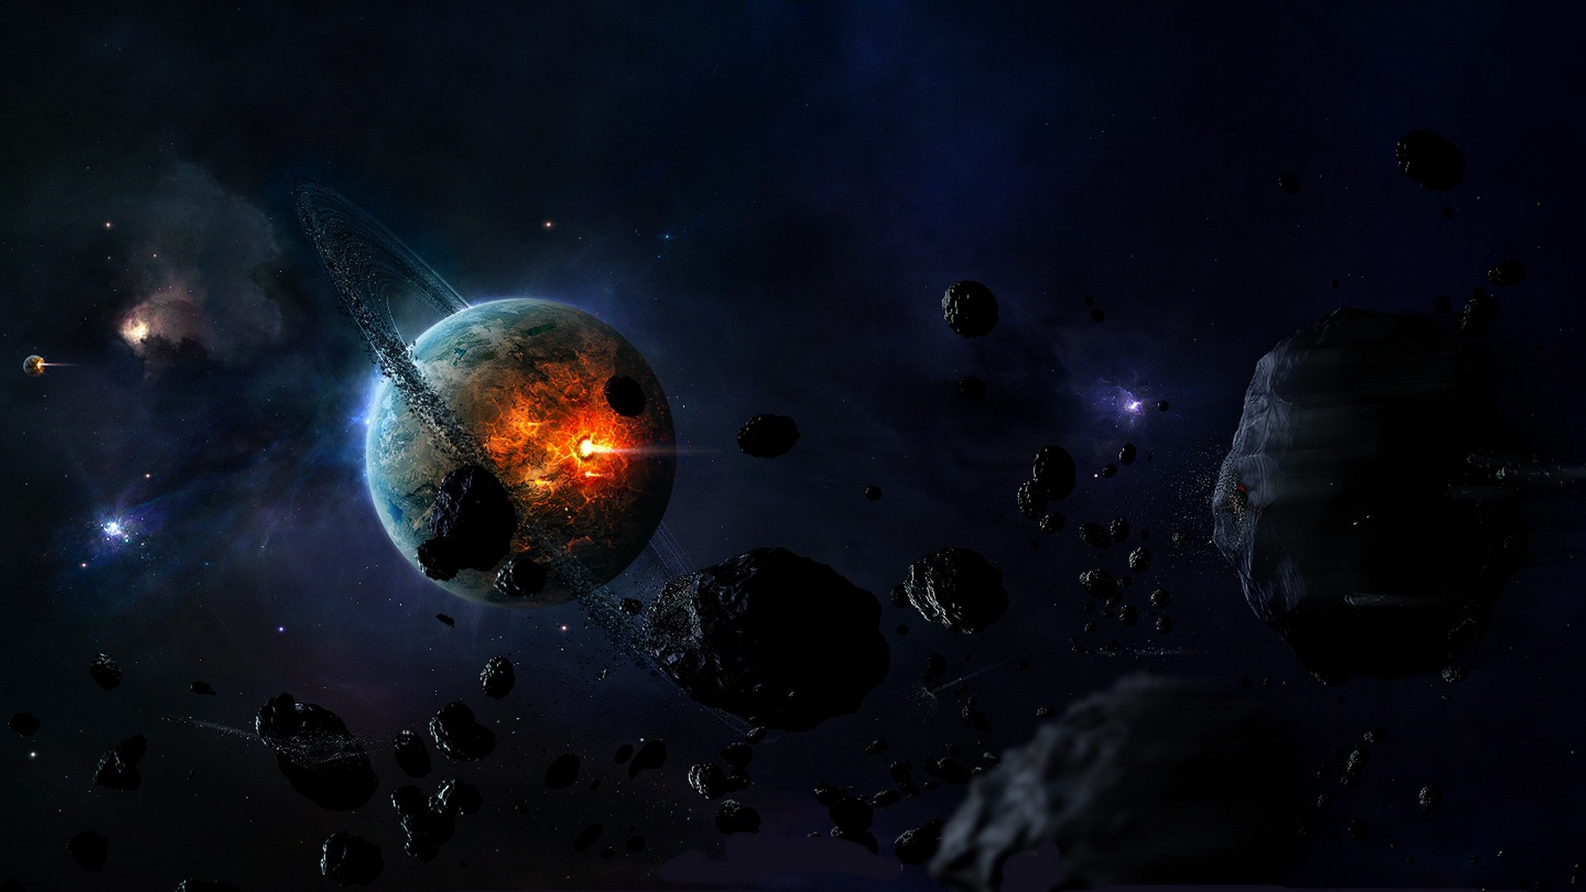
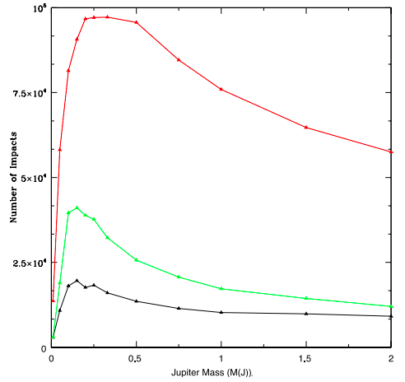
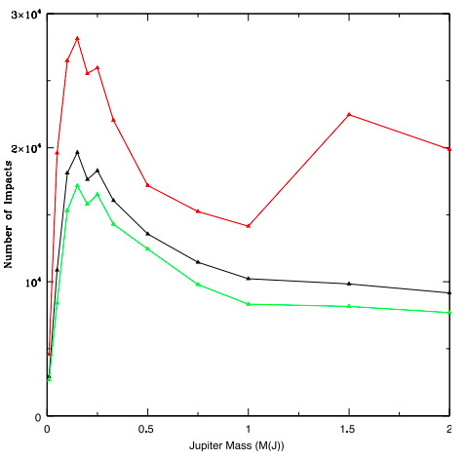
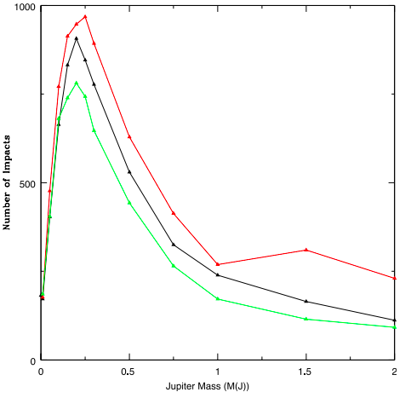
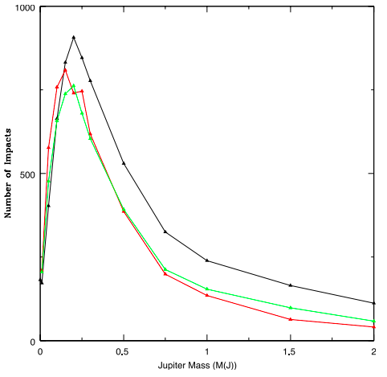
Test #4 – Eccentricity and Inclination
Horner & Jones, 2012, IJA, 11, 147
Jupiters and exoEarths
25/03/2026

Slide 12
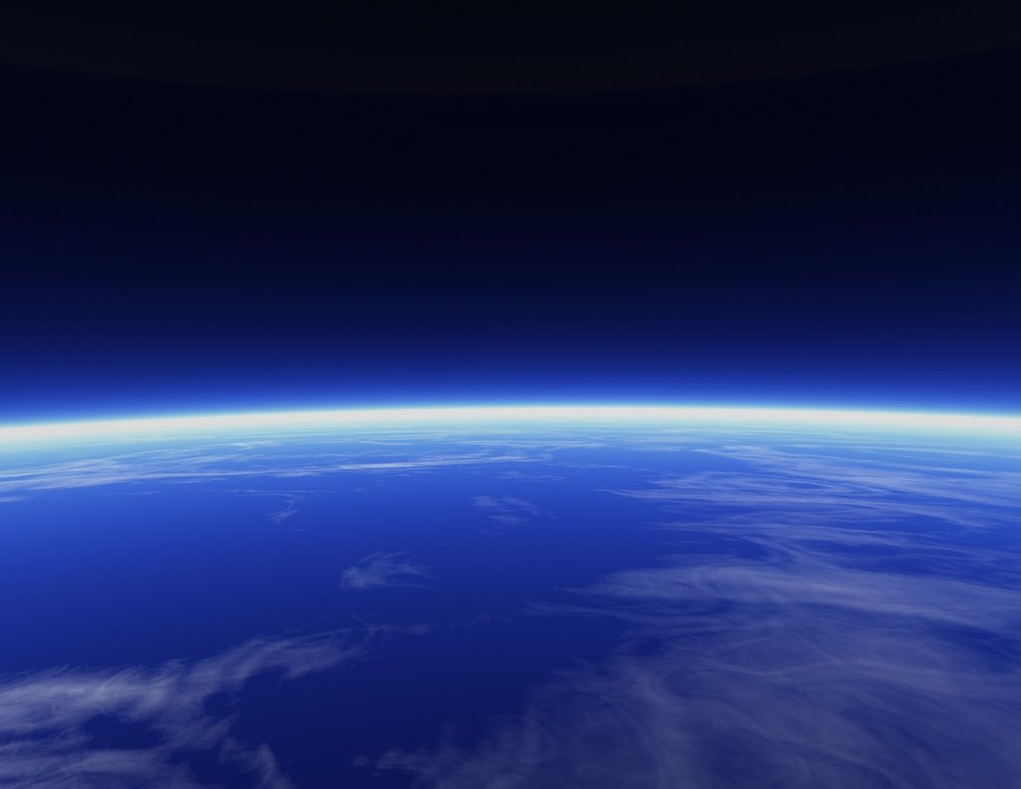
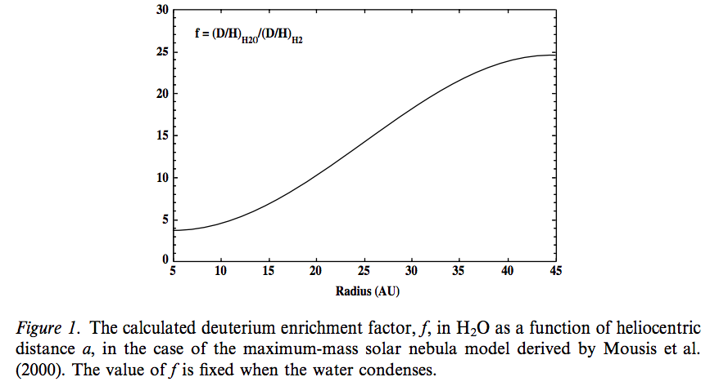
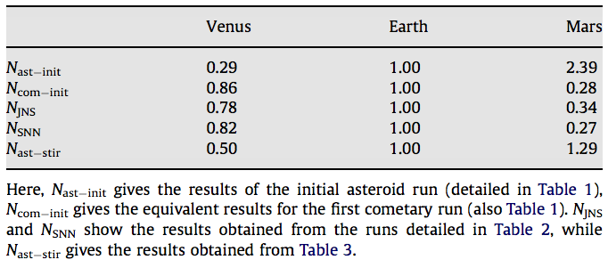
Testing an implicit assumption…
Horner, Mousis & Hersant, 2007, EM&P, 100, 43
Horner et al., 2009, P&SS, 57, 1338
Jupiters and exoEarths
25/03/2026

Slide 13
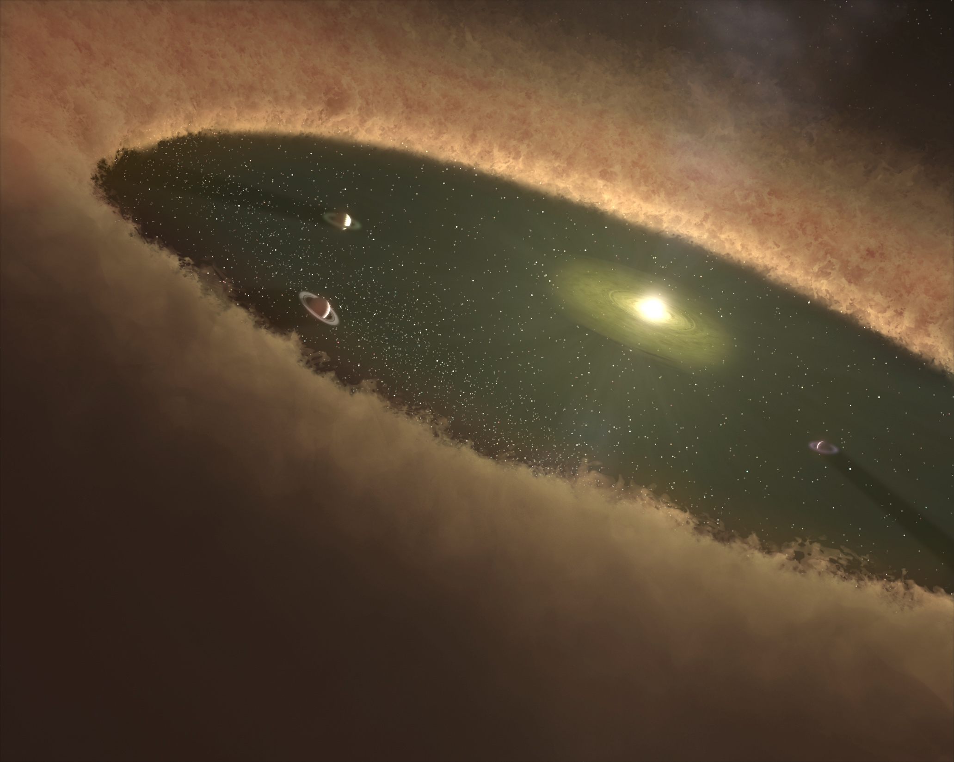
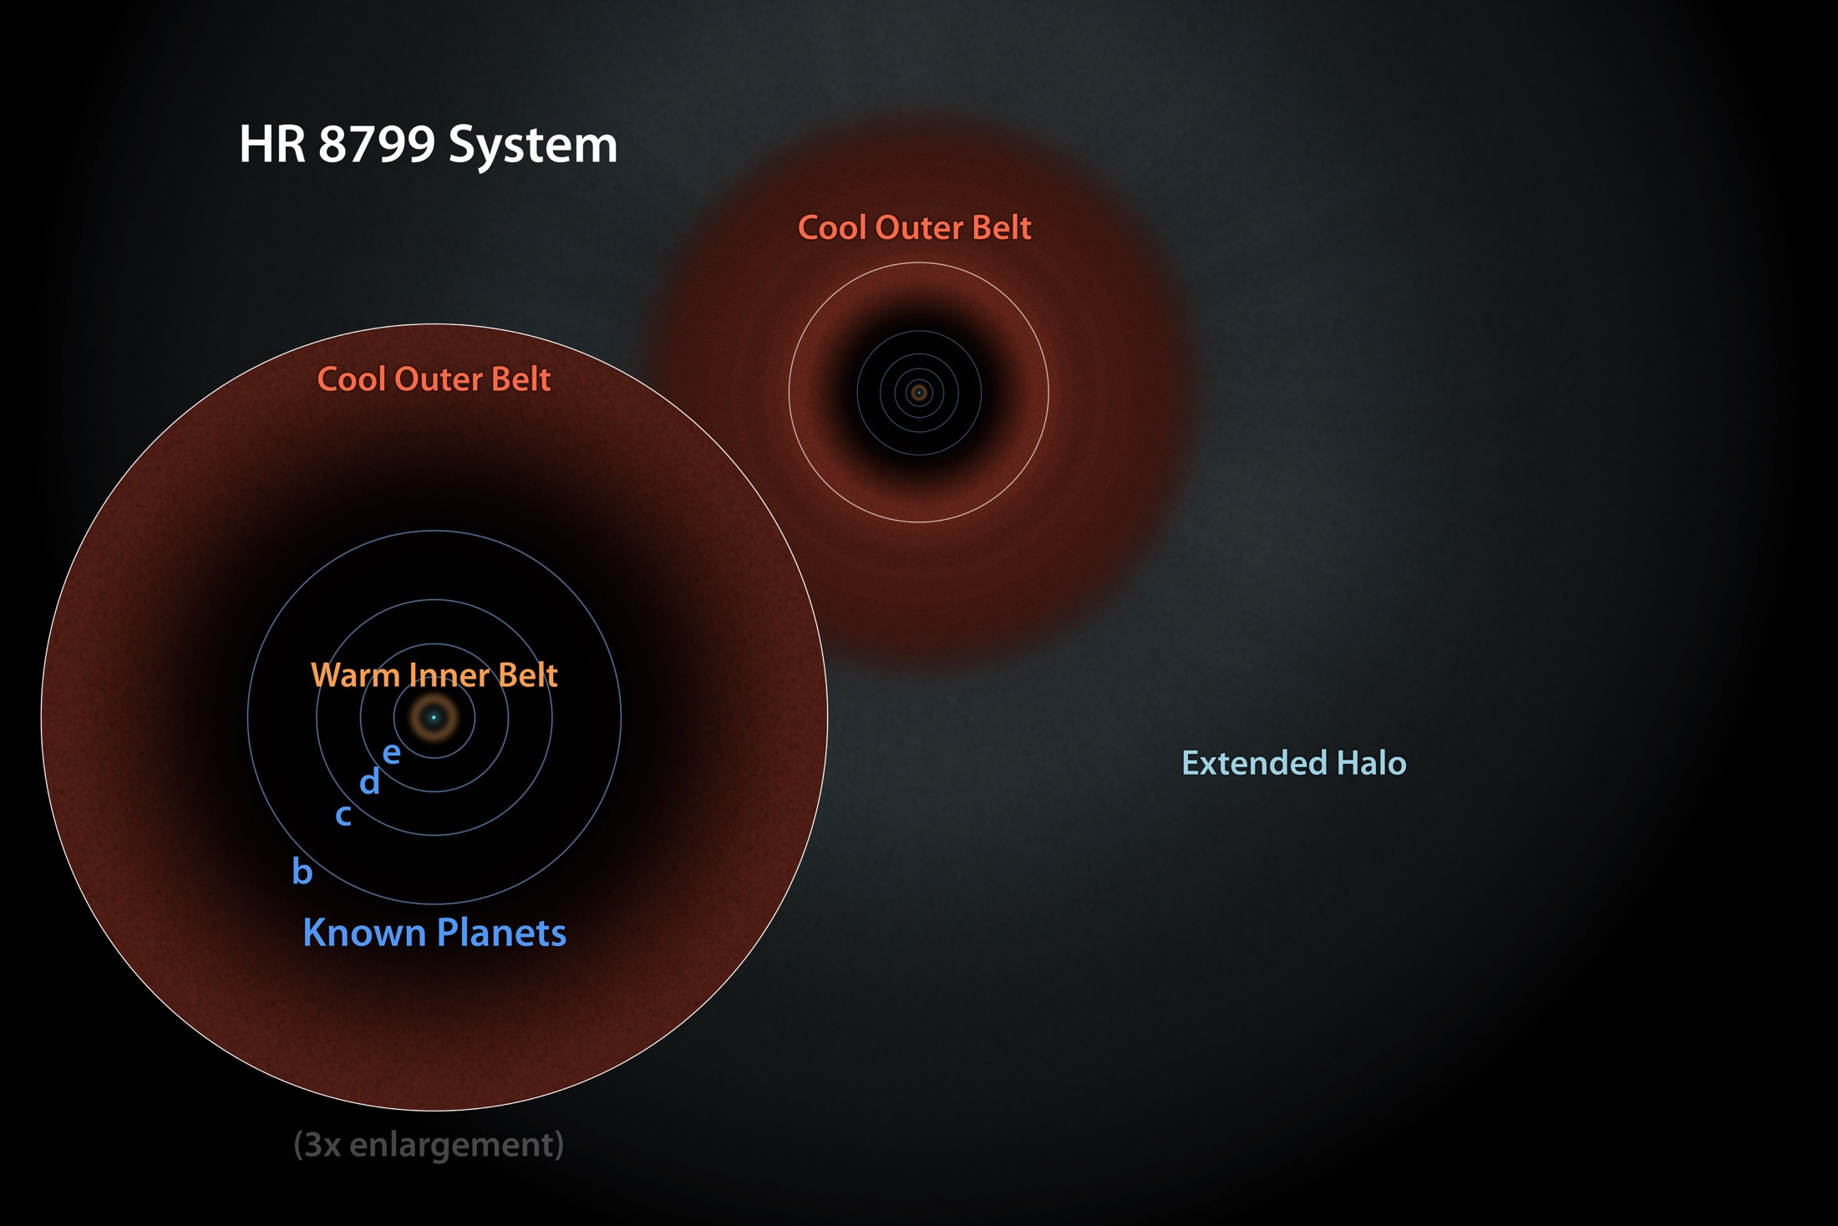
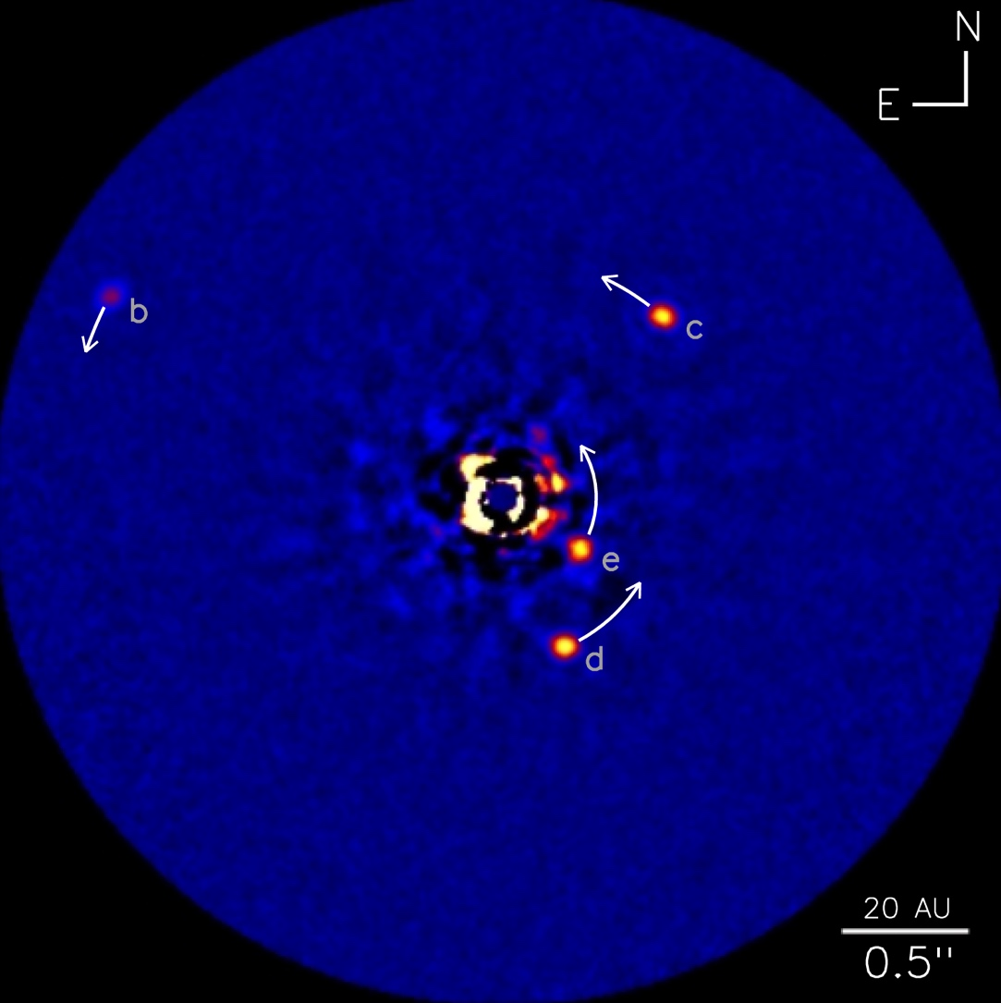
HR 8799 is a planetary system a bit like ours…
4 giant planets
2 debris belts
Jupiters and exoEarths
25/03/2026
Notes:
13

Slide 14
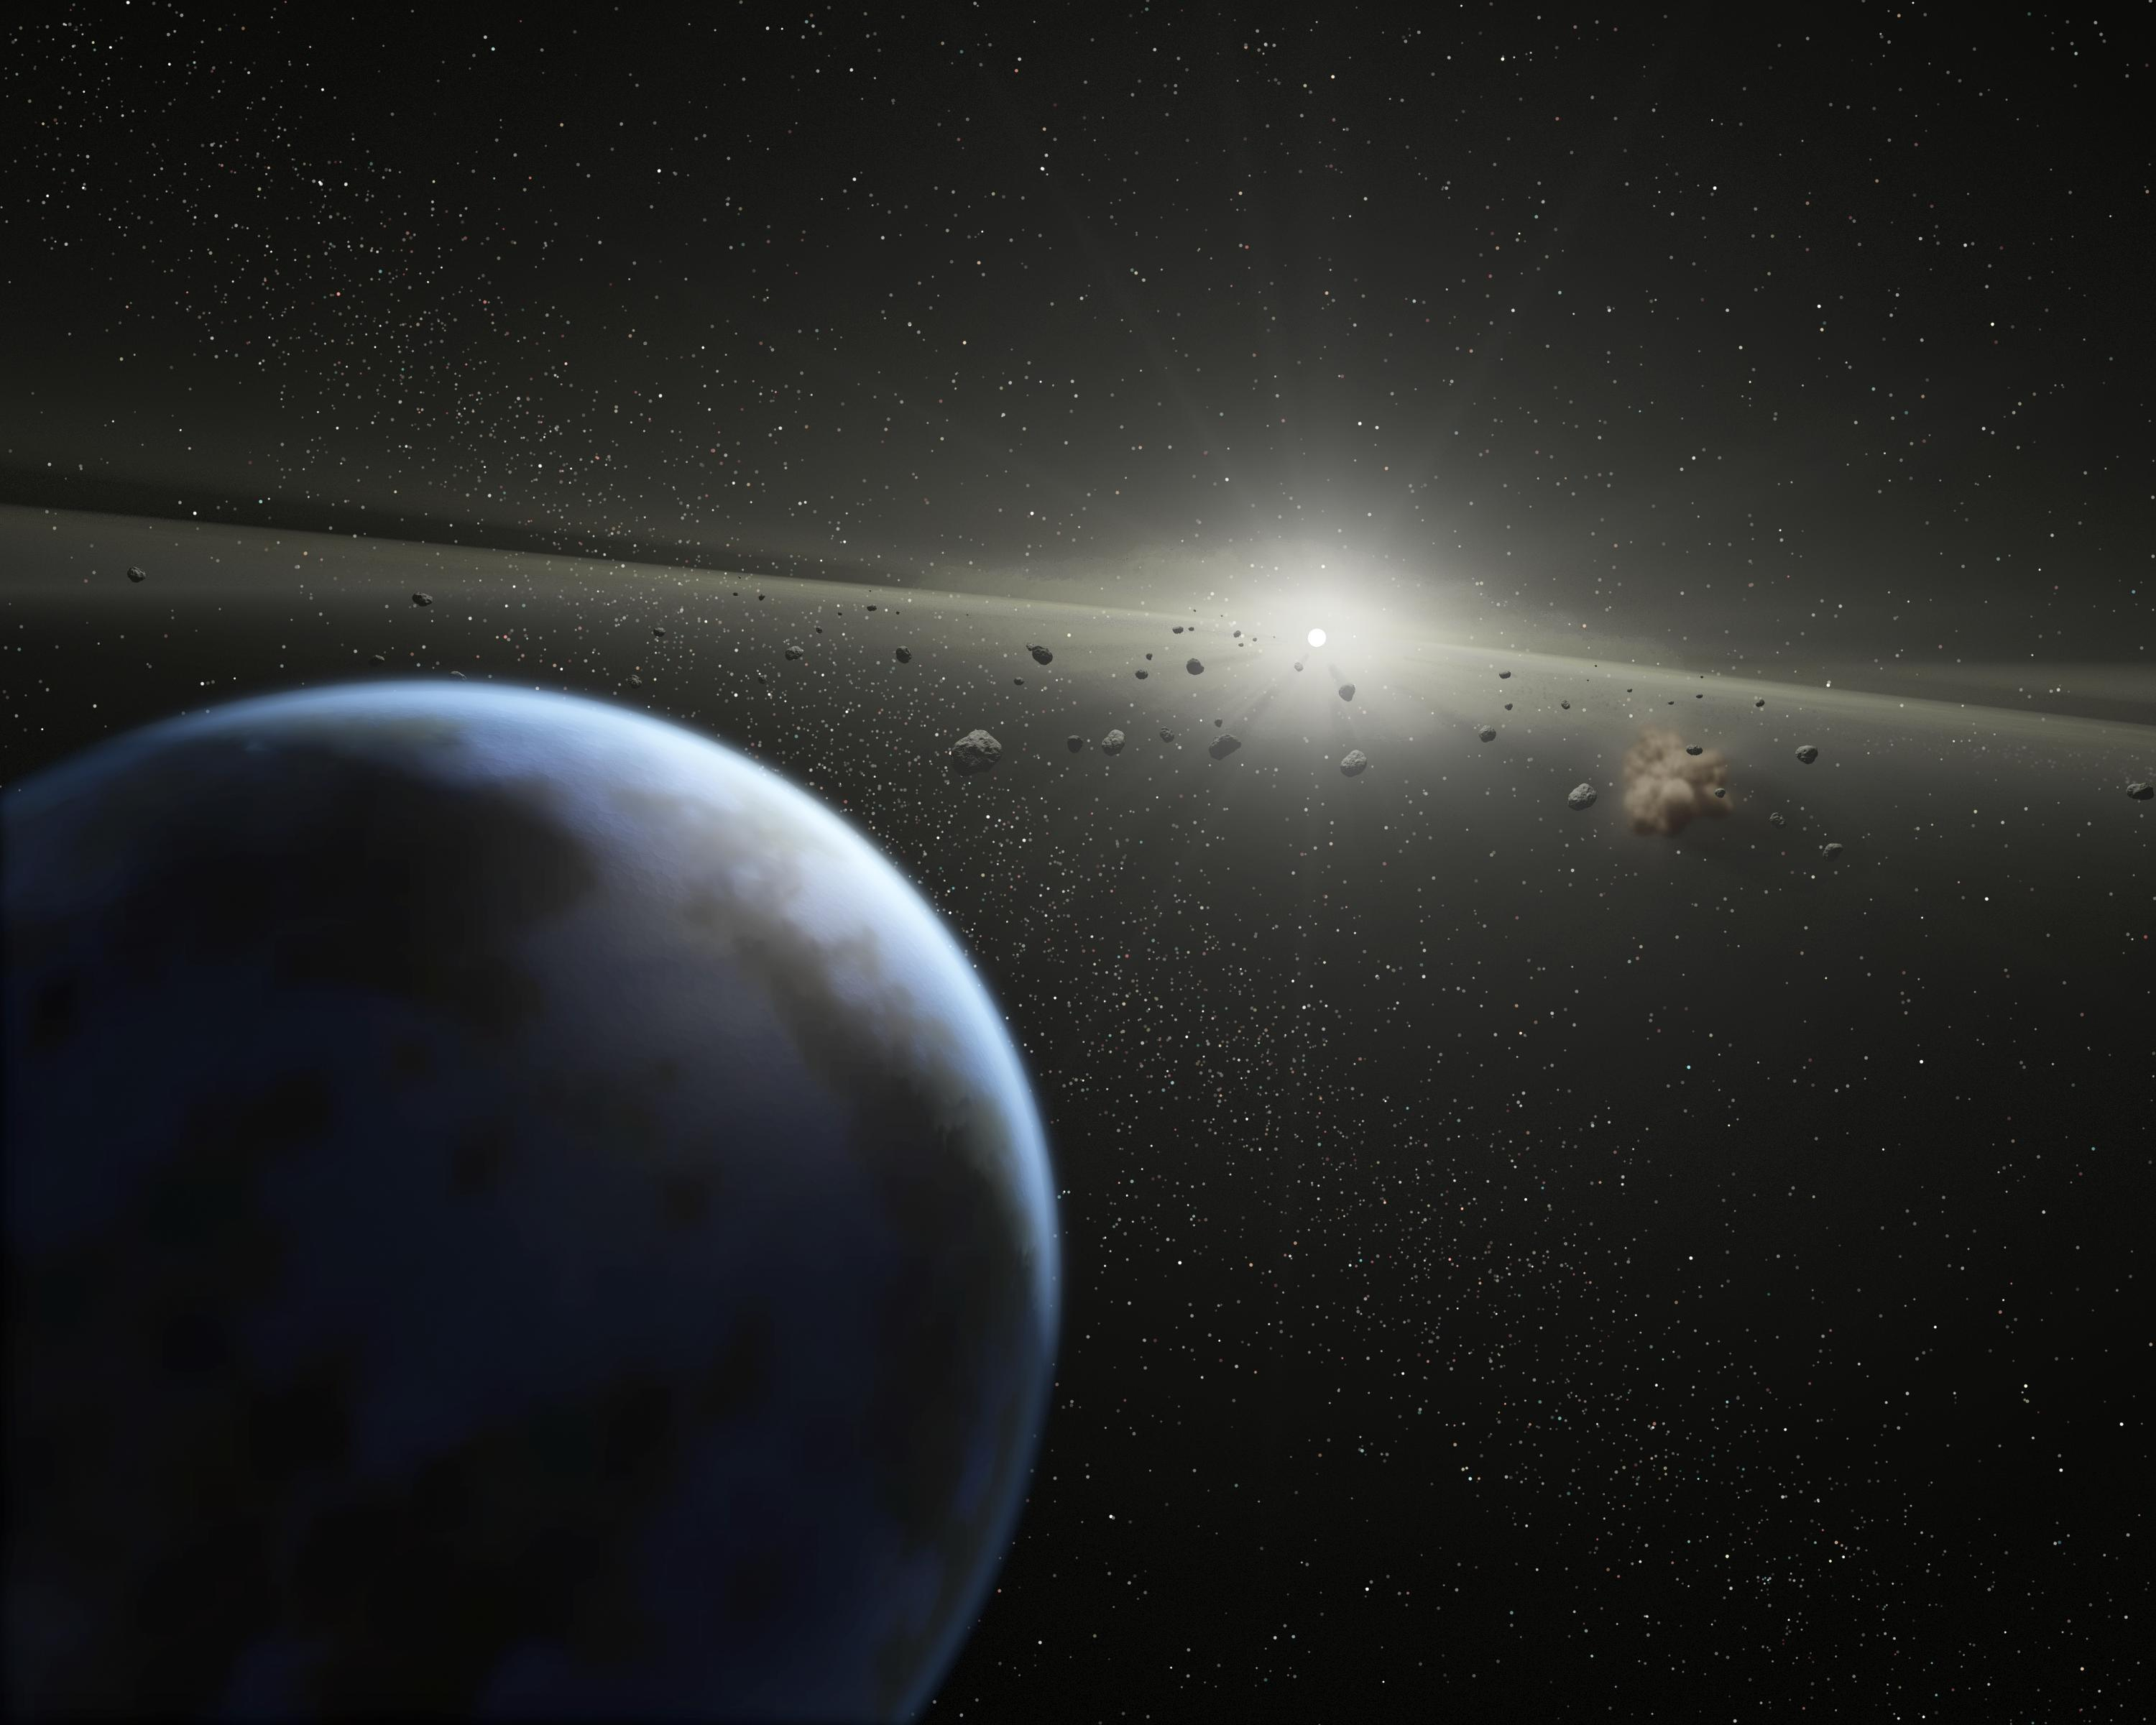
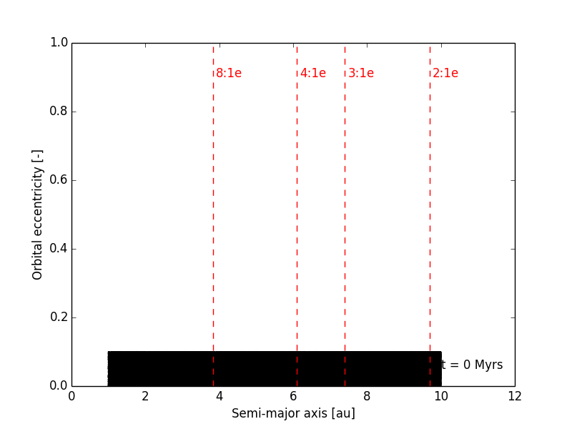
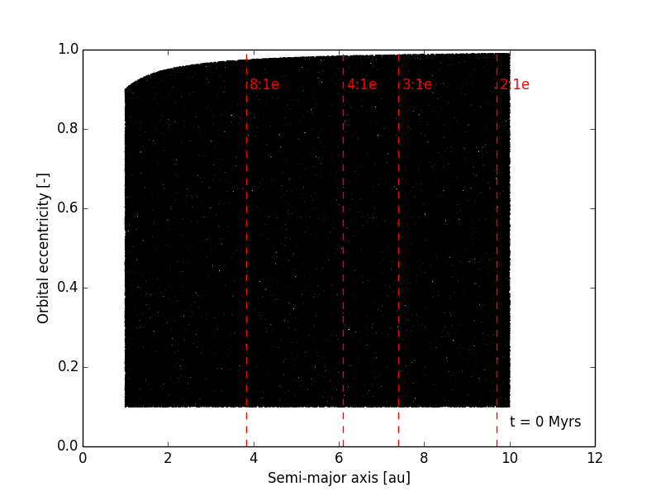
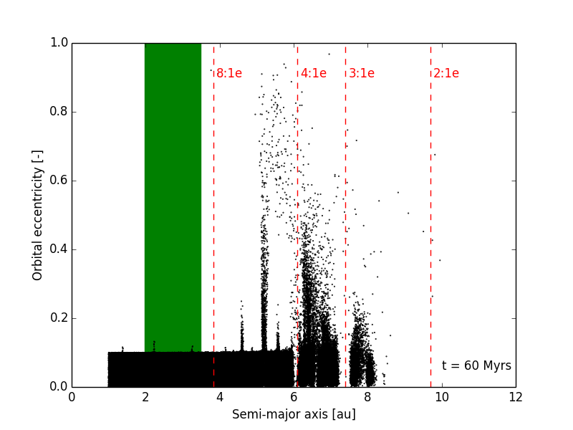
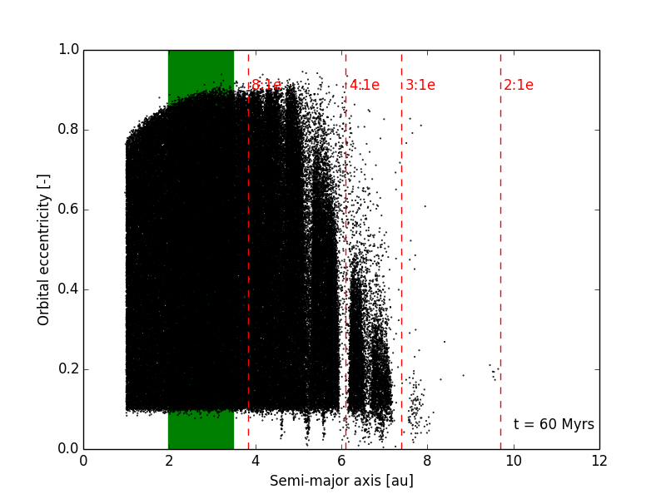
So what does the disk look like?
Contro et al., 2016, MNRAS, 463, 191
Jupiters and exoEarths
25/03/2026
Notes:
14

Slide 15
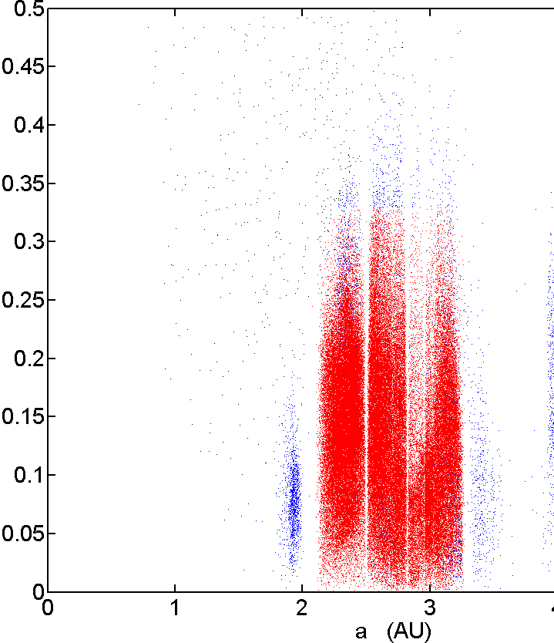
Answer: Kind of like the asteroid belt!
Jupiters and exoEarths
25/03/2026
Notes:
15

Slide 16
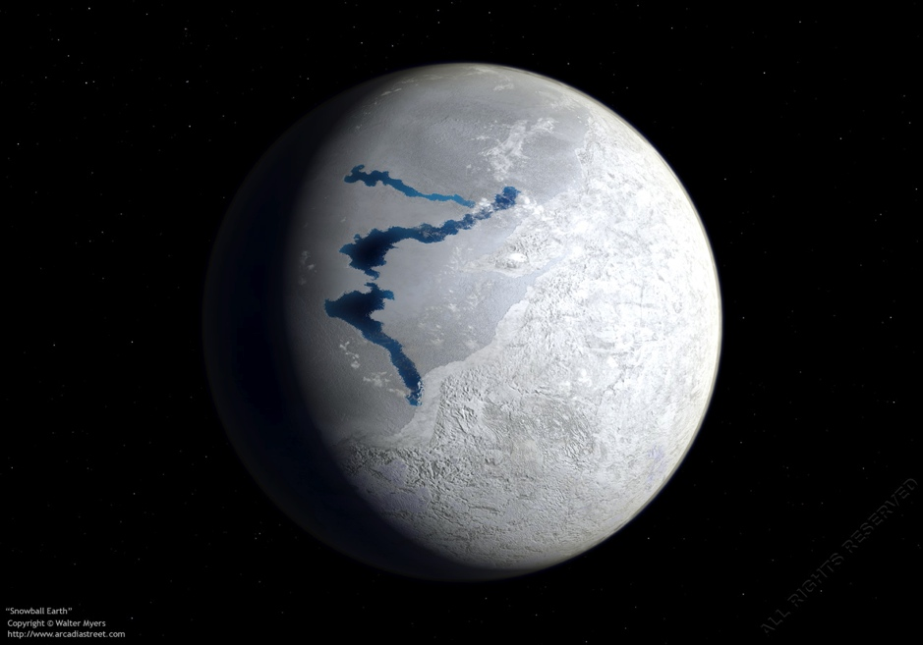
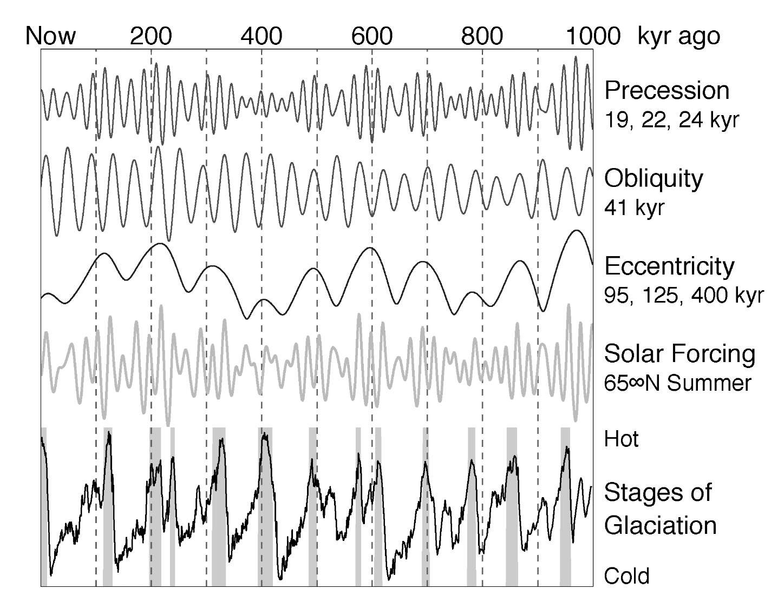
Dynamics and Climate: The Milankovitch Cycles
Jupiters and exoEarths
25/03/2026

Slide 17
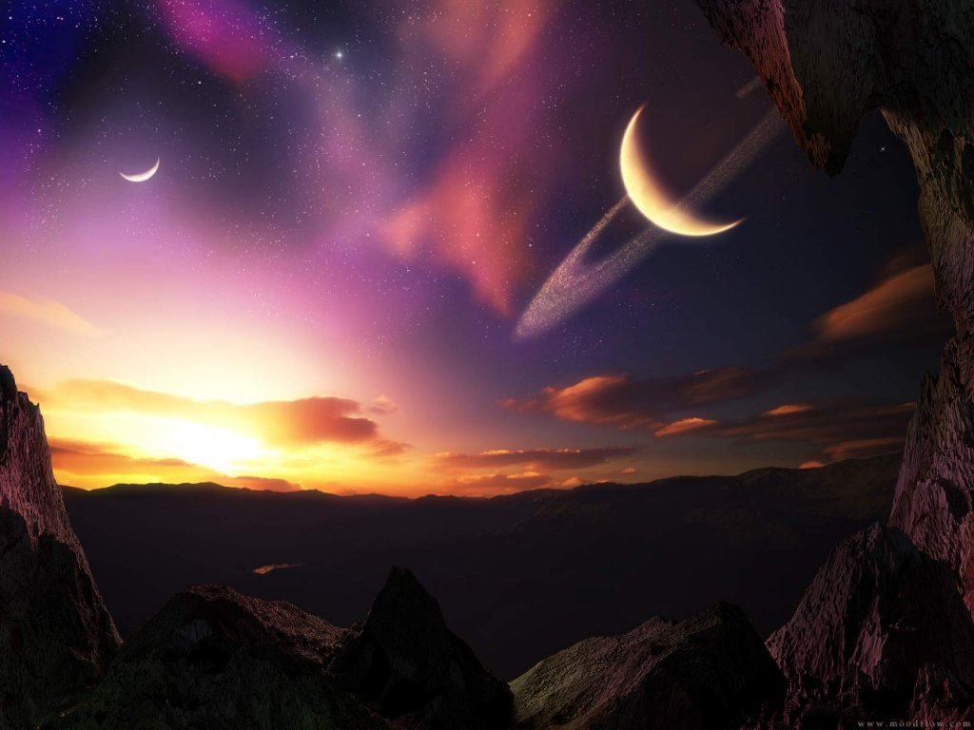
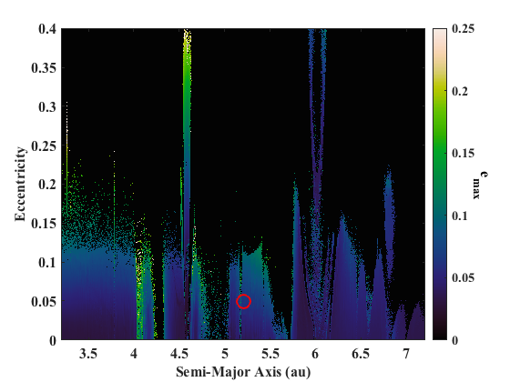
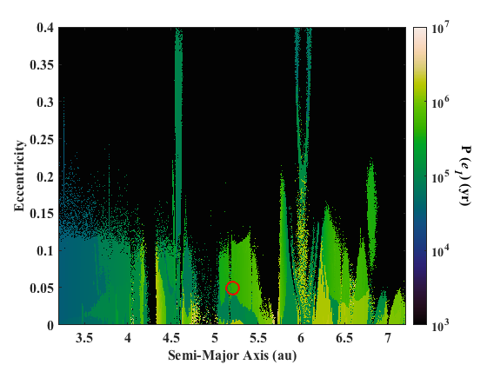
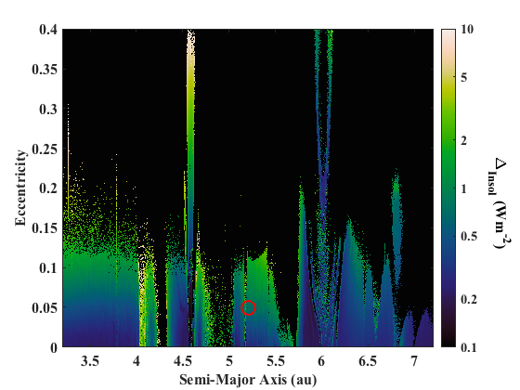
Terrestrial Orbital Variability if Jupiter is moved around…
Horner et al., 2020, AJ, 159, 10
Jupiters and exoEarths
25/03/2026
Notes:
17

Slide 18
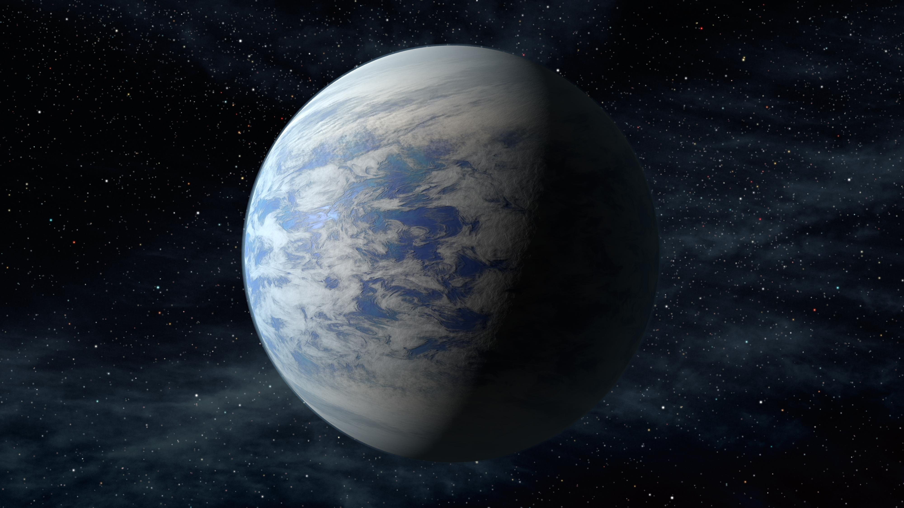
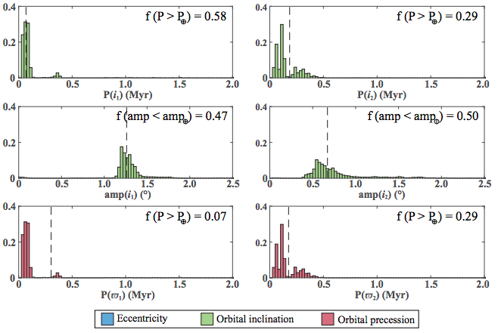
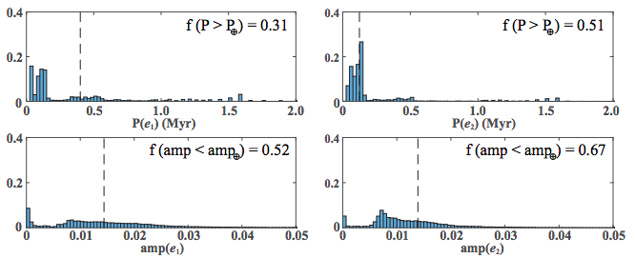
Rare Earth? Well… not quite!
Horner et al., 2020, AJ, 159, 10
Jupiters and exoEarths
25/03/2026
Notes:
18

Slide 19
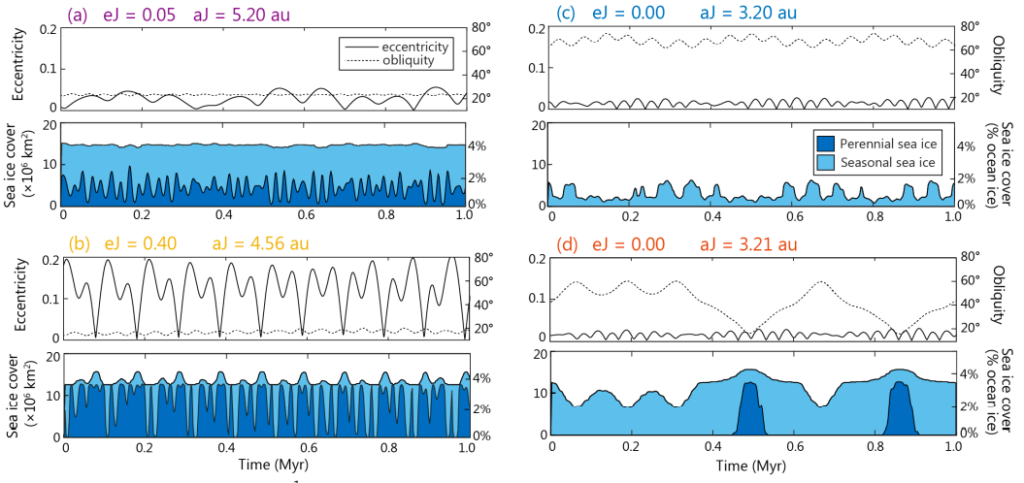
What about the ice ages?
Vervoort et al., 2022, AJ, 164, 130
Jupiters and exoEarths
25/03/2026
Notes:
19

Slide 20
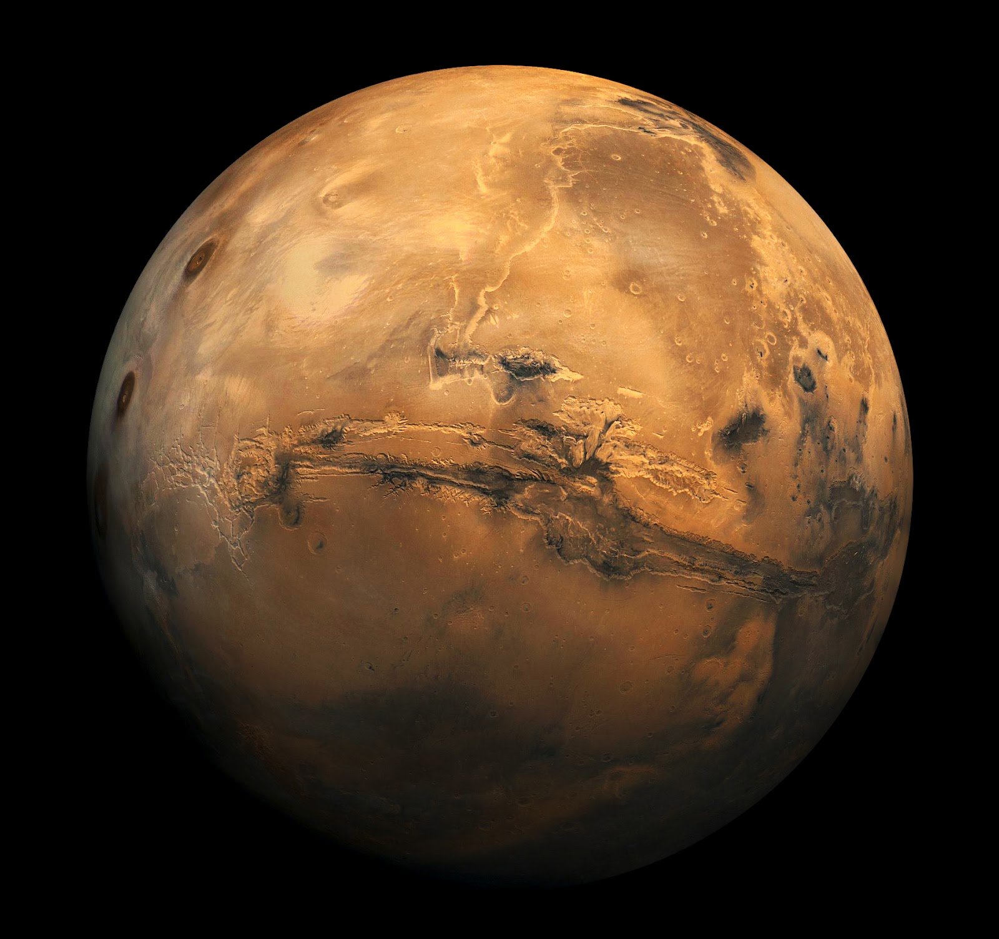
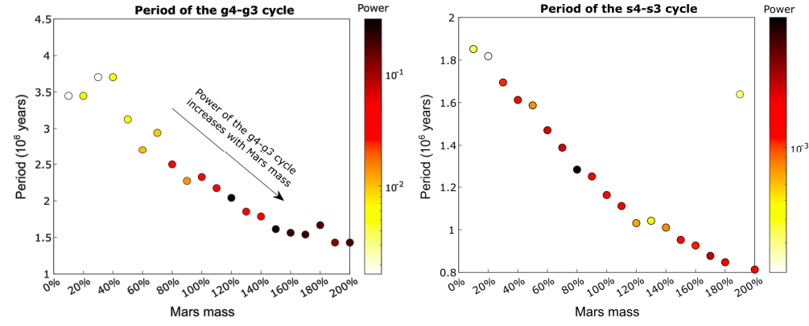
How about the impact of Mars?
Kane, Vervoort & Horner, 2025, PASP, 137, 124402
Jupiters and exoEarths
25/03/2026
Notes:
20

Slide 21
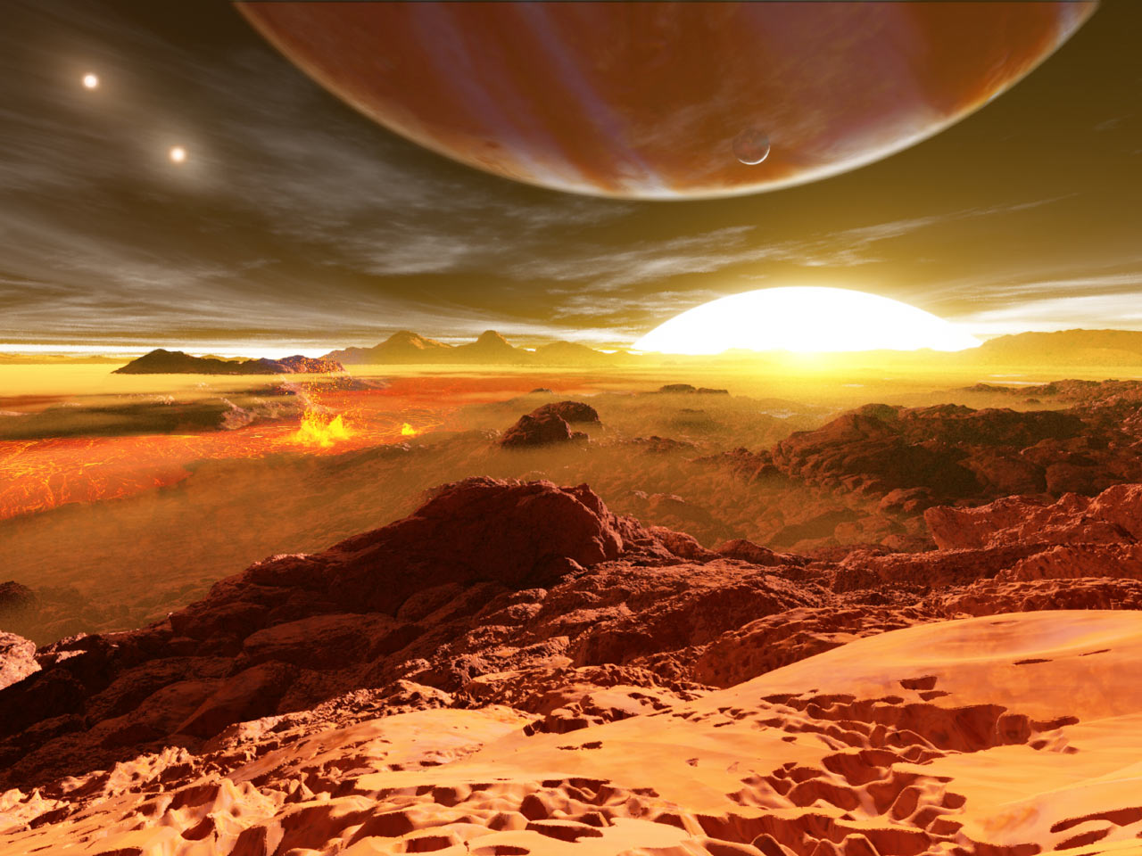

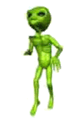
The Future…
Discovered
In
Toowoomba
Jupiters and exoEarths
25/03/2026

Slide 22
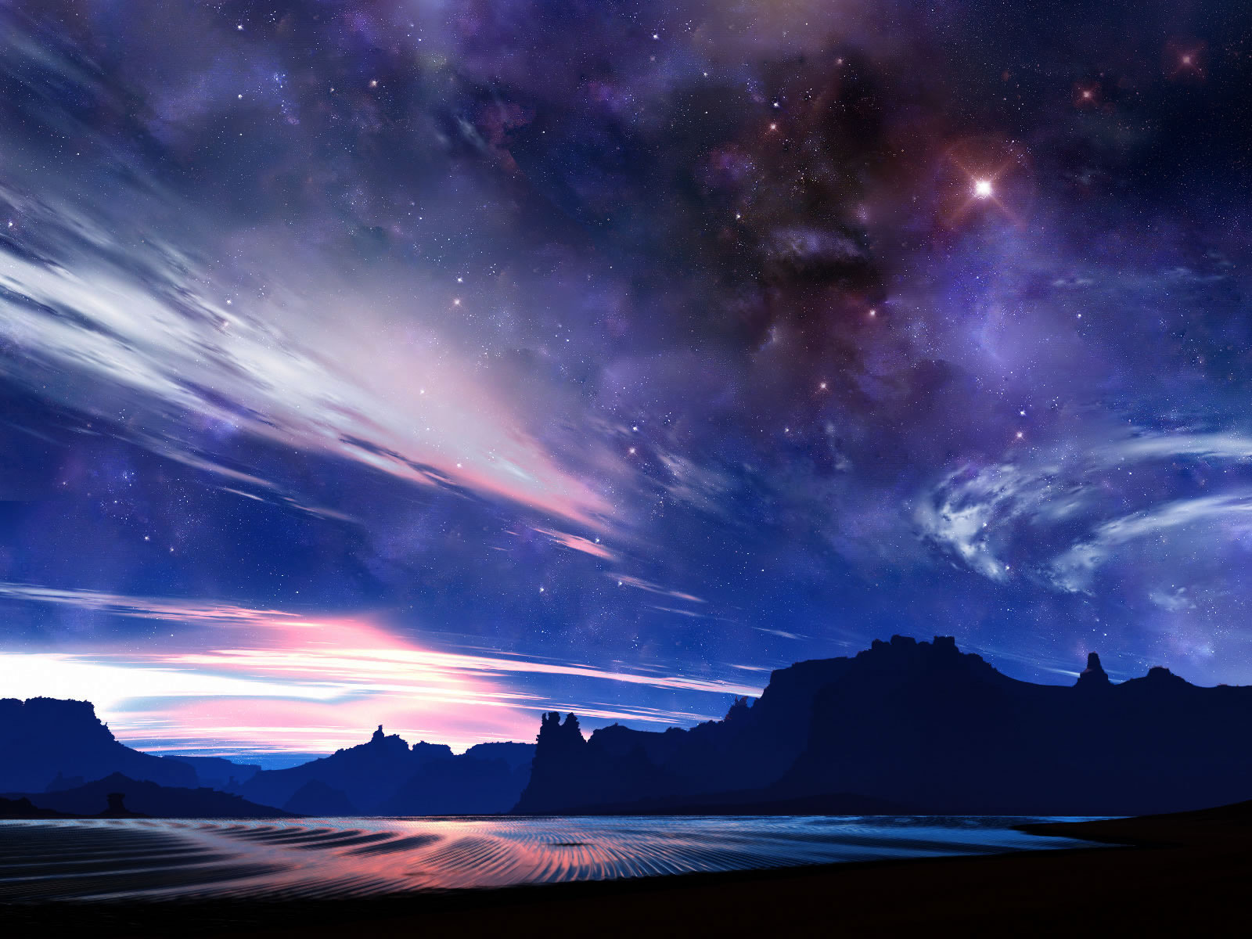
Questions?
jonti.horner@unisq.edu.au http://jontihorner.com
@JontiHorner

