Slide 1
The DARKERSKY4CE Photometer Network
An Open Network to Monitor Light Pollution in Central Europe
PRISMA Days 2025
Teramo | 08 November 2025
Name
Dario Barghini, INAF – Torino, Italy

Slide 2
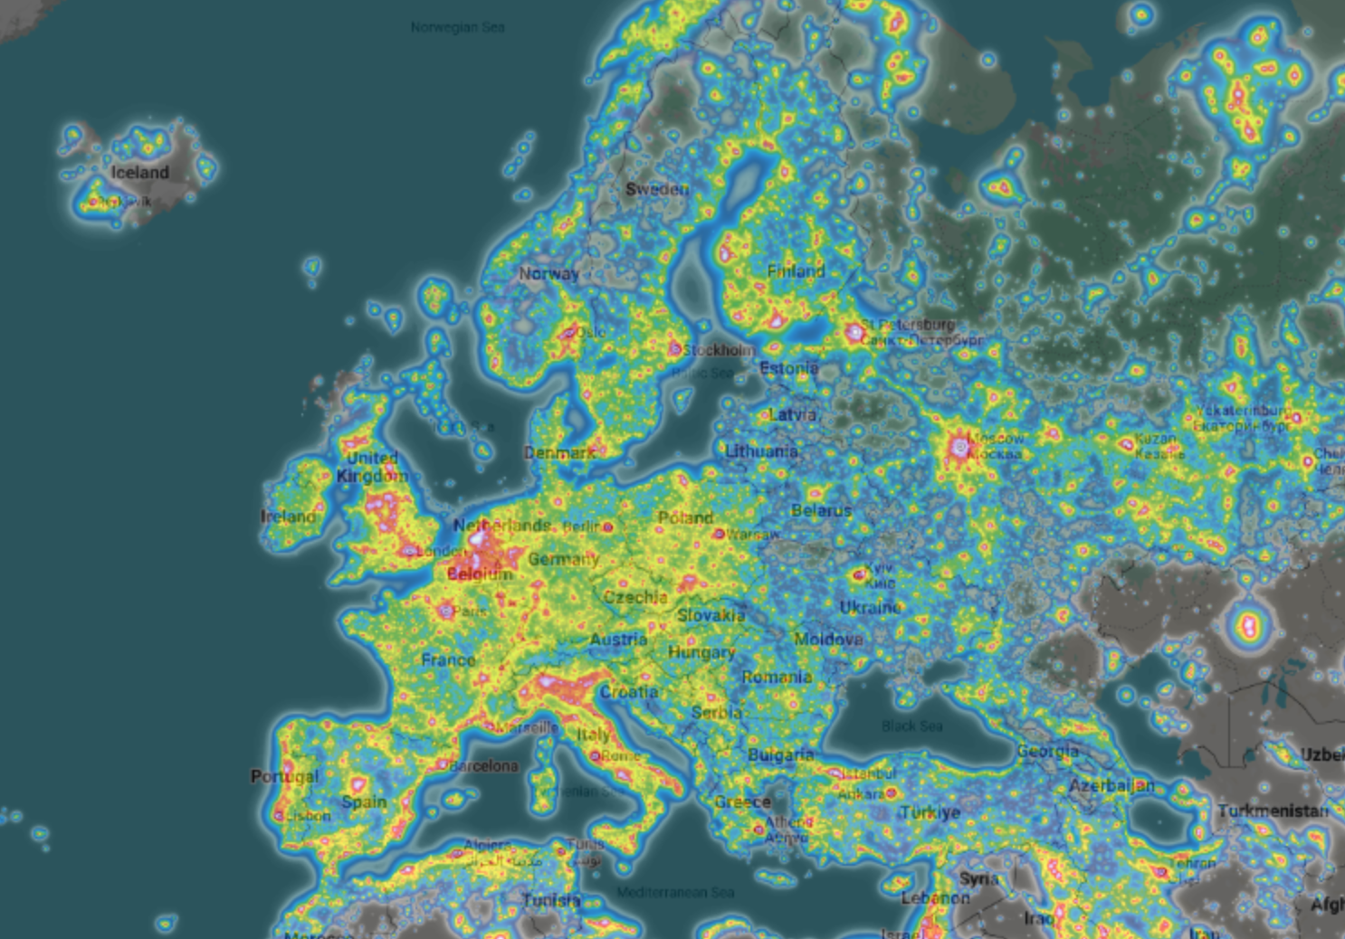
LightPollutionMap.info

Slide 3

LIGHT POLLUTION
A Threat that Calls for Action
Piloting new measurements of light pollution impacts by collecting new data and harmonising existing ones
Data will be the knowledge base for a community of practice based on a dynamic monitoring system for scientific data

Slide 4
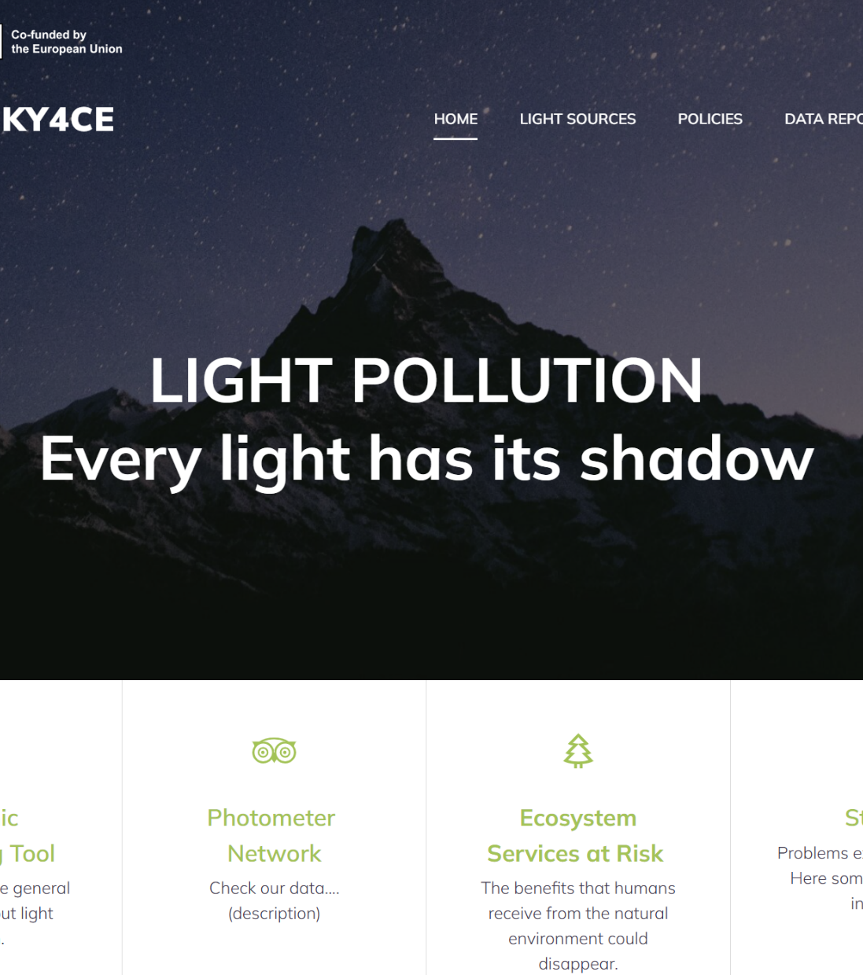
Light Pollution Data Repository for CE
Harmonising light pollution qualitative and quantitative data for Central Europe

Slide 5
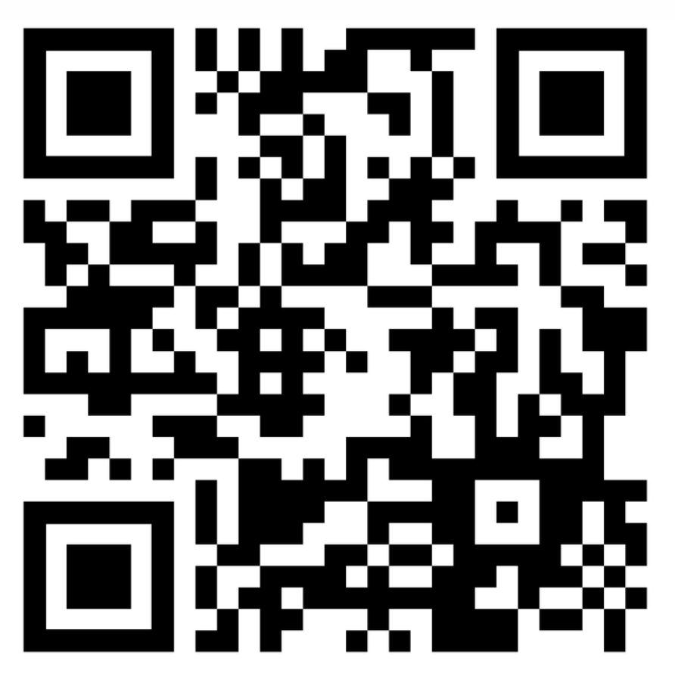
Light Pollution Data Repository for CE
Harmonising light pollution qualitative and quantitative data for Central Europe

Slide 6
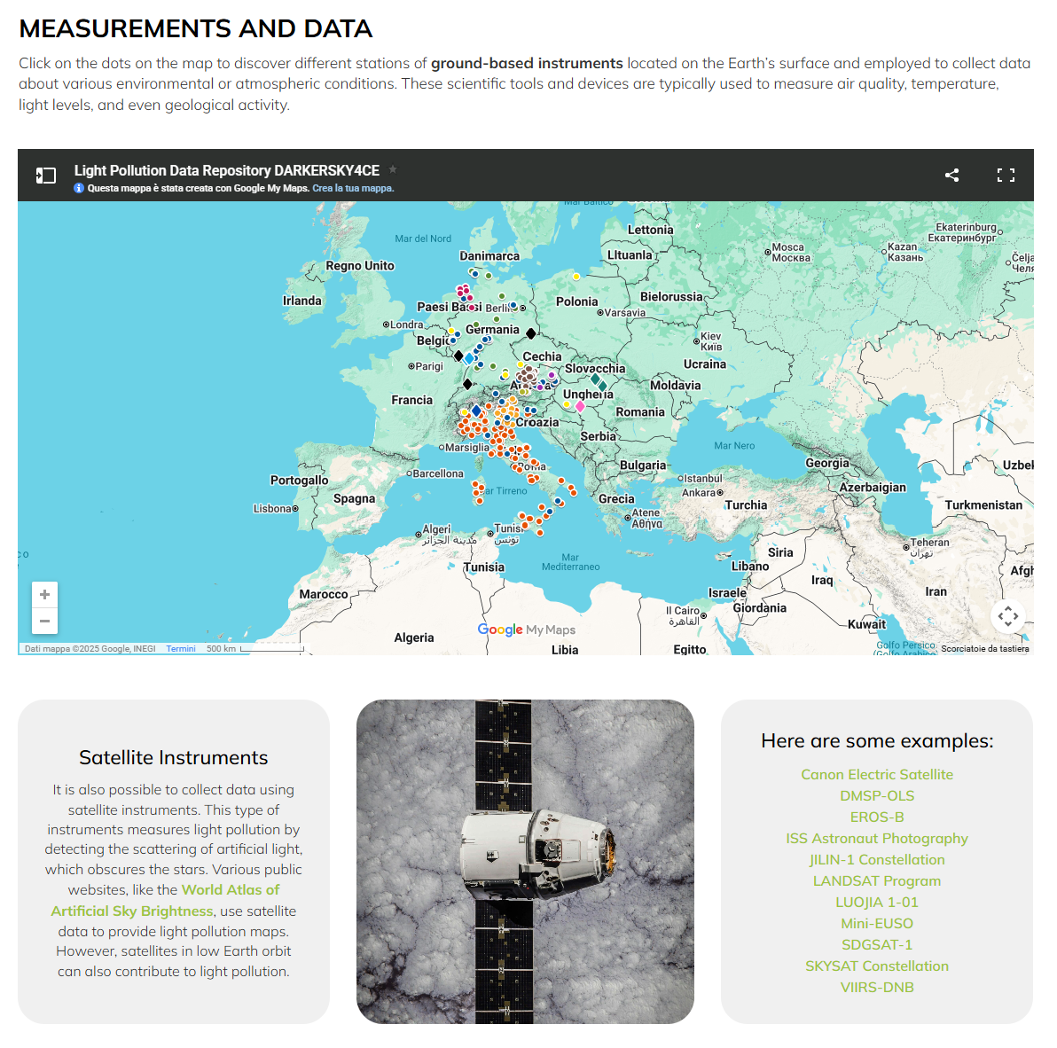
Light Pollution Data Repository
An open access point to all measurements and data about Light Pollution and Dark Skies in Central Europe
Hosted on INAF – OA Trieste infrastructure
Accessible and useful to both general and specific public
Reports data and metadata needed to correctly interpret the night-sky brightness measurements

Slide 7
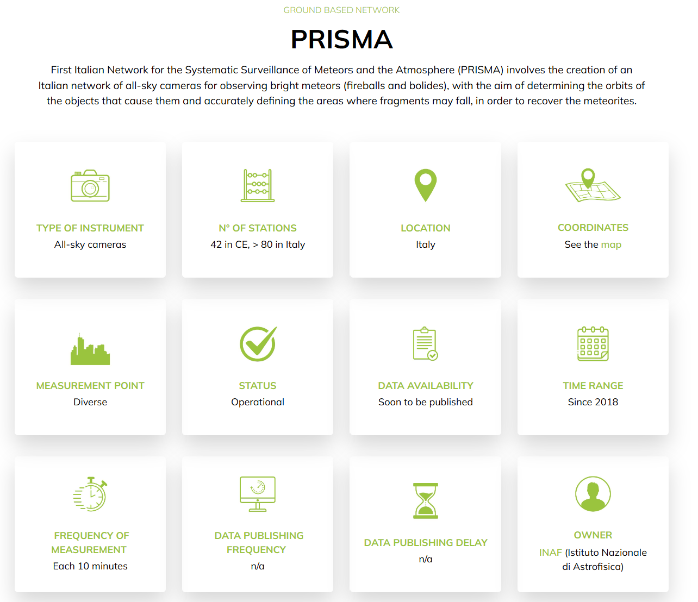
Light Pollution Data Repository
An open access point to all measurements and data about Light Pollution and Dark Skies in Central Europe
Hosted on INAF – OA Trieste infrastructure
Accessible and useful to both general and specific public
Reports data and metadata needed to correctly interpret the night-sky brightness measurements

Slide 8
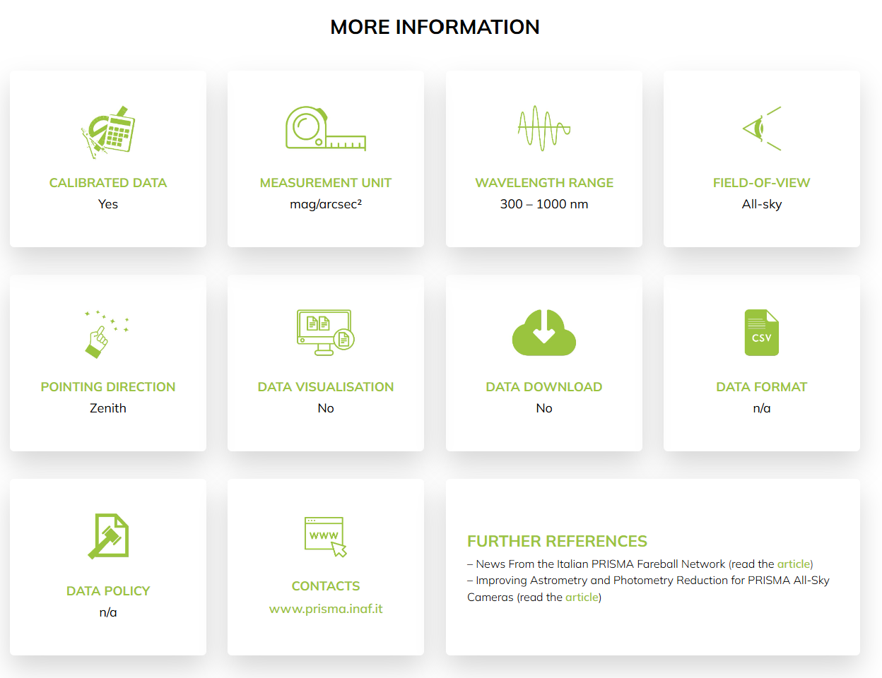
Light Pollution Data Repository
An open access point to all measurements and data about Light Pollution and Dark Skies in Central Europe
Hosted on INAF – OA Trieste infrastructure
Accessible and useful to both general and specific public
Reports data and metadata needed to correctly interpret the night-sky brightness measurements

Slide 9
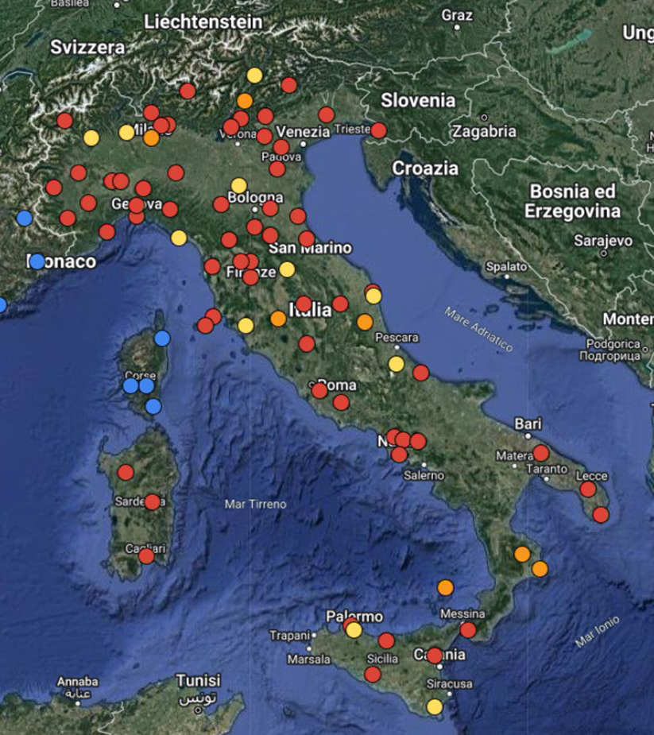

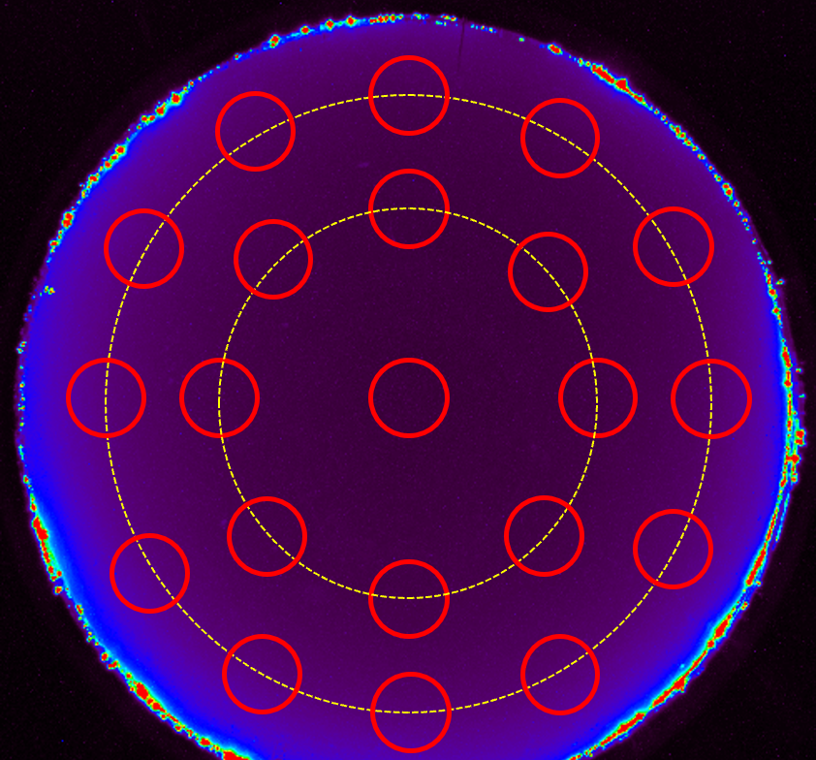
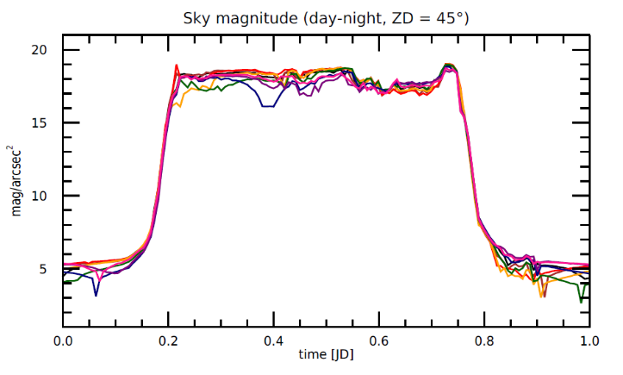
Light Pollution Data Repository
Exploiting existing data to improve Light Pollution measurements density and quality

Slide 10
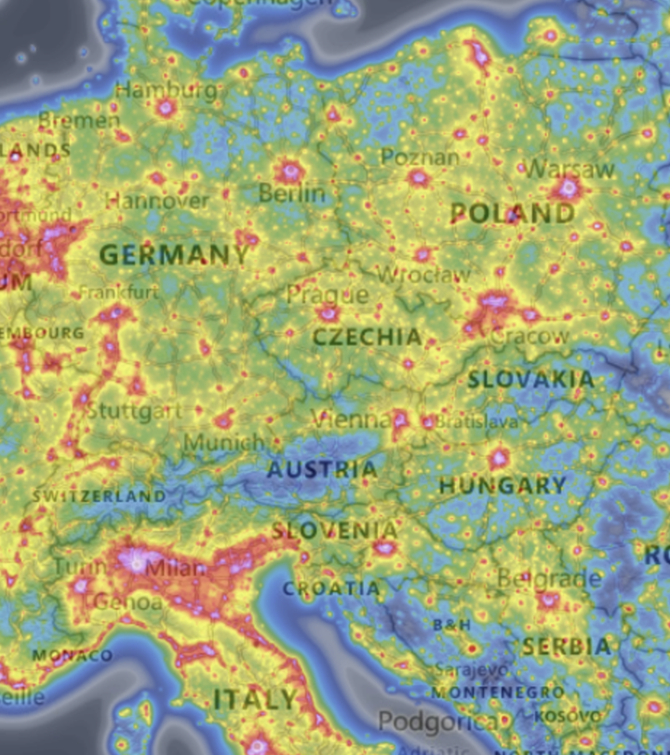
Photometre Network
Measuring the night sky brightness in Pilot Sites
lightpollutionmap.info

Slide 11
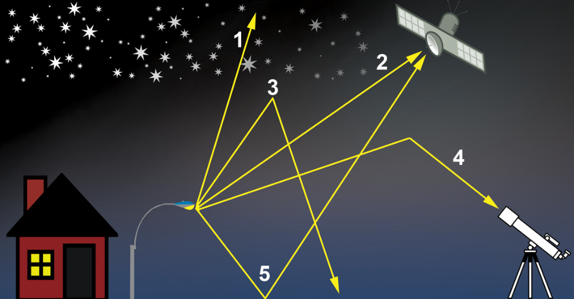
Photometre Network
Why do we need a ground-based
measurement network?
Satellite measurements provide a much more uniform and continuous measurements
BUT:
Often not calibrated
Often not freely available (or at least not completely)
Upward radiance measured by space-based instruments is not directly representative of the night-sky brightness as perceived by the human eye or by flora and fauna (modelling is needed to interpret them)

Slide 12
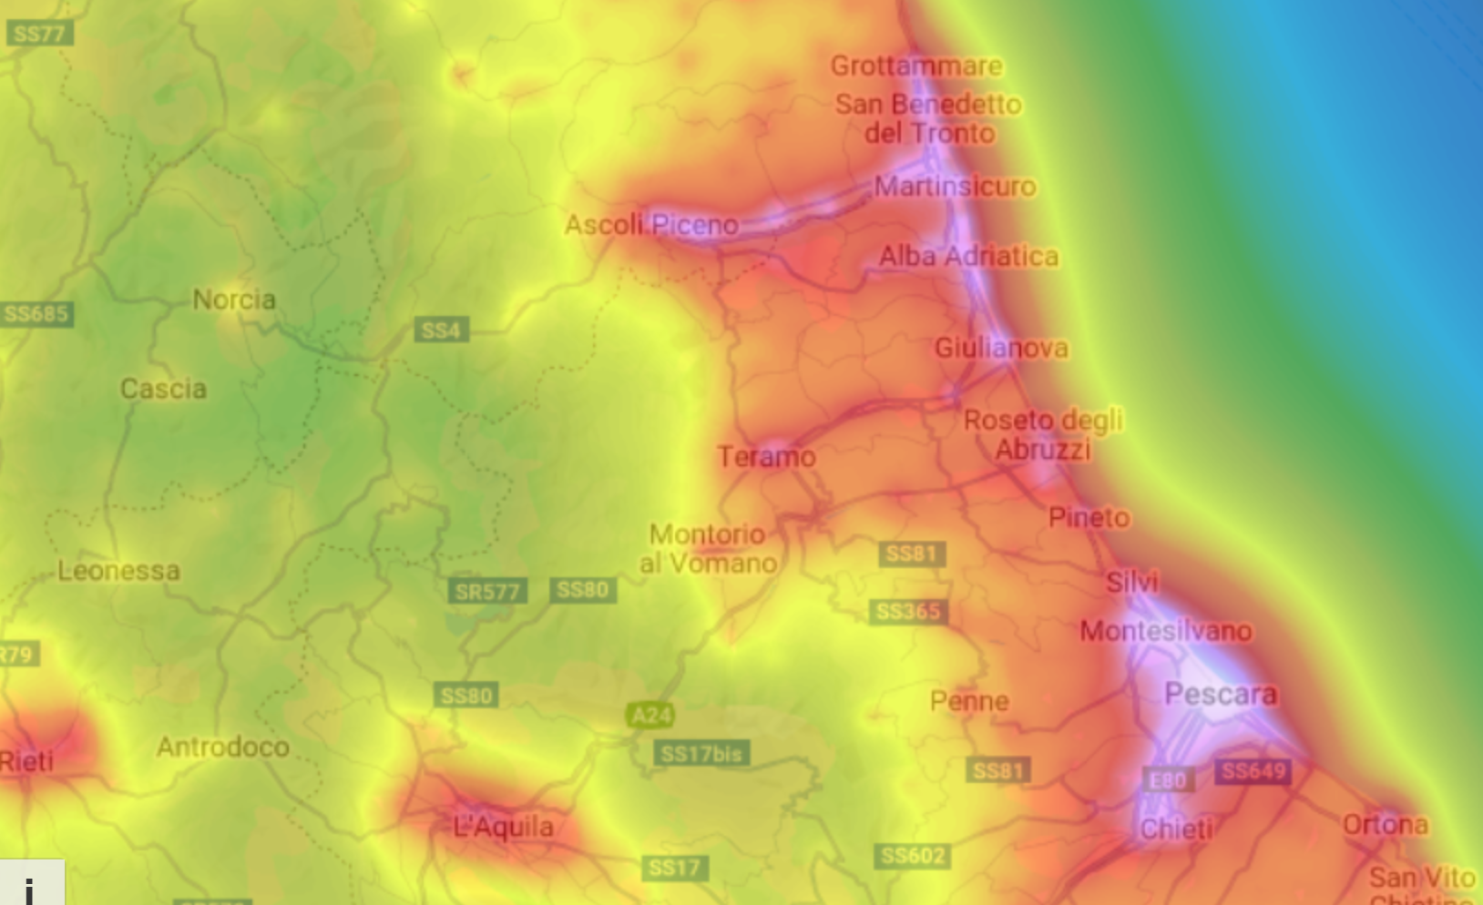

Slide 13
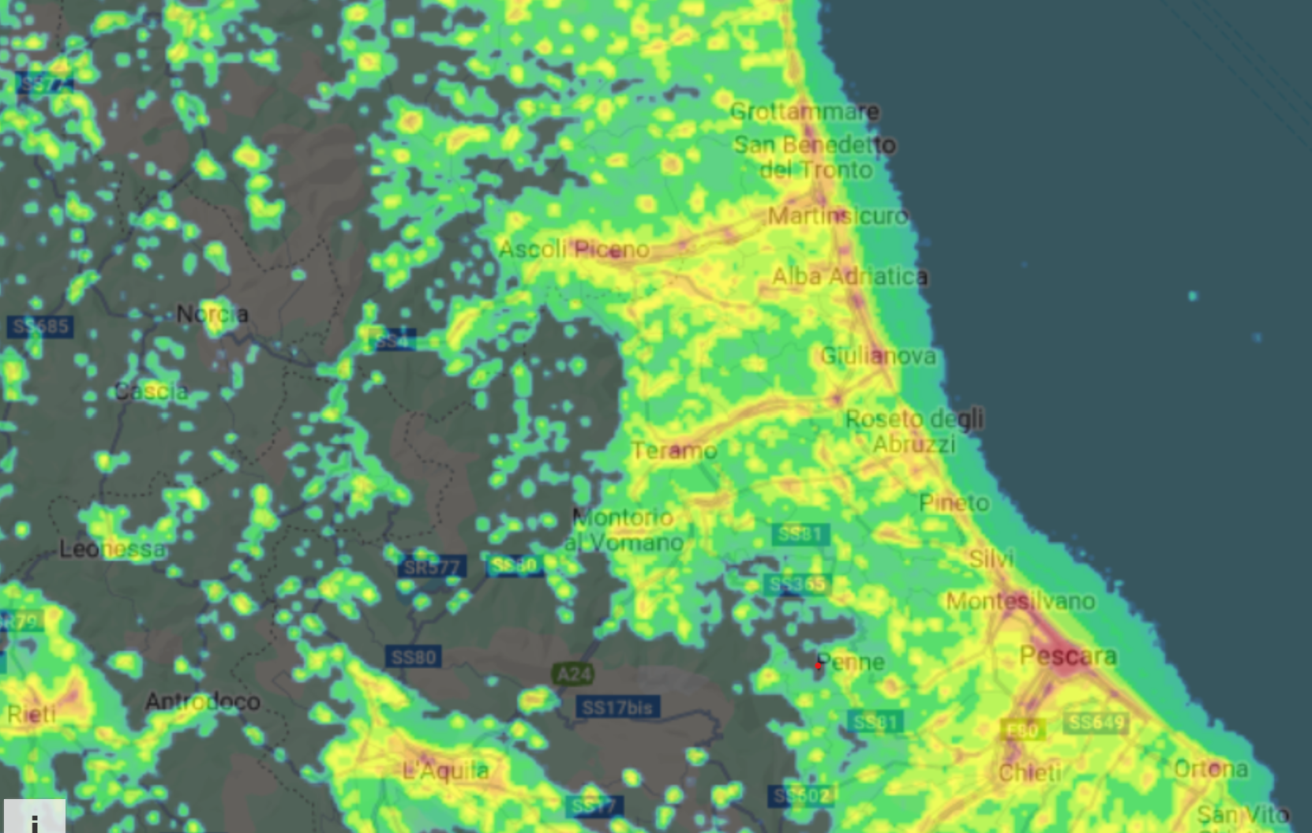

Slide 14
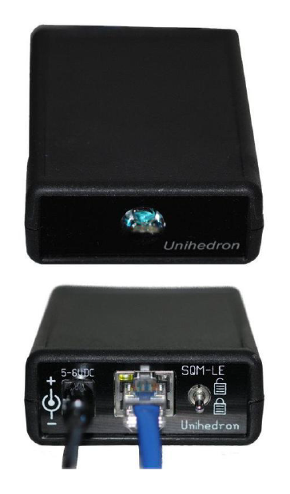
Photometre Network
Providing new measures of night sky brightness where there are none, with particular focus on the areas of the Pilot Demo Sites
New SQMs deployed in Hungary and Germany, with other project partner contributing with existing devices
Other SQMs joining the network and funded by other/ side projects (Italy, Austria)
Focus on measuring the change before and after the Pilot Actions at the Demo Sites

Slide 15
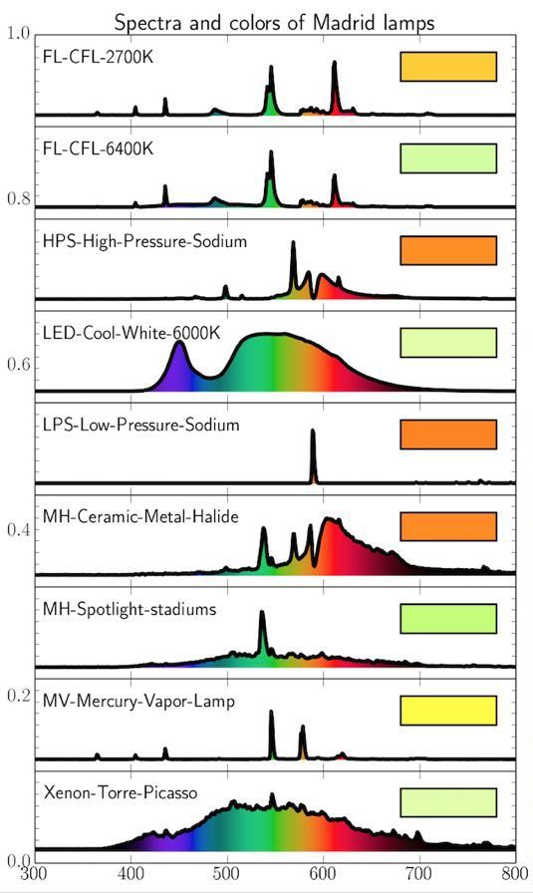
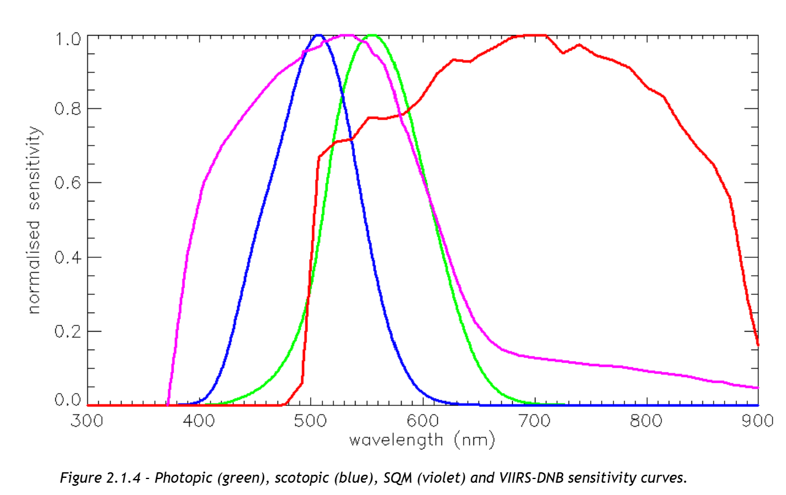
Photometre Network

Slide 16
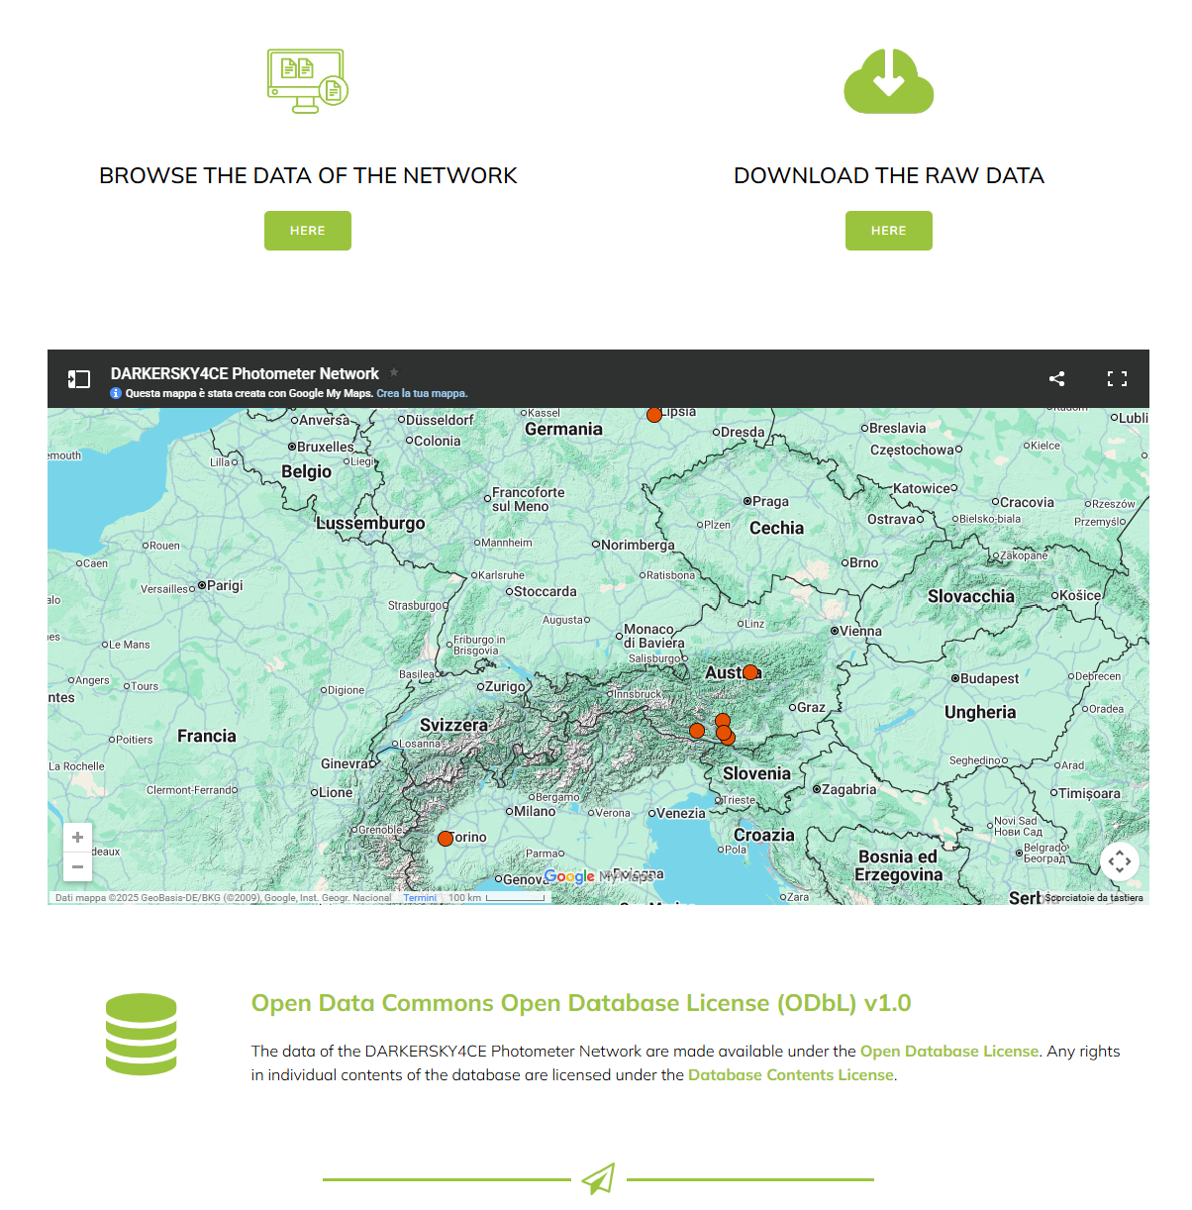
Photometre Network

Slide 17
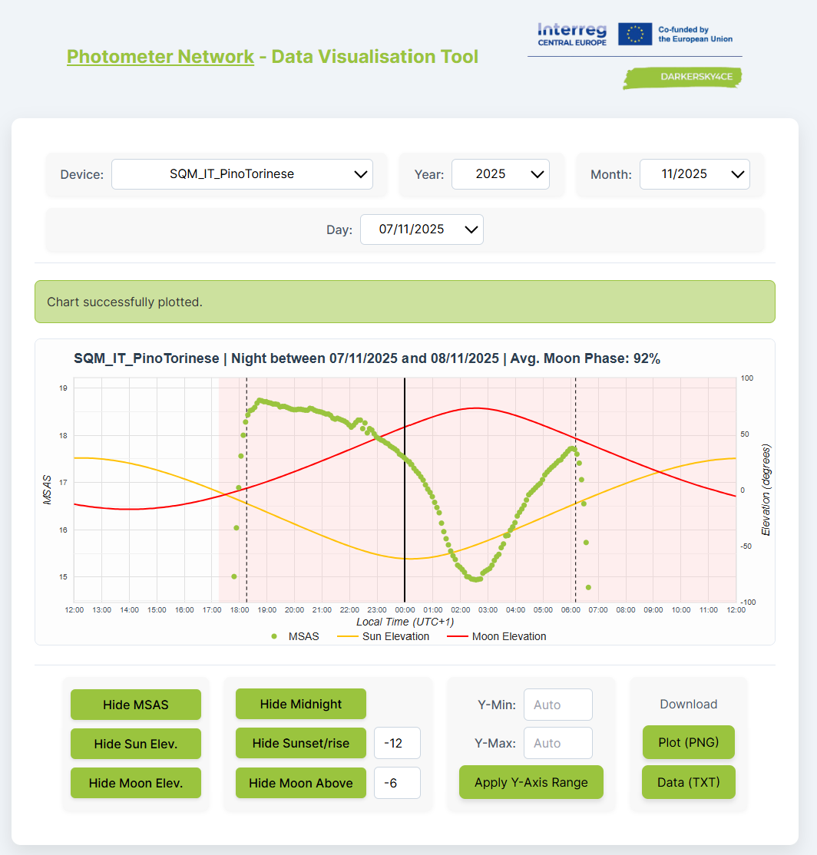
Photometre Network

Slide 18
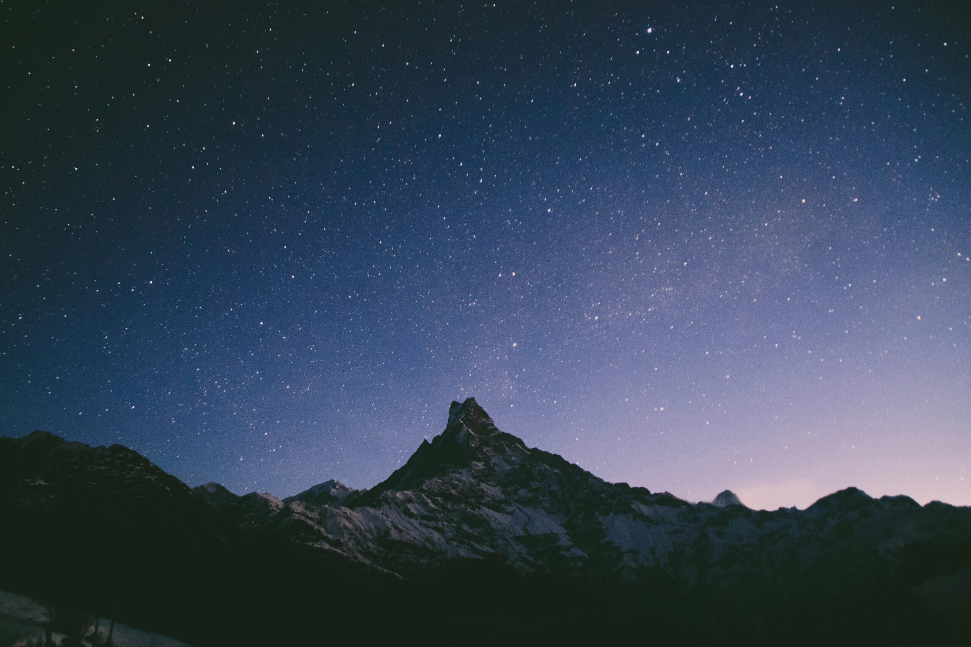
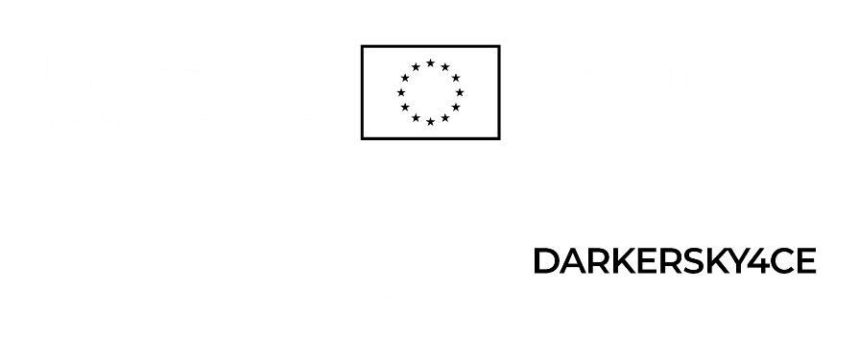
Thank you for
your attention!
Dario Barghini
for the DARKERSKY4CE team

