Slide 1



Search for a coincident meteor detection
between Mini-EUSO and ground-based observations
Anike N. Bowaire, M. E. Bertaina, D. Barghini
(Univ. Torino, INFN, INAF-OATo)
on behalf of the JEM-EUSO Collaboration
Notes:
Hello everyone My name is Anike I am a second year PhD student in the University of Torino, under supervision Mr. Bertaina and Mr. Dario. I will explain about our work about search of a coincident meteor detection using meteor data from Mini-EUSO observations compared to observation data from the ground-base observation.

Slide 2
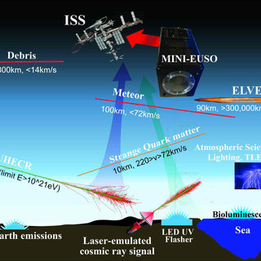
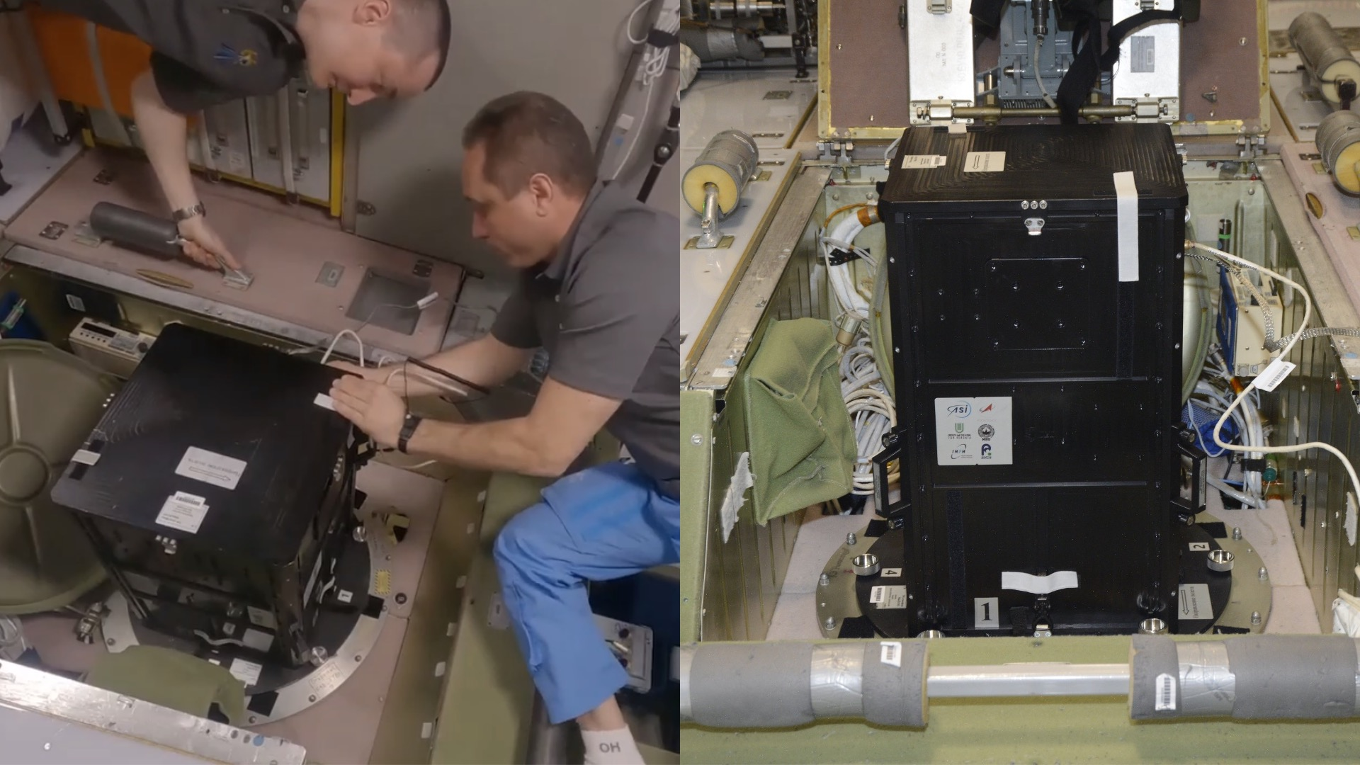
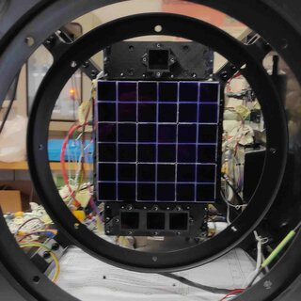
Mini-EUSO
Multiwavelength Imaging New Instrument for the Extreme Universe Space Observatory
On the ISS in the Russian modul
Detector: dimensions of 36 x 36 x 62 cm3, two Fresnel lenses (25 cm of diameter)
The light focuses on 36 multi-anode photomultiplier tubes (MAPMTs)
Focal surface of 2304 pixels
Field of view of 44°x 44°
Spatial resolution on ground ~6.3 km/pixel
Bandwidth: 290 –430 nm
also capable of observing Extensive Air Showers generated by Ultra-High Energy Cosmic Rays with an energy above 10^21 eV
gate time unit (GTU)
D1 = 2.5 μs for UHECRs
D2 = 320 μs for slower lightnings
D3 = 40.96 ms for meteors, space debris
Scientific objectives
PRISMA Days 2025
Notes:
Let me give you a short introduction about Mini-EUSO before I explain about my work. Mini-EUSO is an experiment under JEM-EUSO space program. Mini-EUSO launched on board the International Space Station in 2019 and currently located in the Russian section of the station. Its main scientific objectives are the search for nuclearites and Strange Quark Matter, the study of atmospheric phenomena such as Transient Luminous Events, meteors and meteoroids, the observation of sea bioluminescence and of artificial satellites and man-made space debris. It is also capable of observing Extensive Air Showers generated by Ultra-High Energy Cosmic Rays with an energy above 10^21 eV and detect artificial showers generated with lasers from the ground. The detector of Mini-EUSO focal surface also called PDM (Photo Detector Modul) consist of 9 MAPMT (Multi Anode Photo Multiplier Tube), and each MAPMT consist of 8x8 pixels.
Mini-EUSO performs data acquisition in single-photon counting mode. The time step of each temporal resolution is called a gate time unit (GTU). Photon counts are summed in a 2.5 μs data stream called D1, 320 μs called D2, 40.96 ms called D3.
D1 data suitable to search for UHECRs, D2 data is appropriate for slower lightnings, D3 data is well suited to capture much slower phenomena such as meteors, but also for bioluminescence studies, search for SQM, space debris, among others.

Slide 3
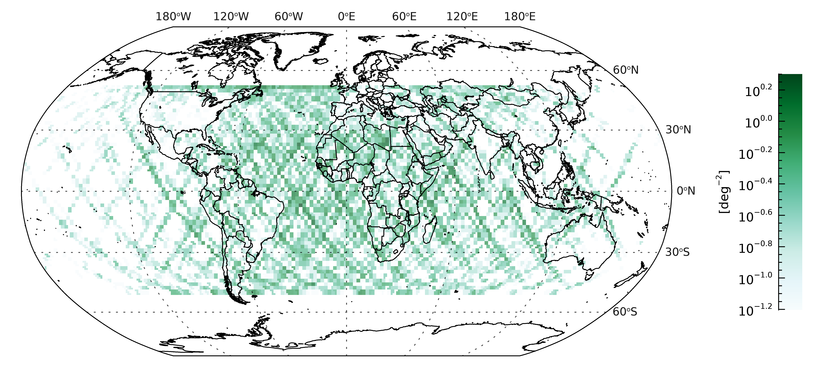
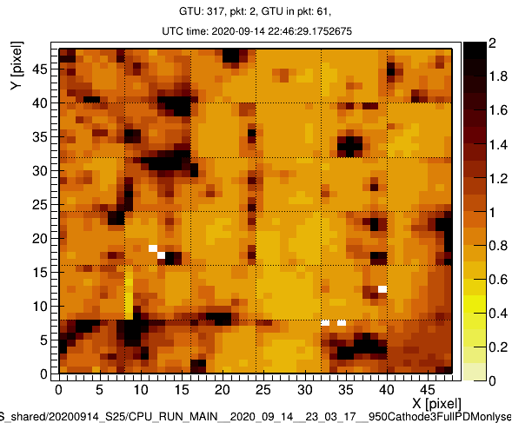
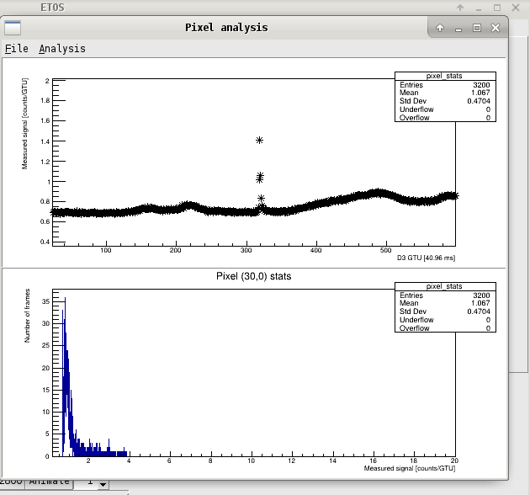
Mini-EUSO meteors
A map of the spatial density (in logarithmic colour scale, bins of 2◦ × 2◦) of meteor events detected by the Mini-EUSO telescope in the data sessions n.05-44
PRISMA Days 2025
Notes:
From space (ISS), Mini-EUSO detected 24 thousand meteors within the first 40 data-taking sessions from November 2019 to August 2021, for a total observation time of approximately 6 days with a limiting absolute magnitude of +6.
This is a map of the spatial density (in logarithmic colour scale, bins of 2◦ × 2◦) of meteor events detected by the Mini-EUSO telescope in the data sessions n.05-44 (from
November 2019 to August 2021). Next to it are a video and the analysis result as an example how if Mini-EUSO detect a meteor on ETOS.

Slide 4
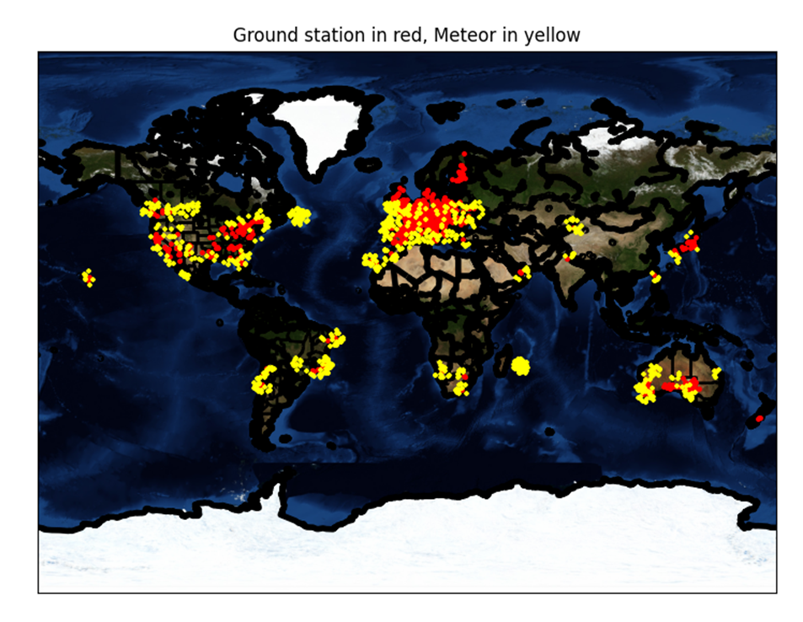
Mini-EUSO meteors and ground-based stations
Red : ground stations
Yellow: Mini-EUSO meteors
PRISMA Days 2025
Notes:
The idea of ​​this work is the analysis of the meteor observations from two experiments, Mini-EUSO UV telescope onboard the International Space Station (ISS) and ground-based camera. As you can see in this picture, in red dots there are 820 stations in the meteor network list for ground-based observation, and yellow are meteors detected by Mini-EUSO near those stations. The checks for double detections from space and ground has been performed by looking at time and the actual latitude and longitude of meteor trajectories from pixel positions of Mini-EUSO, and by requiring sufficiently close distance from the location of ground-based meteor stations. In case I get succesful events, I cross-check event parameters from both ground and space experiments. I worked using Mini-EUSO meteor data sessions n.05-44 (from November 2019 to August 2021)

Slide 5
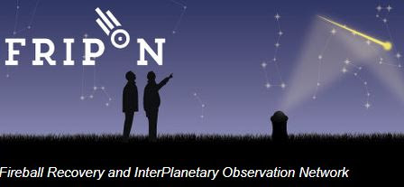
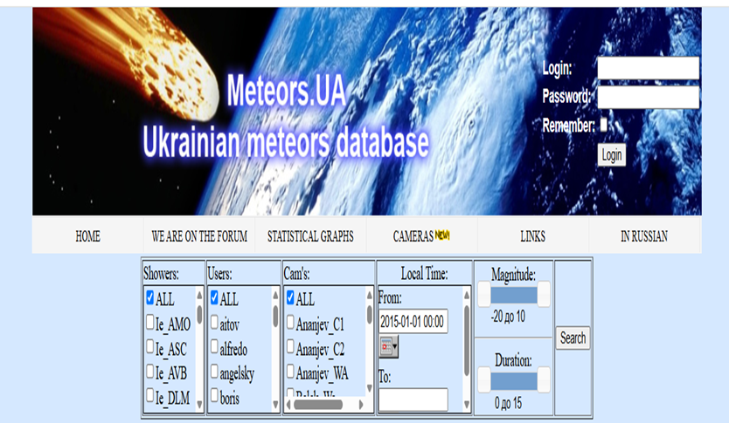


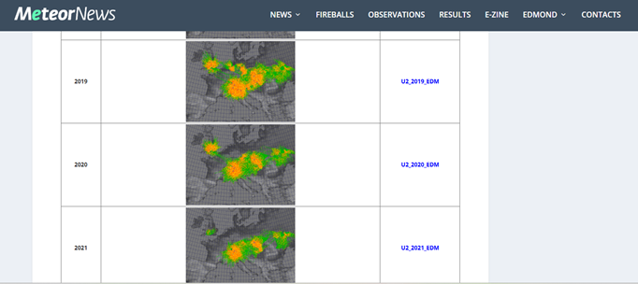
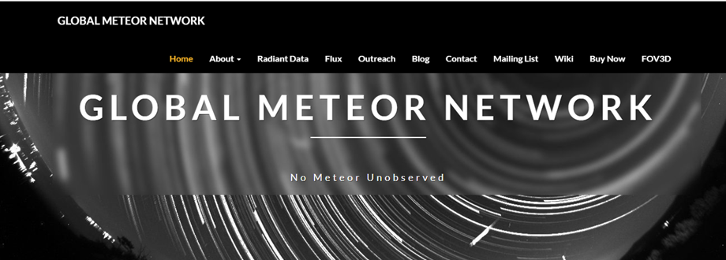
Comparing with several ground-based observations
PRISMA Days 2025
Notes:
I work using several meteor ground-based observation data, which are FRIPON (and PRISMA), SonotaCo Network Japan, EDMOND, GMN, and Meteors UA Ukrainian meteor database.

Slide 6
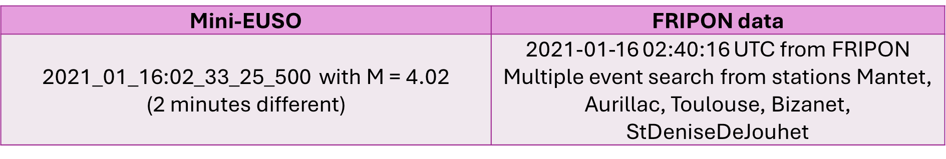
Comparing with several ground-based data
Mini-EUSO | EDMOND
rootfile 2019_12_31__03_56_47 with M = 0.69 | Version 516, # 35326 with M = -0.89298
Mini-EUSO | SonotaCo Newtork Japan data
rootfile 2021_01_15__19_03_20 with M = 3.79, 3.82, 4.61 | with M = 0.4 from 'SCN-Miyazaki1' 'SCN-Miyazaki3' 'SCN-Kumamoto1'
PRISMA Days 2025
Notes:
With FRIPON database, I used multiple event search data. I got one event from Mini-EUSO but different in 2 minutes with one event from FRIPON.
For EDMOND, I got one meteor event from Mini-EUSO detected at the same time and position, but with little bit difference in magnitude with one event detected by EDMOND’s camera.
For SonotaCo, I got three meteors event from Mini-EUSO but different in magnitude with one event from SonotaCo.
After comparing /analysis further the parameter, I can not say that they are the same meteor events.

Slide 7
Comparing with several ground-based data
Mini-EUSO | Meteors UA Ukrainian Meteor data
rootfile 2020_09_14__21_25_53 with M = 2.8, 5.58, 2.46 | with M = 0.6 from Camera Khmelnitsk_M4 with M = 0.9 from Camera Vishnevoe_WE
rootfile 2020_09_14__23_03_17 with M = 2.67, 5.25, 3.84, 4.5 | with M = 1 from Camera Vishnevoe_WE with M = -0.2 from Camera Vishnevoe_WE
Mini-EUSO | GMN
rootfile 2019_12_31__03_56_47 with M = 1.18 | Identifier 20191231034813_PXYU9 ,M = -1.13
rootfile 2019_12_31__03_56_47 with M = 2.77 | Identifier 20191231034813_PXYU9, M = -1.13
rootfile 2021_01_16__01_08_24 with M = 2.72 | Identifier 20210116005819_MgI67’, M = 3.06
rootfile 2021_05_04__00_57_56 with M = 4.09 | Identfier 20210504004654_CyOmo’, M = 3.9
PRISMA Days 2025
Notes:
For Ukrainian meteors database, we got seven meteor events from Mini-EUSO detected at the same time and position, but with difference in magnitude with four events detected by Ukrainian’s cameras.
For GMN, I got four meteor events from Mini-EUSO detected at the same time and position, but with difference in magnitude with four events detected by GMN’s cameras.
After comparing /analysis further the parameter like before, I can not say that they are the same meteor events.

Slide 8
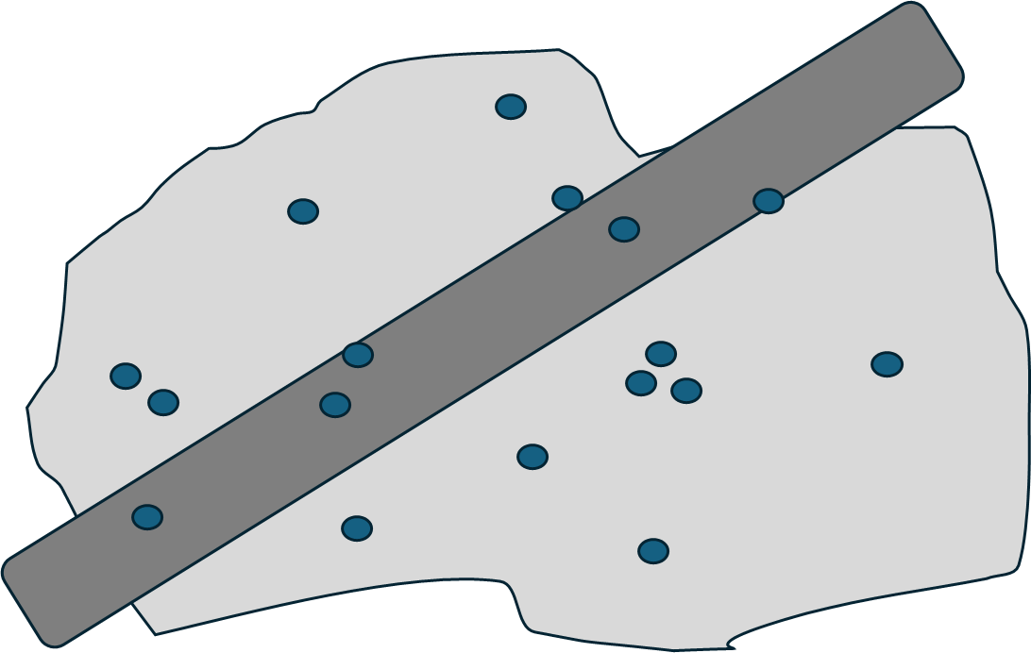
Detection number comparing with several data bases
Using our rough assumption that the observations done in in 3 years with each year has 365 days, and they are observed in 8 hours per day (arbitrary assumption to be better estimated
Then we calculate total minutes where Mini-EUSO is near with ground-based stations
Total area observation for ground-based stations is taken from calculating total area of stations assuming that each station has a 200 x 200 km equivalent sensitive area in the sky and we removed superpositions between stations field of view.
$$GB Stations Rate=\frac{Total meteor event of each GB Stations Data}{Number Of Minutes In 3 Years}$$
$$Max Number=GB Stations Rate ×Total Minutes Mini−EUSO near \text{GB} stations$$
$$Number by Mini−EUSO=Maximum Number×\frac{Area Mini−EUSO}{Area GB stations}$$
PRISMA DAYS 2025
Notes:
So, we think that we need to calculate the rate of meteor detection comparing with the ground-based observation.
Using our rough assumption that the observations done in in 3 years with each year has 365 days, and they are observed in 8 hours per day (arbitrary assumption to be better estimated!), we got detection rate for each ground-based stations data.
Then we calculate total minutes where Mini-EUSO is near each stations of ground-based observation database.
By multiplying total minutes with the ground-based rate, we got the maximum number of meteor can be detected by Mini-EUSO near those stations.
We need to consider also the area of detection because ground-based stations observed larger area than Mini-EUSO.
So, here, we multiply the maximum number with ratio of observation area between Mini-EUSO and each ground-based stations.
Area of ground-based stations is taken from calculating total area of all stations for each database assuming that each station has a 200 x 200 km equivalent sensitive area in the sky and we removed superpositions between stations field of view. This result is using rough assumption, but provides a reference number to estimate the expected number of events in coincidence.
This result indicates that with more data we might expect to have coincidence events.

Slide 9
Detection number comparing with several data bases
 | Mini-EUSO expected number
Fireball Recovery and InterPlanetary Observation Network (FRIPON) | 0.02 event
European video MeteOr Netrwork Database (EDMOND) | 0.65 event
SonotaCo Network Japan | 0.06 event
Global Meteor Network (GMN) | 1.75 event
PRISMA Days 2025
Notes:
This is the result is using rough assumption, but provides a reference number to estimate the expected number of events in coincidence for each meteor ground-based observation database, using the meteor data from 2019-2021 and Mini-EUSO meteor data session no. 05-44.

Slide 10
Conclusion
For the moment there is no evidence of a common detection but a new dataset is now available to be processed.
The expected statistics of Mini-EUSO is going to increase by a factor of 3 and this might give us finally a coincidence event.
PRISMA Days 2025
Notes:
For the moment there is no evidence of a common detection but a new dataset is now available to be processed.
The expected statistics of Mini-EUSO is going to increase by a factor of 3 and this might give us finally a coincidence event.

Slide 11
Thank you
PRISMA Days 2025

