Slide 1


An overview of INAF's cooperation with South Africa: context, programmes and opportunities
Pierguido Sarti
Institute of radioastronomy - INAF

Slide 2

Summary
Italian’s international cooperation framework in STI
The concept of science diplomacy
Multilateral and bilateral cooperation => South Africa
Strategic partnership: funding opportunities

Slide 3
1. Context and stakeholders
Ministry of Foreign Affairs and International Cooperation
Directorate General for Country Promotion
Office IX – Bilateral Scientific Cooperation
Office VIII – Multilateral Scientific Cooperation and IP
The network of Embassies and Consulates
Ministry of University and Research
DG for Internationalization and Communication
Office I – General Affairs and coordination (S&T and Space attaché)
Office III – Internationalization of Research
Universities and Public Research Institutions

Slide 4
1.1 Country promotion: the stakeholders
Government Representatives
Ministries
Regions and Public Entities and Institutions
Regional Technology districts
Local and regional agencies for the promotion of the territory
International Relation Office of Public Institutions, Research Institutes and Universities
National Technology Clusters
High Tech companies
Entrepreneurs Organizations
NGOs
Schools, Museums
…

Slide 5
2. Science diplomacy and International relations
Scientific International Relations are:
Composed by a large cohort of stakeholders
Rooted in and tightly connected to Science diplomacy
Diplomacy for science – the use of diplomatic action to facilitate international scientific collaboration, e.g. by negotiating R&D agreements and exchange programmes or enabling the establishment of international research infrastructures;
Science for diplomacy – the use of science as a soft power to advance diplomatic objectives, e.g. for building bridges between nations and creating good will on which diplomatic relations can be built;
Science in diplomacy – the direct support of diplomatic processes through science, e.g. by providing scientific advice and evidence to inform and support decision-making in foreign and security policies.
Are mandatory institutional activities for any Research Entity interested in Internationalization
Serve and support the work of every research scientist

Slide 6
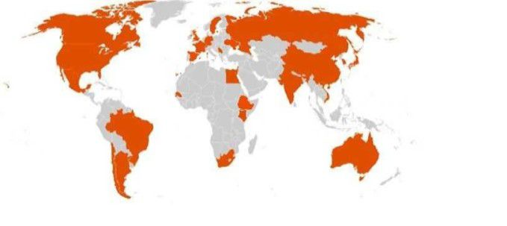
2.1 Supporting internationalization: the tools
Trieste Scientific Hub:
International Centre for Theoretical Physics (ICTP) - [UNESCO Category 1 Institute]
International Centre for Genetic Engineering and Biotechnology (ICGEB) - [IGO]
The World Academy of Science (TWAS) - [NGO]
Participation in large projects (e.g. SKAO, CERN, ESO, ECMWF…)
The Science and Technology attachés network
Bilateral Cooperation Agreements (≈15)
(IT-SA signed in 1998; into force since 2000) => Triennial Executive Programmes

Slide 7
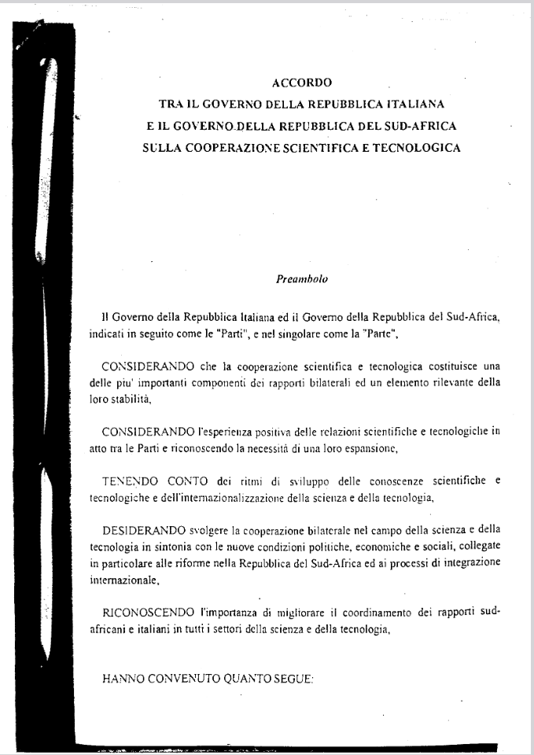
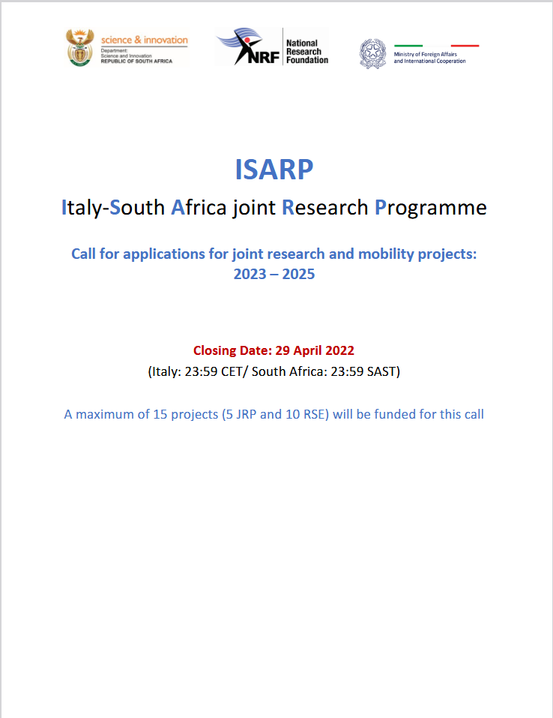
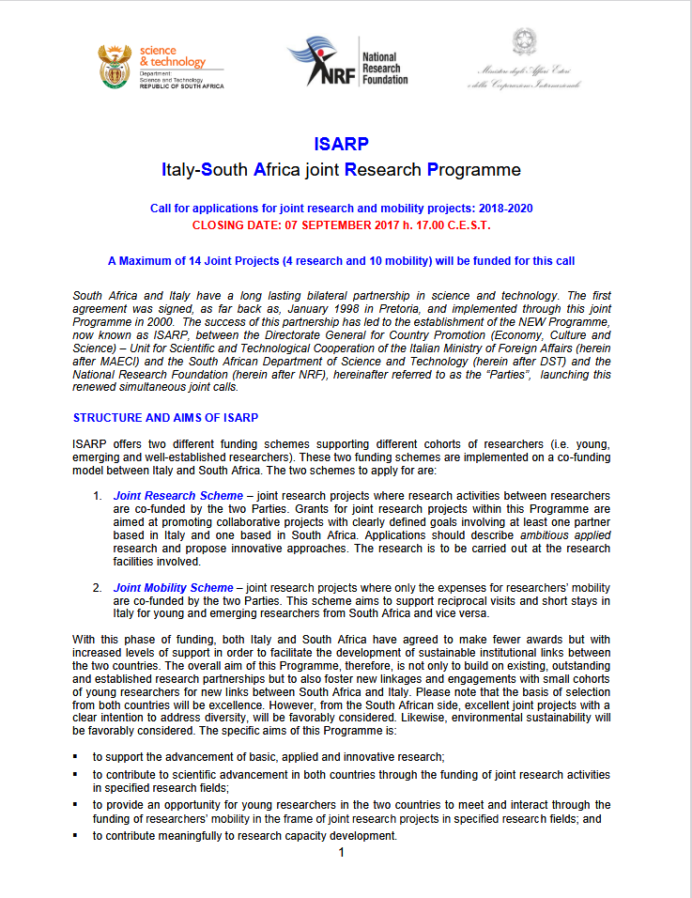
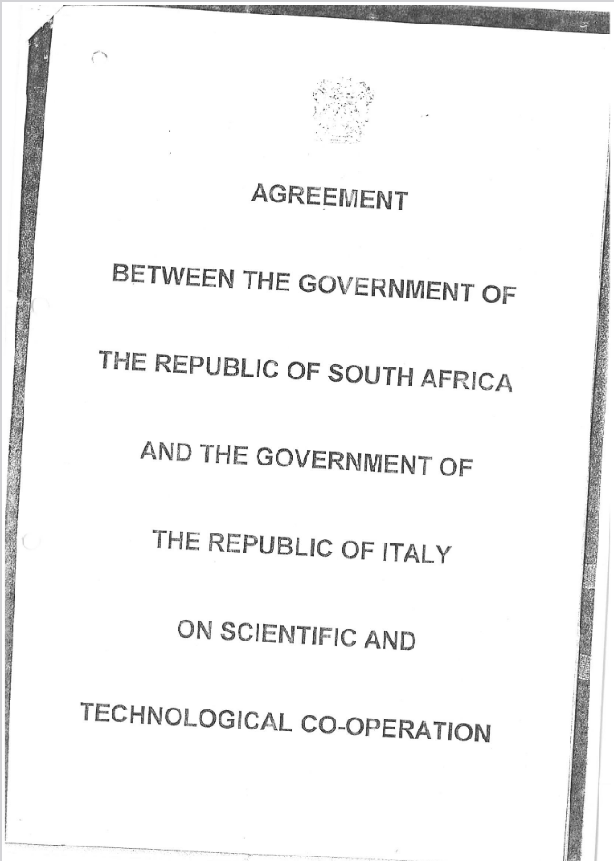

Slide 8
3. The Italy-south Africa Executive programme: funding radio astronomy
2011-2013
-----------------------------------
2014-2016
PIs: Prandoni-Vaccari (Research)
Mapping the Universe on the pathway to SKA. From black holes to large cosmic structures: a multi-scale approach to next-generation radio surveys
PIs: Venturi-Bernardi (Mobility)
Synergy between Italy and South Africa: Galaxy Clusters: a pivotal case for SKA precursor
2018-2020 (co-funded)
PIs: Venturi-Vaccari (Research)
RADIO SKY 2020 - Fostering cooperation between Italy and South Africa through radio astronomy
2021-2023
Delays and postponement due to Covid-19 pandemic
2023-2025 (co-funded)
PIs: Umana-Vaccari (Research)
RADIOMAP- Science & technology pathways to MeerKAT+: the Italian and South African synergy

Slide 9
Major Scientific Results (2023–2024)
A total of 36 joint scientific pubblications
MeerKAT Galactic Plane Survey: Highest-resolution L-band survey.
MeerKAT Fornax Survey: 200+ hours processed on ilifu;
SARAO PhD collaboration.
MIGHTEE Survey: Discovery of the most distant OH megamaser
Galaxy Clusters: Shapley Supercluster study; new PhD projects.
Courtesy of G. Umana and M. Vaccari

Slide 10
3.1 INAF: Ongoing and Future initiatives in South Africa
Participation into SKAO
MeerKAT+ contribution
MoA INAF-SARAO on Band 5b receivers (PI: Umana)
ISMoS: IT-SA Mobility Scheme (INAF-SARAO)

Slide 11
4. ISMoS: Italy-South Africa Mobility Scheme
Genesis of the ISMoS
Finalization and announcement
Funding scheme
Practicalities

Slide 12
4.1 Funding opportunities: ISMoS
Need to maximize Human Capacity Development (HCD) actions within the “broad” SKA project (research, technology and infrastructures)
International cooperation initiatives realize an optimal framework
In March 2023 INAF and SARAO agree to develop a bilateral scheme to:
Support education and training in SA at the PhD and Postdoc level
Facilitate bidirectional mobility IT ⬄ South Africa => international exposure for young researchers
Boost cooperation and support long lasting (years) joint research
Areas of cooperation:
SKA
MeerKAT
MeerKAT Plus
HERA

Slide 13
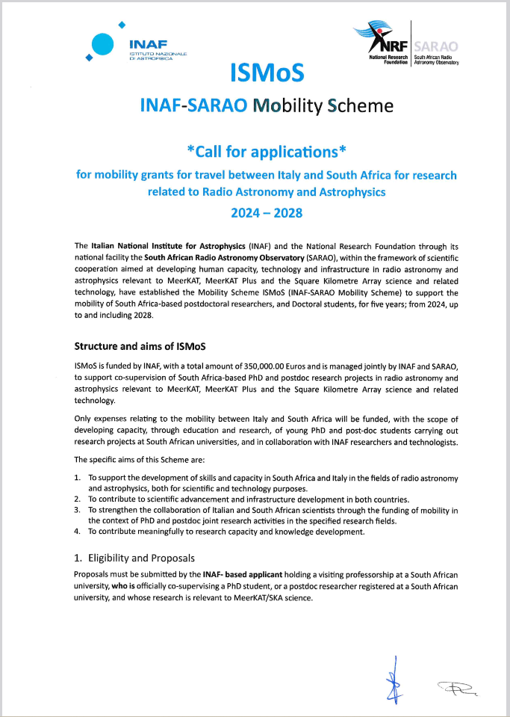
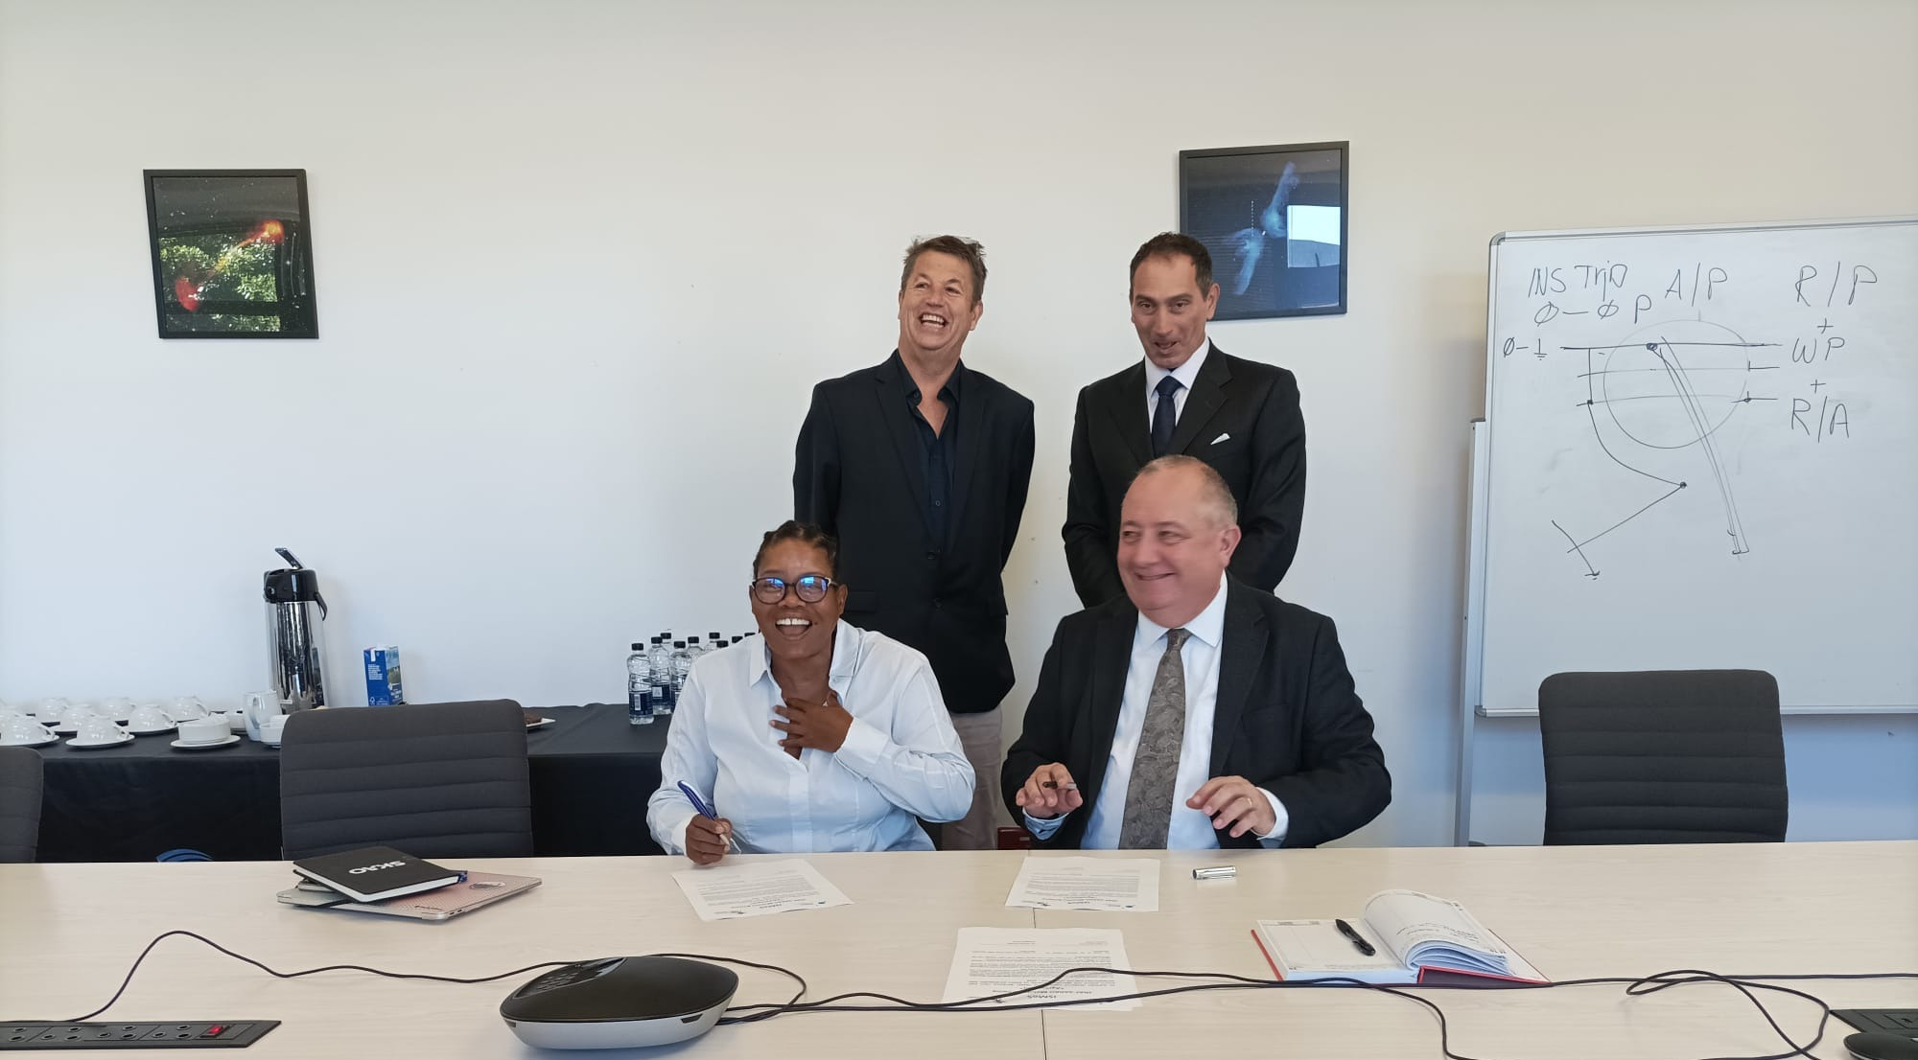
4.2 Finalization, signing and announcement
By February 2024 ISMoS is reviewed and finalized!
On the 19th of February 2024 ISMoS is signed at SARAO Headquarter
On the 18th of July 2024 the ISMoS “Call for applications” is announced by the INAF Scientific Directorate

Slide 14
4.3 Funding scheme
Proposals must be submitted by an INAF-based applicant officially co-supervising:
a South African PhD student (must be registered at a SA university)
a South African Postdoc student (must be registered at a SA university)
The INAF-based applicant must be:
Holding a “visiting professorship” at the South African university
The research activity must be relevant to SKA/MeerKAT
Applications can be presented anytime up to June 2029
Applicants may apply up to three times and no more than once per year
The grant will only fund mobility (travel expenses, accommodation and per diem*)
Visiting professorship => there are various forms of association in SA, depending on the university. The relevant INAF researcher must have some official affiliation with a South African university that will allow them to be a co-supervisor of a student/postdoc at said South African university.
INAF’s Evaluation Committee will review and decide accordingly.

Slide 15
4.4 Timeline
Open | Close | Decision by | Travel begins after
1st January | 31st March | End of April | 1st July
1st April | 30th June | End of July | 1st October
1st July | 30th September | End of October | 1st January
1st October | 31st December | End of January | 1st April

Slide 16
4.5 Practicalities (per diem)
Maximum contribution for accommodation and living expenses in Italy:
150 €/day, for stays up to 20 days (max 3,000 €)
100 €/day, for stays up to 60 days (max 6,000 €)
60 €/day, for stays up to 180 days (max 10,800 €)
Maximum contribution for accommodation and living expenses in South Africa:
2,000 ZAR/day, for stays up to 20 days (max 40,000 ZAR)
1,500 ZAR/day, for stays up to 60 days (max 90,000 ZAR)
1,000 ZAR/day, for stays up to 180 days (max 180,000 ZAR)

Slide 17
Thank you for your attention!

