Slide 1





The great synergy between SKA and THESEUS
Transient High-Energy Sky and Early Universe Surveyor
Lorenzo Amati
on behalf of the THESEUS Consortium

Slide 2
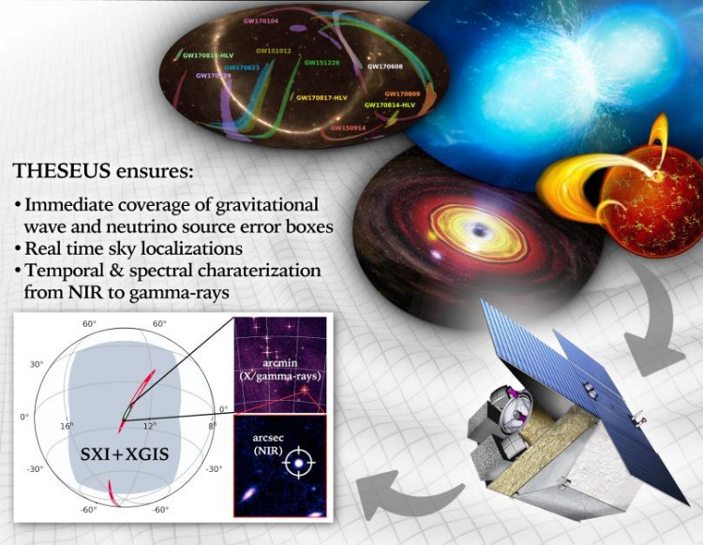
THESEUS core science goals
Probe the early Universe (first stars, first galaxies, cosmic reionization), by unveiling and exploiting the population of extremely distant cosmic Gamma - Ray Bursts (GRB)
Provide a fundamental contribution to multi-messenger and time domain astrophysics through GRB and other X/gamma-ray transient sources
Operate as a flexible multi-purpouse and multiwavelength GO facility
Notes:
Presenter’s note:

Slide 3

- 2018-2021: ESA Phase-A study (2018-2021) as M5 candidate - 2022: Selected for Phase 0 study (2023) within M7 process
- 2023: Selected for Phase-A study (2024-2026) as M7 candidate - M7 timeline: Phase-A (2024-2026), adoption 2028, launch 2037
Payload consortium: Italy, Germany, UK, France, Switzerland, Spain, Poland, Denmark, Belgium, Hungary, Czech Republic, Norway, Slovenia, Ireland, Sweden
Leads: L. Amati (INAF – OAS Bologna, Italy, lead proposer), A. Santangelo (Un. Tuebingen, D), P. O’Brien (Un. Leicester, UK), D. Gotz (CEA-Paris, France), E. Bozzo (Un. Genève, CH)
Amati et al. 2018 ( Adv.Sp.Res., arXiv:1710.04638 )
Stratta et al. 2018 (Adv.Sp.Res., arXiv:1712.08153)
Articles for SPIE 2020 and Exp..Astr. (all on arXiv)
http://www.isdc.unige.ch/theseus
http://www.isdc.unige.ch/theseus/

Slide 4
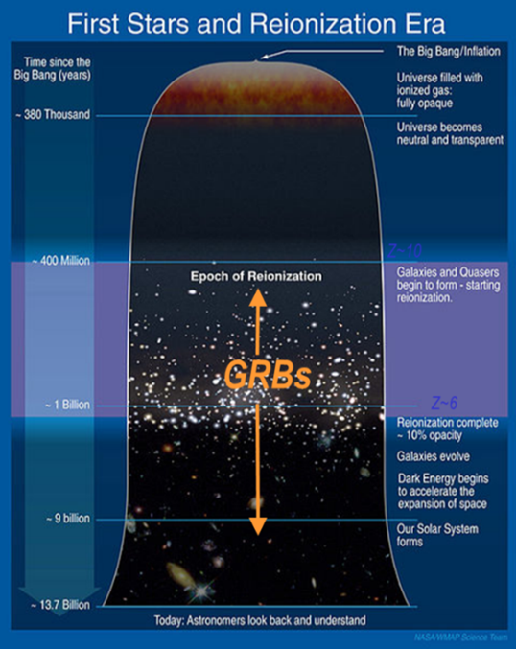
Shedding light on the early Universe with GRBs
Long GRBs: huge luminosities, mostly emitted in the X and gamma-rays
Redshift distribution extending at least to z ~9 and association with exploding massive stars
Powerful tools for cosmology: SFR evolution, physics of re-ionization, high-z low luminosity galaxies, pop III stars

Slide 5
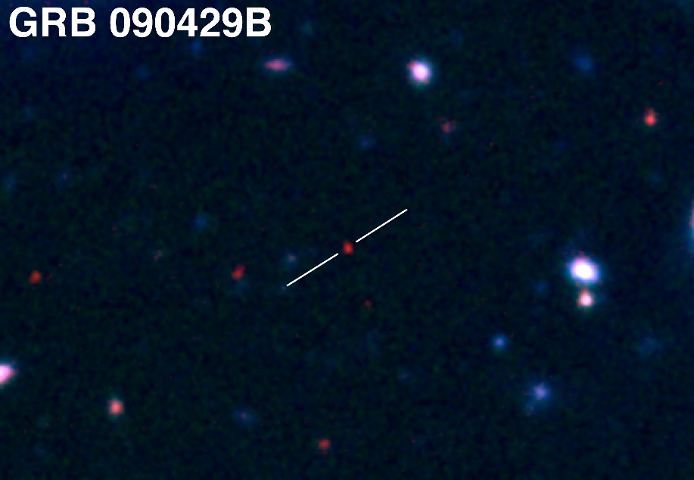
Shedding light on the early Universe with GRBs
A statistical sample of high–z GRBs can provide fundamental information:
measure independently the cosmic star–formation rate, even beyond the limits of current and future galaxy surveys
directly (or indirectly) detect the first population of stars (pop III)
Z = 9.4
Copyright: Gemini Observatory / AURA / Levan, Tanvir, Cucchiara

Slide 6
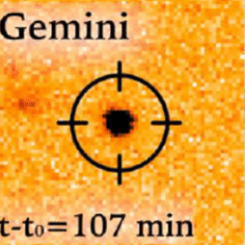
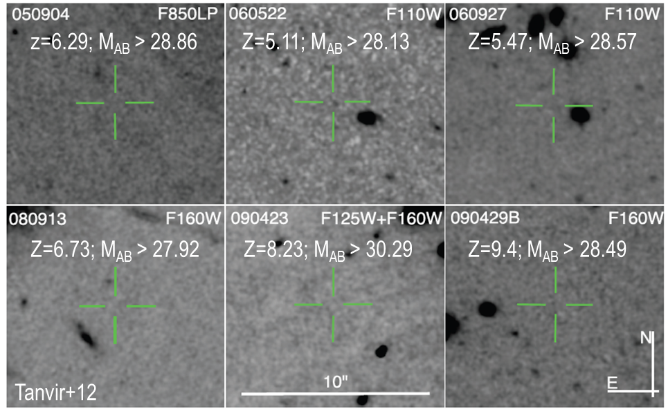
Detecting and studying primordial invisible galaxies
Robertson&Ellis12
Even JWST and ELTs surveys will be not able to probe the faint end of the galaxy Luminosity Function at high redshifts (z>6-8)

Slide 7
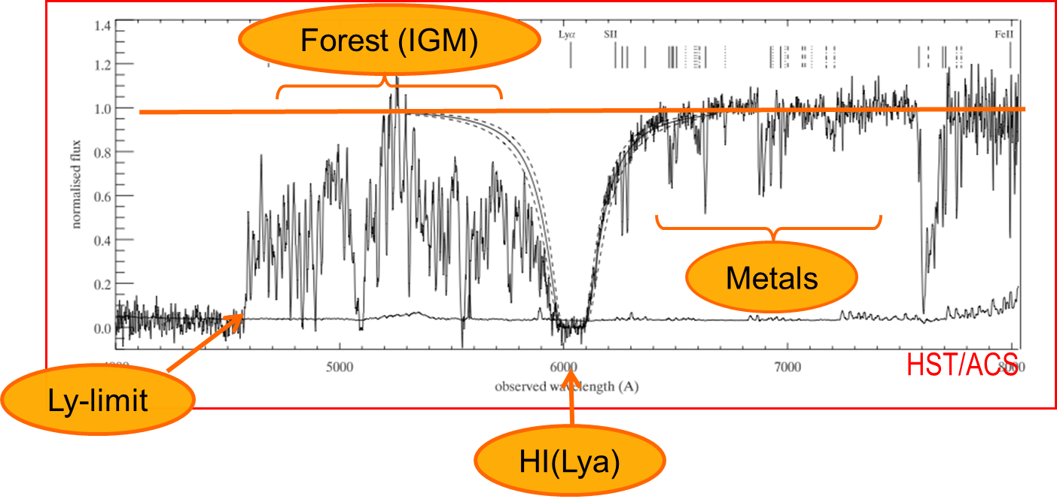
Detecting and studying primordial invisible galaxies
Robertson&Ellis12
Robertson&Ellis12

Slide 8
Detecting and studying primordial invisible galaxies
neutral hydrogen fraction
escape fraction of UV photons from high-z galaxies
early metallicity of the ISM and IGM and its evolution
Robertson&Ellis12
Robertson&Ellis12

Slide 9
Detecting and studying primordial invisible galaxies
neutral hydrogen fraction
escape fraction of UV photons from high-z galaxies
early metallicity of the ISM and IGM and its evolution
Beyond even JWST capabilities:
Primordial galaxies detection and characterization Independent on mass and luminosity
Allow absorption spectroscopy (needed because most metals are in neutral gas and and for dust ratio)
Properties of primordial IGM
Targets for JWST
Robertson&Ellis12
Robertson&Ellis12

Slide 10
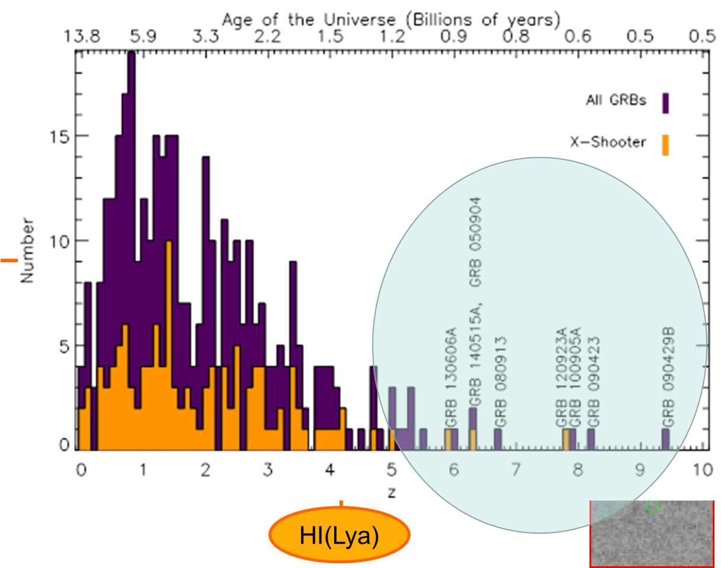
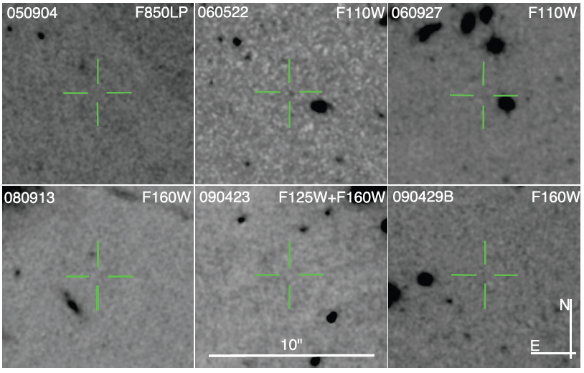
Shedding light on the early Universe with GRBs
z=6.29; M_{AB} > 28.86
Z=5.11; M_{AB} > 28.13
Z=5.47; M_{AB} > 28.57
Z=6.73; M_{AB} > 27.92
Z=8.23; M_{AB} > 30.29
Z=9.4; M_{AB} > 28.49
Tanvir+12
Robertson&Ellis12

Slide 11
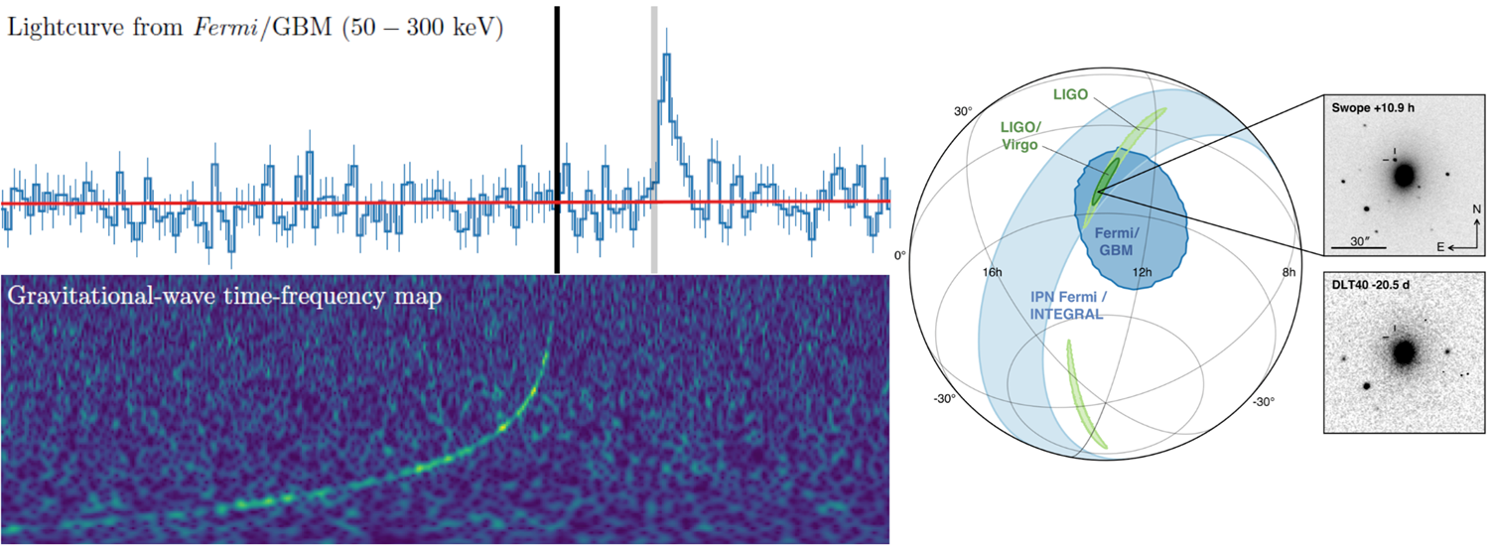
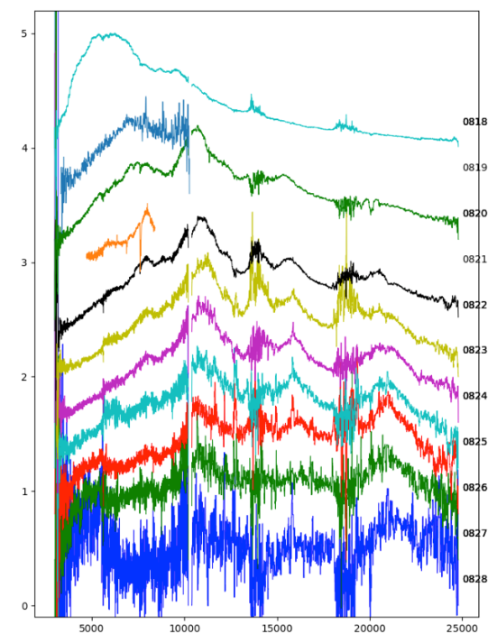
GRBs and multi-messenger astrophysics
GW170817 + SHORT GRB 170817A + KN AT2017GFO (~40 Mpc):
Notes:
Presenter’s note:

Slide 12
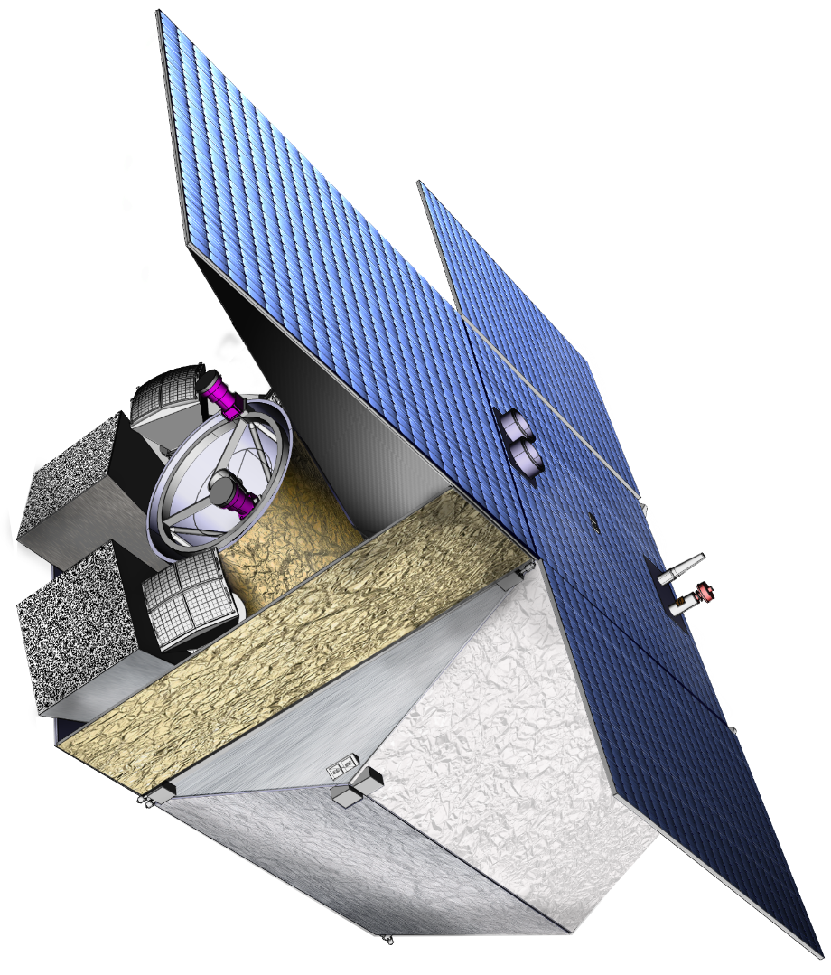
THESEUS Mission Concept
THIS BREAKTHROUGH WILL BE ACHIEVED BY A MISSION CONCEPT OVERCOMING MAIN LIMITATIONS OF CURRENT FACILITIES
Set of innovative wide-field monitors with unprecedented combination of broad energy range from gamma-rays down to soft X-rays, FOV and localization accuracy
Notes:
Presenter’s note:

Slide 13
THESEUS Mission Concept
THIS BREAKTHROUGH WILL BE ACHIEVED BY A MISSION CONCEPT OVERCOMING MAIN LIMITATIONS OF CURRENT FACILITIES
Set of innovative wide-field monitors with unprecedented combination of broad energy range from gamma-rays down to soft X-rays, FOV and localization accuracy
On-board autonomous fast follow-up in optical/NIR, arcsec location and redshift measurement of detected GRB/transients
Notes:
Presenter’s note:

Slide 14
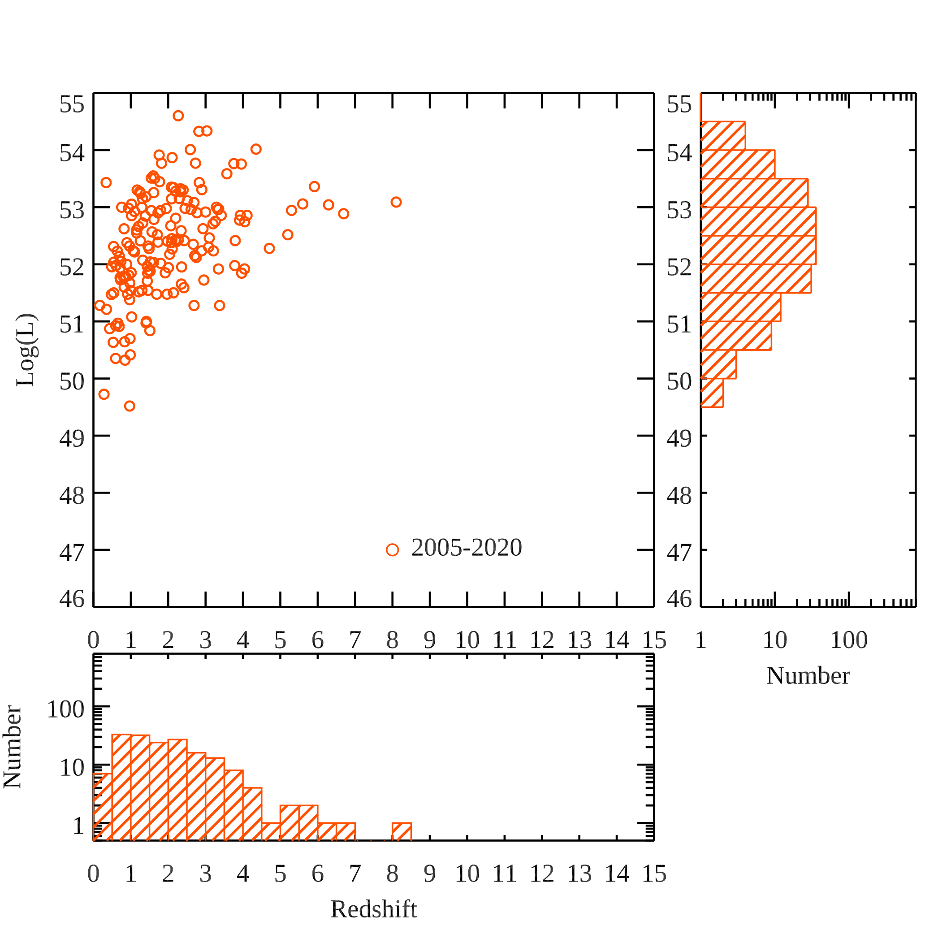
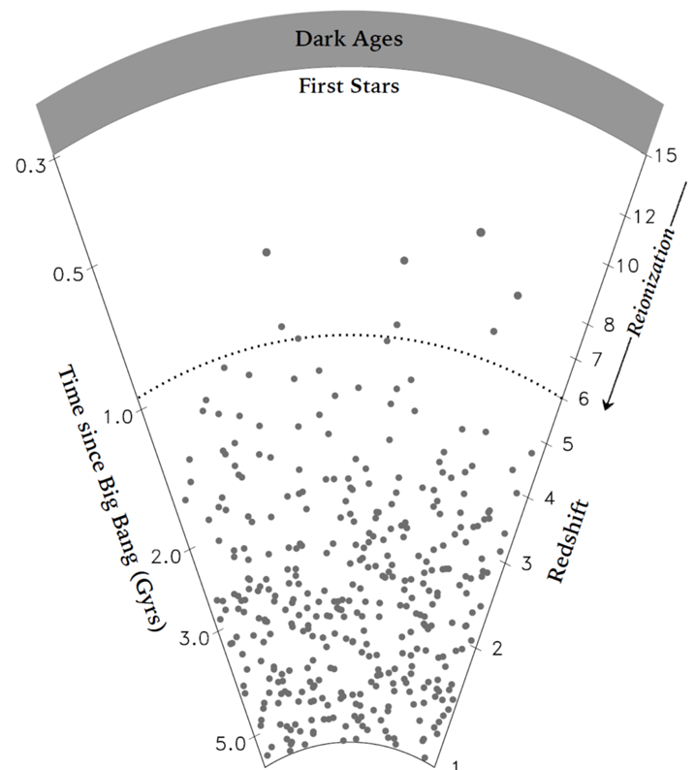
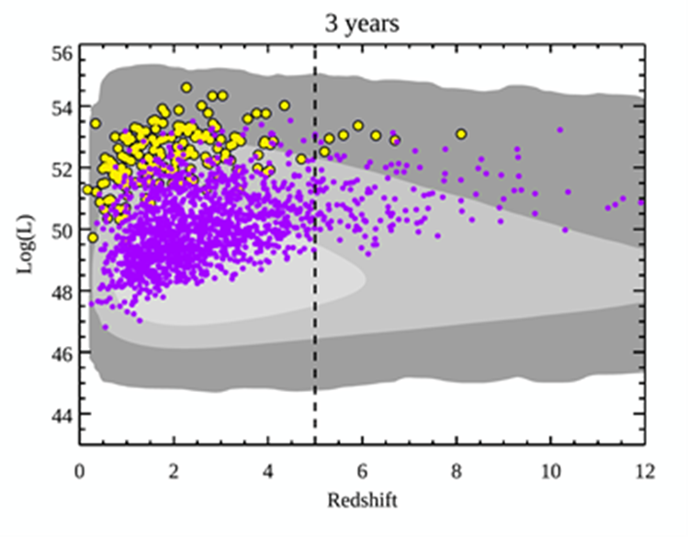
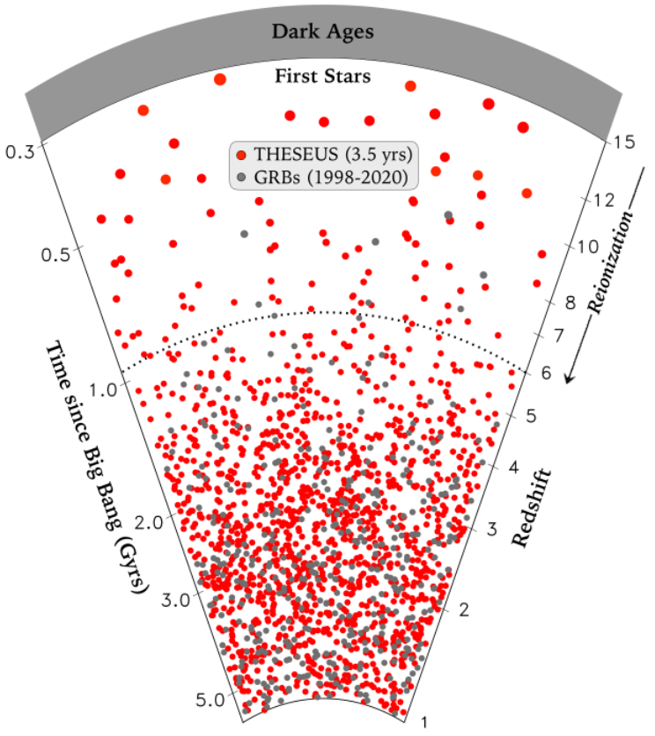
Expected performances: early Universe

Slide 15
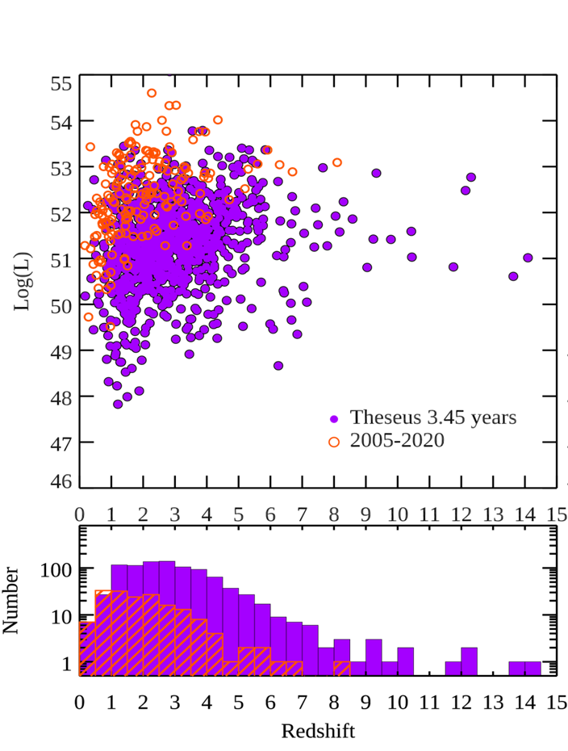
Expected performances: early Universe

Slide 16

Multi-messenger science with THESEUS
THESEUS:
short GRB detection over large FOV with arcmin localization
Kilonova detection, arcsec localization and characterization
Possible detection of weaker isotropic X-ray emission

Slide 17

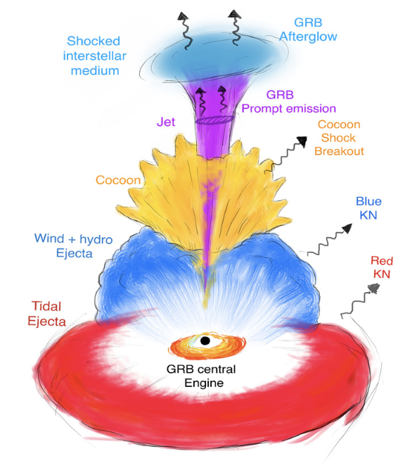
Multi-messenger science with THESEUS
INDEPENDENT DETECTION & CHARACTERISATION OF THE MULTI-MESSENGER SOURCES
Lessons from GRB170817A
Aligned GRBs
Misaligned GRBs
THESEUS + ET in 3 years:
~70 aligned+misaligned short GRB
additional long GRBs from mergers and possible GW-X-ray transients
Higher redshift events – X/𝛾 is likely only route to EM detection: larger statistical studies including source evolution, probe of dark energy and test modified gravity on cosmological scales
Notes:
Presenter’s note:
Very brief explanation of the red and blue KN (we can take in case another figure). Focus on explain 1) the “standard short GRB”-aligned and “soft short GRB”-misaligned issue 2) the synergy with upgraded 2G to study KN and jet structure with off-axis afterglow 3) the statistical studies possible with synergies with 3G

Slide 18

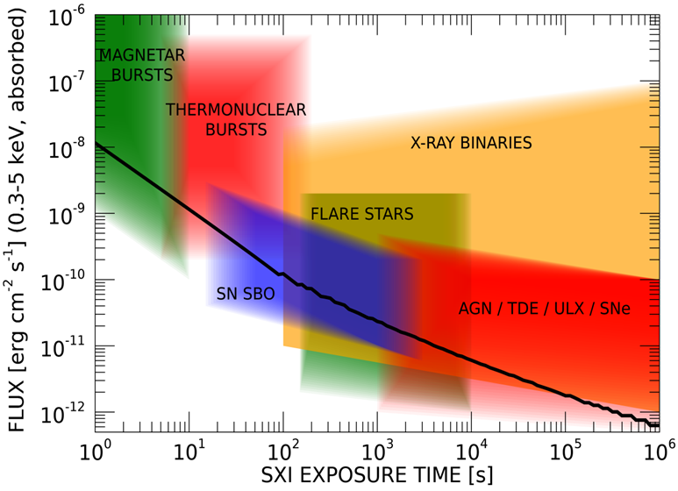
Exploring the transient sky
GRBs extreme emission physics, central engine, sub-classes & progenitors
Study of many classes of X-ray sources by exploiting the simultaneous broad band X-ray and NIR observations
Provide a flexible follow-up observatory for fast transient events with multi-wavelength ToO capabilities and guest-observer programme

Slide 19
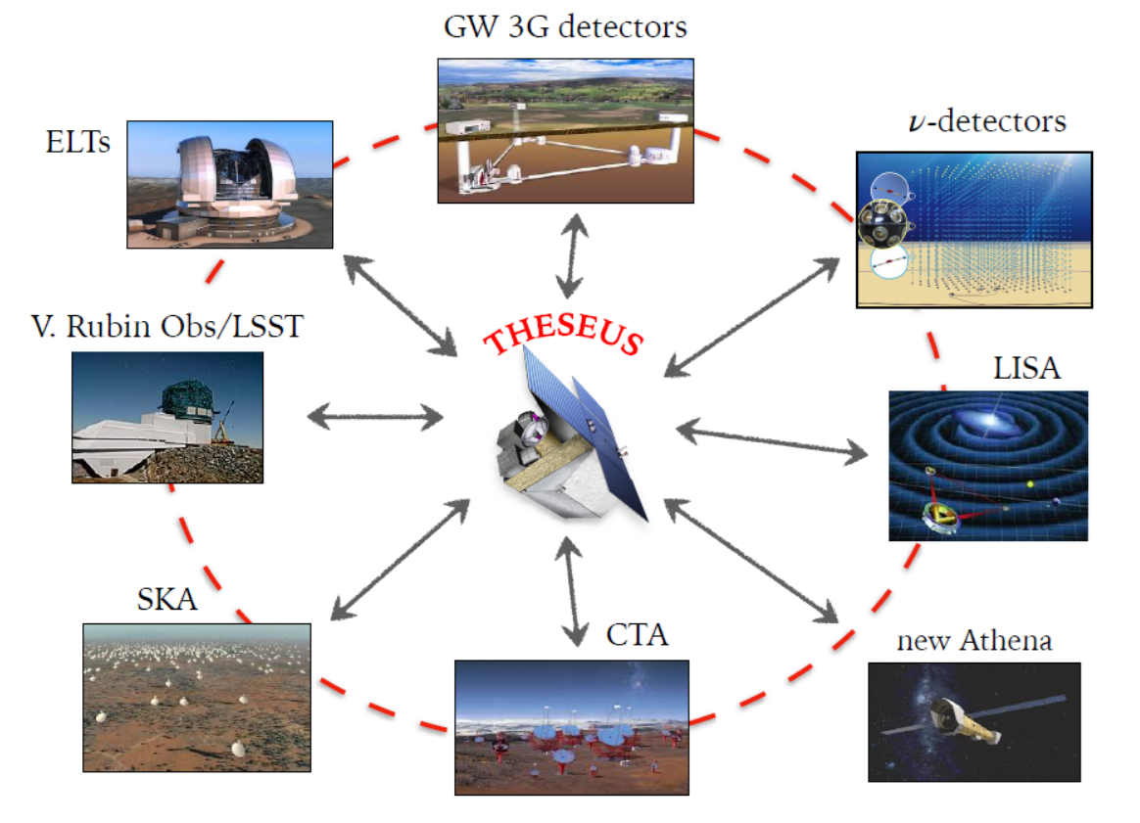
THESEUS: crucial synergies in the late ‘30s
The «M7» timeline will allow to widely broaden the mission scientific impact by taking advantage of the perfectly matched synergies with major facilities coming fully operative in the 2030s (e.g., 3G GW detectors)

Slide 20
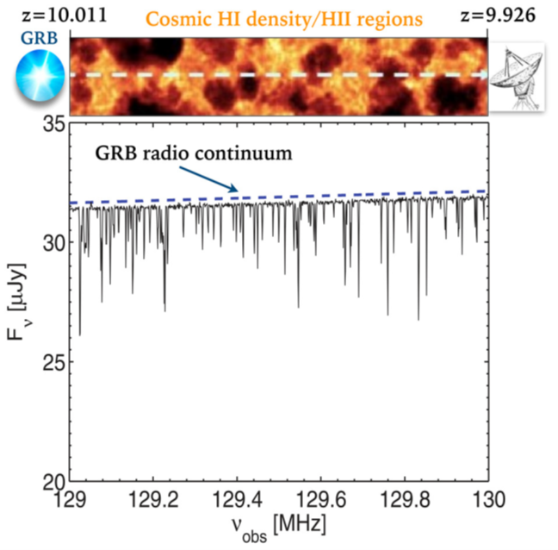
THESEUS - SKA: straightforward synergies
High complementarity in the study of the early Universe:
History, topology and physics of cosmic re-ionization
(2) Pop-III stars and SFR evolution up cosmic dawn
Population, properties and evolution of weak/low-lum first galaxies

Slide 21
THESEUS - SKA: straightforward synergies
THESEUS will be the perfect GRB and transients machine allowing SKA to fully exploit its capabilities for time-domain and multi-messenger astrophysics:
Short GRBs and soft X-ray transients as e.m. counterparts of GW emitters (NS-NS, NS-BH)
GRBs: physics / geometry of the emission, population studies, cosmology
Long GRBs – SNe-Ib/c – neutrinos
Many other transients found by THESEUS (e.g., TDEs, magnetars, …) will also be high-value targets for SKA

Slide 22
In summary
GRBs are a key phenomenon for cosmology, multi-messenger astrophysics and fundamental physics
THESEUS, a mission concept developed by a large European collaboration led by Italy and under study by ESA (M7 Phase-A) will fully exploit these potentialities, providing a substantial contribution to extreme GRB physics and time-domain astronomy
The “M7” timeline will allow an unprecedented great synergy with future very large observing facilities in the e.m. and multi messenger domains, enhancing their scientific return and fully exploiting the European leadership and investments put in them.
A very strong synergy of with SKA is envised: early Universe cosmology (pop III stars, cosmic re-ionization, first galaxies), GRBs, transients and multi-messenger astrophysics
THESEUS: ESA/M5 Phase A study and selected for M7 Phase A (->2037)
SPIE articles on instruments, Adv.Sp.Res. & Exp.Astr. articles on science
http://www.isdc.unige.ch/theseus/

Slide 23
Back-up slides

Slide 24
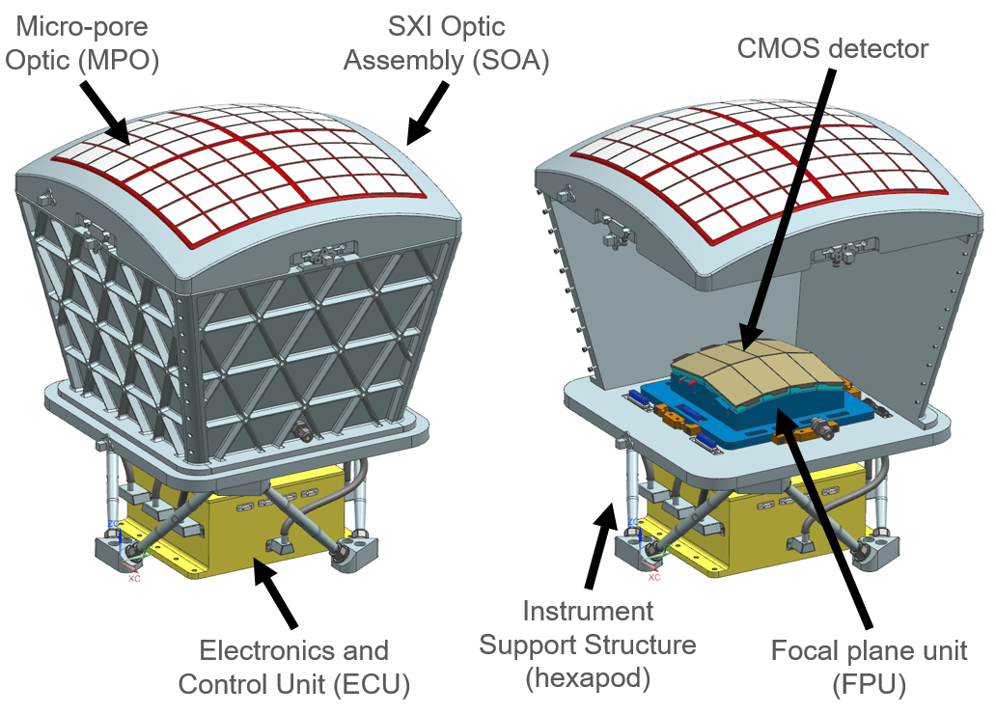
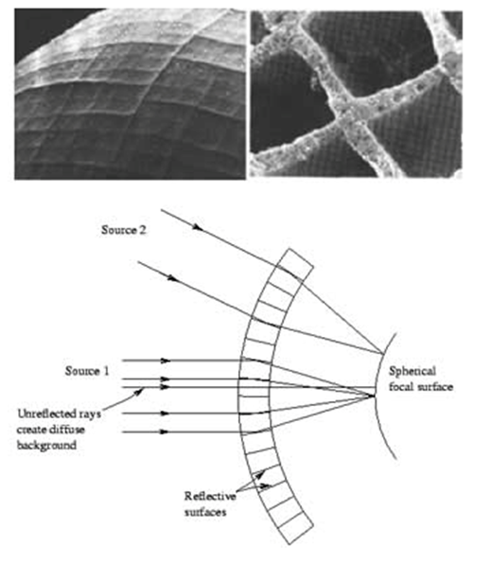
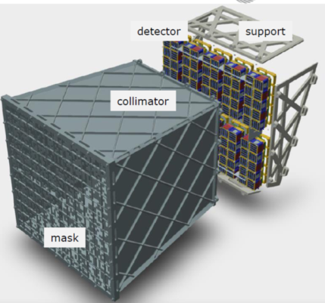
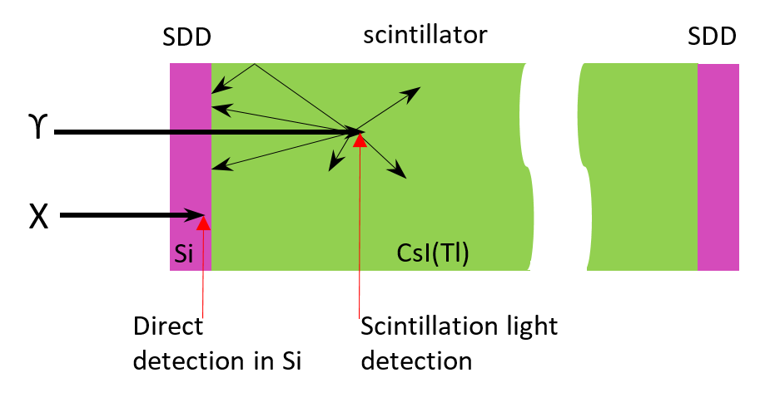
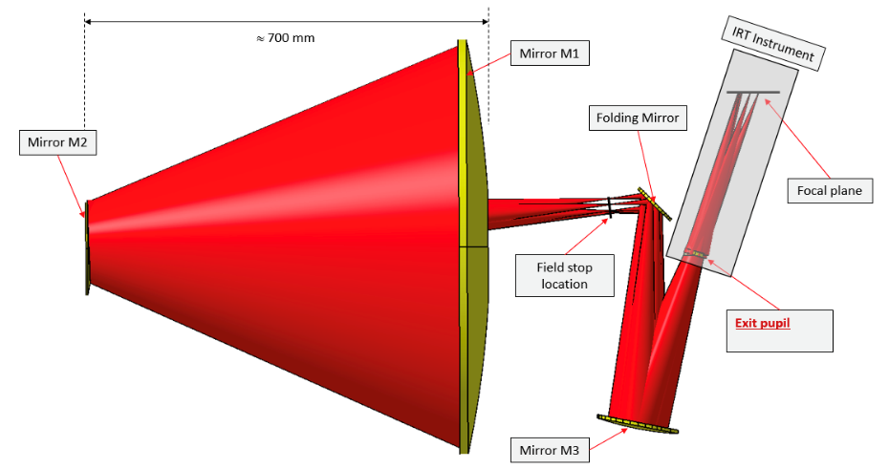
THESEUS Mission Concept
Soft X-ray Imager (SXI): a set of two sensitive lobster-eye telescopes observing in 0.3 - 5 keV band, total FOV of ~0.5sr with source location accuracy <2’
X-Gamma rays Imaging Spectrometer (XGIS): 2 coded-mask X-gamma ray cameras using Silicon drift detectors coupled with CsI crystal scintillator bars observing in 2 keV – 10 MeV band, a FOV of >2 sr, overlapping the SXI, with <15’ GRB location accuracy
InfraRed Telescope (IRT): a 0.7m class IR telescope observing in the 0.7 – 1.8 μm band, providing a 15’x15’ FOV, with both imaging and moderate resolution spectroscopy capabilities
Y_{IRTOR}
Z_{IRTOR}
Notes:
Presenter’s note:

Slide 25
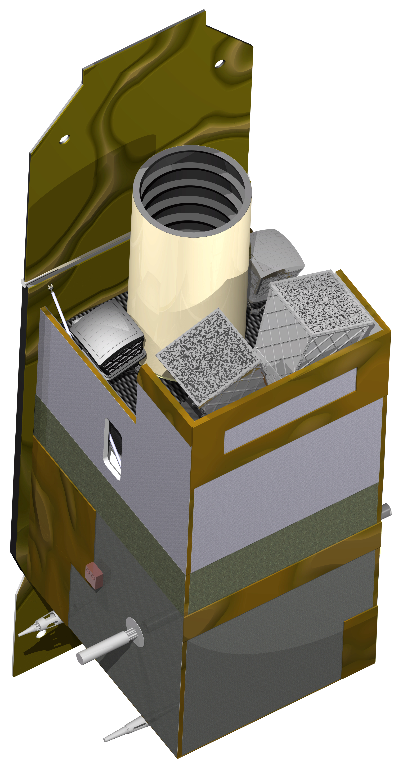
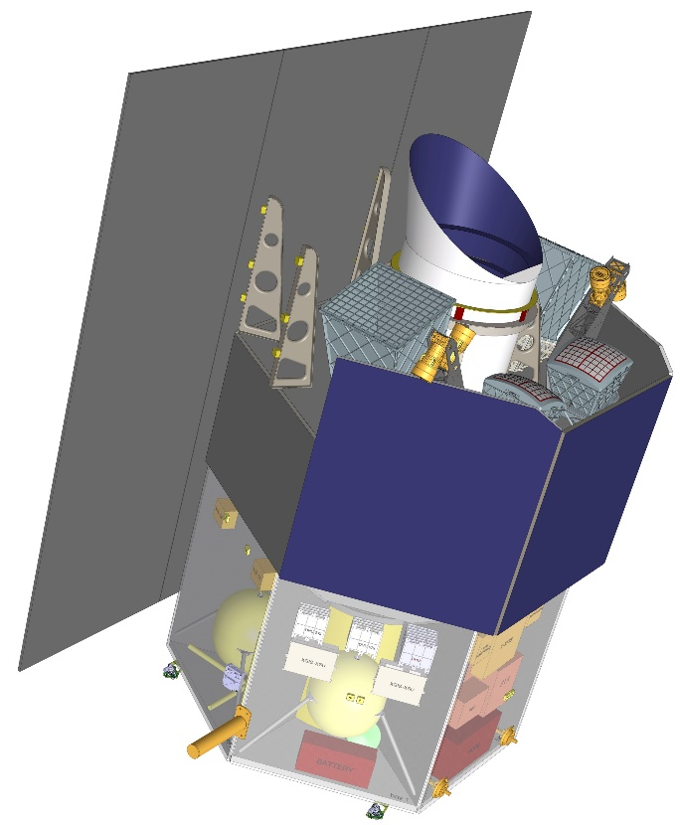
THESEUS Mission Concept
Fast slewing capability (>10°/min), granting prompt NIR follow-up of GRBs and transients
Low-Earth Orbit (LEO), with about 4° inclination and 550-640 km altitude, granting low and stable BKG for the monitors
The weight (about 2.3 tons) and dimensions are suitable for launch with VEGA-E
(ADS)
(THALES)
Notes:
Presenter’s note:

Slide 26






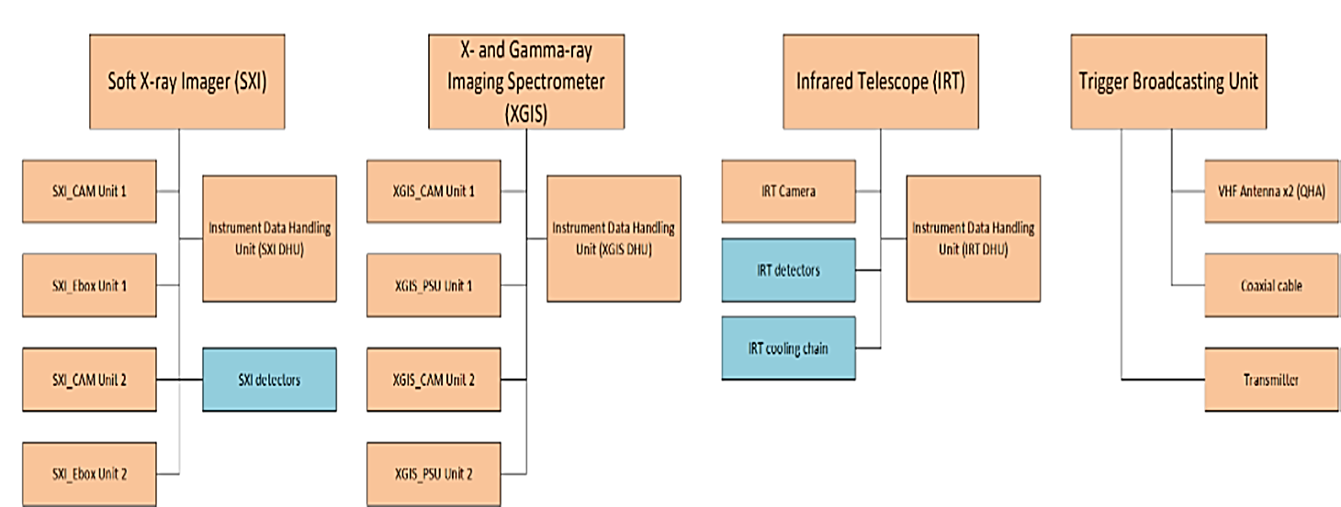










THESEUS responsibilities for M7
IRT Telescope
P/L system Master DHU
Science Data Centre
Main ground station & Fast Alert Broadcasting system
Notes:
Presenter’s note:

Slide 27
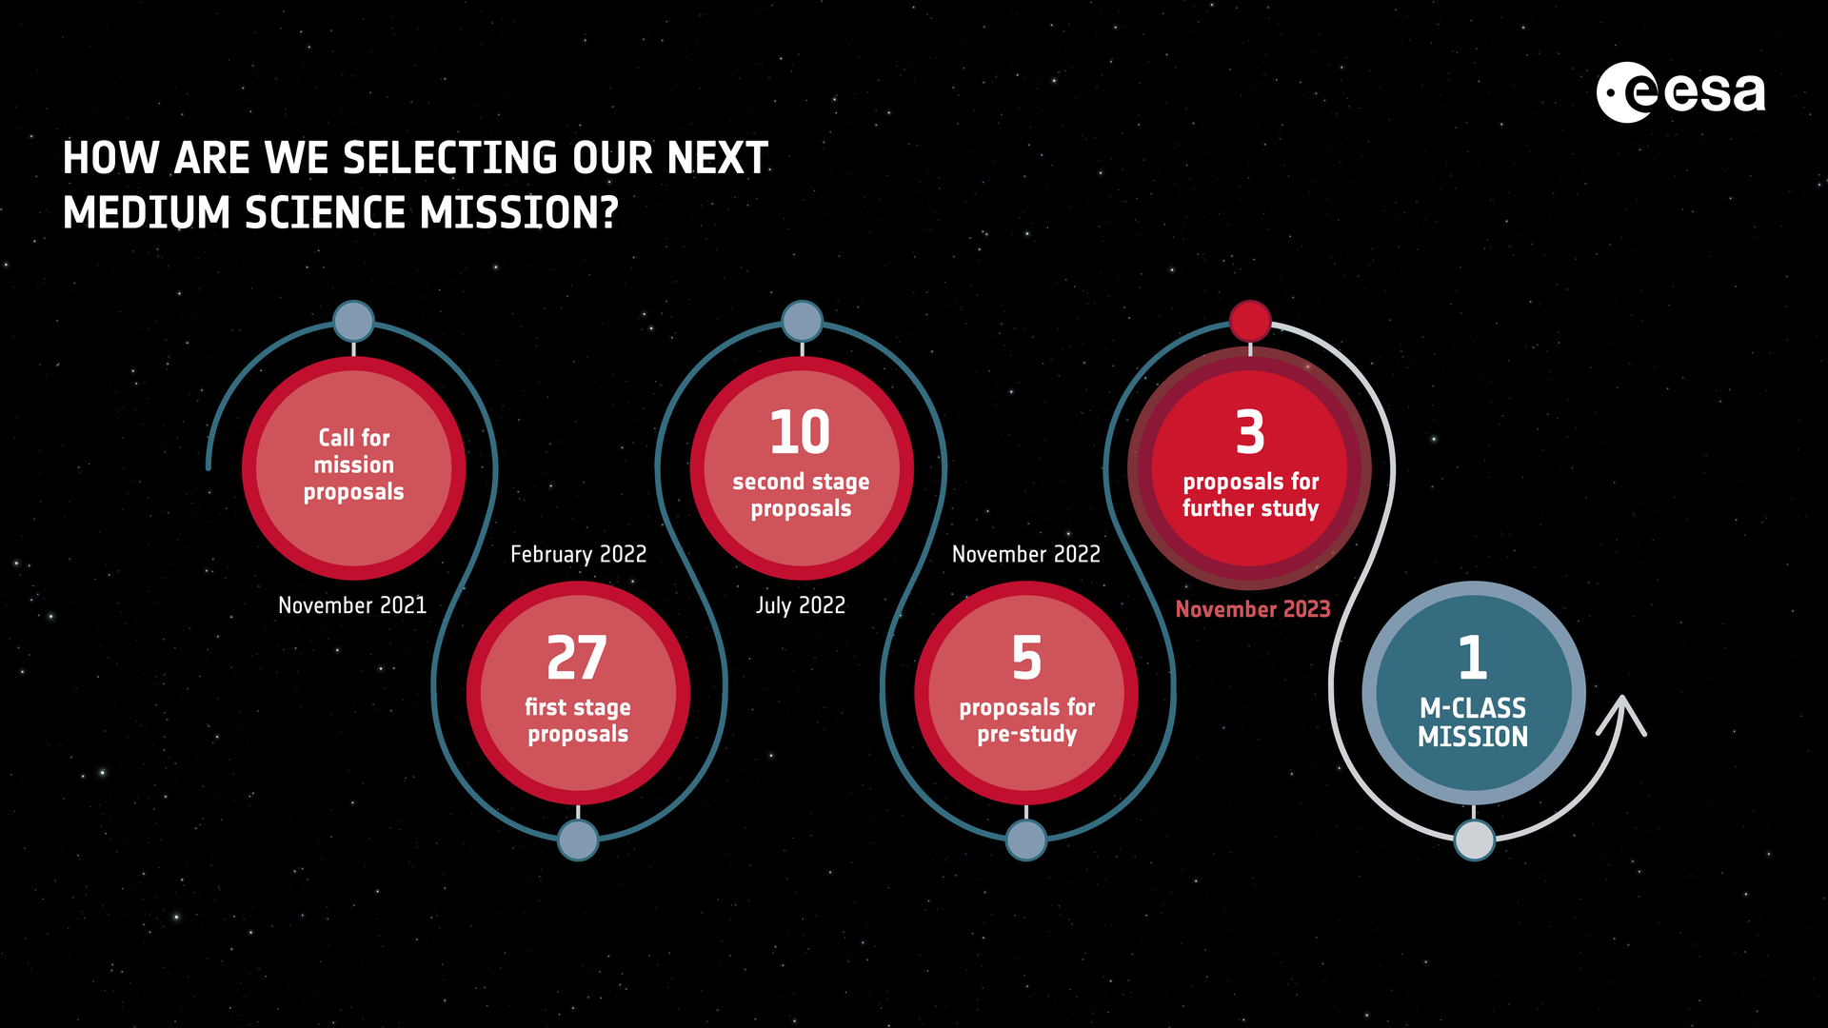
ESA/M7 Selection process
Phase-0 (2023): Calico, Haydn, M-Matisse, Plasma Observatory, THESEUS
Phase-A (2024-2026): M-Matisse, Plasma Observatory, THESEUS

Slide 28
M7 Phase-A timeline
Nov. 8th, 2023: SPC approval and ESA announcement of the three selected candidates (THESEUS, M-Matisse, Plasma Observ.)
Jan. 2024: ESA internal Phase-A KO (17th); ESA KO with Consortium (29th)
May. 2024: KO of industrial Phase-A
Mar. – Apr. 2025: Mission Consolidation Review (MCR)
Feb. – Apr. 2026: Mission Selection Review (MSR)
May 2026: Final scientific evaluations (SARP, SSC)
June 2026: Selection of one M7 candidate for Phase-B1

Slide 29
THESEUS/M7 MCR
Quite smooth and efficient process, thanks to great efforts by ESA Study Team, Consortium instruments treams, ESA panel
No show-stoppers identified: THESEUS passed successfully the review and was admitted to Phase A2 without changes to the mission profile and instruments design baseline
As is normal, actions have been set on the Consortium and ESA study team to address most relevant items, consoldidate mission design and arrive at MSR with most robust / lowest risk baseline
Some of the above involve TSST discussions and decisions; consolidation of the SciRD in the short term is also needed (this telecon and next in person meeting)

Slide 30
M7 Phase-A timeline
Nov. 8th, 2023: SPC approval and ESA announcement of the three selected candidates (THESEUS, M-Matisse, Plasma Observ.)
Jan. 2024: ESA internal Phase-A KO (17th); ESA KO with Consortium (29th)
May. 2024: KO of industrial Phase-A
Mar. – Apr. 2025: Mission Consolidation Review (MCR)
Feb. – Apr. 2026: Mission Selection Review (MSR)
Apr. - May 2026: Final scientific evaluations (SARP, SSC)
June 2026: Selection of one M7 candidate for Phase-B1

Slide 31
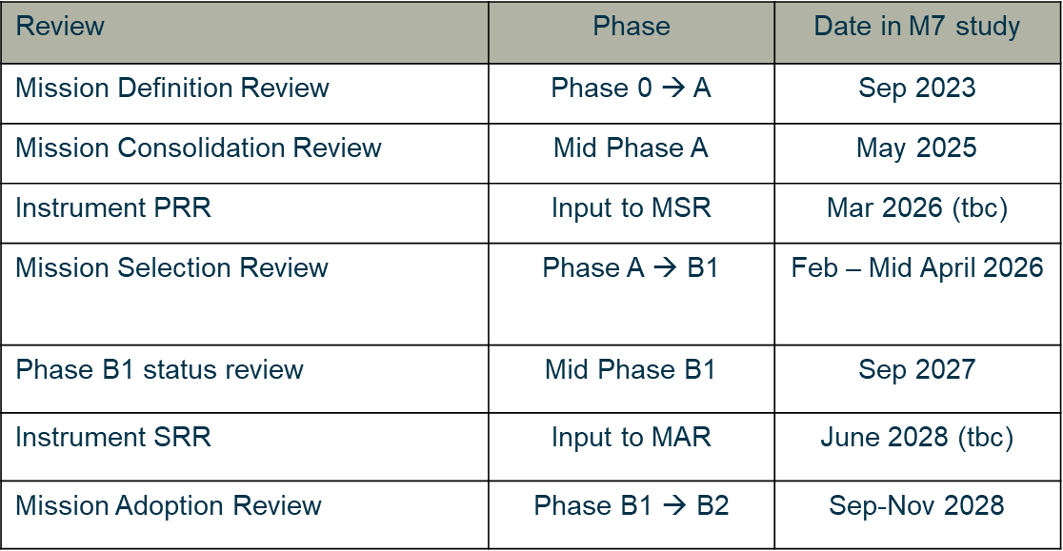
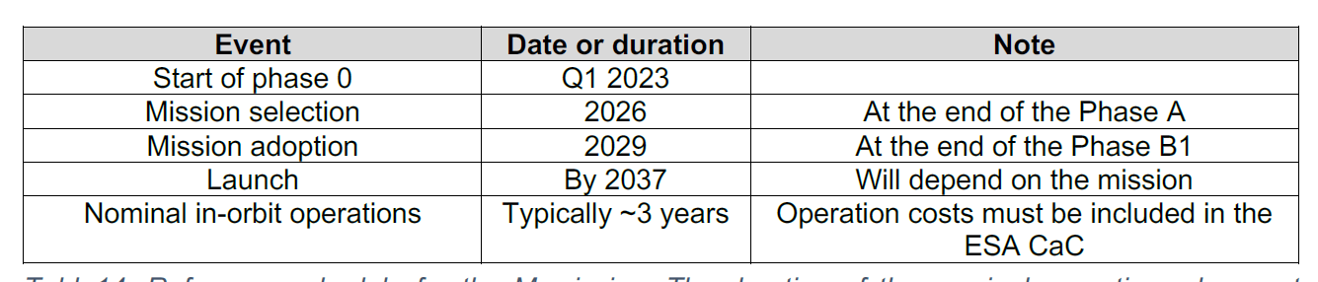

Overall ESA/M7 timeline

Slide 32
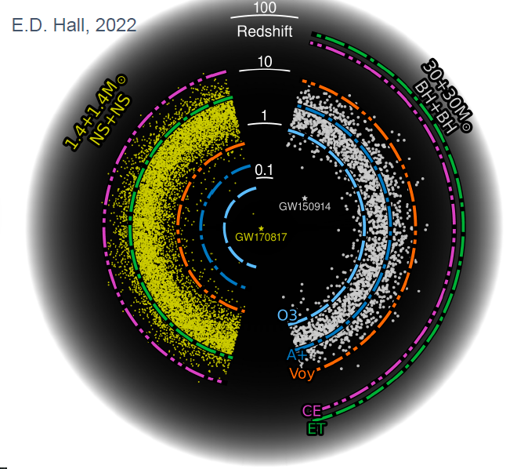
Multi-messenger science with THESEUS
M7 timeline: great synergy with 3G GW detectors (ET, CE)
Notes:
Presenter’s note:
Very brief explanation of the red and blue KN (we can take in case another figure). Focus on explain 1) the “standard short GRB”-aligned and “soft short GRB”-misaligned issue 2) the synergy with upgraded 2G to study KN and jet structure with off-axis afterglow 3) the statistical studies possible with synergies with 3G

Slide 33
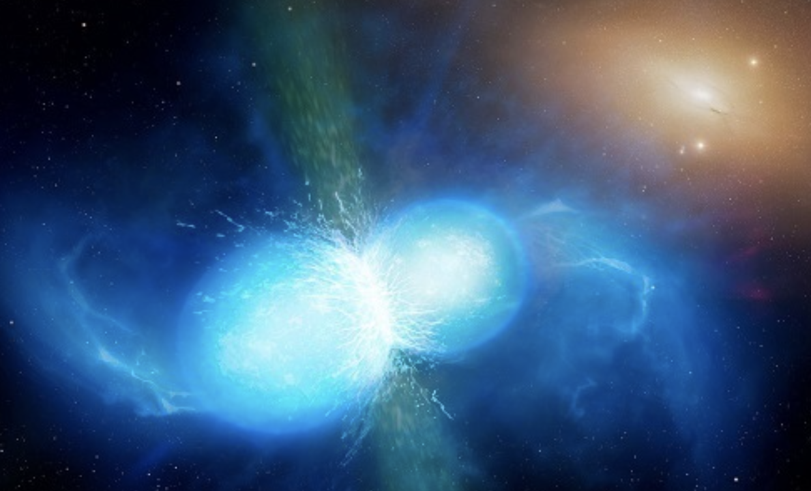
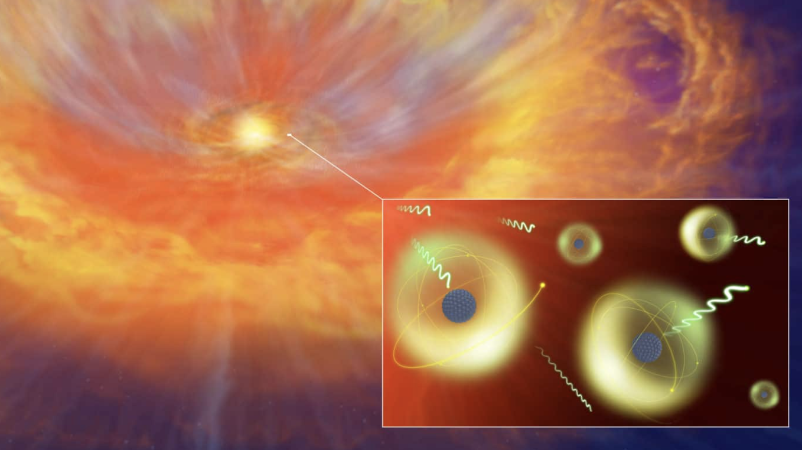
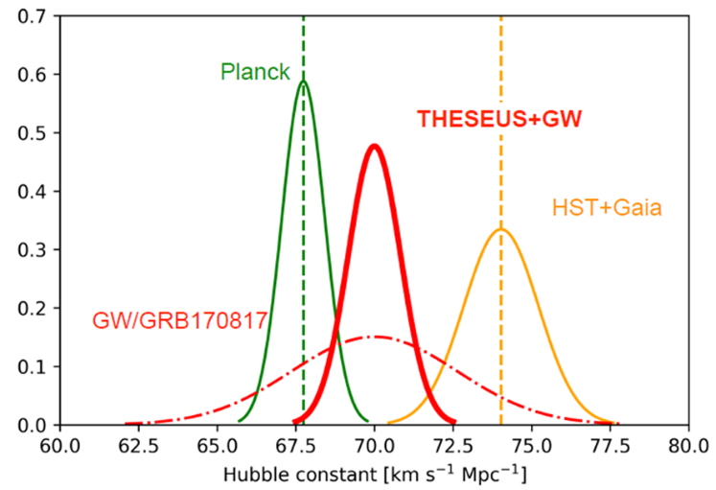
GRB: a key phenomenon for multi-messenger astrophysics (and cosmology)
GW170817 + SHORT GRB 170817A + KN AT2017GFO
Relativistic jet formation, equation of state, fundamental physics
Cosmic sites of r-process nucleosynthesis
New independent route to measure cosmological parameters
Notes:
Presenter’s note:

Slide 34
Multi-messenger science with THESEUS
THESEUS & 3G SCIENCE
Main topics | THESEUS role | What will we learn?
Physics of compact binaries | short GRB+GW detection and localization | relativistic jet formation mechanism/efficiency, remnant nature, NS EoS
Relativistic plasma | accurate sky coordinates of GW events associated with misaligned afterglows | Jet propagation, jet structure and its universality, NSBH vs NSNS
Physics of kilonova | accurate sky coordinates of GW events | Role of NS-NS/NSBH in r-process element nucleosynthesis
Fundamental physics | Identify counterparts for events at z>0.3 | Tests of modified gravity theories
Cosmology | accurate sky coordinates of GW events allowing redshift measurement | Independent H0 measure
:
Notes:
Presenter’s note:
With THESEUS & 2G++ we will move from GW+EM studies of single cases to a statistical approach, starting to build the full picture of compact binary coalescences and to answer questions that with 3G will find full confirmation

Slide 35
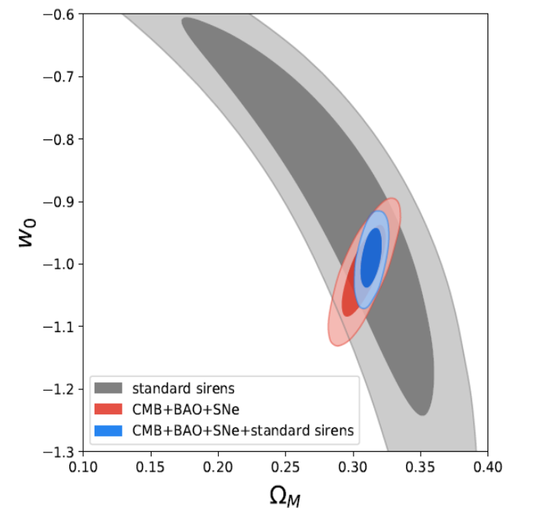
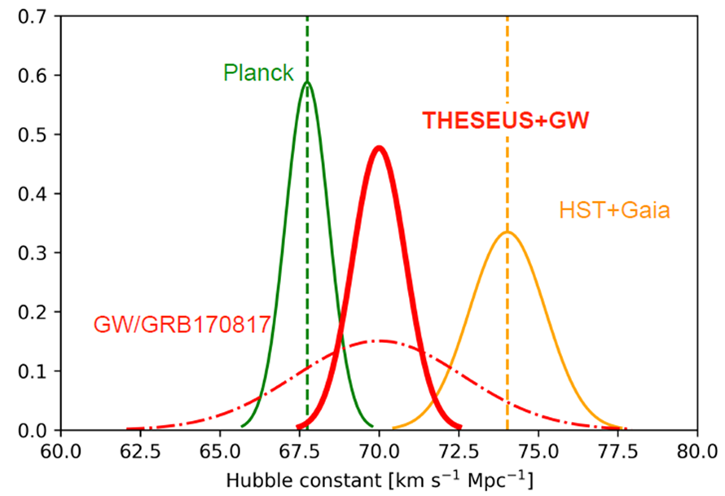
Multi-messenger cosmology
MEASURING THE EXPANSION RATE AND GEOMETRY OF SPACE-TIME
~20 joint GRB + GW events
ET collaboration
Notes:
Presenter’s note:

Slide 36
Simulated ELT 30-minute spectrum of a z=8.0 GRB afterglow with J(AB)=20 (typical after ~0.5 day). The S/N provides exquisite abundance determinations from metal absorption lines (in this example, 1% solar metallicity), while fitting the Ly-alpha damping wing simultaneously fixes the IGM neutral fraction and the host HI column density, as illustrated by the two overlaid models, a pure 100% neutral IGM (green,) and a log(NHI/cm-2)=21.2 host absorption with a fully ionized IGM (orange). A well-fitting combined model is shown in red.

Slide 37
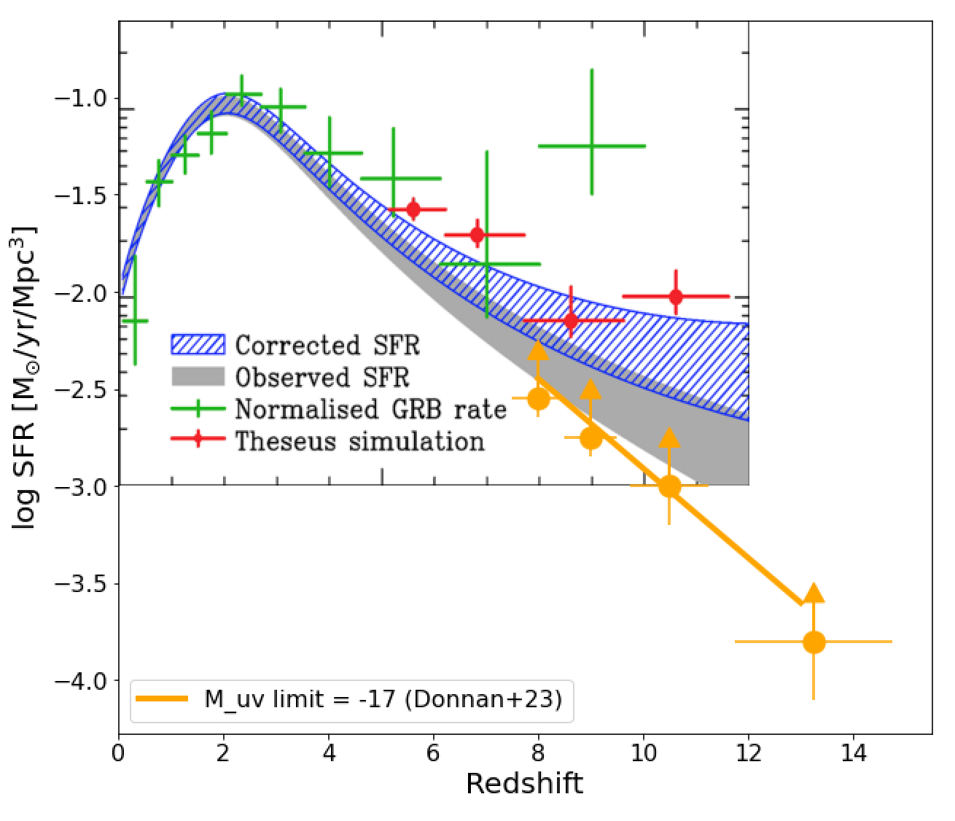

Slide 38
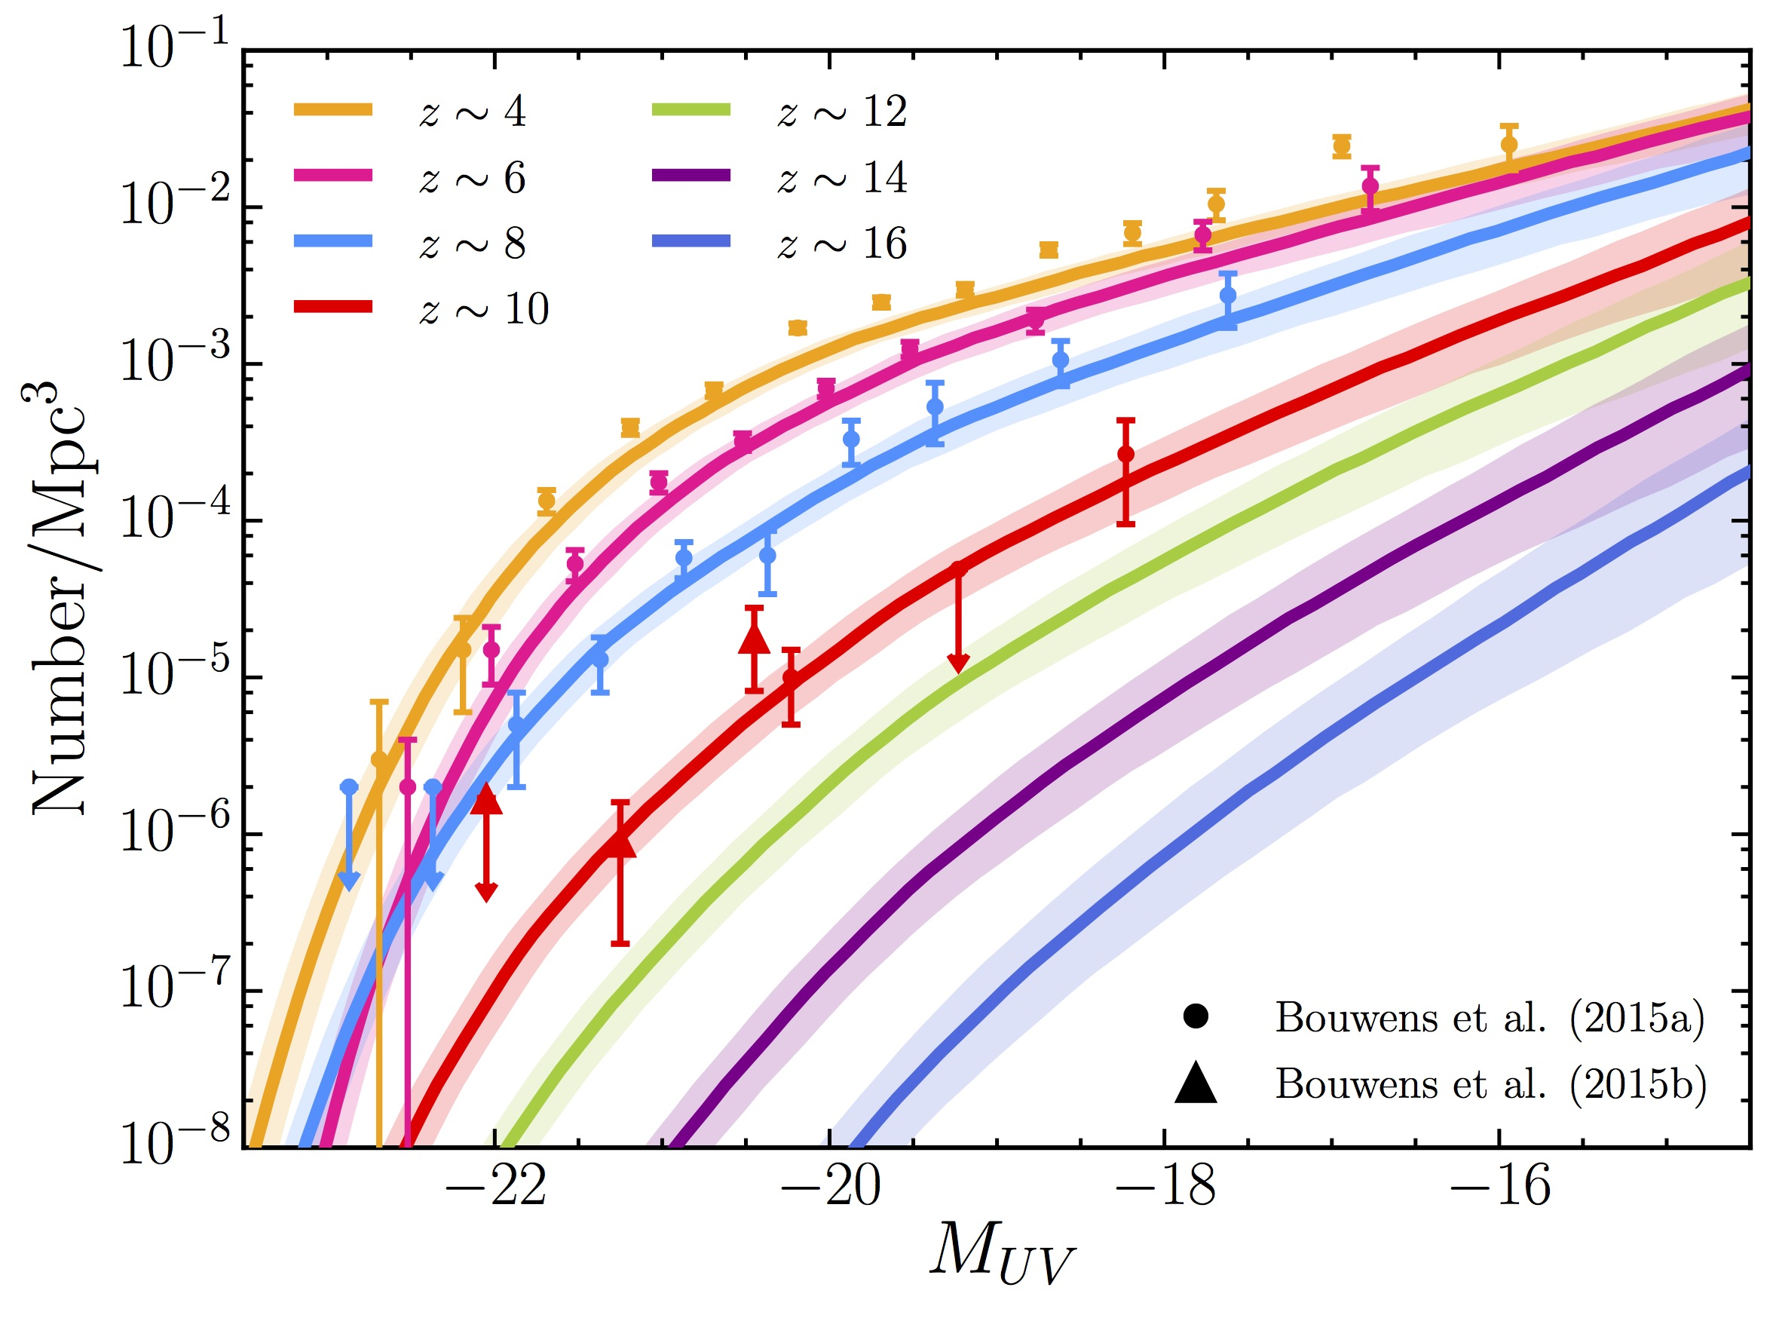
Detecting and studying primordial invisible galaxies
The proportion of GRB hosts below a given detection limit provides an estimate of the fraction of star formation “hidden” in such faint galaxies
m_{UV} ≈ 30
?
Bright
Faint
THESEUS Consortium 2021
Notes:
Presenter’s note:

Slide 39
Shedding light on cosmic reionization
Combination of massive star formation rate and ionizing escape fraction will establish whether stellar radiation was sufficient to reionize the universe, and indicate the galaxy populations responsible
THESEUS Consortium 2021
Notes:
Presenter’s note:

Slide 40
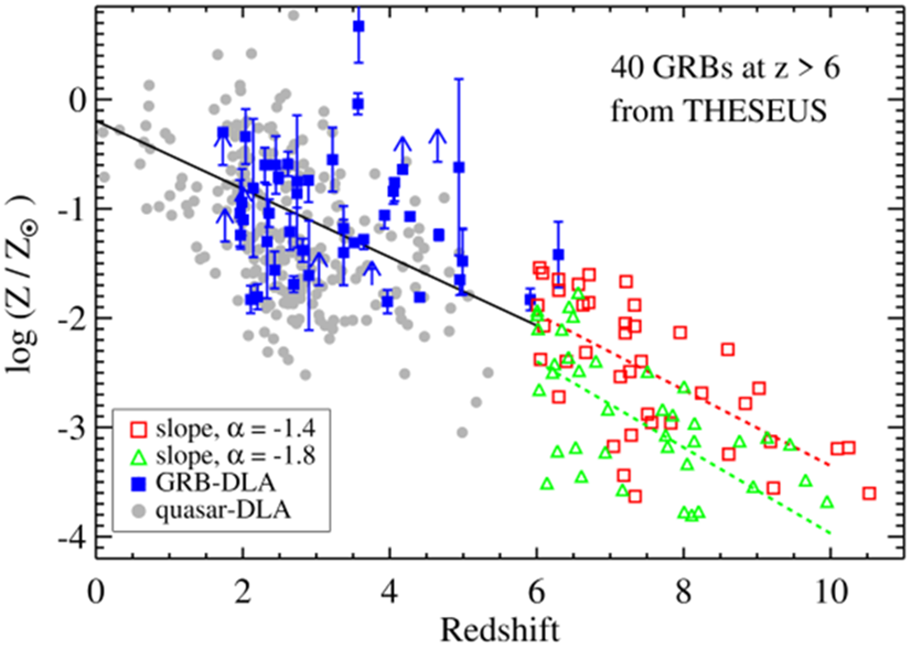
Cosmic chemical evolution at high-z
THESEUS Consortium 2021
Notes:
Presenter’s note:

Slide 41
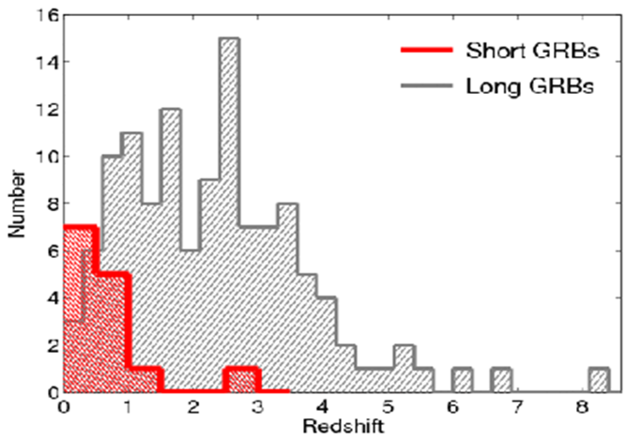
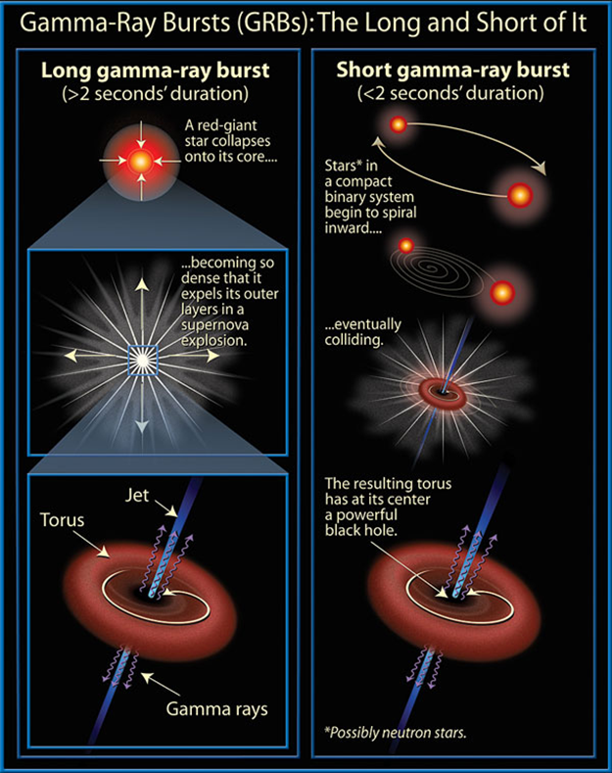
Gamma-Ray Bursts: the most extreme phenomena in the Universe
Long GRBs: core collapse of pecular massive stars, association with SN
Short GRBs: NS-NS or NS-BH mergers, association with GW sources

Slide 42
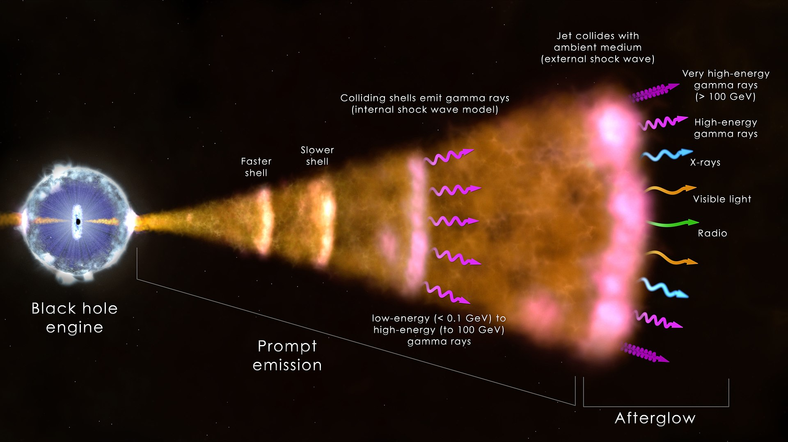
Gamma-Ray Bursts: the most extreme phenomena in the Universe
Long GRBs: core collapse of pecular massive stars, association with SN
Short GRBs: NS-NS or NS-BH mergers, association with GW sources

Slide 43
THESEUS will have a combination of instrumentation and mission profile allowing the detection of all types of GRBs (long, short/hard, weak/soft, high-redshift) and provide accurate location and redshift measurement for a large fraction of them
Fermi/GBM
GRB170817A/GW170817
High-redshift

Slide 44
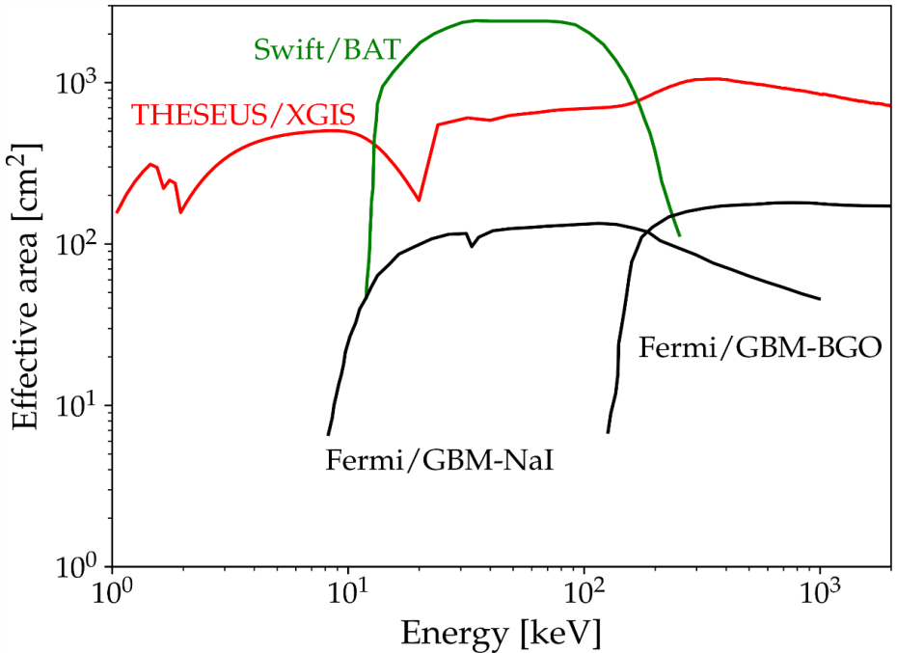
GRBs extreme and fundamental physics
THESEUS will measure the prompt and early afterglow emission of thousand GRBs over an unprecedented huge energy band (0.3 keV – 10 MeV) with great sensitivity, timing and spectroscopic capabilities, plus NR afterglow and redshift measurement

Slide 45
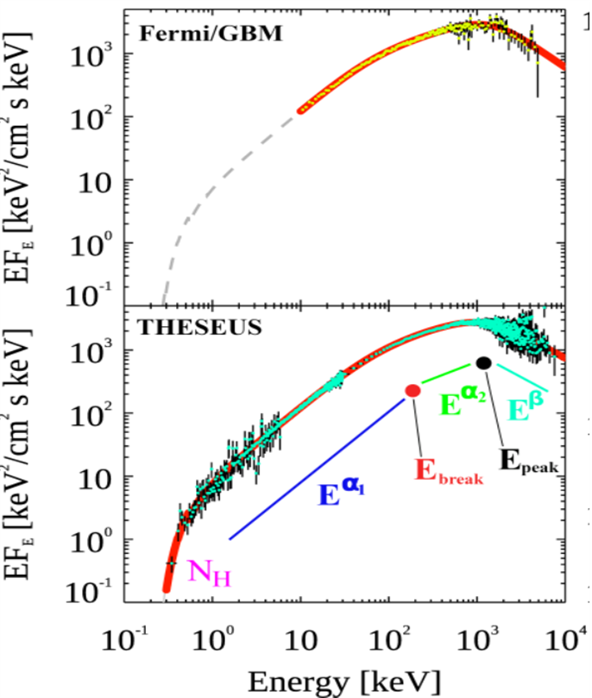
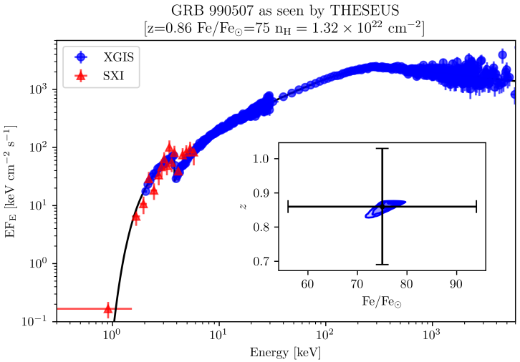
GRBs extreme and fundamental physics
Extreme prompt emission physics & jet structure
Central engine, sub-classes & progenitors,
Cosmological parameters & fundamental physics

Slide 46
Expected progress in the near future (’20s)
Continuing operations of current main GRB / related missions (Swift, Fermi, Konus-WIND, GECAM, HXMT, MAXI, GRBalpha, …)
New / near future GRB / related missions (EP, SVOM, POLAR-2, COSI, …) and cubesats networks (e.g., HERMES)
Synergies with new / growing on-ground very large facilities (late ’20s): JWST, ELT, LSST, CTA, SKA, upgraded 2nd generation GW and neutrino detectors
Main improvements on GRB physics, incremental progress in GRB cosmology, likely little progress in multi-messenger astrophysics (mostly limited by capabilities of 2G detectors)

Slide 47
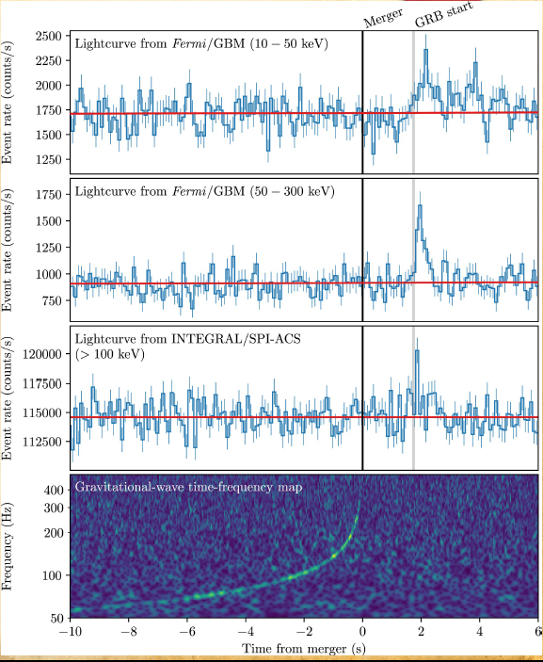
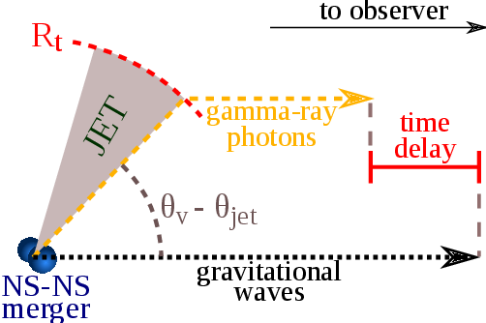


Fundamental physics: GW vs. light speed
GW170817/GRB170817A, D ~ 40 Mpc
|V_{gw}-C| / C <10⁻¹⁶

Slide 48
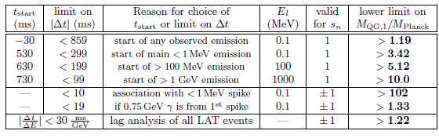
Fundamental physics: testing LI / QG
Using time delay between low and high energy photons to put Limits on Lorentz Invariance Violation (allowed by unprecedent Fermi GBM + LAT broad energy band)
GRB 990510

Slide 49

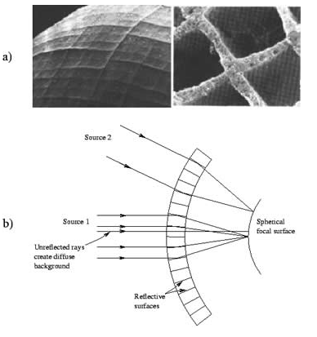



The Soft X-Ray Imager (SXI)
Two sensitive “lobster-eye” X-ray telescopes (0.3 - 5 keV); total FOV of 0.5sr (>1000 $×$ conventional X-ray telescopes); 100ms photon timing; source location accuracy <2’
Mimic a lobster-eye using curved, square-pore MPOs
No single optical axis: get a wide field of view plus focusing with constant effective area
Spot (double reflection) Lines (single reflections)
Notes:
Presenter’s note:
LOFT is being designed to address one of the key science themes of Cosmic Vision: matter under extreme conditions.
Two are the objectives at the core of the LOFT mission:
- First, to probe the state of matter at supra nuclear densities, the ones only reached in the interiors of Neutron Stars.
- Second, to probe the theory of gravity, general relativity, in the very strong environment of Black holes.
LOFT is therefore an observatory designed to probe two key questions of nature, through astrophysics.
But of course LOFT is an observatory and will explore, in addition to its core science, the physics of hundred of
galactic and extragalactic sources.

Slide 50
The Soft X-Ray Imager (SXI)
2 identical SXI modules:
Focal length: 300mm
Optic: 8x8 array of plates
Focal plane: 8 CMOS detectors
0.5sr total field of view
SXI will show a unique combination of FOV and effective area (GRASP), enabling simulatneous detection and localization of many transients in parallel.
Notes:
Presenter’s note:
LOFT is being designed to address one of the key science themes of Cosmic Vision: matter under extreme conditions.
Two are the objectives at the core of the LOFT mission:
- First, to probe the state of matter at supra nuclear densities, the ones only reached in the interiors of Neutron Stars.
- Second, to probe the theory of gravity, general relativity, in the very strong environment of Black holes.
LOFT is therefore an observatory designed to probe two key questions of nature, through astrophysics.
But of course LOFT is an observatory and will explore, in addition to its core science, the physics of hundred of
galactic and extragalactic sources.

Slide 51

The X-Gamma Ray Imaging Spectrometer (XGIS)
Two coded-mask X-gamma ray cameras using innovative coupling between Silicon drift detectors (2-30 keV) and CsI crystal scintillator bars (20 keV–10 MeV)
Notes:
Presenter’s note:
LOFT is being designed to address one of the key science themes of Cosmic Vision: matter under extreme conditions.
Two are the objectives at the core of the LOFT mission:
- First, to probe the state of matter at supra nuclear densities, the ones only reached in the interiors of Neutron Stars.
- Second, to probe the theory of gravity, general relativity, in the very strong environment of Black holes.
LOFT is therefore an observatory designed to probe two key questions of nature, through astrophysics.
But of course LOFT is an observatory and will explore, in addition to its core science, the physics of hundred of
galactic and extragalactic sources.

Slide 52

The X-Gamma Ray Imaging Spectrometer (XGIS)
Unprecedented energy band (2 keV – 10 MeV)
Large effective area down to 2 keV
FOV >2 sr overlapping the SXI one
GRB location accuracy <15’ in 2-150 keV
Excellent timing (< a few μs)
Notes:
Presenter’s note:
LOFT is being designed to address one of the key science themes of Cosmic Vision: matter under extreme conditions.
Two are the objectives at the core of the LOFT mission:
- First, to probe the state of matter at supra nuclear densities, the ones only reached in the interiors of Neutron Stars.
- Second, to probe the theory of gravity, general relativity, in the very strong environment of Black holes.
LOFT is therefore an observatory designed to probe two key questions of nature, through astrophysics.
But of course LOFT is an observatory and will explore, in addition to its core science, the physics of hundred of
galactic and extragalactic sources.

Slide 53
The Infra-Red Telescope (IRT)
A 0.7 m class telescope with an off-axis Korsch optical design allowing for a large field of view (15’x15’) with imaging and moderate (R~400) spectroscopic capabilities
Mimic a lobster-eye using curved, square-pore MPOs
Teledyne H2RG sensitive in 0.7-1.8 microns
Expected sensitivity per filter (over 150 s): 20.9 (I), 20.7 (Z), 20.4 (Y), 21.1 (J), 21.1(H). Spectral sensitivity limit (over 1800 s), about 17.5 (H) over the 0.8-1.6 microns
Y_{IRTOR}
Z_{IRTOR}
Notes:
Presenter’s note:
LOFT is being designed to address one of the key science themes of Cosmic Vision: matter under extreme conditions.
Two are the objectives at the core of the LOFT mission:
- First, to probe the state of matter at supra nuclear densities, the ones only reached in the interiors of Neutron Stars.
- Second, to probe the theory of gravity, general relativity, in the very strong environment of Black holes.
LOFT is therefore an observatory designed to probe two key questions of nature, through astrophysics.
But of course LOFT is an observatory and will explore, in addition to its core science, the physics of hundred of
galactic and extragalactic sources.

Slide 54


The Infra-Red Telescope (IRT)
On-board photometric redshift for >90% detected GRB afterglows
On-board sensitive absorption spectrosocpy for medium-bright events
Notes:
Presenter’s note:
LOFT is being designed to address one of the key science themes of Cosmic Vision: matter under extreme conditions.
Two are the objectives at the core of the LOFT mission:
- First, to probe the state of matter at supra nuclear densities, the ones only reached in the interiors of Neutron Stars.
- Second, to probe the theory of gravity, general relativity, in the very strong environment of Black holes.
LOFT is therefore an observatory designed to probe two key questions of nature, through astrophysics.
But of course LOFT is an observatory and will explore, in addition to its core science, the physics of hundred of
galactic and extragalactic sources.

Slide 55


THESEUS consortium science: 6 WGs, > 200 contributing scientists
http://www.isdc.unige.ch/theseus/

