Slide 1

Small but Mighty:
Unveiling low-power radio AGN with SKA
Ranieri D. Baldi (INAF-IRA)
in collaboration with A. Capetti, G. Giovannini, F. Gandossi, L. Penna, M. Brienza & many others

Slide 2
Classical Extended Radio Galaxies
Radio galaxies are RL AGN with extended jets from pc to Mpc
connecting the optical galaxy and the extended lobes
Associated with elliptical galaxies and M_{BH} > 10⁸ M⊙
FRII
FRI
Fanaroff & Riley (1974)
0.1 -1 Mpc
Third Cambridge (3C) SAMPLE: classical RG sample ( Flux@178 MHz > 9 Jy) :
FRI and FRIs, L >10²⁴ W Hz⁻¹
Red massive early-type galaxies

Slide 3

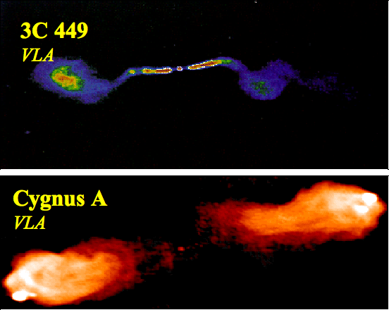
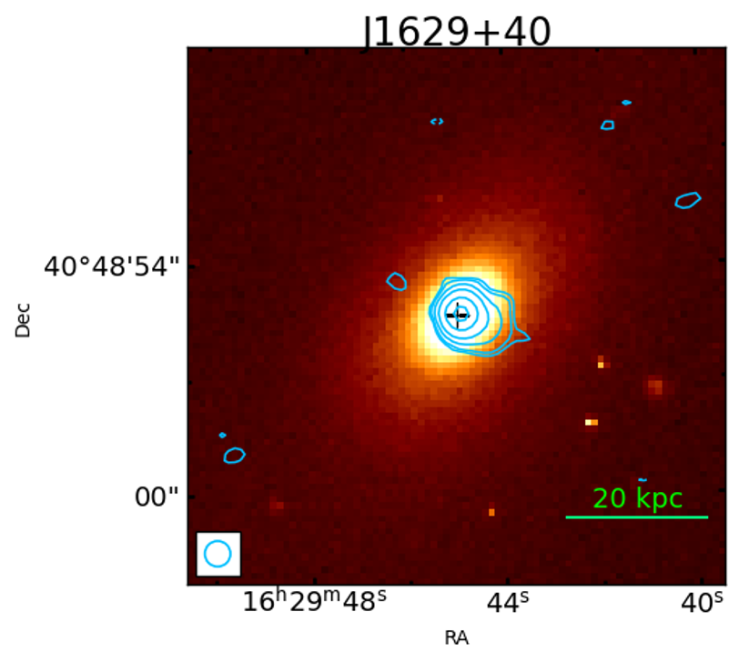
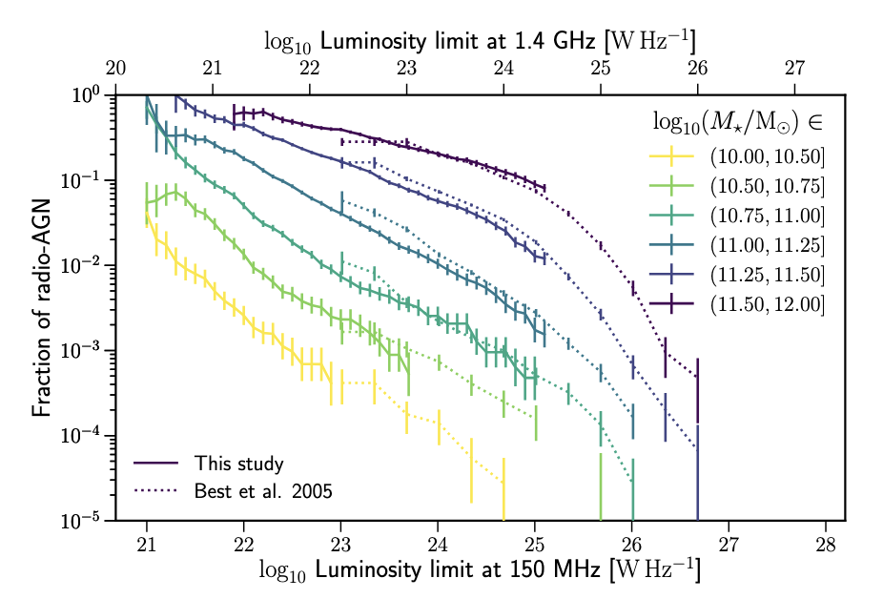
RADIO LUMINOSITY FUNCTION
z < 0.3
Baldi et al (2015)
LINER
FRI
FR0
Seyfert
FRII
Compact on arcsec/galaxy scale
Extended over kpc scales
Heckman & Best (2014)
The bulk of local the radio-loud AGN population consists of low-power AGN
(< 10²⁴ W Hz⁻¹) with compact radio morphology in the most massive galaxies (> 10¹¹M⦿)
Sabater et al (2019)

Slide 4
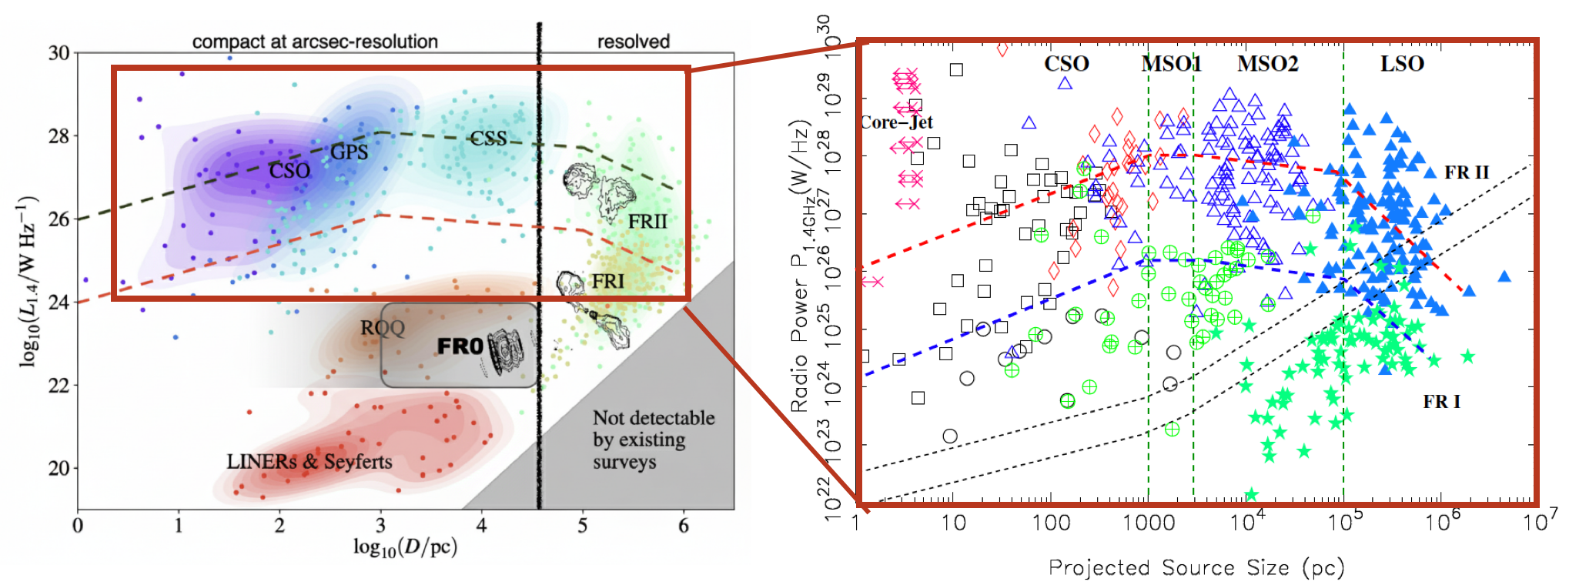
Luminosity-size diagram
Radio size and luminosity can be used as proxies of an evolving jetted structure
Baldi (2023)
An & Baan (2012)
The ‘high-luminosity’ young RGs can evolve into FRI or FRII
But low-power radio AGN (FR0)?

Slide 5

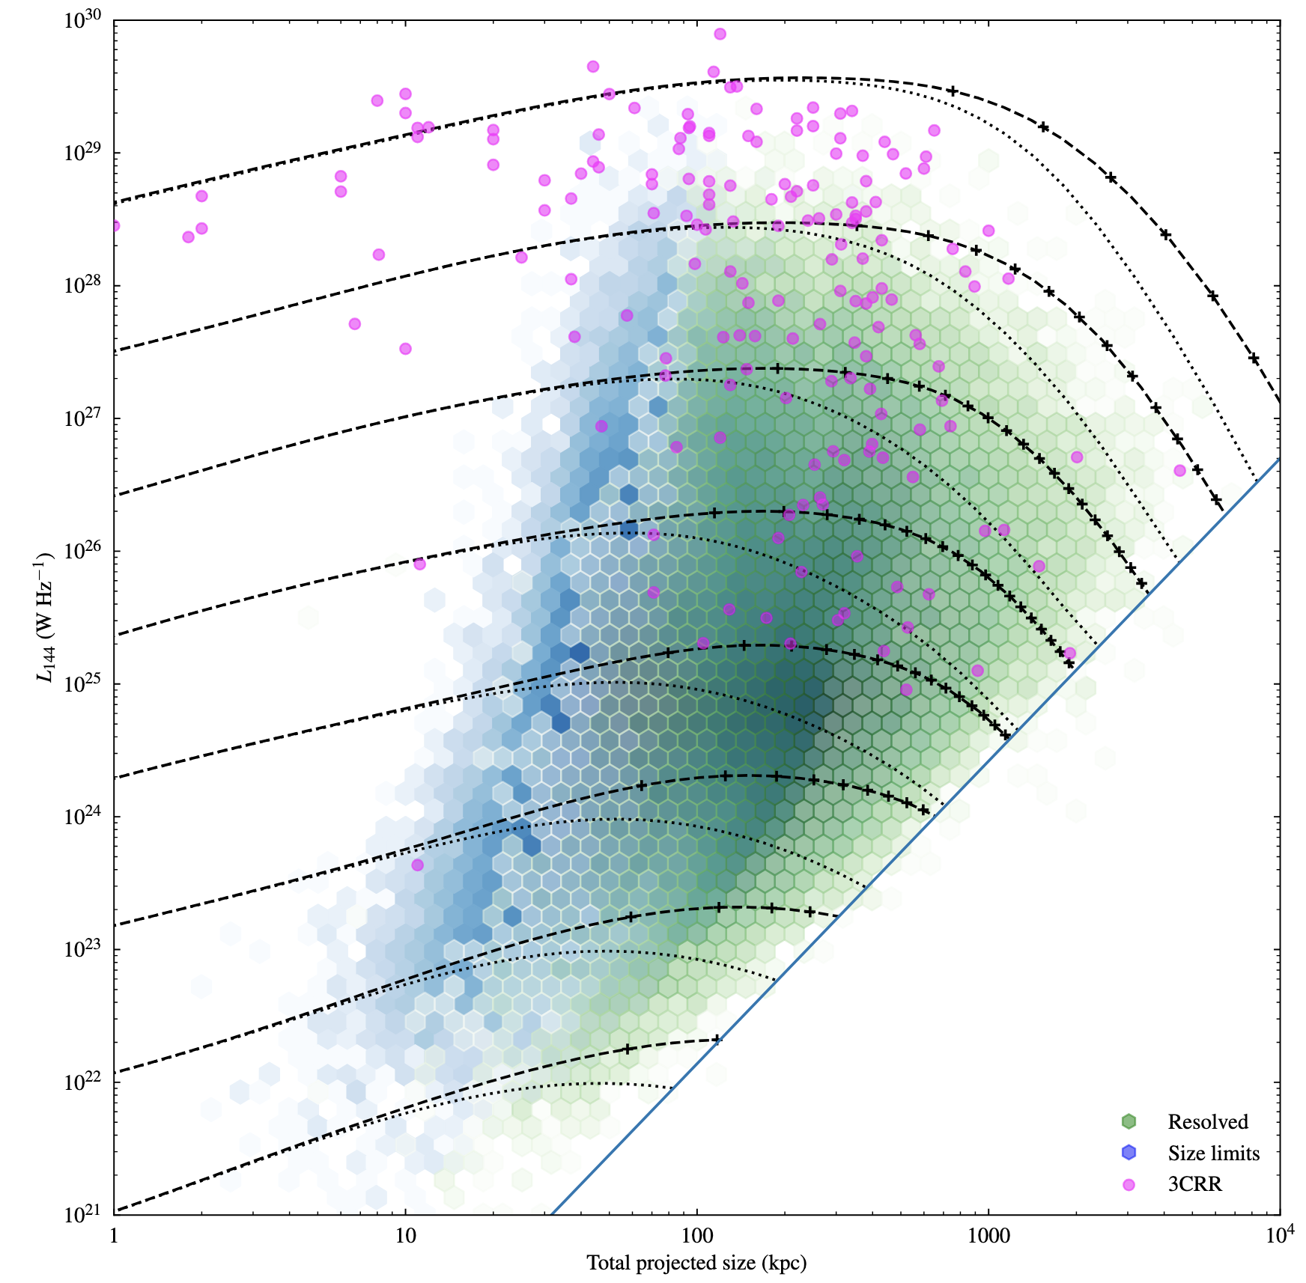
(Simplified) Family tree of radio AGN
Intrinsically low efficient
jet launcher
Intrinsically
high efficient
jet launcher
z < 0.1
~80%
~15%
~5%
Adult 10⁷⁻⁸ y
age, size, L
Young 10⁴⁻⁵ y
An & Baan 2012, O’Dea & Saikia (2021), Hardcastle & Croston (2020), Baldi (2023),
Progenitors

Slide 6
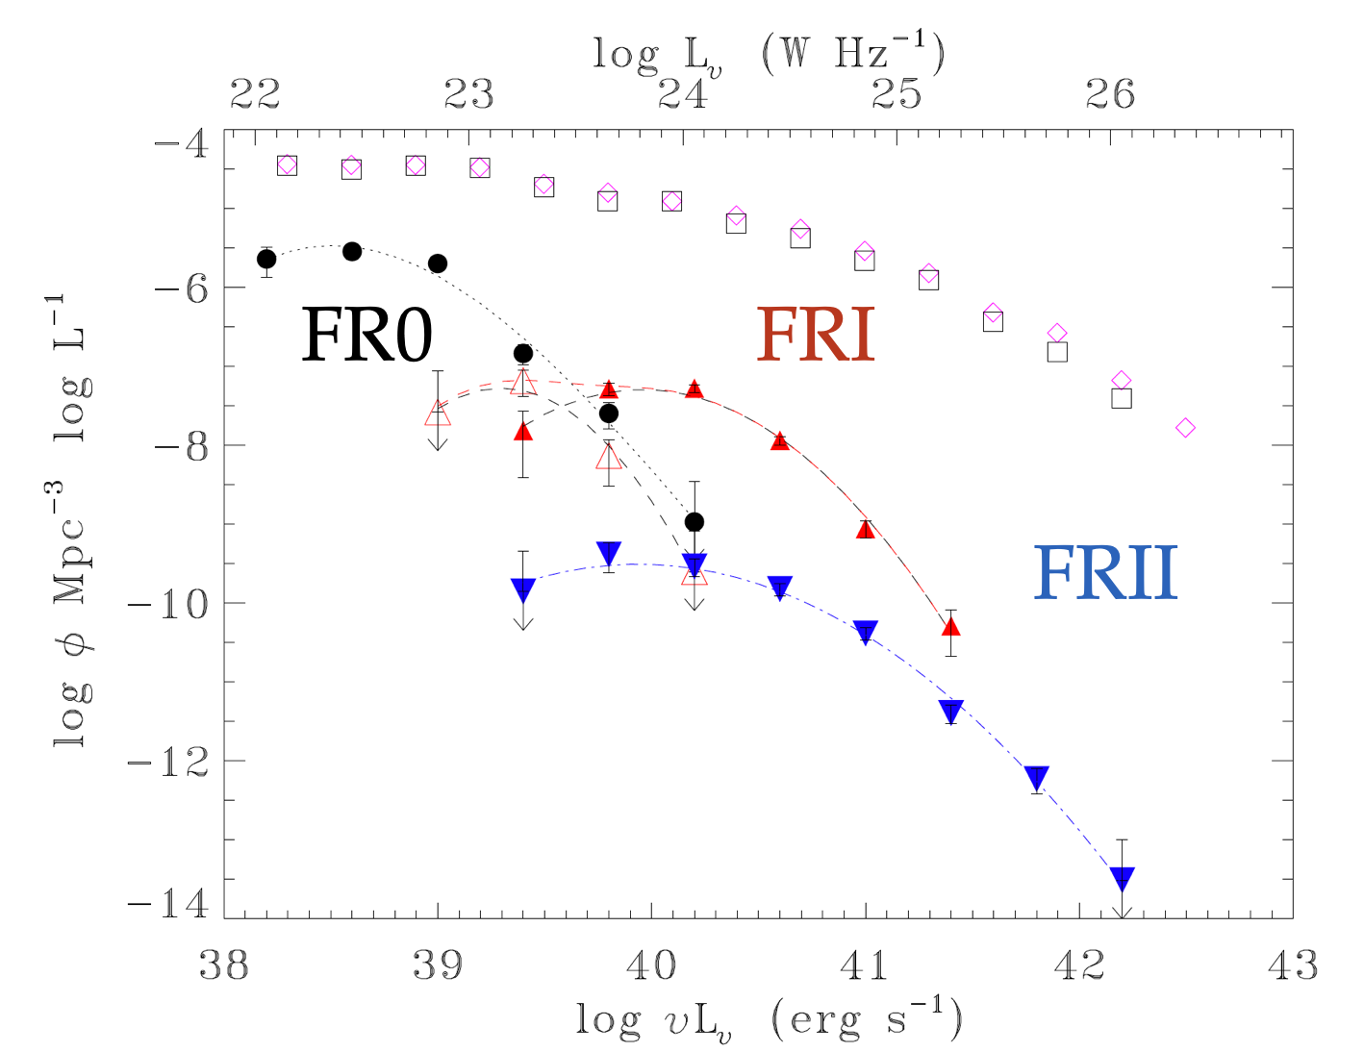

Census of BH activity at low power
High-resolution maps in the radio can provide direct views of BH accretion even in dusty environments, and can detect AGN at accretion rates below those detectable in other wave-bands.
Our view of the nuclear activity in the Universe is biased towards massive, bright and unobscured galaxies, which leads to a partial understanding of the BH accretion and ejection
FR-0/I/II radio galaxies in FIRST/SDSS catalogue
Necessity to go to
low luminosities..
To study the duty cycle of RGs from low to
high power
FR0s are 5 times more
abundant than FRIs
Baldi (2023)

Slide 7
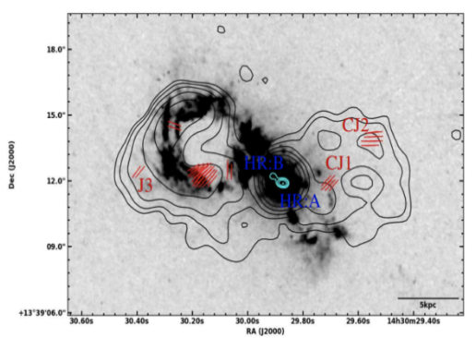
Why low-luminosity compact radio galaxies are important?
The bulk of RL AGN population
ordinary accretion-ejection mechanism
AGN feedback: low-power galactic-scale jets can have an important, but gentle, impact on their hosts by continuously injecting and depositing energy into the host as supported by the state-of-the-art jet simulations.
Wagner & Bicknell (2011), Massaglia et al (2016), Mukherjee et al (2018, 2020), Rossi et al (2020)
Morganti et al 2017,
Jarvis et 2019, 2021
Hardcastle et al 2020,
Smith et al 2020,
Venturi et al 2020,
Silpa et al 2022
1 kpc

Slide 8
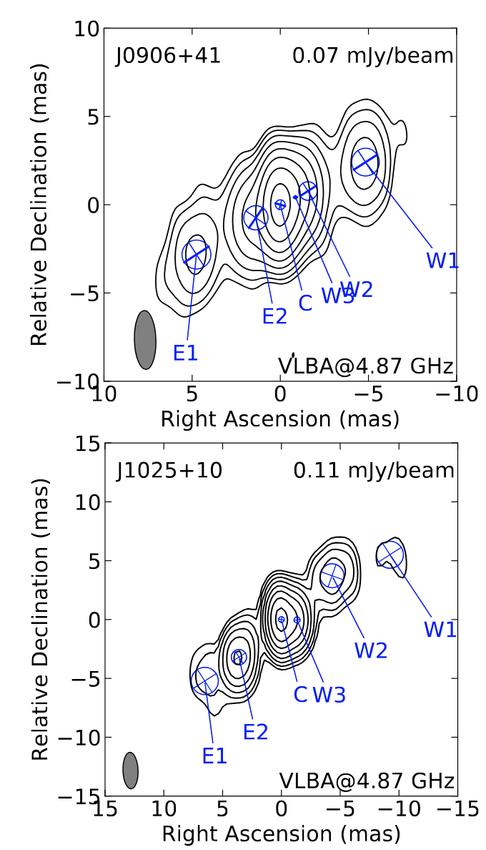
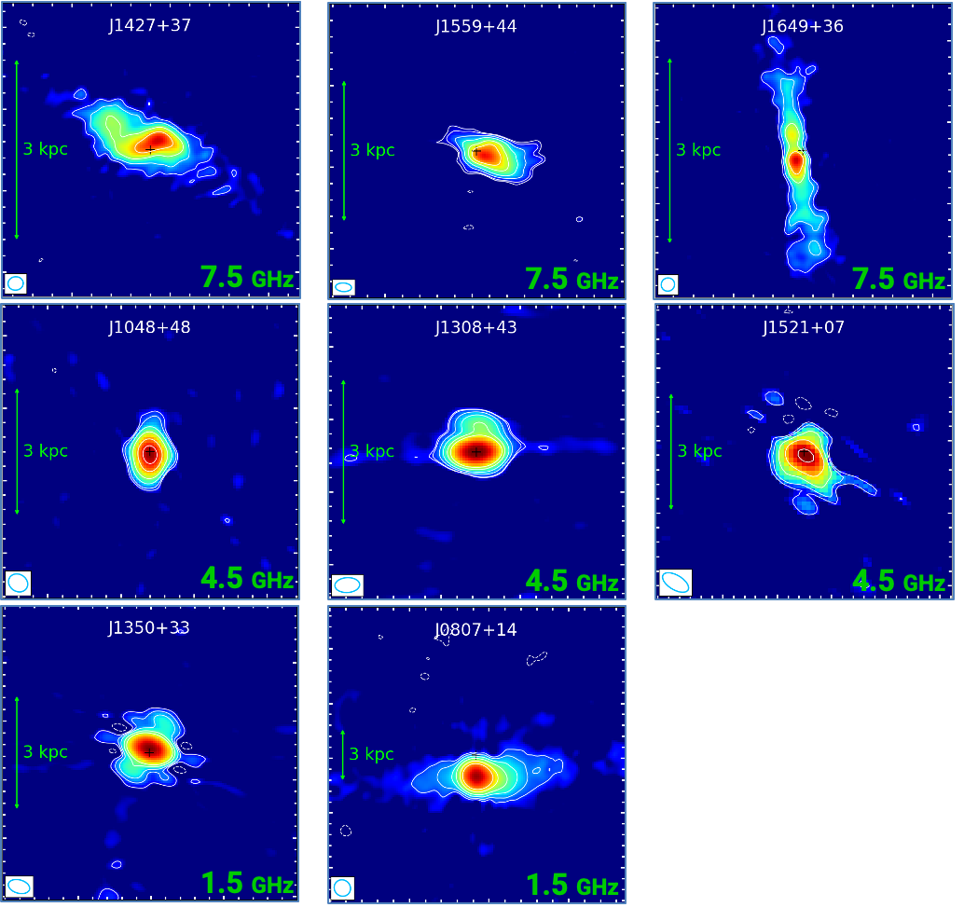
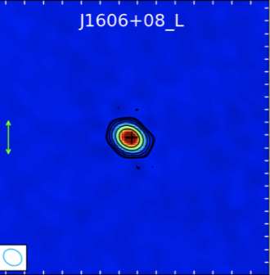

VLA/VLBI survey of FR0s
Accretion-ejection
Cheng et al (2019), Giovannini, et al (2023)
Baldi et al 2019; Penna, RB at al. in prep.
VLA observations for ~50 sources at 1.5, 4.5 and 7.5 GHz (1-0.3”; 40μJy beam⁻¹ sensitivity) with luminosity L > 10^{22 W} Hz⁻¹
70% Compact/unresolved
30% Symmetric structures of a few kpc when resolved
50 pc
VLA
VLBI
VLBA/EVN/eMERLIN can resolve the pc-scale jets for 80% of the sources
(0.1-0.2 mJy beam⁻¹)
Unresolved

Slide 9
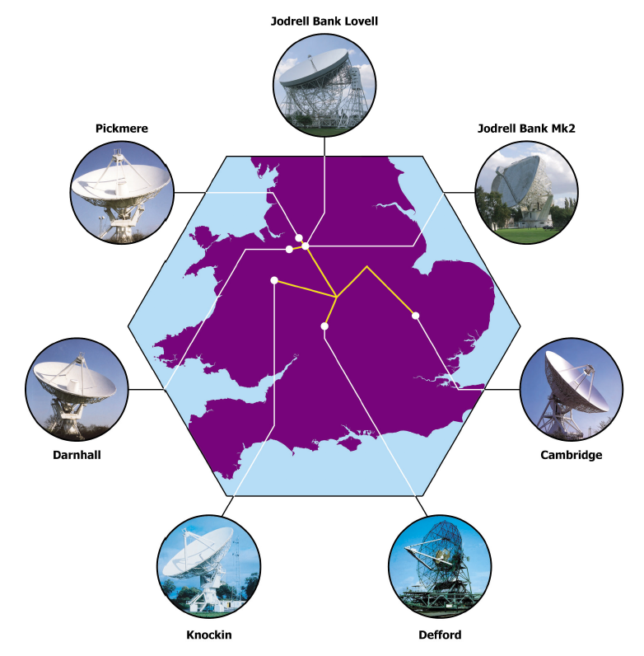
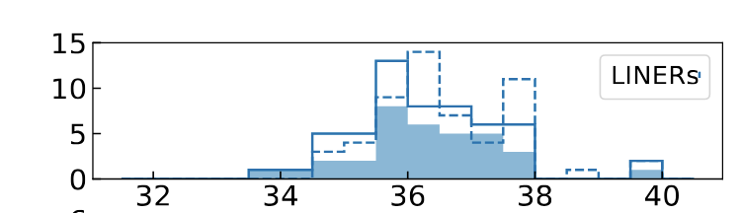
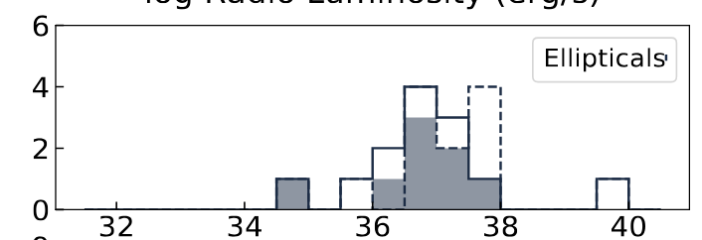
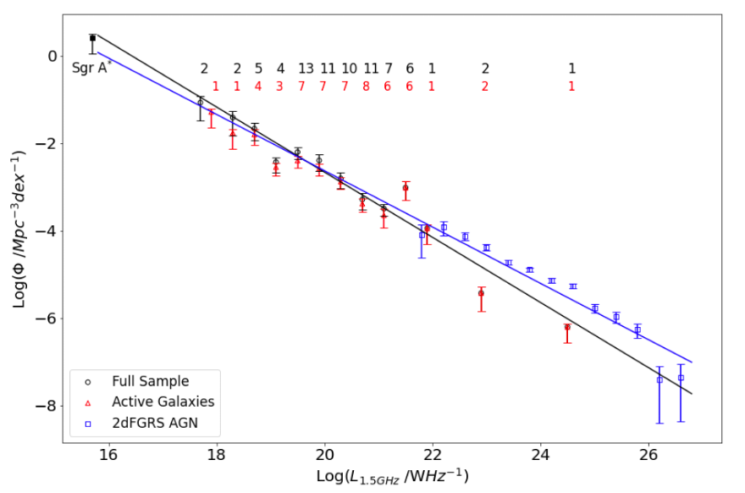
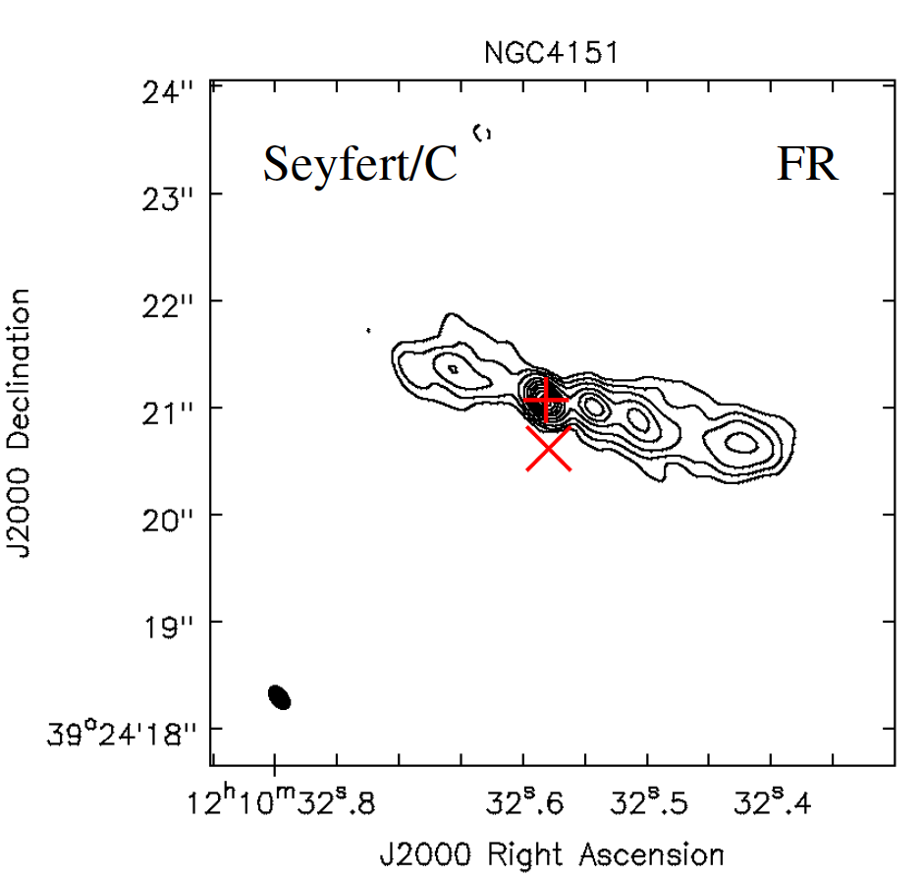
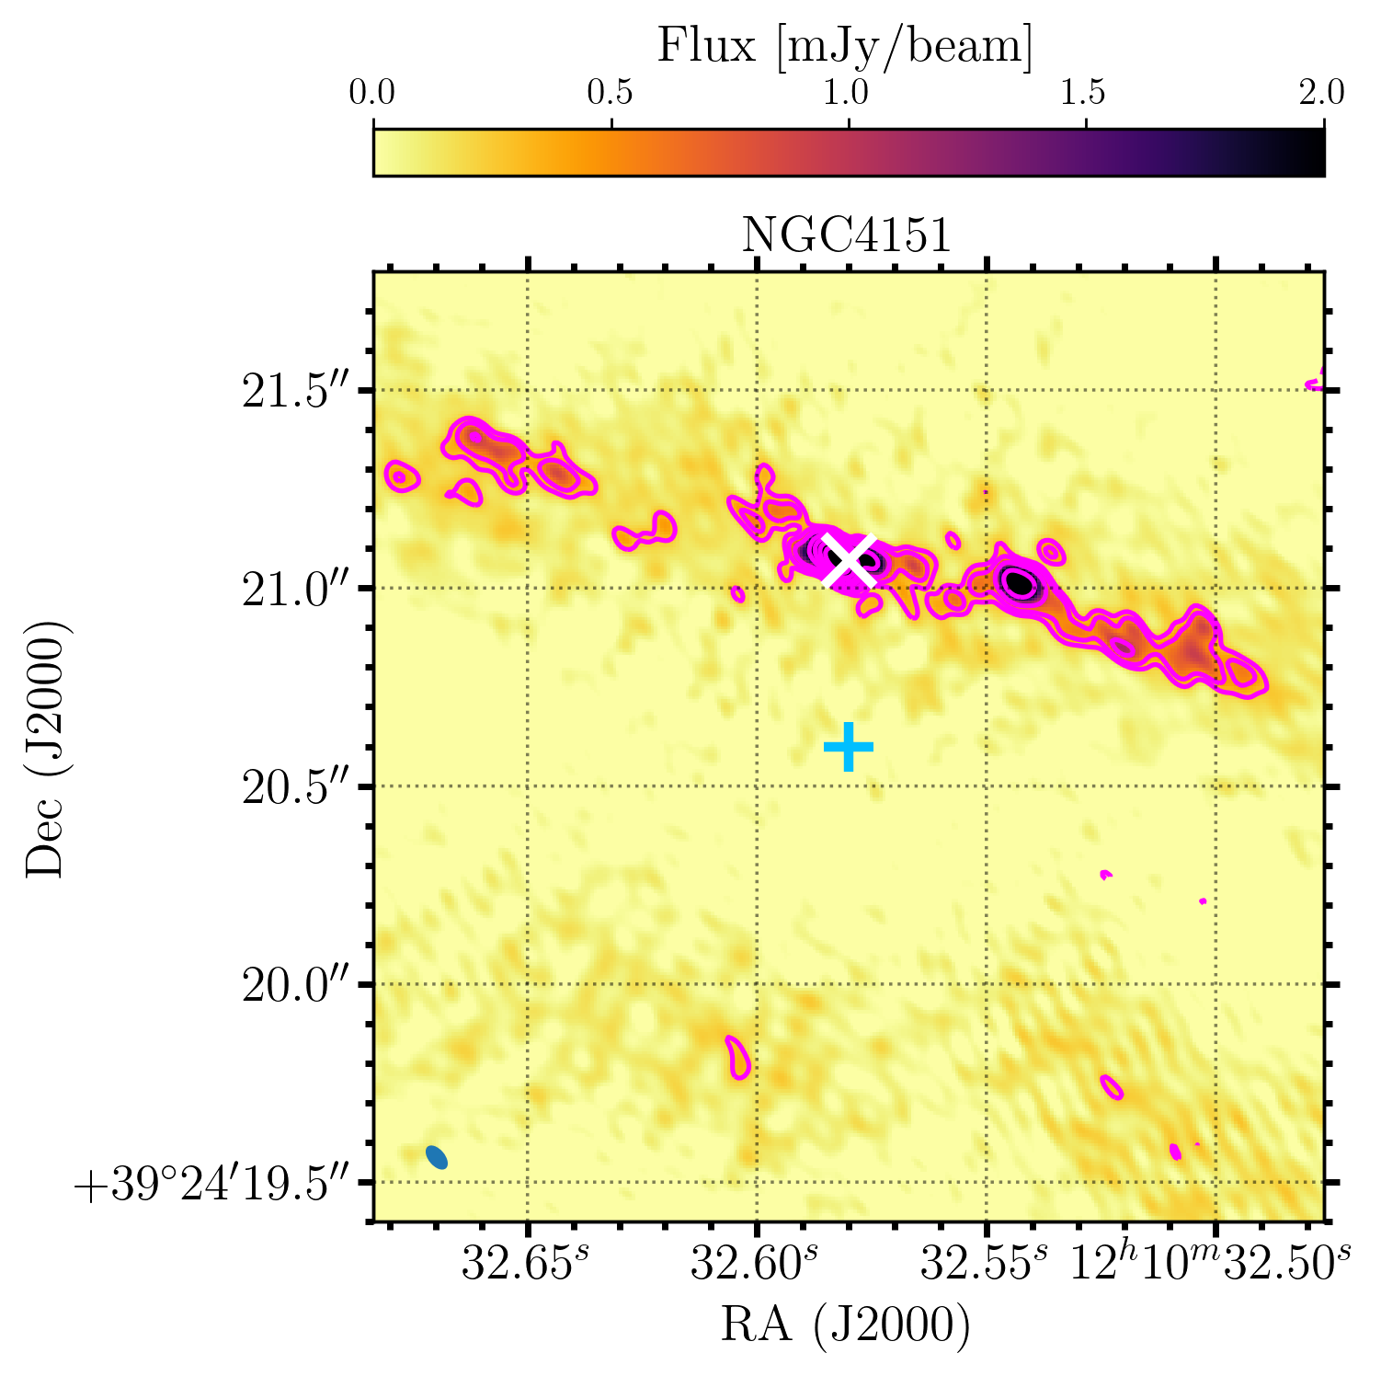
Accretion-ejection
The LeMMINGs survey:
Legacy e-MERLIN Multi-band Imaging of Nearby Galaxies
Deep survey of 280 nearby galaxies (<120 Mpc) with eMERLIN array at 1.4 and 5 GHz, with resolution of 150 and 50 mas and 80 and 60 μJy beam⁻¹
50% detected; 50% show sub-kpc jet
Baldi et al (2021), Williams, RB et al in prep
1 kpc
L_{1.4GHz} > 10^{17.7} W Hz⁻¹
L band
C band

Slide 10

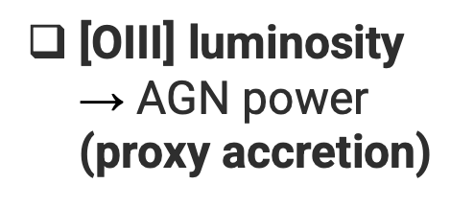

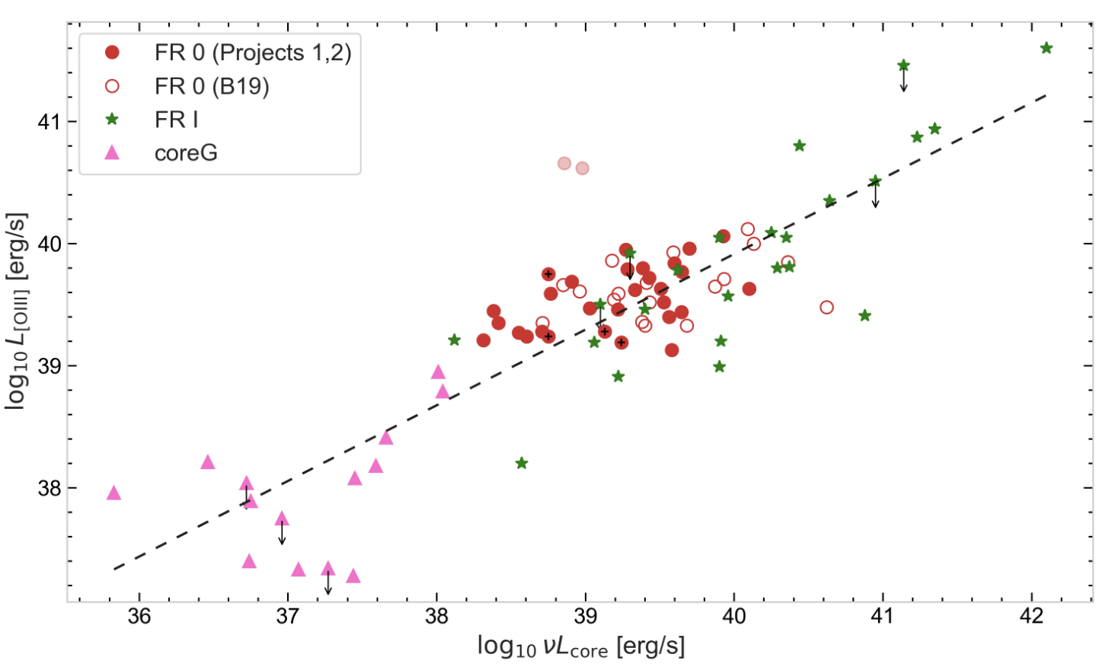

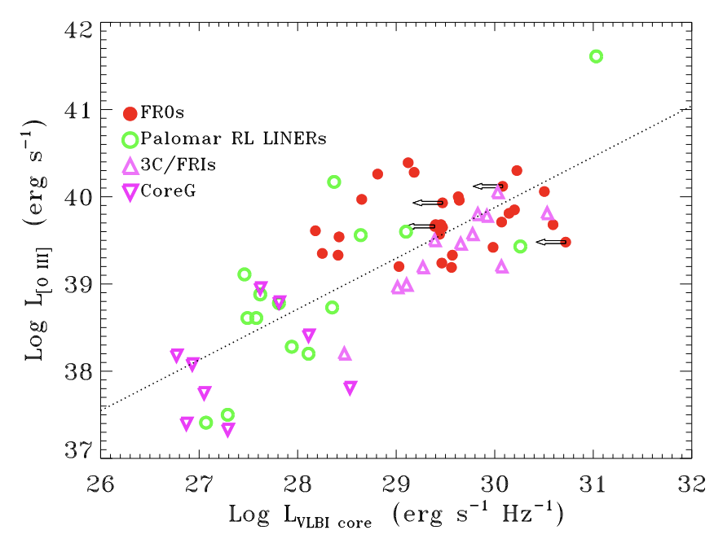
Accretion & Ejection Diagram
FR0-FRI sharing similar “central engine”
Scaled-down FRI
VLA
FRI
Why FR0 and low-power RL AGN do not produce extended kp-scale jets?
Falcke et al (2004), Wang et al (2024)
FR0
VLBI
FRI
RL LINERs
FR0
Penna, RB at al. in prep.
Baldi (2023)
RL LINERs
Low-power RL LINERs/FR0s are powered by radiatively inefficient discs (ADAF with low ṁ) launching (mildly) relativistic jets
37 38 39 40 `

Slide 11

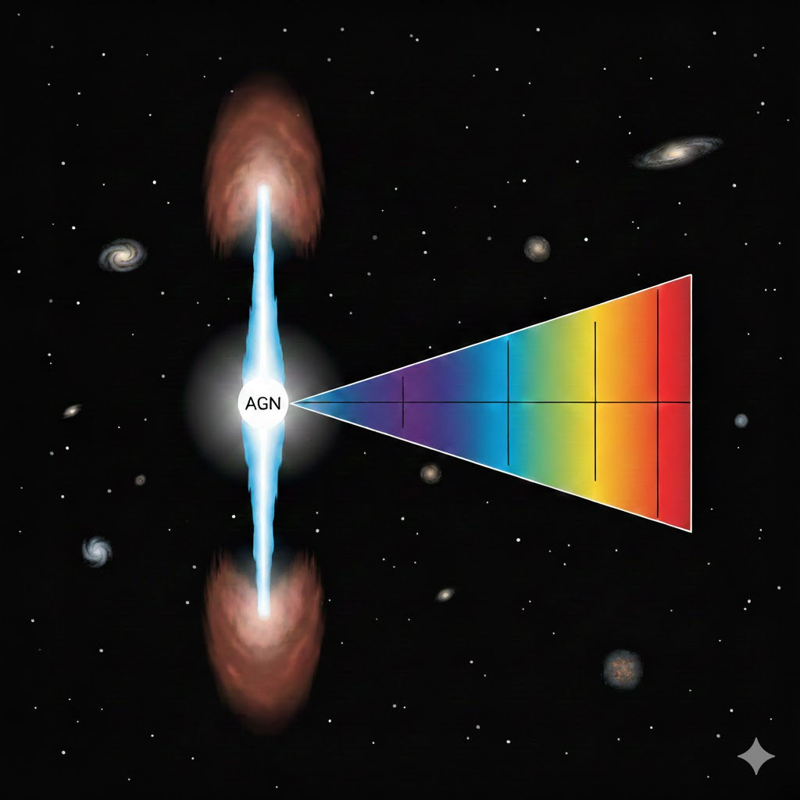
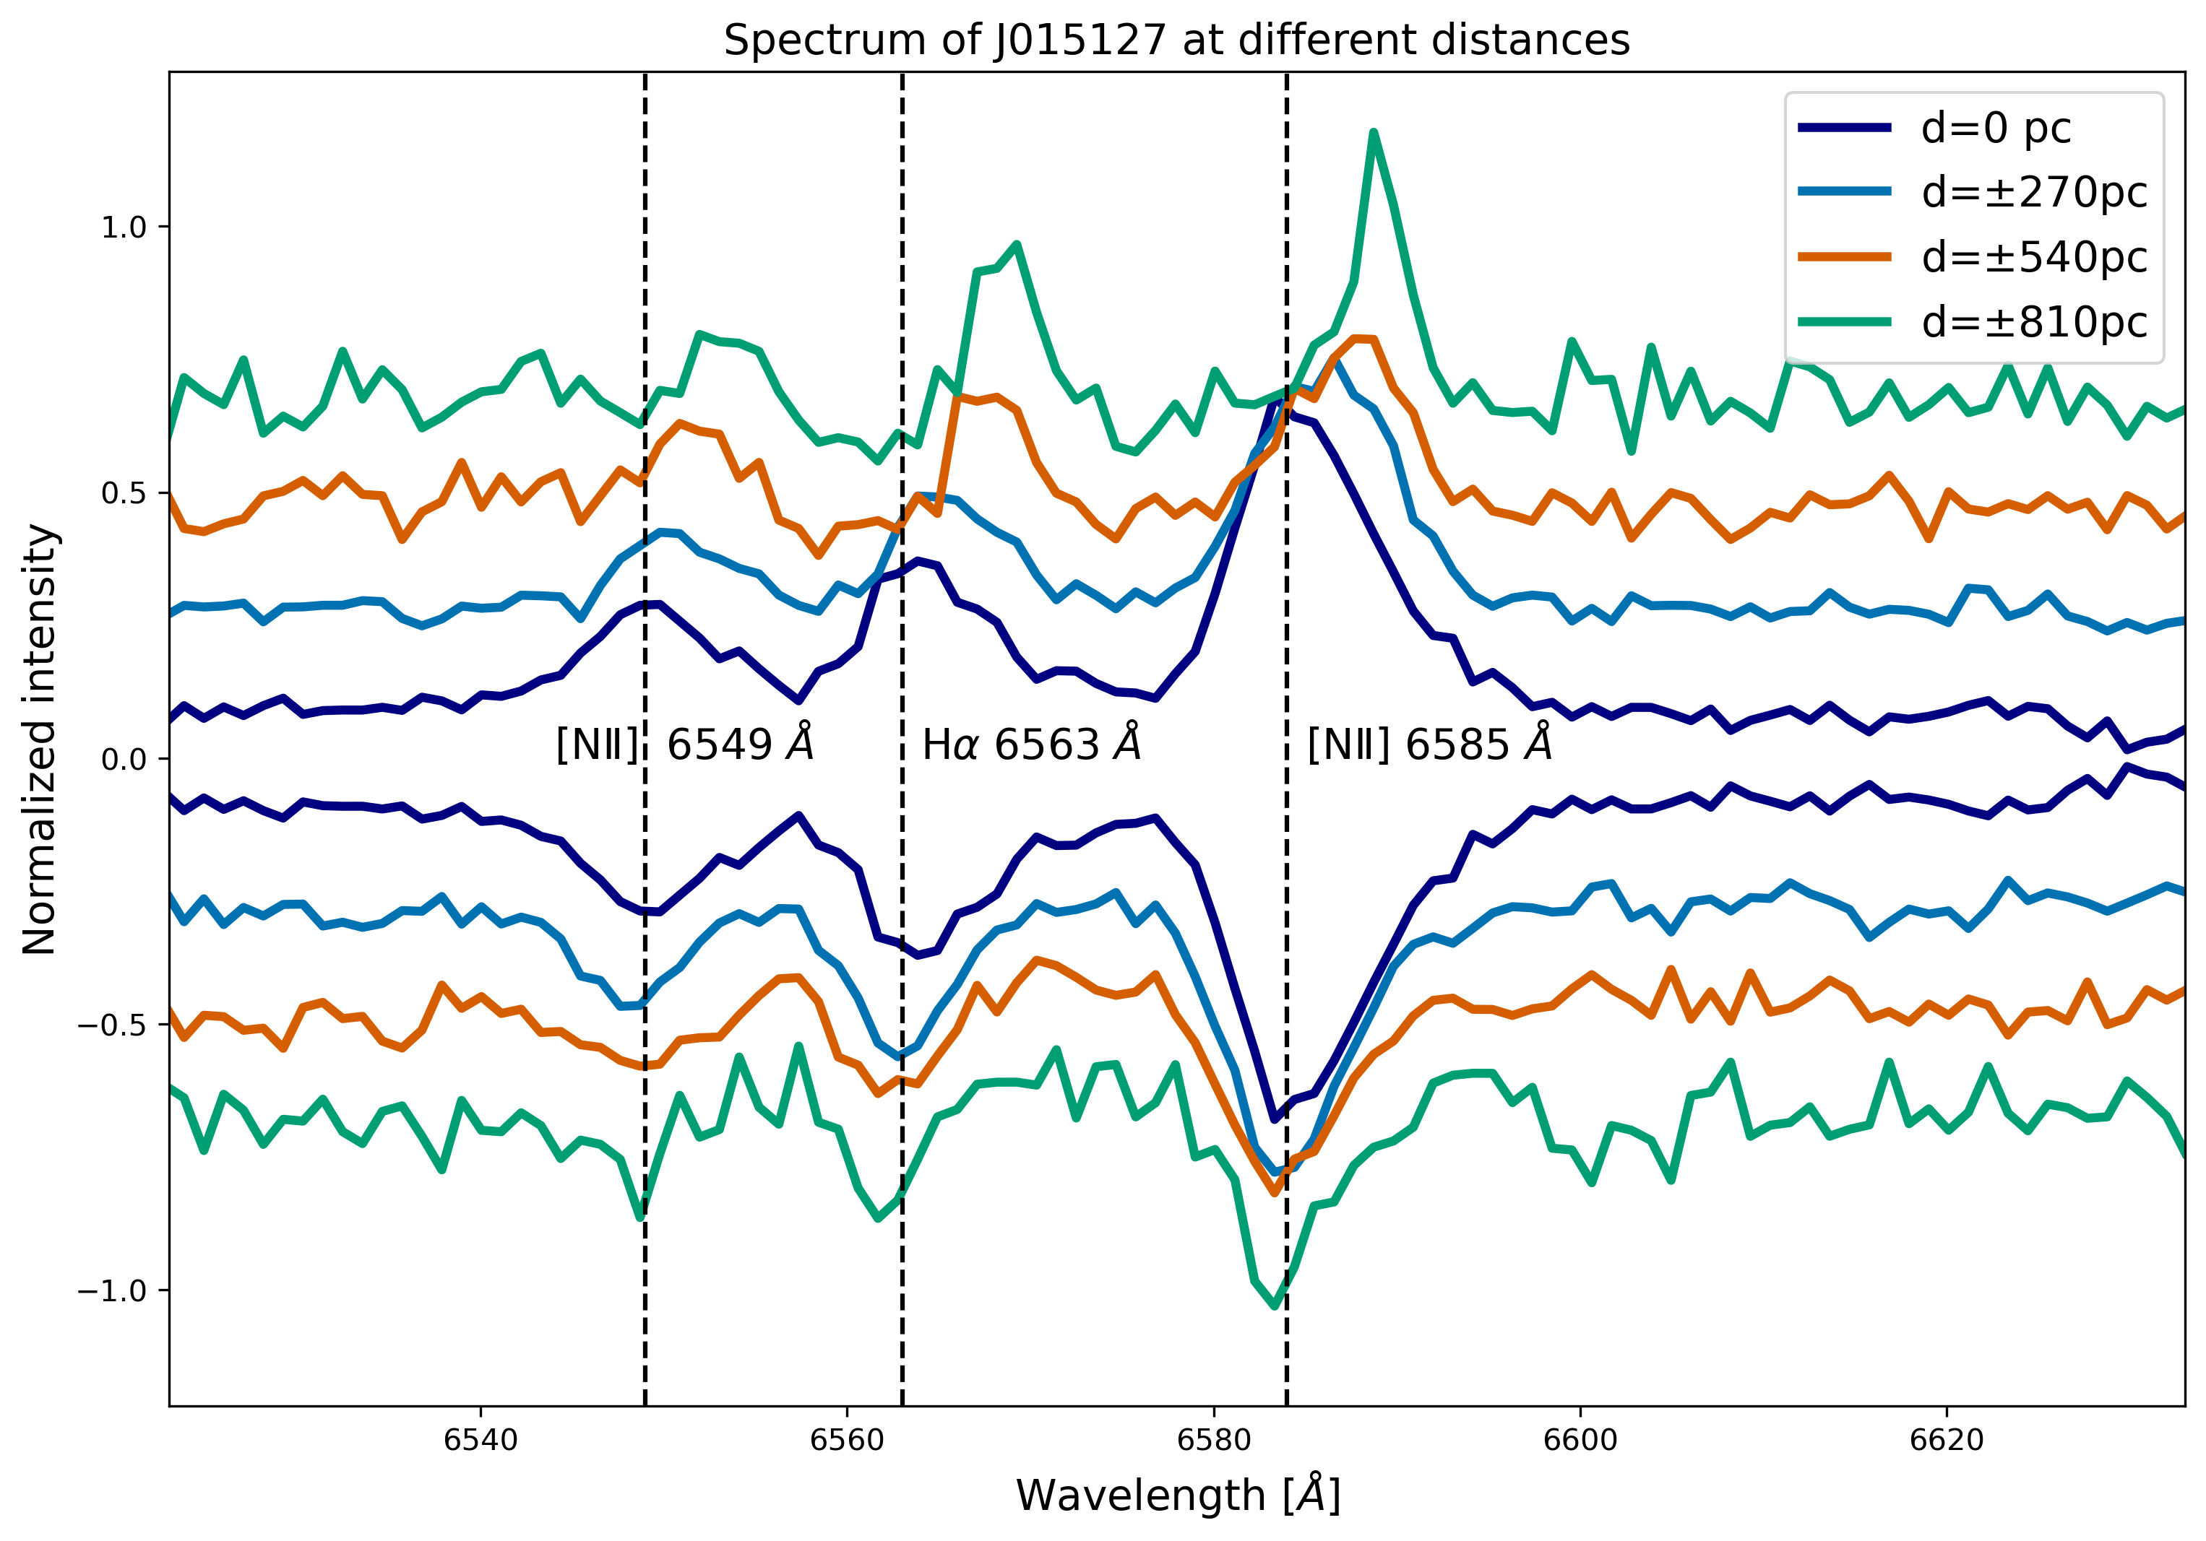
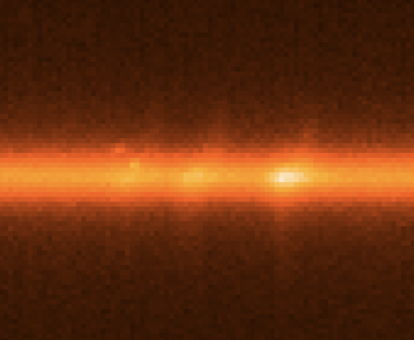
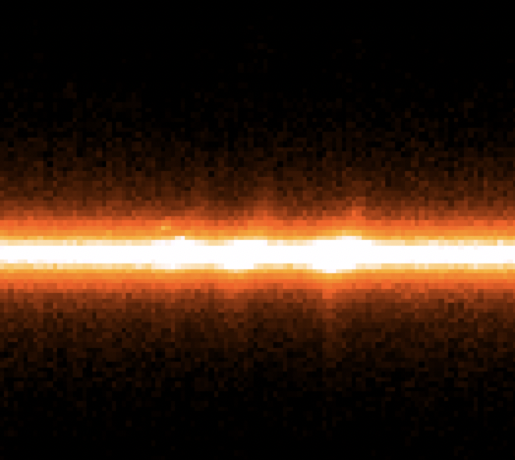
Radio-mode feedback
Gandossi, RB et al (in prep.)
Study of the radio-mode feedback with optical NTT spectra for a sample of 20 FR0s to catch evidence of spatial variation of the emission lines (<1 kpc) because of jet shocks and turbulence injected in the ISM.
North
red-shifted?
receding jet
H⍺
λ
[NII]
[NII]
6549 - 6563 – 6585 Å
approaching jet
South
blue-shifted?
First evidence of ongoing radio feedback in FR0s!

Slide 12
SKA: unique for survey and VLBI mode
z < 0.1
∼0.25 𝜇Jy beam⁻¹ @ 8 hr
<10¹⁹ W Hz⁻¹
0.14′′
∼12 𝜇Jy beam⁻¹ @ 1 hr
<10²⁰ W Hz⁻¹
10′′
SKA-Mid
0.35-15 GHz
SKA-Low
50-350 MHz
Low-power
Radio AGN
SKA-Mid/Low survey over 30 deg² will detect ∼3 ×10⁵ low-power radio AGN at arcsec/sub-arcsec resolution
with z <0.3
SKA-VLBI
L-C band
(with EVN)
SKA-VLBI follow-up studies of FR0 samples (down to sub-mas scale at some GHz)
a few 𝜇Jy beam⁻¹ @ few hr
<10¹⁹ W Hz⁻¹
~1 mas

Slide 13



Conclusions & next steps
FR0 population and low-power radio-loud LINERs in general are the dominant class of radio AGN in the local Universe
Compact on arcsec/sub-arc scale (~ galaxy scale)
Too many compact RGs challenge the standard RG evolution scheme
VLBI can resolve pc-scale jets with mildly-relativistic jets
Accretion-ejection similar to FRI: ADAF+jet, but why not extended jet emission?
Radio-mode feedback crucial for galaxy evolution: first evidence of ongoing feedback process in FR0s
what next? SKA and synergies with other (sub-)mm-optical-X-ray facilities for accretion-ejection and feedback studies!

Slide 14

For any question, please contact me: ranieri.baldi@inaf.it

