Slide 1
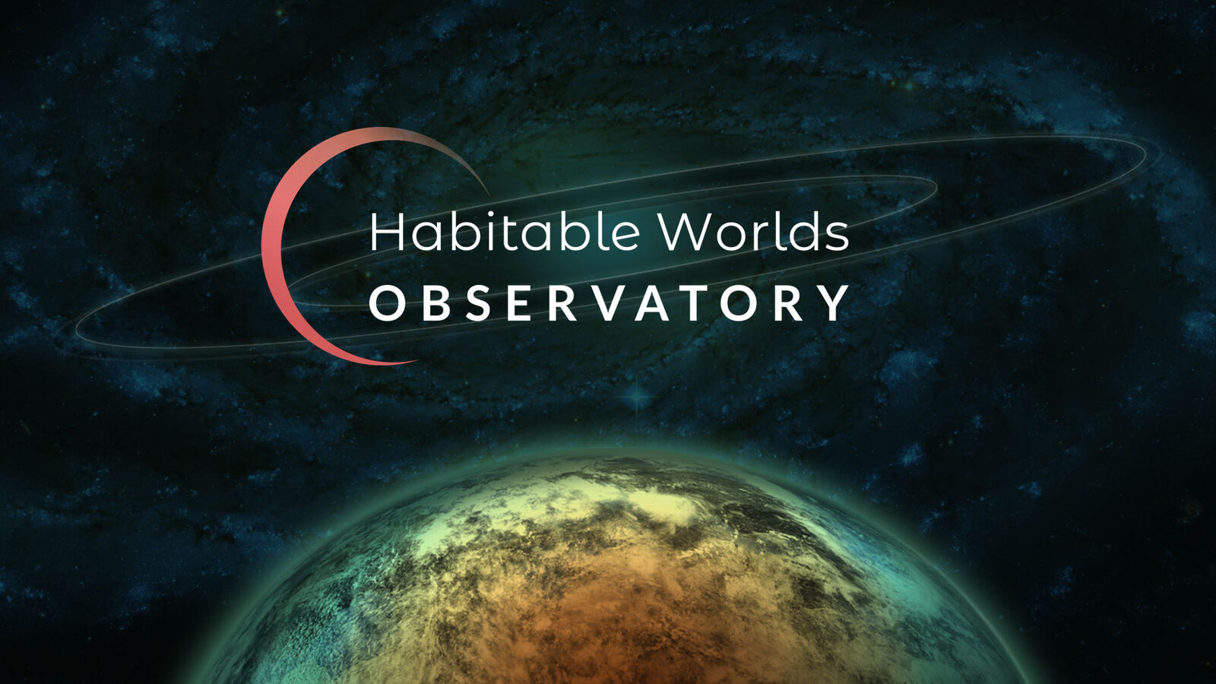
Astrometry of resolved stellar popultions with MAVIS and HWO
Davide Massari

Slide 3
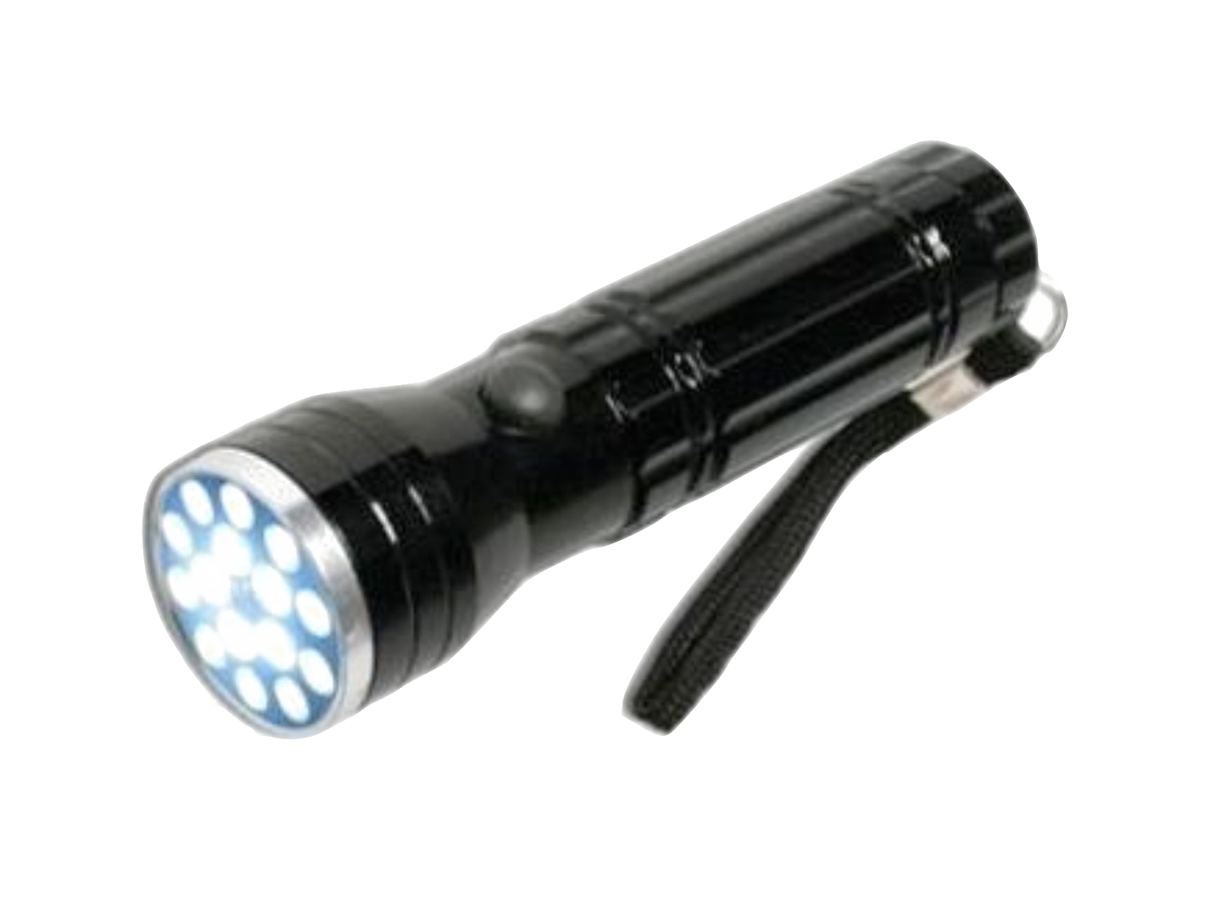
MAVIS
Intermediate Mass Black Holes
This Photo by Unknown Author is licensed under CC BY-NC

Slide 4
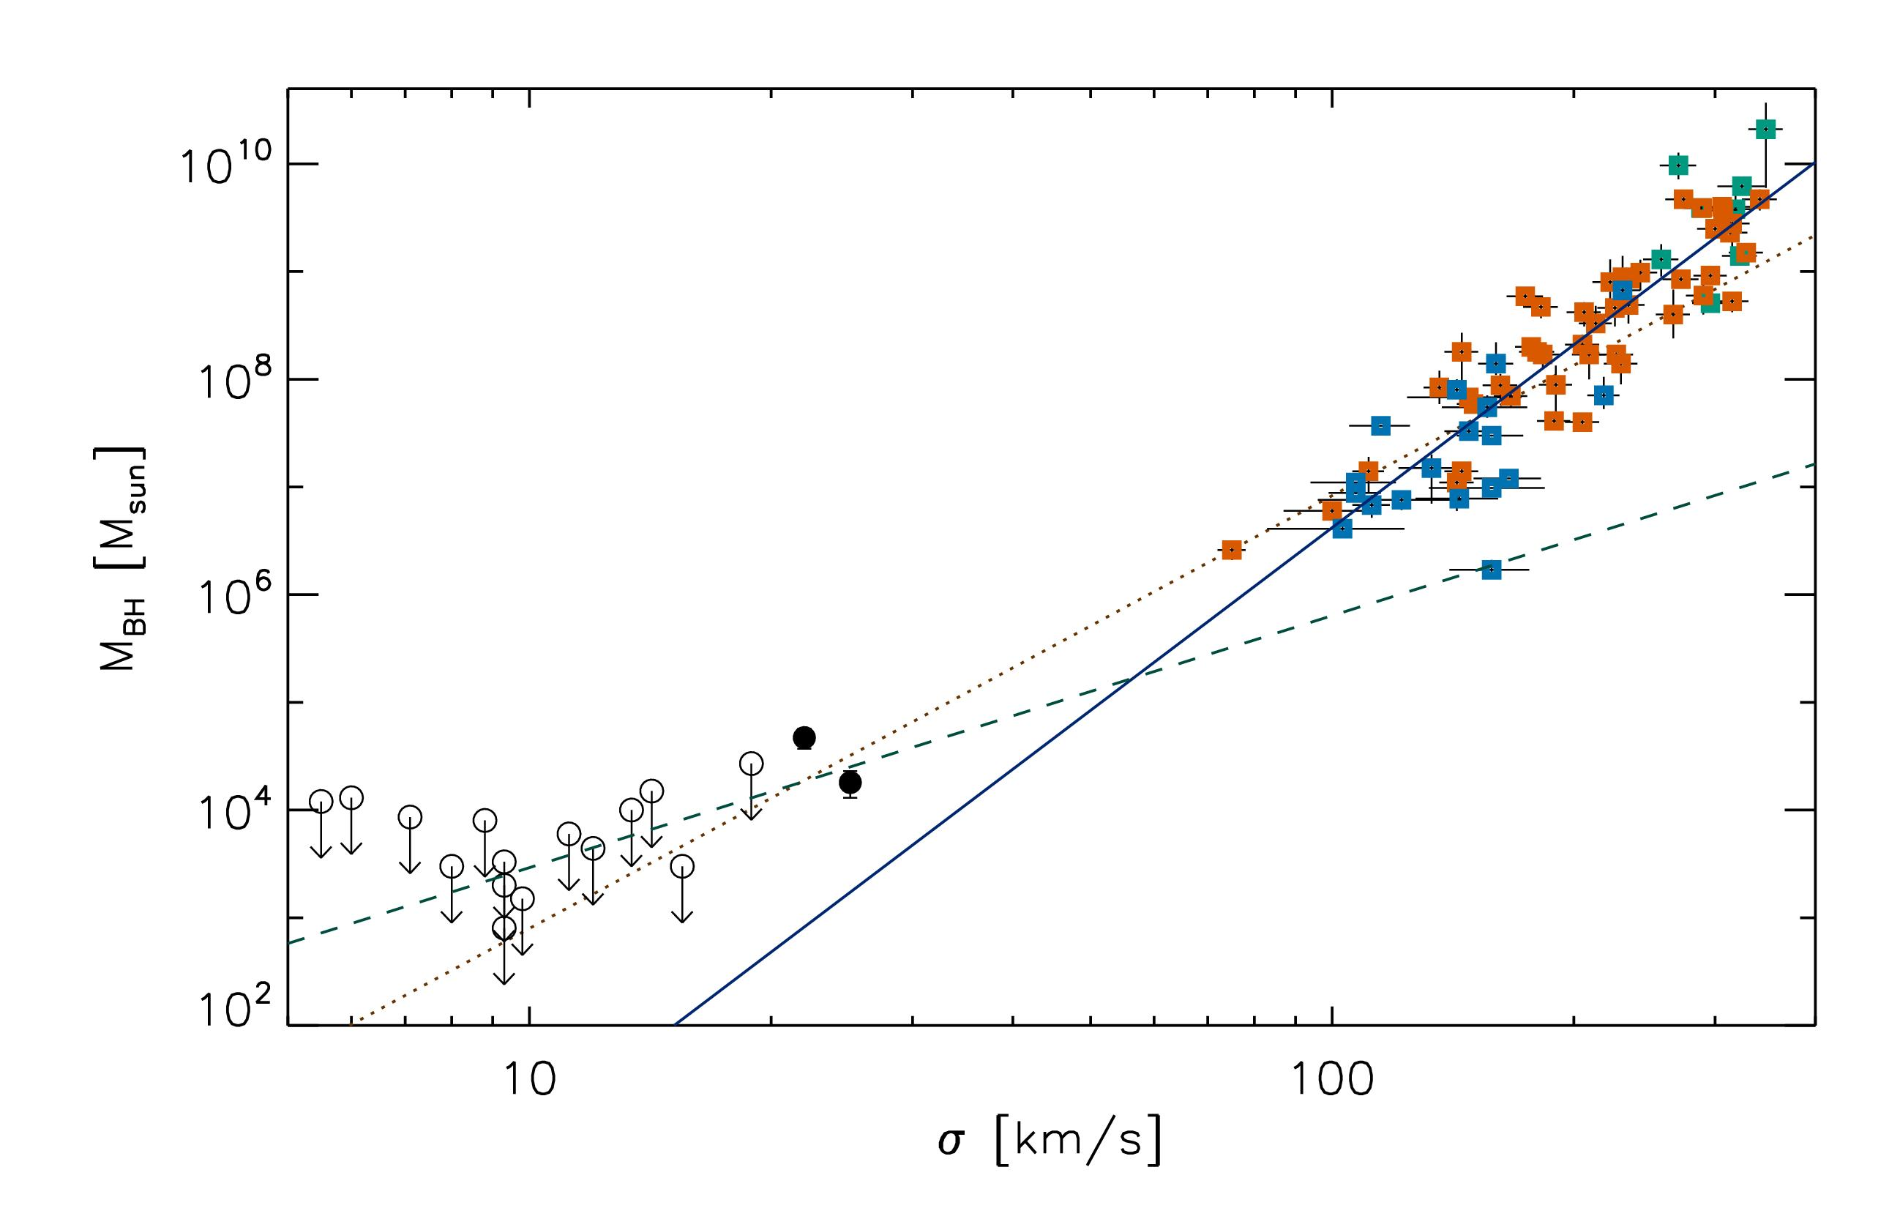
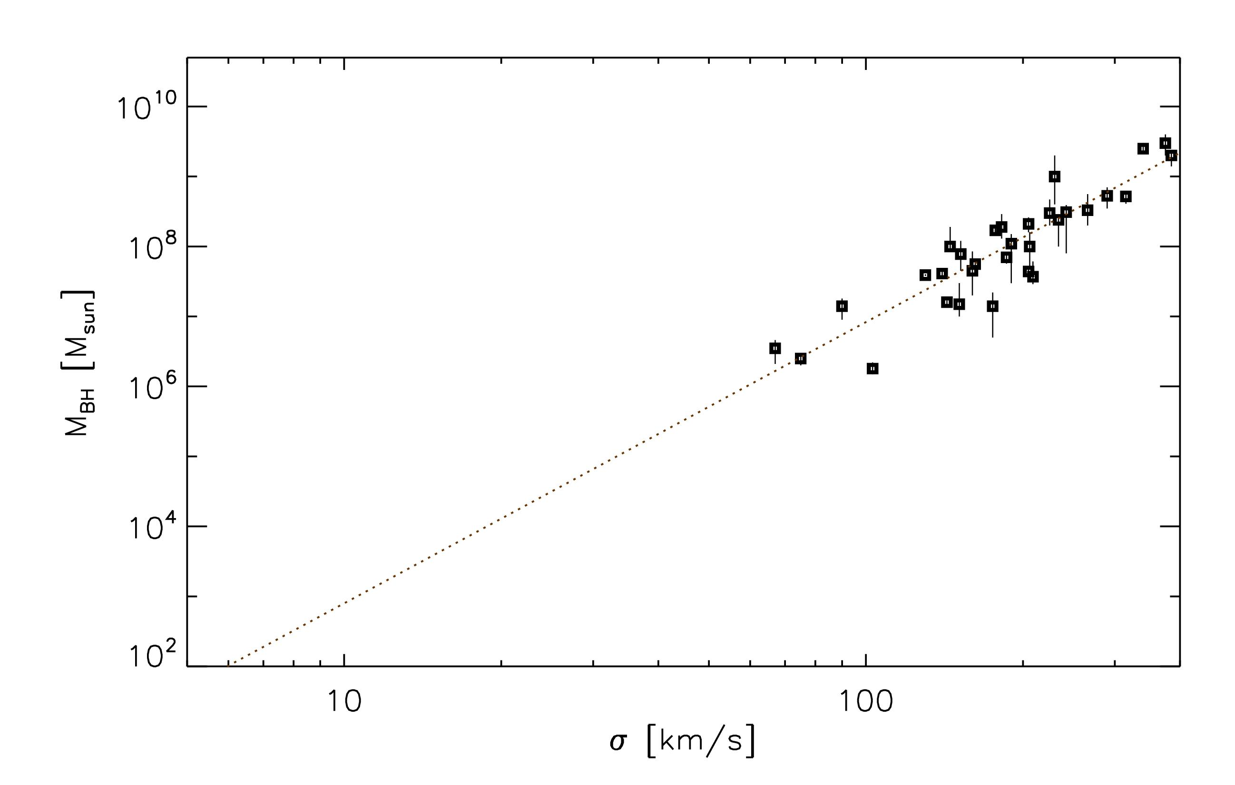
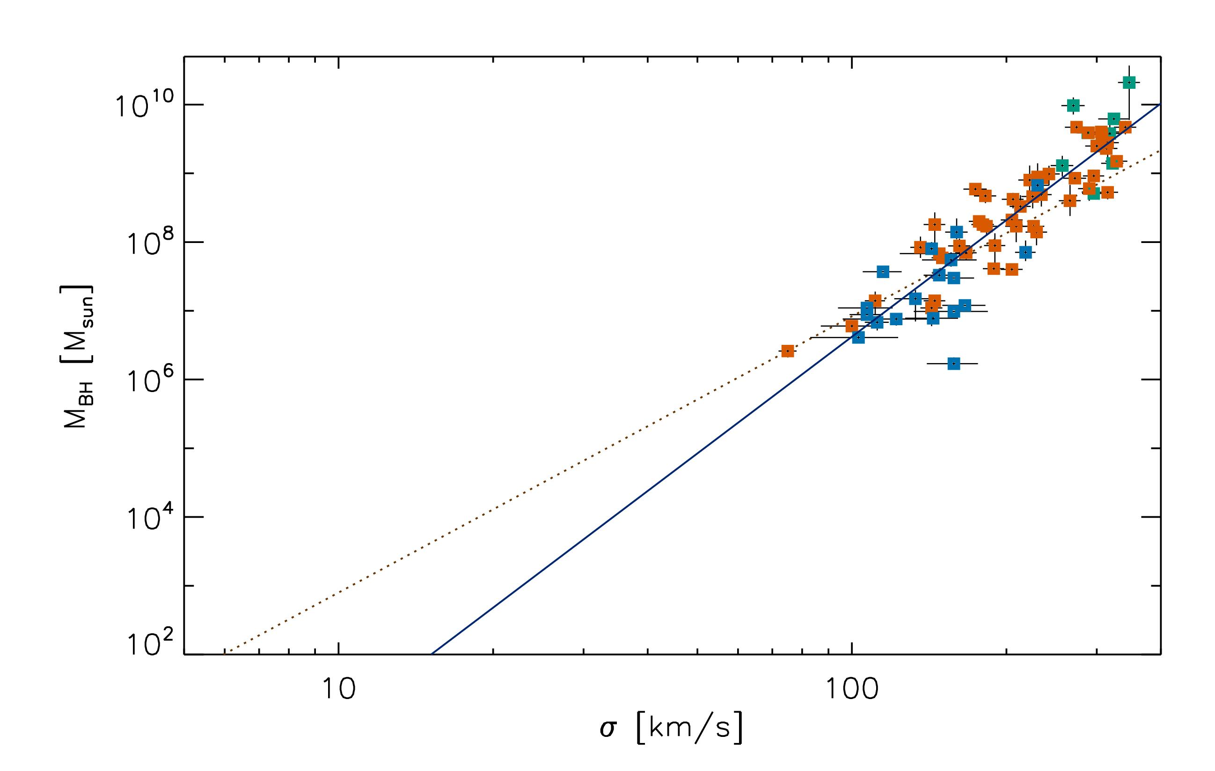
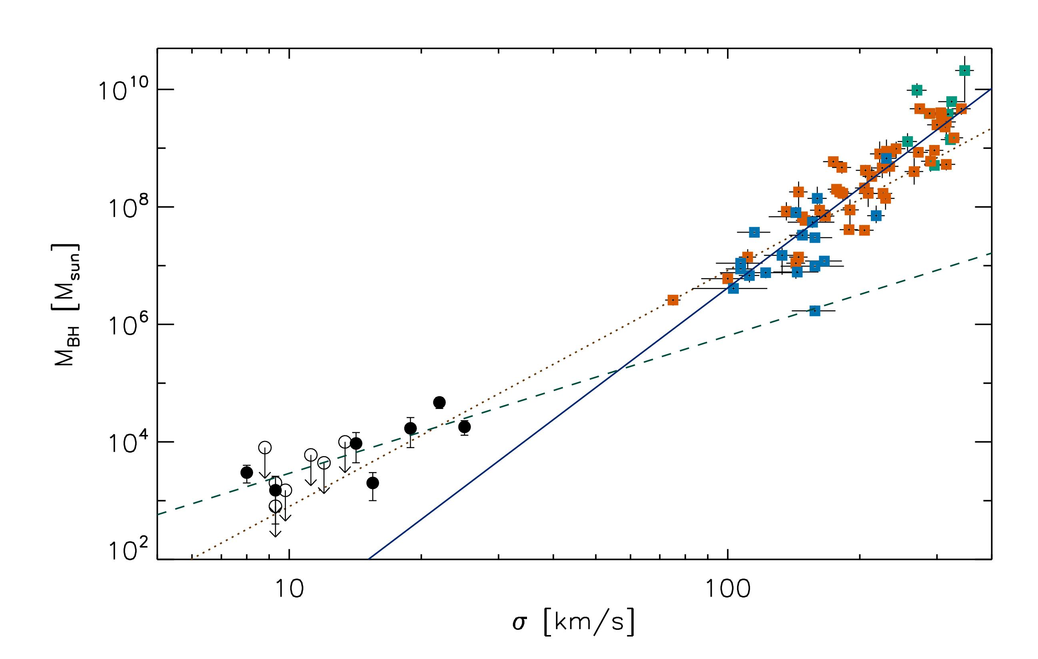


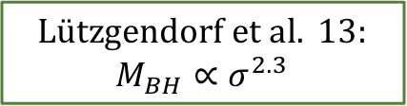


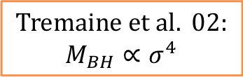
IMBH: do they exist?
Kamann et al. 14
M_{BH} – σ* relation
M_{BH} – σ* relation
M_{BH} – σ* relation
$$Tremaine et al. 02:$$
$$M_{BH}∝σ^{4}$$
$$Tremaine et al. 02:$$
$$M_{BH}∝σ^{4}$$
$$Tremaine et al. 02:$$
$$M_{BH}∝σ^{4}$$
$$Tremaine et al. 02:$$
$$M_{BH}∝σ^{4}$$
$$Lützgendorf et al. 13:$$
$$M_{BH}∝σ^{2.3}$$
$$Lützgendorf et al. 13:$$
$$M_{BH}∝σ^{2.3}$$
$$McConnell et al. 13:$$
$$M_{BH}∝σ^{5.6}$$
$$McConnell et al. 13:$$
$$M_{BH}∝σ^{5.6}$$
Globular clusters
$$McConnell et al. 13:$$
$$M_{BH}∝σ^{5.6}$$

Slide 5
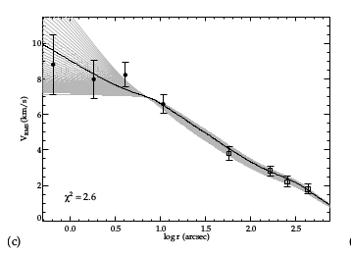
IMBH: astrometric evidence

Slide 6
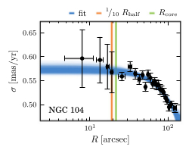
IMBH: state-of-the-art
(Watkins et al. 2022)
No proper motions with enough precision
Within the sphere of influence of the IMBH

Slide 7
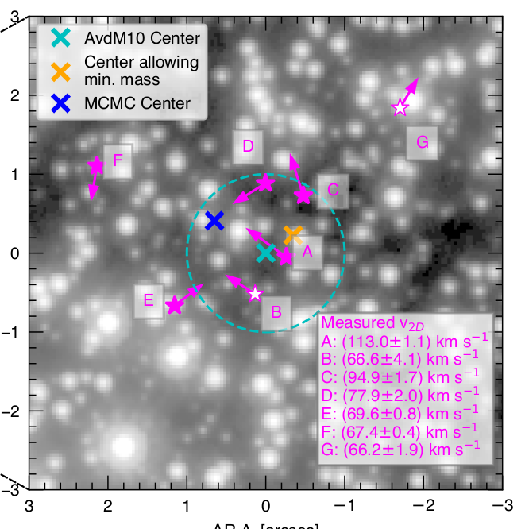
IMBH: state-of-the-art
(Haberle et al. 2024)
High-velocity stars in the central regions
of Omega-Centauri
BUT
Debated membership;
Alternative accelerating sources

Slide 8
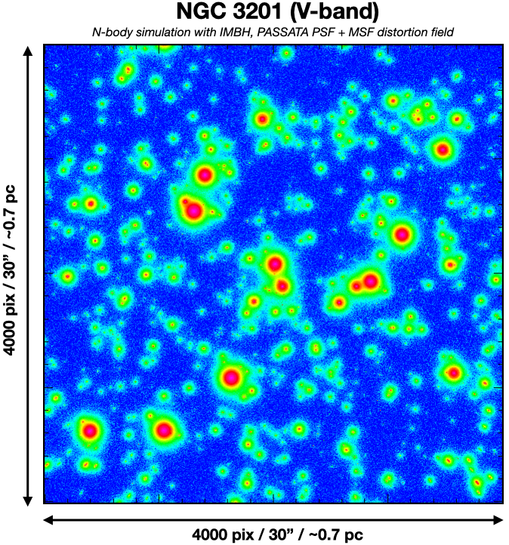
MAVIS astrometric simulations
- N-body simulations by H. Baumgardt
and S. Monty
Simulated images by J. Cranney
And O. Rebrysh
Astro-photometric analysis with
Superstar by A. Marasco

Slide 9
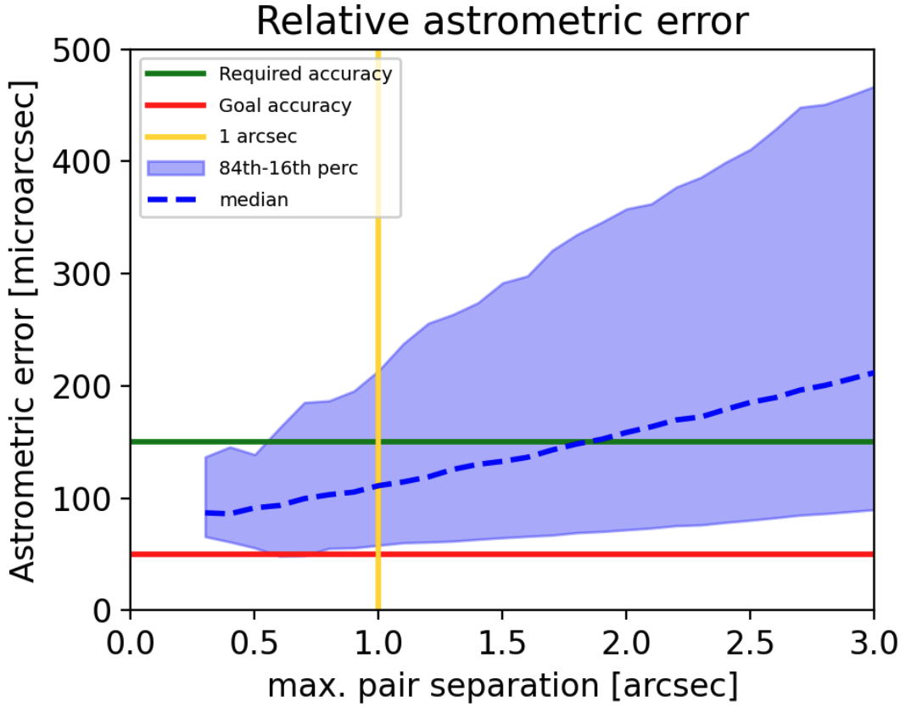
MAVIS astrometric simulations
Credits: A. Marasco

Slide 10
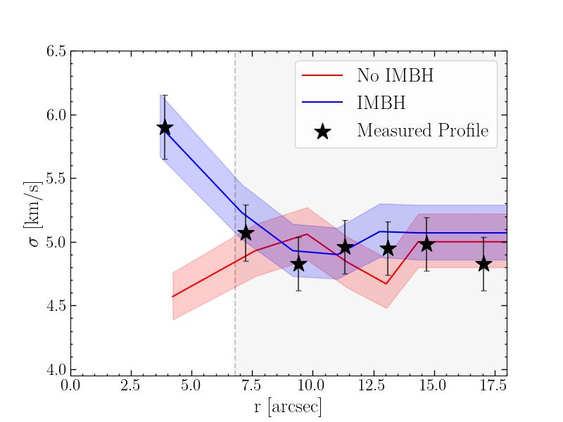
MAVIS astrometric simulations
Credits: S. Monty

Slide 12
HWO
Dark Matter
This Photo by Unknown Author is licensed under CC BY-NC

Slide 13
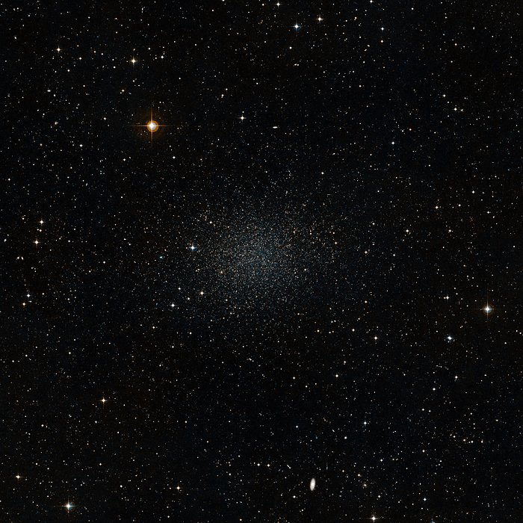
Proper Motions in dSph to investigate dark matter
99%

Slide 14
Proper Motions in dSph to investigate dark matter
Dynamics
Mass distribution
Test DM models
BUT
No PMs = mass-β degeneracy

Slide 15
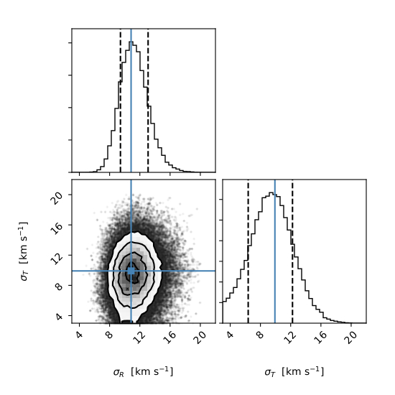
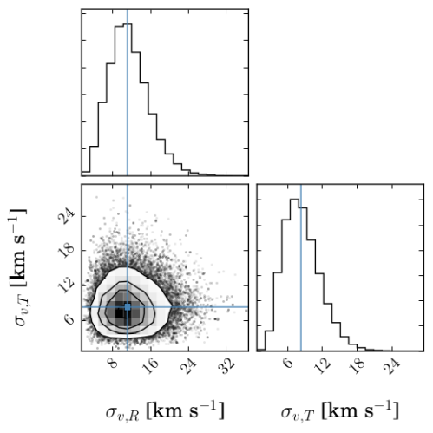
Proper Motions in dSph to investigate dark matter
Sculptor dSph
(Massari et al. 2018)
Draco dSph
(Massari et al. 2020)
+2.1
σR=11.5±4.3 km/s
σT=8.5±3.2 km/s
σR=11.0 km/s
σT=9.9 km/s
-1.5
+2.3
-3.1

Slide 16
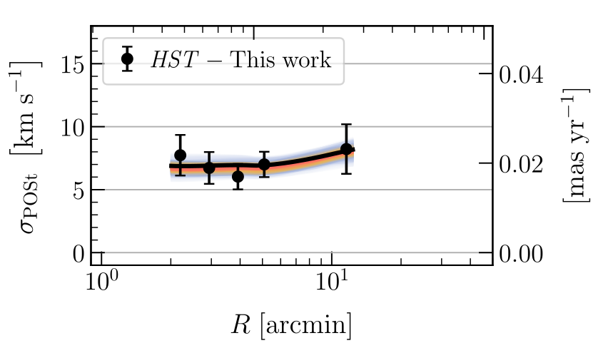
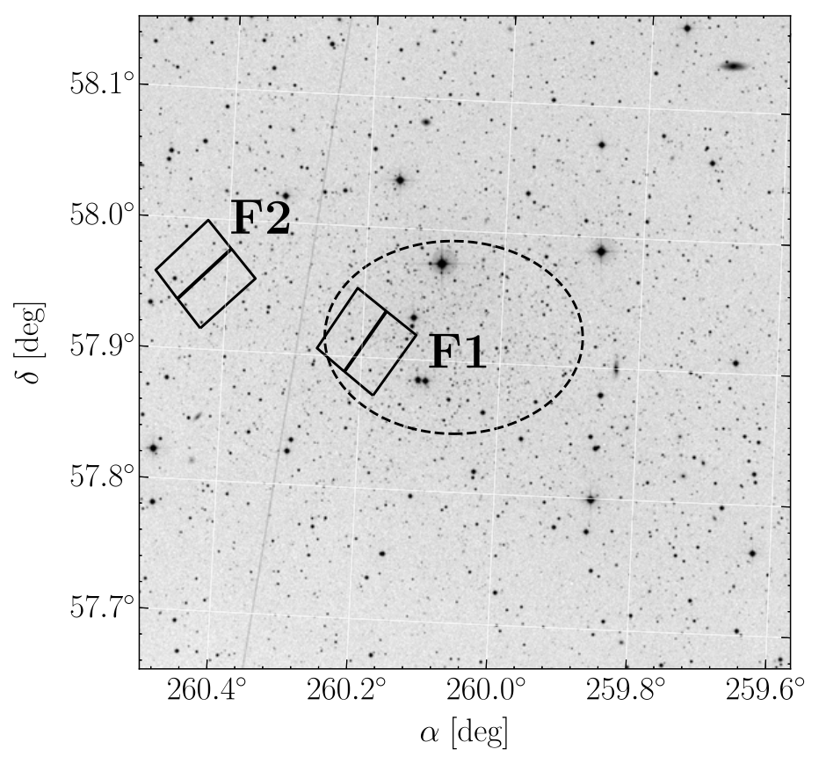
Proper Motions in dSph to investigate dark matter
Vitral et al. 2024

Slide 17
HWO and Dark Matter
With a 6-m mirror the diffraction limit at 500 nm is ~10 mas.
We do not want to be undersampled → pixel size < 5 mas
With an HST-like stability, PM precision in 10 years = 2 μas/yr
HWO can investigate the nature of DM via PM out to 1 Mpc

Slide 18
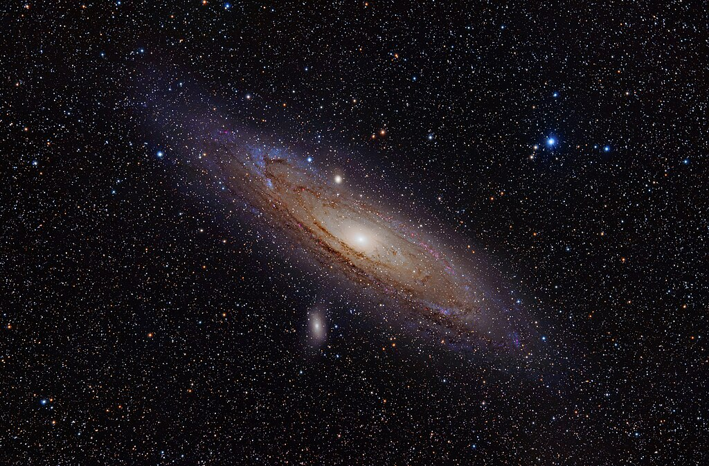

Slide 19
HWO and Dark Matter
Astrometric competition:
Depth beats Gaia → many more DM-dominated systems
Large FoV (?) + resolution beats HST and JWST → whole galaxy in one go
Resolution beats Roman → better PM precision means larger distance
Sky coverage beats ELTs → many more DM-dominated systems

