Slide 1
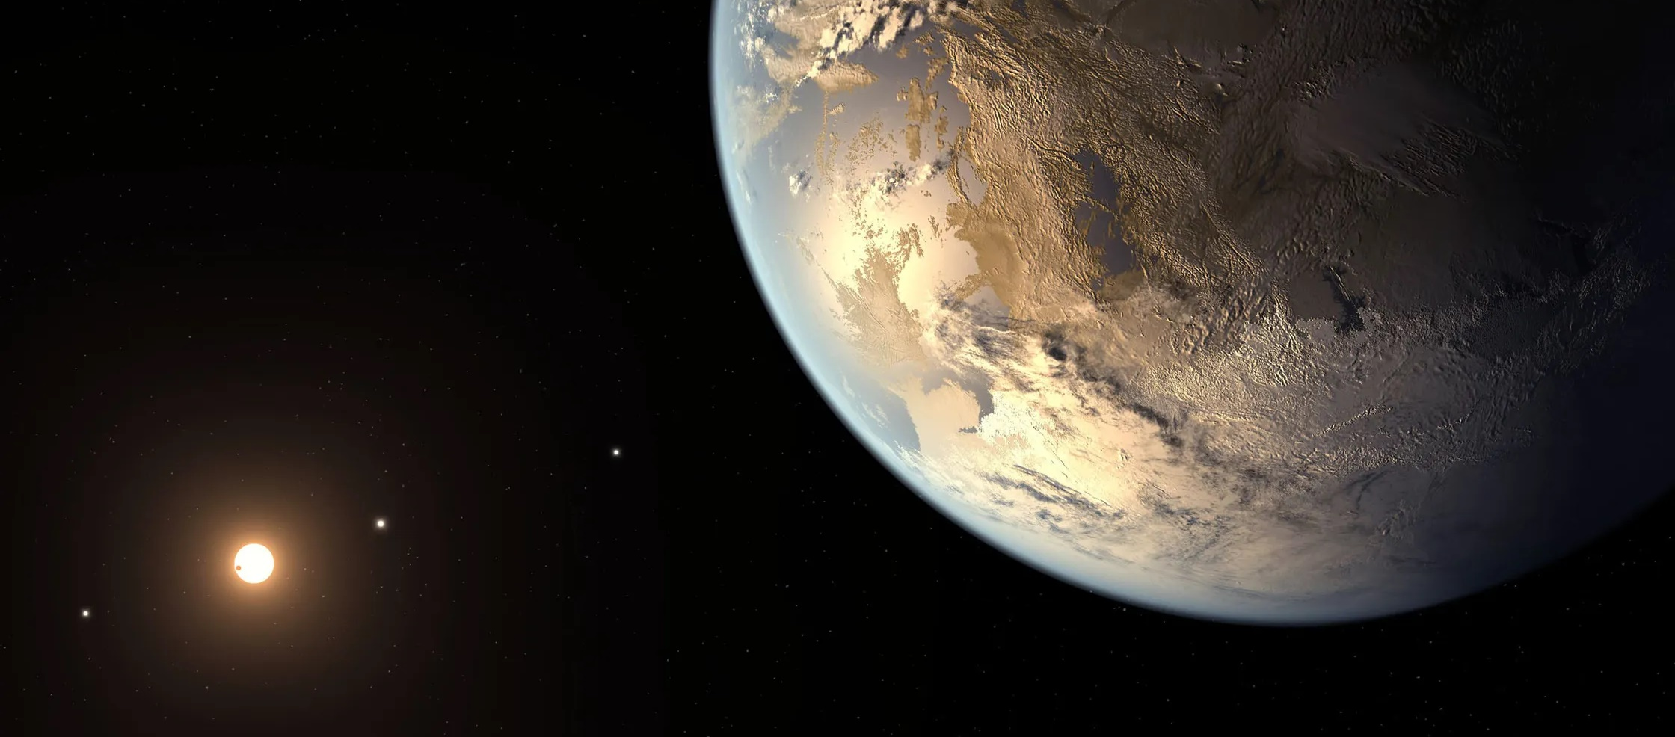


Habitable Worlds Observatory (HWO)
Architecture & Technology Development
Lee Feinberg, HWO Principal Architect
Matthew R. Bolcar, HWO Chief Technologist
NASA Goddard Space Flight Center
Shaping the Italian Contribution to HWO
10 July 2025

Slide 2
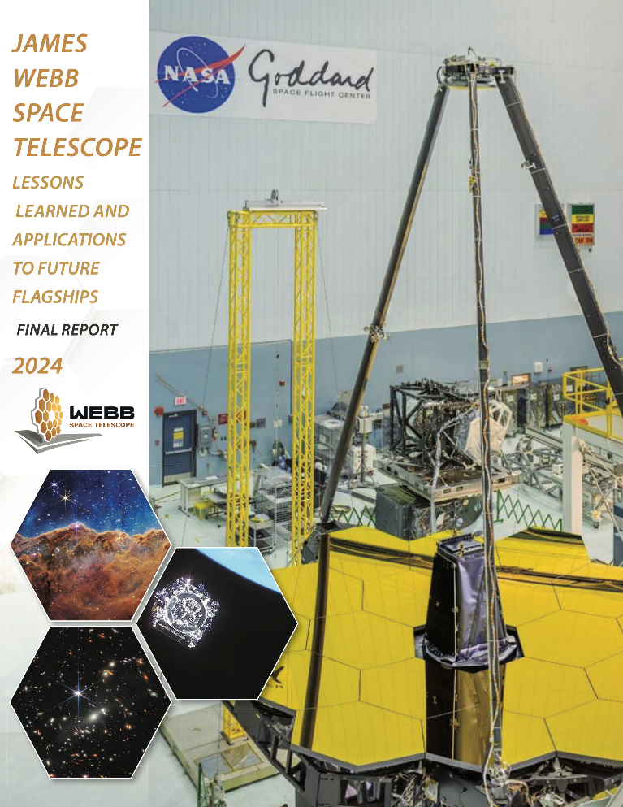
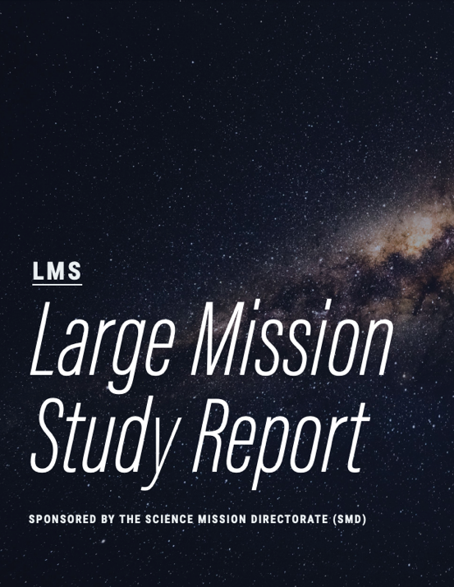
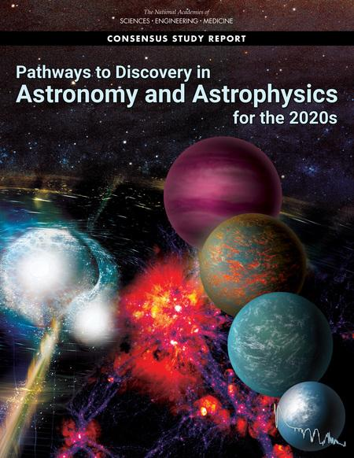
Changing How We Do Flagship Missions
“Design problems are baked into the cake at the start and not uncovered until you have eaten half the cake.”
“Mature the architecture, technology, science holistically early on. Build in large system margins from the Start”
“Prior to commencing mission formulation, a successful Great Observatories Mission and Technology Maturation program must be completed…”
When architected for success, Roman Space Telescope demonstrates that flagship missions can deliver on cost and schedule

Slide 3
Architecture

Slide 4
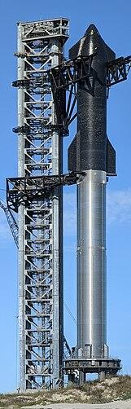

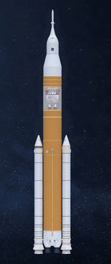
Future Rockets Are A Key Driver
  Rockets that can provide sufficient mass & volume margin are a key driver of the architecture approach
    Roman Space Telescope was initially designed to be compatible with 3 rockets, only Falcon 9H was ready and available
    Ariane V used for Webb could lift about half the mass of HST or RST
  Goal: a flexible and modular architecture that can best take advantage of the next generation of large rockets and associated uncertainties
NASA
Space Launch System
Space-X
Starship
Blue Origin
New Glenn
(not to scale)

Slide 5
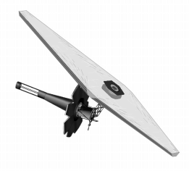
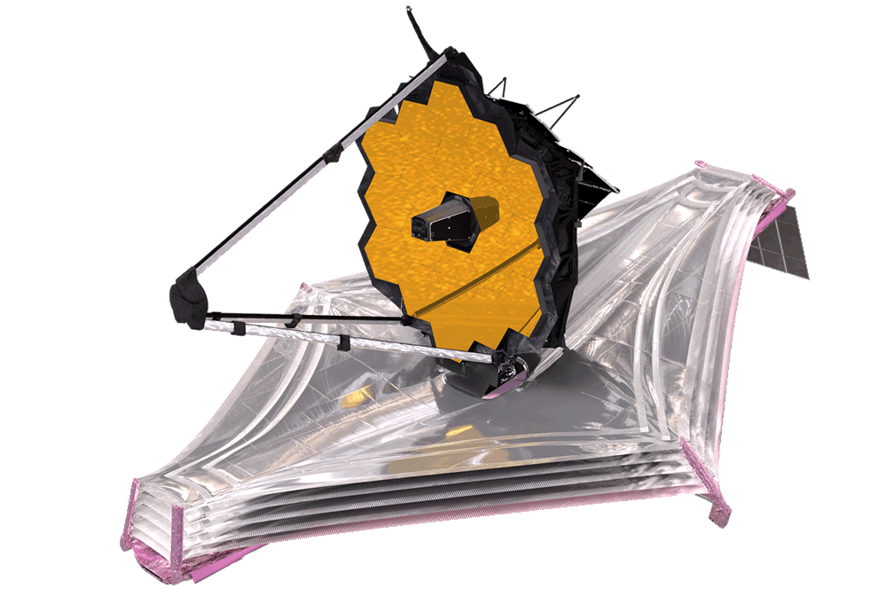
Exploratory Analytic Cases (EACs)
1st round mission architectures are being developed to explore the HWO trade space:
  Practice end-to-end modeling, from science to engineering. Develop initial models & codes to ”pipeclean” the process using representative examples, understand end to end modeling capabilities and needs
  Use EACs to identify key technology gaps and guide maturation of potential technology solutions
  Explore key architectural options and breakpoints in the context of rockets to help guide future point design choices
  Provide feedback to rocket vendors as soon as possible to help influence their direction
  We don’t expect any of the cases studied will become a baseline design going forward.
  These are only intended to explore and practice.
Early JWST
(where HWO will be at MCR)
Final JWST
CML 9+

Slide 6
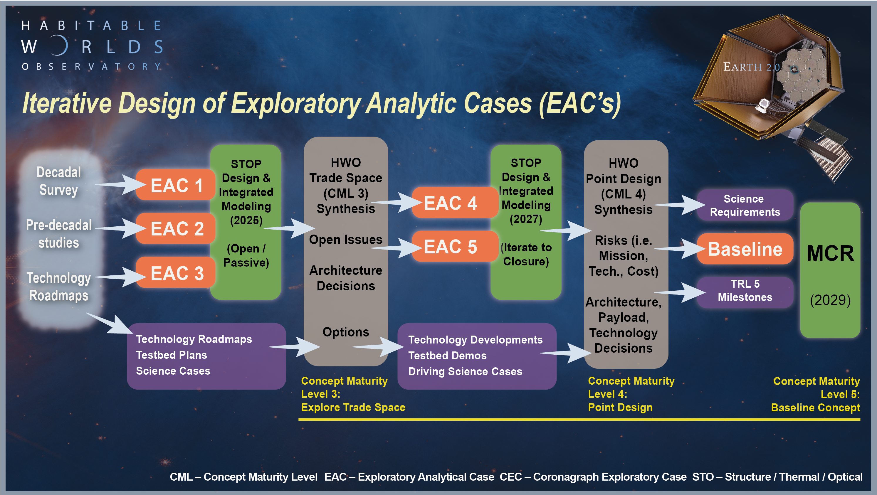
We Are Here

Slide 7
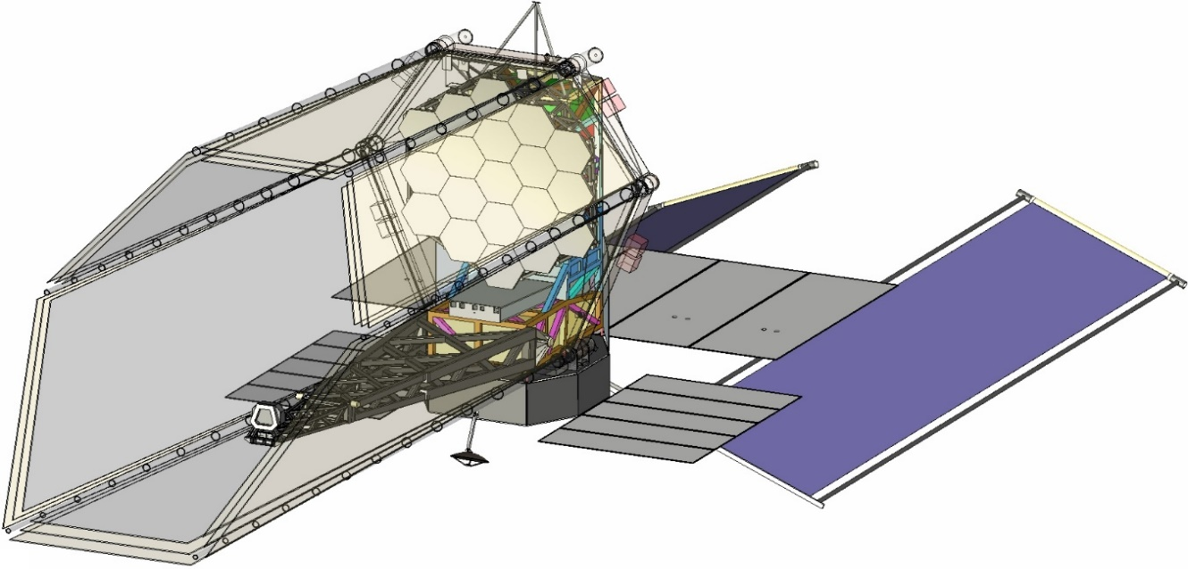
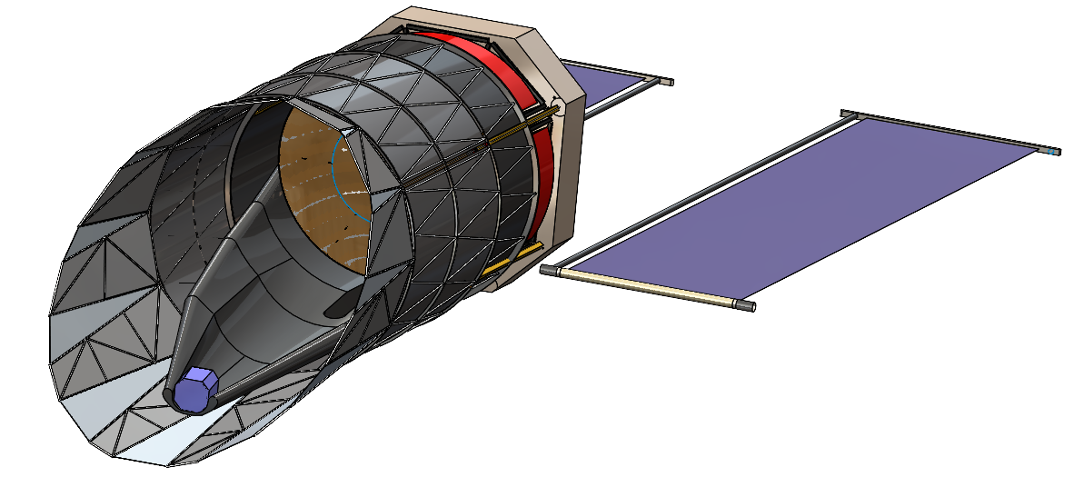
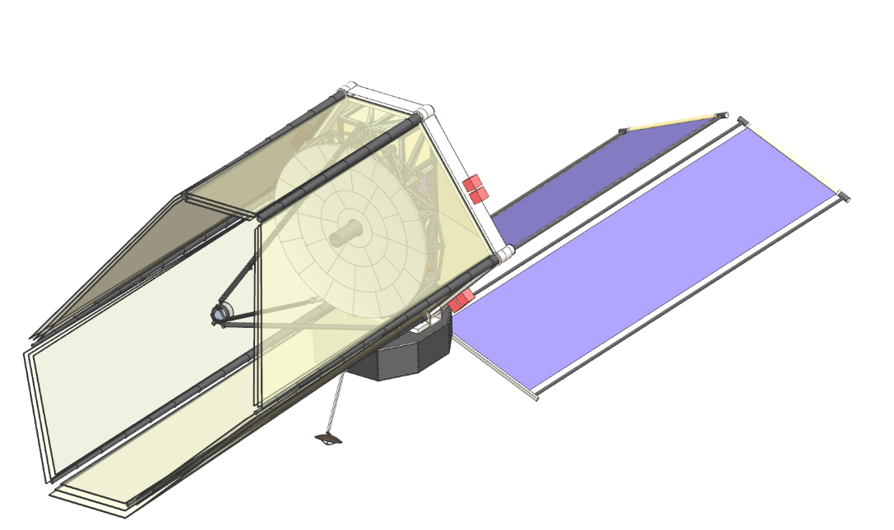
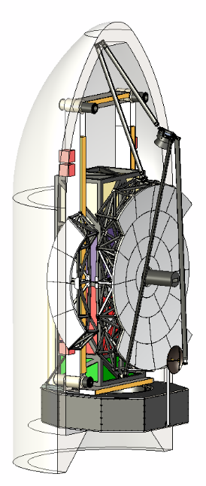
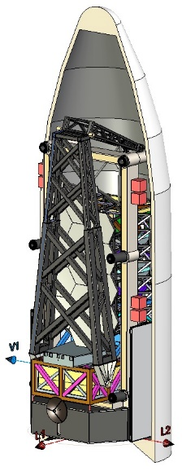
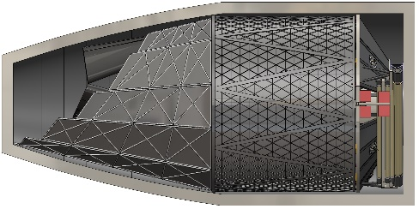
Notional Exploratory Analytic Cases
EAC1 | Assumption | Comments
Launch Vehicle Fairing Assumption | New Glenn (or Starship) | 7m Diameter Fairing
Mass | Bottoms up estimate
# of Mirrors | 19 Hex Segments | 1.65m point to point
Telescope Diam + Config | Off-Axis, 6.0m ID 7.2m OD | Starshade compatible
Deployment | JWST-like Wings, SM Hinged tower
EAC2 | Assumption | Comments
Launch Vehicle Fairing Assumption | Starship or Equivalent | 9m Diameter Fairing
Mass | Bottoms up estimate
# of Mirrors | 6+1 | 3m central mirror, 6 Keystone
Telescope Diam + Config | Off-Axis, 6.0m Circular | Starshade compatible
Deployment | SM hinged, Barrel only
EAC3 | Assumption | Comments
Launch Vehicle Fairing Assumption | Starship or Equivalent | 9m Diameter Fairing
Mass | Bottoms up estimate
# of Mirrors | 34 Keystone
Telescope Diam + Config | On-Axis, 8.0m Circular | Starshade compatible
Deployment | JWST-like Wing, SM

Slide 8

EAC 1-3 Deployment Styles Studied
Webb-like wings, secondary with barrel unfolding
Roman-like Hard Barrel with
“Camping Cup” Deployment
Servicing…
Allows multiple generations of Instruments
Enables earlier launch date by focusing on minimum needs initially
Architecting for Serviceability helps Integration and Testing

Slide 9
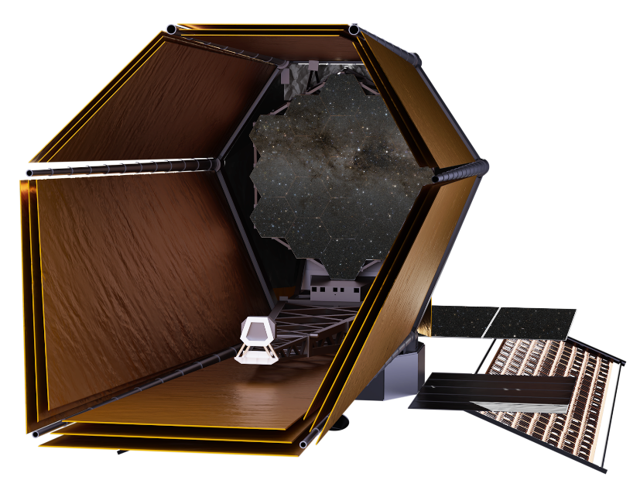
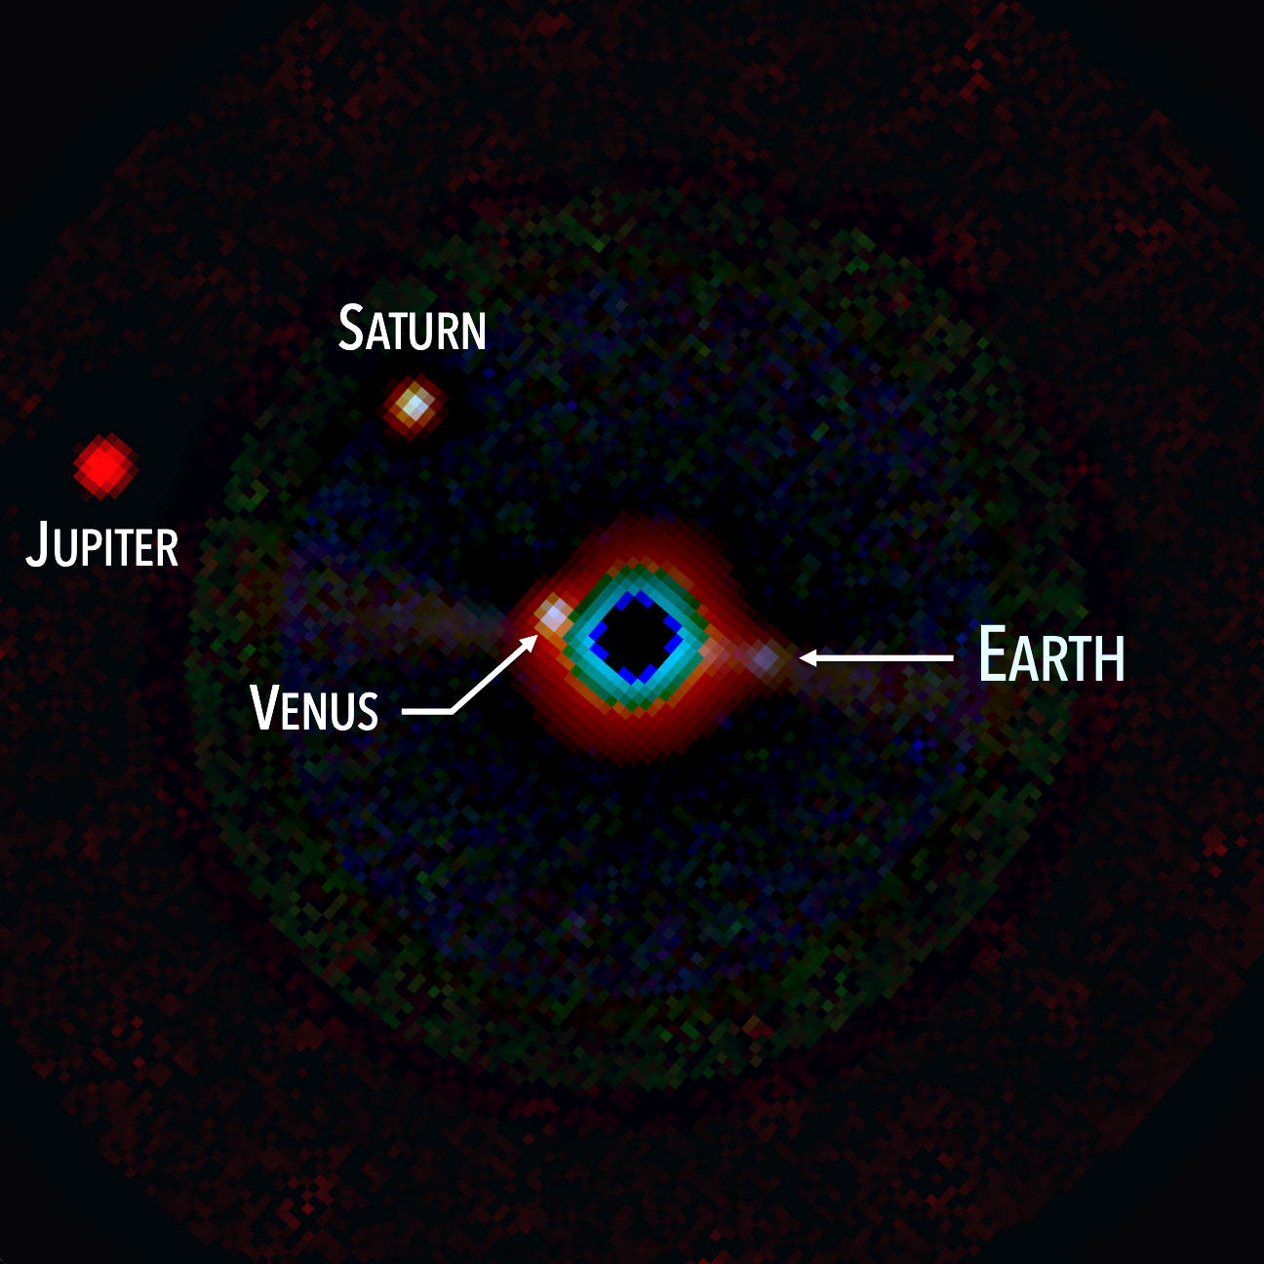
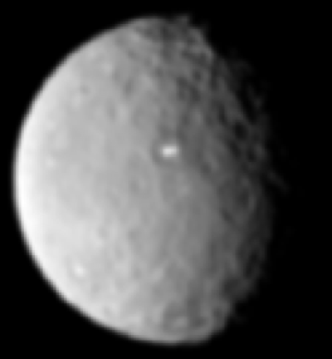
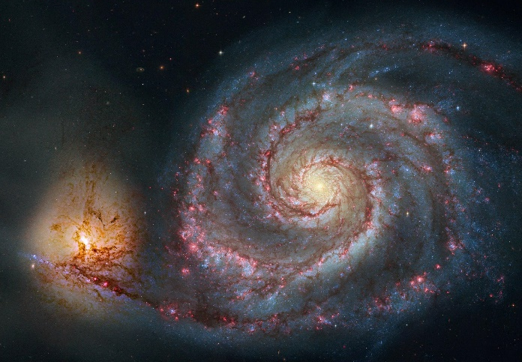
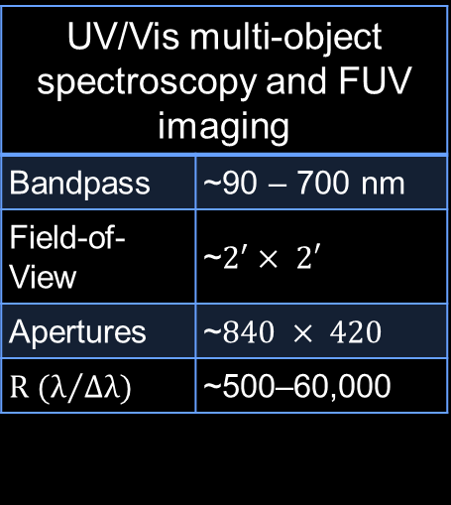
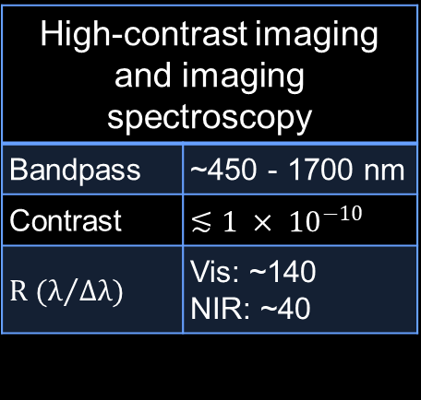
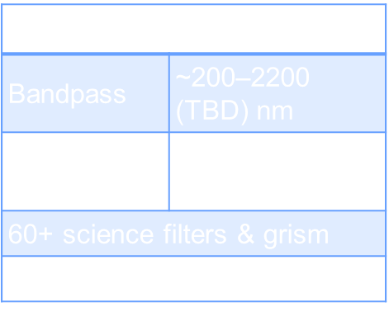
Preliminary Specs & Candidate Instruments
Telescope
Coronagraph
High-Resolution Imager
UV Multi-Object Spectrograph
Diameter | ~6-8 m (inner)
Bandpass | ~100–2500 nm
High-contrast imaging and imaging spectroscopy
Bandpass | ~450 - 1700 nm
Contrast | $$≲1 × {10}^{−10}$$
$$R (λ/{Δλ)}$$ | Vis: ~140 NIR: ~40
UV/Vis and NIR imaging
Bandpass | ~200–2200 (TBD) nm
Field-of-View | ~$3^{′}× 2′$
60+ science filters & grism
High-precision astrometry?
UV/Vis multi-object spectroscopy and FUV imaging
Bandpass | ~90 – 700 nm
Field-of-View | ~$2^{′}× 2′$
Apertures | ~$840 × 420$
$$R (λ/{Δλ)}$$ | ~500–60,000
Other Possible Instrument(s)
May include NUV coronagraph, NUV starshade, UV/VIS IFS, Spectropolarimeter
International contributions will be welcomed.
Notes:
International: Instruments, components, members of instrument study teams
ESA could do its own instrument study
We want to go out with a call a year from now for instrument studies.

Slide 10
International Partners
Internal partnerships that add value are an important part of the architecture approach
We are being wide open in what we are considering in terms of contributions but obviously system engineering / interfaces and ITAR are considerations
We expect the Community Science & Instrument Team (CSIT) to have international ex-officio members (to be named soon)
We are having quarterly dialogs with ESA, CSA, and JAXA reps and have been working with individual member countries in Europe in particular
We hope that International teams will parallel our instrument studies or participate on US teams that perform instrument studies
By Mission Concept Review (MCR), we hope to have a draft set of international contributions for large contributions; Smaller contribution drafts by Mission Definition Review (MDR)

Slide 11
Technology

Slide 12
Organization
The HWO Technology Plan is organized along three tracks:
Each track is further divided into lanes associated with specific technology components or capabilities
Coronagraph
System
Technologies
Feng Zhao
Ultra-stable Telescope System
Technologies
Matt Bolcar
High-sensitivity UV/VIS Instrumentation Technologies
Paul Scowen
Starlight Suppression
Ultra-stable Mirrors
Far-UV Mirror Coatings
Deformable Mirrors
Ultra-stable Structures
Near-UV / VIS Detectors
Contrast Stabilization
Thermal Control System
Far-UV Detectors
Low-noise / Noiseless Detectors
Sensing & Control
Multi-object Selection / Integral Field Unit
Spectroscopy
Low-Disturbance Systems
Near-UV Capability
Deployable Systems
UV Gratings & Filters
Post-Processing

Slide 13
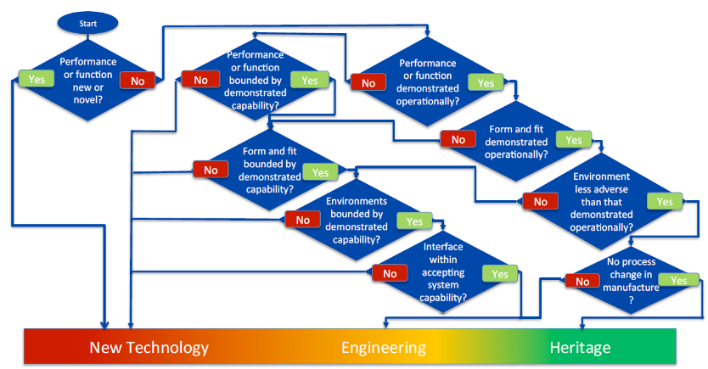
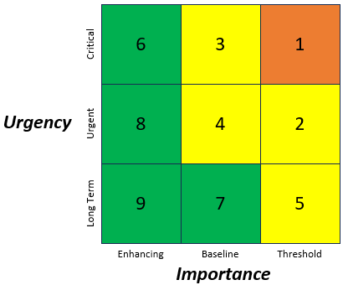
Gap Identification & Prioritization
For each lane, gaps are classified as
Technology or Engineering
Modeling and Testbed / Facility Gaps are also captured to
facilitate the development of specific technologies
Gaps are then prioritized based on
Importance and Urgency
Importance gauges how enabling the technology is
Urgency gauges impact to critical path or mission design
SP-20205003605: Technology Readiness Assessment Best Practices Guide

Slide 14
Technology Assessment Summary
ID | Technology Lane | Estimated Current TRL | I x U
T1 | Starlight Suppression | 3-4 | 3 x 3
T2 | Contrast Stabilization | 3-5 | 3 x 3
T3 | Deformable Mirrors | 4 | 3 x 2
T4 | Low-noise / Noiseless Detectors | 3-4 | 3 x 2
E5 | Spectroscopy | 4 | 3 x 1
E6 | Post-Processing | 3-4 | 3 x 2
T7 | Near-UV High-contrast Capability | 2 / 4 | 2 x 2
T8 | Ultra-stable Mirrors | 4-5 | 3 x 3
E9 | Ultra-stable Structures | 4-5 | 3 x 2
E10 | Thermal Control System | 4 | 3 x 2
T11 | Telescope Sensing & Control | 3-4 | 3 x 3
T12 | Low-Vibration & Pointing Control | 4 | 3 x 1
E13 | Deployable Systems | TBD | 3 x 1
T14 | Far-UV Mirror Coatings | 4 | 3 x 2
E15 | Near-UV / Visible Detectors | 4 | 2 x 2
E16 | Far-UV Detectors | 3-5 | 2 x 2
T17 | Multi-Object Selection | 3-5 | 2 x 2
E18 | UV Gratings & Filters | 4-6 | 2 x 1
T19 | Cryogenic / Superconducting Detectors | TBD | 1 x 3
T20 | Quantum Sensors | TBD | 1 x 1
T21 | Meta Surfaces | TBD | 1 x 1
T22 | Photonic Integrated Circuits | TBD | 1 x 2
T23 | Artificial Intelligence / Machine Learning | TBD | 1 x 2
T19
T1, T2, T8, T11
Critical
Critical
3
T22, T23
T7, E15, E16, T17
T3, T4, E6, E9, E10, T14
2
Urgent
Urgent
T20, T21
E18
E5, T12, E13
Long Term
1
Long Term
Enhancing
Baseline
Threshold
Enhancing
Baseline
Threshold
1
2
3

Slide 15
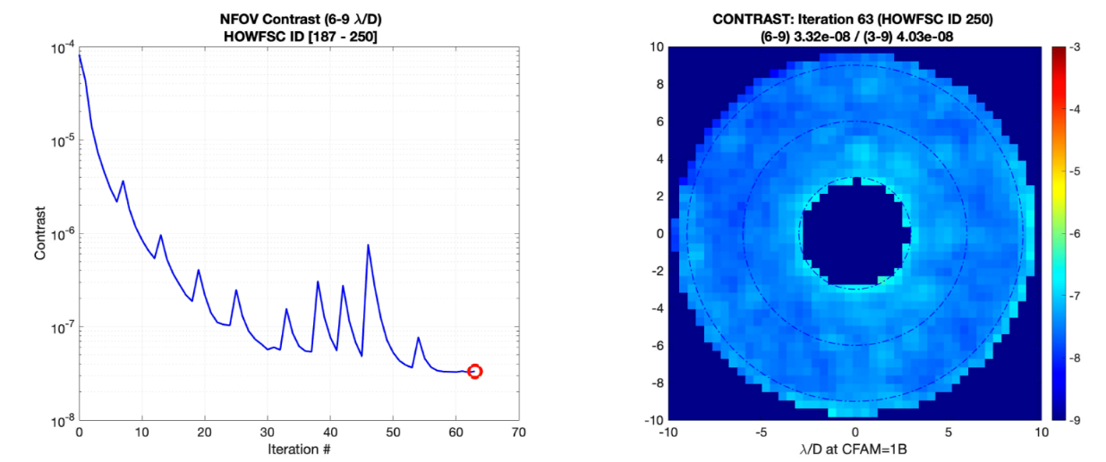
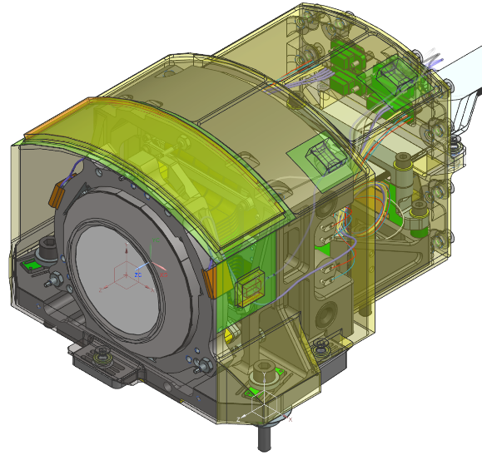
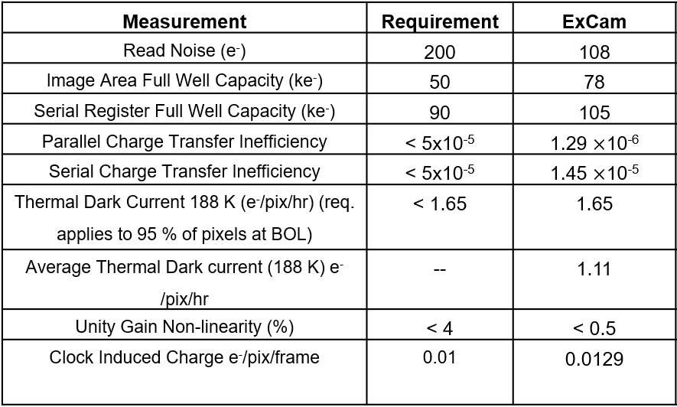

Current Gaps – Coronagraph System
State-of-the-Art:
Roman CGI
1. Starlight Suppression (TRL ~3-4)
Overall ability to achieve desired raw contrast, bandwidth, inner working angle, etc.
2. Deformable Mirrors (TRL ~4)
High actuator count; stable smooth surface; robust, precision electronics and interconnects
3. Contrast Stabilization (TRL ~3-5)
Achieve and maintain contrast stability during observations
4. Low-noise/Noiseless Detectors (TRL ~3-4)
Photon-counting, low-noise, rad-hard capability with high QE at biomarker wavelengths
5. Spectroscopy (TRL ~4)
Resolve questions about speckle chromaticity; achieve desired R for key biomarkers
6. Near-UV Capability (TRL ~2 / 4)
Achieve high contrast between 250-450 nm for key ozone features
7. Post-processing (TRL ~3-4)
Achieve desired SNR in context of observatory stability and sensing & control
4.0e-8
Raw Contrast
3-9 λ/D
CGI/JPL
48x48 DM
CGI/JPL
Ref Star
Target Star
Target Star - roll
CGI/JPL
Con-ops and Post Processing:
Reference Differential Imaging (RDI)
➔ FRN = 3.94×10⁻⁹
(Courtesy of B. Kern)

Slide 16
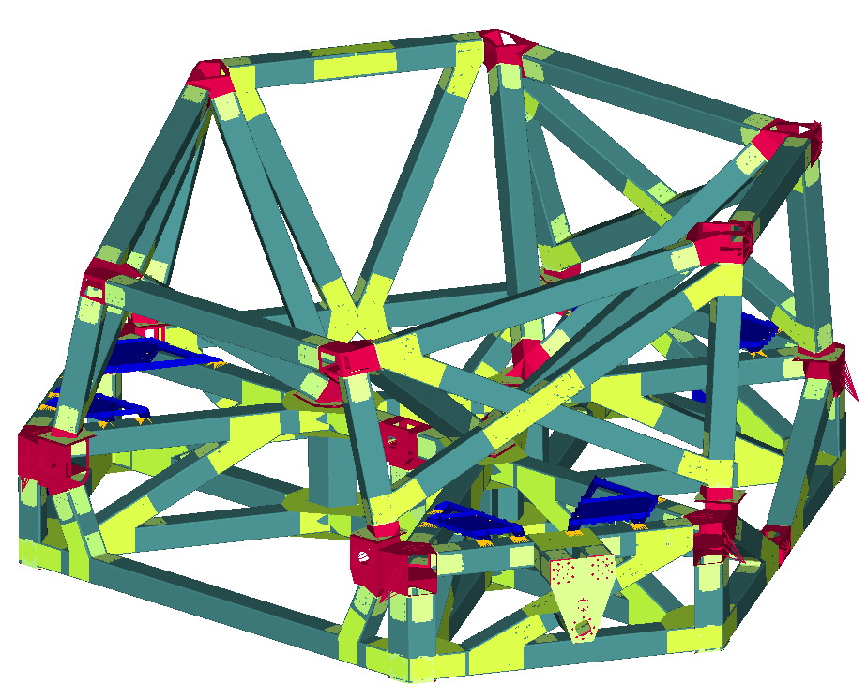
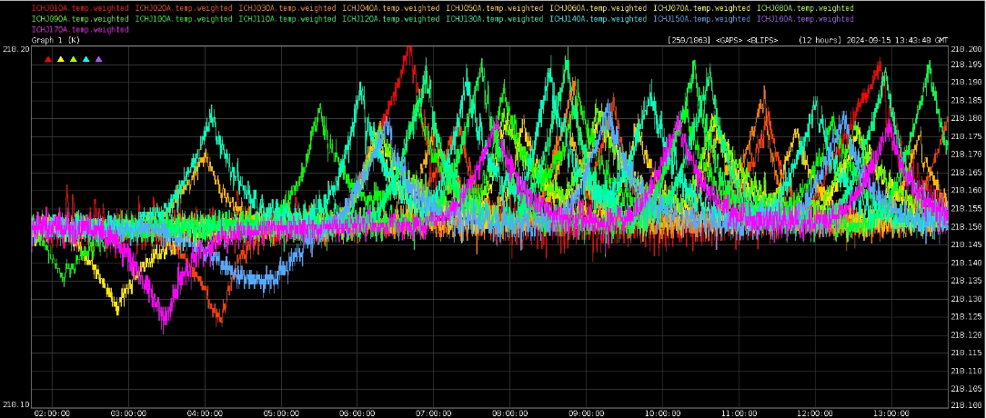
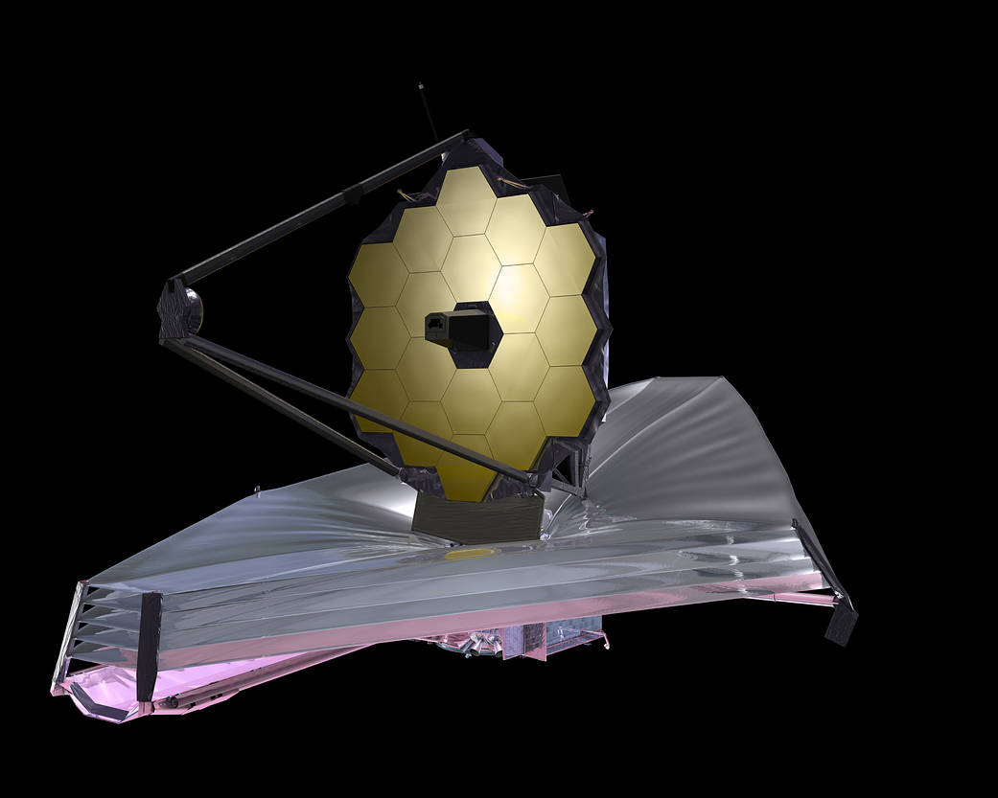
Current Gaps – Ultra-Stable Telescope
State-of-the-Art:
JWST, Roman
8. Ultra-stable Mirrors (TRL ~4-5)
Mirror cell that meeting required stability and optical performance
9. Ultra-stable Structures (TRL ~4-5)
Composites and joints with low creep and high-stiffness
10. Thermal Control System (TRL ~4)
Milli-kelvin control with compact Flight electronics, low-vibe thermal control systems
11. Telescope Sensing & Control (TRL ~3-4)
Sense and control segment-level and global telescope alignment at picometer level
12. Low-disturbance Systems (TRL ~4)
Active and passive isolation, Microthrusters, and low-disturbance mechanisms
13. Deployable Systems (TRL TBD)
Large deployable baffle, stable hinge and latch systems
218.2
218.1
NASA/GSFC
Roman Instrument Carrier achieves 10 mk stability
Roman Telescope thermal vacuum test results consistent with 10s of pm wavefront error stability.
JWST continues to exhibit extraordinary on-orbit passive stability.
L3Harris

Slide 17
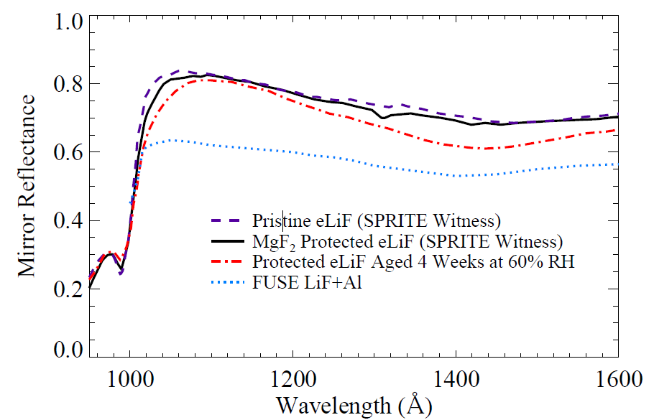
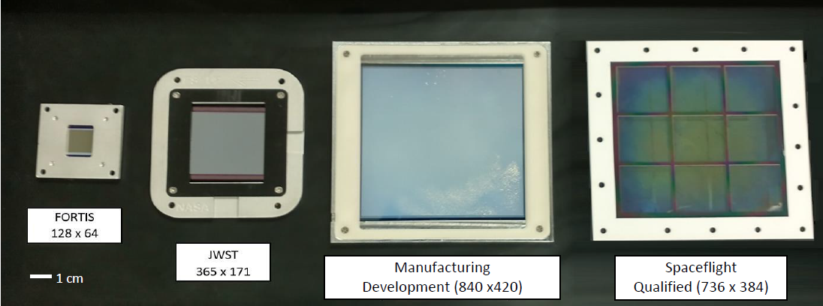
Current Gaps – High-Sensitivity UV/VIS Instruments
State-of-the-Art:
Sub-orbital & Lab
14. Far-UV Mirror Coatings (TRL ~4)
Broadband with high reflectivity down to 100 nm; high-uniformity and low scattering
15. Near UV/VIS Detectors (TRL ~4)
Large format, low noise, high-QE
16. Far-UV Detectors (TRL ~3-5)
Large format and high-QE, with high solar-blindness
17. Multi-object Selection (TRL ~3-5)
Microshutters, micro-mirrors, or slicers for multi-object or integral field spectroscopy
18. UV Gratings and Filters (TRL ~4-6)
High out-of-band rejection; curved substrates for aberration control
20x20 cm MCP for DEUCE
SPRITE mirror coating
FORTIS & JWST microshutters (left) with next gen devices (right)
See: Tuttle, et al. 2024 for comprehensive review of state-of-the-art.

Slide 18
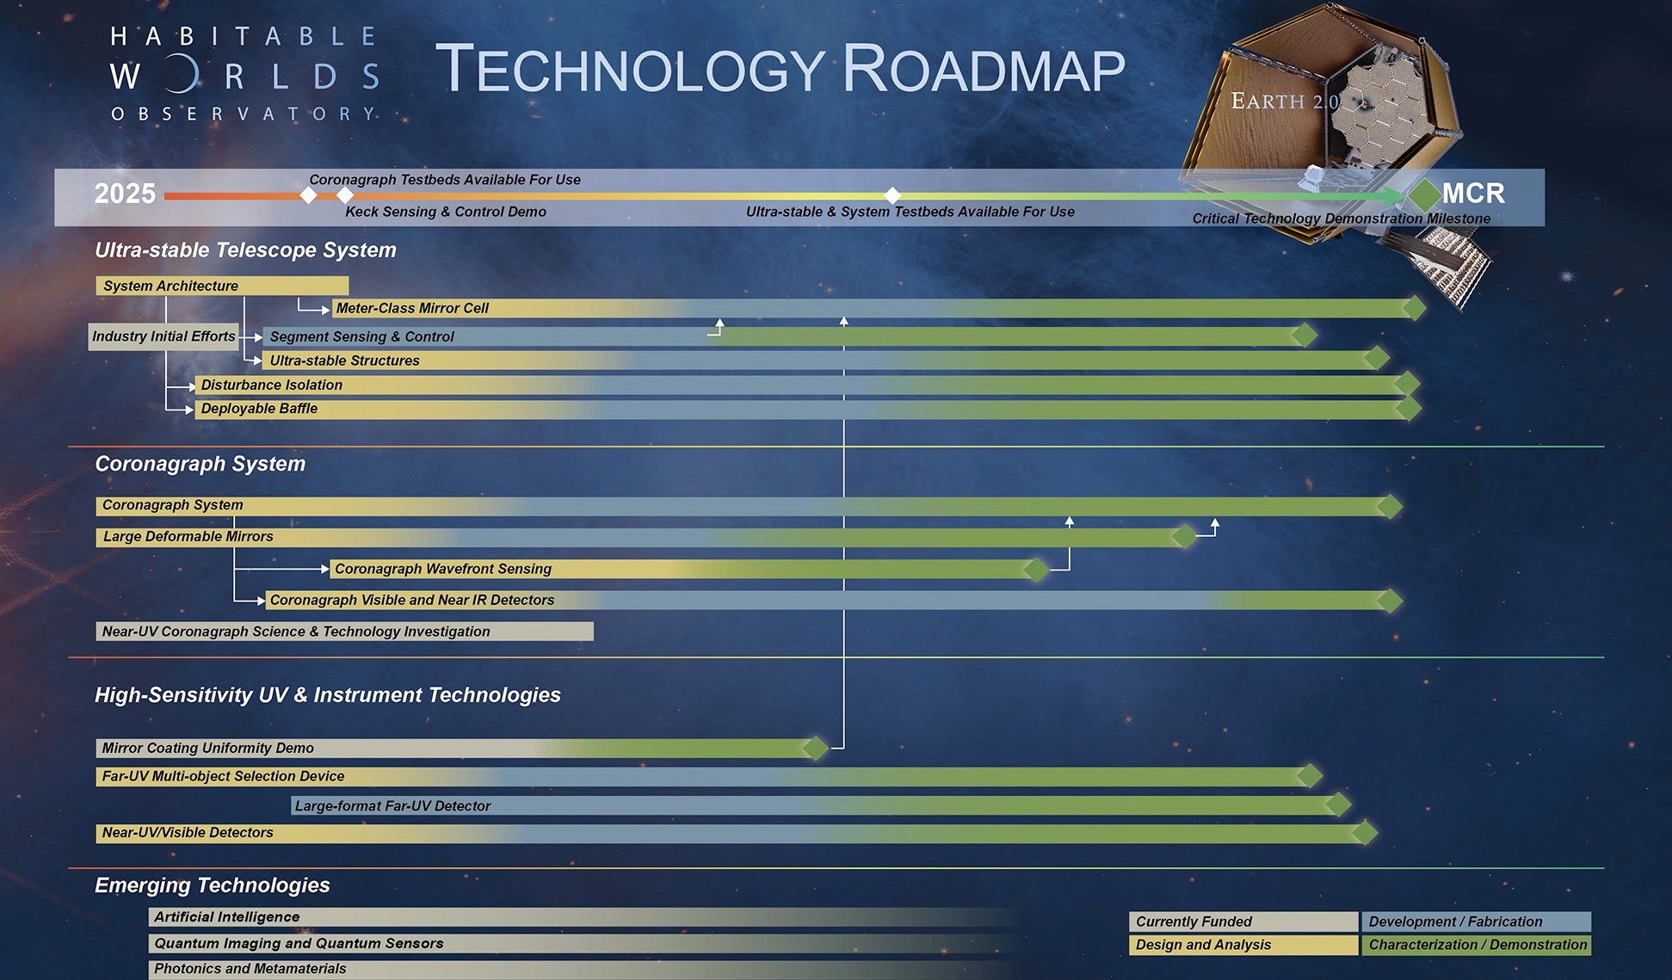

Slide 19
Conclusion
The Habitable Worlds Observatory is exploring multiple architectures to advance the Concept Maturity Level
Three Exploratory Analytic Cases (EACs) studied so far; EACs 4 & 5
in progress
Technology gaps have been identified, and initial development plans have
been drafted
Internation contribution will be key to both architecture and instrument concept studies as well as technology development

