Slide 1
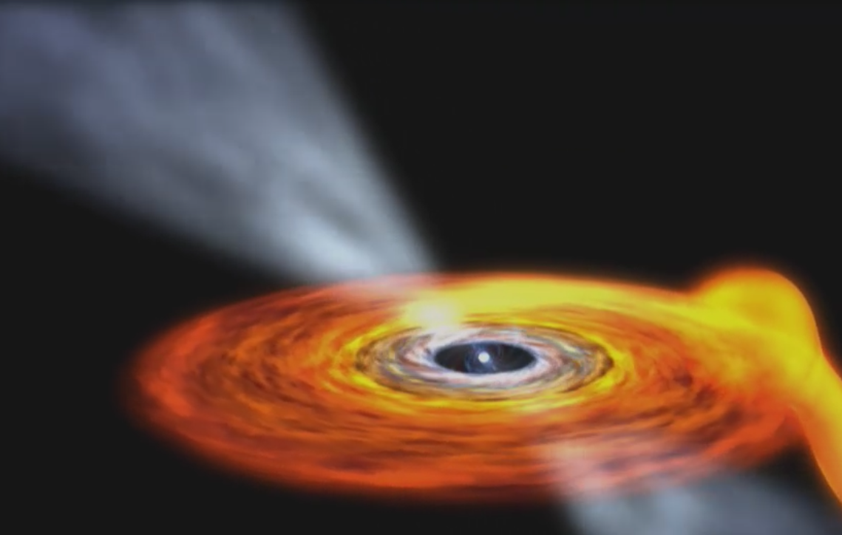

Millisecond Pulsars
Bridging accretion
and rotation-powered
neutron stars
Alessandro Papitto
alessandro.papitto@inaf.it
INAF PhD School F. Lucchin
31/10/2024

Slide 2
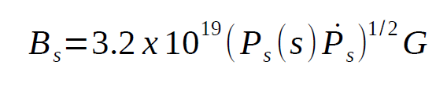
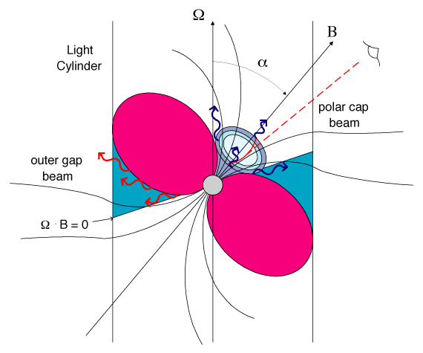
Rotation-powered Pulsars
Notes:
Rate of kinetic energy lost = Larmor formula rotating dipole
Estimate the magnetic field
Assuming constant mag field -> spin down age of the pulsar
Classical pulsars, death line,

Slide 3
Life of a Rotation-powered Pulsar
Pulsar spin down
Notes:
Rate of kinetic energy lost = Larmor formula rotating dipole
Estimate the magnetic field
Assuming constant mag field -> spin down age of the pulsar
Classical pulsars, death line,

Slide 4
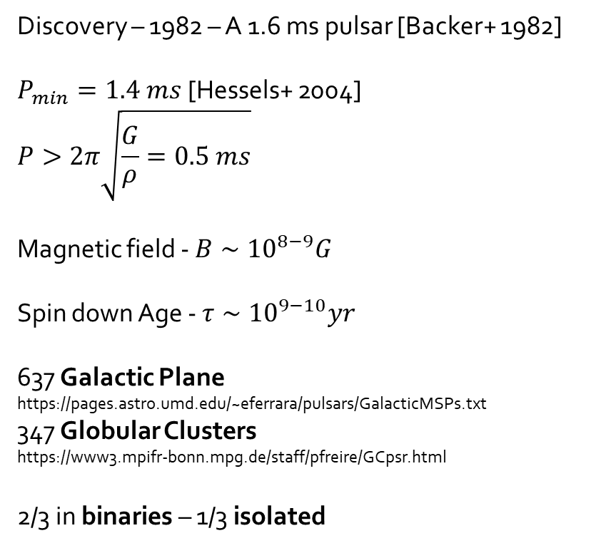
Rotation-powered Millisecond Pulsars
Discovery – 1982 – A 1.6 ms pulsar [Backer+ 1982]
$P_{min}=1.4 ms$ [Hessels+ 2004]
$$P>2π\sqrt{\frac{G}{ρ}=0.5 ms}$$
Magnetic field - $B∼{10}^{8−9}G$
Spin down Age - $τ∼{10}^{9−10}yr$
637 Galactic Plane
https://pages.astro.umd.edu/~eferrara/pulsars/GalacticMSPs.txt
347 Globular Clusters
https://www3.mpifr-bonn.mpg.de/staff/pfreire/GCpsr.html
2/3 in binaries – 1/3 isolated
Notes:
Discovery of millisecond pulsars. Weaker magnetic field. Very old spin down age.
How fast they can be? Frequency close to the maximum possible.

Slide 5
Millisecond pulsars
- weakly magnetized (B≈10⁸G)
- old (1-10 Gyr)
- often in globular clusters
- often with a low mass companion
Bisnovatyi-Kogan & Komberg 1974,
Alpar+1982, Radhakrishnan+ 1982
Pulsar spin-down
They must have been spun up
by accretion of matter from
a disk in an X-ray binary system
-> recycling scenario
Pulsar spin-up
Notes:
How do you produce millisecond pulsars?

Slide 6
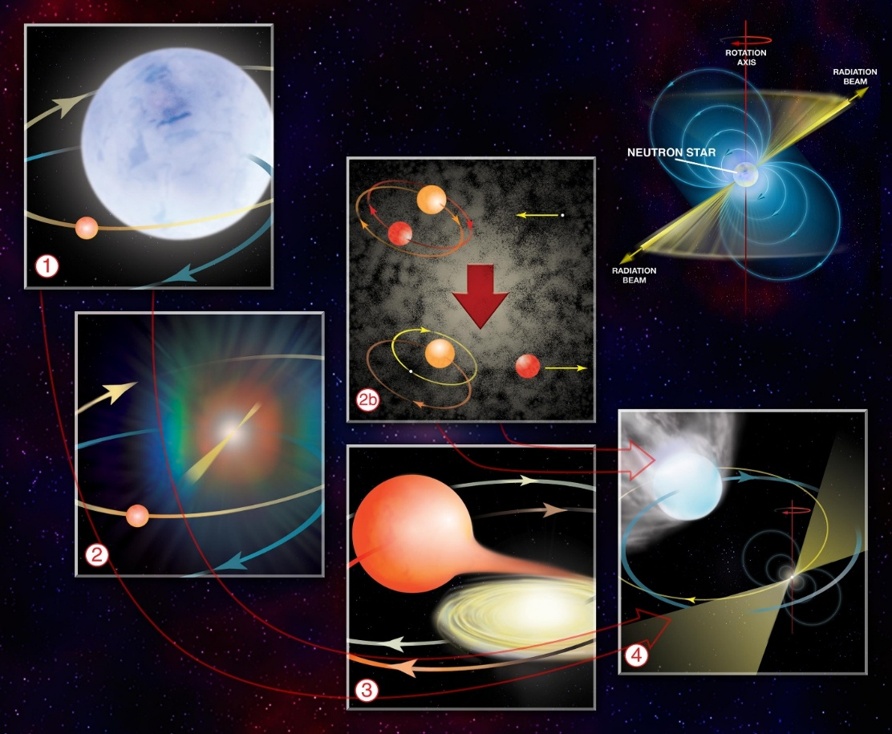

Slide 7
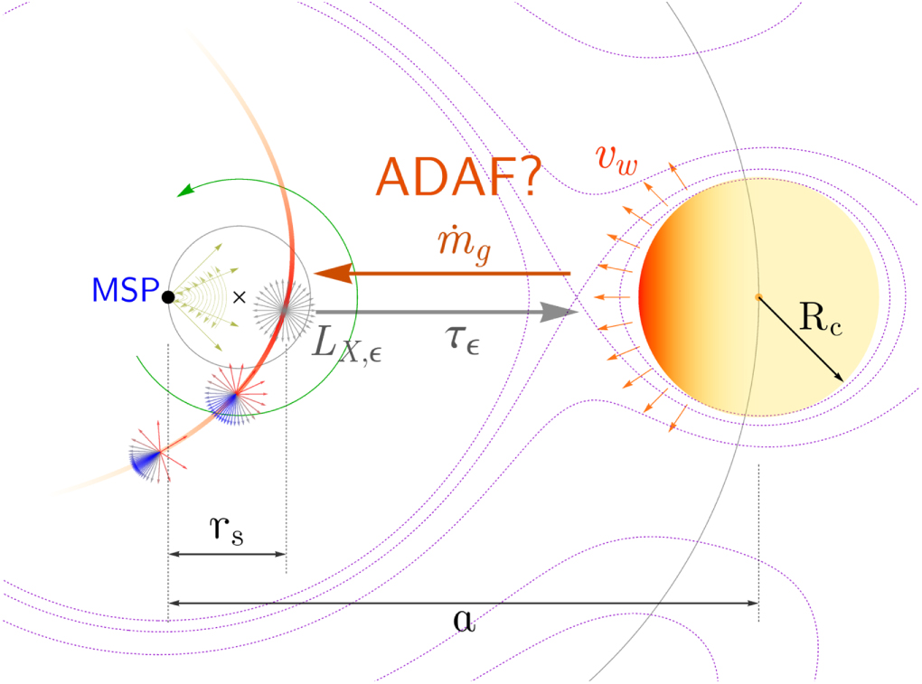
Equilibrium?
NS gravitation
Donor wind
Pulsar wind
Irradiation
NS rotation
e.g. Lipunov 1987

Slide 8
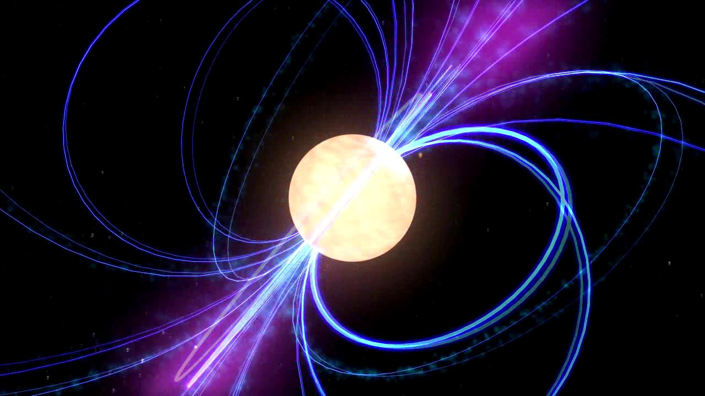
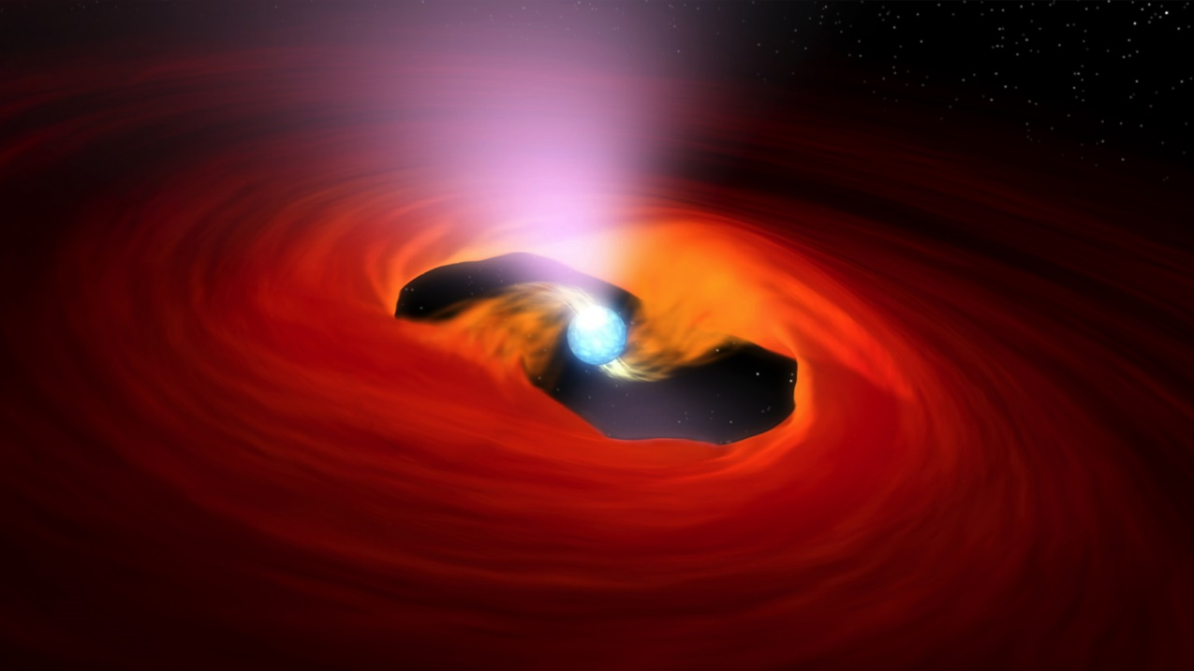
Rotation-powered Pulsars
Rotation of the e.m. field → particle acceleration
→ emission from the radio to the gamma-rays
Accretion-powered Pulsars
Matter lost by a companion star channeled
by the NS magnetic field
→ X-ray emitting hotspots/columns
Notes:
MSP also tell a story that bridges the two main characters of pulsars

Slide 9
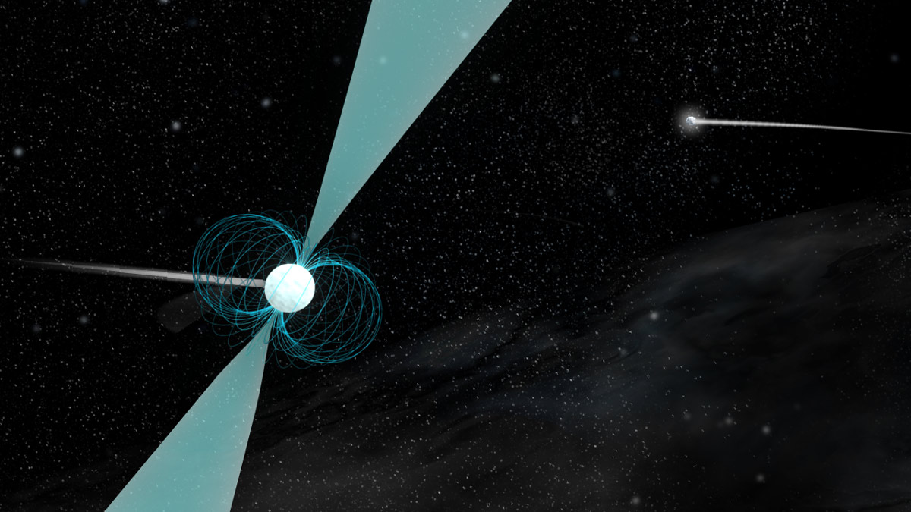
Rotation-powered millisecond pulsars

Slide 10
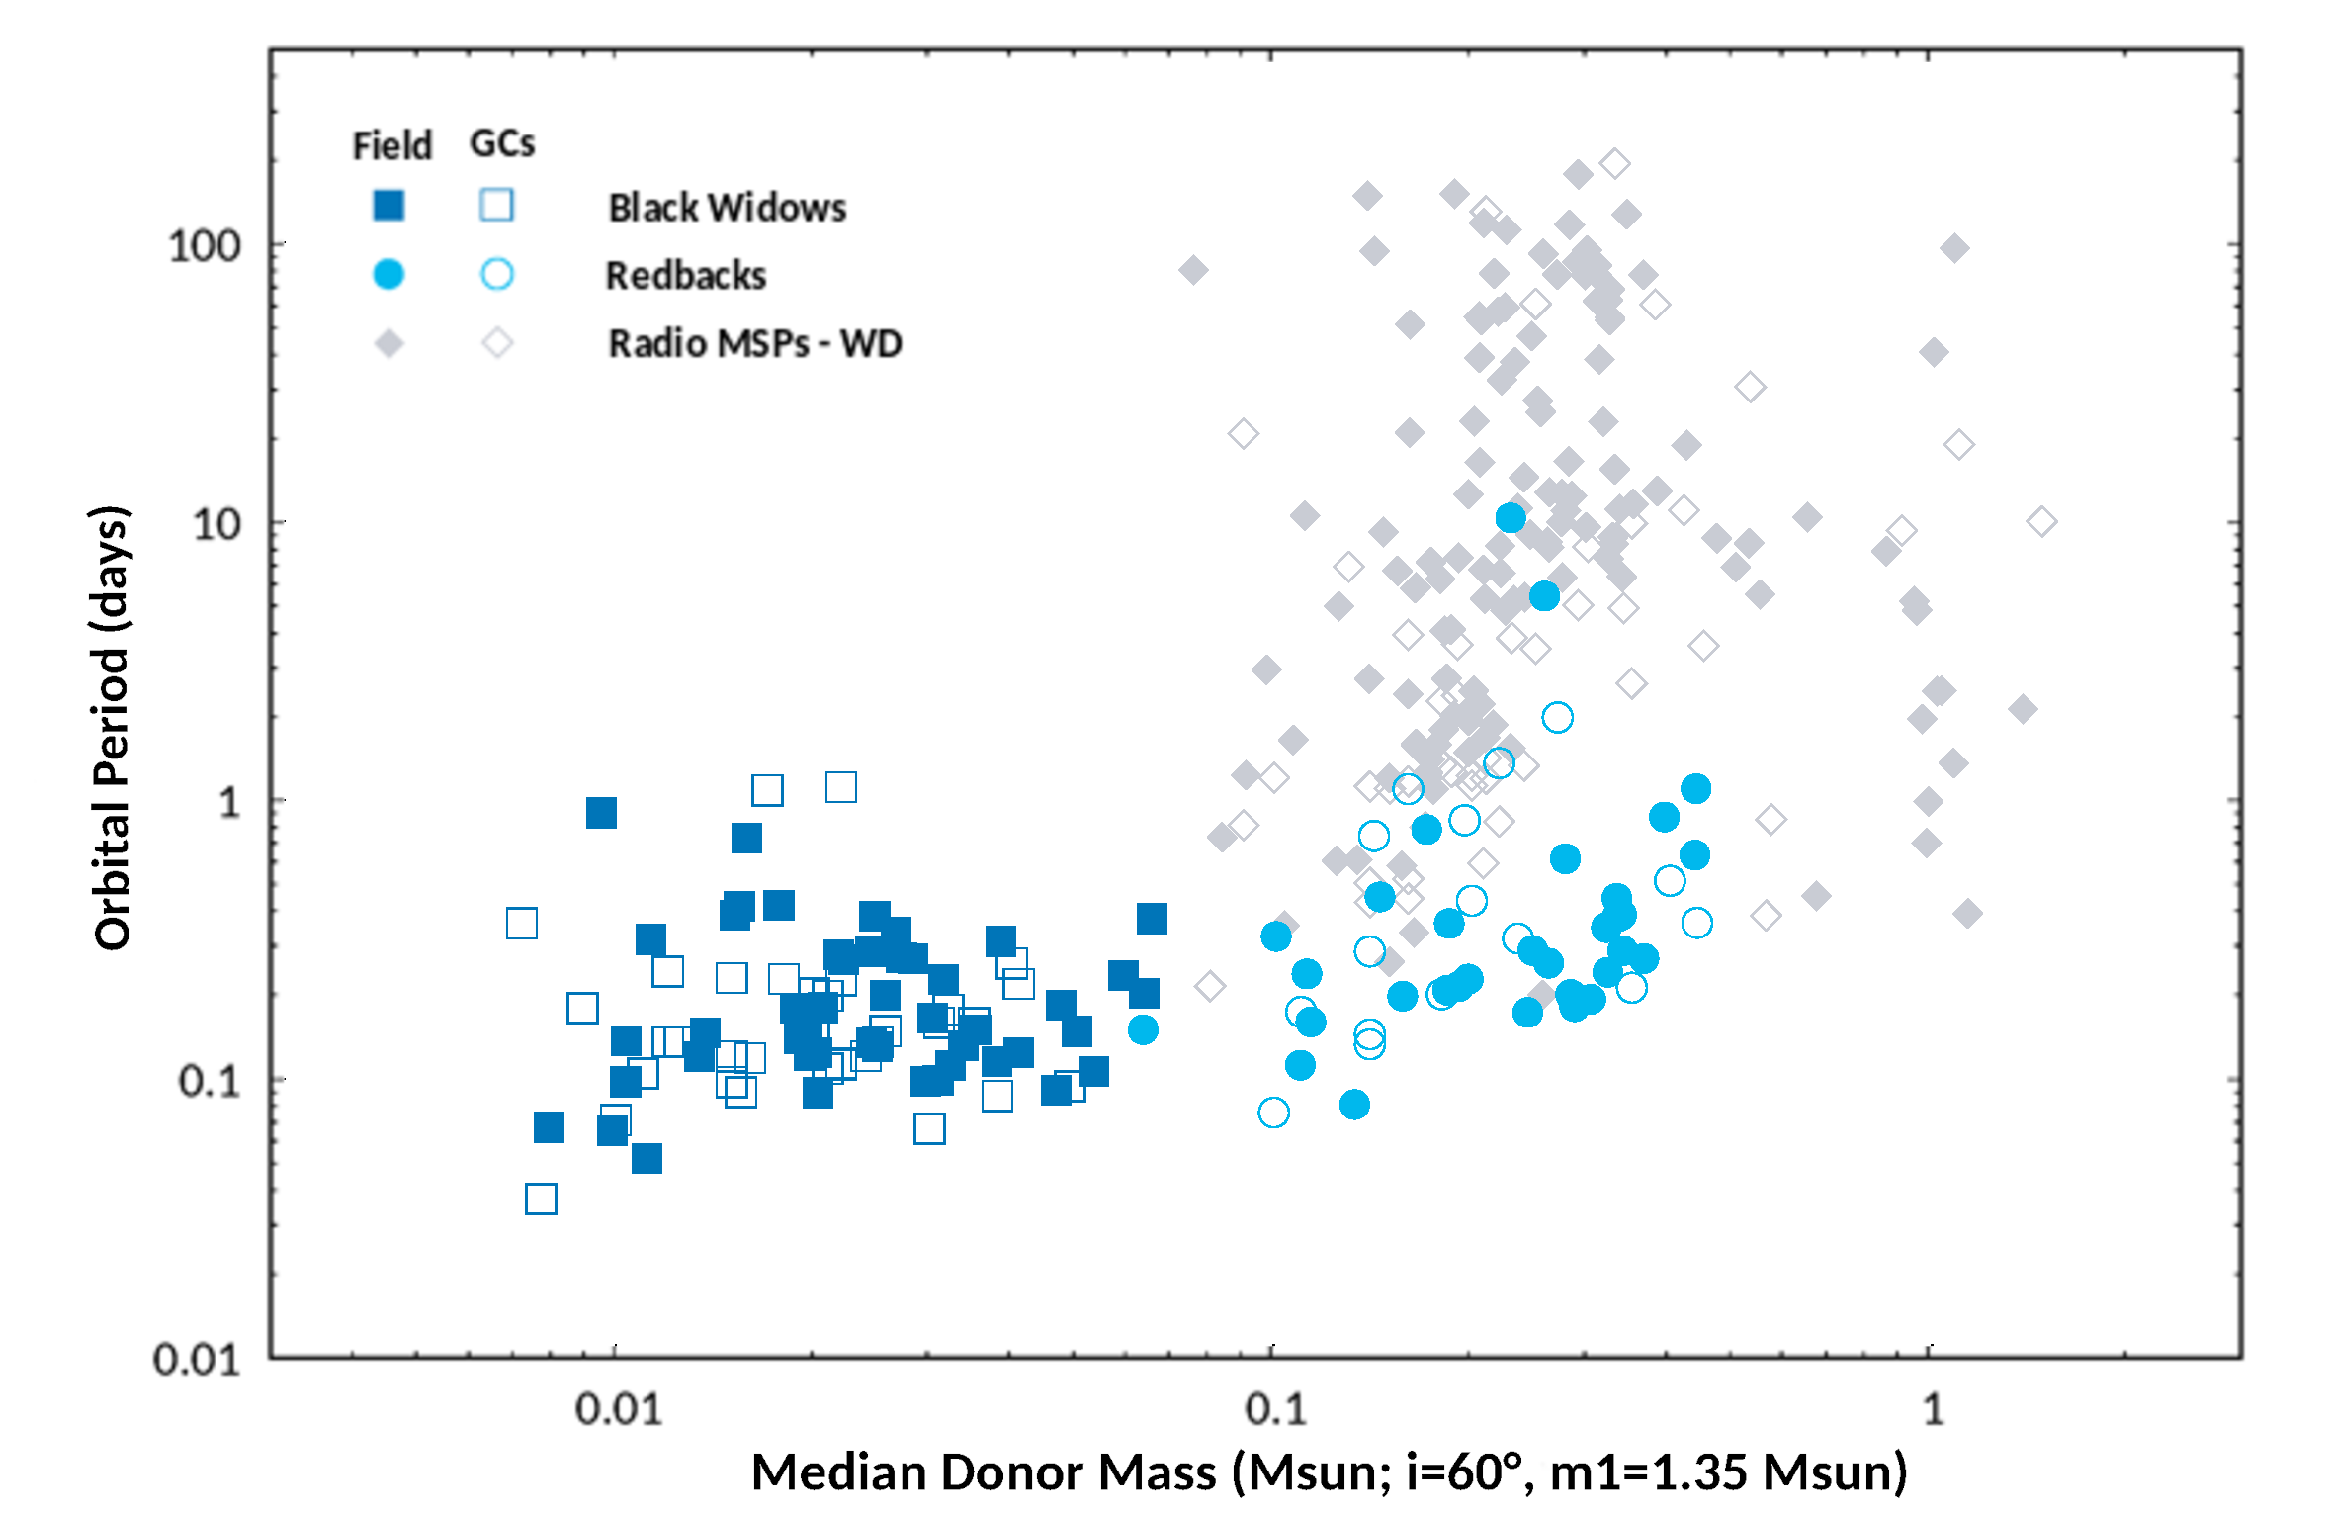
Özel & Freire 2016; Fonseca+ 2020

Slide 11
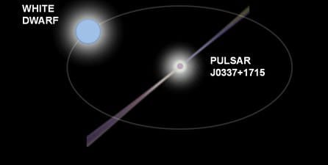
MSP + White Dwarf
(Md =0.1-0.8 M ⊙)
Özel & Freire 2016; Fonseca+ 2020

Slide 12
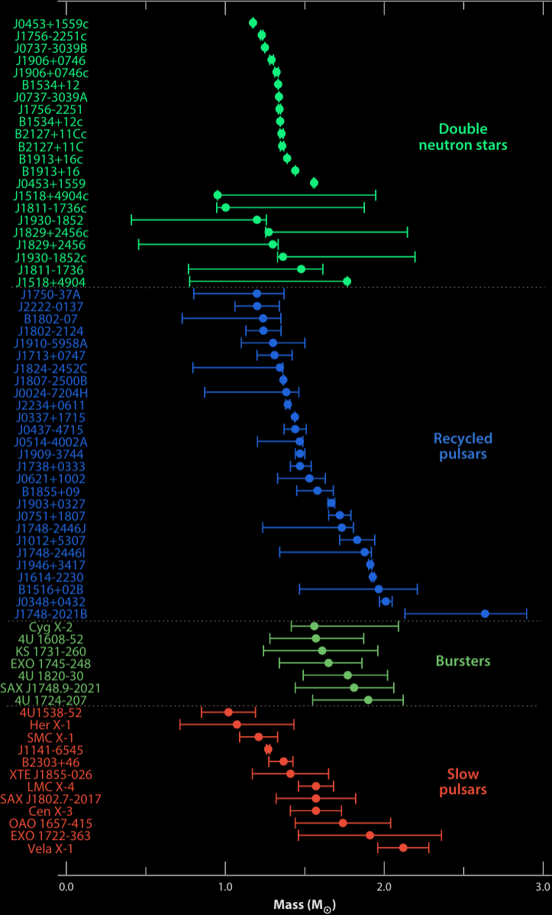
MSP + White Dwarf
(Md =0.1-0.8 M ⊙)
Özel & Freire 2016; Fonseca+ 2020

Slide 13
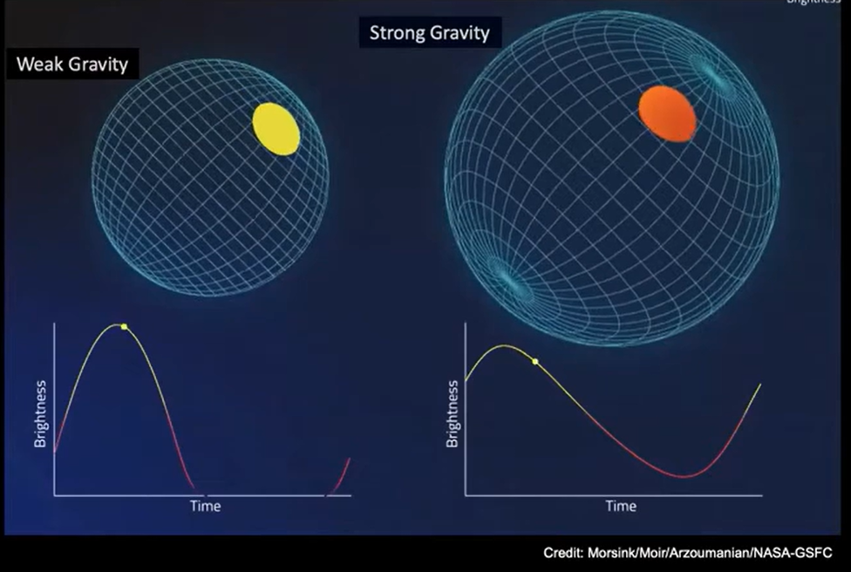

Slide 14
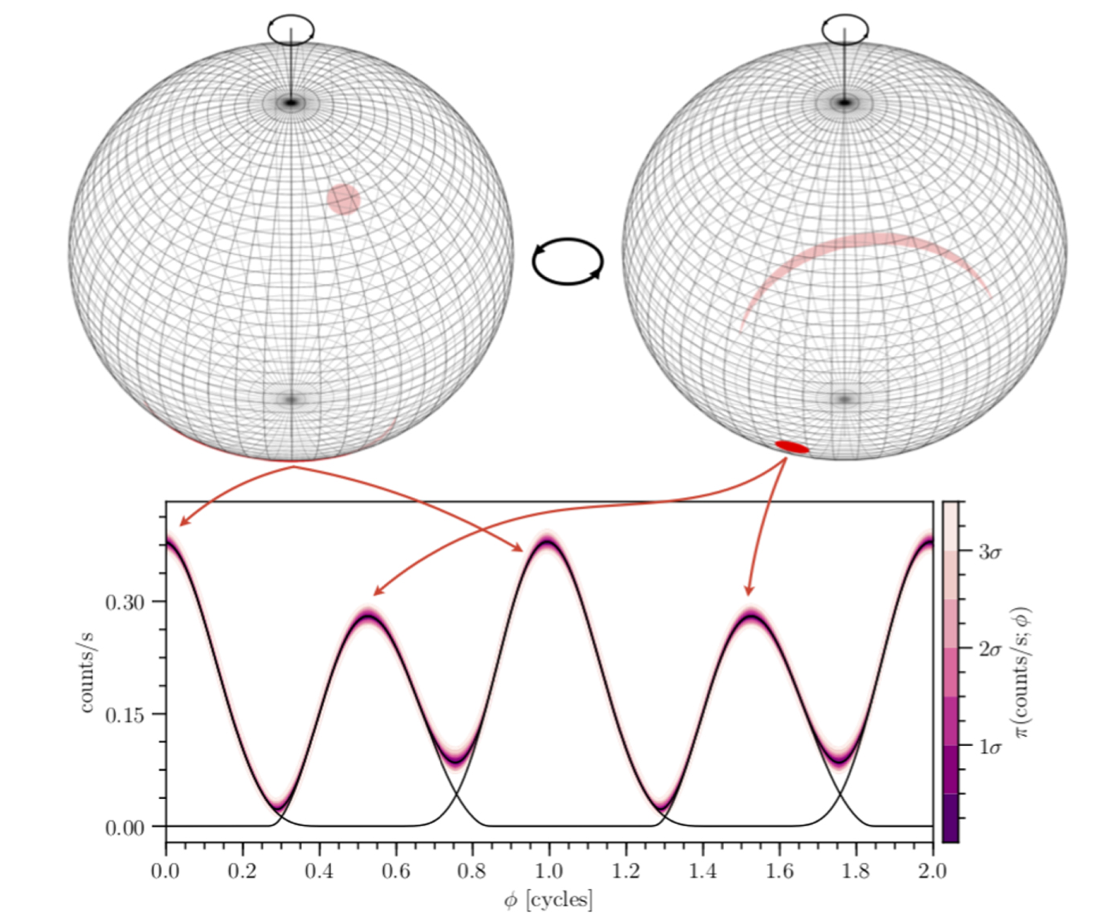
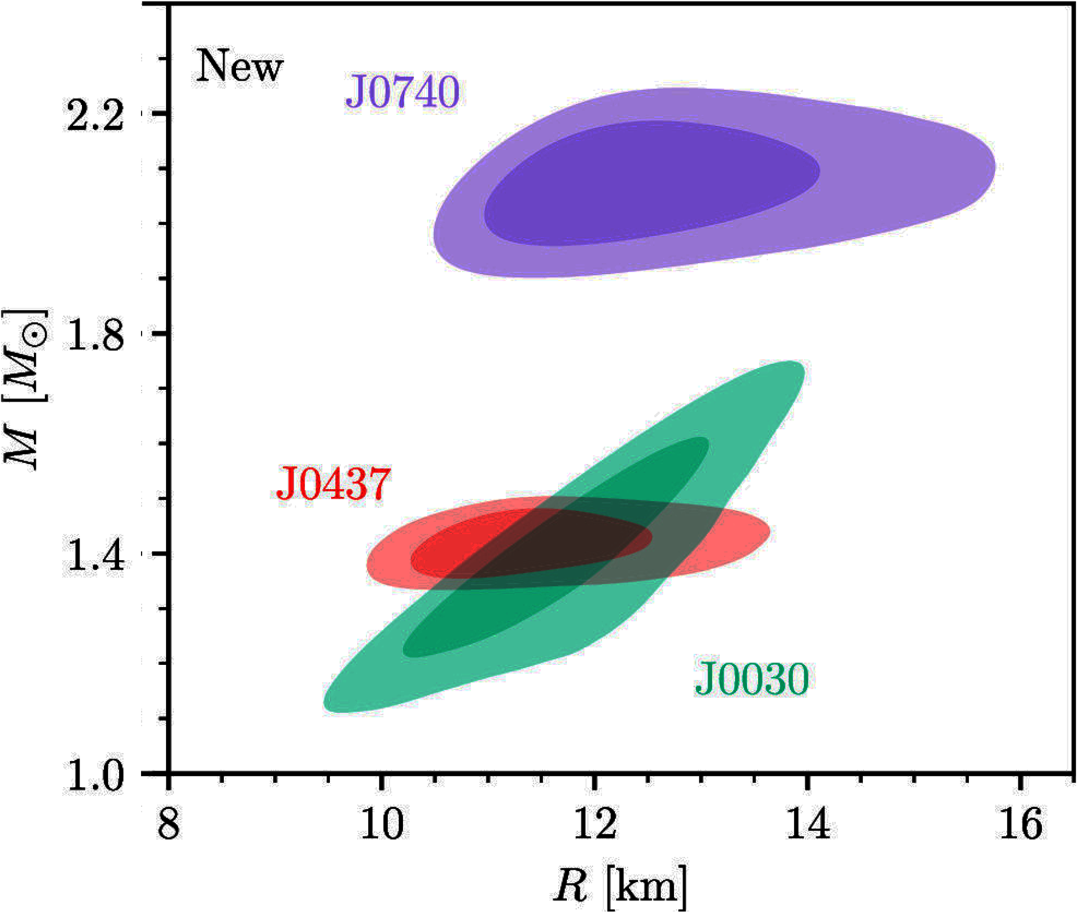
Isolated Rotation-powered pulsars
N = 3.5 x 10⁷ (for A=5%) photons required
Riley+ 2019, 2021, Miller+ 2019, 2021; Guillot+ 2019; Vinciguerra+ 2023; Choudhury+ 2024; Salmi+ 2024

Slide 15
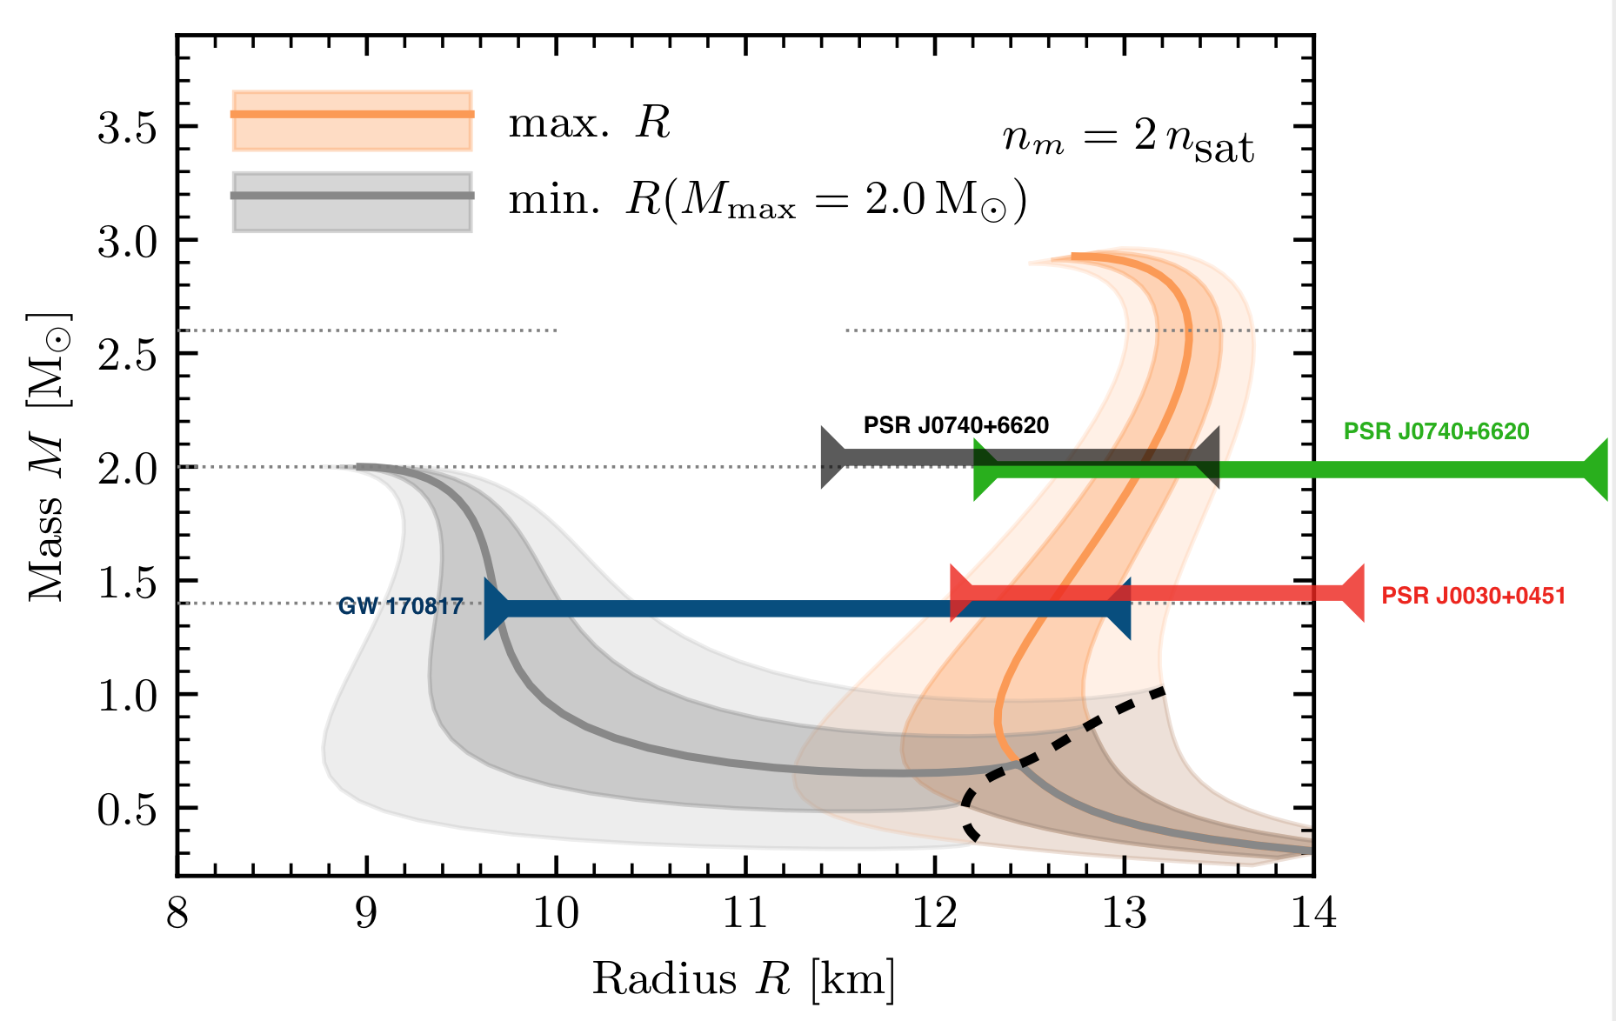
Isolated Rotation-powered pulsars
N = 3.5 x 10⁷ (for A=5%) photons required
Riley+ 2019, 2021, Miller+ 2019, 2021; Guillot+ 2019; Vinciguerra+ 2023; Choudhury+ 2024; Salmi+ 2024

Slide 16
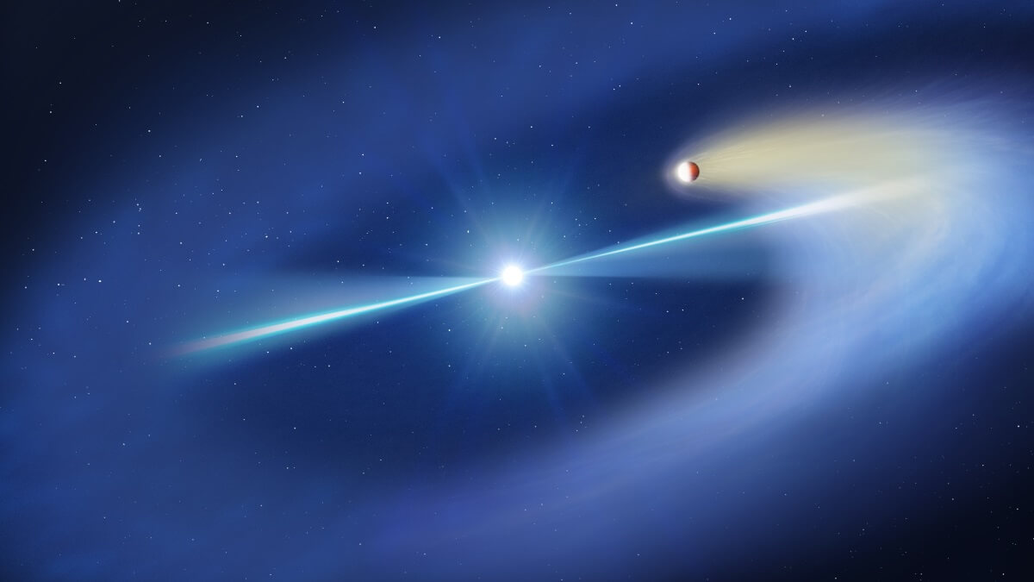
Earth-Moon distance
Spiders: Compact binary MSPs
Credit: Mark Garlick/Science Photo Library / Getty

Slide 17
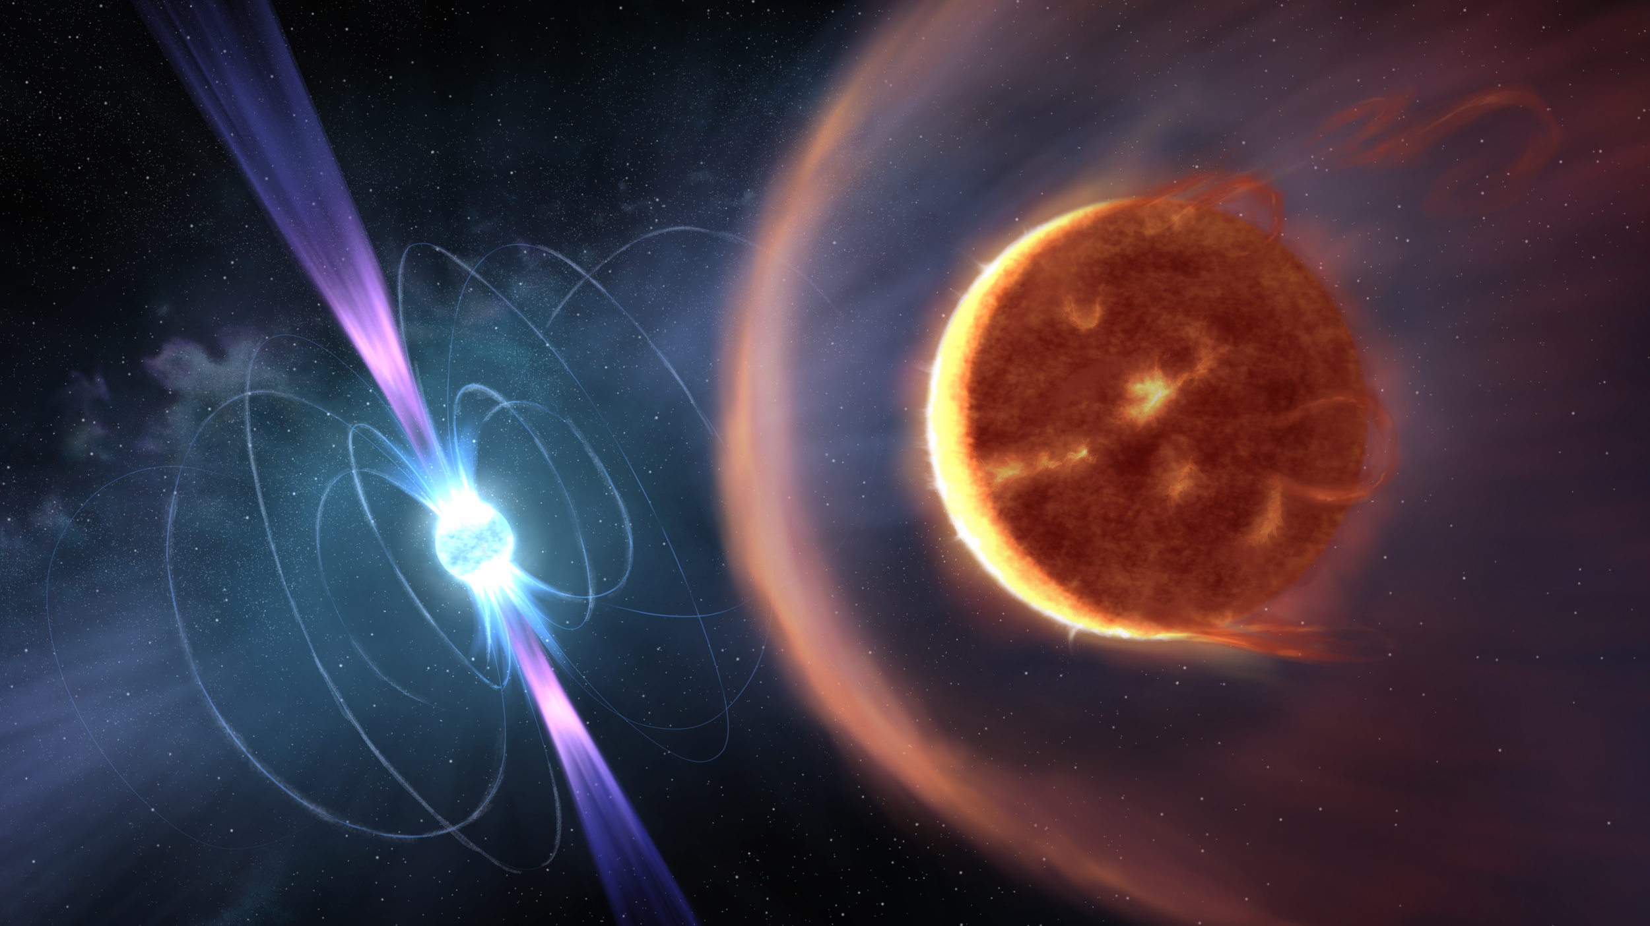
Earth-Moon distance
Credit: John A. Paice

Slide 18
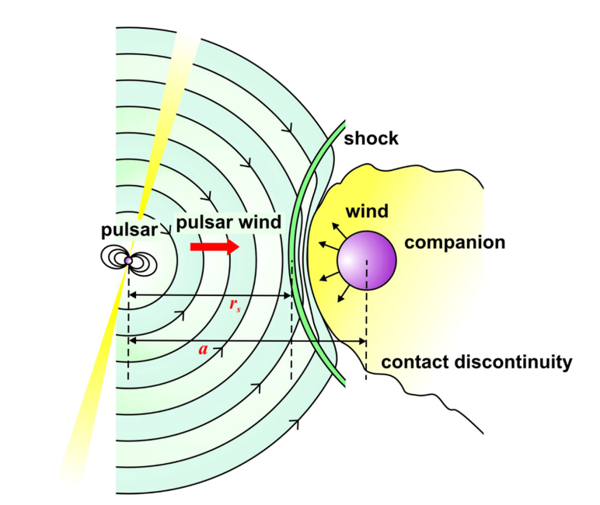
Venter+ 2015; Cortes & Sironi 2022; Harding 2022

Slide 19
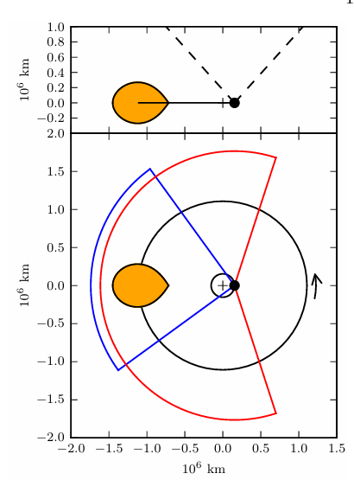
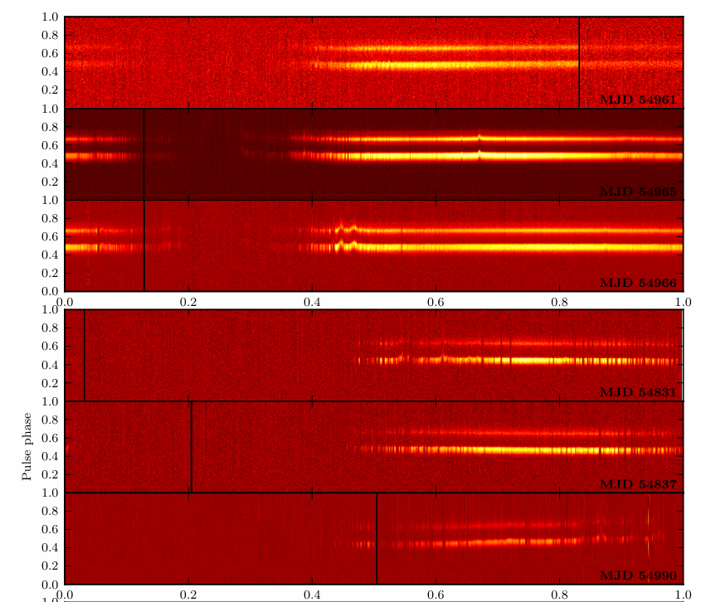
1.4 GHz
350 MHz
Archibald+ 2009, 2013

Slide 20

Redbacks
(Md =0.1-0.8 M ⊙)
Black Widows
(Md =0.01-0.1 M ⊙)
Strader+ 2018, Guillemot+ 2019, Koljonen & Linares (2025)

Slide 21
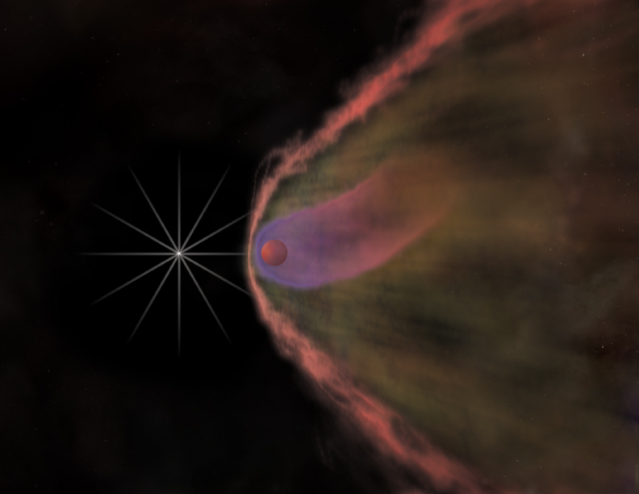
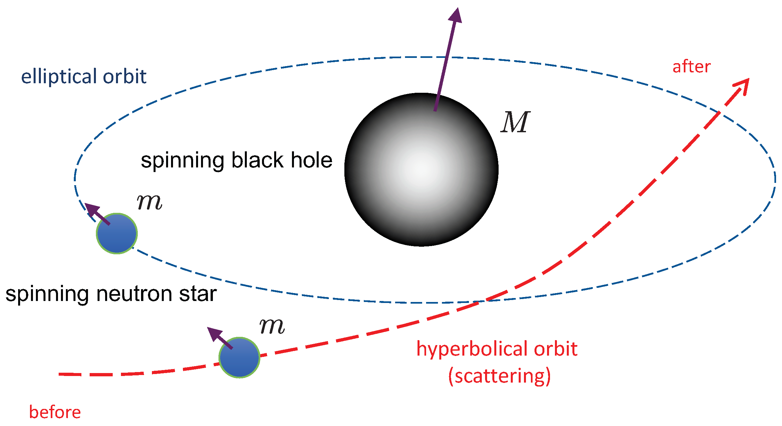
How do isolated millisecond pulsars form?
One third of the MSP population is isolated
Complete evaporation in a Black Widow pulsar
MSPs surrounded by planets
Dynamical encounters in Globular clusters

Slide 22
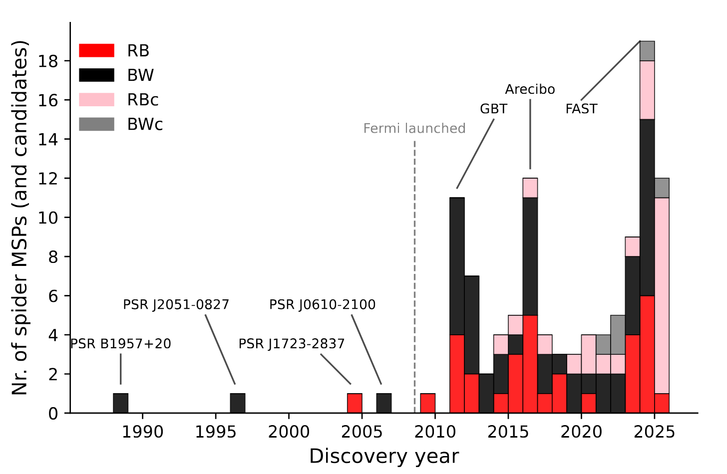
A gamma-ray driven endeavor
Koljonen & Linares 2025

Slide 23
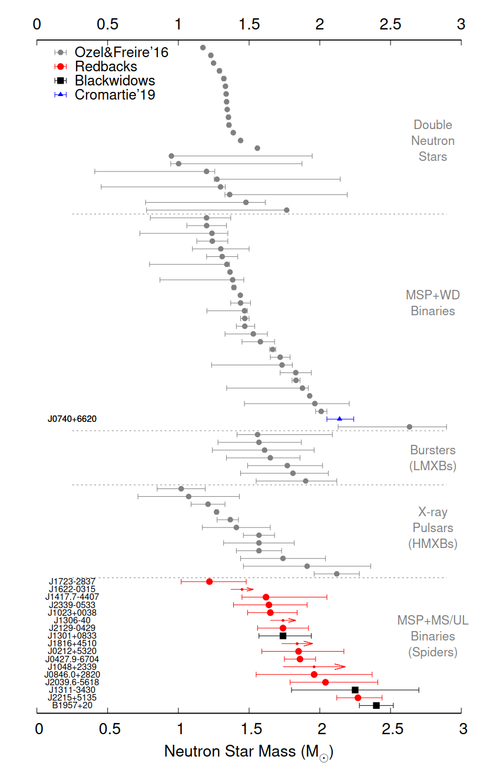
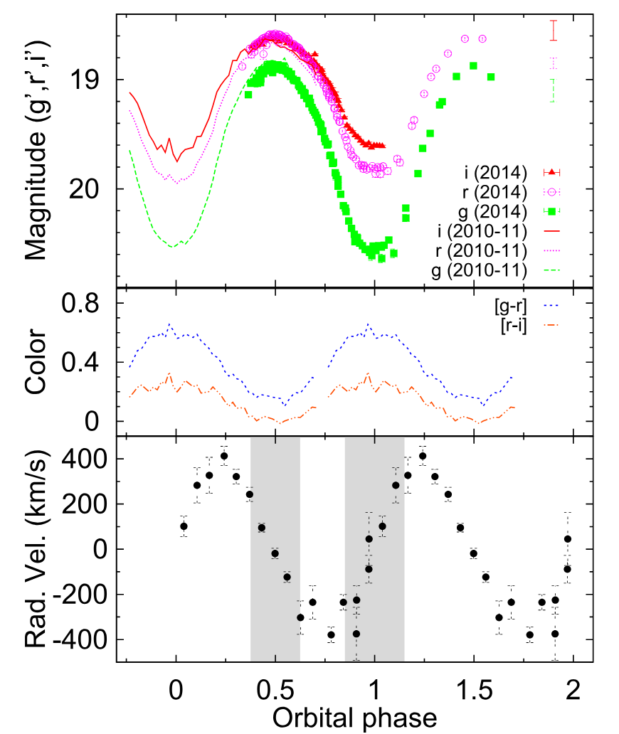
Measuring the neutron star mass
PSR J2215+5135
Redback
M_{NS} = 2.27^{+0.15}_{-0.17} M⊙
Linares+ 2018
PSR B1957+20
Black Widow
M_{NS} = 2.40 ± 0.12 M⊙
Van Keerkwijk+ 2011
van Keerkwijk+ 2011, Romani+ 2015, Linares+ 2018, Strader+ 2018, Linares 2019 Romani+ 2021

Slide 24
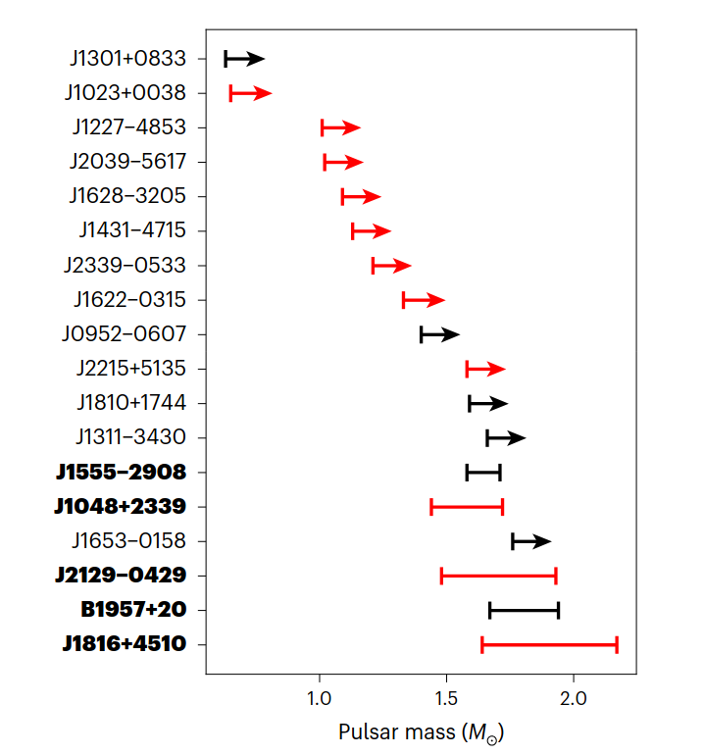
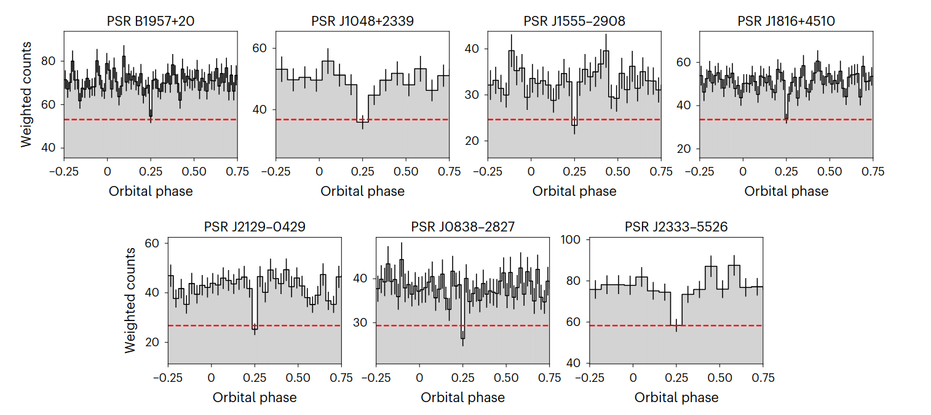
Measuring the neutron star mass
Clark, Kerr, Barr+ 2023, Nature Astronomy, 7, 451

Slide 25
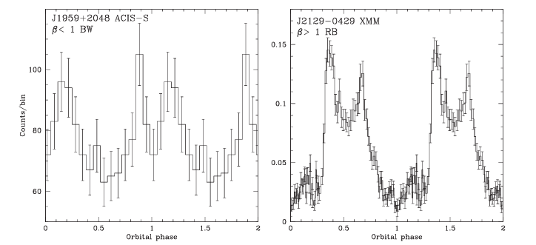
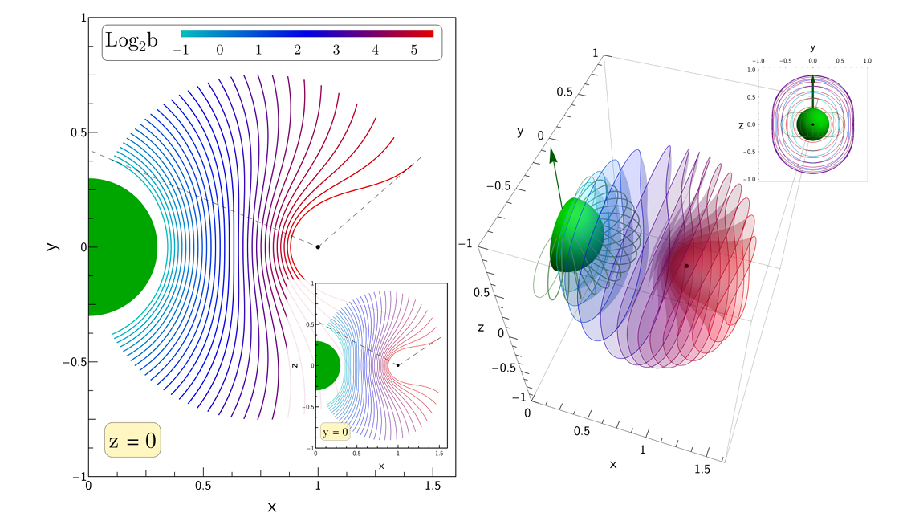
X-rays track the shape of the intra-binary shock
Black Widow Pulsars
Redback Pulsars
Shock bent around the donor
Pulsar wind >> donor wind
Shock bent around the pulsar
Donor wind/mag field >> pulsar wind
X-ray maxima close to pulsar INF conjunction
Romani & Sanches 2016; Wadiasingh+ 2017, 2018

Slide 26

The quest
for accreting
millisecond
pulsars
The quest for accreting millisecond pulsars
Credit: Bill Saxton (NRAO)

Slide 27




$$∆\text{ν}≈\frac{d\text{ν}}{dt}∆t=\frac{dM/dt}{2πI}\sqrt{GMR_{NS}}×∆t$$
For dM/dt ≈ 0.1 (dM/dt)_{Edd}= 2 x 10¹⁷ g/s
R_{acc} = R_{NS} ≈ 10 km
M_{NS} = 1.4 Msun
I = 10⁴⁵ g cm²
to reach $\text{ν}\text{f}$= 500 Hz (i.e. P ≈ 2ms)
$∆t≈ \frac{\text{ν}\text{f}}{d\text{ν}/dt}=$10⁸ years
$$∆M≈ \frac{dM}{dt}∆t=6 × {10}^{32} {g ≈0.3 M}_{sun}$$

Slide 28
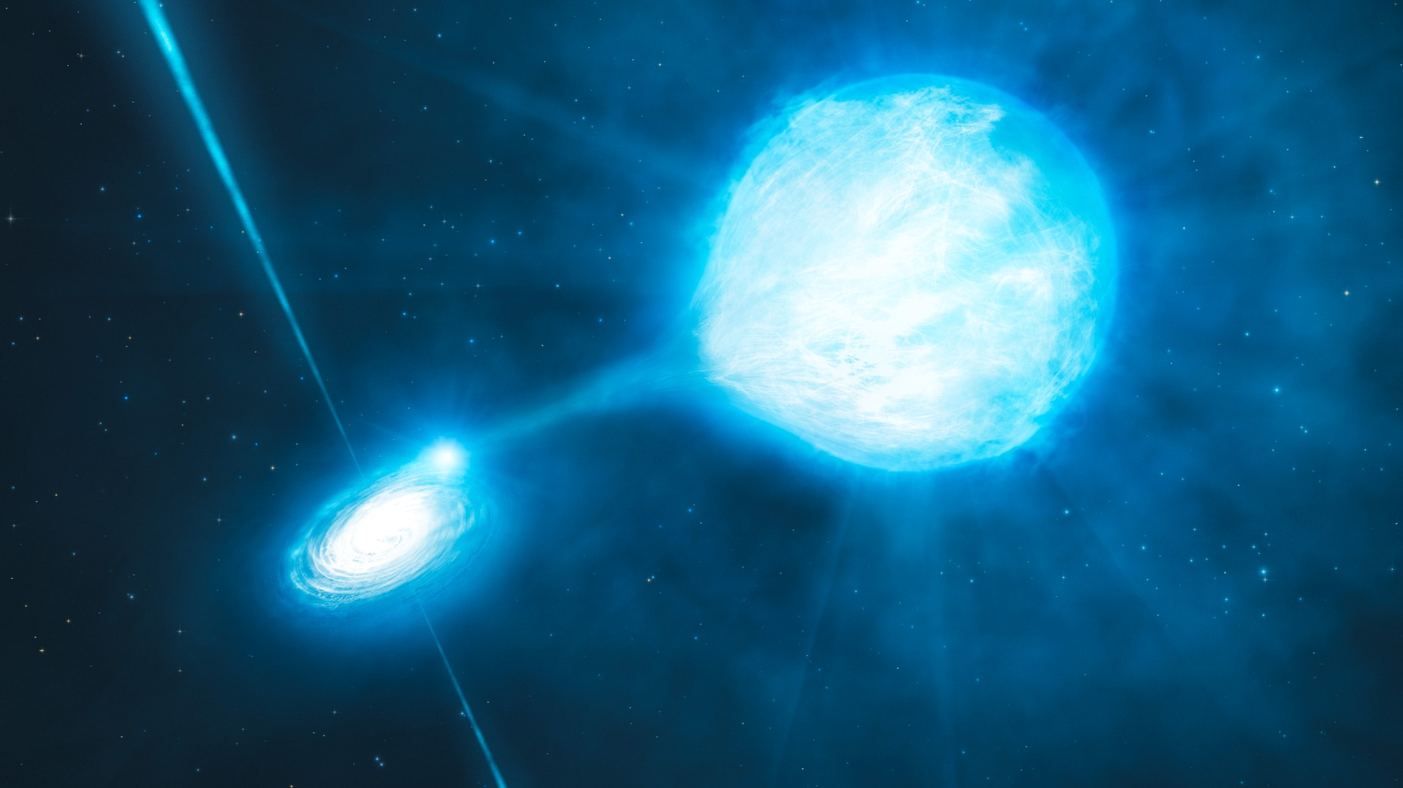
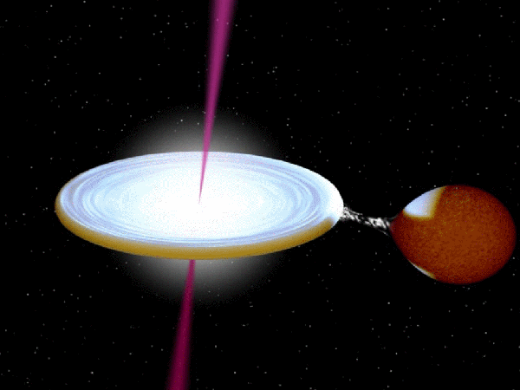
Progenitors of millisecond pulsars?
Weakly magnetized (10⁸ G), old (10 Gyr) and spun up by disk accretion
High Mass X-ray Binaries
Low Mass X-ray Binaries
Wind and/or disk mass transfer
O/B companion (1 Myr)
NS Magnetic field ≈ 10¹² G
(cyclotron lines & pulsations)
Only disk mass transfer
K/M companion (10+ Gyr)
NS Magnetic field ≈ 10⁸ G
(often no pulsations)

Slide 29

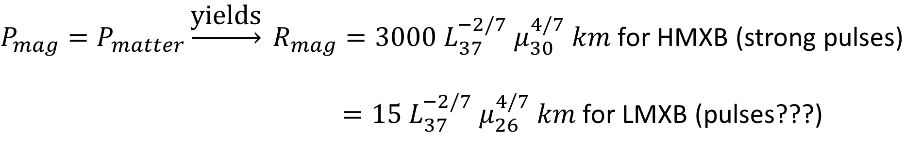

The magnetospheric radius
$$P_{matter}=\frac{\dot{M}}{4πr^{2}}\sqrt{\frac{GM}{r}}$$
$$P_{mag}=\frac{μ^{2}}{8πr^{6}}$$
$P_{mag}=P_{matter}\underset{→}{\text{yields}} R_{mag}=3000 L_{37}^{−2/7} μ_{30}^{4/7} km$ for HMXB (strong pulses)
$=15 L_{37}^{−2/7} μ_{26}^{4/7} km$ for LMXB (pulses???)
Magnetosphere of HMXBs (B ≈ 10¹² G) > 1000km -> X-ray pulsations always observed
Magnetosphere of LMXBs (B ≈ 10⁸ G) ≈ 10-20 km -> X-ray pulsations hard to detect (especially for bright systems)

Slide 30

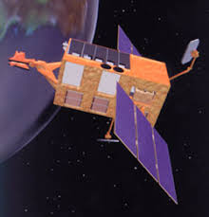
The quest for millisecond pulsars progenitors
No pulsating Low mass X-ray binary known (350 currently known in the Galaxy) until mid-nineties
Power produced by a sinusoidal signal in a Fourier spectrum
A: signal amplitude
N_{γ} = A_{eff} T_{obs} L_{source} number of photons
L_{source} cannot be too large
T_{obs} observing time limited by orbital Doppler shifts
A_{eff} effective area of X-ray telescope
1998 - Rossi X-ray Timing Explorer
- proportional counters A ≈ 6250 cm²
- time resolution ≈ 1 μs
- energy range 2-60 keV

Slide 31
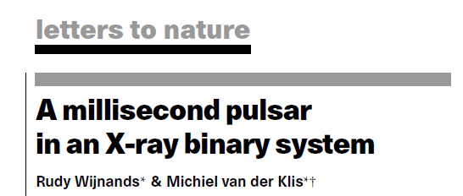
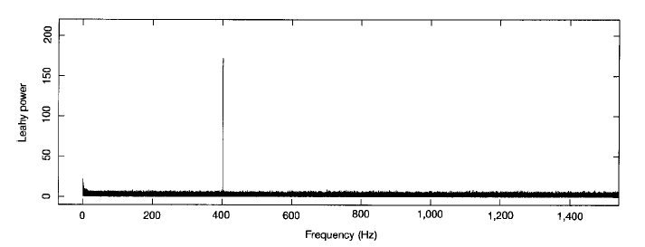
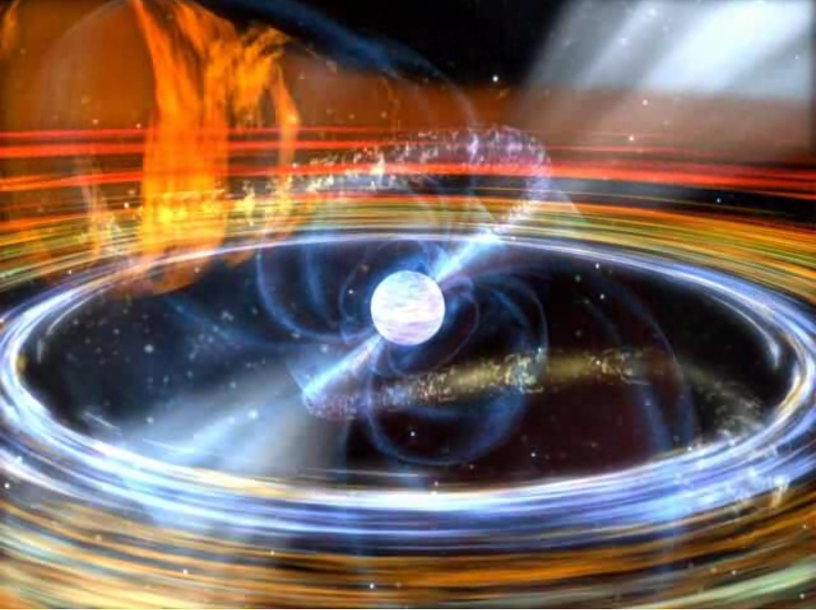
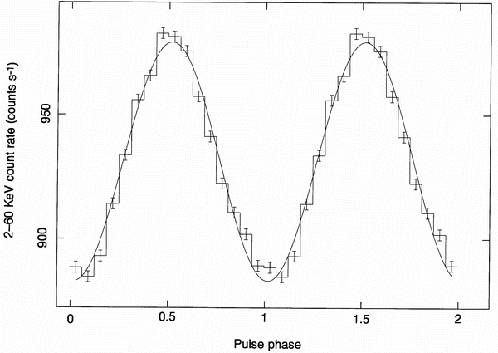

Slide 32
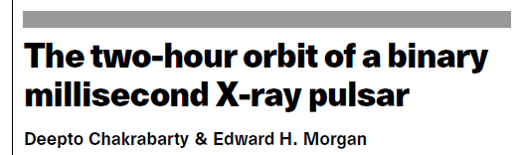
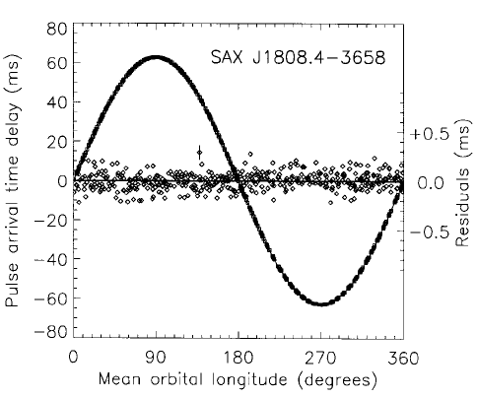
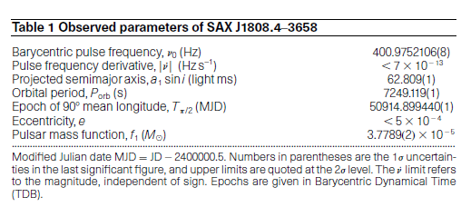
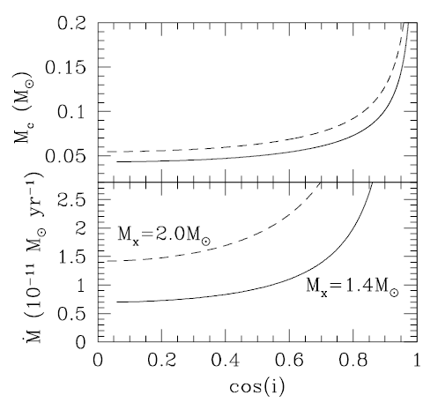

Slide 33
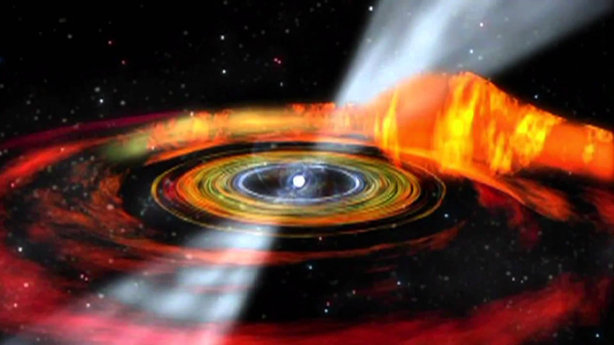
Accreting millisecond pulsars
Credit: D. Barry (NASA)

Slide 34
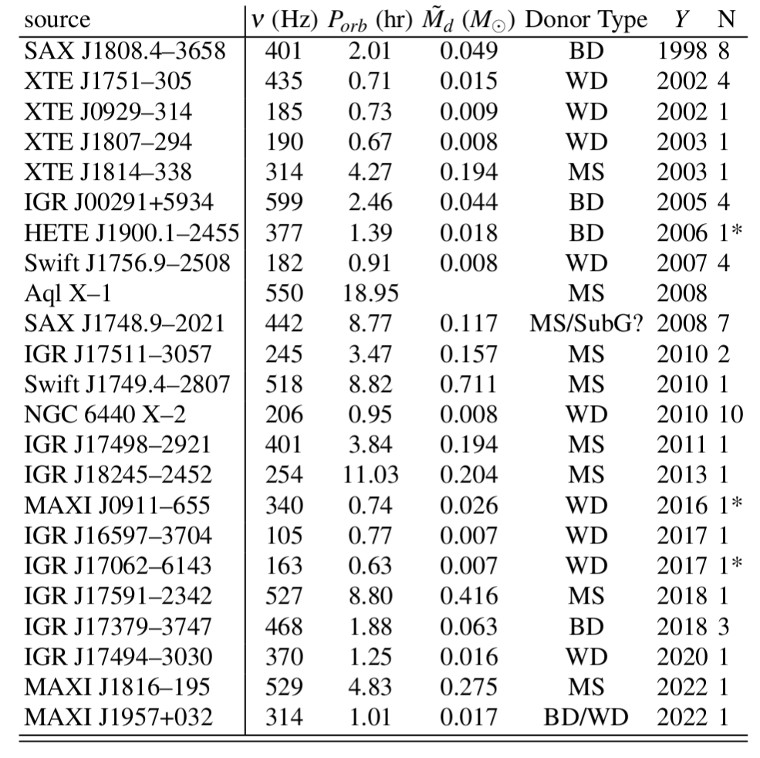
RXTE, XMM-Newton, NICER discover ~ 1 AMSP/year
Brown Dwarf
Main sequence
He/CO White Dwarf
Di Salvo, Papitto+ 2023

Slide 35
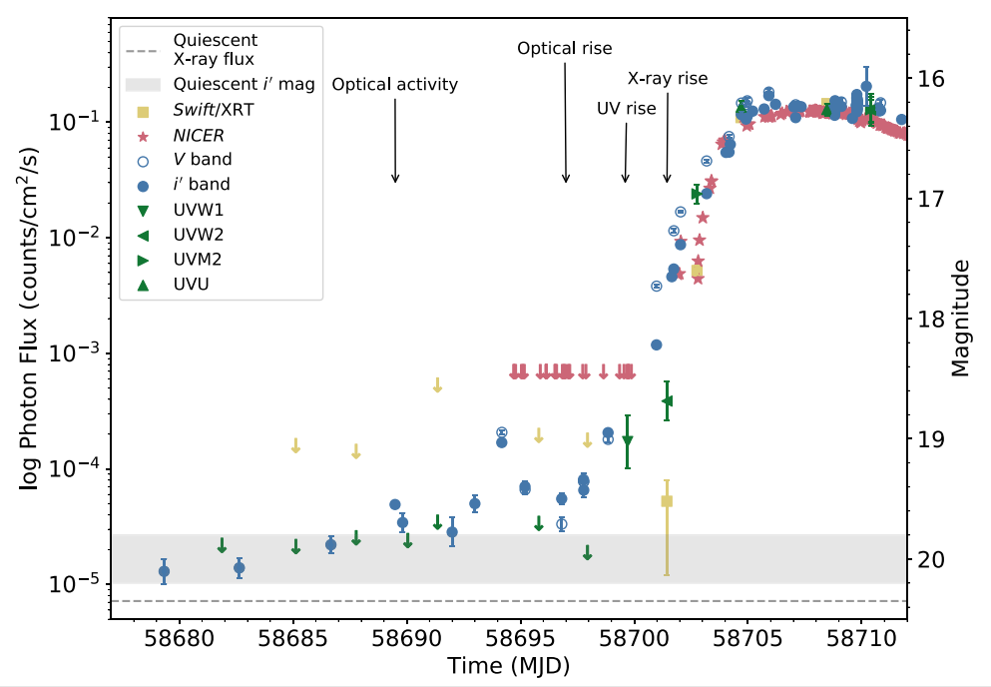
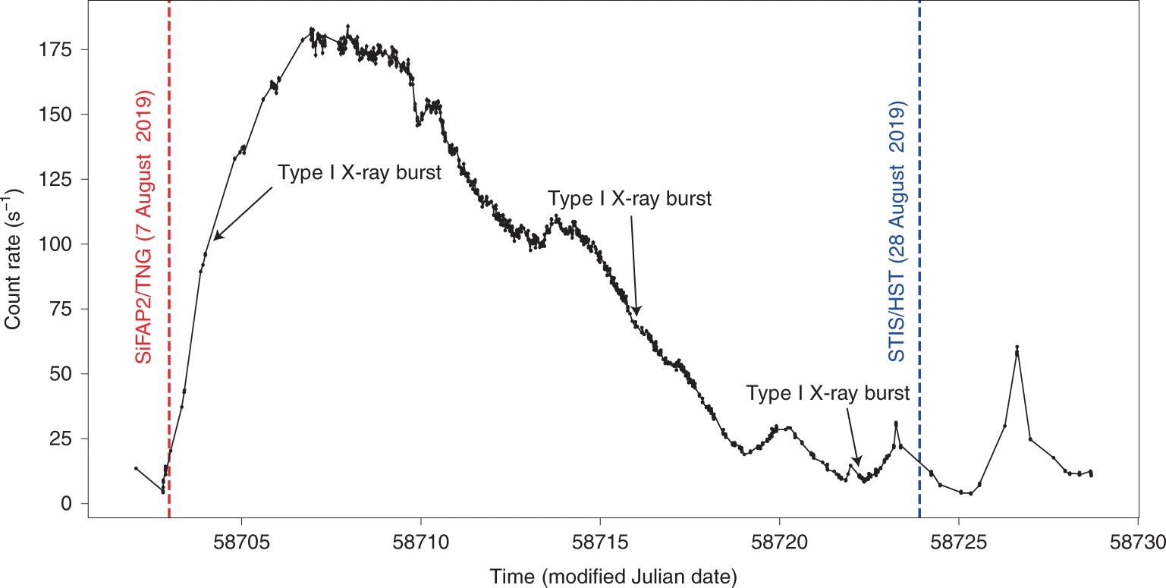
All AMSPs are X-ray transients
Peak X-ray luminosity ~ 10³⁷ erg/s ~ 5-10% Eddington rate
Outburst duration ~ a few weeks/months
Pulsations detected down to ~ 10³⁴ erg/s
Optical/UV emission (disk) precedes the X-ray emission (NS) by a few days

Slide 36
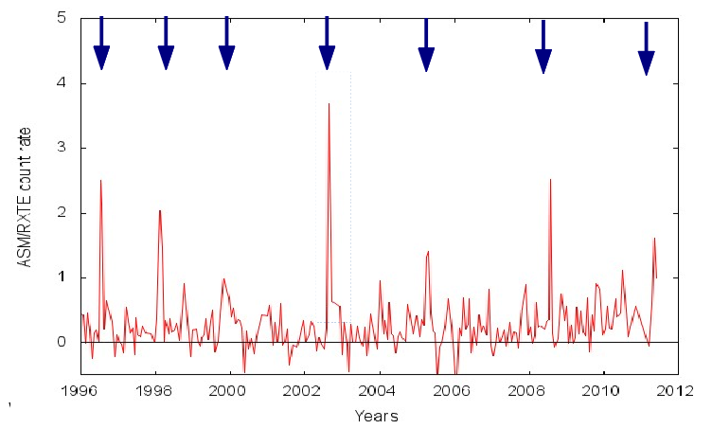

Recurrence times
Some AMSPs show outbursts every 2-3 years
Some seen only once since discovery
Transient accretion due to disk instability
caused by viscosity variations
High dM/dt -> H ionized -> high viscosity
Low dM/dt -> H neutral -> low viscosity
Disk outer edge always hot -> persistent
Disk outer edge below T_{ion} -> transient

Slide 37


The Magnetic Field of accreting MSPs
Corotation radius:
Ω_{NS} = Ω_{disk} (R_{co}) = [GM/R_{co}³]^{1/2}
Rco = 35 (P/3ms)^{-2/3} km
Alfven inner disk radius:
P_{mag} = P_{disk}
R_{in} ~ [μ⁴/2 G M (dM/dt)²]^{1/7} ~ μ^{4/7}/L_{X}^{2/7}
Observation of X-ray pulsations (i.e. accretion onto the NS surface) implies:
R_{co} ≥ R_{in} ≥ R_{ns} for L_{X}=10³⁶ erg/s → μ =10²⁶-10²⁷ G cm3 → B_{ns} = 10⁸-10⁹ G

Slide 38
Why so few AMSPs?
1000 radio MSPs
350 LMXBs
20+ AMSPs
Inner disk radius:
Rin ~ [μ⁴/2 G M (dM/dt)²]^{1/7} ~ μ^{4/7}/L_{X}^{2/7}
At a larger mass accretion rate (X-ray luminosity):
- the disk extends down to the NS surface
- the field is screened by accreting unmagnetized matter [Cumming+ 2008]
- Rayleigh-Taylor instabilities allow equatorial accretion [Romanova+ 2007]

Slide 39


Emission processes
AMSPs are always in a hard state.
Comptonization cut-off above ~50 keV
One or two thermal components
detected below 1 keV
Signature of disk reflection component

Slide 40


X-ray polarimetry measures geometry of
accreting millisecond pulsars
Two antipodal point-like spots
i = (74.1^{+5.8}_{-6.3})°
Θ₁ = (11.8^{+2.5}_{-3.5})°
Θ₂ = (172.6^{+2.0}_{-3.0})°
p1=p2=(4.0 ± 2.0)%
χ_{p}= (57.2 ± 0.5)°
Papitto, Di Marco+ 2025 (using Poutanen & Beloborodov 2006; Poutanen 2006)

Slide 41

Spin Frequency Distribution
NS break-up frequency >1 kHz, depending on equation of state.
Observed distribution compatible with
a cut-off at 730 Hz.
- Gravitational waves
(torque ~ ν⁵)
- EM spin down
(torque ~ ν³)
- Magnetic spin equilibrium
mediated by propeller torques

Slide 42



Spin evolution during outbursts
Precision timing analysis to measure the torque
exerted on the NS and compare with models
IGR J00291+5934
dν/dt = (5.1+/-0.3)x10⁻¹³ Hz/s
[Falanga+2005, Burderi+2010,
Papitto+2010]
Strong timing noise prevents a measure of the accretion torque in other systems
[Burderi+ 2006, Hartman+ 2008, Hartman+ 2009, Patruno+2012]

Slide 43

Spin down at a rate comparable to rotation powered ms radio pulsars during quiescence
Illiano, Papitto+ 2023

Slide 44


Irradiation of the companion star during quiescence
The spin down power of a radio pulsar illuminates the companion ->
Does a radio pulsar turn on during quiescence?
[Burderi+2003; Campana+2004, D'Avanzo+ 2009,2011; Cornelisse+ 2009]

Slide 45

Does a radio pulsar turn on during quiescence?

Slide 46

Magnetospheric radius: R_{m} = 15 L₃₇^{-2/7} μ₂₆^{4/7} km
NS Radius: R_{NS} ≈ 10-12 km
Co-rotation Radius: R_{co} ≈ 30 (P/2ms)^{2/3} km
Light cylinder radius: R_{LC} = cP/2π ≈ 100 (P/2ms) km

Slide 47
High density plasma in the magnetosphere
inhibits particle acceleration
(& rotation-pwd emission)
But, R_{m} ~ B^{2/7} L_{X}^{-2/7} and all AMSPs are transients
At low L_{X} -> R_{m} may exceed the light cylinder

Slide 48



An accreting ms pulsar in the globular cluster M28
IGR J18245-2452
L(X-rays) ~ 5 x 10³⁶ erg/s
Pspin = 3.9 ms
Porb = 11 hr

Slide 49


Radio PSR M28I = Accreting MSP IGR J28245-2452

Slide 50

High mass in-flow rate
Gravity dominates
Accretion-powered (X-ray) PSR
Mass in-flow rate
Low mass in-flow rate
Pulsar wind dominates
Rotation-powered (radio) PSR

Slide 51

Transitional
millisecond pulsars
Credit: ESO / M. Kornmesser

Slide 52

Transitional Millisecond Pulsars
Laccretion >> Lspindown
Laccretion << Lspindown
Archibald+ 2009; Papitto+ 2013; Bassa+ 2014; Linares+ 2014; See review by Papitto & de Martino 2022

Slide 53
Transitional Millisecond Pulsars
Laccretion >> Lspindown
Laccretion ≈ Lspindown
Laccretion << Lspindown
Archibald+ 2009; Papitto+ 2013; Bassa+ 2014; Linares+ 2014; See review by Papitto & de Martino 2022

Slide 54
A sub-luminous disk state
Accretion-power features
Disk emission lines
Thorstensen+ 2000

Slide 55
A sub-luminous disk state
Accretion-power features
Disk emission lines
X-ray pulsations & sudden variability
Linares 2014, Linares+ 2014, Patruno+ 2014, Bogdanov+ 2015, Archibald+ 2015, Campana+ 2016

Slide 56
The faintest X-ray pulsators
L_{X} ≈ 10³⁴ erg/s -> R_{m} ≈ 100 km > R_{co} = 30 km
Propeller ejection? [Papitto+ 2014,15]

Slide 57
A sub-luminous disk state
Accretion-power features
Disk emission lines
X-ray pulsations & sudden variability
Bright compact radio jets
Deller+ 2015, Bogdanov+ 2018, Coti Zelati+ 2021, Baglio+ 2023, Koljonen+ 2025

Slide 58



Radio and mm flares during X-ray low modes
Radio vs X-rays
X-rays
mm
Bogdanov+ 2018; Baglio+ (incl. Papitto) 2023

Slide 59
A sub-luminous disk state
Baglio+ (incl. Papitto) 2025
Accretion-power features
Disk emission lines
X-ray pulsations & sudden variability
Bright compact radio jets
Rotation-power features
Radio pulsar-like spin down (within 5%)
Jaodand+2016, Burtovoi+ (incl. Papitto) 2021, Baglio+ (incl. Papitto) 2025

Slide 60

A sub-luminous disk state
radio psr state
disk state
Accretion-power features
Disk emission lines
X-ray pulsations & sudden variability
Bright compact radio jets
Rotation-power features
Radio pulsar-like spin down (within 5%)
Bright gamma-ray emission (as bright as Xrays)
de Martino+ 2010, Stappers+ 2014, Torres+ 2018; Jaodand+2016, Burtovoi+ 2021; Baglio+ 2025

Slide 61

A sub-luminous disk state
Accretion-power features
Disk emission lines
X-ray pulsations & sudden variability
Bright compact radio jets
Rotation-power features
Radio pulsar-like spin down (within 5%)
Bright gamma-ray emission (as bright as Xrays)
de Martino+ 2010, Stappers+ 2014, Torres+ 2018; Jaodand+2016, Burtovoi+ 2021; Baglio+ 2025

Slide 62


How to identify a candidate transitional MSP?
See Illiano+ 2025
Halpern & Bogdanov 2018; Miller+2020, Coti Zelati+ 2021, Manca+ 2025, Kyer+ 2025, Illiano+ 2025

Slide 63

What powers the sub-luminous disk state emission?
- Enshrouded rotation-pwd pulsar
- Propellering pulsar
- Low Mdot accretion
What drives the high/low mode switching?
Linares+ 2014, Coti Zelati+2014, Takata+ 2015, Papitto+ 2014, 2015, Campana+ 2016, Papitto & de Martino 2022

Slide 64



SiFAP2 at the Telescopio Nazionale Galileo
Ambrosino, Papitto+ 2017, Nature Astronomy; Miraval Zanon+ 2022

Slide 65

Optical/UV pulsations from a transitional MSP
PSR J1023+0038
10000 c/s (V ≈ 16.5 mag)
Pulse amplitude ∼ 0.1-1%
L_{pulsed} ≈ 0.1% L_{SpinDown}
Ambrosino, Papitto+ 2017, Nature Astronomy; Miraval Zanon+ 2022

Slide 66
Stunningly bright optical pulsations: accretion-powered?
Cyclotron emission from accretion column?
PSR J1023 L_{obs} = few x 10³¹ erg/s
50x beaming required
E_{cyc} = 1 (B / 10⁸ G) eV
L_{cyc} = 3x10²⁹ (r_{spot} / 5 km)² erg/s
Lamb & Masters 1979

Slide 67

PSR J1023
L = 2x10⁻⁴ Lsd
>50x Crab PSR efficiency
Stunningly bright optical pulsations: rotation-powered?
Radio pulsars
L=10⁻⁵-10⁻⁸ Lsd
Updated from Ambrosino, Papitto+ 2017, Nature Astr.; Malacaria, Papitto+ 2025, in prep.

Slide 68
A single process to explain optical/UV/X-ray pulses
Similar pulse shape
Papitto+ 2019; Illiano, Papitto+ 2023

Slide 69

A single process to explain optical/UV/X-ray pulses
Similar pulse shape
Simultaneously disappear during X-ray low modes
Papitto+ 2019

Slide 70
A single process to explain optical/UV/X-ray pulses
Similar pulse shape
Simultaneously disappear during X-ray low modes
SED of pulsed emission:
a single non-thermal process?
Papitto+ 2019

Slide 71
A single process to explain optical/UV/X-ray pulses
Similar pulse shape
Simultaneously disappear during X-ray low modes
SED of pulsed emission:
a single non-thermal process?
Polarized emission:
PA and SED compatible
Baglio, Coti Zelati+ (incl. Papitto) 2025

Slide 72


Coexistence of Rotation & Accretion-power
Papitto+ 2019; Veledina, Nättila, Beloborodov 2019 (simulations by Parfrey+ 2017)

Slide 73
Coexistence of Rotation & Accretion-power
Pulsar wind terminated by the
accretion disk at r≈100 km
Pulses from the interaction between the pulsar striped wind and the mass in-flow
Cerutti & Beloborodov 2017; Papitto+ 2019; Veledina, Nättila, Beloborodov 2019; Richard Romei, Papitto in prep.

Slide 74

A stunningly bright accreting MSP
Credit: Dana Berry (Skyworks Digital)

Slide 75

Optical and UV pulsations from an accreting MSP
SAX J1808.4-3658
August 2019 outburst (confirmed in August 2022 and 2025)
L_{X-rays} = 10³⁵ erg/s
A_{opt} ≈ A_{UV} ≈ 1-2%
Ambrosino, Miraval Zanon, Papitto+ 2021, Nature Astr.; Ballocco, Papitto+ 2025

Slide 76

Optical and UV pulsations from an accreting MSP
Accretion-powered (L_{X}>>Lsd)
Most efficient optical pulsar
Accretion-powered optical pulses
Strongly beamed?
Coexistence of accretion
and rotation power?
Ballocco, Papitto, Miraval Zanon in prep.

Slide 77
A candidate optical rotation-powered MSP
Credit: Mark Garlick/Science Photo Library / Getty

Slide 78


Optical pulsations from a rotation-pwd redback?
PSR J2339-0533
m_{V}^{pulsed} = (26.0+/-0.6) mag
False Alarm Prob. (0.4-4) x 10⁻³
Papitto+ 2025, arXiv:2508.08760; Malacaria+ in prep.

Slide 79

Optical pulsations from a rotation-pwd redback?
PSR J2339-0533
m_{V}^{pulsed} = (26.0+/-0.6) mag
False Alarm Prob. (0.4-4) x 10⁻³
Papitto+ 2025, arXiv:2508.08760; Malacaria+ in prep.

Slide 80
Are all millisecond pulsars in Porb<1day binaries transitional?
Rotation-powered
Accretion-powered

Slide 81
A few open questions…
What drives the variations of the mass in-flow rate?
Magnetic activity, Photospheric mass transfer,
Tidal interactions, Mass accumulation
Are all millisecond pulsars in Porb<1day binaries transitional?
What is the process powering the sub-luminous disk state?
What powers optical/UV pulsations of ms pulsars?

Slide 82






The MSP@OAR team
www. oa-roma.inaf.it/heag
Filippo Ambrosino, Caterina Ballocco, Giulia Illiano, Riccardo La Placa, Christian Malacaria, Arianna Miraval Zanon, Alessandro Papitto
Supprted by CARIPLO/CdP SPES grant 2023-2560,
PRIN MUR 2020 (GEMS - 2020BRP57Z)
& INAF Large Grant (FANS, PULSE-X)

Slide 83

www.oa-roma.inaf.it/heag/

Slide 84
Millisecond pulsars
- Lorimer 2008, https://arxiv.org/abs/0811.0762
Kramer 2004, https://arxiv.org/pdf/astro-ph/0405178.pdf
Bhattacharya S., Papitto, A., Bhattacharyys, S., Millisecond Pulsars, 2022, Springer, https://link.springer.com/book/10.1007/978-3-030-85198-9
Recycling scenario
- Verbunt ARA&A 1993, 31, 93
- Tauris & van den Heuvel 2003, astro-ph:0303456
- Bhattacharya & van den Heuvel 1991, Phys. Rep, 1, 124
Accreting ms pulsars
- Patruno & Watts 2012, arXiv:1206.2727
- Campana & Di Salvo 2018, arXiv: 1804.03422
- Di Salvo & Sanna 2020 arXiv: 2010.09005
Transitional & optical ms pulsars
- Archibald et al. 2009, Science, arXiv:0905.3397
- Papitto et al. 2013, Nature, arXiv:1305.3884
- Papitto & de Martino 2022, arXiv: 2010.09060
- Ambrosino, Papitto et al. 2017, Nature Astronomy, arXiv:1709.01946

Slide 85

https://link.springer.com/book/10.1007/978-3-030-85198-9

