Slide 1
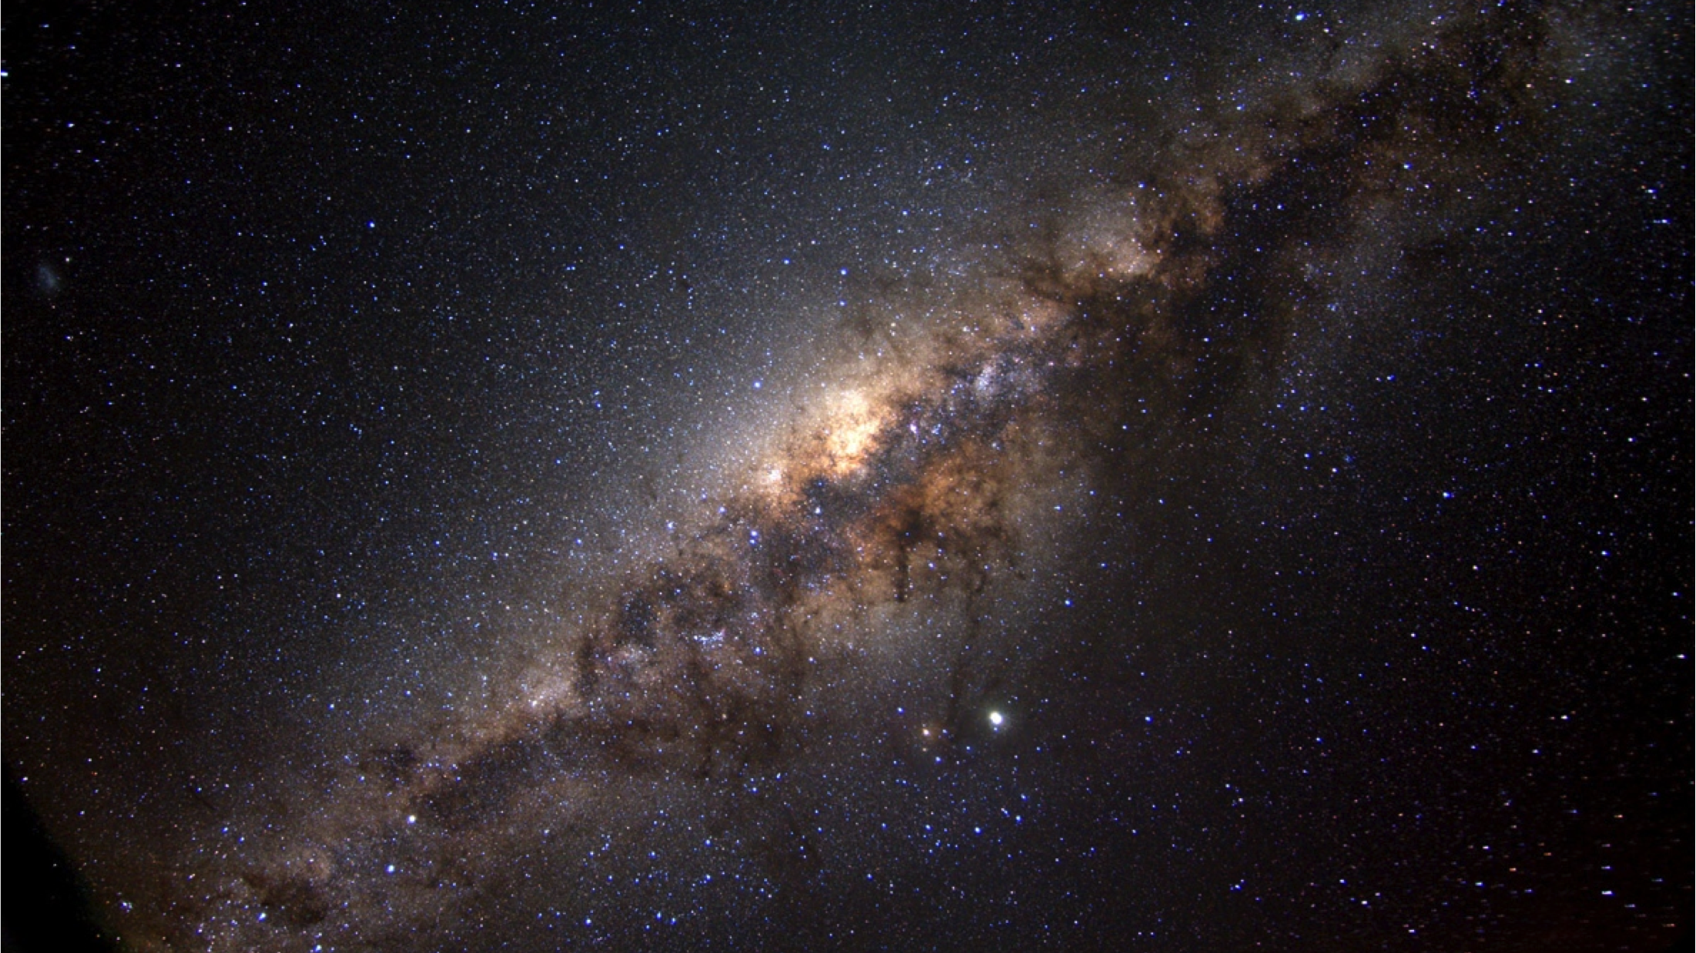
The role of giants and variables in tracing the Milky Way bulge
Elena Valenti
European Southern Observatory

Slide 2
PART II

Slide 3
To recap ……
From the study of RC giants stars we we have learned that:
The bulge is a massive Galactic component (M = 2 x 10¹⁰M☉ in stars and remnants )
The bulge is a bar with a pivot angle ~27º, and has a B/P/X-shape in the outer regions
The central axisymmetric density peak is likely responsible for the change of the observed pivot angle in the innermost regions (i.e., no inner/nuclear bar)
The long thin bar is the natural extension of the main bar at large longitude
The bulge rotates cylindrically
→ Products of disk evolution
The observed MDF is bimodal → m-poor and m-rich component whose relative fraction changes across the bulge producing the observed global gradient
M-poor SP is spherically distributed, m-rich stars are arranged as a bar

Slide 4
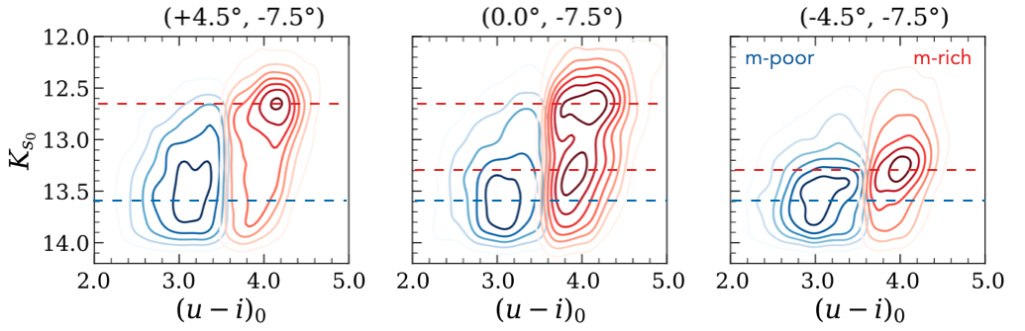
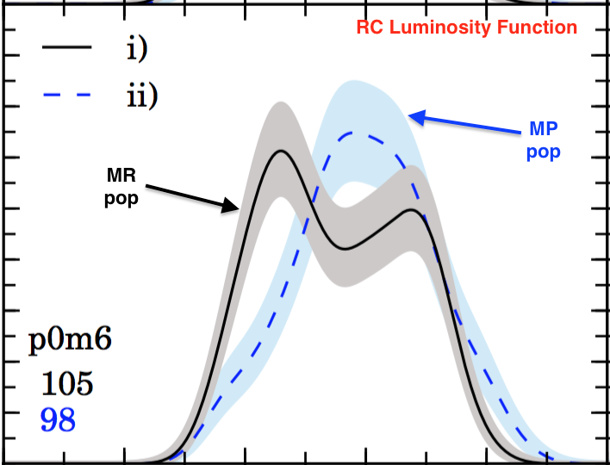
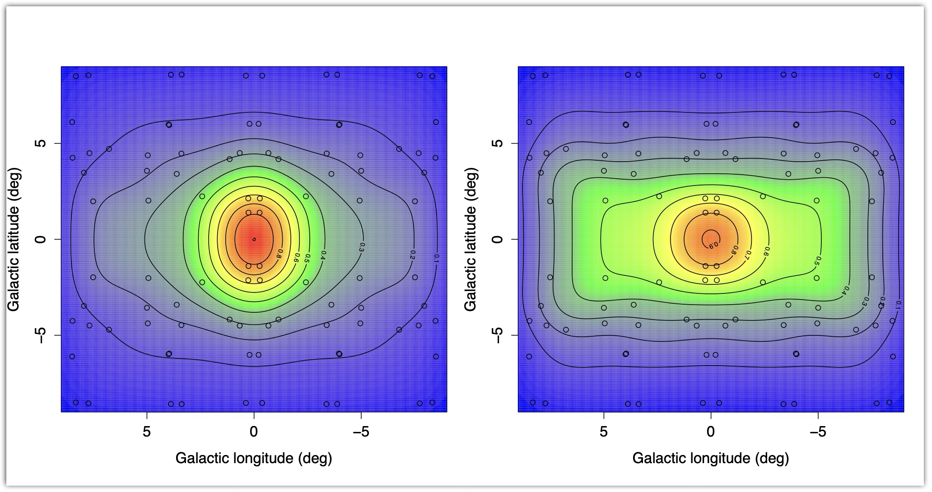
m-poor vs m-rich spatial distribution
BDBS: Lim+2021

Slide 5
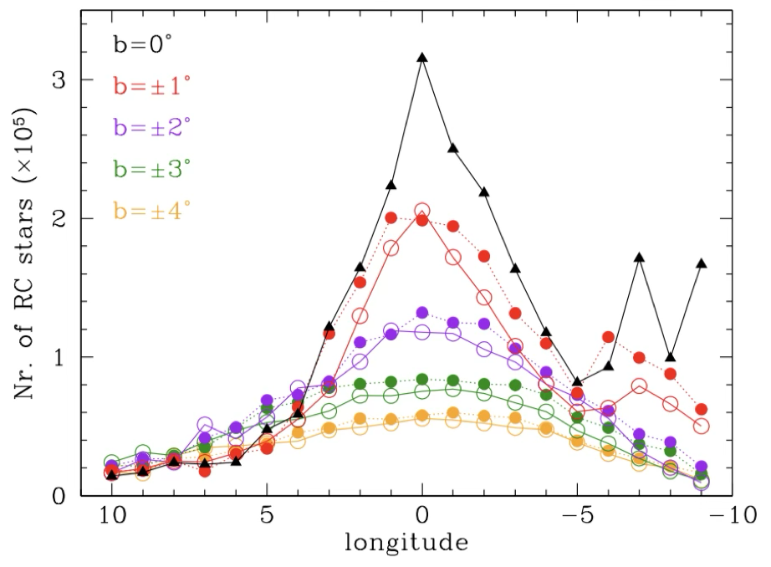
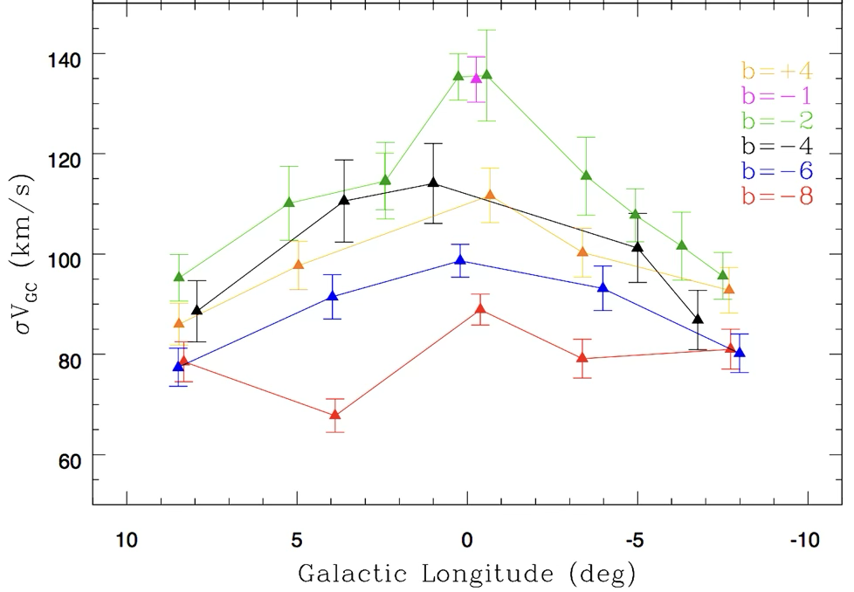
Stellar Density vs Kinematics
Density profile
Sigma profile

Slide 6
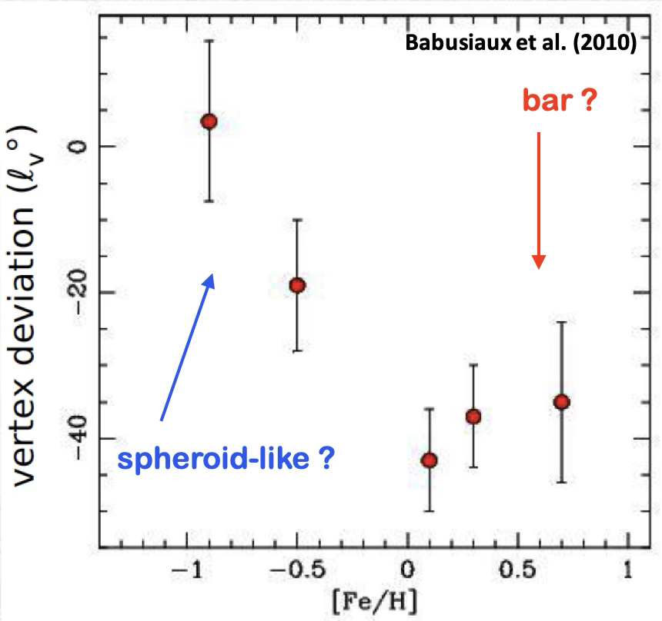
Coupling metallicity & kinematics
A non-zero vertex deviation indicates a correlation between U and V velocities — meaning that stellar orbits are not randomly oriented but skewed often due to non-axisymmetric structures in the Galaxy → bar
Only m-rich stars trace the bar!

Slide 7
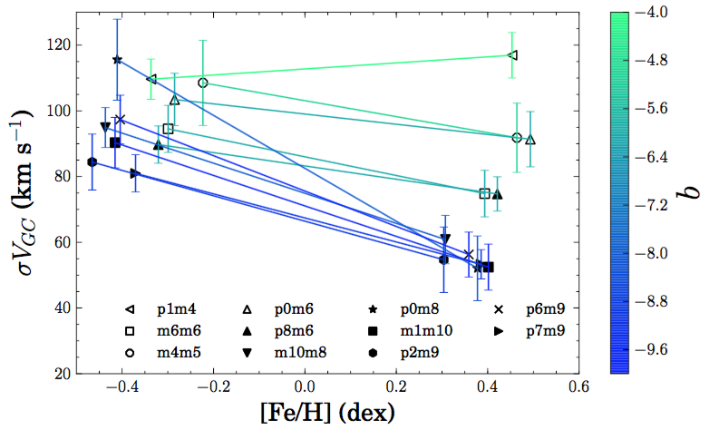
Coupling metallicity & kinematics
The velocity dispersion of m-rich stars show a steeper gradient (50-120 km/s)
than m-poor stars, which rotate slower (i.e., m-poor kin hotter than m-rich)
Rojas-Arriagada et al. 2017

Slide 8
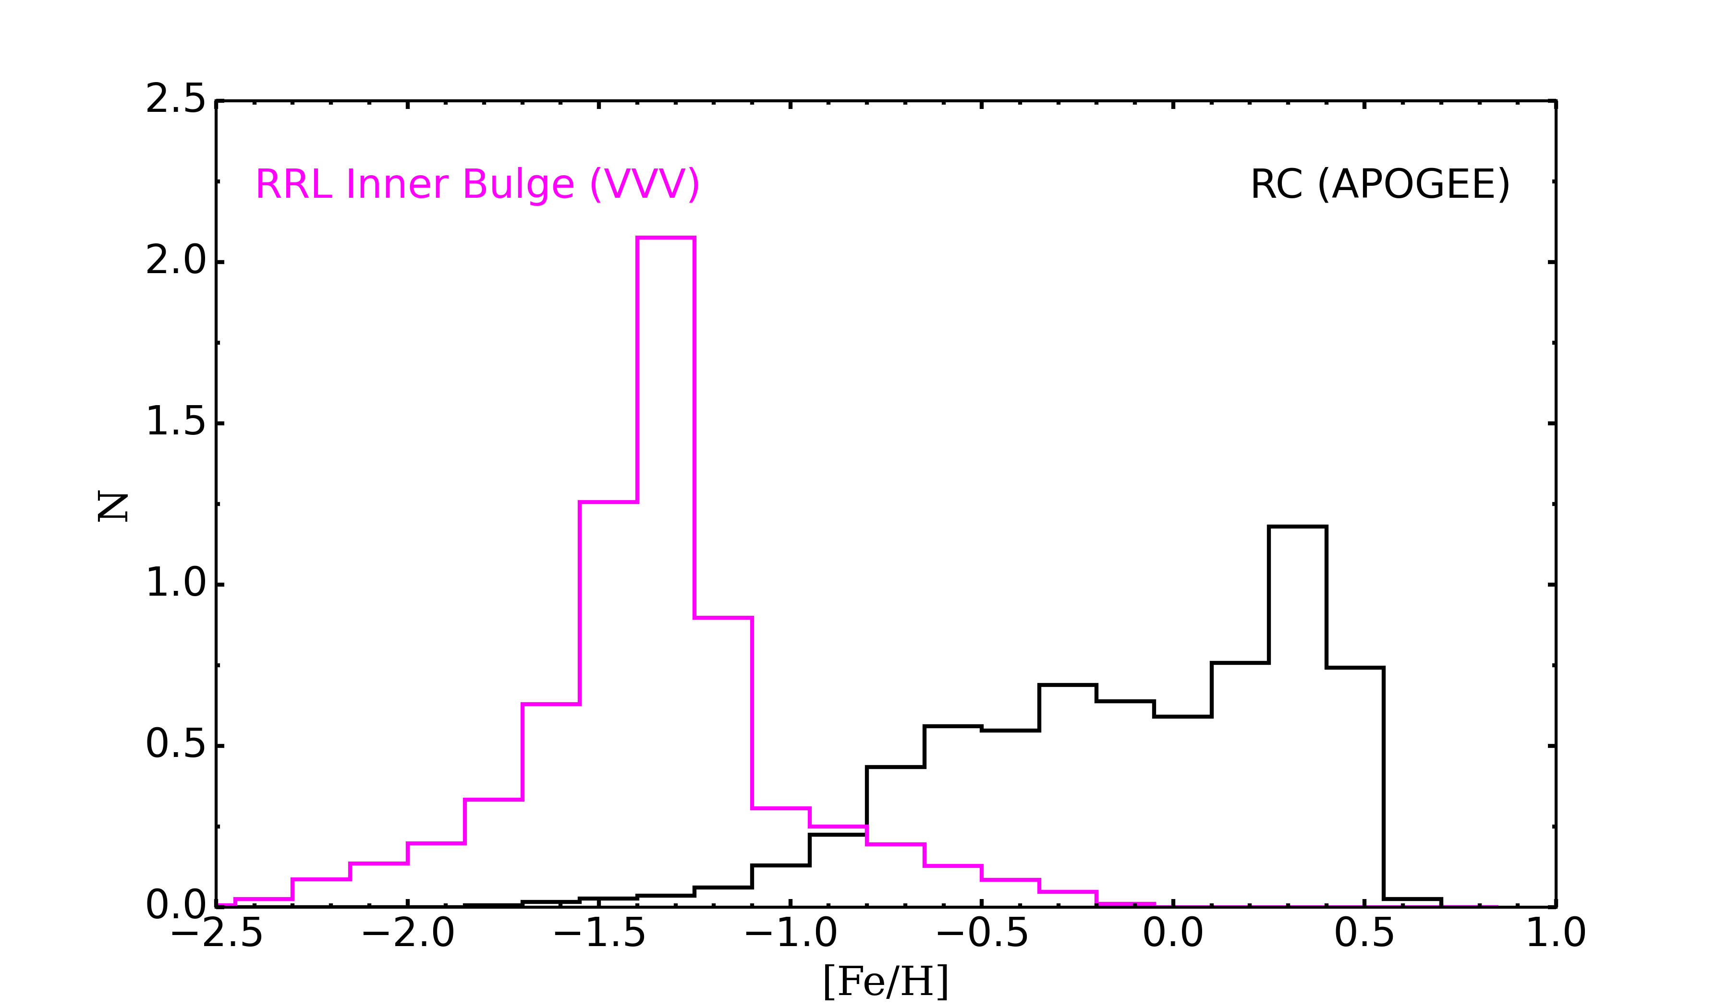
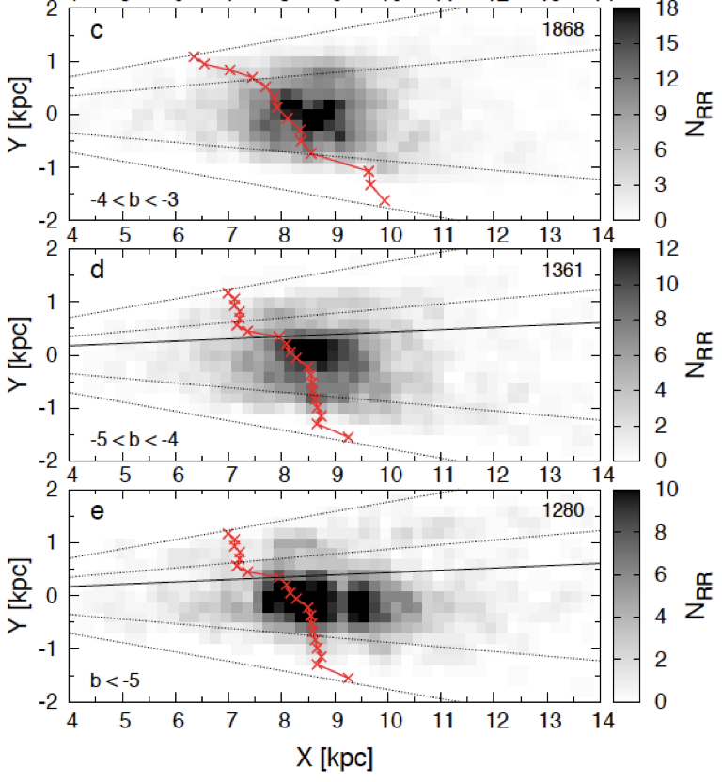
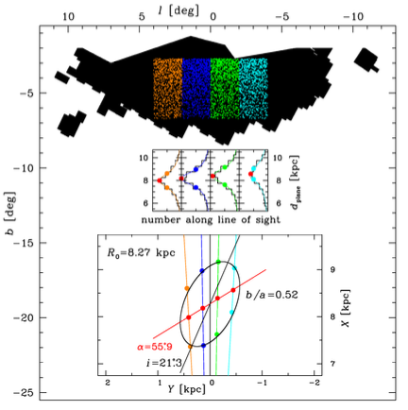
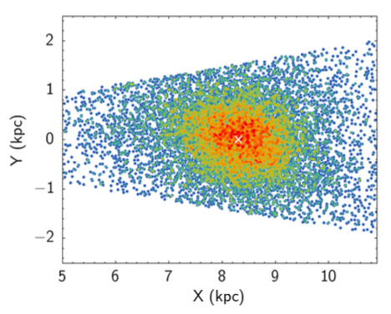
The RRL variables
RRL are possibly the cleanest tracers to infer 3D structure
Old (i.e., >10 Gyr)
Metal-poor
Accurate standard candles
RRL spatial distribution is more spherical
Outer Bulge RRL
Inner Bulge RRL
Dekany+2013(VVV+OGLEIII)
Zoccali+2024
Pietrukowicz+2015 (OGLEIV)
|l| ≤10º, |b| ≤2.5º

Slide 9
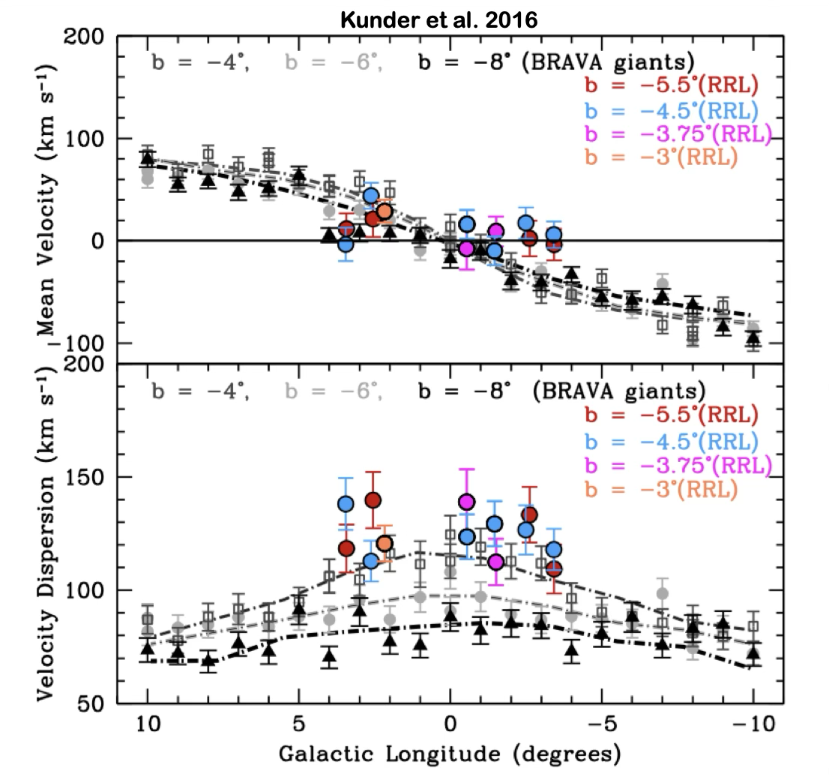
The RRL variables
RRLs rotate slower than K and M giants → hot kinematics with negligible rotation

Slide 10
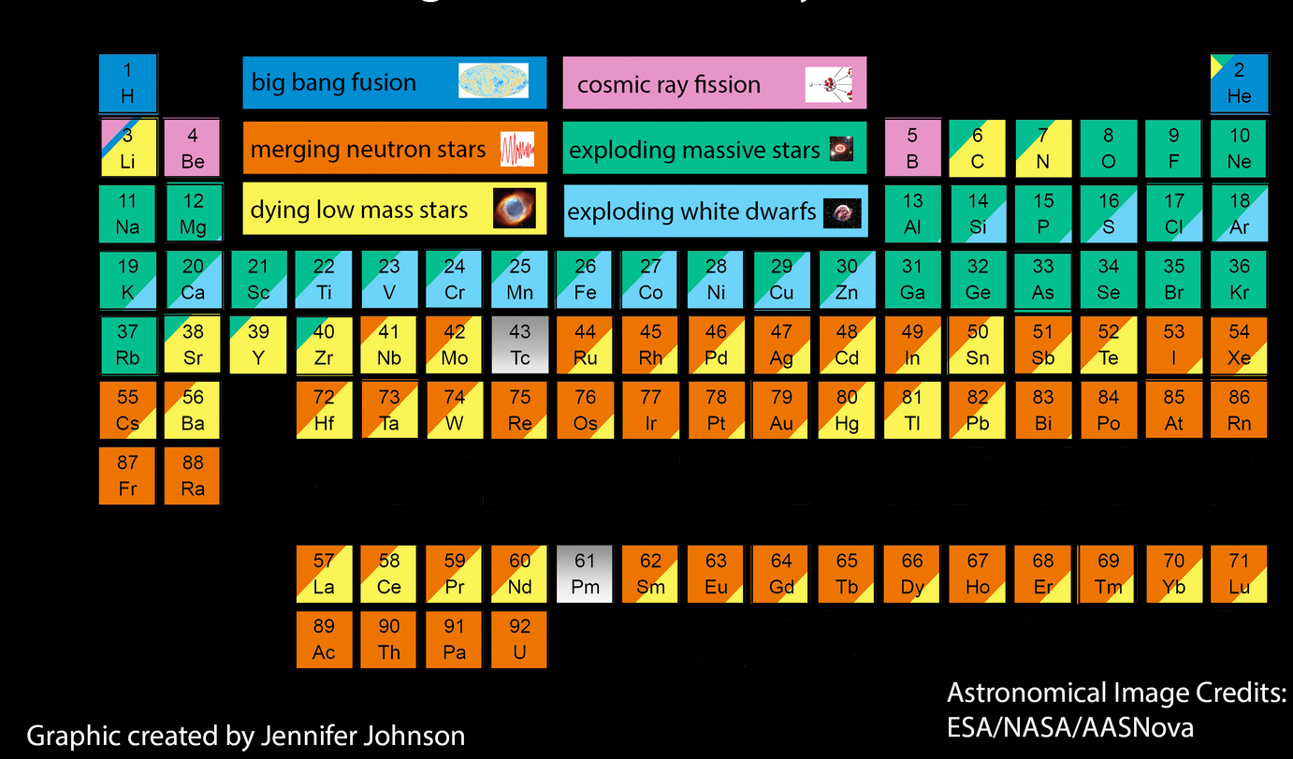
Why chemical content is crucial?
Stellar abundances and abundance patterns trace evolutionary timescales, as different elements are released into
the interstellar medium by dying stars on distinct timescales

Slide 11
Alpha-elements abundance
⍺-elements: almost entirely produced by massive short living stars (M>10M⦿, type II SNe) with lifetimes 10⁶ - 10⁷ yr
Fe-peak elements: partially produced by II SNe and mostly by type Ia SNe with lifetimes from several 10⁷ to 10¹⁰ yr
[⍺/Fe] can be used as cosmic clock

Slide 12
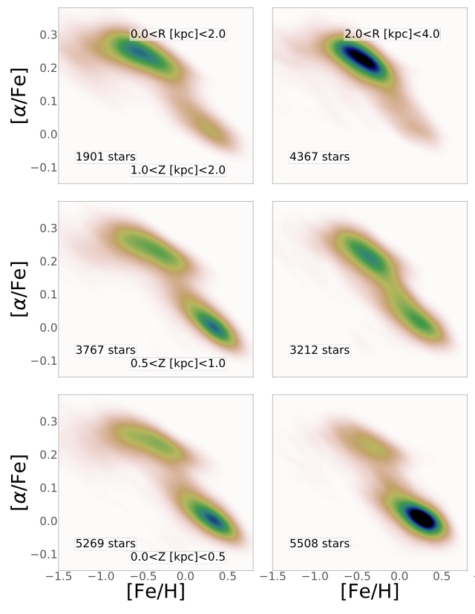
Queiroz et al. 2021
Distance from GC
APOGEE DR16 + StarHorse + Gaia DR2
m-poor stars are ⍺-rich
m-rich are ⍺-poor
True chemical discontinuity suggesting different formation scenarios
Distance above the plane
Debattista et al. 2023: stars originally formed within one of the
disk clumps are ⍺-rich, while those formed outside the clumps,
in the disk field where star formation proceeded at a slower rate,
are ⍺-poor.
Queiroz et al. 2022: m-poor stars trace pressure supported
spheroid, while m-rich stars the bar (i.e., disk evolution)

Slide 13
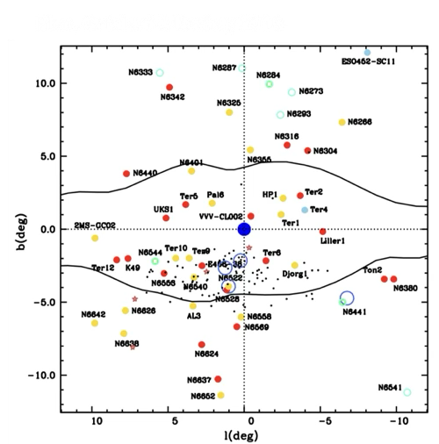
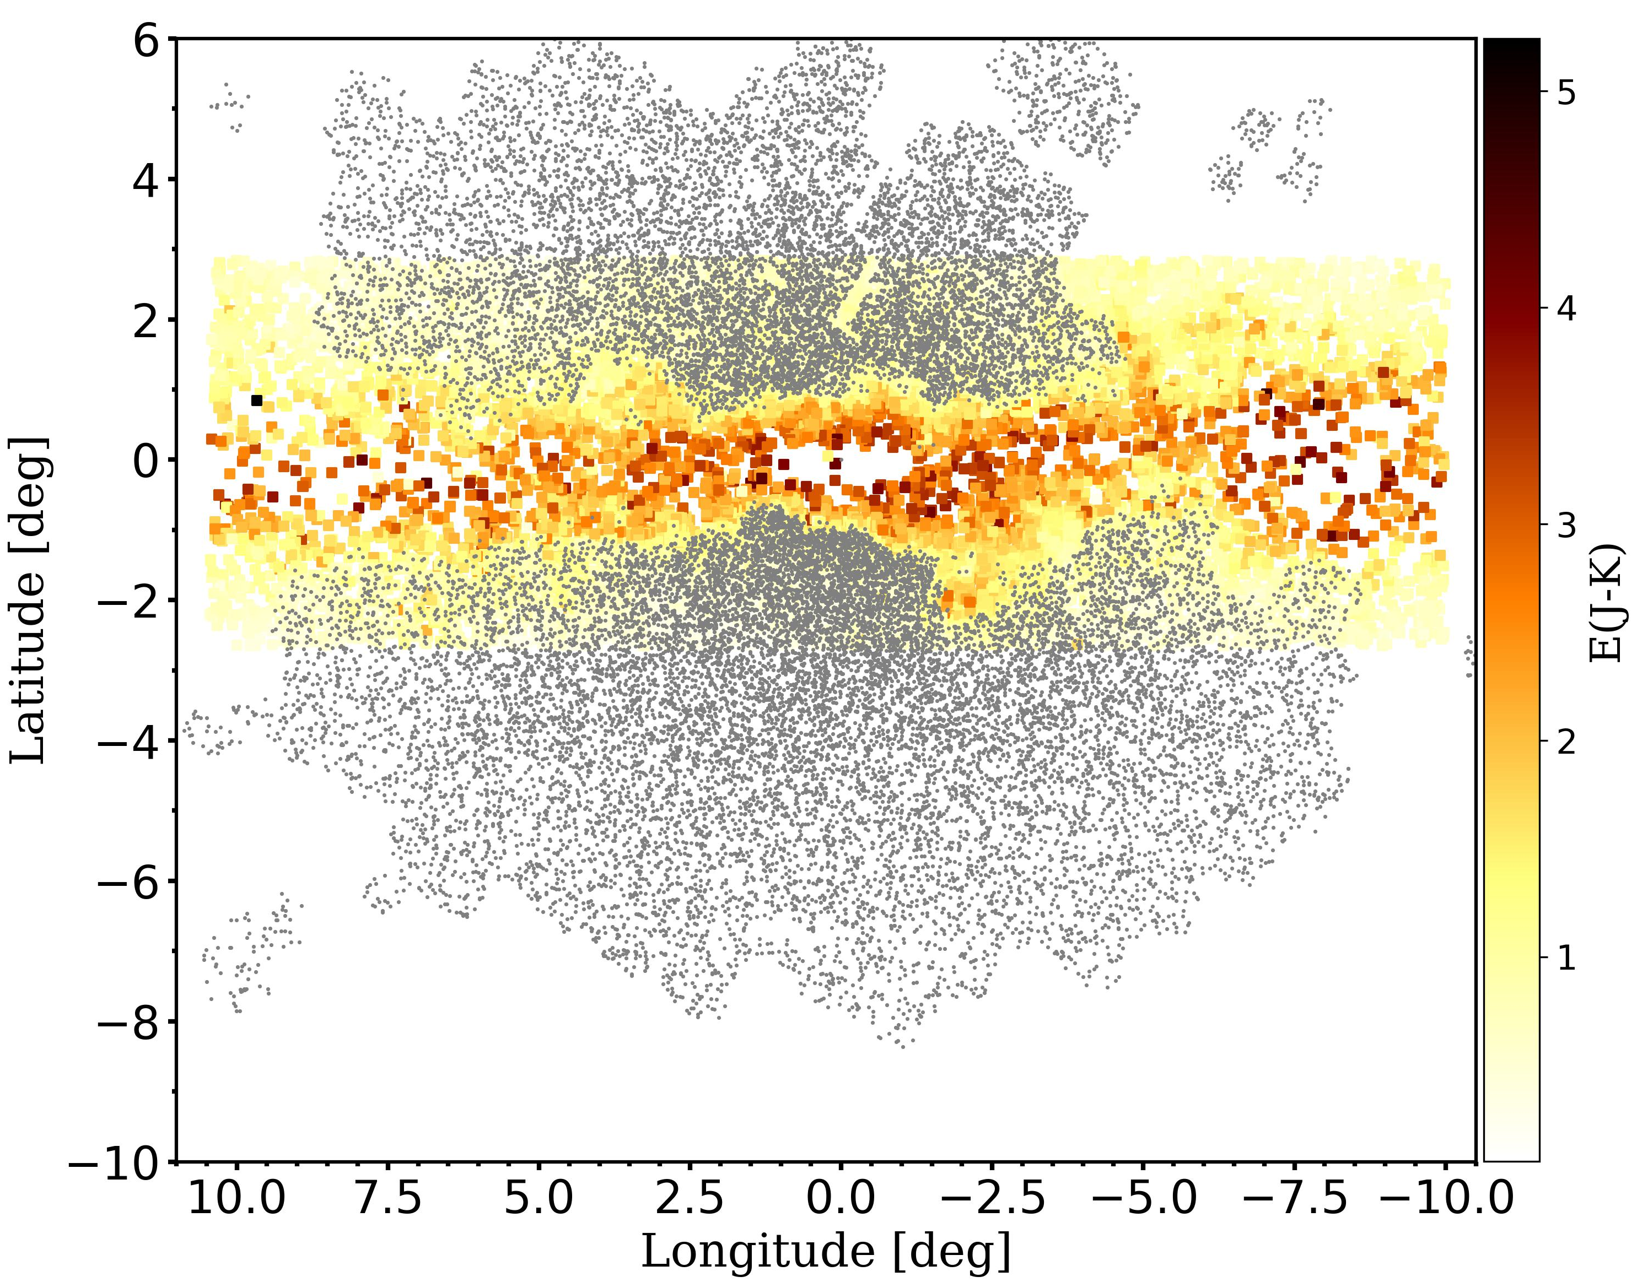
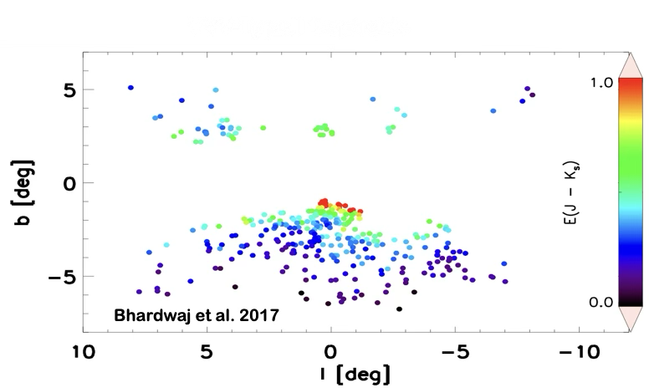
The Age
The bulge hosts very old populations (>10Gyr):
Globular Cluster system
Prominent RRL population
Type II Cepheids
RRL OGLE + VVV
Zoccali et al. 2024

Slide 14
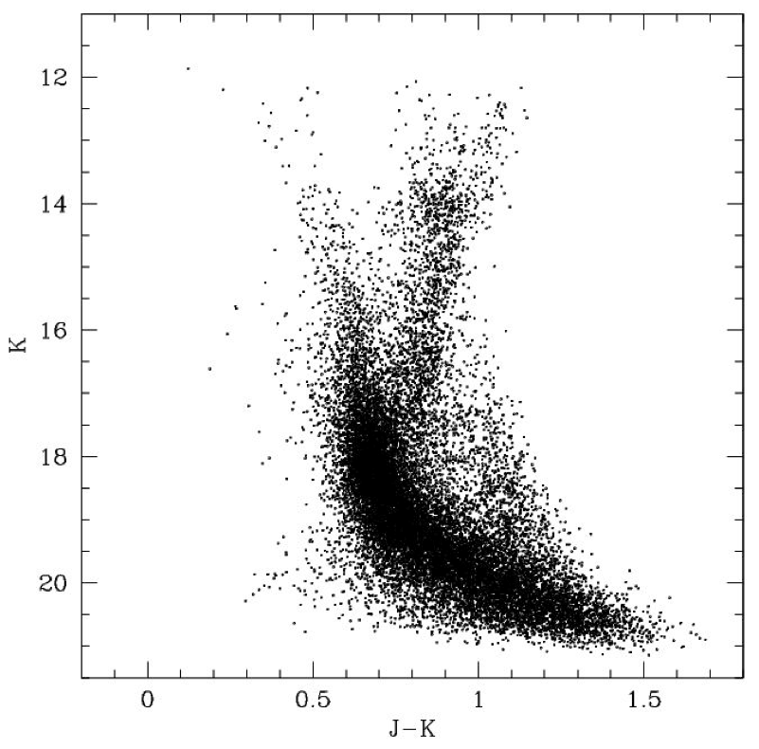




Photometric age determination (MS-TO)
disk RC
disk MS
RGB
➤ disk contamination
➤ differential reddening
➤ depth effect
➤ metallicity spread
➤ stellar crowding
bulge RC
bulge TO
MS

Slide 15


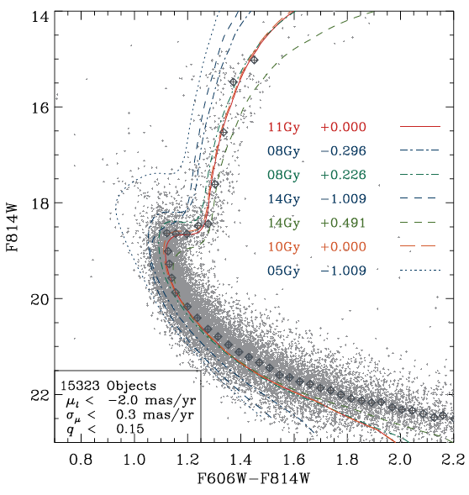
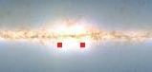
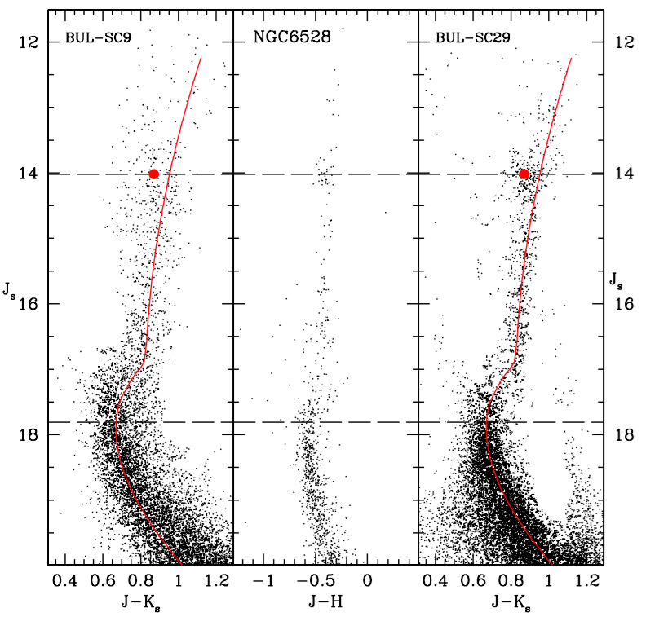


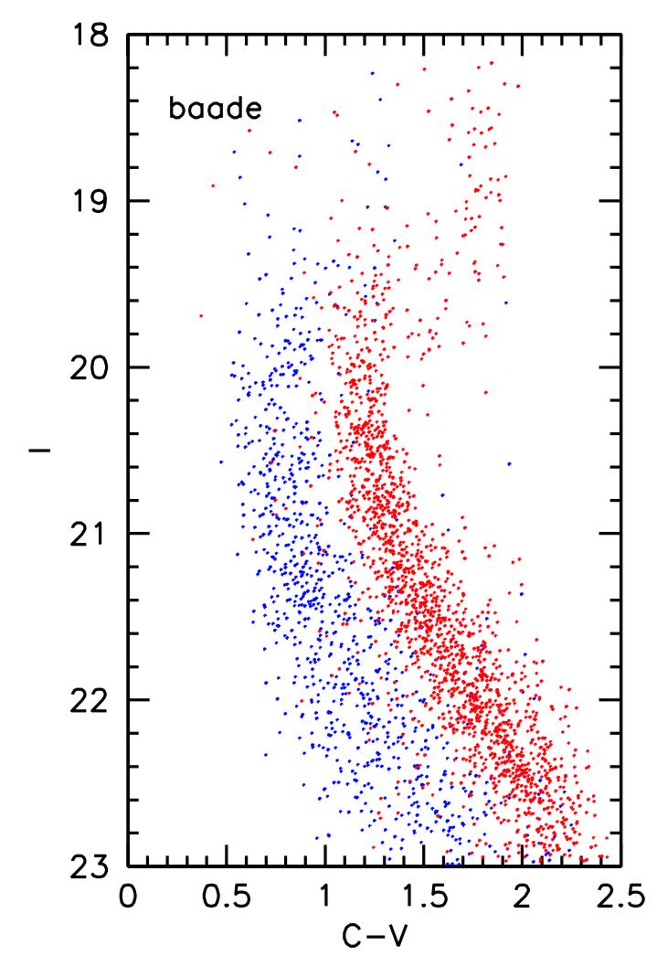
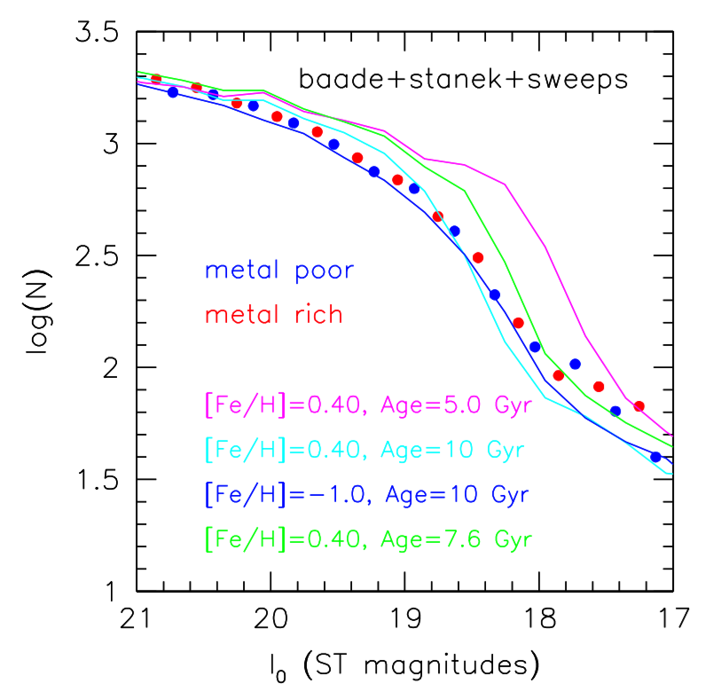
Photometric determinations of the AGE of SP in the several bulge fields suggest that the bulk of the Bulge is uniformly OLD (i.e., >10Gyr)
EV et al. 2013
Low Red Fields: -7º < l <10º & -4º<b<-2º
Renzini et al. 2018
Clarkson et al. 2008, 2011
See also i.e., Bergh & Herbst 1974; Terndrup 1988; Ortolani et al. 1995; Feltzing & Gilmore 2000; Kuijken & Rich 2002; Zoccali et al. 2003; Clarkson et al. 2008,2011; EV et al. 2013, Renzini et al. 2018

Slide 16
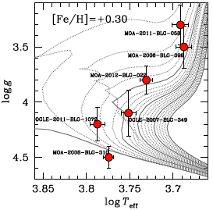
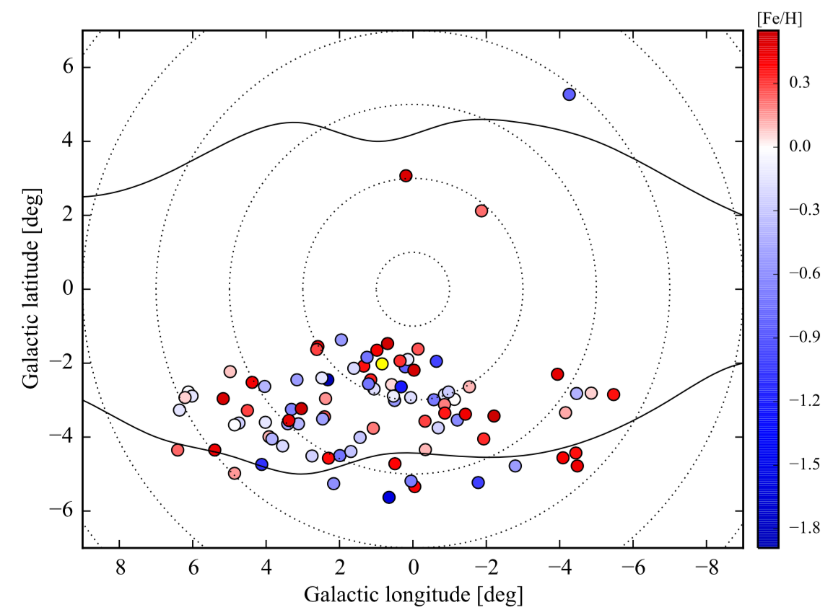
Spectroscopic age determination
UVES@VLT, R>40,000, 90 stars
Teff: from excitation balance of abundances from FeI lines
g: from ionization balance between abundances of FeI and FeII lines
Bensby et al. (2011, 2013, 2017)

Slide 17
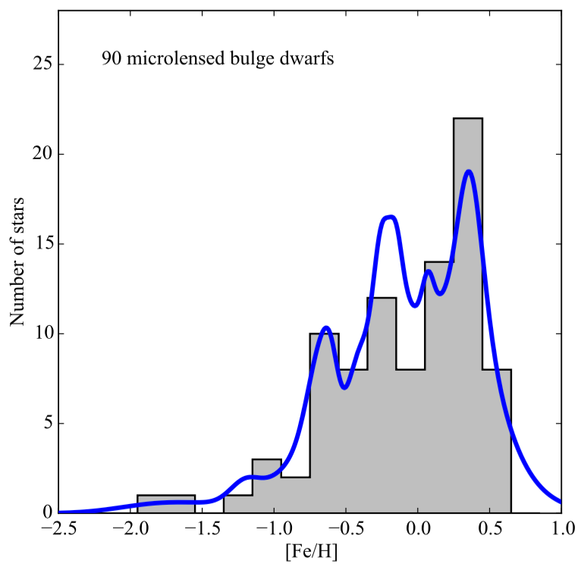
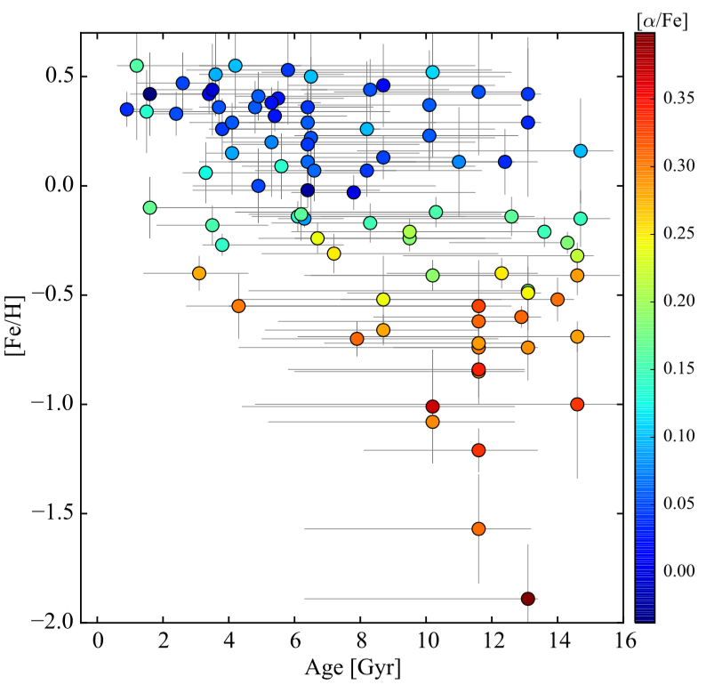

Age – Metallicity relation based on dwarfs and sub giants
+ MP stars are mostly old (> 10 Gyr), MR stars show a wide range of ages.
+ At least 18 % of the stars, at all metallicities are young (<5 Gyr).
+ At super-solar metallicities more than 35 % are younger than 8 Gyr.
+ Several episodes of SF occurred 3, 6, 8 and 12 Gyr ago

Slide 18
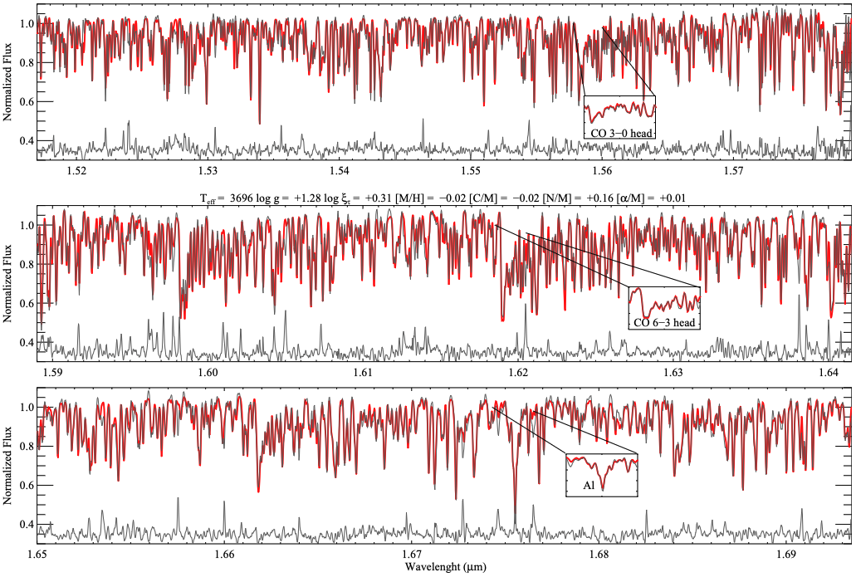
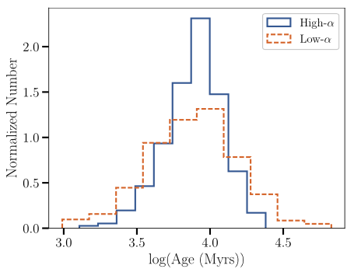
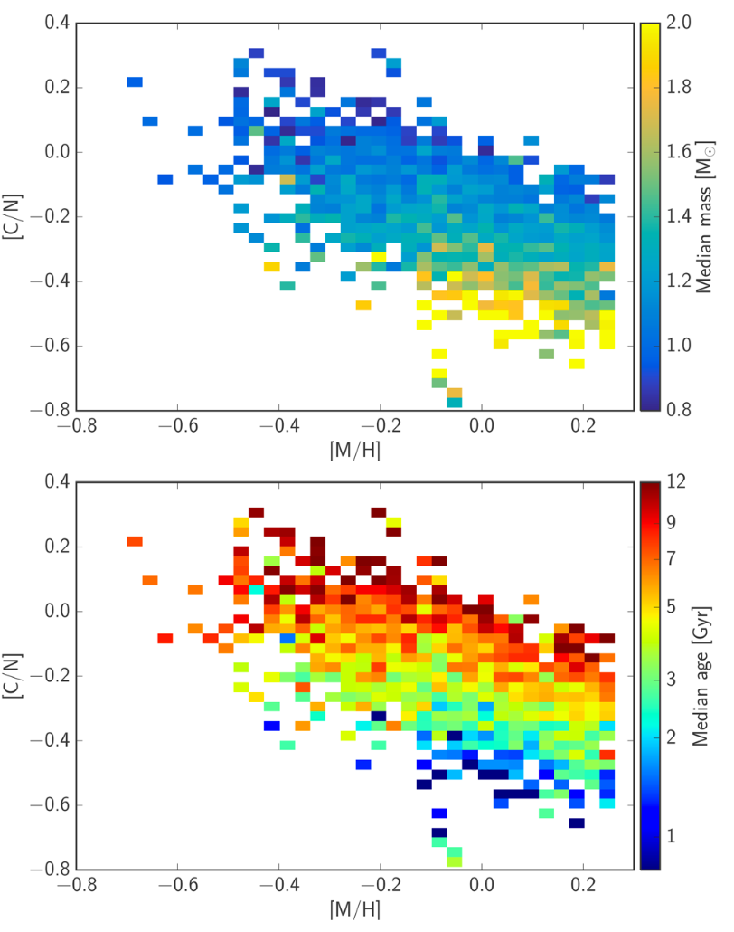
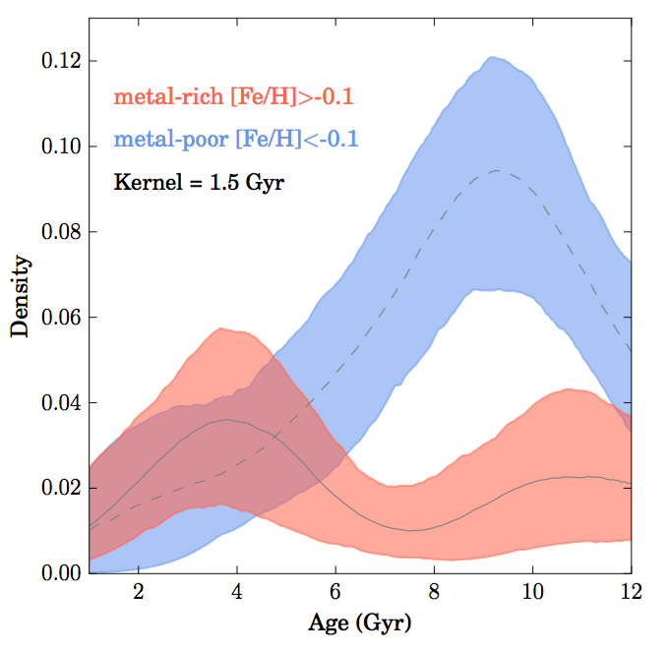

Stellar ages in the spectroscopic survey’s era:
stellar label and [C/N] abundance
APOGEE Spectra bright RGB
H-band, R~22,500
—> [C/N]
APOKASP, APOKASP2
Mass from asteroseismology
Sit & Ness 2020
X
Schultheis et al. 2017
The Bulge is primarily old (>8Gyr) BUT
its age distribution shows a tail of young stars (~1Gyr)

Slide 19
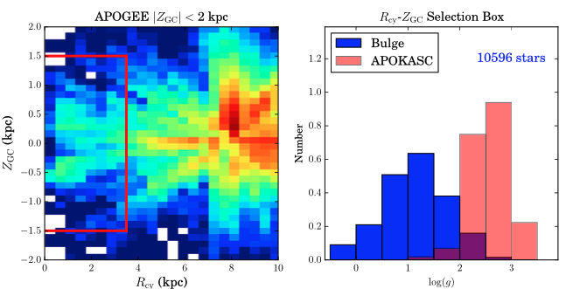
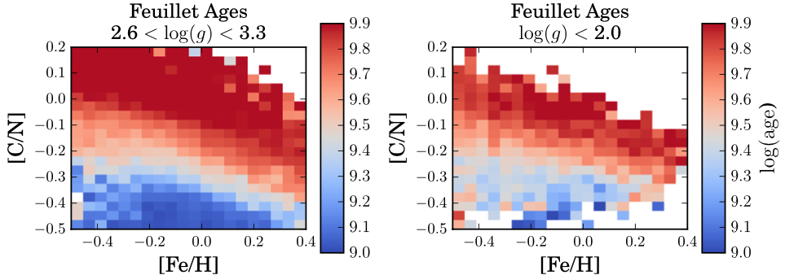
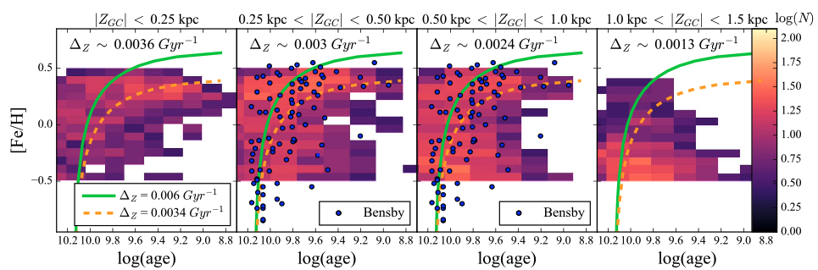

Tension between spec and phot age remains!
APOGEE (~6000 bright RGB; -0.5<[Fe/H]<+0.5 ) + Feullet Age training sample (Age vs [C/N]) + TheCannon
AMR suggests that the Bulge is NOT uniformly old, with stars as young as ~1-2Gyr at [Fe/H]>0.1 & |ZGal|<0.25kpc
Hesselquist et al. 2020

Slide 20
Final Summary:
With a stellar mass of M∼ 1.7-2 × 10¹⁰ M⊙, mostly made of ∼10 Gyr old stars, the Galactic bulge is the first massive component to form
The bulge hosts a bar with an inclination of ∼27 degrees with respect to the Sun-GC direction, extending for about1 kpc from the center
The dynamical evolution of the bar (i.e., buckling and vertical resonance heating) lends the bulge a boxy/peanut shape in its southern regions
Overall, the bulge SP is rich in iron, but its subsolar and super-solar components display very distinct properties in terms of spatial distribution, kinematics and abundances pattern.
The m-rich component is depleted in ⍺-elements and is spatially arranged in a bar-like structure
The m-poor and ⍺ -rich component does not appear to follow the bar, being symmetrically concentrated as a spheroid-like structure
Although the bulge as a whole rotates cylindrically, m-poor stars show slower rotation with a relatively large velocity dispersion (100–120 km/s) rather constant across the sky. The m-rich component, instead, has a velocity dispersion gradient, with values ranging from 60 km/s at b = -8º to 140 at b = -1º.
The presence and fraction of young-intermediate age stars remain an open question
The origin of the gap in the [⍺/Fe] vs [Fe/H] is not yest fully understood

Slide 21
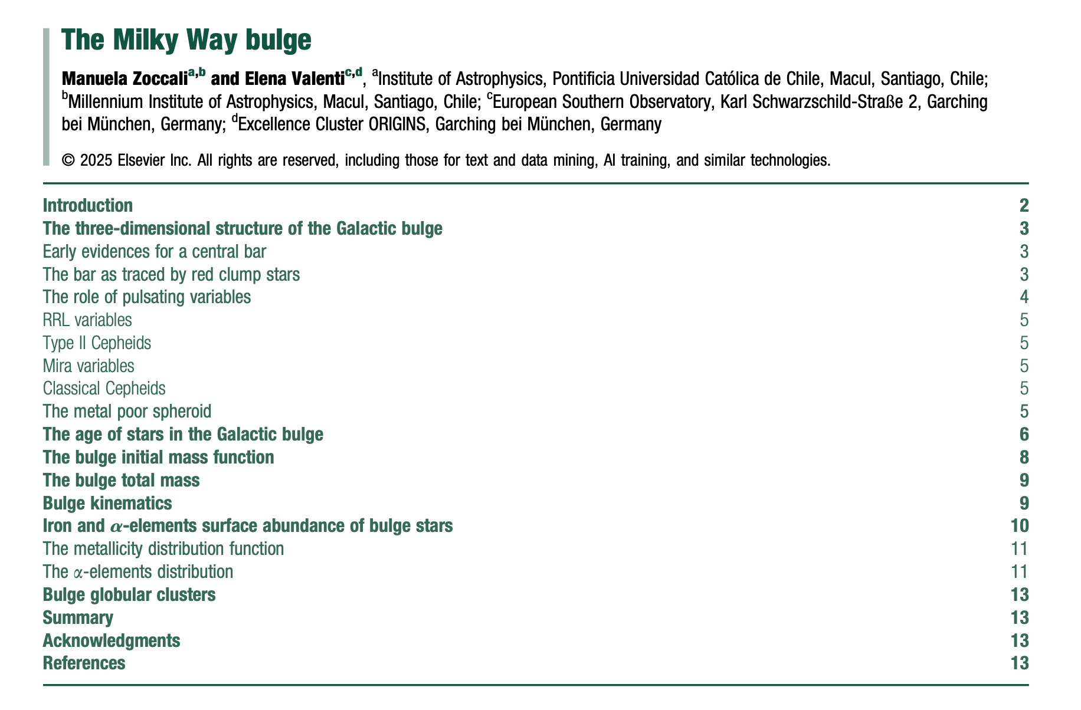
Fairly exhaustive bibliography ….

Slide 22
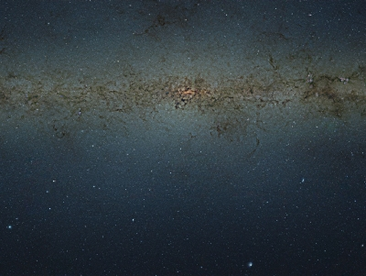
Open Questions
Wegg+2015
How many components coexist in the MW inner region?
What is the nature of the super thin-bar and its connection to the Bar and B/P bulge?
What is the connection between the Bulge and its Nuclear region?
What are the properties (i.e., kinematics, abundances) of the RRL pop?
What is the age of the m-rich component?

Slide 23
Open Questions
Wegg+2015
How many components coexist in the MW inner region?
What is the nature of the super thin-bar and its connection to the Bar and B/P bulge?
What is the connection between the Bulge and its Nuclear region?
What are the properties (i.e., kinematics, abundances) of the RRL pop?
What is the age of the m-rich component?
→ Comprehensive chemo-dynamical map of its stellar populations

Slide 24
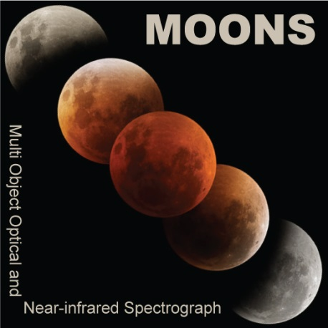

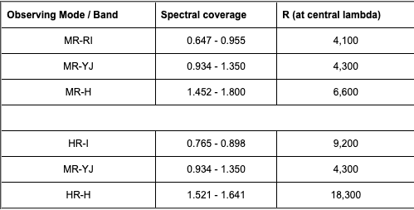
Multi-Object Optical and Near-IR Spectrograph
PI: M. Cirasuolo
Multiplexing: 1000 fibers per pointing
FoV: 500 arcmin²
Medium and High spectral resolution
Wavelength coverage: 0.65 – 1.8 µm
2 observing modes (MR, HR), each providing 3 channels
MR mode
HR mode

Slide 25
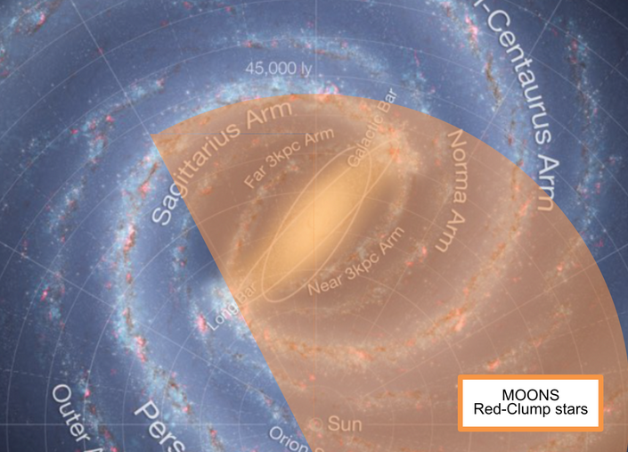
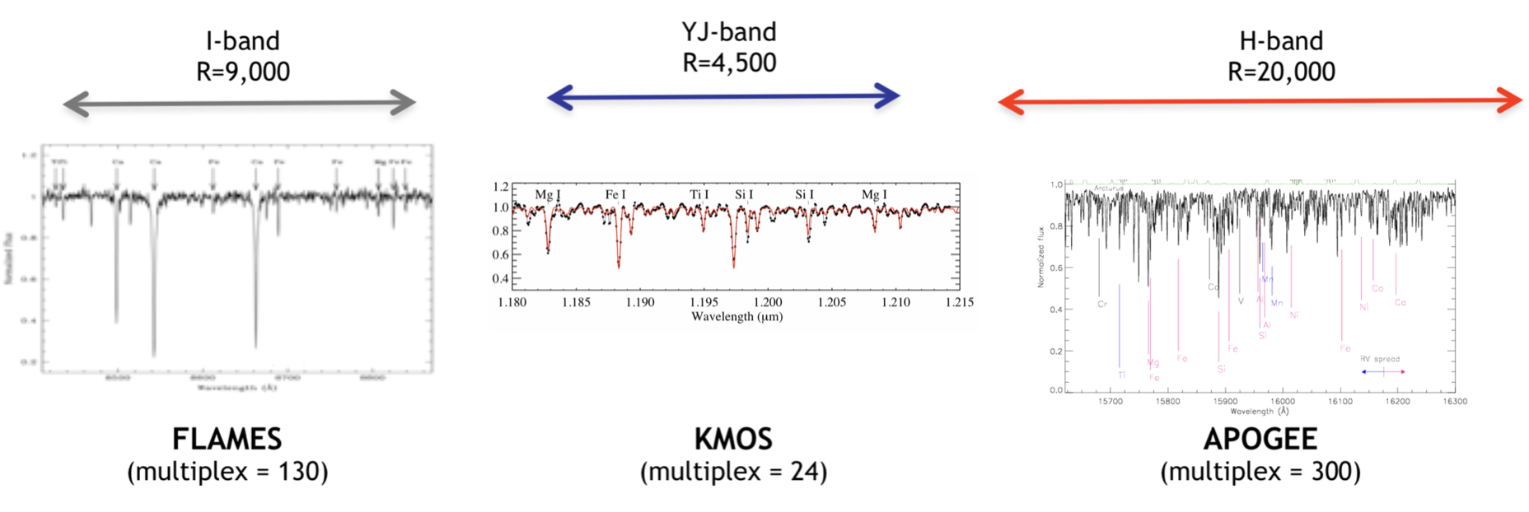
MOONS: Unique facility for bulge studies
IR coverage:
Overcoming dust extinction → most central regions
Multiplexing + simultaneous wavelength coverage
High observing efficiency → large number statistics
HR mode:
Chemical abundances (⍺, light, iron-peak, neutron-capture elements)
Kinematics
Xcalibration with complementary surveys (e.g., Gaia RVS)
VLT collecting area
Faintest RC → surveys depth &
reliable selection function
l,b=(-2º,-8º)
l,b=(-2º,0º)
APOGEE
Mag limit
MOONS
1hr, S/N~60

Slide 26
MOONS GTO Galactic Surveys
GOAL: Comprehensive chemo-dynamical map of the resolved stellar populations in the MW, and closest satellites, focusing on those environments/populations poorly - if any - sampled by previous/ongoing/future spectroscopic surveys (e.g., Gaia, GES, GIBS, WAVE, APOGEE, 4MOST)
The Reddened MW Survey [~70 nights, PI: O.A. Gonzalez]:
The Nuclear Region [Resp: L. Origlia]
The bulge/bar/disk @ low latitude [Resp: O.A. Gonzalez]
The Boxy/Peanut bulge. [Resp: M. Zoccali]
Inner Bulge GCs [Resp: P. Di Matteo]
Young star clusters [Resp. S. Randich]
Very metal poor stars [Resp. E. Caffau]
The MW Satellites Survey [~30 nights, PI: A. Mucciarelli]:
Magellanic Clouds and Sagittarius Chemistry [Resp. A. Mucciarelli]
Magellanic Clouds and Sagittarius Kinematics [Resp. E. Dalessandro]

Slide 27
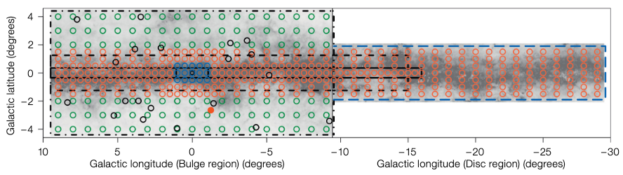
The MOONS REDdened Milky WAY survey
Nuclear region: RCs, RGBs, |l| ≤ 1º, |b| ≤ 0.5º , 15 fields, ~14K stars
Bulge/bar/disk at low latitude: RCs, -30º ≤ l ≤ 10º, |b| ≤ 1º, >500 fields, ~0.5M stars
Boxy/Peanut Bulge: RCs, RRL , |l| ≤ 10º, 2º ≤ |b| ≤ 4º, ~115 fields, ~100K stars
Setup: HR mode, SNR>60 (per pixel)
Target Selection: 13 < H < 17 (VVV phot catalog, PMs from Gaia & VVV)
Accuracy: Δt_{eff} < 100K, Δlogg < 0.3dex, ΔRV < 1km/s, Δ[Fe/H] < 0.1dex, Δ[X/Fe] < 0.15dex
X=C, N, O, Mg, Al, Si, S, Ca, Ti, Ni, Cr, Co, Cu, V

Slide 28
The Extremely Large Telescope

Slide 29
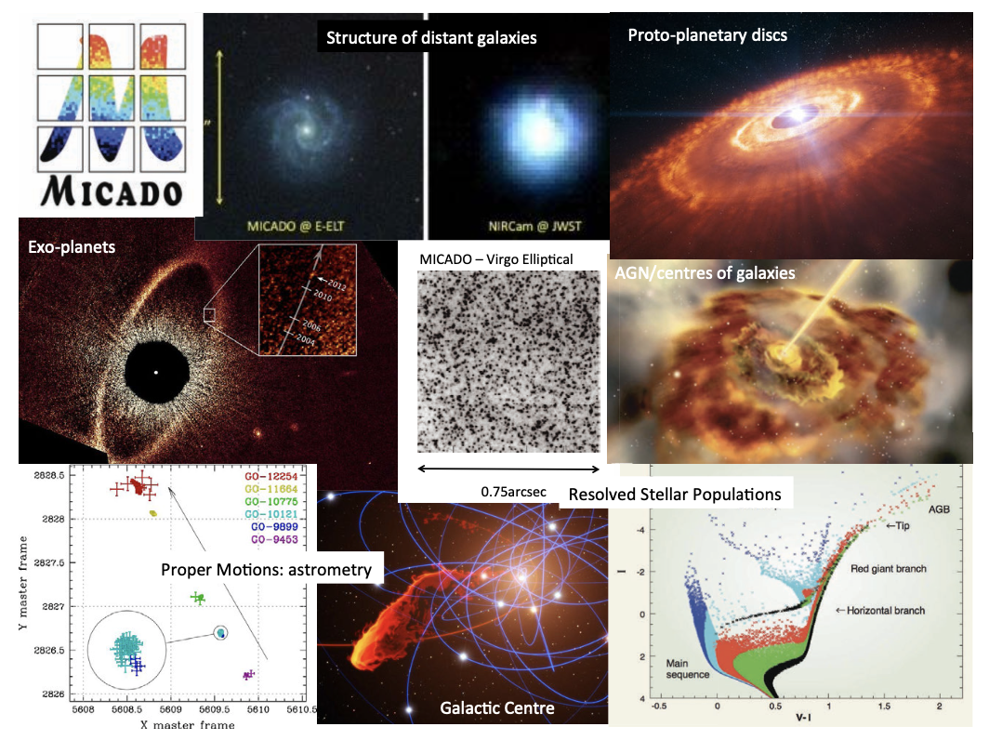
MultI-AO CAmera for Deep Observations
PI: R. Davies
1st light ELT capability for diffraction limited imaging, long-slit spectroscopy, focal and pupil plane coronography in the NIR (0.8-2.45µm )
Optimised for the MCAO module MORFEO, but also equipped with its own SCAO
High sensitivity and spatial resolution
Work-horse instrument

Slide 30
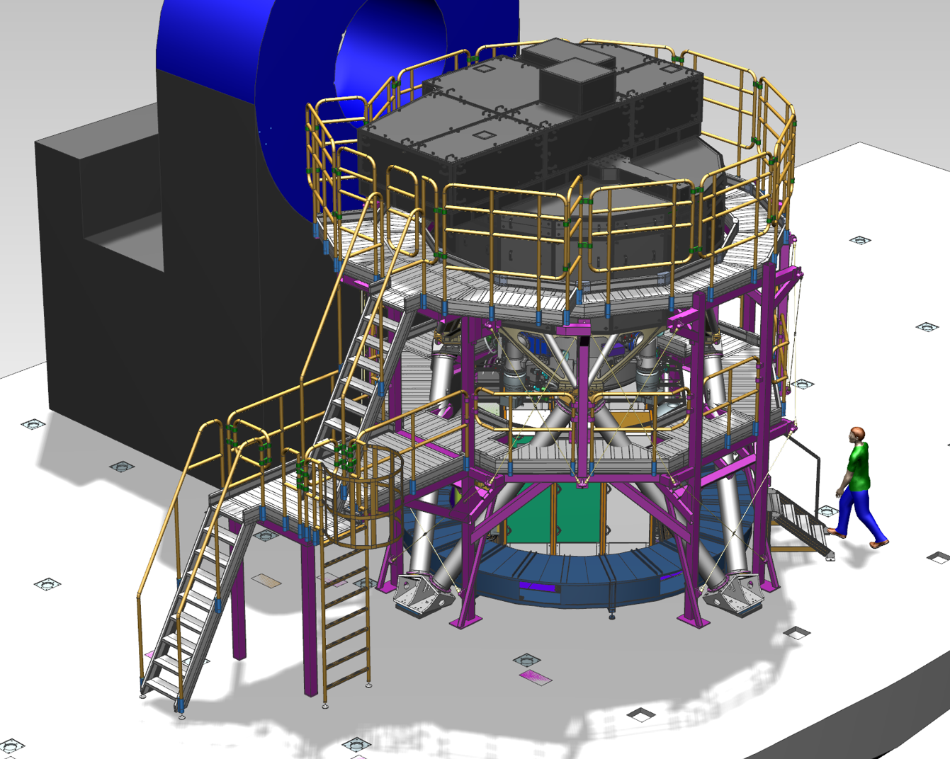
Key Capabilities
Standard Imaging
0.8 - 2.4 µm with 27 BB/NB filters
1.5 mas (HRI) & 4 mas (LRI) pixels for 19” and 51” FoV
Similar sensitivity to JWST, but x6 better spatial resolution
Astrometric Imaging
10-50 µas precision anywhere in the field
10µas/yr = 5km/s at 100kpc after few year
High Contrast Imaging
Focal & Pupil plane coronagraphs, SAM
Angular Differential Imaging
Small inner working angle
Slit Spectroscopy
For compact and point sources
Fixed configuration for 0.82-1.55 µm & 1.49-2.45 µm
R~20K for point sources (R~10K across the slit)
Slit width:16mas, 20mas, 48mas. Slit length: 15”, 3”
6 meters

Slide 31
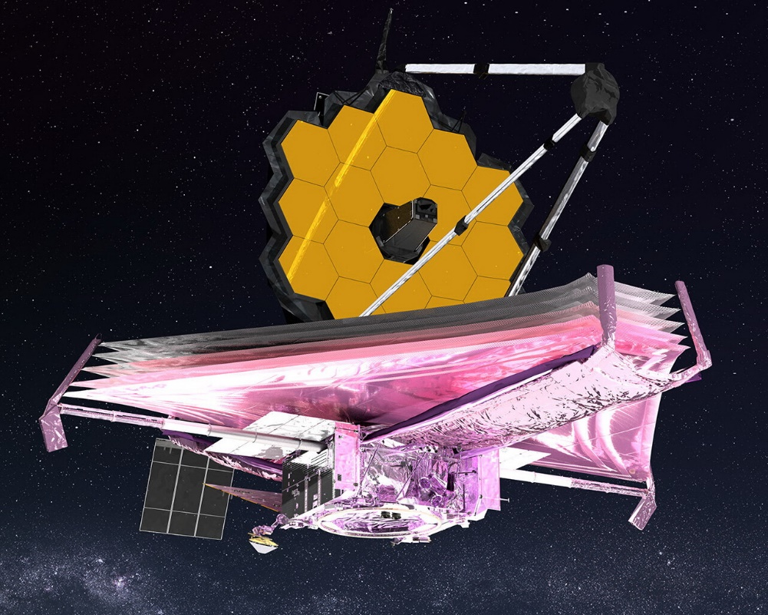
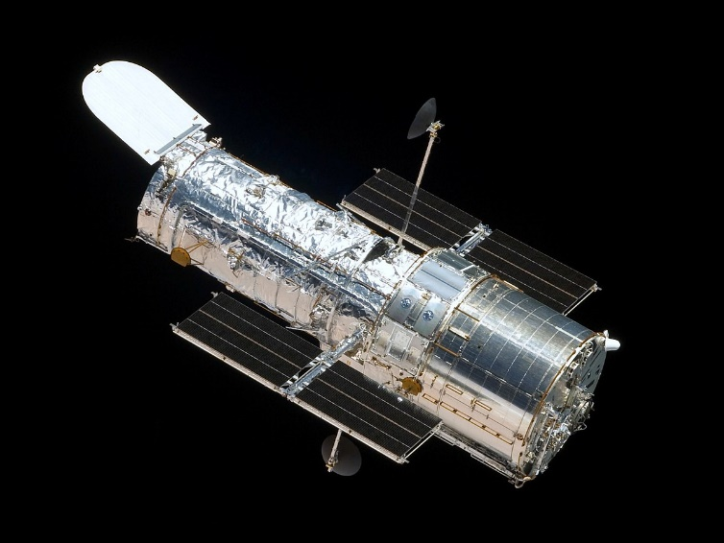
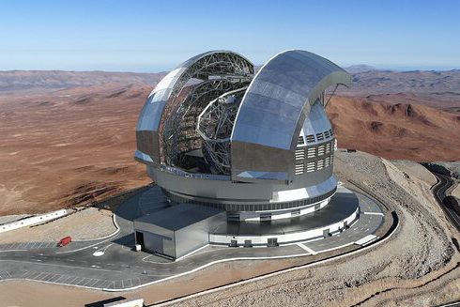
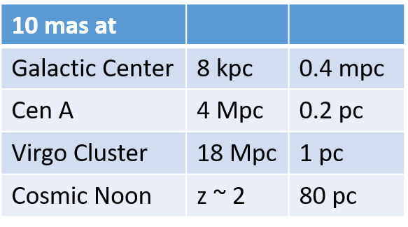
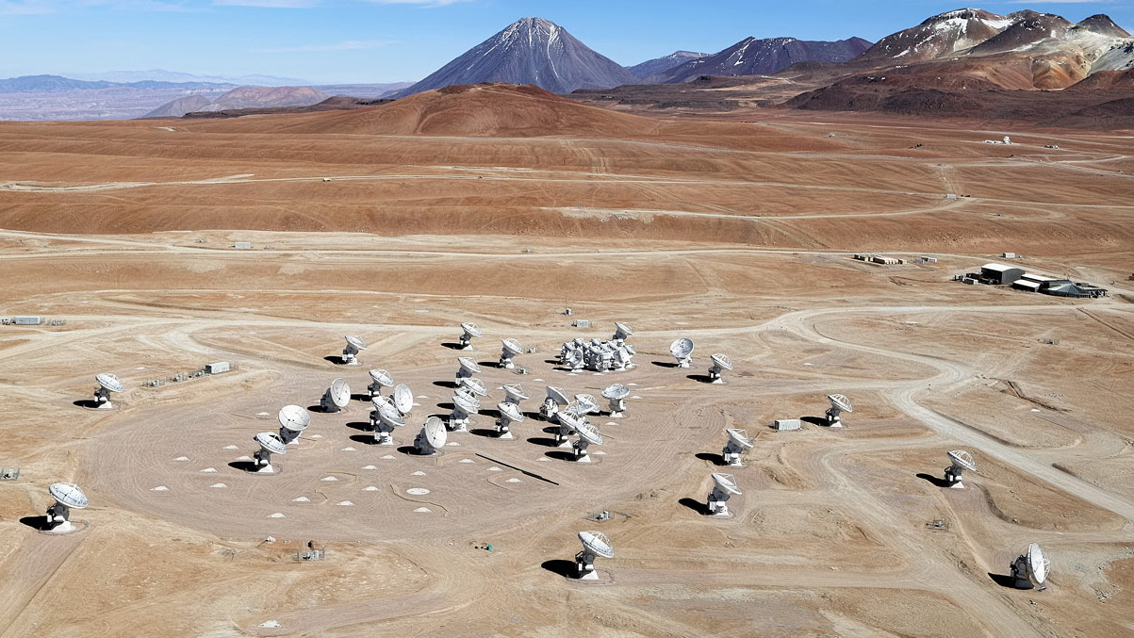
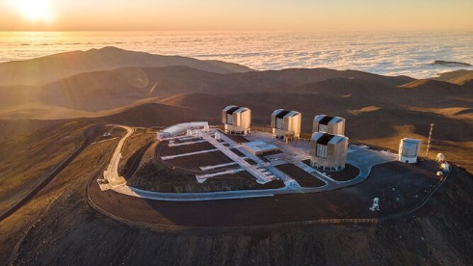
Resolution in context
Courtesy R. Davies
HST at 2 µm, JWST/VLT at 5 µm
~160 mas
JWST/VLT at 2.2 µm,
ELT at 12 µm
~65 mas
VLT at 500 nm,
ELT at 2.2 µm
~12 mas
ALMA C8 230 GHz,
HST at 500 nm
~40 mas
ELT at 1 µm
~6 mas

Slide 32



SCAO concept
On-axis
Off-axis
NGS properties:
mag range: R < 16
max off-axis separation: 25”
Point-source or extended object up to ~1” diameter
Tracking options:
Sidereal
Non-sidereal
Differential

Slide 33







Multi-conjugate adaptive Optics Relay For ELT Observations
PI: P. Ciliegi
The MCAO module for the ELT
Primary client: MICADO
2nd port instrument
6 LGS, 3 NGS, M4 + 2 pfDMs
Highly uniform AO correction with optimal SR over large field of view
Large sky coverage
Not a scientific instrument, BUT indispensable to enable cutting edge science!

Slide 34



MICADO & MORFEO
High redshift Universe
Formation and evolution of AGNs and BHs
Bulges and globular clusters formation
Characterization of z~2 galactic structure sub-components (~100pc scale)
Local Universe
SF in different environments beyond LG up to Virgo (~20Mpc)
Dynamics of dense stellar systems & dark matter in dwarf galaxies
Stellar spectroscopy beyond LG as cosmic abundance probes
Cosmological distances from Cepheids
Resolved Stellar Populations
Internal kinematics and dynamics of star clusters
Dark remnants and IMBH in GCs
Planetary Systems
Formation and evolution of minor bodies in the solar system
Protoplanetary disks (jets and feedback)
Parsec iso, 10 Gyr, [Fe/H] = -1.65
TP-AGB
P-AGB
E-AGB
RGB
HB

Slide 35
AO system concept
LOR3
80”
HO correction:
6 LGS
LO correction:
3 NGS: 9 ≤ H ≤ 21, (R ≤ 23)
3 guide probes, spanning 180º each and located 120º apart:
Technical field: R=180”
LO-WFS FoV: 3.6” x 3.6”
R-WFS FoV: 1” x 1”
NGS-NGS minimum separation = 25”
13”
LOR1
50.5”
LOR2

Slide 36


MORFEO performance
A case of Faint and loose NGS configuration in the HUDF-S

Slide 37
Thanks!

