Slide 1
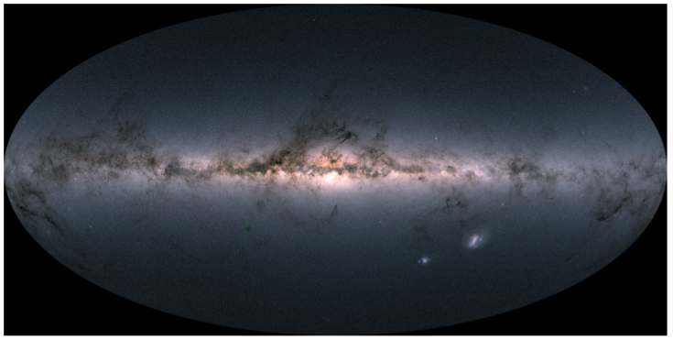



Leftovers/Residuals or Remove a thorn from my side
GB, M. Monelli, V.F. Braga, G. Fiorentino, M. Tantalo, M. Fabrizio, V. D’Orazi, G. Bocek, R. da Silva + A. Nunnari, K. B. Villagra, M. Sanchez Benavente, G. Ceci, N. Baena, B. Pozo + EFHEBO
Agerola, October 30 2025

Slide 2
Summary of the talk
Radial gradients → Why?
MW & M31 early formation and evolution
To be (binary) or not to be (binary)
Clonclusions
Agerola, October 30 2025

Slide 3
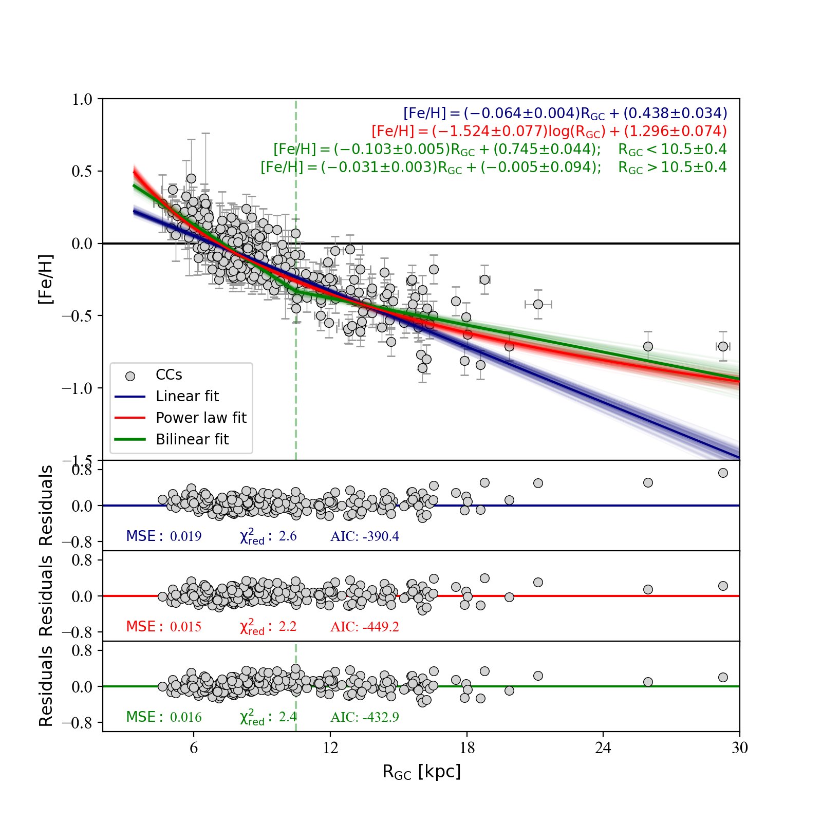
Chemical abundance radial gradients
WHY?
in a log-log plane a parameter
following a power law is linear
…. more weight to the tails!!
Antonino fecit
Chemical enrichment history
Stellar radial heating & stellar migration
Stellar yields: SNIa, SNII, AGB, Novae … Neutron stars .... (relics)

Slide 4
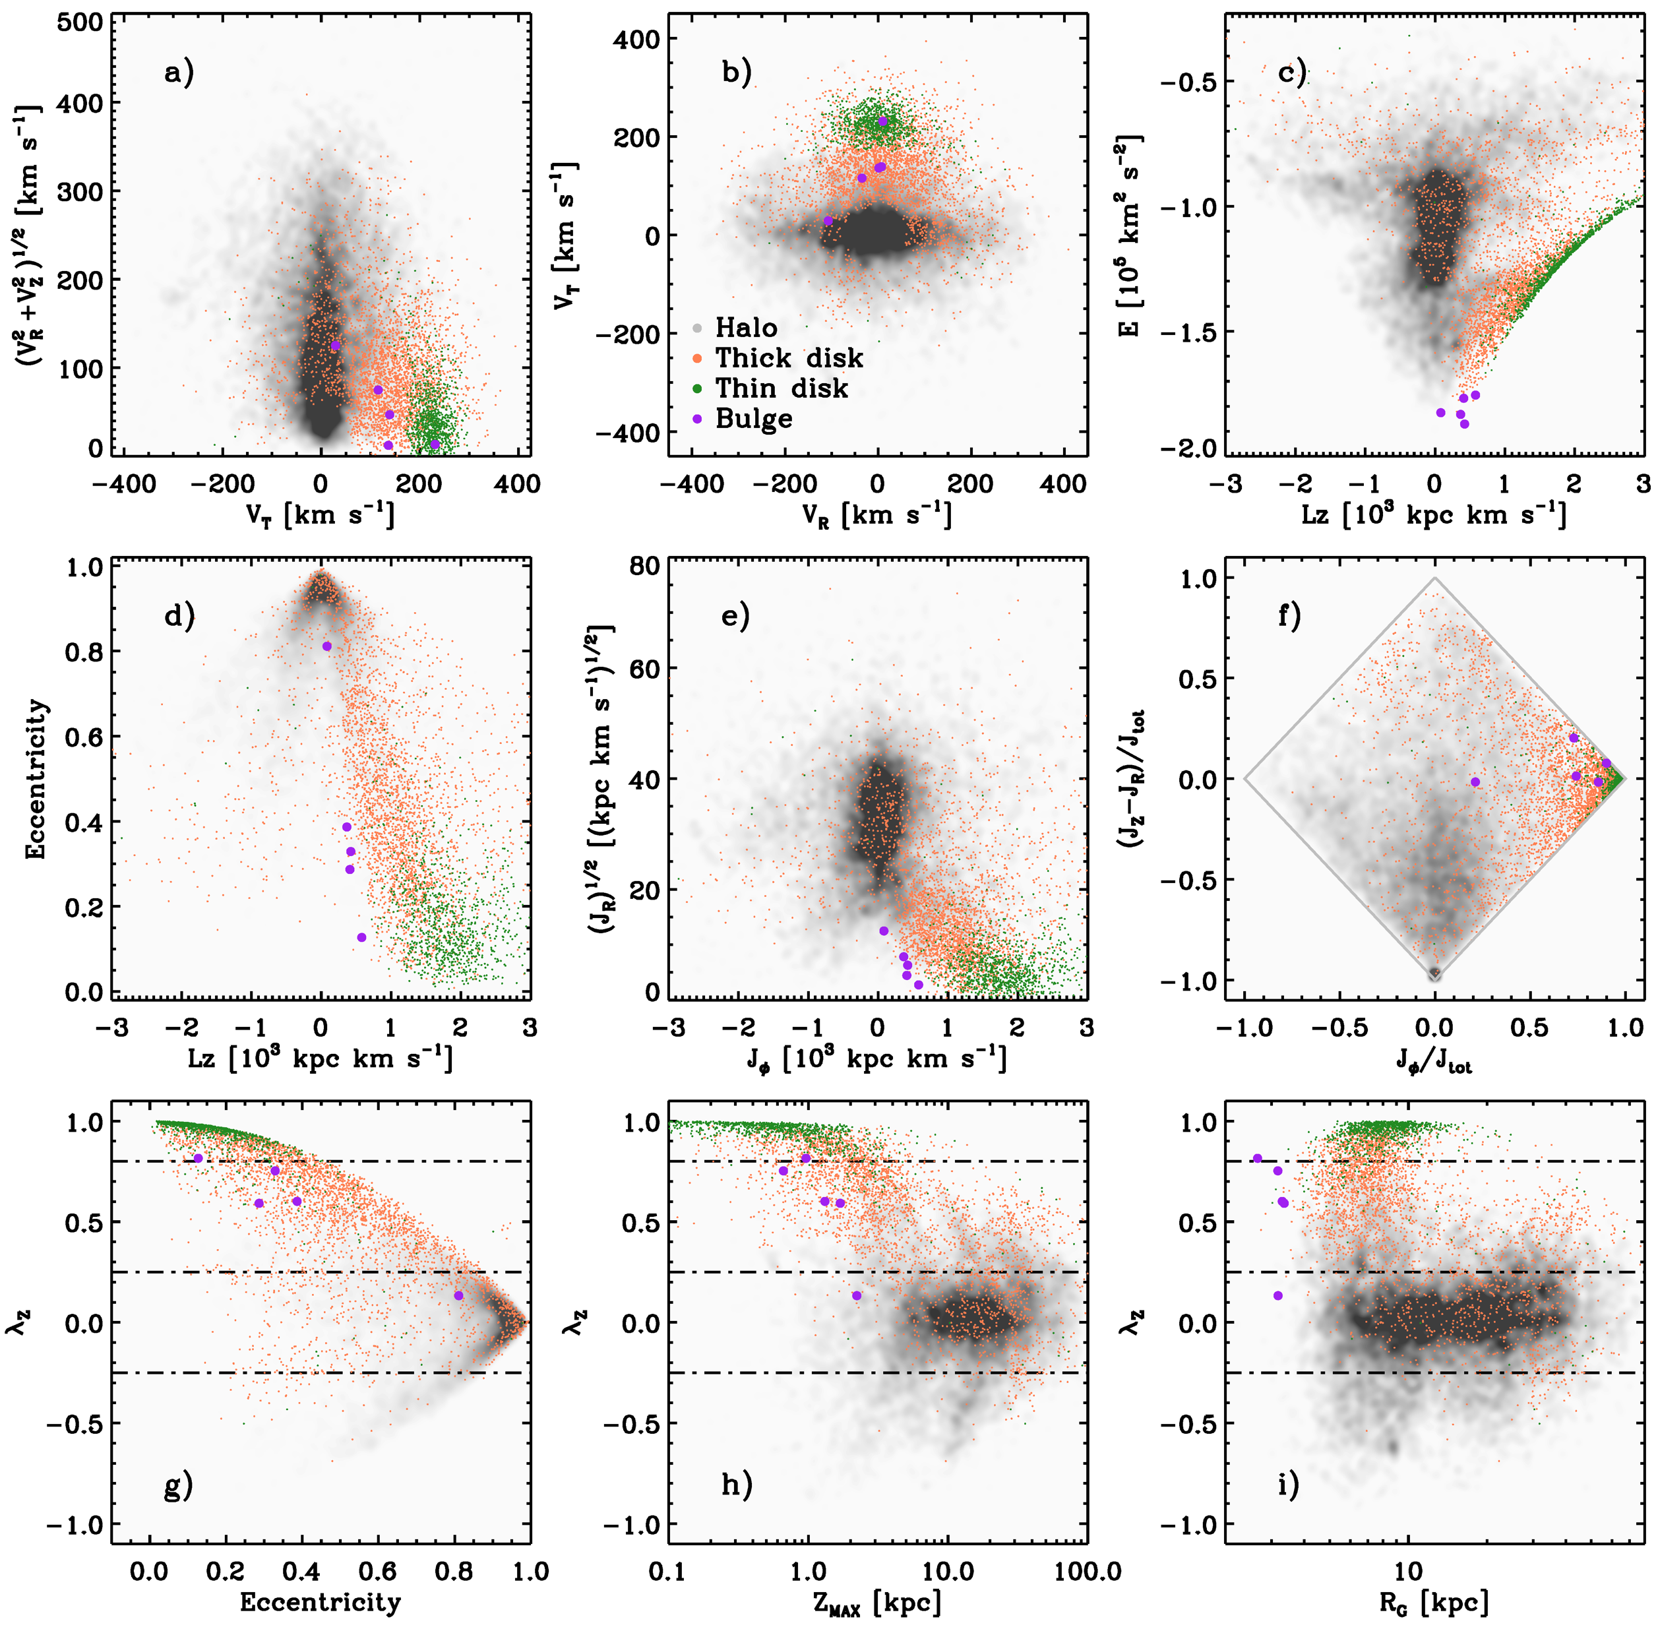
Kinematic selections based on RRLs
6+3 kinematic planes
severe degeneracy
redundancy helps!!
Based on MWpotential

Slide 5
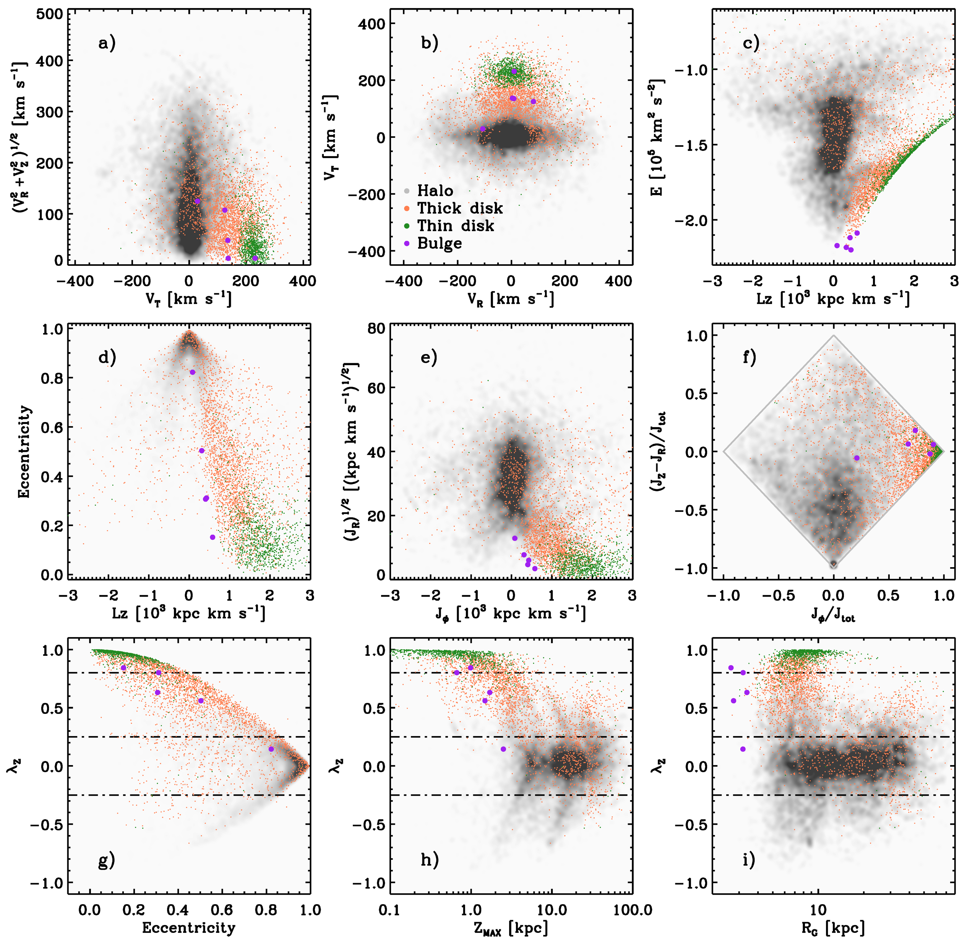
Kinematic selections based on RRLs
6+3 kinematic planes
severe degeneracy
redundancy helps!!
Based on McMillan2017

Slide 6
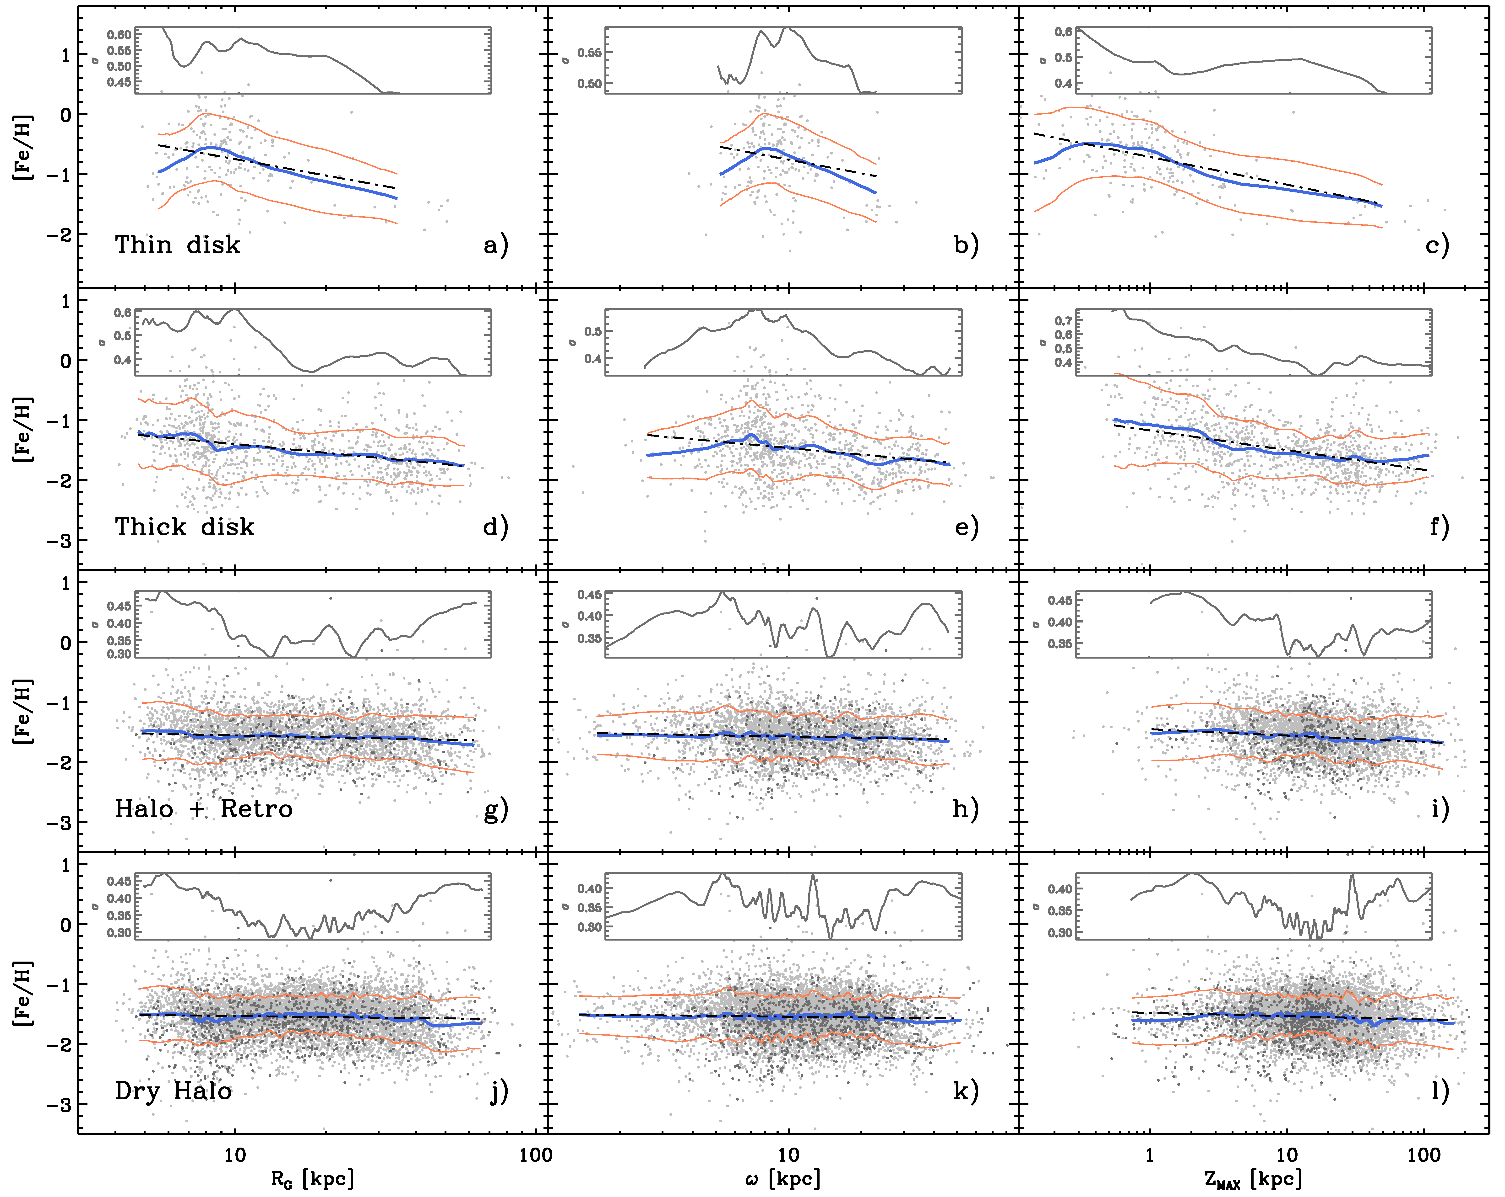
RRL metallicity gradient
The gradients in
Thin/Thick disk show
up in Zmax or in |Z|
Matteo docet
Halo &
dry Halo (no streams)
almost flat

Slide 7
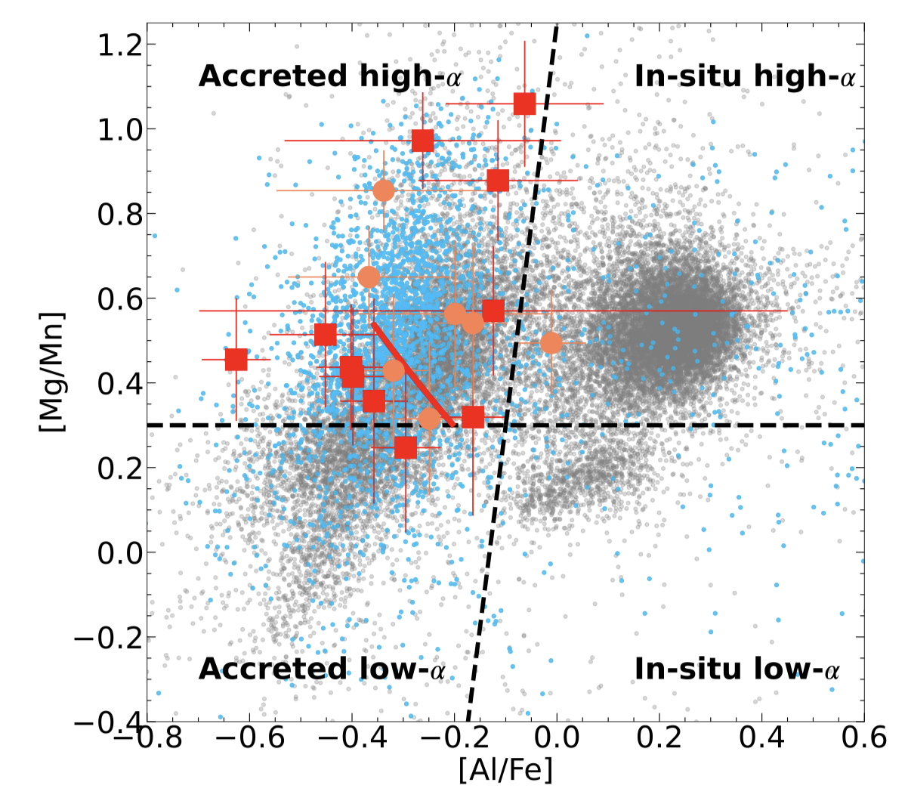
A new spin on chemical tagging
there is evidence that
kinematics and chemistry
are telling us different stories ….
are these planes age dependent?
are these planes changing in the very metal-poor/ metal-rich regime?
Sestito + 2024
Kinematics & chemistry are telling us different stories!

Slide 8
Old stellar tracers in M31 & in the MW
Quite well accepted that
M31 and MW are smilar, but
different … the former one
significantly more massive
more accretion, more …..
no quantitative investigation
of old stellar tracers
preliminary evidence of a
decrease in alpha enhanc.
in the outer halo
waiting for Karina for the
outer halo …..

Slide 9
The more you get the more you want!!!
The similarity also applies to
Gaia-Saudsage-Enceladus (MW)
vs
Giant Stellar Stream &
Kinematically cold component (M31)
once again a decrease in alpha enhancement in the outer halo!

Slide 10
To be (binary) or not to be (binary)?
It has been suggested that RRL with Thin disk kinematics are metal-rich & young (a few Gyrs) they are the aftermath of binary evolution.
However:
Why they obey to the same PL relations?
Why we do not have any evidence of binarity in metal-rich RRLs?
Why binarity should only be present in metal-rich RRLs?
Photometric path:
only one impostor from OGLE
but Kervella’s paper + Gaia DR4 very promising
Chemical path:
only one object from George Preston (95 & still very active!)

Slide 11
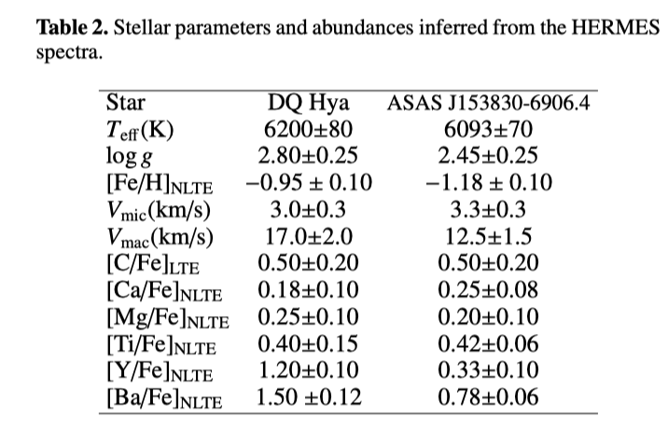
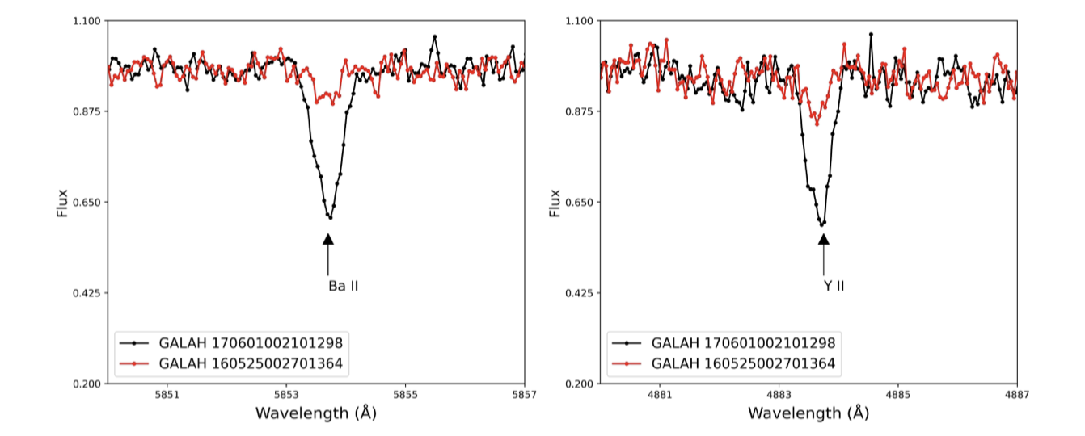
The more you get the more you want!!!
Two new binary candidates!
Valentina fecit

Slide 12
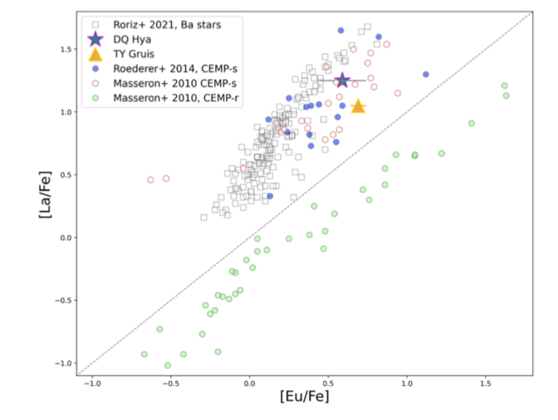
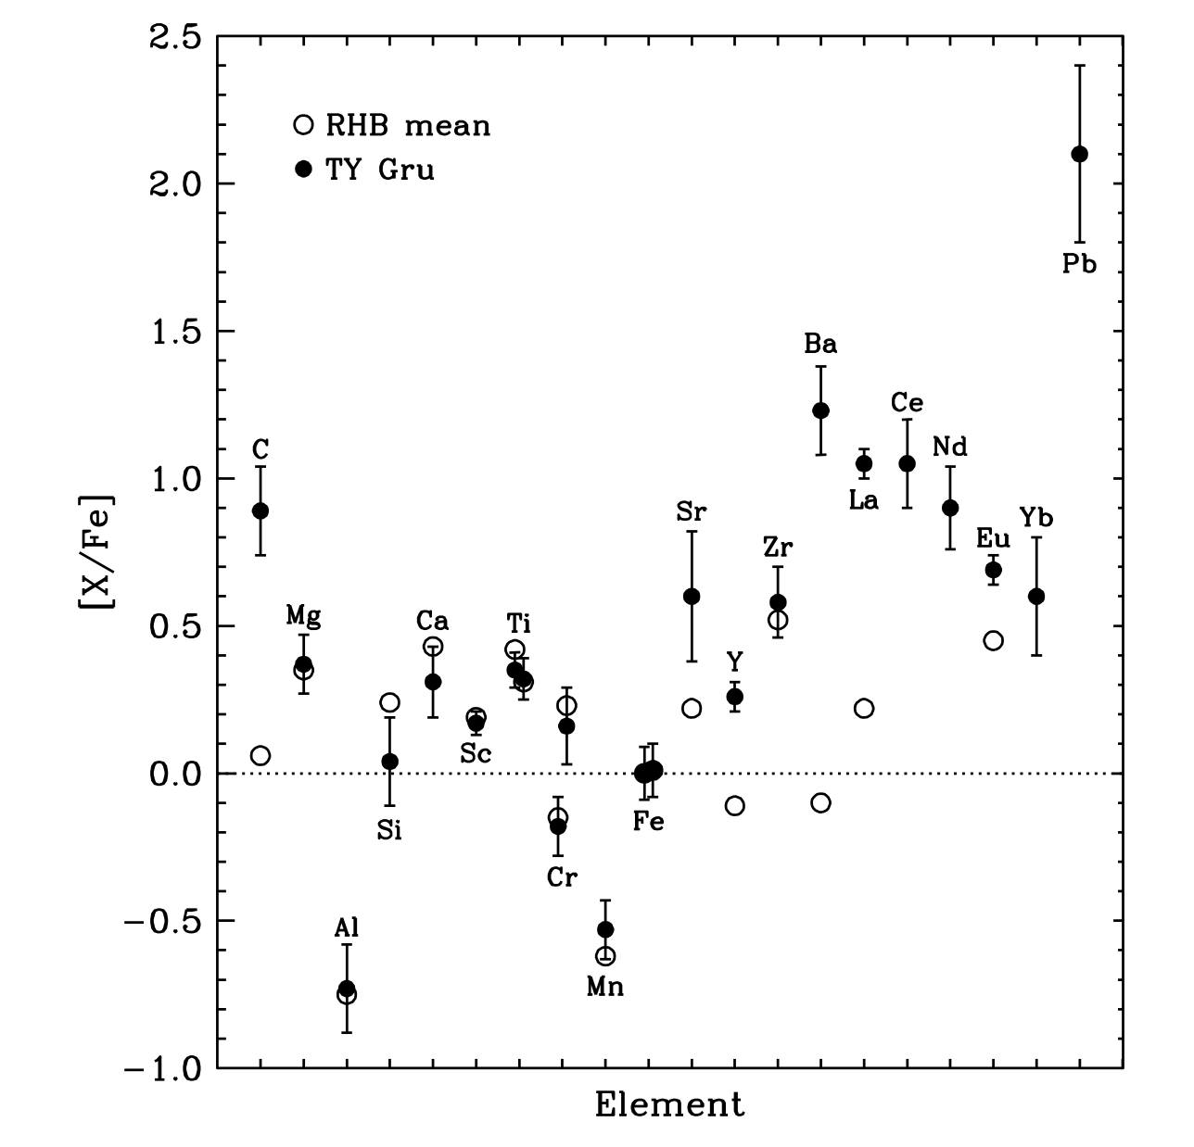
The more you get the more you want!!!
[Fe/H]=-0.95/-1.18 (0.10)
[Fe/H]=-2.0 (0.2)
2+1 binary candidates!
in thousands of HR RRL spectra

Slide 13

A joke concerning the RRL young age
The evidence that I can (possibly) dance
KPOP Music doesn’t mean that I am young!!

Slide 14
CONCLUSIONS I
-→ Golden age for stellar populations
Ground-based follow up spectroscopy: Blue MUSE + MOONS + 4MOST
MAVIS → Halo outskirts
ERIS → Galactic Bulge
Ground-based multi-band photometry: LSST
from 20-21 to 25-26 mag → JWST/WFIRST?
ELT: MICADO, HARMONI, ANDES …..
→ MSE/WST (!!!) ++++

Slide 15
CONCLUSIONS II
In the near future we are going to have tons of
both photometric and spectroscopic data
There are good reasons to believe that we are going to have new AI/ML approaches
What we really need are new ideas and new eyes
We trust on you!!!

Slide 16
Credits
To young, differently young & senior (PBS!) colleagues with whom I have the pleasure to share this wonderful adventure
THANKS!!!

