Slide 1
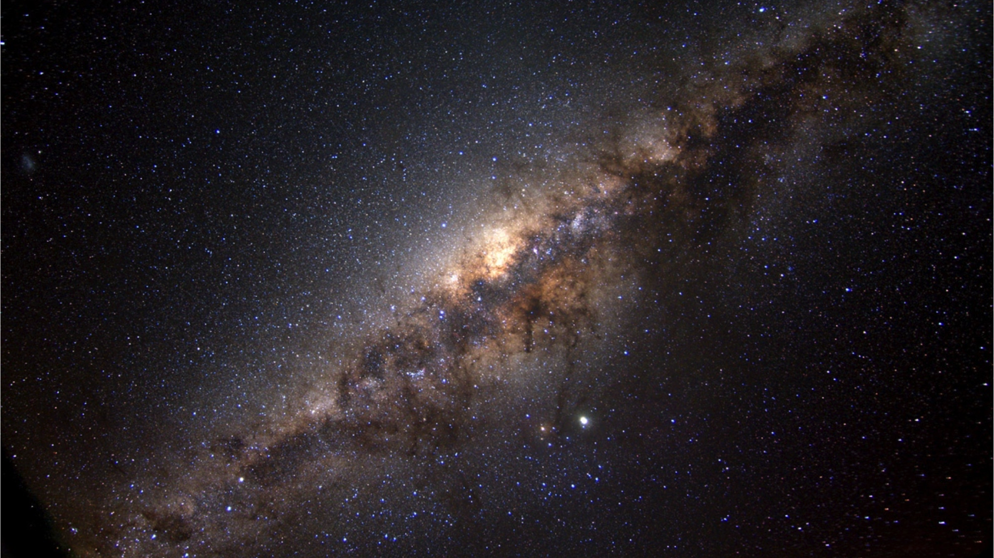
The role of giants and variables in tracing the Milky Way bulge
Elena Valenti
European Southern Observatory

Slide 2
Outline
Bulges in the context of galaxy evolution
Stellar tracers:
  Giants
  Variables
The Milky Way bulge
  3D structure
  Kinematics
  Chemical content
  Age
Future perspectives on galactic bulge and beyond:
  MOONS@VLT
  ELT

Slide 3
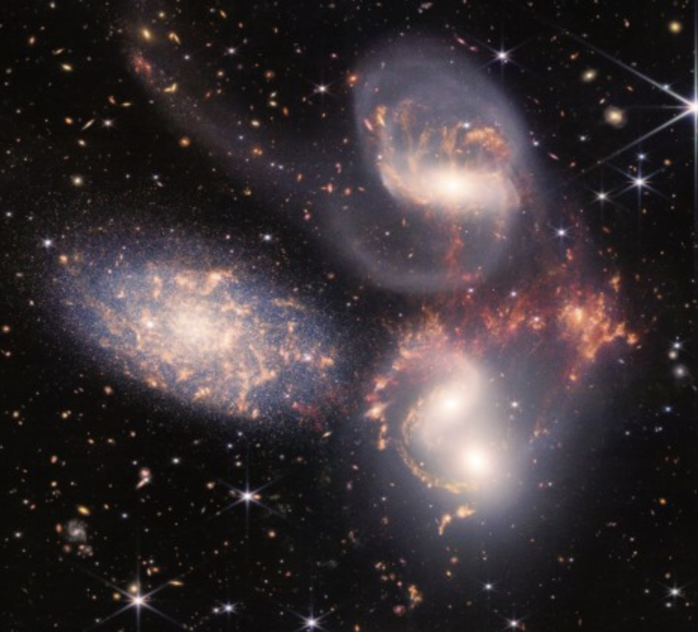
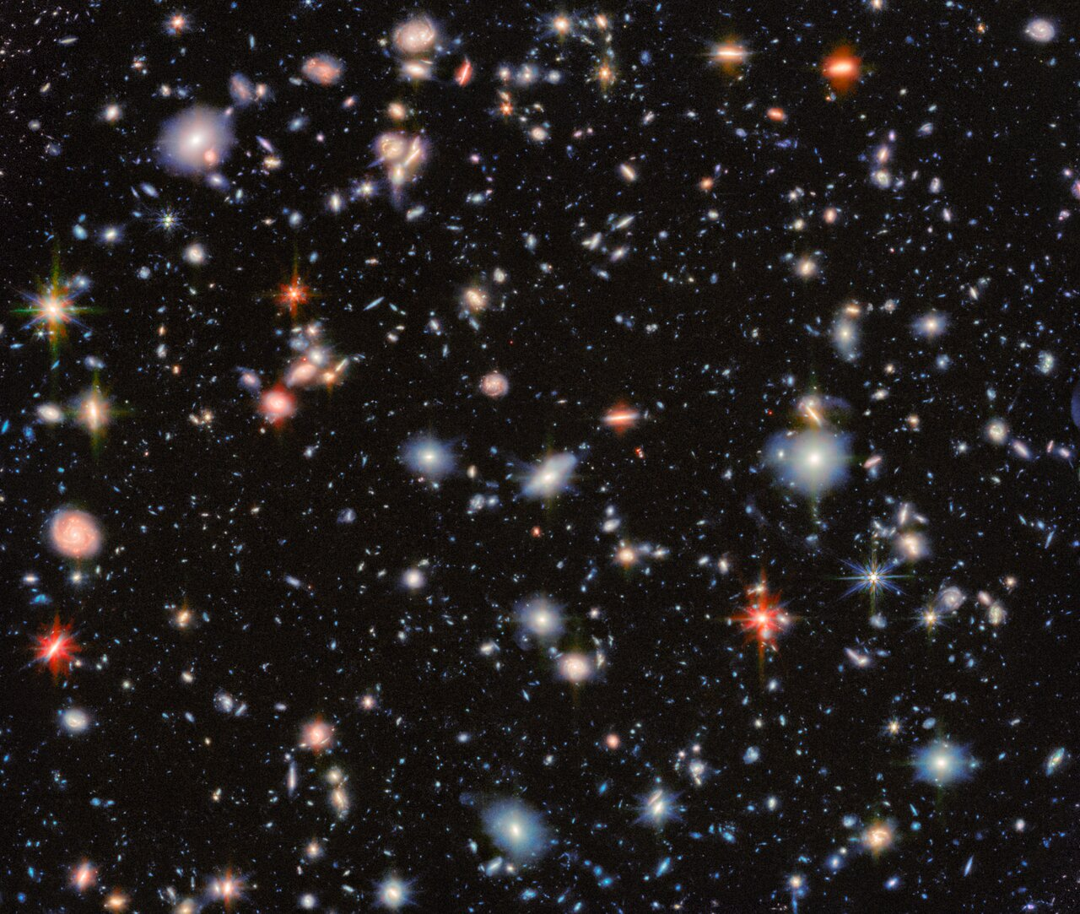
Galaxy Formation & Evolution
Cold gas forms stars → stars heat the gas (a delicate balance)
At the end of their life, massive stars explode → Feedback → a lot of energy → hot gas
What happens to the gas when galaxies merge?
What are the processes driving diverse morphologies?
What’s the role of SMBH?
Notes:
Broadly speaking, about 60-70% of galaxies host bulge

Slide 4
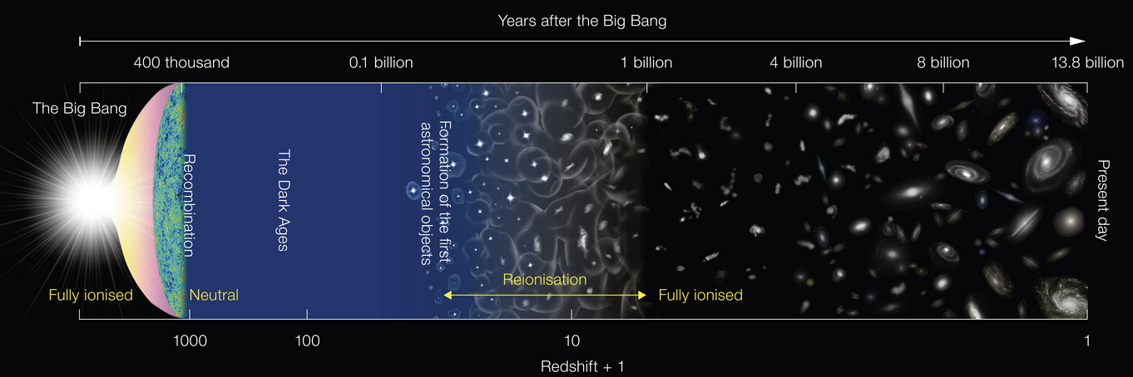
Galaxy Formation & Evolution
Roughly 60%-70% of galaxies host bulges
Bulges formation remains a key open question in galaxy evolution, explored mainly
through two complementary approaches:
Observing high-z galaxies, where bulges are forming
Studying local galaxies, where diverse bulge types are seen
Notes:
Broadly speaking, about 60-70% of galaxies host bulge

Slide 5
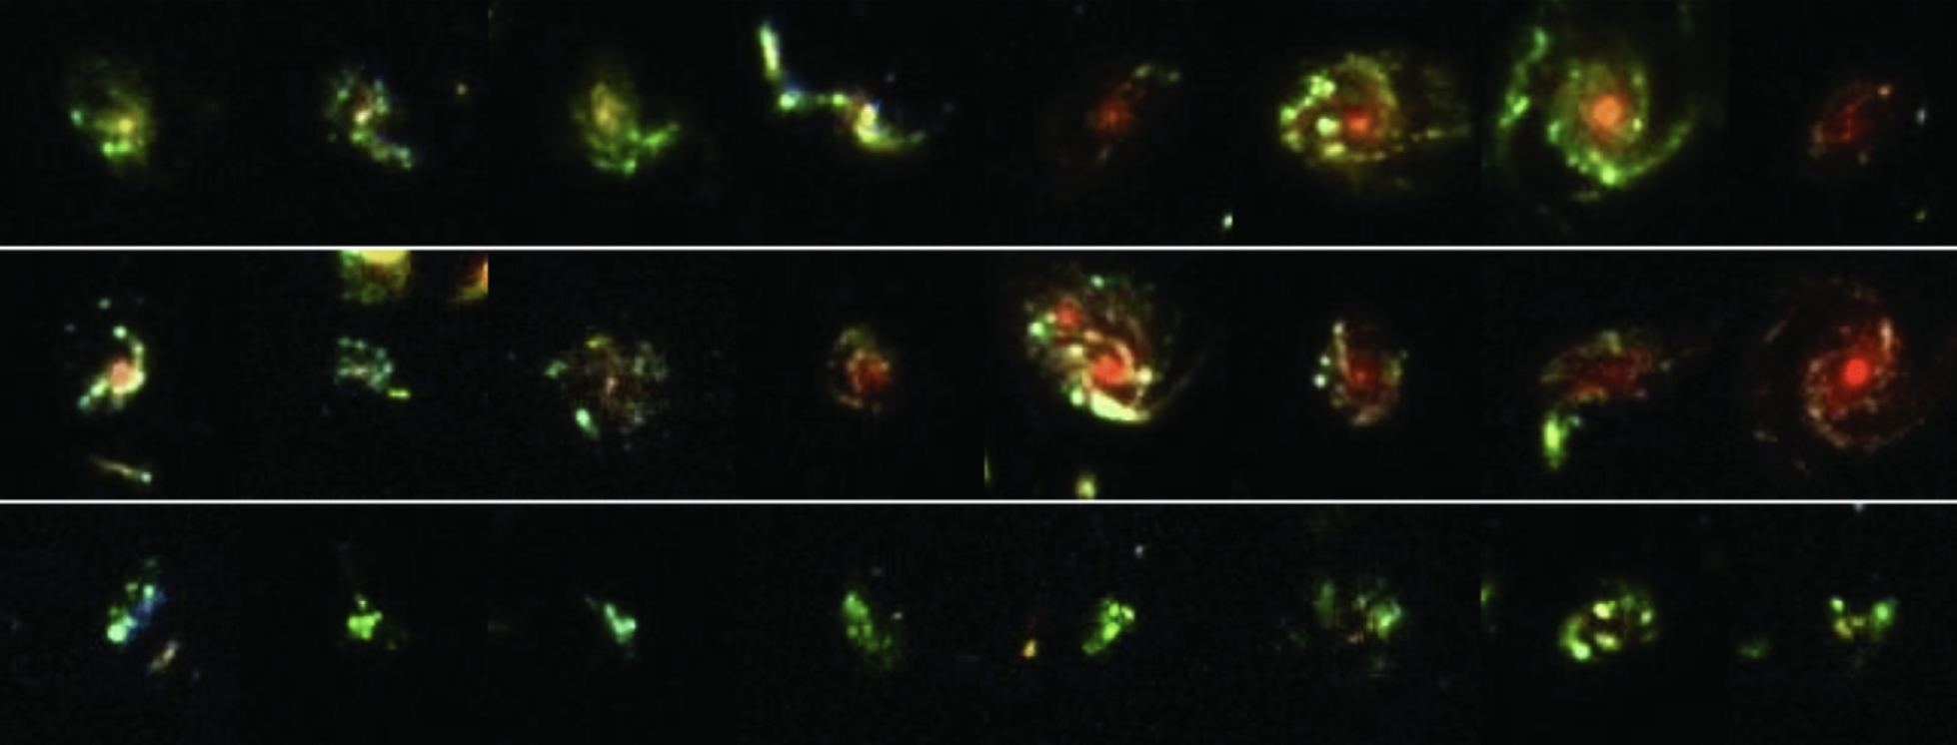
Bulges at High Redshift
High-z disks are gas-rich, turbulent, and highly star forming.
giant clumps migrating and coalescing at the centre
violent disk instabilities driving gas inward on short depletion timescales
→ Rapid formation from the disk within a dissipative gas-rich environment.
Immeli+2004;
Carollo+2007;
Elmegreen+2008;
Genzel+2008; Bournaud+2009;
Dekel & Buret 2014;
Guo+ 2015;
Tacchella+2016

Slide 6
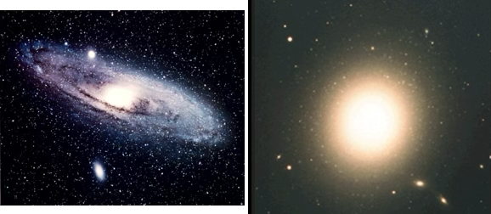
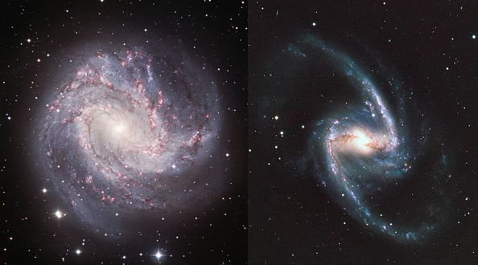
Bulges in the nearby Universe
Local bulges shows very different properties (Kormendy & Kennicutt 2004):
Classical bulges: form through dissipationless mergers of stellar subunits
Psuedo bulges: form via dynamical instability in gas-poor disk, where bars develop and subsequently buckle into thicker, boxy structures (B/P shape)
→ Unlike at high-z, stars form outside the bulge

Slide 7

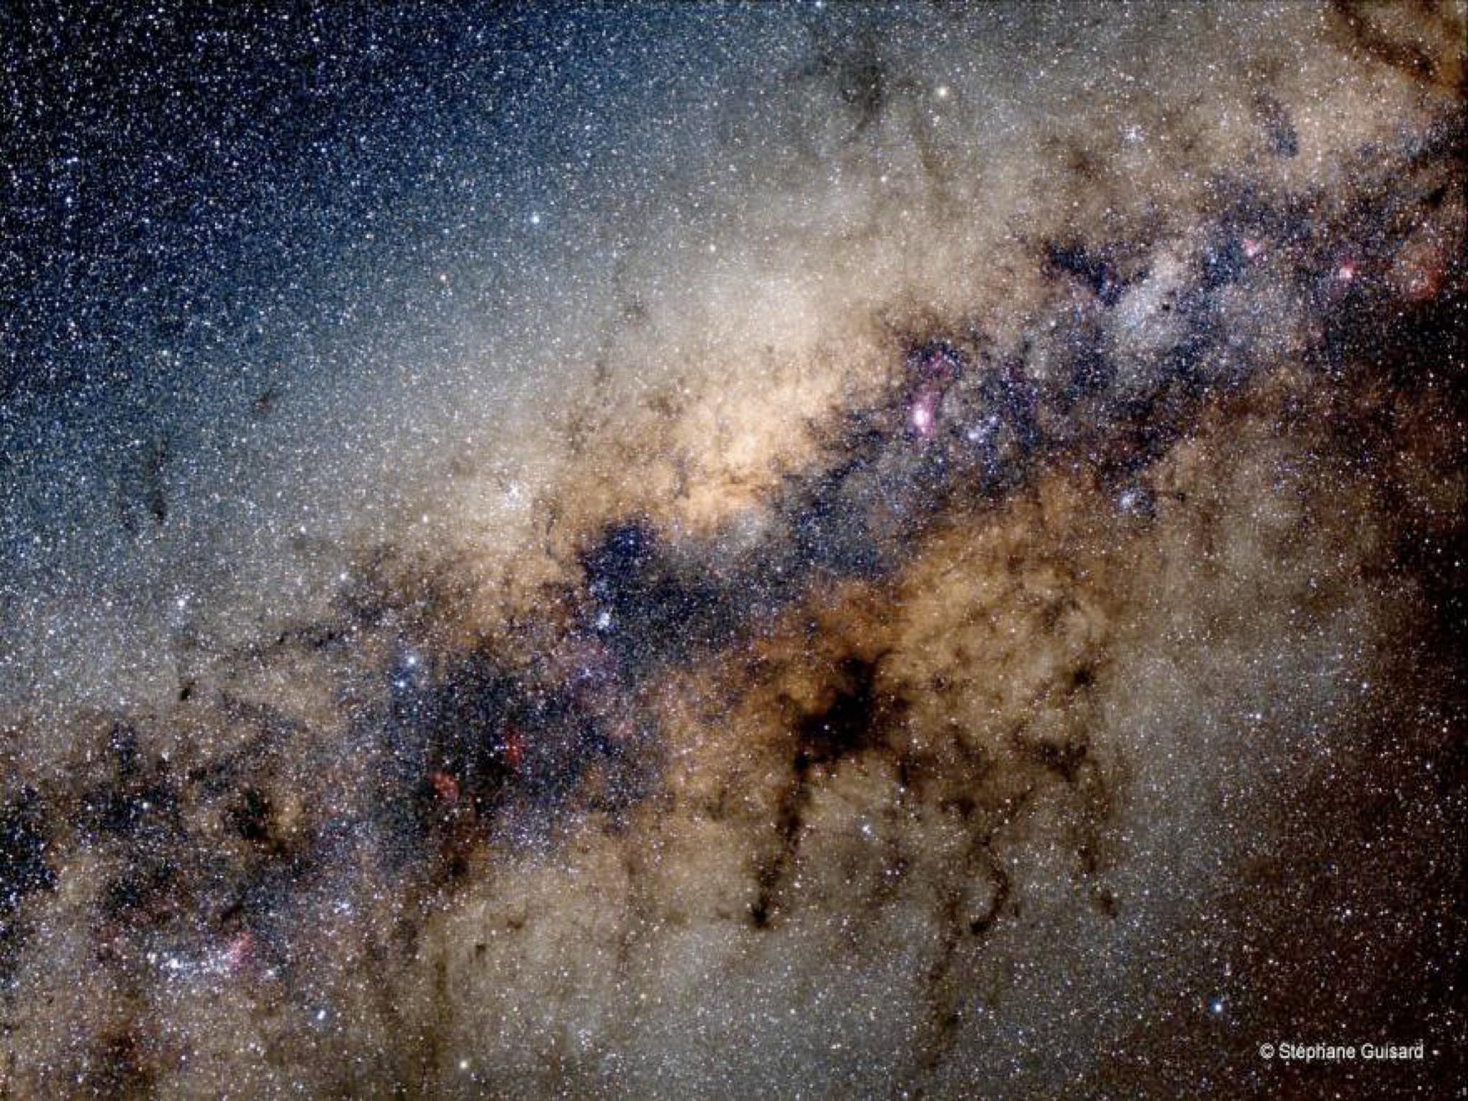
The Milky Way bulge
Bridging the high-z and local perspective!
Unique opportunity to study a bulge where individual stars can be resolved:
Age, chemical composition & kinematics: The three dominant parameters in the population concept (cfr., Sandage)
Global properties (e.g., age, kinematics and chemistry) inferred directly from details of its stellar content
Shape & Morphology
Kinematics
~500 deg²
Age
Chemical content

Slide 8

Why stellar tracers …..
Spectra
HR spectra
Fe
Elements ratio
Chemical Abundances
Radial velocity
Tangential velocity
Any Spectra
Time-series
Accurate phot
Kinematics
Proper motions
Distances
Spatial Distribution
→ Distances
OK but
Dist < 2kpc!
Accurate spec
Accurate phot
Ages
→ Distances

Slide 9
Looking for suitable bulge stellar tracer
Ideally:
Reliable DISTANCE indicators
Age tracers
Metallicity markers
Easy to observe within the bulge
  High occurrence rate
  Bright at near-IR wavelength
High stellar density
High & patchy extinction
Large FoV (R_{G}<3kpc)
Trading off:
Spatial Resolution vs field coverage
Spectral resolution vs multiplexing

Slide 10
Why giant stars?
Ubiquitous and very frequent
Bright in the near-IR

Slide 11
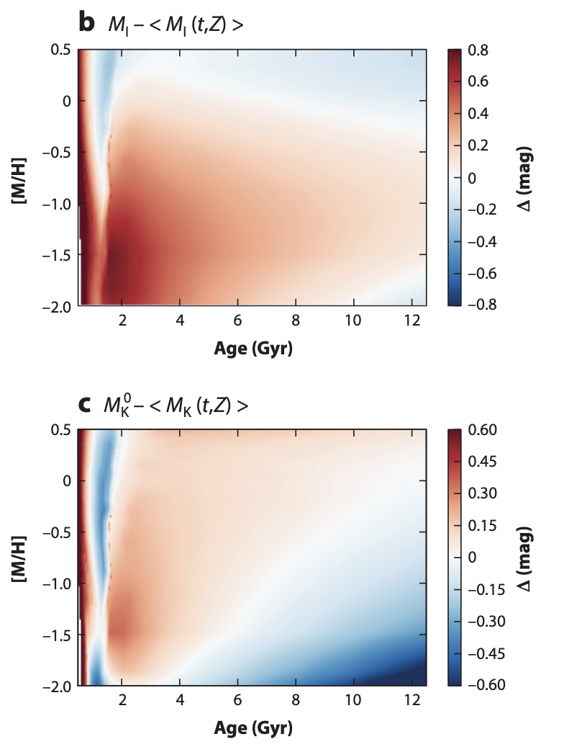
Why giant stars?
See Girardi 2016, review
Ubiquitous and very frequent
Bright in the near-IR
Distance indicators
  extinction
Red Clump stars:
Low-mass stars
Core He-burning phase
1/3 of giants
For age > 2Gyr: weak dependance from age

Slide 12
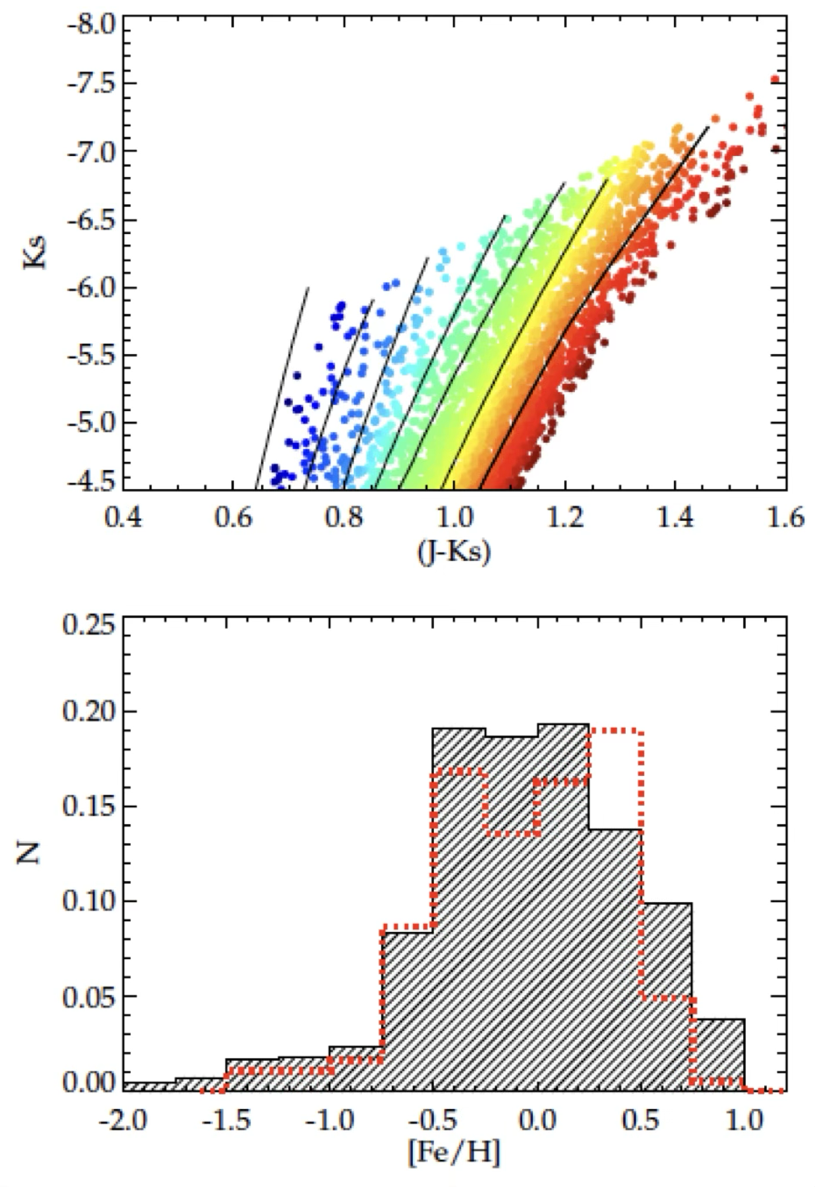
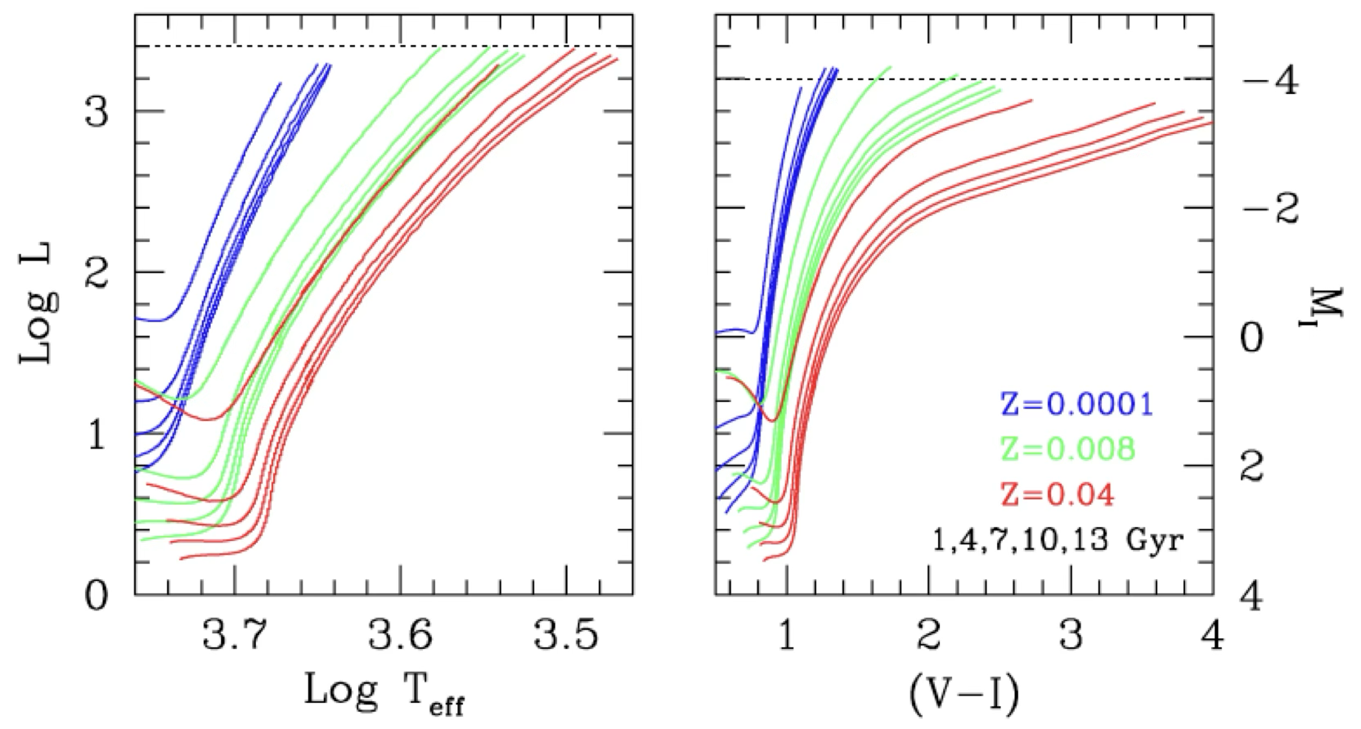
Why giant stars?
Line models
for different [Fe/H]
Ubiquitous and very frequent
Bright in the near-IR
Distance indicators
  extinction
Metallicity tracers
  The RGB color has a strong dependence on metallicity and a weak dependence on age (negligible for old ages)

Slide 13
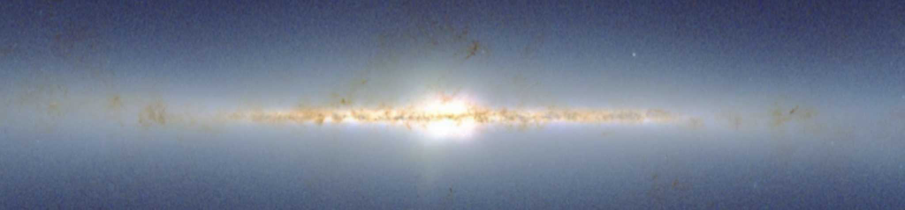
The Galactic bar: early evidences
de Vaucouleurs 1964
Binney 1991
Blitz & Spergel 1991
Dwek et al.1995
Binney et al. 1997
Udalski et al. (1994)
Alcock et al. (2000)
Gerard (2002)
Habing et al. (2006) →. OH/IR and SiO maser kinematics
Gas kinematics
Microlensing
Stellar surface
profile

Slide 14
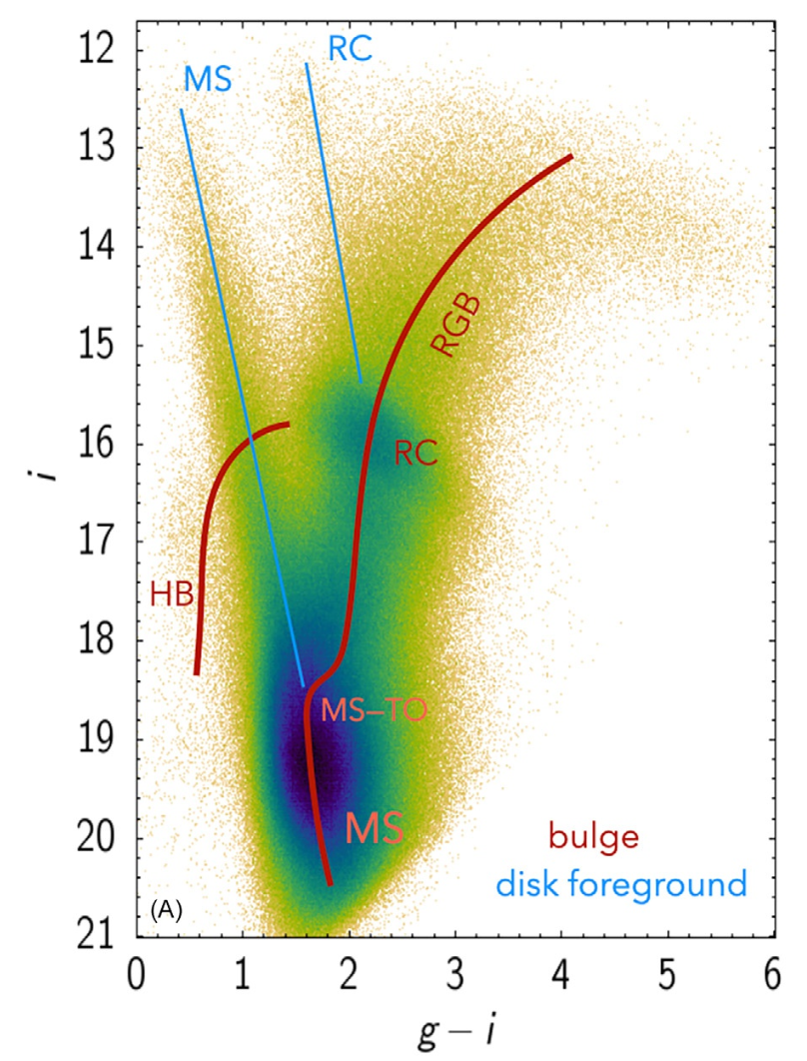
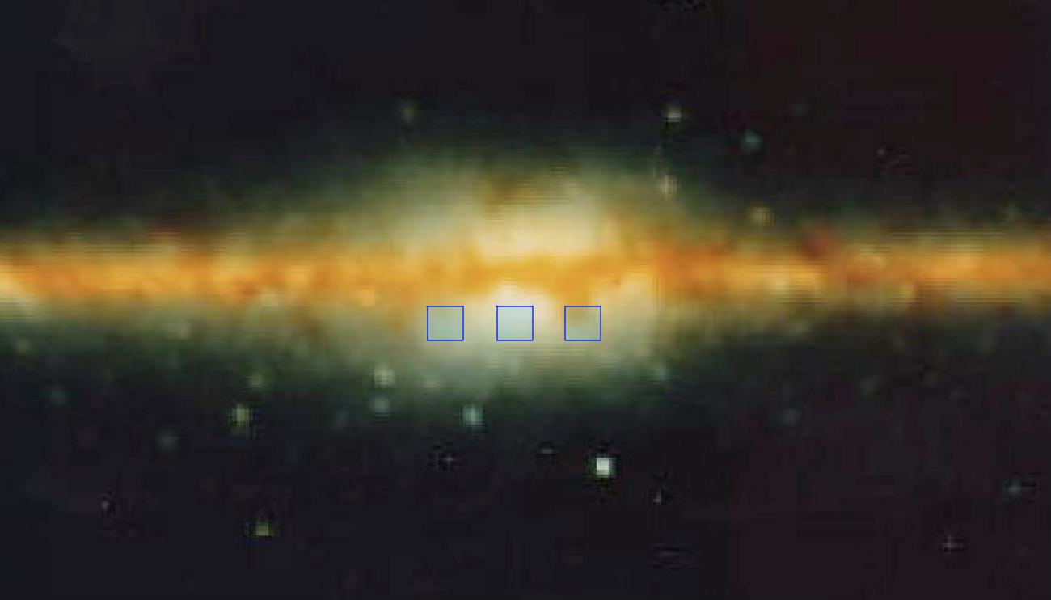
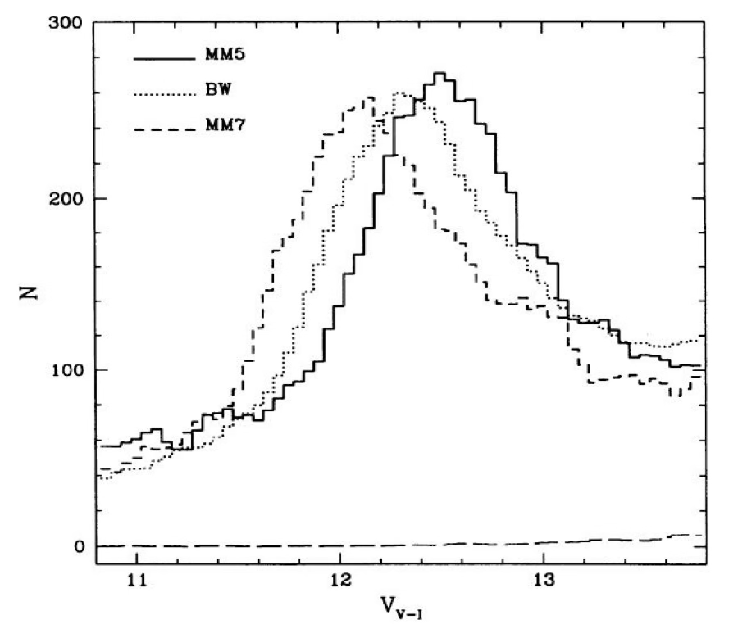
RC tracing the Galactic bar
Stanek et al. (1994)
⍬=45°
Observational evidence:
stars at positive longitudes are brighter (i.e., closer) than those at negative longitudes.
Long>0
Long<0

Slide 15
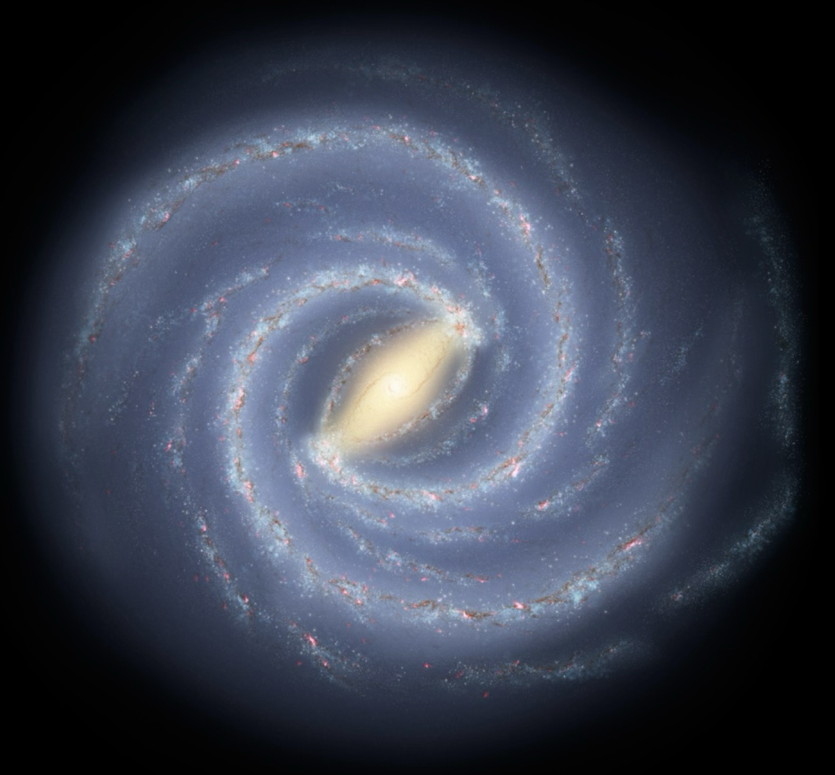
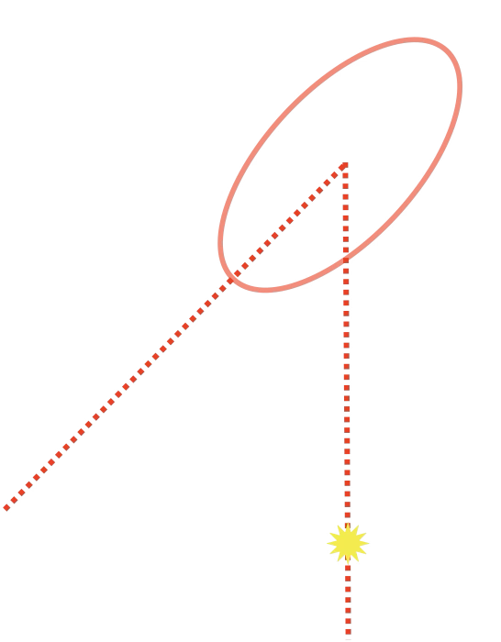
triaxial bar density model:
axis scale lengths (x₀:y₀:z₀)=(1.2:0.40:0.30) kpc Rattenbury+2007
(1.0:0.41:0.38) kpc Cao+2013
Rattenbury+2007:
44 fields
b< - 4º (outer bulge)
A_{tot} ~ 11 deg²
OGLE-II
Cao+2013:
-7º<b<-2º
A_{tot} ~ 90 deg²
OGLE-III

Slide 16
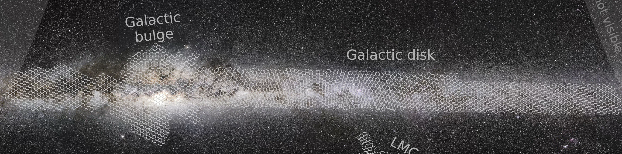
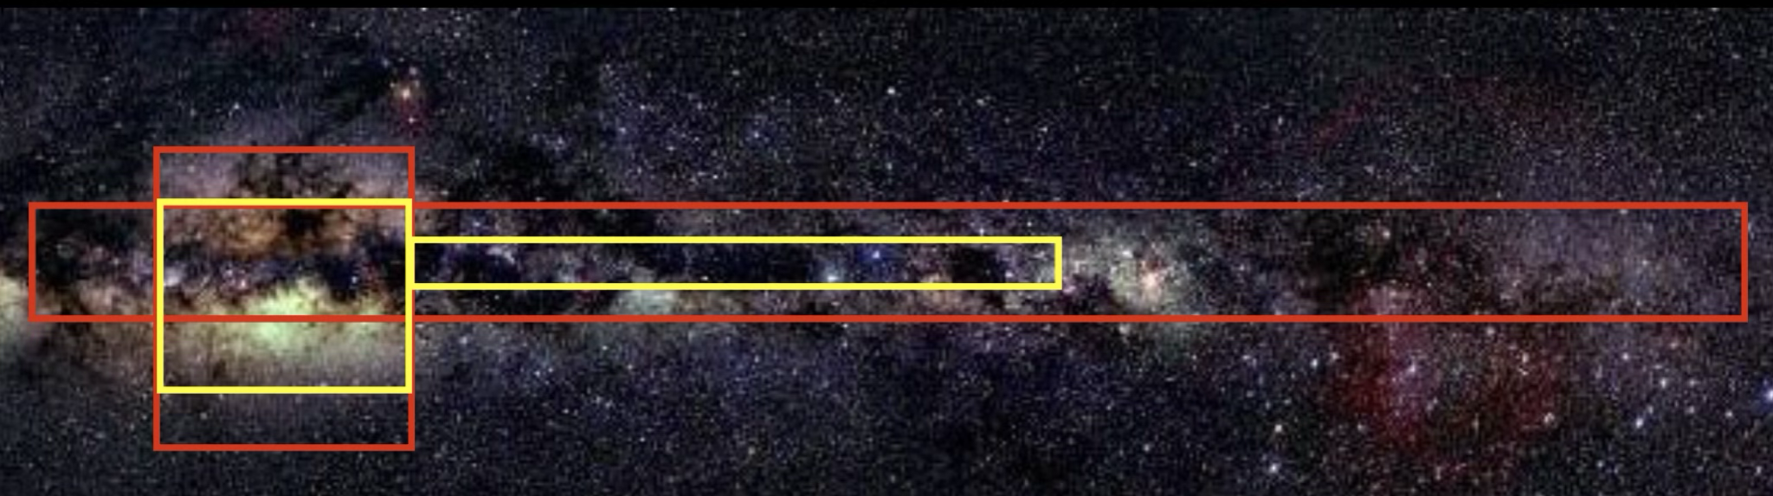
Bulge Photometric surveys
Optical Gravitational Lensing Experiment (OGLE)
Filter: B, V, I
Multi-epochs: I
VISTA Variables in the Via Lactea (VVV/X)
Filter: Y, z, J, H, K_{s}
Multi-epochs: J, H, K_{s}

Slide 17
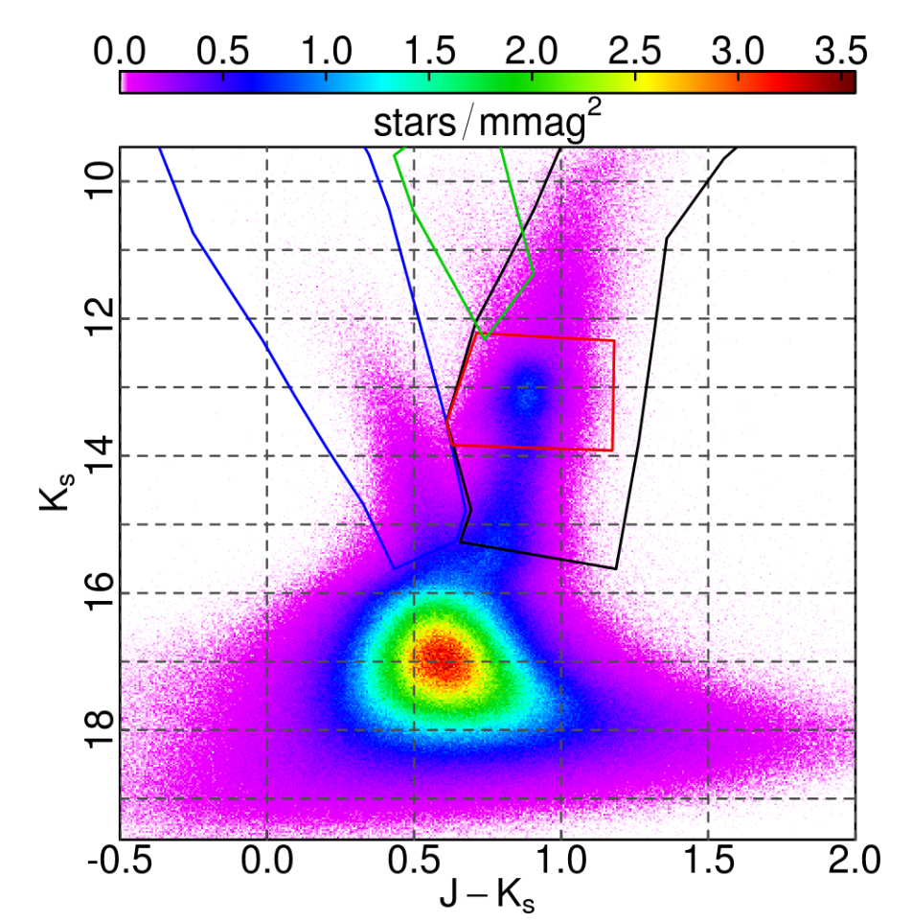
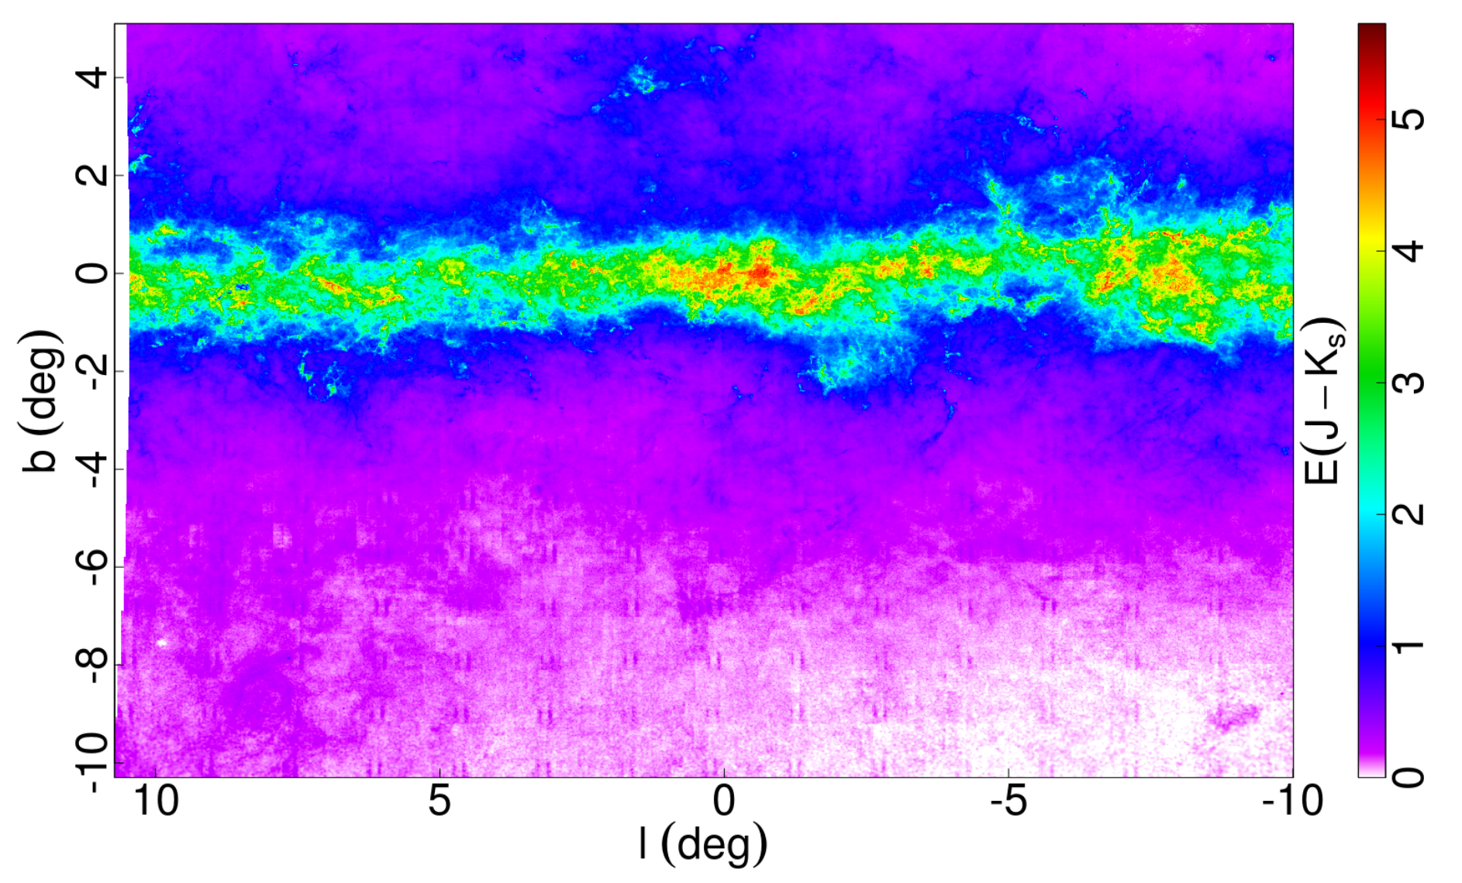
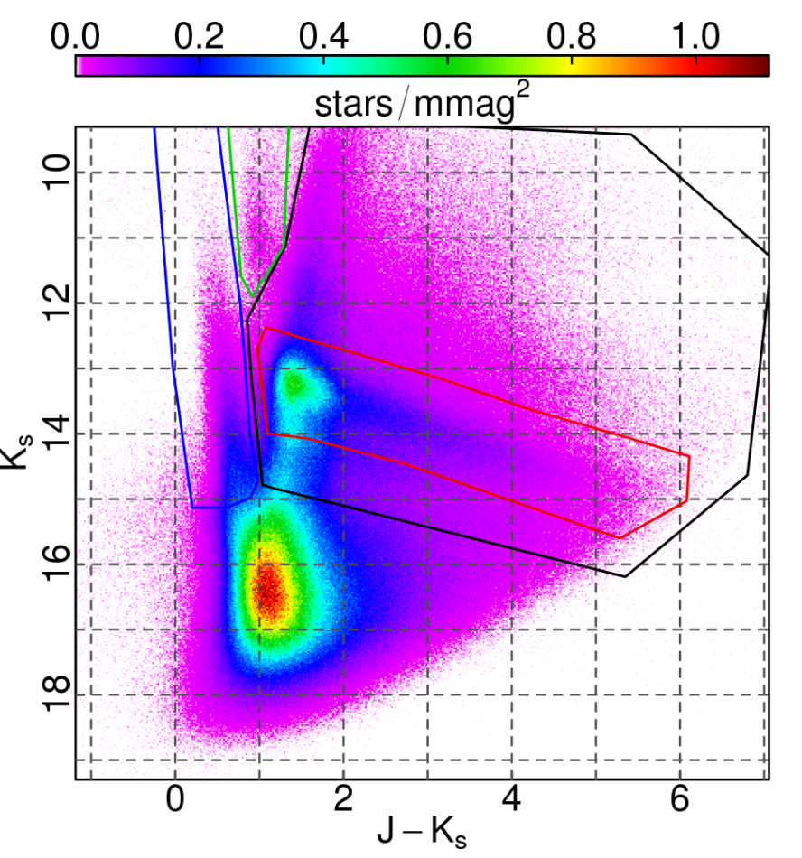
Extinction map from RCs
(I,b) = (0º, -4º)
(I,b) = (0º, -1º)
Surot et al. 2020

Slide 18
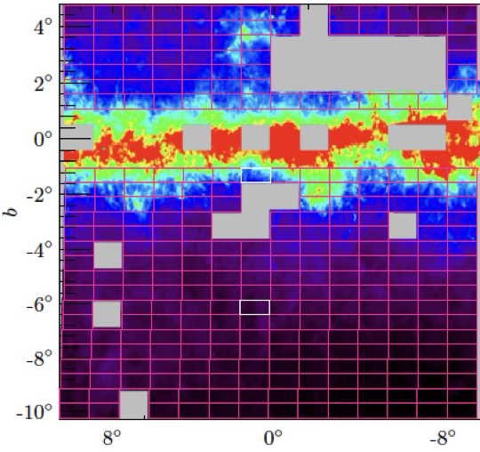
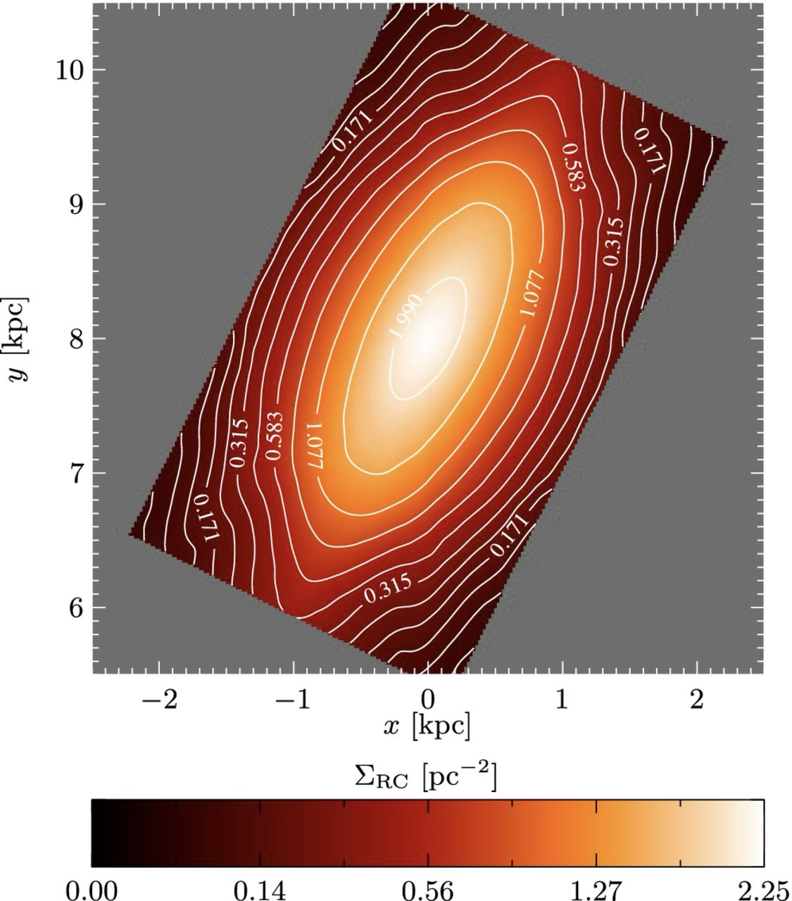
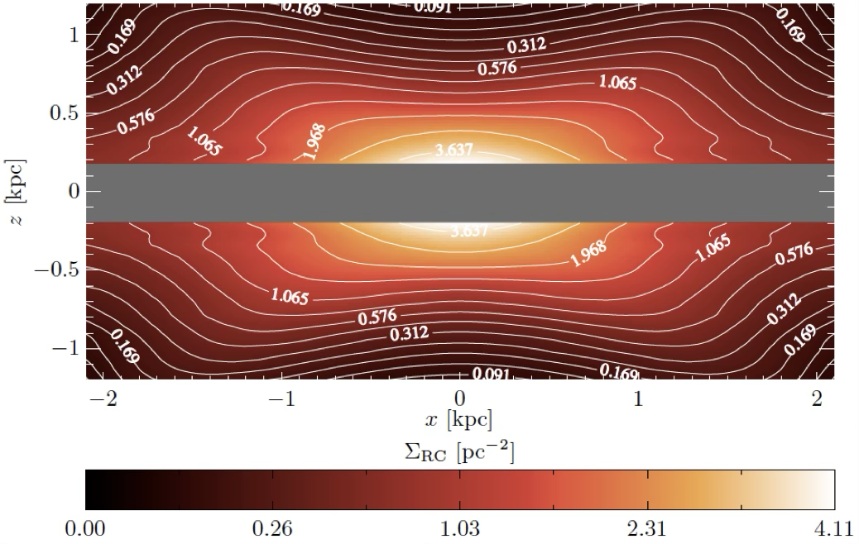
RCs provide a 3D view of the bulge
triaxial bar density model based on VVV DR1:
(x0:y0:z0)=(0.7:0.44:0.18) kpc - Axis ratio: (10:6.3:2.6) kpc - pivot angle ϑ: 27º
Wegg & Gerhard 2013

Slide 19
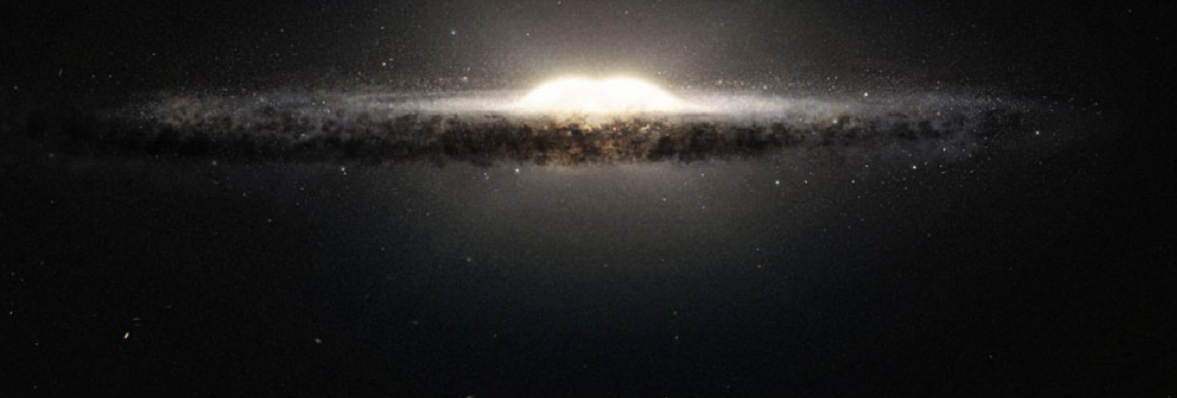
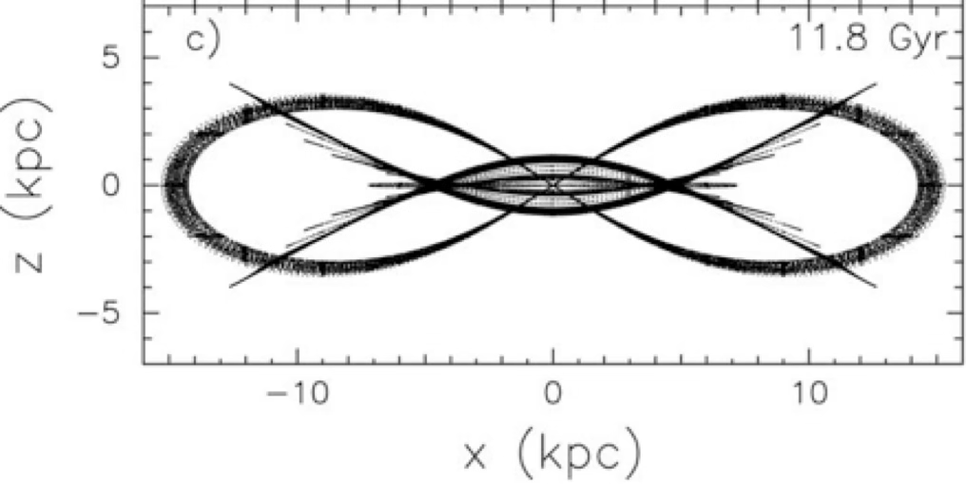
B/P & X-shape structures in galaxies
The boxy morphology is characteristic of all barred galaxies when seen edge-on (Laurikainen+2014)
The peanut shape (X-shape) is also a product of bar evolution, dynamical instabilities produce bending and buckling of the elongated stellar orbits within the bar resulting in the shape of peanut, or an X-shape when it is more pronounced, when seen edge-on (Patsis et al. 2002, Athanassoula 2005)

Slide 20
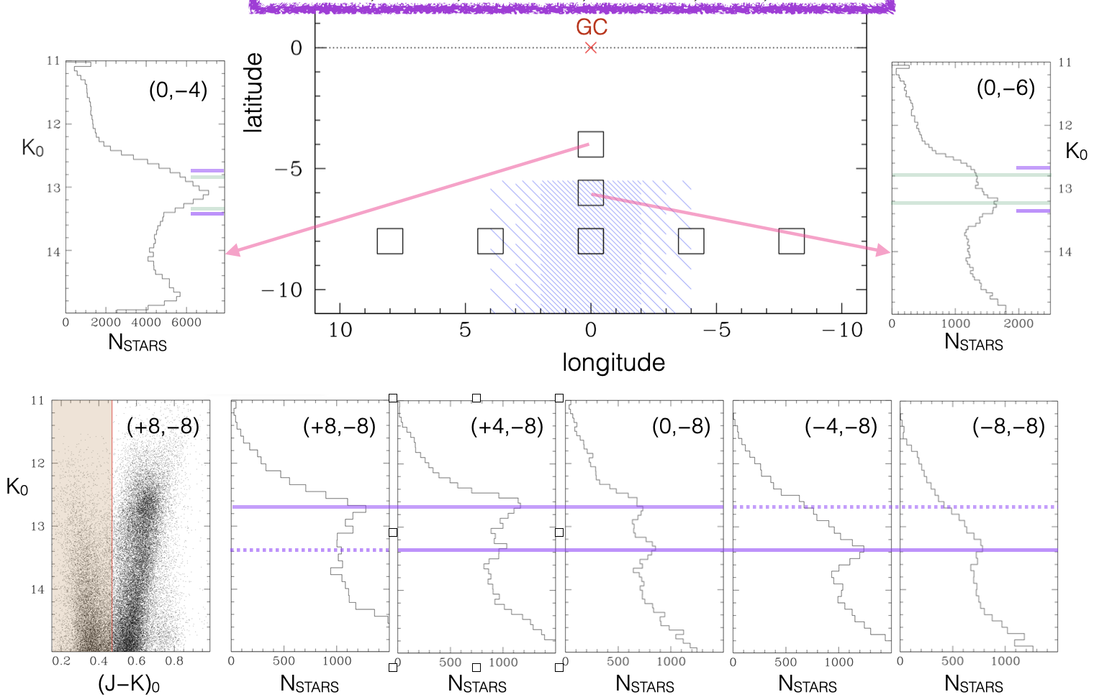
The MW bulge X-shape
First observational evidence: the distribution of the RC stars in the outer bulge (i.e., |b|>5º) but close to the minor axis (i.e., -4º<l<+4º) was found bimodal, suggesting the presence of a double-RC.

Slide 21
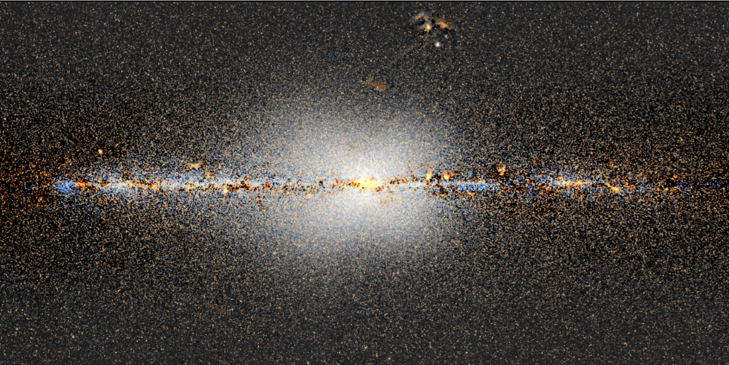
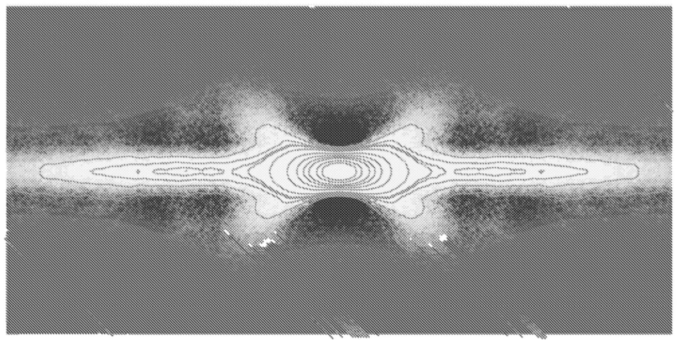
The MW bulge X-shape
McWilliam& Zoccali 2010)
Nataf et al. 2010
Saito et al. 2010
Wegg & Gerhard 2013
Gonzalez et al. 2015
Ness & Lang 2016
The X-shape of the MW bar is a natural product of disk evolution
Ness & Land (2016)
unWISE all sky map
Simulations
Athanassoula 2005

Slide 22
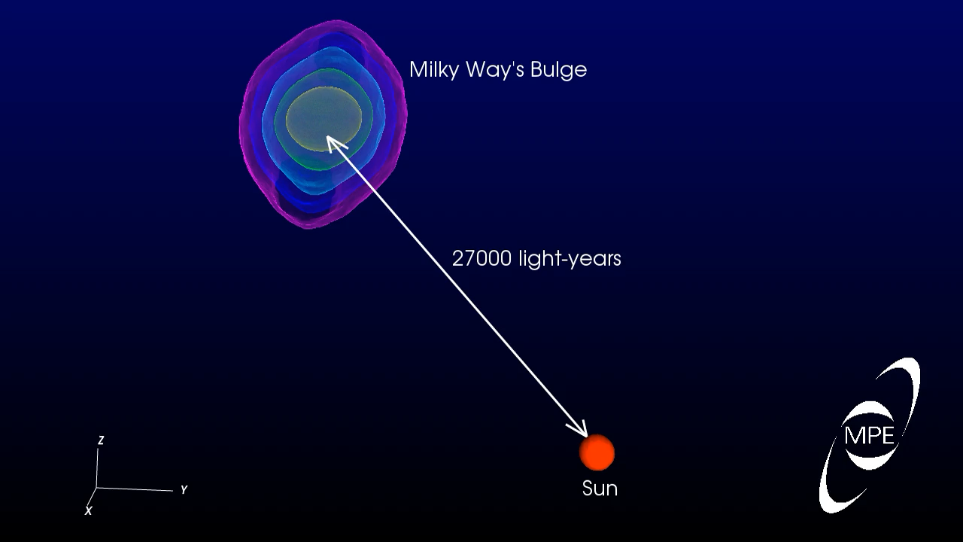

Slide 23
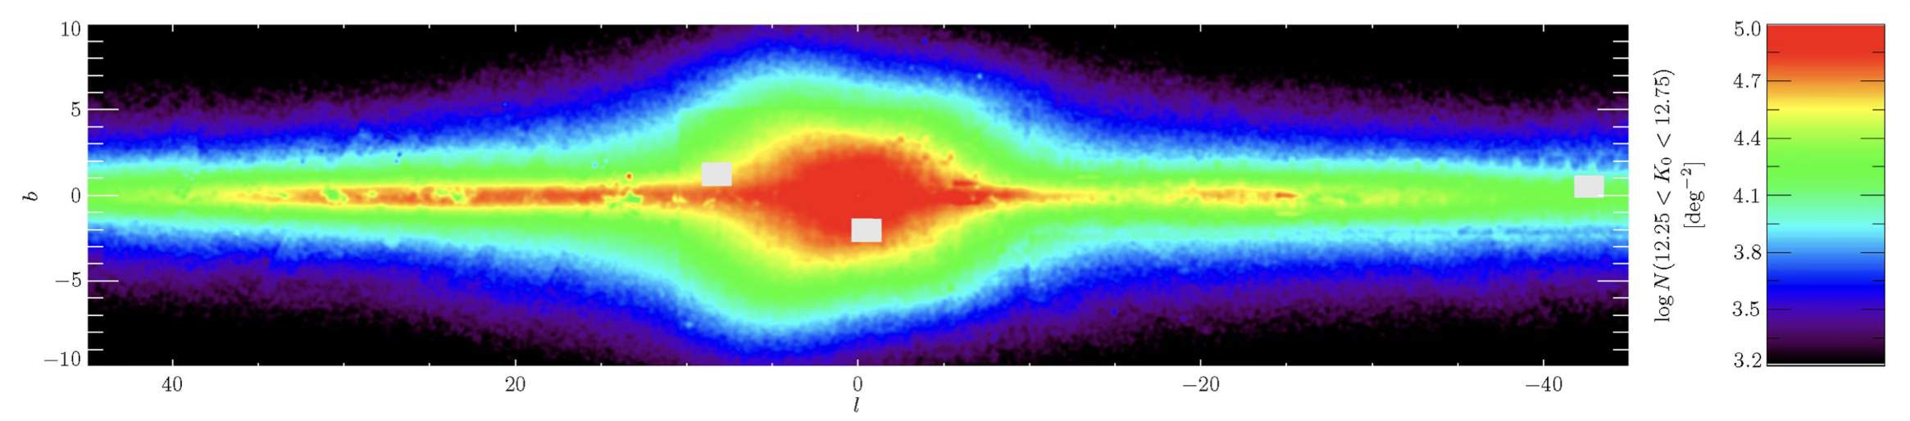
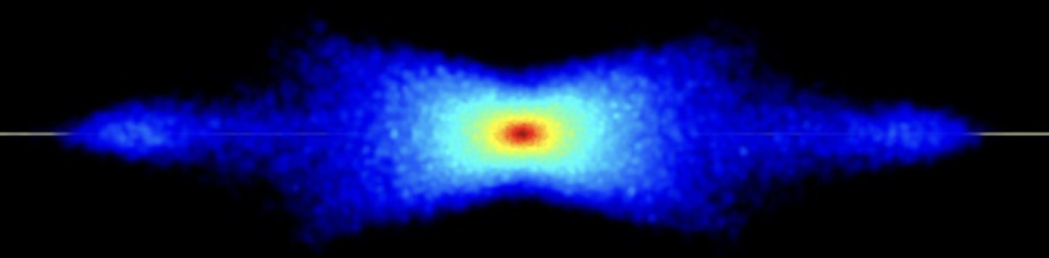
The MW long bar
VVV+2MASS+UKIDSS+GLIMPSE
Wegg et al. 2015
Thin long bar is a natural feature of B/P bulges
Athanassoula 2005
Stellar density map - as obtained from counting RCs – best fits requires a pivot angle ϑ=28º - 33º
No separate long bar
The observed thin long bar is the natural extension of the main bar towards high longitudes

Slide 24
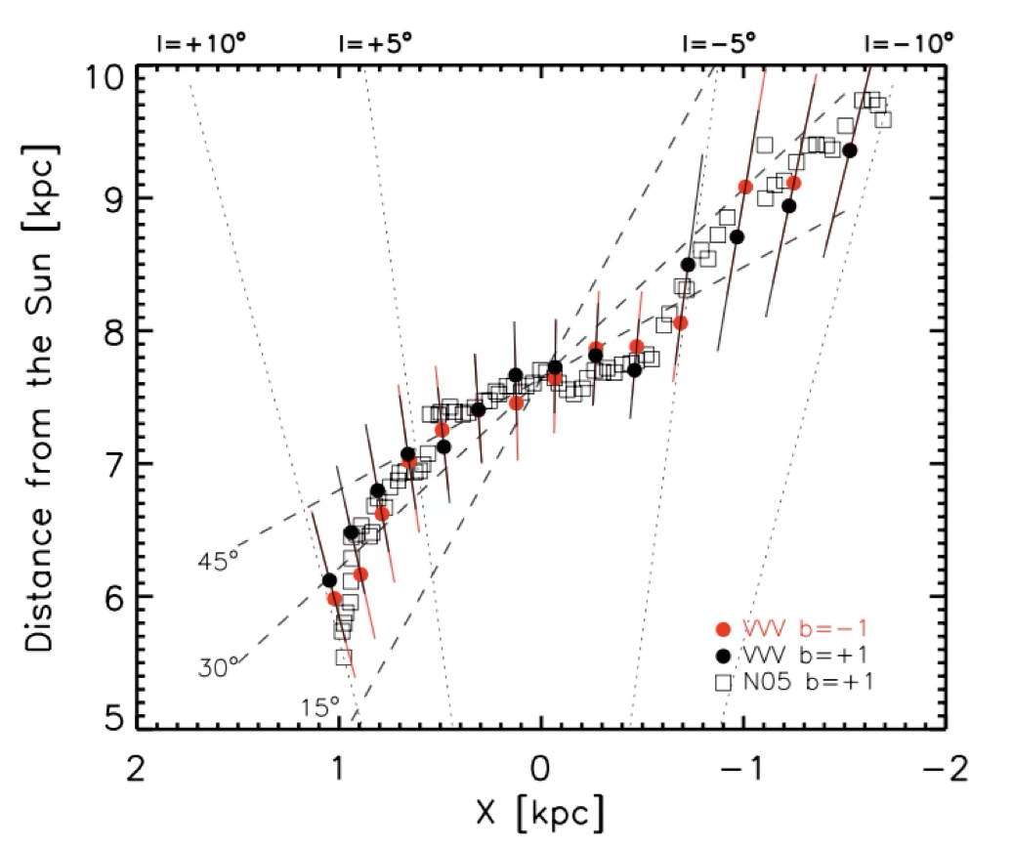
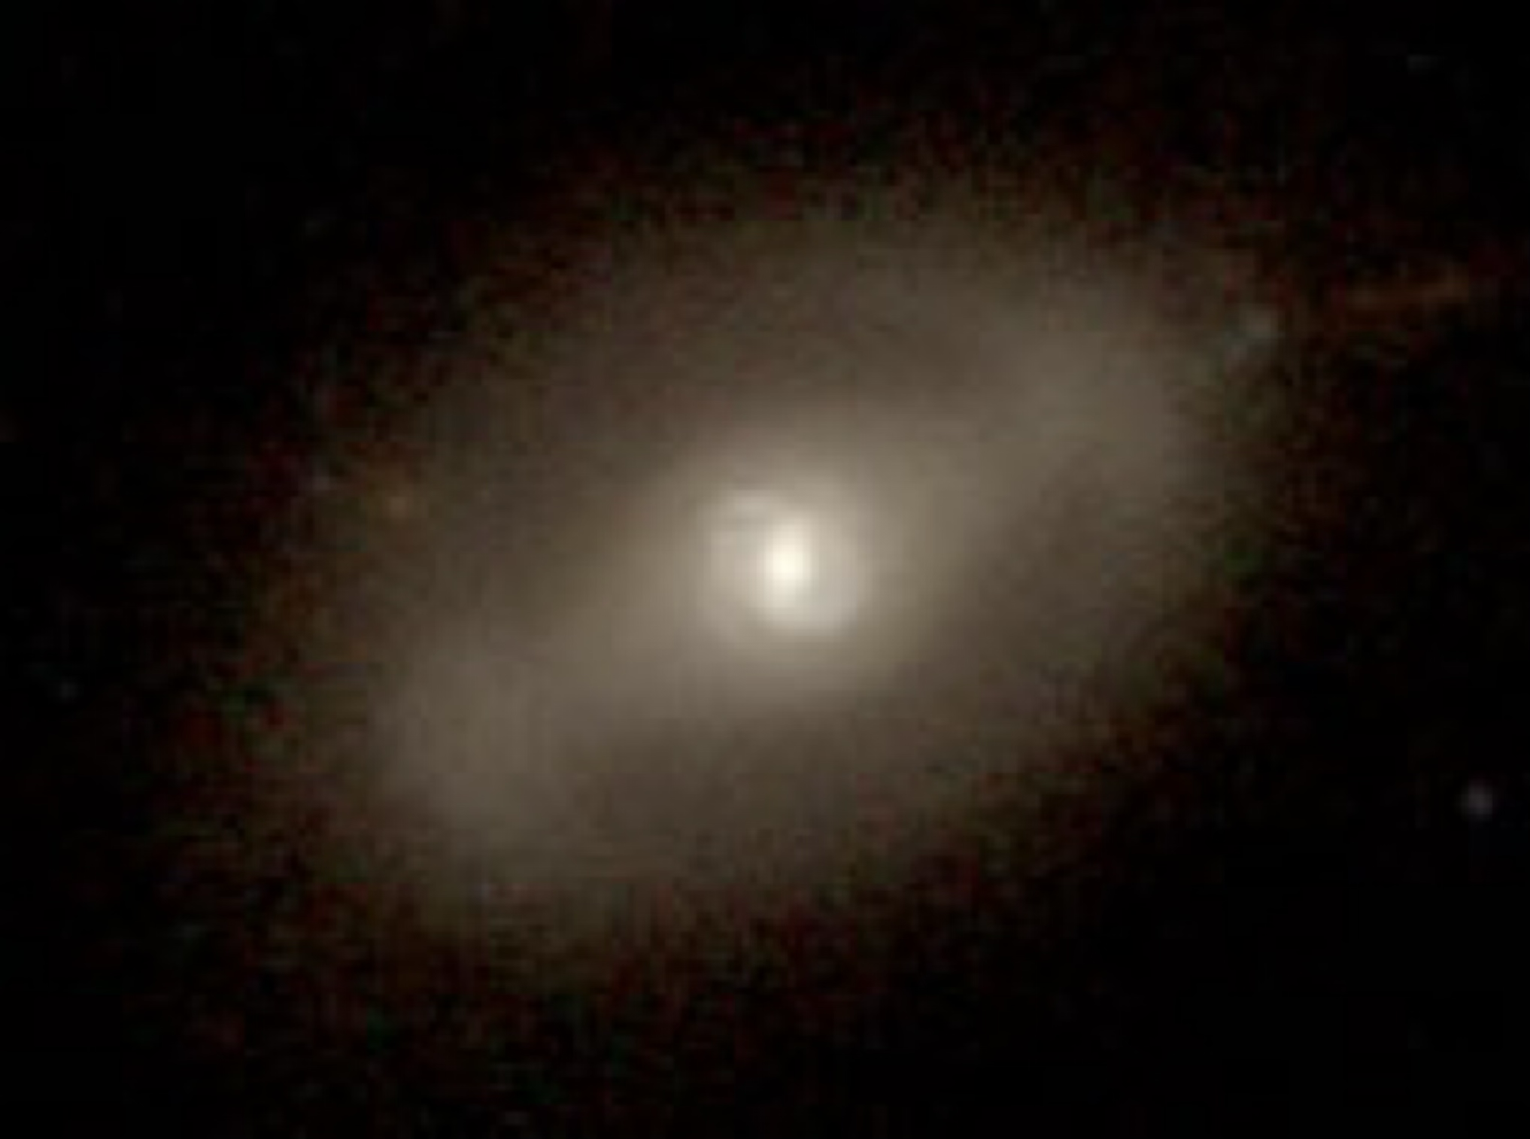
Is there an inner/nuclear bar?
YES
Alard 2001
Nishiyama et al. 2005
Rodriguez-Fernandez & Combes 2008
Gonzalez et al. 2011
1/3 of barred galaxies contain secondary inner bars
(Laine et al. 2002, Erwin 2011)
The variation of the RC slope within innermost ~500pc
is interpreted as evidence for an inner/nuclear bar
Gonzalez et al. 2011

Slide 25
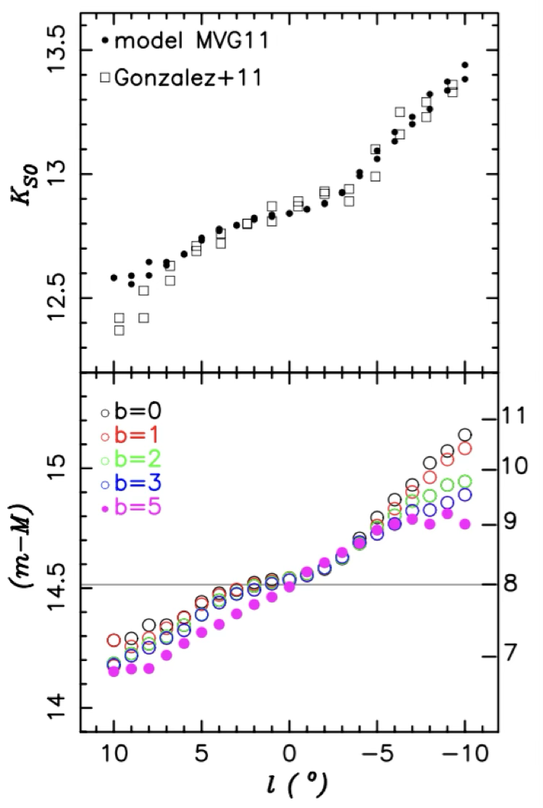
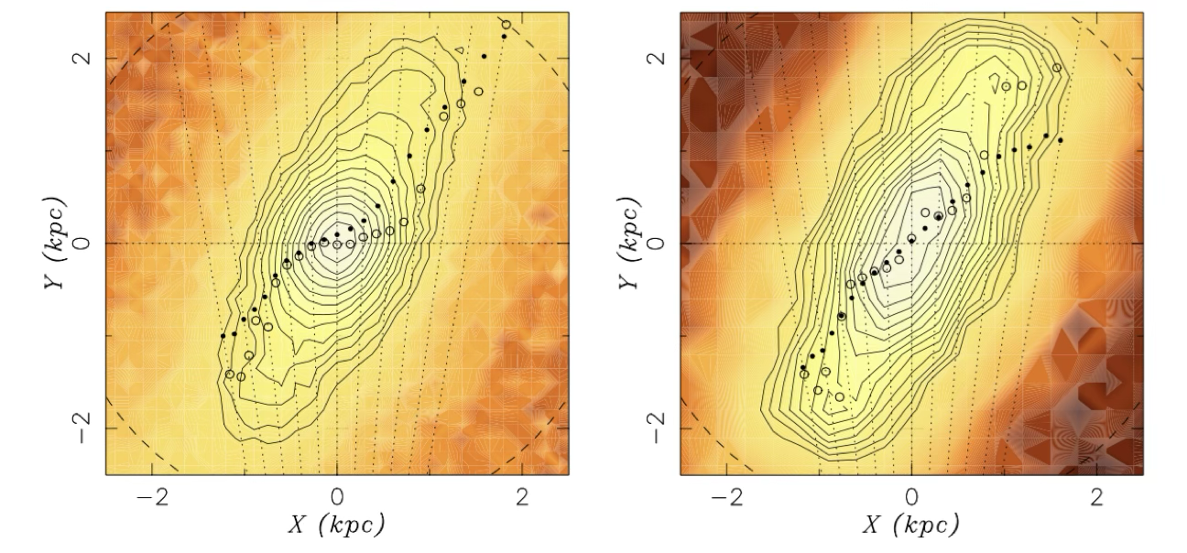
Is there an inner/nuclear bar?
NO
Gerhard & Martinez-Valpuesta 2012
Zoccali & Valenti 2016
The variation of the RC slope within innermost ~500pc
is due to a change in the stellar density along the LOS

Slide 26
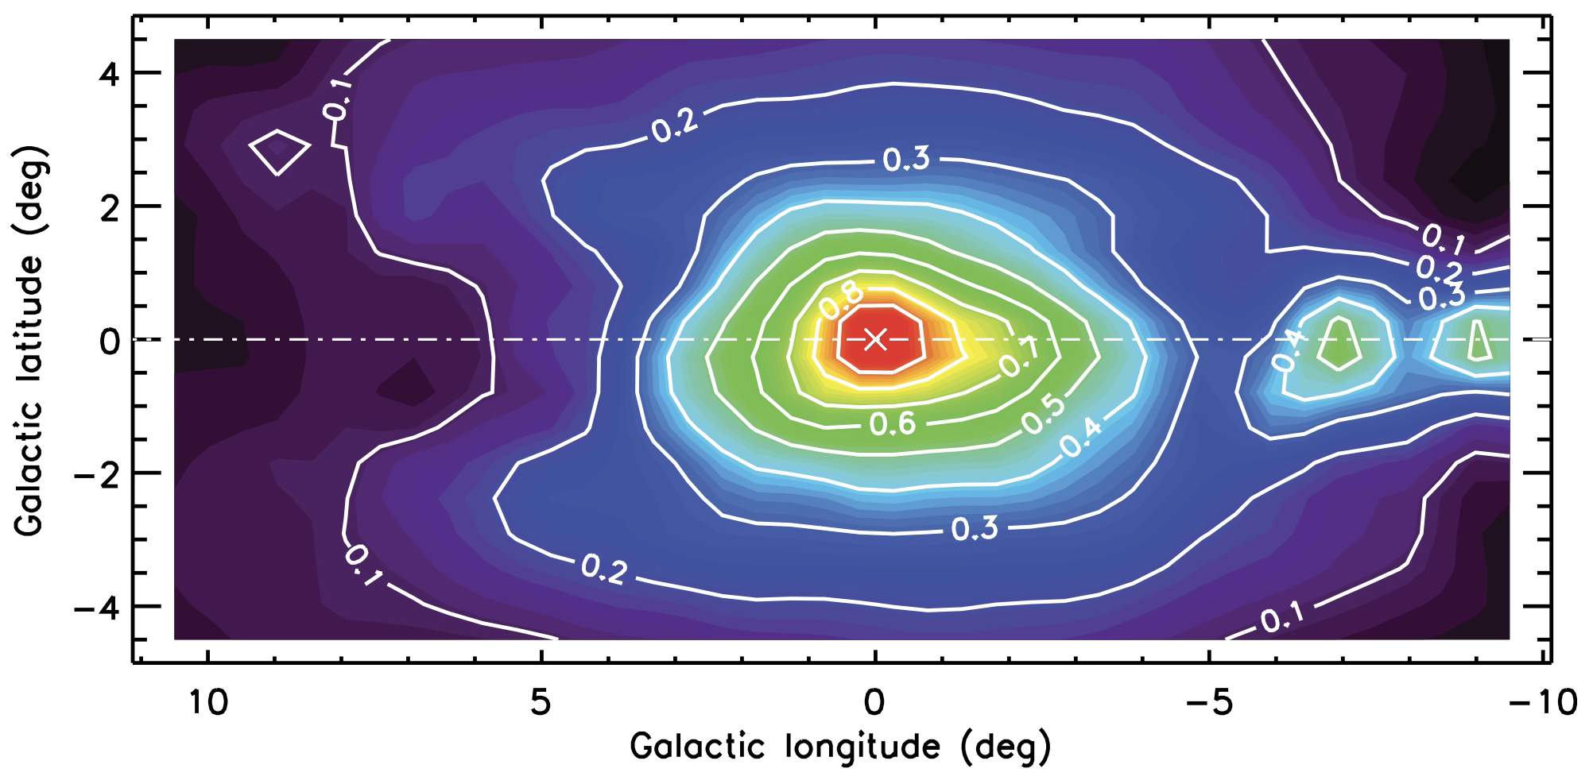
The projected stellar density
… by counting RC stars over ~200 deg²
Valenti et al. 2016

Slide 27
The bulge total mass
Because the mass is likely the main parameter governing galaxy evolution, several studies focused on the MW dynamical mass (i.e., baryonic + dark). Historically, this was done by using dynamical models to match either the galactic rotation curve inside∼1 kpc, or the kinematics (i.e., velocity and velocity dispersion) of different stellar tracers. Then, by assuming an observed luminosity profile (often in K-band) the M/L ratio can be derived, and hence the final bulge mass.
Dynamical mass estimates
Stellar mass estimates
M_{B} = 3.0 x 10¹⁰M☉ (Sellwood & Sanders 1988)
M_{B} = 1.2 x 10¹⁰M ☉ (Kent 1992)
M_{B} = 2.0 x 10¹⁰M ☉ (Zhao 1994)
M_{B} = 1.6 x 10¹⁰M ☉ (Han & Gould 1995)
M_{B} = 1.8 x 10¹⁰M ☉ (Kent 1995)
M_{B} = 2.8 x 10¹⁰M ☉ (Blum 1995)
M_{B} = 1.8 x 10¹⁰M ☉ (Sofue et al. 2009)
M_{B} = 8.0 x 10⁹ M ☉ (Sofue 2013)
M_{B} = 1.8 x 10¹⁰M ☉ (Cao et al. 2013)
M_{B} = 1.8 x 10¹⁰M ☉ (Portail et al. 2015)
M_{B} = 1.3 x 10¹⁰M☉ (Dwek et al. 1995)
M_{B} = 2.4 x 10¹⁰M ☉ (Picaud & Robin 2004)
M_{B} = 2.0 x 10¹⁰M ☉ (Valenti et al. 2016)

Slide 28
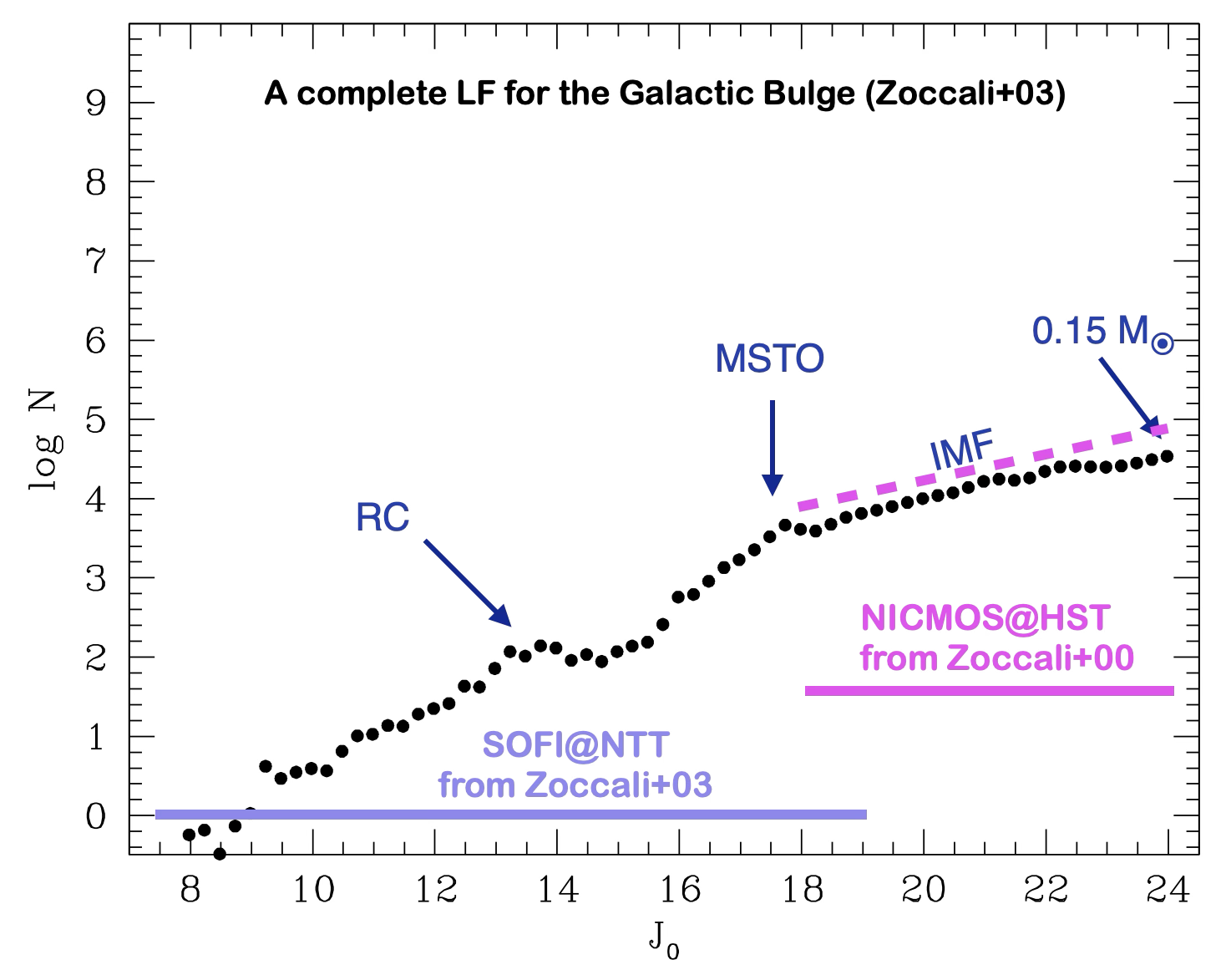
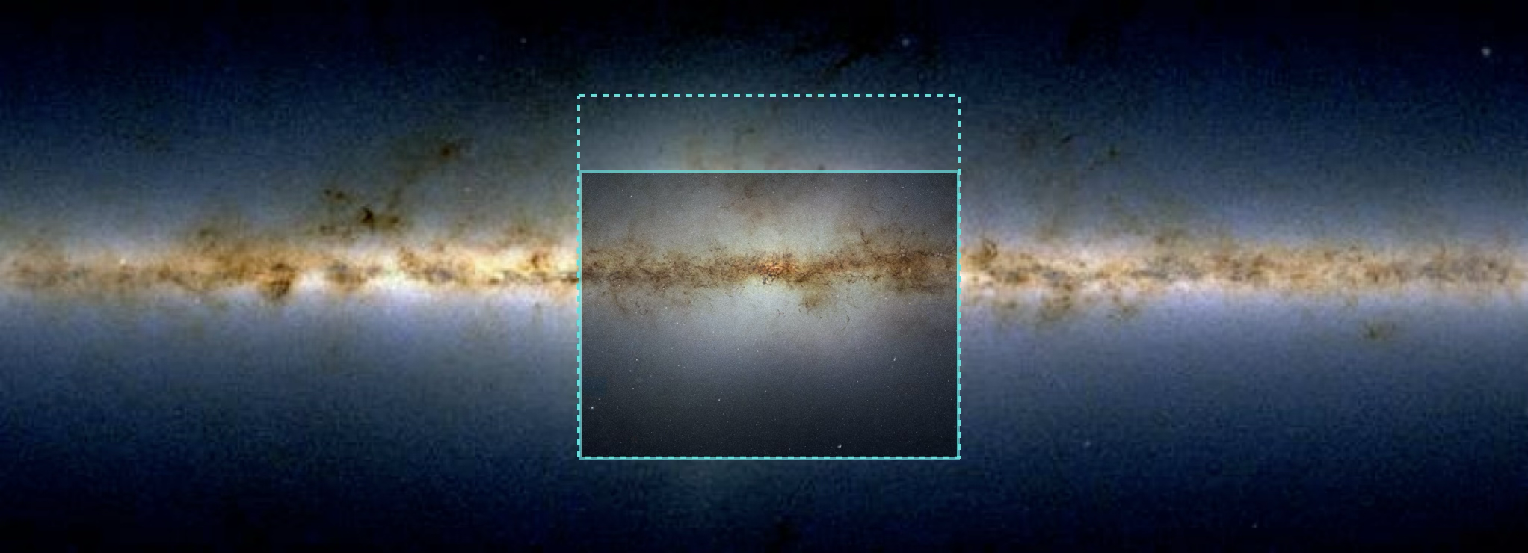
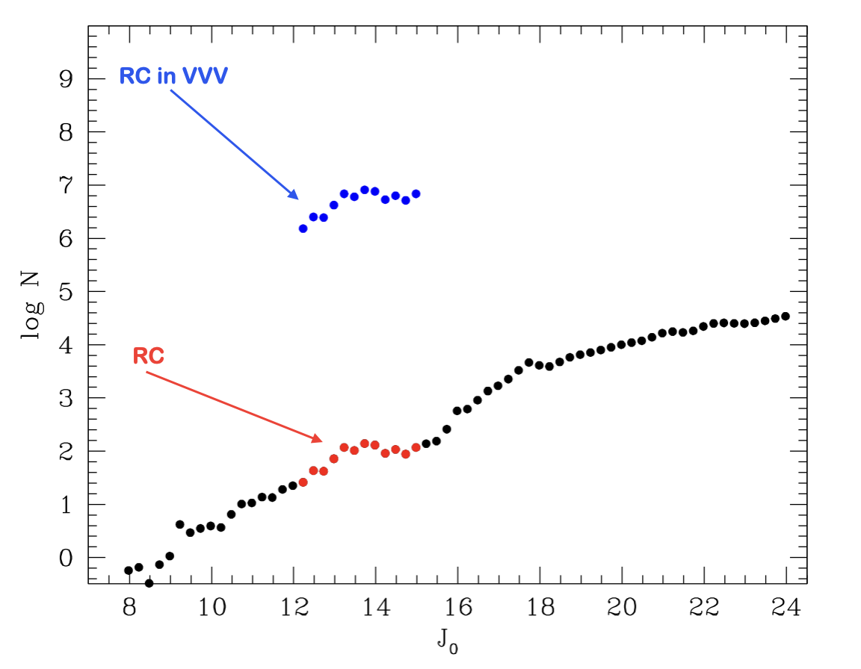
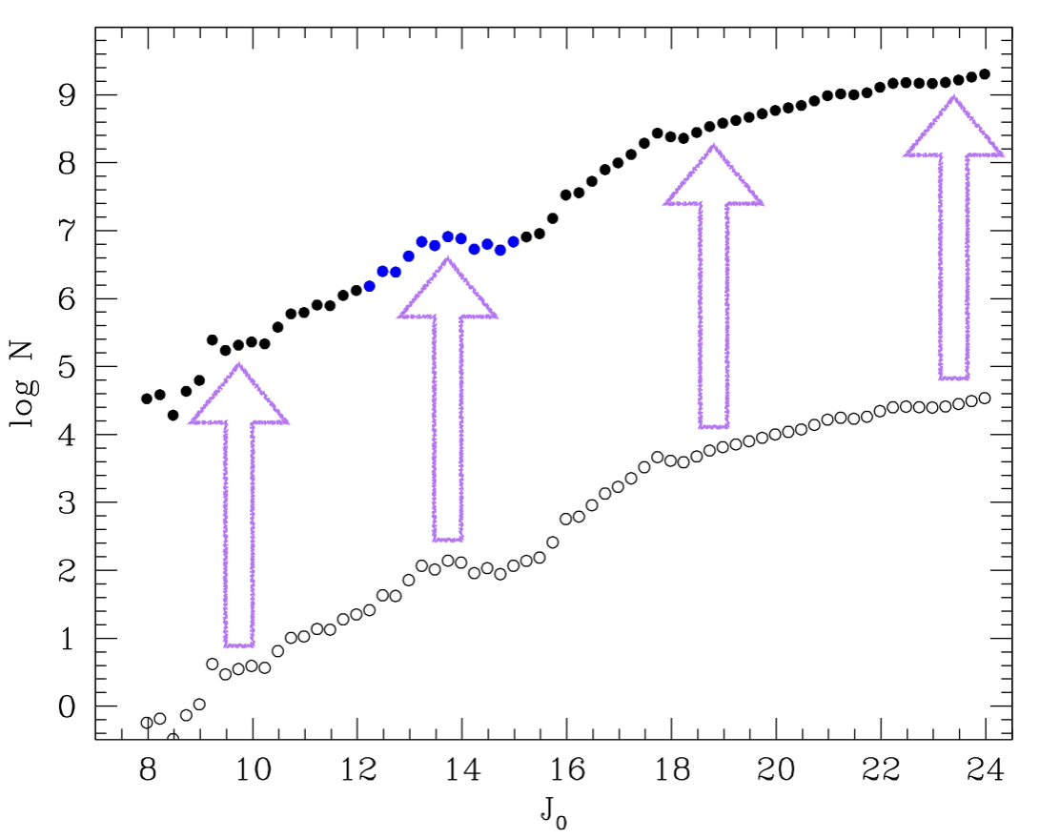
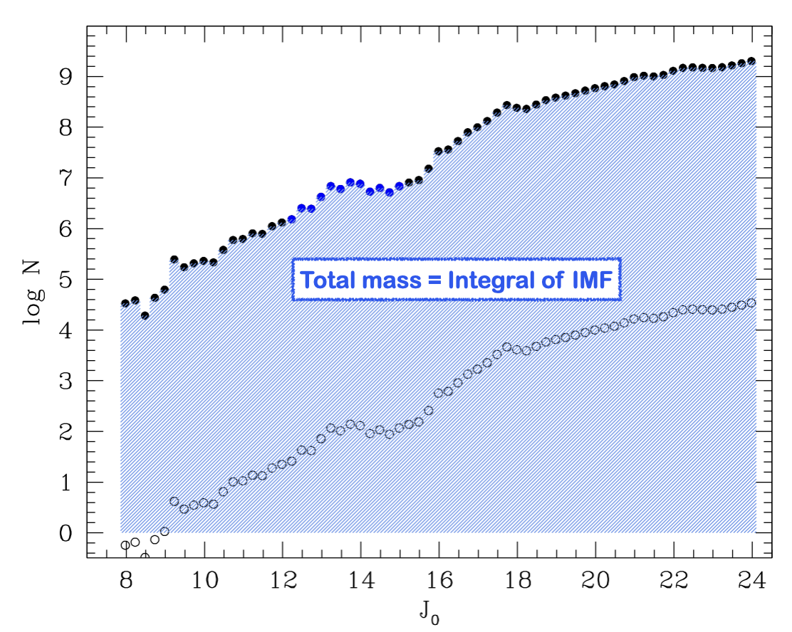
The bulge stellar mass
A fully empirical estimate based on RCs within the VVV bulge area
+
→
→

Slide 29
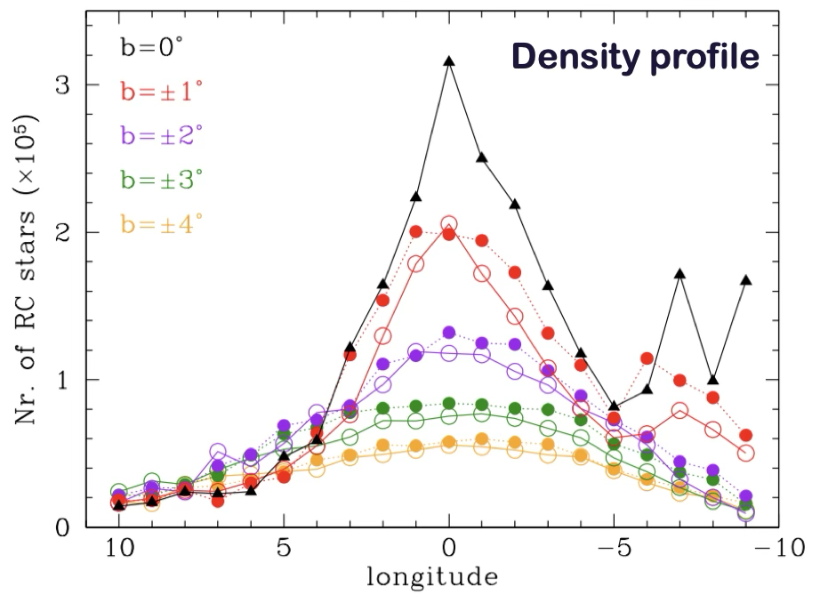
The bulge stellar mass
Valenti et al. 2016
M_{Bulge} = 2 (±0.3) x 10¹⁰M☉
in stars and remnants
Mass profile

Slide 30
Running Summary I
From the study of RC giants stars we we have learned that:
The bulge is a bar with a pivot angle ~27º, and axis ratio (10:6.3:2.6) kpc
The bulge has a B/P X-shape structure in the outer region
The central axisymmetric density peak is likely responsible for the change of the observed pivot angle in the innermost regions (i.e., no inner/nuclear bar)
The long thin bar is the natural extension of the main bar at large longitude
→ Products of disk evolution
The bulge is a massive galactic component with a mass M = 2 x 10¹⁰M☉ in stars and remnants
Bulge: 2x10¹⁰M☉
Halo: 1x10⁹M☉
Disk: 3x10¹⁰M☉ Thin + 2x10¹⁰M☉ Thick
GCs: ~150 x 10⁵M☉
MW Stellar ~ 10¹¹M☉
MW Total ~ 10¹²M☉

Slide 31
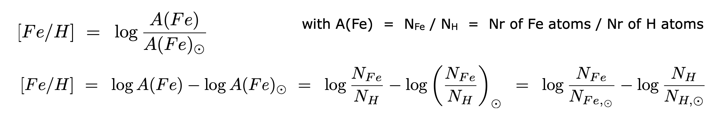
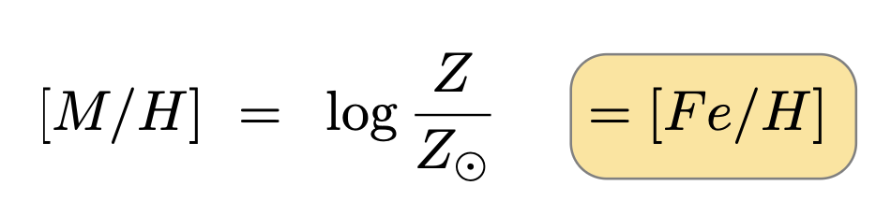
The stellar (surface) chemical composition
Theoretical scale:
Mass Fraction normalized to one: X + Y + Z = 1
X Y Z
First stars in the Universe: 0.75 + 0.25 + 0
MW Halo: 0.74 + 0.25 + 0.001 (down to 0.00001)
Sun: 0.71 + 0.27 + 0.02
MW metal rich stars: 0.67 + 0.30 + 0.03 (down to 0.04)
Observational scale:
H
He
Metals
Conversion:
only IF Fe traces all metals

Slide 32
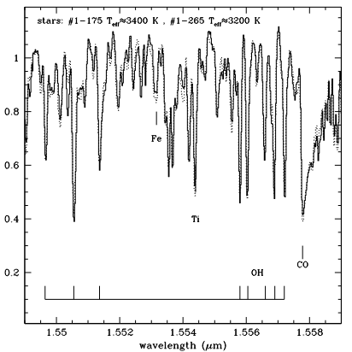
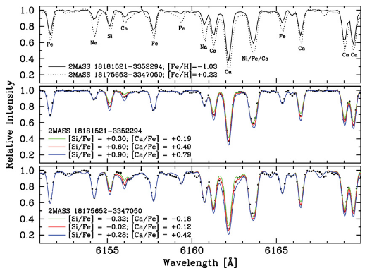
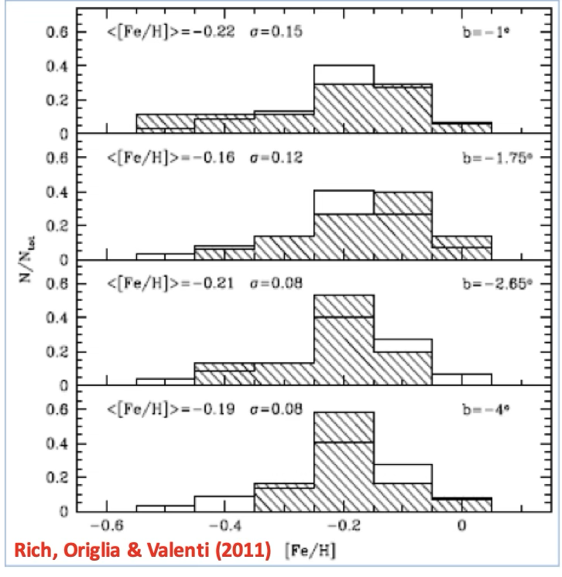
The early MDF from giants
K giant
M giant
Metallicity gradient observed only in the outer bulge!

Slide 33
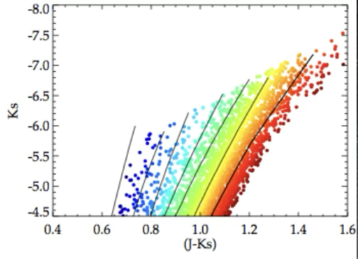

The 1st global MDF
The bulge SP is mostly metal-rich
Metallicity increases towards the centre
Gonzalez et al. 2013

Slide 34



The MDF in the survey's era
Zoccali et al. 2017
GIBS survey:
26 fields
~5000 K-giant, MR opt spectra
~600 K-giant, HR opt spectra
The MDF is clearly bimodal:
m-poor SP (i.e., [Fe/H]>0]) dominates in the outer regions
m-rich SP (i.e., [Fe/H]<0]) increases towards the center
the previously observed global metallicity gradient is due to changes in the relative fraction m-poor/m-rich
CONFIRMED by other surveys, see also: GaiaESO (Rojas-Arriagada et al. 2014, 2017), ARGOS: (Ness et al. 2013)

Slide 35
Two Bulge metallicity components
Combining the Metallicity Distribution with Stellar Density map
Valenti et al. 2016
Zoccali et al. 2017

Slide 36

Two Stellar Density Maps
Zoccali et al. 2017
m-poor component is spherically concentrated
m-rich component traces the bar
Metal Poor stars
Metal Rich stars

Slide 37
The Stellar Mass of the Bulge
Zoccali, Valenti & Gonzalez 2018
48% m-poor
52% m-rich

Slide 38


The Kinematics
BRAVA surveys
R~4200
~42 fields
> 6000 M-giants
Cylindrical rotation
Rich et al. 2007
Howard et al. 2008
Kunder et al. 2012

Slide 39


The Kinematics
GIBS surveys
Zoccali et al. 2014
Zoccali et al. 2014 & Valenti et al. 2018

Slide 40
Stellar Density vs Kinematics
Stellar density follows the velocity dispersion

