Slide 1
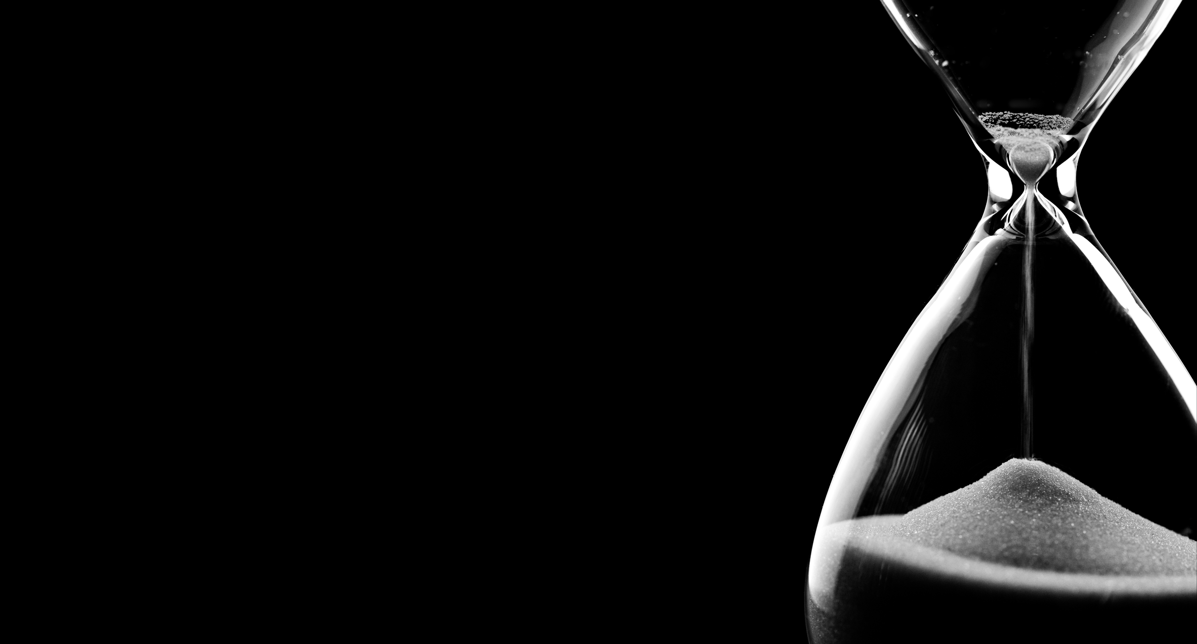

Slide 2

Which is the most accurately directly measured quantity in physics?
Mass
Voltage
Time
Acceleration

Slide 3
Which is the most accurately directly measured quantity in physics?
Mass
Voltage
Time
Acceleration

Slide 4

Time is what a clock reads¹

Slide 5
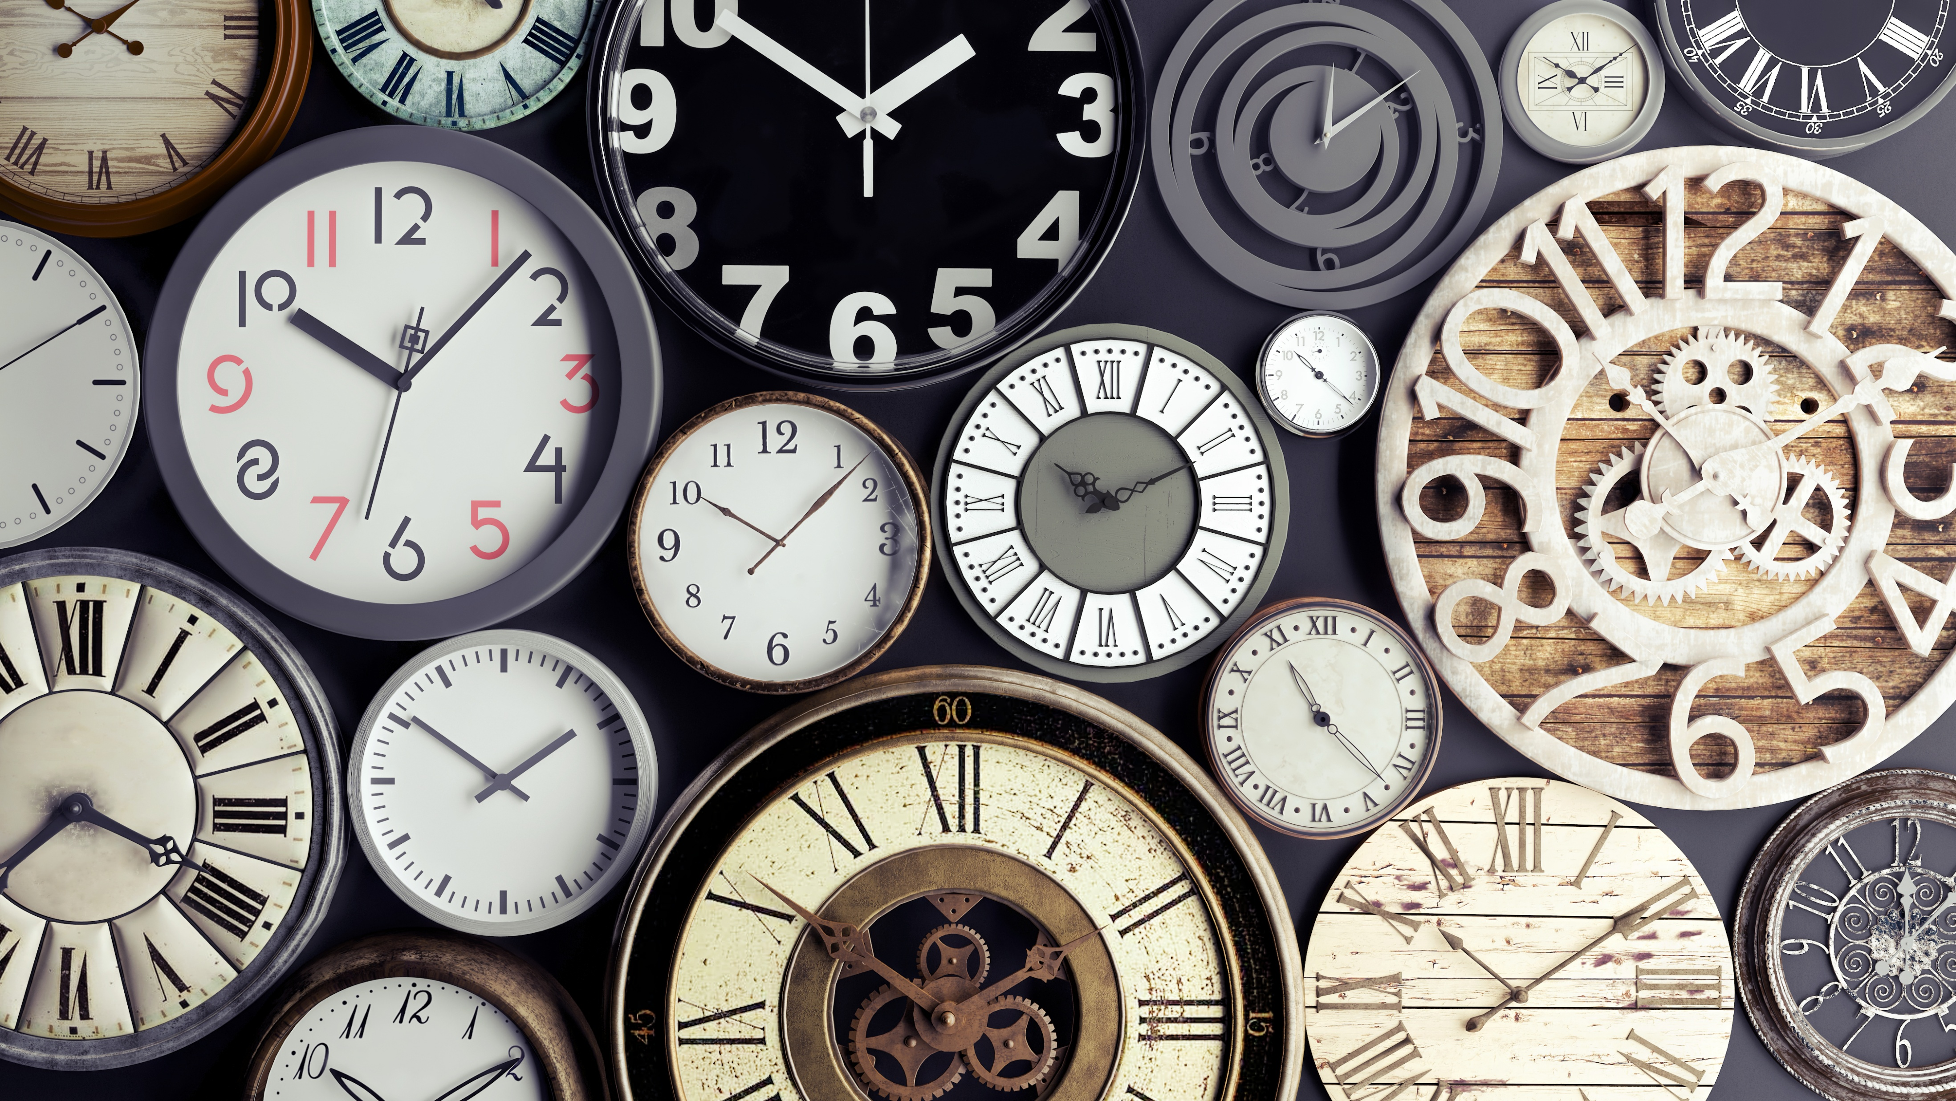

Count the repetions of a periodic phenomenon
$$δt= \frac{N}{ν}$$

Slide 6
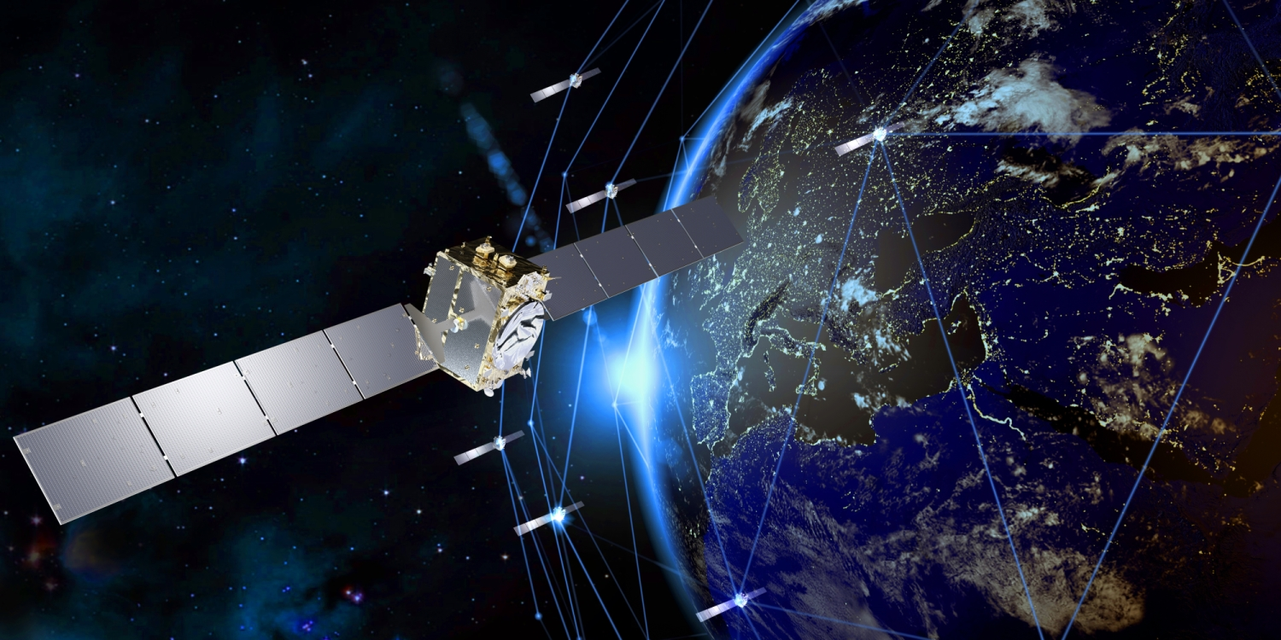

$$δT/T≈5×{10}^{−19}$$
at National Institute of Standards and Technology (NIST)¹
$$δT/T≈{10}^{−11}$$
for less than 10 k€
at INAF OAR/TNG²

Slide 7
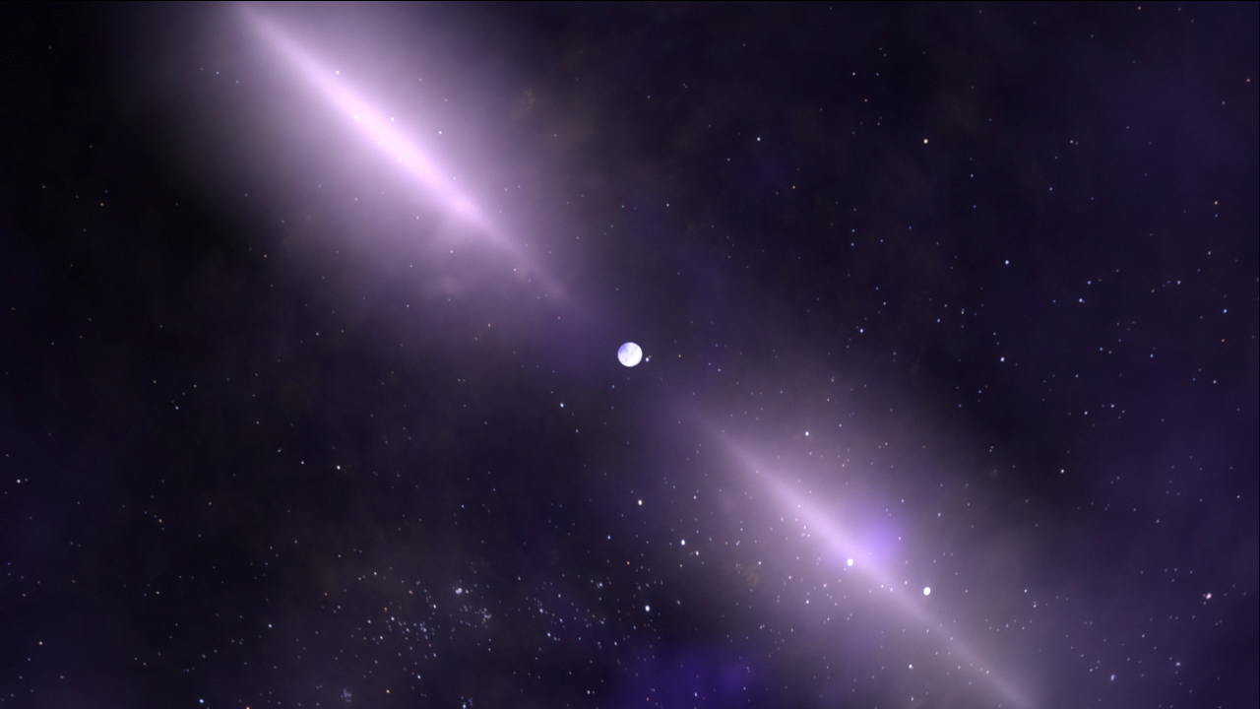

Acceleration of particles
Supranuclear densities
General Relativity tests
Gravitational Waves
Taking the beat of the
quickest spinning
compact objects
Alessandro Papitto
INAF Osservatorio Astronomico di Roma

Slide 8
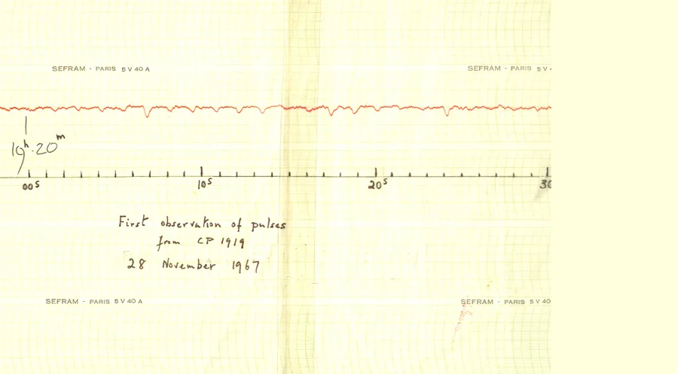
A periodic radio signal at 1.3373 s

Slide 9
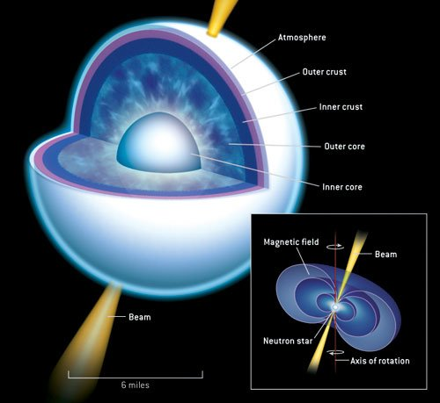





A 1.33 s coherent periodicity
Orbital motion? Much larger derivative expected
Radial oscillations of non degenerate stars
^{Rotation}
$$P≳minutes$$
$$ω^{2}r≲\frac{GM}{r^{2}}$$
^{(stability condition)}
$${ρ≳\frac{ω^{2}}{G}={10}^{8}g {cm}^{3}}^{}$$
^{Neutron stars}
$${ρ≈{10}^{6−7}g {cm}^{3}}^{}$$
^{White dwarfs}
^{Black holes have no hairs}

Slide 10
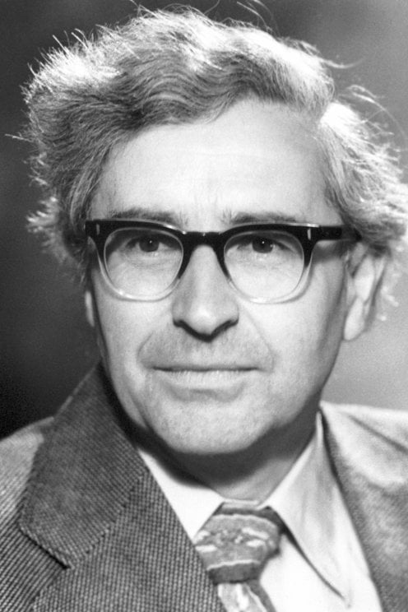
Nobel Prize in Physics 1974
for pioneering research in radio astrophysics (…) for his decisive role in the discovery of pulsars
Sir Anthony Hewish

Slide 11

No-Bell Prize in Physics 1974
for pioneering research in radio astrophysics (…) for his decisive role in the discovery of pulsars
Sir Anthony Hewish
Dr Jocelyn Bell Burnell

Slide 12
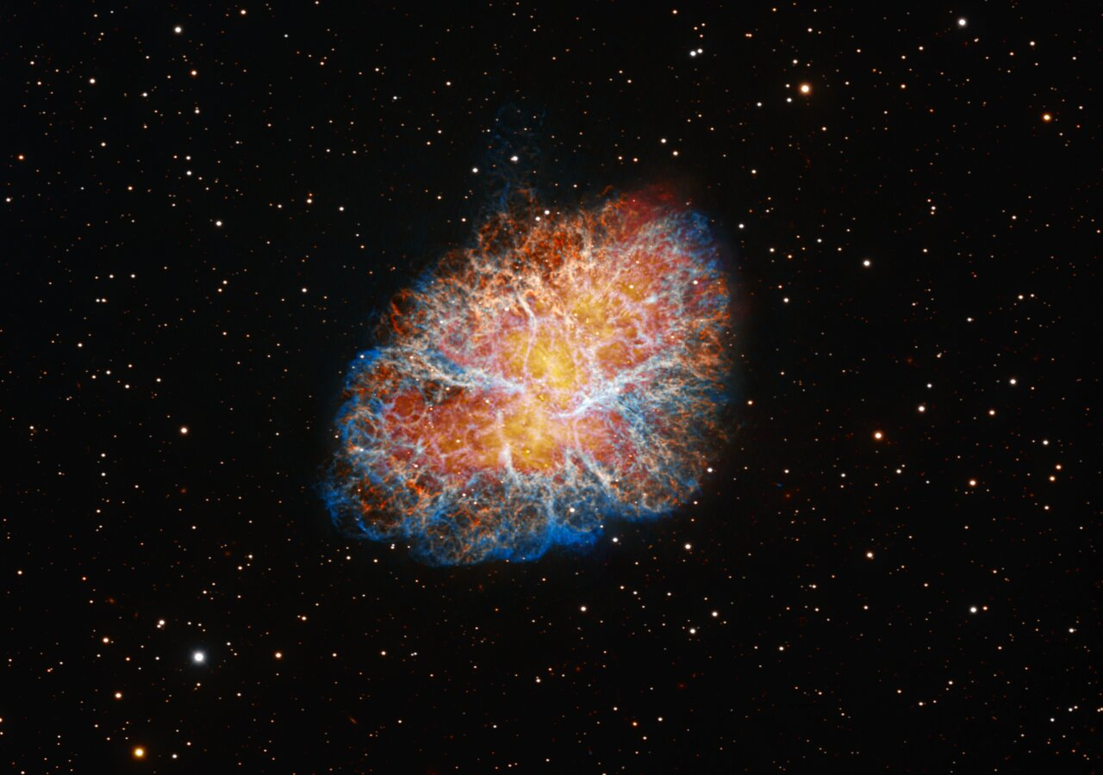
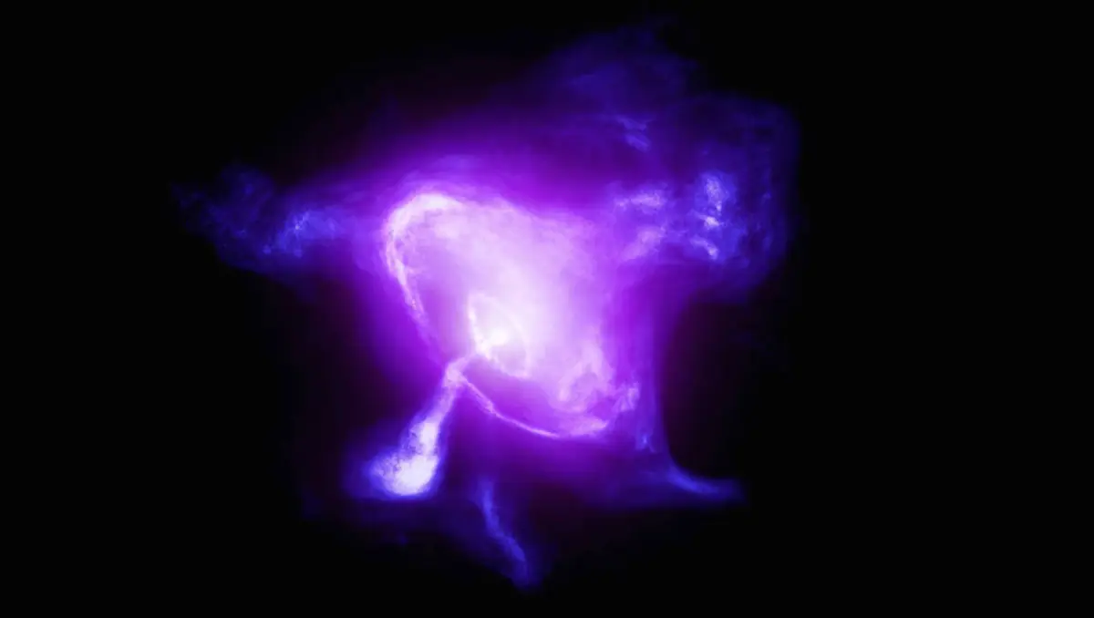

A 33 ms pulsar in the Crab SNR
Neutron stars from core-collapse SNe
$$P=0.033 s$$
$$\dot{P}=4 ×{10}^{−13}$$
$$\frac{dE}{dt}=I ω \dot{ω}=4π I \left(\frac{\dot{P}}{P^{3}}\right)$$
$=4.5×{10}^{38} erg/s$
Spin-down powers the nebula

Slide 13
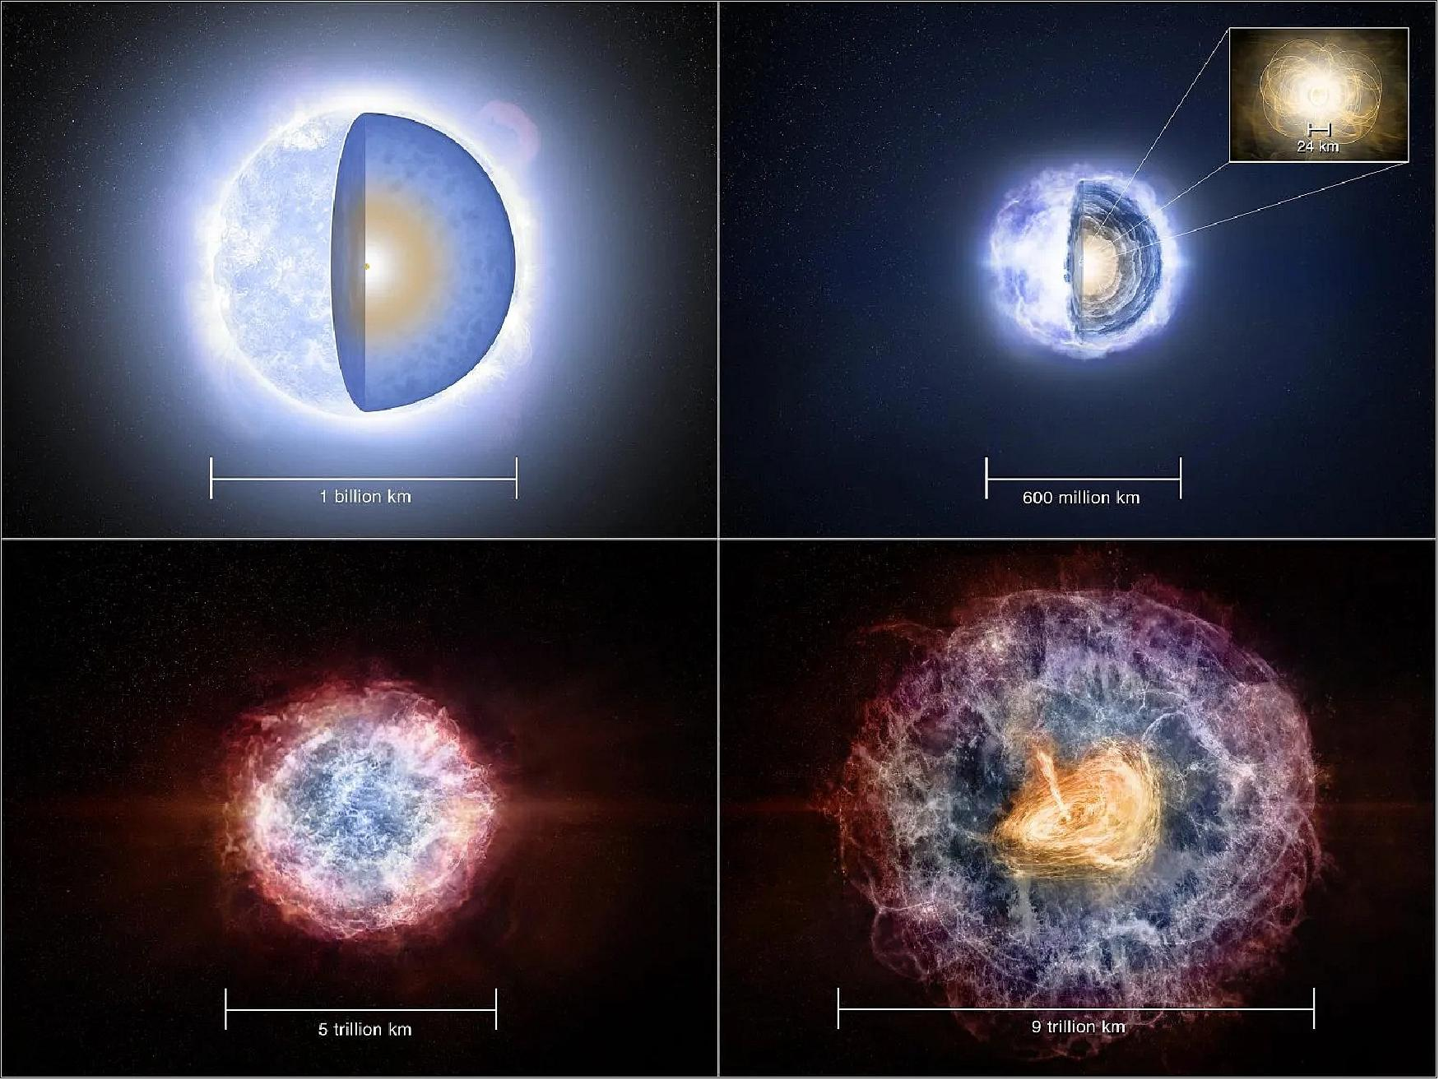
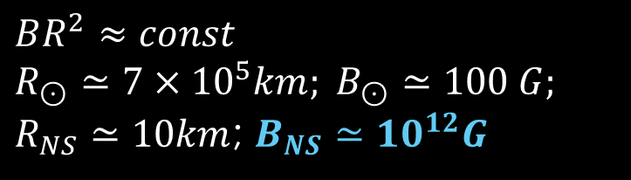
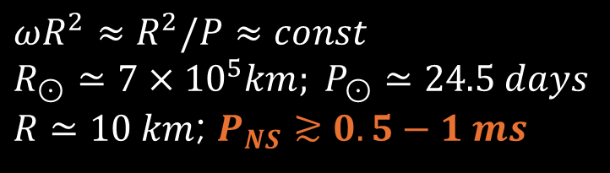
Magnetised
Quickly spinning
$$ωR^{2}≈R^{2}/P≈const$$
$$R_{⊙}≃7×{10}^{5}km; P_{⊙}≃24.5 days$$
$R≃10 km$; $P_{NS}≳0.5−1 ms$
$$BR^{2}≈const$$
$$R_{⊙}≃7×{10}^{5}km; B_{⊙}≃100 G;$$
$R_{NS}≃10km$; $B_{NS}≃{10}^{12}G$

Slide 14
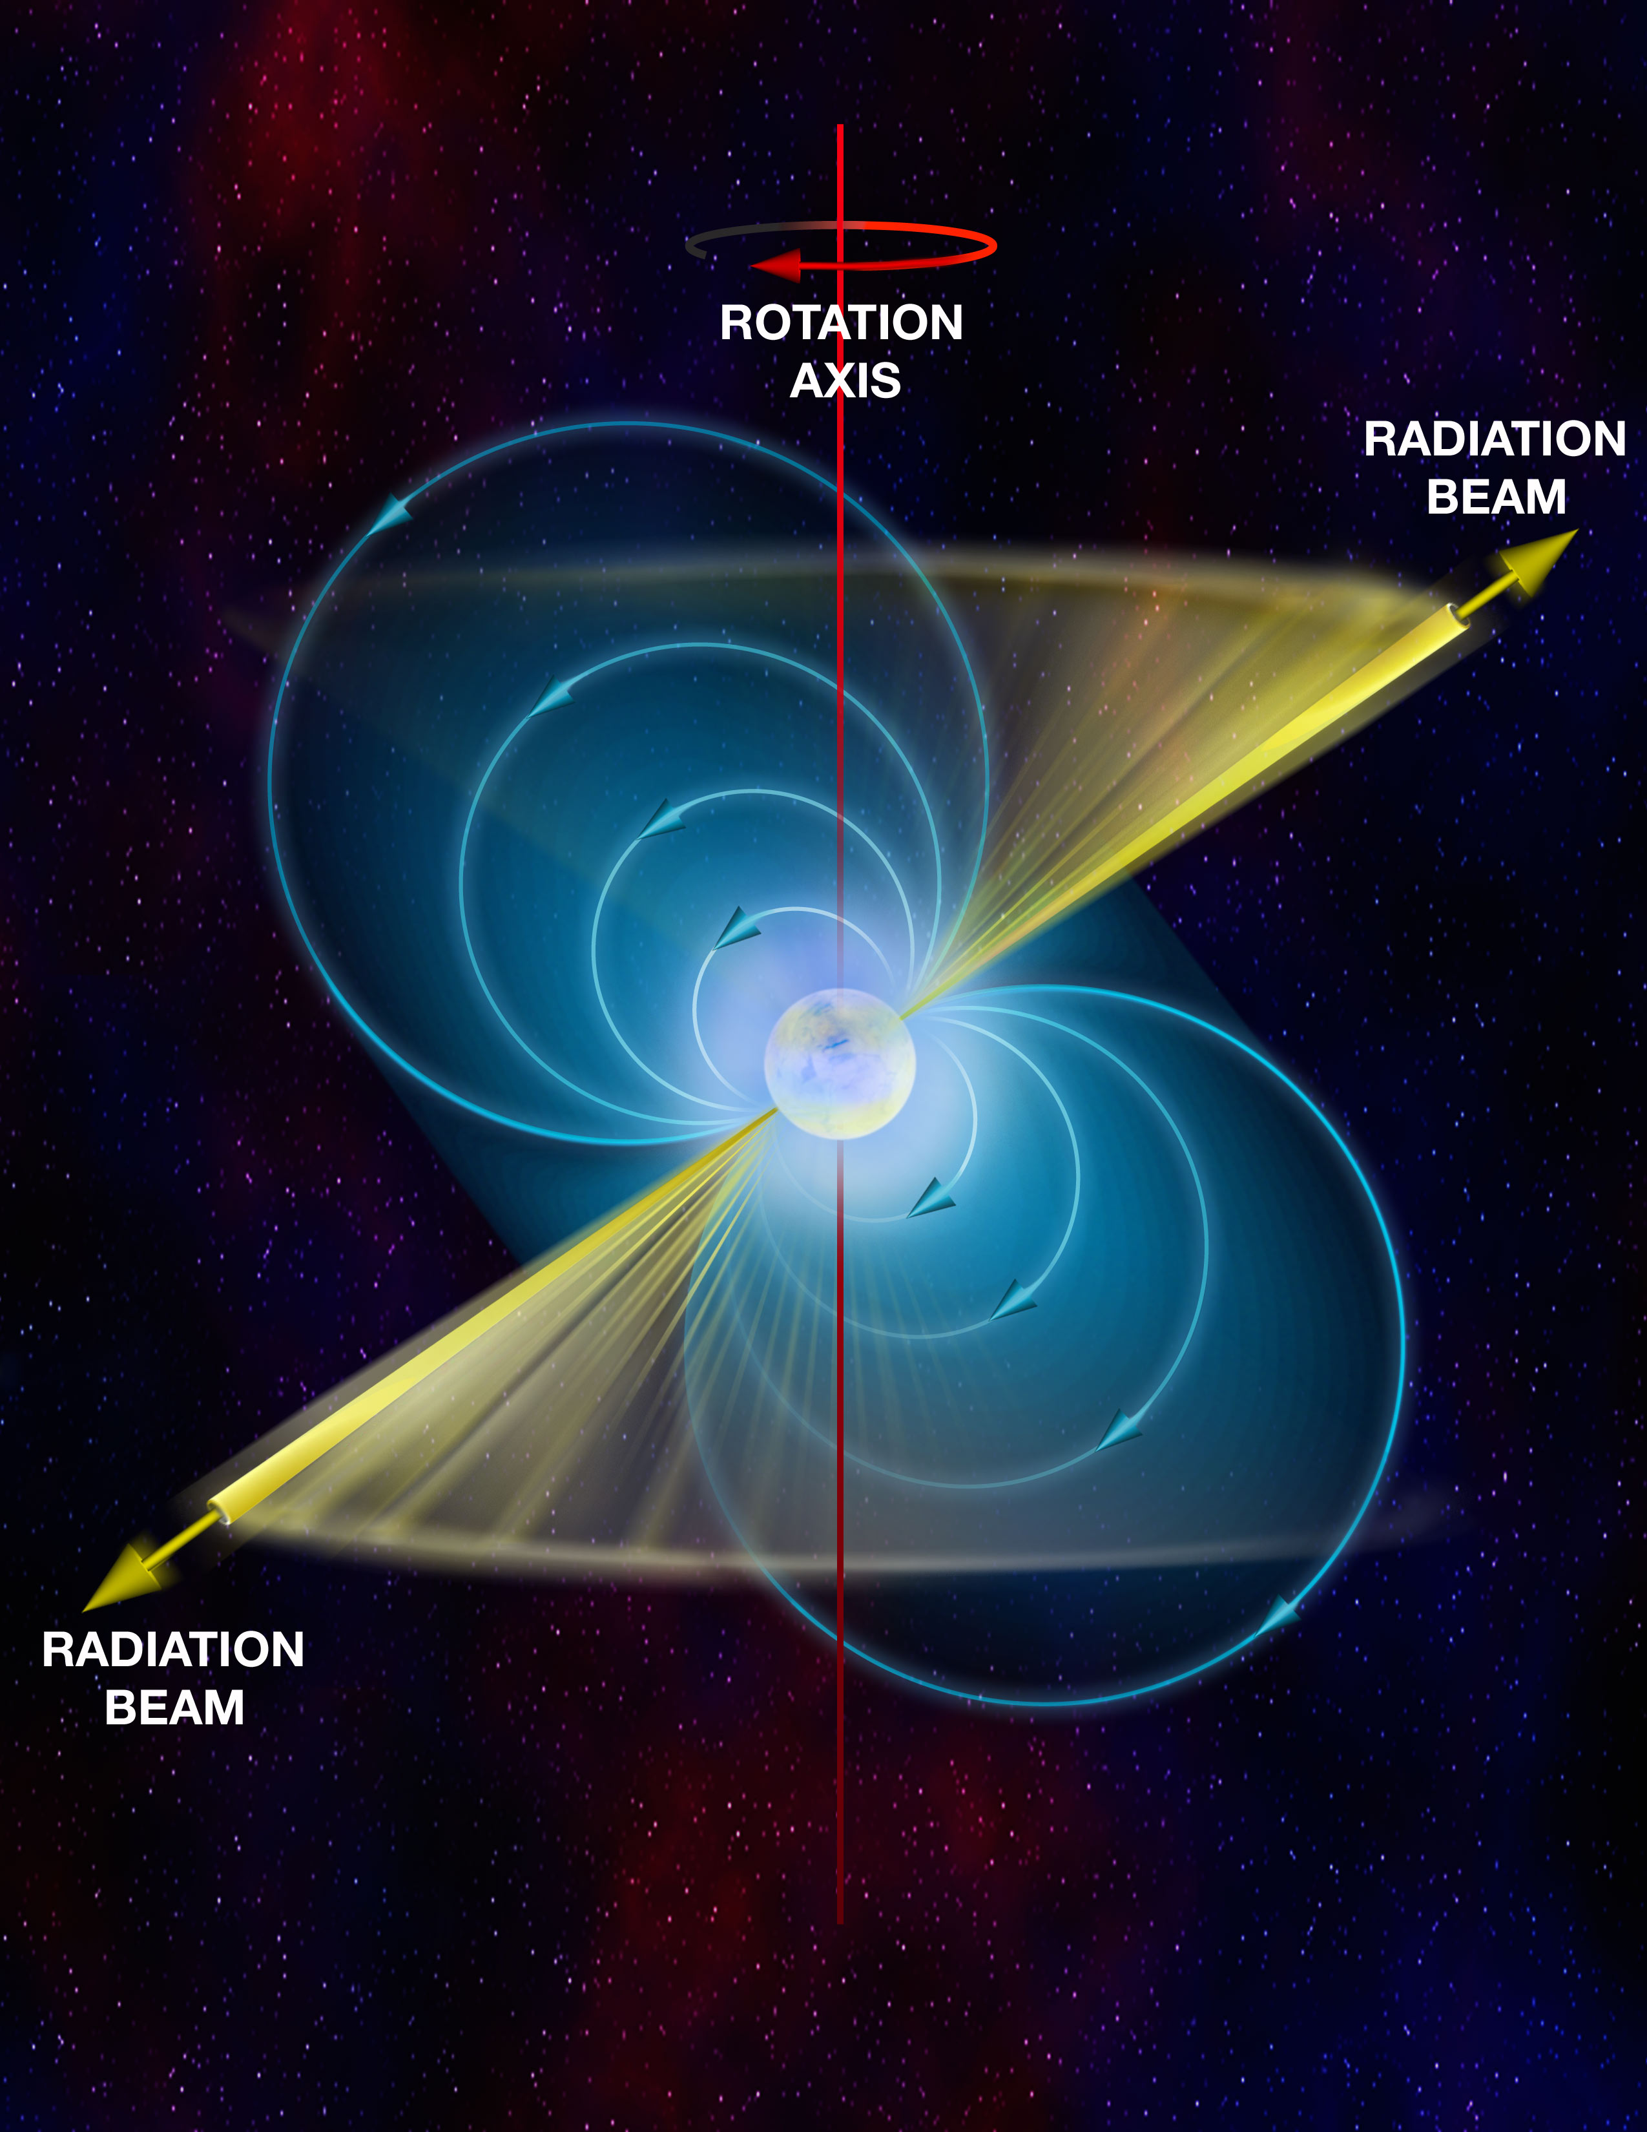
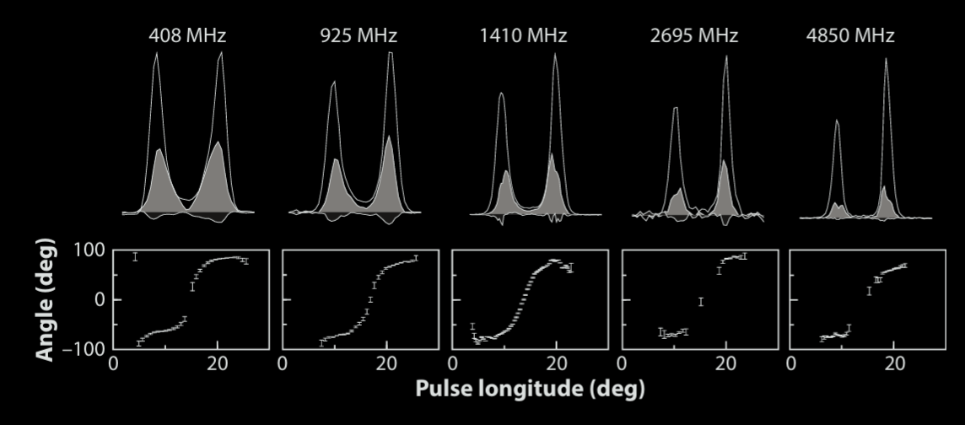
Lighthouse beams

Slide 15
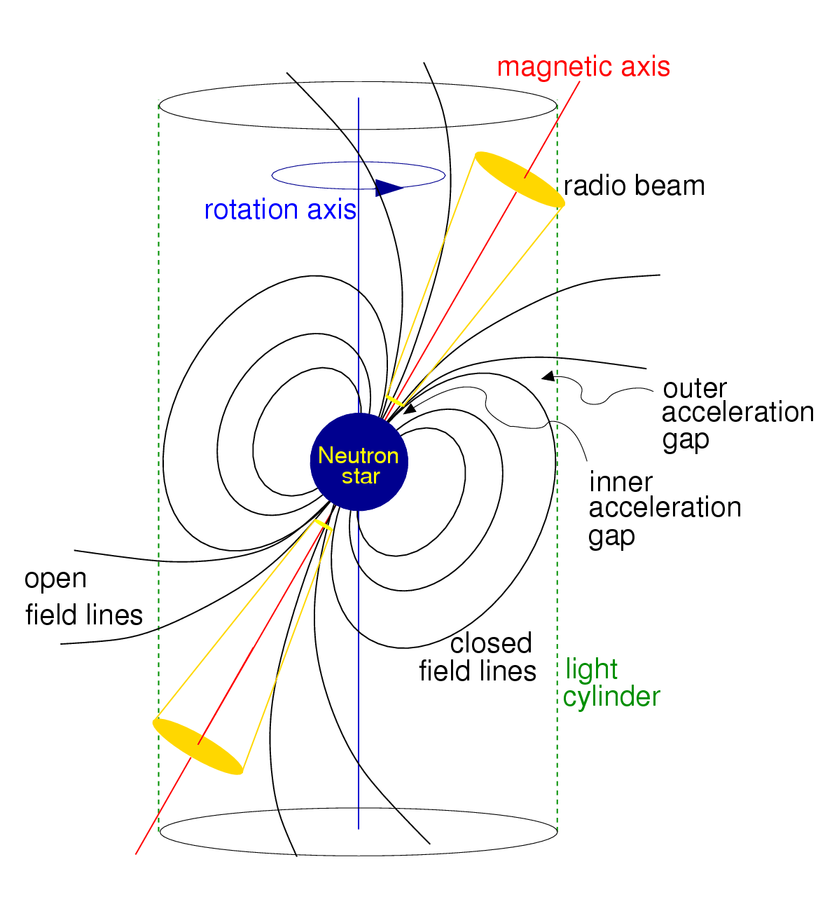

Inclined Magnetic
Dipole Rotation
$${\dot{E}}_{EM}=−\frac{2}{3c^{3}}{\left(\ddot{μ}\sin{α}\right)}^{2}$$
$$\ddot{μ}=ω^{2}μ=ω^{2}B_{NS}{R_{NS}}^{3}$$
$${\dot{E}}_{EM}=−\frac{2}{3c^{3}}{\left({R_{NS}}^{3}\sin{α}\right)}^{2}{B_{NS}}^{2}ω^{4}$$
$${\dot{E}}_{EM}={\dot{E}}_{kin}\underset{→}{\text{yields}}B_{NS}={10}^{12}\sqrt{P\left(\dot{P}/{10}^{−15}\right)}G$$
$=4×{10}^{12}G$for Crab PSR

Slide 16

Inclined Magnetic
Dipole Rotation
Assuming constant magnetic field
$τ=\frac{P}{2\dot{P}}=1250 yr$ for Crab PSR
Matches SN1054 age
(observed by Chinese astronomers)

Slide 17
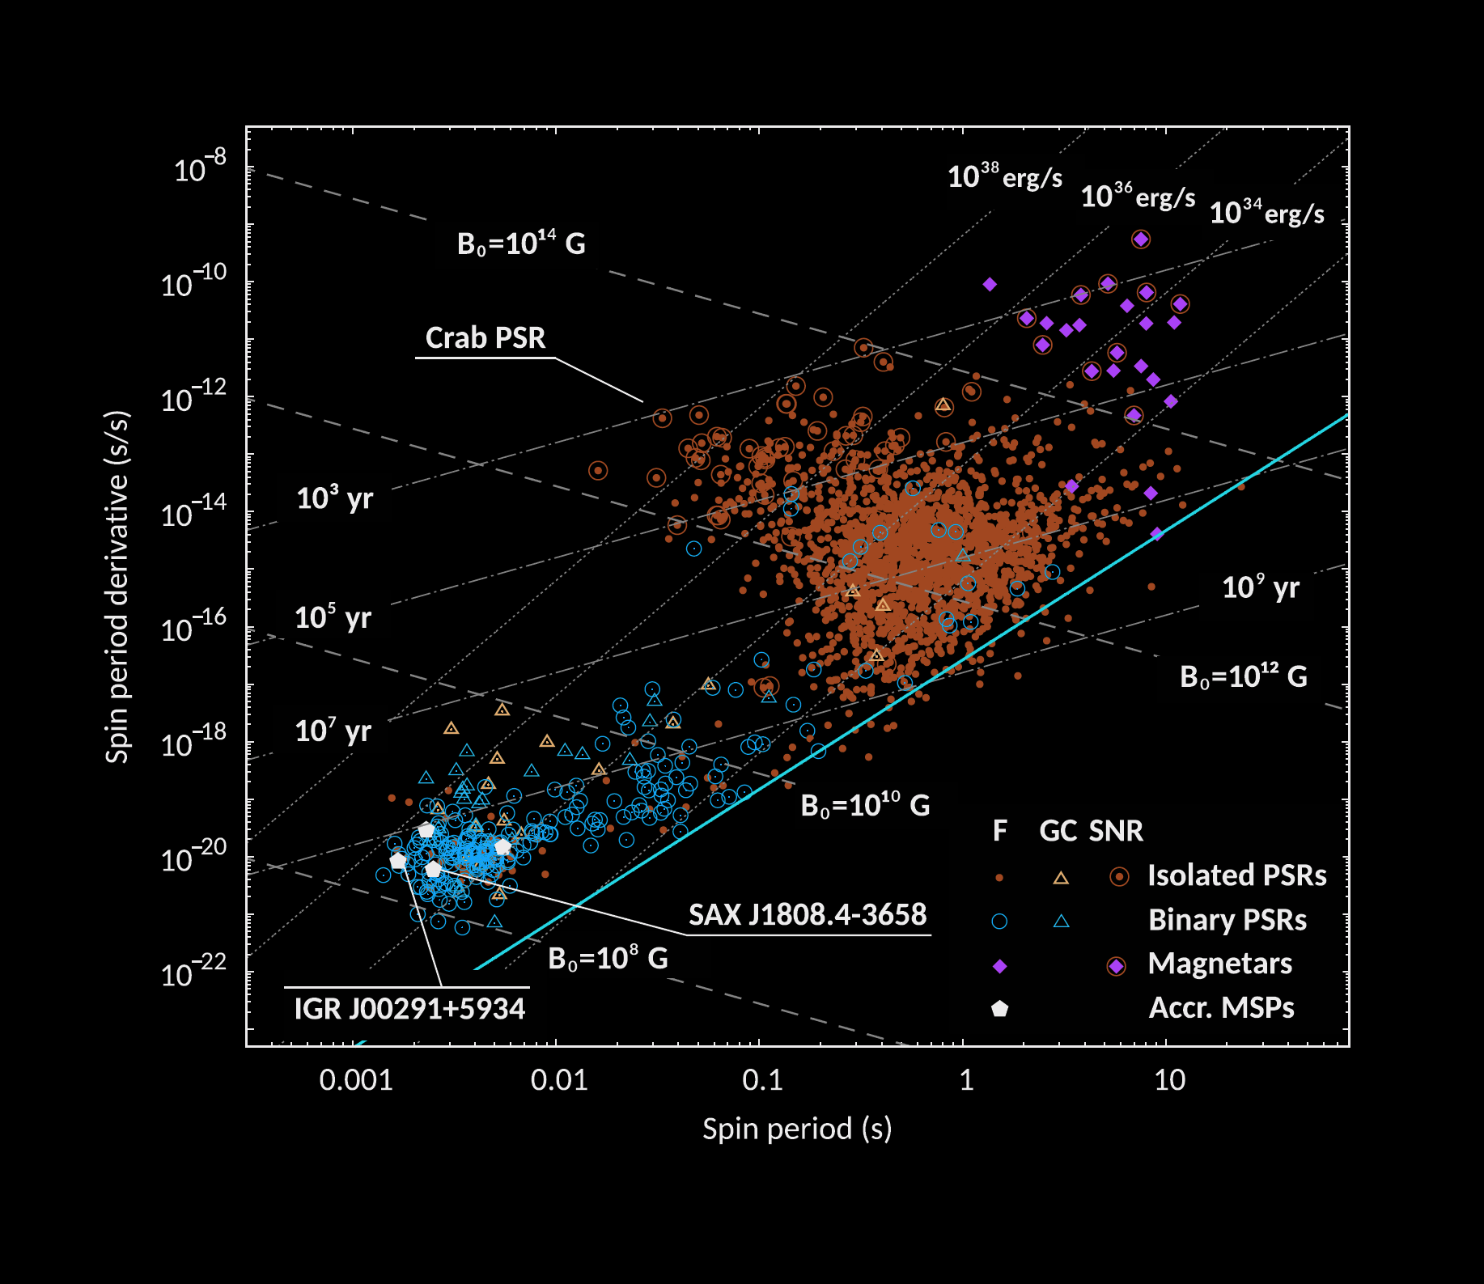
The P-Pdot diagram of Pulsars
4303 radio PSRs
(~10% in binaries)
300+ gamma-ray PSRs
(GeV but also up to ≈10 TeV)
100 X-ray PSRs
5 optical PSRs

Slide 18
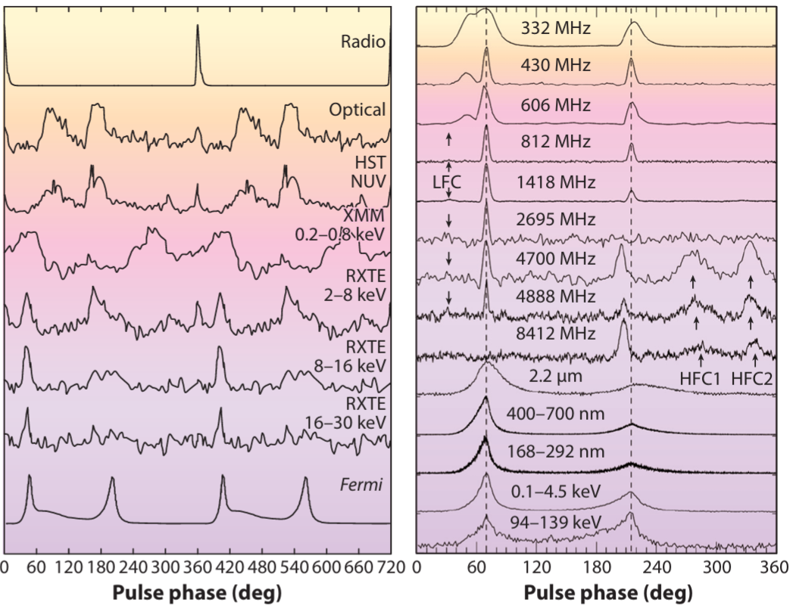
Vela PSR
Crab PSR

Slide 19
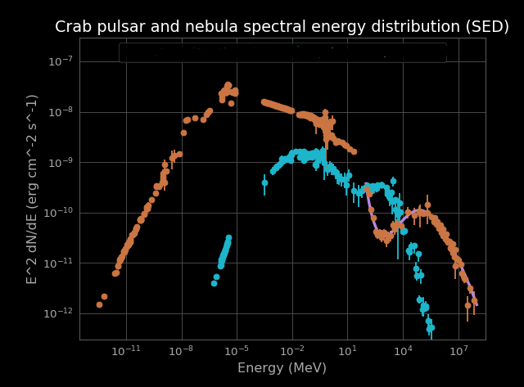



Spectral energy distribution
Pulsar Wind Nebula ($L≈{\dot{E}}_{EM}$)
Crab PSR ($L≈0.1 ×{\dot{E}}_{EM}$)
$${\dot{E}}_{EM}=−\frac{μ^{2}ω^{4}}{c^{3}}$$
$$L_{GeV}≃{10}^{33}\sqrt{{\dot{E}}_{EM}}\frac{erg}{s}$$
$$L_{keV}≃{10}^{−2}{\dot{E}}_{EM}$$
$$L_{eV}<{10}^{−5}{\dot{E}}_{EM}$$
$$L_{GHz} ≳{10}^{−6}−{10}^{−8}{\dot{E}}_{EM}$$
radio
optical
X-rays
GeV γ-rays
TeV γ-rays

Slide 20
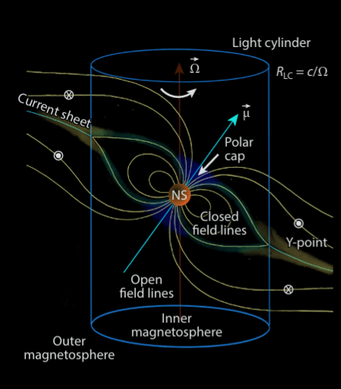
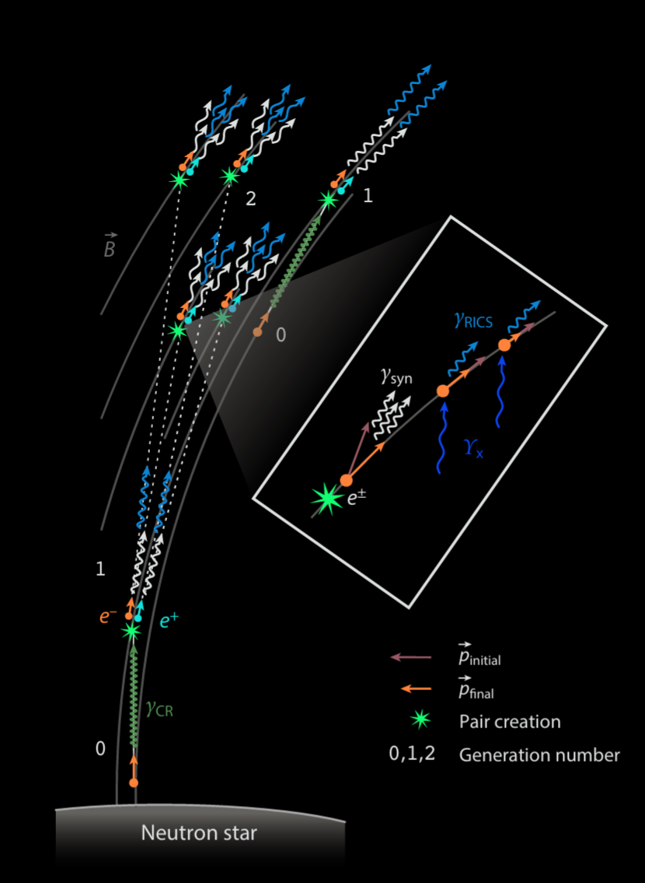
Particle acceleration

Slide 21
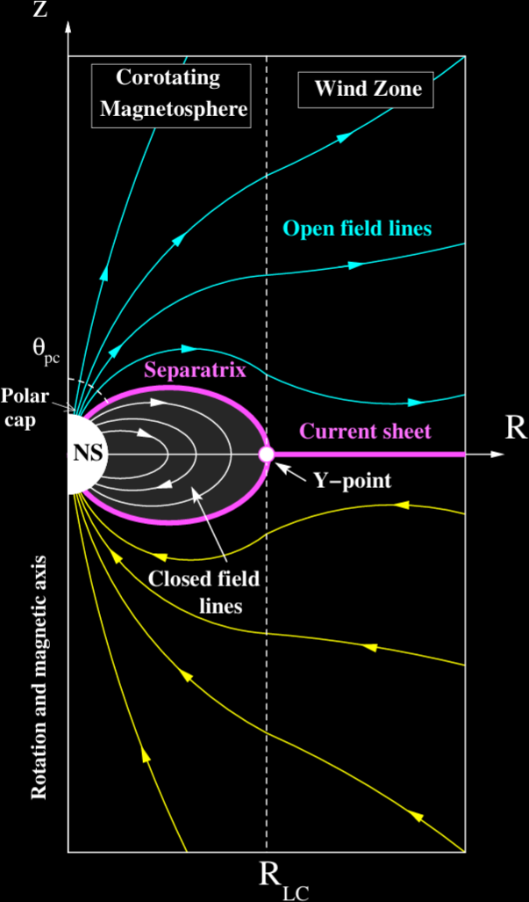

Slide 22
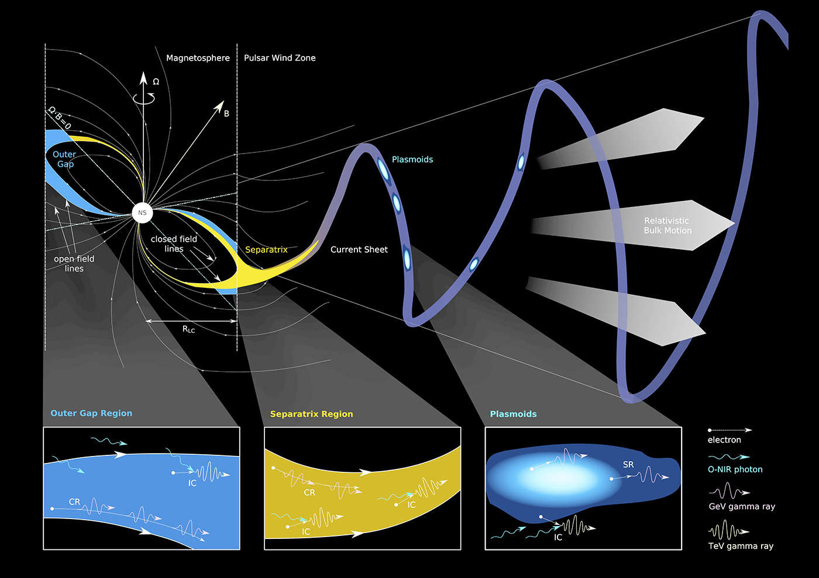
Incoeherent HE/VHE emission
OPT-Xrays synchrotron
GeV: curvature
TeV: IC, synchrotron

Slide 23
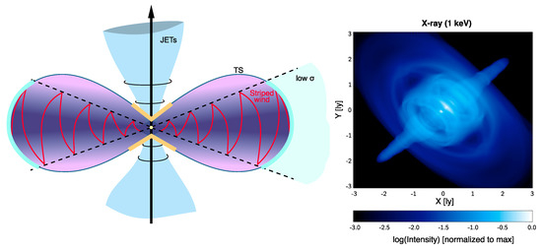

Slide 24
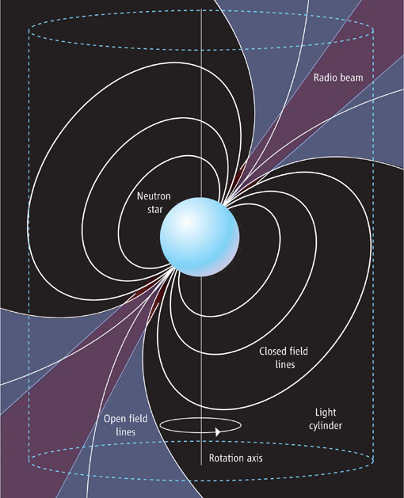
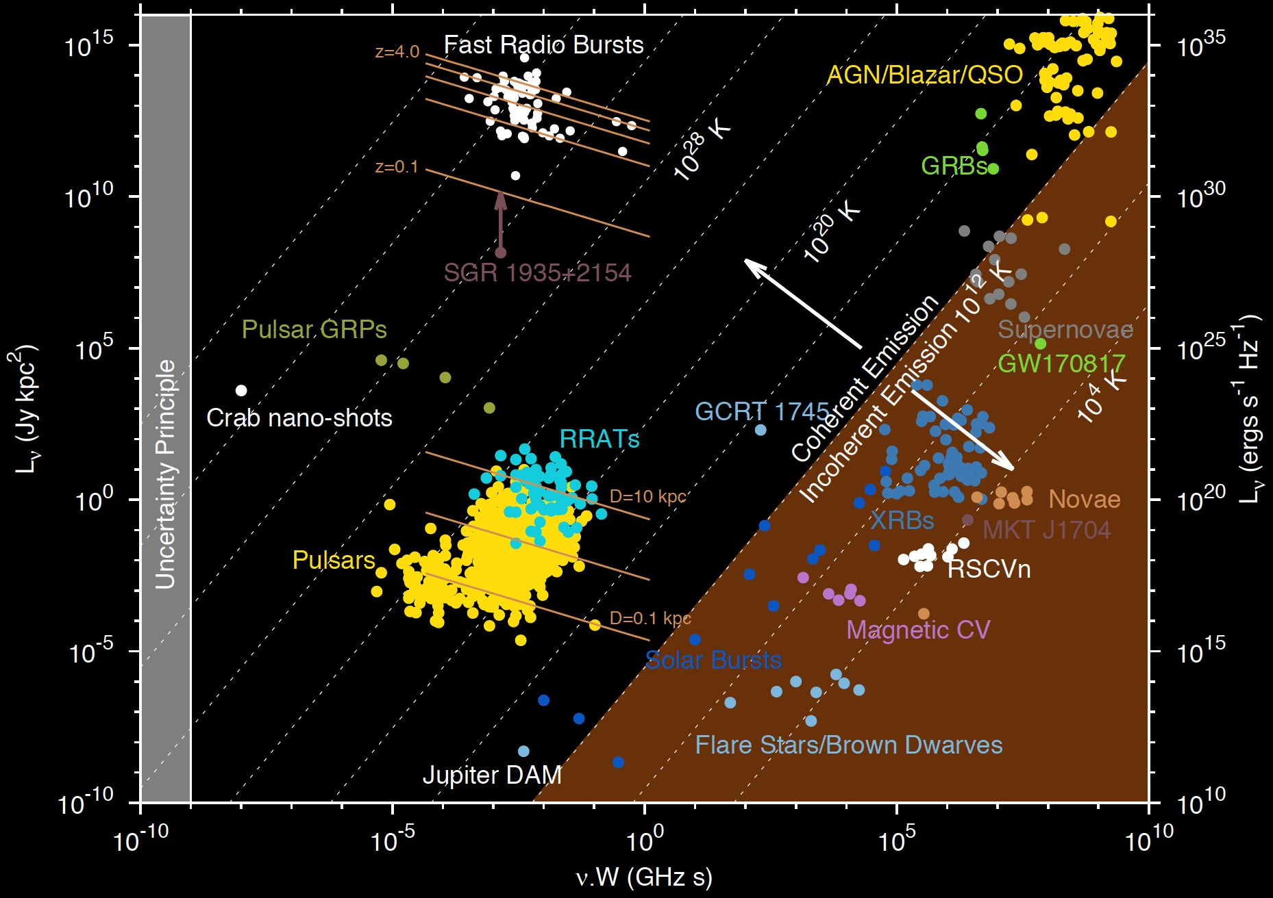

Coeherent radio emission
$$S_{ν}∙4πd^{2}=2{\left(νW\right)}^{2}k_{B}T_{B}$$

Slide 25
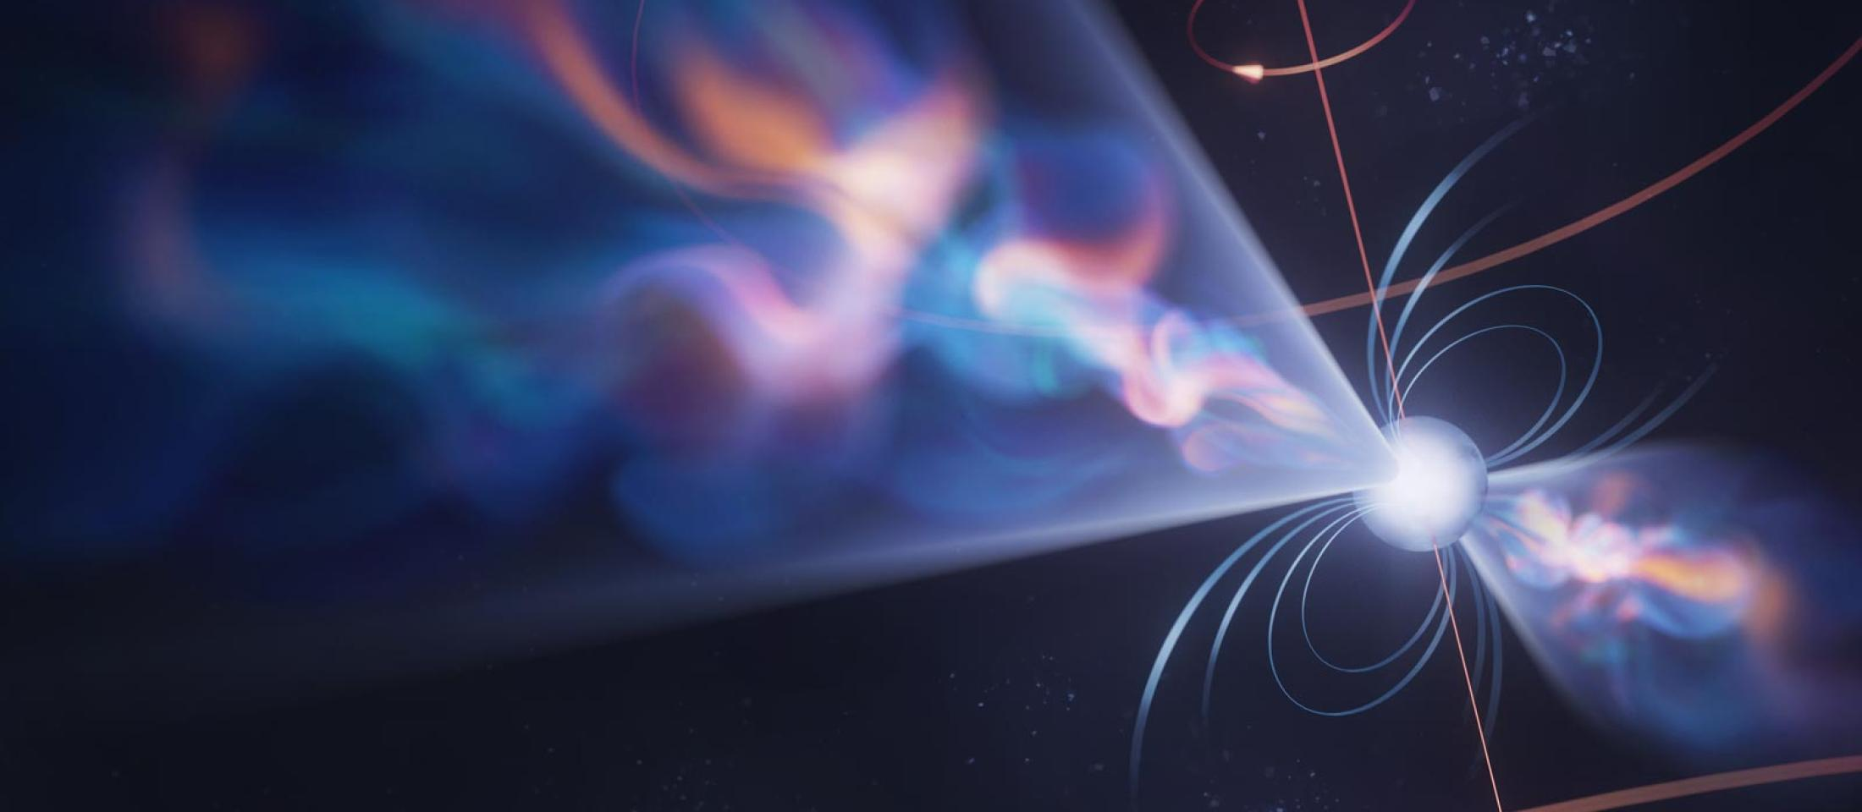
How to use a pulsar as a clock
Credits: Olena Shmahalo - NANOGrav

Slide 26
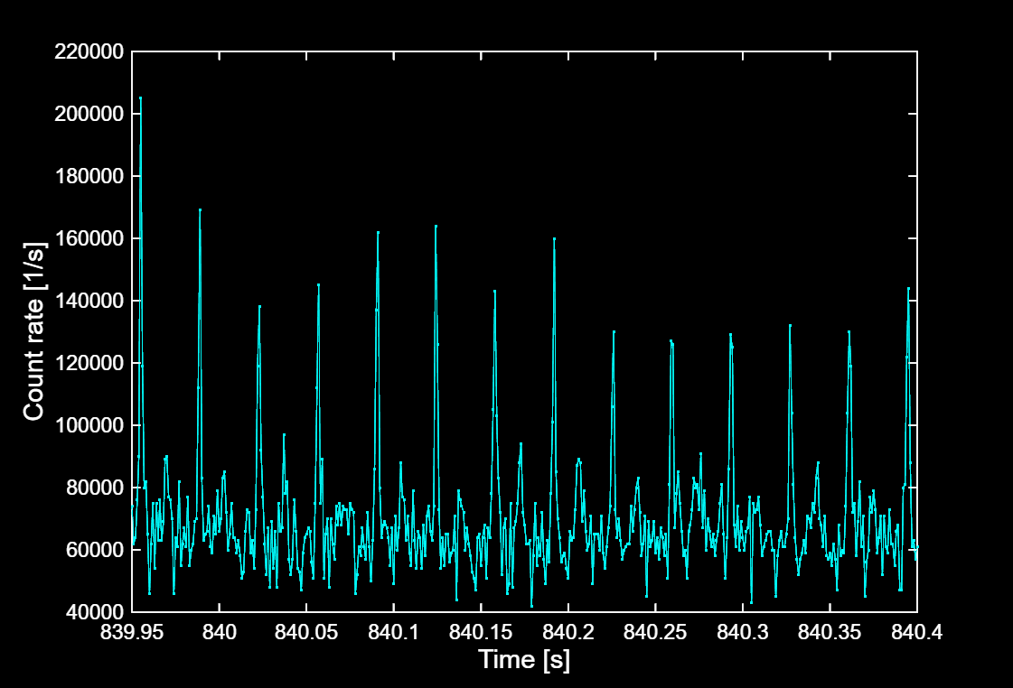

How to detect a pulsar?
$$P=δt=33ms$$

Slide 27

How to detect a pulsar?
$P=δt/N=33ms$ $σ_{P}= σ_{δt}/N$

Slide 28
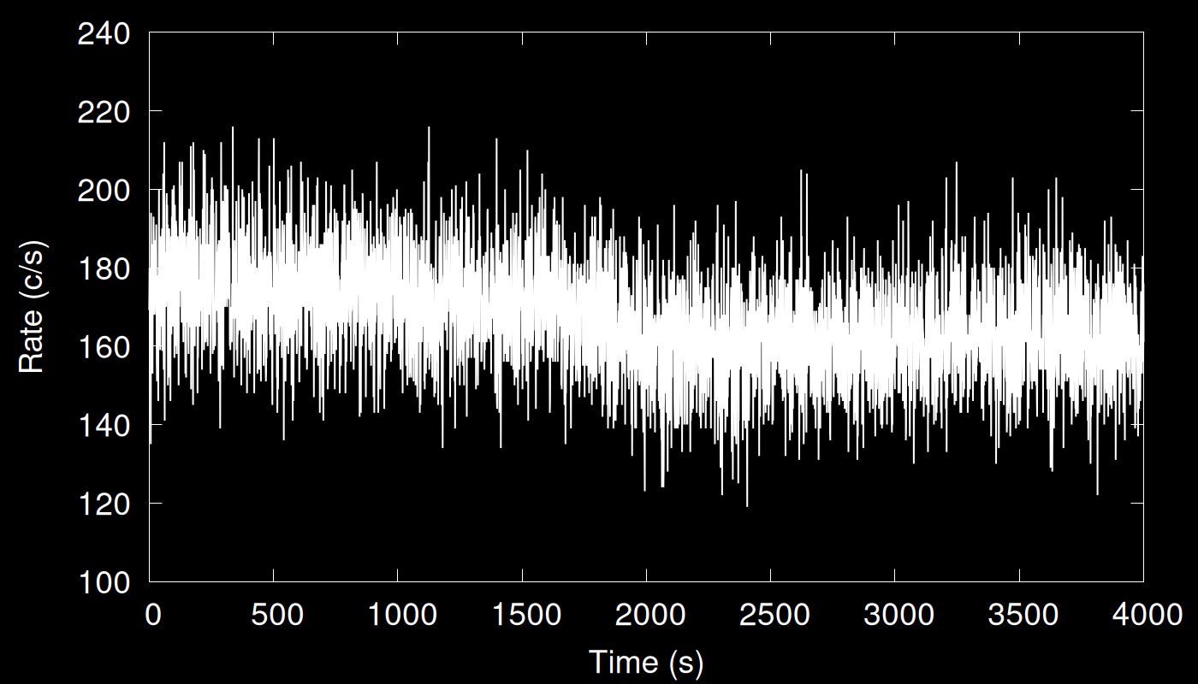

Counting photons is noisy!
$$E\left(X\right)=λ∙Δt$$
$$σ\left(X\right)= \sqrt{λ∙Δt}=\sqrt{N_{γ}}$$
$$\frac{σ\left(X\right)}{E(X)}∼\frac{1}{\sqrt{N_{γ}}}$$

Slide 29
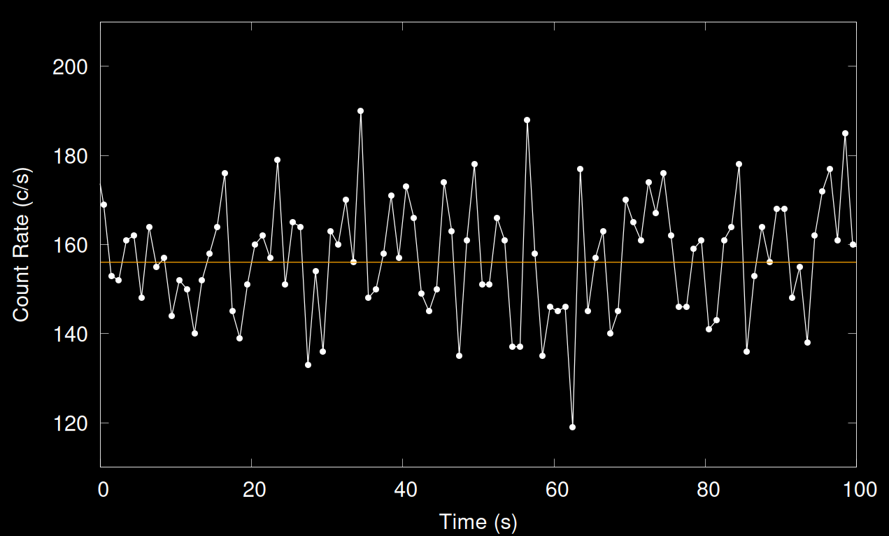

Photon counting is a noisy process
Number of photons $k$ detected in interval $Δt$ for a process with average rate $λ$ is Poisson distrubted
$$p\left(k,Δt\right)= \frac{{\left(λΔt\right)}^{k}e^{−λΔt}}{k!}$$
$$E\left(X\right)=λ∙Δt$$
$$σ\left(X\right)= \sqrt{λ∙Δt}=\sqrt{N_{γ}}$$
$$\frac{σ\left(X\right)}{E(X)}∼\frac{1}{\sqrt{N_{γ}}}$$

Slide 30
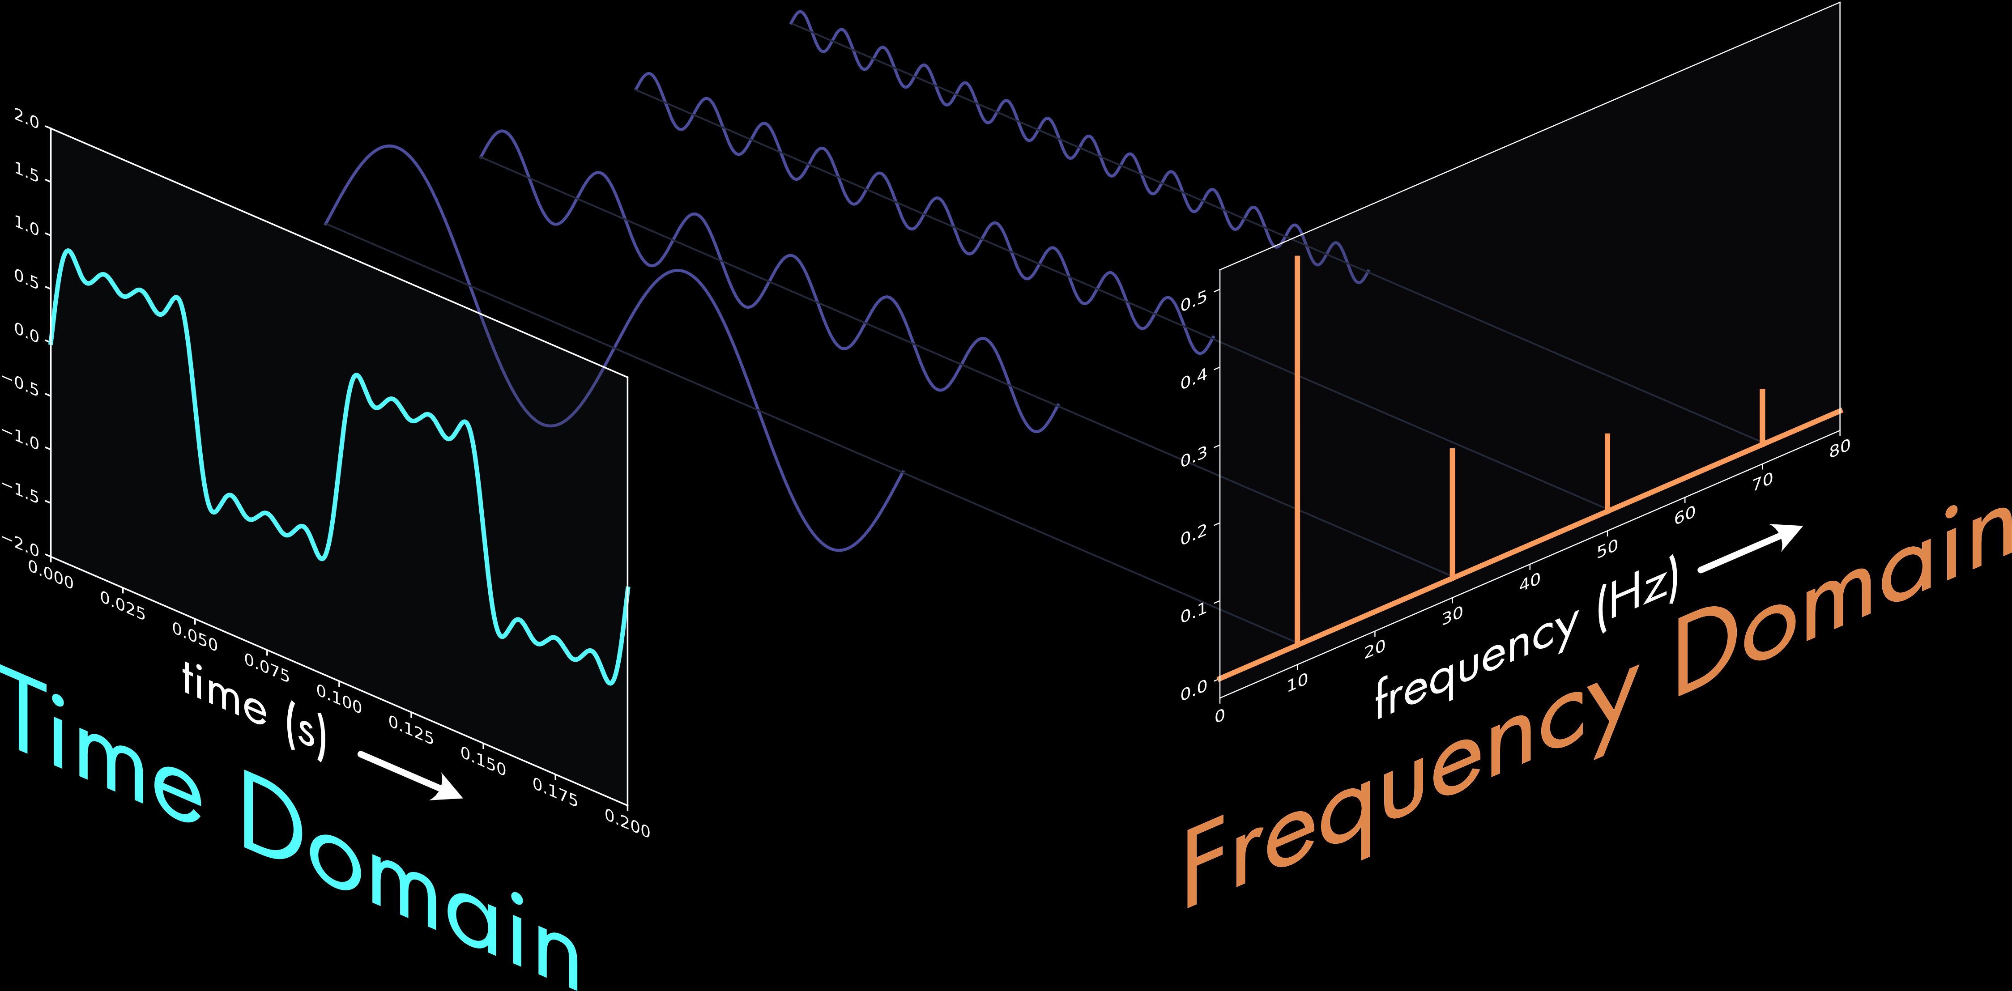

Fourier power spectrum
Goal: quantify variability at different frequencies
Means: decompose the signal into sine waves
-> Fourier transform
$$r\left(t_{k}\right)=\frac{1}{N_{γ}}\sum_{j}{A_{j}e^{−i(2πν_{j}t_{k})}}$$
$$P\left(ν_{j}\right)=\frac{2}{N_{γ}}{\left|A_{j}\right|}^{2}$$

Slide 31
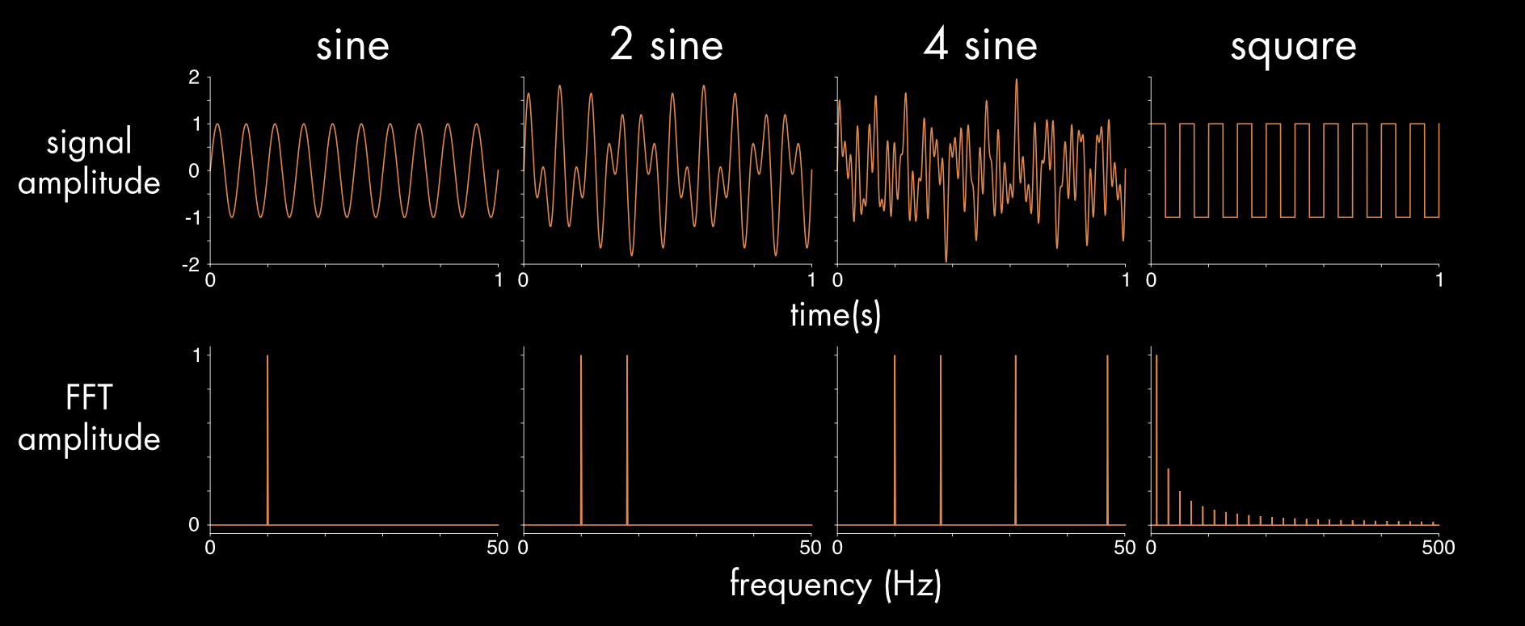
Fourier power of a sine wave

Slide 32
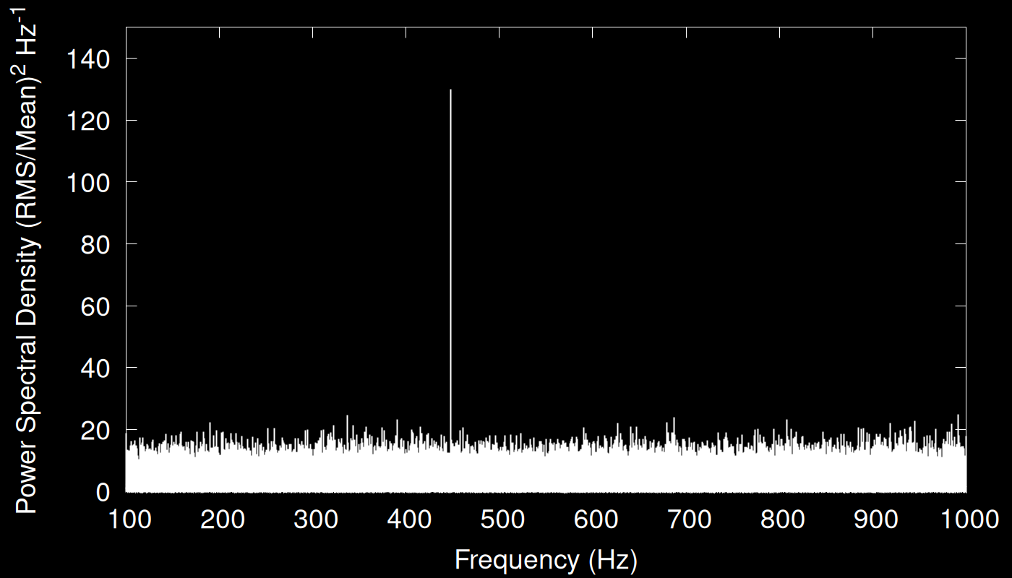
How to detect a pulsar?
3σ False Alarm Prob. (including trials)

Slide 33
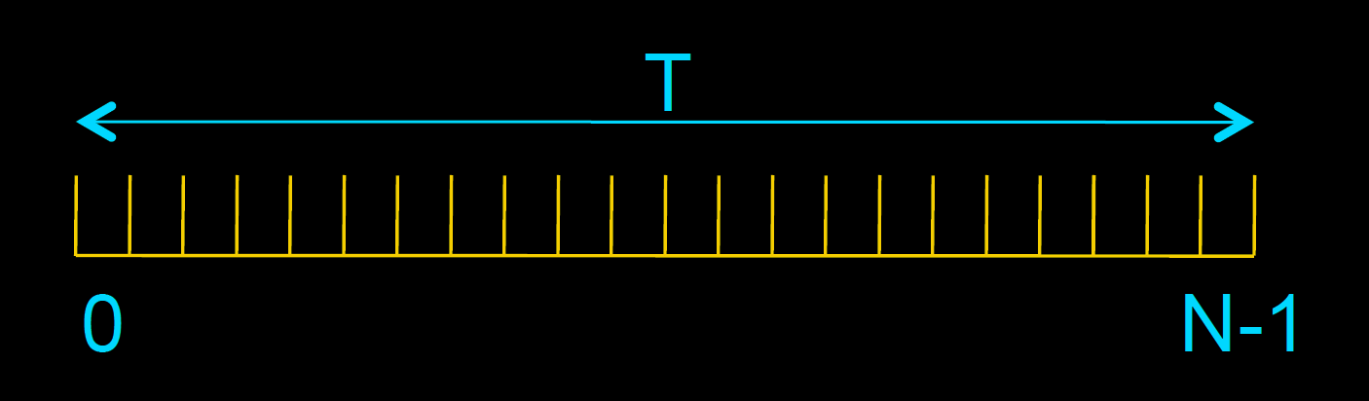
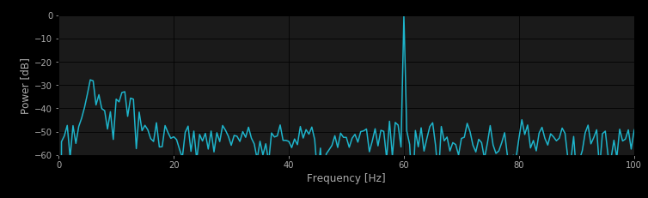



Time series parameters
$$T$$
$$δt$$
Observation length $T$ frequency resolution $δν=1/T=270 μHz$in 1 hour
Sampling time$δt$ maximum frequency $ν_{Ny}=1/(2δt)$
$$δν=1/T$$
$$ν_{Ny}=1/(2δt)$$

Slide 34
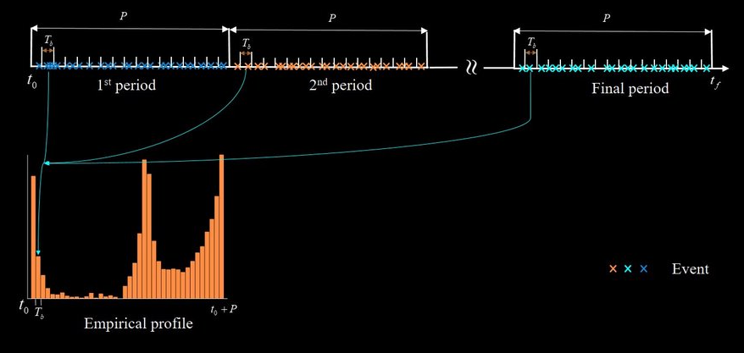
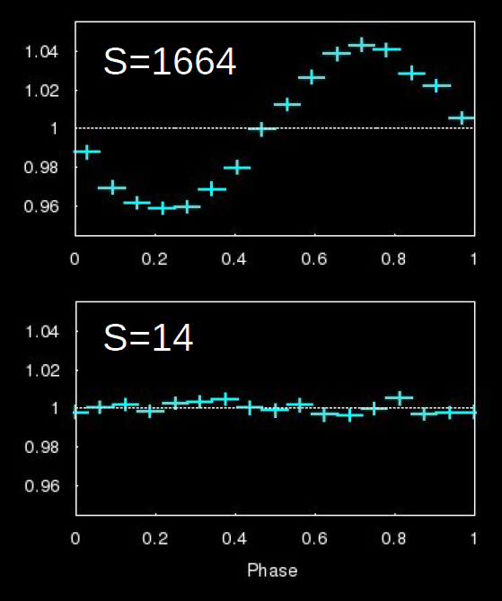

Epoch Folding
Increases the signal to noise ratio
($N_{γ}^{bin}∼R×T/n_{bin}$)
$$S=\sum_{j=1}^{n_{bin}}{\frac{T}{n_{bin}R}{\left(R_{j}−R\right)}^{2}}$$

Slide 35
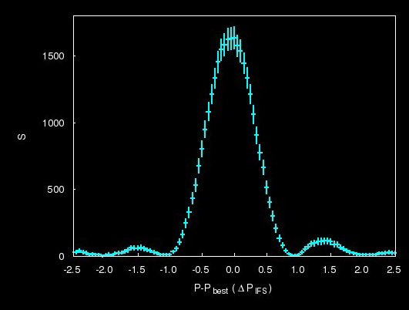

Epoch Folding Search
$δP=\frac{P^{2}}{2Tn_{bin}}$
$δν_{EFS}=\frac{1}{2n_{bin}}\frac{1}{T}=\frac{1}{2n_{bin}}$ $δν_{IFS}$
$δν_{EFS}$= $10 μHz for T=1hr$

Slide 36
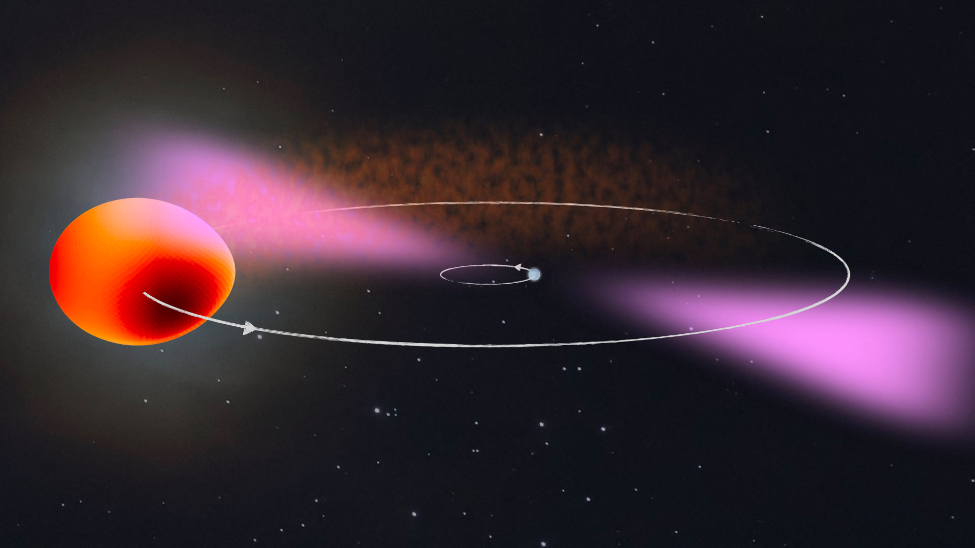
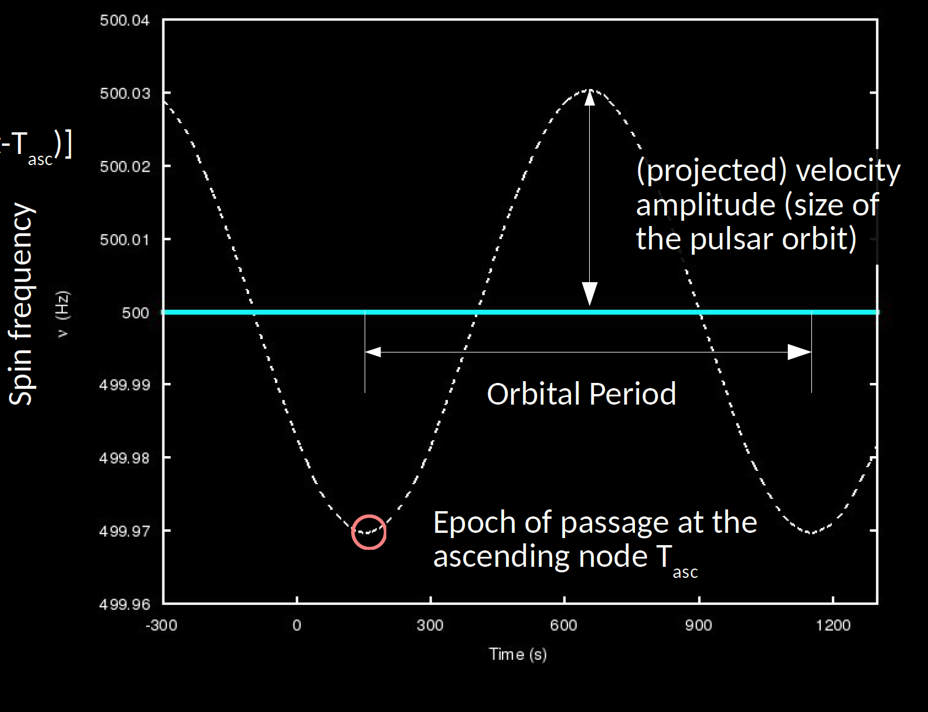
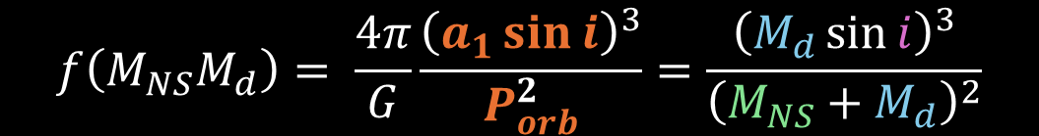
Binary motion introduces Doppler shifts
$$f\left(M_{NS}M_{d}\right)= \frac{4π}{G}\frac{{\left(a_{1}\sin{i}\right)}^{3}}{P_{orb}^{2}}=\frac{{\left(M_{d}\sin{i}\right)}^{3}}{{\left(M_{NS}+M_{d}\right)}^{2}}$$

Slide 37
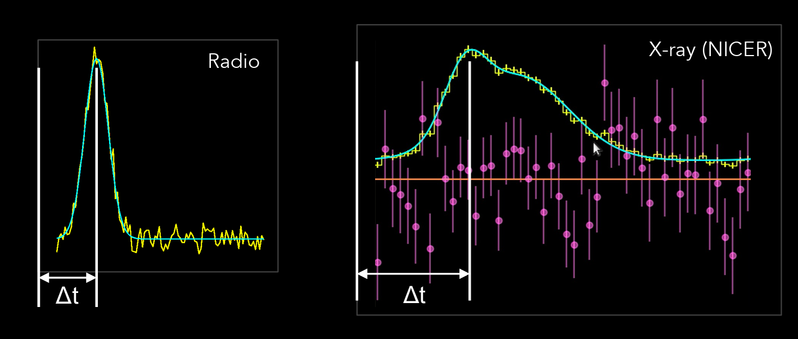
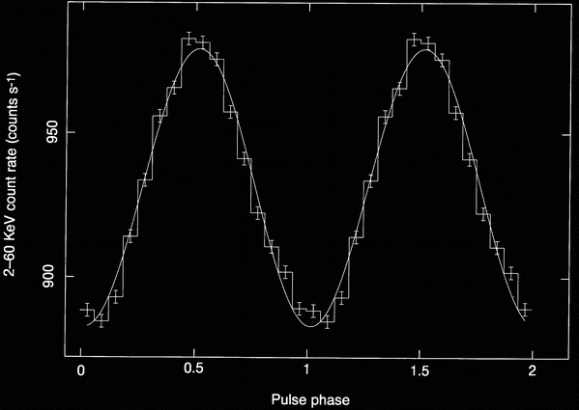
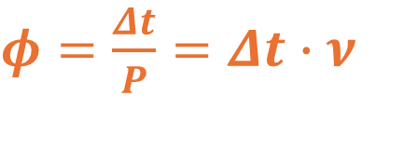


Pulse Phase/Time of Arrival
A coherent signal maintains a constant phase relationship between its cycles
$$φ\left(t\right)−φ_{0}=\int_{T_{0}}^{t}{ν\left(t^{′}\right)dt^{′}}=ν_{0}\left(t−T_{0}\right)$$
$φ=\frac{Δt}{P}=Δt∙ν$
$$Δφ$$

Slide 38
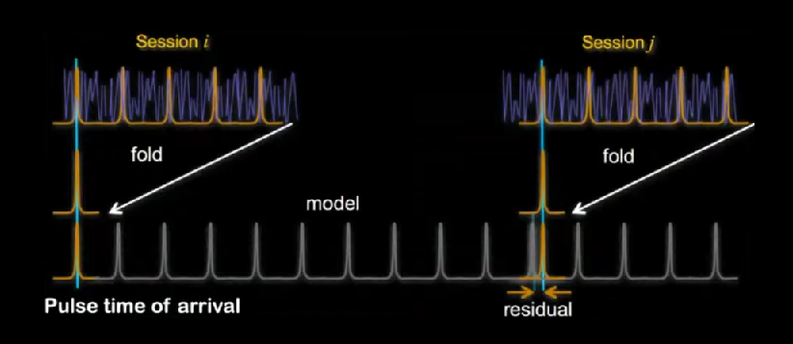

Pulsar timing
Predict the pulse phase (or time of arrival – ToA – for radio pulsar astronomers)
$φ_{pred}\left(t\right)=φ_{0}+ν_{fold}\left(t−T_{0}\right)$
(e.g. assuming $ν=const$)
Predictions up to the
epoch allowed by the
precision of
the preliminary solution

Slide 39
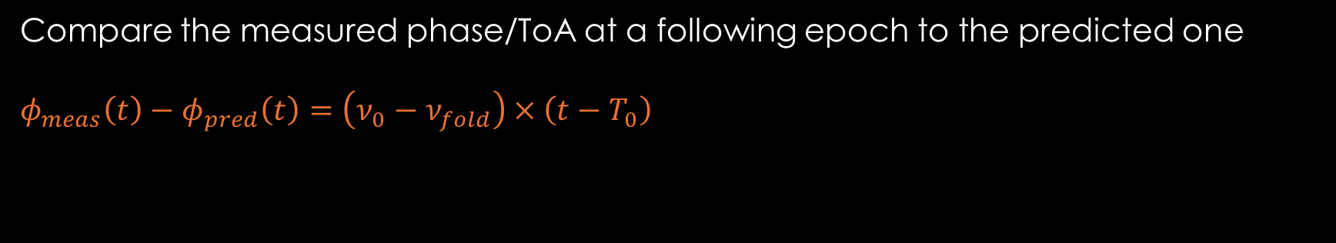
Pulsar timing
Compare the measured phase/ToA at a following epoch to the predicted one
$$φ_{meas}\left(t\right)−φ_{pred}\left(t\right)=\left(ν_{0}−ν_{fold}\right)×\left(t−T_{0}\right)$$

Slide 40


Pulsar timing
Compare the measured phase/ToA at a following epoch to the predicted one
$$φ_{meas}\left(t\right)−φ_{pred}\left(t\right)=\left(ν_{0}−ν_{fold}\right)×\left(t−T_{0}\right)$$
$$δν≃\frac{δφ}{\left(t−T_{0}\right)}≃50nHz in 10 days$$

Slide 41





Pulsar Timing
Frequency (& phase/ToAs) change because of:
Wrong frequency
The observer moves
Pulsar position
The NS moves
Motion in a binary system
Proper Motion
The NS spins up/down or glitches
Magnetic field – mass accretion

Slide 42

Pulsar Timing
Goal of the game:
Include the effects (e.g. binary motion) in the model
Predict phases/ToAs with the updated model
Model residual variations &
improve parameter accuracy
and/or
Go on until residuals are flat
model
predict phases
correct parameters
model residuals

Slide 43

Pulsar Timing
Goal of the game:
Include the effects (e.g. binary motion) in the model
Predict phases/ToAs with the updated model
Model residual variations &
improve parameter accuracy
and/or
Go on until residuals are flat

Slide 44






Why millisecond Pulsars are the best clocks?
Slow classical pulsars
Timing parameter uncertainties
$$σ_{p_{i}}∝1/{N_{cycles}}={{Δt}_{span}}/ν$$
Less timing noise compared
to slower pulsars
Slow pulsars $σ_{Δt}≈ms$
ms pulsars $σ_{Δt}≈μs$
Millisecond pulsar

Slide 45



General Relativity into action
Pulsar timing allows to measure the (variations of) the position of a pulsar with tremendous accuracy
$$σ_{Δt}≈1μs\underset{→}{\text{yields}}σ_{r}≈300m$$

Slide 46

Post Keplerian parameters
Periastron precession
Einstein delay
Orbit decay
Shapiro Delay
Two PK parameters measure the masses

Slide 47


The NS mass
Double NS (PSR+NS)
Pspin ≈ 20-200 ms
Porb ≈ 0.1-20 days
Very eccentric
-> Periastron precession, Einstein Delay
Millisecond PSR (PSR+WD)
Pspin ≈ 1-10 ms
Porb > days
Circular orbits
-> Shapiro delays

Slide 48

The NS mass

Slide 49
Post Keplerian parameters
Periastron precession
Einstein delay
Orbit decay
Shapiro Delay
2+ PK parameters test General Relativity

Slide 50


Double NS binary
B1913+16
Eccentric orbit
3 PK parameters ($\dot{ω}, γ, {\dot{P}}_{orb}$)
GR predictions tested at 0.2% level
Nobel Prize in 1993 (R. Hulse, J. Taylor)

Slide 51





Double PSR binary
PSR J0737-3039A/B
P_{spin,A} = 23ms
P_{orb} = 2.4 hr (most compact DNS)
Mildly eccentric (e=0.1) -> $\dot{ω}, γ, {\dot{P}}_{orb}$
Orbit shrinks by 7mm every day
High inclination (i=89°) -> Shapiro Delay
P_{spin,B} = 2.8 s -> Mass ratio
Second Order PK parameters
(Retardation & Deflection)
6 Gravity tests
Match GR predictions at 0.013% level
Allowed parameter space

Slide 52

Hunting for Gravitational Waves
with millisecond pulsars
Credit: D. Champion

Slide 53


Slide 54


Slide 55


Inspiral of SMBHs (0.1pc → 10⁻⁴ pc)
The sum creates
an isotropic stochastic
Gravitational Waves
Background
Single SMBH interactions hardly observed

Slide 56

Inspiral of SMBHs (0.1pc → 10⁻⁴ pc)
The sum creates
an isotropic stochastic
Gravitational Waves
Background
Red noise in Timing residuals P≈f^{-2/3}

Slide 57



Slide 58


The Hellings-Downs Curve
Correlation btw timing residuals
$$C\left(θ_{ij}\right)=\left[\frac{3}{2}x log\left(x\right)−\frac{x}{4}+\frac{1}{2}\right]+\frac{1}{2}δ_{ij}$$
$$x=(1−cosθ_{ij})/2$$

Slide 59


The Hellings-Downs Curve - NANOGrav
Correlation btw timing residuals
3.5-4 σ correlation

Slide 60


The Hellings-Downs Curve – EPTA+InPTA
Correlation btw timing residuals
$$C\left(θ_{ij}\right)=\left[\frac{3}{2}x log\left(x\right)−\frac{x}{4}+\frac{1}{2}\right]+\frac{1}{2}δ_{ij}$$
$$x=(1−cosθ_{ij})/2$$

Slide 61


How to navigate into space?
$$δt=\frac{{10}^{−10}s}{day} δρ≈1m δv≈10cm/s$$
but requires communication with Earth (unless atomic clocks on spacecrafts)
And works well only in radial direction

Slide 62


How to navigate into space?
$$δToA=μs δρ≈300m$$
Completely autonomous

Slide 63



$δρ≈15 km$ in 6 hours

Slide 64
Conclusions
Pulsars are key probes of
Acceleration of particles
Supranuclear densities
General Relativity tests
Gravitational Waves

Slide 65


Slide 66



Slide 67


Slide 68


Slide 70




Fourier power of a sine wave
$$δν=1/T$$
$$r\left(t\right)=\overline{r}∙\left[1+A\sin\left(2πν_{0}∙t\right)\right]$$
$$\underset{→}{\text{FT}} P\left(ν\right)=\frac{1}{2}N_{γ}A^{2}{\left(\frac{\sin\left[π\left(ν−ν_{0}\right)T\right]}{\left[π\left(ν−ν_{0}\right)T\right]}\right)}^{2}$$
$$P\left(ν_{k}\right)=0.773 N_{γ}A^{2}$$
A coherent signal maintains a constant phase
At first order, it maintains a constant frequency
$Δν⋖1/T$

Slide 71

The effect of finite length

Slide 72


Fourier power of a sine wave
$$δν=1/T$$
$$δν=1/T$$
$$r\left(t\right)=\overline{r}∙\left[1+A\sin\left(2πν_{0}∙t\right)\right]$$
$$\underset{→}{\text{FT}} P\left(ν\right)=\frac{1}{2}N_{γ}A^{2}{\left(\frac{\sin\left[π\left(ν−ν_{0}\right)T\right]}{\left[π\left(ν−ν_{0}\right)T\right]}\right)}^{2}$$
$$P\left(ν_{k}\right)=0.773 N_{γ}A^{2}$$
A coherent signal maintains a constant phase
At first order, it maintains a constant frequency
$Δν⋖1/T$

Slide 73



How to detect a pulsar
$$P\left(ν\right)=P_{sig}(ν)+P_{noise}(ν)$$
Uncorrelated Noise and signal
$P_{det}$A power level unlikely (with prob. ε) to be exceeded by noise $P_{noise}(ν)$
$P_{noise}(ν)$ is the sum of two uncorrelated variables (the Fourier coefficients)
$$E\left(P_{noise}\right)=N_{dof}=2$$
$$var\left(P_{noise}\right)=2N_{dof}=4$$
$$p\left(P_{noise}>P_{det}\right)=e^{−P_{det}/2}$$
For $ε=2.7×{10}^{−3}$ (3σ confidence level)
$$P_{det}=2 ln\left(\frac{1}{ε}\right)=11.8$$

Slide 74

How to detect a pulsar (with many trials)
$$P\left(ν\right)=P_{sig}(ν)+P_{noise}(ν)$$
Uncorrelated Noise and signal
Trials matter
$$N_{trials}=\frac{ν_{max}−ν_{min}}{δν}≃\frac{ν_{Ny}}{δν}=\frac{T}{2δt}$$
$$p\left(P_{noise}>P_{det}\right)=1−{\left(1−e^{−P_{det}/2}\right)}^{N_{trials}}≃$$
$≃$ $N_{trials}$ $e^{−P_{det}/2}$
$$P_{det}=2 ln\left(\frac{1}{ε}\right)+2ln\left(N_{trials}\right)$$

Slide 75

Pulsar detection (optimal strategy)
$$N_{trials}=\frac{ν_{max}−ν_{min}}{δν}≃\frac{ν_{Ny}}{δν}=\frac{T}{2δt}$$
$P_{det}=2 ln\left(\frac{1}{ε}\right)+2ln\left(N_{trials}\right)∼ln\left(T\right)$ decreasing $T$ (e.g. averaging intervals)
reduces the detection threshold
$P_{sig}\left(ν_{k}\right)=0.773 N_{γ}A^{2}∼T$ but decreases also the signal power
To maximize a detection, take the longer time series compatible in which the signal maintains coherence

Slide 76

Coherent periodic signal
$$r\left(t\right)=\overline{r}∙\left[1+A\sin\left(2πν∙t\right)\right] \underset{→}{\text{FT}} P\left(ν\right)=\frac{1}{2}N_{γ}A^{2}$$

Slide 77
Bibliography
Amato & Olmi, Universe 2021, 7(11), 448
Philippov, Kramer 2022, Annual Review Astronomy & Astrophysics, 60, 495
Lorimer 2005, Living Rev. Relativity, 8, (2005), 7
Kramer+ 2021, Phys. Rev. X 11, 041050
Özel & Freire 2016, Annual Review Astronomy & Astrophysics, 54, 401
Wang+ 2023, Ch. J. Astronautics, 36, 44
Harding 2022 in Millisecond Pulsars, ASSL, edited by Bhattacharyya, Sudip; Papitto, Alessandro; Bhattacharya, Dipankar; Springer

