Slide 1
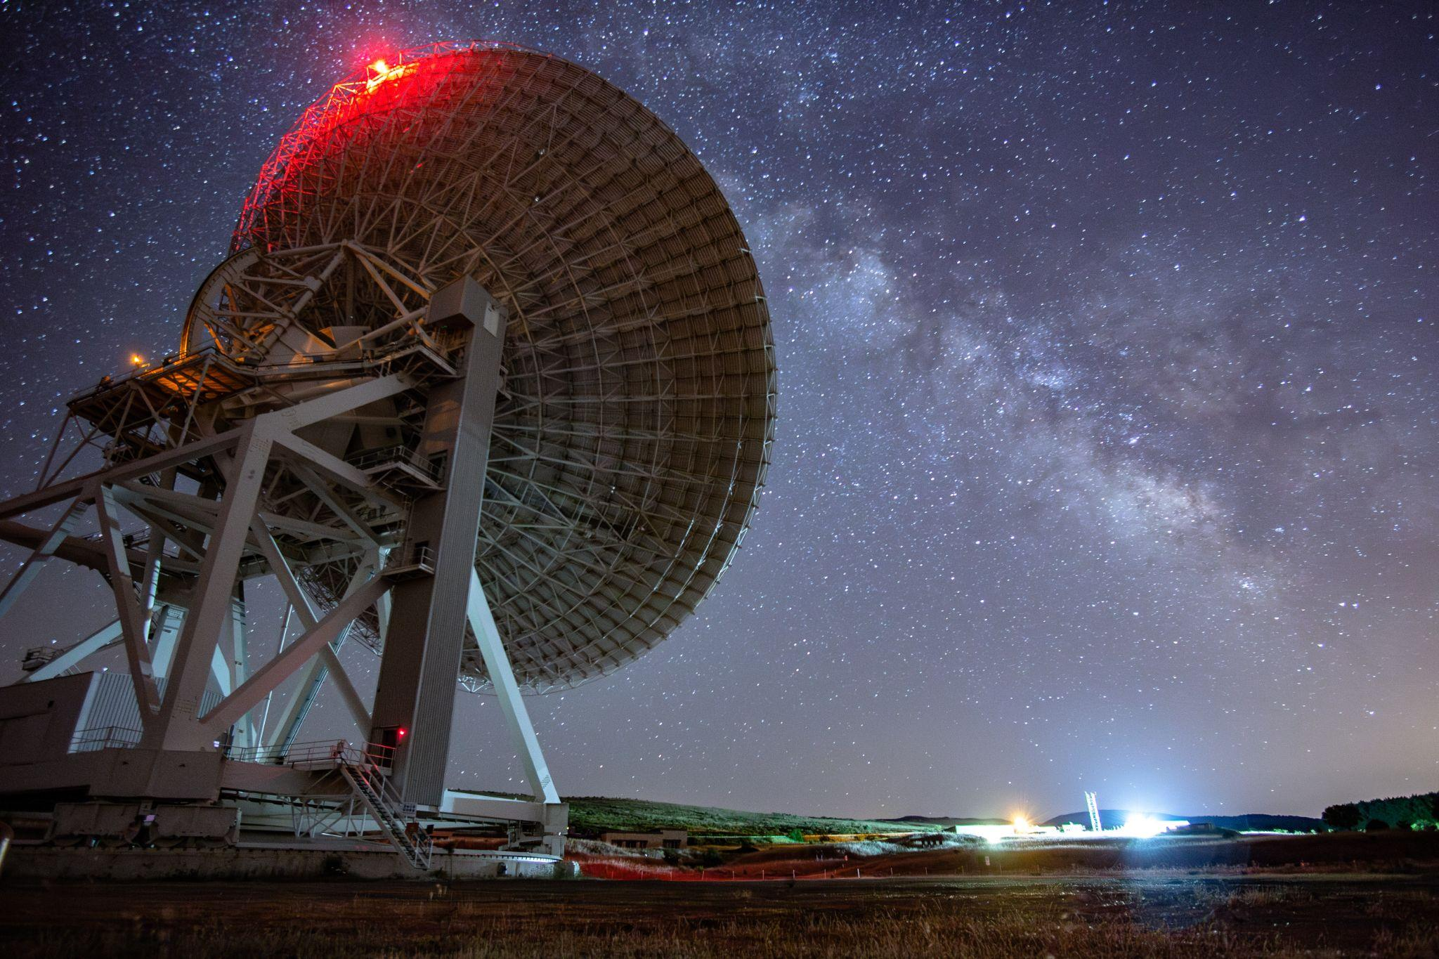



Sardinia Radio Telescope
status and challenges
Sergio Poppi
INAF OA-Cagliari
Towards high-performance mm-VLBI science operations with multi-band receivers
Bologna 28 - 30 October 2025

Slide 2
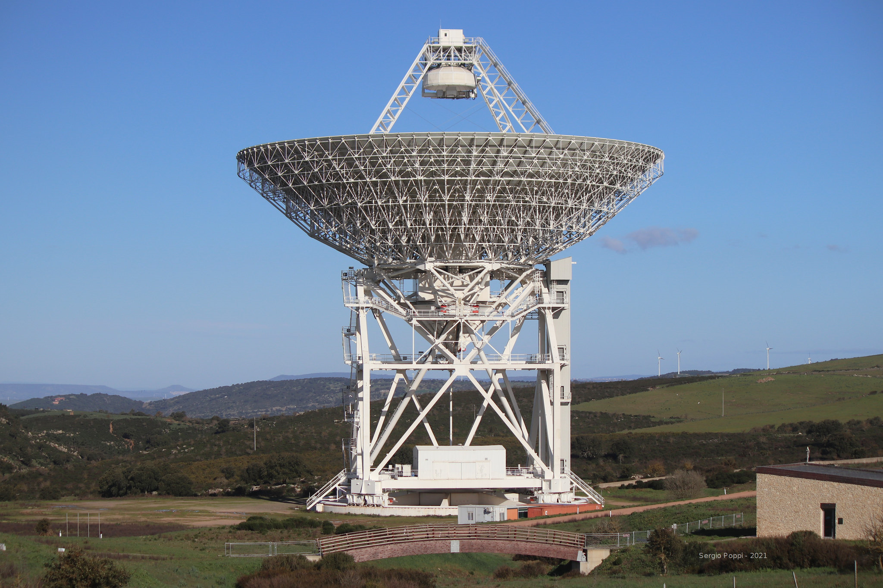
SRT: overview
Diameter | 64 meter
Optical Design | Gregorian shaped
Focal Positions | 6 (primary, gregorian an BWG)
Active Surface | 1008 Panels, 1096 Actuators
Frequency Coverage | 0.3 - 116 GHz (1000 mm - 3 mm)
Panel surface accuracy | 50 microns
Surface RMS | < 250 microns
Subreflector size | 7.9 meter
resolution at 100 GHz | 12 arcsec
Instantaneous FOV at 100 Ghz | 4 arcmin
Scanning speed | up to 1 - 6 arcmin/s
Servo System accuracy | < 0.20 arcsec

Slide 3
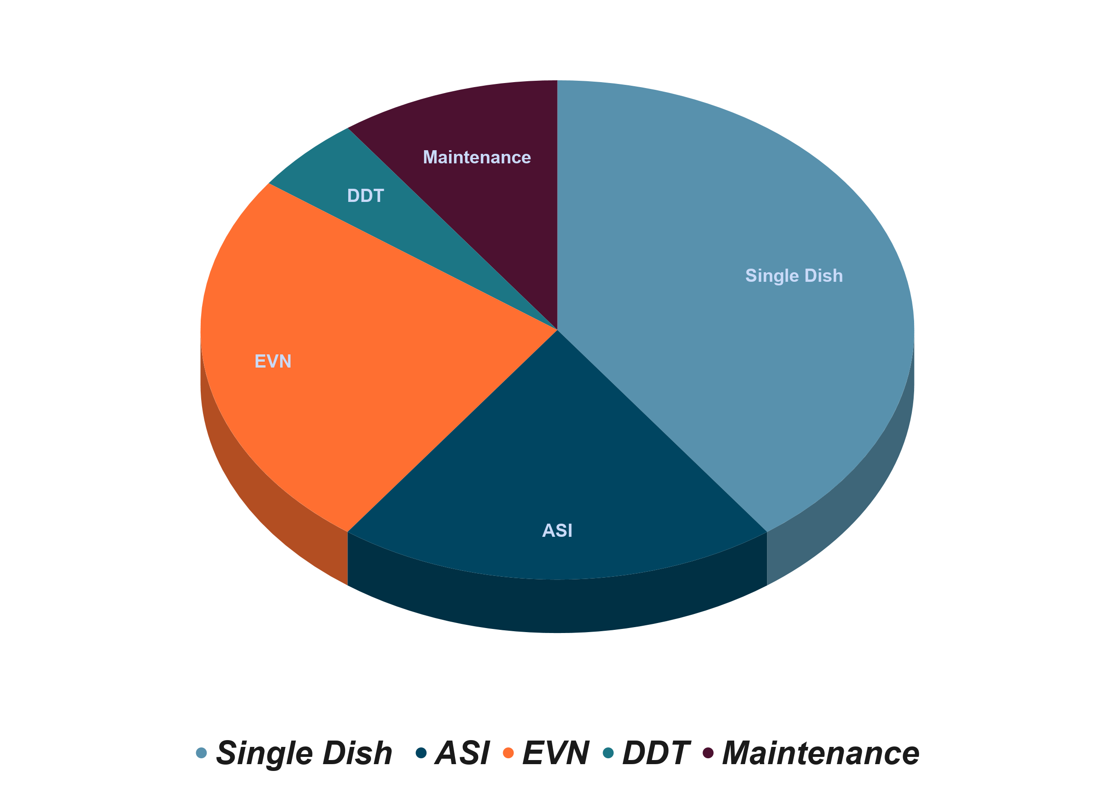
Time allocation
Operating Time is divided in:
European VLBI Network time (25%)
Time allocated by INAF for Single-dish observations, Italian VLBI(40%) and EATING vlbi
Director's discretionary time (5%)
Maintenance (10%)
ASI time(20%)
From Sept. 10,2025 Operations suspended for upgrades of ASI observing infrastructure (project PNRR- EMM).

Slide 4
SRT Receivers
SRT Receivers
Receiver | Frequency [GHz]
Primary-focus L-P dual band | 0.305-0.410
 | 1.3-1.8
Primary focus S-Band (in construction) | 3-4.5 | 7-beam
Secondary focus C_{low}- band | 4.2-5.6 | 1-beam
BWG focusC_{high} | 5.7-7.7 | 1-beam
Secondary focus K-band multi-feed | 18-26.5 | 7 beam
Q-band | 33-50 | 19-beam
W-band KID detector (MISTRAL) | 77-103 | 408 pixels
W-band (CARUSO) | 75-116 | 16-beam
Tri-band(K/Q/W) | 18-26 / 34-50/ 80-116 | Coaxial beams
Notes:
However, A National Operative Programme grant made it possible to increase the fleet of receivers and to extend the observational frequency range up to 116GHz. But as the frequencies increase, performance requirements become more and more restrictive.

Slide 5
PON Project
W.P.1 - W Band multi-beam cryogenic receiver (CARUSO- UKRI ),75– 116 GHz
W.P.2 - Q Band multi-beam cryogenic receiver (INAF) ,33 – 50 GHz
W.P.3 - KIDs based camera (MISTRAL- Universita' La Sapienza ), 77 – 103 GHz
W.P.4 - Tri Band K/Q/W for Italian Radio Telescopes (Korea Astronomy and Space Science Institute)
W.P.5 - SRT Metrology System
W.P.6 - Backends per SRT
W.P.7 - Mechanical and electronic interfaces and integration of the systems
W.P.8 - HPC and Storage
W.P.9 - Labs upgrade
under commissioning

Slide 6
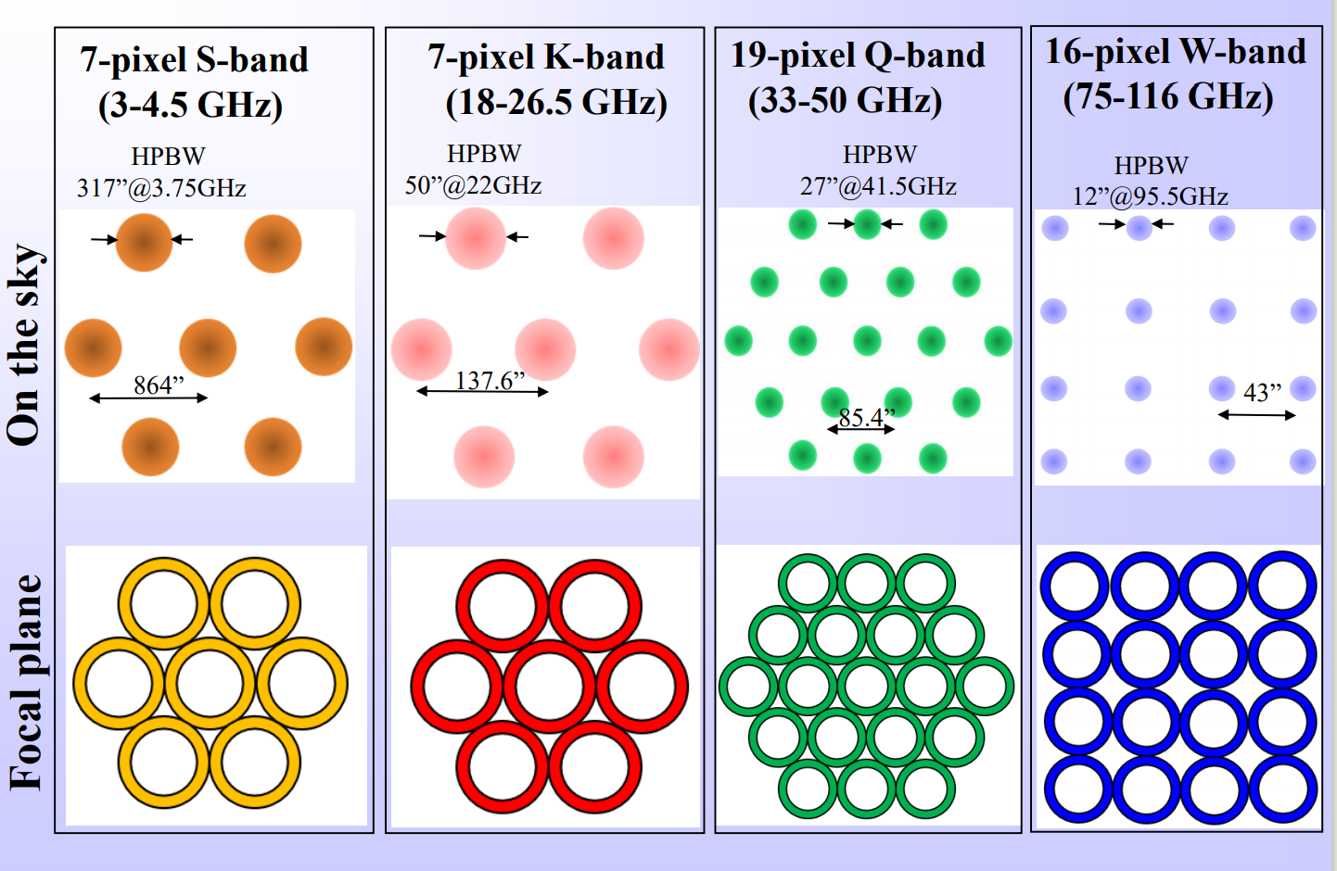
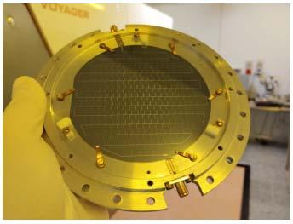
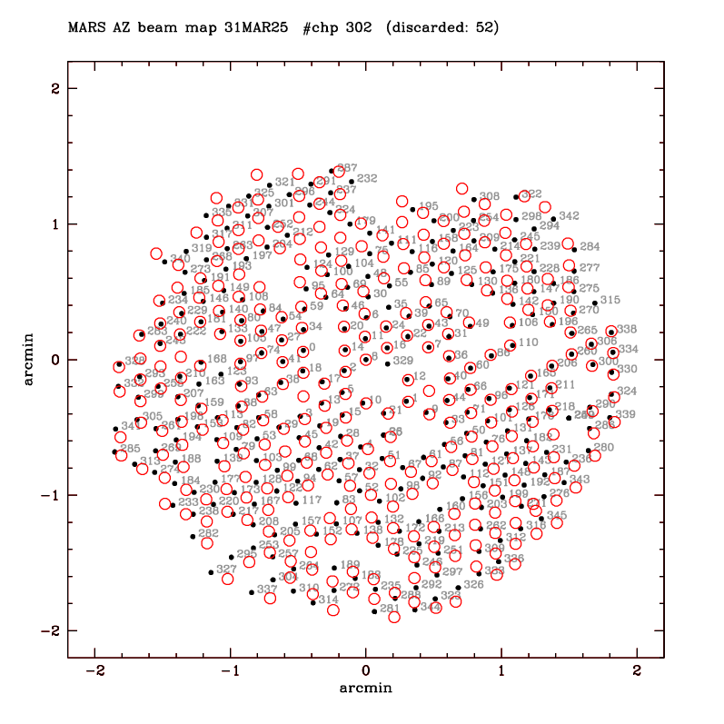
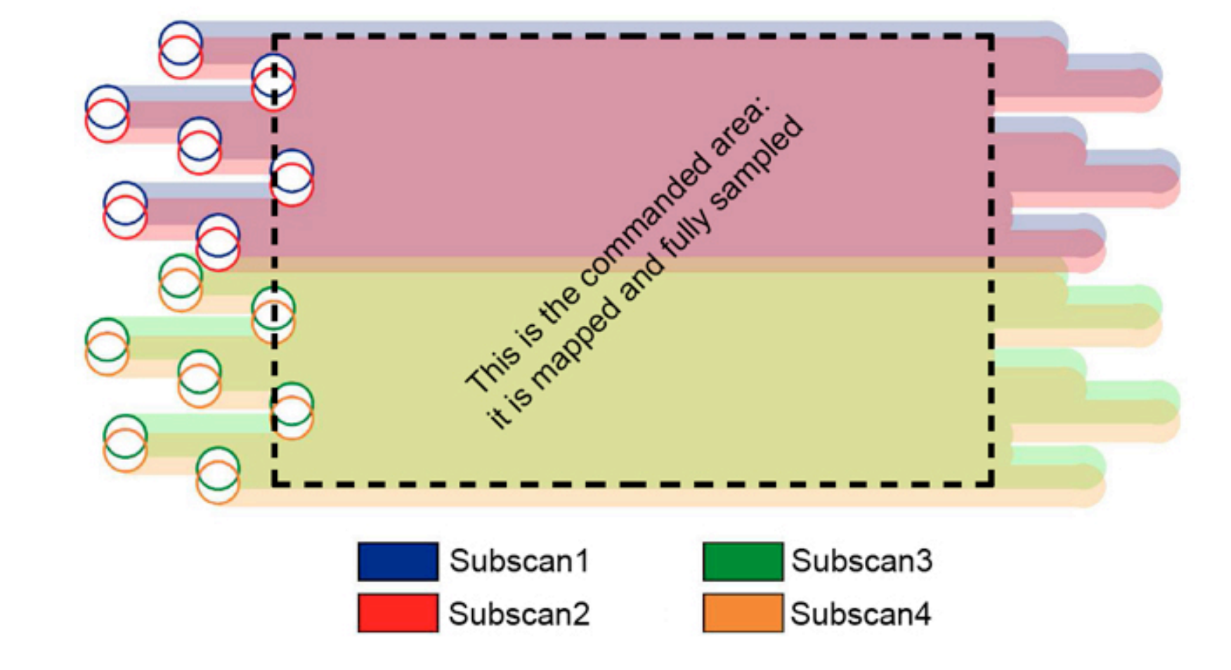
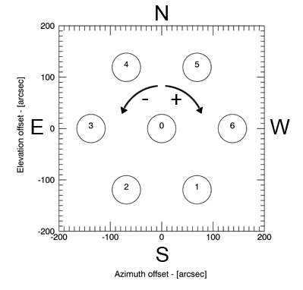
Multibeam receivers
MISTRAL:
415 lumped element kinetic inductance detectors (LEKIDs)

Slide 7

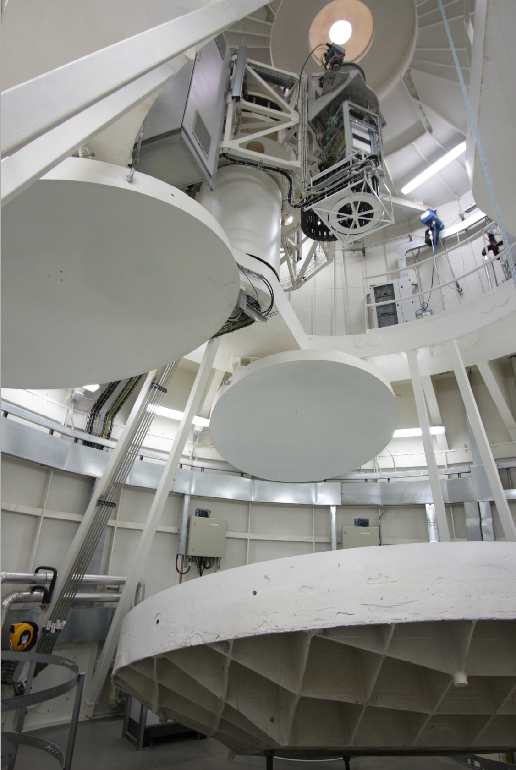
Frequency Agility
Position | Switching time (s)
Prime focus | 40-120
BWG | 11-90
GFR | 11-85

Slide 8
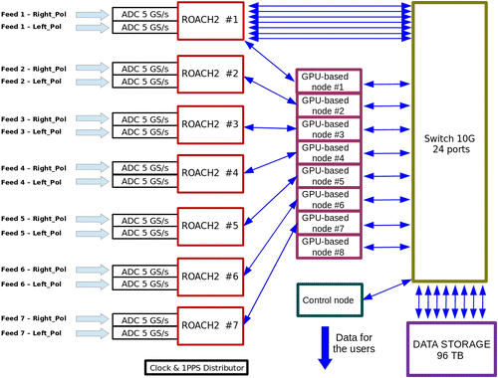
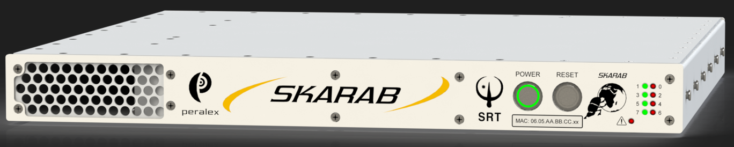
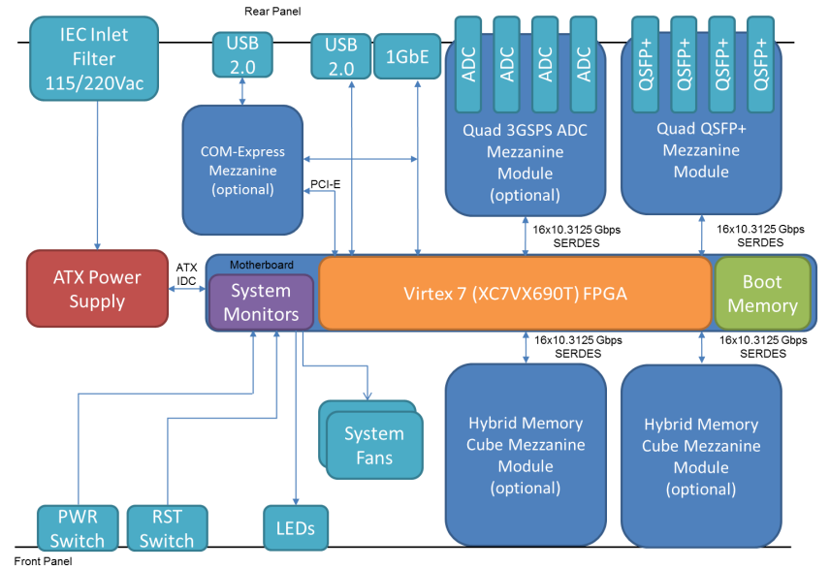
Backends
SARDARA, spettropolarimeter based on ROACH2(Casper) 14 inputs (2/beam)
2 GHz bandwidth, 16384 ch
spectroscopy, spectropolarimetric/continuum
SKARAB (Square Kilometre Array Reconfigurable Application Board)
DFB3 (ATNF) - pulsar timing and folding
Total Power : 7 beam dual polarization
DBBC2
DBBC3 (SRT, Medicina and Noto)

Slide 9
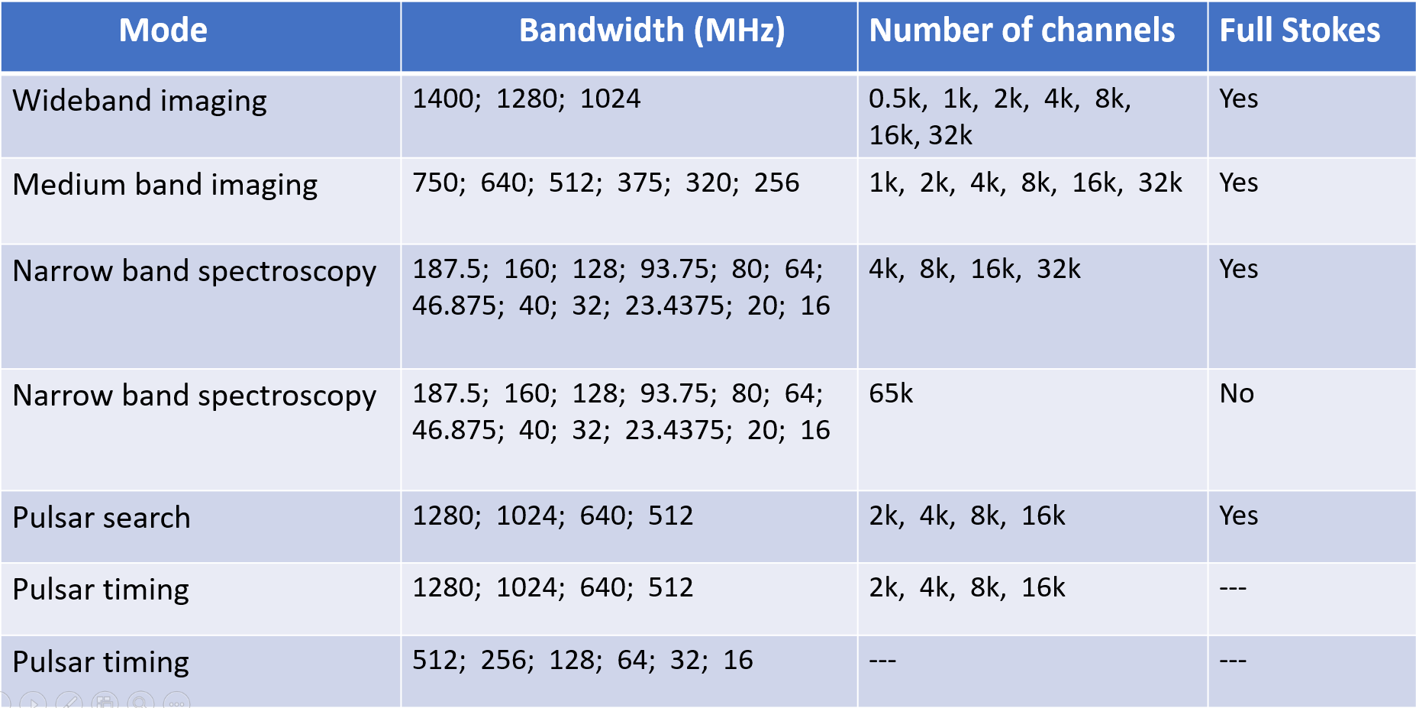
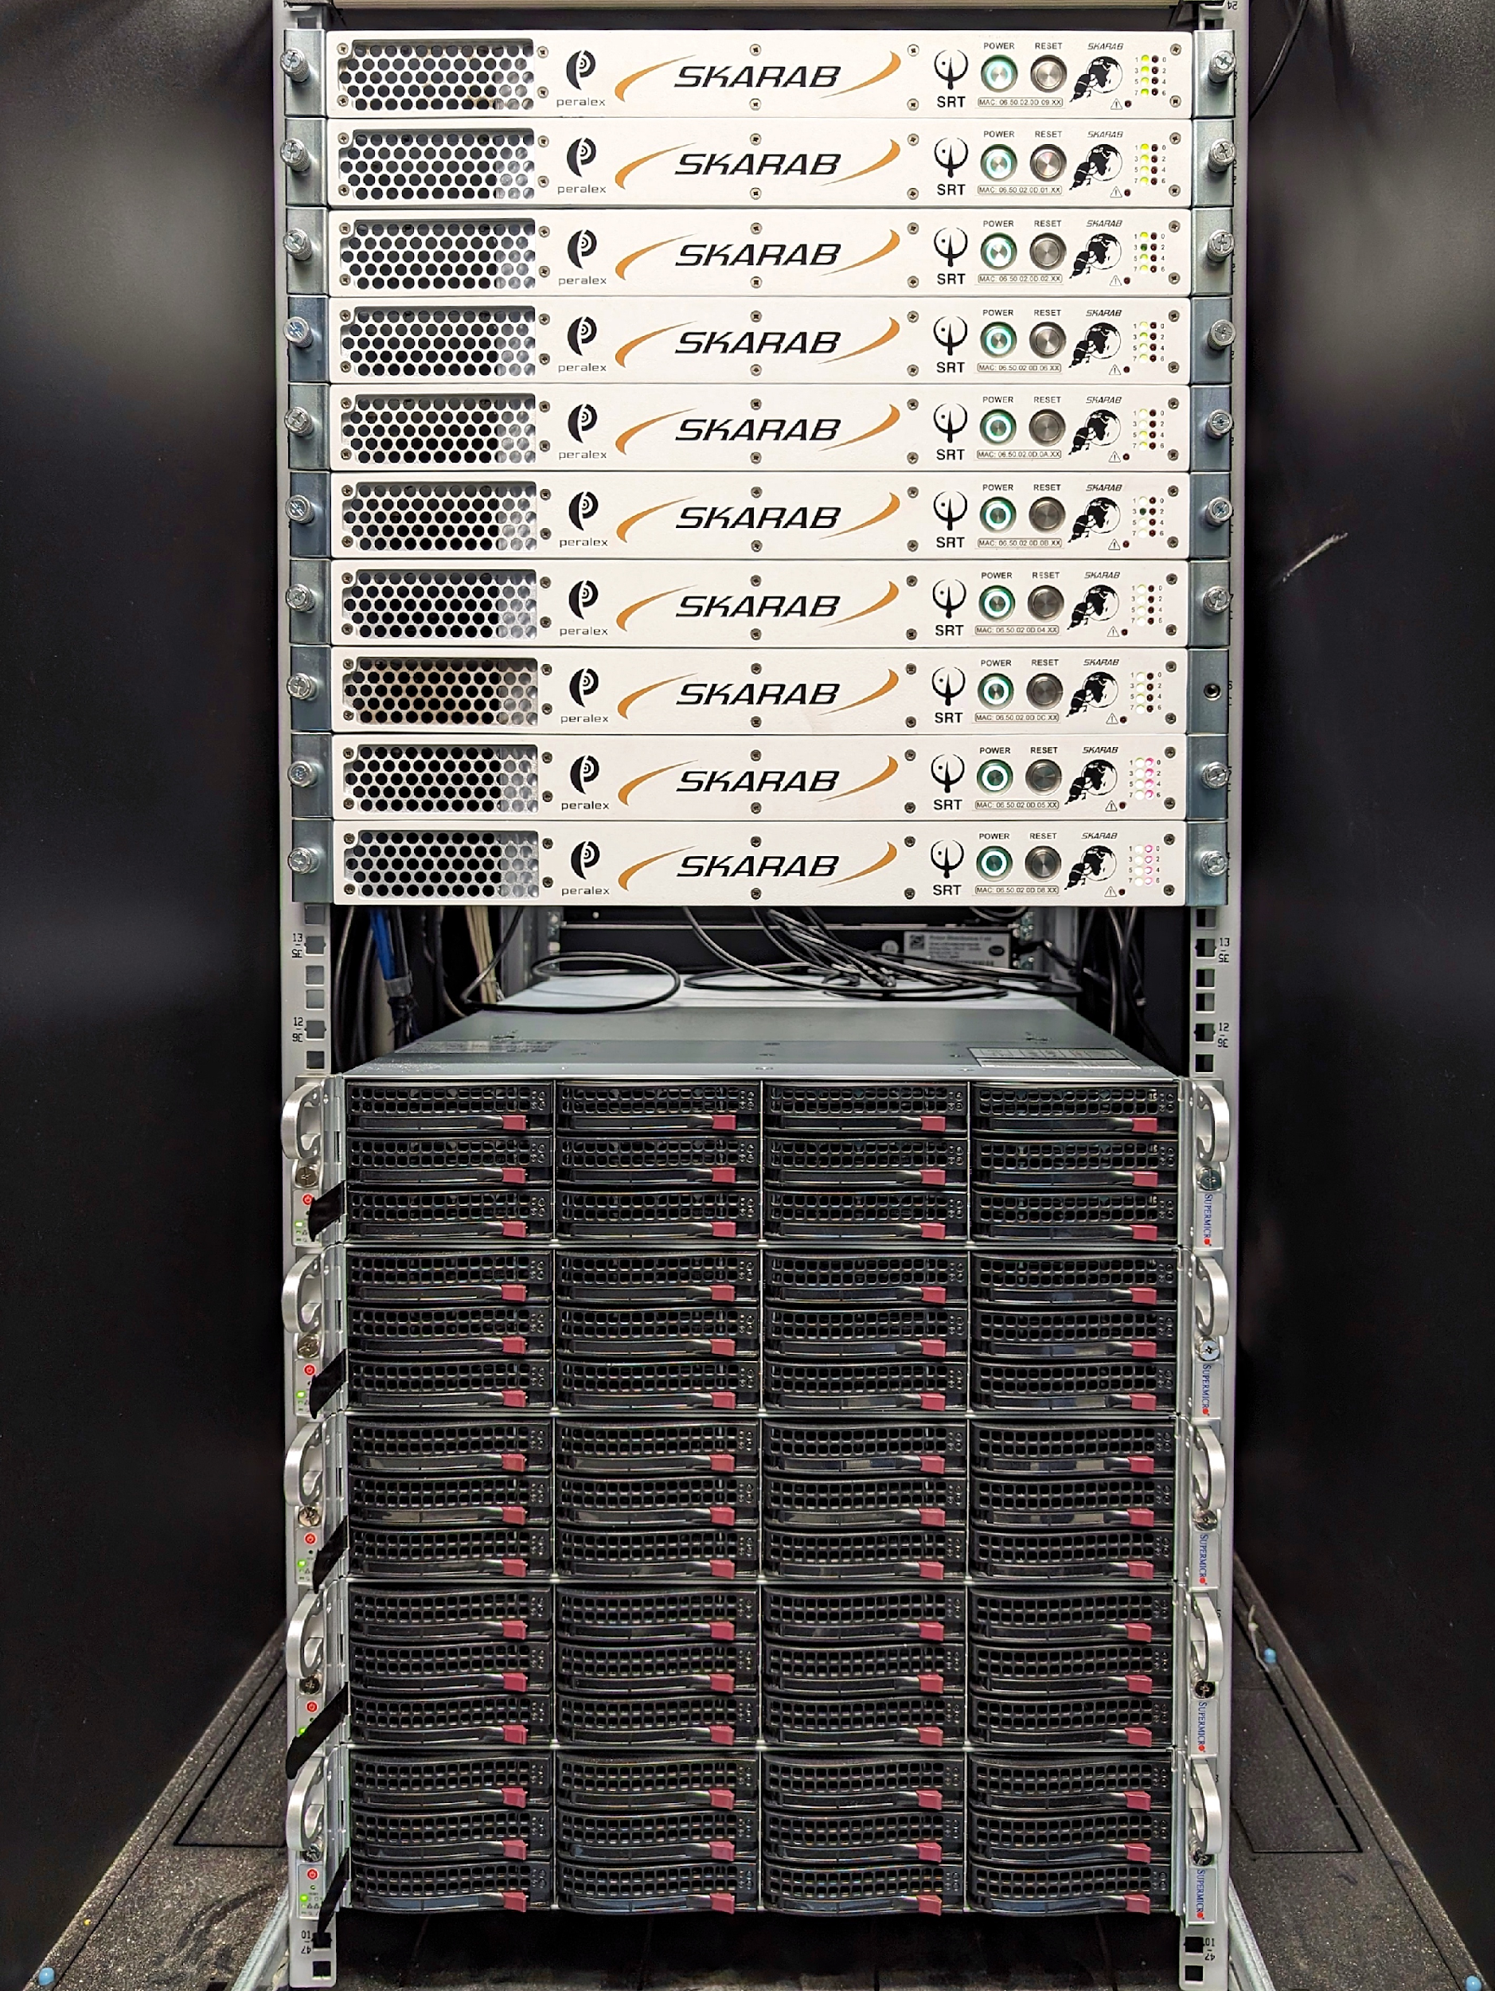
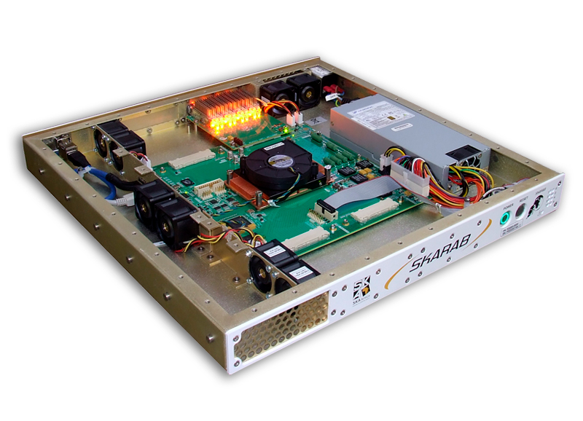
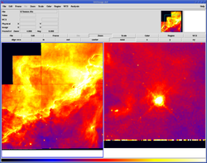

MUSKAS MUlti-feed SKARAB-based backend for the Sardinia radio telescope
DISCOS
NODATA FITS
SKARAB FRONTEND
UDP Packets
ACQ SW
SPECTRA FITS
MERGING
Medicina currently has a SKARAB board
Noto will have two SKARABs, purchased in the framework of the PNRR KM3
Notes:
Allineare le informazioni per tipo sui tre slot, integrazione antenne con il frontend aggiungere nei punti

Slide 10
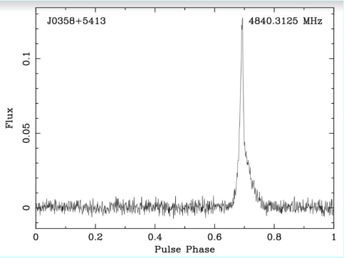
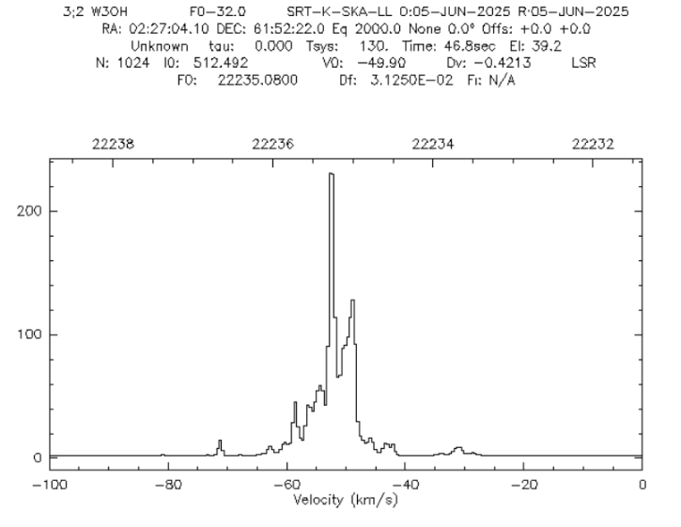
SKARAB
Pulse profile of B0354+54
Notes:
Allineare le informazioni per tipo sui tre slot, integrazione antenne con il frontend aggiungere nei punti

Slide 11
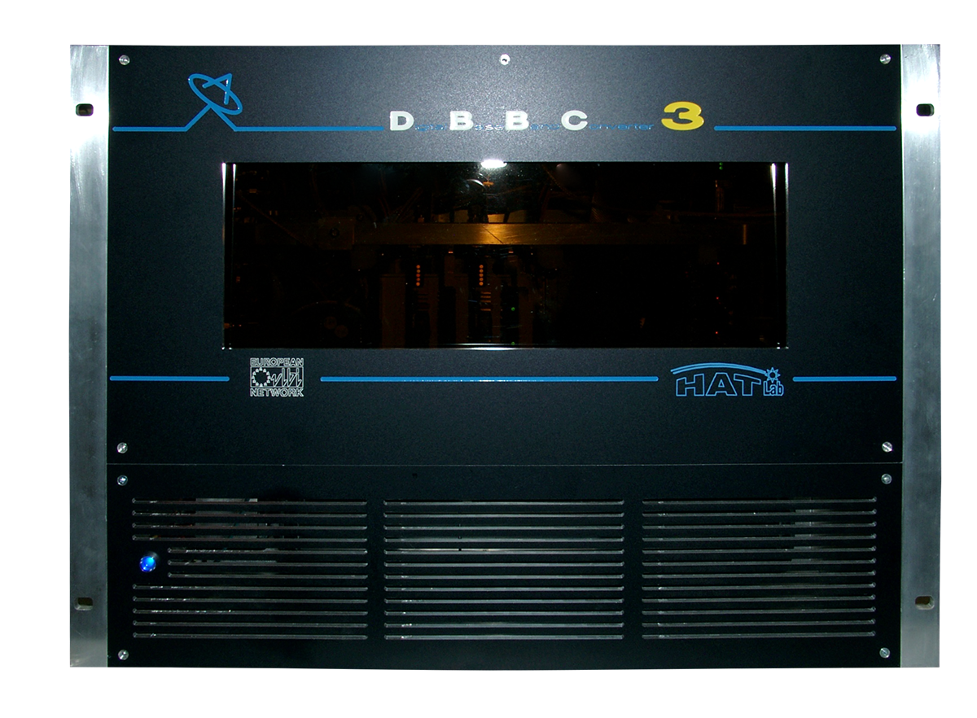
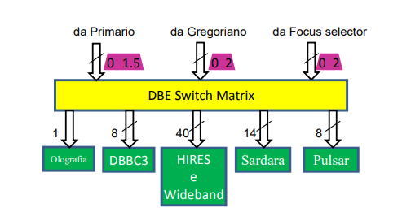
DBBC3
INAF has acquired DBBC3 backends for SRT, Medicina and Noto. The chosen acquisition was:
DBBC3 6L6H (6 IF)
Bandwidth 4096/2048/1024 MHz
6 port SFP+ (10 Gbps)
Recorder is a FLEXBUF with following configuration:
32 x 16 TB HDD 512TB.
4 SFP+ (10Gbps).
2 RJ45 (10Gbps)
Currently, the SRT DBBC3 is under upgrade at MPIfR with a new board to allow 8 IF to handle all the IF of the triple band receiver ( K, Q , W- low and Whigh)

Slide 12

Control Software
A common monolithic codebase (77%):
management (scheduling, observing modes)
subsystem bosses
user interfaces
libraries
Specific code coping differences among telescopes
Control Software for Italian Radio Telescopes
Based on ALMA Common Software
Distributed objects architecture
ACS component as the basic unit which performs tasks
Components expose interfaces to other components.
Developed by INAF
Team from IRA, OA Cagliari (A.Orlati coordinator)
> 800 K lines of code
Notes:
The word COMMON

Slide 13

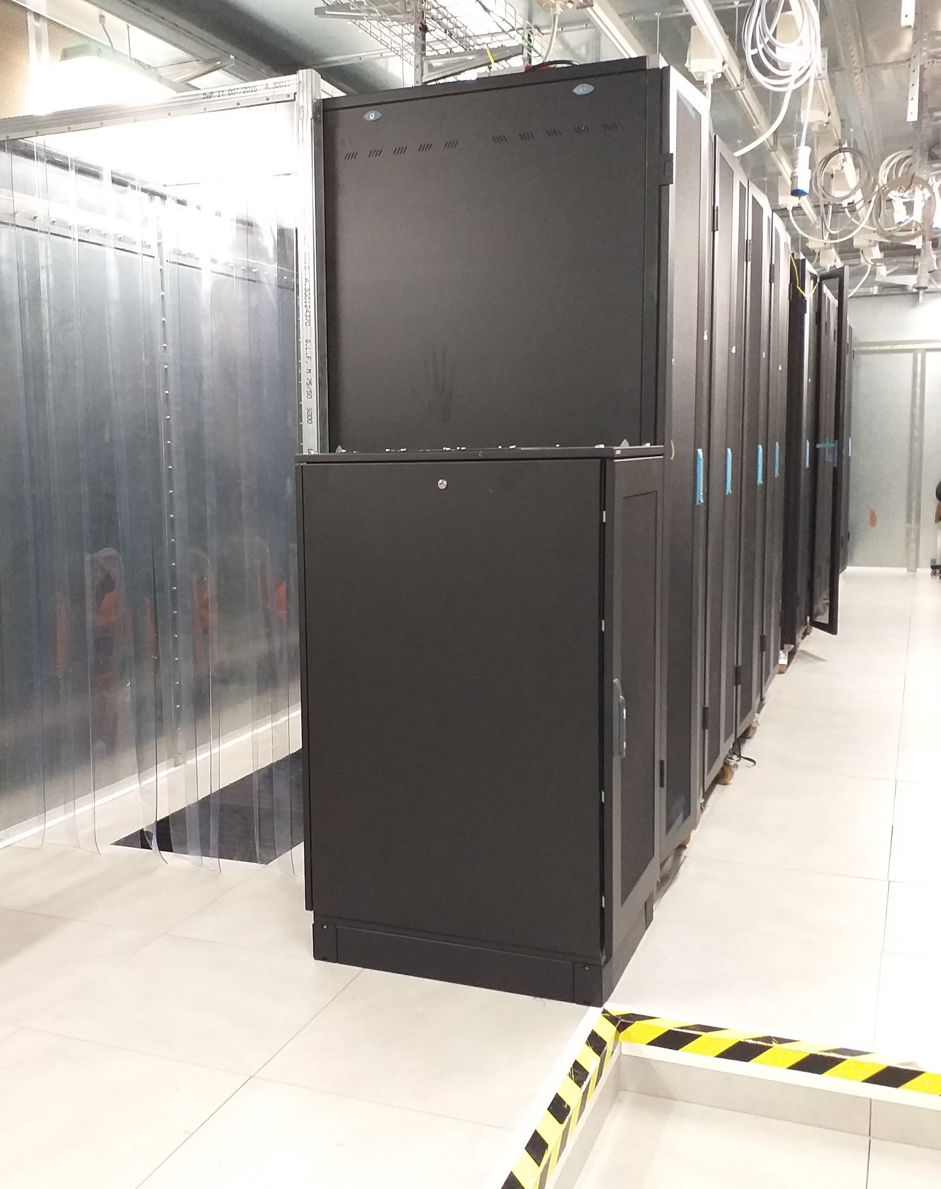

HPC at SRT
Category | Feature | Specification / Detail
Physical Infrastructure | Room Type | Shielded Room (Camera schermata)
 | Cooling & Containment | Closed Cold Aisle
 | Environmental Control | Temp/humidity monitoring via PLC equipment using Twincat
Power | UPS System | 80 KVA Redundant Uninterruptible Power Supply
Networking | WAN Connection | 10 Gbps
 | High-Speed Node | 100 Gbps (for the TeraBIT project)
 | Connected Devices | Over 400 devices (on 1/10/100 Gbps network)
Services & Systems | Core Services | Data and Telephony
 | Compute Resources | Virtualized Services Nodes
 | Monitoring (Operations) | Nagios (for critical equipment with email alerts)
 | Monitoring (Software) | monit
System | Total Nodes | Total Cores | Total RAM (Approx.) | Operating System(s) | Key Hardware / Purpose
DISCOS COW | 12 | 136 | 640 GB | CentOS 7.9 | Compute, Support, & Viewer nodes
Backend Cluster | 5 | 64 | 2.5 TB | Ubuntu 22.04 | Compute nodes with 2x Nvidia A40 GPUs each
HPC | 6 | 64 | 3.0 TB | Rocky 9.6 | Frontend & Compute nodes
Metrology | 7 | 116 | 1.15 TB | Win 11 / Rocky 9.6 | Windows & Linux nodes + 1 Viewer
Storage | N/A | N/A | N/A | CentOS / Lustre / ZFS | 36 TB SSD, ~750 TB HDD, 1.3 PB Long Term
Flexbufs

Slide 14

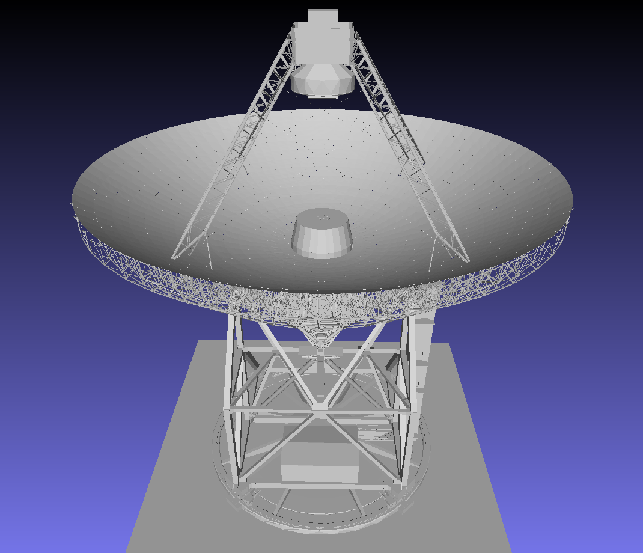
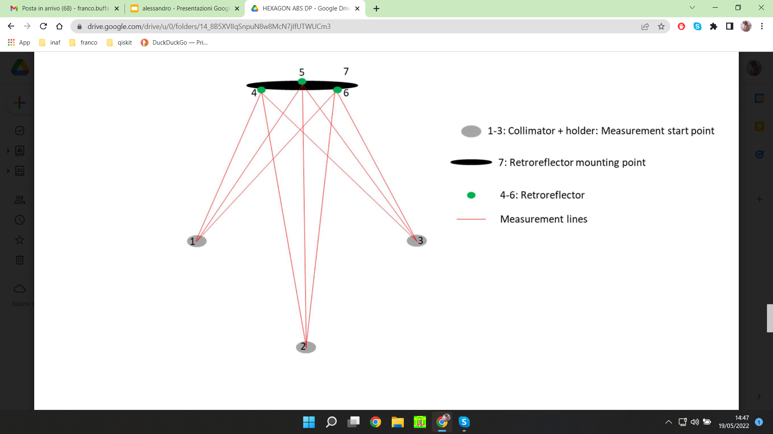
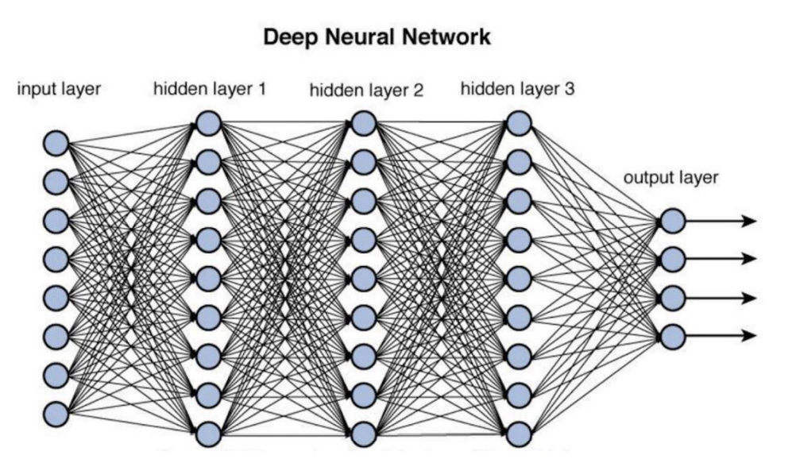
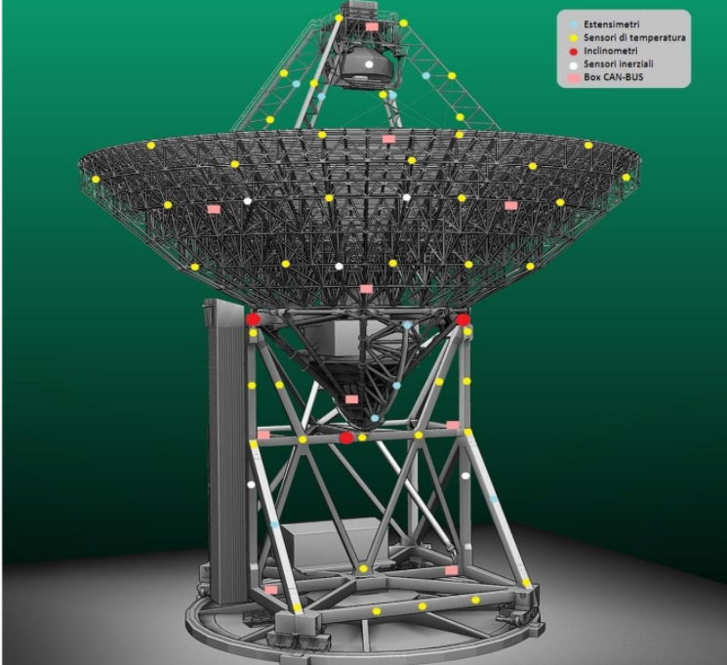



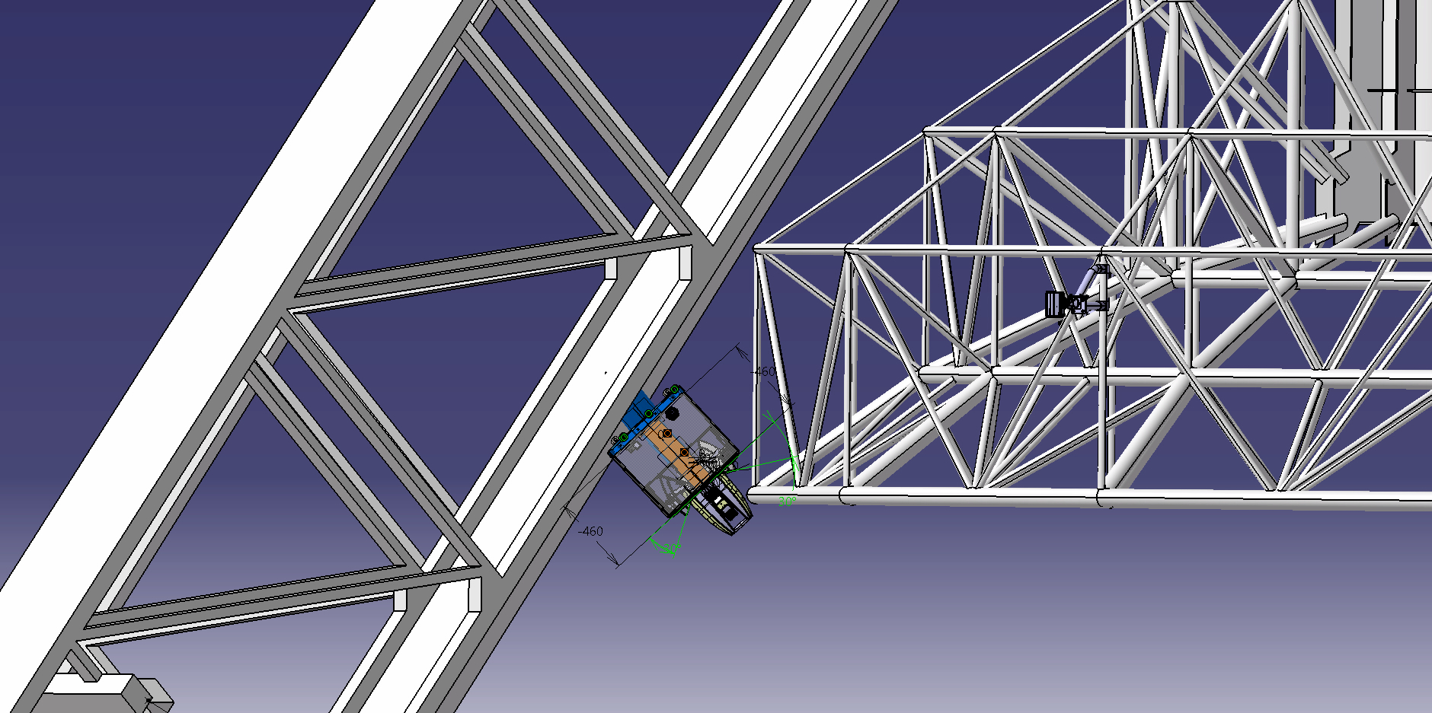
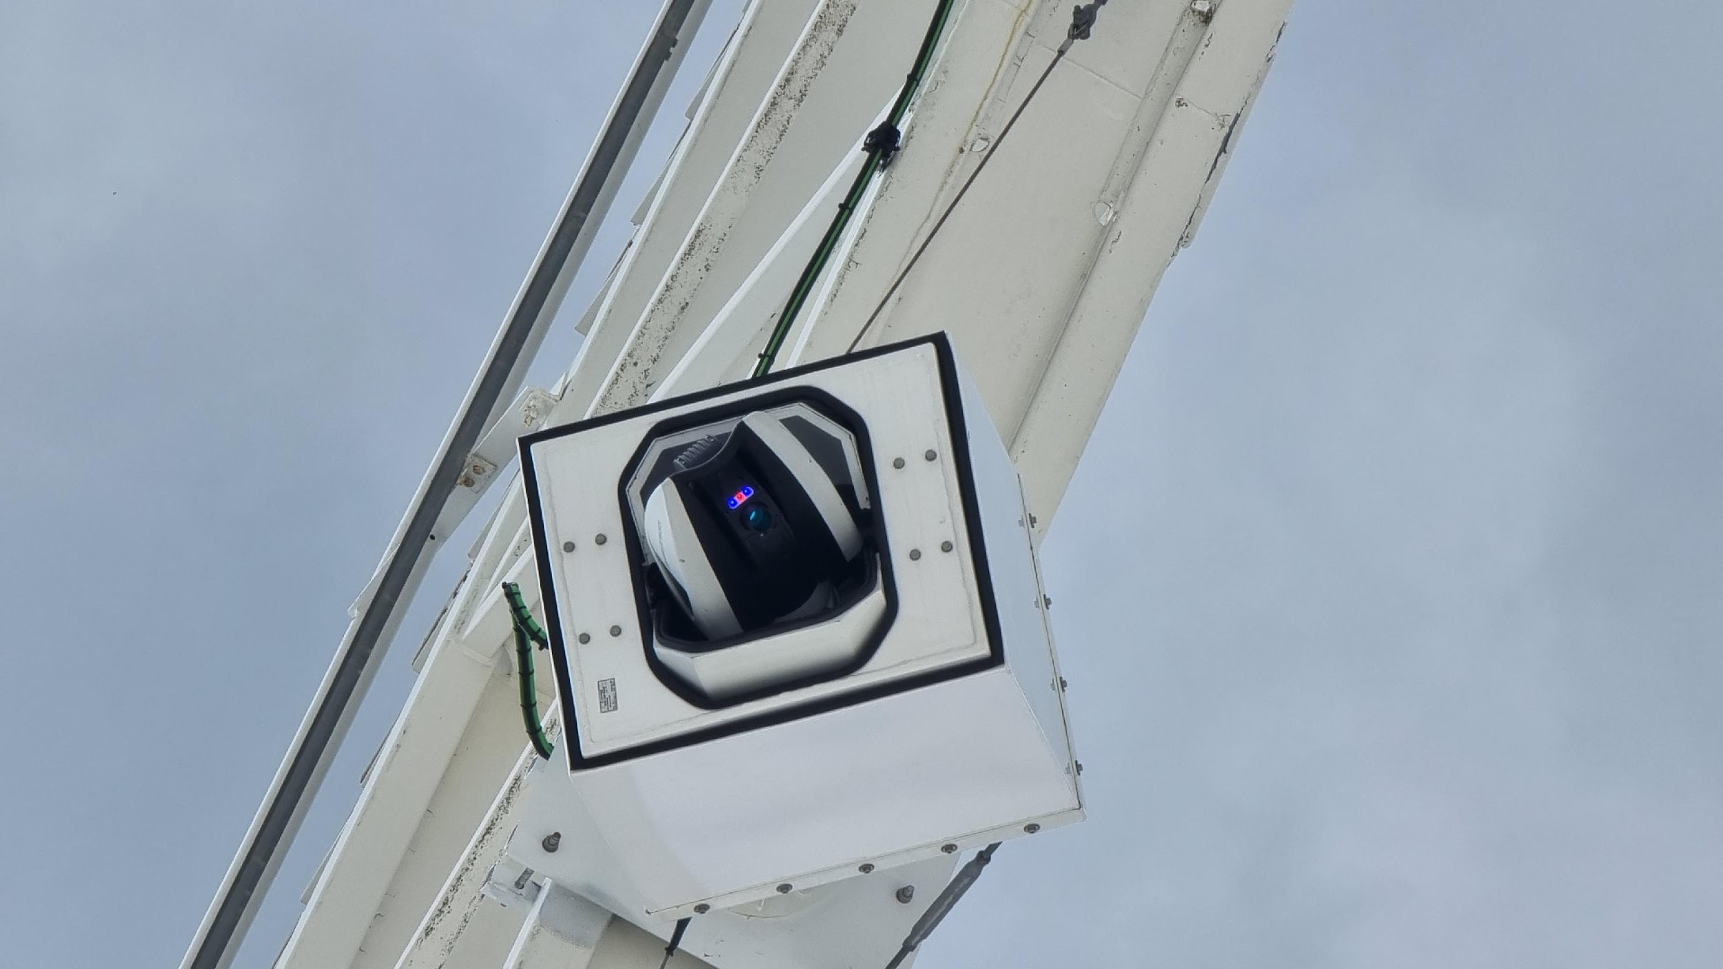
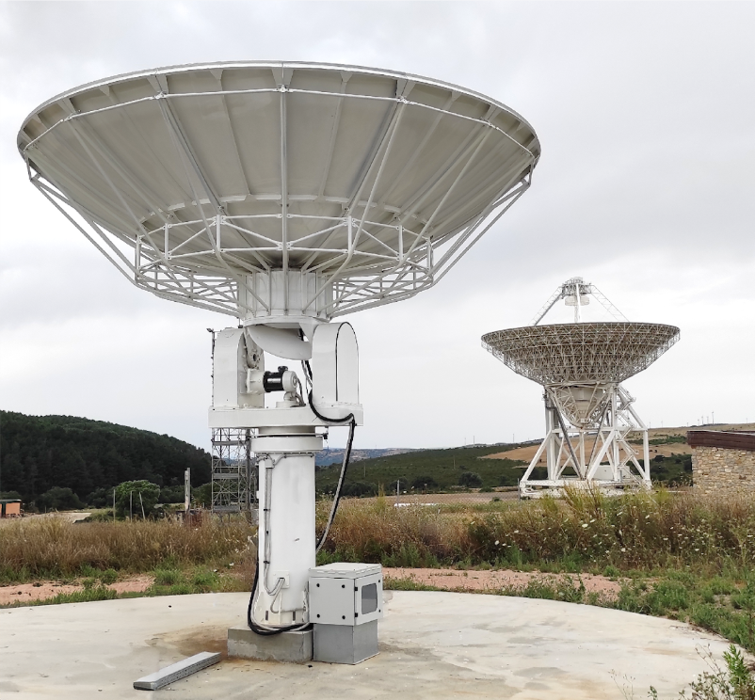

SRT Metrology System (SMS)
Sensor network
Multilateration system
Deformations model(Tensor flow)
Retroreflectors
Thermal sensors
Collimators
Measurement lines
Retroreflectors
mounting plane
Inclinometers
Laser tracker
Holographic system Reference Antenna (RA)
Accelerometers
5.2 meter f=22GHz
criocooled rx
Anemometers
Leica Absolute Tracker ATS600

Slide 15




















SMS Architecture
M2 KINEMATIC MODEL
M1 surface accuracy monitoring
NETWORK OF SENSORS
TRACKER
RA
Pointing errors correction
SRT
POINT-SET REGISTRATION
CORRELATOR \
HOLOGR. SW
NEURAL NETWORK-BASED DEFORMATION MODEL
MOTORS \
ACTUATORS
SRT CONTROL SOFTWARE

Slide 16
Prerequisites for commissioning
Optimal Weather
High Antenna Efficiency
Best Pointing and Focus
Opacity and ILW forecast
Metrology
Metrology / low frequency receivers.

Slide 17
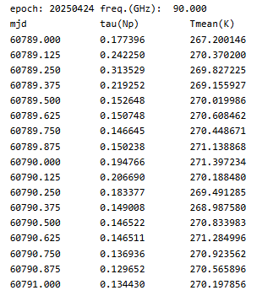
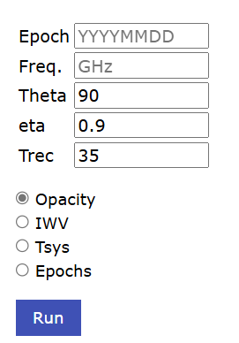
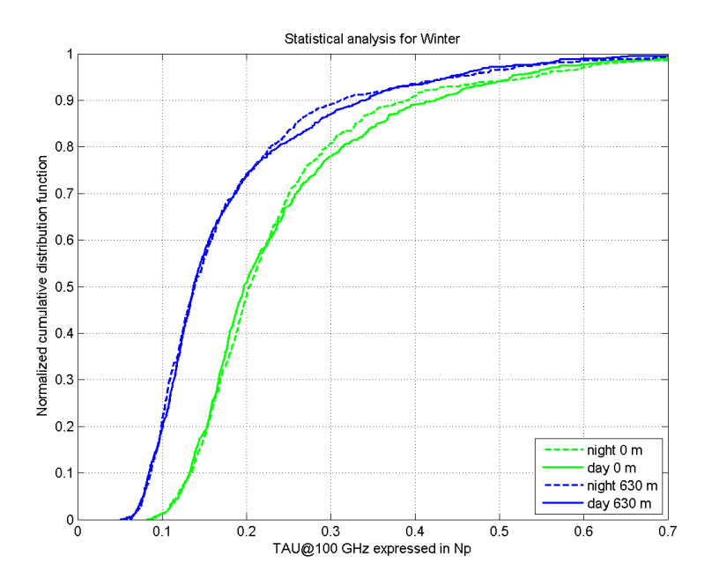
Atmosphere
From 50-year radiosonde data analysis, on average in winter: IVW < 15 mm.Opacity < 0.2 @100 GHz (50th perc.)
A nowcasting model allows tsys forecasts and Opacity

Slide 18
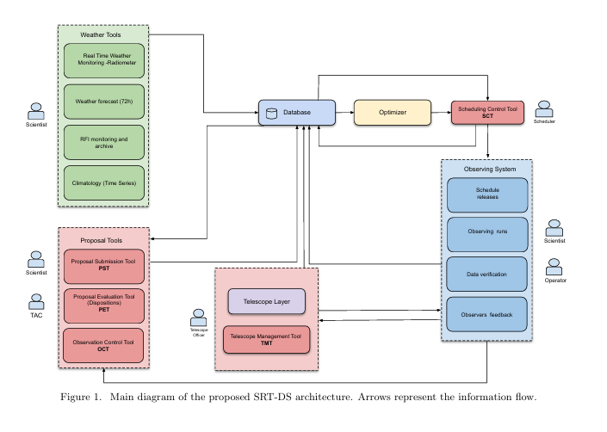
Dynamic scheduling
A dynamic scheduling system for SRT is under design/development (Mulas+ 2024)
Based on observing blocks (OB)
OBs prioritized by bayesian algorithms approach (Cabriolu+ 2024)
Not implemented (yet)
(Mulas+ 2024)

Slide 19
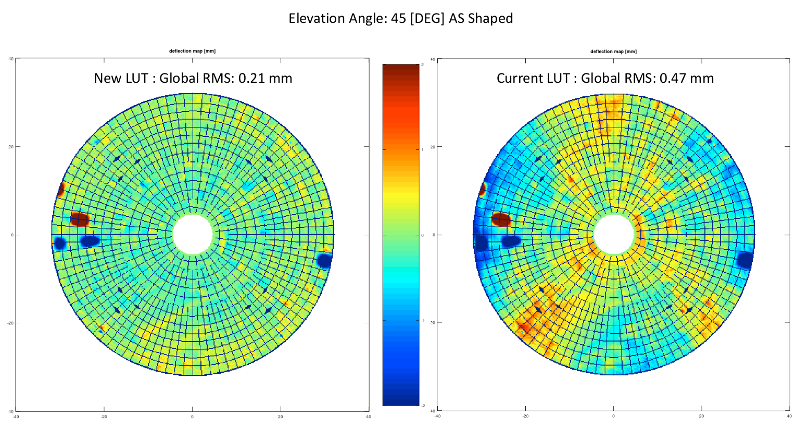
Surface Efficiency
Leica Absolute Tracker ATS600
The absolute tracker has allowed to improve le lookup table
of the actuators. This allow the active surface to keep aligned the main mirror.

Slide 20
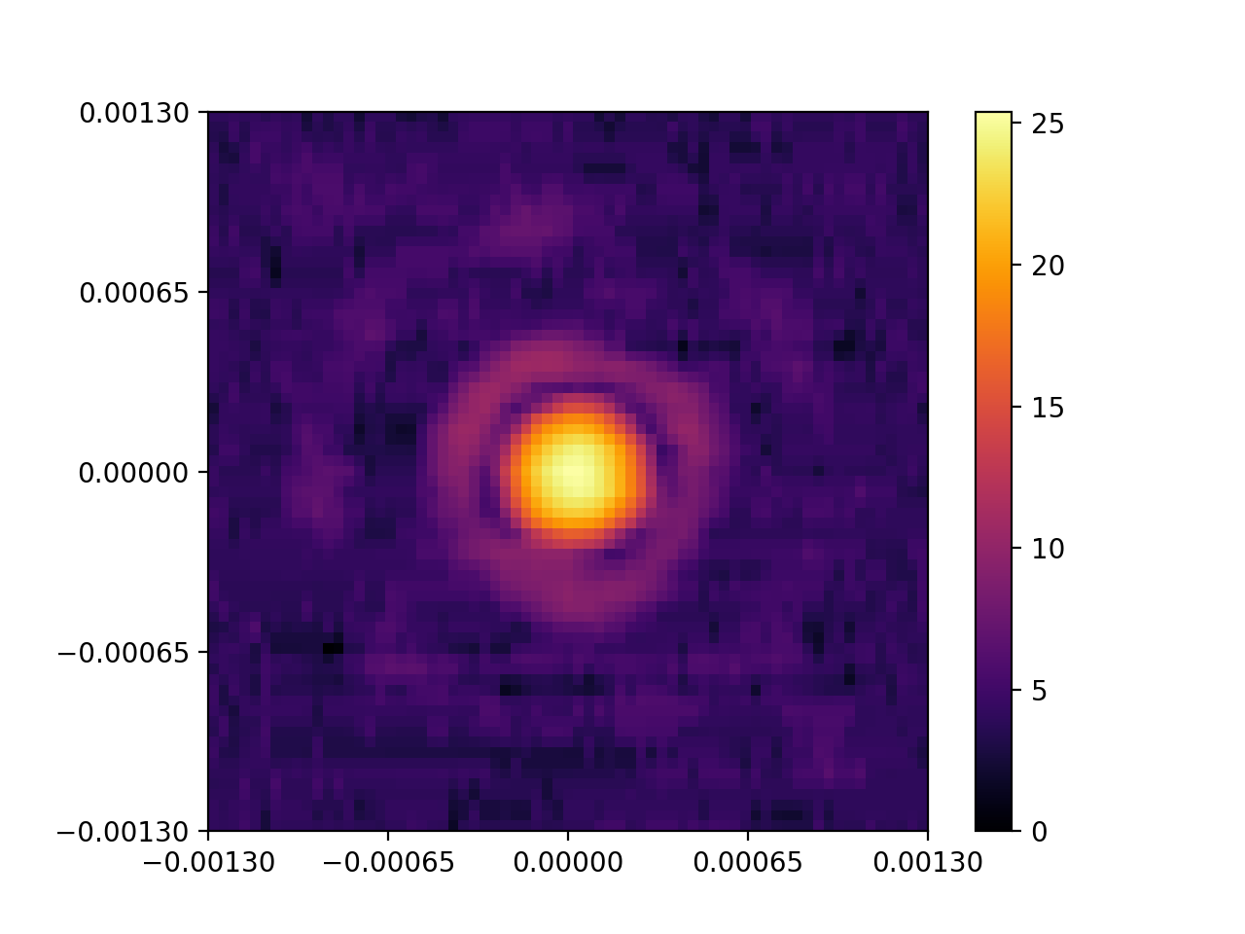
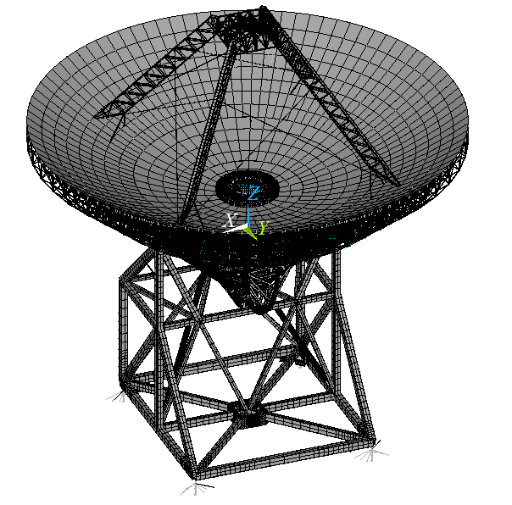
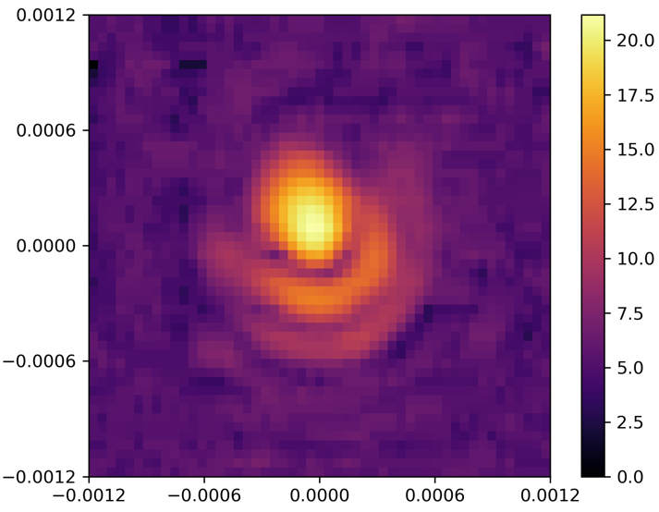
Beam shape optimization
Finite element modeling
M2 LUT
Pointing Model
Beam maps
The FEM has modeled the translations of the subreflector (M2) along the Z, X, and Y axis
The translations as function of the elevation are the lookup table for the control software to track the subreflector
Lateral shifts of the subreflector make pointing offsets to be kept into account in the pointing model
Correct alignment is verified with beam maps when aberrations are minimized.
Z
X
Y
(SRT Metrology group)

Slide 21
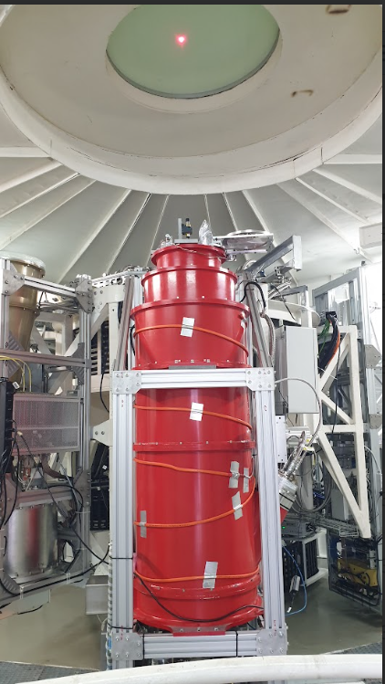
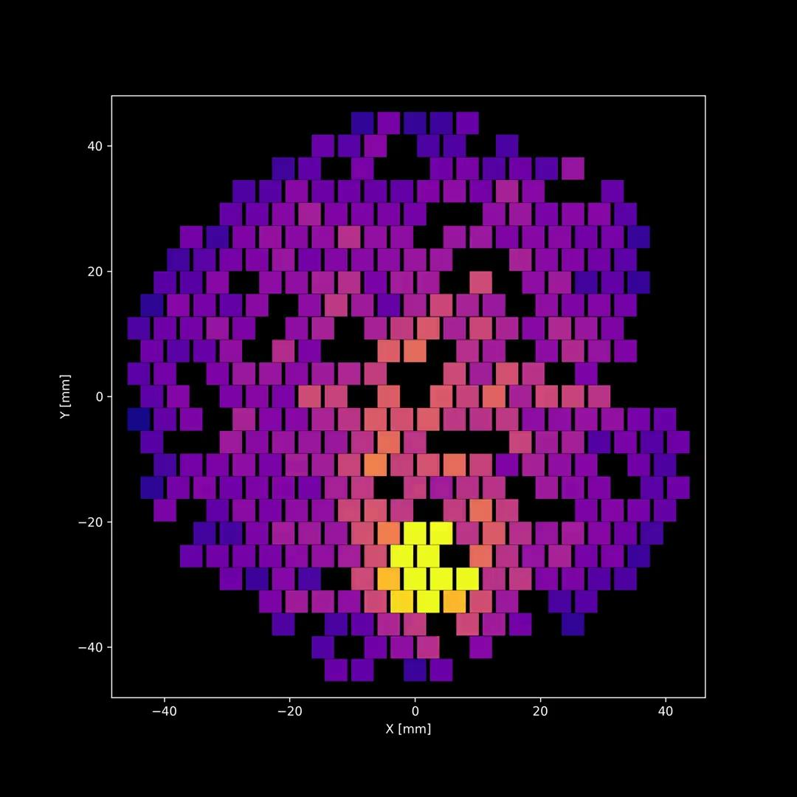
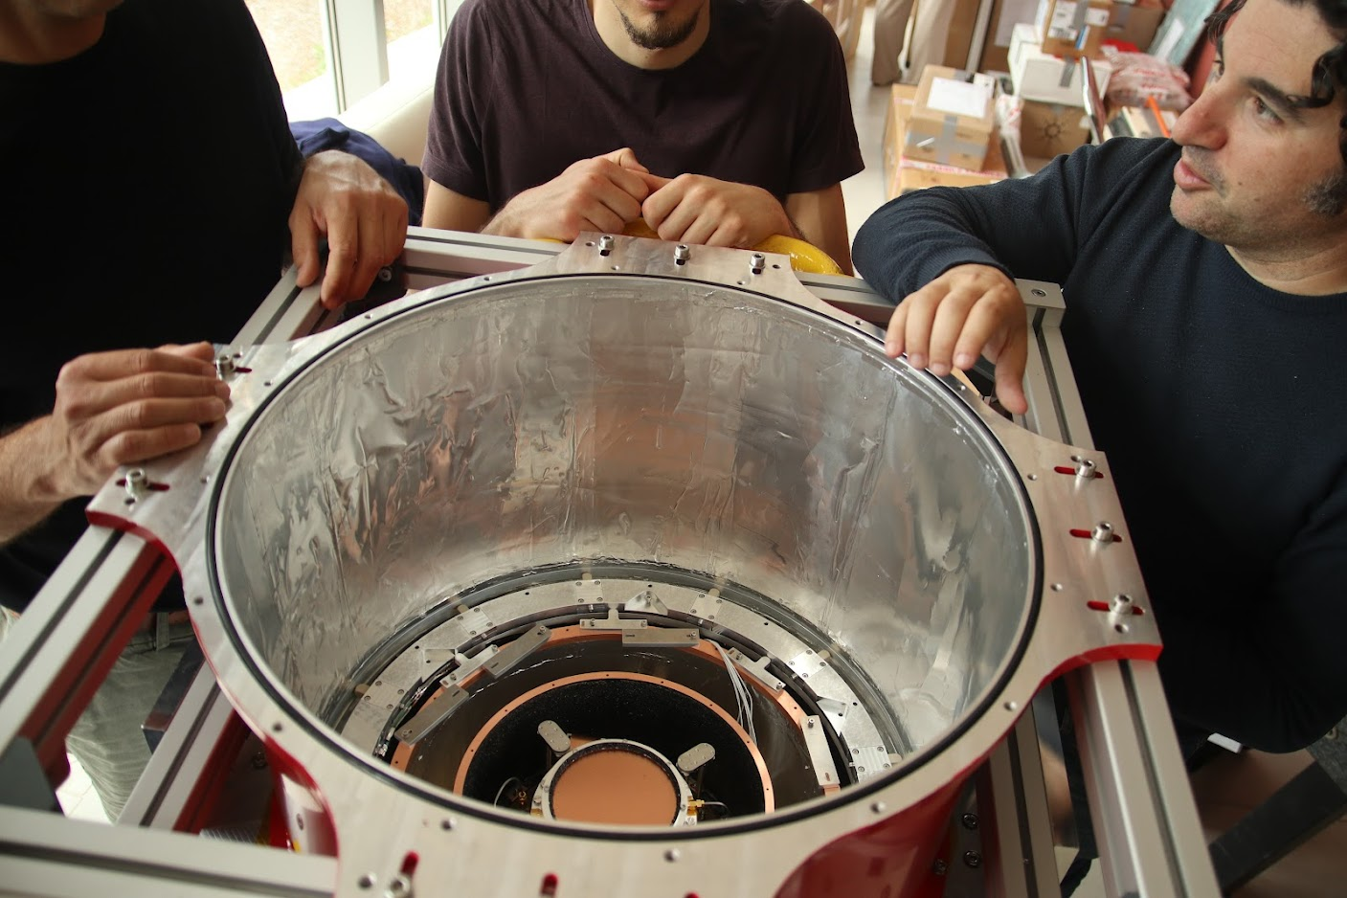
Mistral commissioning
Lumped elements Kinetic inductance (KIDS) receivers developed by Università di Roma La Sapienza.
Detector Layout: 415 pixels, bandwidth: 30 GHz centered at 90 GHz; Field of View = 4 arcmin Cooled at 200 mK
Main science cases: Measurement of the Sunyaev-Zel'dovich (SZ) effect in galaxy clusters and filaments, Spectral Energy Distribution of external galaxies, surveys of star forming regions.
Mistralcommisioning team: INAF and Università La Sapienza

Slide 22
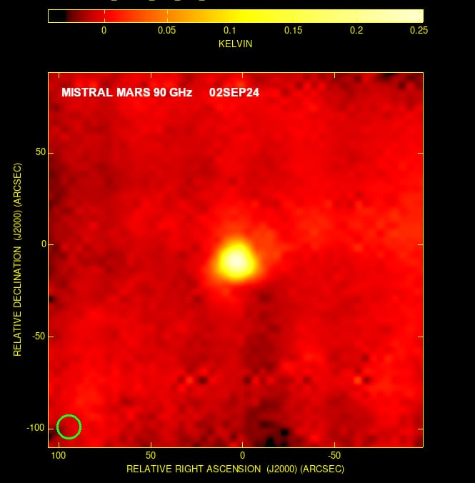
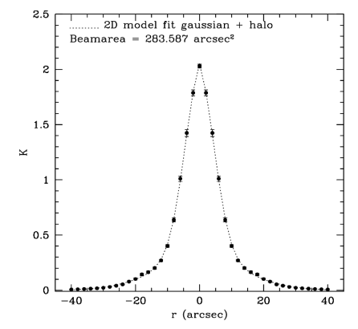
Mistral parameters
Commissioning of Mistral has allowed to verify the stability of the cryogenic system (detectors at 200 mK)
Beam size of each pixel is in line as expectations (12 arcsec; Barbavara+ 2025)
Antenna gain is lower than expected (surface efficiency issues (not working actuators, atmosphere issues like anomalous refraction…)

Slide 23
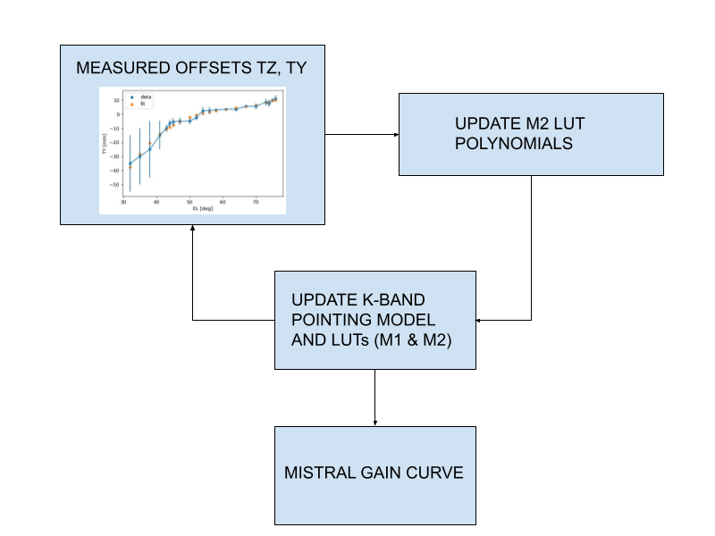
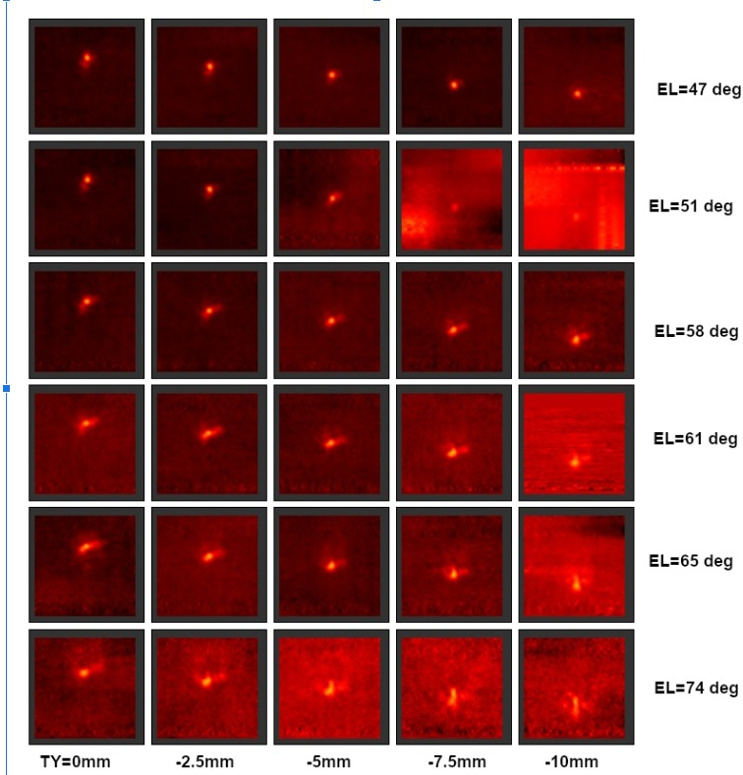
MISTRAL Focus and Pointing
Z
X
Y

Slide 24
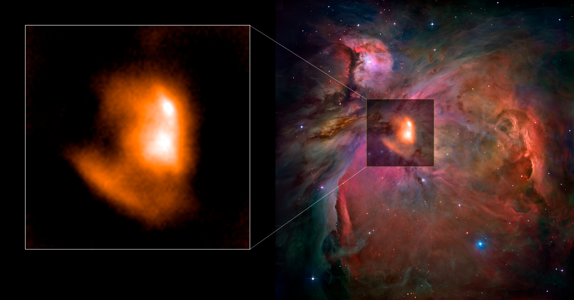
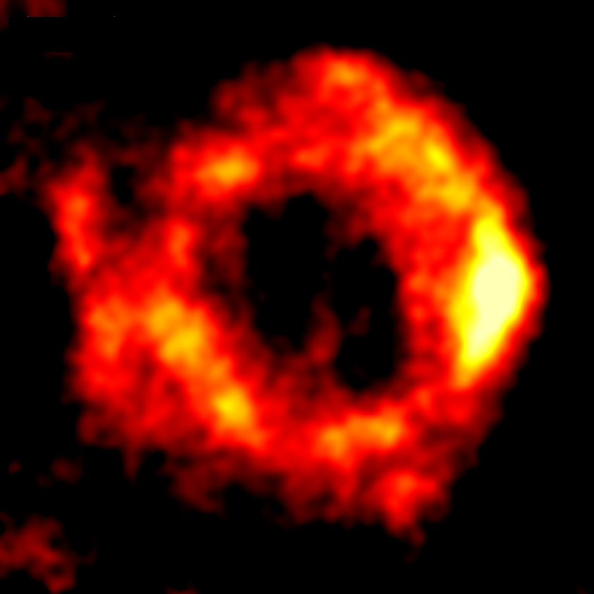
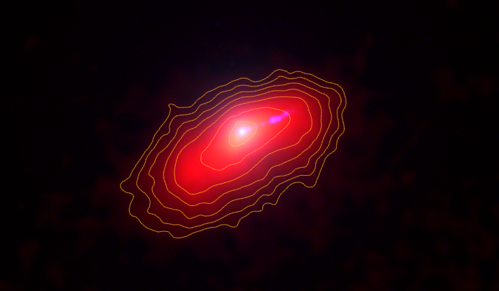
Mistral first light

Slide 25
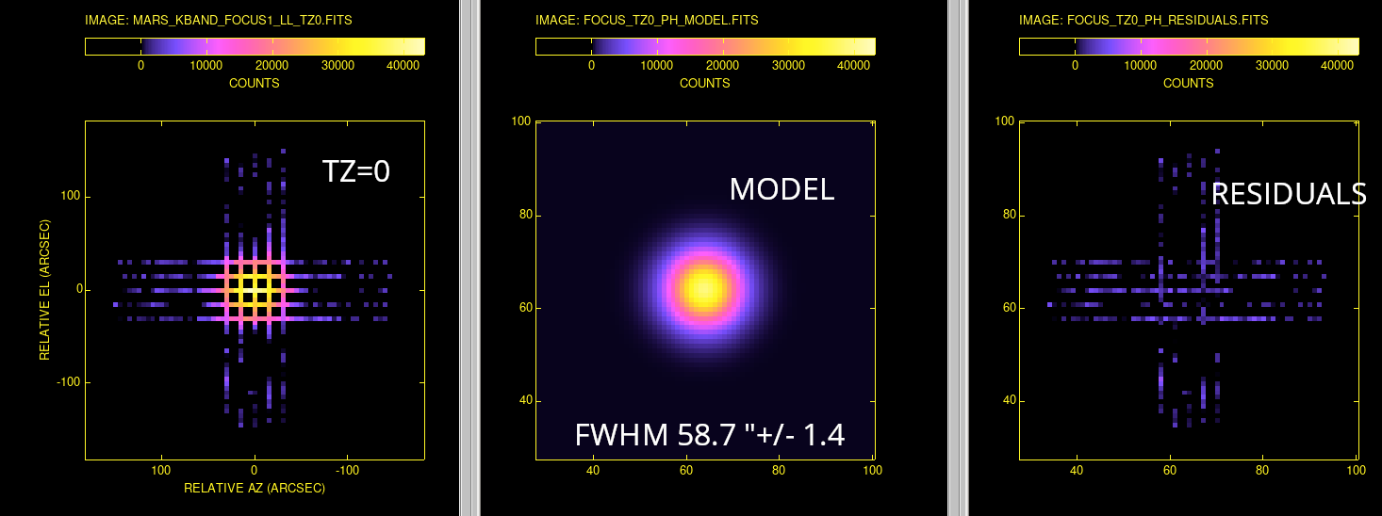
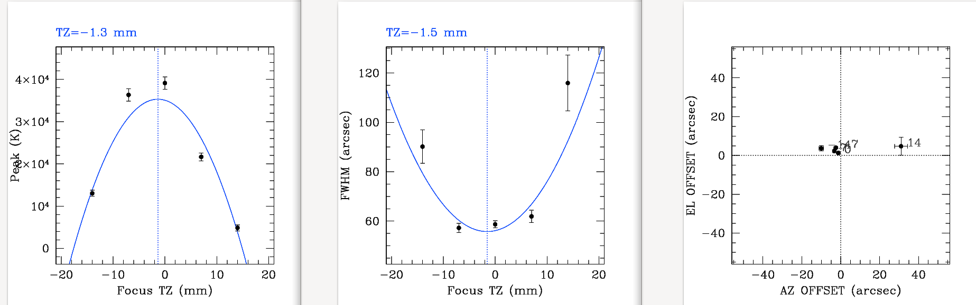
Triple band receiver focus

Slide 26
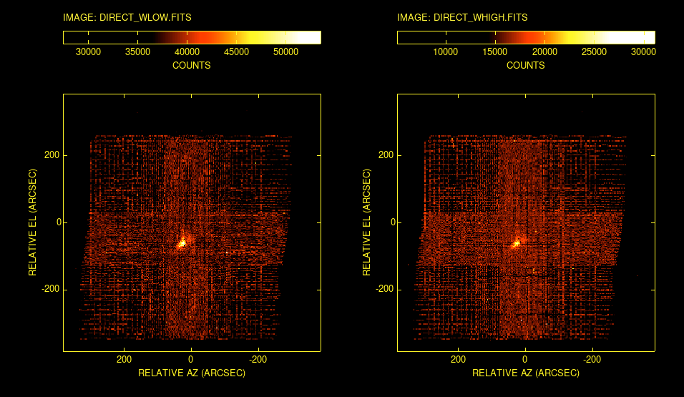
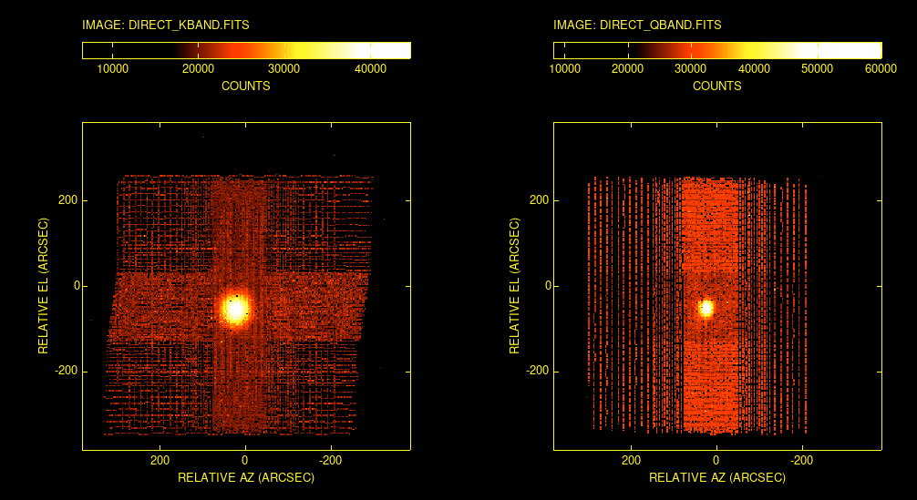
Triple band receiver: beam maps

Slide 27



Triple band receiver: noise calibration

Slide 28



QBand
Fully designed and developed at INAF.
19 dual-polarized pixel in a hexagonal lattice feed system (33-50 GHz).
Installed on SRT
Commissioning depends on full down conversion which is not yet completed

Slide 29


CARUSO
Developed by UK Research and Innovation (UKRI).
4x4 (square lattice). Dual-linear polarization with RF band: 70-116 GHz.
Angular resolution HPBW 12 arcsec at 93 GHz / angular separation between contiguous feeds: 43 arcsec
Custom W-band MMIC amplifiers and sub-harmonic image rejection mixers cryogenically cooled at ≈20 K
Expected Single Side Band receiver noise temperature <60 K;
Mechanical derotator to track the parallactic angle
The receiver is under maintenance to fix issues from first tests at SRT.
Same issues for downcoversion as the triple band receivers and the Qband

Slide 30
Conclusions
The PON project has allowed to extend the SRT capabilities to the frequencies it was designed to work up to.
Commissioning of MISTRAL and first tests on Triple band receivers are giving encouraging results about the performances SRT at high frequencies.
Improvements can arrive from commissioning of the whole metrology system: the holographic system can give accuracies beyond the limit of the accuracy of the Laser tracker
Atmosphere characterization is fundamental and also dynamic scheduling.

