Slide 1
Prospects for sub-mm astrometry with the updated EHT
Bona-Fide Astrometry in (sub-)mm-VLBI
Allows image registration
Richard Dodson (ICRAR)
Maria J. Rioja (ICRAR/OAN-IGN)
Notes:
I thank the organizers for the invitation to talk about astrometry with next gen inst and the opportunity to discuss the results reported in recent papers.
Astrometry at the very highest of frequencies is an unexplored frontier for VLBI observations. Astrometry is equally vital to connect observations at different times and different frequencies. The former is used for measuring proper motions and parallaxes to derive distances to the targets - and thus their physical characteristics. The latter is to reference two images at different frequencies together, which is equally important. No spectral index or rotation measure is valid if the observations are not registered. One of the exciting new facilities that will be available shortly is the updated Event Horizon Telescope (EHT-2030). The plan is that that multiple frequencies will be observed simultaneously; 86-, 230- and 340-GHz. Multi-frequency observations result in a transformational boost in the capabilities of the EHT, providing the vital phase referenced registration between frequencies. We will describe how this new capability will allow ultra-precise bona-fide astrometric studies, based on simulations. We will report on our first attempts to apply frequency phase transfer at mm-wavelengths (86 to 230GHz); three demonstrations have been made, two of which are now published and the third is being correlated. These are allowing to demonstrate the potential and to discover the hidden issues to be addressed.

Slide 2
Outline
Challenges for mm-VLBI
Drivers – limitations in EHT and Science Drivers for mm-wave Astrometry
Low frequency Demonstrations
High frequency Simulations
High frequency Experimental demonstrations of FPT and steps towards SFPR
2
“The unified theory of everything”
Where we come from
Where we are going
Ultra Precise Astrometry with SKA-VLBI
“MultiView” Fact Sheet:
Feasibility
Case studies
“SFPR” Fact Sheet:
Feasibility
Case studies
Notes:
Will review Challenges & Drivers with lower freq demonstrions, simulations and now baseline high freq demonstrations

Slide 3
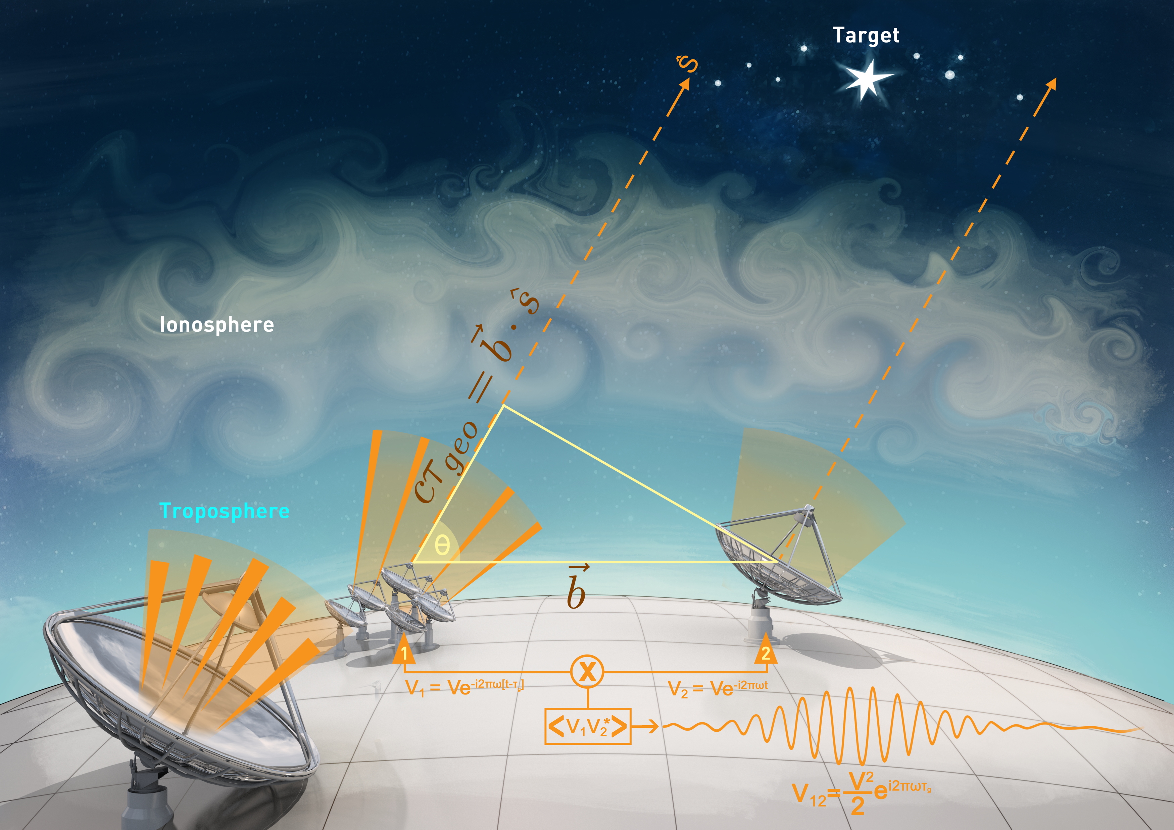
Challenges for Astrometry at high freq.
For Phase Referenced observations (and thus astrometry)
The reference observations need to provide a valid solution
for the target. I.e. has temporal and/or spatial coherence
The higher the frequency the harder the former (due to the troposphere)
Equally the longer the wavelength the harder the latter (due to the ionosphere)
From: Rioja & Dodson, 2020, AARv
That is: the troposphere has short temporal coherence and
the ionosphere has short spatial coherence.
Of course, this is not strictly true: it is worse than that.
The troposphere/ionosphere is dominated by temporal/spatial changes
But the other term exist. (see Asaki etal 2007 or Rioja&Dodson 2020)
Notes:
Summary of challenge
Astrometry at the very highest of frequencies is an unexplored frontier for VLBI observations. Astrometry is equally vital to connect observations at different times and different frequencies.
Astrometry is vital to connect observations at different times and different frequencies. The former is used for measuring proper motions and parallaxes to derive distances to the targets - and thus their physical characteristics. The latter is to reference two images at different frequencies together, which is equally important. No spectral index or rotation measure is valid if the observations are not registered.
Astrometry requires the reference solutions to be temporally and spatially coherent.
Hard at the high and the low freq

Slide 4
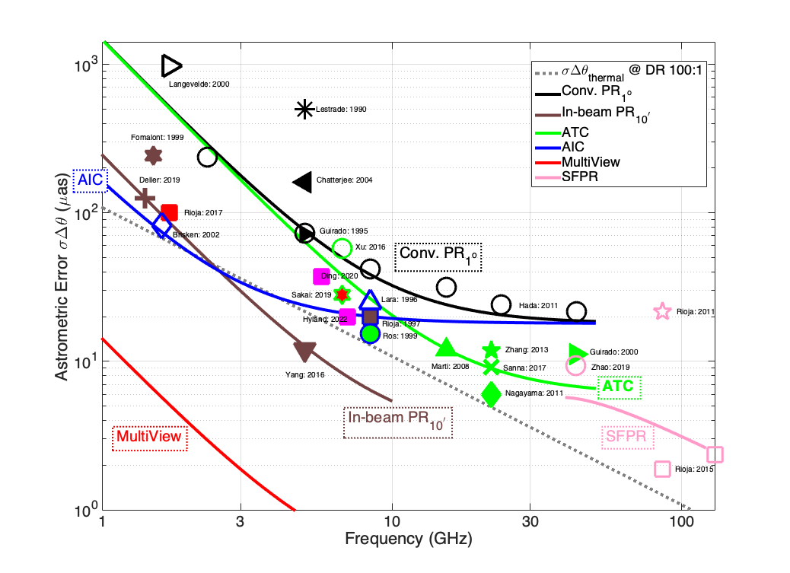
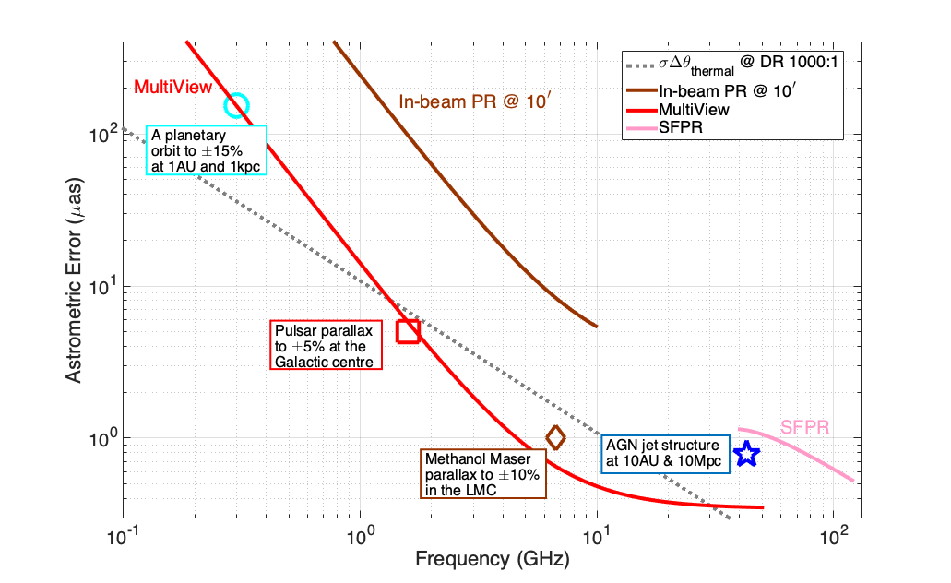
In NextGen telescope Era
TODAY
GOAL: Extend astrometry to highest VLBI regimes
As seen in Maria Rioja’s talk
Thermal noise matching
with in-beam (at 10’)
but far greater than
MultiView (at 30’)
100μas
100 μas
For SKA
DR 1000:1
in-beam is far greater
than thermal noise,
but MultiView matches
10μas
Measured (MWA)
ionospheric residuals
Thermal DR 1000:1
10 μas
Measured (SMA)
tropospheric residuals
1.6 GHz
1 μas
Thermal noise limited astrometry
EHT-2030
Also frequencies far lower
SKA-Low
SKA-Mid
ngVLA
From: Rioja & Dodson, 2020, AARv
8
Notes:
We will have ~2 orders of mag improvement in thermal sensitivity, but this does NOT directly improve the astrometry.
Most current observations are SYSTEMATICS limited, so we focus on METHODS
This can provide ultra-precise astrometry on ground and space and radio frequencies
Where we are today, with themal ~ matching in-beam
Future leads us to:
1) Next-Gen. Huge increase in sensitivity (very small thermal noise errors), potential for 10 micro-arcsecond astrometric accuracy at L-band
Requires matching calibration of ionospheric systematic effects
2) MV curve is based on MEASURED residuals from MWA and SMA
MV can achieve 1uas with 3 cal sources within 1 deg of target, widely applicable to many targets and at a wide range of frequencies (m to (sub)mm waves)
3) SFPR curve is based on STATIC iono residuals and wide-separated (5deg) second source
SFPR will target DR 100:1 and deliever 1uas. Improved residuals would improve performance
we argue ngEHT is capable of ultra-precise astrometric measurements, potentially reaching 1-microarcsecond. Therefore opening up new innovative high-impact science possibilities.

Slide 5
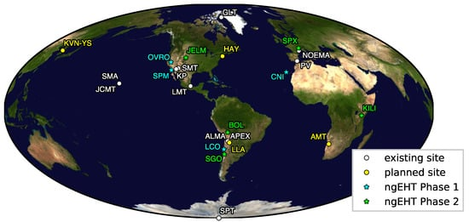
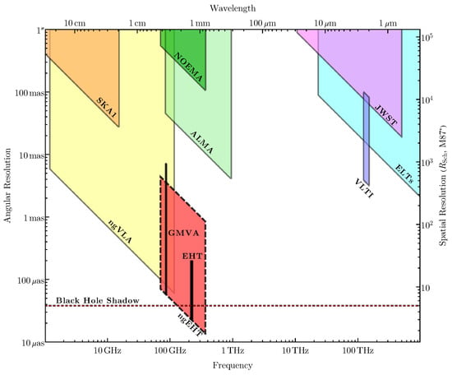
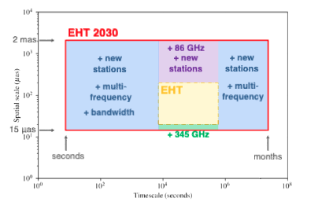
EHT transformation into 2030
Triple band also provides everything needed for astrometry
More antennas
(less optimal sites)
proposal addresses these issues:
UV-coverage
Frequency Coverage
Temporal Coverage
Provided by triple band
Resolution (inner and outer)
EHT: uv response 20uas to 100uas
→More antennas (10+)
Frequency range
Higher freq – higher resolution
→Triple band (86, 230, 340GHz) - better calibration
Response time
Low freq – all year observing
Dedicated array – movies of M87 (20day)
Snapshot uv-coverage – movies of SgrA* (20min)
Greater freq coverage
(& allows cross calibration)
See Michael Johnston’s paper: Key Science Goals for the Next-Generation Event Horizon Telescope ‘23
Notes:
ngEHT addresses the (huge) limitations of the EHT
In uv coverage, in Frequency Coverge and in Temporal sampling
First from More antennas. from 100 to 20 uas to 2000 to 15uas
Second from the triple band. More science and much better imaging
Third from more and dedicated antennas

Slide 6
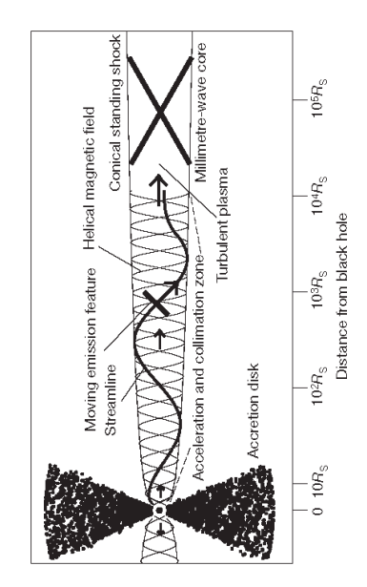
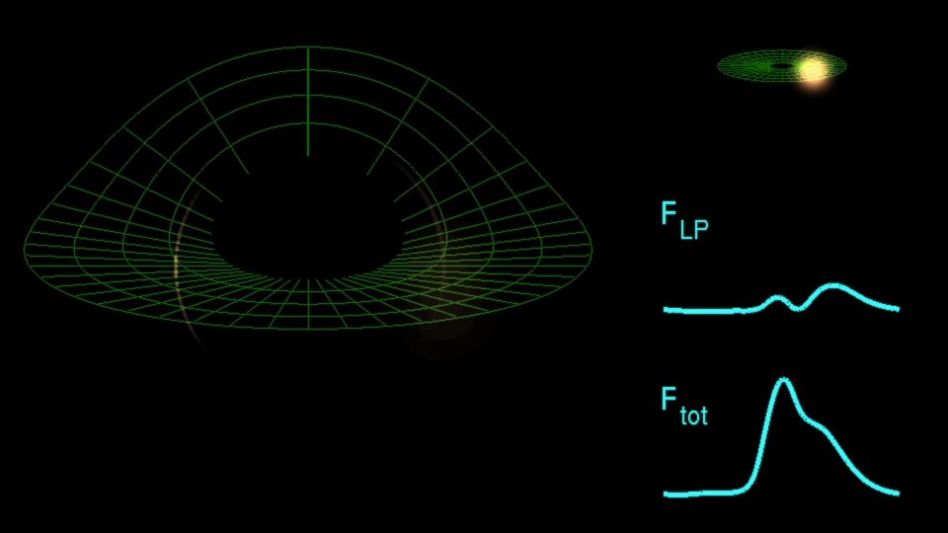
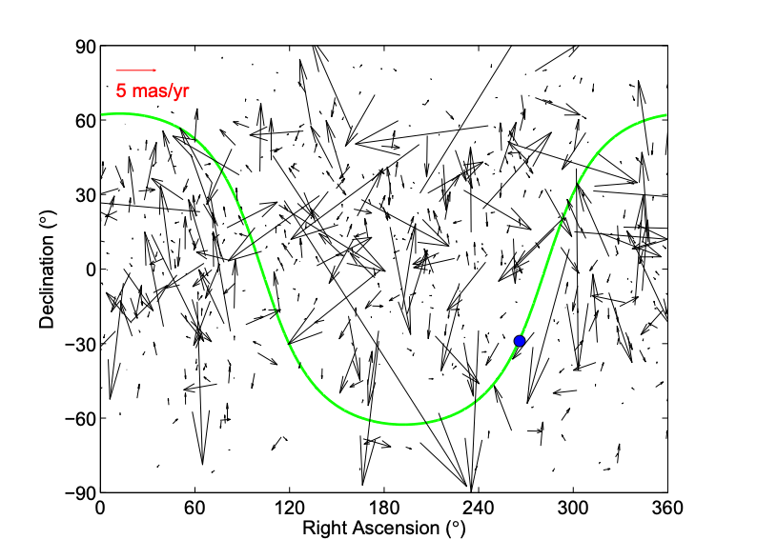
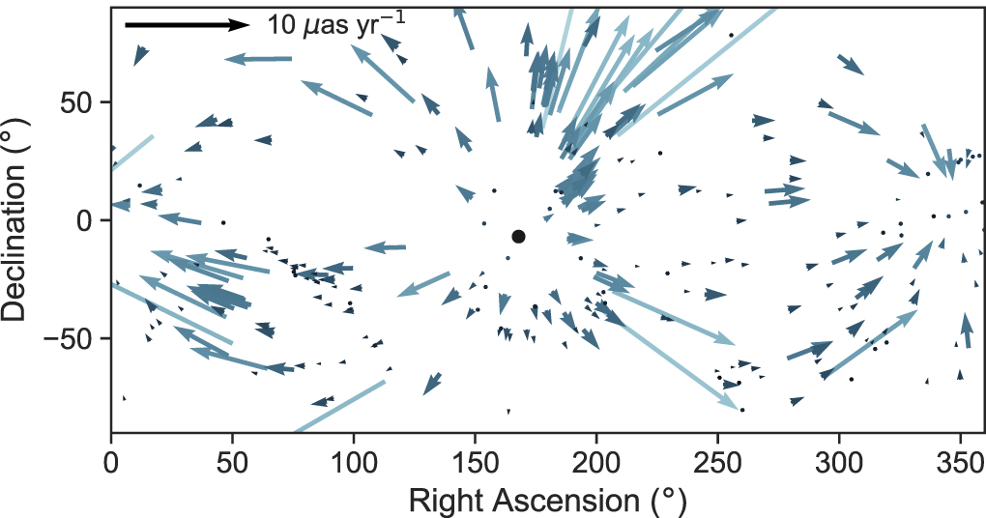
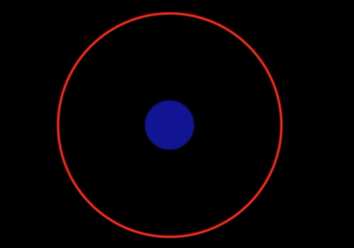
Drivers for PR at sub-mm wavelength
Offset between Foot of Jet and true Black Hole location
SFPR between 86 and 340GHz will provide bona-fide astrometry
Low risk
Long term quest
Structural Variability
Marscher 1998
Astrometry cases for sub-mm VLBI require SFPR and MV techniques
What is the progress of these at high frequencies?
EHT Coll.: Broderick, Loeb
(Sim.) Phase Referencing can break degeneracy between Structural and Atmospheric variability
Vital for SgrA*
Does not need to be astrometric
Cosmological Secular Aberation/Parallax
MV + SFPR will provide bona-fide astrometry between BH CoM
High(er) Risk (abs. astro. @ 340GHz)
Reduces as a function of red-shift (78uas/yr/D_{Mpc})
Jet Structure removed but LSS not
Titov, O. 2013
Spin shift between Photon Ring and CoM
From Paine 2020 for GAIA
SFPR + MV to measure shift between between photon ring and CoM
Direct Spin measurement (rel. astro. @ 340GHz)
Very hard! Optical measure of CoM + small errors between Optical/Radio frames
From Johnson,Younsi 2016
Notes:
So why would you do this? We list some drivers for ngEHT astrometry/phase referencing
A low-risk project is to measure the astronomical offset between 86GHz, which would be the foot of the jet, and the 340GHz, which would be the BH CoM (no need to resolve the ring)
Such a measurement is a long-term quest, and would allow understanding of the cross correlation of Gamma ray and Radio flares
PR, even without achieving astrometry, would break the degeneracy between structural variation and atmospheric variation. Big impact for SgrA* imaging
The secular parallax is a probe of the hubble flow; established GAIA project, but that is limited to z<0.2 – Radio would be looking an order of magnitude further
Note that this has been attempted, but the core jitter mask the signal. With ngEHT we would be directly observing the BH CoM
Direct measurement of the spin magnitude and direction is possible if we measure offsets from CoM and ring centre. Hard but works on paper

Slide 7
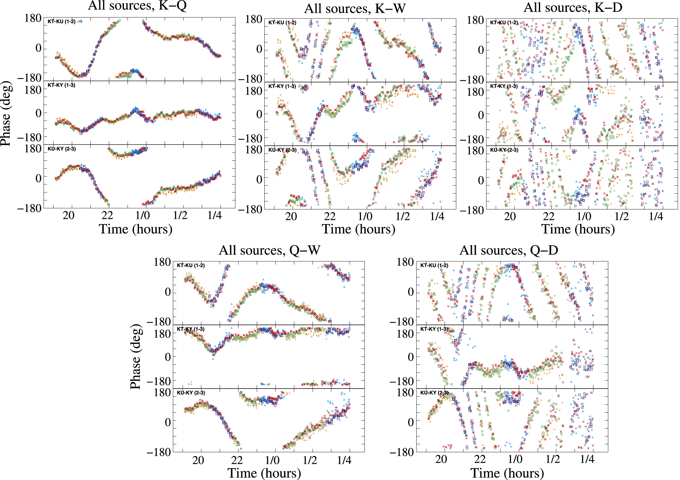
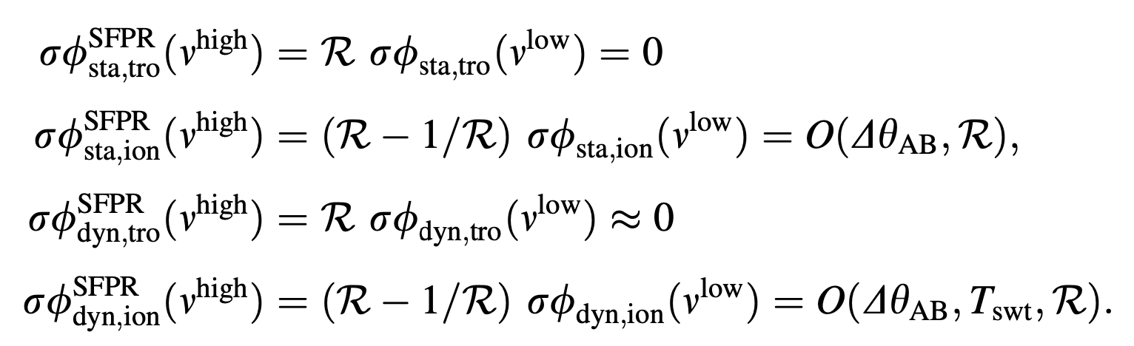
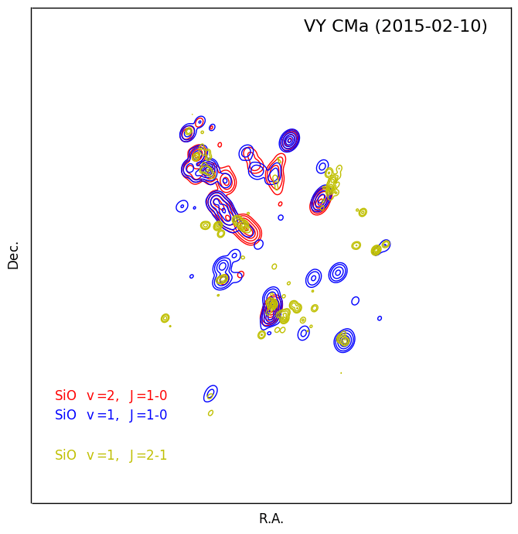
Astrometric Solutions: Source/Freq PR
Source/Frequency Phase Referencing: Solves for non-dispersive
(i.e. troposphere) by scaling low freq solutions
All errors tend to zero
Assuming Sim Frequencies
Residuals are from Ionosphere – so small at high freq.
From: Rioja & Dodson, 2020, AARv
From: Rioja etal, 2015, AJ
First demonstrations with VLBA and frequency switching.
Worked but complex and inefficient.
Huge improvement with KVN and simultaneous multi-channel receiver
Almost effortless application. (Can we expect similar for multi-beams?)
VLBA Memo 31
Rioja & Dodson 2011 (VLBA)
Rioja & Dodson 2020 (Review)
Rioja etal 2014 (VLBA/KVN comparison)
Rioja etal 2015 (130GHz)
Dodson etal 2014 (non-integer)
KVN-KSP 202x- (SiO multi-epoch
multi-tranistion)
SFPR Works at 130GHz
Notes:
The KVN has produced lots of examples of SFPR – and we have seen a lot of discussions on this
But to summarise again.
Using these next-generation methods all errors can be set to (or close to) zero
Implementation is easy and the impact impressive
Our favorite example aligns the water and many SiO transitions (42,9-129GHz) around a AGB star – probing the astro-chemistry

Slide 8
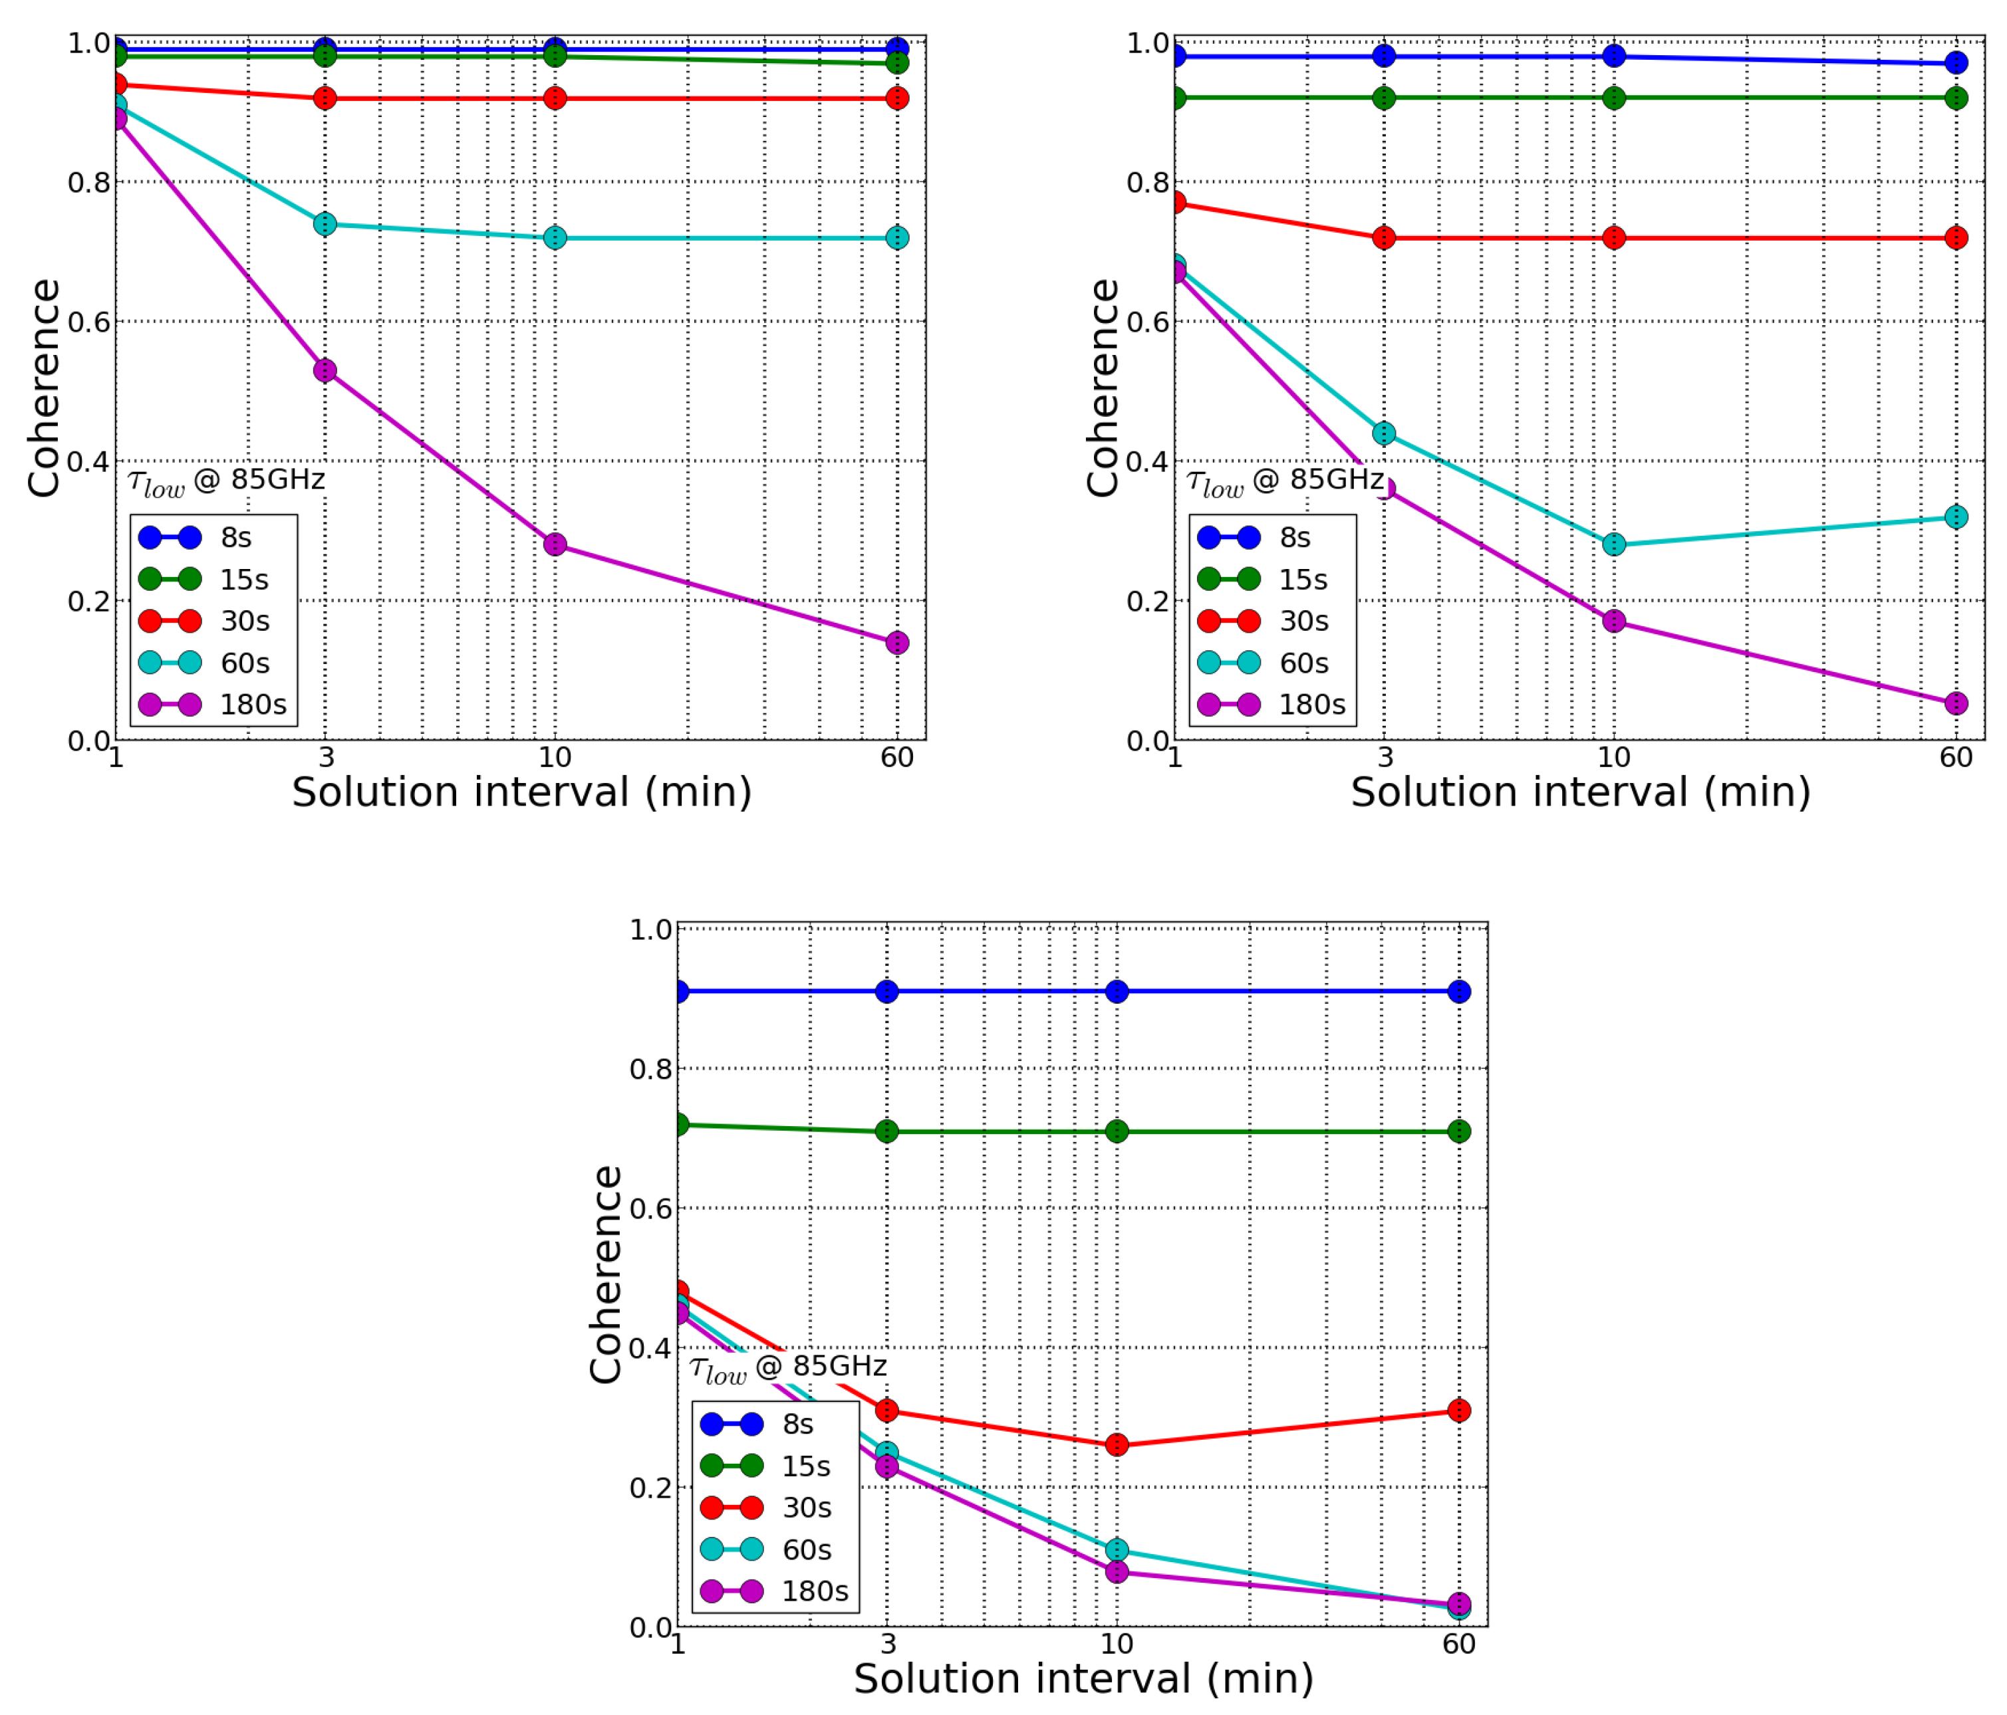
Astrometric Simulations for EHT-2030
We have simulated the impact of SFPR in ngEHT Galaxies special issue, with three frequencies
Assuming Sim Frequencies
Residuals are from Ionosphere – so small at high freq.
FPT Simulations at 340GHz
Using 86GHz to condition the 1mm frequencies:
Excellence Coherence for hours with 30s 86GHz sols in ALMA-type weather
Acceptable Coherence for hours with 30s 86GHz sols in good weather
Acceptable Coherence for hours with 15s 86GHz sols in normal weather
Typical weather: Cw=2≅2000m
From: Rioja etal, 2023, Galaxies
Notes:
Astrometric Simulations (using ARIS - see paper)
Impact of adding 3rd `low' frequency at 3mm allows for Freq Phase Transfer to ~1mm wavelengths.
Coherence tied to solutions at low freq (scaled and applied at the high)
Excellent (>0.8) coh with 30s@86GHz in VG weather
Acceptable (~0.7) coh with 30s@86GHz in G weather
Acceptable (~0.7) coh with 15s@86GHz in T weather

Slide 9
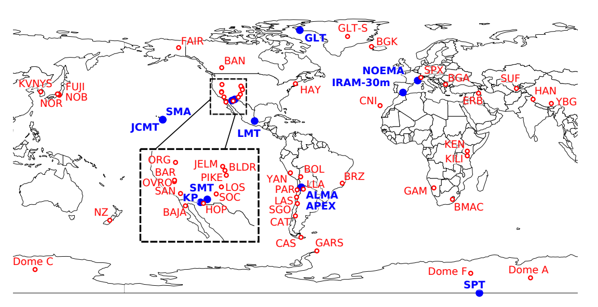

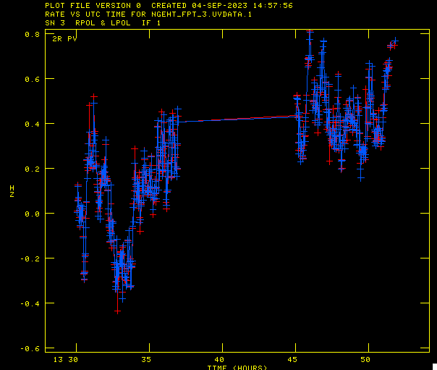

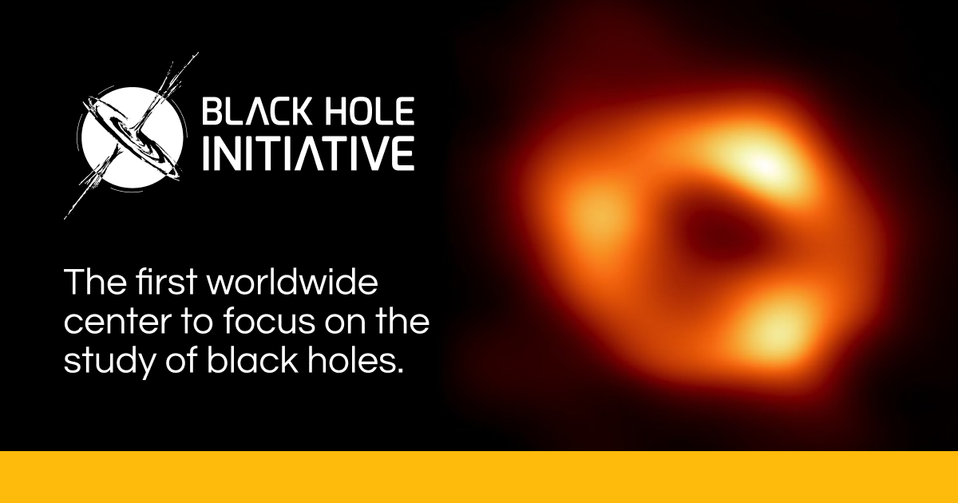

KVN-FPT test between EHT-2030 sites #1
KVN FPT Tests:
FPT between 86 and 215GHz
FPT test 50% successful
PV observed 3/1mm in SOP!
But not phase-locked ☹
Real FPT Data at 215GHz
Observed Dec 2022
But KY dual freq data lost
Dual
Single
GOALS:
*1st KVN 215GHz VLBI
*FTP test for
KVN, Pico V., SMA+JCMT
*Phase screen transfer
SMA+JCMT paired ante.
From: Raymond 2102.05482
Notes:
Plans for ngEHT telescopes will be suitable SFPR astrometry at 1mm
https://arxiv.org/pdf/2102.05482.pdf
Testing is vital.
KVN +
Makes a powerful multi-freq mm-VLBI array
PV, Yb are KVN-style (SOP) receivers at 86 and 215
SMA and JMCT share a phase screen – transfer solutions between ‘paired antennas’
Can test all the m:ajor issues i.e.

Slide 10
FPT test between EHT-2030 sites #2
Test #2 correlated in Haystack and Shanghai by
Dan Hoak and Wu Jiang
FPT: Observed Jan 2024
Dual
GOALS:
*FTP test for just
Pico V., SMA+JCMT
*Same goals
*No Shared Optical Path bl
From: Raymond 2102.05482
Notes:
Plans for ngEHT telescopes will be suitable SFPR astrometry at 1mm
https://arxiv.org/pdf/2102.05482.pdf
Testing is vital.
KVN +
Makes a powerful multi-freq mm-VLBI array
PV, Yb are KVN-style (SOP) receivers at 86 and 215
SMA and JMCT share a phase screen – transfer solutions between ‘paired antennas’
Can test all the major issues i.e.

Slide 11
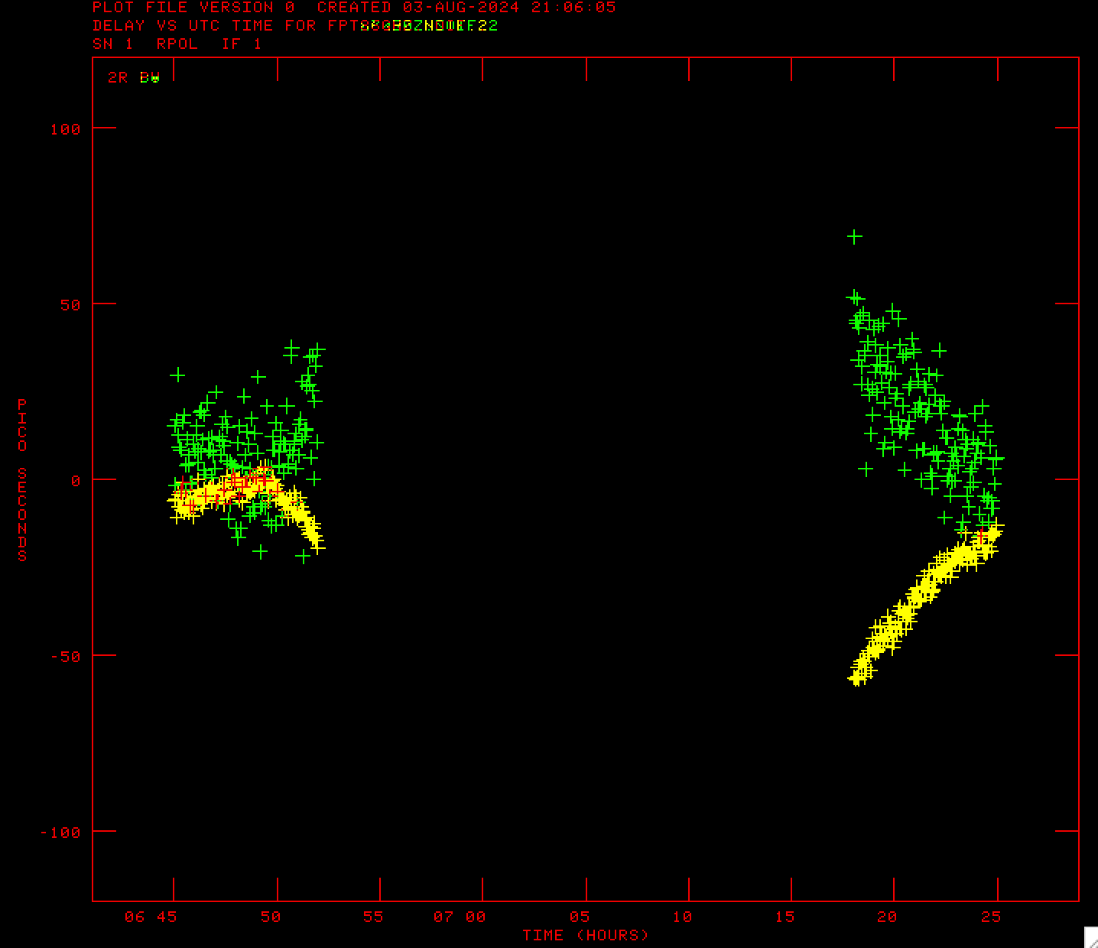
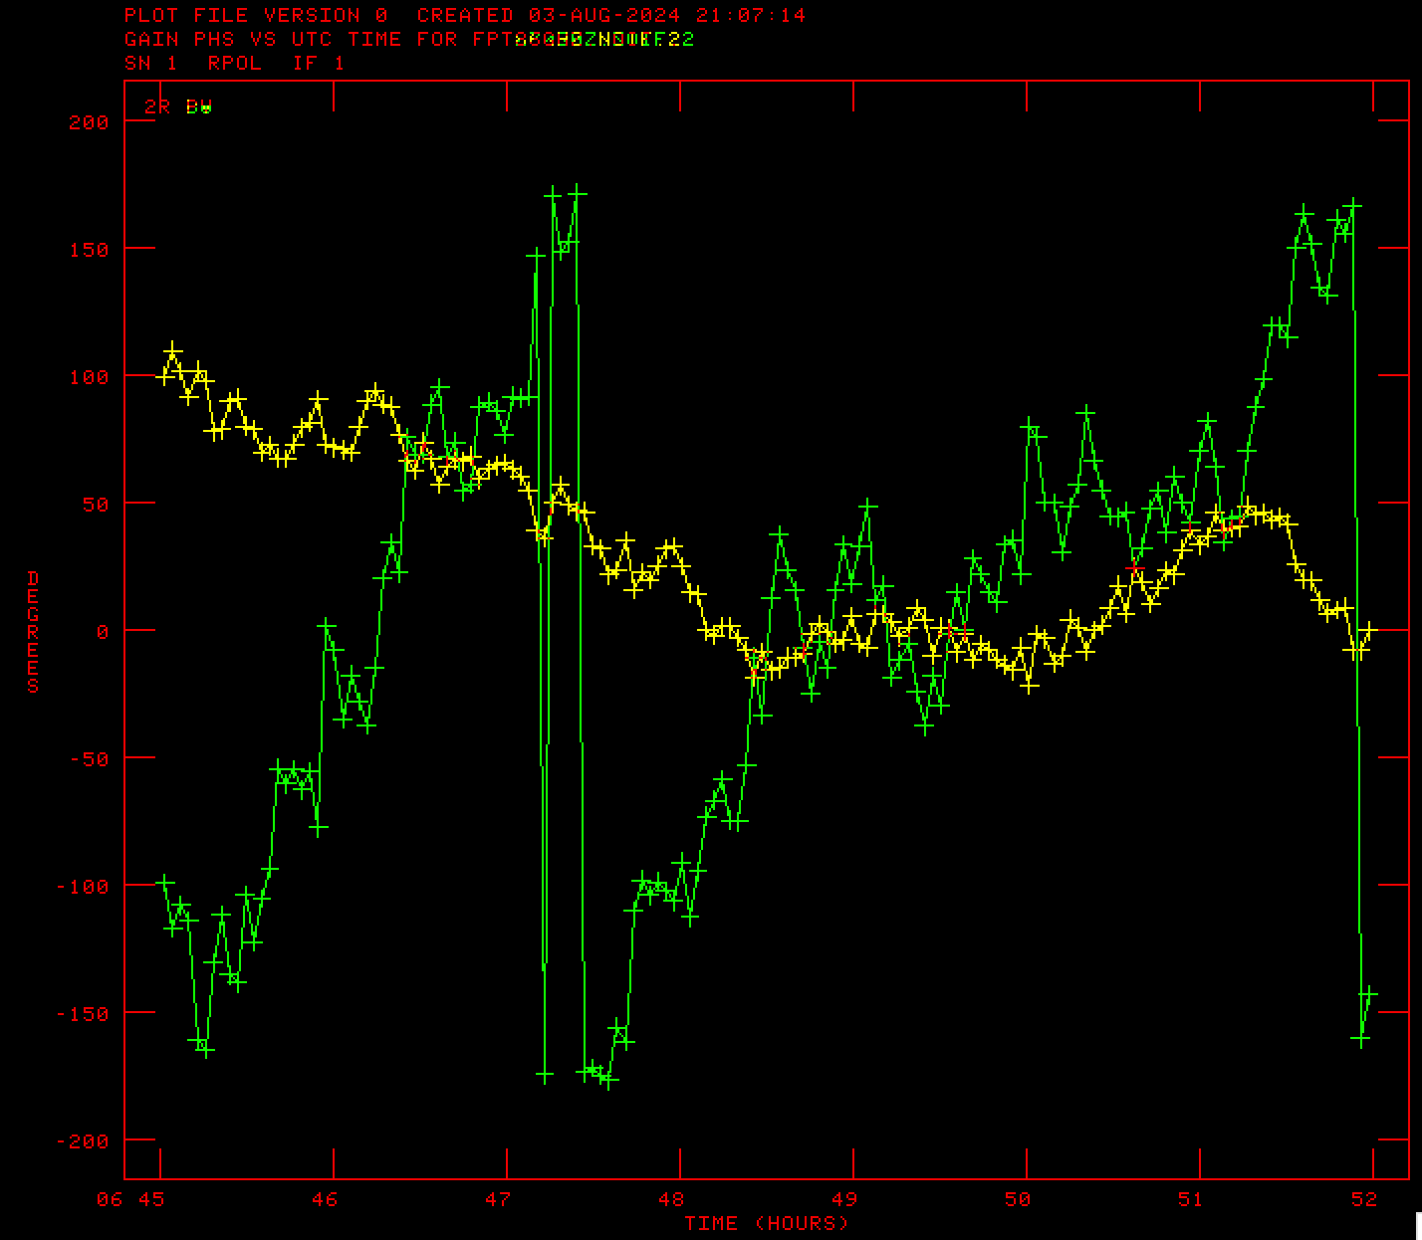
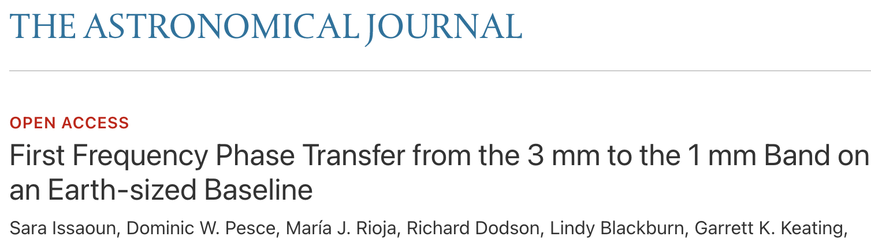
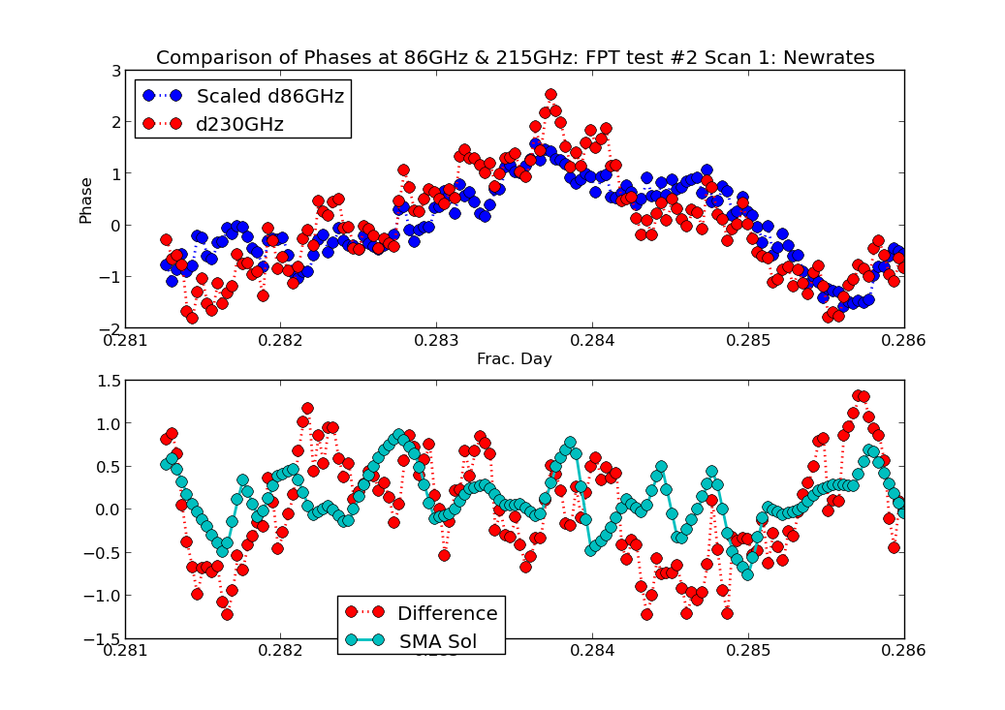
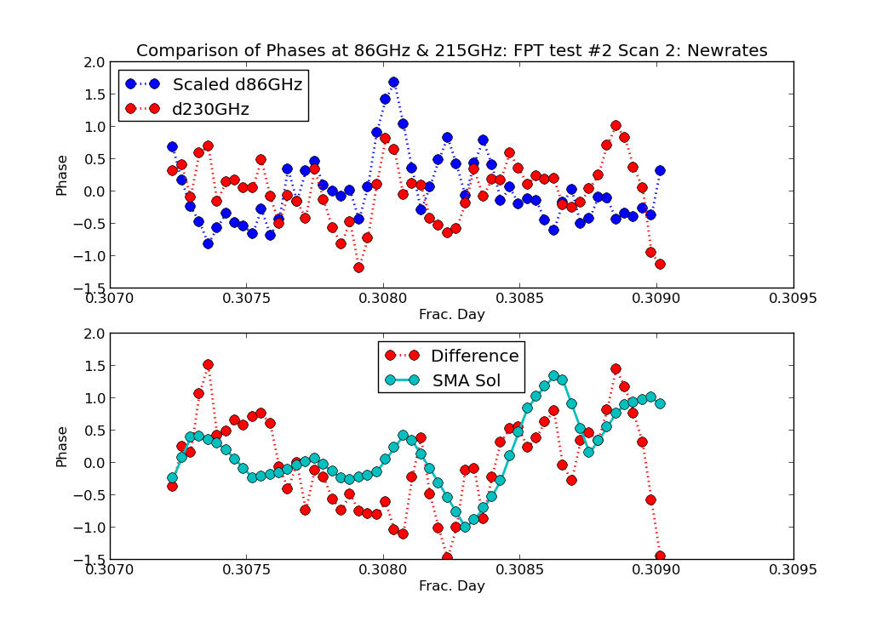
FPT test between EHT-2030 sites #2
Correlated data (after preparation)
Shows the delays tracking
And the phases tracking
with higher rates on high freq.
Dual
Scans Rates different (location? Clock?)
Correlation of detrended residuals ~0.8
Correlation of difference and SMA phase slope ~0.4
From: Raymond 2102.05482
Notes:
Plans for ngEHT telescopes will be suitable SFPR astrometry at 1mm
https://arxiv.org/pdf/2102.05482.pdf
Testing is vital.
KVN +
Makes a powerful multi-freq mm-VLBI array
PV, Yb are KVN-style (SOP) receivers at 86 and 215
SMA and JMCT share a phase screen – transfer solutions between ‘paired antennas’
Can test all the major issues i.e.

Slide 12
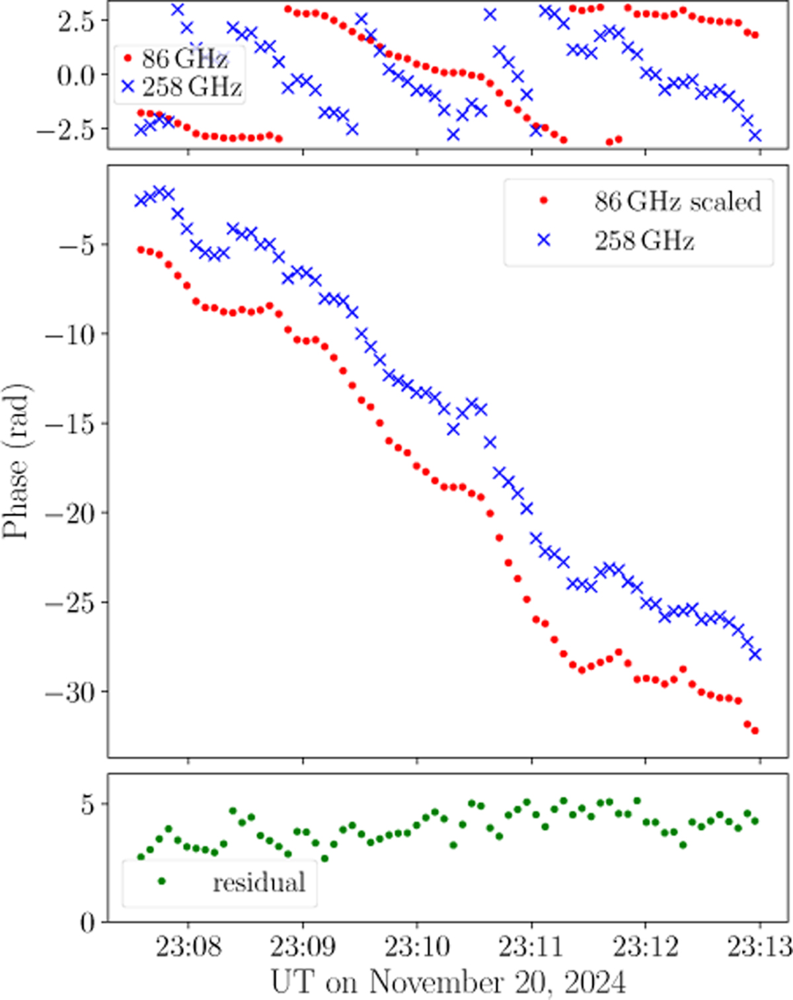
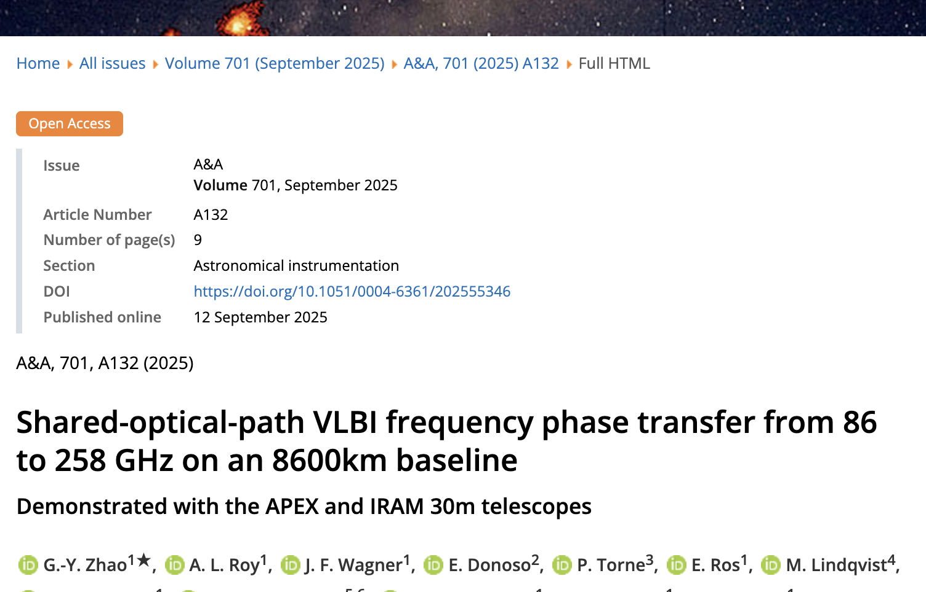
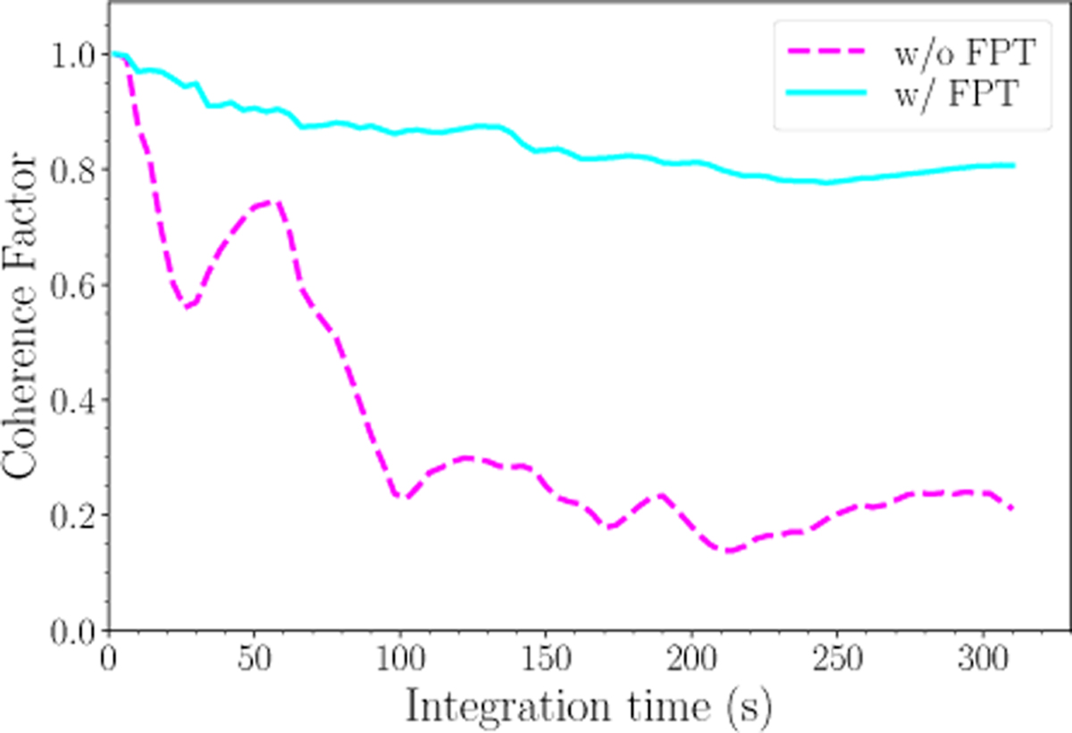
APEX test between EHT-2030 sites #1
A parallel experiment was performed shortly afterward – but with an impressively fast data transfer and correlation of just a few days!
Dual
SOP on both antennas
Integer Freq Ratio
Capable of SFPR tests
Confirmation/Competition
From: Raymond 2102.05482
Notes:
Plans for ngEHT telescopes will be suitable SFPR astrometry at 1mm
https://arxiv.org/pdf/2102.05482.pdf
Testing is vital.
KVN +
Makes a powerful multi-freq mm-VLBI array
PV, Yb are KVN-style (SOP) receivers at 86 and 215
SMA and JMCT share a phase screen – transfer solutions between ‘paired antennas’
Can test all the major issues i.e.

Slide 13
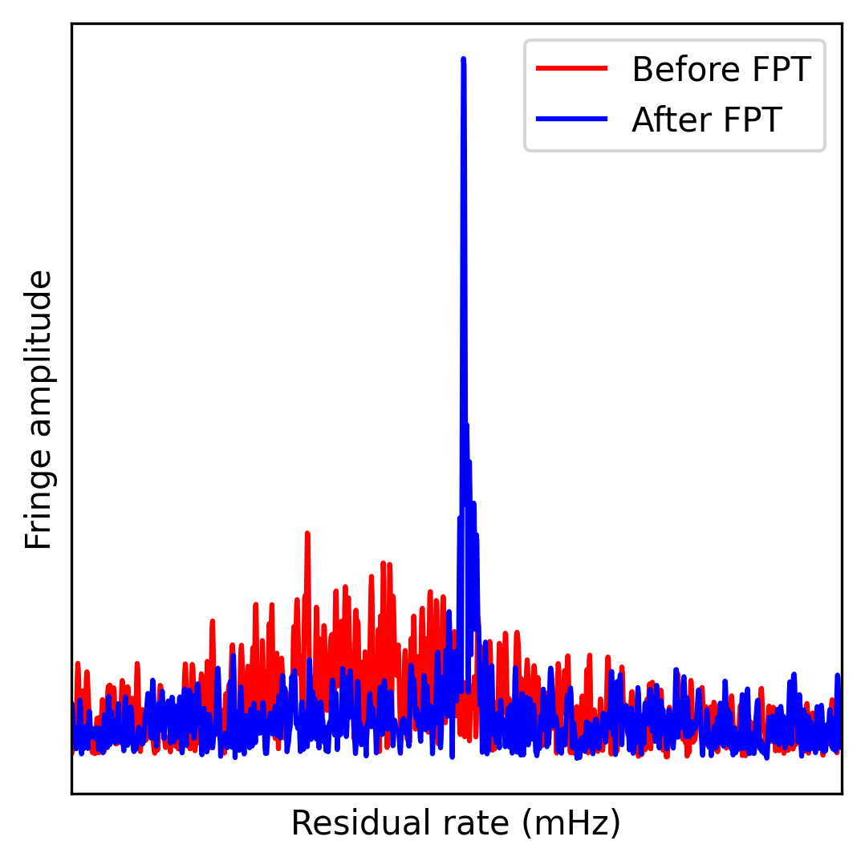
KVN-FPT test between EHT-2030 sites #3
KVN FPT Tests:
Ys+Kp between 86 and 215GHz
+PV+SMA/JCMT
December 2024
GOALS:
*New Antenna: Kitt Peak
*FTP test on SOP with 3 ant.
*better understanding of paired ante.
From Dom: 1mm data
Scheduling:
*Long Scans (30min) to measure
coherence >> few min
* Closure triangles
* maser-free @ Hawaii
From: Raymond 2102.05482

Slide 14
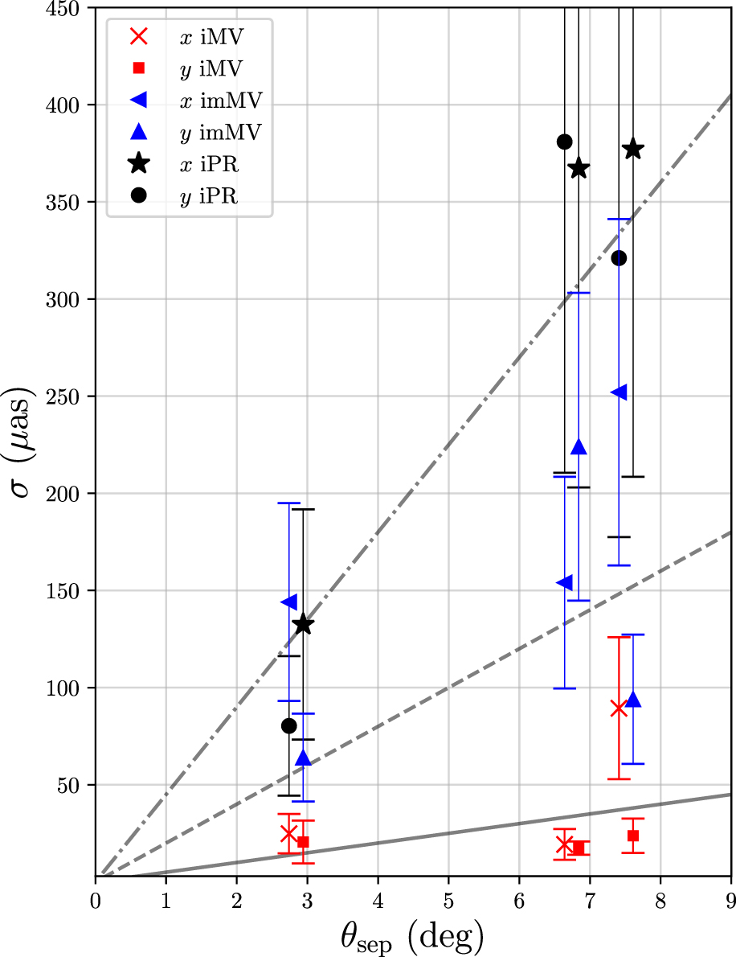
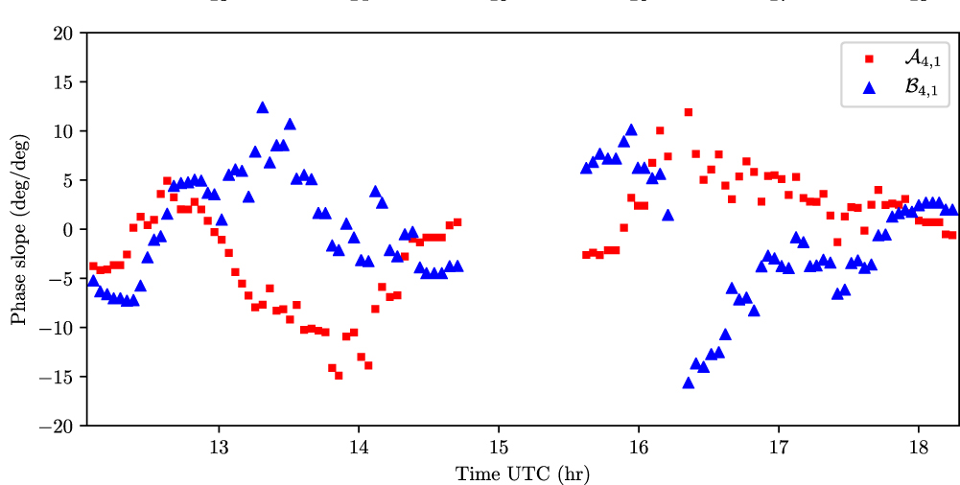
Astrometric Solutions: MultiView
Very nice demonstration of effectiveness of MultiView astrometry at 8GHz from Hyland iMV-I (2022):
Results consistent with thermal noise and/or systematic limits
MV corrects for all errors by generating a virtual calibrator at zero angular offset
Expect to be dominated
by ionosphere.
Variation on ~hour scales
Proposed for lower freq to correct for ionosphere where multiple sources in beam.
But MV works just as well for troposphere and higher freq
20uas thermal limit
MV: C band – 8 & 6.7GHz
Notes:
Next discuss the other astrometric method we developed: MV
This (published) work is at 8GHz – and can be called inverse MV.
Central source is Target and "daisy over" rather than "looping over" calibrators.
High costs in on source time, but faster calibration cycle.
Achieving thermal limits and correcting for phase gradients over antenna sites
MV corrects for all errors by generating a virtual calibrator at zero angular offset
Here is working just at well 5 times higher in proposed freq..
Next step is another factor of 5, i.e. 43GHz

Slide 15
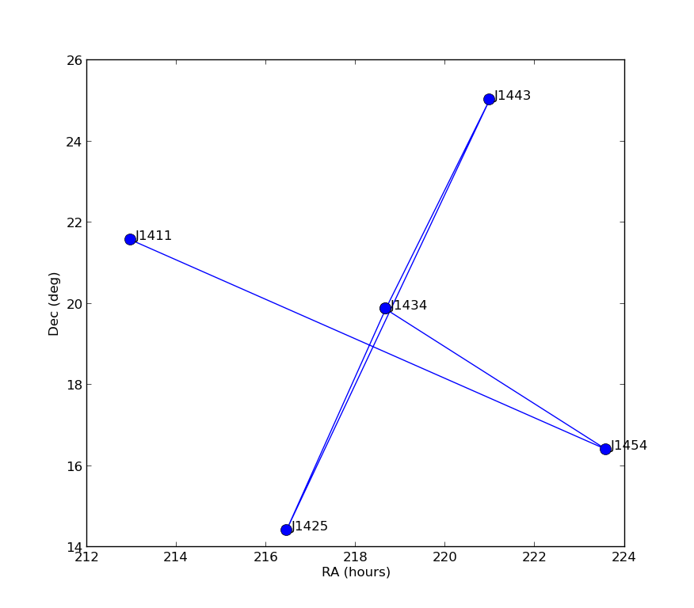
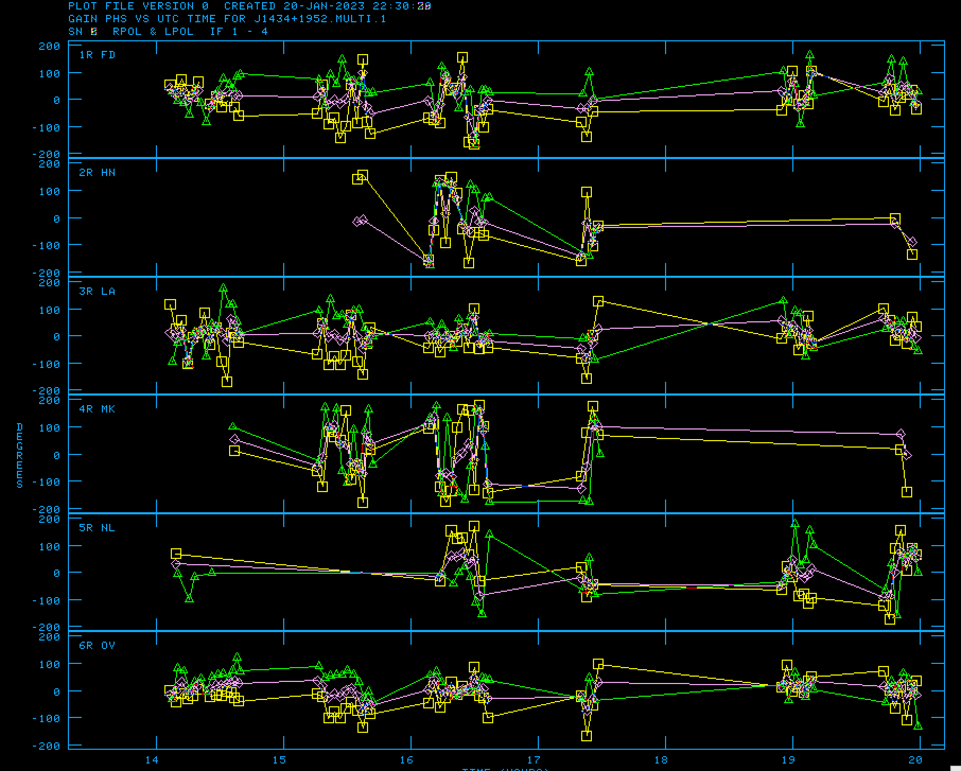
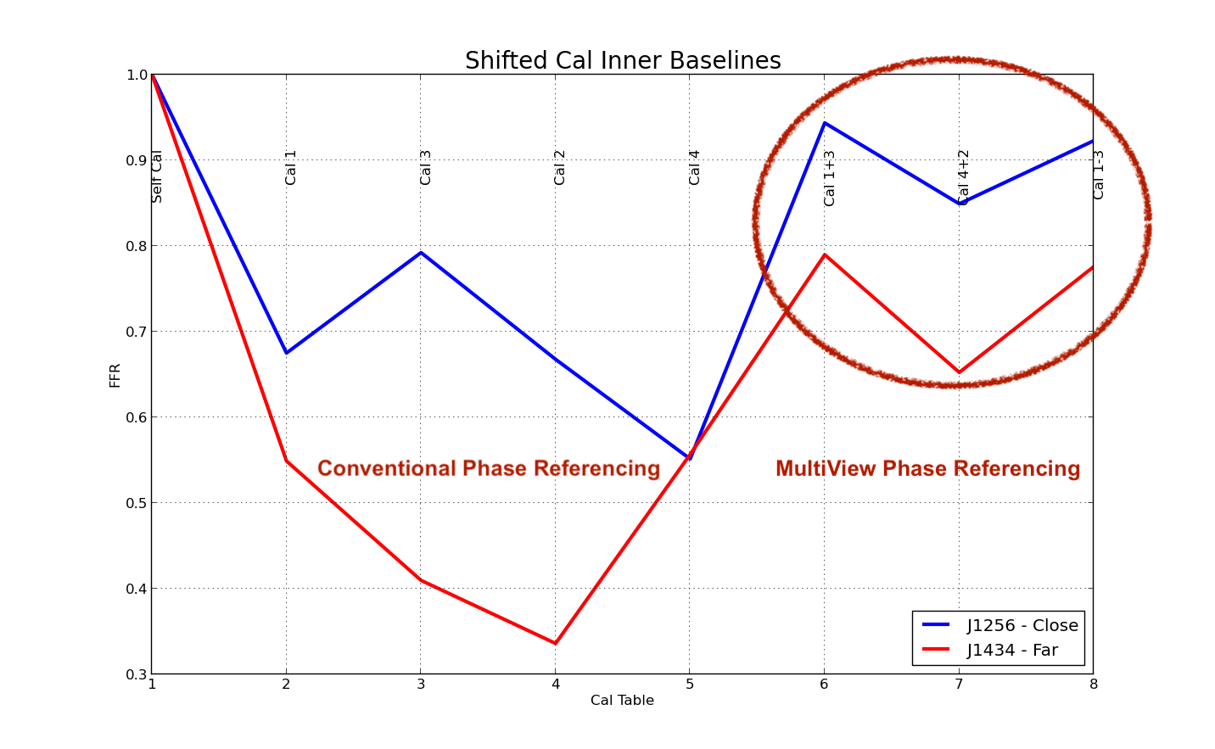
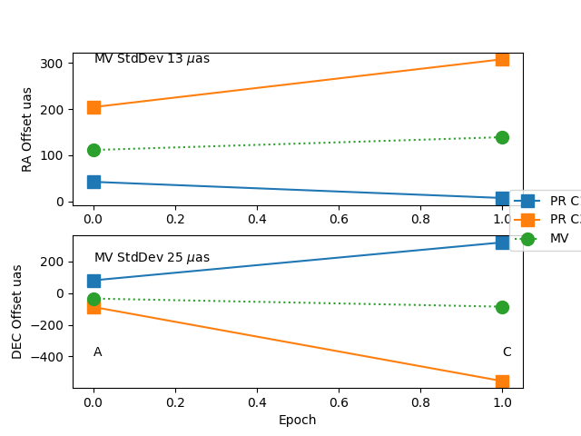
Astrometric Solutions: MultiView
Appears to continue to work at 43GHz with VLBA
Dec (deg)
RA (deg)
Rapid switching between 5 sources that form a cross ~10º across.
Centre is reference (ala inverse MV)
Phases on opposite sides track each other
Green C1+ Yellow C3 → Purple Target
86GHz MV will require (IMO) stations to subarray at least 3 simultaneous beams (4 better).
Which matches ngVLA/LEVERAGE
MV Frac. Flux Recovery ~80%
c.f. conventional PR ~20%
At 43GHz we are seeing troposphere; same should apply at 86GHz (or even higher).
MV: Q band – 43GHz
Notes:
Work in progress
Cal Phases track each other, but mirrored around zero (as expected)
Four epochs (3 Q 1K).
MV calibration shows significant improvement in recovered flux
Winter worked well.
Summer difficult, but can be made to work. Last epoch (Q) has poor results
Astrometric Comparison show 10-20uas repeatability (errors of ~10uas)
High freq will work with careful scheduling and analysis
Next: More winter observations at 43GHz.
Test at 86GHz with KVN
BUT will need simulataneous observations

Slide 16
Conclusions
mm-wave astrometric VLBI was impossible, but now - with new methods and technologies - could be `straight forward’
Interesting astrometrical targets & science exist even at the very high frequencies.
Astrometrical solutions (SFPR/MV) for next generation instrument should continue to work even up to 340GHz.
Sub-mm arrays with FTP/SFPR capabilities between 86, 230 and 340GHz. (array demonstration to 130GHz, simulations at 340GHz, baseline demonstrations at ~230GHz. 3-baseline demo in analysis)
➜ Lambda Astrometry will be possible
MultiView (with ALMA sub-arrays and multi-antenna anchor stations to allow for observing in simultaneous directions) demonstrated (up to 43GHz)
➜ Allowing MultiView Positional Astrometry at 86GHz.
SFPR + MV will give spatial astrometry at 230 and 340GHz.

